Slide 1

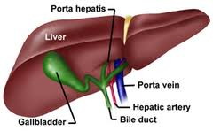
GROSS ANATOMY
LIVER
DR. PRAVEEN KURREY
M.B.B.S., M.S. BCME, BCBR,CISP PROFESSOR ANATOMY

Slide 2
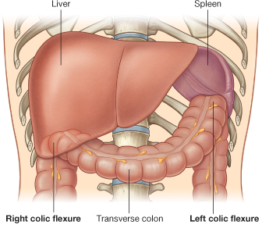
LIVER
Largest gland of the body
Both Exo & endocrine
- Bile, Glucose
- Plasma proteins
- Cholesterol
- Heparin
Highly vascular,
Rapid mitosis

Slide 3
The liver is the largest gland in the body and has a wide variety of functions
Weight: 1600 gm in males & 1300 gm in females.
It is wedge shaped structure.

Slide 4
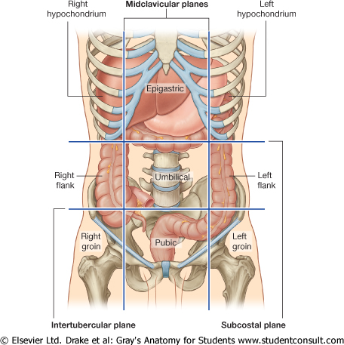
Situation --Right hypochondrium + Epigastrium
Extends to left Hypochondrium

Slide 5
Functions of liver
1. Secretion of bile.
2. Metabolism of carbohydrate, fat and protein.
3. Formation of heparin & anticoagulant substances, prothombin.
4. Storage of glycogen and vitamins
5. Activation of vit D
6. Protective by, destruction, phagocytosis , antibody formation and excretion.

Slide 6
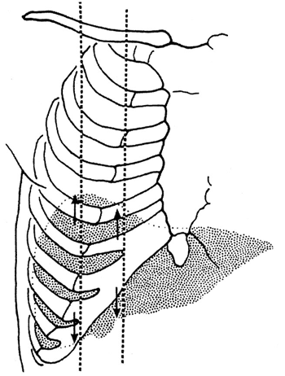
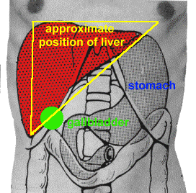
Surface anatomy of the liver
The greater part of the liver is situated under cover of the right costal margin
-Diaphragm separates it from the pleura, lungs, pericardium, and heart.

Slide 7
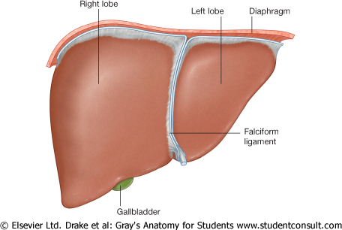
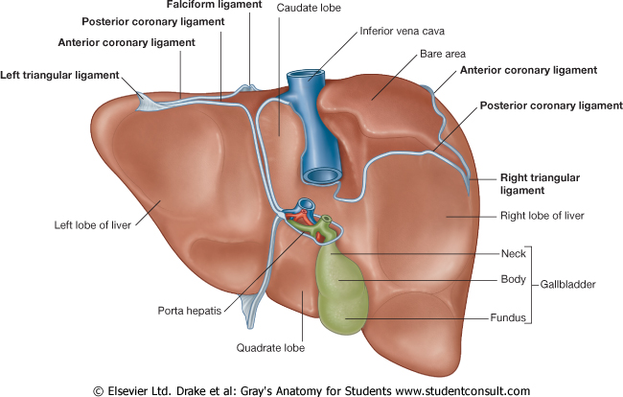
LIVER
FACTORS keeping liver in position :
- Hepatic veins opening in IVC, Tone of Abd muscles
- Ligaments (Peritoneal reflections) - Least important)

Slide 8
External features
5 Surfaces
1 Prominent border
2 lobes

Slide 9
LIVER
PRESENTING PARTS:
SURFACES :
Parietal : Superior, Rt Lateral, Anterior & Posterior
Visceral (Inferior)
Superior Surface
Ant Surface
Rt Lat Surface

Slide 10
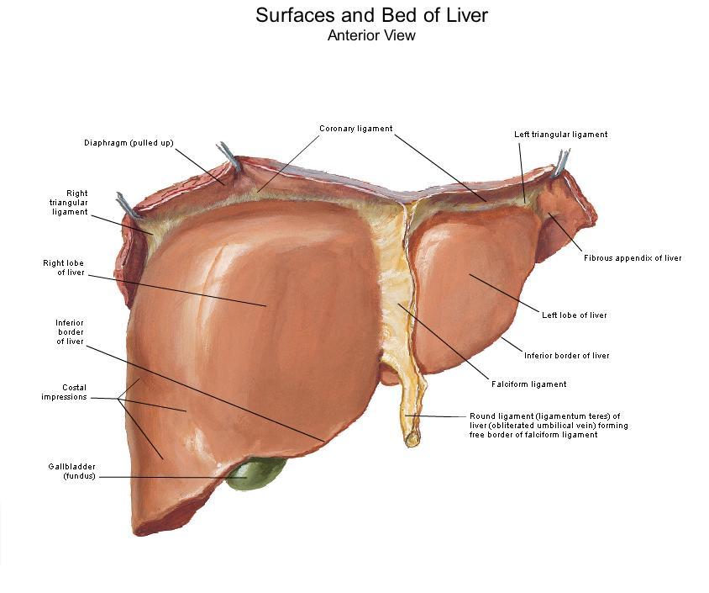
Surfaces of the liver, their relations & impressions
1. Inferior surface= visceral surface
2. Superior surface = Diaphragmatic surface
3. Anterior surface
4. Posterior surface
5. Right surface

Slide 11
LIVER :PRESENTING PARTS : Cont’d
BORDERS : Inferior, Postero-inferior, Postero-superior
Visceral (Inferior)
Surface
Post Surface
Inf Border

Slide 12
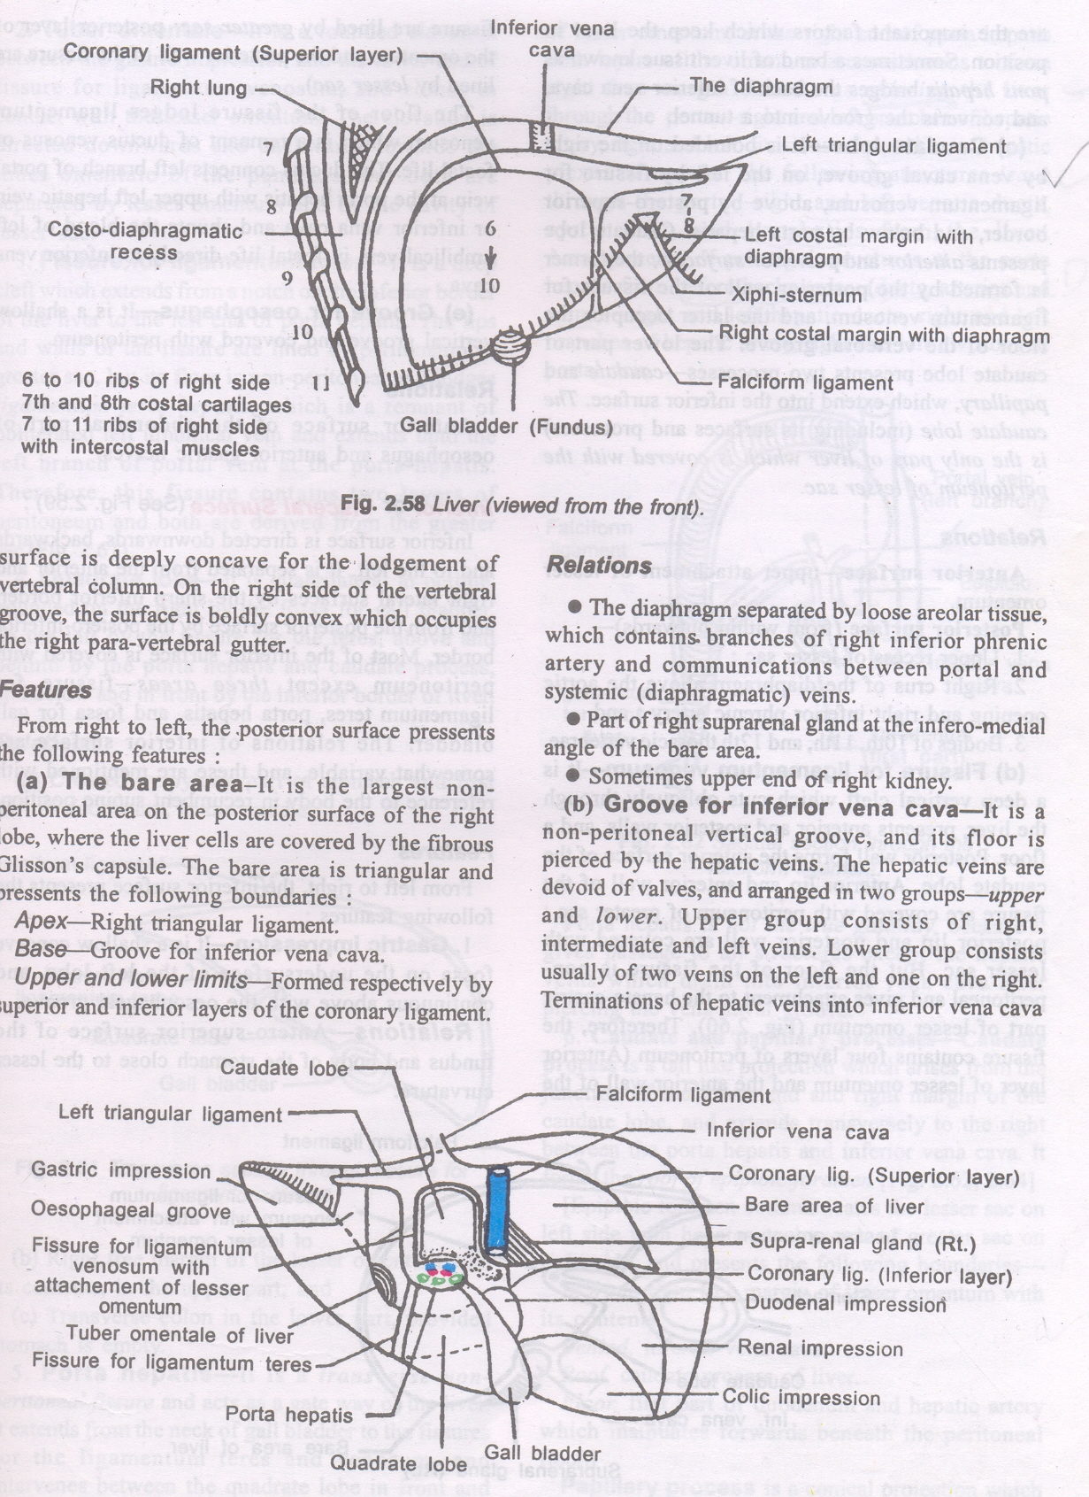
LIVER
RELATIONS :
Anterior Surface

Slide 13
Relation - Anterior Surface
Diaphragm
Rt & Lt pleura and lung
Costal cartilage
Xiphoid process
Ant. abdominal wall
Diagram --

Slide 14
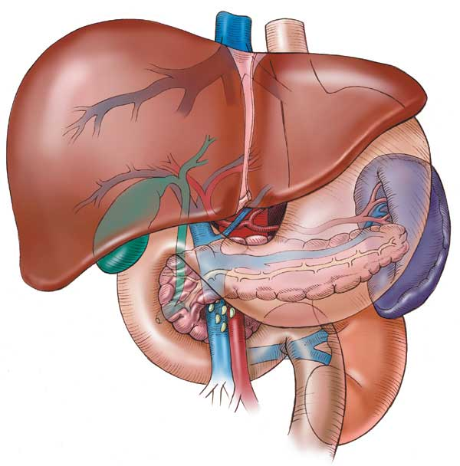
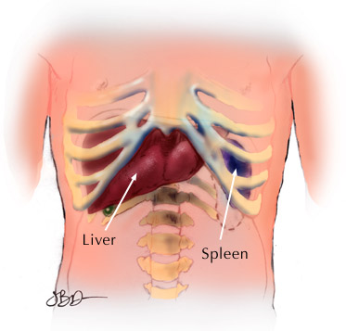

Slide 15
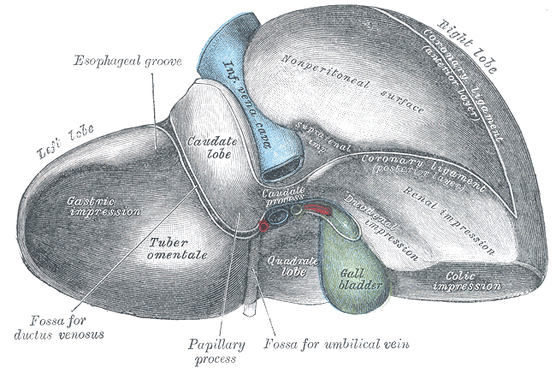
Relation - Posterior Surface
Diaphragm
Rt. Kidney
Supra renal gland
T.colon(hepatic flexure
Duodenum
Gall bladder
I.V.C
Esophagus
Fundus of stomach

Slide 16
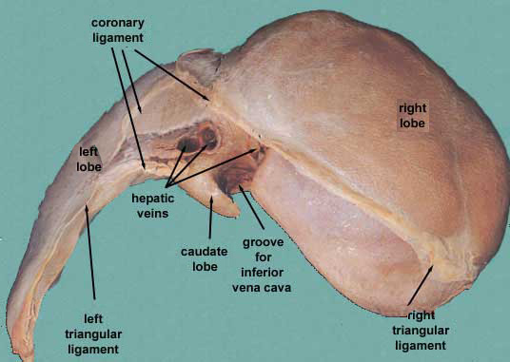
Relation - Superior Surface
Right & left lobes
Cut edge of the Falciform ligament
The cut edges of the superior and inferior parts of the coronary ligament
The left triangular ligament
The right triangular ligament

Slide 17
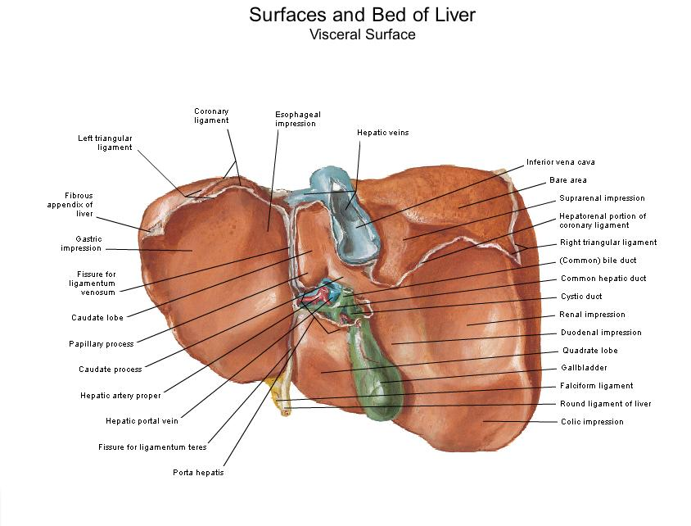
Relation -- Inferior surface( visceral surface)
Relations
I.V.C
the esophagus
the stomach
the duodenum
the right colic flexure
the right kidney

Slide 18
RELATIONS : Visceral (Inferior) Surface
Duodenal Imp
Oesophageal groove
Renal impression
Gastric impression
Fissure for
Lig Venosum
Tuber omentale
Colic impression
Rt SR Gland

Slide 19
LIVER
ANATOMICAL POSITION : IVC in Vertical position

Slide 20
LIVER : LOBES
PHYSIOLOGICAL : RT & LT LOBES
Boundary : Imaginary line through floor of Fossa for Gall bldr & Grove for IVC.
  Anteriorly : Passes a little to the Rt of Falciform Lig
  Supplied by respective branches (Rt / Lt) of Hepatic art & Portal vein
  Drained by the respective branch of Bile duct
SEGMENTS :
  Rt Lobe : Ant & Posterior
  Lt Lobe : Medial & Lateral

Slide 21
LIVER
LOBES : Right & Left
Anatomical
Physiological
Physiological

Slide 22
LIVER : LOBES
Physiological
LOBES :
Right & Left
Anatomical

Slide 23
LIVER : LOBES
Caudate & Quadrate lobes : Part of Physiological Lt lobe & Anatomical Rt lobe
Riedel’s lobe :
- Tongue like – from lower bdr
Porta hepatis : Gate way
Hep Ducts, Brs of HA & PV
(Antero-posteriorly : D-A-V)
Caudate lobe
(Lesser Sac)
Porta hepatis
Quadrate lobe

Slide 24
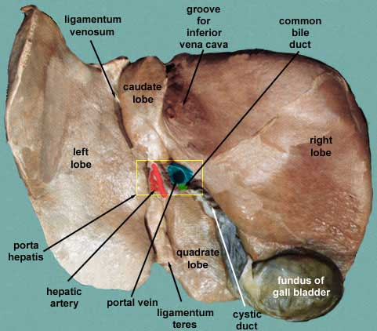
Caudate Lobe
  -Present in the posterior surface from the Rt. Lobe
  It has caudate process and papillary process
  Relations of caudate lobe
- Inf. → the porta hepatis
- The right → the fossa for the inferior vena cava
- The left →the fossa for the lig.venosum.

Slide 25
Quadrate lobe
Present on the inferior surface from the Rt. Lobe
Rectangular in shape
Relation
- Ant.→ anterior margin of the liver
- Sup.→ porta hepatis
- Rt. →fossa for the gallbladder
- Lt→ by the fossa for lig.teres

Slide 26
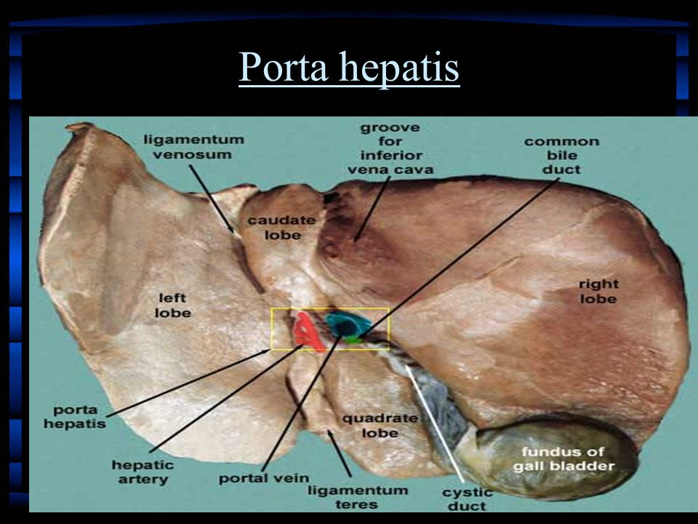
Porta hepatis
It is the hilum of the liver, 5cm long
It is found on inferior surface
lies between the
caudate lobe above
and quadrate lobes
below

Slide 27
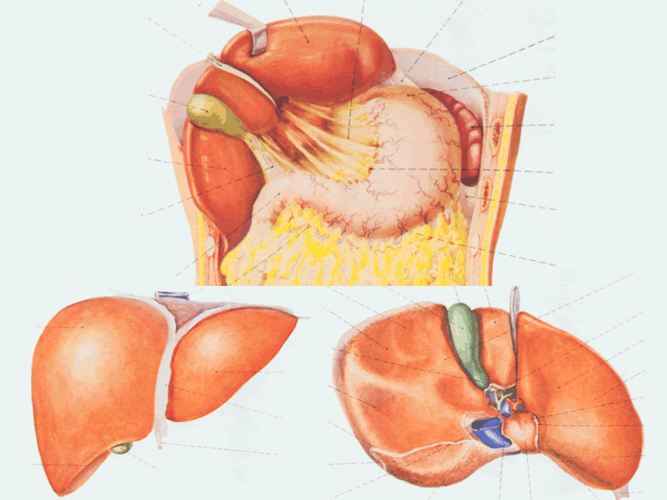
Peritoneum of the liver
The liver is covered by peritoneum (intraperitoneal organ)except at bare area.
Inferior surface covered with peritoneum of greater sac except porta hepatis, G.B & Lig.teres fissure
Rt. Lateral surface covered by peritoneum, related to diaphragm which separate it from Rt. Pleura , lung and the Rt Ribs (6-11)

Slide 28
The ligaments of the liver
The liver is attached to the anterior abdominal wall, diaphragm and other viscera by several ligaments, which are formed from condensations of the peritoneum.

Slide 29
The ligaments of the liver
1- The Falciform ligament of liver
2- The Ligamentum teres hepatis
3- The coronary ligament
4- The right triangular ligament
5- The left triangular ligament
6- The Hepatogastric ligament
7- The hepatoduonedenal ligament
8- The Ligamentum Venoosum

Slide 30
LIGAMENTS :
False ligaments (Peritoneal folds)
- Falciform,
- Ant & Post Coronary
- Rt & Lt Triangular
- Lesser omenutm
True ligaments :
- Ligamentum Teres hepatis : Obliterated Lt Umbilical vein
- Ligamentum Venosum : Obliterated Ductus venosus

Slide 31
Ligamentum Venosum
Lesser omenutm

Slide 32
Lig Teres hepatis

Slide 33
Blood supply of the liver
Two sources provide blood to the liver
Hepatic artery- Celiac trunk of aorta
Portal vein

Slide 34
The liver has two venous systems.
The portal system
conveys venous blood from the majority of the gastrointestinal tract and its associated organs to the liver.
The hepatic venous system
drains blood from the liver parenchyma into the inferior vena cava.

Slide 35
Lymphatic drainage of the liver
Lymph leave the liver and enters several lymph nodes in porta hepatis → efferent vessels pass to coeliac nods
A few vessels pass from the bare area of the liver through the diaphragm to the posterior Mediastinal lymph nodes.

Slide 36
Nerve supply
Sympathetic → hepatic plexus
Parasympathetic → vagous nerve

Slide 37
Couinaud segments
The liver is divided by the 'principal plane' into two halves of approximately equal size.
The principal plane is defined by an imaginary
parasagittal line from the gallbladder anteriorly to the inferior vena cava posteriorly.
The usual functional division of the liver into right and left lobes lies along this plane.
The liver is further subdivided into segments, each supplied by a principal branch of the hepatic artery, portal vein and bile duct

Slide 38
Segments I, II, III and IV make up the functional left lobe,
Segments V, VI, VII and VIII make up the functional right lobe.
Segment I corresponds to the gross anatomical caudate lobe and segment IV to the quadrate lobe.

Slide 39
LIVER : SURGICAL (COUINAUD) SEGMENTS
SEGMENTS :
  Rt Lobe : Ant & Posterior
  Lt Lobe : Medial & Lateral
VIII
V
II
IV III
I
VII
VI

Slide 40
CLINICAL ANATOMY
HEPATITIS
CIRRHOSIS
CAPUT MEDUSAE
LIVER RESECTION
LIVER TRANSPLANTATION
TIPS( Transjugular intraparenchymal portosystemic shunt)

Slide 41
LIVER : APPLIED ANATOMY
Rt Hepatic lobectomy :
Along Lt side of GB &
Rt of IVC
GB also is removed
Lt Hepatic Lobectomy :
Lt lobe + Most of CL&QL,
Along Lt side of IVC, G B - Intact
Left
Right

Slide 42
LIVER: APPLIED ANATOMY
NEEDLE BIOPSY :
8/9th ICS in M A L
Thru C-D Recess,
below lung
< 6cm deep
Complications :
Injury to IVC, Kidney, Pancreas, Colon
Pneumothorax

Slide 43

For Students……..
Don’t take the university exam lightly.
Study hard ,daily, in a routine and all subjects daily.
Don’t break continuity.
Focus on ur future.
Careful about ur health, diet and sleep.
I hope all u will get grand success….
Hoping best for ur future……………
Dr. Praveen Kurrey
Be Positive…….Feel Positive…Stay Positive…..and Live Positive…

Slide 44

http://pkanatomyworld.com/

Slide 45

THANK YOU

