Slide 1
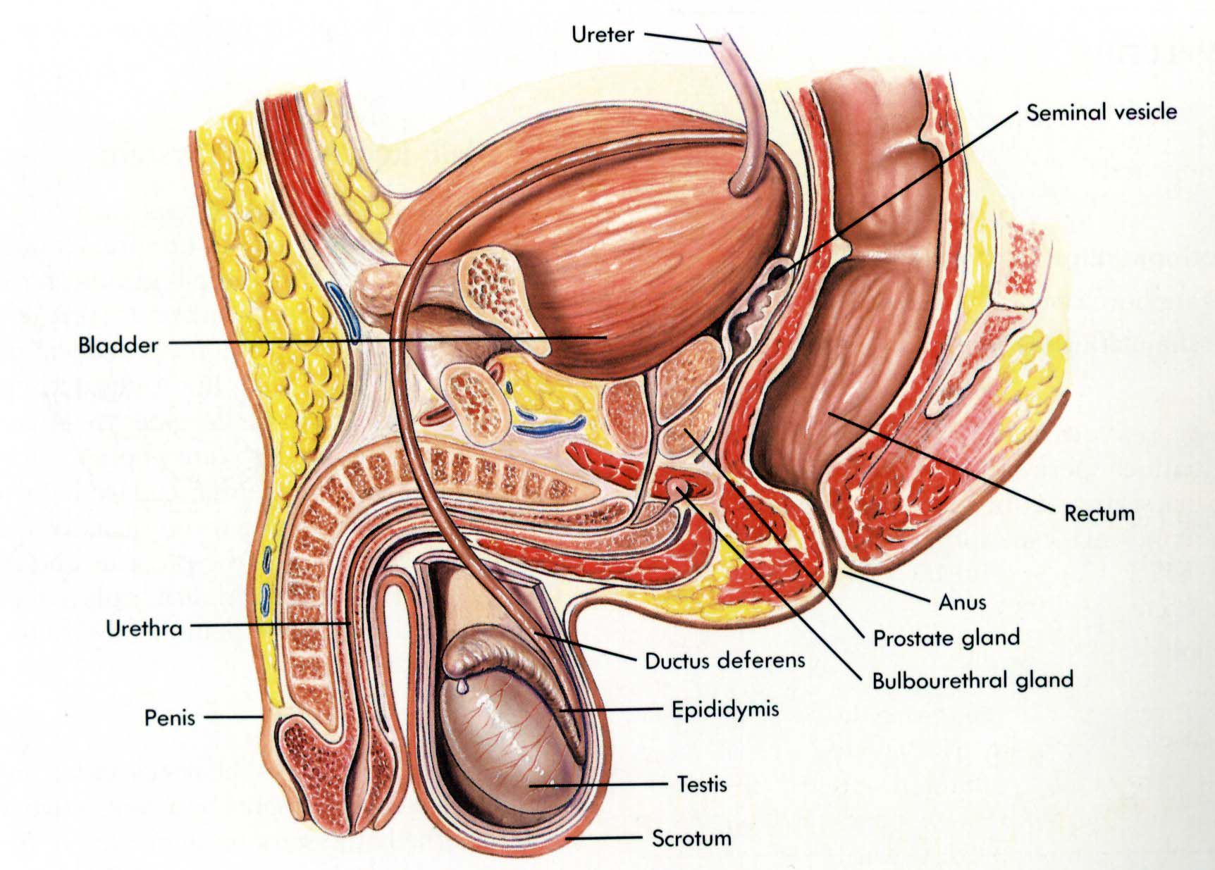
UROGENITAL SYSTEM -3
DEVELOPMENT 0F GENITAL SYSTEM
DR. PRAVEEN KURREY
M.B.B.S., M.S. ASSISTANT PROFESSOR
DEPT.OF ANATOMY PT.JNMMC RAIPUR

Slide 2
Develops from 3 sources
1. Gonadal /Genital ridge
2.Primordial germ cell
3. Local mesenchyme/ Mesonephric ridge

Slide 3
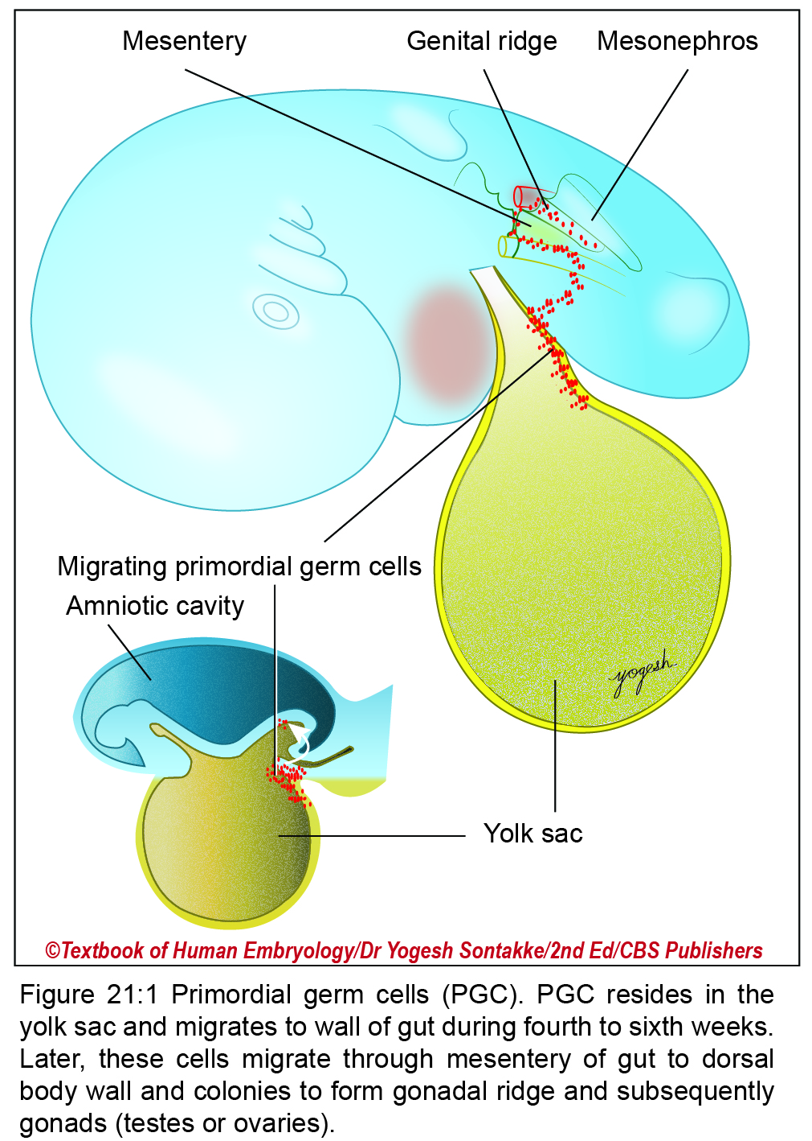

Slide 4
Primordial germ cells
Primordial germ cells arise from epiblasts (primary ectoderm) in the second week.
These primordial germ cells remain within extra‑embryonic mesoderm of connecting stalk and wall of the yolk sac (Figure 21.1).
On formation of the tail fold, primordial germ cells come to lie in splanchnopleuric mesoderm that surrounds hindgut.
Coelomic epithelium covering mesonephric ridges proliferate to form genital ridges (Figure 21.2).
By fifth week, primordial germ cells migrate bilaterally through dorsal mesentery to the region of genital ridges (by amoeboid movements).

Slide 5
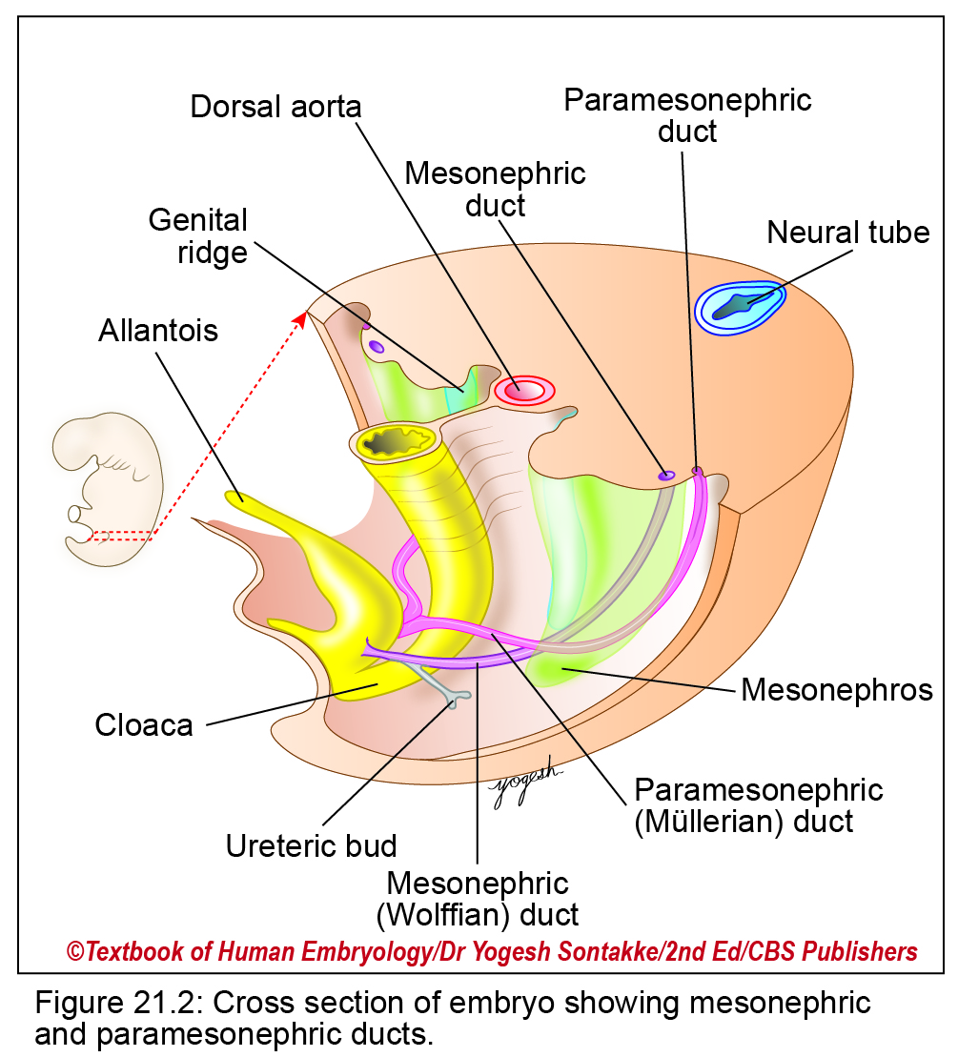

Slide 6
Formation of Primitive Gonads
Genital Ridge (gonadal ridge)
In fifth week of intrauterine life, coelomic epithelium (lining epithelium of primitive peritoneal cavity) covering medial surface of mesonephros proliferates to form a genital ridge.
Genital ridge is an elevation of posterior abdominal wall (Figure 21.2).
Genital ridge consists of inner medulla and outer cortex.
Migration of Primordial Germ Cells
In fourth week, primordial germ cells migrate to genital ridge along dorsal mesentery ((Figure 21.1).
Formation of primitive sex cords: From surface (coelomic) epithelium, numerous cord-like processes develop and enter the genital ridge to form finger-like cords called primitive sex cords.

Slide 7
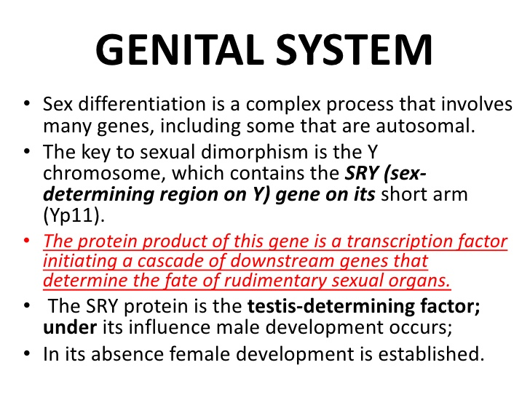
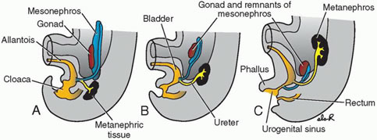

Slide 8
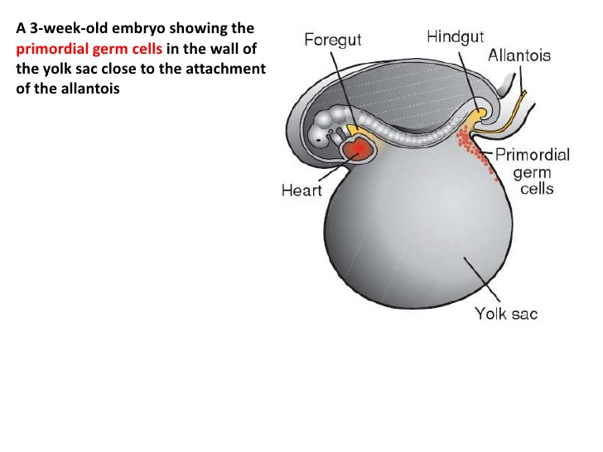

Slide 9
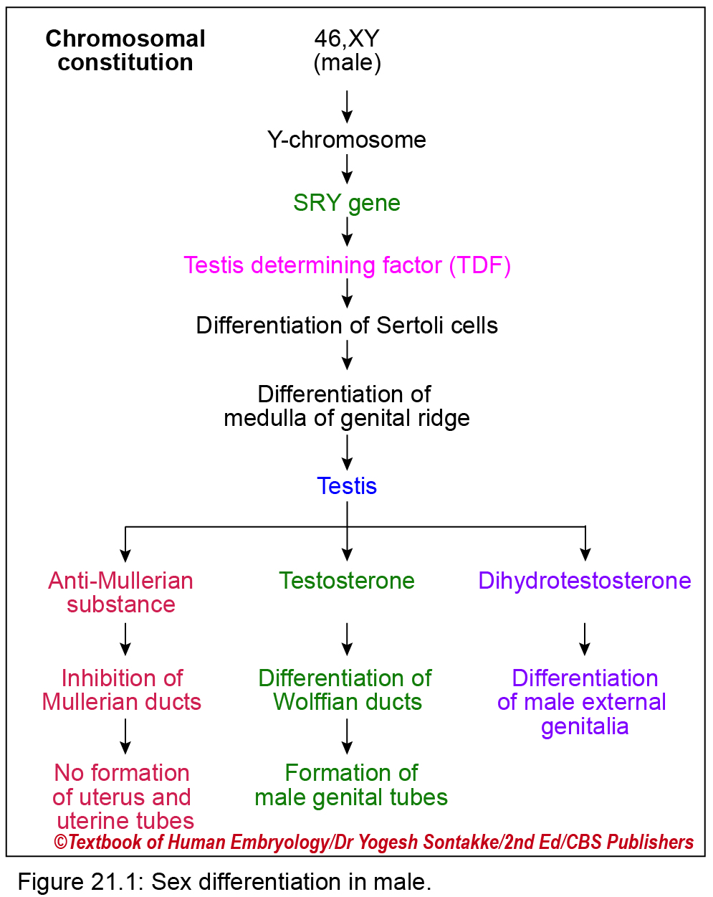

Slide 10
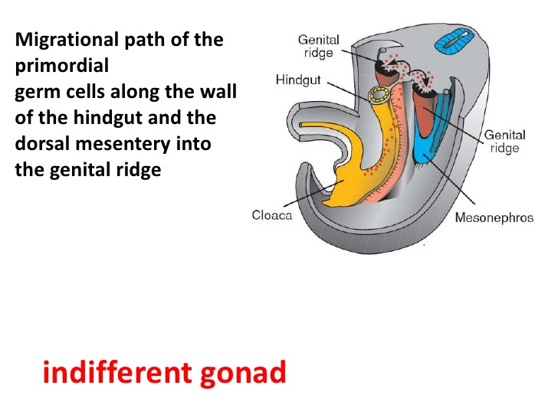

Slide 11
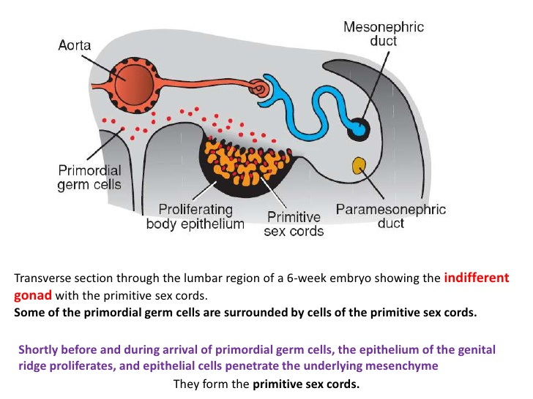

Slide 12
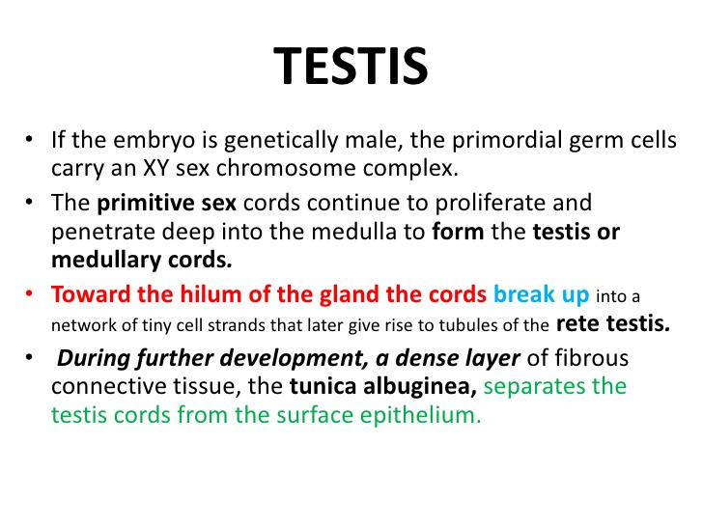

Slide 13
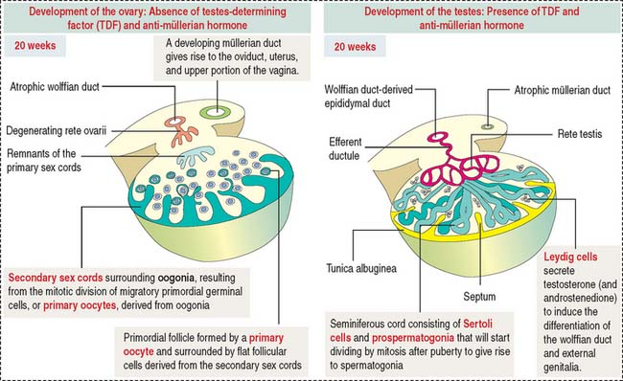

Slide 14
TESTIS DEVELOPEMENT
Primordial germ cell (PGC) -- Spermatogonia
Coelomic epithelium (Sex cords) -- Medullary cords
Tunica albugenia
Sertoli cell
Local Mesoderm -- Interstitial cell

Slide 15
Development of testis
Part of testis | Embryological Source
Seminiferous tubules rete testis | Medulla of genital ridge (sex cords)
Interstitial cells of Leydig, fibrous septa and coverings of testis | Mesenchymal condensation of genital ridge
Efferent tubules | 12–15 mesonephric tubules
Canal of epididymis and vas deferens | Mesonephric duct
Appendix of testis | Remnant of paramesonephric duct
Appendix of epididymis | Remnant of mesonephros

Slide 16
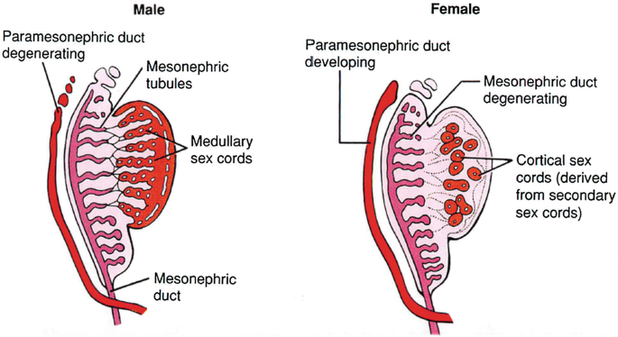

Slide 17
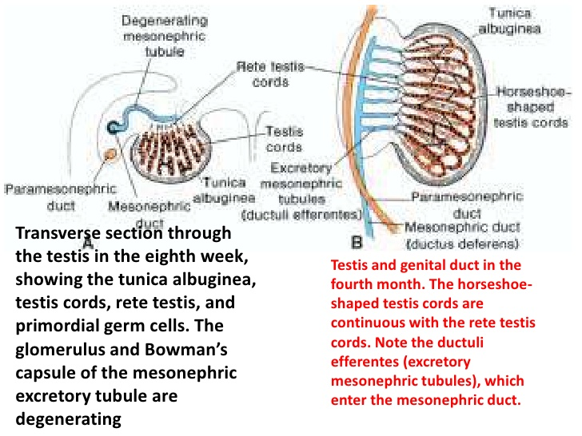

Slide 18
Role of XY chromosome –
XY chromosome contains Testis determining factor (TDF). They cause –
Development of medullary cords.
Non development of secondary cortical cords.
formation of tunica albugenia
Initiation and differentiation of sertoli cell.

Slide 19
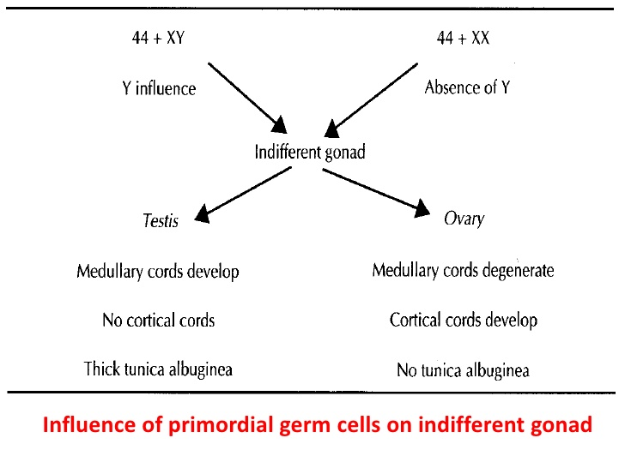

Slide 20
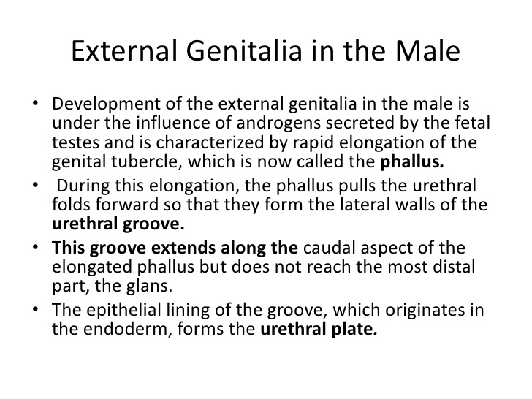

Slide 21
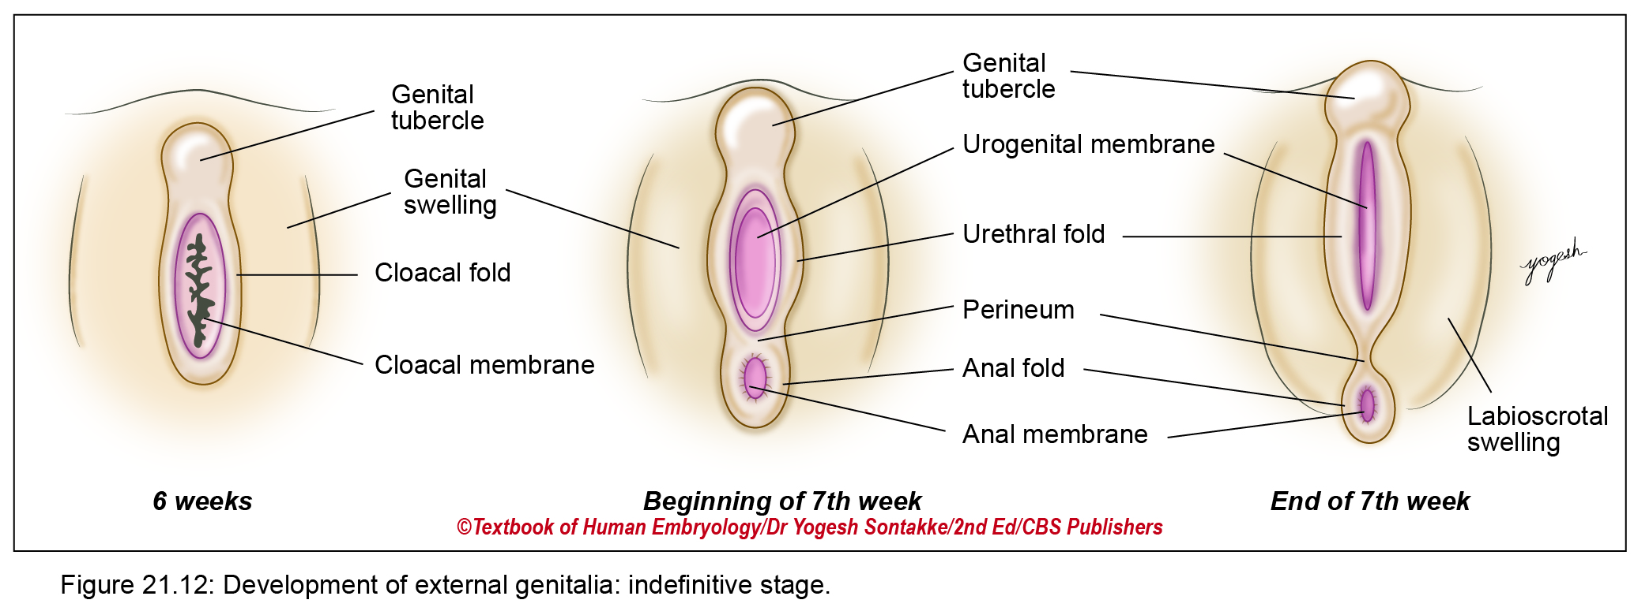

Slide 22
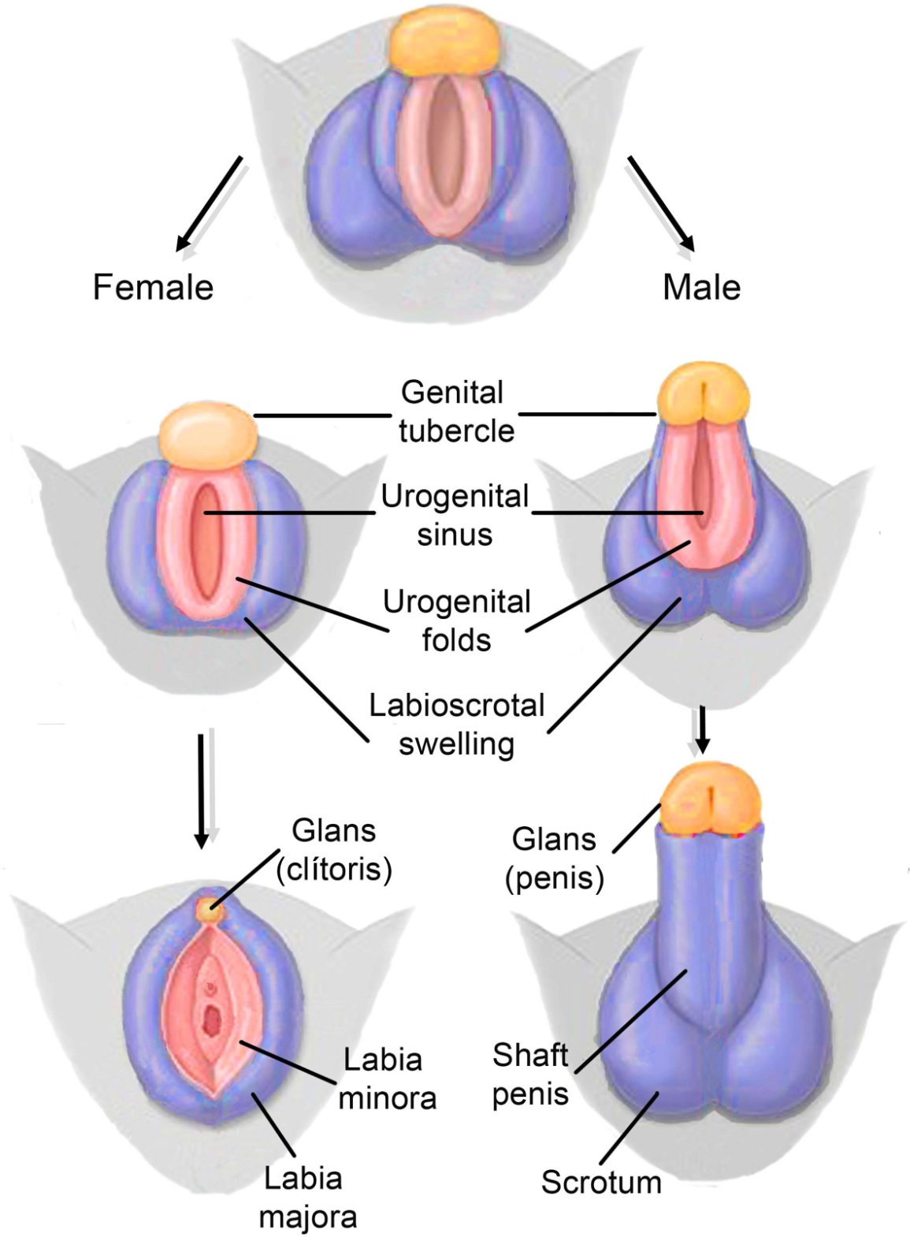

Slide 23
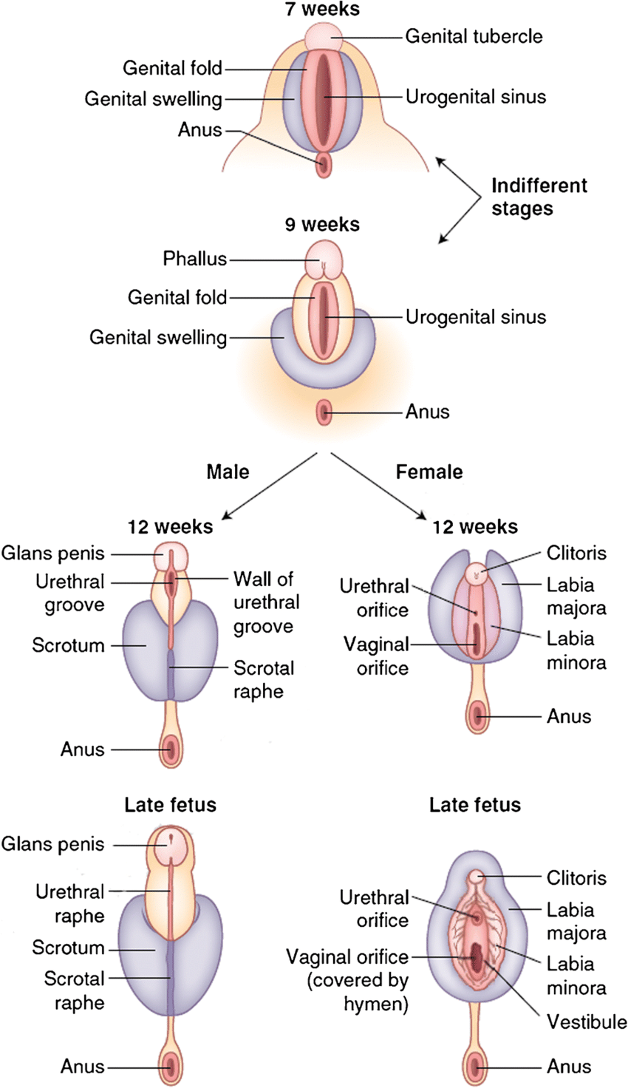

Slide 24
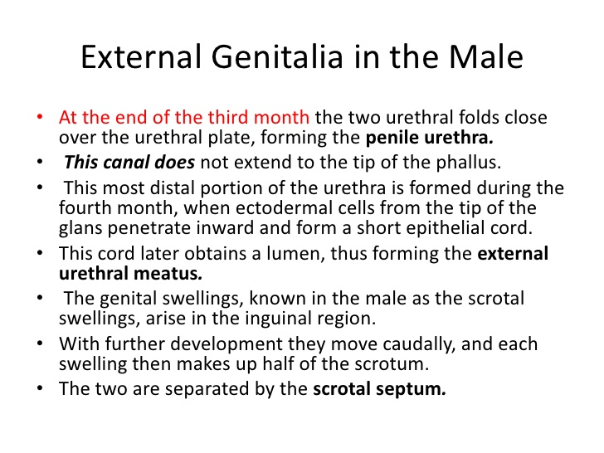

Slide 25
MALE EXTERNAL GENITALIA
1. Genital tubercle -- Penis
2. Urethral fold -- Penile urethra (Part)
3. Labioscrotal swelling - Scrotum

Slide 26
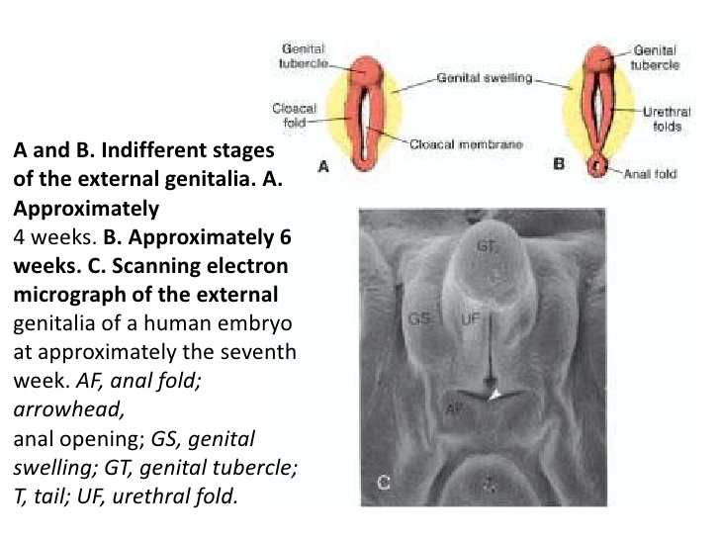

Slide 27
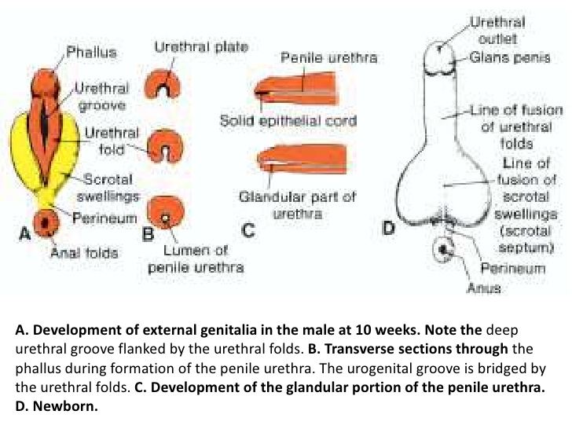

Slide 28
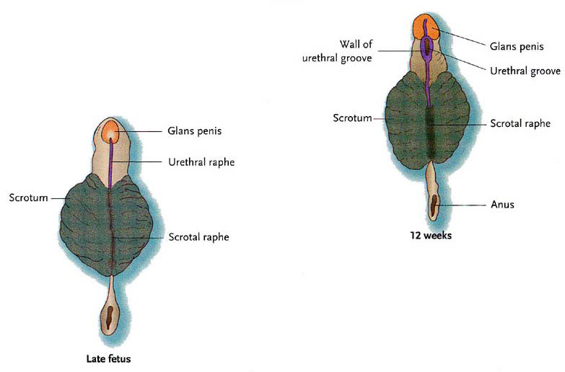

Slide 29
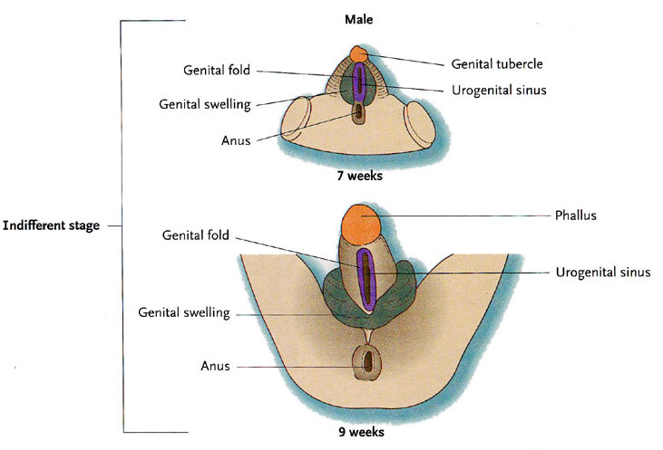

Slide 30
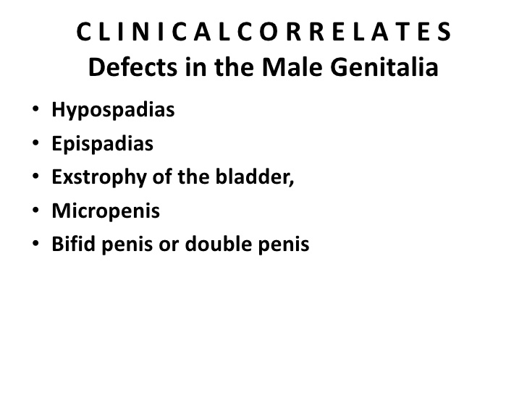

Slide 31
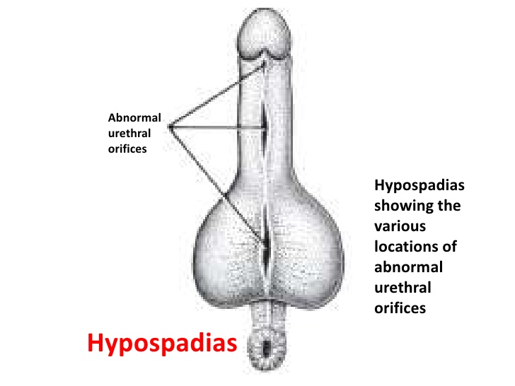

Slide 32
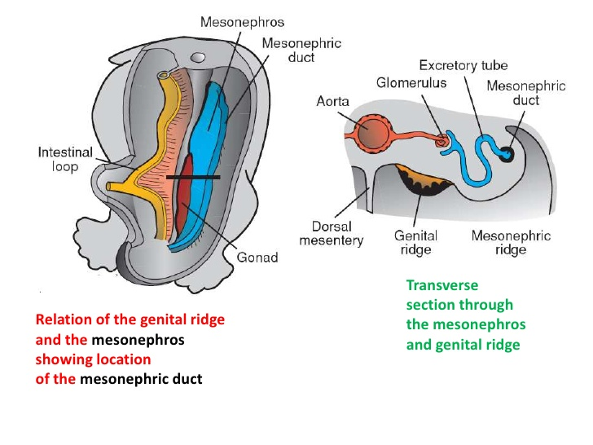

Slide 33
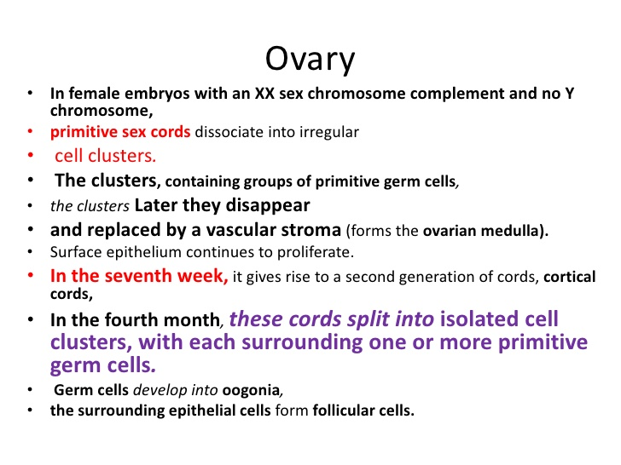

Slide 34
DEVELOPMENT OF OVARY
1. Primordial germ cell (PGC – Oogonia
2. Coelomic epithelium (Sex cords) –
Second generation of cortical cords form
Cortical cords
Follicular cells
3. Local Mesoderm -- Interstitial cell

Slide 35
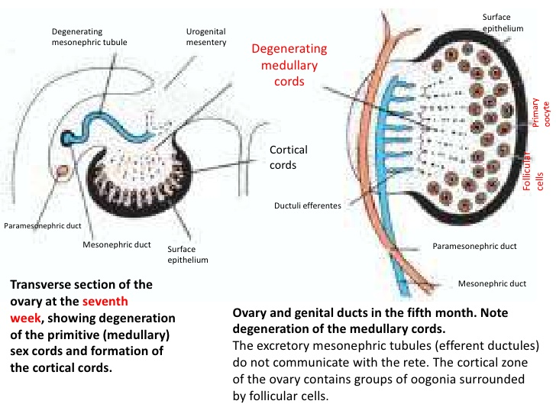

Slide 36
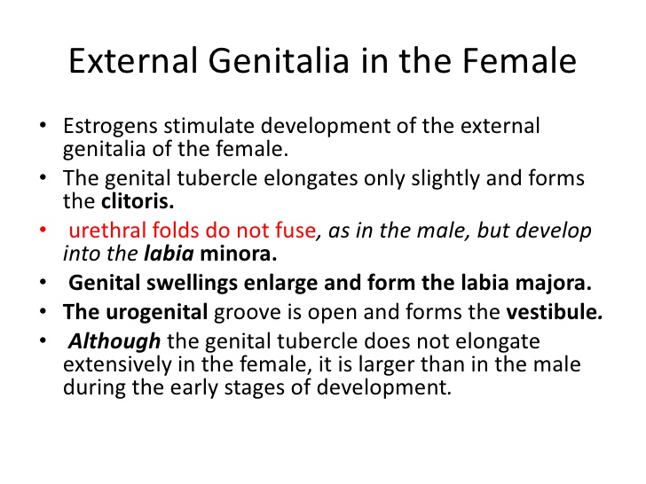

Slide 37
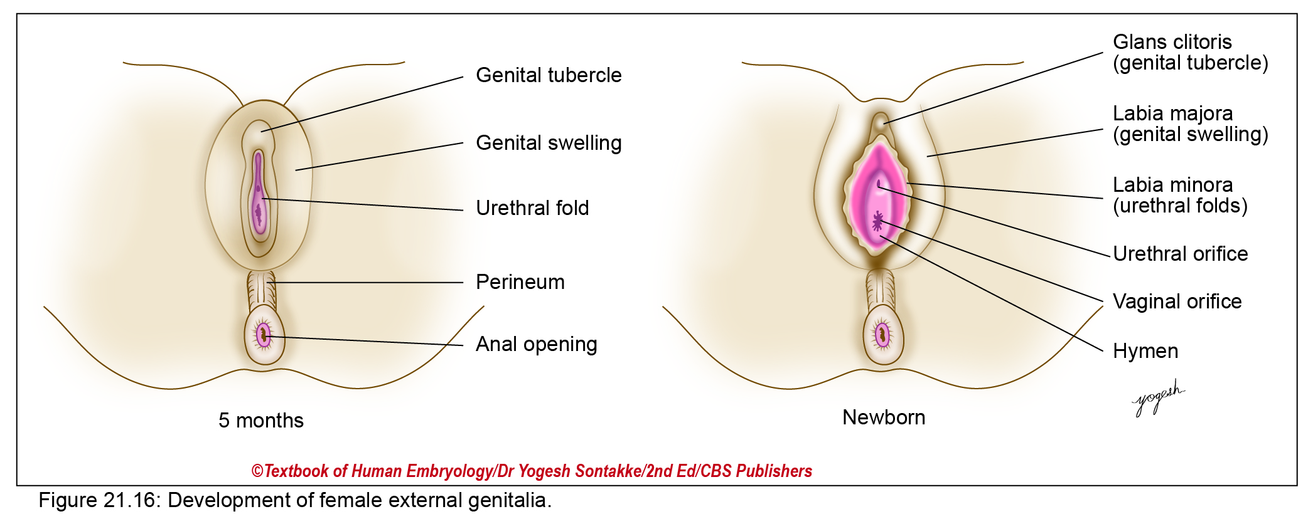

Slide 39
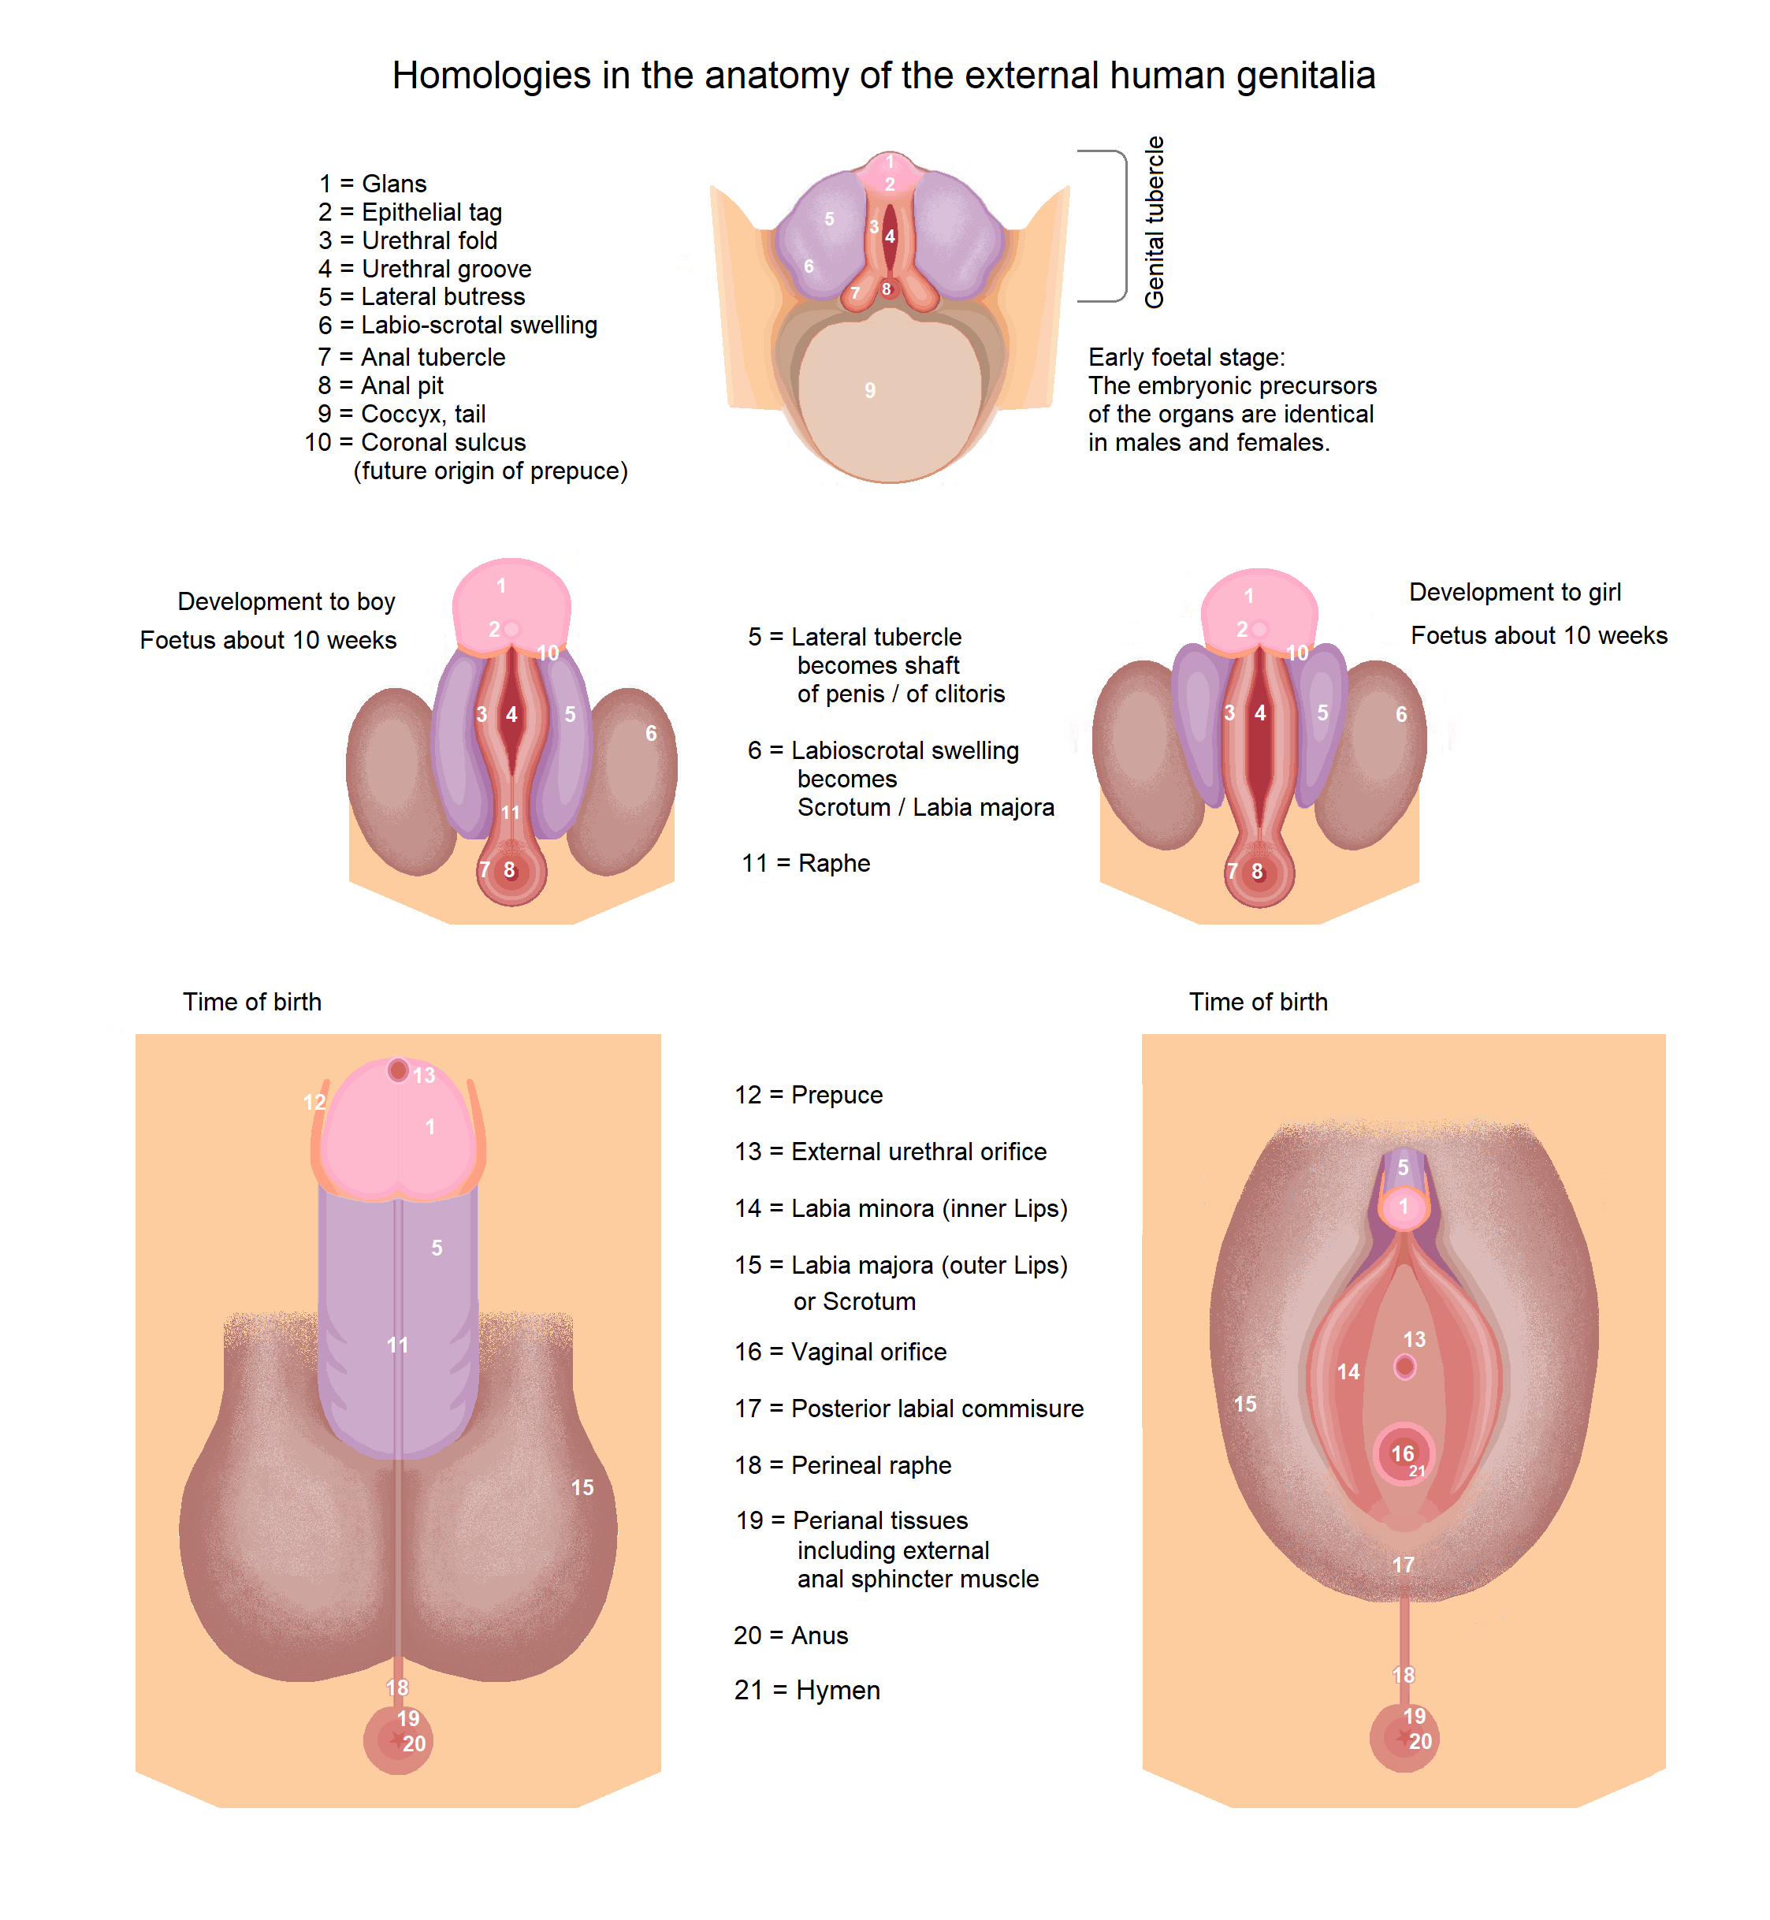

Slide 40
FEMALE EXTERNAL GENITALIA
Genital tubercle -- Clitoris
Urethral fold – Labium minus
Labioscrotal swelling -- Labium majus

Slide 41
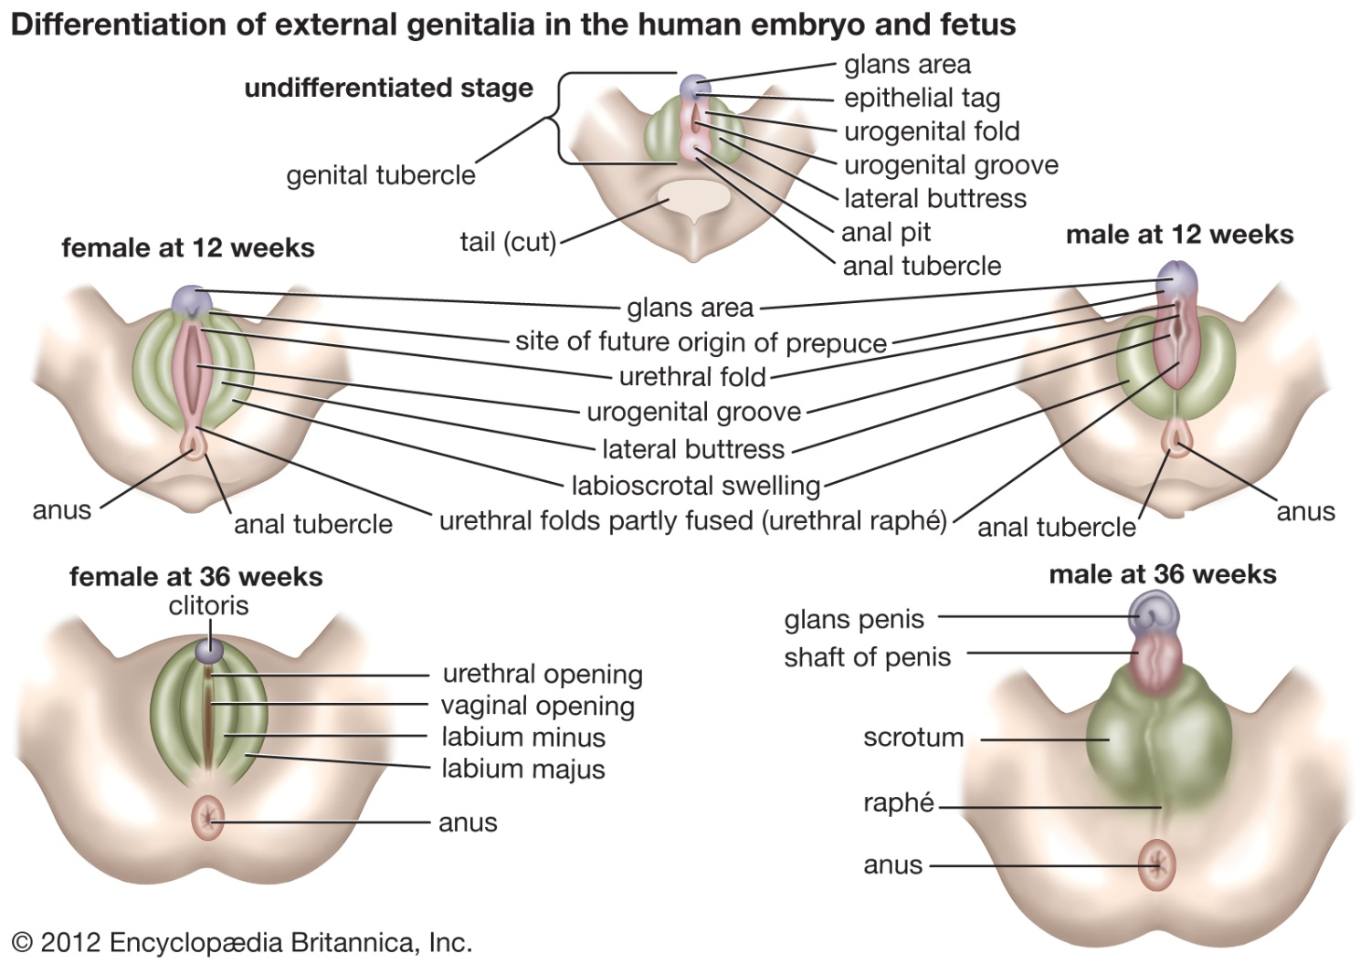

Slide 42
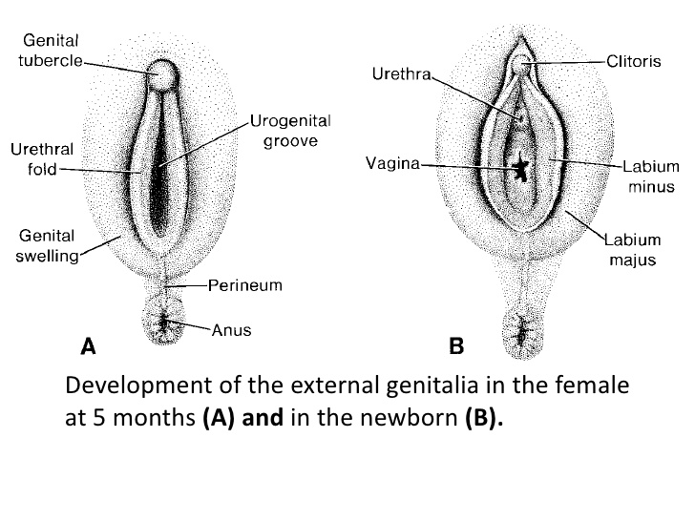

Slide 43
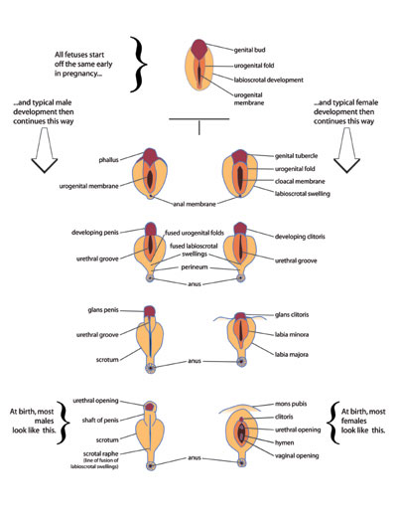

Slide 44
Genital Anomalies - Genetics
Hermaphroditism - ambiguous external genitalia
True hermaphrodite - both ovarian and testicular tissues
Generally 46,XX (crossing over, X with short arm of Y)
Ovotestes formation - medulla and cortex development
Male pseudohermaphroditism - 46,XY
External genitalia and ducts are intersex
Inadequate testosterone or abnormal MIS production
Female pseudohermaphroditism - 46,XX
Overproduction of androgens
Masculinization of genitalia - clitoral hypertrophy
Androgen insensitivity syndrome (Testicular feminization
syndrome) - 46,XY - female in all ways but with testis -
results from androgen receptor defects

Slide 45

Be Positive…….

Slide 46

THANK YOU

Slide 47

THANK YOU

