Slide 1
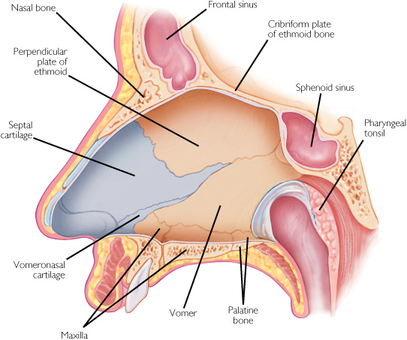
GROSS ANATOMY NOSE
DR. PRAVEEN KURREY MBBS, MS, BCME, BCBR, CISP
PROFESSOR ANATOMY

Slide 2
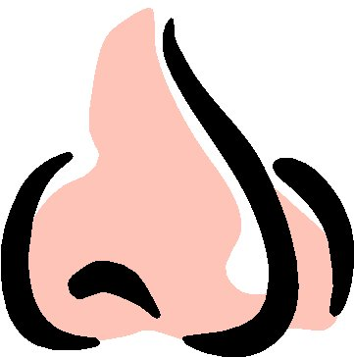
ANATOMY
External Nose
Nasal Cavity
Nasal Septum
Lateral Wall
Anatomical Variations

Slide 3
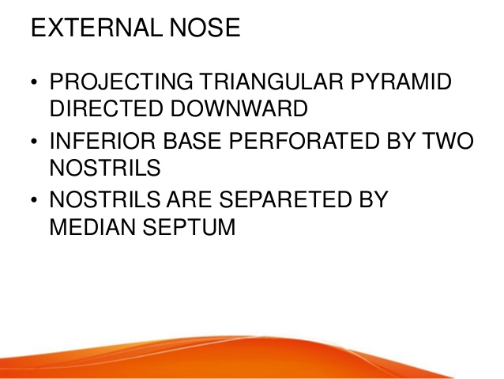

Slide 4
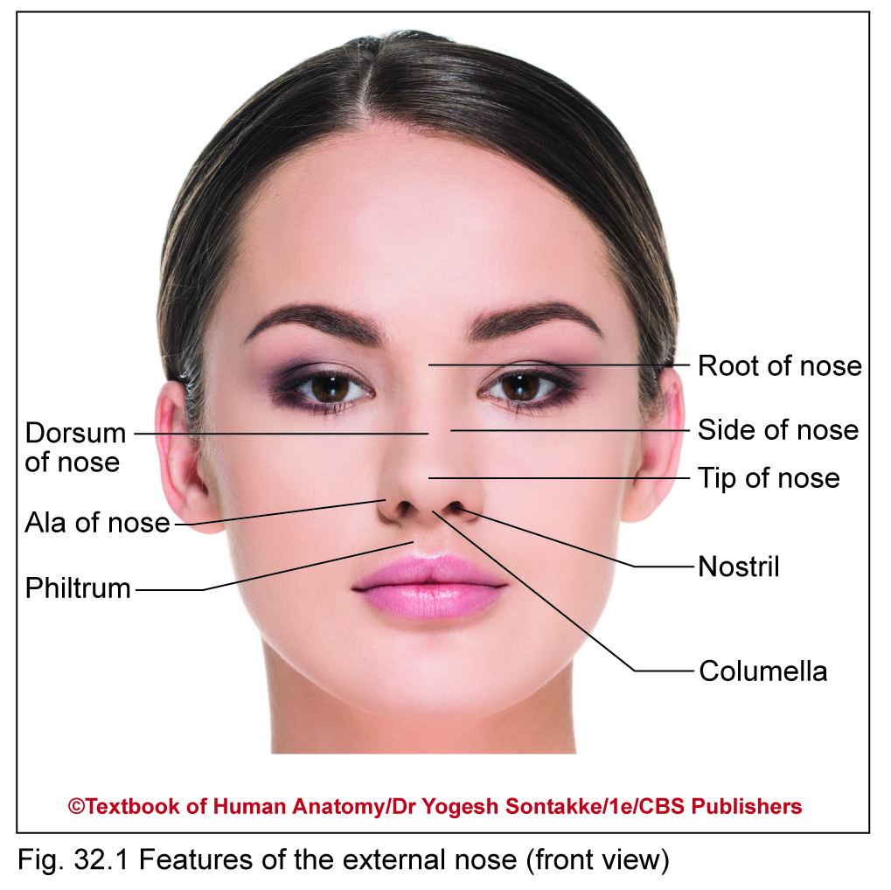
EXTERNAL NOSE
Pyramidal projection of face
Features
Presents following features
Tip or apex – lower free end
Root or bridge – upper narrow part which is continuous with forehead
Dorsum – rounded border between tip and root

Slide 5
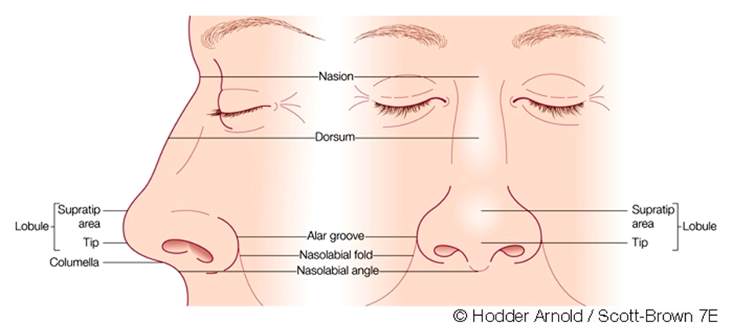
External nose :

Slide 6
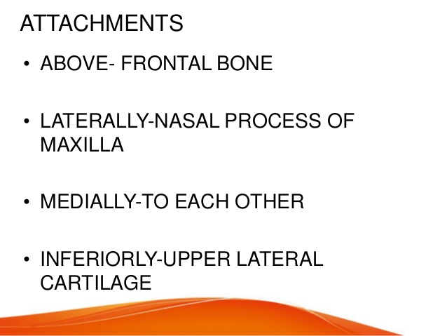

Slide 7
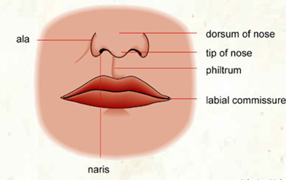
External Nose
The external nose has two elliptical orifices called the naris (nostrils), which are separated from each other by the nasal septum.
The lateral margin, the ala nasi, is rounded and mobile.

Slide 8
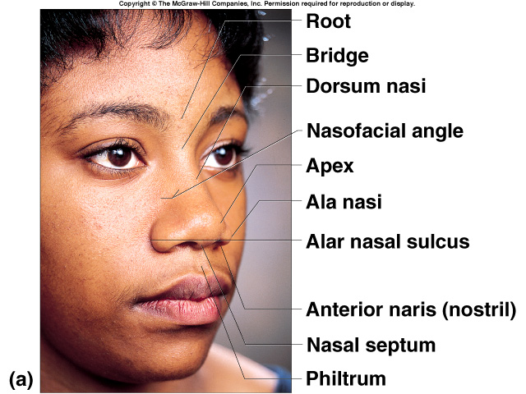
External Nose

Slide 9
Skin & Vestibule :
Skin :
Thickness of skin and soft tissue varies.
Over dorsum and side – thin and loose
Over tip & alar region – thick and adherent
Vestibule :
Anteriormost part of nasal cavity lined by stratified squamous keratined epithelium.
Demarcated by limen nasi
Lined by coarse vibrissae, glands

Slide 10
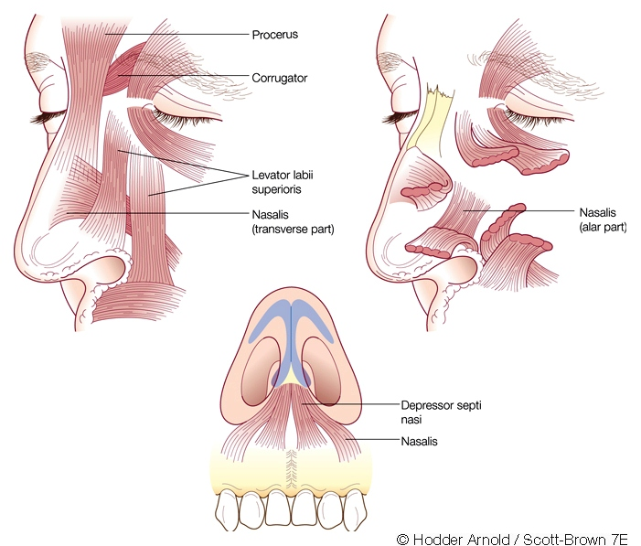
Transverse – Pyriform aperture to Dorsum of nose & Contracts nasal aperture
Alar – beneath nasomaxillary suture line via short thin tendon to skin of nasal alae Contraction causes shortening and dilation of Nostril

Slide 11
framework
Bony :
Nasal Bone
Nasal process of frontal Bone
Frontal process of maxilla
Cartilagenous:
Paired upper lateral cartilages
Septal Cartilage
Paired lower lateral cartilage / Greater alar cartilage
Minor accessory alar cartilages (Sesamoid Cartilage)

Slide 12
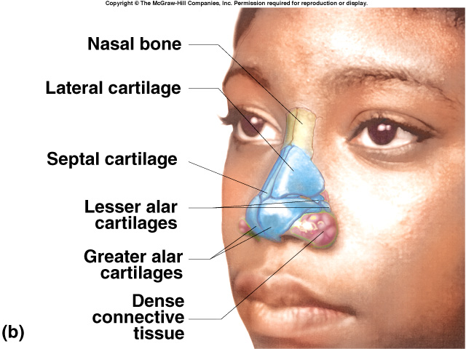
External Nose

Slide 13
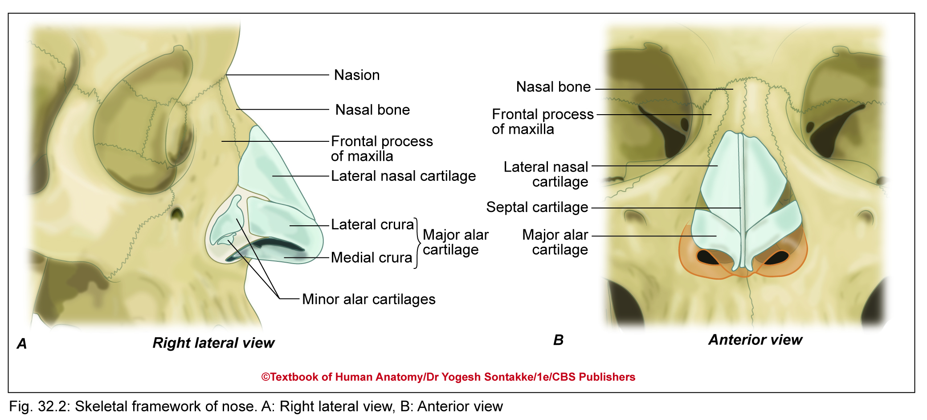

Slide 14
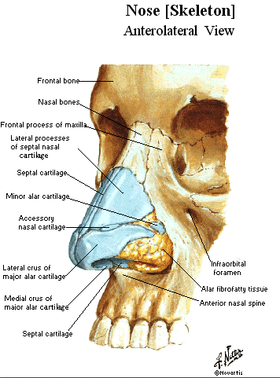
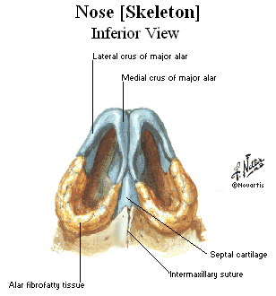
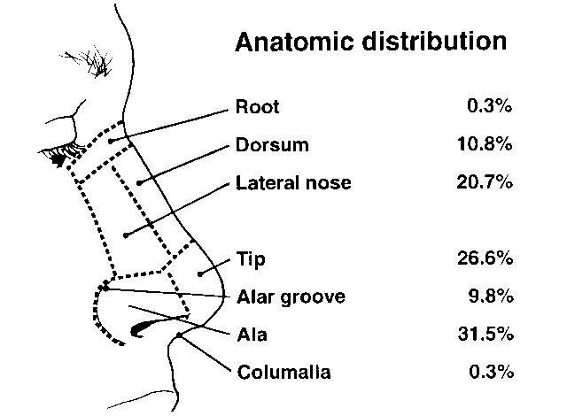
Nasolacrimal Suture
Supported by Nasal Spine and perp. Plate of ethmoid

Slide 15
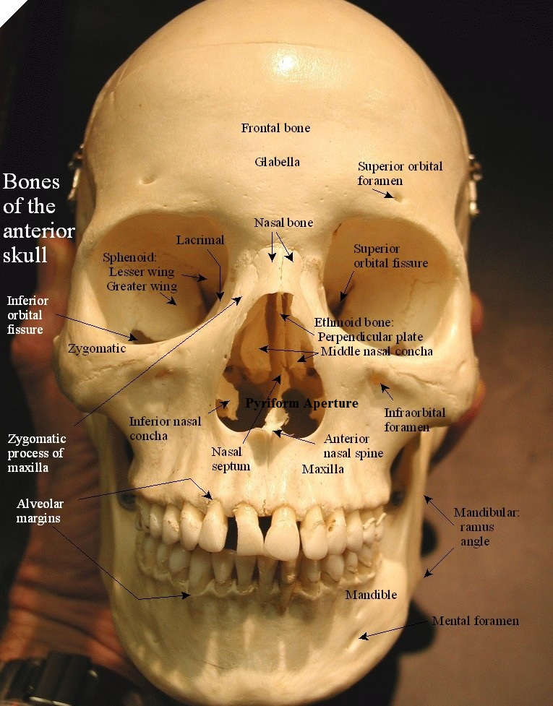
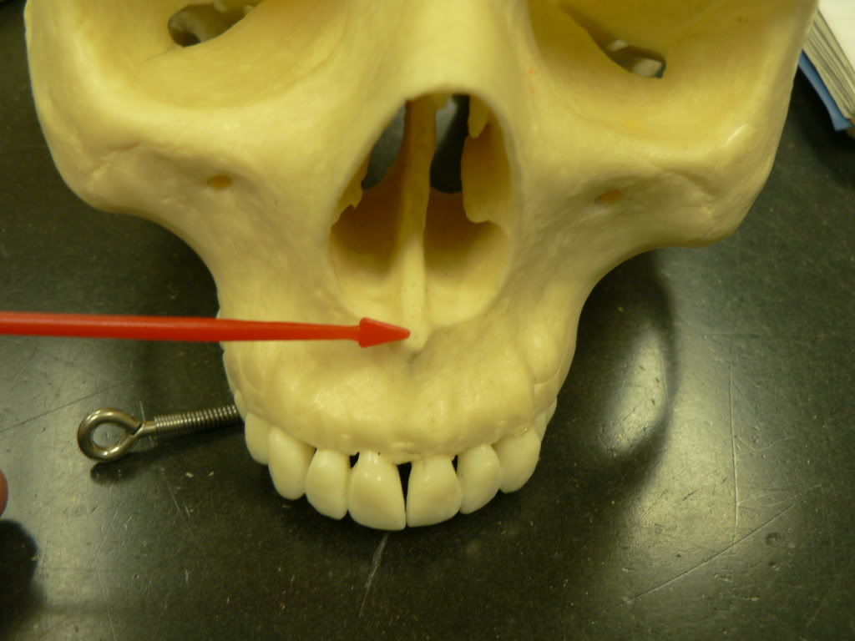
Upto 15mm
Nasal bones are supporetd by perp plate of ethmoid and nasal spine both of which groove the bone

Slide 16
NASAL CAVITY
Vestibule of Nose
Small anteroinferior part of nasal cavity
Lined by skin which contains sebaceous glands and hairs
Vibrissae: Are stiff interlacing hairs of vestibule
Limen nasi – ridge between vestibule and nasal cavity proper
Columella – median lower part of nose separating right and left vestibules of nose

Slide 17
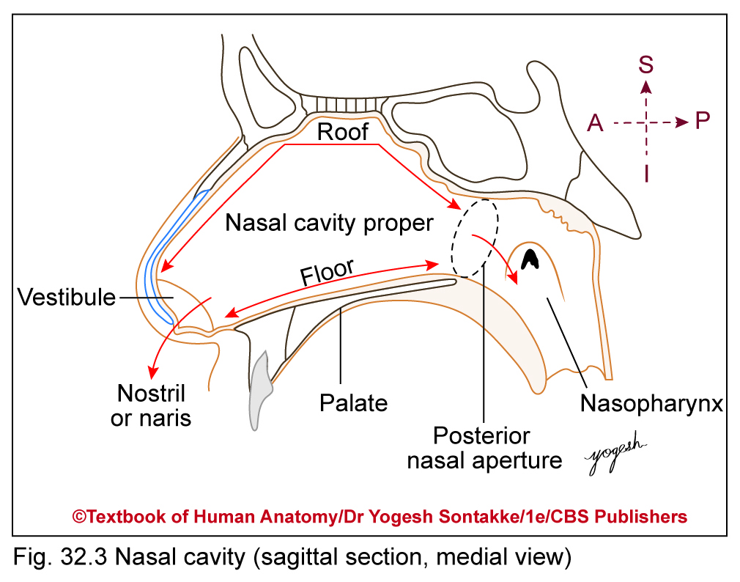
Nasal Cavity Proper
Boundaries
Each nasal cavity proper has following boundaries
Roof
Floor
Medial wall
Lateral wall

Slide 18
Nasal Cavity Proper
Roof
About 7 cm long and 2 cm wide
Slopes downward both in front and behind
Divided into three parts
Anterior or frontonasal part
Slopes downward and forward
Supported by frontal and nasal bones and junction of septal and lateral cartilages

Slide 19
NASAL SEPTUM
Formation
Has following parts
Bony part: Formed by
Vomer
Perpendicular plate of ethmoid
Cartilaginous part: Formed by
Septal cartilage
Septal processes (medial crura) of major alar Cartilage
Cuticular part
Lower end of nasal septum
Formed by fibrofatty tissue covered by skin
Columella: Lowest margin of nasal septum

Slide 20
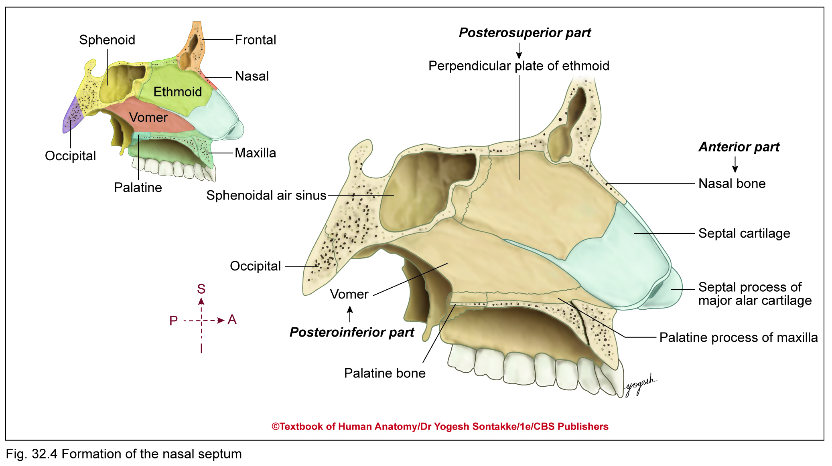

Slide 21
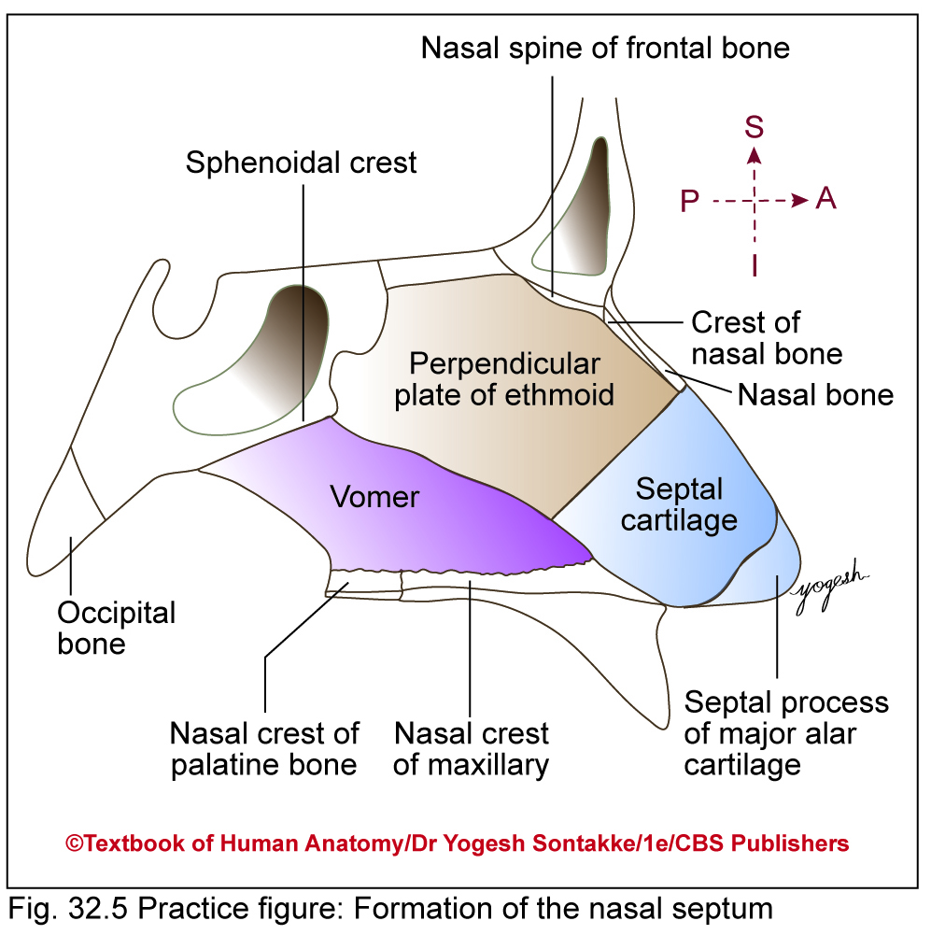

Slide 22
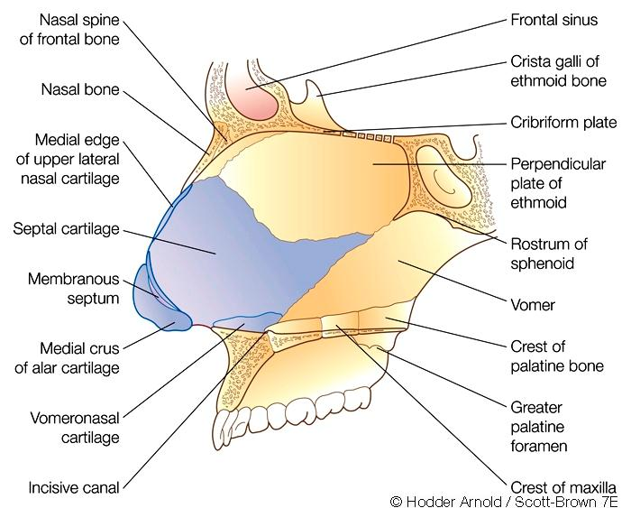
Nasal septum
Bones –
Perpendicular plate of ethmoid
Vomer
Two bony crests of the
maxilla and palatine
Rostrum of sphenoid
Nasal spine of frontal bone
Cartilages –
Quadrilateral cartilage
Upper and lower lateral cartilages contribution
Vomeronasal Cartilage
Membranous septum

Slide 23
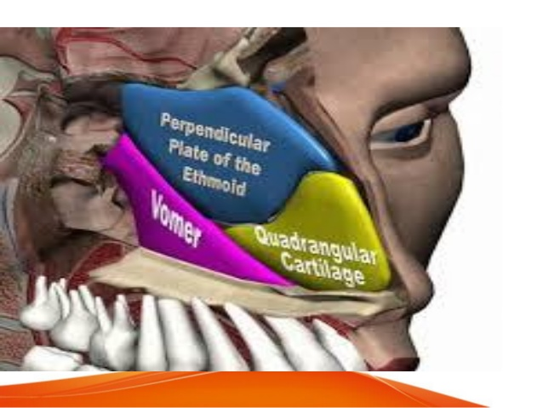
NASAL SEPTUM

Slide 24
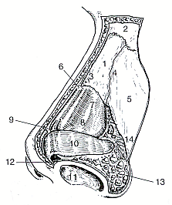
QUADRANGULAR CARTILAGE
3 – 4 mm centrally and 4 – 8 mm anteroinferiorly (footplate)
Above dome of lower lateral cartilages, upper angle expanded forming anterior septal angle
PerpENDICULAR Plate of ethmoid
forms superior and anterior bony septum
Above is cribriform plate and cristae galli
Grooves nasal bones
Post free edge of vomer
vomer
Posterior and inferior septum
With 2 alae articulates with rostrum of sphenoid, forms vomerovaginal canals which transmit pharyngeal branch of maxillary artery
Inferiorly – with both crests
Anterior – perp plate & septal cartilage

Slide 25
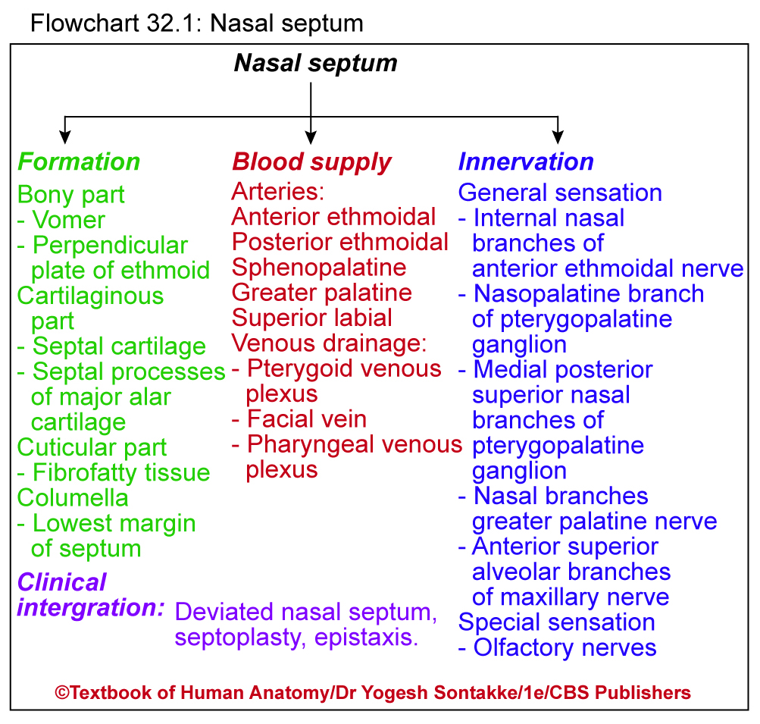

Slide 26
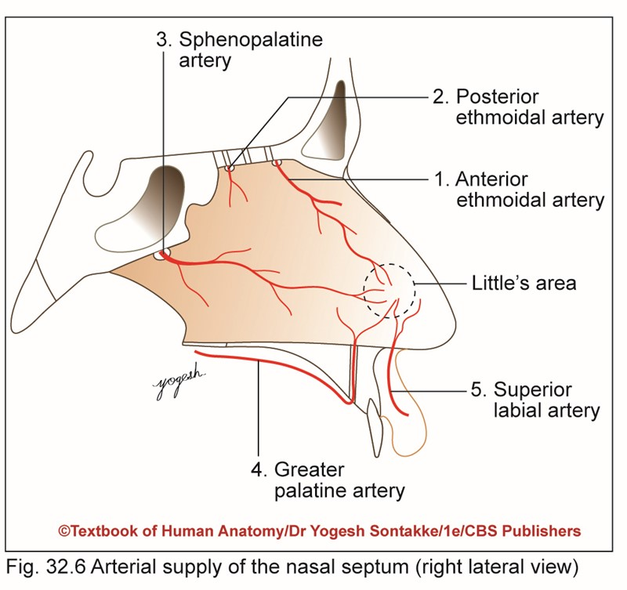
Blood Supply
Arterial supply
Supplied by septal branches of following arteries
1. Anterior ethmoidal artery –branch of ophthalmic artery
2. Posterior ethmoidal artery –branch of ophthalmic artery

Slide 27
Blood Supply
Supplied by septal branches of following arteries
3. Sphenopalatine artery –branch of maxillary artery
4. Greater palatine artery –branch of maxillary artery
5. Superior labial artery –branch of facial artery

Slide 28
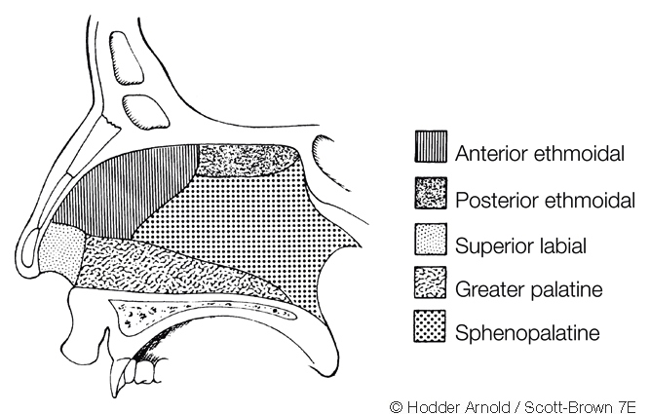
Blood Supply
Posteroinferior septum and anteroinferior face of sphenoid sinus
& posterior halves of middle & inf turbinates
b/o maxillary artery b/o ECA

Slide 29
Kiesselbach plexus
Little’s area: Area at anteroinferior part of nasal septum just above vestibule
Highly vascular
Kiesselbach plexus: Arteries form arterial anastomosis at Little’s area called Kiesselbach plexus

Slide 30
Kiesselbach plexus
Has arterial anastomosis between septal branches of following arteries:
Sphenopalatine artery
Anterior ethmoid artery
Greater palatine artery
Superior labial artery
Epistaxis
Nose bleeding
Commonly occurs in Little’s area of nasal septum
Common in children and young adults
Note: Artery of epistaxis – Sphenopalatine Artery

Slide 31
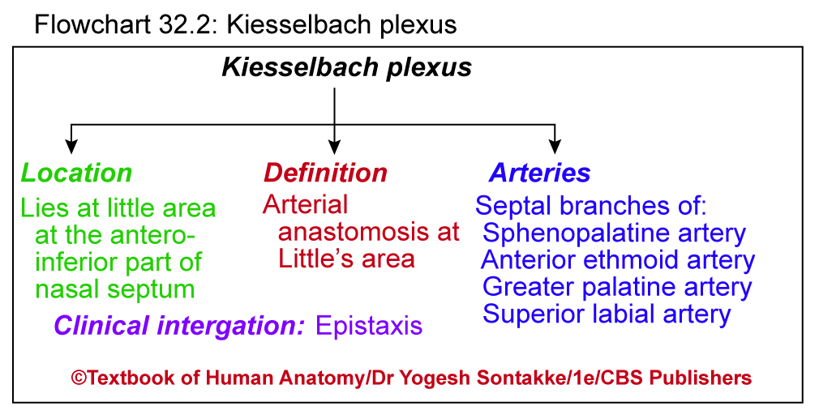

Slide 32
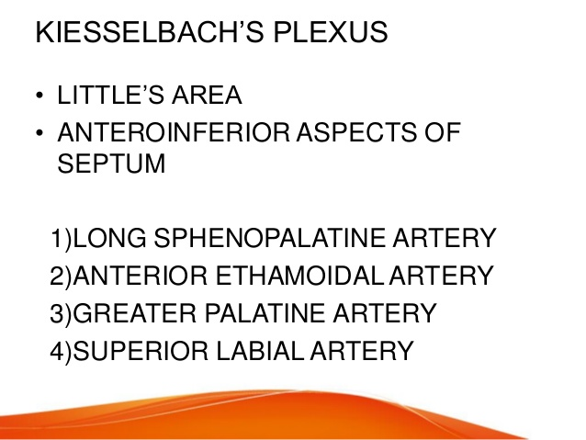

Slide 33
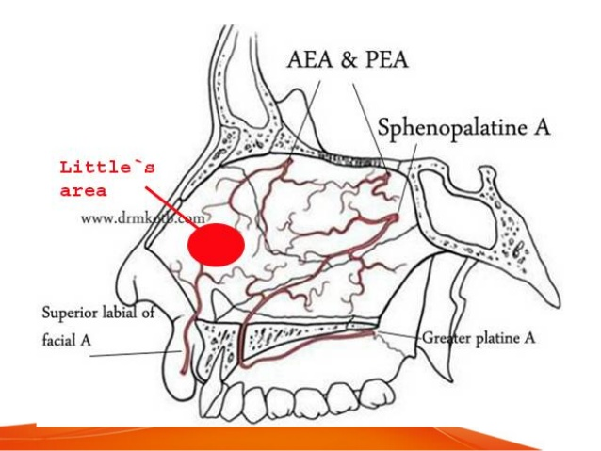

Slide 34
Venous drainage
Veins from nasal septum correspond to arteries
They drain blood to
Pterygoid venous plexus
Facial vein
Pharyngeal venous plexus
Submucous venous plexus is more marked in Little’s area

Slide 35
Lymphatic drainage
Submandibular nodes drain anterior half of nasal septum
Retropharyngeal nodes drain posterior half of nasal septum

Slide 36
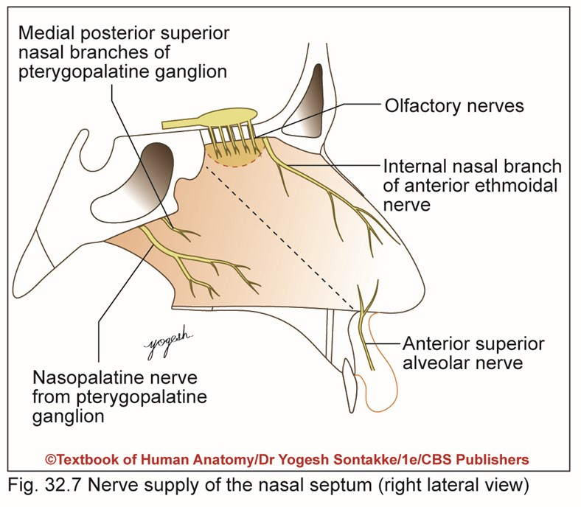
NERVE SUPPLY
General sensation is carried by
1. Internal nasal branches of anterior ethmoidal nerve (branch of nasociliary branch of ophthalmic nerve)
2. Nasopalatine branch of pterygopalatine ganglion
3. Medial posterior superior nasal branches of pterygopalatine ganglion

Slide 37
NERVE SUPPLY
4. Nasal branches of greater palatine nerve
5. Anterior superior alveolar branches of maxillary nerve
6. Special sensory supply from olfactory nerves in upper part of nasal septum

Slide 38
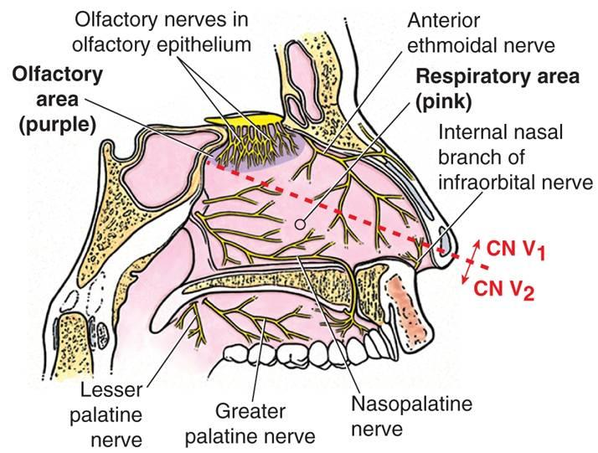
Anterior superior alveolar nerve
b/o pterygopalatine ganglion and carries both sensory and parasympathetic fibres
& also Vidian nerve

Slide 39
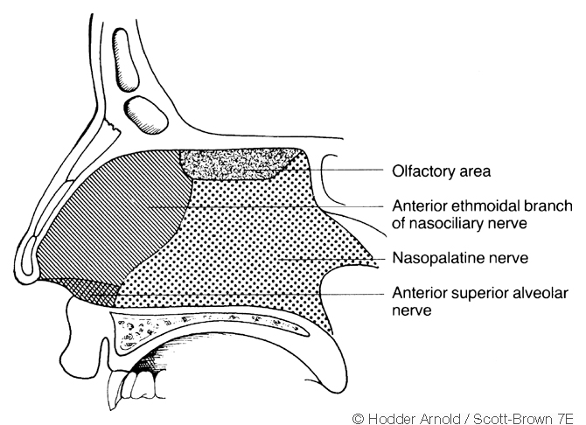
Nerve supply of septum

Slide 40
Deviated nasal septum (DNS)
Involves physical deviation of nasal septum from midline
About 80% of people with DNS do not have any symptoms
Signs and symptoms
Mechanical obstruction causing difficulty in nasal breathing
Separated episode of sinusitis
Excessive snoring
Headache
Commonly affects males than females
May occur due to trauma or developmental reasons (congenital)

Slide 41
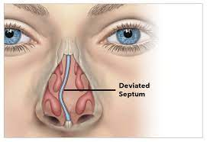
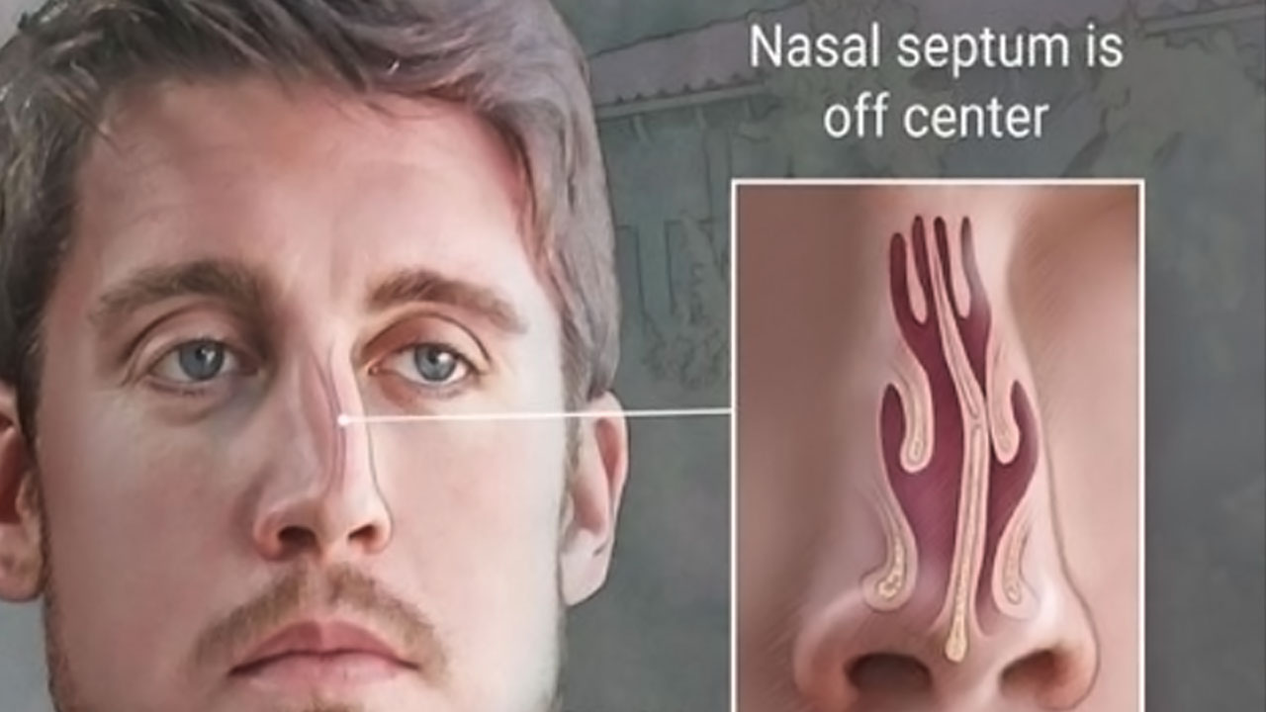
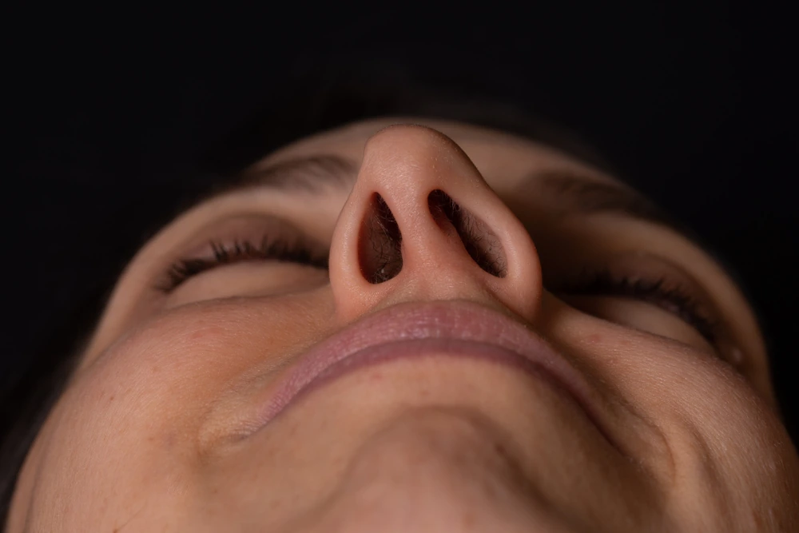
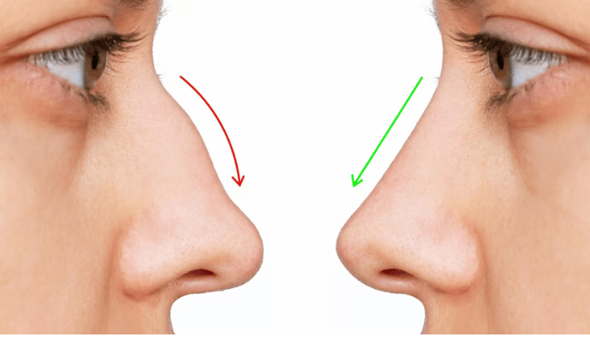

Slide 42
Deviated nasal septum (DNS)
Treatment
Septoplasty (submucosa resection of septum) – surgical correction of DNS
May be required for patients with DNS having recurrent episodes of symptoms
Deviated piece of septal cartilage – removed in septoplasty

Slide 43
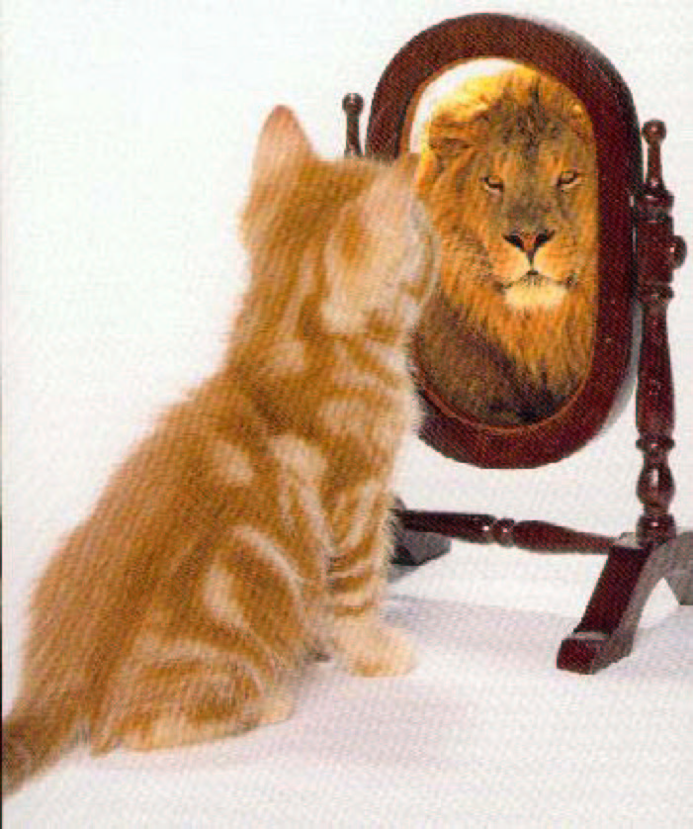
What matters most is how you see yourself …

Slide 44
LATERAL WALL OF NOSE

Slide 45
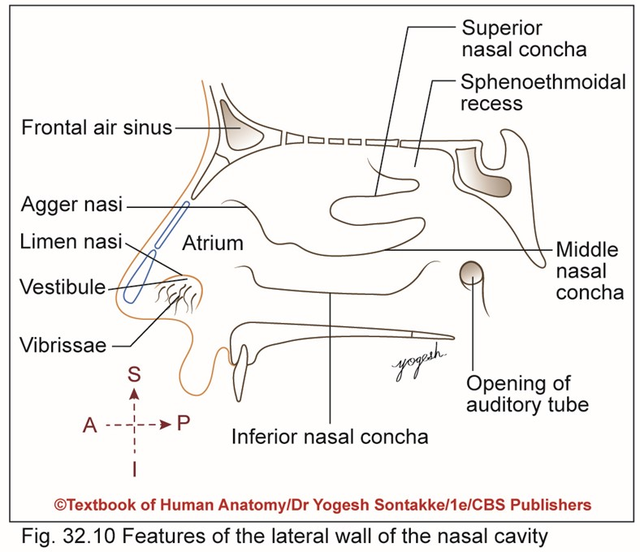
LATERAL WALL OF NASAL CAVITY
Three parts
1. Anterior part: Has depressed area called vestibule
Lined by skin with short, stiff curved hairs called vibrissae

Slide 47
LATERAL WALL OF NASAL CAVITY
Features
2. Middle part: Called atrium of middle meatus
Limited above by agger nasi (a faint ridge of mucous membrane
3. Posterior part
Has three shelf-like projections called conchae
Spaces separating conchae are meatus

Slide 48
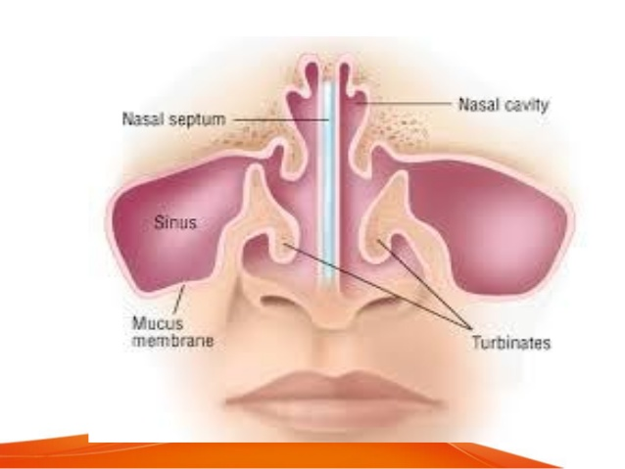

Slide 49
Atrium – Structureless area
Shows bulge anterior to middle turbinate formed by agger nasi cells
Ridge from agger nasi to apex of superior border of inferior turbinate which overlies NLD
3 scrolls of turbinates. Occasionally supreme turbinate.
Sphenoethmoidal recess above superior turbinate which forms niche between posterior ethmoidal cells and sphenoidal cells
Fossa of rosenmuller forms a deep cleft behind torus tubaris
Attachments of middle turbinate :
Anterior 1/3rd – cribriform plate at jnct in saggital plane also takes a small anterior attachment to frontonasal process(maxilla)
Middle 1/3rd – lamina papyracea in coronal plane (ground lamellae)
Posterior 1/3rd – to lamina papyracea and the perpendicular plate of the palatine bone extending upto the roof of posterior choanae

Slide 50
LATERAL WALL OF NASAL CAVITY
Wall of nose – irregular and has shelf-like projections called conchae or turbinate
Formation
Bones
Formed by following bones
Nasal
Frontal process of maxilla
Lacrimal bone
Ethmoid
Inferior nasal concha
Perpendicular plate of palatine bone
Medial pterygoid plate of sphenoid

Slide 51
LATERAL WALL OF NASAL CAVITY
Cartilages
Lateral nasal cartilage
Major alar cartilage
Three-to-four minor alar cartilages

Slide 52
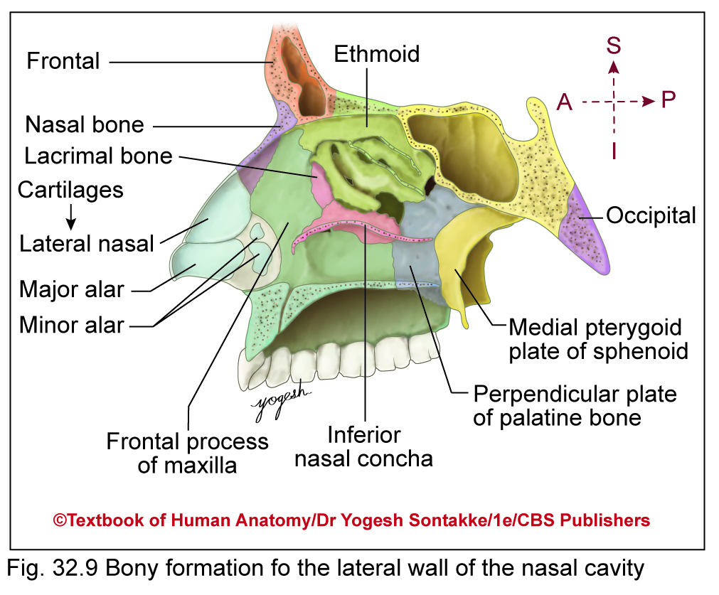

Slide 53
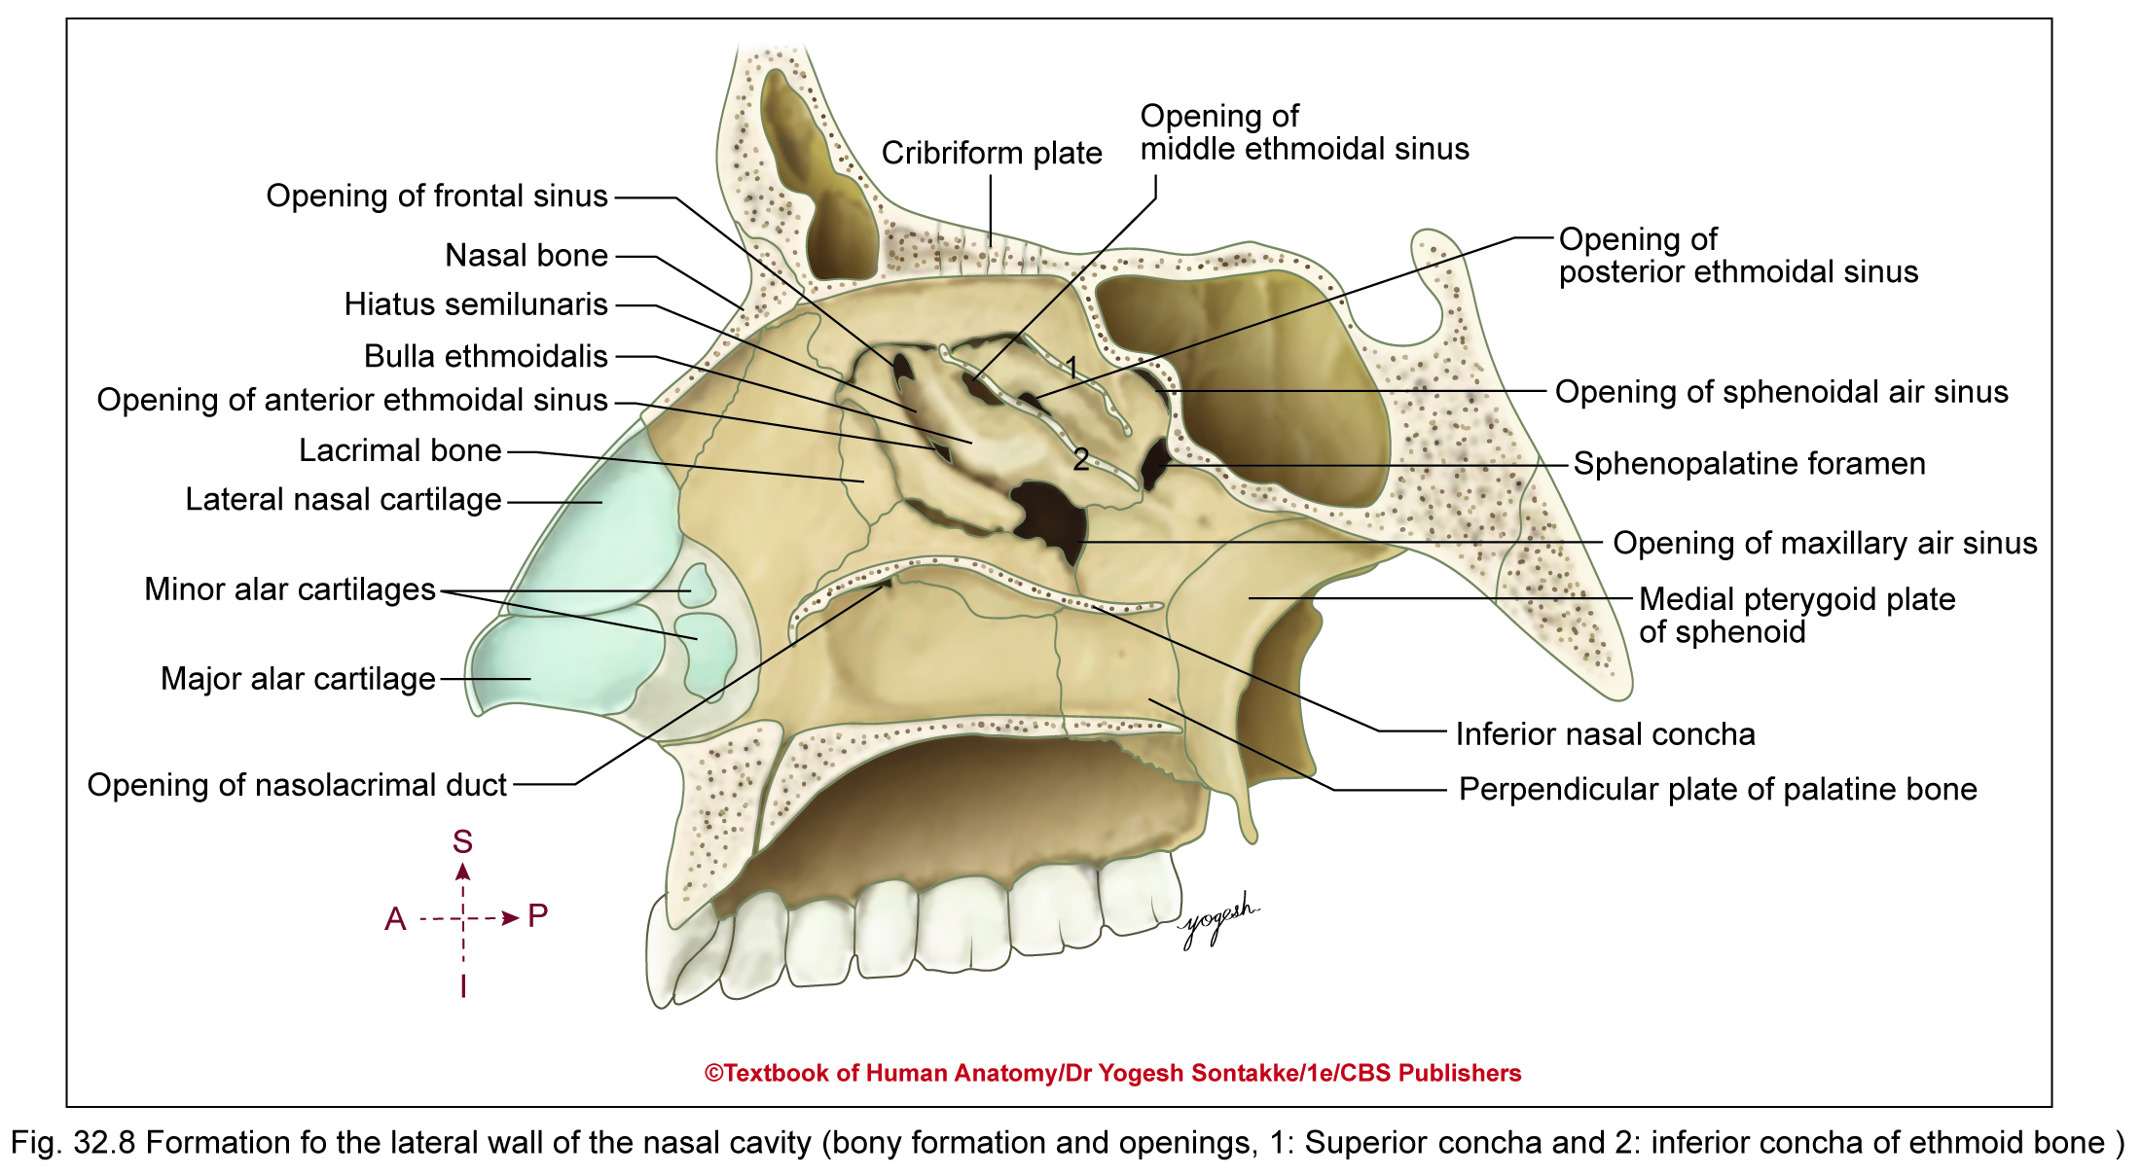

Slide 54
The Lateral Walls of Nasal Cavity
Marked by 3 projections:
Superior concha
Middle concha
Inferior concha
The space below each concha is called a meatus.

Slide 55
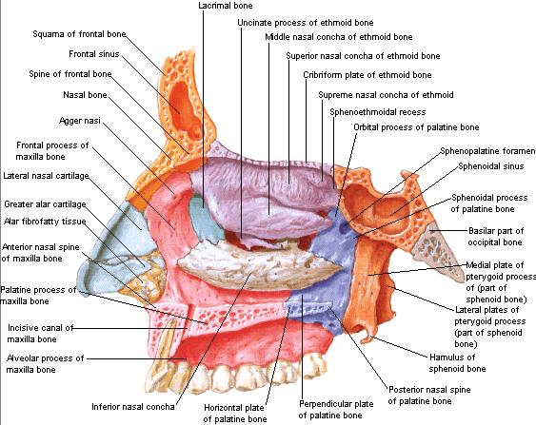

Slide 56
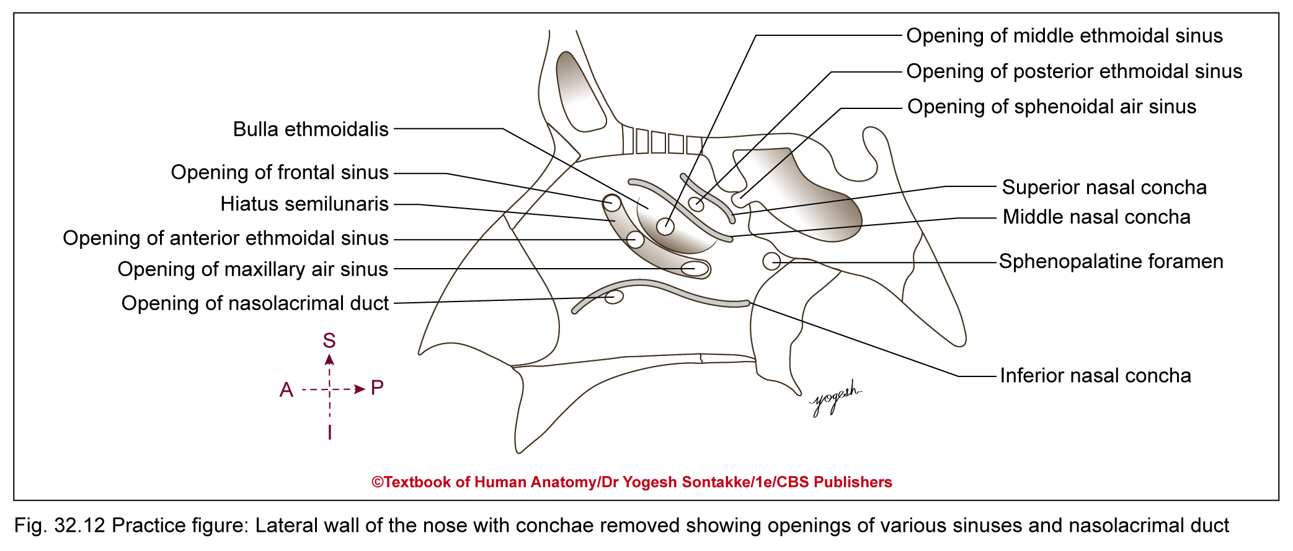

Slide 57
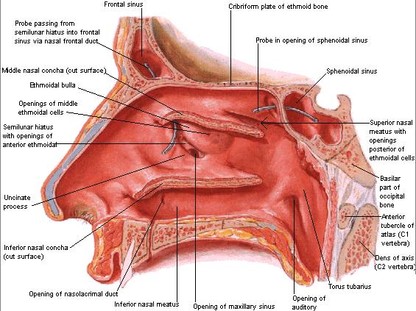

Slide 58
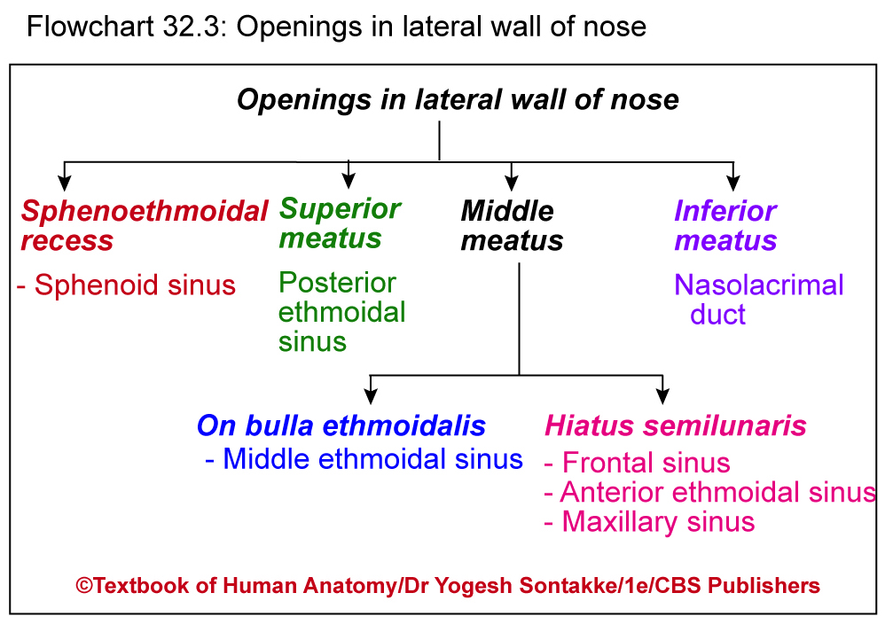

Slide 59
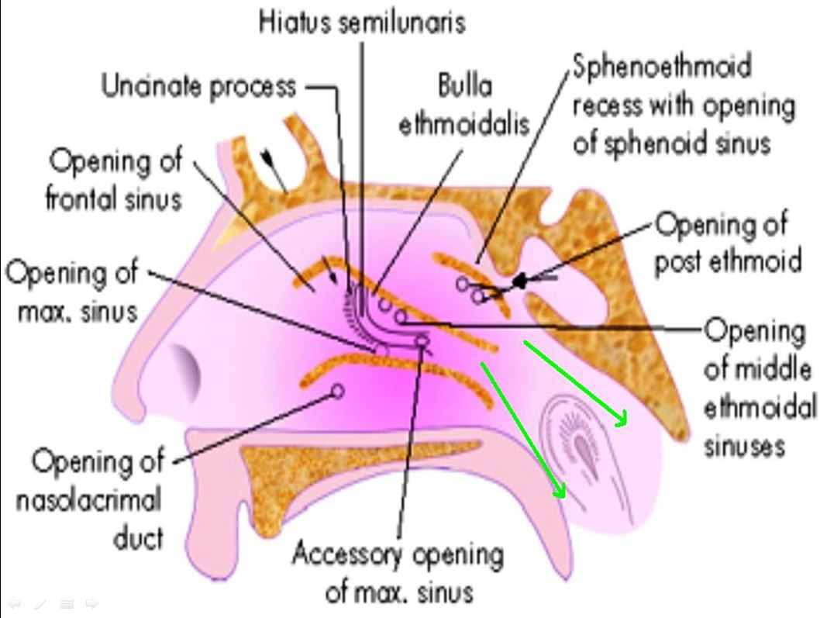
Meatal Drainage
Inferior meatus :
NLD (Hasners valve)
Middle meatus :
Frontal
Anterior ethmoidal
Maxillary
Superior meatus :
Posterior ethmoidal
Sphenoethmoidal recess :
Sphenoid

Slide 60
Openings in lateral wall of nose
Site | Structure opening
Sphenoethmoidal recess | Sphenoidal air sinus
Superior meatus | Posterior ethmoidal sinus
On the ethmoidal bulla | Middle ethmoidal sinus
In hiatus semilunaris | Anterior-to-posterior 1. Frontal air sinus 2. Anterior ethmoidal sinus 3. Maxillary air sinus
Inferior meatus | Nasolacrimal duct

Slide 61
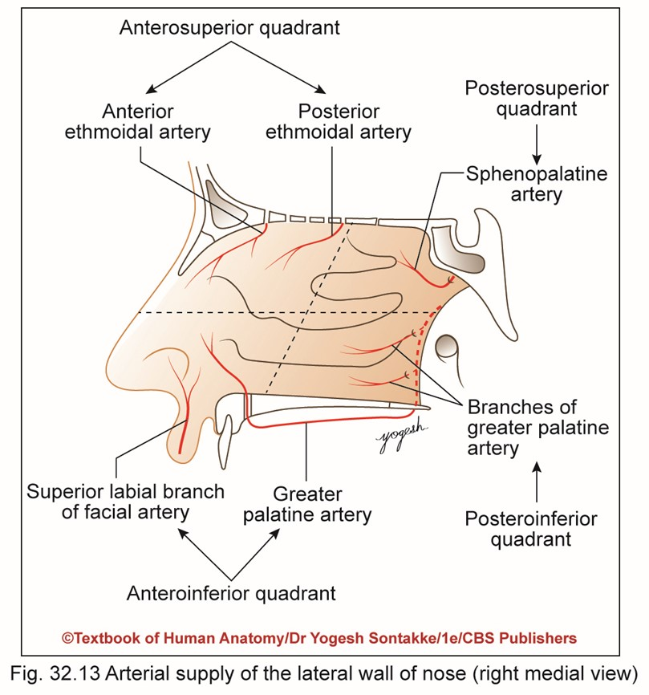

Slide 62
Blood Supply
Arterial supply
Divided into four quadrants
Anterosuperior quadrant – supplied by anterior and posterior ethmoidal arteries – branches of ophthalmic artery

Slide 63
Blood Supply
Anteroinferior quadrant – supplied by facial and greater palatine arteries
Posterosuperior quadrant – supplied by sphenopalatine artery (branch of maxillary artery)
Posteroinferior quadrant – supplied by branches of greater palatine artery which pierce perpendicular plate of palatine plate of palatine bone

Slide 64
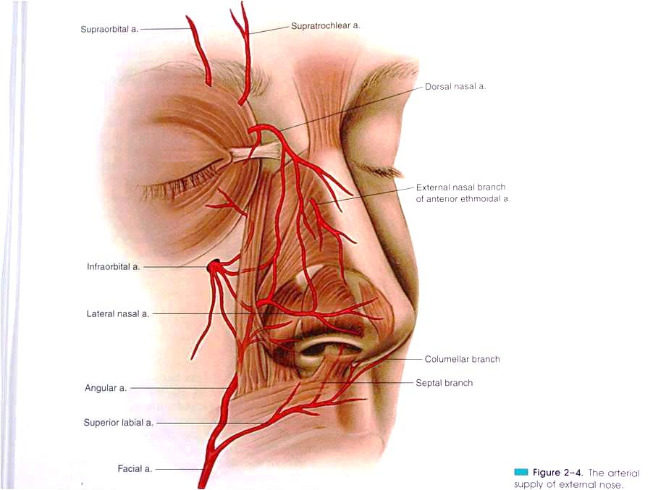
Blood supply
ICA → Ophthalmic Artery
Vth → Ophthalmic nerve → Anterior ethmoidal →External nasal nerve (Dorsum, tip)
Vestibule of nose
Maxillary artery
ECA

Slide 65
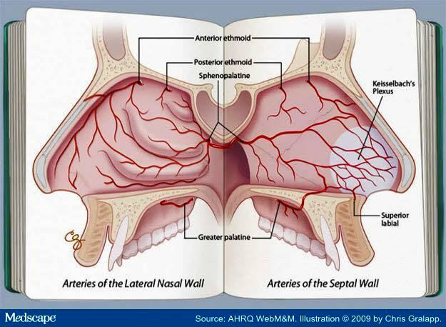
Arteries Of lateral and medial wall of Nose

Slide 66
Artery | Branch of | Supplies
Anterior ethmoidal & Posterior Ethmoidal arteries | Ophthalmic artery(ICA) | Ethmoid and frontal sinuses, roof of the nose, upper part of lateral wall and septum
Sphenopalatine artery | Maxillary artery 3rd part (ECA) | Mucous membrane, superior and middle meatus, conchae and septum
Greater palatine artery | Maxillary artery (ECA) | Posterior part of lateral nasal wall (also anteroinferior end of septum)
Superior Labial | Facial artery (ECA) | Region of vestibule of nose

Slide 67
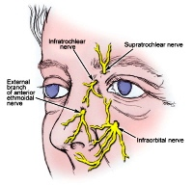
Nerve supply
Trigeminal Nerve
Ophthalmic Branch
Maxillary Branch
Infraorbital nerve
Anterior Ethmoidal
Nasociliary
External Nasal
Infratrochlear

Slide 68
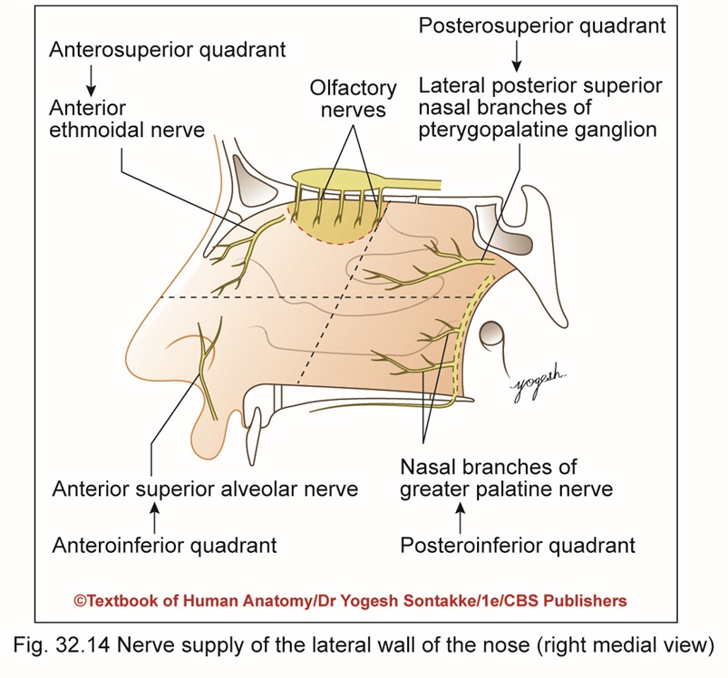

Slide 69
Innervation
Innervation
General sensation
Carried from lateral wall of nose as follows
Anterosuperior quadrant by anterior ethmoidal nerve (branch of ophthalmic nerve)

Slide 70
Innervation
Anteroinferior quarant by anterior superior alveolar nerve (branch of infraorbital branches of maxillary nerve)
Posterosuperior quadrant by lateral posterior superior nasal branches of pterygopalatine ganglion

Slide 71
Innervation
Posteroinferior quadrant by anterior palatine branches of pterygopalatine ganglion
Special sensation
Carried by olfactory nerve from uppermost part of roof of lateral wall

Slide 72

(V1)
(V2)

Slide 73
VENOUS DRAINAGE
Corresponds to arteriovenous units.
Frontomedian area drains into the facial vein
Orbitopalpebral area – ophthalmic vein (cavernous sinus communication)
LYMPHATIC DRAINAGE
Submandibular and submental nodes and sometimes buccal nodes intervene

Slide 74
Clinical Anatomy
Common cold
Viral infection of upper respiratory tract
Symptoms of common cold include coughing, sore throat, runny nose, sneezing, headache and fever
These symptoms appear due to immune response to viruses causing inflammation of mucosa
People usually recover in week

Slide 75
Clinical Anatomy
Rhinitis:
Inflammation of mucous membrane lining nasal cavity
May be allergic
May cause nasal blockage, sneezing, and rhinorrhea (watery discharge from nose)
Clinical examination of nasal cavity Called rhinoscopy
May be anterior – carried out by inserting nasal speculum through turbinate, superior and middle meatuses, nasal septum, and floor of nasal cavity

Slide 76

Clinical Anatomy
Posterior rhinoscopy – carried by inserting warm mirror into pharynx
Useful to visualize conchae or turbinate, opening of auditory tube, and posterior border of nasal septum
Anosmia: Loss of smell sensation due to aging or olfactory nerve injury

Slide 77

THANK YOU

Slide 78

THANK YOU

