Slide 1
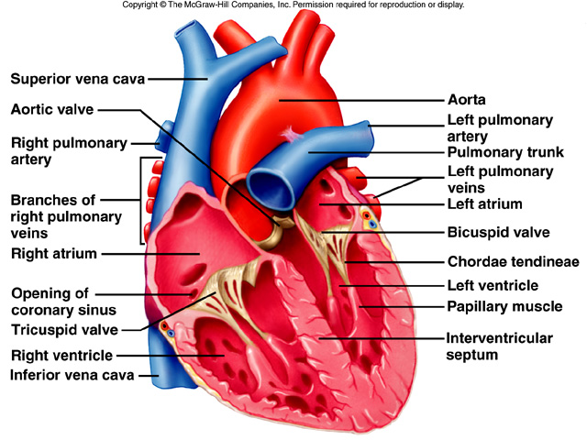
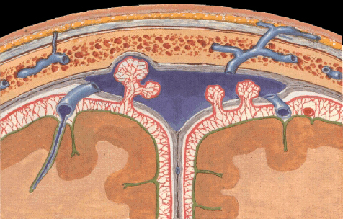
GROSS ANATOMY - head and neck scalp
Dr. Praveen Kumar Kurrey
M.B.B.S., M.S.,BCME, BCBR,CISP
Professor Anatomy

Slide 2
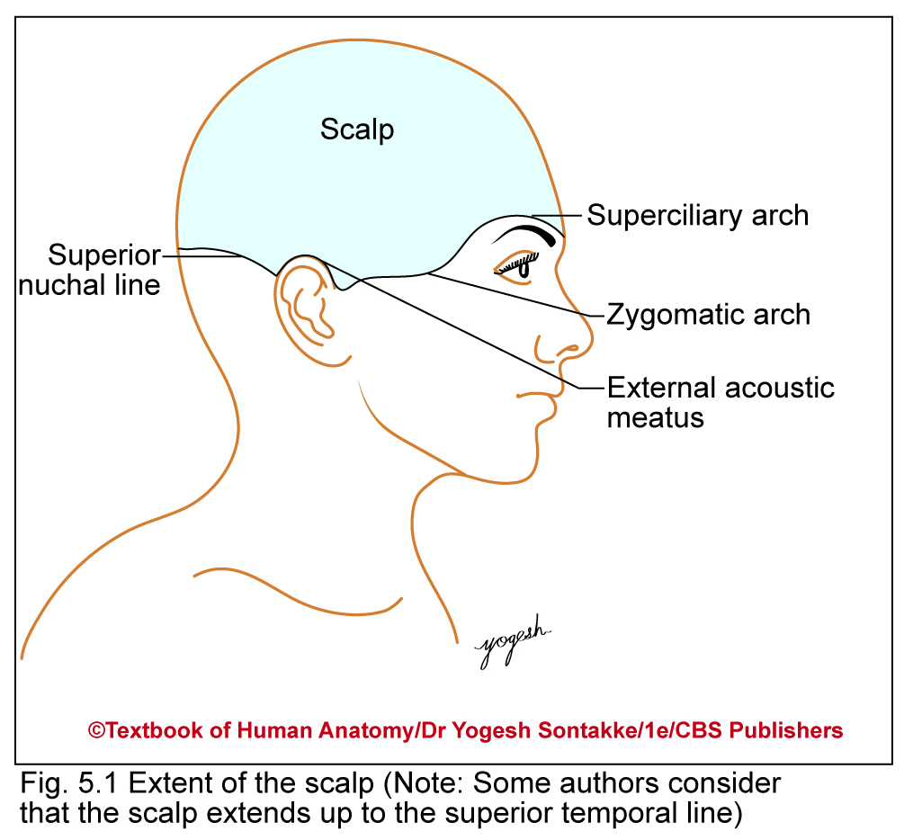
SCALP
Soft Tissue covering of skull vault or skull cap

Slide 3
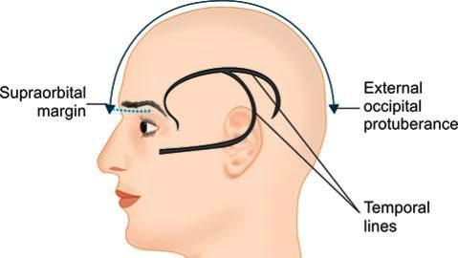
SCALP
Extent
Anteriorly: Up to supraorbital margins
Posteriorly: Up to external occipital protuberance and superior nuchal line
On each side: Up to zygomatic arch and external acoustic meatus

Slide 4
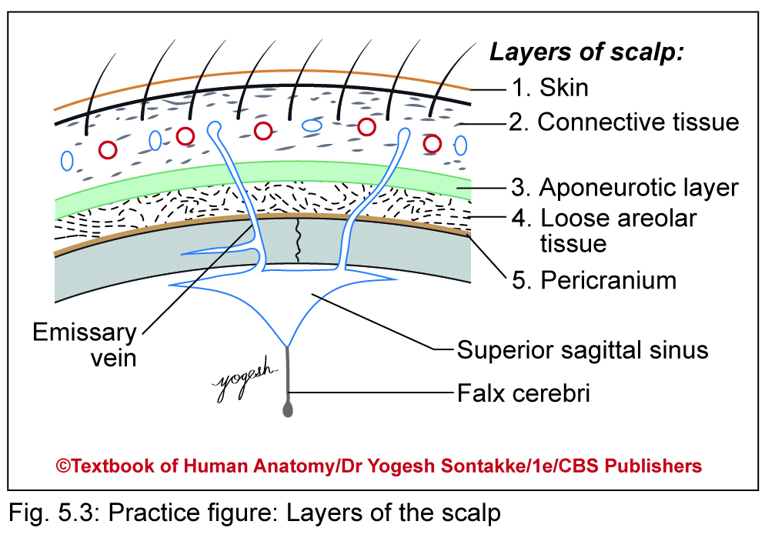
SCALP
Five layers
S--Skin
C--Superficial fascia (subcutaneous Connective tissue)
A--Deep fascia (Epicranial Aponeurosis)
L--Loose areolar tissue
P--Pericranium

Slide 5
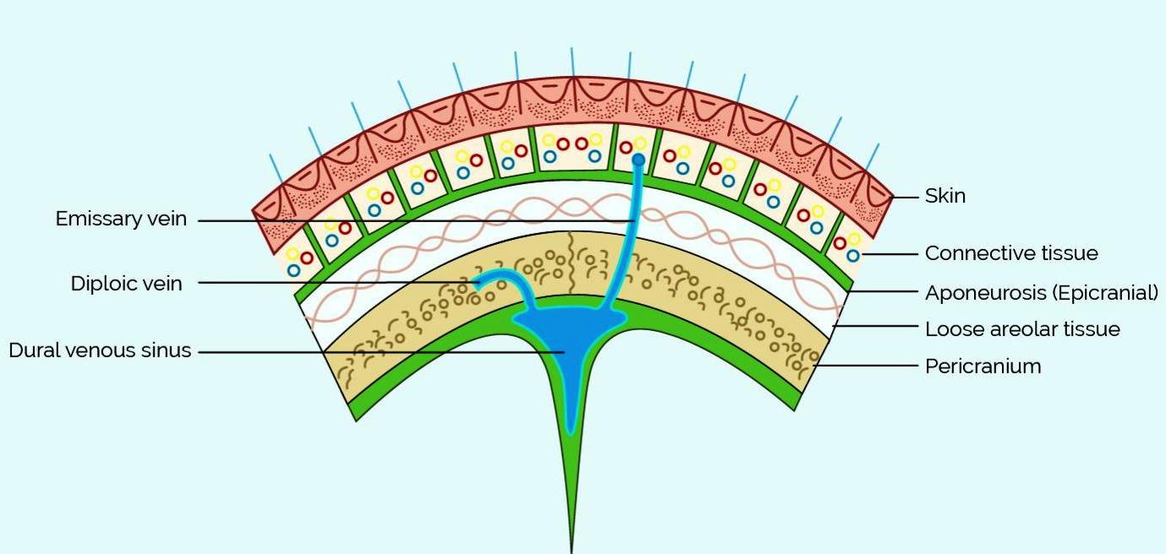
LAYERS OF SCALP

Slide 6
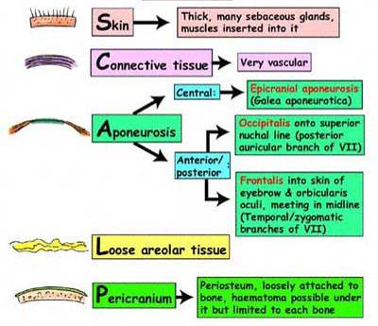

Slide 7
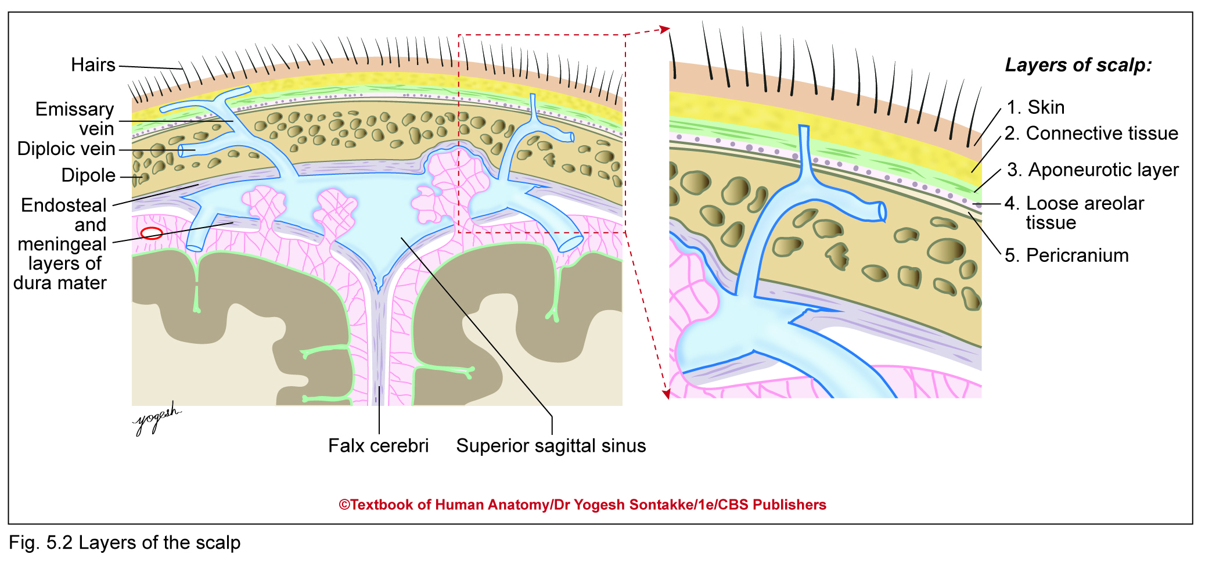

Slide 8
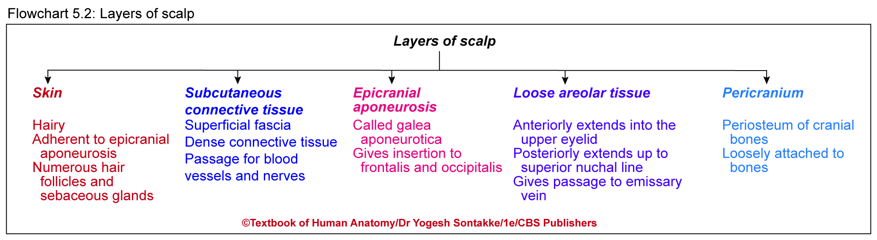

Slide 9
1. Skin of scalp
Very Thick and Hairy except over forehead
Adherent to epicranial aponeurosis by dense superficial fascia
Hence, difficult to separate skin from epicranial aponeurosis
Contains numerous hair follicles and associated sebaceous glands
Sebaceous cyst Common
Sweating

Slide 10
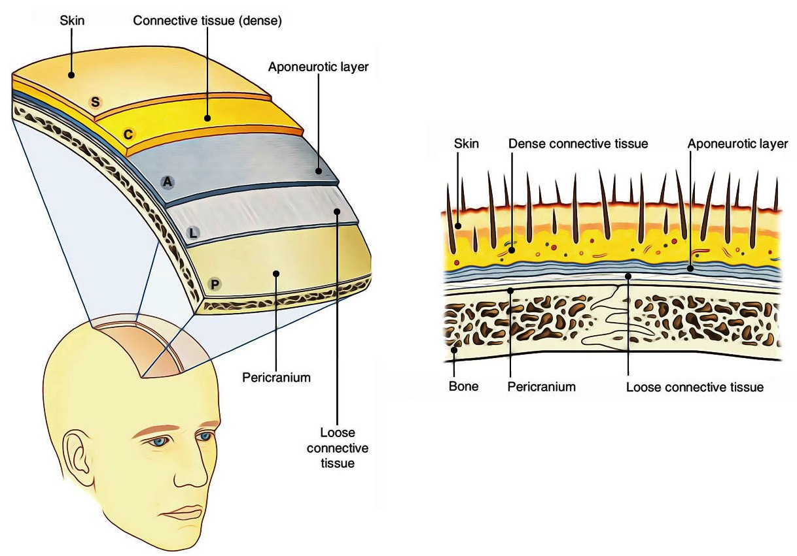
SKIN

Slide 11
2. Subcutaneous Dense connective tissue (superficial fascia of scalp)
Made up of dense fibrous connective tissue firmly adhere skin with epicranial aponeurosis
Loculated– No Increase in fat even in obese person
Localised Infection
Small swelling- Very Painful
Numerus blood vessels and nerves
Walls of vessels – adhered to connective tissue-- Hence, injury of vessels may lead to profuse bleeding due to failure of retraction (closure) of vessels
Bleeds Profusely but Heals Rapidly
Bleeding Checked by Pressure

Slide 12
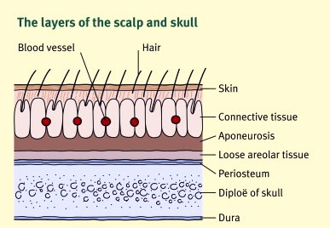

Slide 13
3. Epicranial aponeurosis or galea aponeurotica
Fibrous sheet can move over pericranium along with overlying skin and fascia
Receives insertion of frontalis anteriorly and occipitalis posteriorly
Attachment: Epicranial aponeurosis – attached to
external occipital protuberance,
highest or superior nuchal lines, and
superior temporal line

Slide 14
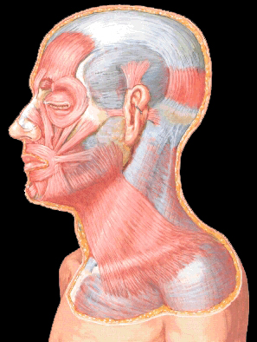
Epicranial Aponeurosis

Slide 15
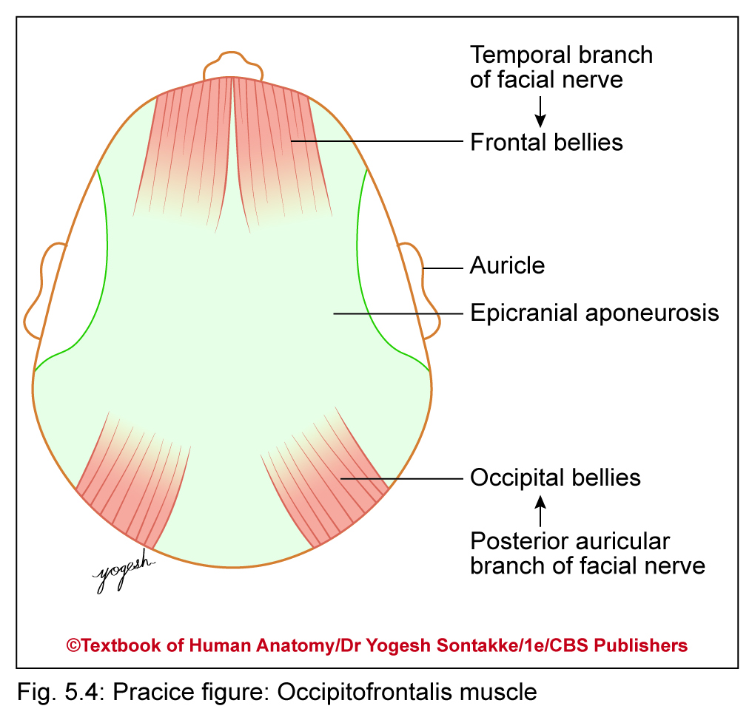
OCCIPITOFRONTALIS MUSCLE
Has two bellies: occipital and frontal, both are inserted into epicranial aponeurosis
Frontal bellies (frontalis)
Wider and mostly fused in midline
They arise from skin of upper eyelid and forehead
Occipital belly (occipitalis)
Overlies back of skull
Originates from lateral two- thirds of superior nuchal lines of occipital bone

Slide 16
Occipitofrontalis muscle
Insertion: Epicranial aponeurosis
Innervation: Supplied by temporal branch and occipitalis by posterior auricular branch of facial nerve
Actions
Movement of scalp over vault of skull
Contraction of frontalis elevates eyebrows (surprise expression)
If eyebrows – fixed, frontalis produces transverse wrinkling of forehead
Transverse cut, tends to Gap.

Slide 17
4. Loose areolar tissue layer
Consists of loose connective tissue
Anteriorly, extends into eyelids because frontalis muscle does not have bony attachment
Posteriorly, extends up to superior nuchal line and laterally superior temporal line
Gives passage to emissary veins connects intracranial venous sinuses and extracranial vein

Slide 18
diploic veins
Emissary vein
venous sinus of dura mater

Slide 19
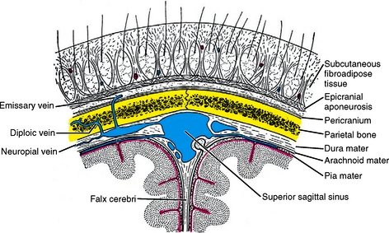
LAYER 4 - LOOSE AREOLAR TISSUE

Slide 20
CLINICAL – Layer 4
Dangerous area of Scalp
Safety Valve Haematoma
Caput Succedanium
Cephalohaematoma

Slide 21
5.PERICRANIUM
Periosteum of skull bones
Loosely attached to skull bone except at suture where – firmly adherent
Cephalohaematoma – Takes shape of the Bone

Slide 22
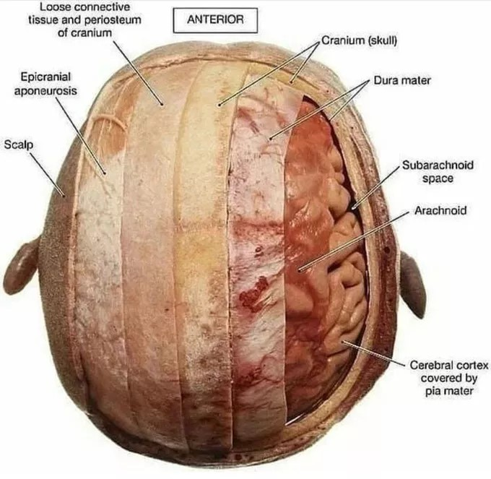
PERICRANIUM

Slide 23
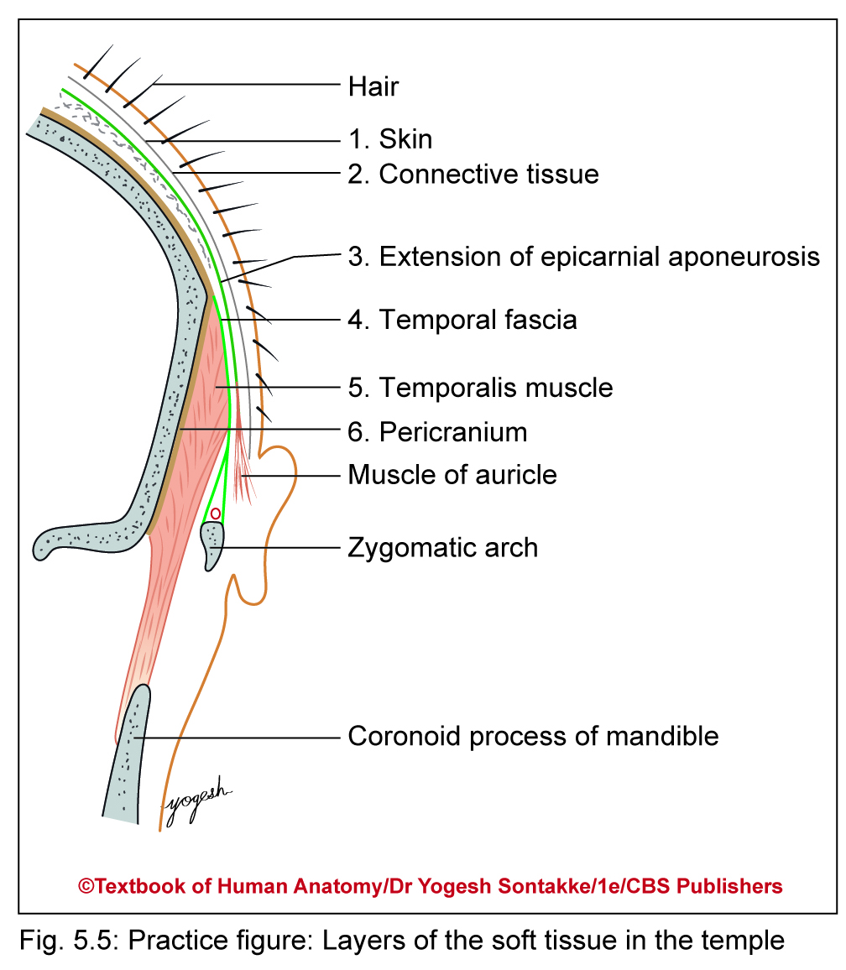
SURGICAL LAYERS OF THE SCALP
First three layers of scalp
(firmly adherent to each other) – considered as surgical layers of scalp or scalp proper

Slide 24
Superficial temporal region
Area between superior temporal line and zygomatic arch
Considered as part of scalp
Consists of six layers as follows
Skin
Superficial fascia
Extension of epicranial aponeurosis
Temporal fascia
Temporalis muscle
Pericranium

Slide 25
Temporalis fascia
Thick fibrous sheet, morphologically represents shell of bone
Can be used as graft for tympanoplasty, repair of tympanic membrane (eardrum)

Slide 26
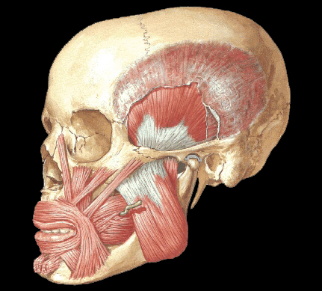
Temporalis and Temporal Fascia

Slide 27
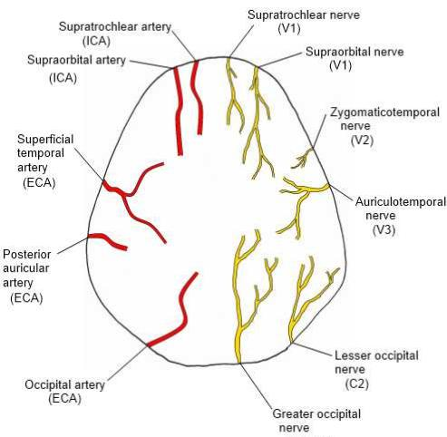
Blood Supply of Scalp
Arterial supply
five arteries on each side
In front of auricle
Supratrochlear artery
Supraorbital artery
Superficial temporal artery
Behind auricle
Posterior auricular artery
Occipital artery

Slide 28
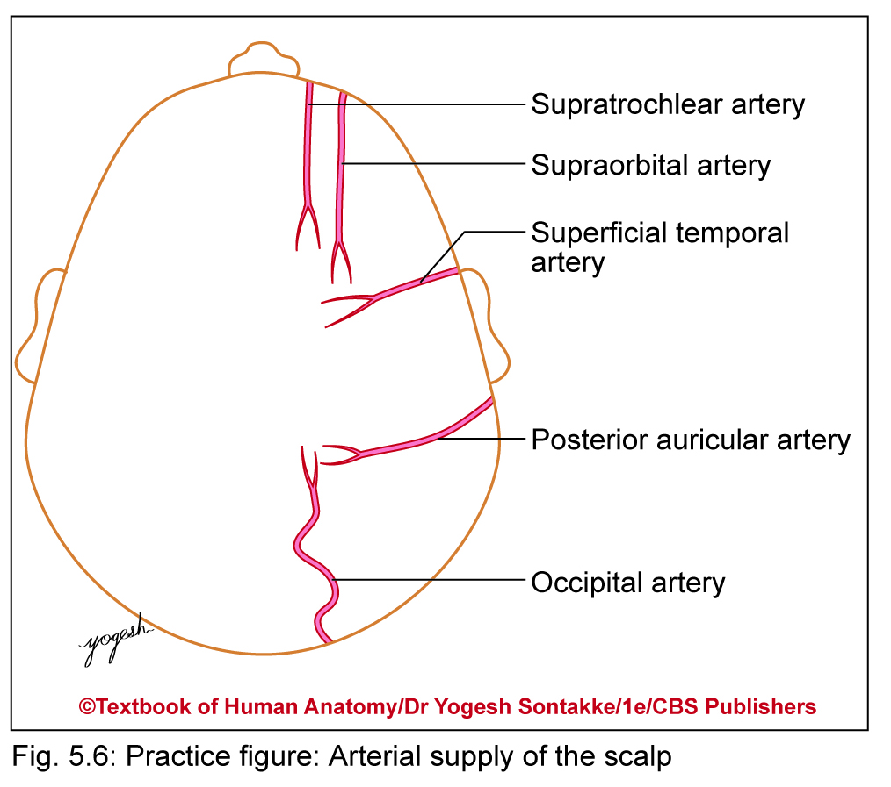

Slide 29
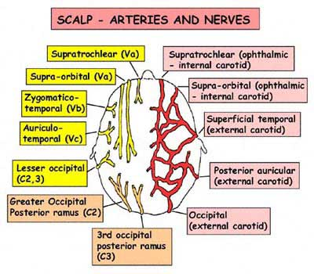

Slide 30
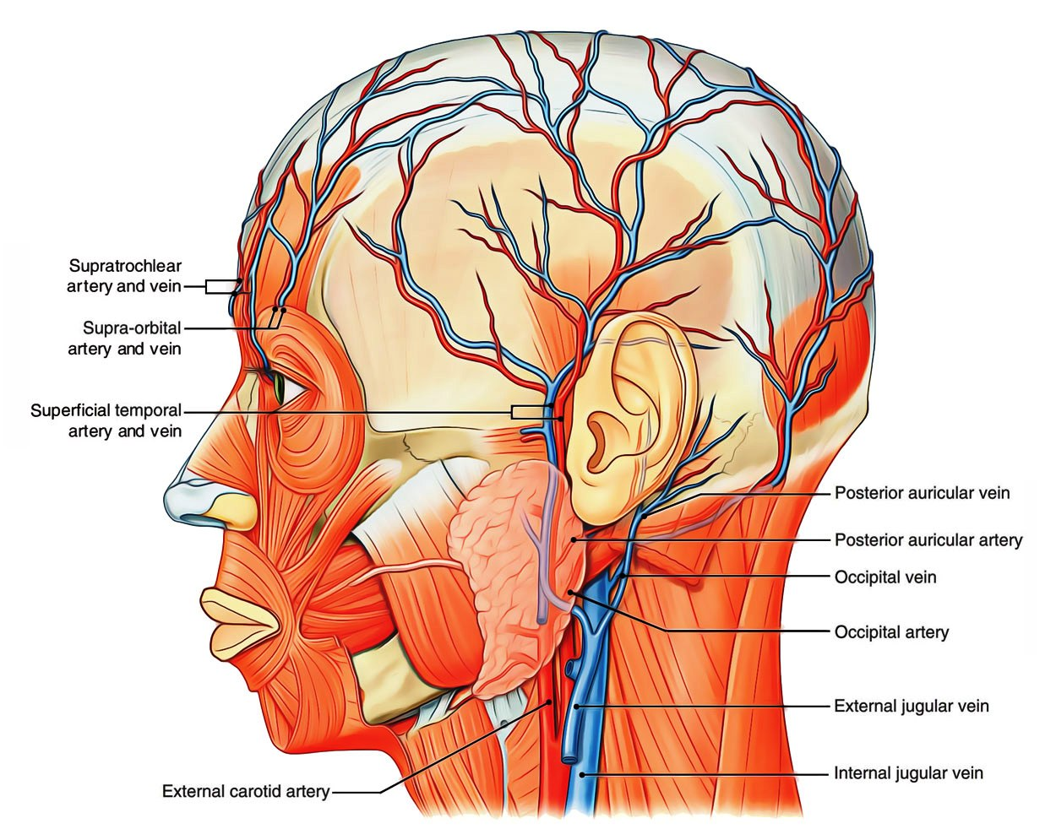

Slide 31
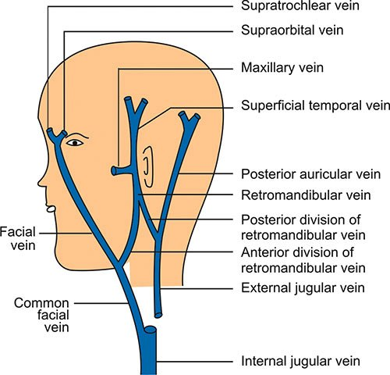
VENOUS DRAINAGE
Drained by following veins on each side
Infront of ear:
Supratrochlear vein
Supraorbital vein
Superficial temporal vein
Behind ear
Posterior auricular vein
Occipital vein

Slide 32
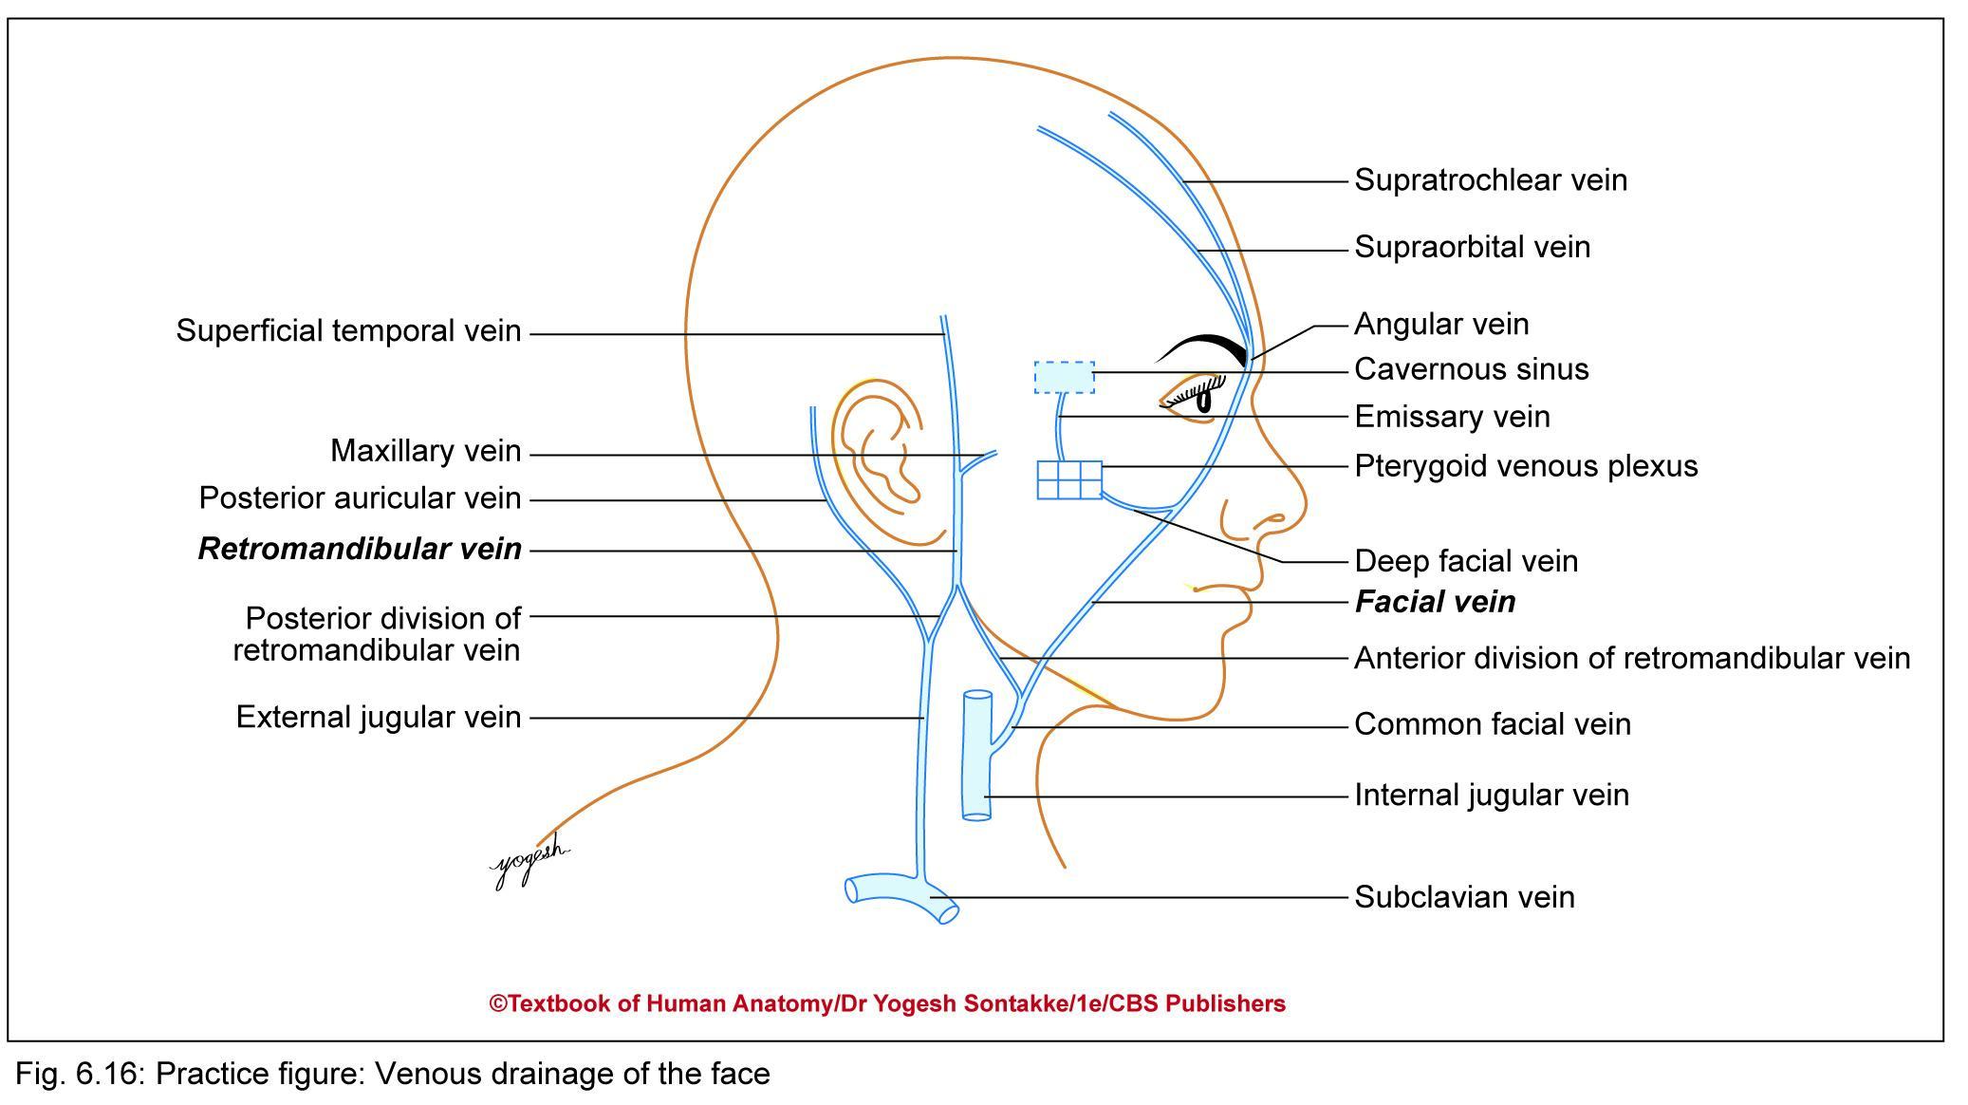

Slide 33
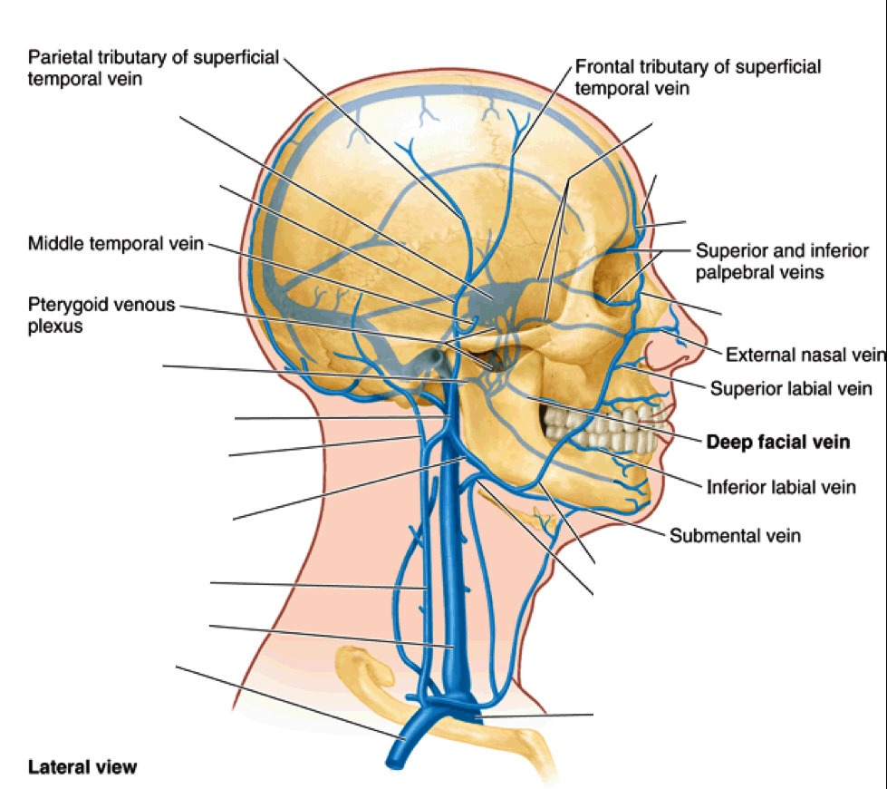
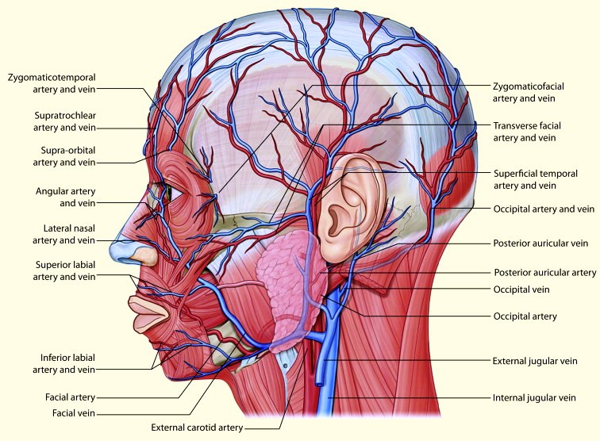
VEINS OF SCALP AND FACE

Slide 34
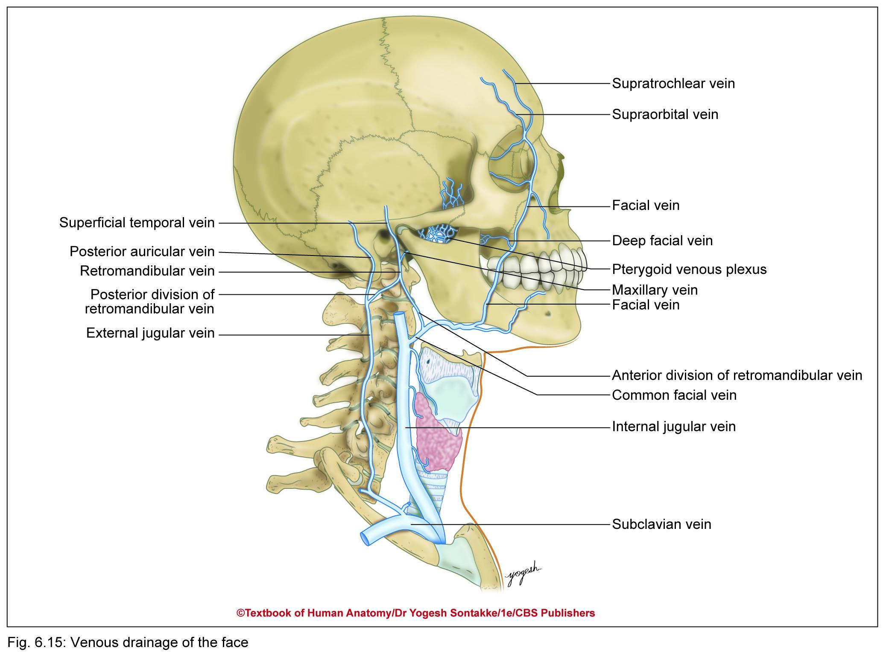

Slide 35
VEINS OF SCALP
Supratrochlear and supraorbital vein
They accompany corresponding arteries
At medial angle of eye, they join to form angular vein which continues downward as facial vein
Superficial temporal vein
Descends in front of tragus of ear to enter parotid glands
In substance of parotid gland, joins with maxillary vein to form Retromandibular vein which divides into anterior and posterior divisions

Slide 36
Anterior division of retromandibular vein joins facial vein to form common facial vein which drains into internal jugular vein
Posterior division of retromandibular vein joins posterior auricular vein to form external jugular vein which runs downward in neck and drain into subclavian vein
Occipital vein terminates into suboccipital venous plexus

Slide 37
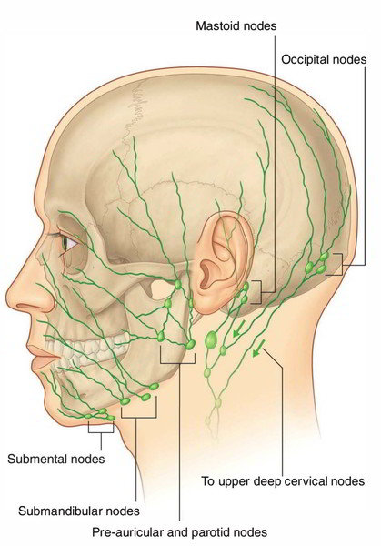
LYMPHATIC DRAINAGE OF SCALP
From anterior part of scalp drain into preauricular or parotid lymph nodes
Are situated on lateral surface of parotid glands
Posterior part of scalp drains into posterior auricular or mastoid and occipital lymph nodes

Slide 38
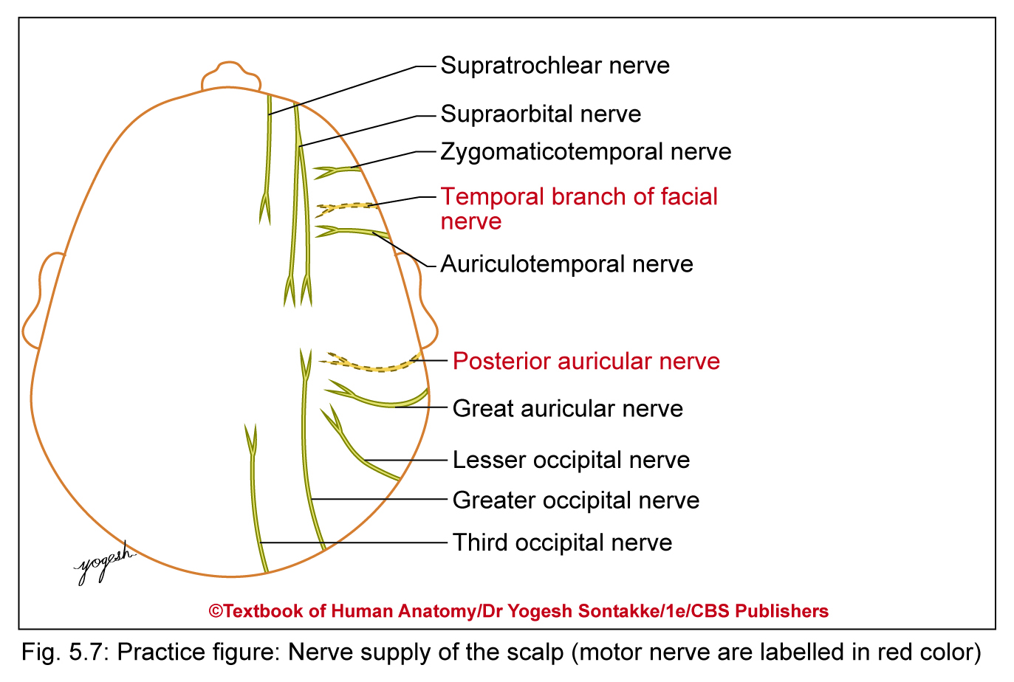
NERVE SUPPLY OF SCALP
Divided into sensory and motor supply
Supplied by 10 nerves on each side
Out of these, five nerves (four sensory and one motor) supply in front of auricle and five nerves (4 sensory and 1 motor) supply behind auricle

Slide 39
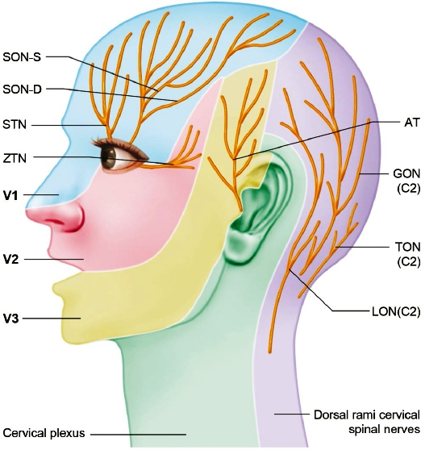
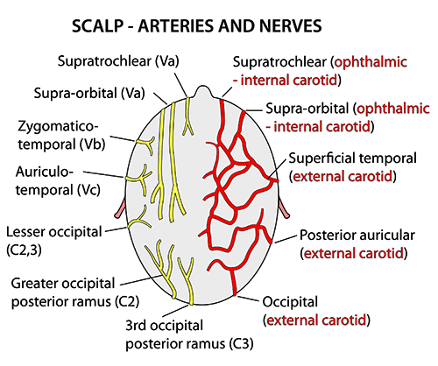
NERVES OF SCALP

Slide 40
NERVE SUPPLY OF SCALP
Infront of auricle
Sensory nerves Motor nerve | 1. Supratrochlear – branch of frontal nerve (ophthalmic division of trigeminal nerve) 2. Supraorbital – branch of frontal nerve 3. Zygomatic temporal nerve – branch of zygomatic nerve (maxillary division of trigeminal nerve) 4. Auriculotemporal nerve – branch of mandibular division of trigeminal nerve 5. Temporal branch of facial nerve
Behind auricle
Sensory nerves Motor nerve | 1. Posterior division of great auricular nerve (C2, 3) – From the cervical plexus 2. Lesser occipital nerve (C2) – From ventral ramus of 2nd cervical nerve 3. Greater occipital nerve (C2) – From dorsal ramus of C3 nerve 4. Third occipital nerve (C3) – From dorsal ramus of C3 nerve 5. Posterior auricular branch of facial nerve

Slide 41
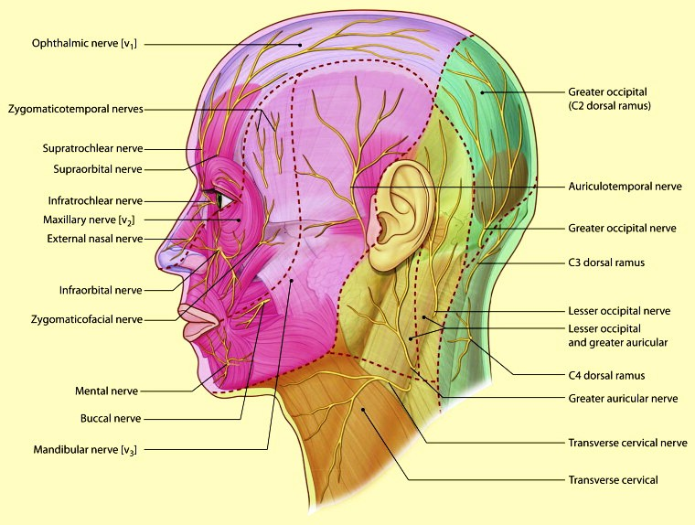

Slide 42
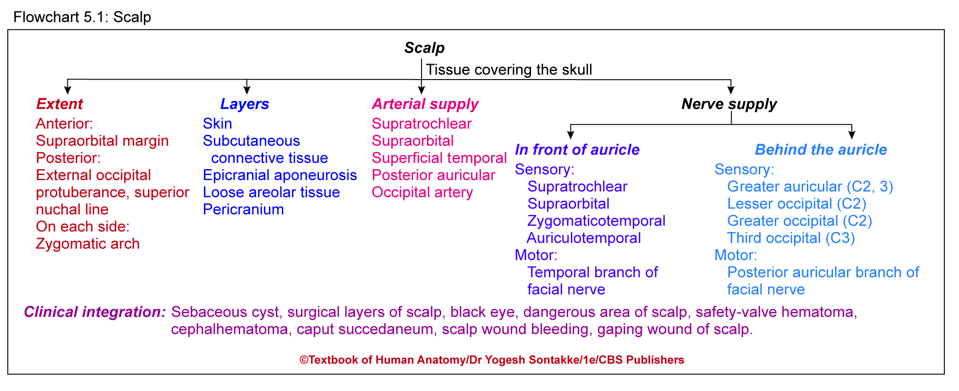

Slide 43
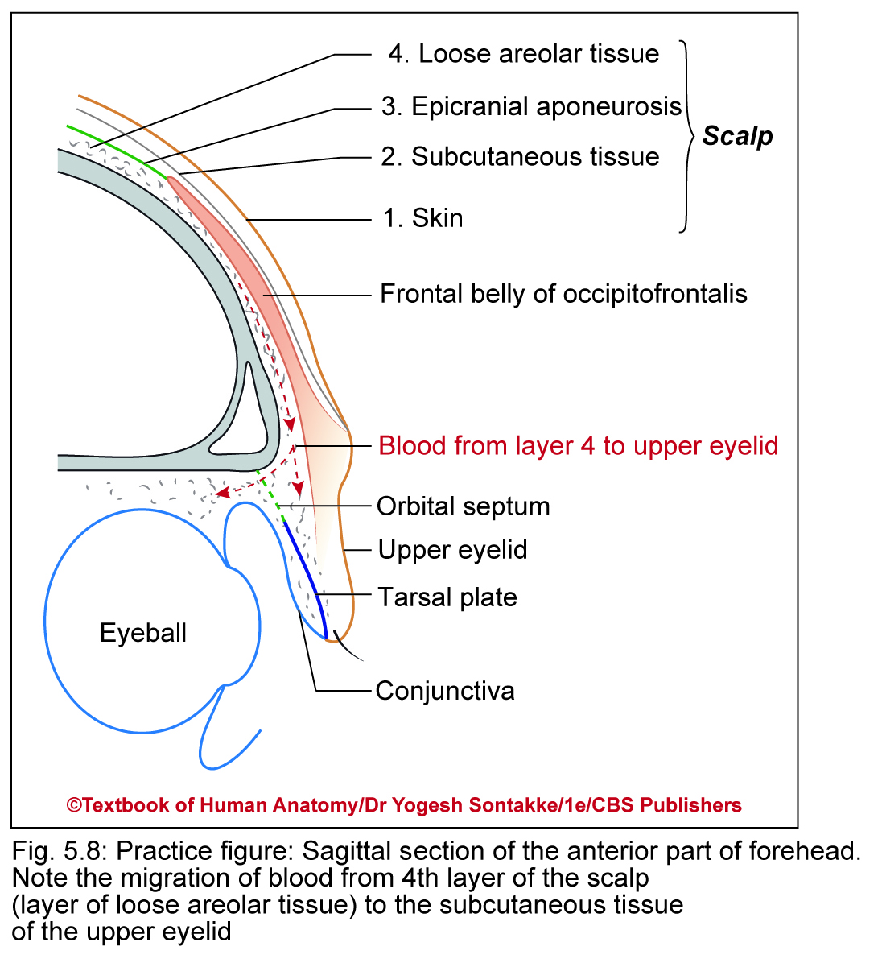
APPLIED ANATOMY
1. Sebaceous cyst
Scalp has numerous sebaceous glands
Common site for sebaceous cysts
Surgical layers of scalp
2. First three layers of scalp (skin, connective tissue, and epicranial aponeurosis) – adhered to each other and can not be separated surgically Are called surgical layers of scalp

Slide 44
APPLIED ANATOMY
3. Black eye
Blood from damaged vessels in layer of loose areolar tissue of scalp extends anteriorly into roof of nose and upper eyelids
Occurs as frontalis muscle and epicranial aponeurosis do not have bony attachments anteriorly
Results in black eye

Slide 45
APPLIED ANATOMY
Due to bony attachments of occipitalis and epicranial aponeurosis, blood cannot extend beyond external occipital tubercle, superior nuchal lines, and superficial temporal lines
4. Dangerous area of scalp
Layer of loose areolar tissue – dangerous area of scalp because emissary veins connect veins of this layer with dural venous sinuses

Slide 46
APPLIED ANATOMY
Dangerous area of scalp
Hence, any infection of loose areolar tissue layer easily spreads to dural venous sinuses
May lead to thrombosis of dural venous sinuses which may be fatal

Slide 47
APPLIED ANATOMY
5. Safety-valve hematoma
Fractures of cranial vault cause escape of intracranial hematoma into subaponeurotic space of scalp through fracturelines
Prevents compression of cerebrum
This process of collection of blood in subaponeurotic space (fourth layer) – called safety valve hematoma

Slide 48
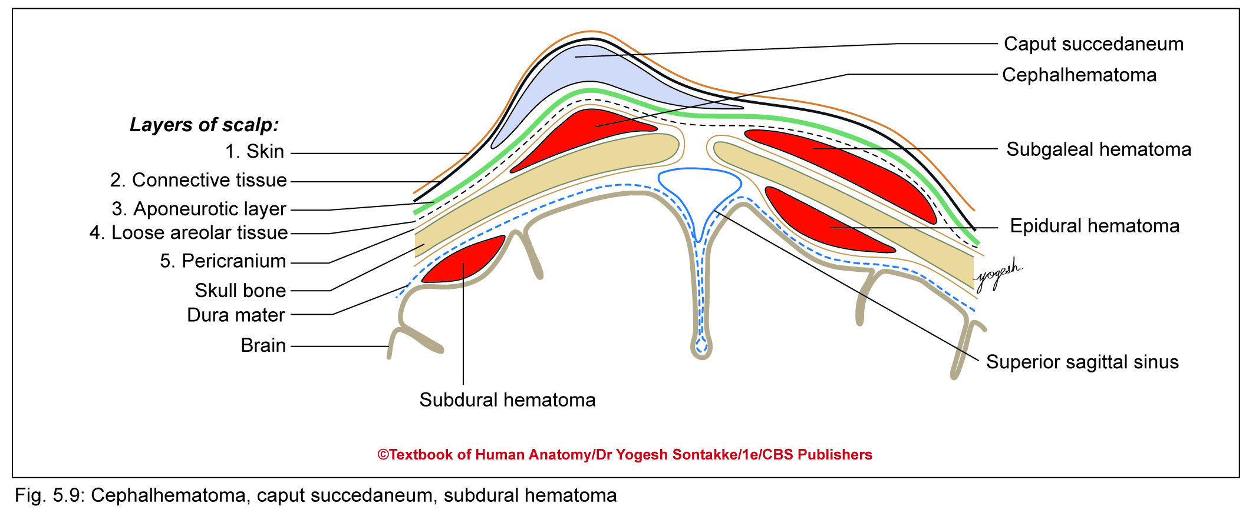
APPLIED ANATOMY
6. Cephalhematoma
Pericranium – firmly adherent to suture lines
Hence, collection of blood or fluid deep to pericranium takes shapes of particular bone
This collection of fluid – called cephalhematoma
Commonly occurs in parietal region

Slide 49
APPLIED ANATOMY
7. Caput succedaneum
Subcutaneous edema of scalp produced during delivery
Occurs due to interference in venous return during passage of head through birth canal
Usually subsides in few days on own

Slide 50
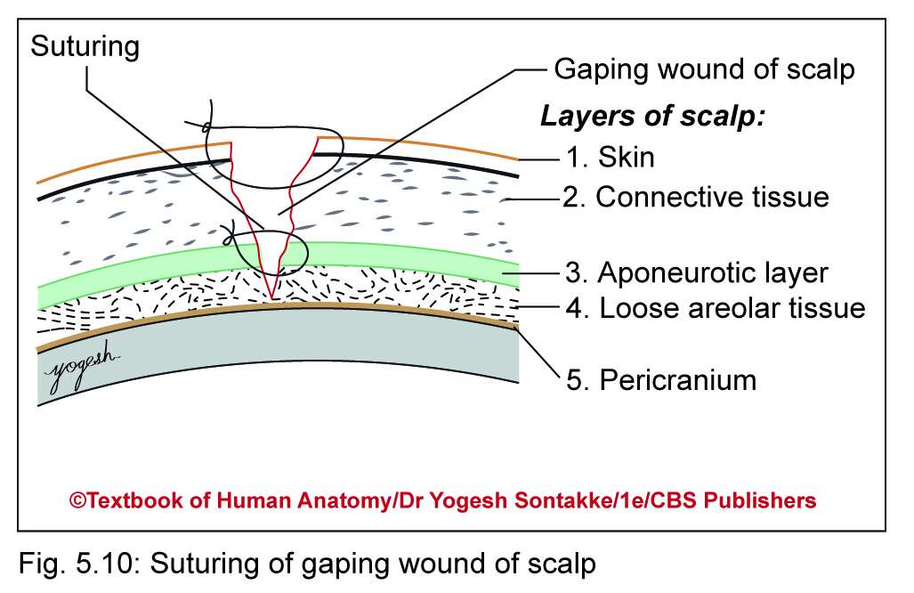
APPLIED ANATOMY
8. Scalp wound bleeding
Bleeds profusely because vessels – prevented from retraction after their injuries; because of firm adherence of vessels wall with fibrous connective tissues
Treatment: To stop this bleeding, apply pressure on bleeding vessels against skull bone

Slide 51
APPLIED ANATOMY
9. Healing of avulsed scalp
As scalp and superficial temporal region – richly supplied by anastomosing vessels, avulsed portion need not to cut away
Can be placed on position and stitched
Usually heals

Slide 52
10. Gaping wound of scalp
If epicranial aponeurosis – divided transversely, wound of scalp gape
Such wound needs stitching of layer of aponeurosis carefully

Slide 55

THANK YOU

