Slide 1
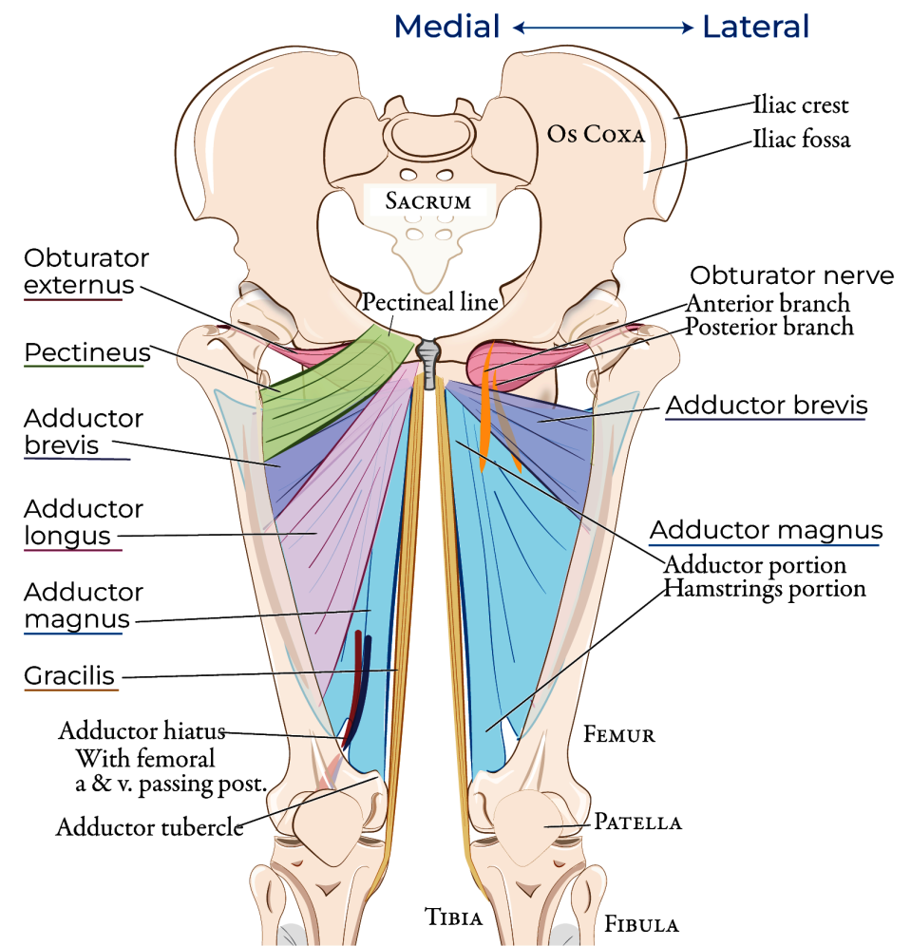
GROSS ANATOMY- LOWER LIMB
MEDIAL COMPARTMENT OF THIGH
Dr. Praveen Kumar Kurrey
M.B.B.S., M.S., B.C.M.E, B.C.B.R.,CISP
Professor Anatomy

Slide 2
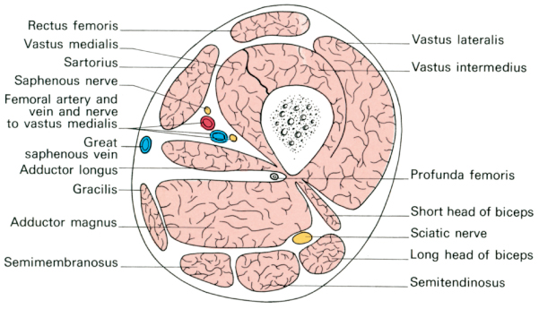
Compartments

Slide 3
Contents of the Medial Compartment of Thigh
Muscles:
Adductor longus,
Adductor brevis,
Adductor magnus,
Gracilis,
Pectineus
obturator externus
Vessels:
Medial circumflex vessels and Obturator vessels
Nerve:
Obturator nerve and Accessory obturator nerve

Slide 4
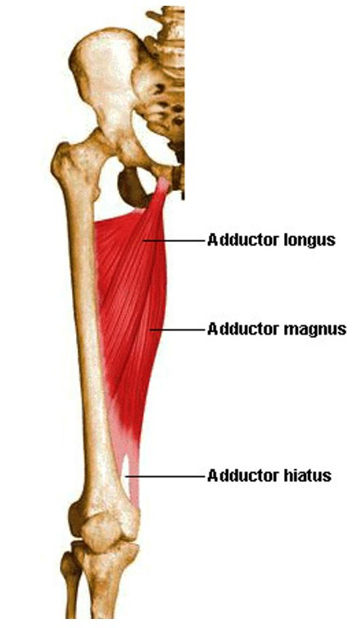
1. ADDUCTOR LONGUS
Triangular muscle
Forms medial part of floor of femoral triangle Adductor longus and pectineus lie in same plane
Origin
Originates as rounded tendon from front of body of pubis in angle between pubic crest and symphysis pubis

Slide 5
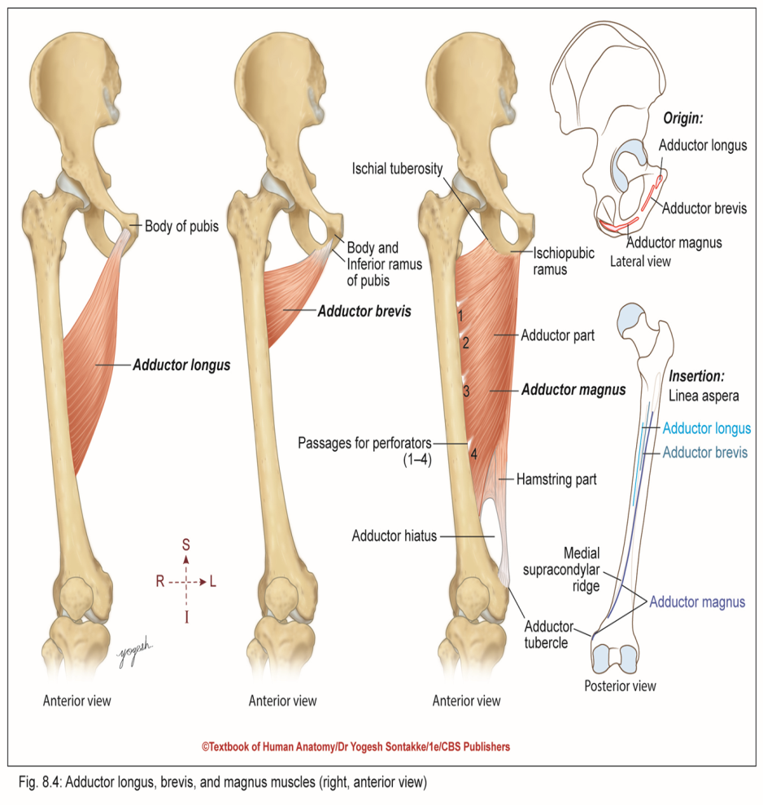
Adductor Longus
Direction of fibers
Runs downward, laterally and slightly backward to reach linea aspera
Insertion
Inserts in middle third of shaft of femur, on linea aspera between vastus medialis and adductor brevis and magnus
Innervation
Anterior division of obturator nerve
Actions
Strong adductor and flexor of thigh

Slide 6
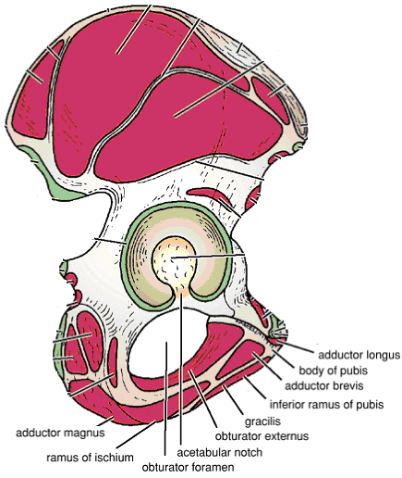
ORIGIN OF MUSCLES OF MEDIAL COMPARTMENT OF THIGH

Slide 7
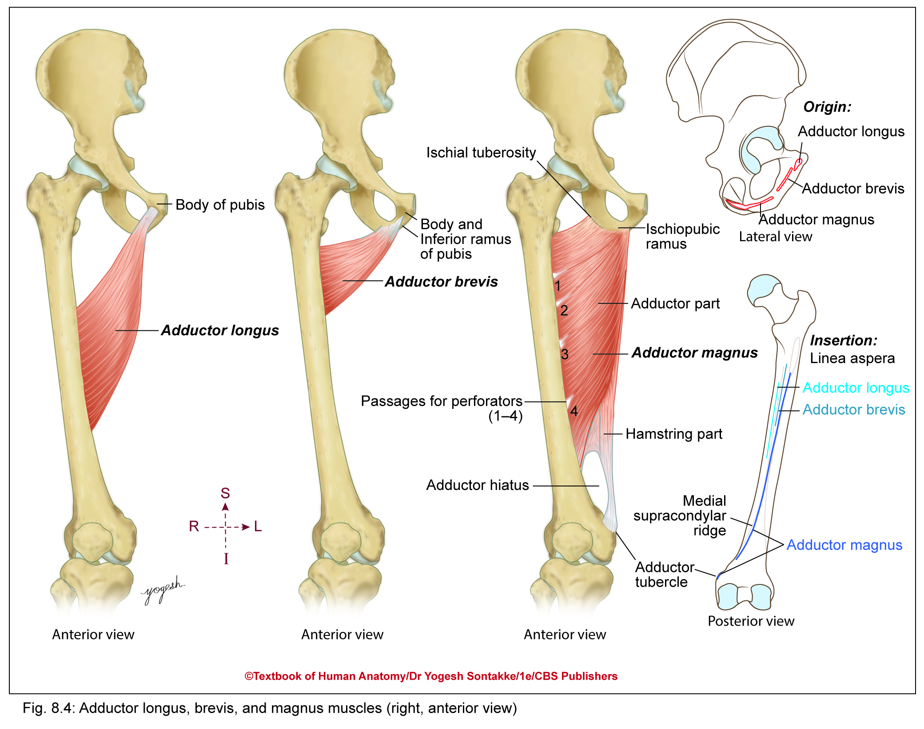

Slide 8
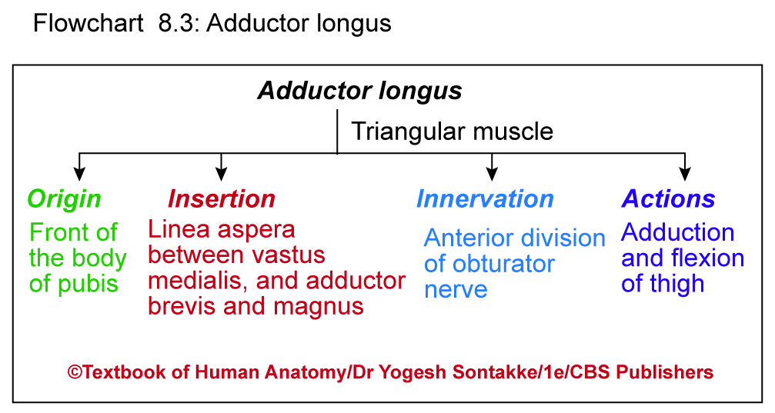

Slide 9
Clinical Anatomy
Rider’s bone
Sesamoid bone develops in rounded tendon of adductor longus
Particularly occurs in horse riders due to friction of tendon with horse back

Slide 10

2. ADDUCTOR BREVIS
Triangular muscle – located in between adductor longus and adductor magnus
To visualize adductor brevis muscle, cut adductor longus muscle near origin and reflect it laterally
Origin
Originates from
  Anterior surface of body of pubis and
  Outer surface of inferior ramus of pubis, between gracilis and obturator externus

Slide 11
ORIGIN OF MUSCLES OF MEDIAL COMPARTMENT OF THIGH

Slide 12
Adductor Brevis
Direction of fibers
Pass downward, backward, and laterally and expands to reach linea aspera
Insertion
Inserts in line extending from lesser tronchanter to linea aspera
Extends on upper part of linea aspera
Innervation
Anterior or posterior division of obturator nerve
Action
Adduction of thigh

Slide 14

3. ADDUCTOR MAGNUS
Large triangular muscle situated on medial side of thigh
Lies posterior to pectineus, adductor longus, and adductor brevis muscles
Hybrid or composite muscle having dual nerve supply

Slide 15
Adductor Magnus
Origin
Has two parts-
Adductor part
  Originates from outer surface ischiopubic ramus
Hamstring part
  Originates from inferolateral part of ischial tuberosity

Slide 16
ORIGIN OF MUSCLES OF MEDIAL COMPARTMENT OF THIGH

Slide 17
Adductor Magnus
Direction of fibers
Originating from pubic ramus are nearly horizontal
Originating from ischial ramus run obliquely downward, backward, and laterally
Originating from ischial tuberosity descend vertically downward

Slide 18
Adductor Magnus
Insertion
Adductor part inserts on medial margin of gluteal tuberosity, linea aspera, and medial supracondylar ridge.
Hamstring part inserts on adductor tubercle of medial condyle of femur
Innervation
Adductor part – supplied by posterior division of obturator nerve
Hamstring part – supplied by tibial part of sciatic nerve
Actions
Adductor part: Adduction and medial rotation of thigh at hip joint
Hamstring part: Extension of thigh

Slide 20
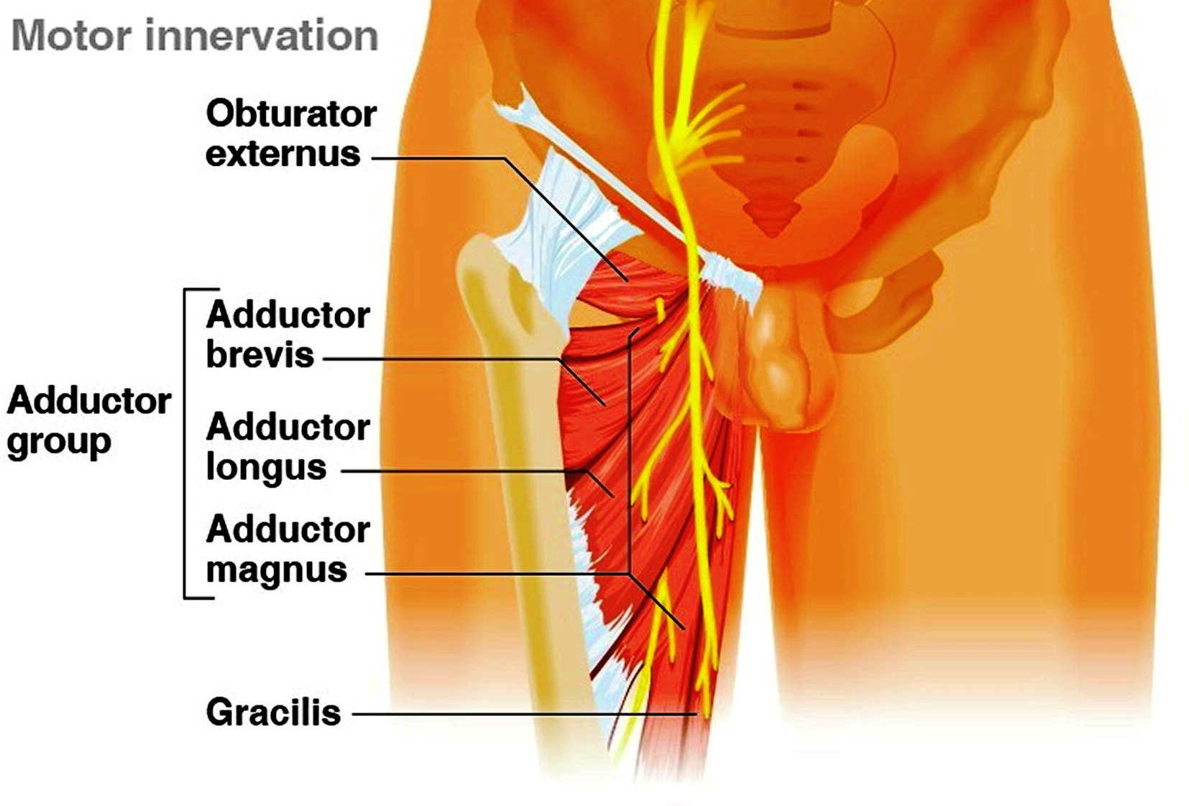

Slide 21
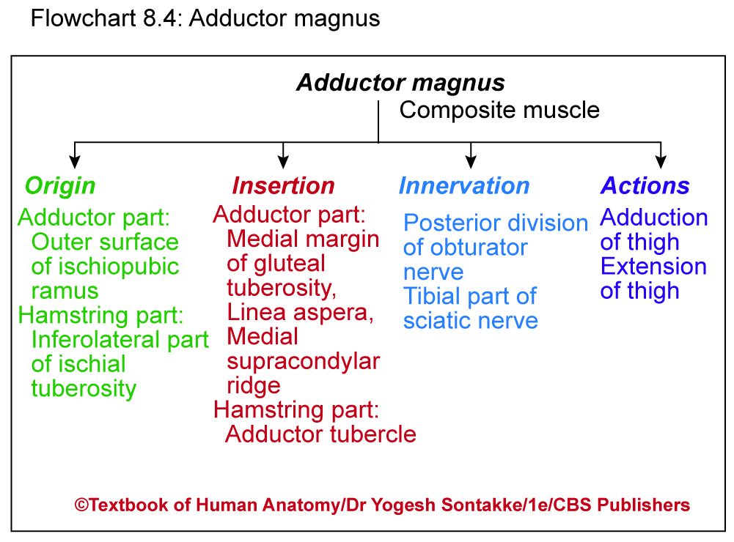

Slide 22
Clinical Anatomy
Pectineus and adductor magnus – Hybrid muscles as they have dual nerve supply
Adductor hiatus
Large lowest osseoaponeurotic gap between adductor magnus and shaft of femur
Gives passage to femoral vessels from adductor canal to popliteal fossa
Upper four osseoaponeurotic openings give passage to perforating branches of profunda femoris artery

Slide 23
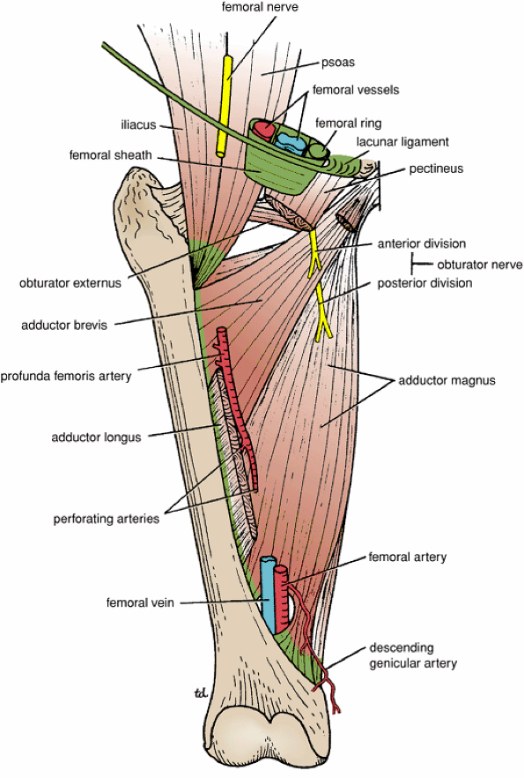
The Adductor Hiatus is a gap in the distal attachment of adductor magnus to the femur, which permits the femoral vessels to pass from the adductor canal downward into the popliteal space.

Slide 24
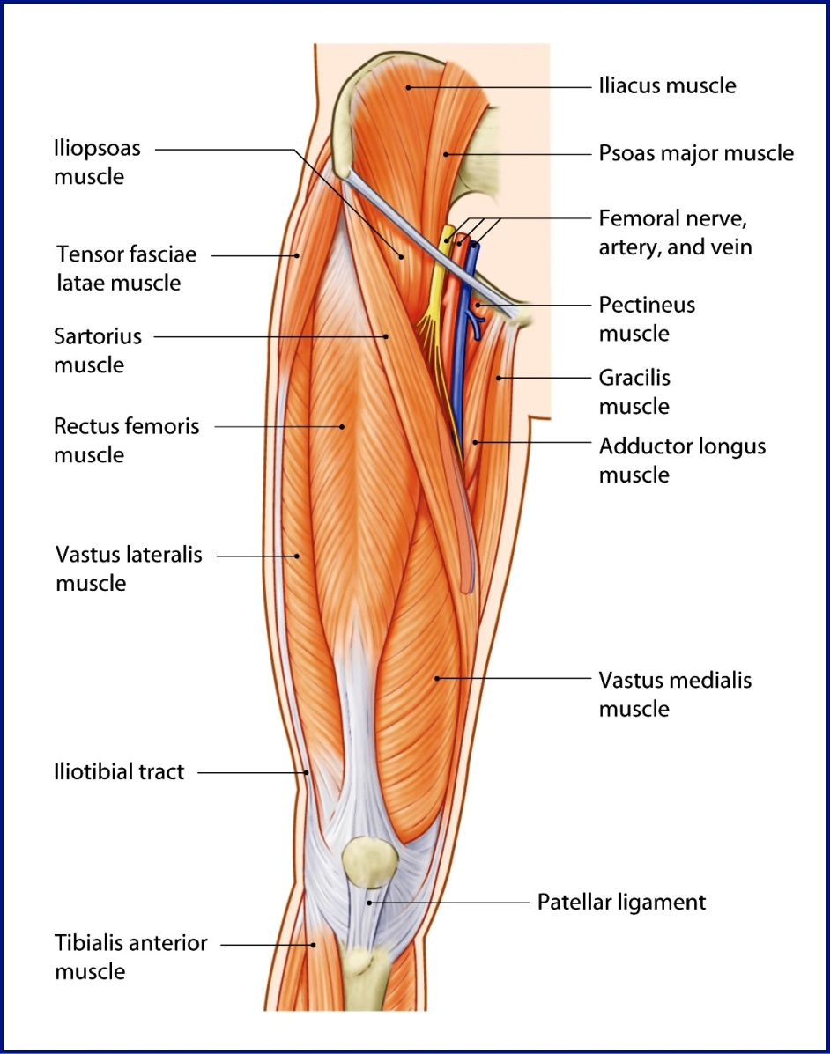
4. Gracilis
Most Beautiful, superficial, long slender muscle of medial compartment of thigh
(Gracialis = slender in Latin)
Origin
Originates from
Medial margin of lower half of body of pubis
Ischiopubic ramus
Direction of fibers
Run vertically downward
Upper part of muscle – wide and lower part tappers to form rounded tendon

Slide 25
ORIGIN OF MUSCLES OF MEDIAL COMPARTMENT OF THIGH

Slide 26
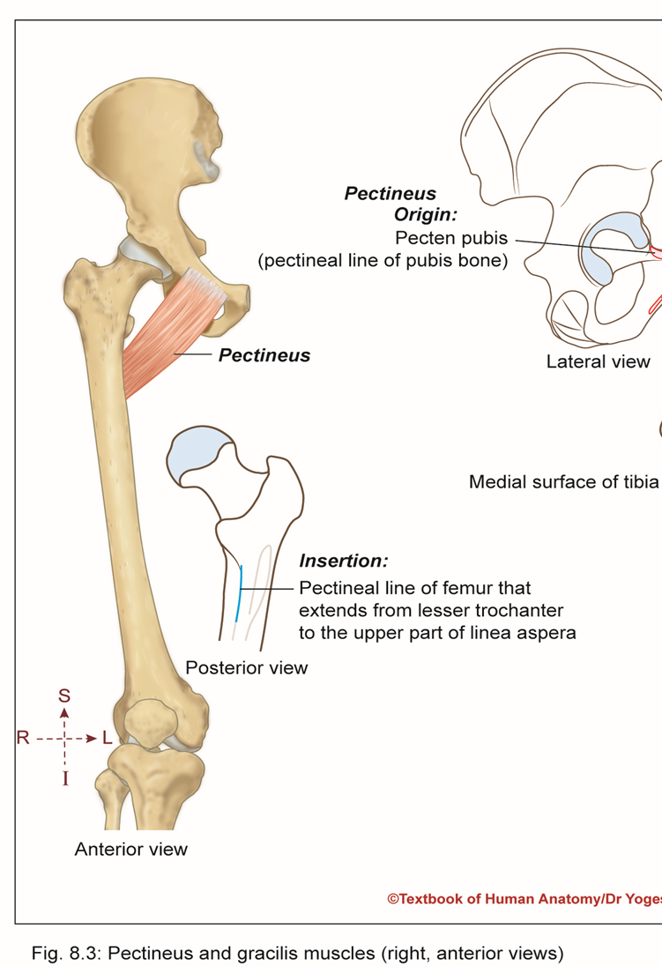
Gracilis
Insertion
Inserts on upper part of medial surface of tibia in between sartorius and Semitendinosus.
Innervation
Anterior division of obturator nerve
Actions
Adduction of thigh
Flexion and medial rotation of leg

Slide 27
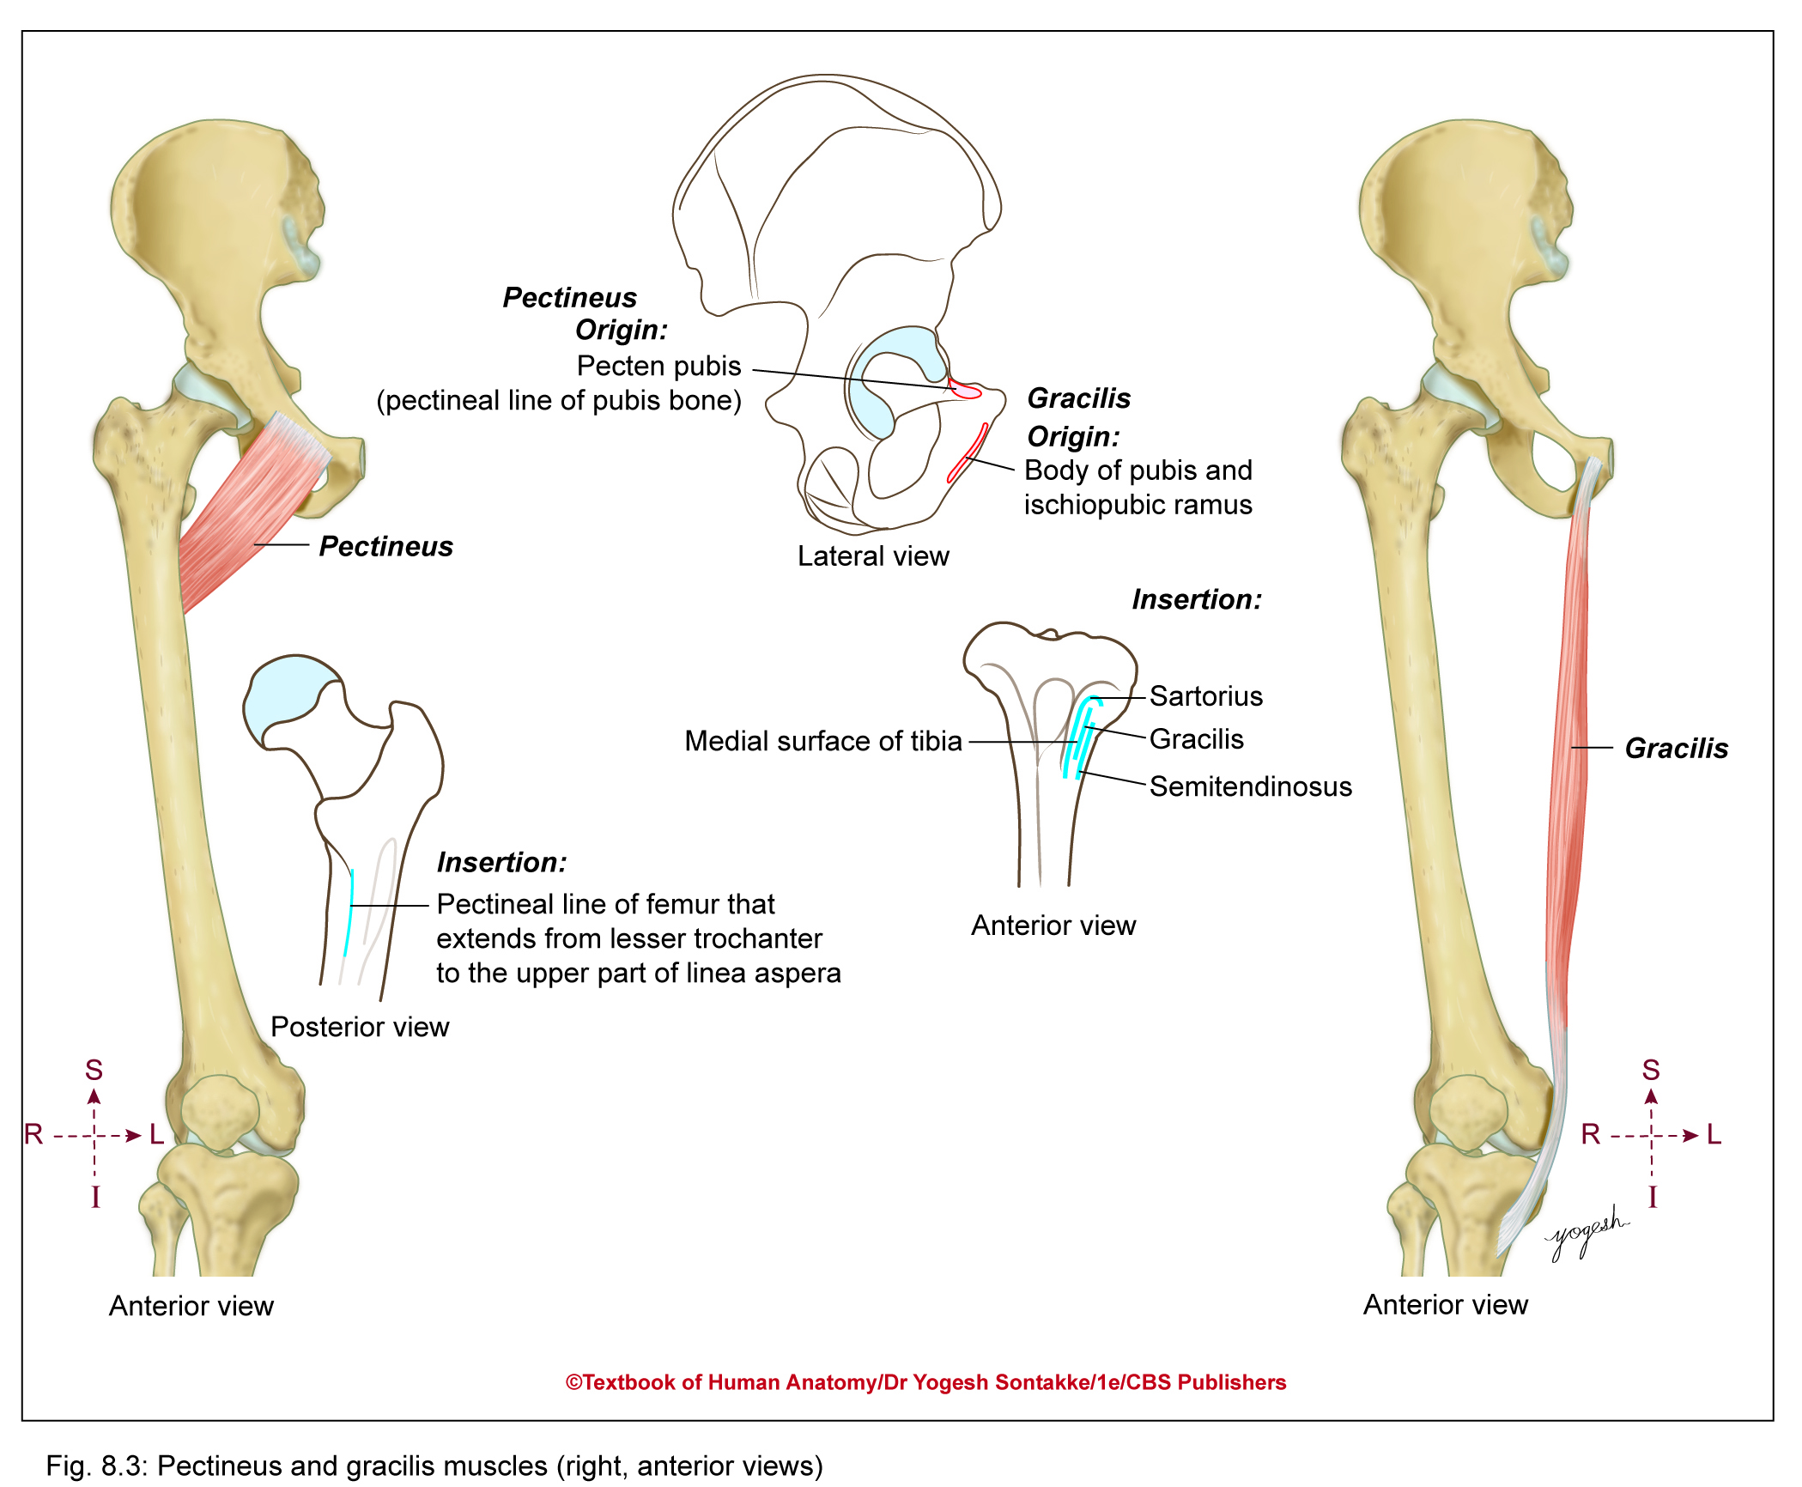

Slide 28
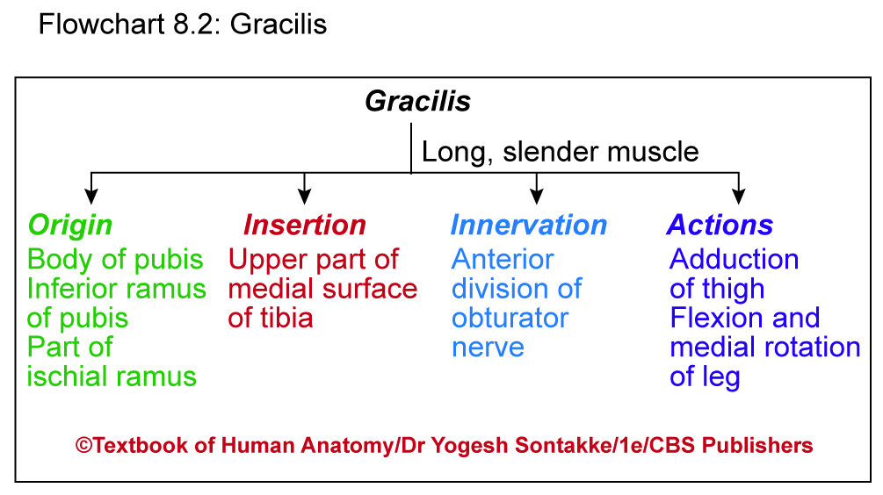

Slide 29
Clinical Anatomy
Muscle transplantation
Gracilis – commonly used for muscle transplantation and reconstructive surgery
Most Beautiful Muscle of Body
  Gracilis – also called Custodian of virginity

Slide 30
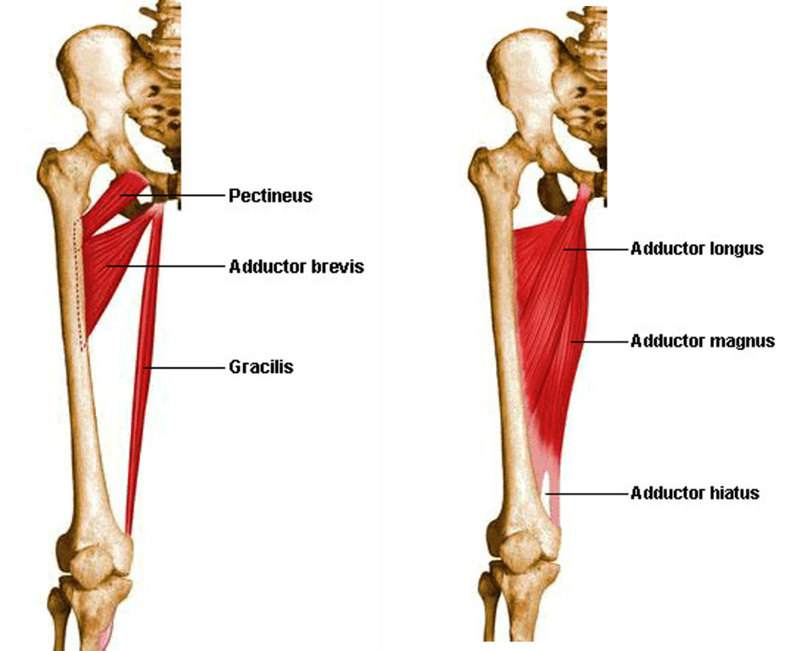
5. PECTINEUS
Flat, quadrangular muscle (pectun = comb in Latin)
Forms part of floor of femoral triangle
Origin
Pecten pubis (pectineal line of pubis bone)
Upper half of pectineal surface of pubis bone
Fascia covering pectineus (pectineal fascia)

Slide 31

Pectineus
Insertion
Pectineal line of femur extends from lesser trochanter to upper part of linea aspera

Slide 32
Pectineus
Innervation
Dual nerve supply
Anterior fibers – supplied by femoral nerve
Posterior fibers – supplied by anterior division of obturator nerve
Actions
Flexion and adduction of thigh

Slide 33
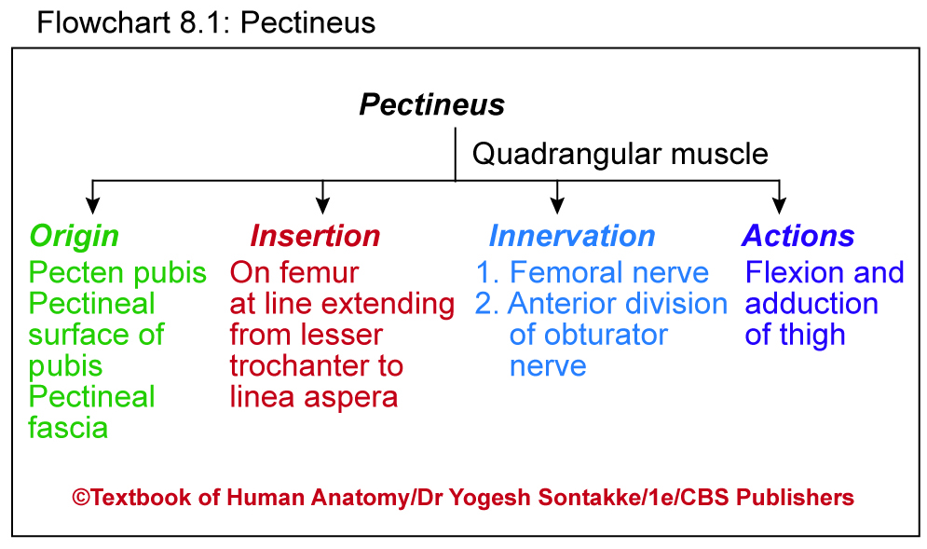

Slide 34
Clinical Anatomy
Pectineus and adductor longus lie in same coronal plane
Developmentally, pectineus – composite muscle derived from two different sources.
Has dual nerve supply (femoral and obturator nerves)
Accessory obturator nerve (present in 30% people),if present, supplies pectineus muscle

Slide 35
Muscles of the Medial Fascial Compartment of the Thigh
Muscle | Origin | Insertion | Nerve Supply |  | Action
Gracilis | Inferior ramus of pubis, ramus of ischium | Upper part of shaft of tibia on medial surface | Obturator nerve |  | Adducts thigh at hip joint; flexes leg at knee joint
Adductor longus | Body of pubis, medial to pubic tubercle | Posterior surface of shaft of femur (linea aspera) | Obturator nerve |  | Adducts thigh at hip joint and assists in lateral rotation
Adductor brevis | Inferior ramus of pubis | Posterior surface of shaft of femur (linea aspera) | Obturator nerve |  | Adducts thigh at hip joint and assists in lateral rotation
Adductor magnus | Inferior ramus of pubis, ramus of ischium, ischial tuberosity | Posterior surface of shaft of femur, adductor tubercle of femur | Adductor portion: obturator nerve Hamstring portion: sciatic nerve |  | Adducts thigh at hip joint and assists in lateral rotation; hamstring portion extends thigh at hip join
Obturator externus | Outer surface of obturator membrane and pubic and ischial rami | Medial surface of greater trochanter | Obturator nerve |  | Laterally rotates thigh at hip joint

Slide 36
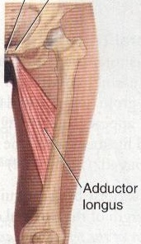
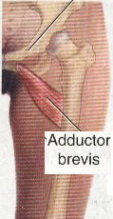

Slide 37
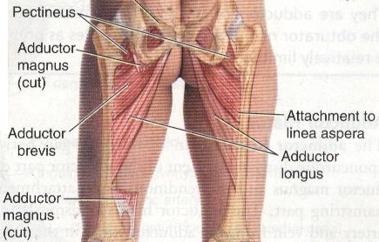
POSTERIOR VIEW

Slide 38
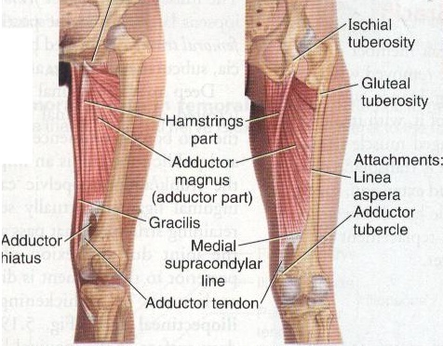
ANTERIOR VIEW
POSTERIOR VIEW

Slide 39
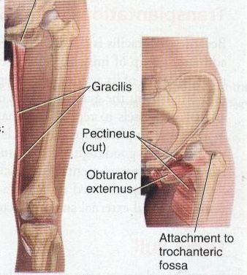
ANTERIOR VIEW

Slide 40
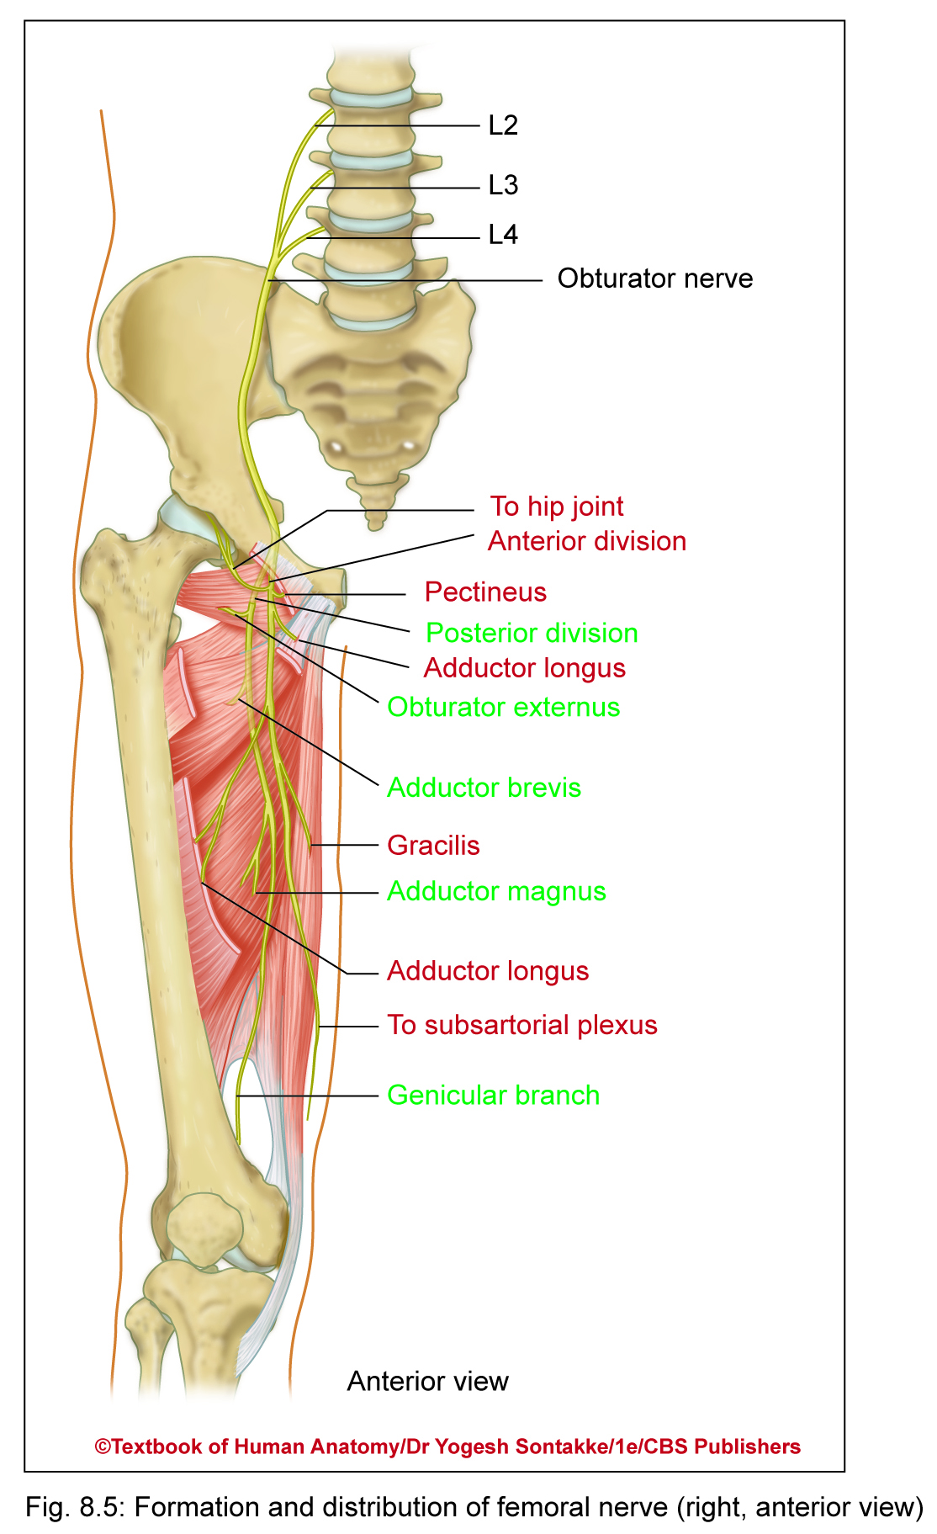
OBTURATOR NERVE
Main nerve of adductor compartment of thigh
Formation
Branch of lumbar plexus
Formed by ventral divisions of anterior primary rami of L2, L3 and L4 spinal nerves
Root value
L2, L3, L4

Slide 41
OBTURATOR NERVE
Course
In pelvic cavity
  Proximal (upper) part of nerve lies in abdominal and pelvic cavity
  Emerges out through medial border of psoas major muscle and passes downward behind common iliac arteries
In thigh
  Enters thigh through obturator foramen
  While passing through obturator foramen (canal), divides into anterior and posterior divisions

Slide 42
OBTURATOR NERVE
Course
In thigh
  Anterior division passes downward in front of obturator externus
  Further, descend behind pectineus and adductor longus in front of adductor magnus
  Posterior division passes through substance of obturator externus muscle

Slide 43
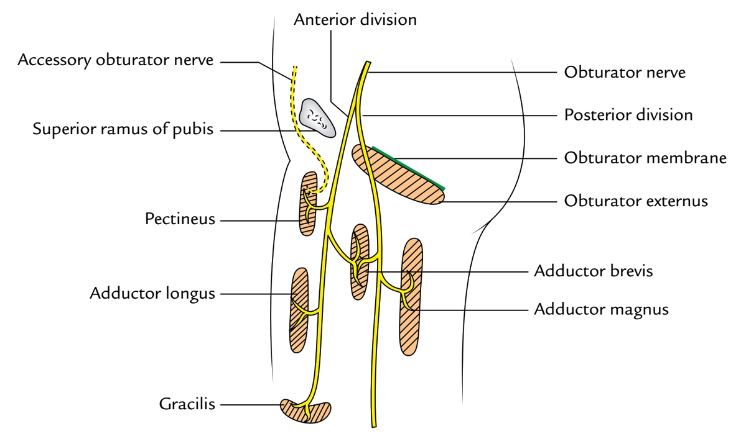

Slide 44
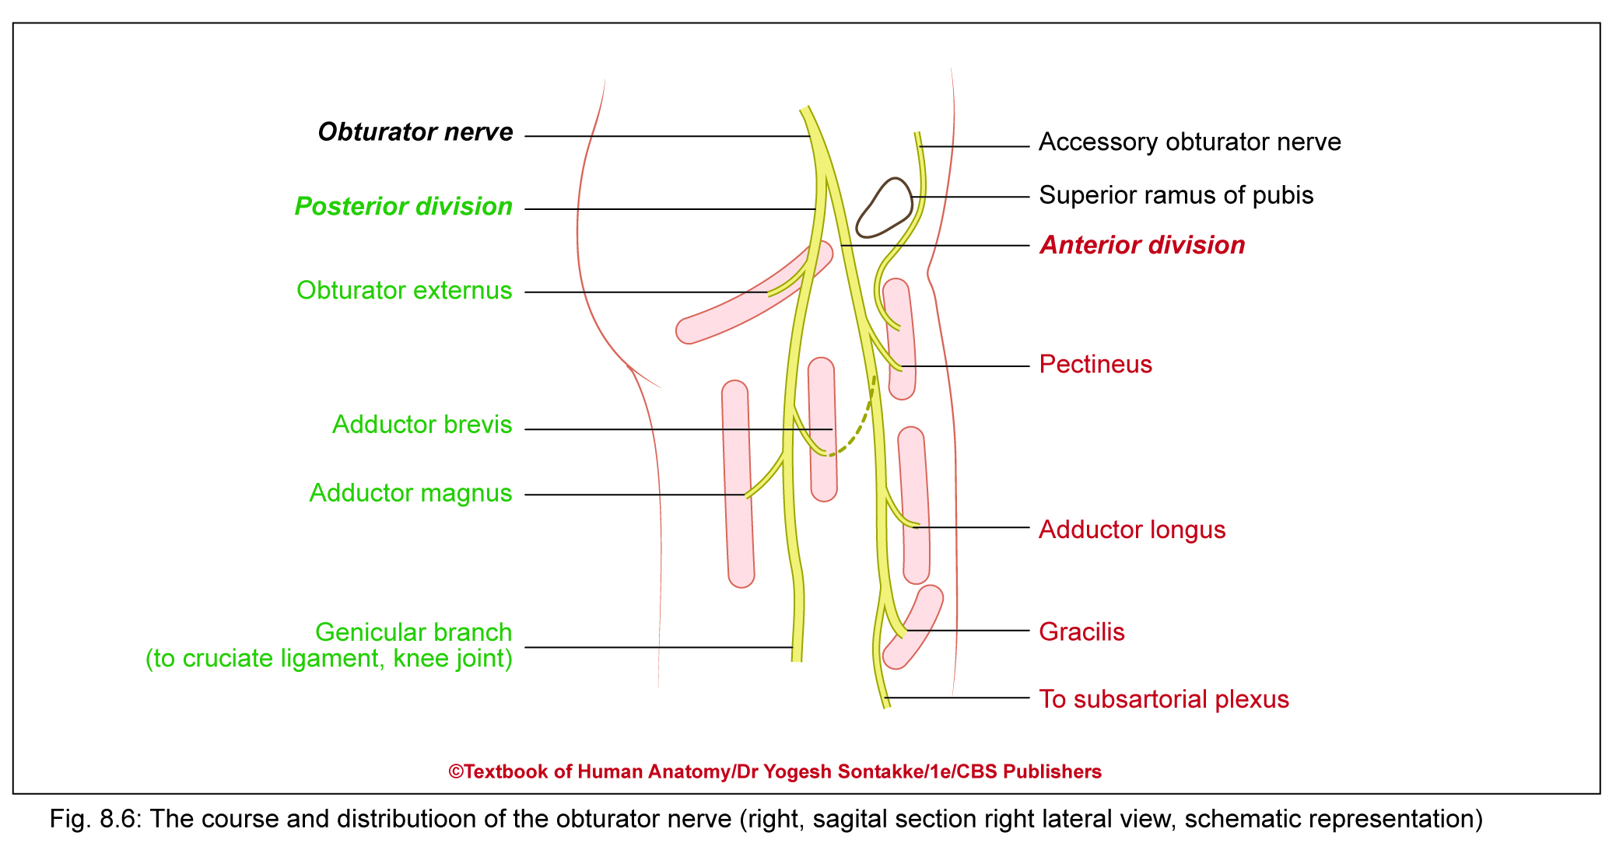

Slide 45
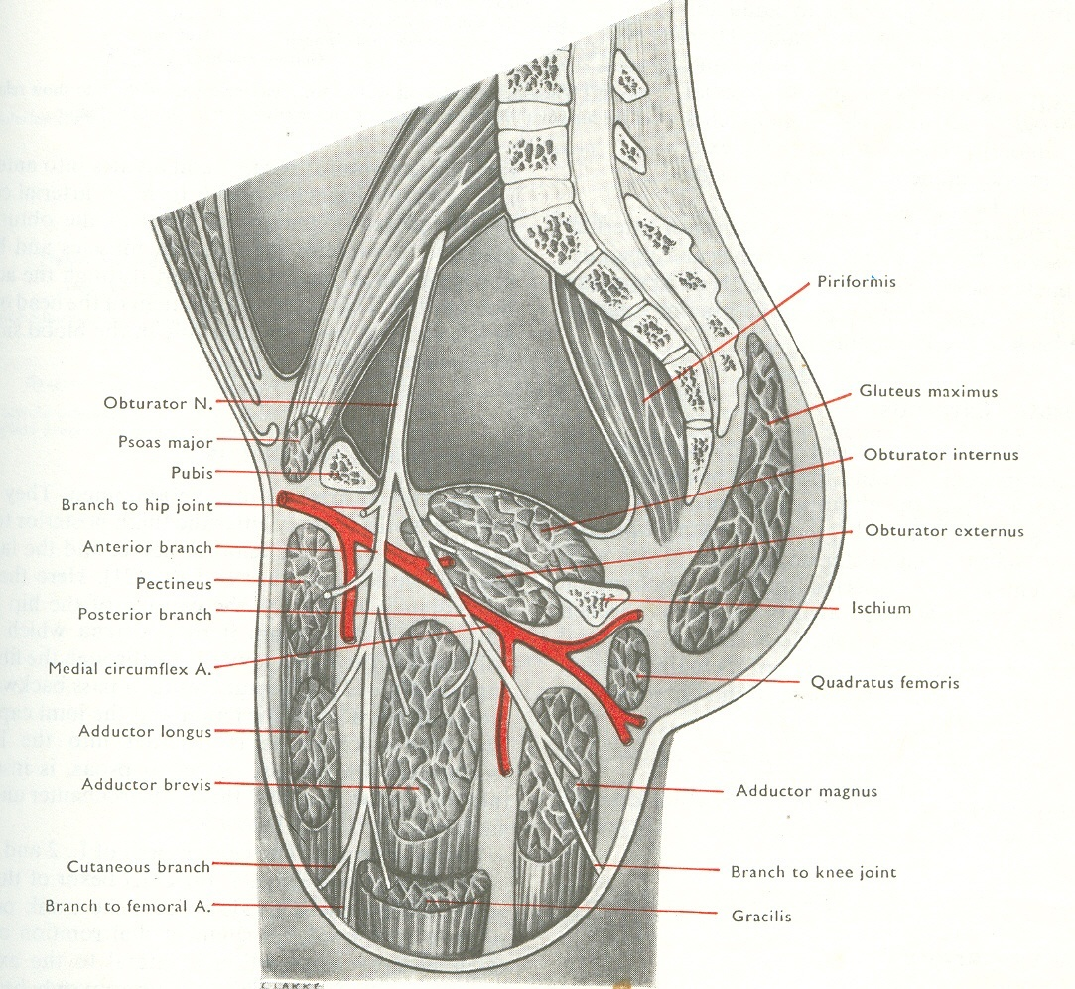
OBTURATOR NERVE

Slide 46
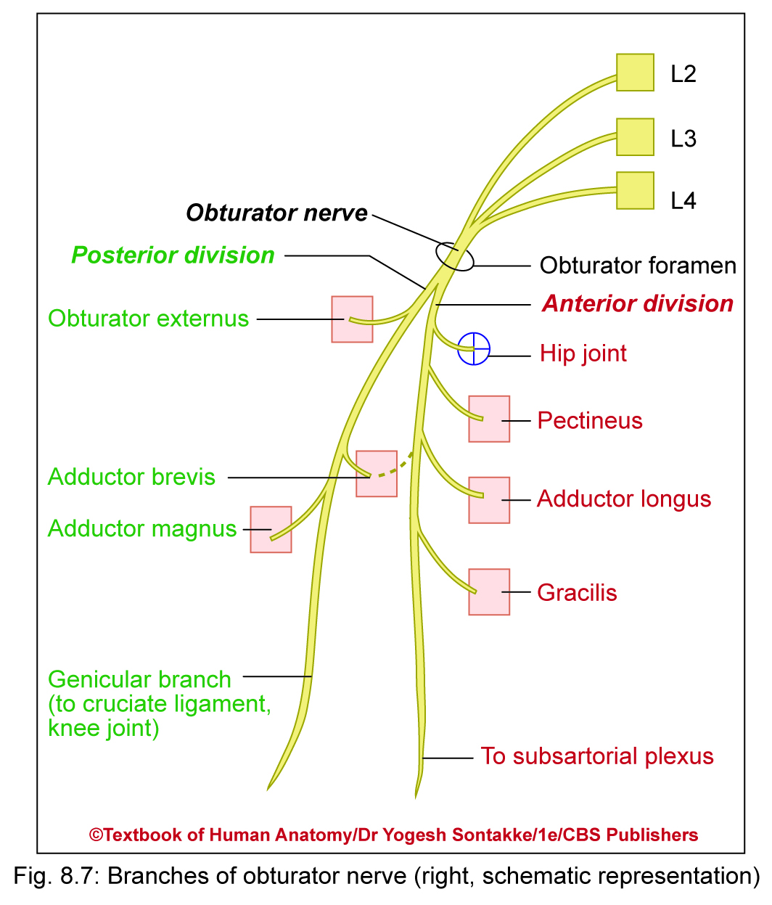
OBTURATOR NERVE
Branches (distribution)
Anterior division
It supplies
  Adductor longus
  Gracilis
  Pectineus
  Adductor brevis (If not supplied by Posterior Division)
  Hip joint
  Branch to subsartorial plexus in adductor canal to supply femoral artery

Slide 47
OBTURATOR NERVE
Branches (distribution)
Posterior division
Pierces obturator externus muscle and supplies
  Obturator externus
  Adductor magnus
  Adductor brevis (if not supplied by anterior division)
  Genicular branch for popliteal vessels, cruciate ligaments, and capsule of knee joint

Slide 48
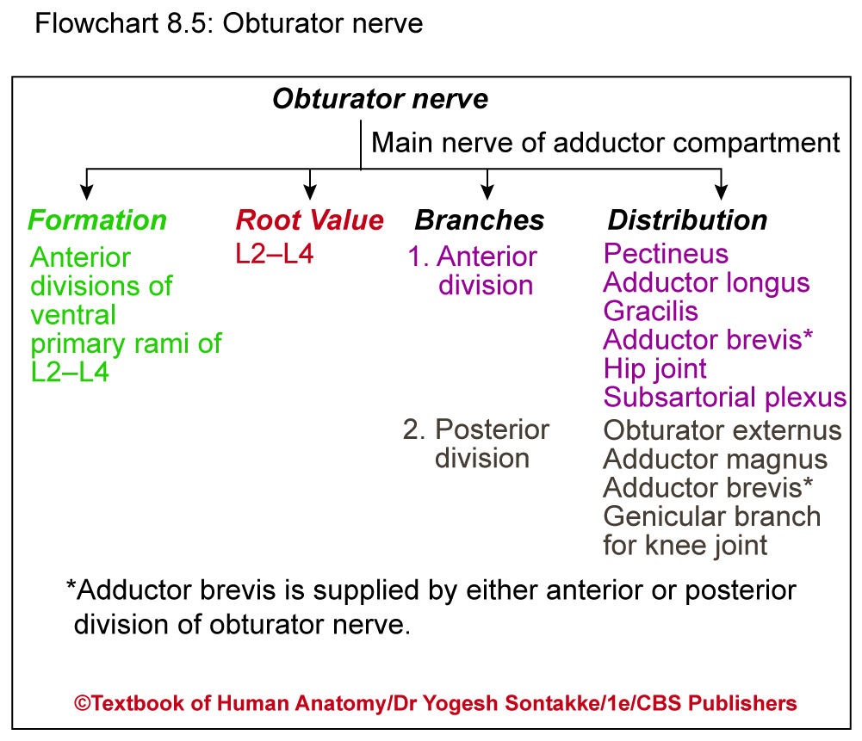

Slide 49
Applied Anatomy
Obturator nerve emerges out from medial border of psoas major muscle
Anterior division of obturator nerve lies deep to adductor longus and pectineus, whereas posterior division lies behind adductor brevis
Genicular branch – continuation of posterior division of obturator nerve
  Enters in popliteal fossa and supplies popliteal vessels
  Then pierces lateral popliteal ligament to enter knee joint
  Occasionally pectineus – supplied by anterior division of obturator nerve and also by femoral nerve
Pectineus has dual nerve supply

Slide 50
Clinical Anatomy
Surgical division of obturator nerve
Spastic paraplegia causing adductor muscle spasm, surgical division of obturator nerve may be useful to relieve symptoms
Referred pain of hip to knee
As obturator nerve supplies both hip and knee joints, may cause referred pain to knee joint

Slide 51
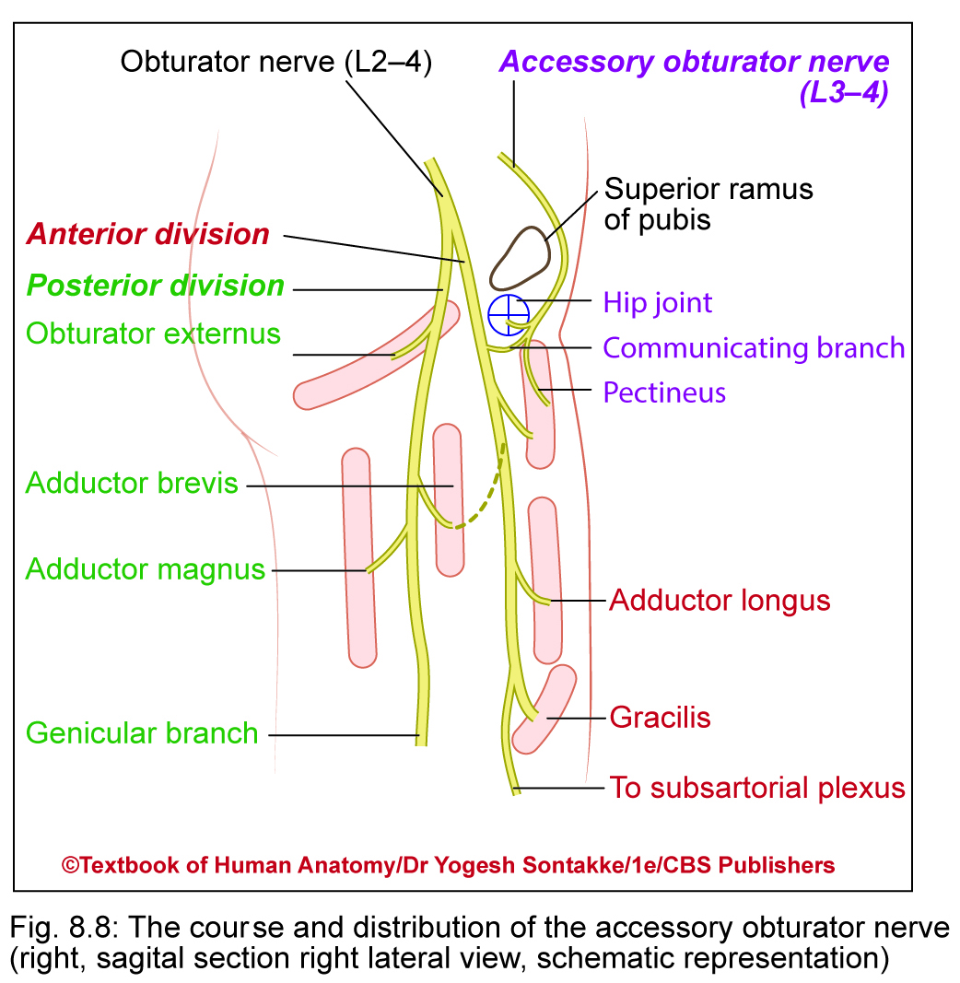
Accessory obturator nerve
Present in 30% individuals
Formation: Branch of lumbar plexus
Formed by divisions of ventral primary rami of L3 and L4 spinal nerves
Root value: L3, L4
Course
Emerges out of medial border of psoas major muscle on posterior abdominal wall

Slide 52
Accessory Obturator nerve
Course
Descends downward and crosses superior ramus of pubis anterior to enter thigh
Branches (distribution)
Supplies
  Pectineus
  Hip joint
  Gives communicating branch of anterior division of obturator nerve

Slide 53
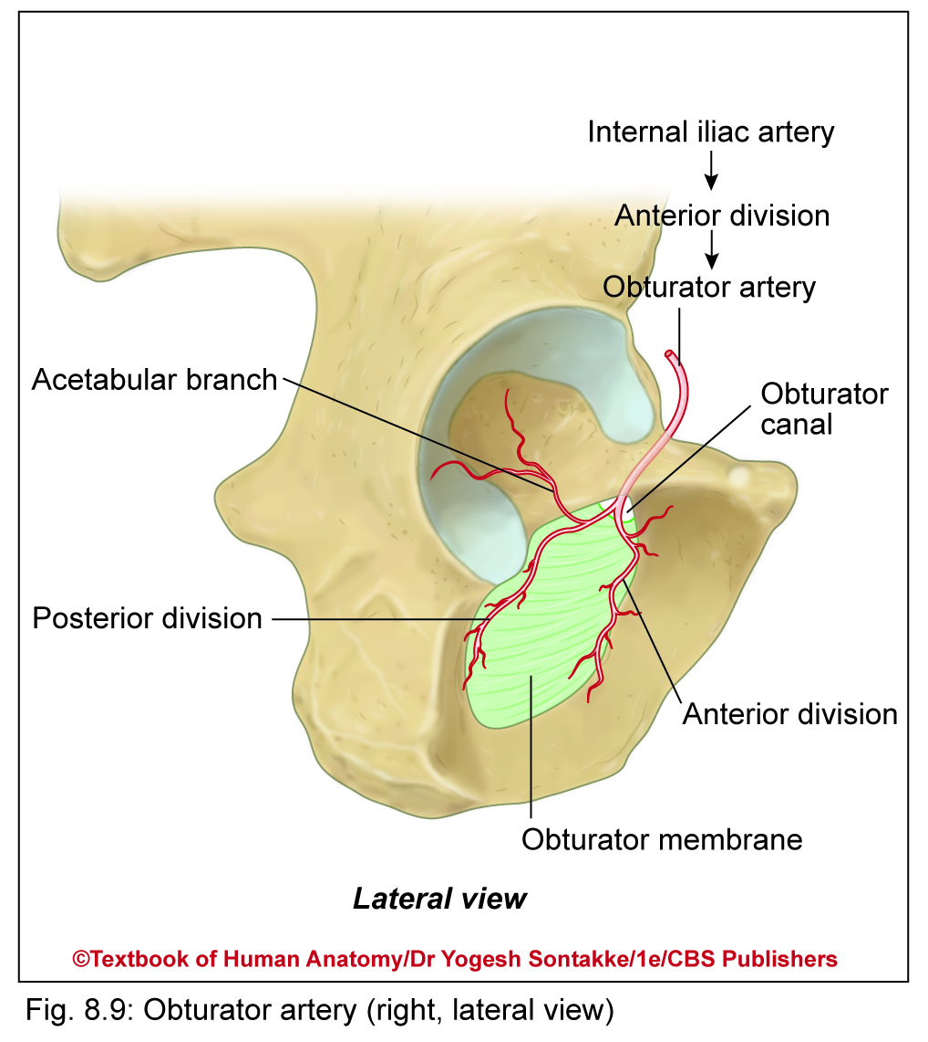
OBTURATOR ARTERY
Supplies adductor muscles along with profunda femoris artery
Beginning
Branch of anterior division of internal iliac artery
Course and branches
Runs downward along with obturator nerve in pelvic cavity
Enters thigh through obturator canal and divides into anterior and posterior branches

Slide 54
OBTURATOR ARTERY
Course and branches
Anterior branch
  Runs in outer surface of obturator membrane
  Supplies adjacent muscles and anastomoses with medial circumflex femoral artery
Posterior branch
  Supplies muscles attached with ischial tuberosity
  Gives acetabular branch passes through acetabular notch to supply acetabular pad of fat and head of femur

Slide 55

Be Positive…….

Slide 56

……..THANK YOU……..

Slide 57
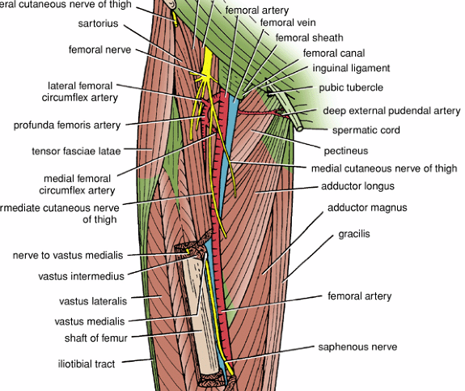

Slide 58
The Adductor hiatus is a gap in the distal attachment of adductor magnus to the femur, which permits the femoral vessels to pass from the adductor canal downward into the popliteal space.

Slide 59
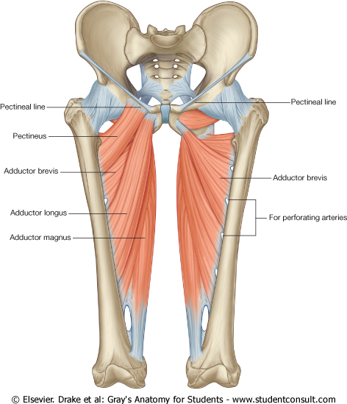
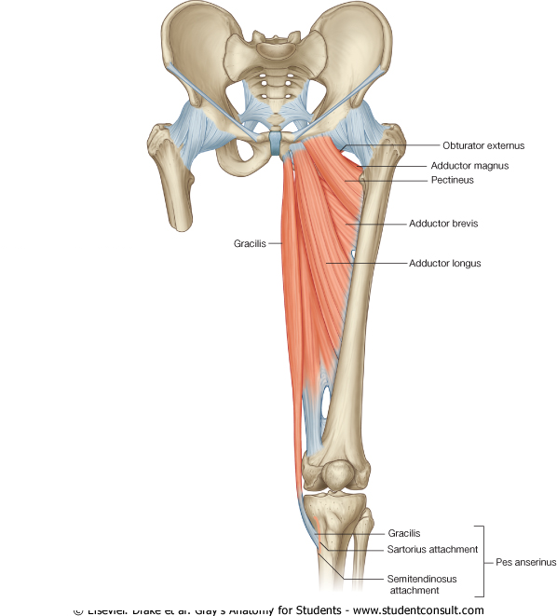
Adductors
Adductor longus
Adductor brevis
Adductor magnus
  Origin – inferior pelvis
  Insertion - femur
  Action – adducts and medial rotates
  Innervation – Obturator nerve
Pectineus
  Origin - pubis
  Insertion – lesser trochanter
  Action – adducts, medial rotates
  Innervation – femoral, sometimes obturator
Gracilis
  Origin - pubis
  Insertion – medial tibia
  Action – adducts thigh, flex, medial, rotates leg
  Innervation – Obturator nerve

Slide 60
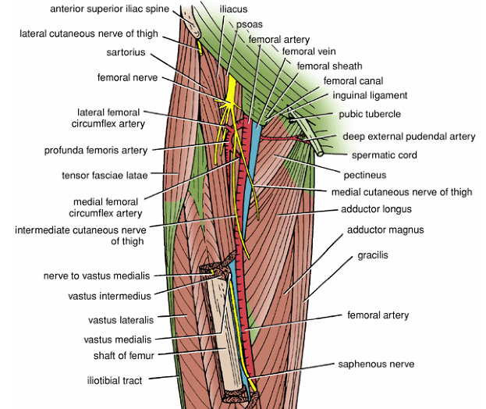

Slide 61
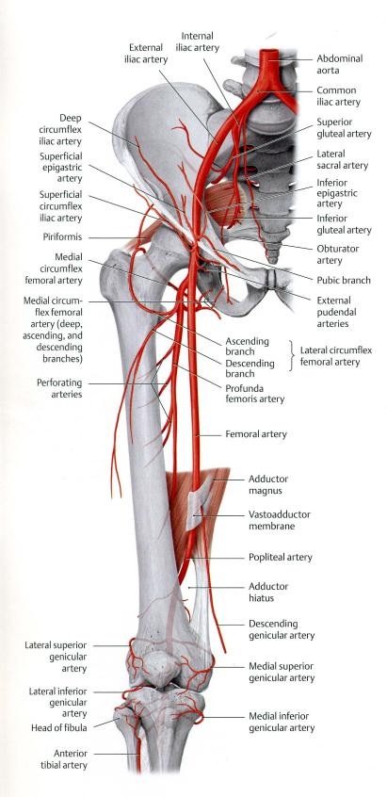

Slide 62
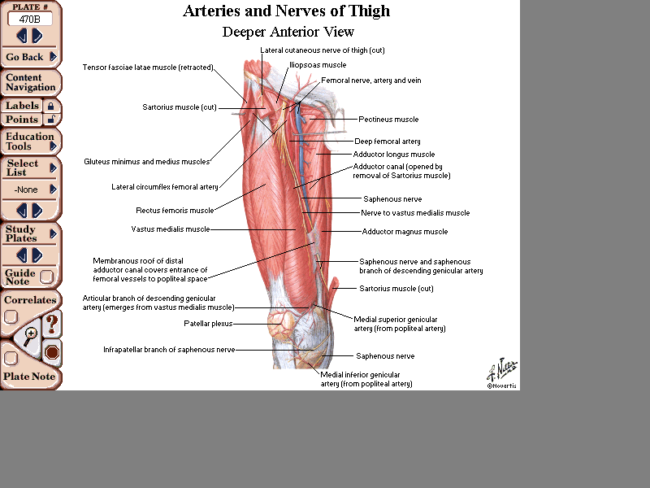

Slide 63
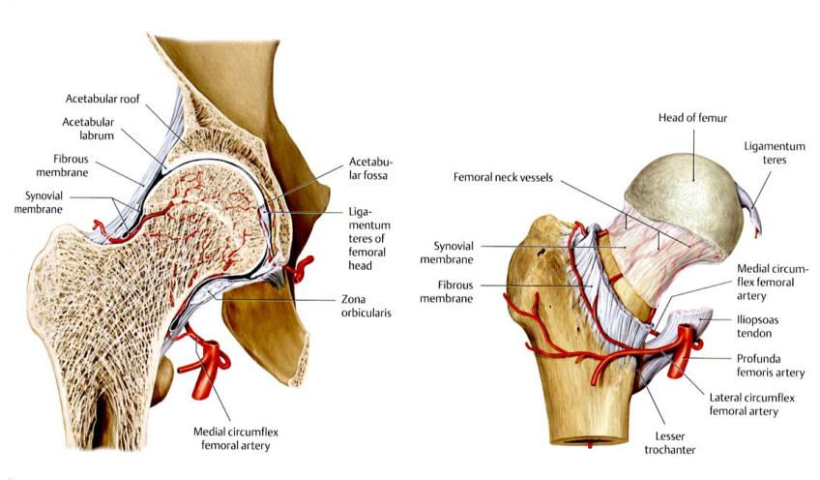

Slide 64
Profunda Femoris
Is a branch of femoral artery in the femoral triangle. Descends in the interval between the adductor longus and adductor brevis and then lies on the adductor magnus, ends as the fourth perforating artery
Branches
Medial femoral circumflex artery:
Give muscular branches to medial compartment Takes part cruciate anastomosis
Lateral femoral circumflex artery:
Perforating branches:
3 arise as branches of the profunda femoris artery; the fourth perforating artery is the terminal part of the profunda artery

Slide 65
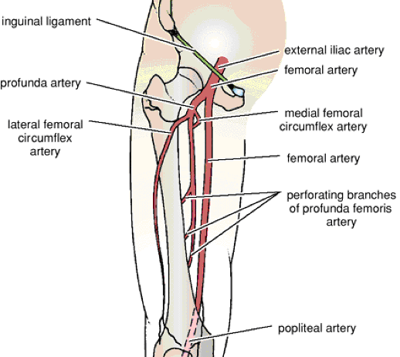

Slide 66
Profunda Femoris Vein
The profunda femoris vein receives tributaries that correspond to the branches of the artery. It drains into the femoral vein.
The obturator artery
Is a branch of the internal iliac artery.
On entering the medial fascial compartment of the thigh, it divides into medial and lateral branches, It gives off muscular branches and an articular branch to the hip joint.
Obturator Vein
The obturator vein receives tributaries that correspond to the branches of the artery. It drains into the internal iliac vein.

Slide 67
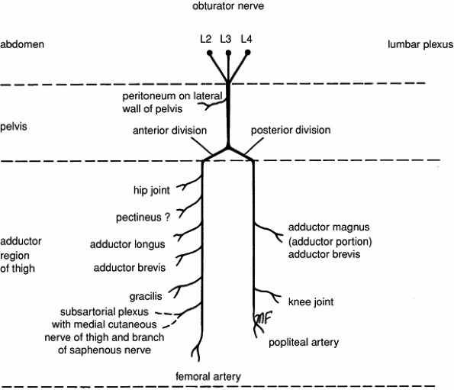
Obturator Nerve
Nerve of Medial Fascial Compartment of the Thigh
The posterior division pierces the obturator externus and passes downward behind the adductor brevis and in front of the adductor magnus
The anterior division passes downward in front of the obturator externus.

Slide 68
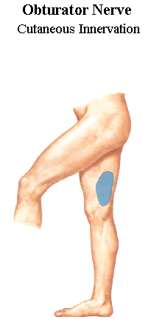

Slide 69
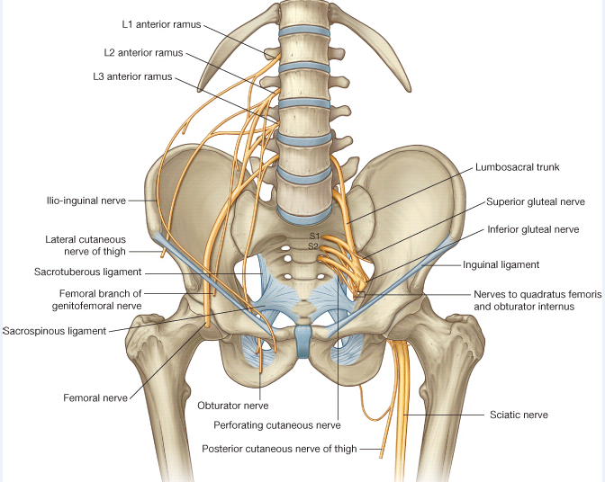

Slide 70
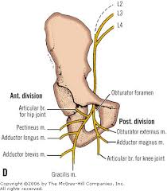
COURSE OF OBTURATOR NERVE

Slide 71
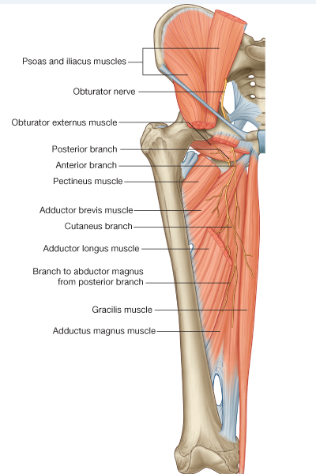
OBTURATER
NERVE

Slide 72


Slide 73

THANK YOU

