Slide 1
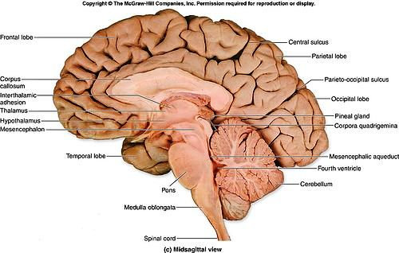
BRAIN SECTIONS OF BRAIN-2
DR. PRAVEEN KURREY
MBBS, MS, BCME, BCBR, CISP
PROFESSOR ANATOMY

Slide 2
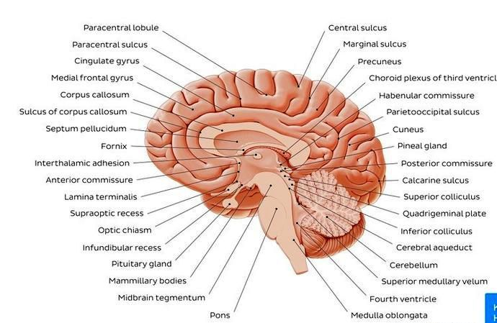
MID-SAGGITAL SECTION

Slide 3
MEDIAN SECTION

Slide 4
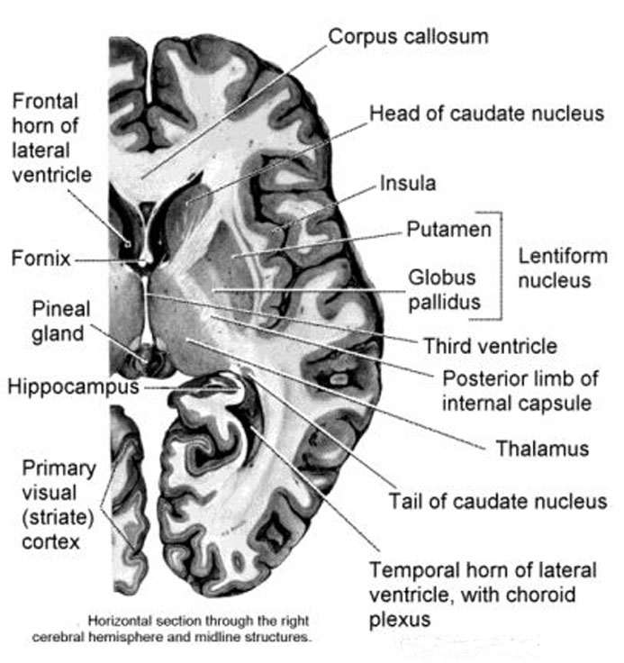
Horizontal Section through Rt Cerebral Hemisphere

Slide 5
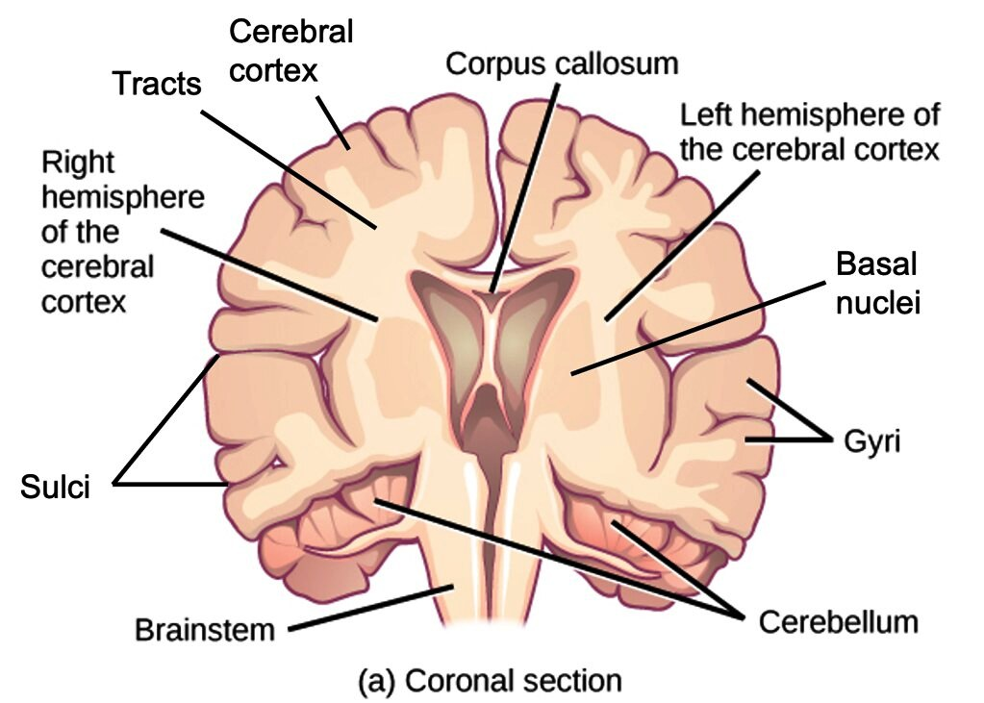

Slide 6
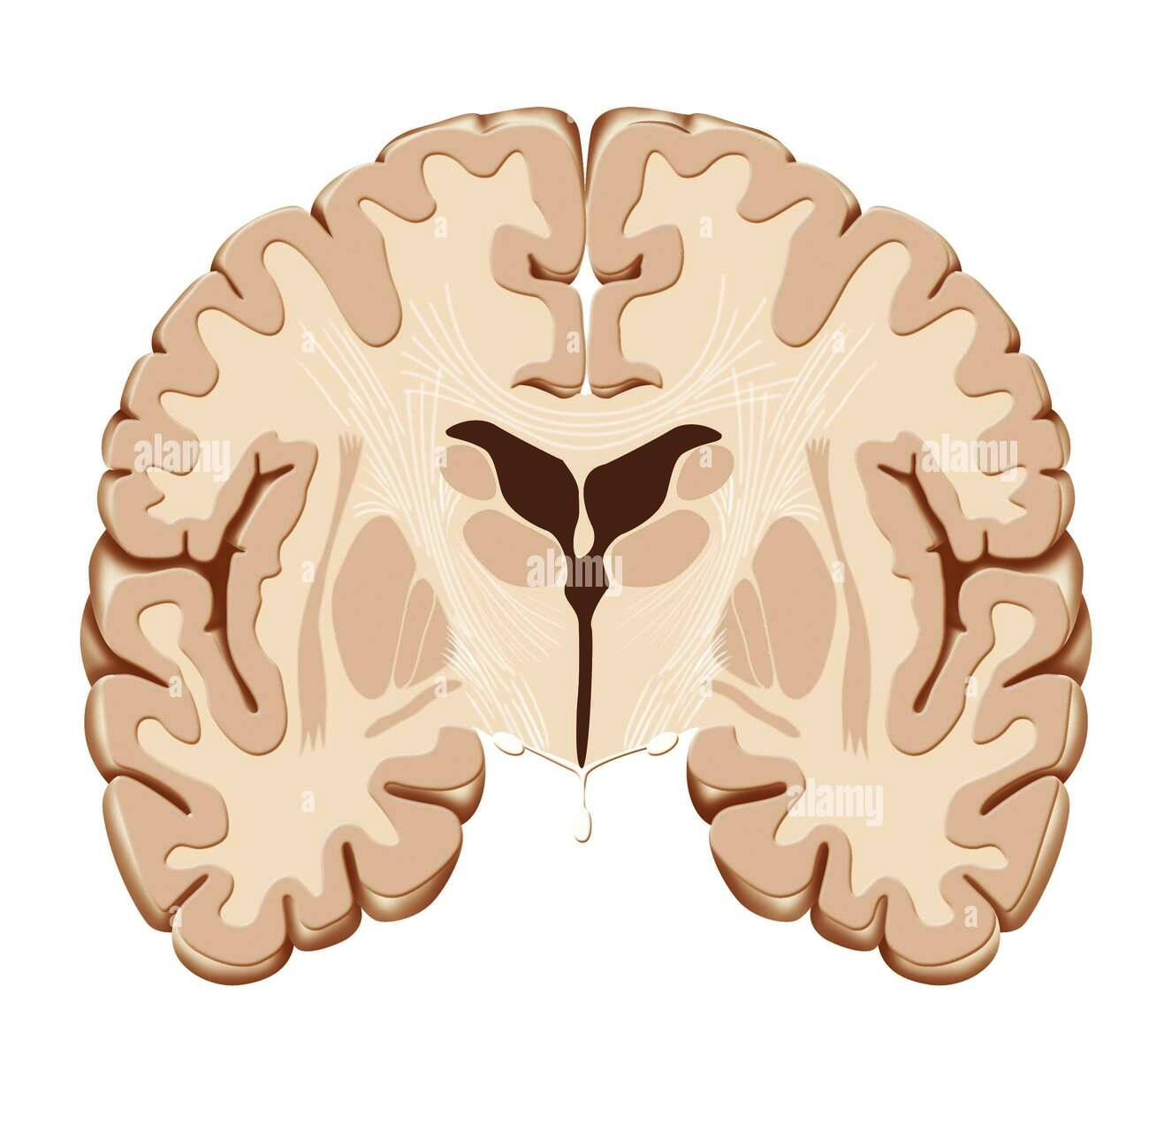
CORONAL SECTION- LATERAL VENTRICLE

Slide 7
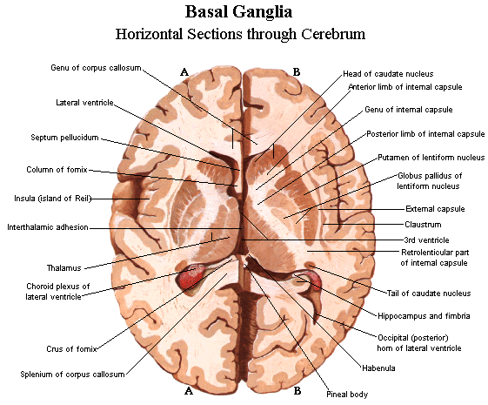

Slide 8
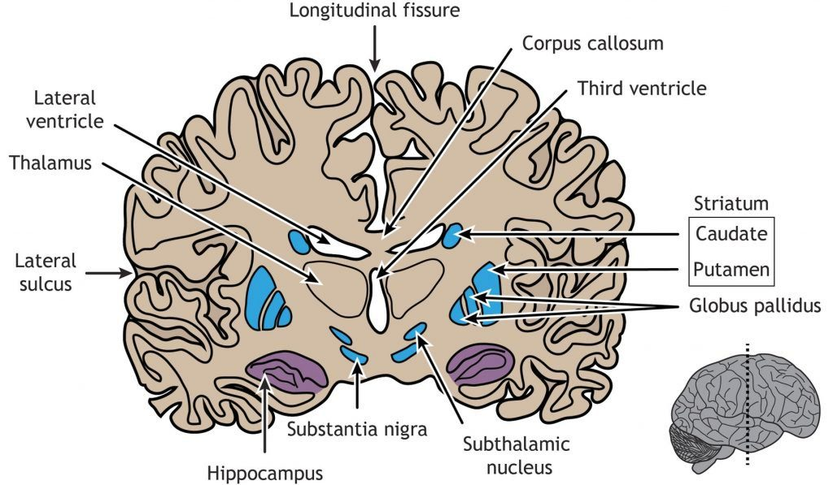
CORONAL SECTION

Slide 9
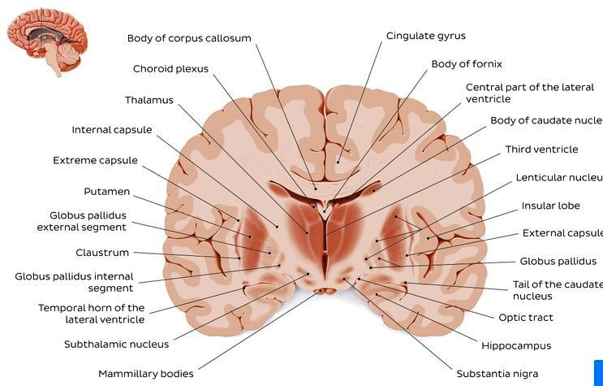
LATERAL VENTRICLE- CORONAL SECTION

Slide 10
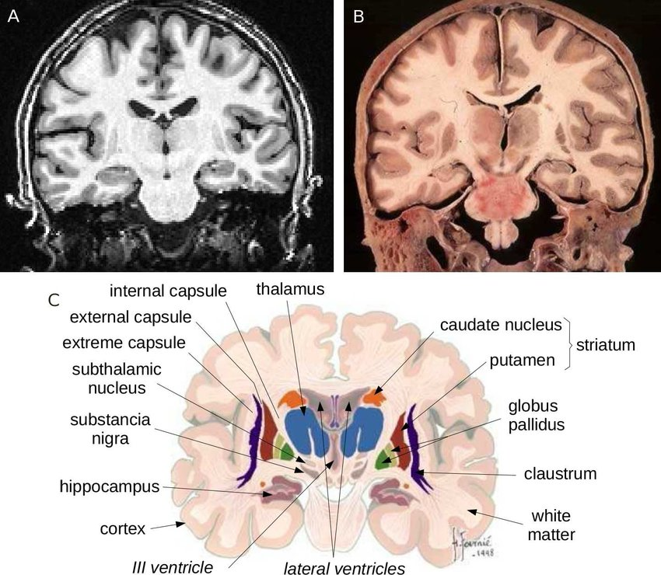

Slide 11
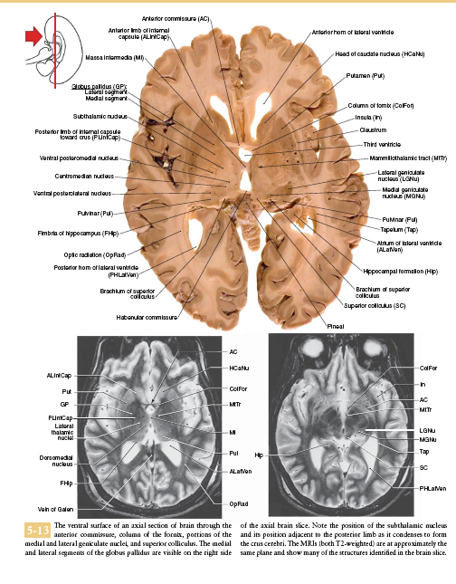

Slide 12
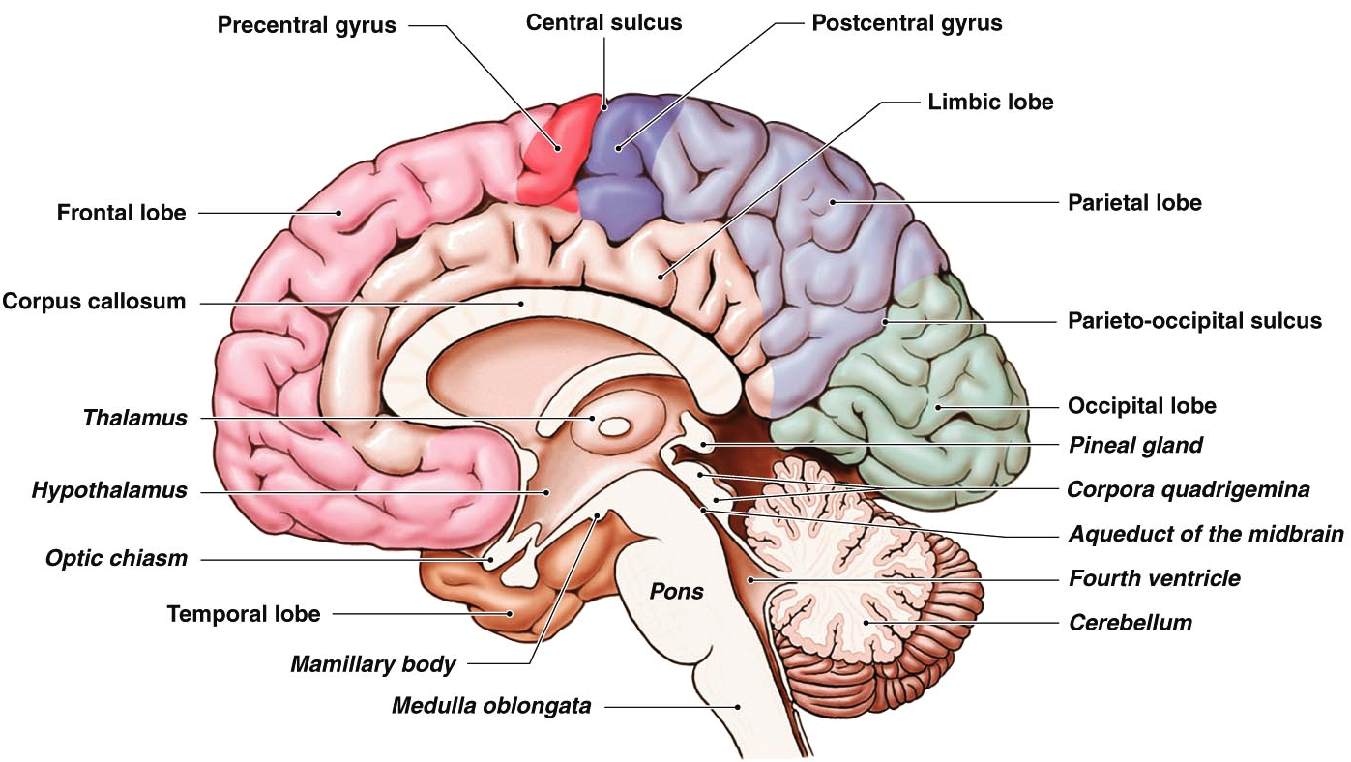
MEDIAL SURFACE

Slide 13
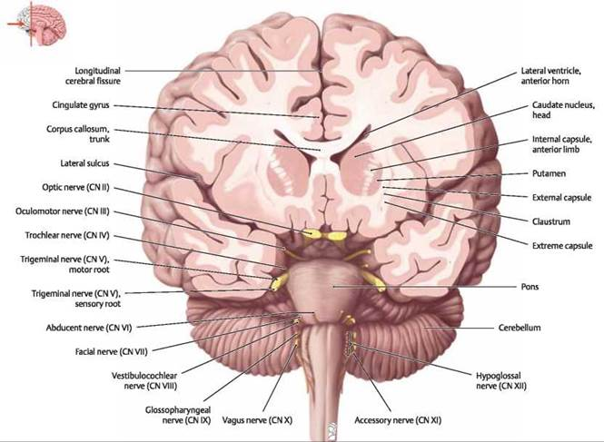
CORONAL – FRONTAL LOBE

Slide 14
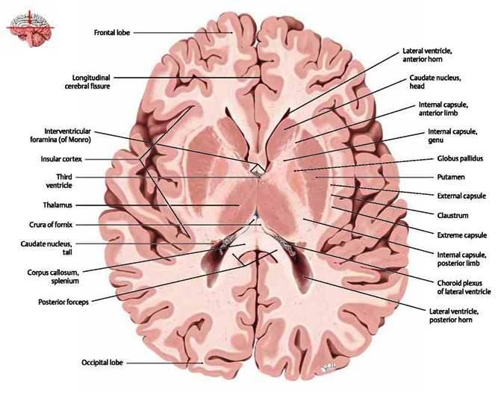
HORIZONTAL SECTION

Slide 15
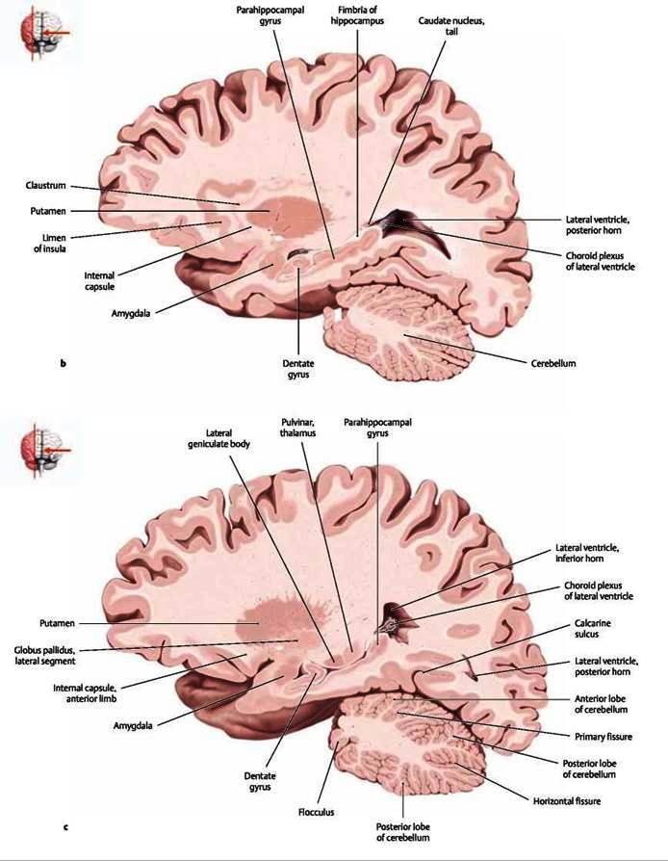
LATERAL SIDE- SAGGITAL

Slide 16
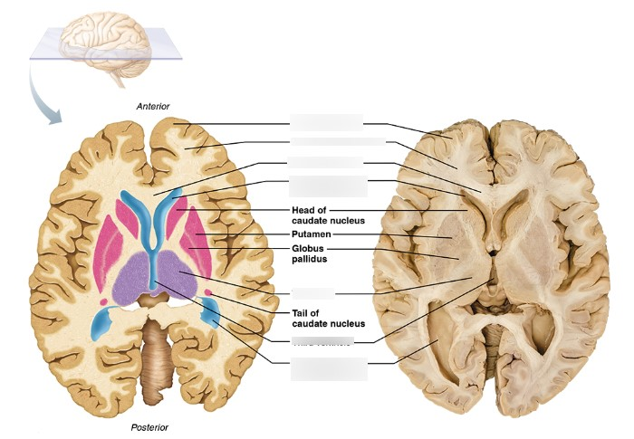
HORIZONTAL - MIDDLE PART

Slide 17
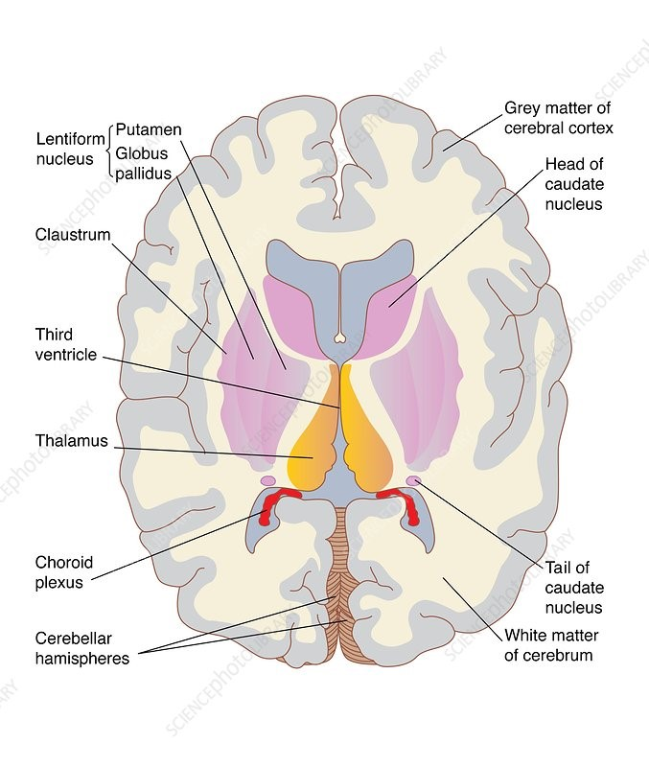
HORIZONTAL SECTION

Slide 18


