Slide 1
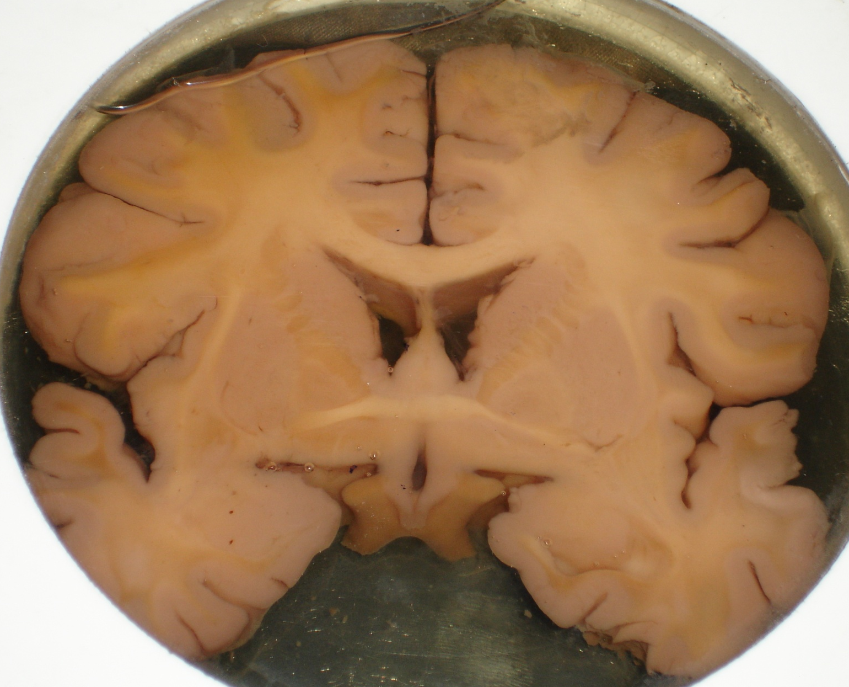
BRAIN
SECTIONS OF BRAIN
DR. PRAVEEN KURREY
MBBS, MS, BCME, BCBR, CISP
PROFESSOR ANATOMY

Slide 2
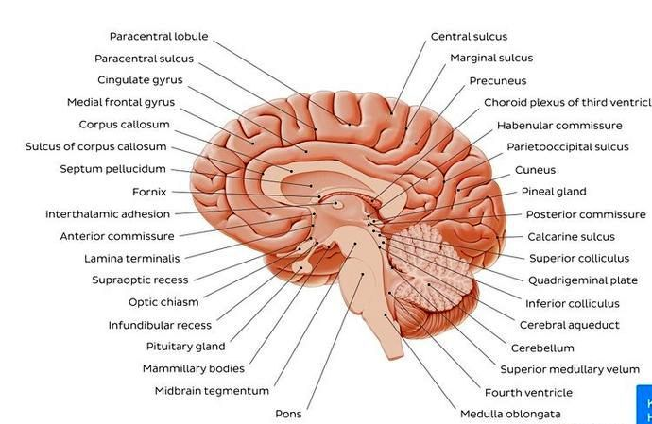

Slide 3
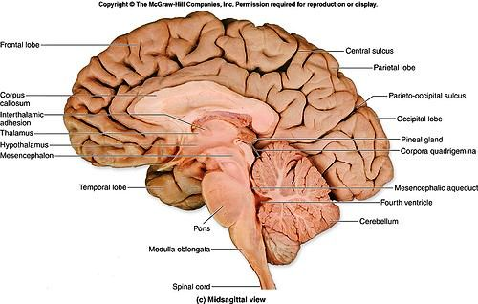

Slide 4
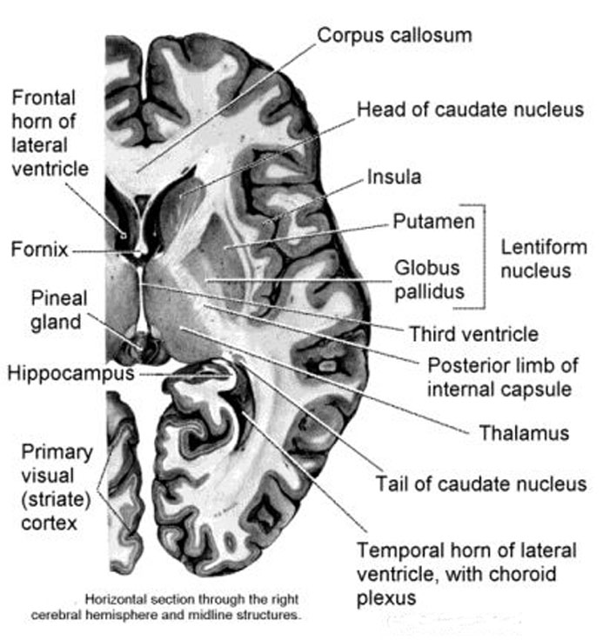
Horizontal Section through Rt Cerebral Hemisphere

Slide 5
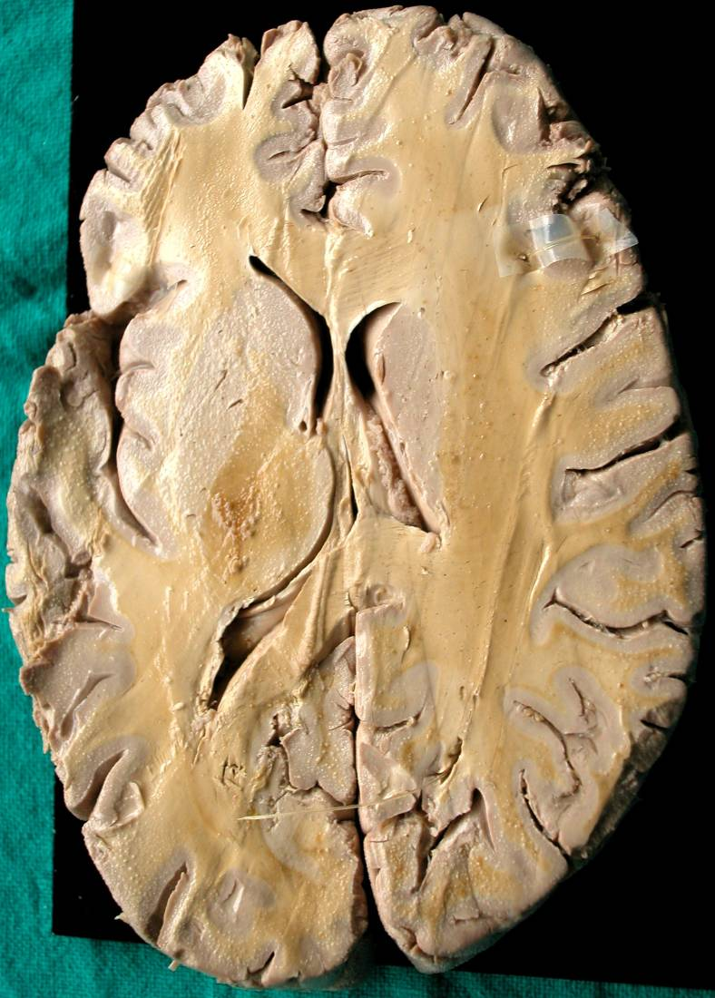
1 - Corona Radiata
2 - Ant Horn of Lat Ventricle
3 - Head of Caudate Nucleus
4 - Body (Central Part) of Lat Ventricle
5 - Genu of Int Capsule
6 – Post Limb of Int Capsule
7 – Lentiform Nucleus
8 – Thalamus
9 – Retrolentiform Part of Int Capsule
10 – Post Horn of Lat Ventricle
11 – Optic Radiation
1
2
3
4
7
5
6
8
9
10
11
Horizontal Section through Cerebral Hemispheres

Slide 6
1 - Corona Radiata
2 - Ant Horn of Lat Ventricle
3 - Head of Caudate Nucleus
4 - Body (Central Part) of Lat Ventricle
5 - Genu of Int Capsule
6 – Post Limb of Int Capsule
7 – Lentiform Nucleus
8 – Thalamus
9 – Retrolentiform Part of Int Capsule
10 – Post Horn of Lat Ventricle
11 – Optic Radiation
1
2
3
4
7
5
6
8
9
10
11
Horizontal Section through Cerebral Hemispheres

Slide 7
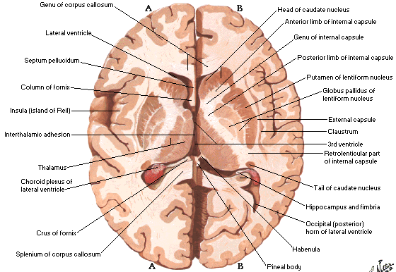
Horizontal Section through Cerebral Hemispheres

Slide 8
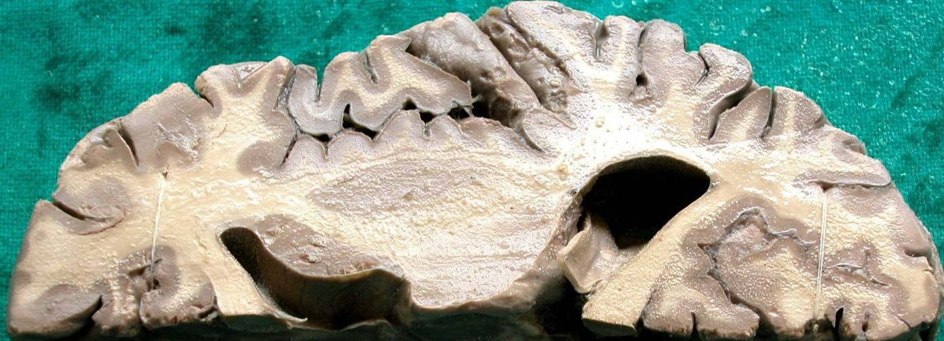
Internal Capsule
External Capsule
Claustrum
Insular Cortex
2
3
4
5
Extreme Capsule
6
1
7
12
11
Genu of Corpus Callosum
Head of Caudate Nucleus
9
Lentiform Nucleus
Thalamus
10
Splenium of Corpus Callosum
8
Horizontal Section through Right Cerebral Hemisphere

Slide 9
Internal Capsule
External Capsule
Claustrum
Insular Cortex
Extreme Capsule
Ant Horn of Lat Ventricle
Post Horn of Lat Ventricle
Genu of Corpus Callosum
Head of Caudate Nucleus
Lentiform Nucleus
Thalamus
Splenium of Corpus Callosum
Horizontal Section through Right Cerebral Hemisphere

Slide 10
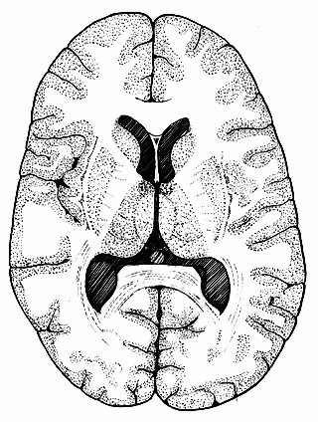
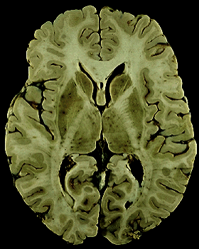
1
1
2
2
3
3
4
5
4
5
6
8
6
8
7
7
9
9
10
10
11
11
12
12
1 - Corona Radiata 2 - Ant Horn of Lat Ventricle 3 - Head of Caudate Nucleus 4 - Central Part of Lat Ventricle 5 – Ant Limb of Int Capsule 6 - Genu of Int Capsule
7 – Post Limb of Int Capsule
8 – Lentiform Nucleus
9 – Thalamus
10 – Retrolentiform Part of Int Capsule
11 – Post Horn of Lat Ventricle
12 – Optic Radiation
Horizontal Section through Cerebral Hemispheres

Slide 11
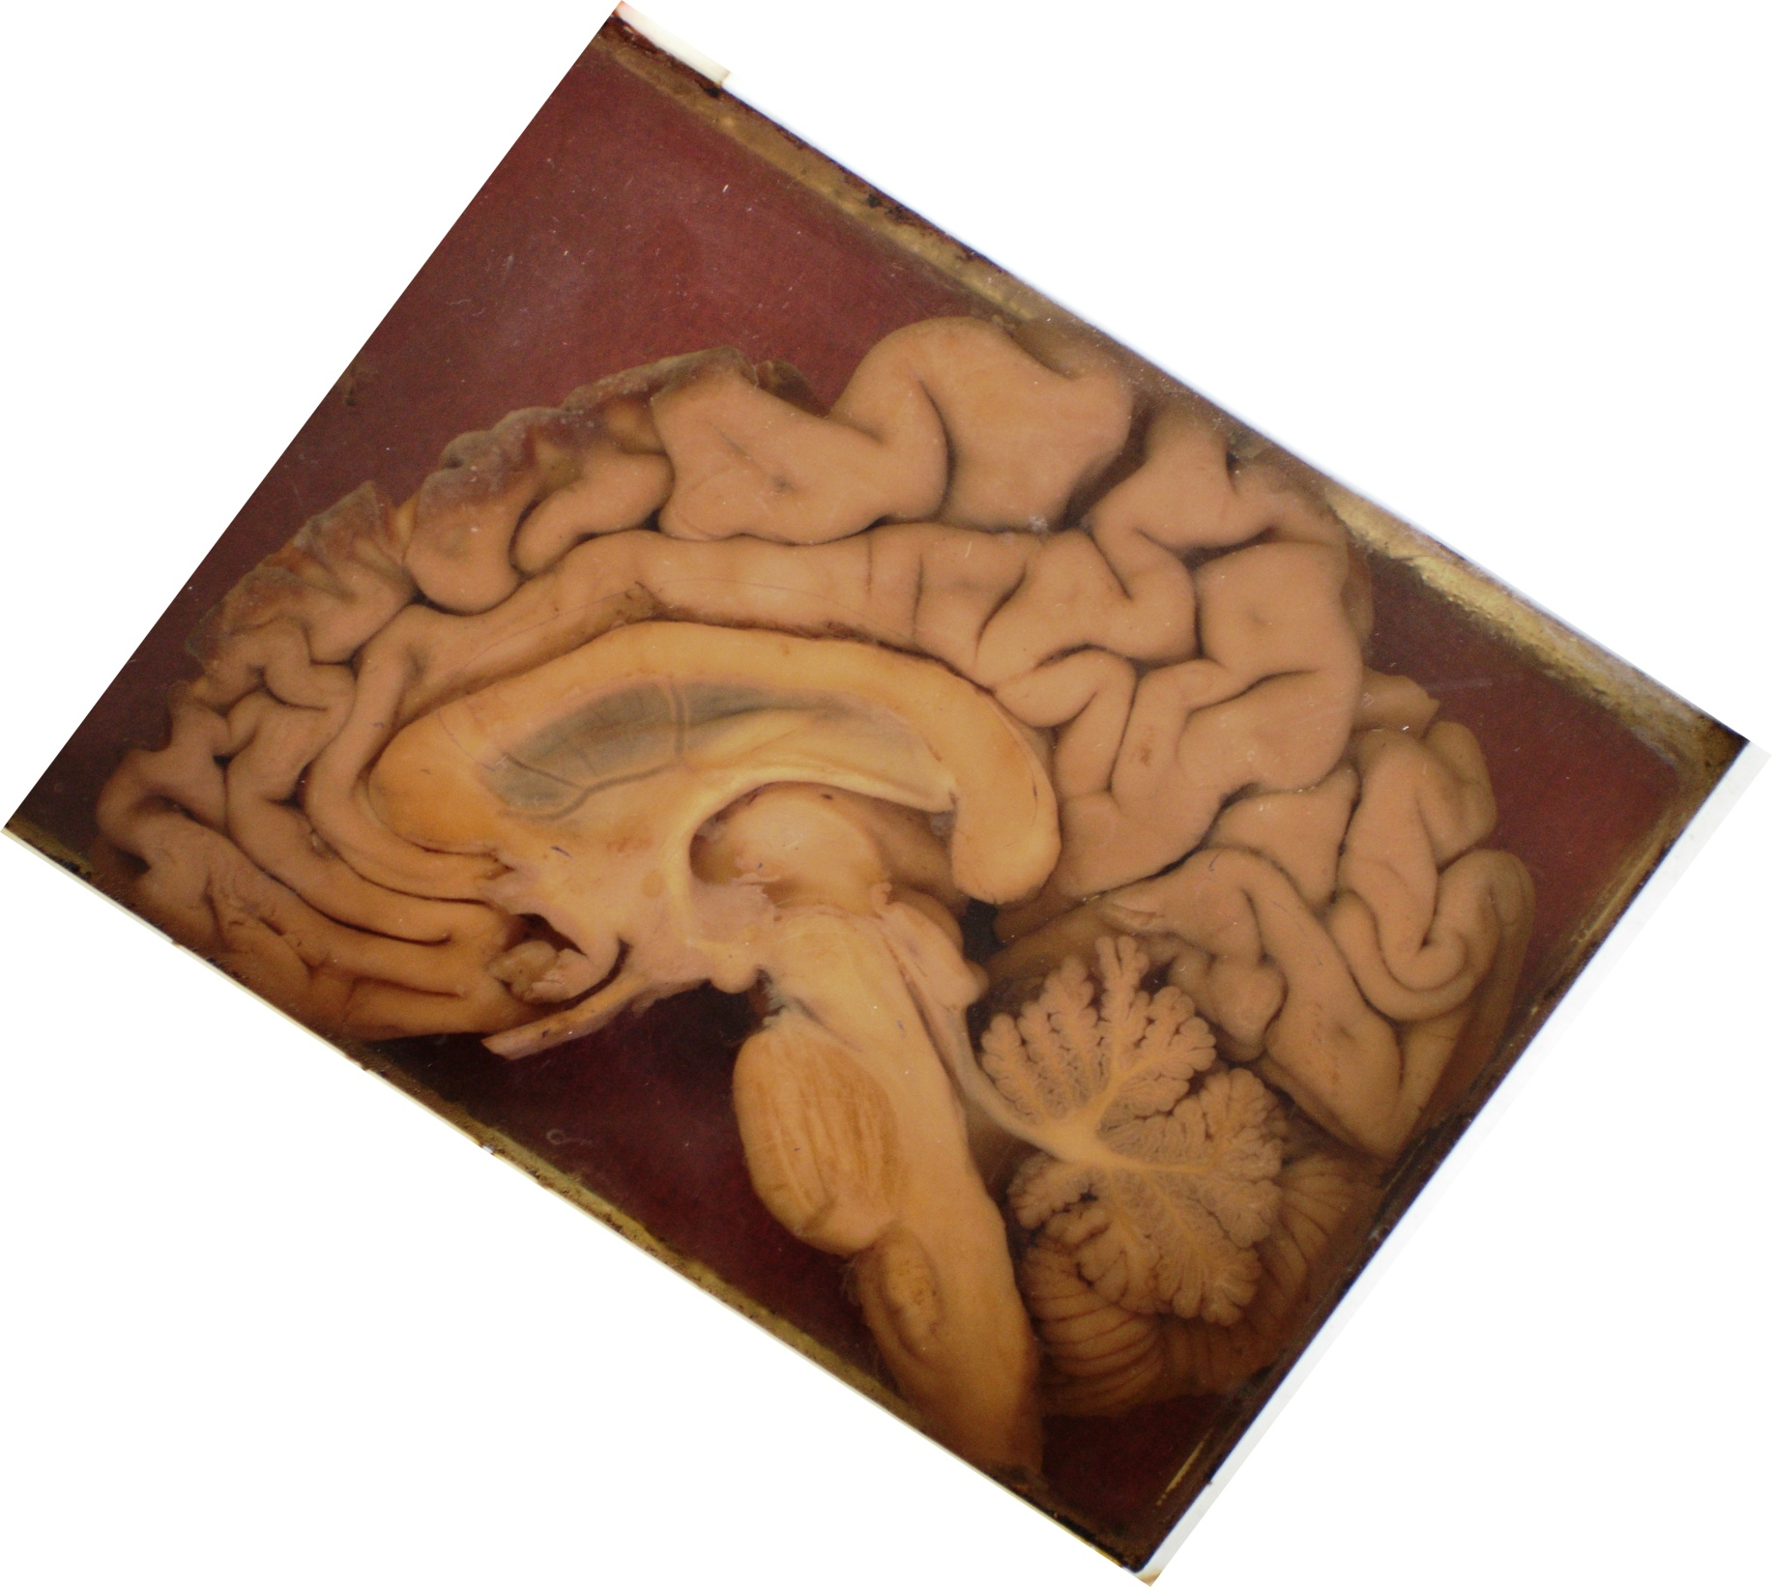
Median Section through brain showing levels of coronal sections
C
D
E
B
A
A - through genu of Corpus Callosum
B - through optic chiasma
C - through infundibulum of Pituitary
D - through Midbrain & Pons (oblique section)
E - through splenium of Corpus Callosum

Slide 12
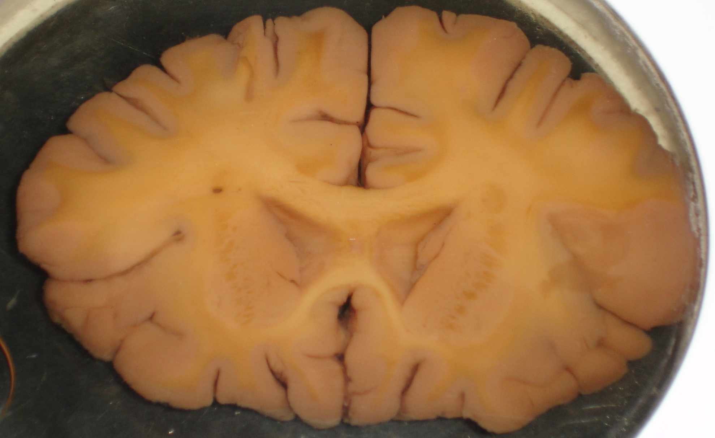
5
1
2
3
4
1 - Genu of Corpus Callosum 2 - Ant Horn of Lat Ventricle 3 - Head of Caudate nucleus 4 - Internal Capsule 5 - Corona Radiata
Coronal Section through Cerebral Hemispheres at level of Genu of Corpus Callosum

Slide 13
5
1
2
3
4
1 - Genu of Corpus Callosum 2 - Ant Horn of Lat Ventricle 3 - Head of Caudate nucleus 4 - Internal Capsule 5 - Corona Radiata
Coronal Section through Cerebral Hemispheres at level of Genu of Corpus Callosum

Slide 14
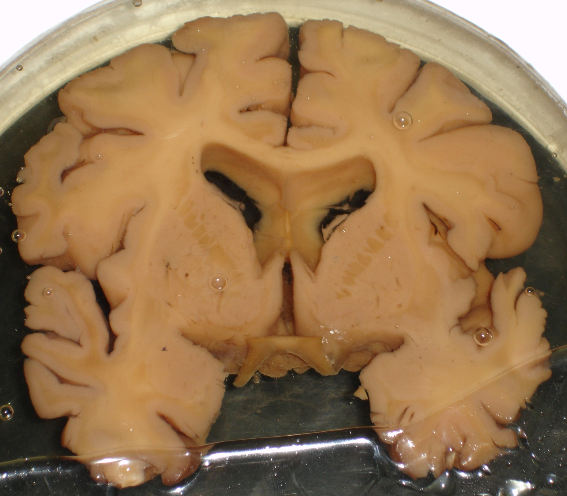
2
1
9
3
4
8
Coronal Section through Cerebral Hemispheres at level of Optic Chiasma
7
5
6
1- Trunk of Corpus Callosum 2 - Corona Radiata 3 - Head of Caudate Nucleus 4 - Internal Capsule
5 - Lentiform Nucleus 6 - Optic Chiasma 7 - Third Ventricle 8 - Insular Cortex
9 – Body of Lat Ventricle

Slide 15
2
1
9
3
4
8
Coronal Section through Cerebral Hemispheres at level of Optic Chiasma
7
5
6
1- Trunk of Corpus Callosum 2 - Corona Radiata 3 - Head of Caudate Nucleus 4 - Internal Capsule
5 - Lentiform Nucleus 6 - Optic Chiasma 7 - Third Ventricle 8 - Insular Cortex
9 – Body of Lat Ventricle

Slide 16
2
1
10
3
4
Coronal Section through Cerebral Hemispheres at level of Infundibulum of Pituitary
9
6
13
12
5
11
8
7
1- Trunk of Corpus Callosum 2 - Corona Radiata 3 - Head of Caudate Nucleus 4 - Internal Capsule 5 - Globus Pallidus
6 - Putamen 7 - Infundibulum 8 - Third Ventricle 9 - Columns of Fornix 10 - Septum Pellucidum
11 - Ant Commissure 12 - Insular Cortex 13 – Post ramus of lateral sulcus

Slide 17
2
1
10
3
4
Coronal Section through Cerebral Hemispheres at level of Infundibulum of Pituitary
9
6
13
12
5
11
8
7
1- Trunk of Corpus Callosum 2 - Corona Radiata 3 - Head of Caudate Nucleus 4 - Internal Capsule 5 - Globus Pallidus
6 - Putamen 7 - Infundibulum 8 - Third Ventricle 9 - Columns of Fornix 10 - Septum Pellucidum
11 - Ant Commissure 12 - Insular Cortex 13 – Post ramus of lateral sulcus

Slide 18
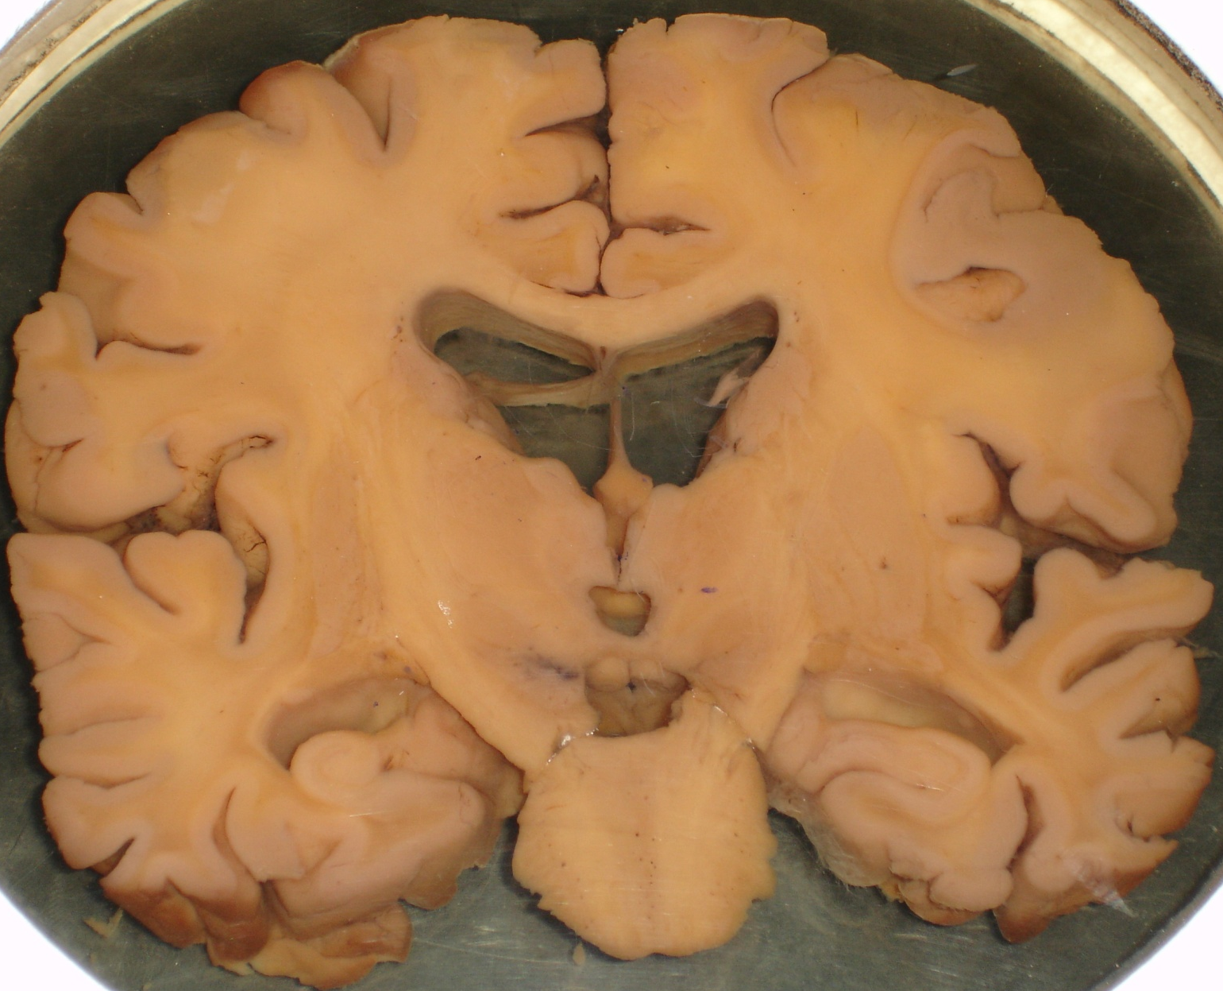
5
1
2
3
15
4
18
14
Coronal Section passing through Cerebral Hemispheres and Brainstem
19
8
7
13
6
12
11
9
17
16
10
1- Trunk of Corpus Callosum 2 - Body of Central Ventricle 3 - Body of Caudate Nucleus 4 - Internal Capsule 5 - Corona Radiata 6 - Globus Pallidus 7 - Putamen
8 – Thalamus 9 – Crus Cerebri 10 – Pons 11 – Fourth Ventricle 12 – Aqueduct of Sylvius 13 – Third Ventricle 14 – Columns of Fornix
15 – Septum Pellucidum 16 – Pes Hippocampus 17 – Inf Horn of Lat Ventricle 18 – Insular Cortex 19 – Post Ramus of Lat Sulcus

Slide 19
5
1
2
3
15
4
18
14
Coronal Section passing through Cerebral Hemispheres and Brainstem
19
8
7
13
6
12
11
9
17
16
10
1- Trunk of Corpus Callosum 2 - Body of Lateral Ventricle 3 - Body of Caudate Nucleus 4 - Internal Capsule 5 - Corona Radiata 6 - Globus Pallidus 7 - Putamen
8 – Thalamus 9 – Crus Cerebri 10 – Pons 11 – Fourth Ventricle 12 – Aqueduct ofSylvius 13 – Third Ventricle 14 – Columns of Fornix
15 – Septum Pellucidum 16 – Pes Hippocampus 17 – Inf Horn of Lat Ventricle 18 – Insular Cortex 19 – Post Ramus of Lat Sulcus

Slide 20
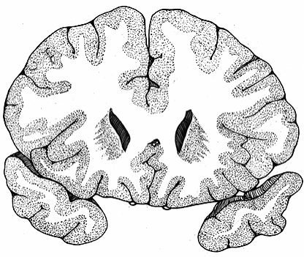
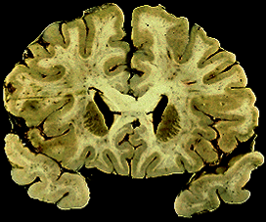
4
4
1
2
1
2
3
3
1 - Genu of Corpus Callosum 2 - Ant Horn of Lat Ventricle 3 - Head of Caudate nucleus 4 - Corona Radiata
Coronal Section through Cerebral Hemispheres at level of Genu of Corpus Callosum

Slide 21
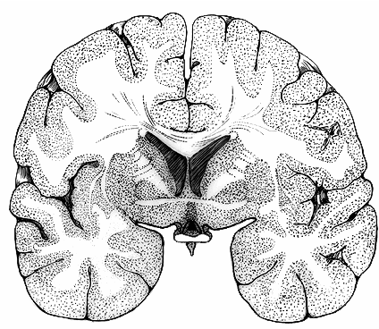
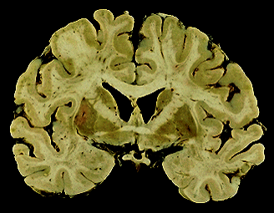
2
2
1
1
3
8
3
4
8
5
4
7
7
5
6
6
1- Trunk of Corpus Callosum 2 - Corona Radiata 3 - Head of Caudate Nucleus 4 - Internal Capsule
5 - Lentiform Nucleus 6 - Optic Chiasma 7 - Insular Cortex 8 - Body of Lat Ventricle
Coronal Section through Cerebral Hemispheres at level of Optic Chiasma

Slide 22
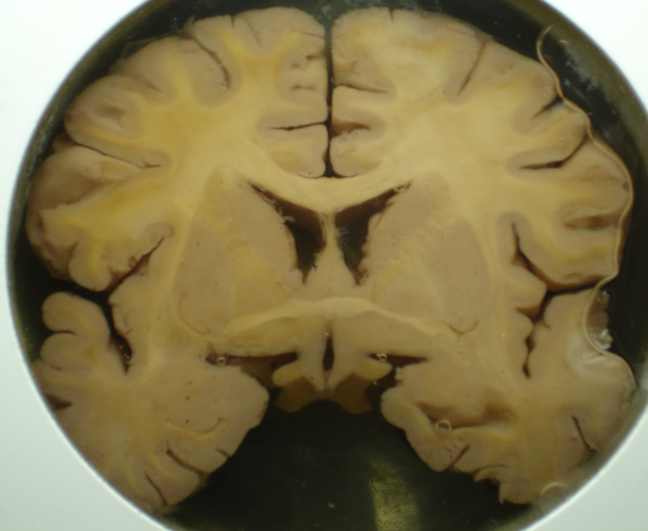
2
1
3
4
10
6
Coronal Section through Cerebrum at level of Infundibulum of Pituitary
9
5
12
11
8
7
1- Trunk of Corpus Callosum 2 - Corona Radiata 3 - Head of Caudate Nucleus 4 - Internal Capsule 5 - Globus Pallidus
6 - Putamen 7 - Infundibulum 8 - Third Ventricle 9 - Columns of Fornix 10 - Septum Pellucidum
11 - Ant Commissure 12 - Insular Cortex

Slide 23


