Slide 1
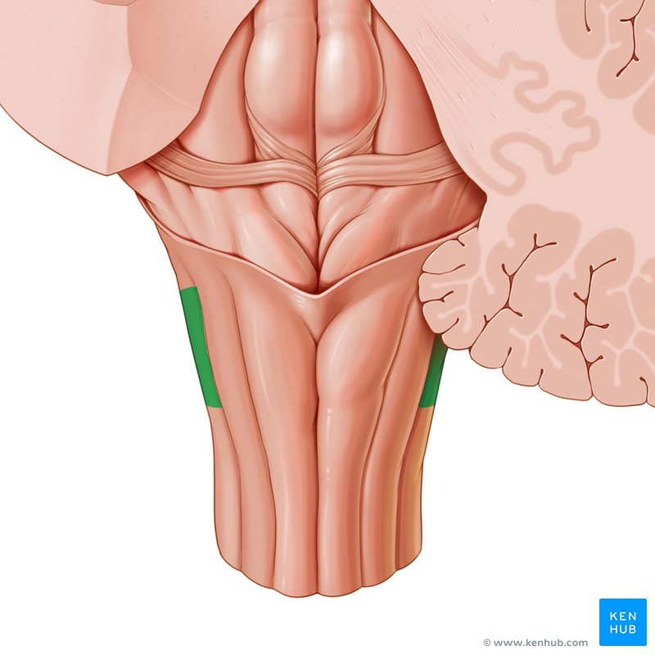
CENTRAL NERVOUS SYSTEM
MEDULLA -2
Dr. Praveen Kumar Kurrey
M.B.B.S., M.S.,BCME , BCBR,CISP
Professor Anatomy

Slide 2
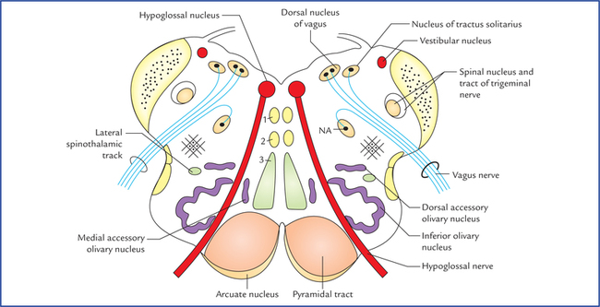
3. T.S. AT OPEN PART OF MEDULLA

Slide 3
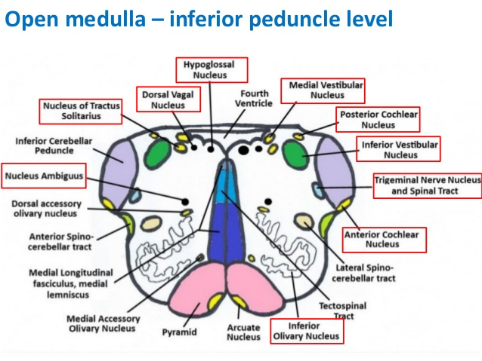

Slide 4
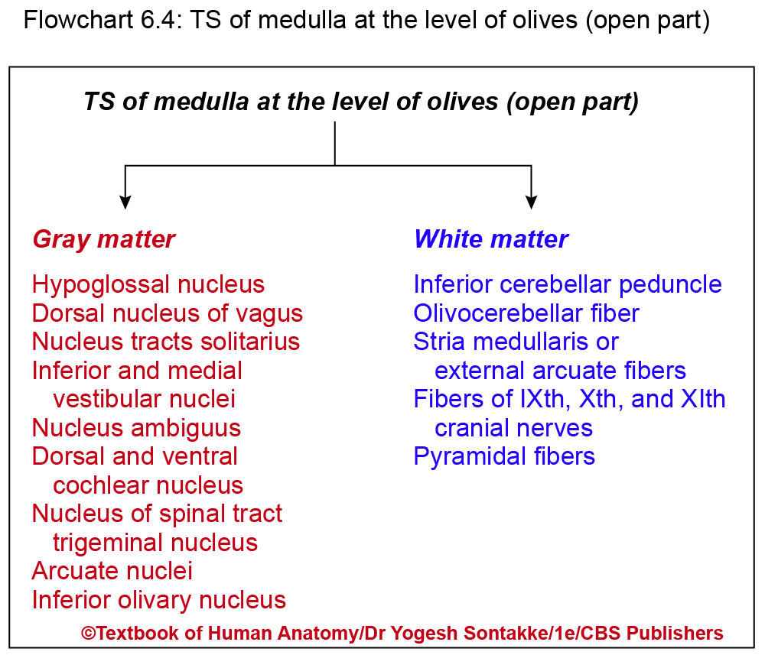

Slide 5
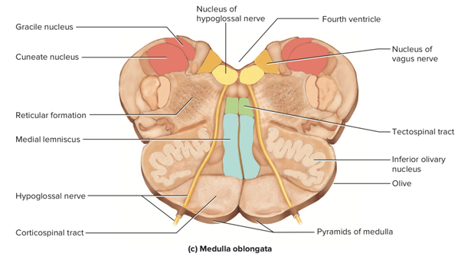
T.S. OPEN PART OF MEDULLA

Slide 6
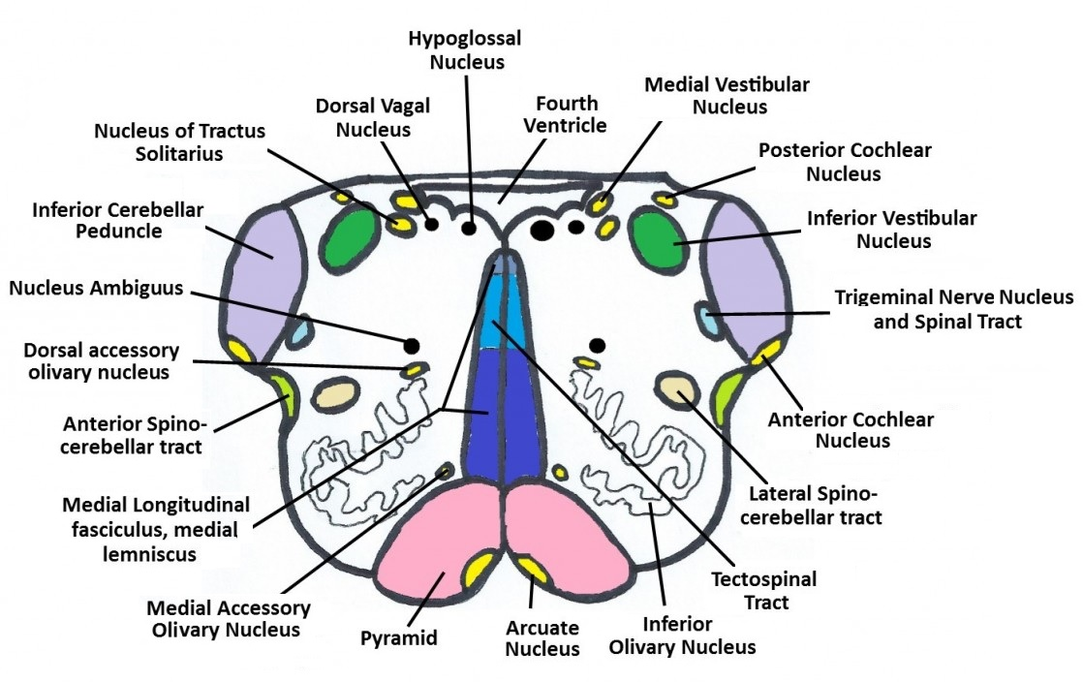

Slide 7
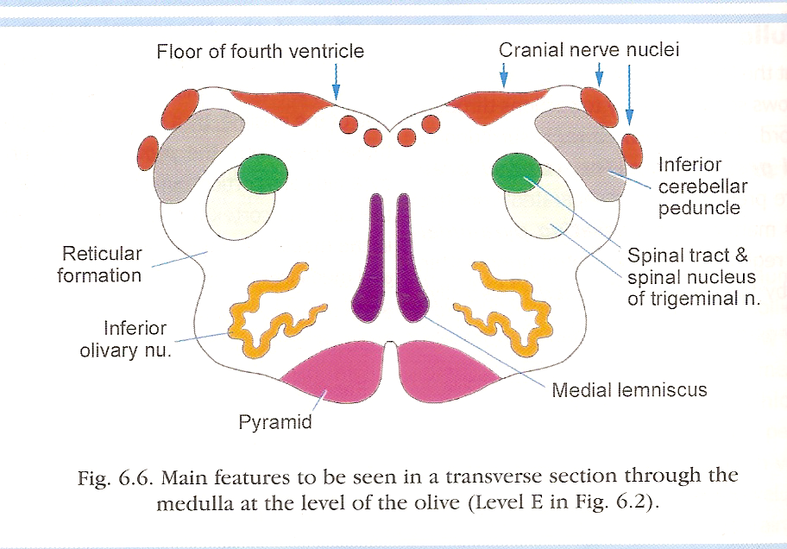
pons

Slide 8
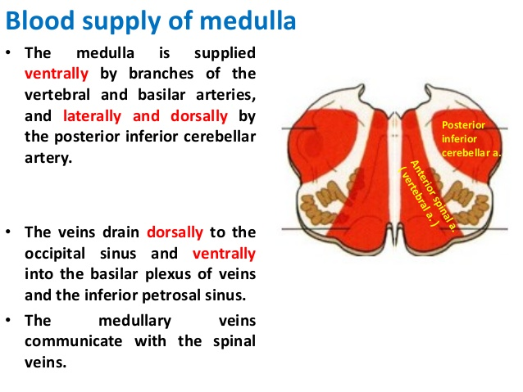

Slide 9
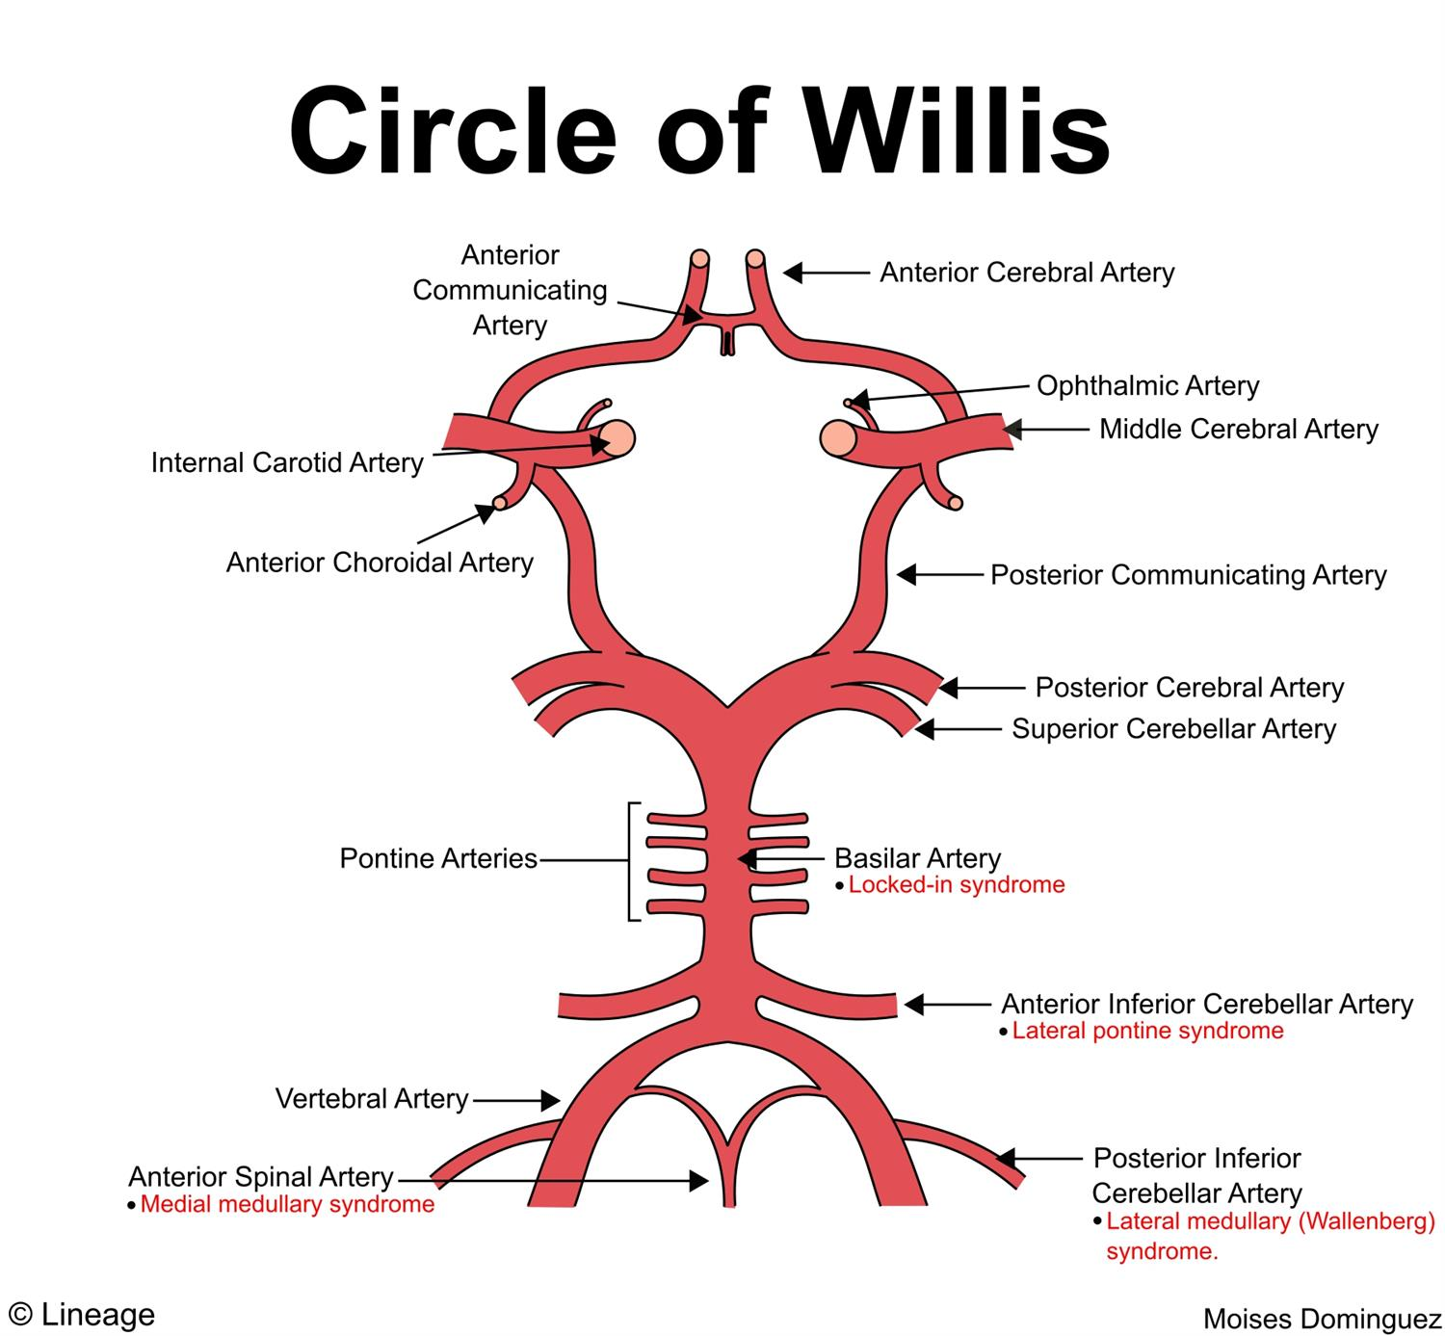

Slide 10
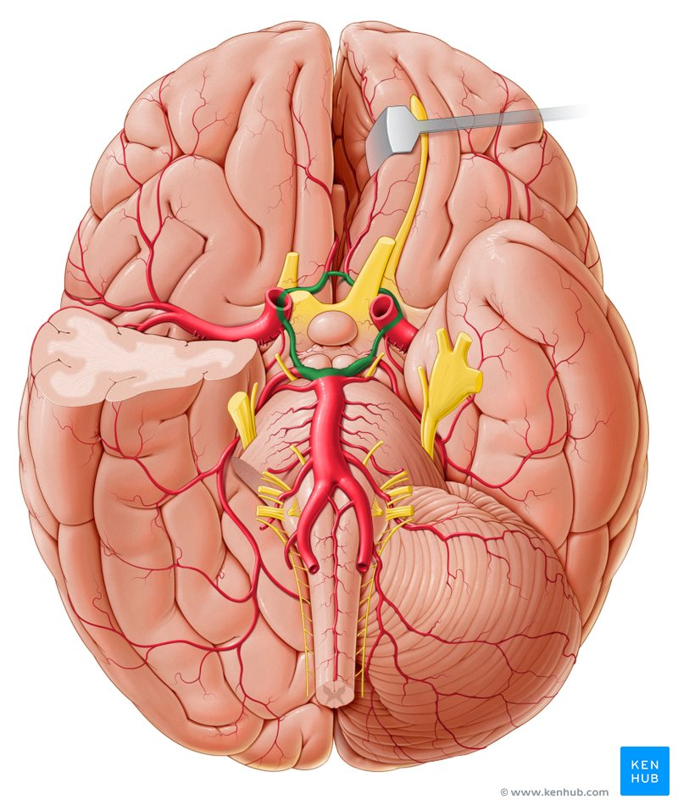

Slide 11
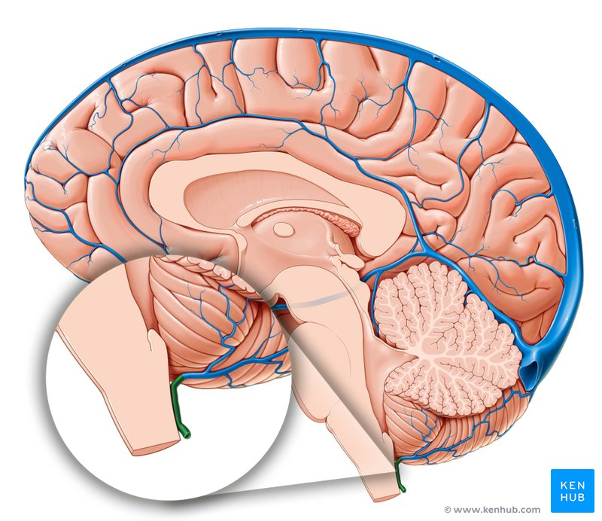

Slide 12
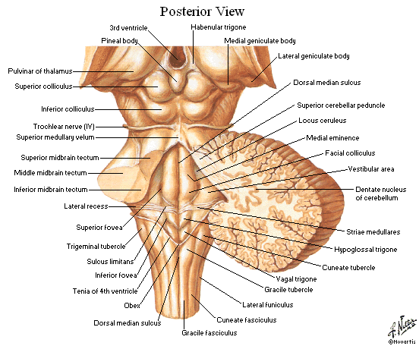
APPLIED ANATOMY

Slide 13
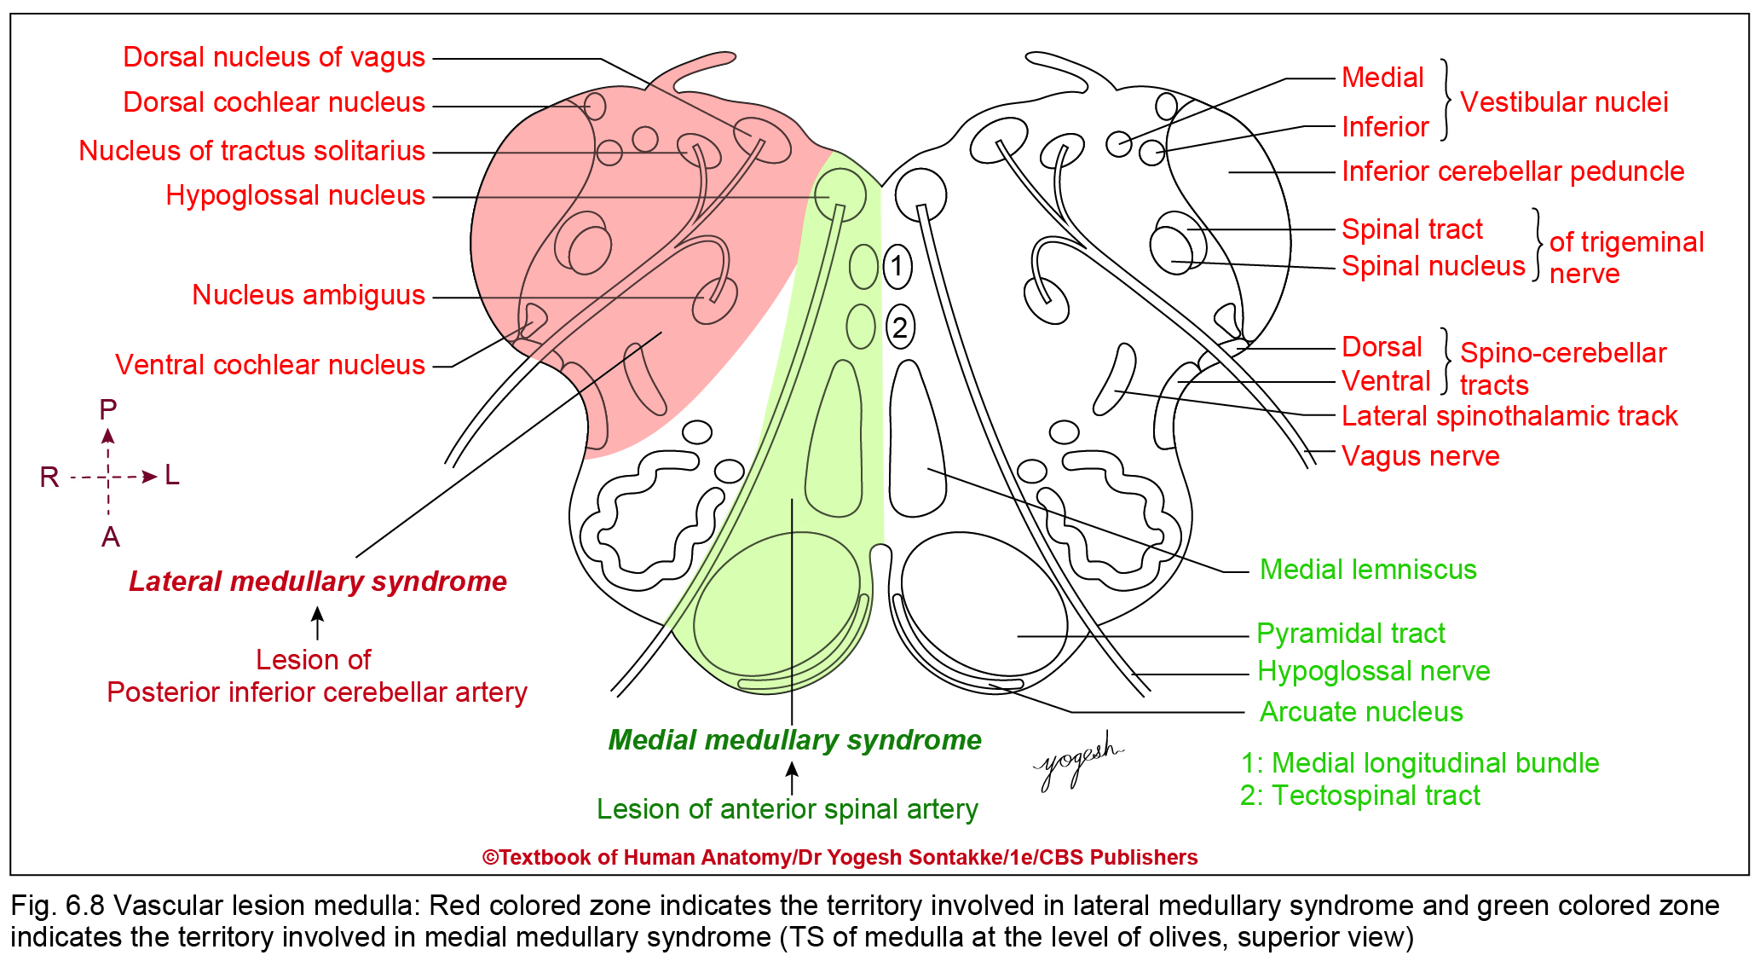

Slide 14
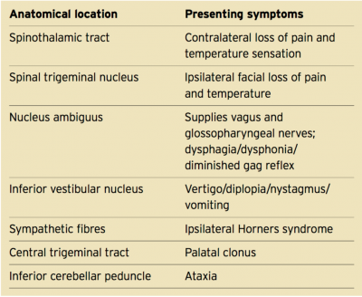
LATERAL MEDULLARY SYNDROME

Slide 15
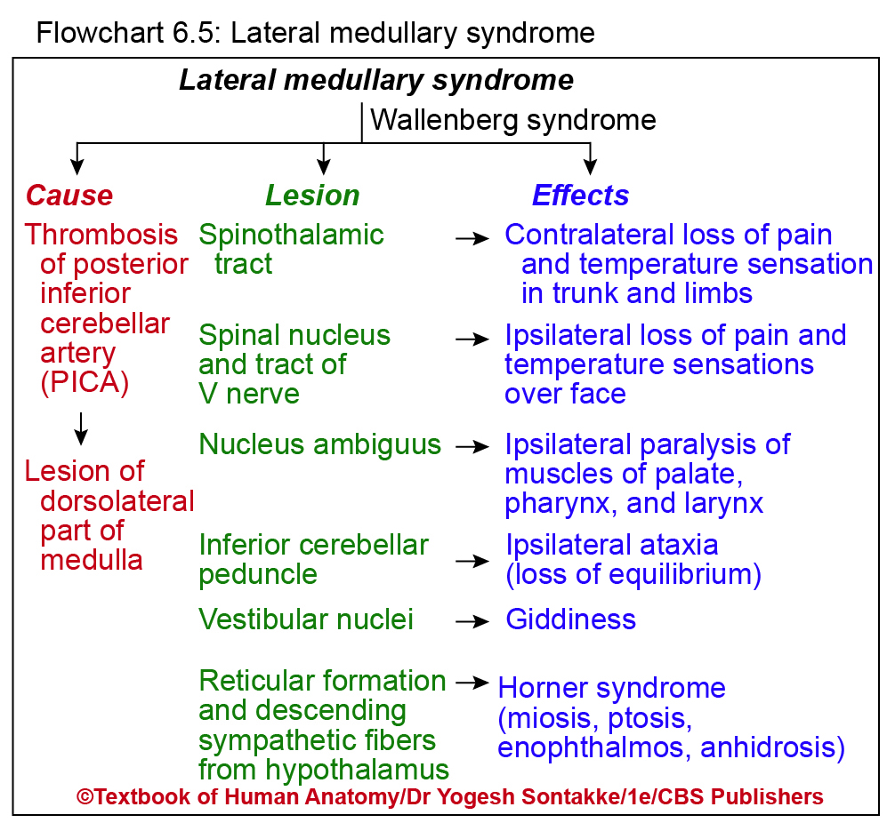

Slide 16

WALLENBERG SYNDROME (PICA ARTERY)

Slide 17

MEDIAL MEDULLARY SYNDROME (ANTERIOR SPINAL ARTERY)

Slide 18
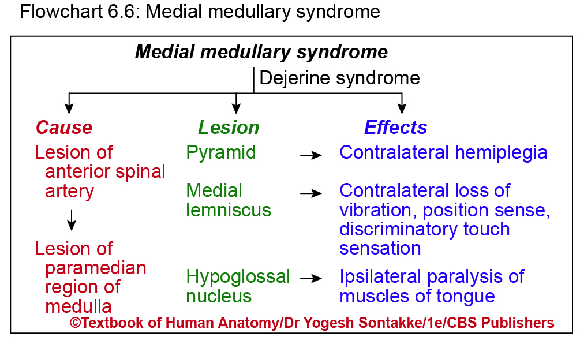

Slide 19
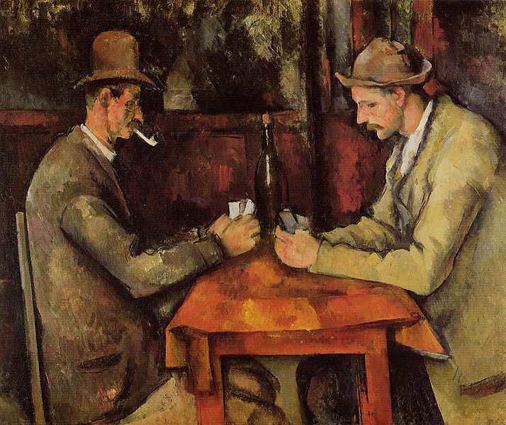
Painting by- Paul Cezane (CARD PLAYERS,1894) Rs. 1,15,00,00,000 - SOLD

Slide 20


