Slide 1
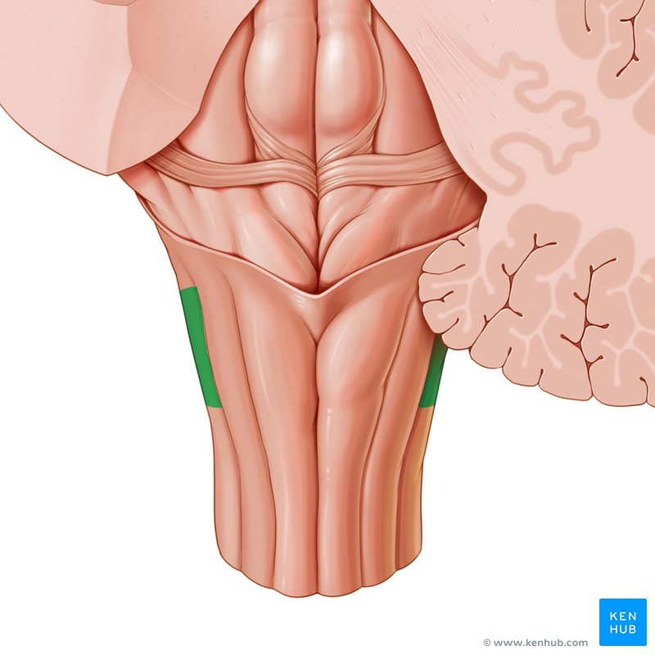
CENTRAL NERVOUS SYSTEM
MEDULLA -1
Dr. Praveen Kumar Kurrey
M.B.B.S., M.S.,BCME , BCBR,CISP
Professor Anatomy

Slide 2
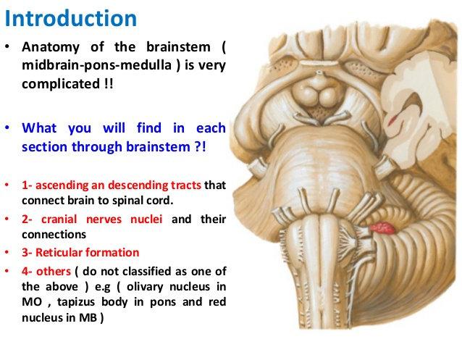

Slide 3
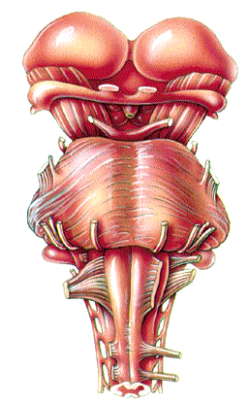
BRAIN STEM

Slide 4
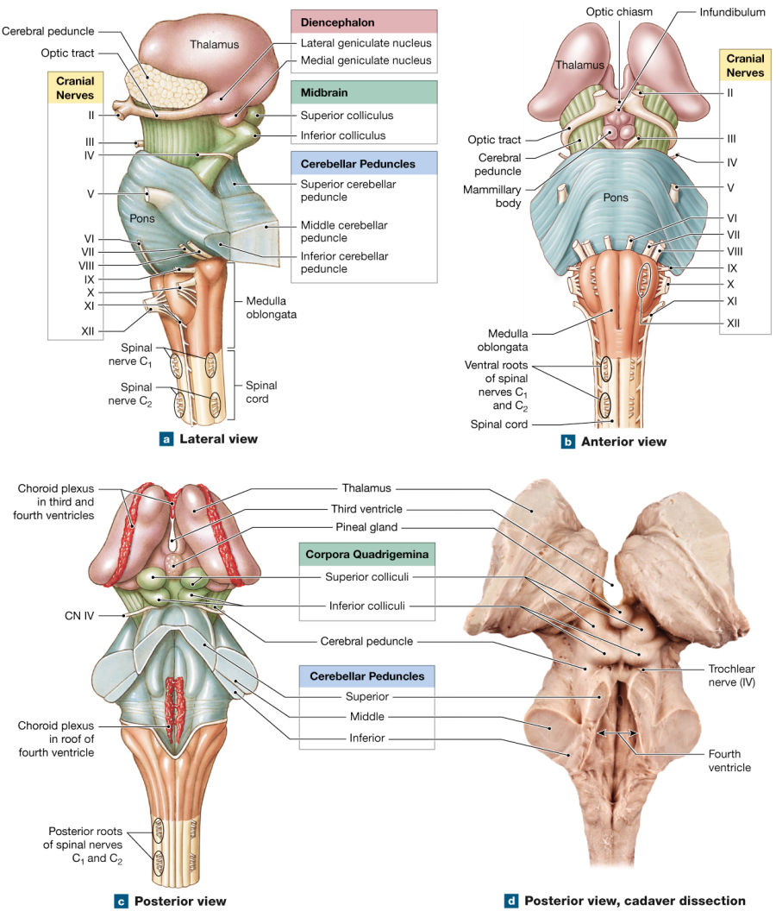
BRAIN STEM

Slide 5
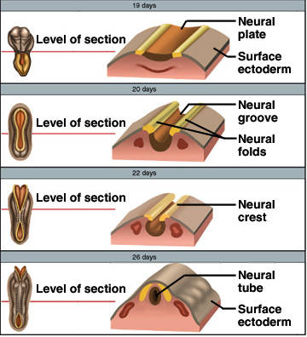
Embryonic Development
Nervous system develops from Ectoderm
by 3rd week, neural plate becomes a groove with neural folds along each side
by 4th week, neural folds join to form neural tube
lumen of the neural tube develops into central canal of spinal cord & ventricles of the brain
cells along the margin of the neural groove is called the neural crest
develop into sensory and sympathetic neurons & schwann cells
by 4th week, neural tube exhibits 3 anterior dilations

Slide 6
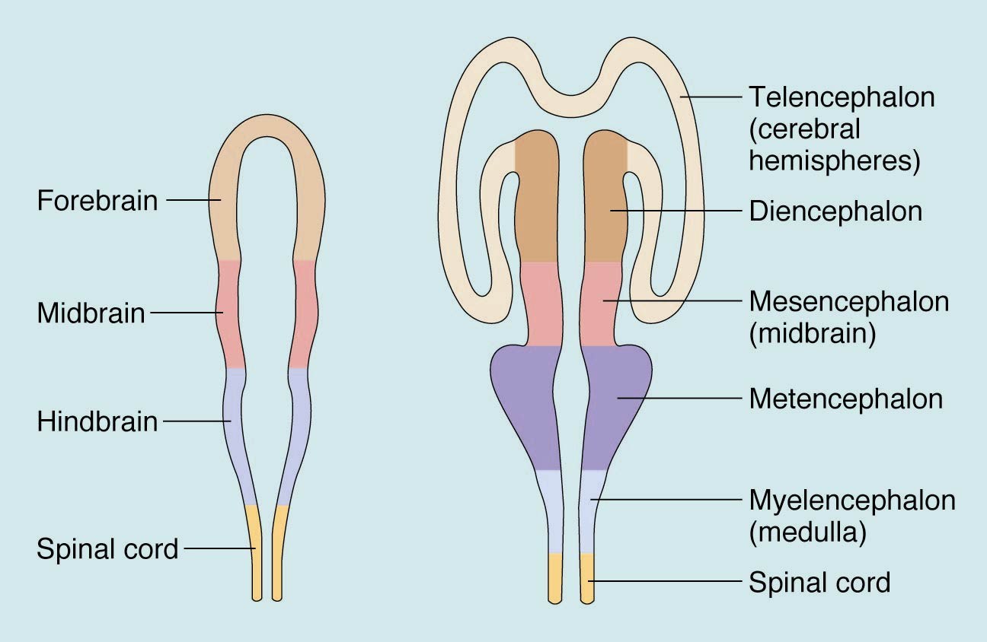
Primary & Secondary Brain Vesicles

Slide 7
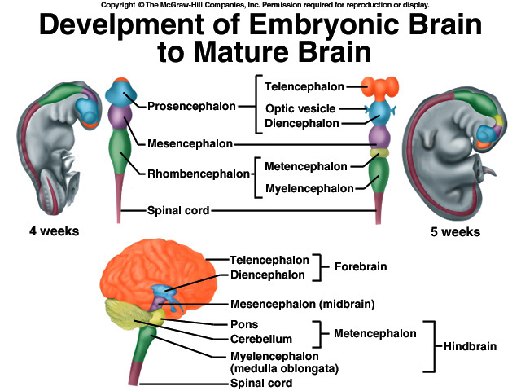
Brain Development
4th week
forebrain
midbrain
hindbrain
5th week
telencephalon
diencephalon
mesencephalon
metencephalon
myelencephalon

Slide 8
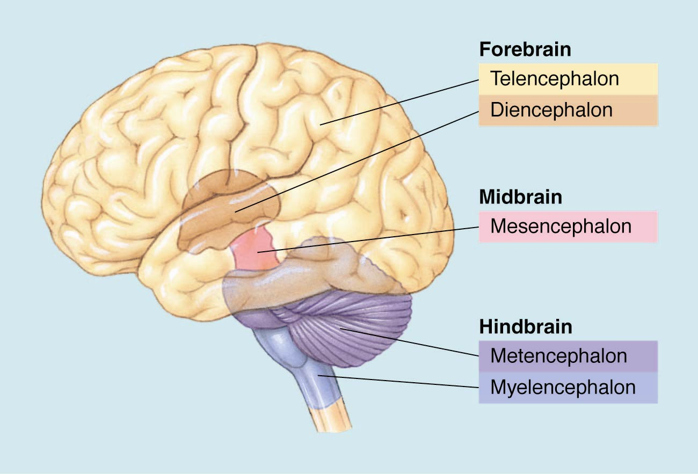
Primary and Secondary Brain Vesicles

Slide 9
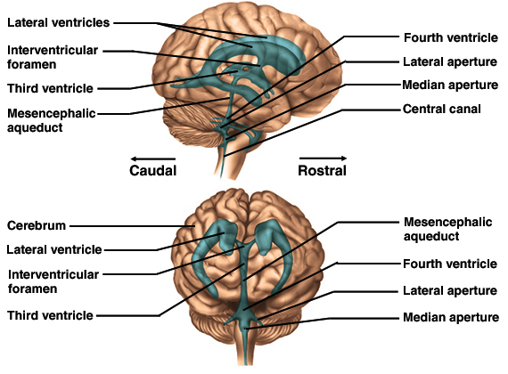
Brain Ventricles

Slide 10
MEDULLA OBLONGATA
Upward continuation of spinal cord
Forms caudal and ventral part of hindbrain
Extent
Extends from Foramen Magnum to lower border of pons
Extends upward from transverse plane passing along upper border of posterior arch of atlas

Slide 11
Medulla Oblongata Dimensions
Length: 3 cm
Width: 2 cm at widest part
Thickness: 1.25 cm

Slide 12
SHAPE
Truncated Cone
Pyramidal
Like Onion -- BULB

Slide 13
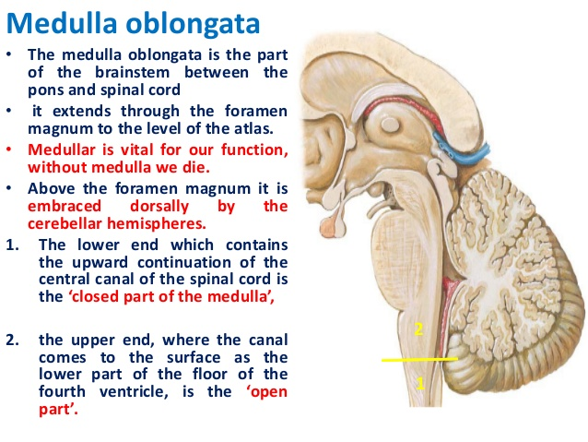

Slide 14
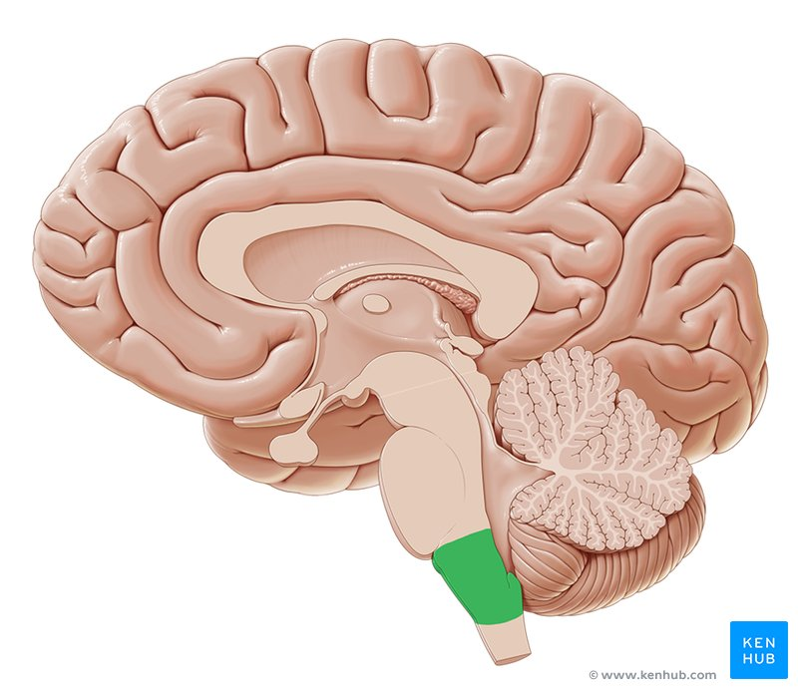
MEDULLA (SAGGITAL SECTION)

Slide 15
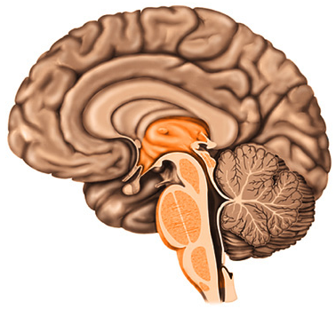
Medulla Oblongata
3 cm extension of spinal cord
Ascending & descending nerve tracts
Nuclei of sensory & motor cranial nerves (3rd to 12th)
Cardiac center adjusts rate & force of heart beat
Vasomotor center adjusts blood vessel diameter
Respiratory centers control rate & depth of breathing
Reflex centers for coughing, sneezing, gagging, swallowing, vomiting, salivation, sweating, movements of tongue & head
Pyramids and olive visible on surface

Slide 16
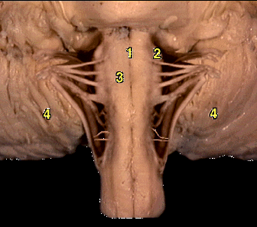
Medulla Oblongata
Nuclei in the medulla are associated w/ autonomic control, cranial nerves, and motor/sensory relay.
Autonomic nuclei:
It Contains-
Cardiovascular centers
Respiratory rhythmicity centers
Vasomotor
Additional Centers
Emesis, deglutition, coughing, hiccupping, and sneezing

Slide 17
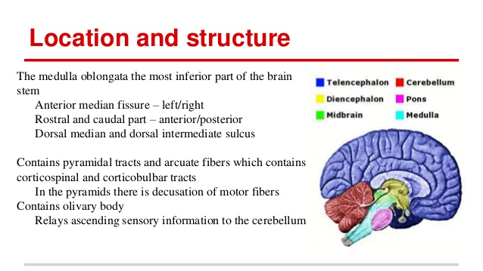

Slide 18
MEDULLA OBLONGATA
Cavity
Has two parts
Lower closed part as an upward continuation of central canal of spinal cord
Upper open, expanded part form lower part of 4th ventricle
Divided into lower closed part and upper open part

Slide 19
MEDULLA OBLONGATA
External Features
Has anterior (ventral) and posterior (dorsal) surfaces
Piriform in shape
Fissures and sulci
Divided into right and left halves by anterior median fissure and posterior median sulcus

Slide 20
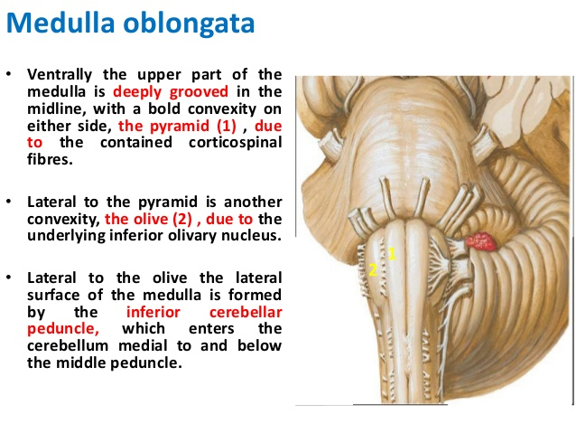
ANTERIOR SURFACE

Slide 21
MEDULLA OBLONGATA
Posterior median sulcus
Narrow groove present in midline at posterior surface of closed part of medulla oblongata
Inferiorly, continuous with posterior median sulcus of spinal cord
Also has anterolateral and posterolateral sulci – direct upward continuation of similar sulci of spinal cord
Regions of Medulla Oblongata
Divided into three regions: anterior, lateral, and posterior by anterolateral and posterolateral sulci

Slide 22
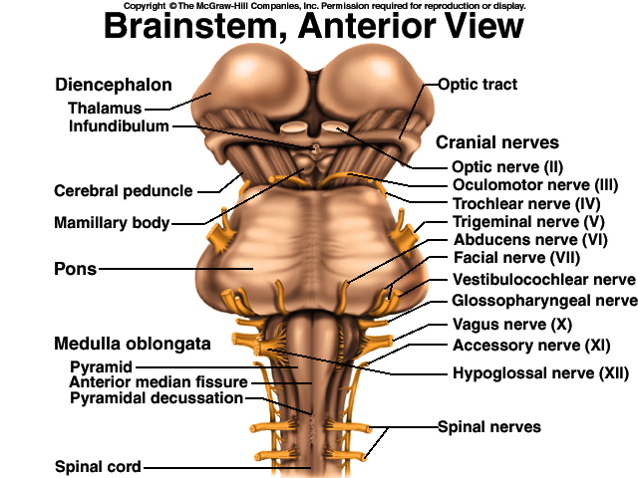
Medulla
Olive

Slide 23
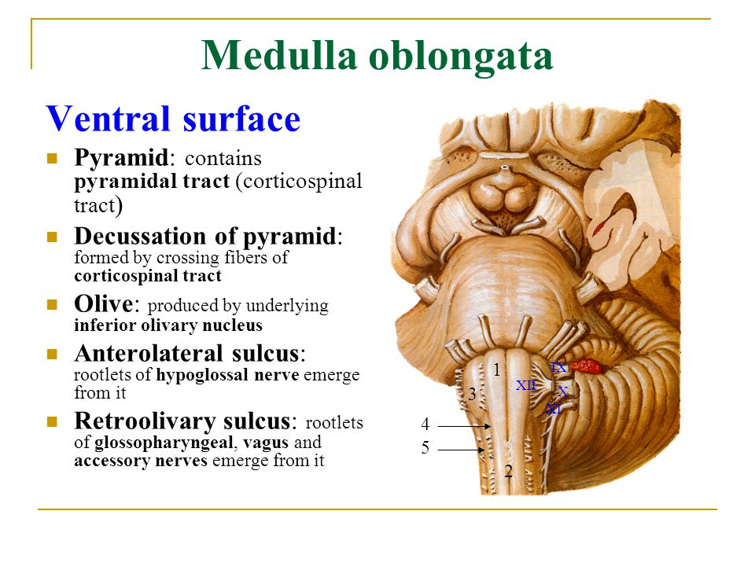

Slide 24
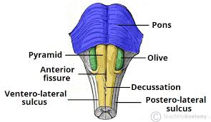
PYRAMIDAL DECUSSATION

Slide 25
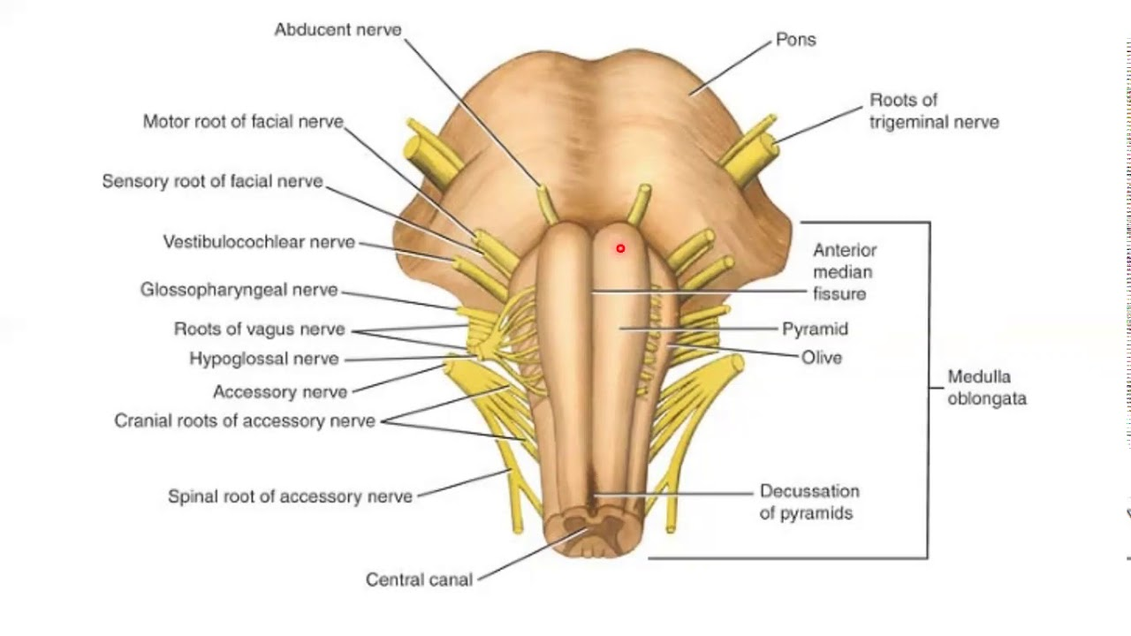
CRANIAL NERVES IN MEDULLA

Slide 26
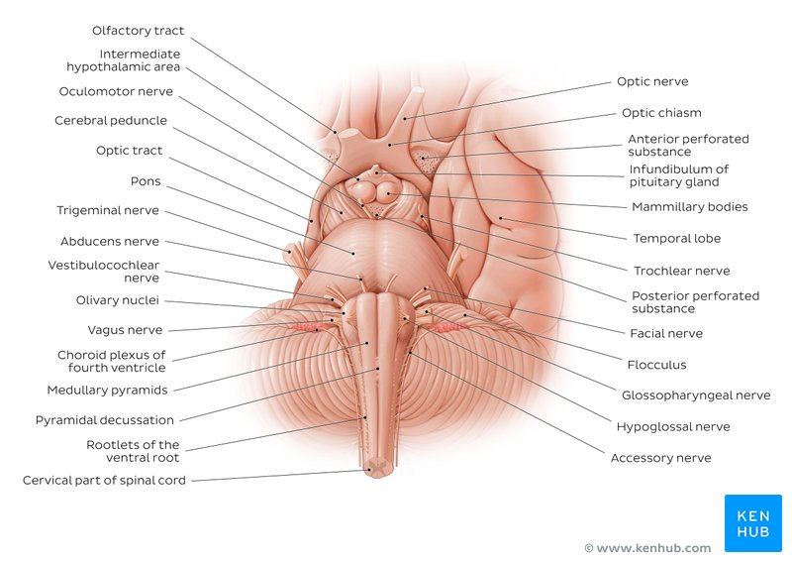
BASE OF BRAIN (NERVES)

Slide 27
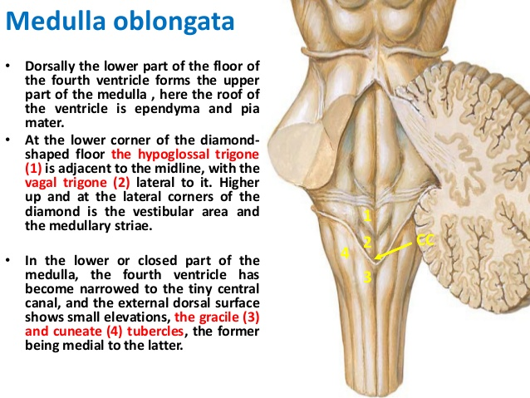
POSTERIOR SURFACE

Slide 28
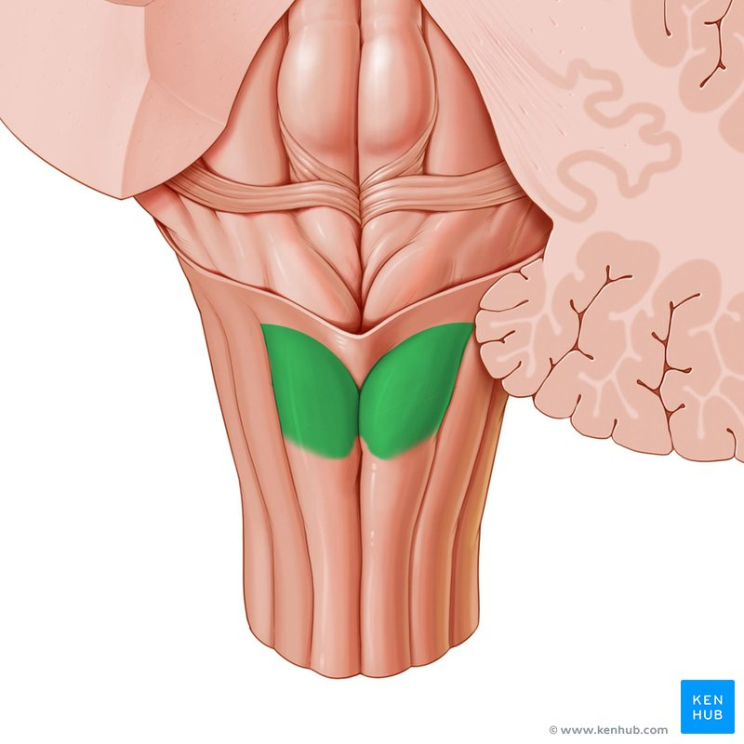
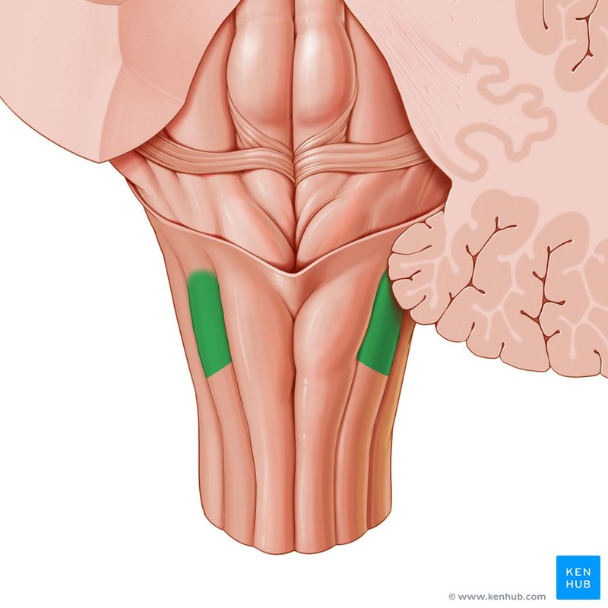
GRACILE AND CUNEATE TUBERCLE

Slide 29
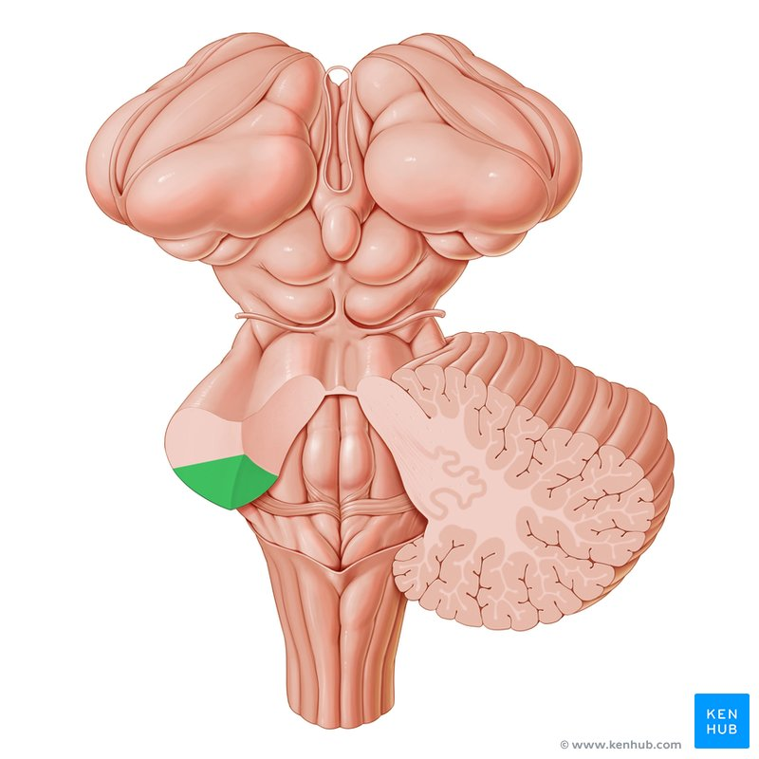
ICP AND TUBER CINERIUM

Slide 30
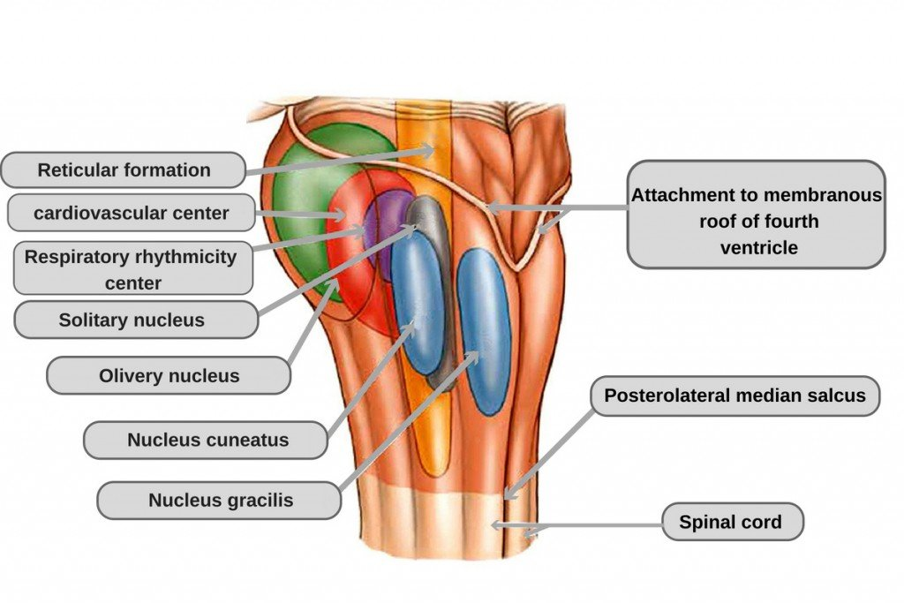
NUCLEI IN POSTERIOR SURFACE

Slide 31
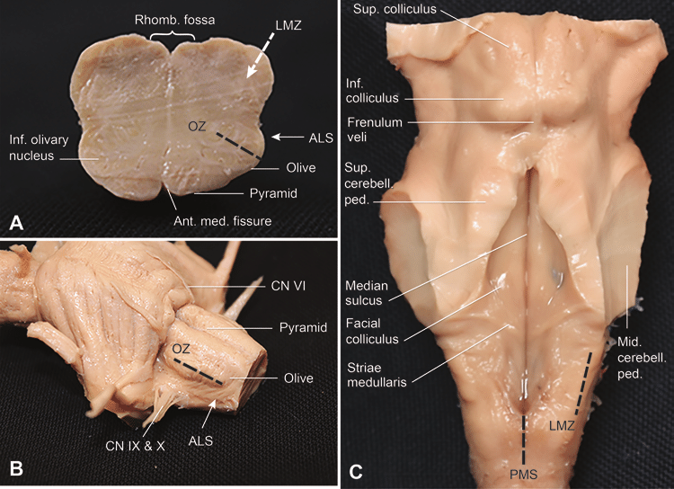

Slide 32
Internal Structure of Medulla
Shows white matter surrounds central gray matter
In upper part central gray matter splits into number of nuclei
Studied at 3 levels
At lower closed part – at level of Pyramidal /Great Motor decussation
At upper closed part – at level of Sensory decussation
At level of olives – Open part of medulla

Slide 33
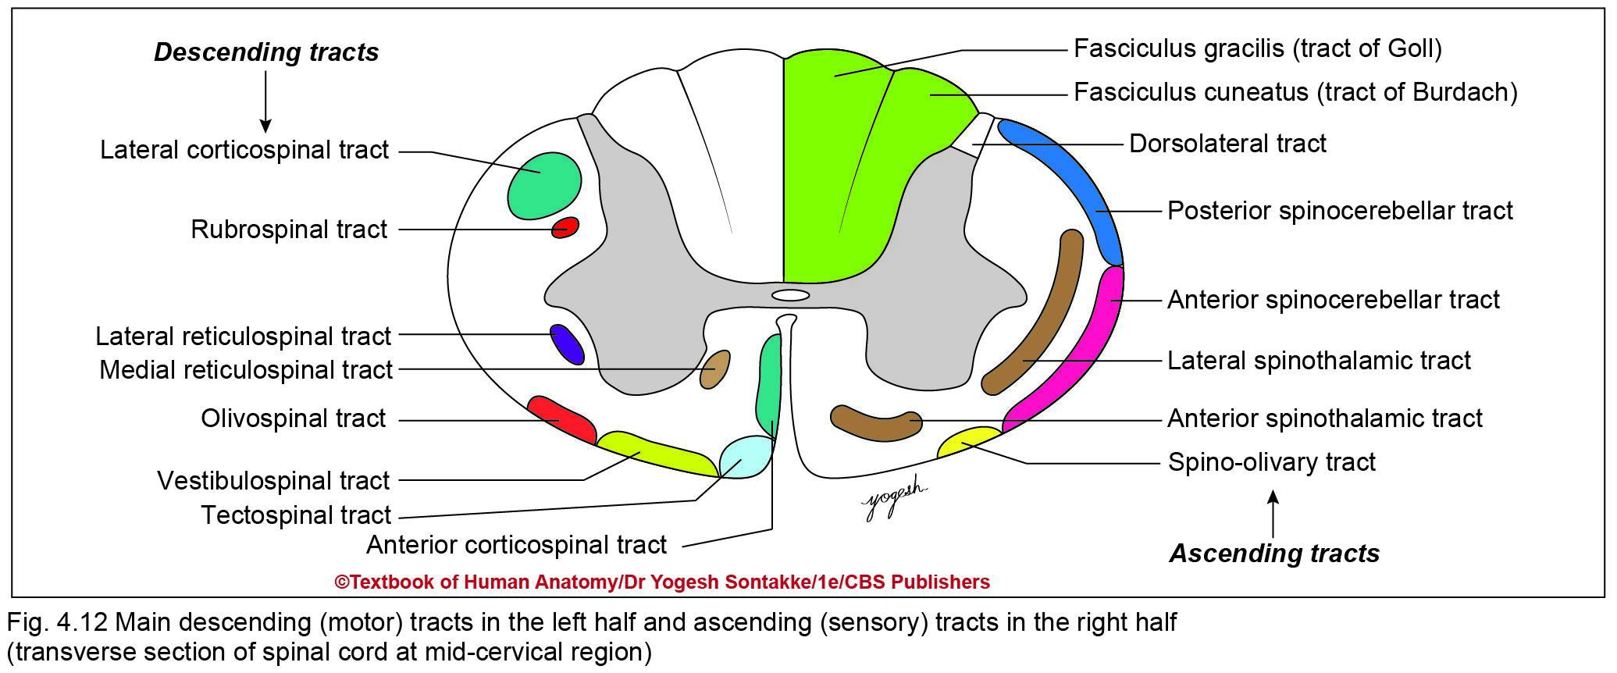
TS. OF SPINAL CORD

Slide 34
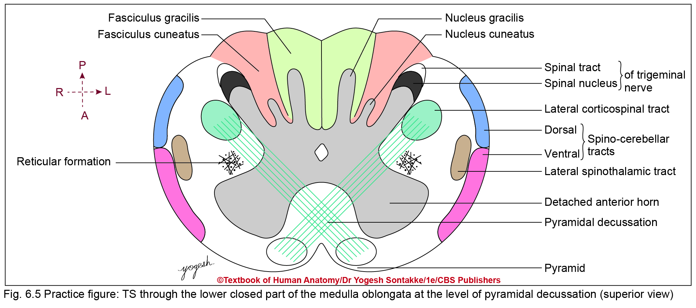
1. T.S. AT CLOSED PART OF MEDULLA (PYRAMIDAL DECUSSATION)

Slide 35
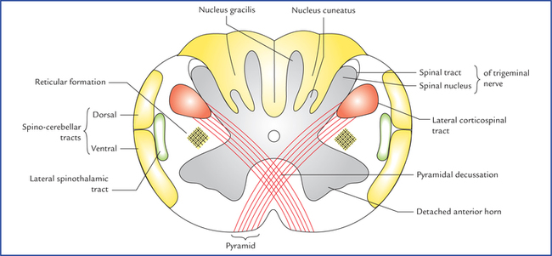
1. T.S. AT CLOSED PART OF MEDULLA (PYRAMIDAL DECUSSATION)/GREAT MOTOR DECUSSATION

Slide 36
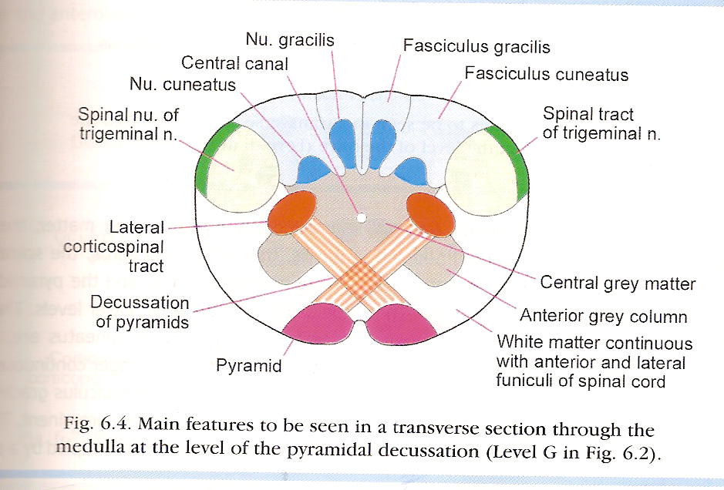
MEDULLA

Slide 37
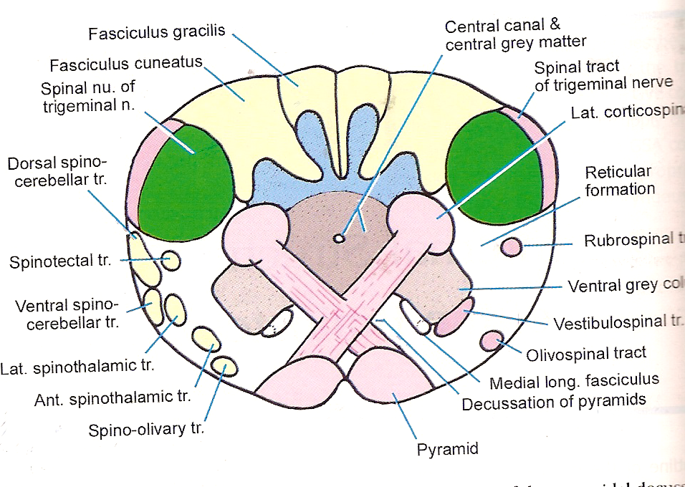

Slide 38
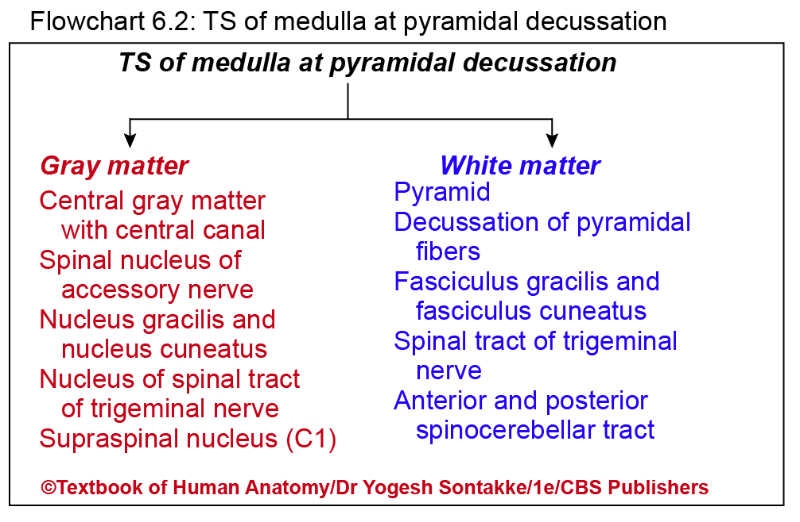

Slide 39
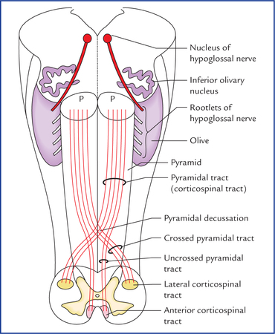

Slide 40
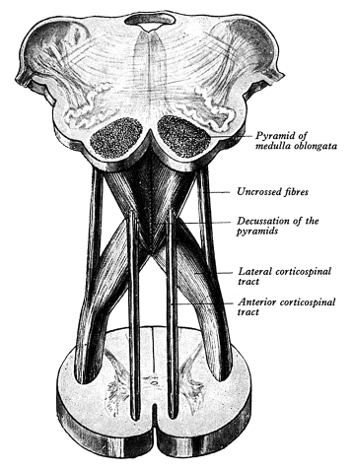

Slide 41
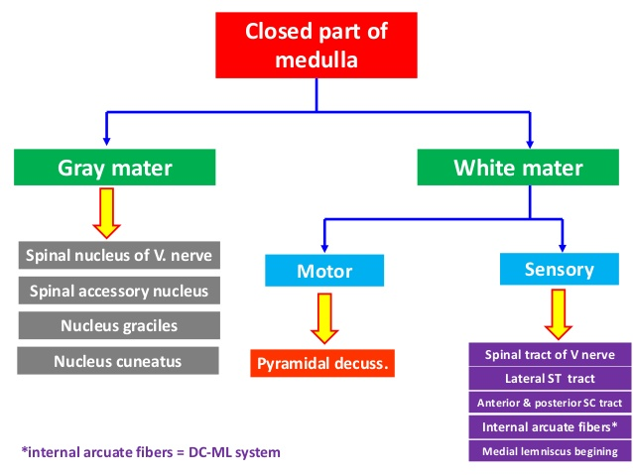

Slide 42
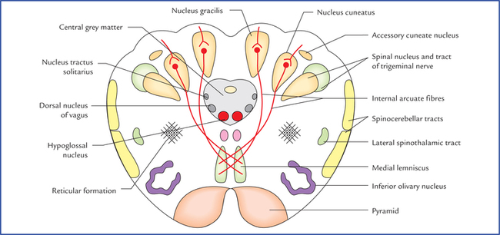
2. T.S. AT SENSORY DECUSSATION

Slide 43
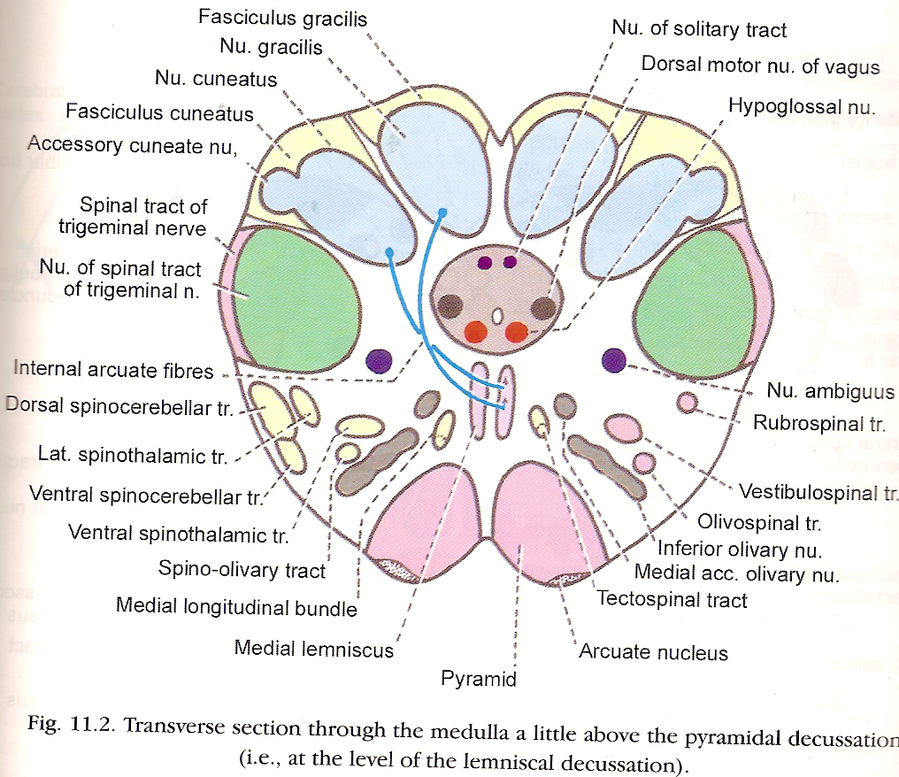
2. T.S. AT SENSORY DECUSSATION

Slide 44
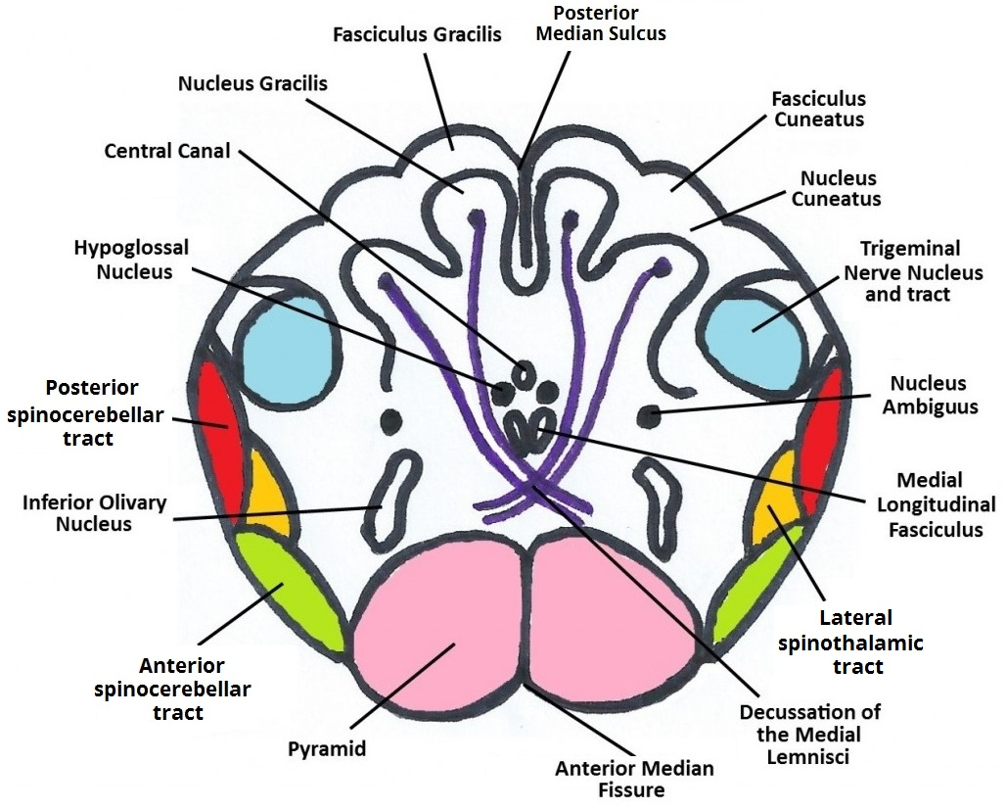
2. T.S. AT SENSORY DECUSSATION

Slide 45
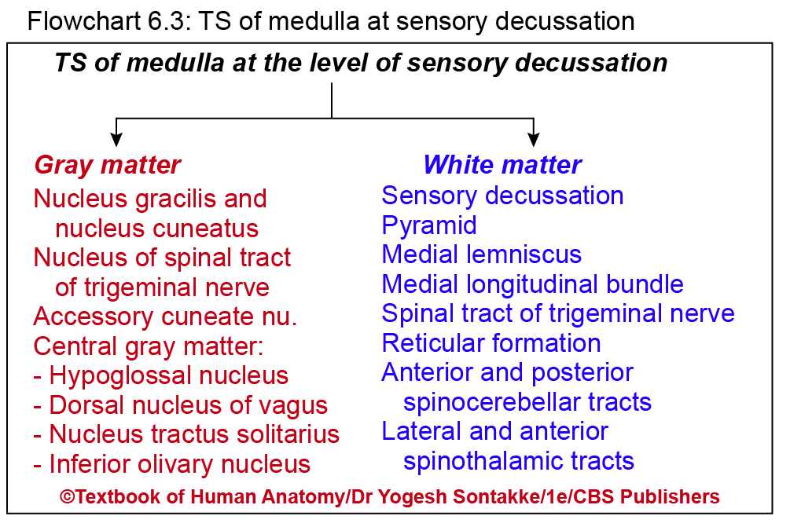

Slide 46
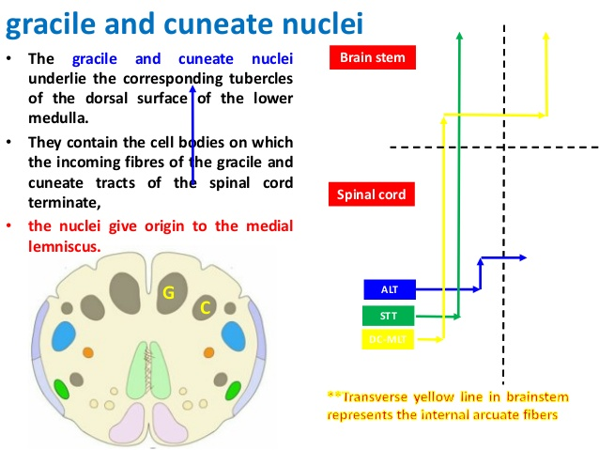

Slide 47

THANK YOU

