Slide 1
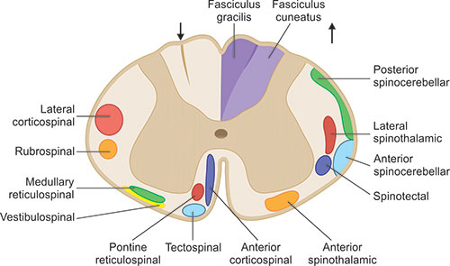
BRAIN
SPINAL CORD - 2
DR. PRAVEEN KURREY
MBBS, MS, BCME,BCBR,
CISP PROFESSOR ANATOMY

Slide 2
EXTERNAL FEATURES
Fissures and sulci
Attachments of spinal nerves
Enlargements
Cauda equina

Slide 3
EXTERNAL FEATURES
1. Fissures and Sulci
Anterior median fissure
  Deep groove in the midline anteriorly
  Lined by pia mater
  Contains anterior spinal artery
Posterior median sulcus
  Shallow midline sulcus posteriorly
  From septum of neurological tissue (posterior median septum) extends into substance of spinal cord to variable extent

Slide 4
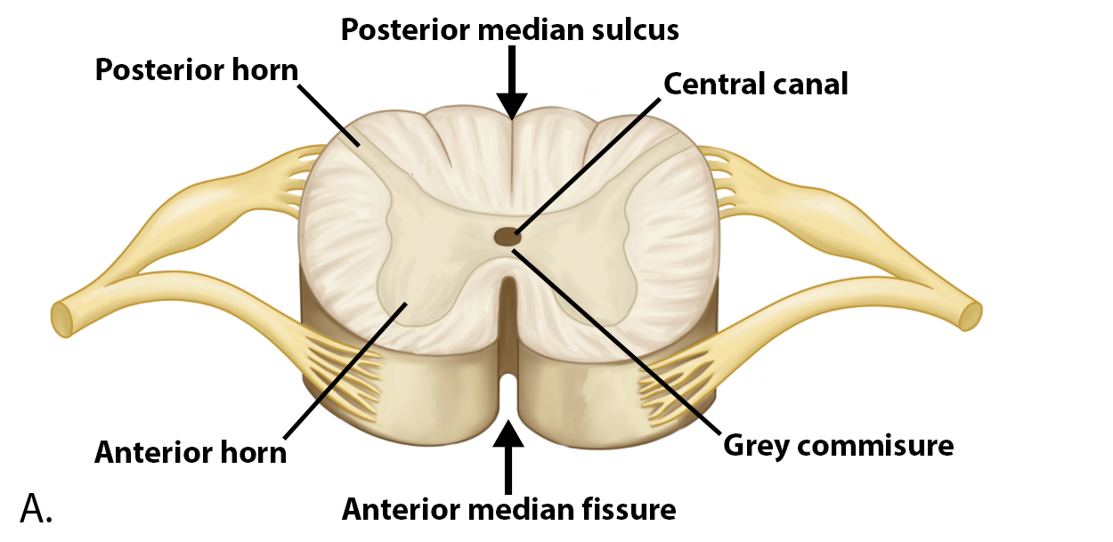

Slide 5
EXTERNAL FEATURES
Ventrolateral (anterolateral) sulcus
Ventral rootlets of spinal nerve emerge at this sulcus
Dorsolateral (posterolateral) sulcus
Lies on each side, at about 2 mm from posterior median sulcus
Corresponds to attachment of dorsal roots of spinal nerve
Dorsointermediate (posterointermediate) sulcus
Lies between posterior median and posterolateral sulcus
Present only in cervical and upper thoracic levels

Slide 6
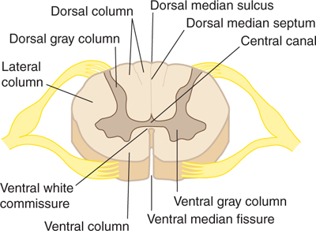

Slide 7
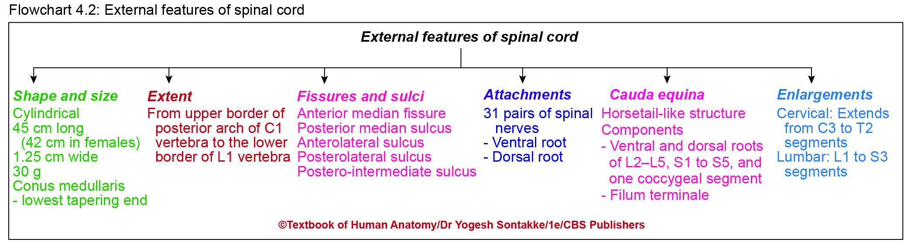

Slide 8
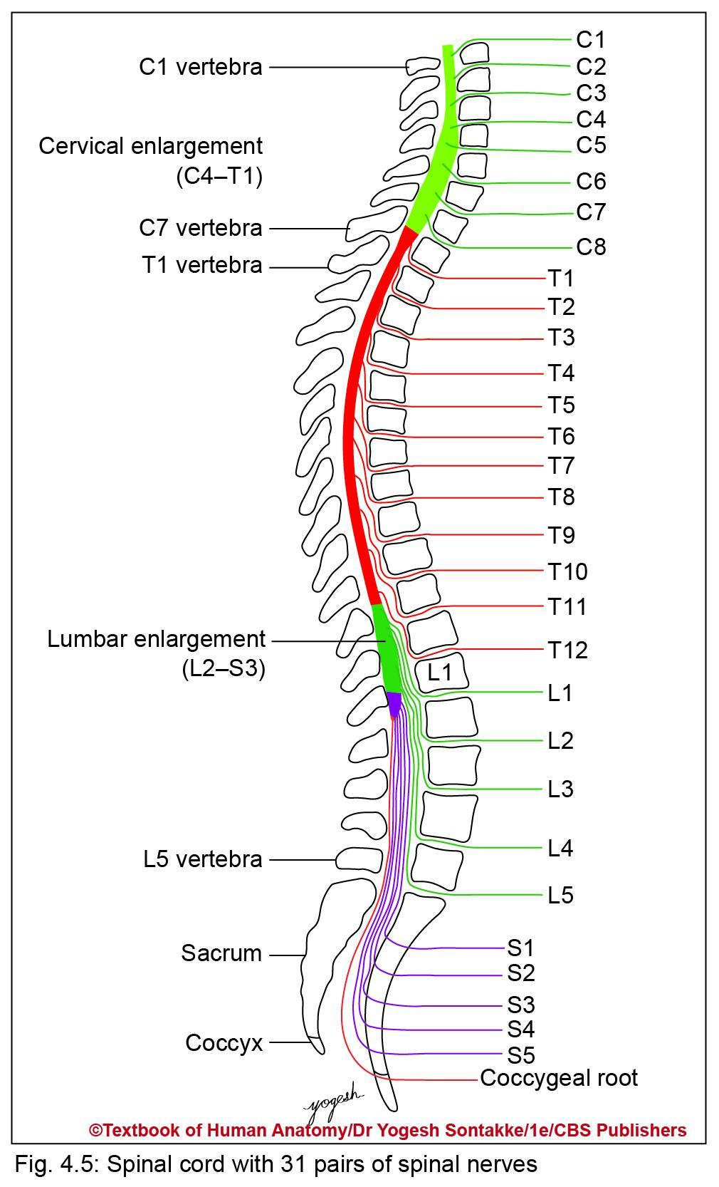
Attachment of Spinal Nerve
Thirty-one pairs of spinal nerves – attached to spinal cord
Include 8 cervical, 12 thoracic, 5 lumbar, 5 sacral, and 1 coccygeal pairs of nerves
Each spinal nerve– attached to spinal cord by 2 roots: Ventral and dorsal nerve roots
Ventral or anterior motor root carries motor or efferent fibers from spinal cord

Slide 9
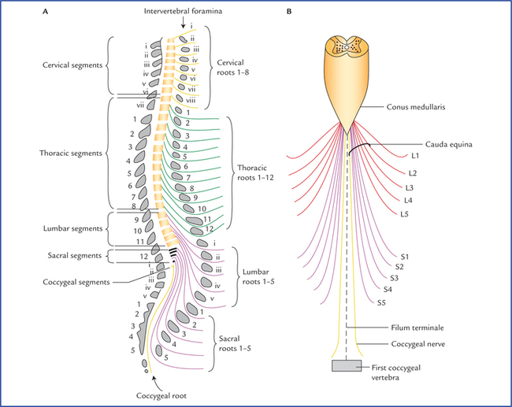

Slide 10
Dorsal or posterior sensory root
Carries sensory or afferent fibers
Shows oval swelling called dorsal root ganglion
Contains pseudounipolar neurons
Fibers divide in Tshaped manner and give rise to
  Central processes enter spinal cord
  Peripheral processes join ventral root to form spinal nerve

Slide 11
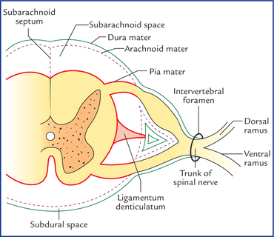
NERVE ROOTS

Slide 12
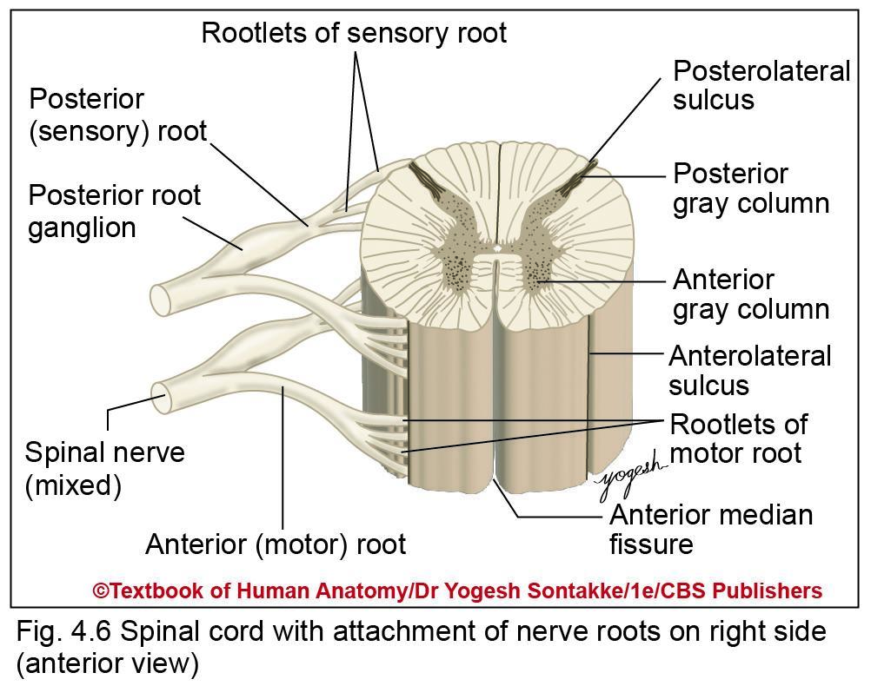

Slide 13
SPINAL SEGMENTS
Portion of spinal cord to which pair of spinal nerve is attached
Consists of 31 spinal segments as follows: 8 cervical, 12 thoracic, 5 lumbar, 5 sacral, 1 coccygeal
Each spinal nerve passes out of vertebral canal through intervertebral foramen
In adults, ends at lower border of L1 vertebra
Lower nerve, does not correspond with level of vertebrae

Slide 14
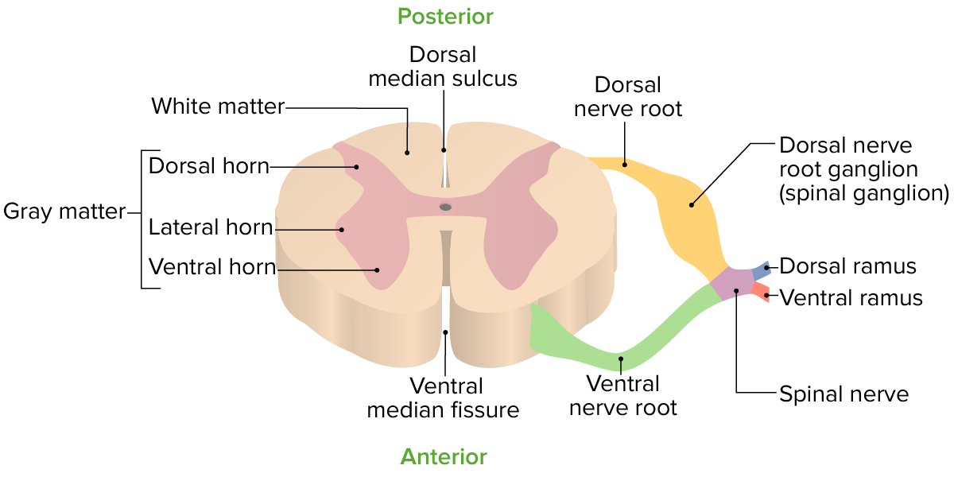
SPINAL NERVE

Slide 15
SPINAL NERVES
Upper spinal nerves pass almost horizontally, but lower nerves pass oblique download and laterally to reach their corresponding intervertebral foramina

Slide 16
Vertebral level of spinal cord segments
Spinal segment | Vertebral level
C1, C2 | Same level
C3 to C6 | One vertebra above
C7, C8, T1 to T5 | Two vertebrae above
T6 to T10 | Three vertebrae above
T11, T12 | Three to five vertebrae above
L1, L2 | At T10 vertebra
L3, L4 | At T11 vertebra
L5 | At T12 vertebra
Sacral and coccygeal segments | At L1 vertebra

Slide 17
Enlargements of Spinal Cord
Shows two enlargements due to presence of large number of motor neurons
1. Cervical enlargement
  Due to large spinal nerve supplying upper limbs
  Extends from C3 to T2 segments of spinal cord
  Maximum diameter of cervical enlargement – 3.8 cm at level of 6th pair of cervical nerve 6th cervical spinal segments

Slide 18
2. Lumbar enlargement
Due to large spinal nerve supplying lower limbs
Extends from 1st lumbar to 3rd sacral segments of spinal cord
Maximum diameter of lumbar enlargement is 3.5 cm at level of 12 thoracic vertebra

Slide 19
Enlargement of spinal cord
Feature | Cervical enlargement | Lumbar enlargement
Extent | From C3–T2 spinal segments | From L1 to S3 spinal segments
Maximum diameter and its location | 3.8 cm at C6 spinal segment | 3.5 cm at T12 vertebral level
Function | Innervation of upper limb | Innervation of lower limb

Slide 20
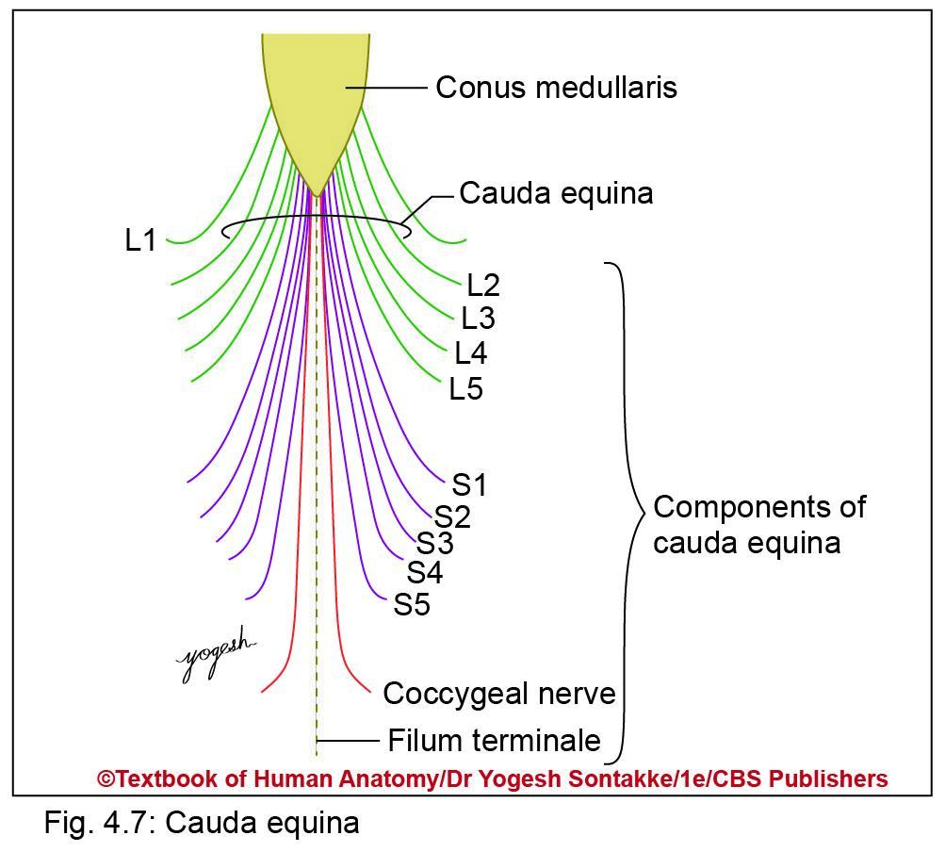
CAUDA EQUINA
Horsetail-like structure formed by bunch of lower spinal nerves surround conus medullaris and filum terminale
Components (10 Pair of Nerves)
Ventral and dorsal roots of lower four lumbar segments (L2–L5), five sacral (S1 to S5), and one coccygeal segments
Filum terminale

Slide 21
  Caudal to cauda equina, root runs obliquely downward and joins to form spinal nerve at respective intervertebral foramen before they exit vertebral canal

Slide 22
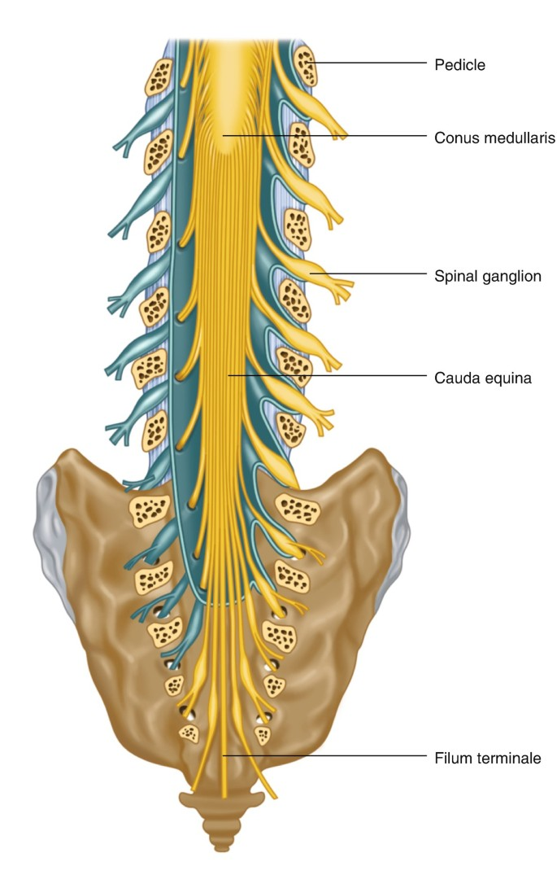
CAUDA EQUINA

Slide 23
INTERNAL STRUCTURE OF SPINAL CORD
Central gray matter
Peripheral white matter
Central canal containing CSF
Gray Matter of Spinal Cord
Lies surrounding central canal of spinal cord
Contains numerous neural cell bodies, their processes, and neuroglia

Slide 24
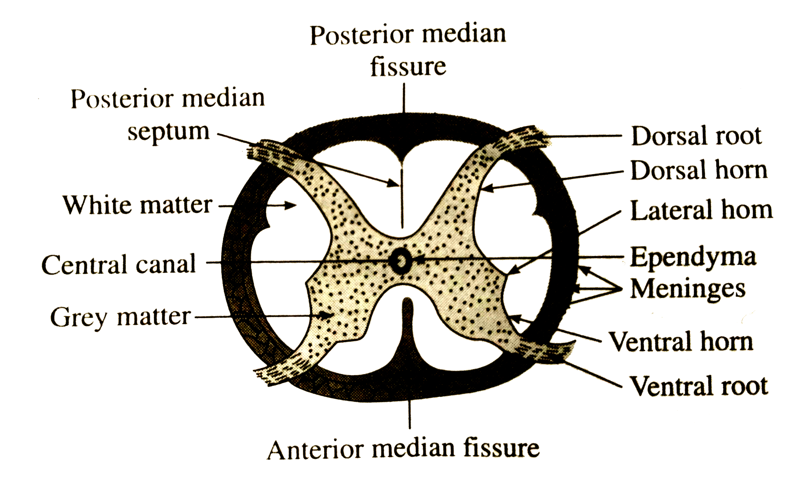

Slide 25
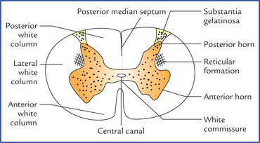
Gray Matter
H-shaped or butterfly-shaped
Divided into right and left symmetric halves connected to each other by transverse band of gray matter called transverse gray commissure

Slide 26
Divisions of gray matter
Anterior horn (anterior or ventral gray column)
  Portion of gray matter which lies in front of transverse gray commissure
  Directed forward and laterally
  Separated from surface of spinal cord by white matter
  Cells of anterior horn give rise to lower motor neurons (efferent fibers) which form anterior root of spinal nerve

Slide 27
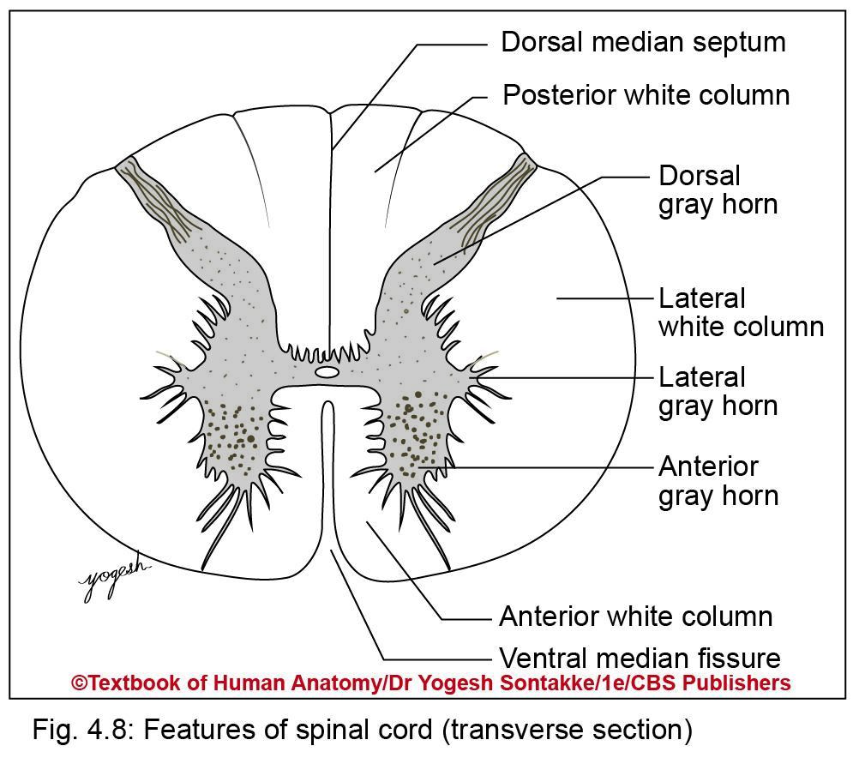
Posterior horn (posterior or dorsal gray column)
Portion of gray matter lies behind transverse gray commissure
Directed backward and slightly laterally
Long, slender and reaches almost up to posterolateral sulcus
Separated from surface of spinal cord by thin tract of nerve fibers (dorsolateral tract)

Slide 28
Parts of posterior horn
Base – continuous with transverse gray commissure
Neck – constricted part between base and head
Head – expanded fusiform part, dorsal to the neck
Apex – posterior end
Substantia gelatinosa
  Gelatinous substance caps posteriormost end (apex) of posterior horn
  Contains translucent nerve tissue

Slide 29
Posterior horn receives central process pseudounipolar cells of dorsal root ganglion
Lateral horn (lateral gray column)
Small angular lateral projection of gray matter
Extent: Extends from T1 to L2 and S2–S4 spinal segments
Lateral horn cells of T1 to L2 give rise to preganglionic or motor fibers of sympathetic nervous system, whereas of S2–S3 give rise to preganglionic parasympathetic fibers

Slide 30
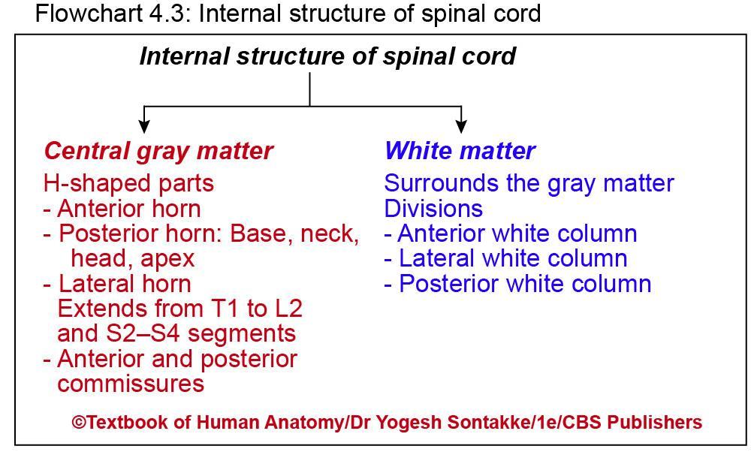

Slide 31
GRAY MATTER OF SPINAL CORD
Consists of
Nerve cells and fibers
Neuroglia
Blood vessels
Neurons of gray matter
Are multipolar and can be grouped functionally as follows: Motor neurons, interneurons, and sensory neurons
Motor neurons
Are present in anterior and lateral horns
Are of two types: Alpha and gamma neurons

Slide 32
Alpha neurons
Are large cells (25 μm or more in diameter)
Supply extrafusal fibers of skeletal muscle
Gamma neurons
Are small multipolar neurons (15–25 μm in diameter)
Supply intrafusal fibers of muscle spinal

Slide 33
Sensory neurons
Are present in posterior horn
Are small neurons
Receive inputs from neurons of dorsal root ganglion
Their axons form ascending or intersegmental tracts
Interneurons (internuncial neurons)
Are small associated neurons
Connect different type of neurons

Slide 34
Regional characteristics of spinal gray matter
Segment | Shape of TS of spinal cord | Anterior horn | Lateral horn | Posterior horn | White matter | Postero- intermediate sulcus
Cervical | Oval | Narrow in C1- C3 segments Broad in C4- C8 seg | Absent | Slender | Huge | Present
Thoracic | Small, circular | Slender except in T1 segment | Present | Slender | Large | Present
Lumbar | Large, circular | Broad | Present only in L1 and L2 | Broad | Less | Absent
Sacral | Small, circular | Broad | Present in S2–S4 segments | Thick | Very less | Absent

Slide 35
CLINICAL
Renshaw cells
Are Golgi type II neurons and located in anterior horn
Receive collateral from alpha motor neurons
Each Renshaw cell has short axon terminates on cell body of same alpha motor neuron from which receives collateral
This neuron provides inhibitory feedback to alpha neuron
Structurally, neurons of spinal cord are classified as
  Golgi type I – with long axons
  Golgi type II – with short axons
Golgi type II neurons do not leave gray matter and form intrasegmental or intersegmental tracts

Slide 36
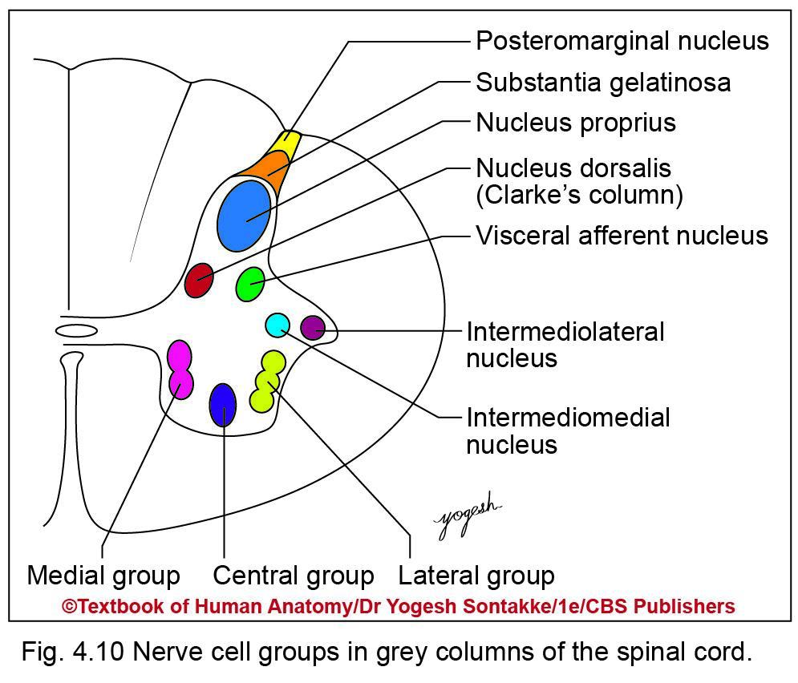
CLARKE’S COLUMN
Are arranged as follows
  In anterior horn: Medial, lateral, and central groups
  In posterior horn: Substantia gelatinosa, marginal nucleus, nucleus proprius, dorsal nucleus (Clarke’s column), cervical and sacral nucleus, visceral afferent nucleus
  In lateral horn: Intermediolateral nucleus, intermediomedial nucleus

Slide 37
Neuronal columns of gray matter of spinal cord
Column | Extent | Functions
Anterior horn • Medial group – Anteromedial group – Posteromedial group • Lateral group – Anterolateral – Posterolateral – Postposterolateral • Central group – Phrenic nucleus – Spinal accessory nucleus | Entire cord Cervical segments Lumbar segments Cervical segments Lumbar segments Cervical segments Lumbar segments C3–C5 C1–C5 | Muscles of back Anterolateral muscles of trunk Muscles of shoulder and arm Muscles of hip and thigh Muscles of forearm Leg muscles Hand muscles Foot muscles Phrenic nerve diaphragm Spinal root of accessory nerve

Slide 38
Neuronal columns of gray matter of spinal cord
Column | Extent | Functions
Posterior horn • Substantia gelatinosa • Marginal nucleus • Nucleus proprius • Dorsal nucleus of Clarke • Visceral afferent nucleus | Entire cord C1–S5 Entire cord C8–L3 T1 to L2 S1 to S4 | Relay of fibers carrying of pain and temperature Relay of some fibers of pain and temperature, light touch Receive pain, light touch, temperature sensation Receive proprioceptive fibers from Golgi tendon organs, and muscle spindle Receive visceral impulses
Lateral horn Intermediolateral cell column Sacral parasympathetic nucleus | T1 to L2 S2–S4 | Give rise to preganglionic temperature Give rise to preganglionic parasympathetic fibers

Slide 39
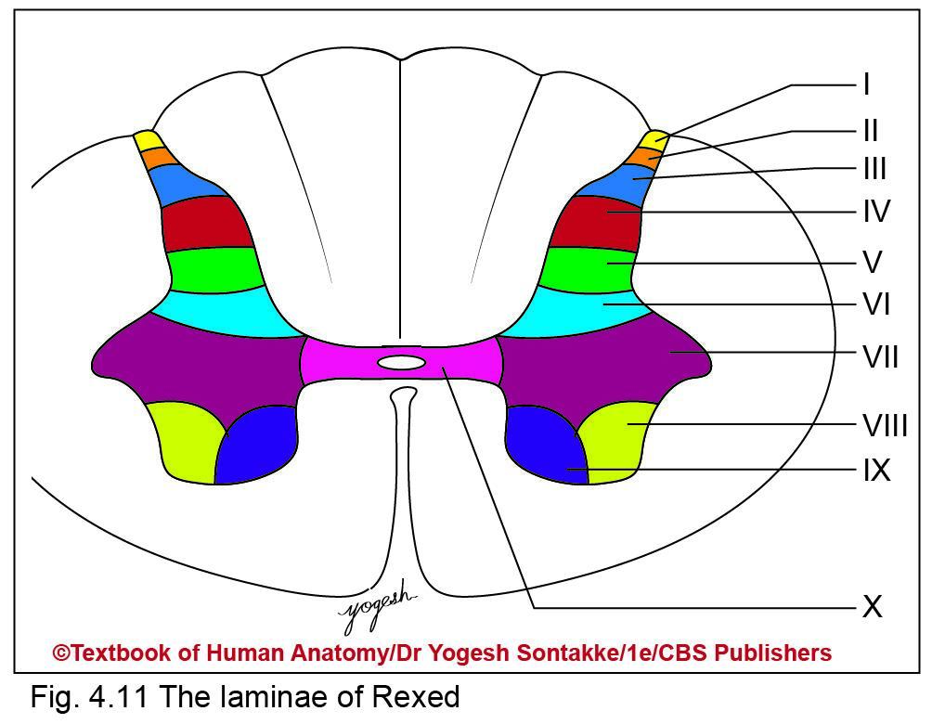
REXED LAMINAE
Laminar architecture of gray matter of spinal cord
Neuronal cells of gray matter – arranged in 10 zones of Rexed laminae

Slide 40
Rexed laminae
Lamina | Corresponding gray column
I | Posteromarginal nucleus
II | Substantia gelatinosa
III | Nucleus proprius
IV | Nucleus proprius
V VI | Base of dorsal horn
VII | Nucleus dorsalis Lateral horn (intermediolateral, intermediomedial nuclei)
VIII | Anterior horn of thoracic region Medial group of anterior horn in cervical and lumbosacral region
IX | Lateral group of nuclei of anterior horn
X | Surrounds the central canal

Slide 41
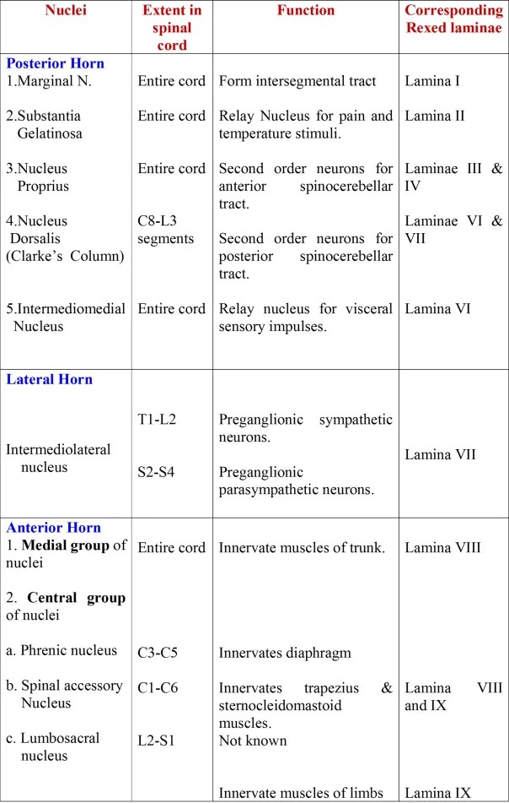

Slide 42
WHITE MATTER OF SPINAL CORD
Surrounds gray matter
Appears white due to presence of myelinated nerve fibers
Divisions of white matter
Divided into right and left halves by anterior median fissure and posterior median septum
Each of spinal cord shows three column or fasiculi of white matter:
  Anterior (ventral) white column (funiculus): Lies between anterior median fissure and lateralmost fibers of ventral root of spinal nerve
  Lateral white column (funiculus): Lies between lateralmost fibers of ventral root and posterolateral sulcus

Slide 43
Posterior or dorsal column (funiculus): Lies between posterior median sulcus and posterolateral sulcus
Types of fibers in white matter
Contains three types of fibers
  Sensory fibers
  Motor fibers
  Association fibers
Sensory fibers -
  Central processes of pseudounipolar neurons of dorsal root ganglion
  Axons of dorsal horn cells forms ascending tracts
Motor neurons -
  Descending fibers from higher centers to spinal cord
  Axon of anterior horn cells
Association fibers include
  Fibers that originate and terminate within spinal cord

Slide 44
Tracts of Spinal Cord
Tract – collection of nerve fibers within central nervous system, have similar origin, course, termination, and functions
Synonyms: Fasciculi, lemnisci
Classification of tracts
Three types
  Ascending
  Descending
  Intersegmental

Slide 45
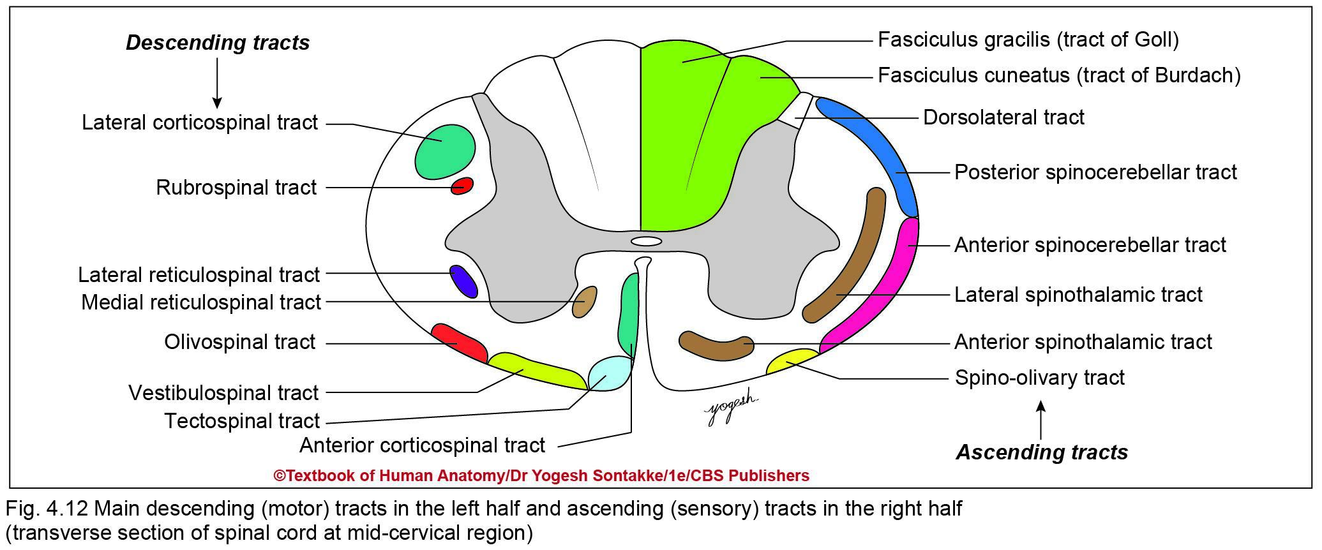

Slide 46
Tracts of spinal cord
Descending tracts | Ascending tracts | Intersegmental tracts
They are motor tracts | Are sensory tracts | Connect one segment of spinal cord with other
Examples: Pyramidal tracts • Lateral corticospinal • Anterior corticospinal Extrapyramidal tracts • Rubrospinal • Medial and lateral reticulospinal • Olivospinal • Lateral vestibulospinal • Tectospinal | Examples: Lateral spinothalamic Anterior spinothalamic Fasciculus gracilis Fasciculus cuneatus Dorsal spinocerebellar Ventral spinocerebellar | Examples: Tract of Lissauer Septomarginal tract Semilunar (comma) tract

Slide 48
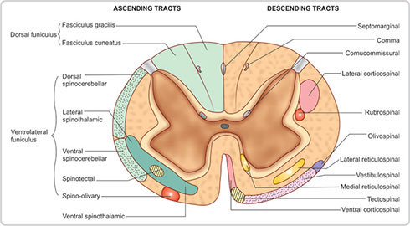

Slide 49
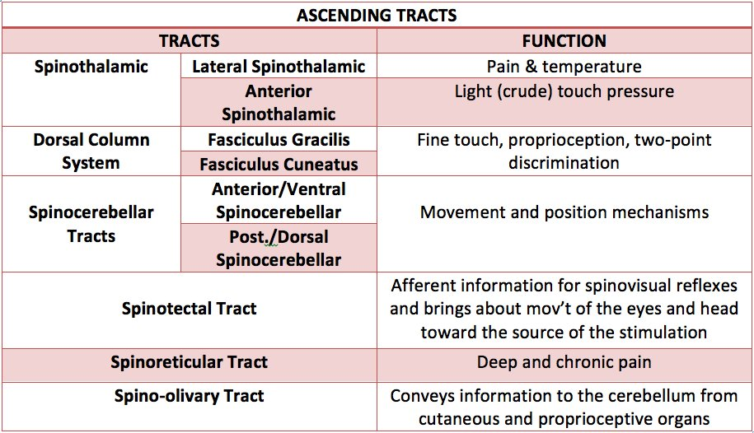

Slide 50
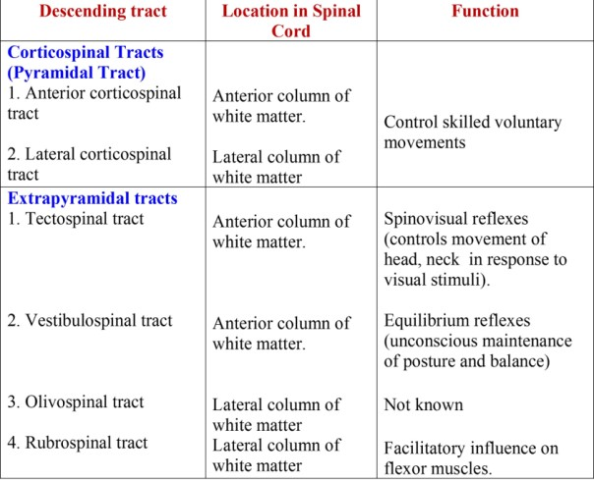

Slide 51
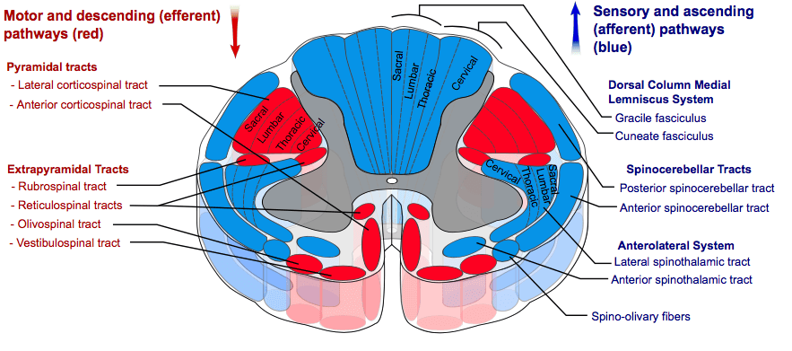
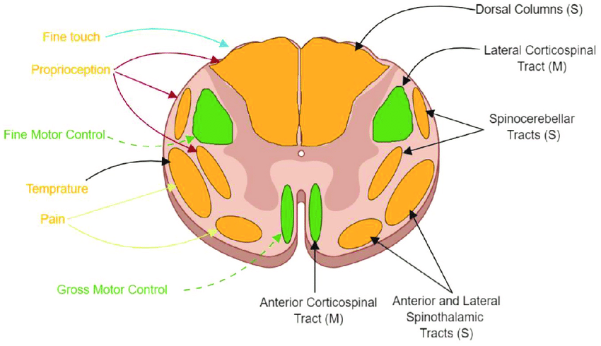

Slide 52
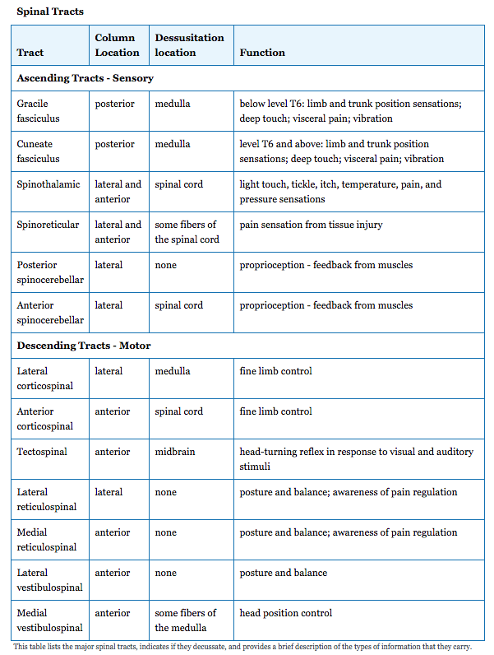

Slide 53


