Slide 1
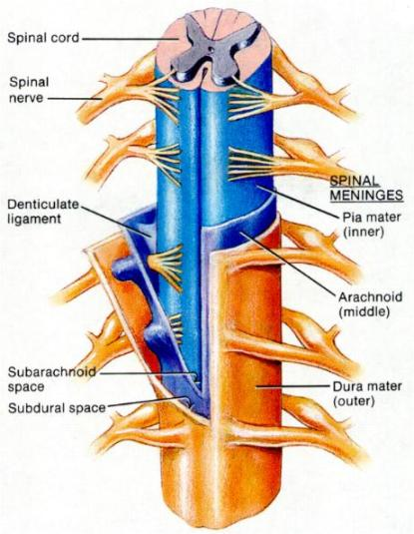
BRAIN
SPINAL CORD - 1
DR. PRAVEEN KURREY
MBBS, MS, BCME, BCBR PROFESSOR ANATOMY

Slide 2
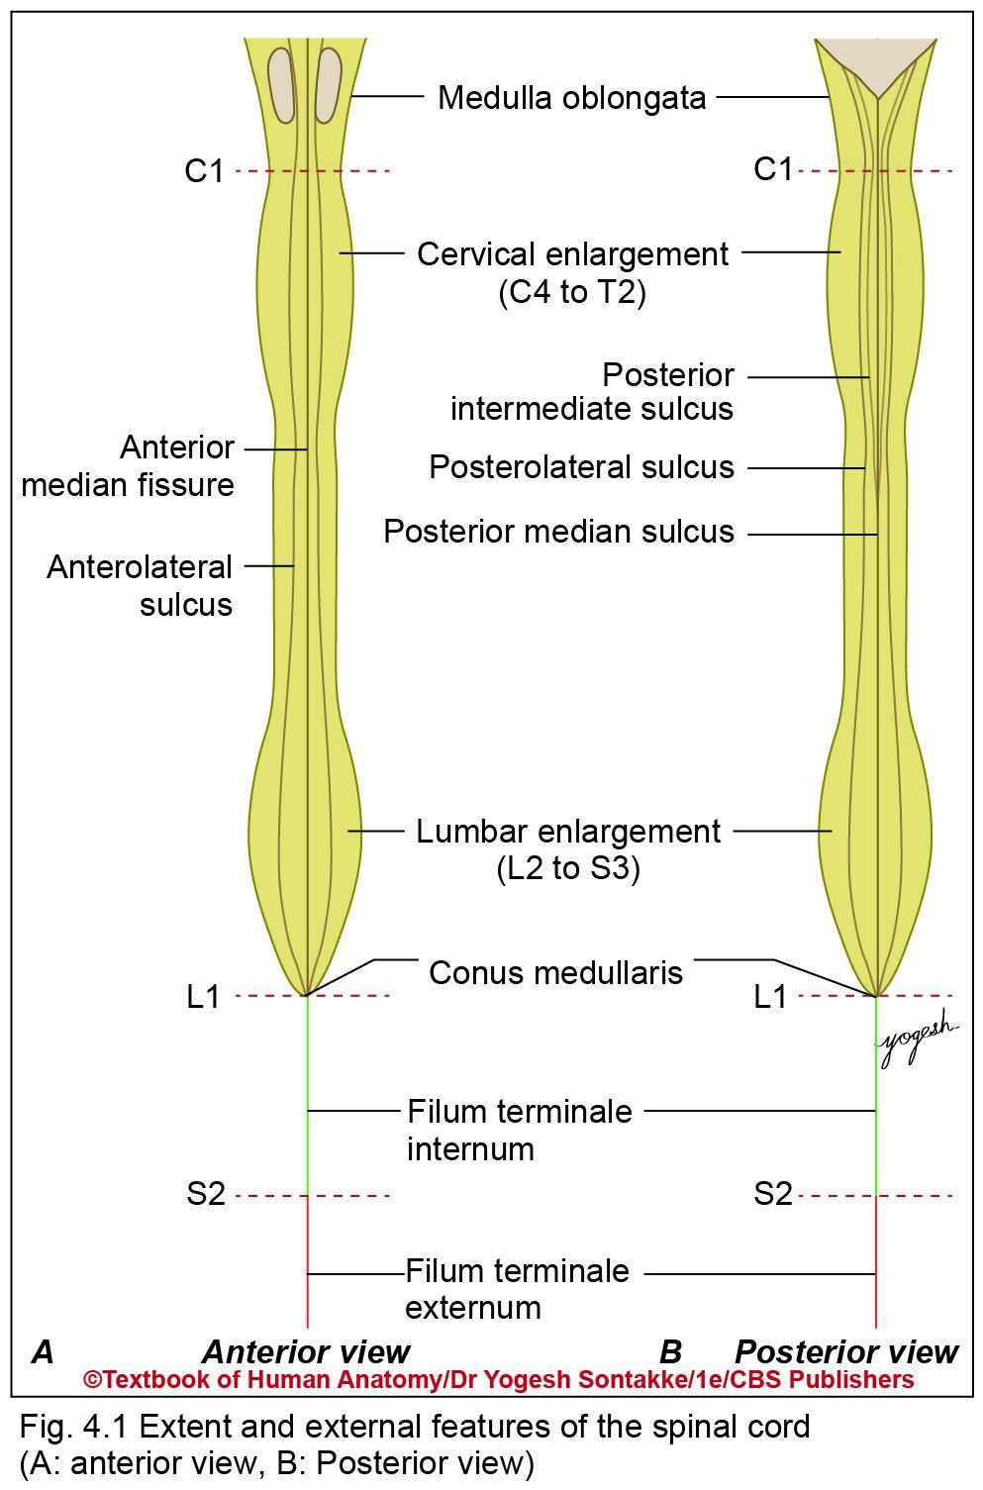
SPINAL CORD
Long cylindrical structure occupies upper two-thirds of vertebral canal
Forms caudal part of central nervous system
Gives rise to 31 pairs of spinal nerves
Connects body and brain through various ascending and descending tracts
Executes many reflex actions

Slide 3
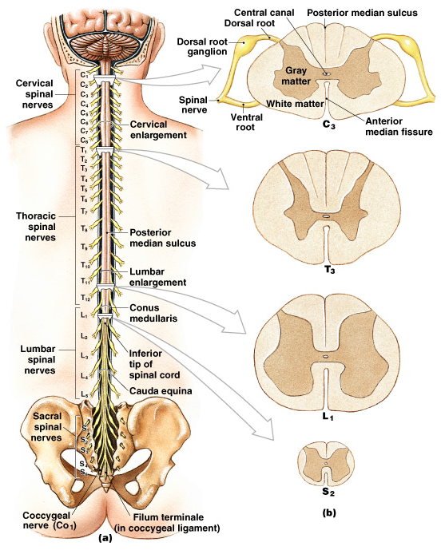
THE SPINAL CORD
Gross anatomy
  3 layers of meninges
  Epidural space (fat & vessels)
  CSF – subarachnoid space
  Terminates at L1/2 vertebral level (conus medullaris)
    Dura extends to S2 vertebral level
  Connects via filum terminale & denticulate ligaments (pia)
  31 pairs of spinal nerves (mixed)
    cauda equina
  Cervical & lumbar enlargements

Slide 4
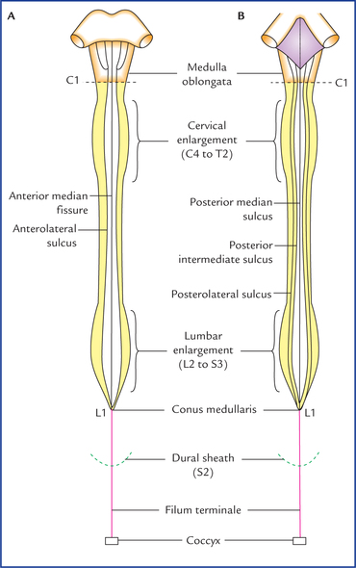
Size and shape
Cylindrical and slightly flattened anteroposteriorly
Measurements in adults
Length
  45 cm (18 inches) in male
  42 cm in female
Width: 1.25 cm
Weight: 30 g

Slide 5
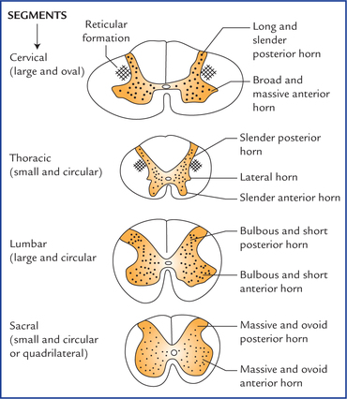

Slide 6
Extent
Extends from upper border of posterior arch of first cervical vertebrae (C1) to lower border of first lumbar vertebra L1 in adults
Conus medullaris: Lower tapering end of spinal cord is called conus medullaris
Filum terminalae: Thin thread-like filament extends from tip of conus medullaris to back of 1st coccygeal vertebral segment

Slide 7
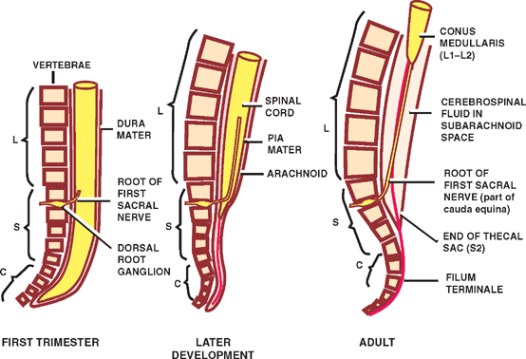
EXTENT

Slide 8
Spinal Cord Anatomy
Conus medullaris – terminal portion of the spinal cord
Filum terminale – fibrous extension of the pia mater; anchors the spinal cord to the coccyx
Denticulate ligaments – delicate shelves of pia mater; attach the spinal cord to the vertebrae
Spinal nerves – 31 pairs attach to the cord by paired roots
  Cervical nerves are named for inferior vertebra
  All other nerves are named for superior vertebra
Cervical and lumbar enlargements – sites where nerves serving the upper and lower limbs emerge
Cauda equina – collection of nerve roots at the inferior end of the vertebral canal

Slide 9
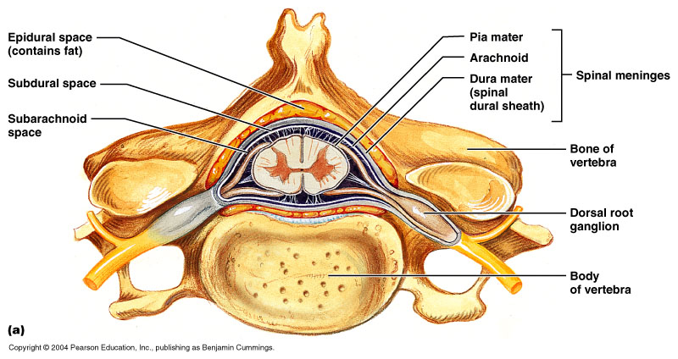
Cross-Sectional Anatomy of the Spinal Cord
Anterior median fissure – separates anterior funiculi
Posterior median sulcus – divides posterior funiculi

Slide 10
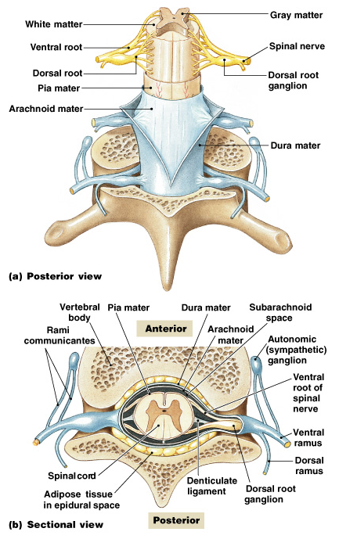
3 Meningeal Layers
Dura mater:
  outer layer of spinal cord
  subdural space:
    between arachnoid mater and dura mater
Arachnoid mater:
  middle meningeal layer
  subarachnoid space:
    between arachnoid mater and pia mater
    filled with cerebrospinal fluid (CSF)
Pia mater:
  inner meningeal layer

Slide 11
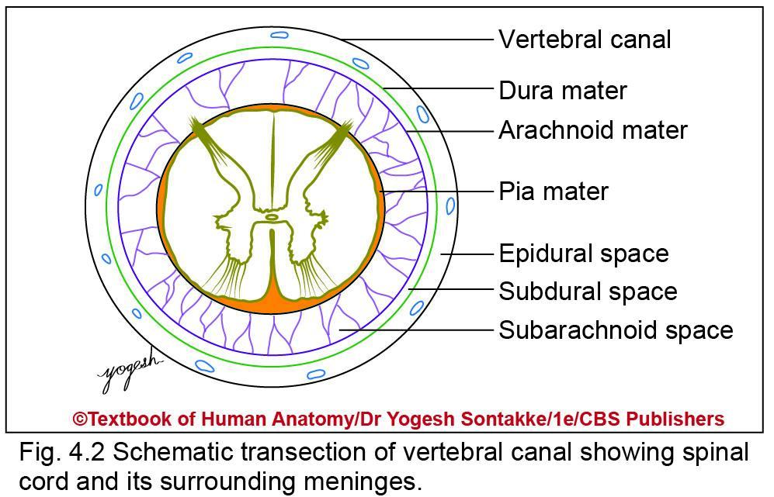
Coverings of spinal cord
Covered by spinal meninges: Outer dura mater, middle arachnoid mater, and innermost pia mater

Slide 12
Coverings of spinal cord
Dura mater: Extends from foramen magnum to lower border of second sacral vertebra
Arachnoid mater (cobweb-like in Latin)
Thin transparent membrane loosely surrounds spinal cord
Also extends up to lower border of S2 vertebra
Pia mater (loving mother in Latin): Thin vascular membrane closely invests spinal cord

Slide 13
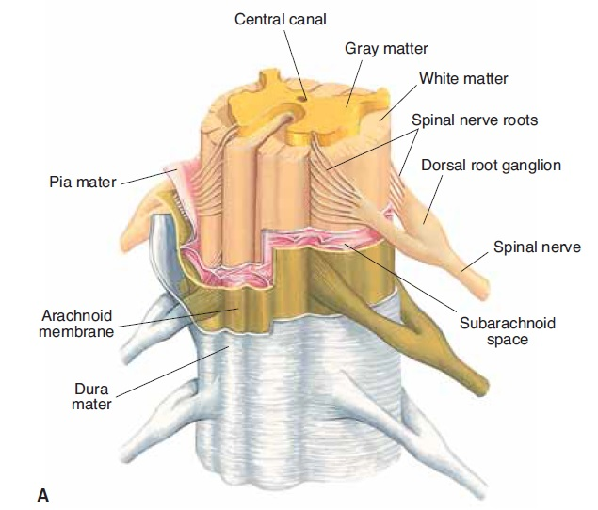

Slide 14
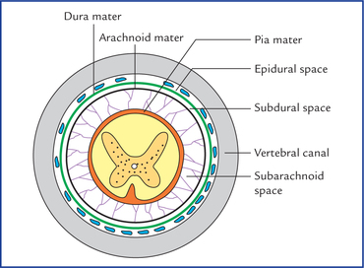
COVERINGS

Slide 15
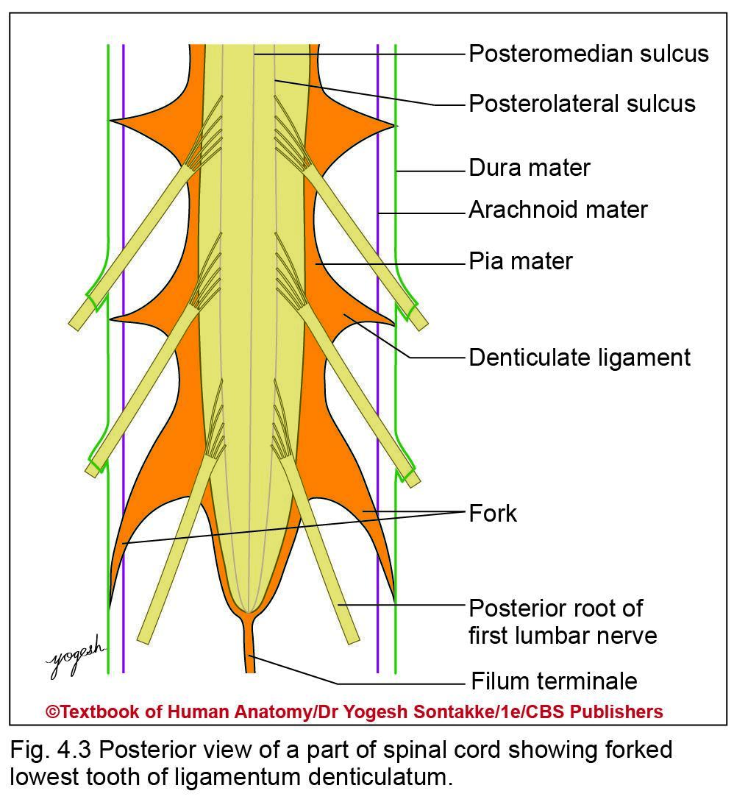
Modifications of Spinal Piamater
  1.Ligamentum denticulatum
    Are 21 pairs of teeth-like projections of pia mater
    Extend from lateral surface of spinal cord and pierce arachnoid mater to get attached to inner surface of dura mater

Slide 16
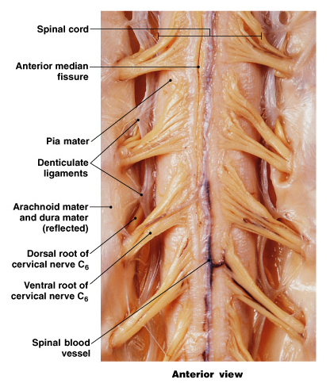
Structures of the Spinal Cord
Ligamentum Denticulatum:
  extend from pia mater to dura mater
  stabilize side-to-side movement
Blood vessels:
  along surface of spinal pia mater
  within subarachnoid space

Slide 17
Modifications of pia mater
Each ligamentum denticulatum lies in between anterior and posterior roots of adjacent spinal nerves
First ligamentum denticulatum lies at level of foramen magnum while last one lies between T12 and L1 spinal nerves

Slide 18
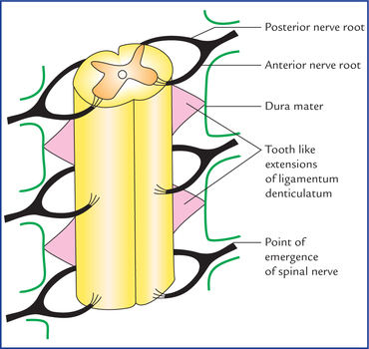

Slide 19
Modifications of Pia mater
2. Filum terminale
Thin fibrous filament extends from tip of conus medullaris to first coccygeal vertebra
Emerges from vertebral canal through sacral hiatus
About 20 cm long

Slide 20
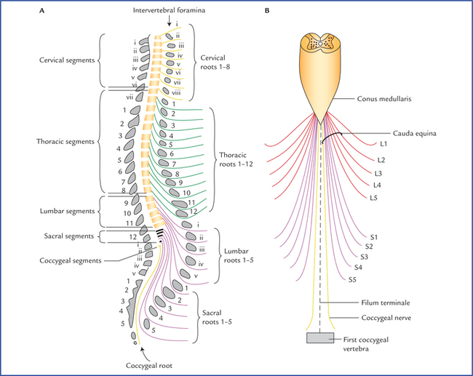

Slide 21
Modifications of Piamater
Consists of two parts
Filum terminale internum
  Upper part
  About 15 cm long and contained within dura mater and arachnoid mater
Filum terminale externum
  Lower part
  About 5 cm long
  Lies outside dura mater and gets attached to posterior surface of first segment of coccyx
  Median fissure of spinal cord

Slide 22
Modifications of Piamater
3. Subarachnoid septum
Midline septum of pia mater which connects posterior surface of spinal cord with arachnoid mater
4. Linea splendens
Thickening of pia mater in anterior median plane in anterior median fissure of spinal cord

Slide 23
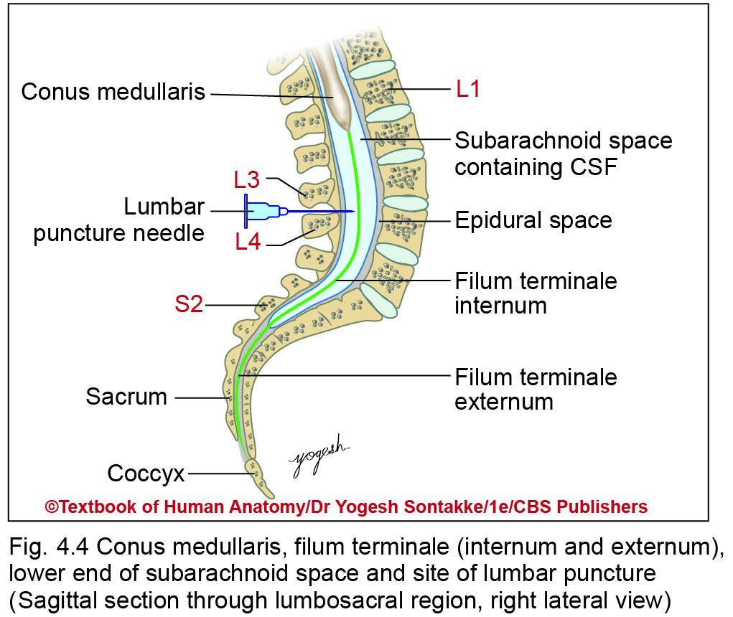

Slide 24
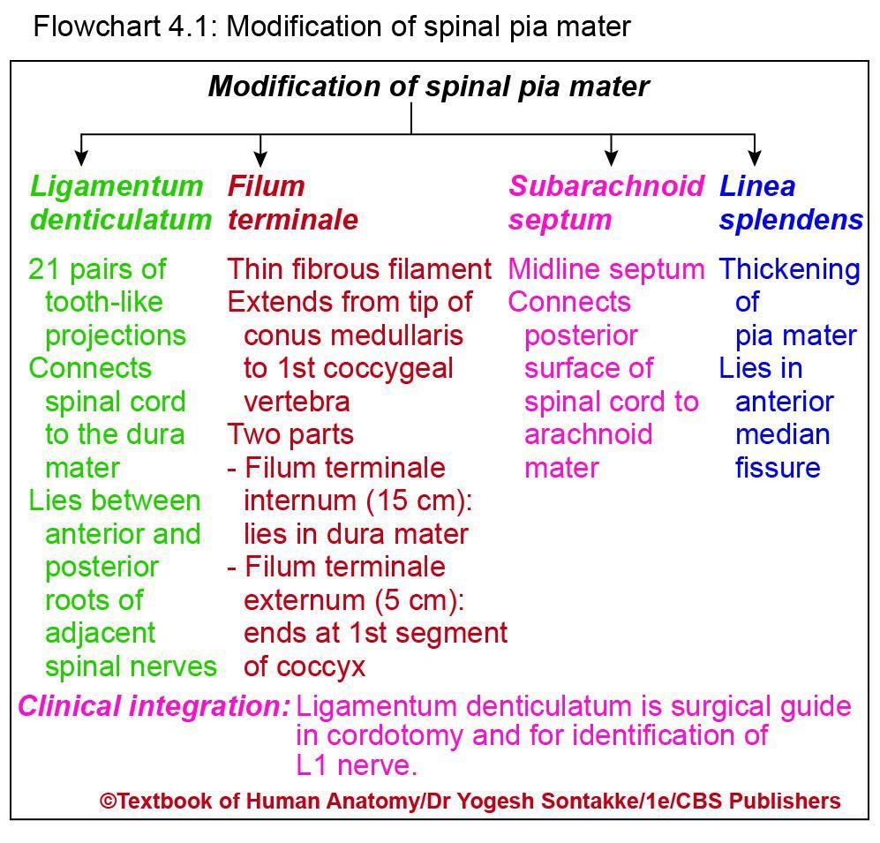

Slide 25
CLINICAL ANATOMY
Ligamentum denticulatum – surgical guide:
In cordotomy surgery
Part of spinal cord behind ligamentum denticulatum is sectioned to relive pain
Part of spinal cord anterior to ligamentum denticulatum is sectioned to paralyze muscles
First lumbar nerve lies just below last pair of ligamentum denticulatum
Helps for identification of desired spinal nerves

Slide 26
Space surrounding spinalcord
Are epidural, subdural, and subarachnoid spaces surrounding spinal cord
Epidural space
Space between spinal dura and vertebra canal

Slide 27
Epidural space
Contains loose areolar tissue, adipose tissue, small arteries and network of internal vertebral venous plexus, spinal nerve roots
Subdural space
Space between dura mater and arachnoid space
Contains thin layer of fluid

Slide 28
Subarachnoid space
Space between arachnoid mater and pia mater
Filled with cerebrospinal fluid (CSF)
Lumbar cistern
In lower part of vertebral column below lower end of spinal cord, subarachnoid space forms pool of CSF
Called lumbar cistern

Slide 29
Clinical Anatomy
Epidural anesthesia
In this, anesthetic agent is injected in epidural space to block pain in a particular region of body, to anesthetize particular part
Useful for lower extremity, gynecological surgeries, cesarean section, and so on
Lumbar puncture: Performed to collect cerebrospinal fluid

Slide 30
Clinical Anatomy
Lumbar puncture
Indications: Performed to collect CSF for
  Diagnostic purpose in meningitis, subarachnoid hemorrhage, and other neurological disorders
  Therapeutic purpose to reduce raised intracranial pressure
Contraindications: Should be avoided in following conditions
  Infection at site of lumbar puncture
  Cases with signs of increased intracranial pressure
  Severe thrombocytopenia or other bleeding disorders

Slide 31
Position of patient
Patient lying down on one side (or sitting) with fully flexed spine
Will raise lower level of spinal cord
Procedure
Insert lumbar puncture needle above or below spine of L4 vertebra which lies in median plane in horizontal line joining highest point of iliac crests
Desired quantity of CSF is aspirated

Slide 32
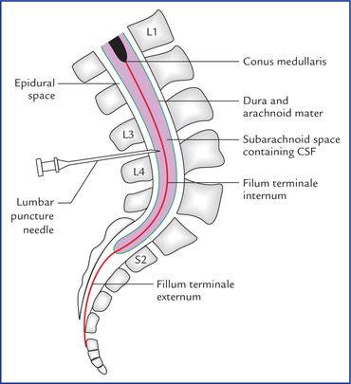

Slide 33
Reasons for site selection
In adults, spinal cord extends at lower border of L1 vertebra
Below this level, only filum terminale, roots of lumbar sacral, and coccygeal nerve are present
Lumbar cistern is roomy at level of interspinous space between L3 and L4

Slide 34


