Slide 1
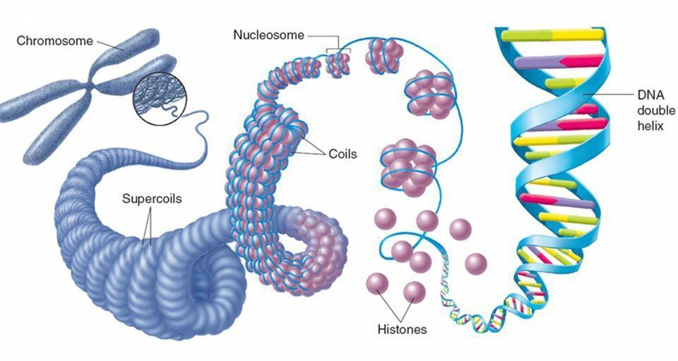
CHROMOSOME (GENETICS)
DR. PRAVEEN KURREY
MBBS, MS, BCME, BCBR, CISP PROFESSOR ANATOMY

Slide 2
Genetics
Genetics is derived from Greek word “gennan”, which means ‘to generate’.
Genetics is a branch of science dealing with the study of heredity or inheritance and variations.
It provides a basis for understanding the fundamental make-up of an organism, thus leading to a better understanding of a disease process.

Slide 3
Chromosome
Genes, the unit of inheritance are located on the chromosomes of the gametes.
Passed from parents to progeny.
A chromosome is a thread like self replicating genetic structure containing organized DNA molecule package found in the nucleus of the cell.
In 1875, E. Strasburger discovered thread like structures which appeared during cell division.
Chromosome term was introduced by Waldeyer in 1888.
Number of chromosomes is fixed in each cell but varies from species to species.

Slide 4
Chromosome
In human beings, the total number is 46 or 23 pairs named as ‘diploid’ (2n).
While in gametes (male or female) the number is 23 i.e. ‘haploid’ (n).
22 pair chromosomes are autosomes while 1 pair is sex chromosome.
Length: 4-6 µ

Slide 5
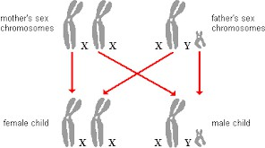
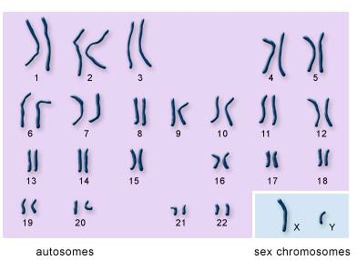
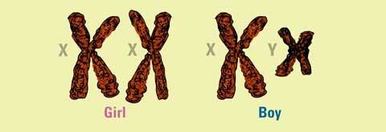

Slide 6
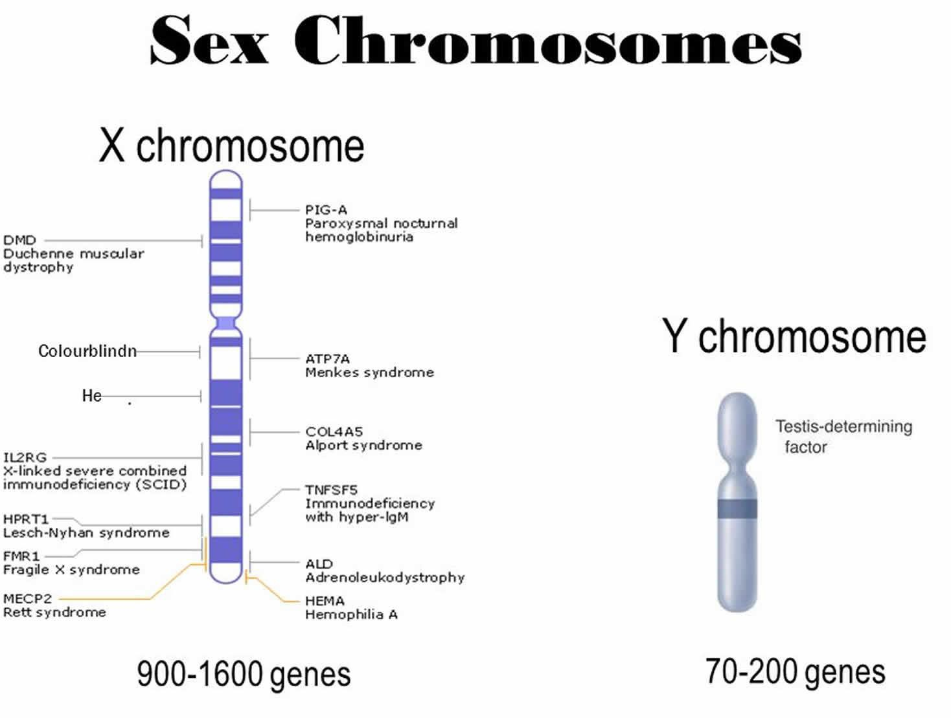

Slide 7
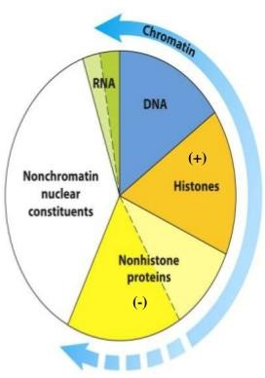
Chemical Constituents
DNA
RNA
Histones (basic in nature)
Non-histone proteins (acidic in nature)

Slide 8
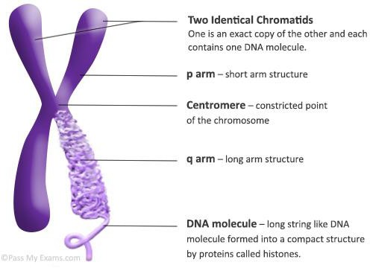
Structure of Chromosome

Slide 9
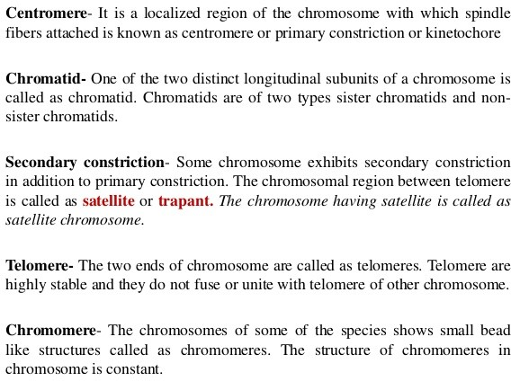

Slide 10
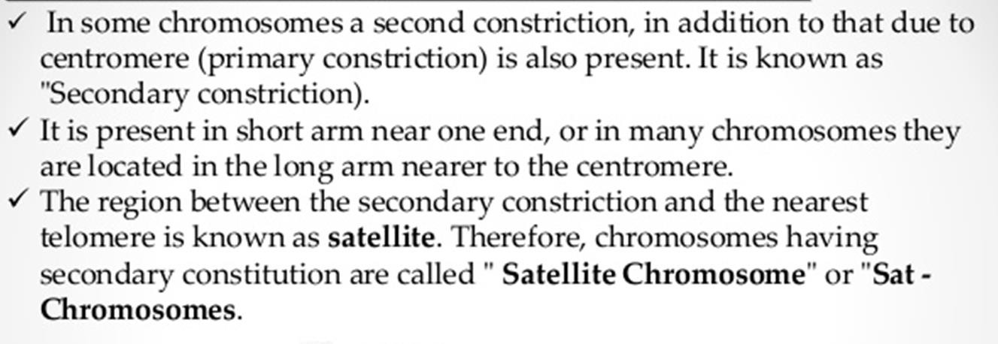
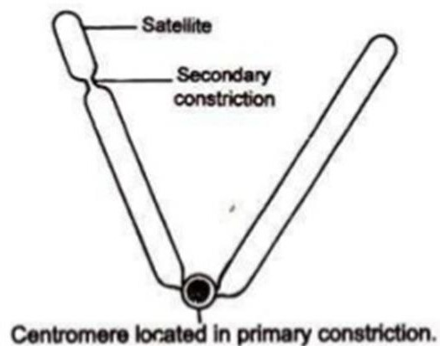
Secondary Constriction

Slide 11
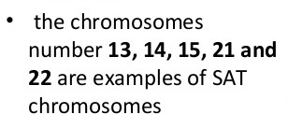
SAT CHROMOSOMES

Slide 12
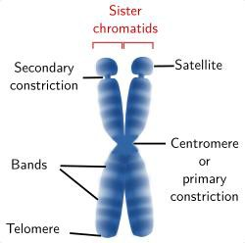
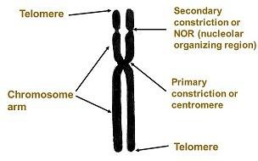
Structure of SAT - Chromosome

Slide 13
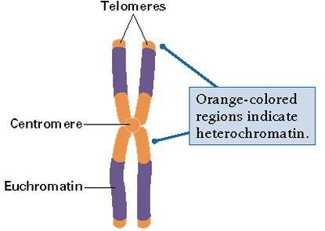
TELOMERE
At two ends of chromosome
Highly stable
Made up of loops of chromatin fibers
Maintenance of structural integrity

Slide 14
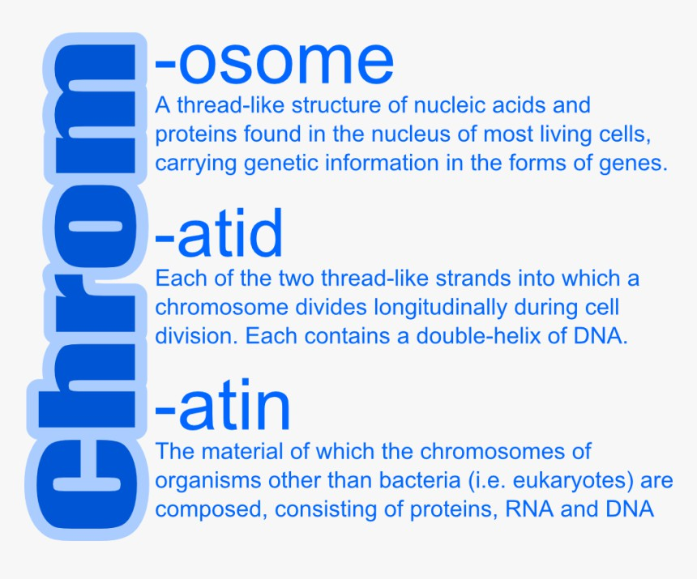

Slide 15
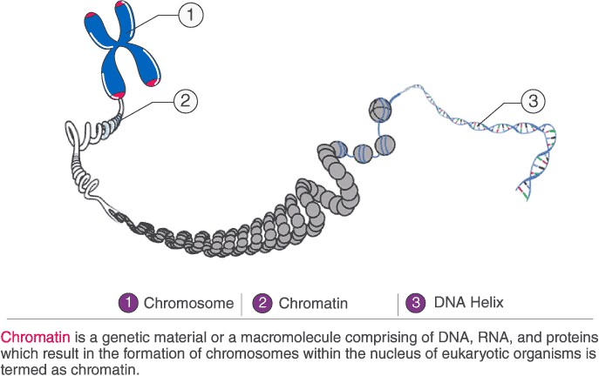
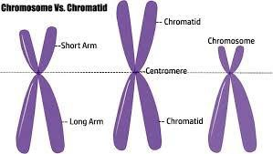
Chromatin, Chromosome, Chromatid

Slide 16
Chromatin
Coiled strands of DNA bound to basic proteins (histones).
2 types:
Euchromatin
Heterochromatin
Basic structural unit: Nucleosome

Slide 17
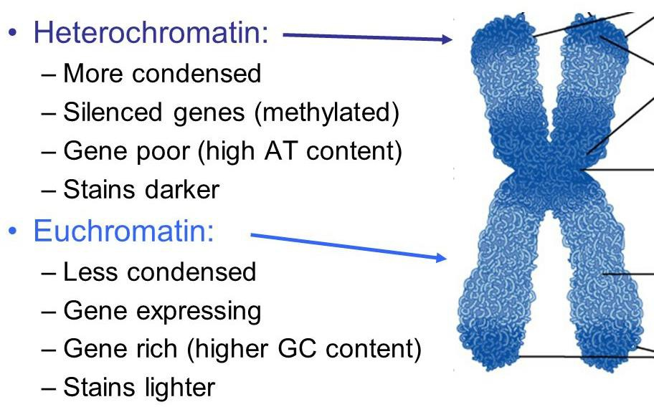

Slide 18
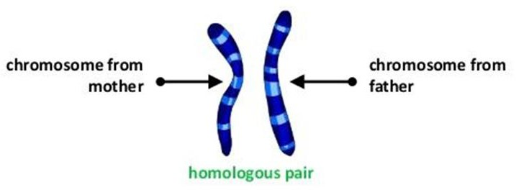
Types of Chromosomes
Homologous chromosomes pertain to two chromosomes which are same, at least in terms of the gene sequences and loci.
Heterologous (non-homologous) chromosomes pertain to any two chromosomes that are different, such as in terms of gene sequence and loci.

Slide 19
FUNCTIONS OF CHROMOSOME
It provides genetic information for cellular functions of organisms.
It protects genetic material (DNA) from damage during cell division.
They ensure a precise distribution of DNA to daughter nuclei during cell division.

Slide 20
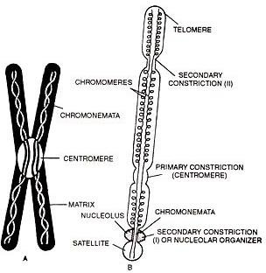
CHROMONEMATA
The spirally coiled central filament of a chromatid carrying all the inherited instructions, along which the chromomeres are aligned.
The set of instructions is called as ‘genome’.

Slide 21
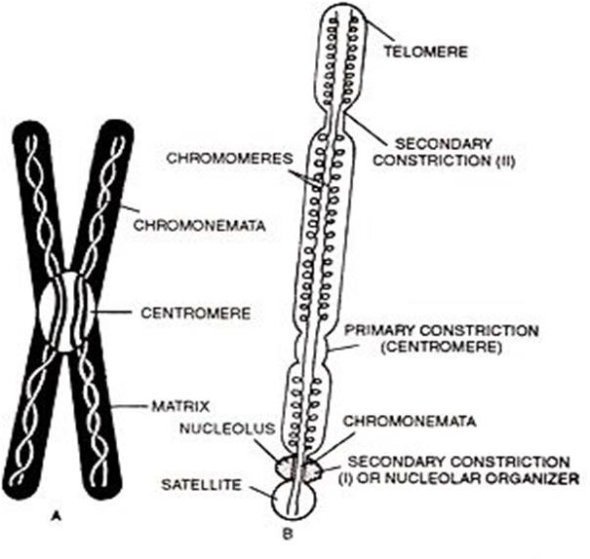
CHROMOMERE
A chromomere, also known as
an idiomere, is one of the
or
serially aligned beads granules of a
eukaryotic
chromosome, resulting from local coiling of a continuous DNA thread.

Slide 22
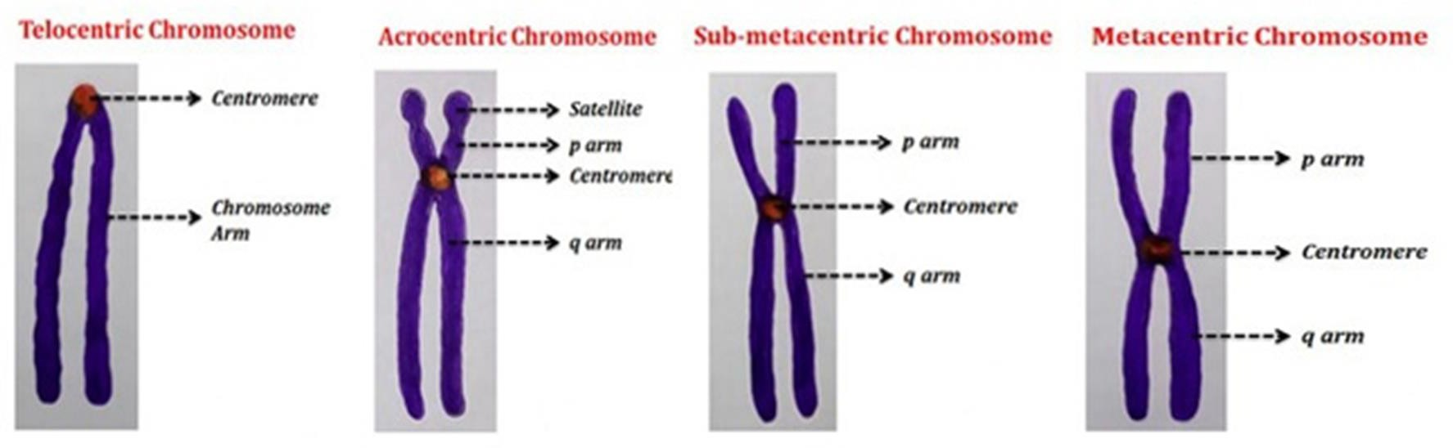
CLASSIFICATION OF CHROMOSOMES
According to position of the centromere:
Metacentric
Submetacentric
Telocentric
Acrocentric:
Satellite chromosomes
(SAT chromosomes)

Slide 23
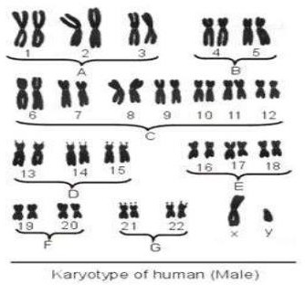
According to total length of the chromosome
(Denver’s classification):
Seven groups (A-G):
A 1,2,3
B 4,5
C 6-12
D 13,14,15
E 16,17,18
F 19,20
G 21,22

Slide 24
According to number of the centromere:
Monocentric
Dicentric
Polycentric
Acentric
(All the 46 human chromosomes are monocentric)

Slide 25
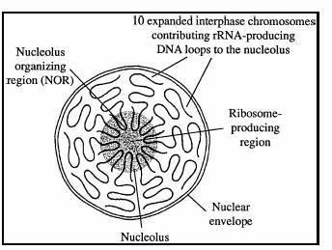
NUCLEOLUS ORGANISER REGION
Nucleolus organizer regions (NORs) are chromosomal regions crucial for the formation of the nucleolus.
In humans, the NORs are located on the short arms of the acrocentric chromosomes 13, 14, 15, 21 and 22.
These regions code for 5.8S, 18S, and 28S ribosomal RNA.

Slide 26
CHROMOSOME NUMBER
Two types:
1) Somatic chromosome number (2n): any chromosome that is not a sex chromosome; appear in pairs in body cells but as single chromosomes in spermatozoa.
2) Gametic chromosome
number
(n):
cell,
any of
specifically a
the chromosomes contained in a haploid
spermatozoon or an ovum, as contrasted with those in a diploid, or somatic, cell.

Slide 27
Chromosome size
Shows variation depending upon stage of cell division.
Longest and thinnest chromosome seen during interphase.
In prophase, decreases in length with an increase in thickness .
Smallest chromosome seen during anaphase.

Slide 28
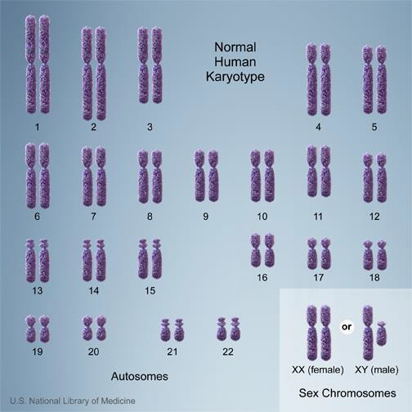
KARYOTYPE
General morphology of somatic chromosome complement of an individual.

Slide 29
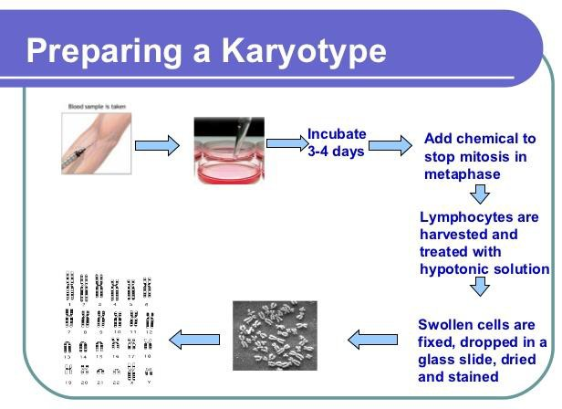
Karyotyping
Karyotyping is the process of pairing and ordering all the chromosomes of an organism, thus providing a genome-wide snapshot of an individual's chromosomes.
Karyotypes describe the chromosome count of an organism and what these chromosomes look like under a light microscope.
Attention is paid to their length, the position of
the centromeres, banding pattern, any differences between the sex chromosomes, and any other physical characteristics.
Karyotypes are prepared using standardized staining procedures that reveal characteristic structural features for each chromosome.

Slide 30
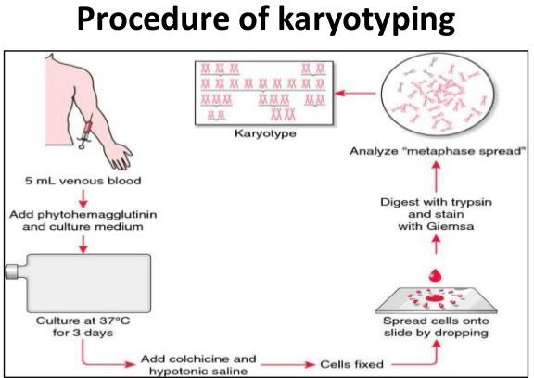

Slide 31
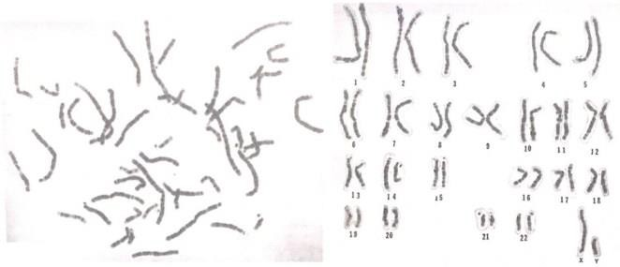
Metaphase Chromosomes
Chromosomes arranged

Slide 32
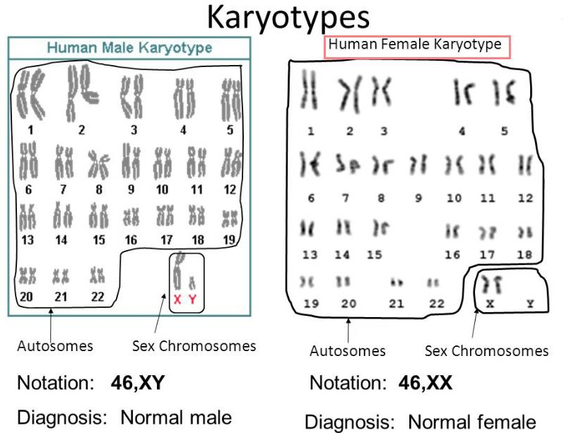

Slide 33
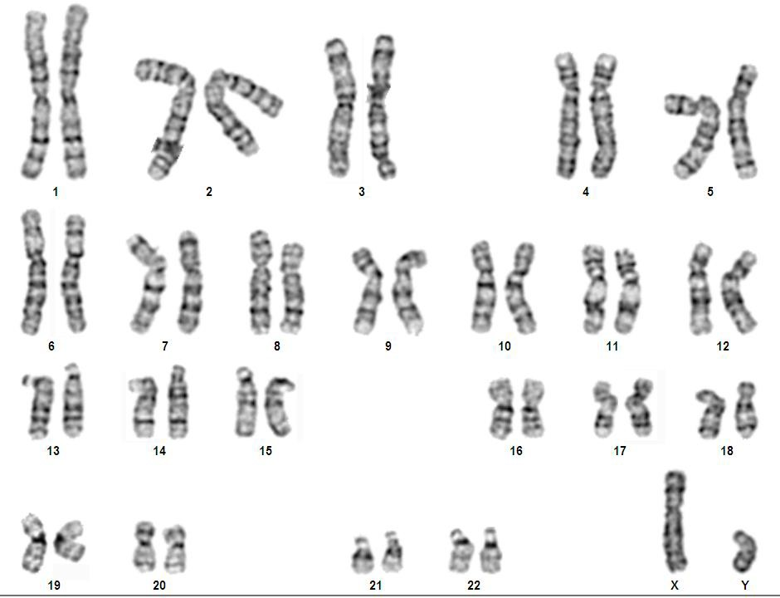
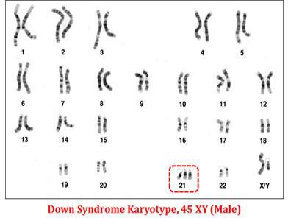
Karyogram: IDIOGRAM a diagram or photograph of the chromosomes of a cell, arranged in homologous pairs and in a numbered sequence, also called idiogram.
Normal Karyotype

Slide 34
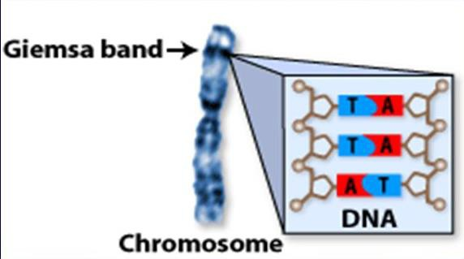
G-banding
G banding, or Giemsa banding is a technique used in cytogenetics to produce a visible karyotype by staining condensed chromosomes.
It is useful for identifying genetic diseases through the photographic representation of the entire chromosome complement.

Slide 35
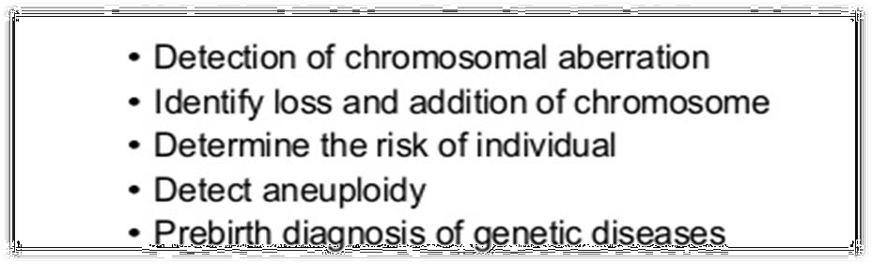
Applications of Karyotyping

Slide 36
Karyotyping can be used to detect a variety of genetic disorders. For example, a woman who has premature ovarian failure may have a chromosomal defect that karyotyping can pinpoint.
The test is also useful for identifying the Philadelphia chromosome. Having this chromosome can signal chronic myeloid leukemia (CML)

Slide 37
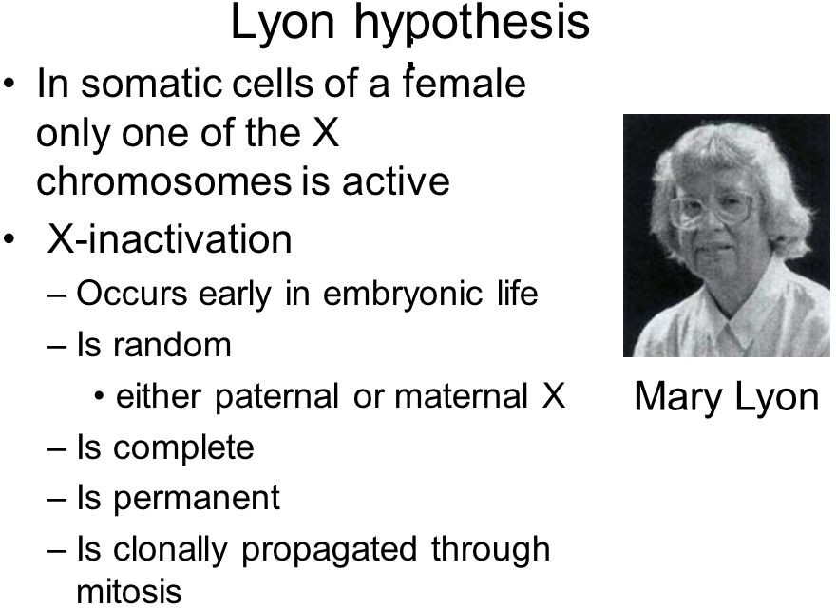

Slide 38

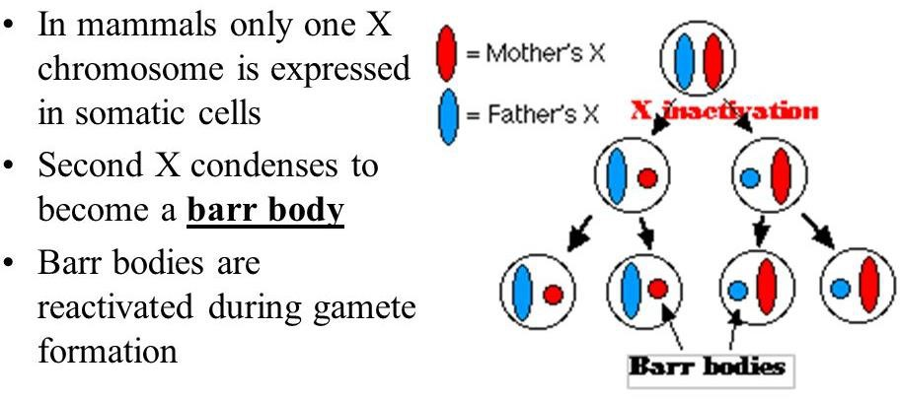

Slide 39
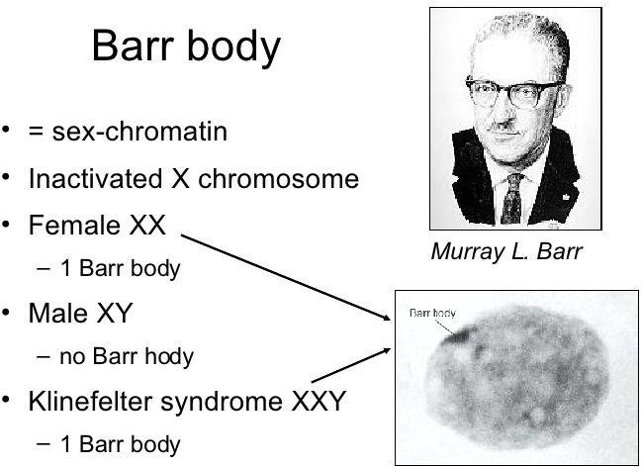

Slide 40
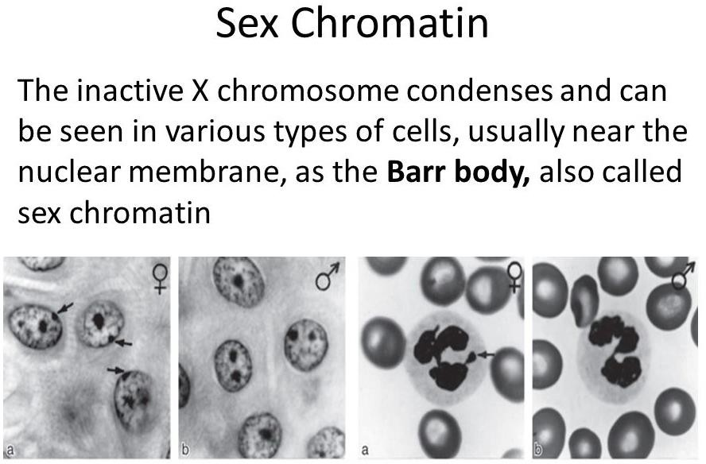

Slide 41
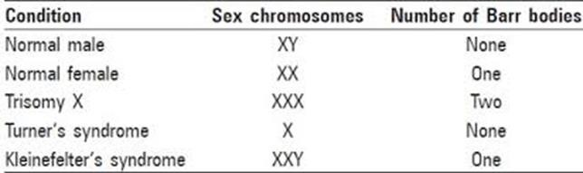
In humans with more than one X chromosome, the number of Barr bodies visible at interphase is always one fewer than the total number of X chromosomes.
For example, people with Klinefelter syndrome (47,XXY karyotype) have a single Barr body, and people with a 47, XXX karyotype have two Barr bodies.

Slide 42
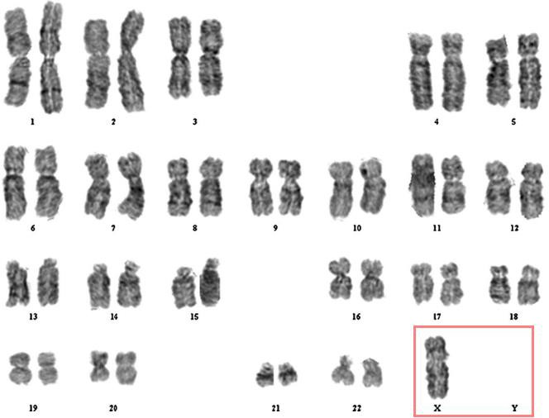
Turner’s Syndrome

Slide 43
