Slide 1
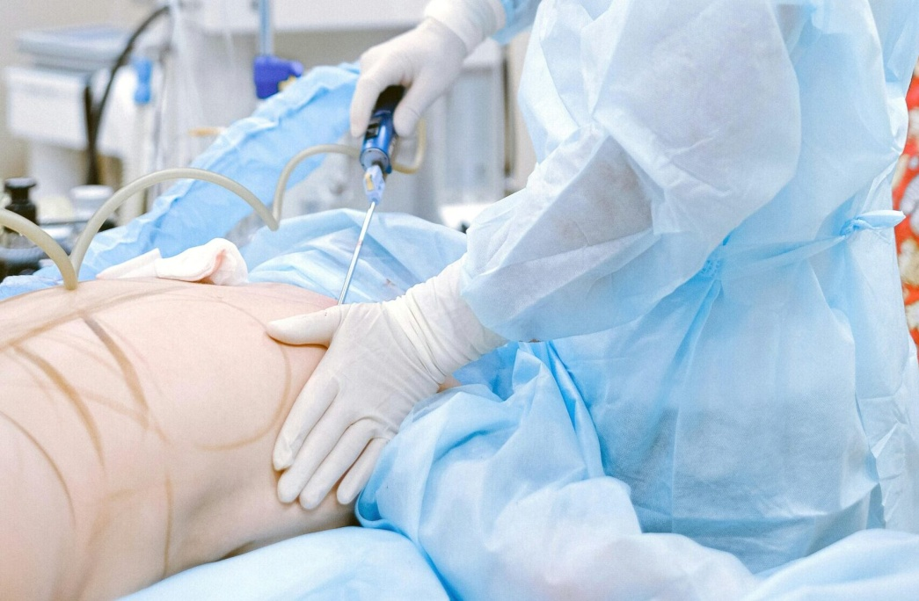
PRACTICAL EMBALMING
DR. PRAVEEN KURREY
MBBS, MS, BCME, BCBR, CISP PROFESSOR ANATOMY

Slide 2
MODERN EMBALMING
Modern embalming is defined as the study and science of treating a dead human body to achieve an antiseptic condition, a pre-mortem appearance and preservation.
The embalming process acts on the body proteins. It changes the protein’s colloidal nature and forms a lattice-work of inert, more stable, longer-lasting, firm substance that can no longer serve as food for bacteria. Moreover, this new protein form can-not be broken down by enzymes from body cells or bacteria.

Slide 3
Criteria for selection of a vessel
to be used
Size of the Vessel – Large enough for proper cannula insertion and drainage.
Depth of the Vessel – Should be superficial to avoid excessive dissection.
Proximity to the Heart – Closer vessels ensure better distribution of embalming fluid.
Choice in Infants & Children – Abdominal aorta and inferior vena cava preferred.
Choice in non autopsied body-

Slide 4
EXPOSURE OF THE VESSELS
Common Carotid Artery and the Internal Jugular Vein
Put a wooden block under the shoulder to elevate the shoulder and lower the head so that the hole length of the neck is exposed. The vessels run vertically from the sternoclavicular joint to the thyroid cartilage and are related medially to the trachea and laterally to the sternocleidomastoid muscle.
A vertical incision about one and a half to two inches long is made through the skin at the root of the neck near the sterno clavicular joint. The two vessels are enclosed together in a fascial sheath-carotid sheath..

Slide 5
The artery occupies a medial position, the vein is lateral one. The vagus nerve lies behind the vessels. Raise the carotid sheath, cut it and dissect out the common carotid artery and internal jugular vein by blunt dissection
Great care should be taken in raising the carotid sheath as the degree of elasticity of both vessels is reduced by their large number of branches.
Axillary artery and Vein
Brachial Artery and Basillic Vein
Radial Artery
Femoral Artery and Vein

Slide 6
Exposure and Cannulation
Arteries carry blood from the heart to the tissues. They are thick walled, have no valves and are usually empty of blood after death, therefore are best suited to carry embalming fluid to the tissues. They are situated in the deeper plane and are_ well supported by connective tissue. They do not collapse when cut.
Veins are large and carry blood from the tissues to the heart. They are thin walled provided with valves, and usually engorged with blood after death. They occur in two planes, subcutaneous and deep with inter-blood connections.
Give a suitable incision
Various type of incisions are used to open artry and veins

Slide 7
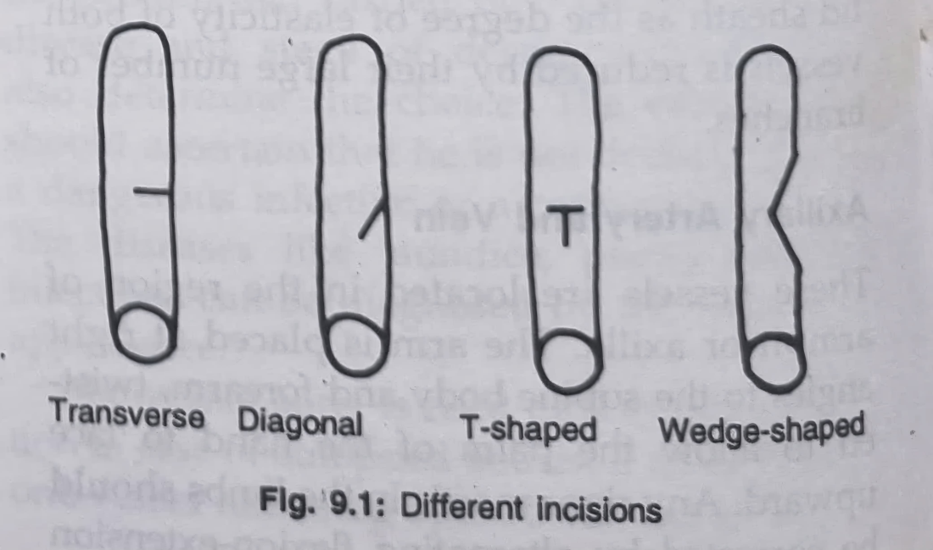
Transverse incision
Longitudinal incision This incision is more suitable for vein,
Combined incision Combination of transverse and longitudinal incision is preferred especially for opening the veins.
Wedge incision- In case the artery is filled with clotted blood

Slide 8
METHODS OF EMBALMING
1.Arterial Embalming
2. Cavity Embalming
3. Hypodermic Embalming
4. Surface Embalming

Slide 9
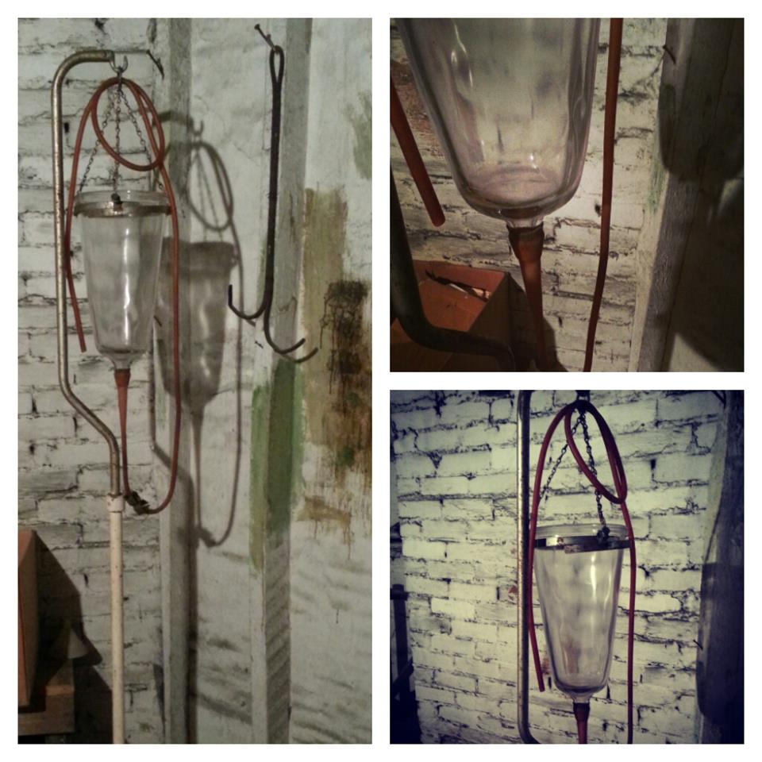
Embalming procedure:
Arterial embalming
Gravity specific – simplest safest least expensive
- gravity bottle- 10L
- raised above – 6-7ft

Slide 10
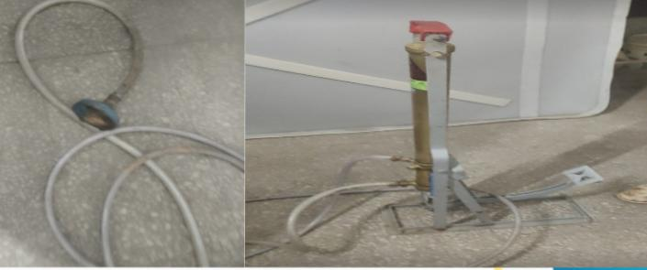
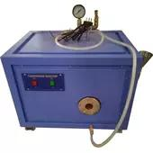
Modified form – cyclical pump overcomes obstruction.
Electric pump- high pressure fluid used to generate pressure using electricity
  It deliver about 8 to 10 liters of arterial fluid
  within 30-35 minutes.

Slide 11


