Slide 1
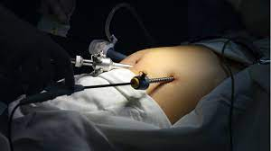
CAVITY EMBALMING
DR. PRAVEEN KURREY
MBBS, MS, BCME, BCBR, CISP PROFESSOR ANATOMY

Slide 2
Introduction
Embalming is the process of preserving a body by delaying the natural effects of death.
The body is first cleaned and then body fluids removed then embalming fluid is injected into arteries, which helps to preserve the body tissues.

Slide 3
Types of embalming
Arterial embalming
Cavity embalming
Surface embalming
Hypodermic embalming

Slide 4
CAVITY EMBALMING
It is normally a two step process aspiration of cavities and their contents and injection treatment of a strong preservative chemical.
It treats contents of hollow viscera, the walls of visceral organs which are not embalmed by arterial embalming and contents of spaces between the visceral organs.

Slide 5
NEED OF CAVITY TREATMENT
When the injection treatment has been completed, it is necessary to aspirate the contents of hollow organ & also body fluids in trunk cavities.
If cavity treatment is not done the continued activity of the bacterial flora, already exist in the viscera, will promote putrefaction and ultimately cause failure of embalming.
In arterial embalming, it is difficult to determine the level of embalming of visceral organs.
The embalmer cannot see the internal organs for signs of arterial fluid distribution.

Slide 6
There are situations in which arterial embalming is not possible.
Cavity embalming along with hypodermic and surface embalming would be chief method of preserving the remains.
These case include - badly burnt body.
- badly decomposed body.

Slide 7
Embalming fluids
Formalin 60%
Methanol 25%
Phenol 10%
Glycerine 2.5%
Mercuric chloride 1%
Lavender 1%
Preservatives
Wetting agents
Disinfectant
Perfumes
Fluids injected into body cavities i.e., Thoracic, abdominal & pelvic cavities with a trocar.
About 2 liters cavity fluid is injected.(for an avg. body).

Slide 8
Instruments required
Scalpel
Electric Aspirator
Rubber tube
Receptacle jar
Cavity injector/simple 100ml syringe
Trocar
Needle
Ligature

Slide 9
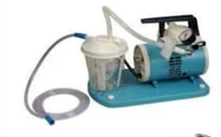
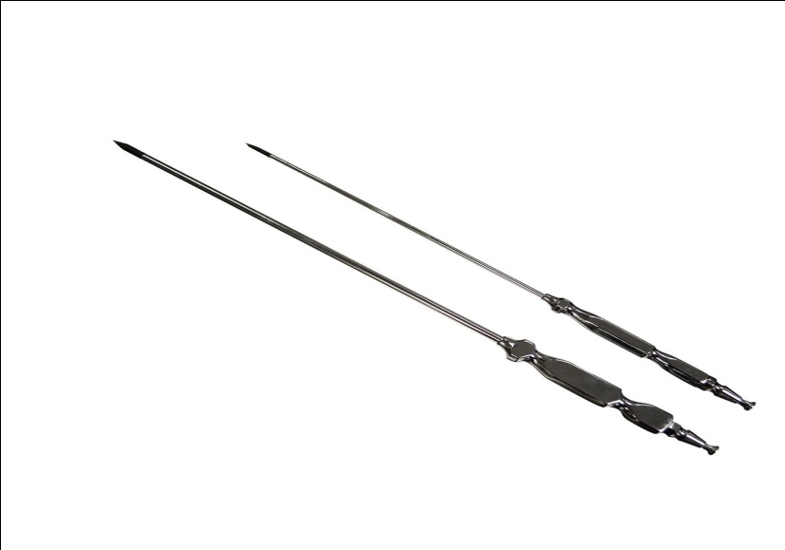
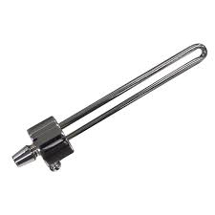
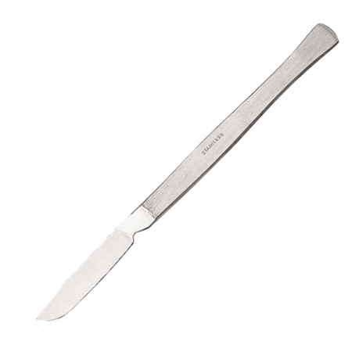
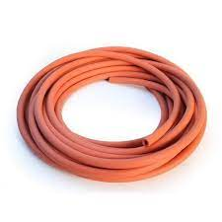
Electric aspirator
Trocar
Scalpel
Cavity chemical injector
Rubber tube

Slide 10
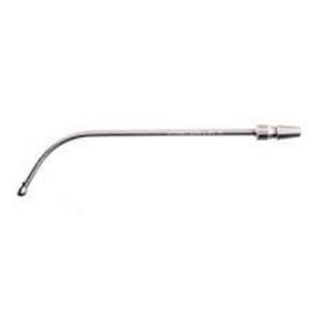
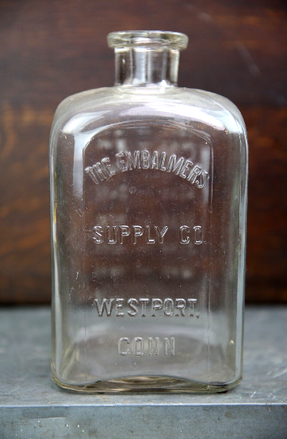
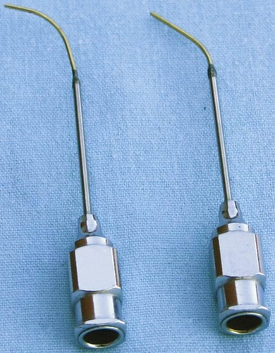
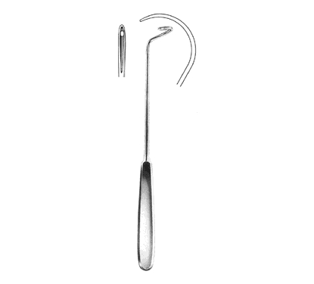
Aspirator
Receptacle jar
Needle
Ligature

Slide 11
PROCEDURE
1. A small incision is made just above the umbilicus (2 inches superior and 2 inches to the right) and pushes the trocar in the chest and stomach cavities to puncture the hollow organs and aspirate their contents.

Slide 12
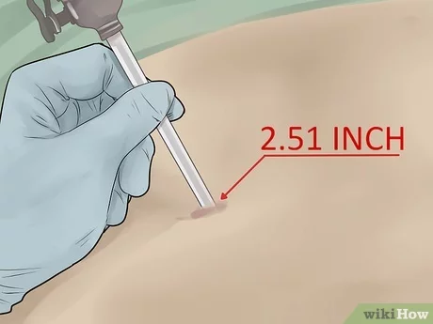
2. Use a trocar to aspirate the organs.
Now that the arteries have been embalmed, you need to suction any liquids or gasses inside the organs in a process called aspiration.

Slide 13
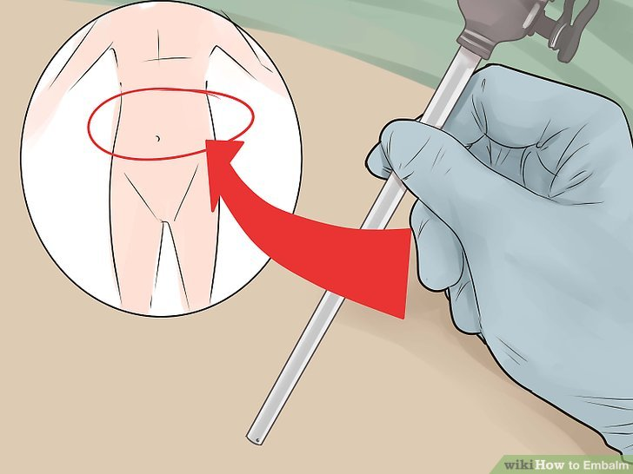
3. Aspirate the lower cavity.
Remove the trocar, turn it around, and insert it into the lower body, aspirating the contents of the large intestine, bladder, and in the case of females, the uterus. The anus and vagina are sometimes packed with cotton to avoid seepage.

Slide 14
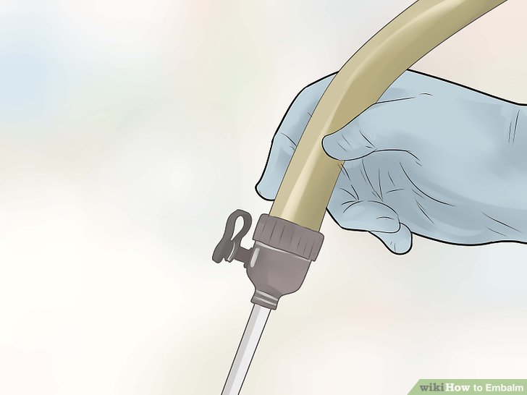
4. Inject cavity fluid into the torso.
Attach a 16 ounce bottle of cavity fluid to the other end of the bottle injector. The gravity injection method is typically used to push the cavity fluid into the hollow organs, sterilizing and preserving them.

Slide 15
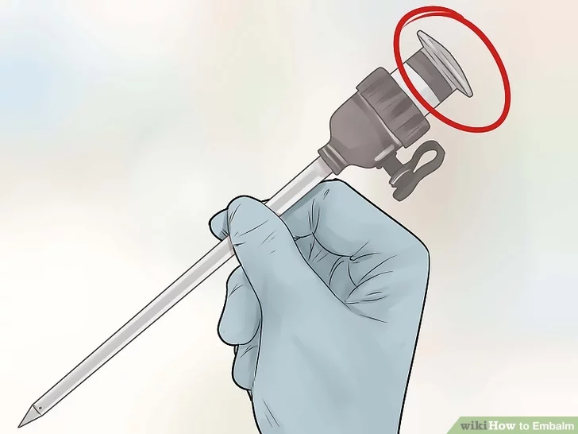
5. Remove the trocar and close the hole with a trocar screw.
Clean out your trocar and put it away

Slide 16
ORGANS WHICH CAN BE TREATED BY CAVITY EMBALMING-
SPLEEN
LIVER
PANCREAS
KIDNEY
BRAIN
LUNGS

Slide 17


