Slide 1
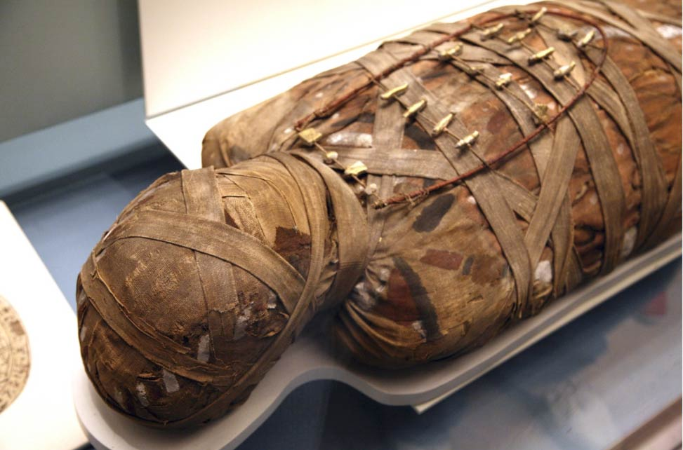
HISTORY OF EMBALMING - 2
DR. PRAVEEN KURREY
MBBS, MS, BCME, BCBR, CISP PROFESSOR ANATOMY

Slide 2
Nothing gives a better perspective of the subject than an appreciation of the steps by which it has reached its present state.
Without a sense of history,no man can understand the problem of our time.

Slide 3
What is embalming
Embalming is the process of chemically treating the dead human body to reduce the presence and growth of microorganisms, to retard decomposition and to restore an acceptable physical appearance. (Frederick and Strub, 1989)
In some part of the world,elements of the climate ,such as extreme cold or dry heat, act as a natural preservative,creating corpses that do not decompose and maintain their form for great length of time.
This natural processes do not require human intervention and are not considered embalming.

Slide 4
Period of embalming histoy
1st period
Originated in Egypt.
3200 BC to 650AD.
Religious motive, believe in resurrection.
Variation in techniques.

Slide 5
EGYPTIAN Treatment approximate this schedule
Day1 through 16; Evisceration and washing of body.
Day16 Through36; Immersion in natron.
Day 36 through68; Wrapping in bandages.
Day68 through78; Body placed in a coffin
EGYPTIAN believed that this process of preservation was necessary for the dead to pass on into the afterlife.

Slide 6
2nd period
650AD to1861
Practiced in EUROPE.
Period of anatomists.
Motive is to advance the development of embalming.

Slide 7
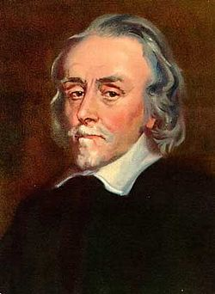
In Europe, embalming didn’t become a common practice until the middle ages , when developments in the realms of science and medicine began to influence death care practice and bodies were needed for dissection and study.
The use of chemical injection to preserve bodies was first made possible in 17th century by William Harvey, an English physician who was the first to study the circulatory system in detail.
The Scottish surgeon William Hunter was the first to apply this knowledge to embalming techniques.

Slide 8
In United states,it was’t until the civil war era that embalming became widespread.
Indeed,demand for embalming grew during this period, mostly for sentimental and practical reasons.
The families of soldiers who died in battle in for off location wanted to see their loved ones and have chance to display their body for other to pay their respect.
Another motive behind embalming at this time was to prevent the spread of disease.

Slide 9
3rd period or modern period
1861 till now.
Funeral purpose, sentiments, public transportation.
Preserve for further study and research in anatomy.

Slide 10
Today there are four types during the actual embalming process.
The first step is called arterial embalming.
Second step is called cavity embalming.
Third step is called hypodermic embalming.
Fourth step is called surface embalming.

Slide 11
Untill the early 20th century, arsenic was usually used as embalming fluid,until it was discovered that less toxic chemical could be used.
In 1867 the german chemist August Wilhelm von Hofmonn discovered formaldehyde and its power to preserve.
This discovery eventually spurred formaldehyde’s use as the fundamental chemical for modern methods of embalming.

Slide 12


