Slide 1
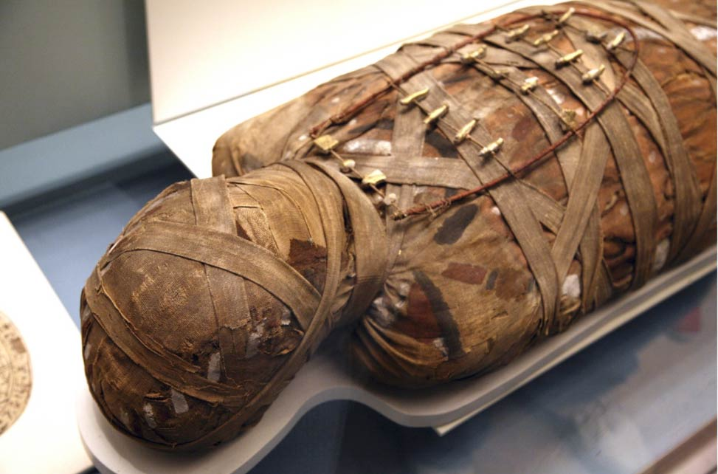
HISTORY OF EMBALMING
DR. PRAVEEN KURREY
MBBS, MS, BCME, BCBR, CISP PROFESSOR ANATOMY

Slide 2
EMBALMING
Embalming is the art and science of preserving human remains by treating them with chemicals in modern times to forestall decomposition
Uses
Funeral Ceremonies
Medical purposes in an anatomical laboratory
Preservation

Slide 3
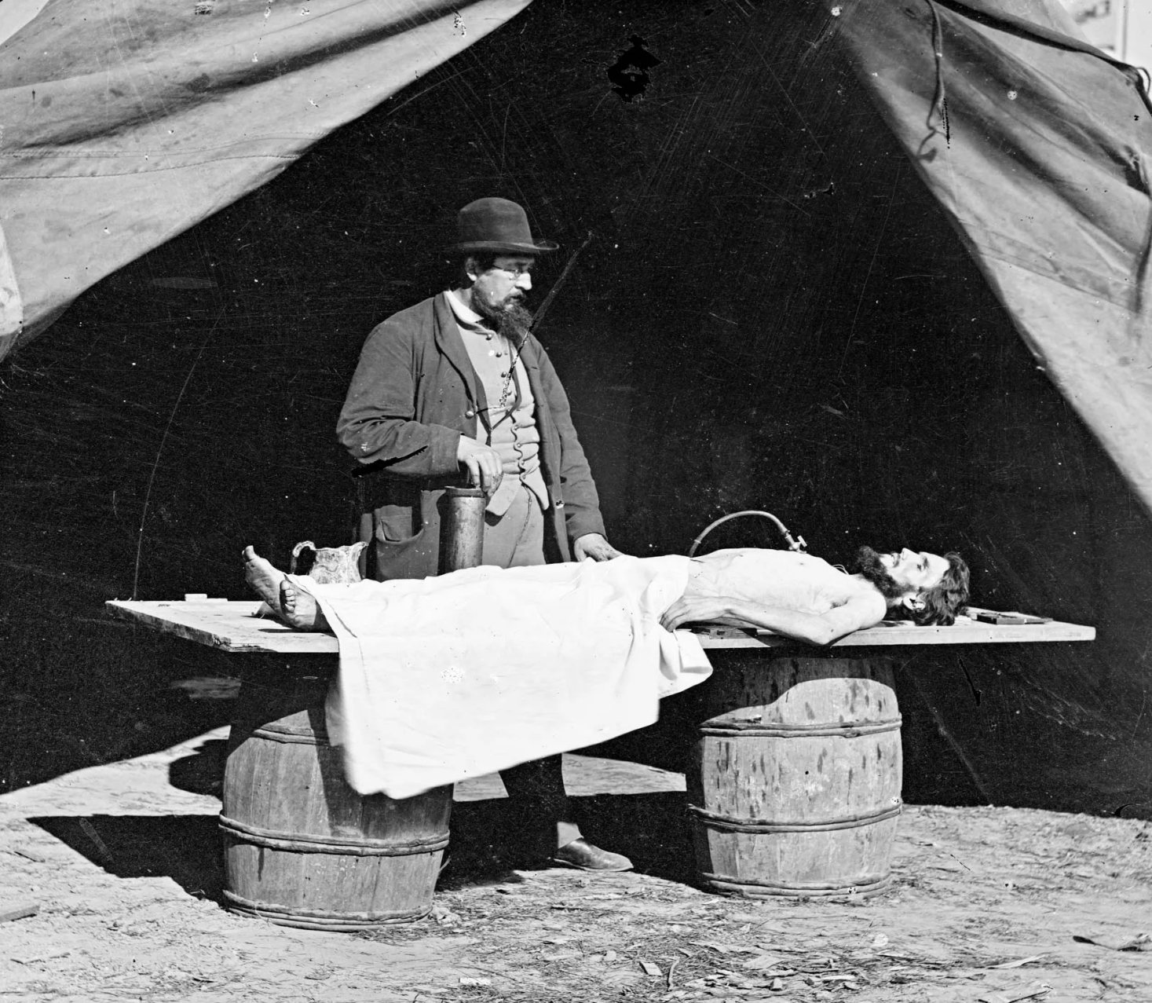
Dr Richard Burr performing embalming

Slide 4
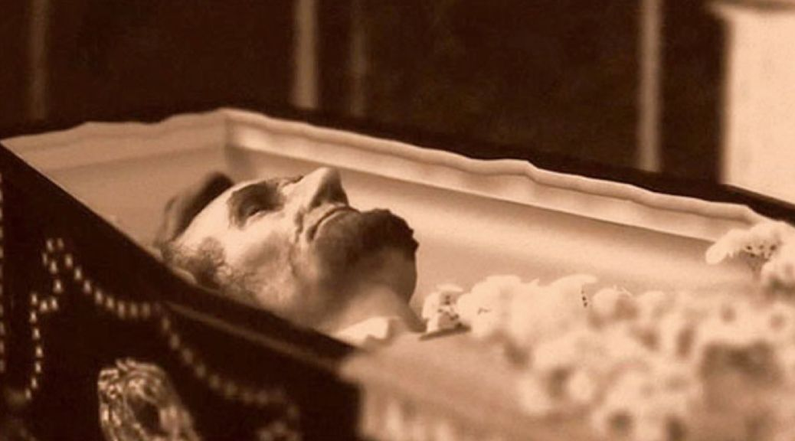
President Abraham Lincoln embalmed after assassination in 1865

Slide 5
HISTORY OF EMBALMING
EGYPTIAN PERIOD
Embalming originated in Egypt, presumably in 3200 BC (period of first dynasty) and continued on until 650 AD.
Egyptians believed in immortality and physical resurrection.
The need for embalming the bodies of the dead in Egypt was associated with religious beliefs that in order to revive a person in the next life, his body in this life should remain intact.
Egyptians got the idea of embalming from the basic process of preserving food which was adapted to preserve the dead.

Slide 6
Other than Egypt, ancient Babylonians, Sumerians and Greeks also practiced very superficial kind of embalming anointing the body with unguents, perfumes and spices.
While the steps in embalming sometimes varied from dynasty to dynasty according to custom and the individual embalmer’s technique, they also varied according to the wealth of the deceased.
Early Technique involved usage of Natron salt for dehydration and then covering with rope/mat/clothes.
Later on myrrh, cinnamon and other aromatic resins & perfumes were used aesthetically in process of embalming.

Slide 7
Steps In Egyptian Preparation
Removal of the Brain
Evisceration
Covering with Natron
Removal from Natron
Wrapping and Spicing

Slide 8
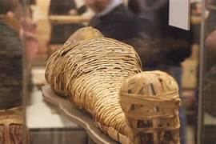
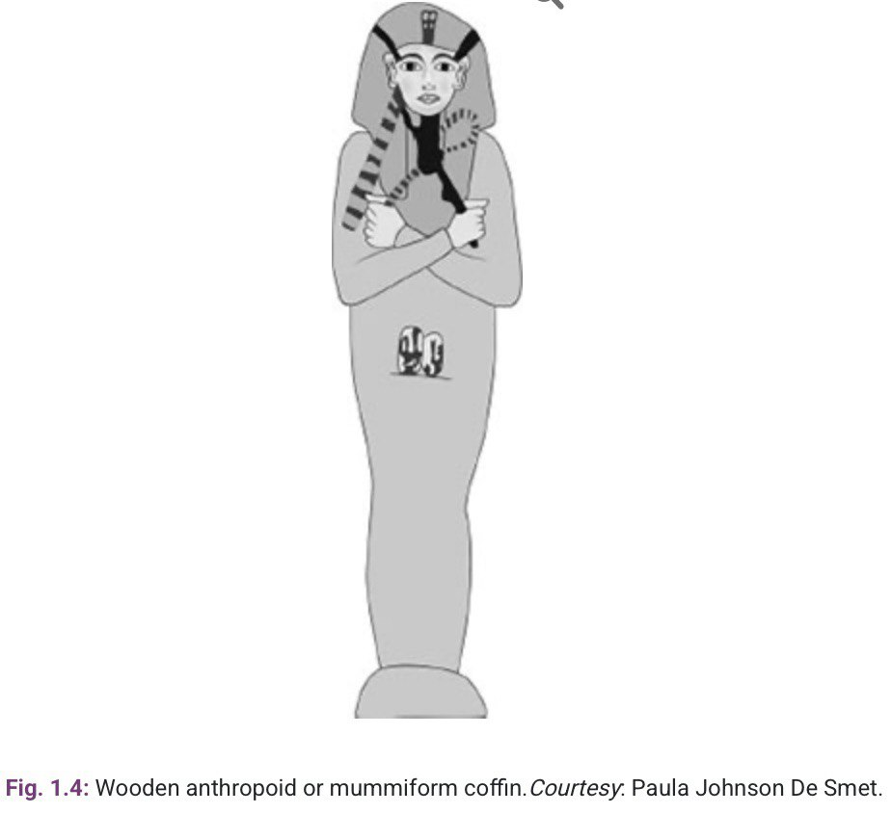
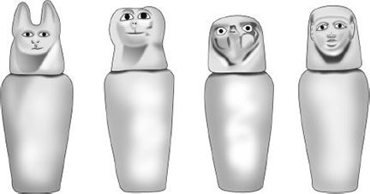

Slide 9
Renaissance & The Middle Age Period
During the Middle ages and the Renaissance a modest amount of embalming was done by specialists who were skilled embalmers with the use of costly spices, unguents, wax, and wrappings.
The great interest in anatomy and surgery during the Renaissance stimulated experiments with other embalming methods.
Leonardo da Vinci, who dissected at least 50 cadavers for study, developed a method of venous injection for preserving them that anticipated modern embalming procedures.
The use of chemical injection to preserve bodies was first made possible in 17th century by William Harvey, an English physician who was the first to study the circulatory system in detail.

Slide 10
One of the best accounts of non anatomical embalming for burial purposes is related by Dutch physician Peter Forestus (1522-1597). He performed embalming of certain eminent personalities like Princess Auractus of Holland and Countess of Haunte Kerken of Holland.
Scottish Anatomists William Hunter & John Hunter in late 1700s innovated embalming techniques. They used cadavers for teaching anatomy and understanding medical procedures.
One of most prominent contribution to embalming was given by French military doctor Jean-Nicolas Gannal(1791-1852). He published his book Histoire des Embaumements in 1838.
This book translated in English became the basis of embalming and spread to USA in modern period, naming the process after scientist the Gannal process.

Slide 11
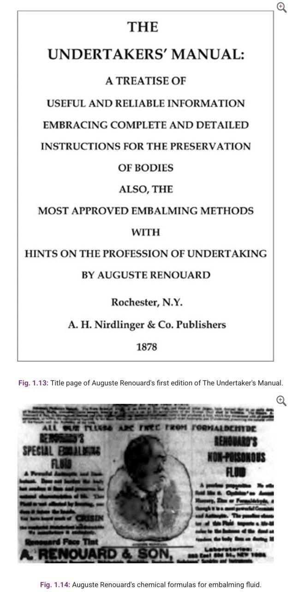
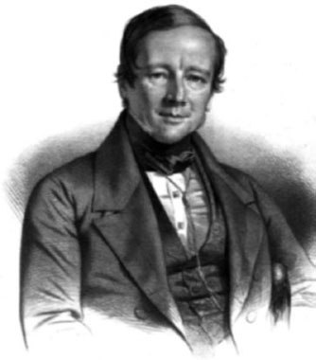
Dr. Jean-Nicolas Gannal

Slide 12
MODERN PERIOD
In United states, it wasn't until the civil war era that embalming became widespread. Indeed, demand for embalming grew during this period, mostly for sentimental and practical reasons.
The families of soldiers who died in battle in for off location wanted to see their loved ones and have chance to display their body for other to pay their respect.
Dr Thomas Holmes along with acquaintance William J Bunnell during civil war is said to embalm almost 4000 bodies(including 8 army generals).
President Abraham Lincoln was embalmed in 1865 by team of Dr Brown and Dr Joseph Alexander among others.
Joseph Henry Clarke with help of anatomist Dr CM Lukens established a premier institute, Cincinnati College of Embalming in Ohio, USA.

Slide 13
After end of World War II, the availability resources led to innovaton of newer devices whivch are in use till date. The concept of utilizing externally generated agitation to assist in blood removing using pulsatile devices became popular.
Another innovation was development of a conventional embalming fluid by the Switzer Corporation of Cleveland that contained a fluorescent dye. This dye acts as a tracer or indicator of the degree of circulation or penetration of the embalming fluid when viewed under UV light.
In the wake of Hiroshima and Nagasaki and other major disasters such as airline crashes, earthquakes a search was instituted for some new means of quickly preserving of huge number of deads.
No process tried to seemed to be capable of such load. The search continues!

Slide 14
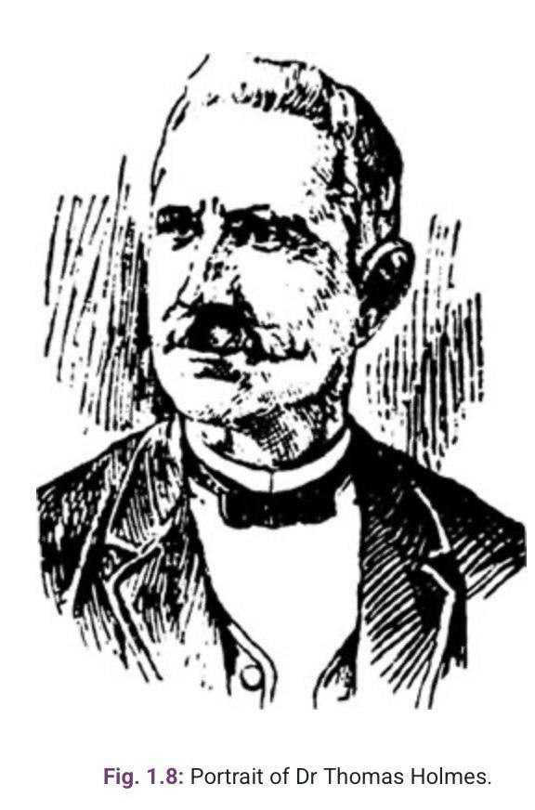
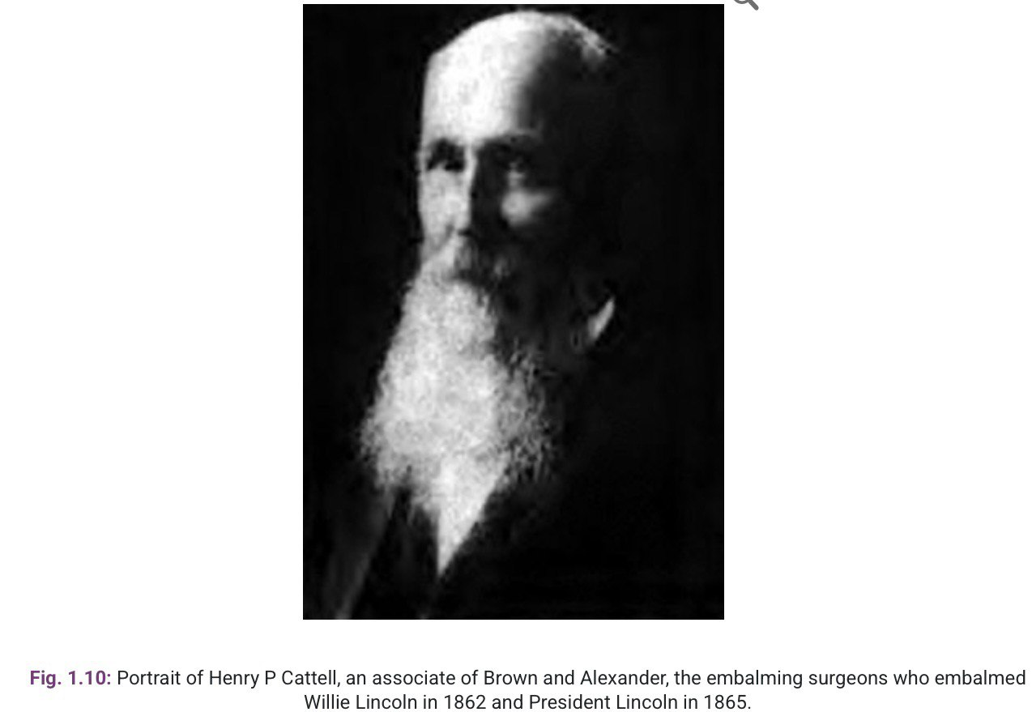

Slide 15
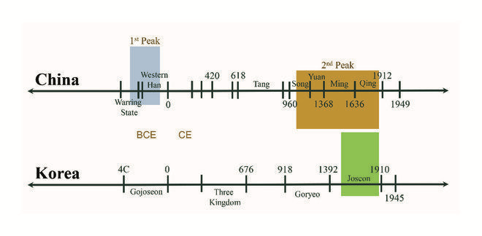
Various communist leaders have been embalmed and put on public display. Perhaps the most famous embalmed body of the 20th century is that of Vladimir Lenin.
Joseph Stalin was also embalmed and placed next to Lenin, but his body was buried in 1961 during de-Stalinization.
Currently, embalmed communist leaders can also be found in the Mausoleum of Mao Zedong, the Ho Chi Minh Mausoleum, and the Kumsusan Palace of the Sun for Kim Il Sung and Kim Jong Il.

Slide 16
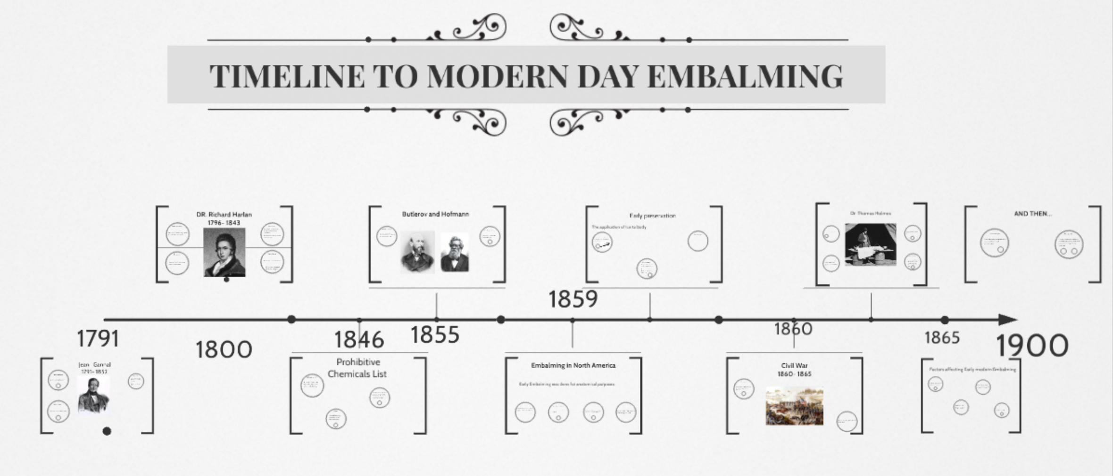

Slide 17
REFRENCES
The Origin and History of Embalming by Edward C Johnson, Gail R Johnson& Mellissa J Williams https://www.jaypeedigital.com/eReader/chapter/9789389129748/ch1
The Egyptian Period in the History of Embalming https://pdfs.semanticscholar.org/7526/5ae1d8678d254f9dba07739156b91d51841b.pdf
Embalming –History https://www.britannica.com/topic/embalming https://en.wikipedia.org/wiki/Embalming
History of Embalming
https://www.brattonfuneral.com
Human body preservation- old and new techniques
https://pmc.ncbi.nlm.nih.gov/articles/PMC3931544/

Slide 18


