Slide 1
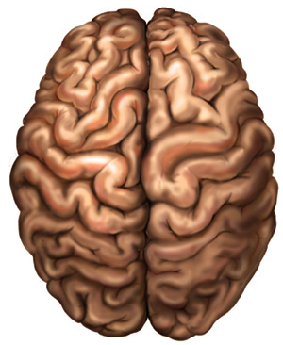
CENTRAL NERVOUS SYSTEM
THE BRAIN
Dr. Praveen Kumar Kurrey
M.B.B.S., M.S.,BCME, BCBR
Professor Anatomy

Slide 2
Nervous System
Central Nervous System (CNS)
  Brain (in the skull)
  Spinal Cord (in the spine)
Peripheral Nervous System (PNS)
  Located outside of the skull and spine
  Serves to bring information into the CNS and carry signals out of the CNS

Slide 3
Nervous System
Peripheral Nervous System
  Somatic Nervous System
    Afferent nerves (sensory)
    Efferent nerves (motor)
  Autonomic Nervous System
    Sympathetic and parasympathetic nerves
    Both are efferent

Slide 4
Autonomic Nervous System
Sympathetic
Thoracolumbar
“fight or flight”
Second stage neurons are far from the target organ
Parasympathetic
Craniosacral
“rest and restore”
Second stage neurons are near the target organ

Slide 5
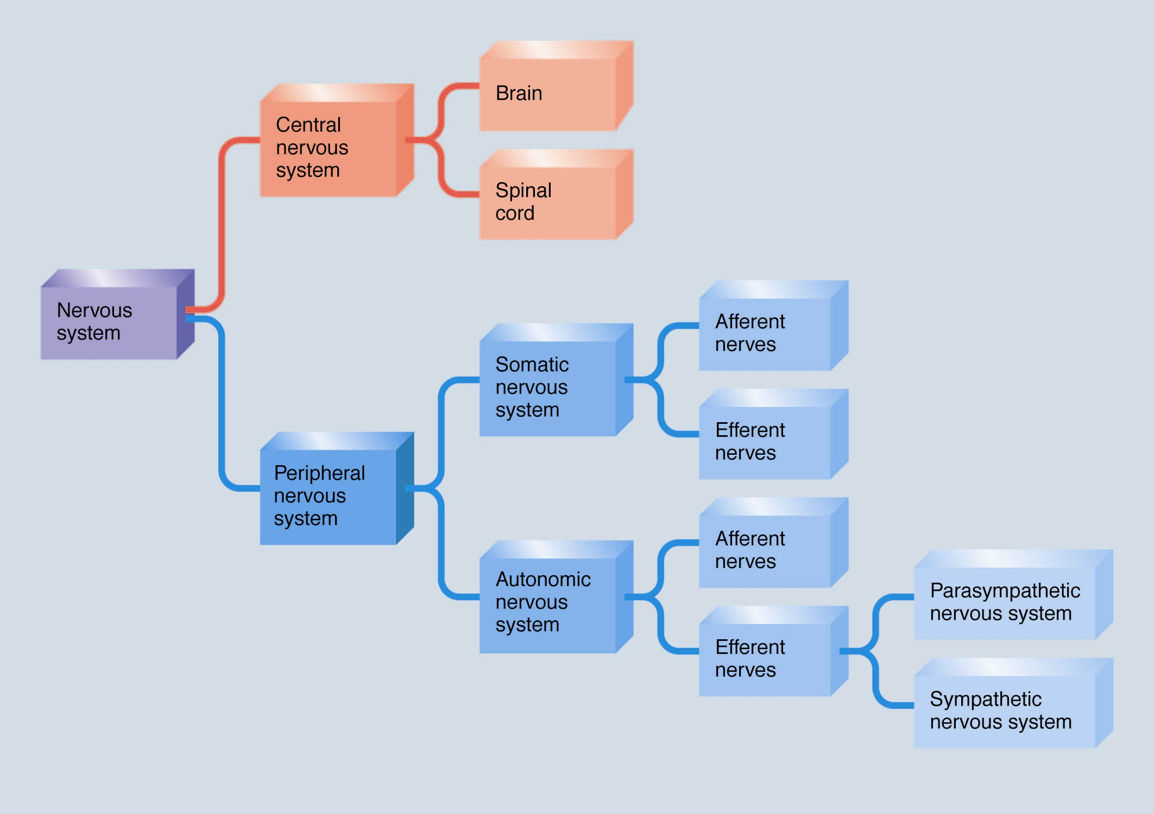

Slide 6
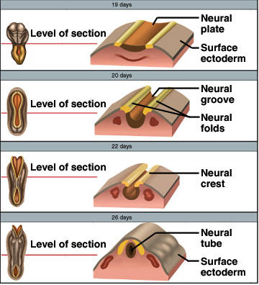
Embryonic Development
Nervous system develops from ectoderm
  by 3rd week, neural plate becomes a
  groove with neural folds along each
  side
  by 4th week, neural folds join to
  form neural tube
  lumen of the neural tube develops
  into central canal of
  spinal cord & ventricles of the brain
  cells along the margin of the neural
  groove is called the neural crest
    develop into sensory and sympathetic neurons & schwann cells
  by 4th week, neural tube exhibits 3 anterior dilations

Slide 7
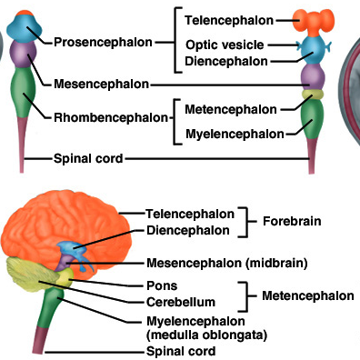
Brain Development
4th week
  forebrain
  midbrain
  hindbrain
5th week
  telencephalon
  diencephalon
  mesencephalon
  metencephalon
  myelencephalon

Slide 8
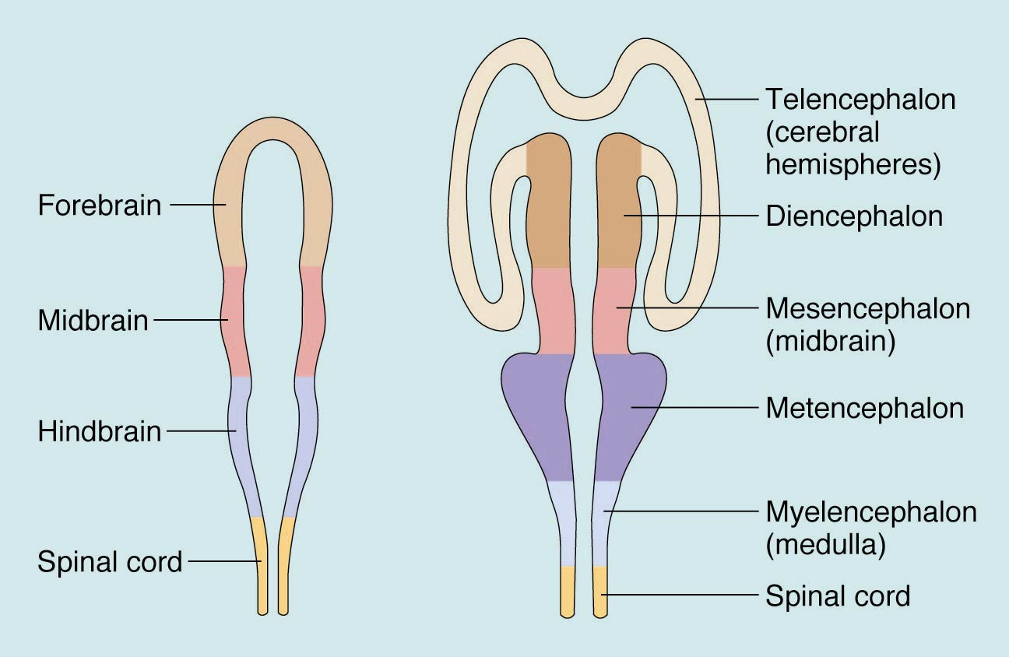
Primary Brain Vesicles

Slide 9
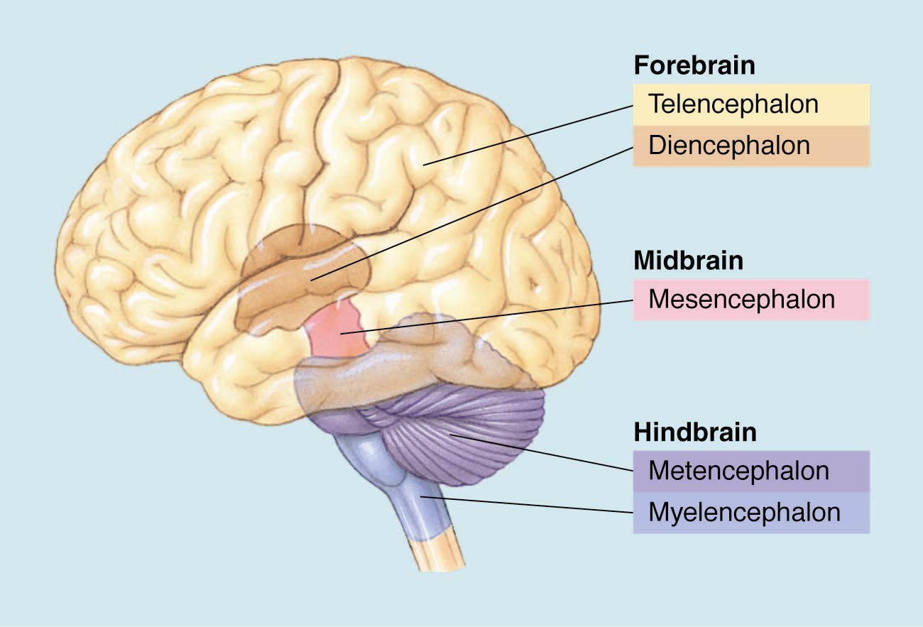
Primary and Secondary Brain Vesicles

Slide 10
Cells of the Nervous System
Neurons – structural classes
  Multipolar
  Unipolar
  Bipolar
  Interneurons
Glial cells – various types, provide a wide variety of supportive functions

Slide 11
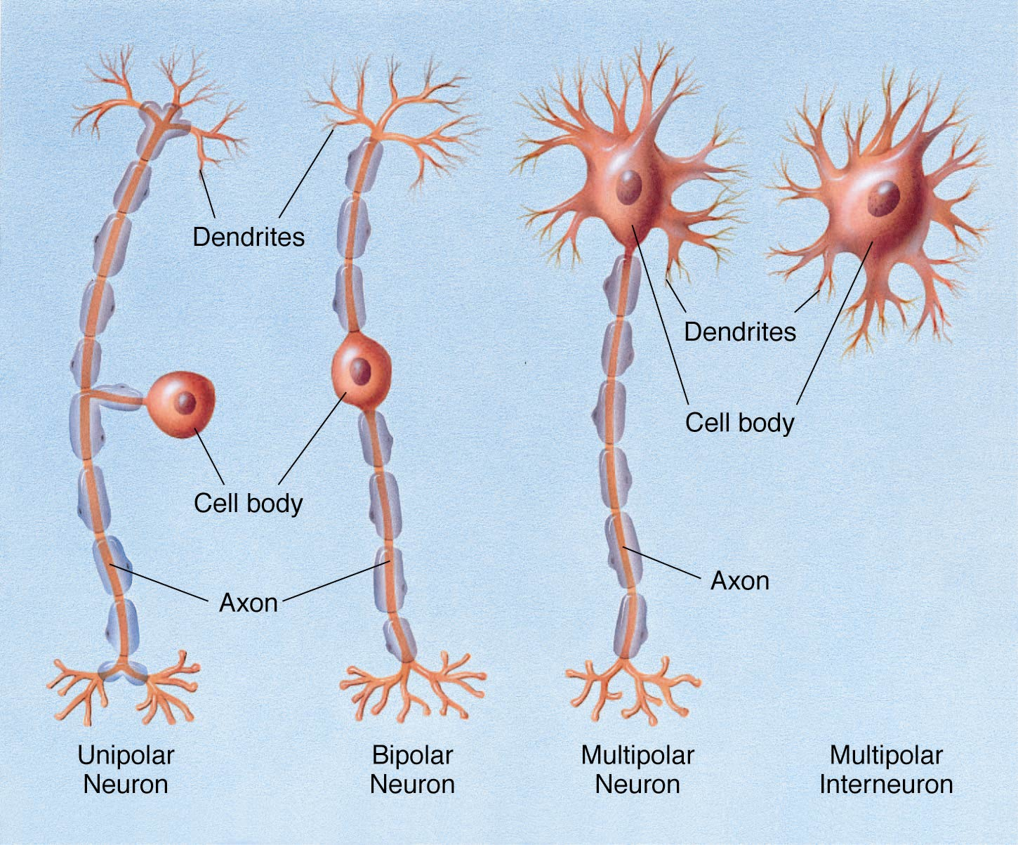

Slide 12
Glial Cells
Myelin producers
  Oligodendrocytes (CNS)
  Schwann cells (PNS)
Astrocytes – largest glia, many functions
Microglia – involved in response to injury or disease

Slide 13
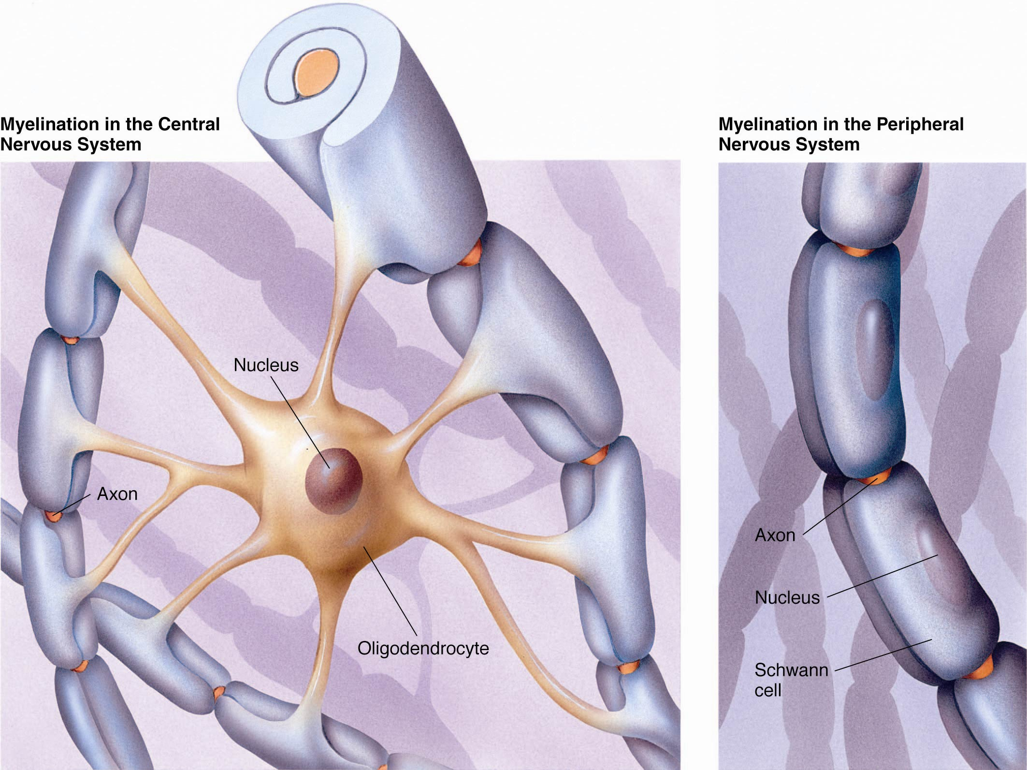

Slide 14
Terminology Note
 | CNS | PNS
Myelin-providing glia | Oligodendrocytes | Schwann Cells
Clusters of cell bodies | Nuclei (singular nucleus) | Ganglia (singular ganglion)
Bundles of axons | Tracts | Nerves

Slide 15
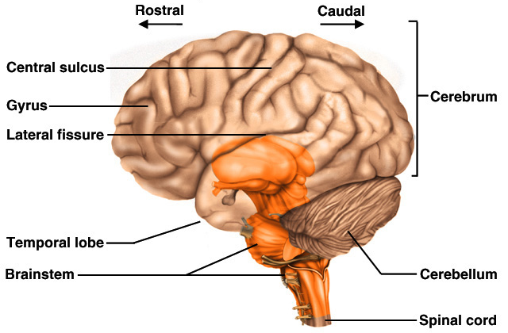
Brain
Brain weighs 3 to 3.5 pounds
Major portions of the brain--brainstem, cerebrum, and cerebellum
  cerebrum is 83% of brain volume; cerebellum contains 50% of the neurons

Slide 16
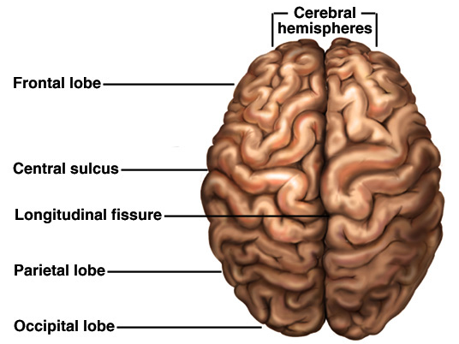
Brain
Longitudinal fissure separates 2 cerebral hemispheres.
Central sulcus separates frontal and parietal lobe.

Slide 17
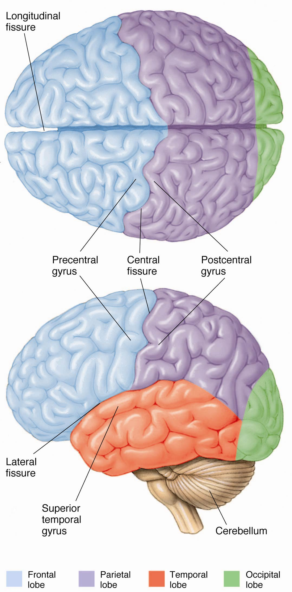

Slide 18
Meninges
Dura mater -- outermost, tough membrane
  outer periosteal layer against bone
  where separated from inner meningeal layer forms dural venous sinuses draining blood from brain
  supportive structures formed by dura mater
    falx cerebri, falx cerebelli and tentorium cerebelli
  epidural space filled with fat in lower back region
    epidural anaesthesia during childbirth
Arachnoid mater is spider web filamentous layer
Pia mater is a thin vascular layer adherent to contours of brain

Slide 19
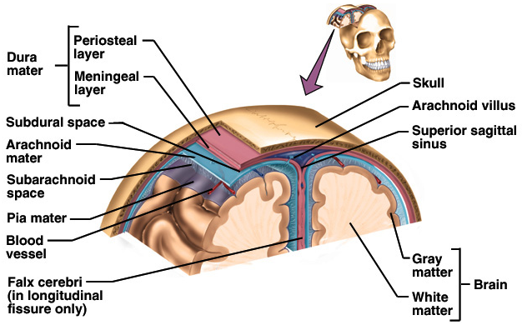
Cranial Meninges

Slide 20
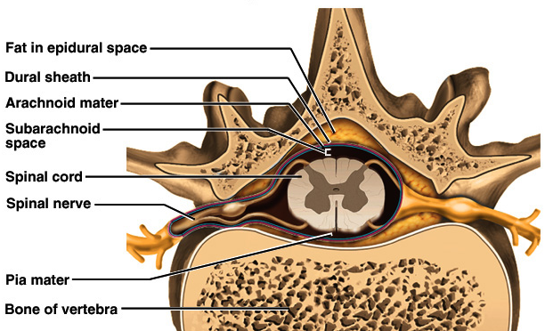
Meninges of Vertebra & Spinal Cord

Slide 21
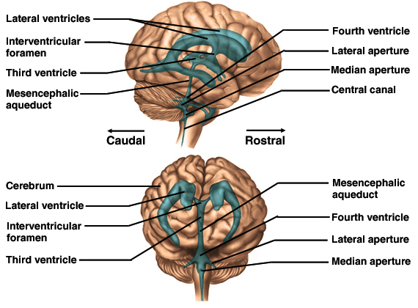
Brain Ventricles

Slide 22
Ventricles and Cerebrospinal Fluid
Internal chambers within the CNS
  lateral ventricles found inside cerebral hemispheres
  third ventricle is single vertical space under corpus callosum
  cerebral aqueduct runs through midbrain
  fourth ventricle is small chamber between pons & cerebellum
  central canal runs down through spinal cord
Lined with ependymal cells and containing choroid plexus of capillaries that produce CSF

Slide 23
Cerebrospinal Fluid
Clear liquid fills ventricles and canals & bathes its external surface (in subarachnoid space)
Brain produces & absorbs about 500 ml/day
  filtration of blood through choroid plexus
  has more Na+ & Cl- but less K+ & Ca+2 than plasma
Functions
  buoyancy -- floats brain so it neutrally buoyant
  protection -- cushions from hitting inside of skull
  chemical stability -- rinses away wastes
Escapes from 4th ventricle to surround the brain
Absorbed by arachnoid villi into venous sinus

Slide 24
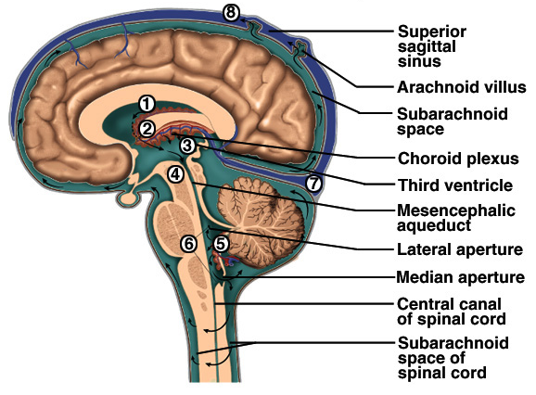
Flow of Cerebrospinal Fluid

Slide 25
Anatomy of the Spinal Cord
Ropelike bundle of nerve tissue within the vertebral canal (thick as a finger)
  vertebral column grows faster so in an adult the spinal cord only extends to L1
31 pairs of spinal nerves coming from cervical, thoracic, lumbar or sacral regions of the cord
  named for level of vertebral column where nerves exit
Cervical & lumbar enlargements in cord
Medullary cone is tapered tip of spinal cord
Cauda equinae is L2 to S5 nerve roots resemble horse’s tail

Slide 26
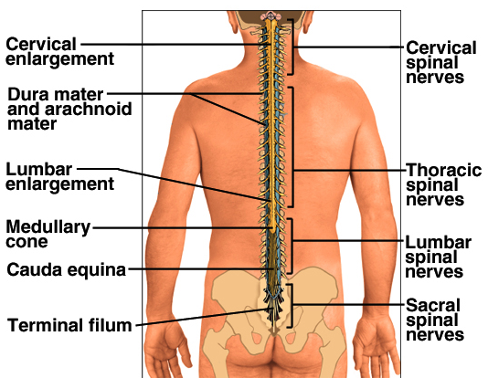
Gross Anatomy of the Spinal Cord

Slide 27
Functions of the Spinal Cord
Conduction
  bundles of fibers passing information up & down spinal cord
Locomotion
  repetitive, coordinated actions of several muscle groups
  central pattern generators are pools of neurons providing control of flexors and extensors (walking)
Reflexes
  involuntary, stereotyped responses to stimuli
    remove hand from hot stove

Slide 28
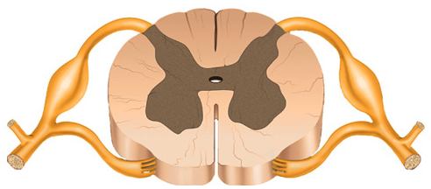
Gray Matter
Pair of dorsal or posterior horns
  dorsal root of spinal nerve is totally sensory fibers
Pair of ventral or anterior horns
  ventral root of spinal nerve is totally motor fibers
Connected by gray commissure punctured by a central canal continuous above with 4th ventricle

Slide 29
White Matter
Bundles of myelinated axons that run up & down
Dorsal or posterior columns or funiculi
Lateral columns or funiculi
Anterior columns or funiculi
Each column is filled with tracts or fasciculi

Slide 30
Major Structures of the Brain
Myelencephalon = medulla
  Composed largely of tracts
  Origin of the reticular formation
Metencephalon
  Many tracts
  Pons – ventral surface
  Cerebellum - coordination

Slide 31
Major Structures of the Brain
Mesencephalon
  Tectum (dorsal surface)
    Inferior colliculi – audition
    Superior colliculi - vision
  Tegmentum (ventral) – 3 ‘colorful’ structures
    Periaqueductal gray – analgesia
    Substantia nigra – sensorimotor
    Red nucleus– sensorimotor

Slide 32
Major Structures of the Brain
Diencephalon
  Thalamus – sensory relay nuclei
  Hypothalamus
    Regulation of motivated behaviors
    Controls hormone release by the pituitary
Telencephalon
  Cerebral cortex
  Limbic system
  Basal ganglia

Slide 33
Telencephalon – Cerebral Cortex
Convolutions serve to increase surface area.
Longitudinal fissure – a groove that separates right and left hemispheres
Corpus callosum – largest hemisphere-connecting tract

Slide 34
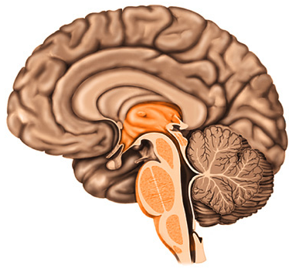
Medulla Oblongata
3 cm extension of spinal cord
Ascending & descending nerve tracts
Nuclei of sensory & motor cranial
nerves (IX, X, XI, and XII)
Cardiac center adjusts rate & force of heart beat
Vasomotor center adjusts blood vessel diameter
Respiratory centers control rate & depth of breathing
Reflex centers for coughing, sneezing, gagging, swallowing, vomiting, salivation, sweating, movements of tongue & head
Pyramids and olive visible on surface

Slide 35
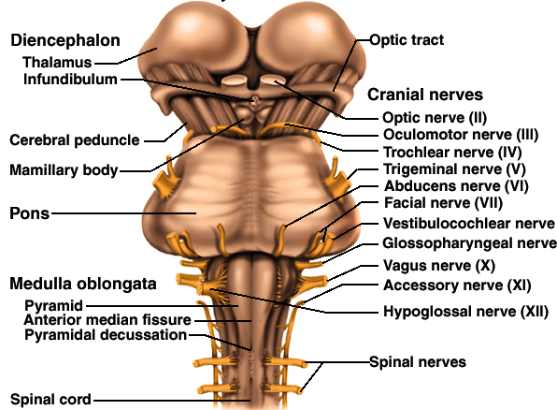
Medulla and Pons
Olive

Slide 36
Pons
Bulge in the brainstem, rostral to
the medulla
Ascending sensory tracts
Descending motor tracts
Pathways in & out of cerebellum
Nuclei concerned with sleep, hearing, balance, taste, eye movements, facial expression, facial sensation, respiration, swallowing, bladder control & posture
  cranial nerves V, VI, VII, and VIII

Slide 37
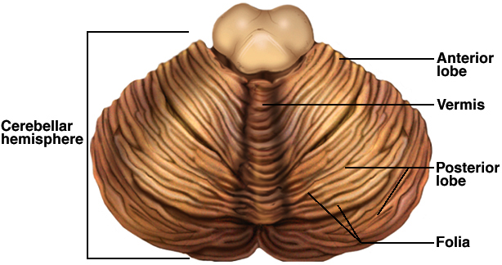
Cerebellum
Right & left hemispheres connected by vermis
Parallel surface folds called folia are gray matter
  all of output comes from deep gray nuclei
  large cells in single layer in cortex are purkinje cells synapse on deep nuclei

Slide 38
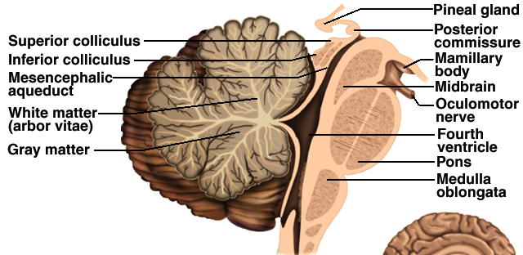
Cerebellum
Connected to brainstem by cerebellar peduncles
White matter (arbor vitae) visible in sagittal section
Sits atop the 4th ventricle

Slide 39
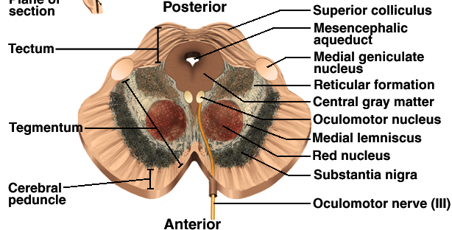
Midbrain, Cross Section
Mesencephalon
Central aqueduct
CN III and IV
  eye movement
Cerebral peduncles hold corticospinal tract
Tegmentum connects to cerebellum & helps control fine movements through red nucleus
Substantia nigra sends inhibitory signals to basal ganglia & thalamus (degeneration leads to tremors and Parkinson disease)

Slide 40
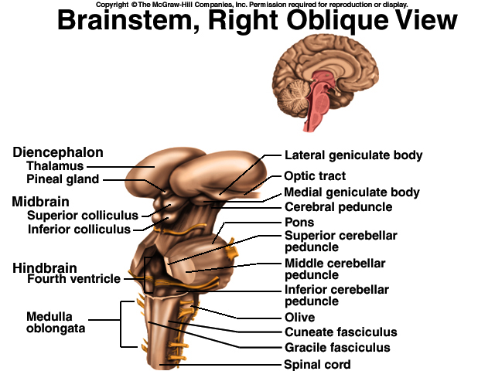
Superior & Inferior Colliculus
Tectum (4 nuclei) called corpora quadrigemina
  superior colliculus (tracking moving objects )
  inferior colliculus (reflex turning of head to sound)

Slide 41
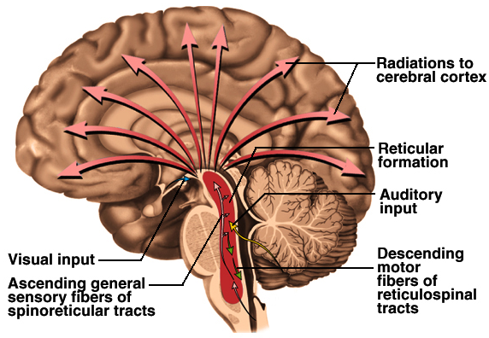
Reticular Formation
Clusters of gray matter
scattered throughout pons,
midbrain & medulla
Regulate balance & posture
  relaying information from
  eyes & ears to cerebellum
  gaze centers allow you to track moving object
Includes cardiac & vasomotor centers
Origin of descending analgesic pathways
Regulates sleep & conscious attention
  injury leads to irreversible coma

Slide 42
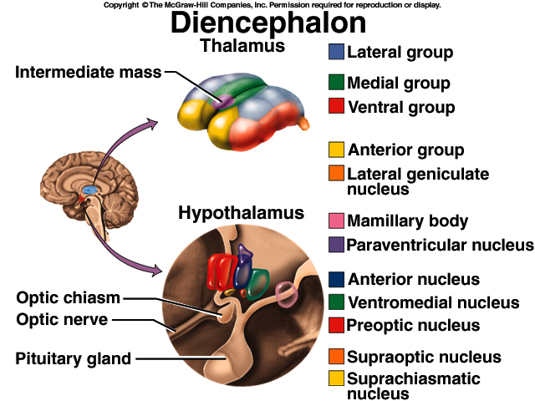
Thalamus
Oval mass of gray matter protruding into lateral ventricle (part of diencephalon)
Receives nearly all sensory information on its way to cerebral cortex
  integrate & directs information to appropriate area
Interconnected to limbic system so involved in emotional & memory functions

Slide 43
Hypothalamus
Walls & floor of 3rd ventricle
Functions
  hormone secretion & pituitary
  autonomic NS control
  thermoregulation (thermostat)
  food & water intake (hunger & satiety)
  sleep & circadian rhythms
  memory (mammillary bodies)
  emotional behavior

Slide 44
Epithalamus (Pineal Gland)

Slide 45
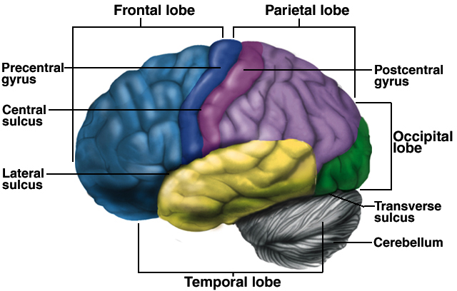
Cerebrum -- Gross Anatomy
Cerebral cortex is 3mm layer of gray matter with extensive folds to increase surface area ---- divided into lobes

Slide 46
Functions of Cerebrum Lobes
Frontal contains voluntary
motor functions and areas for
planning, mood, smell and
social judgement
Parietal contains areas for sensory reception & integration of sensory information
Occipital is visual center of brain
Temporal contains areas for hearing, smell, learning, memory, emotional behavior
Insula is still little known

Slide 47
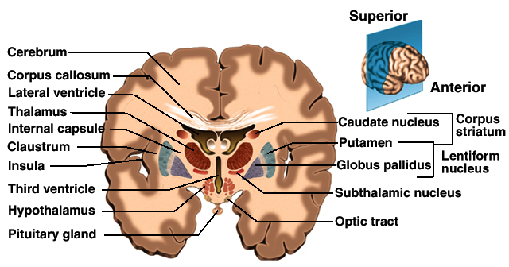
Basal Nuclei / Ganglia
Masses of gray matter deep to cerebral cortex
Receive input from substantia nigra & motor cortex & send signals back to these regions
Involved in motor control & inhibition of tremors

Slide 48
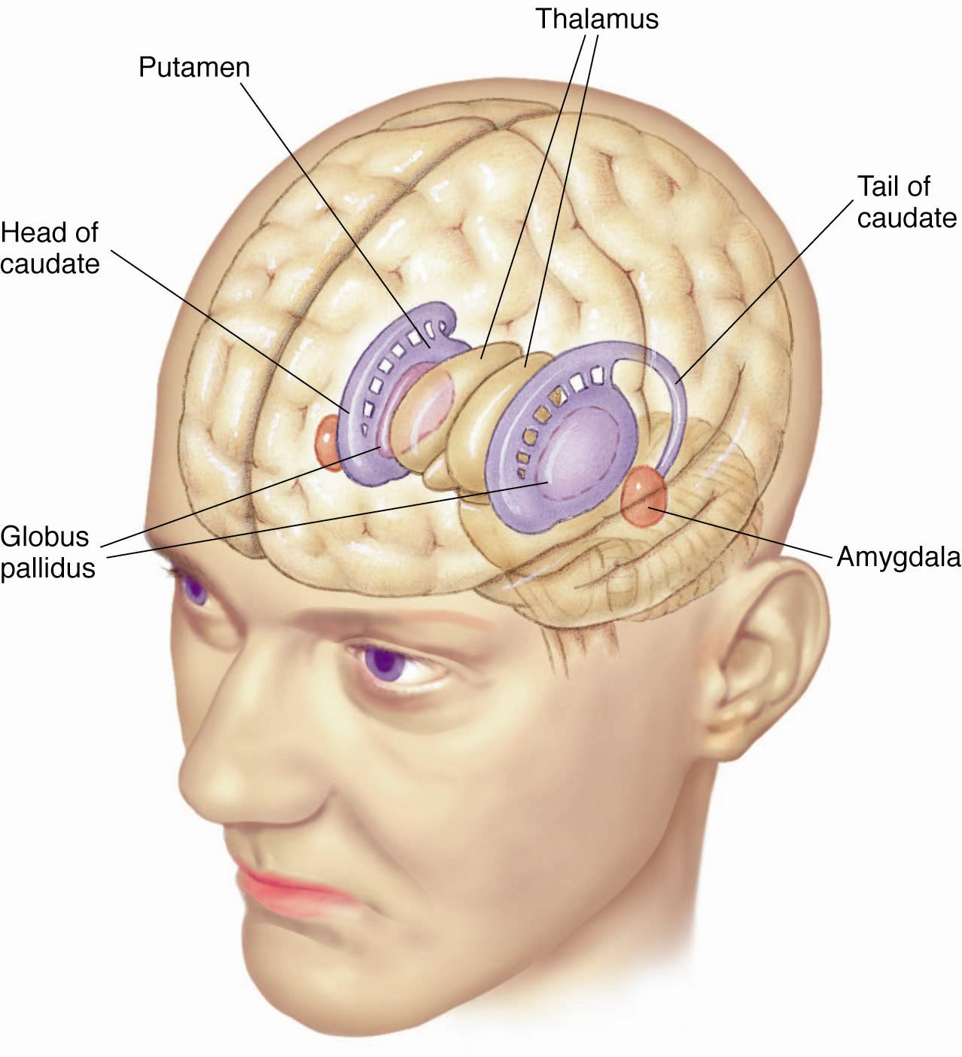

Slide 49
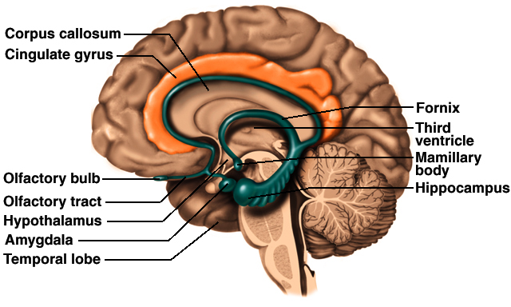
Limbic System
Loop of cortical structures surrounding deep brain
  amygdala, hippocampus, fornix & cingulate gyrus
Amydala important in emotions and hippocampus in memory -- rest are not sure

Slide 50
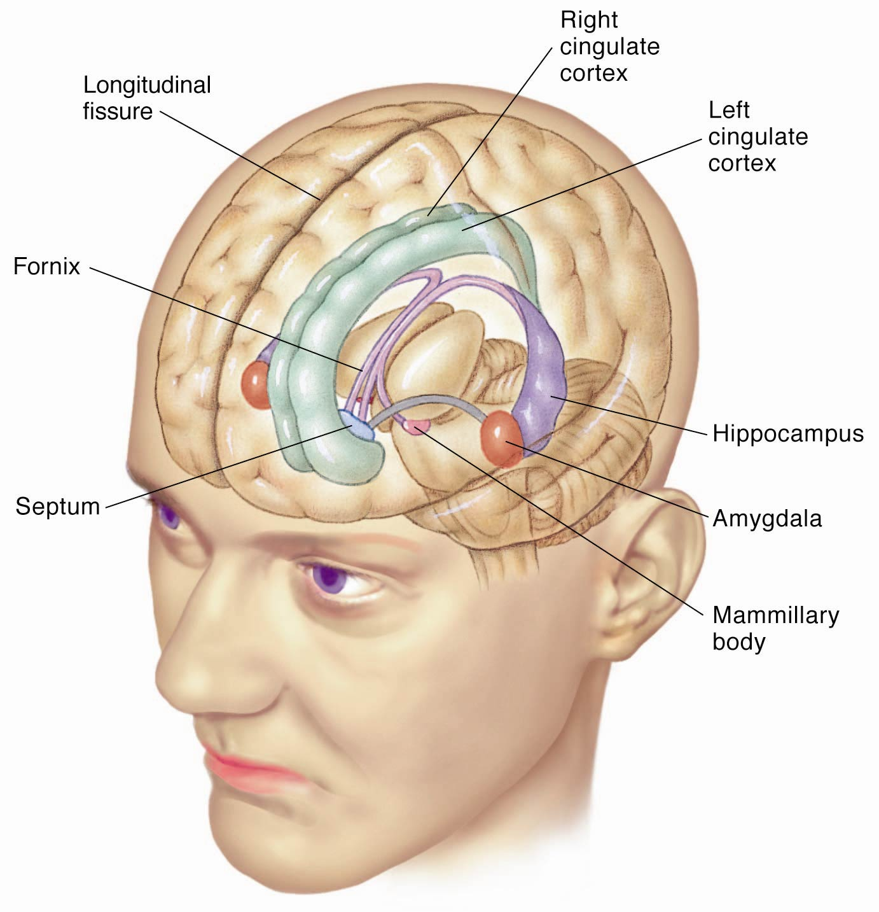

Slide 51
Special Senses
Organs of smell, vision, hearing & equilibrium project to specialized regions of the brain
Locations
  taste is lower end of postcentral gyrus
  smell is medial temporal lobe & inferior frontal lobe
  vision is occipital lobe
  hearing is superior temporal lobe
  equilibrium is mainly the cerebellum, but to unknown areas of cerebral cortex via the thalamus

Slide 52

THANK YOU

