Slide 1

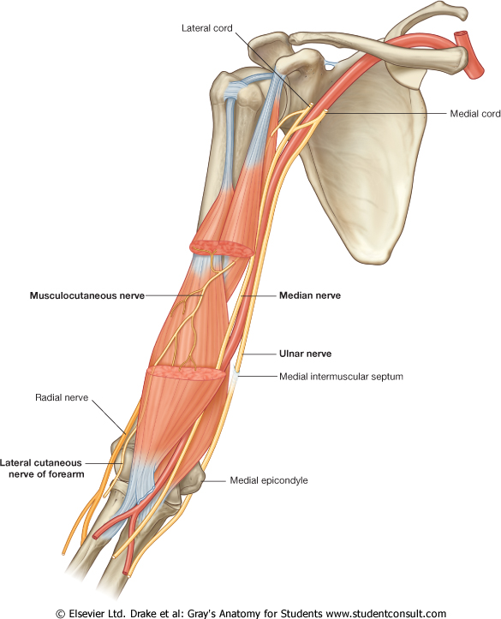
GROSS ANATOMY
ULNAR NERVE
Dr. Praveen Kumar Kurrey
M.B.B.S., M.S.,BCME, BCBR, CISP
Professor Anatomy

Slide 2
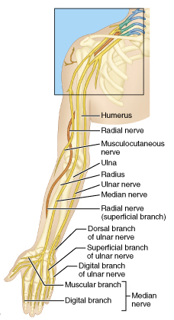
INTRODUCTION
  Branch of Medial cord.
  (C7) C8-T1
    C7- contribution from Communicating branch from Lateral root of median N .
  One of the terminal branch.
  Supplies small muscles in hand
  Called MUSICIAN’S Nerve.

Slide 3
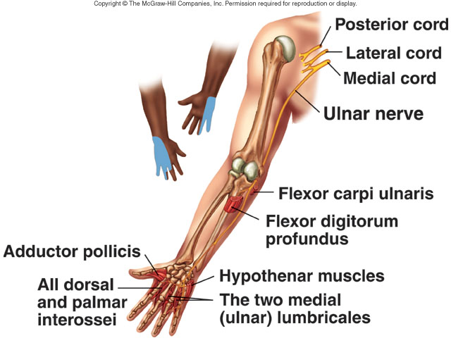
ULNAR NERVE
Origin: Medial Cord of Brachial Plexus: (C7) C8 &T1
Most easily damaged of all the peripheral nerves

Slide 4
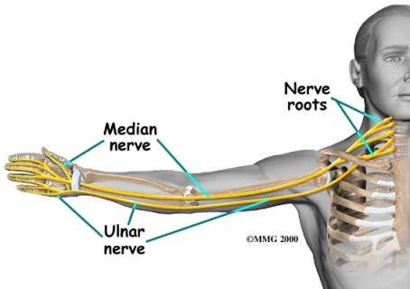

Slide 5
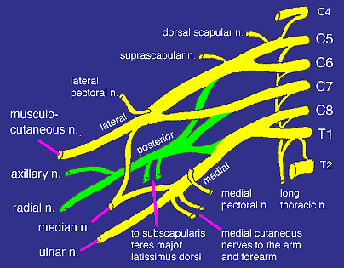
UPPER
Anterior
Posterior
MIDDLE
Anterior
Posterior
LOWER
Posterior
Anterior

Slide 6
Formation of Brachial plexus
Lateral cord
C5
UT
C6
C7
MT
Medial cord
C8
LT
T1
Posterior cord

Slide 7
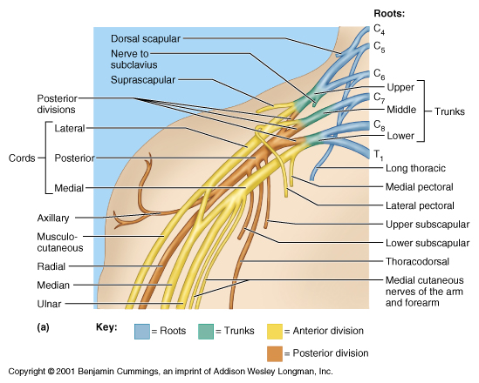
ULNAR NERVE : FORMATION

Slide 8
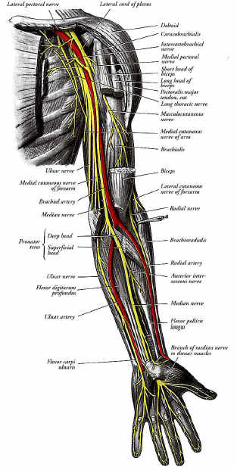
ULNAR NERVE : COURSE
In Axilla
Forms in Axilla.
Runs on medial side of axillary artery
  intervening bt . artery & vein

Slide 9
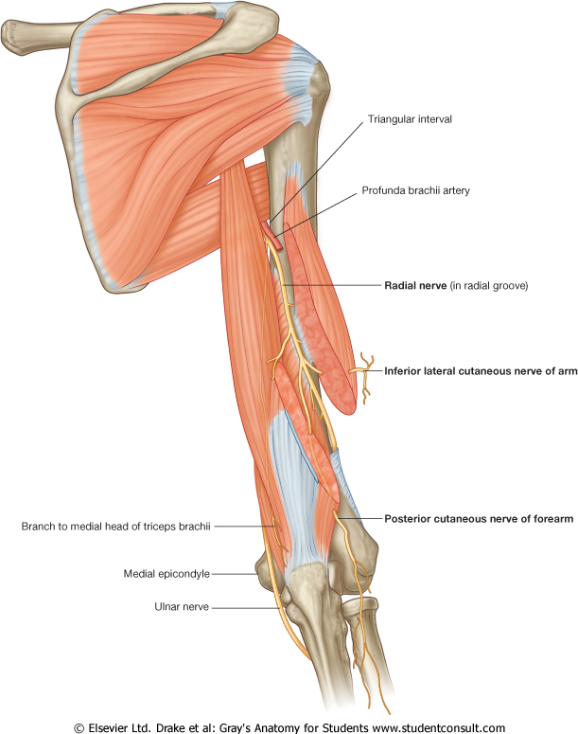
ULNAR NERVE
Ulnar nerve
Medial to brachial artery
Behind medial epicondyle

Slide 10
ULNAR NERVE : COURSE
In the Arm
Runs medial to Brachial Artery till middle.
Pierces IM septum &
enters posterior compartment.
Descends in front of medial head of Triceps along superior ulnar collateral artery (br of Brachial Art)

Slide 11
Ulnar nerve medial to artery
Enters posterior compt by piercing medial IM septum

Slide 12
Ulnar nerve lies infront of medial head of triceps
and then behind the medial epicondyle

Slide 13
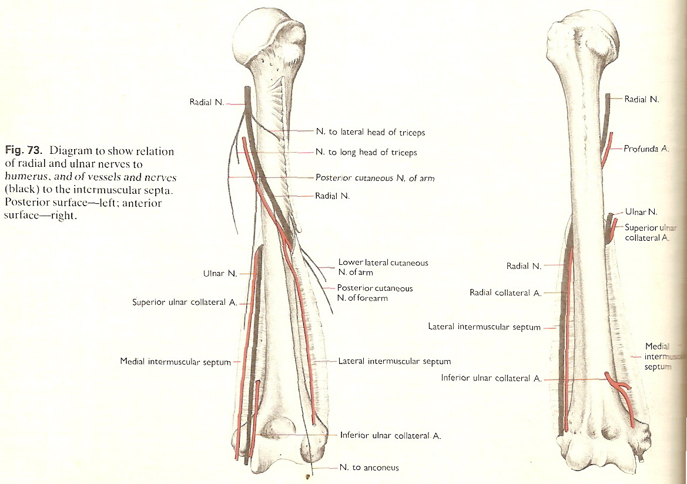
Posterior view
Anterior view
Shows relation of ulnar
and radial nerve in relation to humerus

Slide 14
ULNAR NERVE : COURSE
In Elbow
lies in a groove on dorsal aspect of medial epicondyle
  Interval between medial epicondyle and olecranon process.

Slide 15
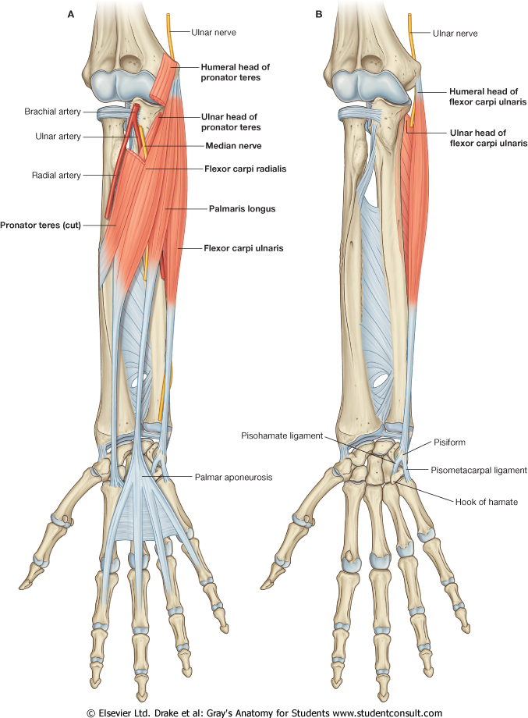
ULNAR NERVE : COURSE
In Forearm
Enters forearm
  between humeral & ulnar
  heads of Flexor carpi
  Ulnaris (FCU)-
  (Cubital Tunnel)
Lies superficial to
  posterior & oblique parts of
  ulnar collateral ligament of
  elbow joint.
Runs downwards
  in medial side of forearm.

Slide 16
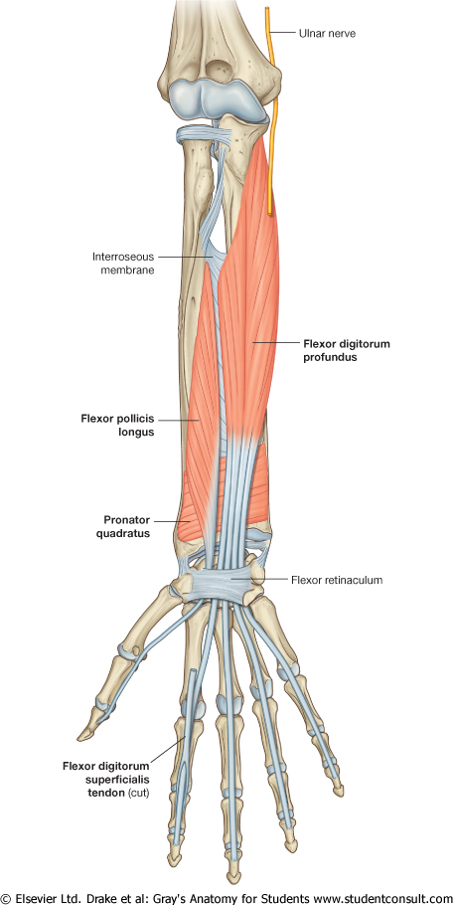
COURSE
Rest on
  FDP and under cover of FCU.
  Ulnar artery is lateral to nerve.
Gives palmar cutaneous and dorsal branch
Enters palm by passing over flexor retinaculum

Slide 17
Ulnar N enters between the two heads of FCU

Slide 18
Ulnar N rest on FDP undercover of FCU which has been removed here

Slide 19
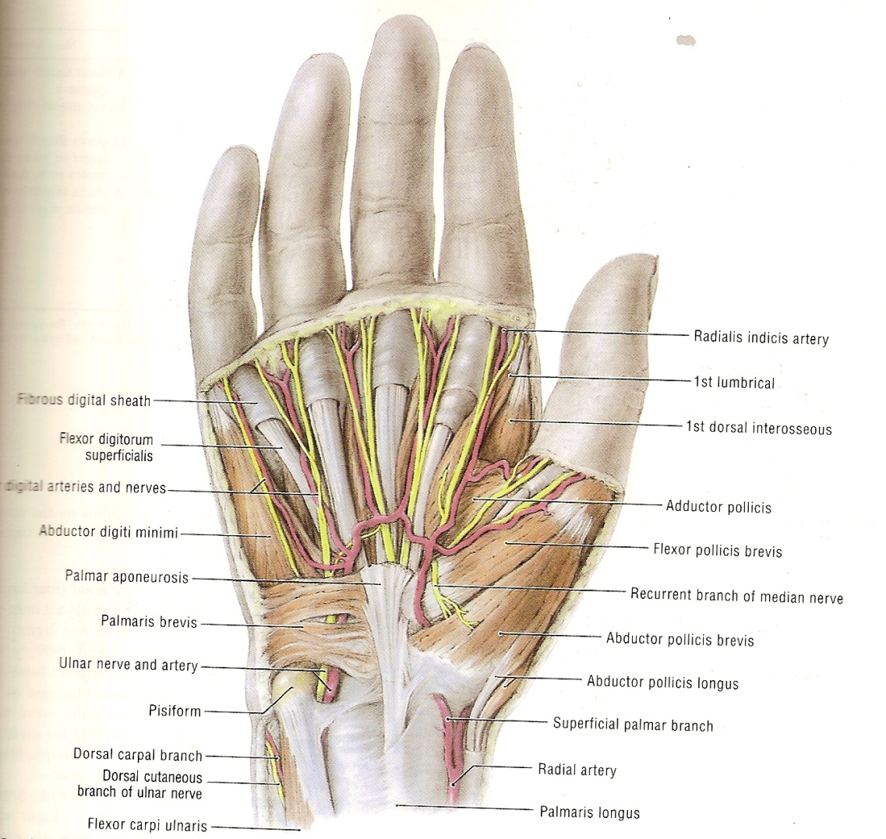
ULNAR NERVE : COURSE
At the Wrist
Enters palm by passing Superficial to flexor retinaculum.
  Ulnar N lies lateral to pissiform and
  medial to hook of hamate.
  Ulnar art is lateral to Nerve

Slide 20

COURSE
Both are bridged over
  by a slender band of fibrous tissue (superficial part of retinaculum)
  forming a canal – GUYON’S CANAL.
In Palm
In palm it passes deep to Palmaris brevis
  and divides into
    superficial &
    deep branches.

Slide 21
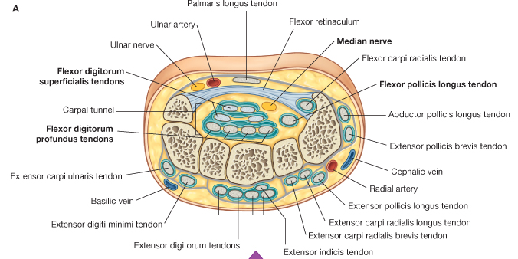

Slide 22
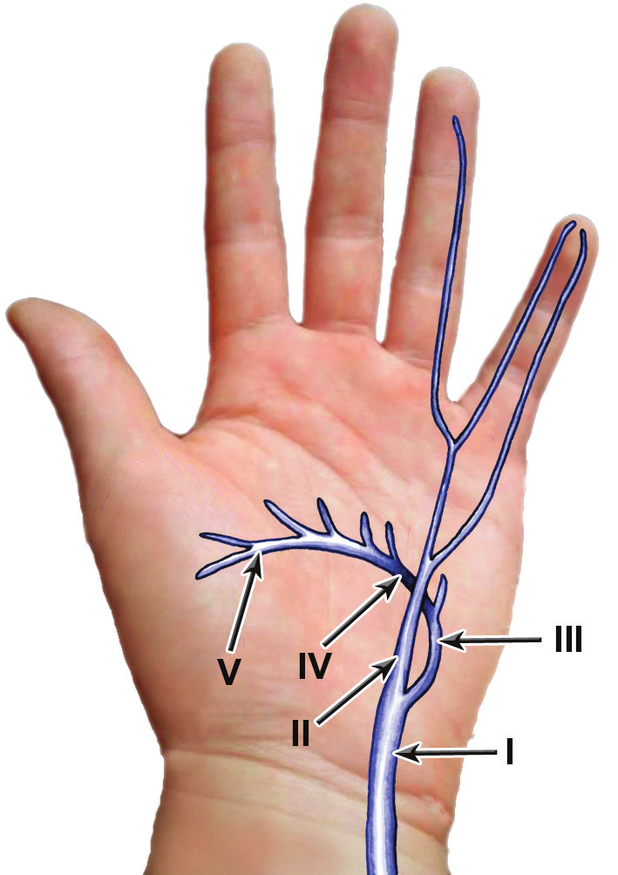
Superficial and Deep Branches of Ulnar Nerve

Slide 23
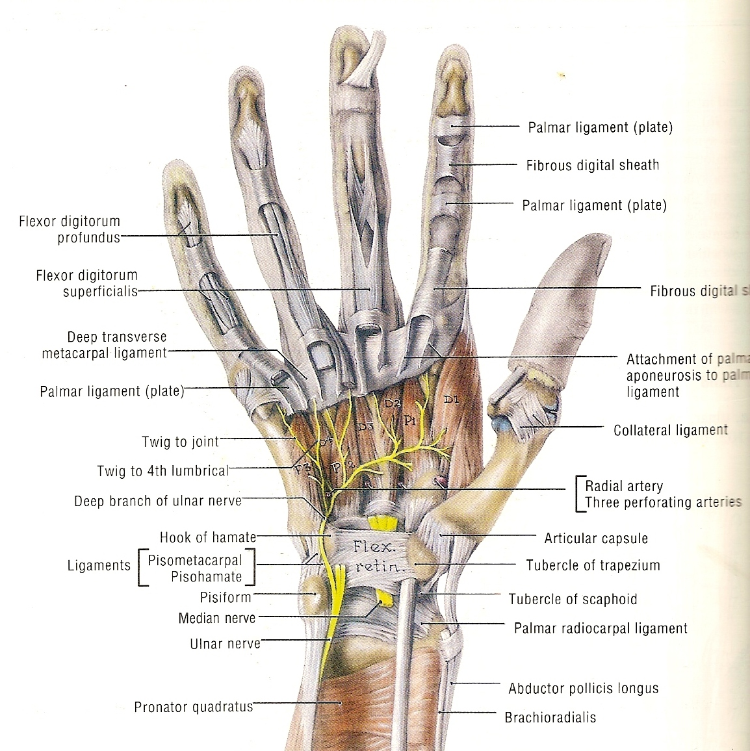
Right palm
Ulnar N lies lateral to pisiform and
medial to hook of hamate.

Slide 24
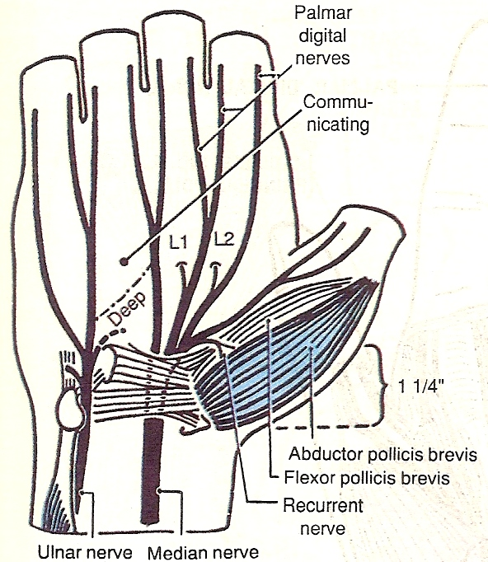
Right palm
Ulnar N lies lateral to pisiform and
medial to hook of hamate.
and divides into
superficial &
deep branches.

Slide 25
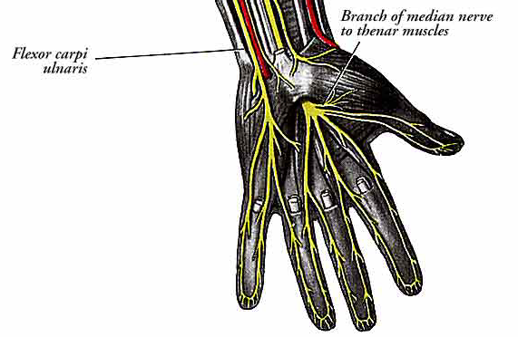
Superficial branch
Supplies –
  Palmaris Brevis &
  skin on medial 11/2 side of hand.
Divides into
  2 palmar digital nerves
  can be compressed against hook of hamate
    1st palmar digital branch –
      medial side of little finger
    2nd palmar digital branch
    adjacent sides of little & ring
fingers

Slide 26
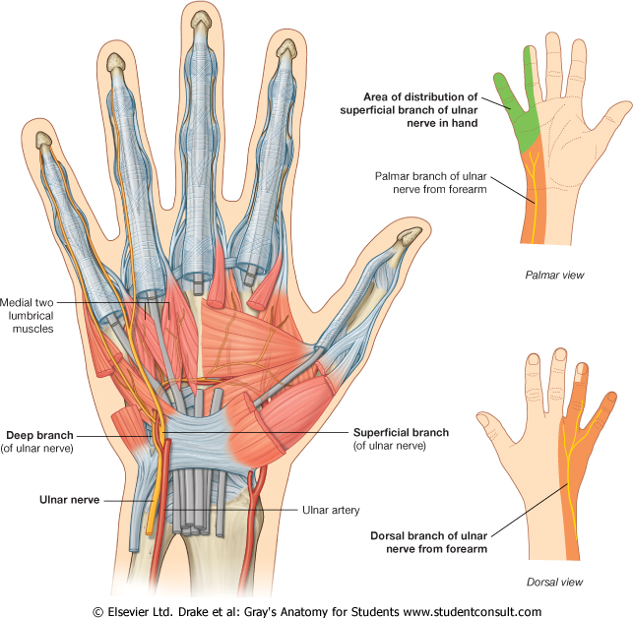

Slide 27
ULNAR NERVE : COURSE IN PALM
Deep branch –
Passes between -
  Abductor Digiti Minimi & Flexor digiti minimi
Then between
  Opponens Digiti Minimi & 5TH Metacarpal.
Follows course of deep palmar arch deep to flexor tendons.

Slide 28
Supplies : 15 ½ Muscles
  Hypothenars ,
  Interossei – dorsal and palmar
  3rd & 4th Lumbricals
  Adductor Pollicis , Flexor Pollicis Brevis)
Ends by supplying Adductor Pollicis – Grave yard of Ulnar nerve

Slide 29
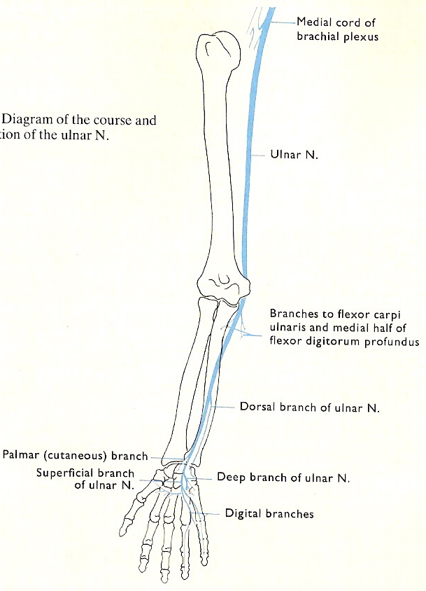
ULNAR NERVE : BRANCHES
ARTICULAR
  Elbow joint
  Wrist joint
  Small joints of hand-
    intercarpal and
    carpometacarpal joints
CUTANEOUS
  Palmar cutaneous branch :
    Skin of hypothenar eminence
  Dorsal branch :
    Dorsal 1 ½ digits (medial) on dorsum of hand
MUSCULAR AT FOREARM
  FCU
  FDP (med. Half)

Slide 30
TERMINAL
  Superficial branch :
    Supplies Palmaris Brevis & medial 1 ½ digits
  Deep branch : (muscular)
Supplies
  Hypothenars :
    Abductor Digiti Minimi,
    Flex0r Digiti Minimi,
    Opponens Digiti Minimi
  Interossei :
    All 4 Dorsal & 4 Palmar
  Lumbricals :
    3rd & 4th (medial two)
  Thenar :
    Adductor Pollicis
    ½ of Flexor Pollicis Brevis (Hybrid Muscle)
VASCULAR
Vascular twigs to Axillary, Brachial, ulnar and deep palmar arch.

Slide 31
5. VASCULAR
Vascular twigs to Axillary, Brachial, ulnar Artery and deep palmar arch.
6. ARTICULAR BRANCHES
Intercarpal
Carpometacarpal
Intermetacarpal joints

Slide 32
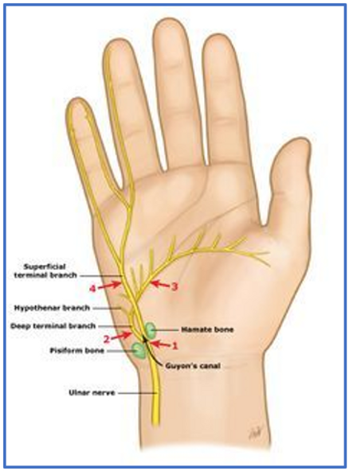
ULNAR NERVE IN HAND

Slide 33
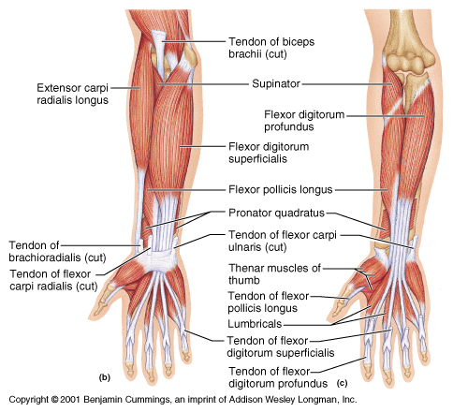
MUSCLES SUPPLIED IN FOREARM
FCU
FDP (Med. half)

Slide 34
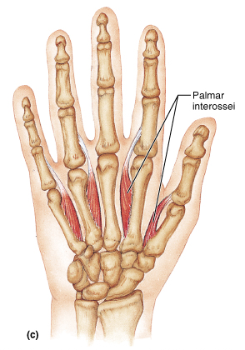
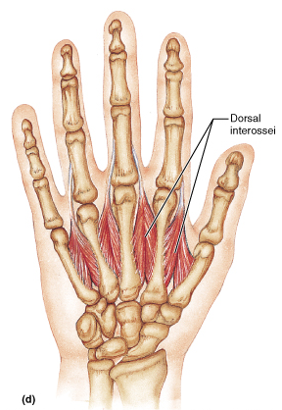
MUSCLES SUPPLIED IN HAND
Palmar aspect
Dorsal aspect

Slide 35
CUTANEOUS INNERVATION OF HAND
PALM
DORSUM
MEDIAN
ULNAR
ULNAR
SUPERFICIAL BRANCH OF RADIAL

Slide 36
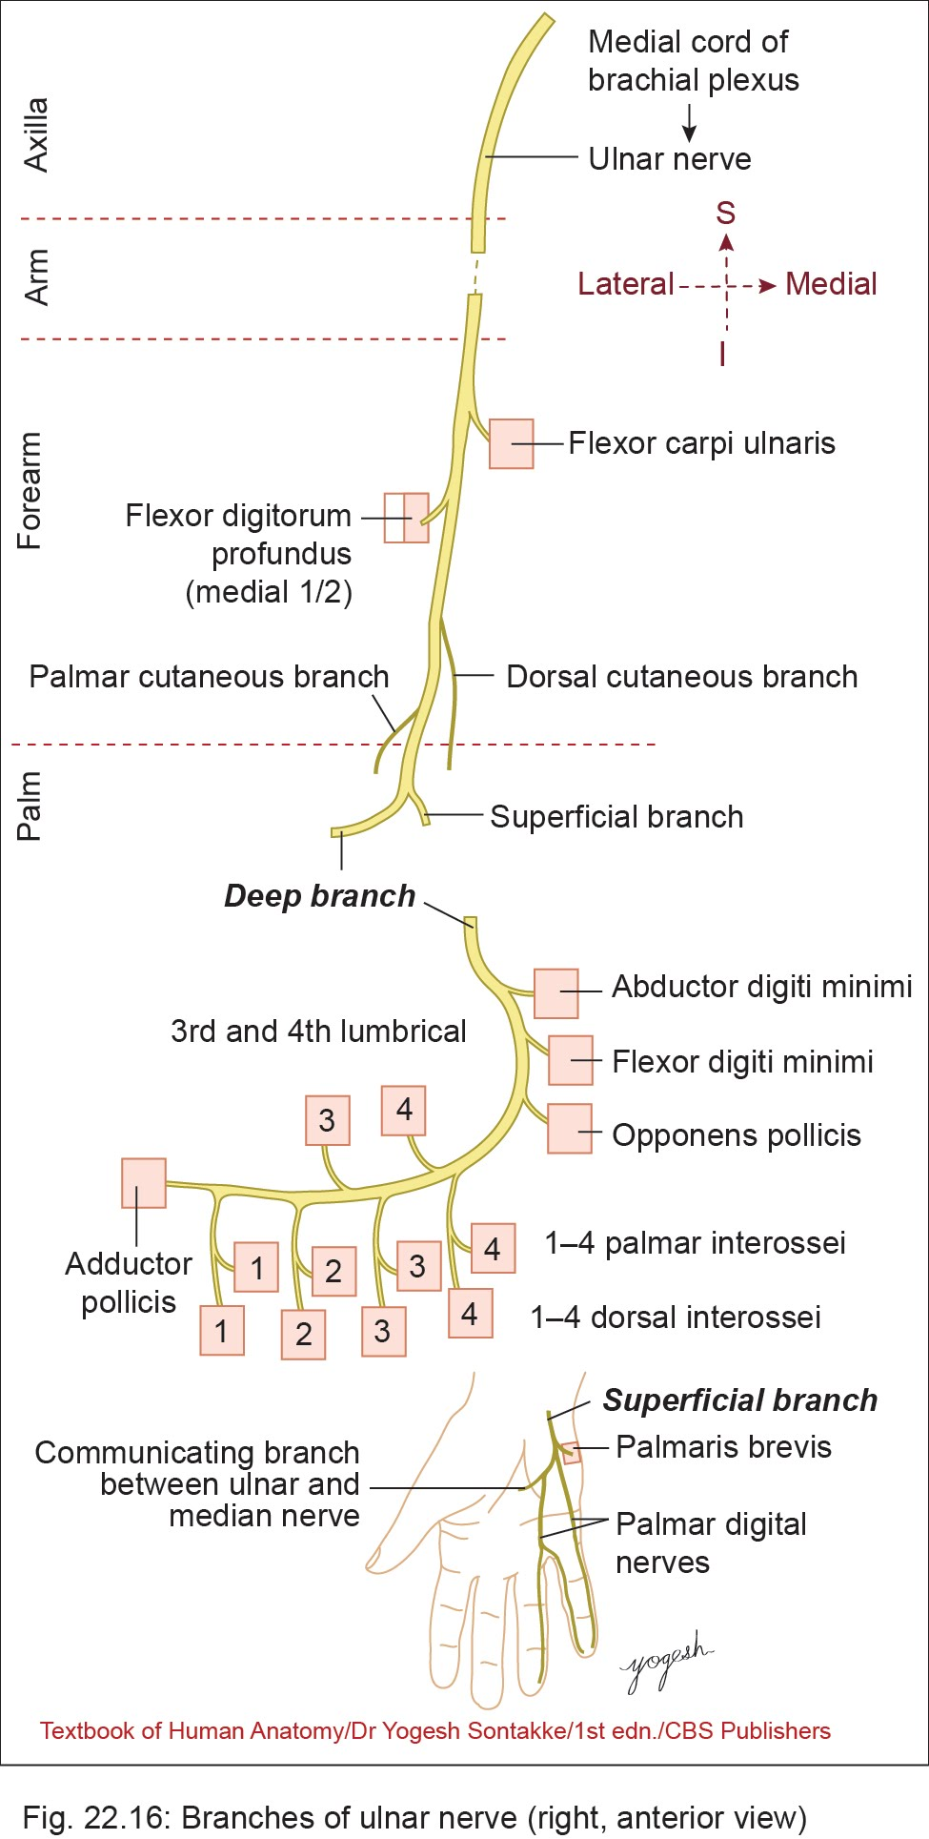

Slide 37
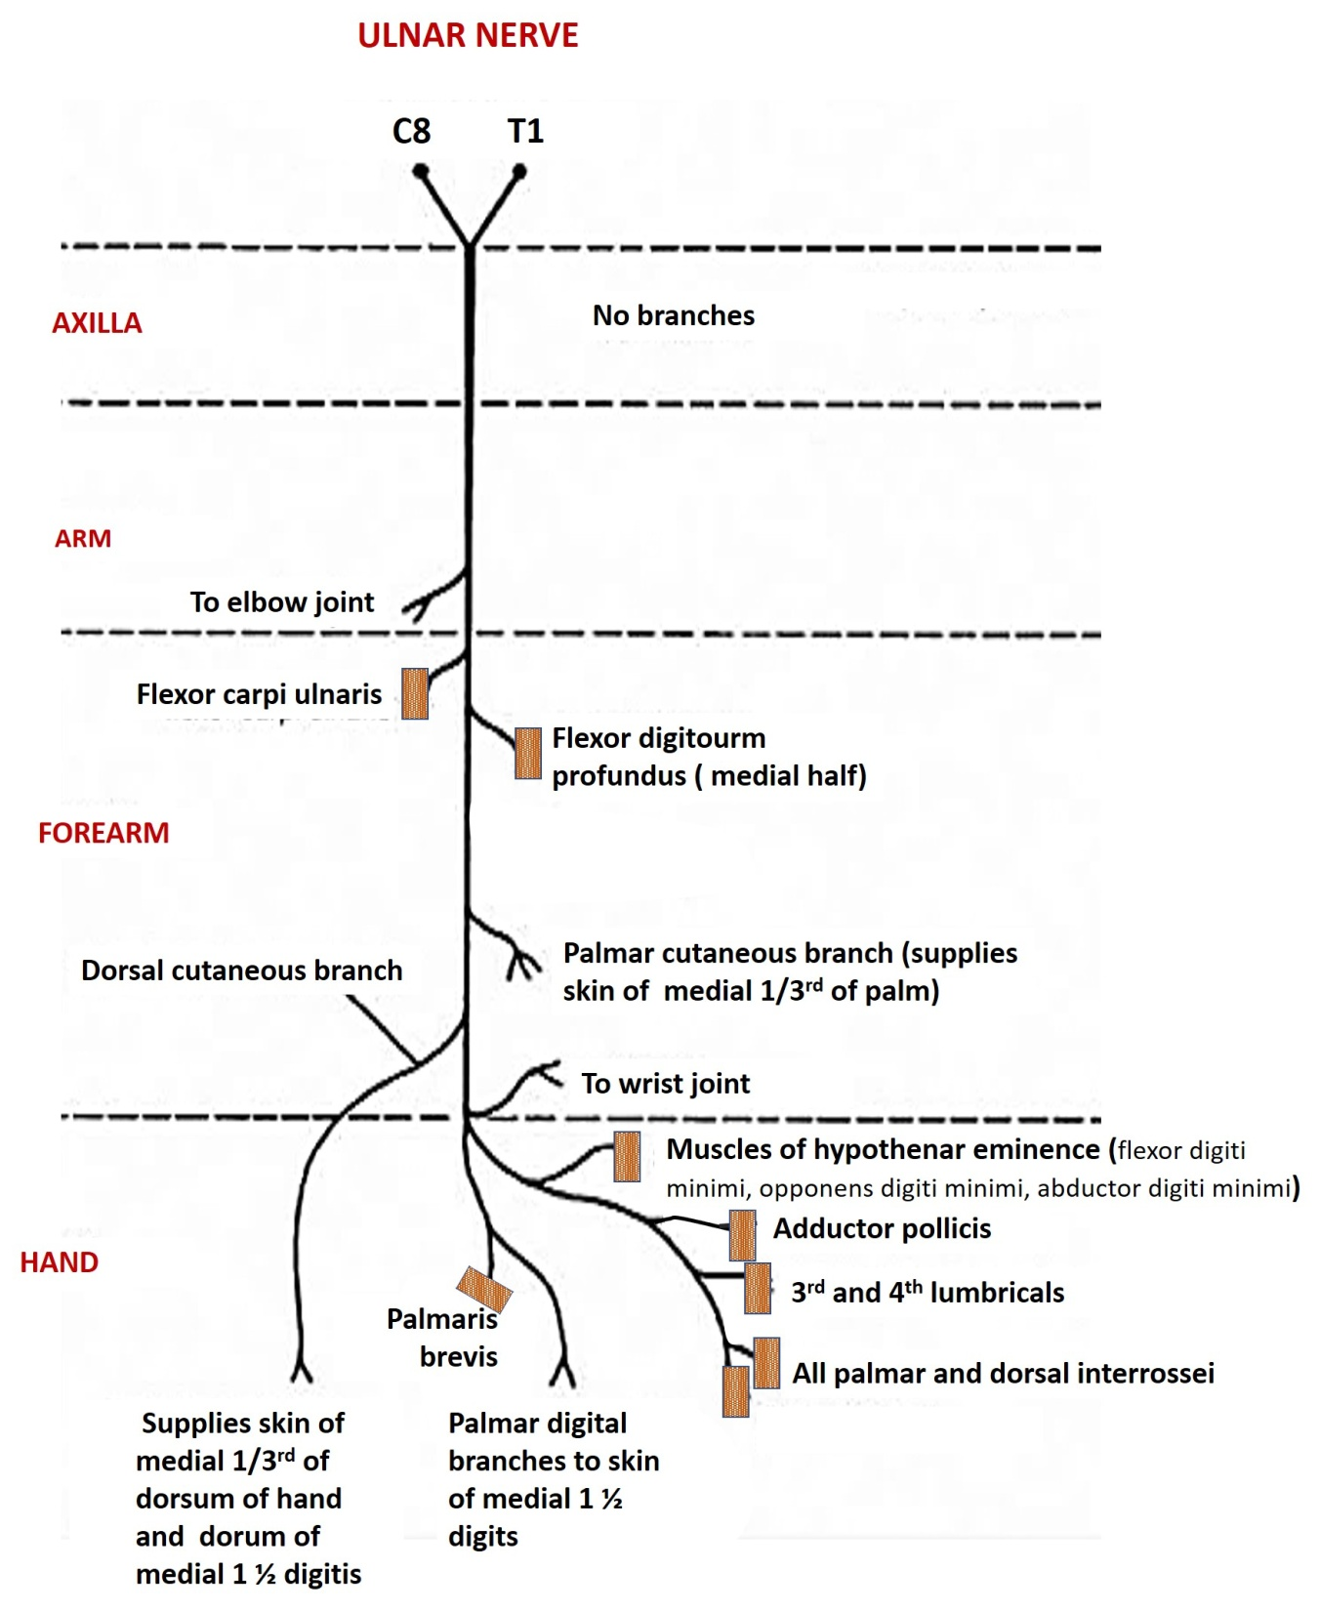

Slide 38
APPLIED ANATOMY

Slide 39
LESIONS OF ULNAR NERVE
AT THE WRIST
ULNAR TUNNEL SYNDROME
Ulnar nerve may be compressed in
  Guyon's canal or
  Deeply through muscles of hypothenar eminence
  Trough formed by pisiform medially and hook of hamate laterally
  Tight pissohamate ligament

Slide 40
Preservation of
  FDP to ring and little fingers.
  Dorsal cutaneous branch and palmar branch of Ulnar nerve are spared –
    lesion is distal to their origin from main trunk of Ulnar nerve in forearm
Lesion of
  Superficial (to digits) and deep branches (intrin msls)
Presentation
  Ulnar claw hand (Medial two fingers are extended at MCP jt and flexed at the IP jt.
  Hypo aesthesia medial 1 ½ fingers

Slide 41
LESIONS OF ULNAR NERVE
2. AT THE ELBOW
Ulnar nerve lesion due to :
  Vulnerable position –
    lies between medial epicondyle & olecranon:
    lies on bone covered only by a thin layer of skin.
    Easily damaged if ulnar groove is shallow.

Slide 42
LESIONS OF ULNAR NERVE
  3. CUBITAL TUNNEL SYNDROME
    Entrapment neuropathy between two heads of FCU - (OSBORNE CANAL)
Presentation
Weakness of FDP
  affect ring & little fingers.
  Produce ulnar claw hand with straighter fingers
  Called “ulnar paradox” – lower lesion has more claw feature
All intrinsic muscles of hand and sensations lost
Radial deviation of wrist on flexion

Slide 43
Cubital tunnel syndrome
  Wartenberg’s sign
    Abducted habitus of small finger
    Weak adduction by third palmar interosseus
  Froment’s sign
    Compensatory hyperflexion of thumb IP
    Hyperextension thumb MP secondary to loss of adductor pollicis and FPB (deep head)
  Claw hand
    MCP hyperextension
    IP Flexion

Slide 44
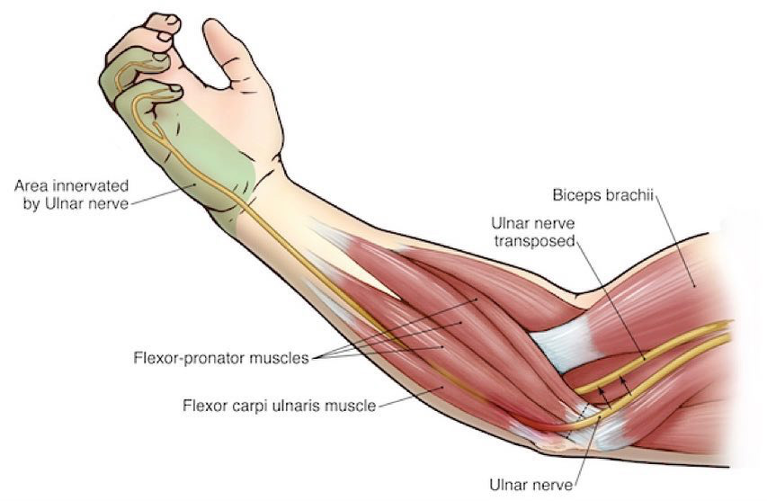
CUBITAL TUNNEL SYNDROME

Slide 45
LESIONS OF ULNAR NERVE
4. IN HAND
CYCLIST / HANDLEBAR PALSY- NEUROPATHY
Deep motor branch of Ulnar nerve compressed against pisiform & hamate
  - When hand is used as a mallet, or if a vibrating tool or motorcycle handlebar is held in such a way that Hypothenar eminence is off the edge of the handle.
Sensory branches are always spared.
involvement of hypothenar muscles is variable. (depends on the level at which branches to these muscles arise)

Slide 46
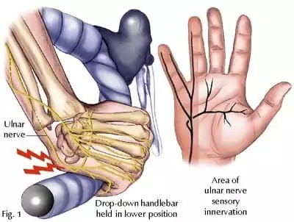
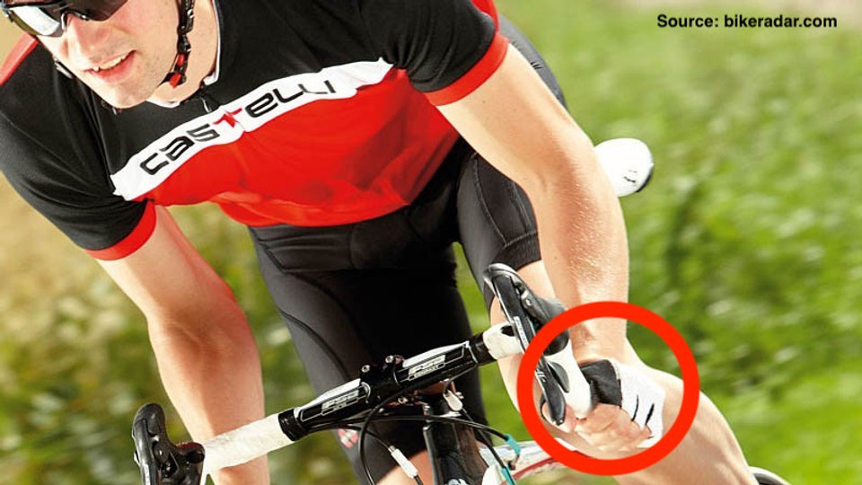
CYCLIST / HANDLEBAR PALSY

Slide 47
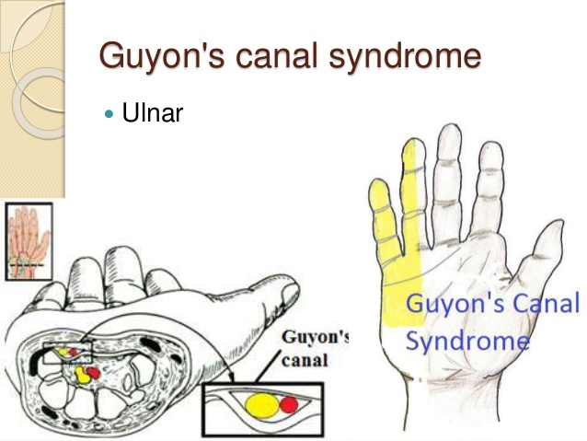
ULNAR TUNNEL SYNDROME
Compression of the ulnar nerve at the wrist, causing symptoms like numbness and tingling in the ring and pinky fingers, and weakness in the hand.
It is also called Guyon’s Canal Syndrome

Slide 48
FEATURES -
Numbness, tingling, or a burning sensation in the ring and pinky fingers
Weakness in the hand, leading to a poor grip or difficulty with fine motor tasks
Loss of coordination in the fingers
A "claw-like" hand deformity in more severe cases
Pain in the wrist or along the ulnar nerve distribution

Slide 49
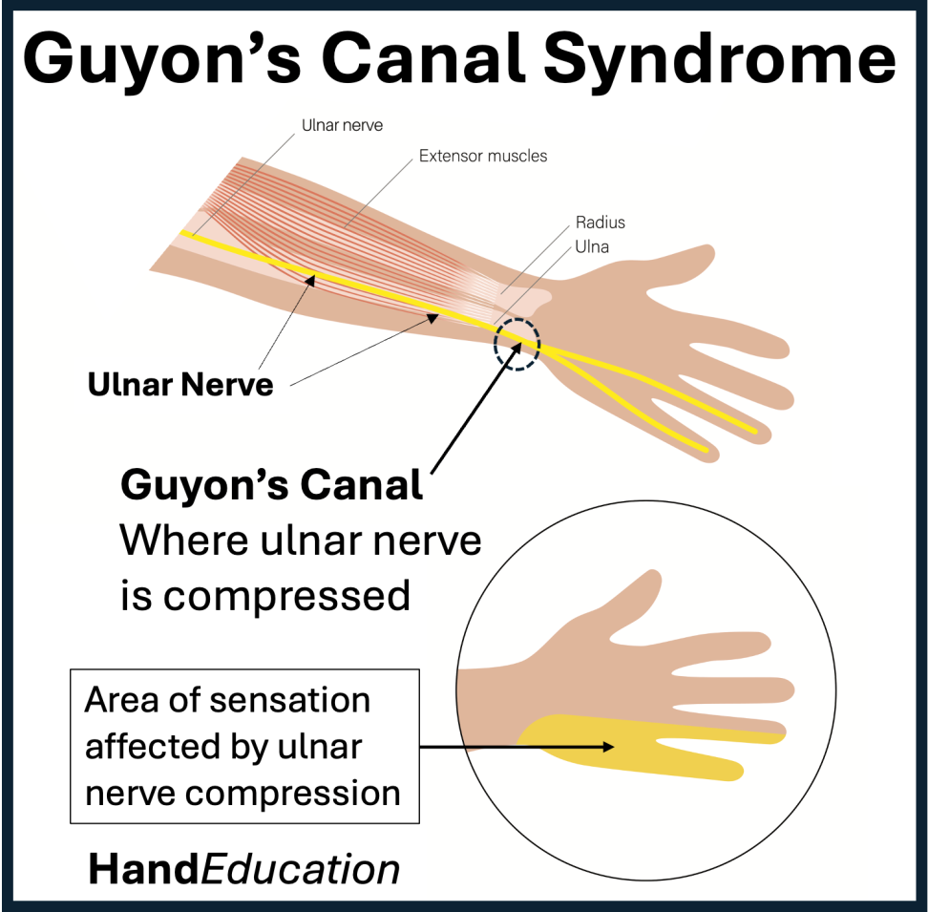
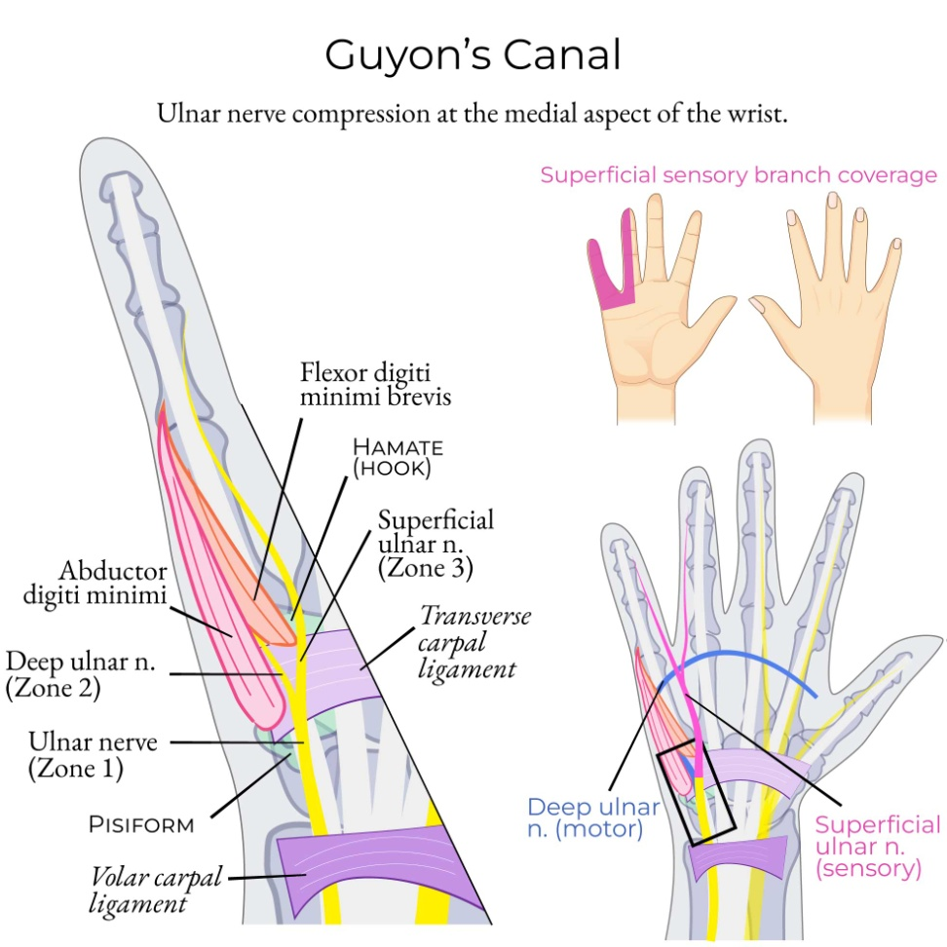
ULNAR TUNNEL SYNDROME

Slide 50
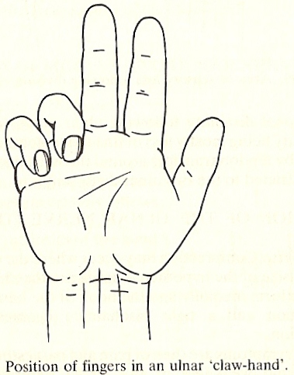
Ulnar claw hand with lesion at wrist
FDP spared

Slide 51
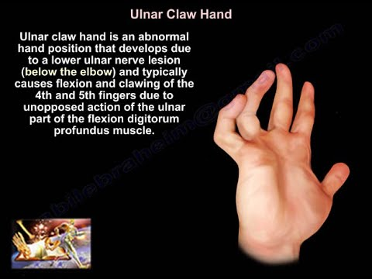
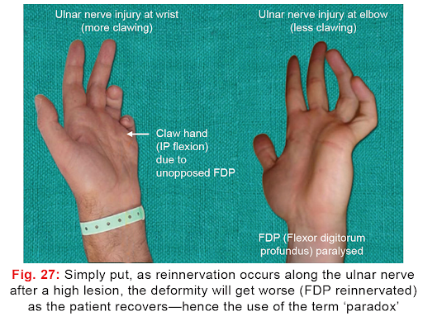
ULNAR CLAW HAND
SPINSTER CLAW DEFORMITY

Slide 52
5. Wartenberg's Sign
Slightly greater abduction of the fifth digit, due to weakness or paralysis of the adducting palmar interosseous muscle and unopposed action of the radial innervated extensor muscles (digiti minimi, digitorum communis

Slide 53
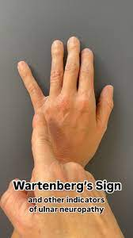
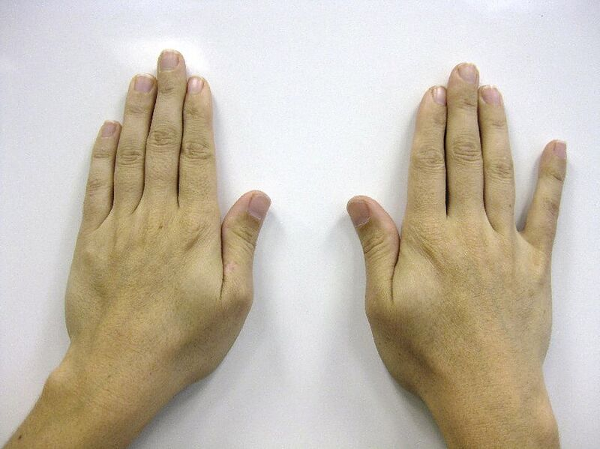
Wartenberg's Sign

Slide 54
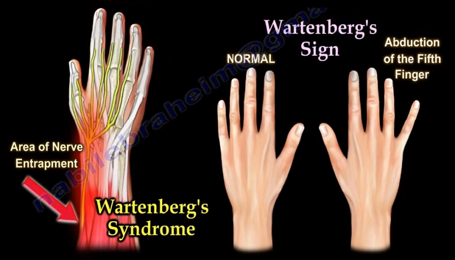

Slide 55
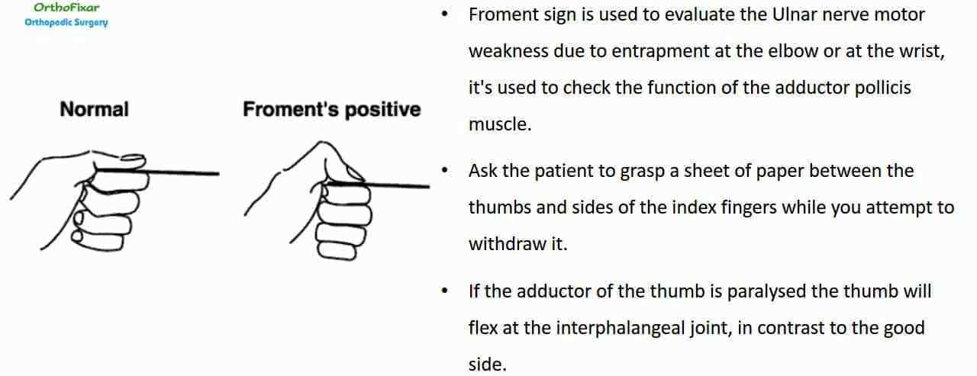
6. FROMENT SIGN

Slide 56
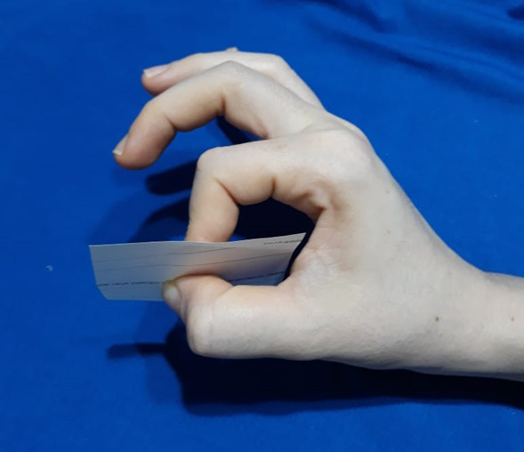
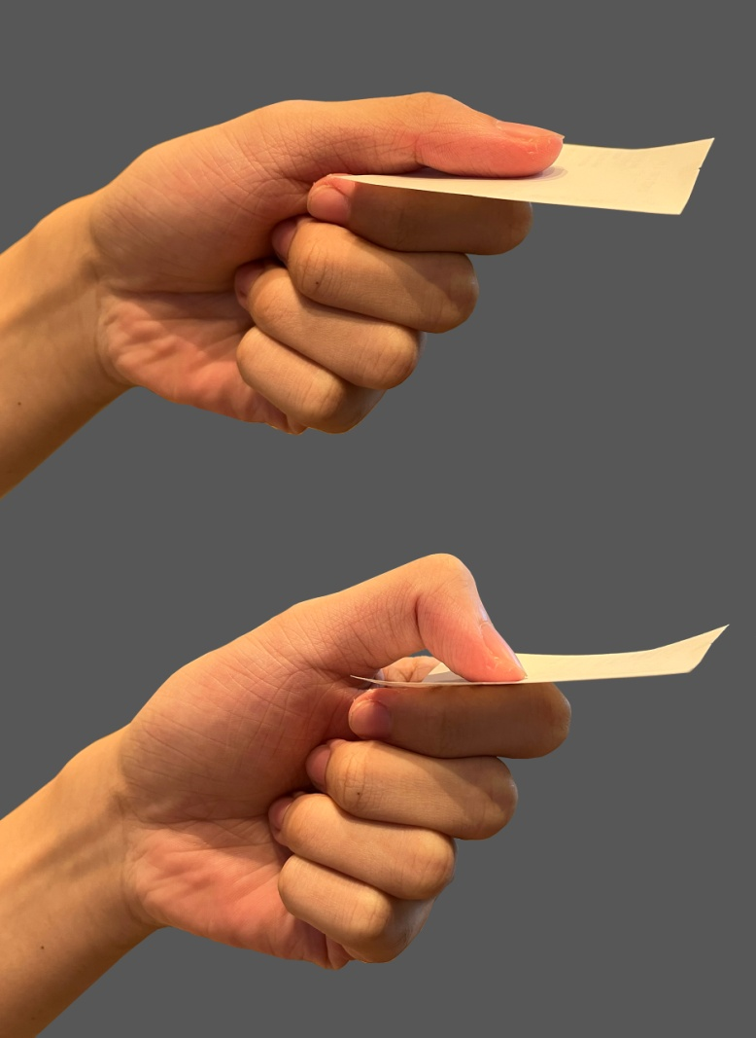
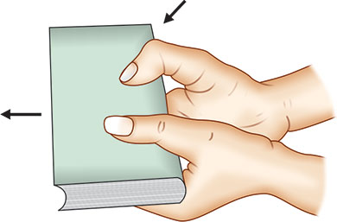
FROMENT SIGN - BOOK TEST

Slide 57
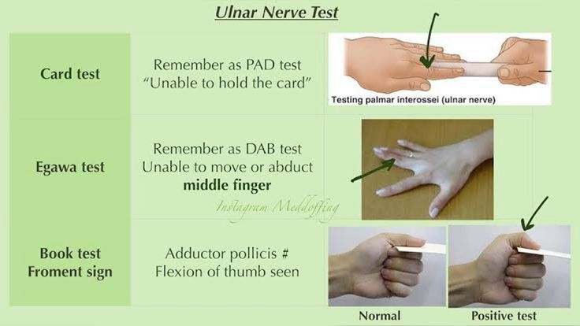
7. ULNAR NERVE TEST

Slide 58
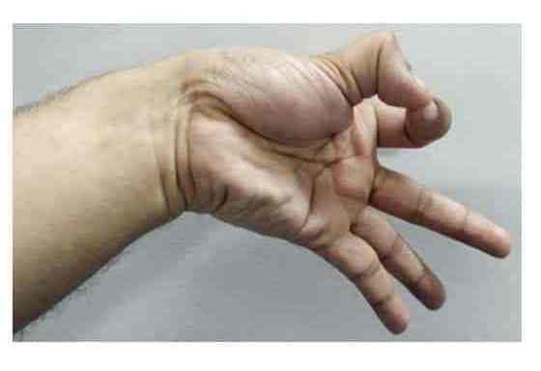
8. JEANNE SIGN
A clinical sign of ulnar nerve palsy that occurs during a key pinch, characterized by hyperextension of the thumb's metacarpophalangeal (MP) joint.
It indicates weakness in the thumb's adductor pollicis muscle, forcing the patient to hyperextend the MP joint to compensate and maintain grip strength

Slide 59
9. ULNAR PARADOX
A phenomenon where a high ulnar nerve lesion (near the elbow) results in a less severe "claw hand" deformity than a low ulnar nerve lesion (near the wrist).
This is because a higher lesion also affects the flexor digitorum profundus muscle, which helps bend the finger joints

Slide 60
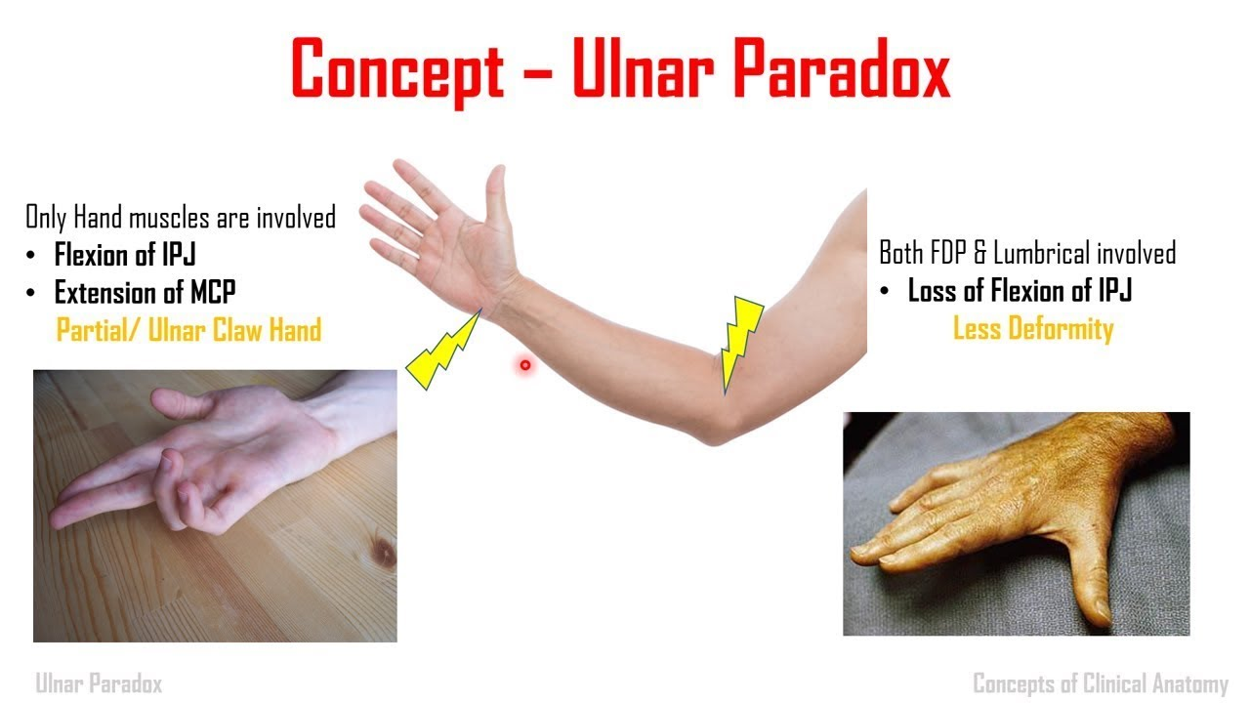

Slide 61
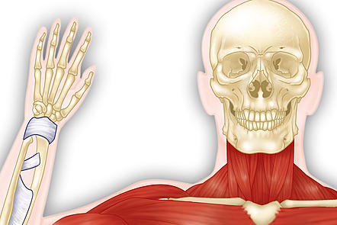
THANK YOU

