Slide 1
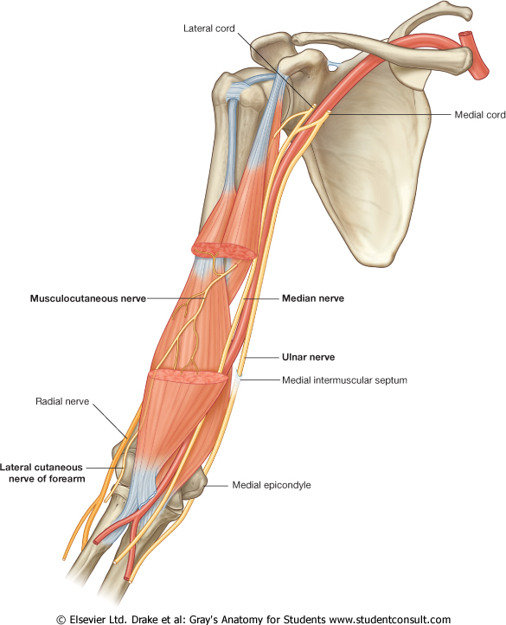
MEDIAN NERVE
UPPER LIMB
Dr. Praveen Kumar Kurrey
M.B.B.S., M.S.,BCME, BCBR, CISP
Professor Anatomy

Slide 2
Root Value: C5,C6,C7,C8,T1
Origin :
By 2 roots from the medial and lateral cords of brachial plexus.
The medial root crosses the 3rd part of axillary artery to join the lateral root.
Contribution from both cords
Medial Root -
derived from Medial cord, C8 & T1
Crosses downward and laterally infront of 3rd part of Axillary and join Lateral root)
Lateral root –
continuation of lateral cord, C5 to C7

Slide 3
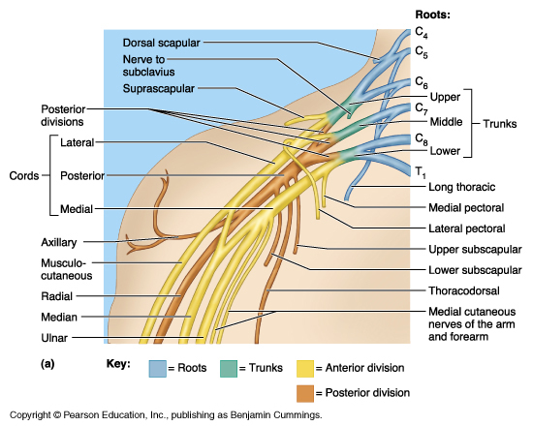
MEDIAN NERVE : FORMATION

Slide 4
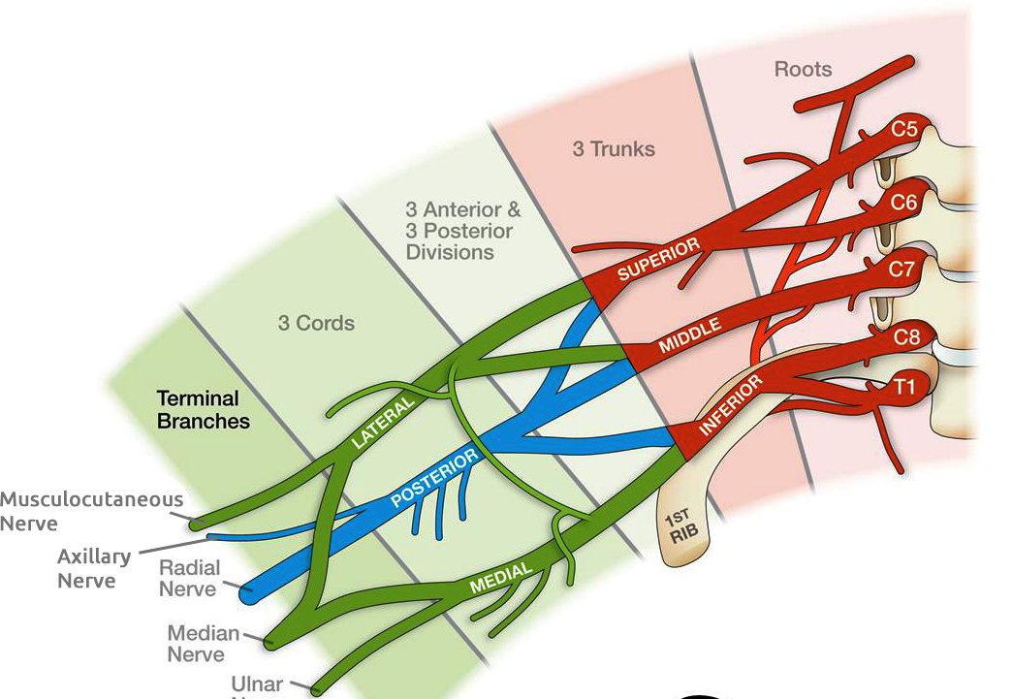
FORMATION OF MEDIAN NERVE

Slide 5
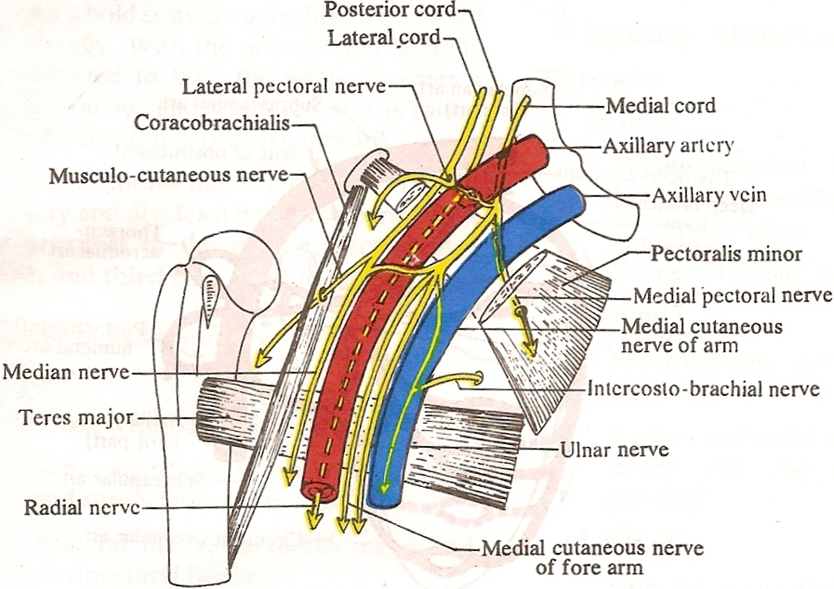
MEDIAN NERVE: COURSE
Formed in Axilla
lateral to 3rd part of Axillary artery

Slide 6
In arm-
Nerve descends lateral to Brachial artery
In middle of arm
crosses in front of artery
runs on its medial side to Cubital fossa

Slide 7
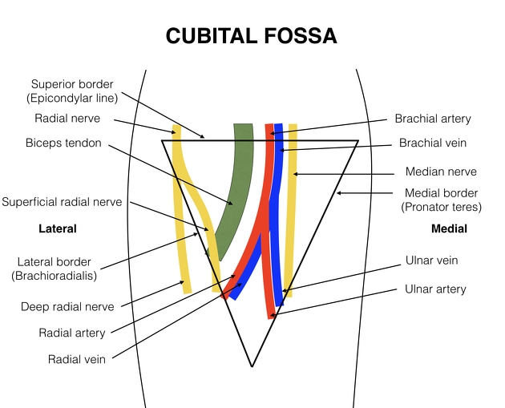
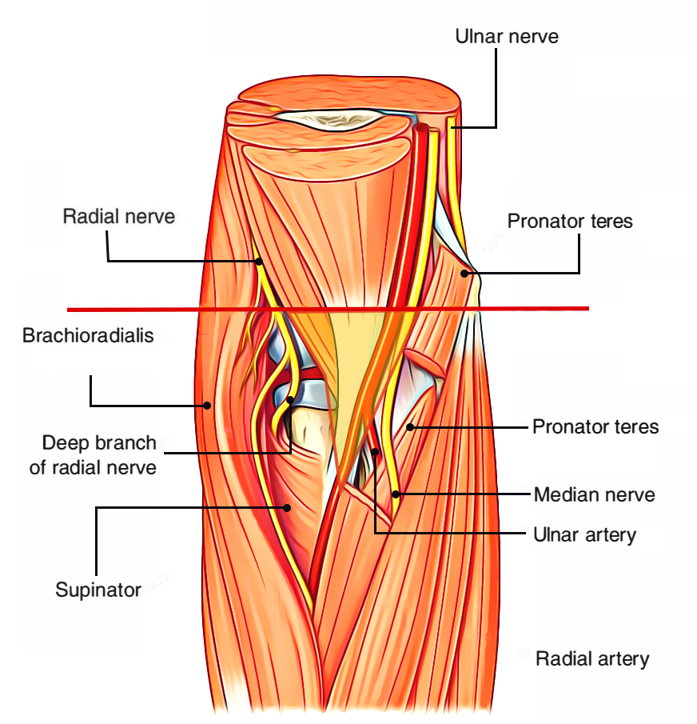
IN CUBITAL FOSSA

Slide 8
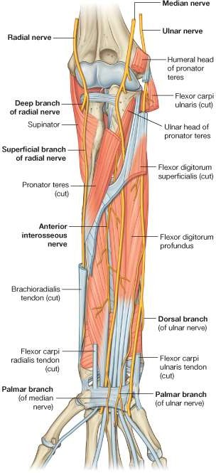
In the cubital fossa it lies deep to the bicipital aponeurosis.
It leaves the fossa between the 2 heads of the pronator teres.
Then it descends between the flexor digitorum superficialis & the flexor digitorum profundus.
It passes to the palm deep or through the carpal tunnel lateral to the tendon of flexor digitorum superficialis, and deep to the tendon of palmaris longus.

Slide 9
In Forearm
Enters forearm
Between Two heads of Pronator Teres
Then passes deep to tendinous bridge
(formed by humero-ulnar & radial heads of FDS)
Descends between
FDS & FDP in forearm
5 cm above Flexor retinaculum
emerges from behind lateral edge of FDS

Slide 10
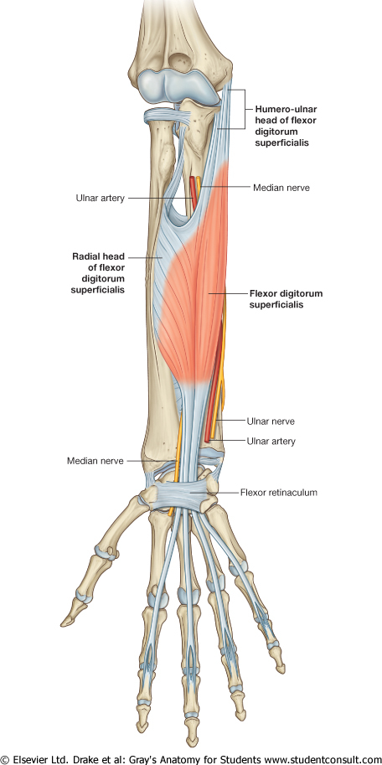
Passes deep to tendinous bridge of FDS
formed by humero-ulnar & radial heads of FDS

Slide 11
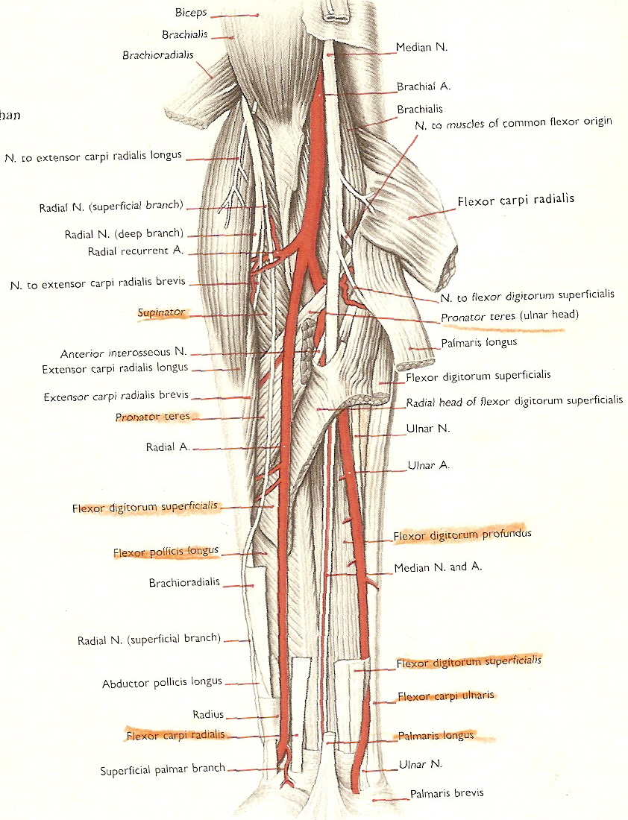
Nerve entering the humero- ulnar head and radial head of FDS

Slide 12
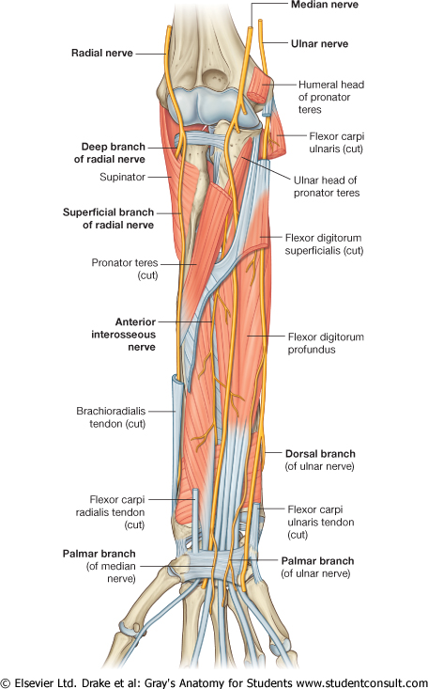
Descends between
FDS & FDP in forearm

Slide 13
5 cm above Flexor retinaculum
Emerges from behind lateral edge of FDS

Slide 14
At Wrist
Becomes superficial
Between FDS & FCR tendons)
Passes deep to Flexor retinaculum to enter palm

Slide 15
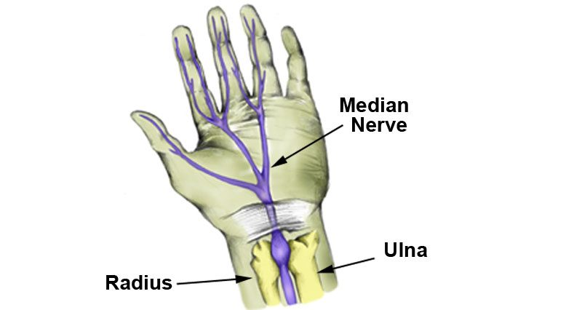
IN PALM
It enters the palm through the carpal tunnel, deep to the flexor retinaculum.
Then it divides into lateral & medial branches.
Lies a finger breadth distal to the tubercle
of scaphoid.
In palm, nerve lies medial to thenar muscle.
– Here it gives terminal branches to thenar muscles, 1st and 2nd lumbricals, and digital branches.

Slide 16
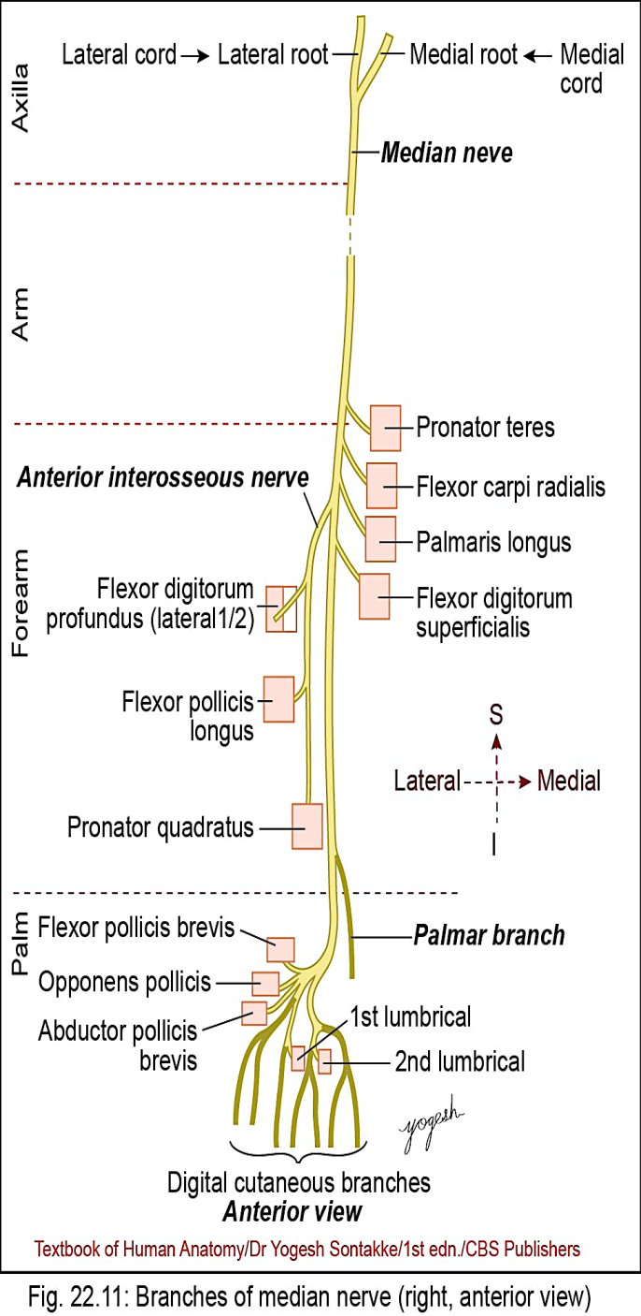
MEDIAN NERVE branches
1. In axilla: Nil
• In arm: Pronator teres
• In cubital fossa:
Muscular branches: For
– Flexor carpi radialis
– Palmaris longus
–Flexor digitorum superficialis

Slide 17
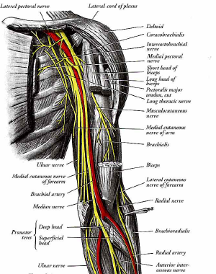
2. IN ARM
Vascular
Branches (symp twigs) to Brachial artery
Branch to Pronator Teres – above elbow

Slide 18
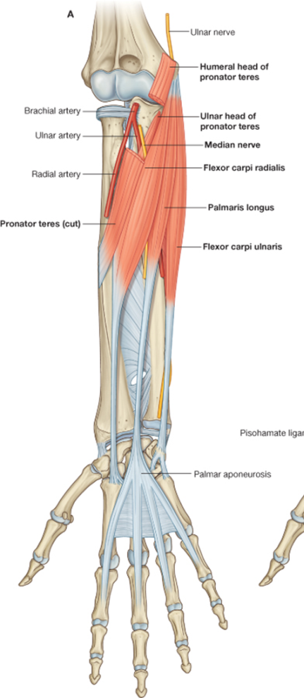
MEDIAN NERVE: BRANCHES
3. IN FOREARM
MUSCULAR
By trunk of median N – to
–Pronator Teres
-- Flexor carpi radialis
– Palmaris longus
–Flexor digitorumsuperficialis
b) Ant. Interrosseous Nerve

Slide 19

MEDIAN NERVE
Branches
3. In forearm
Anterior interosseous nerve
– Lateral half of flexor digitorum profundus
– Flexor pollicis longus
– Pronator quadratus
– Inferior radioulnar and wrist joints
Palmar cutaneous branch – for skin over thenar eminence
• In palm
In palm, median nerves divide into medial and lateral branches.

Slide 20
IN FOREARM
ANTERIOR INTEROSSEOUS NERVE
Arise from Median nerve as it passes bt 2 heads PT.
Runs in front of interrosseous membrane.
Supplies:
Deep flexors – FPL, FDP (Lat half), PQ
joints
Distal Radio- Ulnar joint
Radio- Carpal joint
Carpal joints

Slide 21
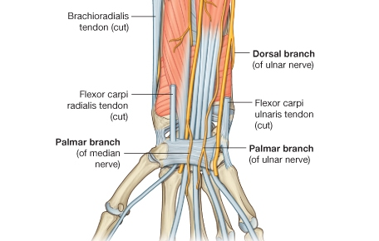
2. ARTICULAR
- Elbow joint
- Proximal R- U joint
PALMAR CUTANEOUS
Given proximal to flexor retinaculum
Passes over retinaculum.
Supplies
central palm,
Skin thenar eminence,
4. COMMUNICATING
To Ulnar nerve.
MARTIN GRUBER CONNECTION
MEDIAN NERVE: BRANCHES

Slide 23
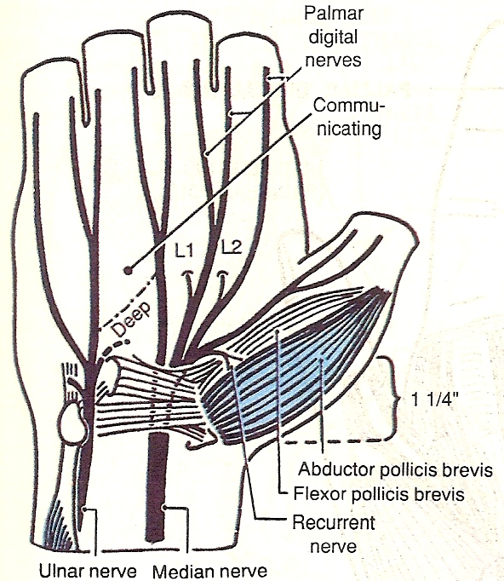
MEDIAN NERVE: BRANCHES
IN HAND
Recurrent branch
recurrent branch – supplies Thenar muscles
Lateral branch / Main Nerve
Lateral branch divides into
3 proper palmar digital branches.
Supply:
Skin of thumb
Lat side of index finger.
1st lumbrical.

Slide 24
Medial branch
Divides into
two common palmar digital nerves.
These further divide into
Proper palmar digital nerves
Supply:
Sides of index, middle & half of ring fingers.
2nd lumbrical
Summary
All proper palmar digital nerves reach on dorsum of Hand to supply nail beds and palmar aspect of lateral 3 ½ fingers
Lateral two lumbricals supplied by Median

Slide 25
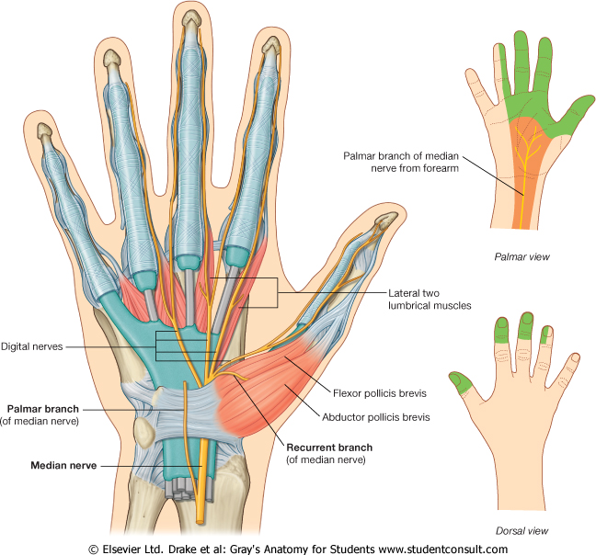
MEDIAN NERVE: BRANCHES

Slide 26
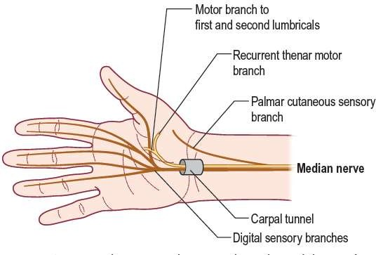

Slide 27
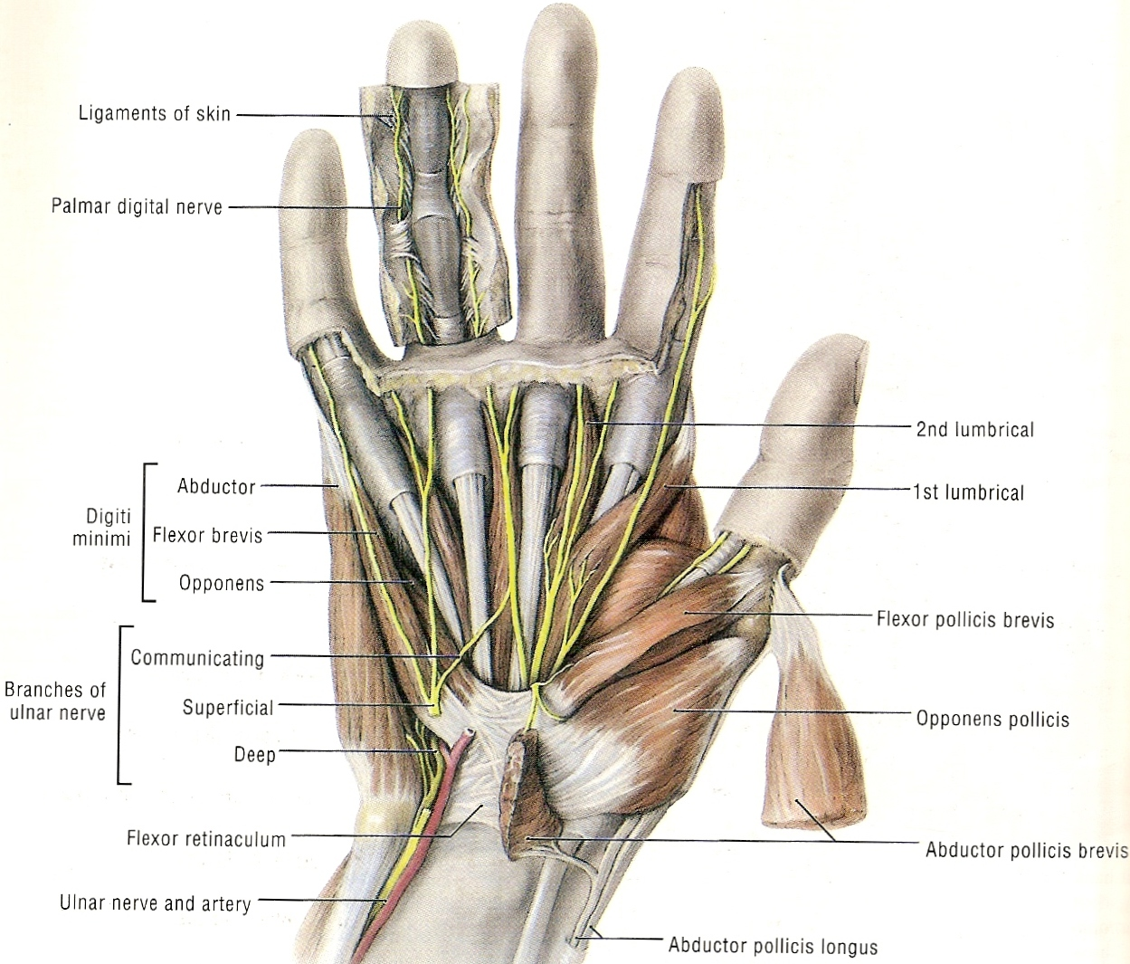

Slide 28
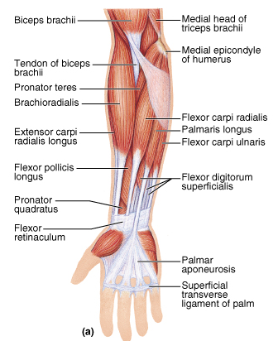
MUSCLES SUPPLIED
These muscles are
primarily flexors of
the wrist and
fingers

Slide 29
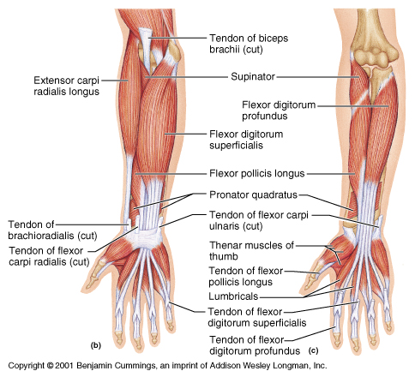
MUSCLES SUPPLIED IN FOREARM
Superficial
PT
FCR
PL
FDS
Deep
FDP (Lat.half)
FPL
PQ

Slide 30
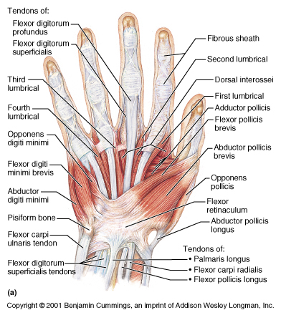
MUSCLES SUPPLIED IN HAND
THENAR MUSCLES
Ab. Pollicis Brevis
Flex. Pollicis Brevis
Opponens Pollicis
Lumbricals
Lateral Two

Slide 31
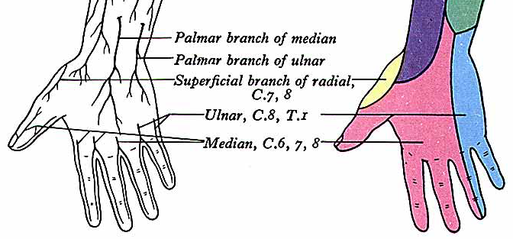
MEDIAN NERVE: CUTANEOUS INNERVATION
PALM

Slide 32
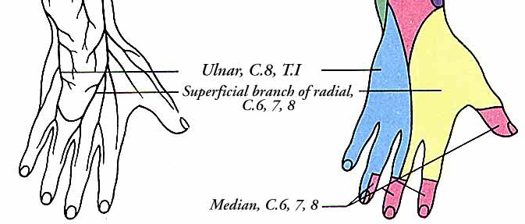
MEDIAN NERVE: CUTANEOUS INNERVATION
DORSUM OF HAND

Slide 33
APPLIED ANATOMY
Median Nerve Injury At Elbow
Carpal Tunnel Syndrome
Pronator Syndrome

Slide 34
1. Median Nerve Injury At Elbow
• Causes:
1. Supracondylar fracture of humerus
2. Nerve entrapment between two heads of Pronator teres muscle
All muscles paralyzed except FCU & FDP (medial half)
MOTOR LOSS
FDS & FDP ( LAT. HALF) –
Loss of flexion at MP & IP Jts
(OCHSNER’S CLASPING TEST – When patient asked to clasp the hands, index finger of affected side fails to flex – remains as Pointing Index Finger)
FCR -
Loss of flexion of wrist on radial side
ulnar deviation on attempts of flexion of wrist.
FPL -
Inability to flex terminal phalanx of thumb.
PQ and PT – pronation lost.

Slide 35
5. Thenar eminence –
Flattening of eminence.
Ape like hand (APE THUMB DEFORMITY)
Abductor Pollicis Brevis and Opponens pollicis– Paralysis.
(PEN TEST : Hand laid flat on table. Patient asked to touch a pen kept at slightly higher level than palm with the thumb)

Slide 36
MEDIAN NERVE INJURY AT ELBOW
INJURY RESULTS IN -
Loss of pronation :
PT & PQ
Loss of powerful flexion at wrist :
FCR & FDS (wrist deviates to ulnar side)
Loss of flexion of PIP of all digits :
FDS is paralysed
Loss of flexion of DIP & MCP Joints of index and middle fingers
FDP – lat. ½ &
Lumbricals 1st , 2nd paralyzed)
Loss of flexion, abduction & opposition of thumb :
Thenar muscles paralyzed
Thumb in adducted & extended position : APE LIKE HAND

Slide 37
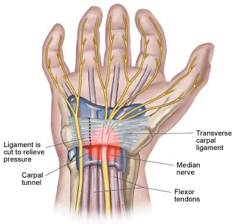
2. CARPAL TUNNEL SYNDROME
Most common entrapment mononeuropathy
Incidence -
females over 50 years.
50% cases B/L. Mostly in dominant hand.
Cause -
Compression of Median nerve in fibro- osseous tunnel beneath flexor retinaculum.

Slide 38
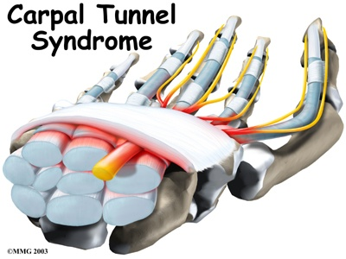
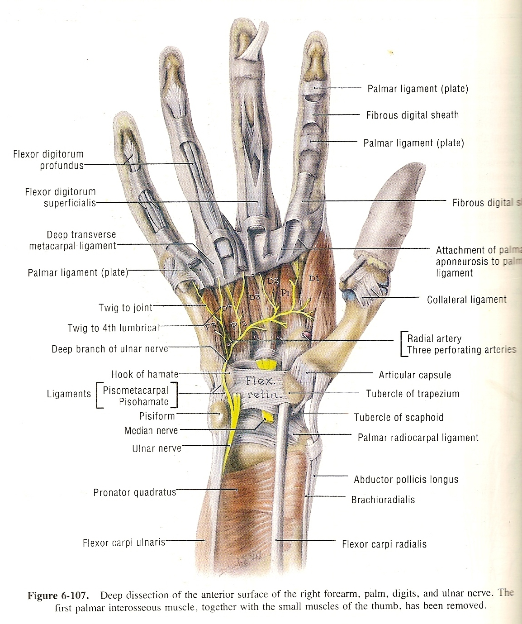
Tunnel may be narrowed by
a) Arthritic changes in wrist joint
b) Anterior dislocation of Lunate / complication of Colle’s fracture
c) Soft tissue thickening in Myxoedema & Acromegaly
d) Oedema & Obesity, Pregnancy

Slide 39
CARPAL TUNNEL SYNDROME
FEATURES
Impairment of finer movements
Sewing
Knitting
Picking a pin
Paresthesia -
Attacks of pain, tingling & numbness of radial 3 ½ digits of affected hand. "pins and needles"
Awakens patient at night.
Pain in the hand, wrist, or forearm that may radiate up the arm
Weakness in the hand and difficulty gripping objects

Slide 40
CARPAL TUNNEL SYNDROME cont’d
Wasting Of Thenar Eminence –
Muscles affected: AbPB & OP
Hypo aesthesia –
palmar aspect of radial 3 ½ digits.
skin over thenar eminence not affected
as it is supplied by palmar cutaneous br of median N which arise proximal to carpal tunnel.
Tinel’s Sign –
Percussion of Median nerve gently at wrist
causing tingling sensation radiating into hand.

Slide 41
Wrist Flexion Test - (Phalen’s Sign) –
Exacerbation of symptoms when patient is asked to flex wrist. Symptoms disappear as wrist straightened.
(No sensory impairment over palm. Palmar cuta. branch is superficial to retinaculum)
Surgical treatment –
Carpal tunnel release.
Partial or complete division of flexor retinaculum
Summary :
For high lesions –
Test FPL and finger flexors by pinching together pads of thumb and index finger
For wrist lesions –
Test AbPB (do not choose FPB as it has variable supply)

Slide 42
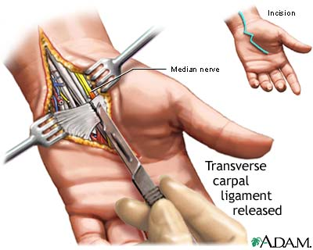

Slide 43
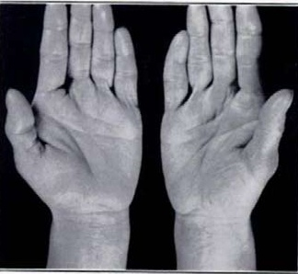
1. Thenar Atropy

Slide 44
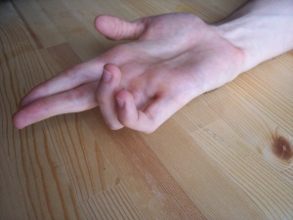
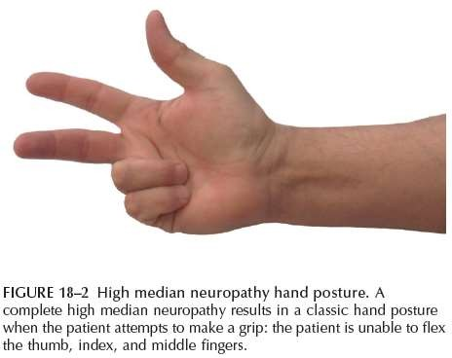
2. BENEDICT’S ATTITUDE / HAND

Slide 45
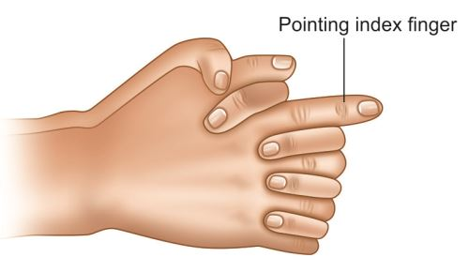
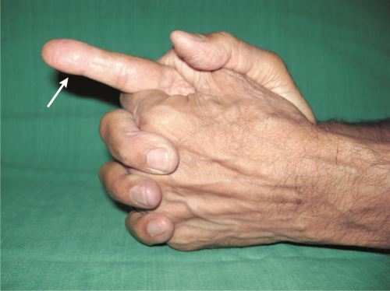
3. POINTING INDEX

Slide 46
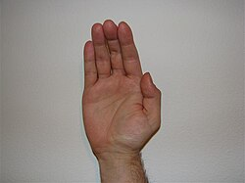
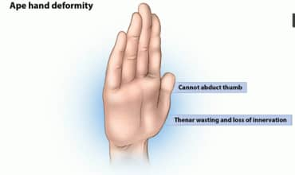
4. Ape thumb / hand deformity

Slide 47
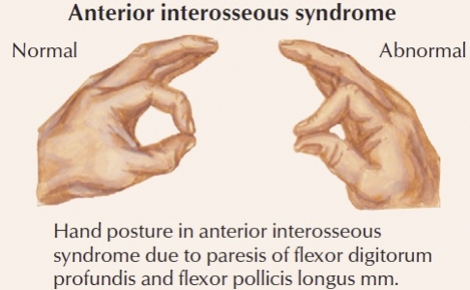
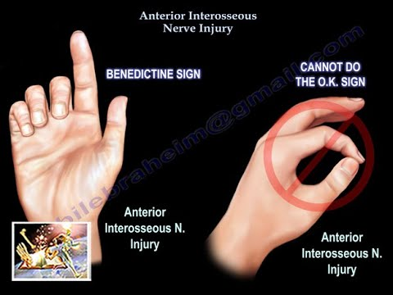
5. NEGATIVE ‘OK’ SIGN

Slide 48
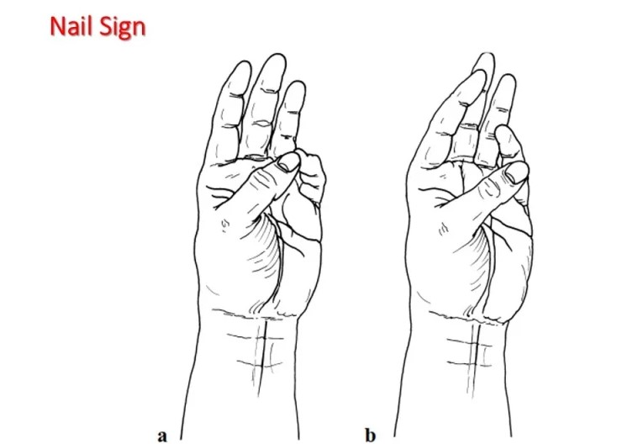
6. NAIL SIGN

Slide 49
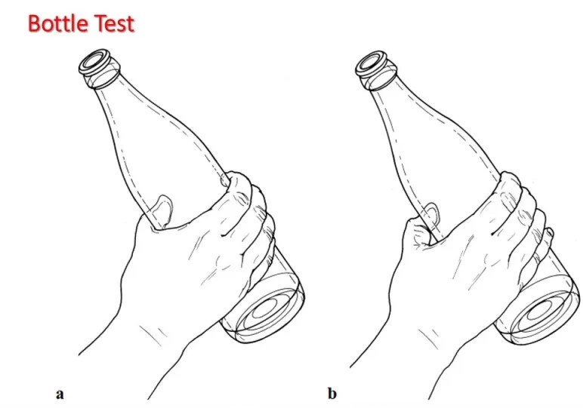
7. BOTTLE TEST

Slide 50
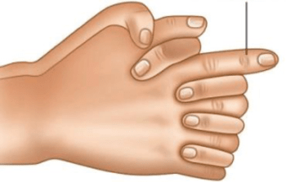
8. OCHSNER’S CLASPING TEST

Slide 51
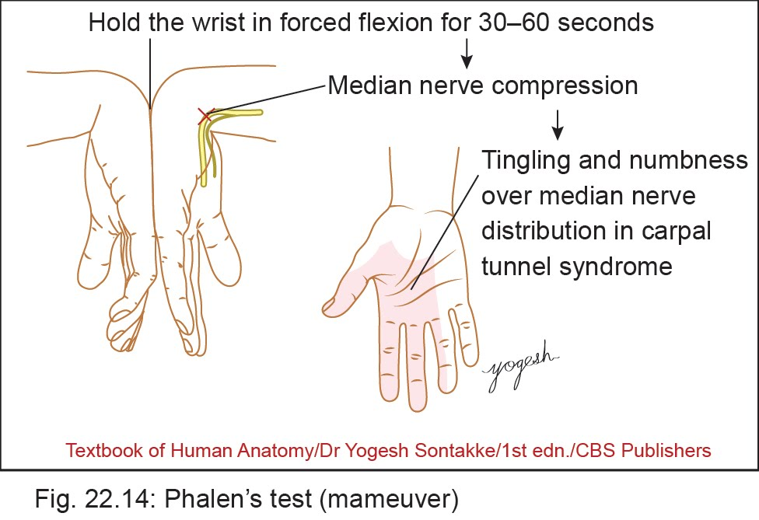
9. PHALEN’S TEST/ SIGN
Exacerbation of symptoms when patient is asked to flex wrist. Symptoms disappear as wrist straightened.
(No sensory impairment over palm. Palmar cuta. branch is superficial to retinaculum)

Slide 52
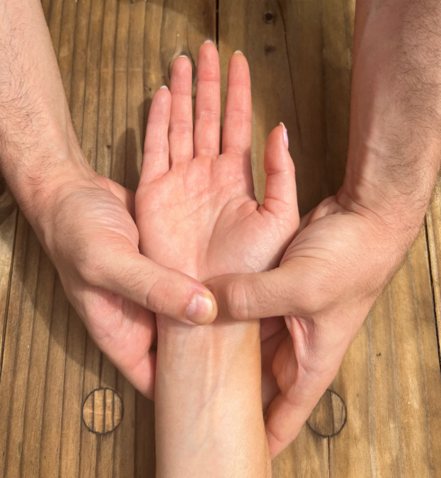
10. DURKAN’S TEST
Pressure over Carpal Tunnel for 30 seconds induces pain in lateral
3 and 1/2 fingers in the Carpal tunnel syndrome

Slide 53
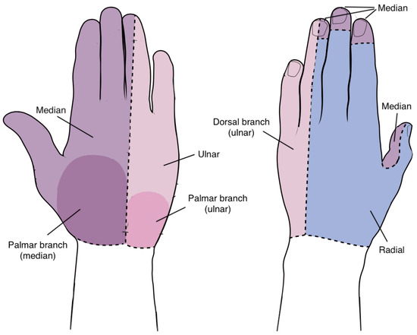
11. PERIPHERAL ‘EYE OF HAND’
Major nerve of the arm and hand that controls both motor and sensory functions.
It is called the "eye of the hand" because it provides sensation to the thumb, index, middle, and part of the ring finger, as well as control over muscles essential for grip, wrist flexion, and thumb movement.

Slide 54
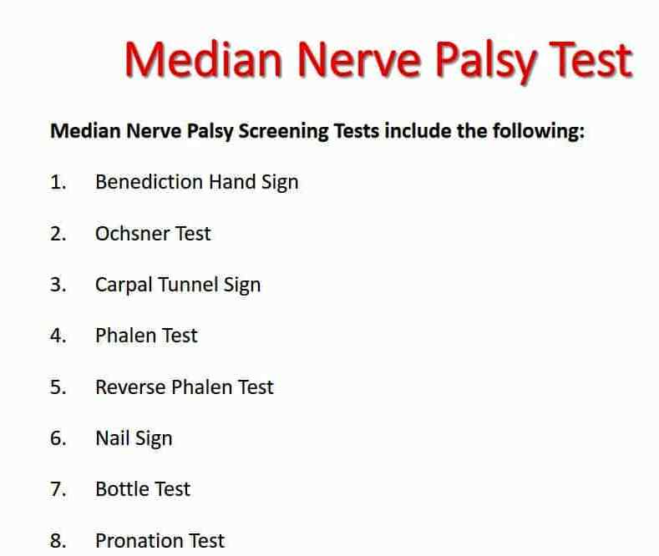

Slide 55
3. PRONATOR SYNDROME
Can occur as nerve passes
Between two heads of Pronator Teres
Deep to Bicipital Aponeurosis
Through a fibrous arch of Flexor Digitorum Superficialis
Clinical Features:
Pain & tenderness in proximal aspect of anterior forearm.
Weakness of all muscles innervated by Median nerve.
- Including Abductor Pollicis Brevis & long finger flexors.
Sensory impairment on palm of hand.
.

Slide 56
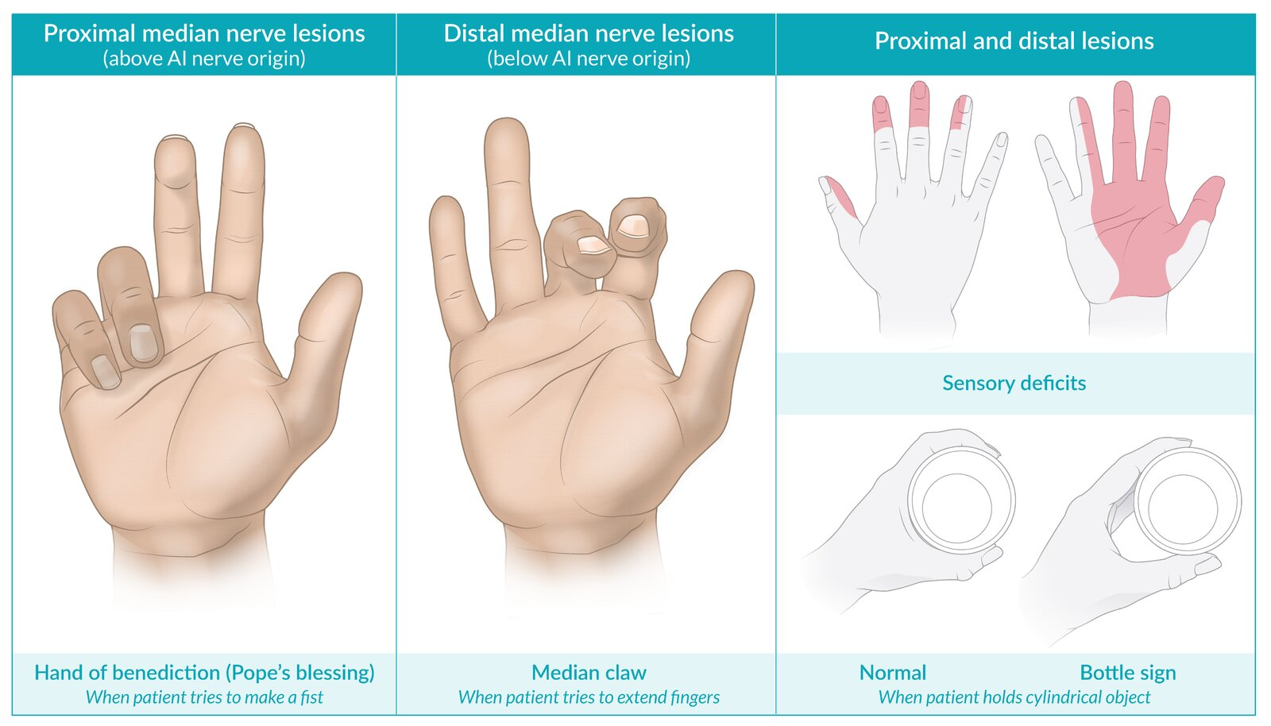
MEDIAN NERVE INJURY

Slide 57
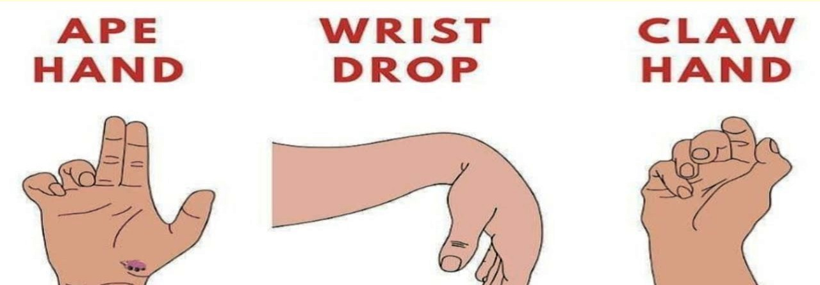

Slide 58


