Slide 1
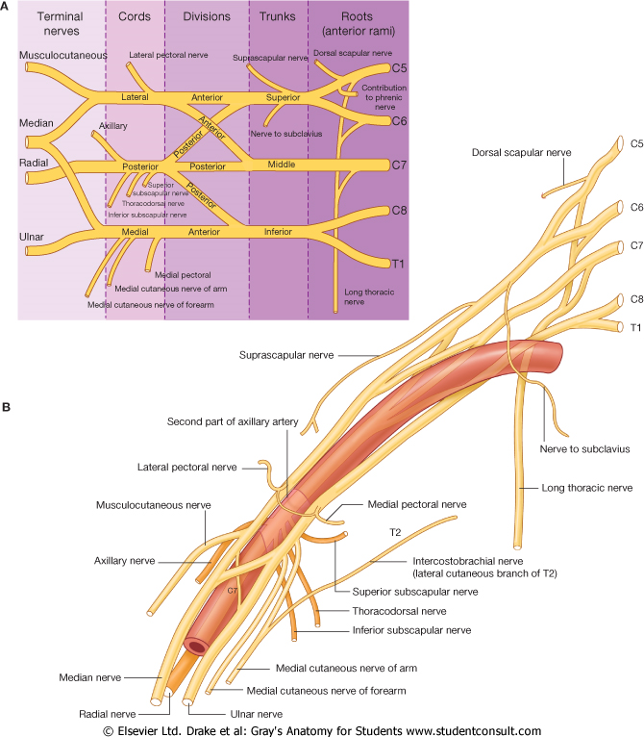
UPPER LIMB
BRACHIAL PLEXUS
Dr. Praveen Kumar Kurrey
M.B.B.S., M.S.,BCME, BCBR
Professor Anatomy

Slide 2
BRACHIAL PLEXUS
Lies in the neck and axilla
Formed by ventral rami of C 5 to T 1, called roots
Prefixed
  Brachial Plex : C4- C8 (10%),
Post fixed
  C6-T2 (10%).
Roots–
  Behind Scal Anterior, emerge between scalene msls,
Trunks
  Cross lower part of posterior triangle of neck
Divisions
  behind clavicle,
Cords
  arranged around 2nd part of Axillary art in axilla.
cords give rise to main nerves of the upper limb
Supraclavicular part ---Roots and trunks
Infraclavicular part – cord and branches

Slide 3
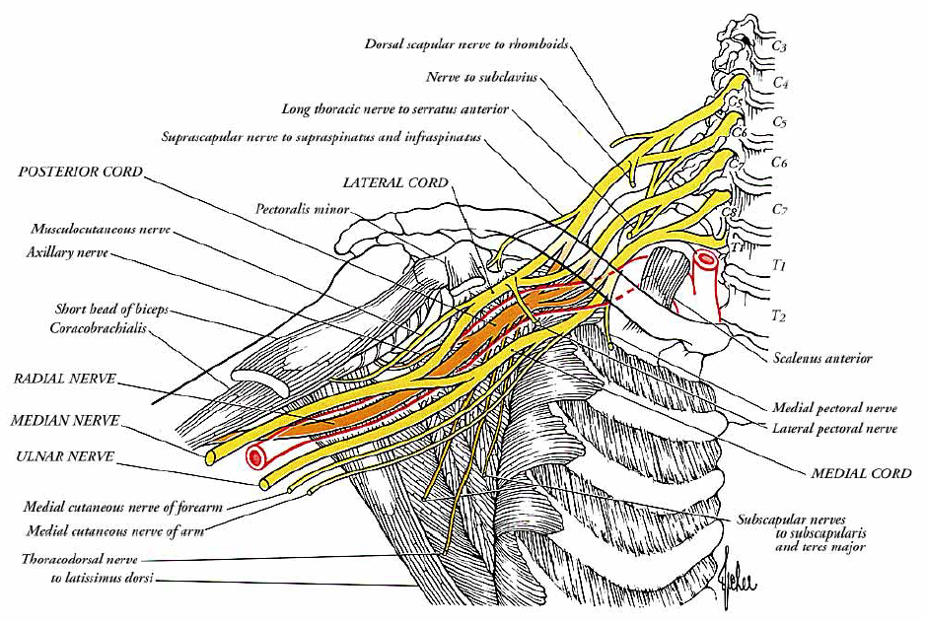
BRACHIAL PLEXUS

Slide 4
BRACHIAL PLEXUS
Gives rise to nerves - innervate upper limb
Five major components of the Plexus
  ROOTS –
    Five ventral rami (C₅-T₁)
  TRUNKS –
    Upper, Middle, and Lower, which form divisions
  DIVISIONS –
    Anterior & Posterior serve - front and back of limb..???
  CORDS –
    Three - Lateral, Medial and Posterior
  BRANCHES –
    From the cords

Slide 5
Formation of Brachial plexus
Lateral cord
C5
UT
C6
C7
MT
Medial cord
C8
LT
T1
Posterior cord

Slide 6
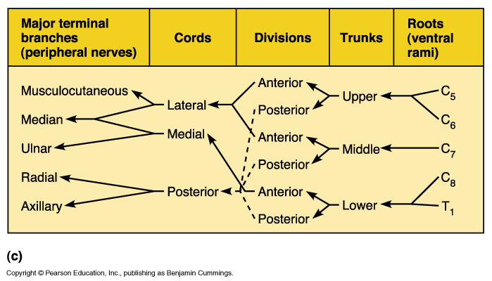
BRACHIAL PLEXUS

Slide 7
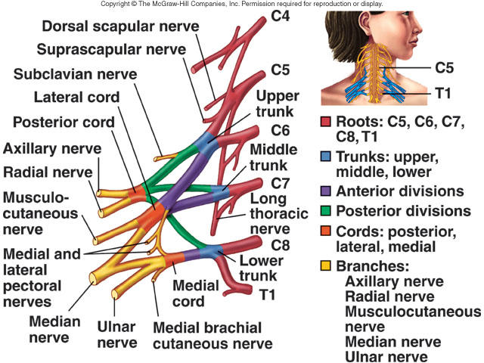
BRACHIAL PLEXUS
MAJOR NERVES
  Axillary
  Radial
  Musculocuta.
  Ulnar
  Median

Slide 8
BRANCHES
Roots | Trunks | Divisions | Cords
 |  |  | Lateral | Medial | Posterior
3 | 1 | NIL | 3 | 5 | 5

Slide 9
BRACHIAL PLEXUS:NERVES
FROM ROOTS
Dorsal scapular nerve C5
Nerve to subclavius C5, 6
Long thoracic nerve C5, 6 (7)
Unnamed muscular branches from all roots- scaleni / longus colli
5. C5 root of Phrenic nerve
FROM TRUNK (UPPER TRUNK ONLY)
Suprascapular nerve C5, 6
Nerve to Subclavius
      No branches arise from Divisions

Slide 10
BRACHIAL PLEXUS: NERVES FROM CORDS
Lateral cord Lateral pectoral C5, 6, 7
Musculocutaneous C5, 6, 7
Lateral root of median C(5), 6, 7
Medial cord Medial pectoral C8, T1
Medial cutaneous of forearm C8, T1
Medial cutaneous of arm C8, T1
Ulnar C(7), 8, T1
Medial root of median C8, T1
Posterior cord Upper subscapular C5, 6
Thoracodorsal C6, 7,8
Lower subscapular C5, 6
Axillary C5, 6
Radial C5, 6, 7, 8, (T1)

Slide 11
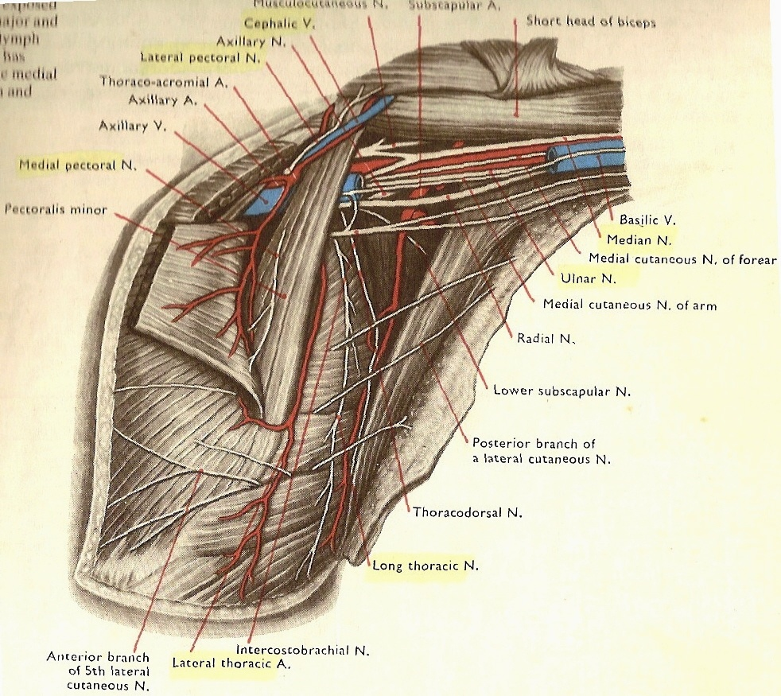
L
M
Relative positions
Of Nerves

Slide 12
BRACHIAL PLEXUS: NERVES
DISTRIBUTION OF MAIN NERVES
  AXILLARY –
    Deltoid & Teres minor
  MUSCULOCUTANEOUS –
    Muscles of Anterior Compartment of arm (flexors)
  MEDIAN –
    Most of the Flexor muscles of forearm & Intrinsic muscles in hand- labourer
  ULNAR –
    FCU & part of FDP (forearm) and Intrinsic muscles in hand- musician
  RADIAL –
    Innervates all Extensor muscles of arm & forearm

Slide 13
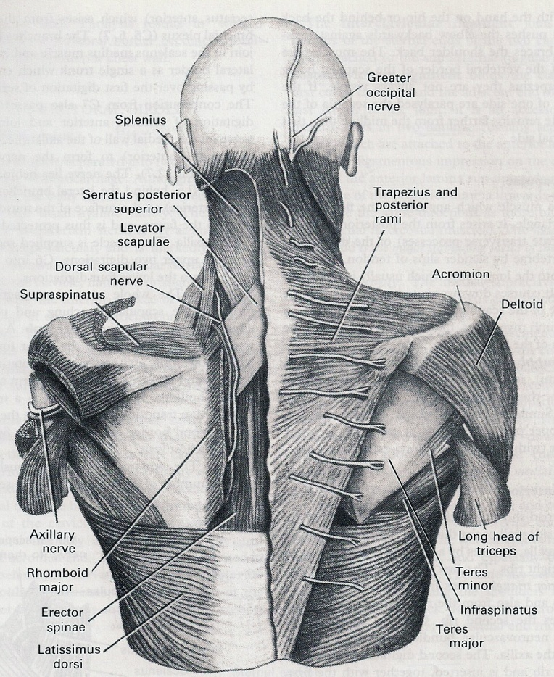
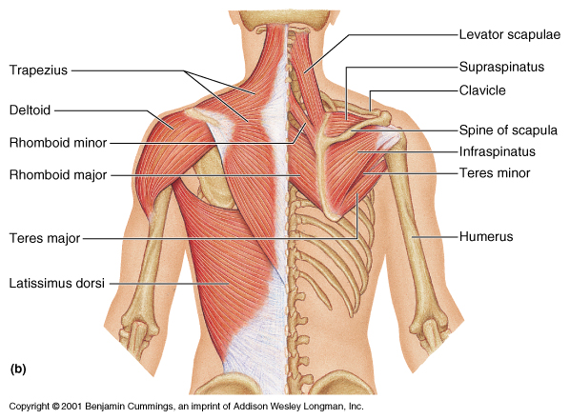
DORSAL SCAPULAR NERVE – From Root
  arise from C 5,6, posterior aspect
  Run down deep to levator scapulae and two rhomboids.
  Supply
    levator scapulae and two rhomboids

Slide 15
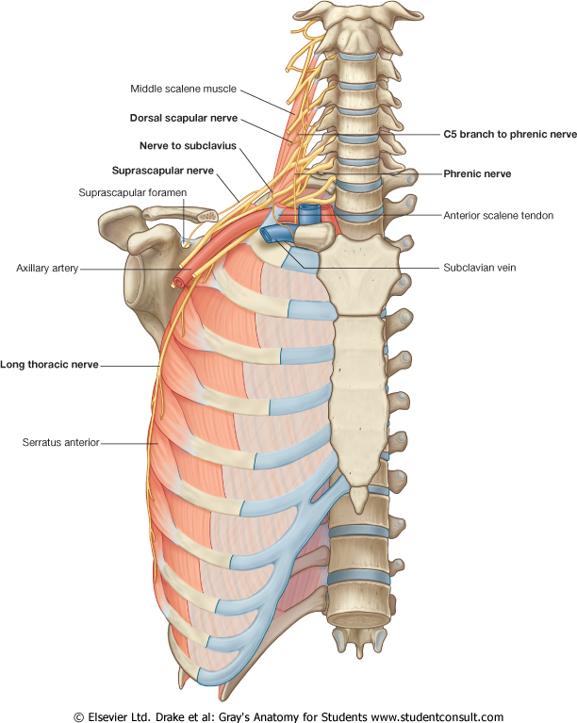
BRACHIAL PLEXUS- ROOTS
NERVE TO SUBCLAVIUS
  Small & arises near the junction of C5 and C6 ventral rami (ERBS POINT)
  Descends
    anterior to the trunks of plexus and Subclavian vessels
  connected to Phrenic nerve (if it contains fibres of accessory phrenic nerve.)
  supply
    Subclavius.

Slide 16
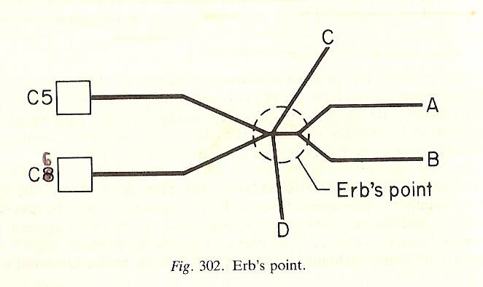
ERB’S POINT
Suprascapular N
Ant Div
Post Div
C6
N to Subclavius ??

Slide 18
BRACHIAL PLEXUS- ROOTS
LONG THORACIC NERVE
  Arise from C 5,6,7
  Forms on first digitations of SA muscle
  run vertically downwards just behind the mid axillary line.
  Nerve supply
    C5 – supply first two digitations,
    C6 – next two digitations,
    C7 – lowest four digitations.

Slide 19
LONG THORACIC NERVE OF BELL

Slide 20
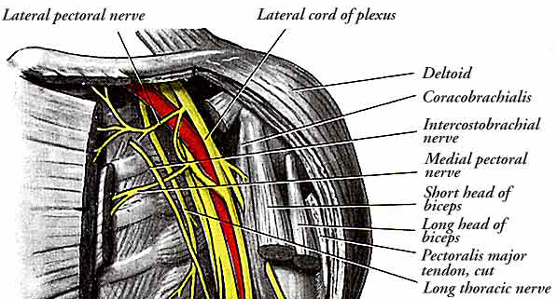
LONG THORACIC NERVE

Slide 21
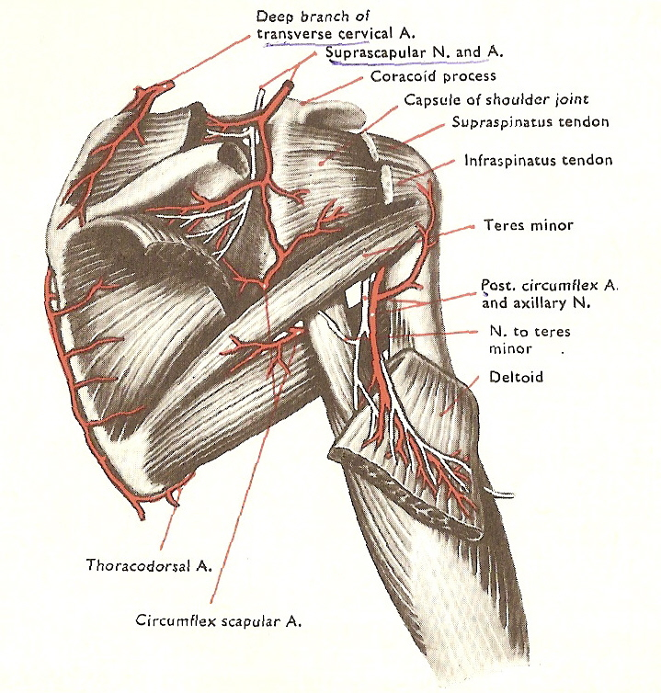
BRACHIAL PLEXUS: UPPER TRUNK NERVES
SUPRASCAPULAR NERVE
  Derived from C5,6.
  Branch of upper trunk- Erb’s point.
  Course :
    Runs laterally deep to Trapezius
    Enters supraspinous fossa (through Suprascapular notch below transverse scapular ligament).
    Runs deep to Supraspinatus
    curves round the lateral border of scapular spine with Suprascapular artery to reach infraspinous fossa.

Slide 22
  Branches to
    Supraspinatus,
    Infraspinatus and
    Articular rami to Shoulder and Acromio clavicular joints.
  Supplies - skin of proximal third of arm within the territory of Axillary nerve.

Slide 23
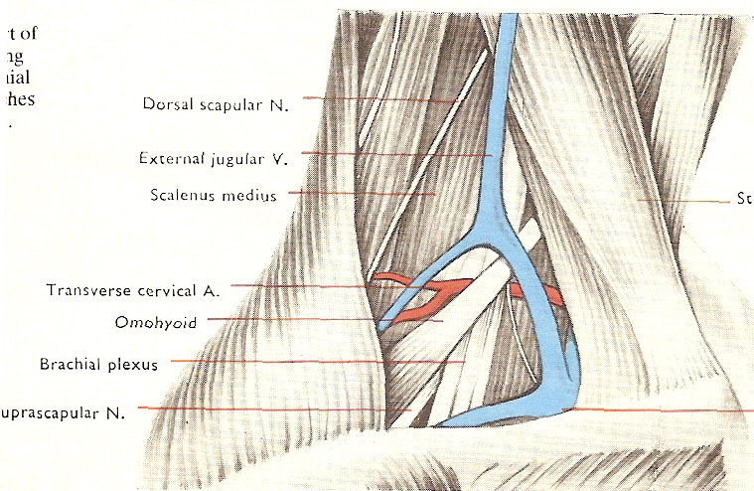
Nerve deep tp Trapezius and omohyoid

Slide 24
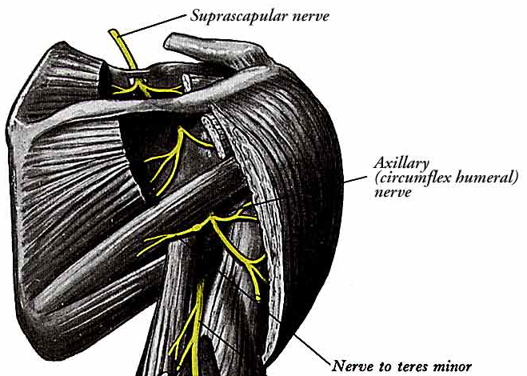
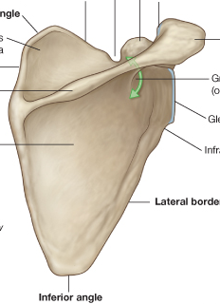
SUPRASCAPULAR NERVE
Course

Slide 25
BRACHIAL PLEXUS - LAT CORD
LATERAL PECTORAL NERVE
  Derived from C5.6,7. Larger than medial.
  Course :
    Makes loop of communication with medial pectoral N in front of First part of Axillary Art.
    Pierce clavipectoral fascia.
  Supply :
    Pectoralis Major,
    Pectoralis minor ( through communication with medial pectoral N)
LAT ERAL ROOT OF MEDIAN NERVE
  Is joined by medial root at lateral side of axillary art to form Median N.

Slide 26
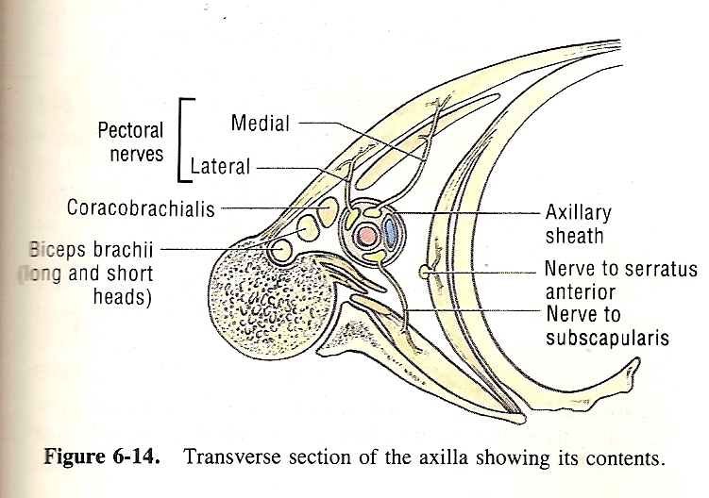
TRANSVERSE SECTION OF AXILLA WITH CONTENTS

Slide 28
MusculocutaneousN

Slide 29
- LAT ERAL CORD
MUSCULOCUTANEOUS NERVE
  opposite lower border of Pectoralis Minor.
  Derived from C5-C7 cervical ventral rami
  Course :
  Supplies Coracobrachialis and then pierces it.
  Descends laterally between Biceps and Brachialis to lateral side of arm.
  Just below elbow it pierces deep fascia.
  Continues as lateral cutaneous nerve of forearm..
  Branch to the Coracobrachialis leaves the musculocutaneous before
  it enters the muscle. Branches to the Biceps and Brachialis – after
  musculocutaneous pierces the coracobrachialis

Slide 30
  Supplies –
    Coracobrachialis,
    Biceps and
    most of Brachialis.
    Branch to Brachialis supplies Elbow joint.

Slide 31
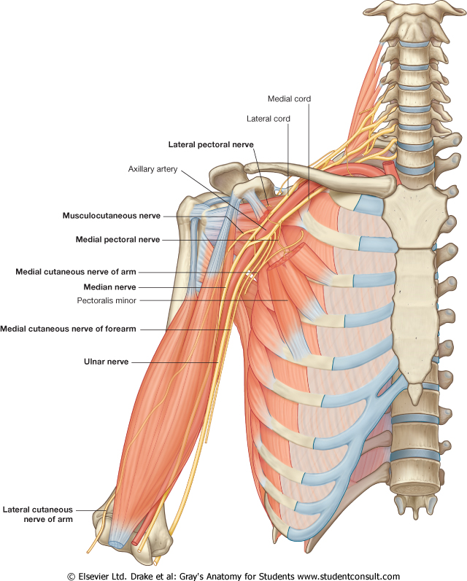

Slide 32
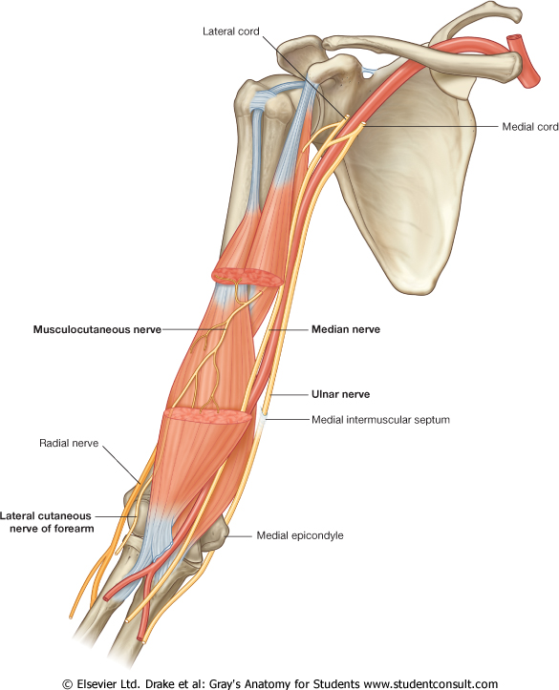

Slide 34
MEDIAL CORD
MEDIAL PECTORAL NERVE
  Derived from C8-T1 ventral rami.
  Course
    Arise from medial cord behind axillary artery.
    Anterior to artery it joins the lateral pectoral nerve to form a loop.
    Enters deep surface of Pectoralis minor to supply it and Pect Major.
    Two or three branches pierce Pectoralis minor and others may pass round its inferior border to end in Pectoralis major.

Slide 35
TRANSVERSE SECTION OF AXILLA WITH CONTENTS

Slide 36
MEDIAL ROOT OF MEDIAN
  Derived from C8, T1
  Crosses axillary art to join the lateral root to form Median N.
MEDIAL CUTANEOUS N OF ARM
  Derived from C8,T1
  Runs down medial to axillary vein,
  pierce deep fascia and
  supply skin on the front and medial side of upper arm.
  Sometimes entirely replaced by intercostobrachial N

Slide 37
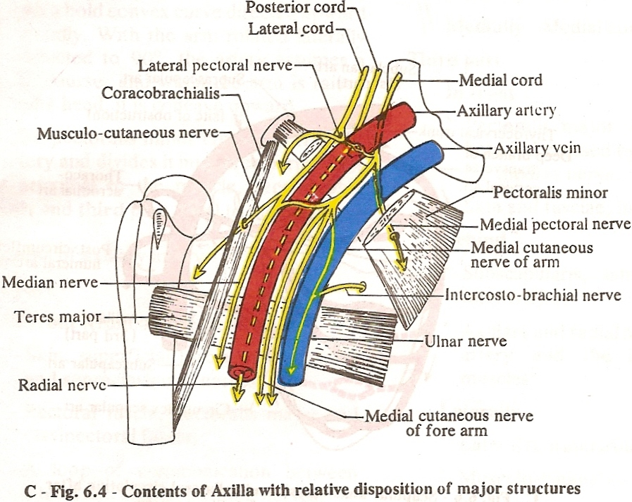

Slide 39
BRACHIAL PLEXUS- MEDIAL CORD cont’d
MEDIAL CUTANEOUS N OF FOREARM
  Derived from C8,T1
  Course
    Run down bt axillary art and vein,
    pierce deep fascia halfway down to elbow.
  Supply
    lower arm and ulnar border of forearm to wrist.
  Part of nerve in arm can be used as grafts. (no branches here)

Slide 40
ULNAR
  Derived from C8, T1, (C7)
  Course
    Largest branch, run bt Axillary artery and vein behind medial cut N of forearm
    Passes down medial aspect of arm,
    post to medial epicondyle to enter forearm.
  Supply
    1 ½ flexor forearm msl, (FCU – C7 Comp)
    most small msl of hand,
    skin of hand med 1 ½.

Slide 42
BRACHIAL PLEXUS- POSTERIOR CORD
UPPER SUBSCAPULAR NERVE
  Smaller than lower.
  Arises from Posterior cord (C5 and 6).
  Enters Subscapularis at a high level. Frequently double.
LOWER SUBSCAPULAR NERVE
  From Posterior cord (C5 and 6).
  Pass inferolaterally deep to sub scapular art.
  Supplies
    Subscapularis (lower part ) &
    Teres major (sometimes supplied by a separate branch)

Slide 43
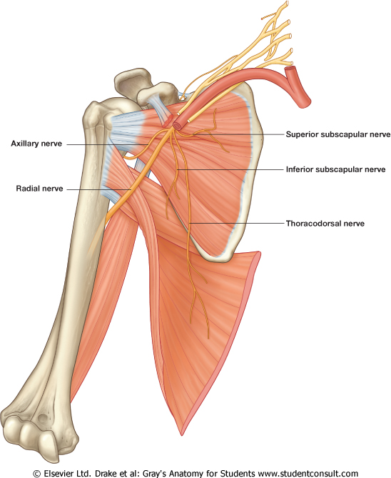

Slide 44
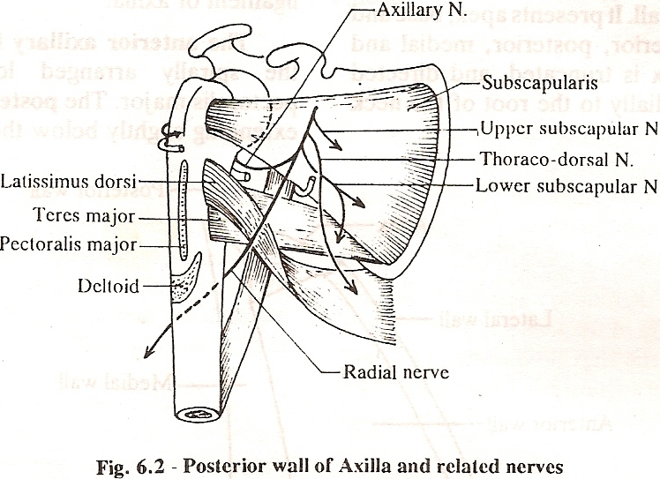
Showing upper and lower sub scapular and thoracodorsal nerves

Slide 45
THORACODORSAL NERVE
  Nerve to Lattissimus Dorsi
  Middle Subscapular Nerve
  From Posterior cord.
  Fibres from C6-C8.
  Arises between upper and lower Sub scapular nerves .
  Accompanies sub scapular artery along posterior axillary wall.
  Supplies
    Latissimus dorsi.

Slide 46
Thoracodorsal nerve
Accompanies subscapular art in post axillary wall

Slide 47
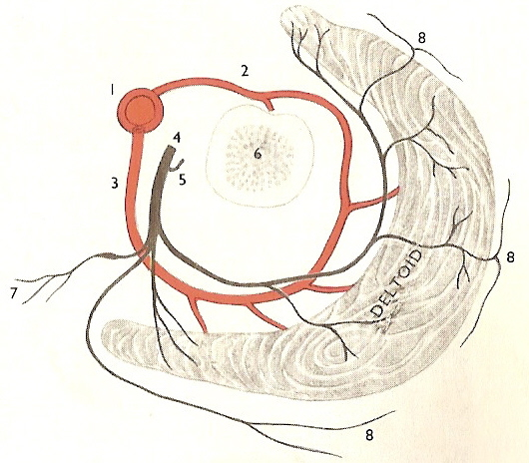
BRACHIAL PLEXUS- POSTERIOR CORD
AXILLARY (CIRCUMFLEX) NERVE
  From posterior cord (C5 - C6) .
  Posterior to Axillary artery (3rd part) and anterior to Subscapularis,
  Above posterior circumflex humeral vessels, traverses quadrangular space.
  Axillary trunk supplies a branch to shoulder joint.

Slide 48
BRACHIAL PLEXUS- Axillary Nerve
  Divides into
    anterior and
    posterior branches.
  Anterior branch
  along posterior circumflex humeral vessels,
  curves behind the humeral neck,
  Supplies
    Deltoid (deep to).
    skin over its middle part.(cutaneous branches which pierce the muscle)

Slide 49
Anterior br of Axillary Nerve
Posterior branch

Slide 50
    Posterior branch
    supplies
      Teres minor
        Branch to Teres minor has a pseudoganglion
      posterior and lower part of Deltoid.
      upper part of long head of Triceps
      upper lateral cutaneous nerve of arm
        (Continuation of posterior branch which pierces deep fascia low on posterior border of Deltoid).

Slide 51
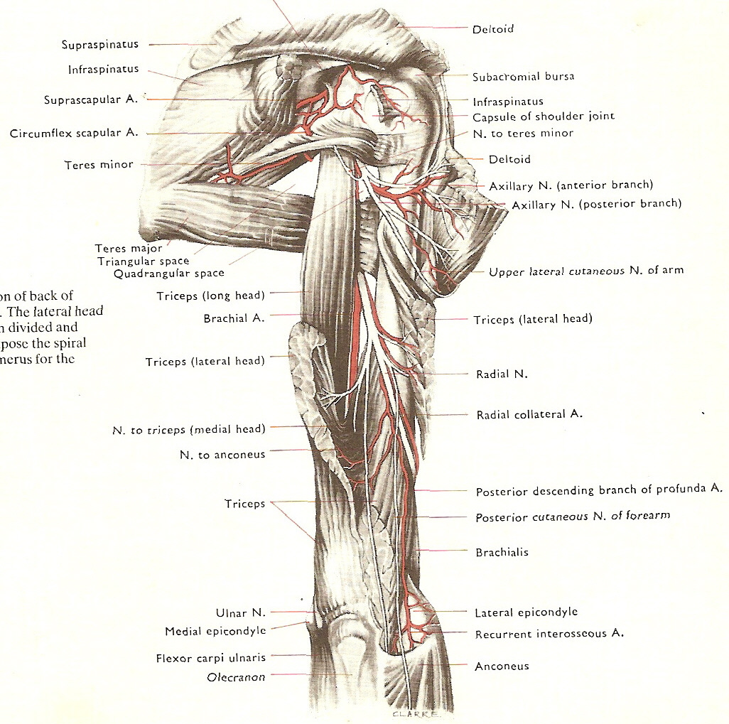
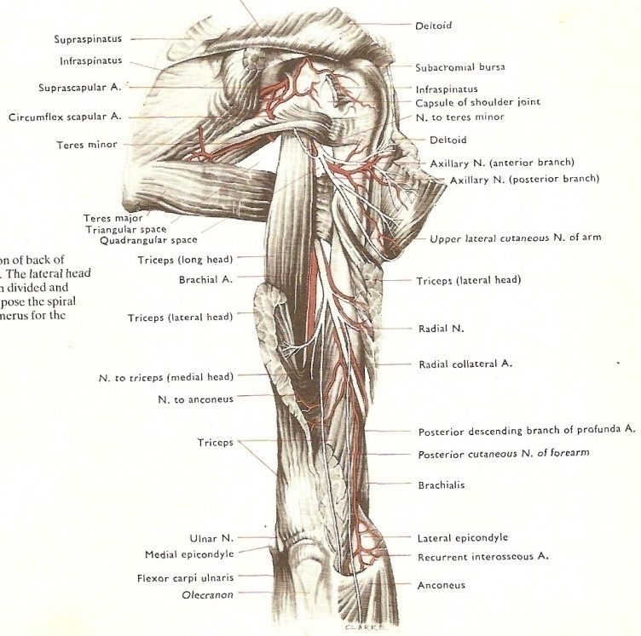

Slide 52
AXILLARY NERVE

Slide 53
BRACHIAL PLEXUS- POSTERIOR CORD
RADIAL NERVE
Derived from C 5,6,7,8 and T 1.
Largest br of the whole plexus
Course:
  Pass down behind third part of axillary and infront of msl of post wall of axilla.
  Leaves axilla through Triangular space
  Enter radial groove to pass bt long and medial heads of triceps.

Slide 54
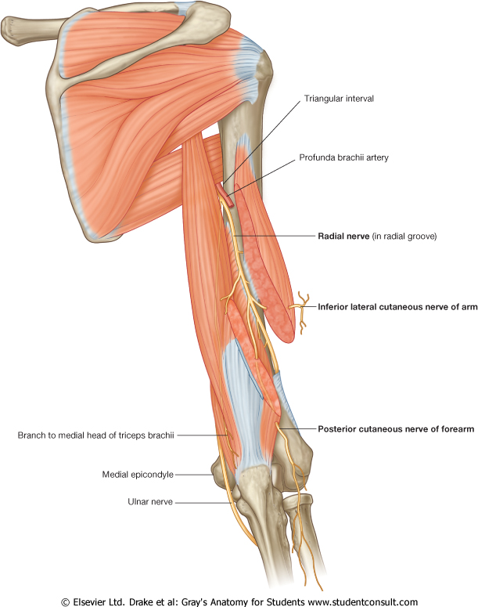

Slide 55
  Supply :
    Triceps,
    anconeus,
    Brachioradialis
    Extensor msl of forearm
    Supply skin
      post aspect of arm,
      forearm and
      hand ( radial 3 ½ fingers excl nail beds and dorsum)

Slide 57
APPLIED ANATOMY
Lesion of Suprascapular N
Lesion of Long Thoracic N of Bell
Upper trunk palsy
Lower trunk palsy
Cord injuries – Lateral, Medial , Posterior
Lesion of Axillary N
Lesion of Musculocutaneous N
Variations
Brachial plexus block

Slide 58
COMMONEST CAUSES
  Entrapment neuropathy
    may occur in scapular notch.
  trauma to
    scapula and shoulder.
  Pain in shoulder and
  weakness and wasting
  of
    supraspinatus and
    infraspinatus.
LESIONS OF SUPRASCAPULAR NERVE

Slide 59
LESIONS OF NERVE OF BELL
COMMONEST CAUSES
  Sudden heavy loads on shoulder
  Carrying heavy loads on shoulder
Symptom and sign
  Winging of scapula
    prominence of medial border of scapula
  may be the only clinical manifestation.
  Loss of pushing and punching actions.
  Abduction of arm affected.
Demonstrated by
  asking the patient to push against resistance with the forearm extended at the elbow and flexed to 90° at the shoulder.

Slide 60
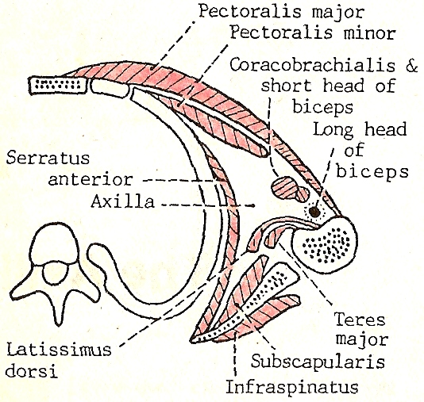
Serratus anterior keeps the medial border of scapula in close apposition to the thoracic wall
Scapula medial border

Slide 61
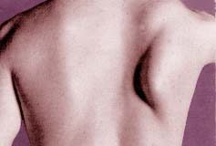
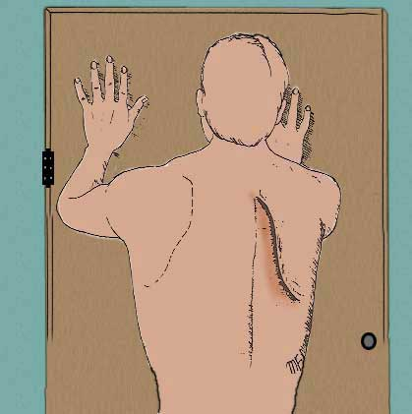
Winging of scapula

Slide 62
LESIONS OF AXILLARY NERVE
Commonest causes
  Dislocations of shoulder
  Fractures of upper end humerus
  Misplaced injections into deltoid
Symptom and sign
    Wasting and weakness of Deltoid-
      abduction of shoulder affected.
    sensory loss
      on outer aspect of upper arm below acromian.
Differentiated from a C5 root lesion by finding normal function in the distribution of Suprascapular nerve.

Slide 63
LESIONS OF AXILLARY NERVE

Slide 64
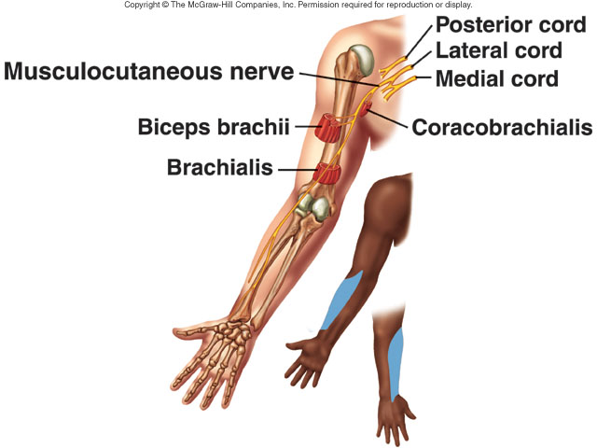
LESIONS OF MUSCULOCUTANEOUS NERVE
Commonest causes
  Isolated lesion is rare.
  injuries to
    upper arm and
    shoulder including fracture of humerus.

Slide 65
LESIONS OF MUSCULOCUTANEOUS NERVE
Symptom and sign
  Marked weakness of elbow flexion
    because of paralysis of
      biceps brachii and much of
      brachialis
  Sensory impairment
    on the extensor aspect of the forearm in the distribution of lateral cutaneous nerve of the forearm.
  Pain and paraesthesia
    may be aggravated by elbow extension.

Slide 66
UPPER TRUNK PALSIES – ERB’S PALSY
3
1&2 – NERVE ROOTS
3- SUPRASCAPULAR N
4- SUBCLAVIUS N
5- UPPER TRUNK
6 & 7- ANT/POST DIVISIONS OF UT
C 5
1
6
C 6
5
2
7
4
ERB’S POINT
Site of Injury
Erb’s point
  meeting of six N in upper trk.
  Nerves arising from upper trk, lat and post cord involved.
Cause of injury
  Separation of head from shoulder due birth
    ERB DUCHENNE PARALYSIS
  fall on shoulder.
Nerve roots involved
  C5, C6

Slide 67
C 6

Slide 68
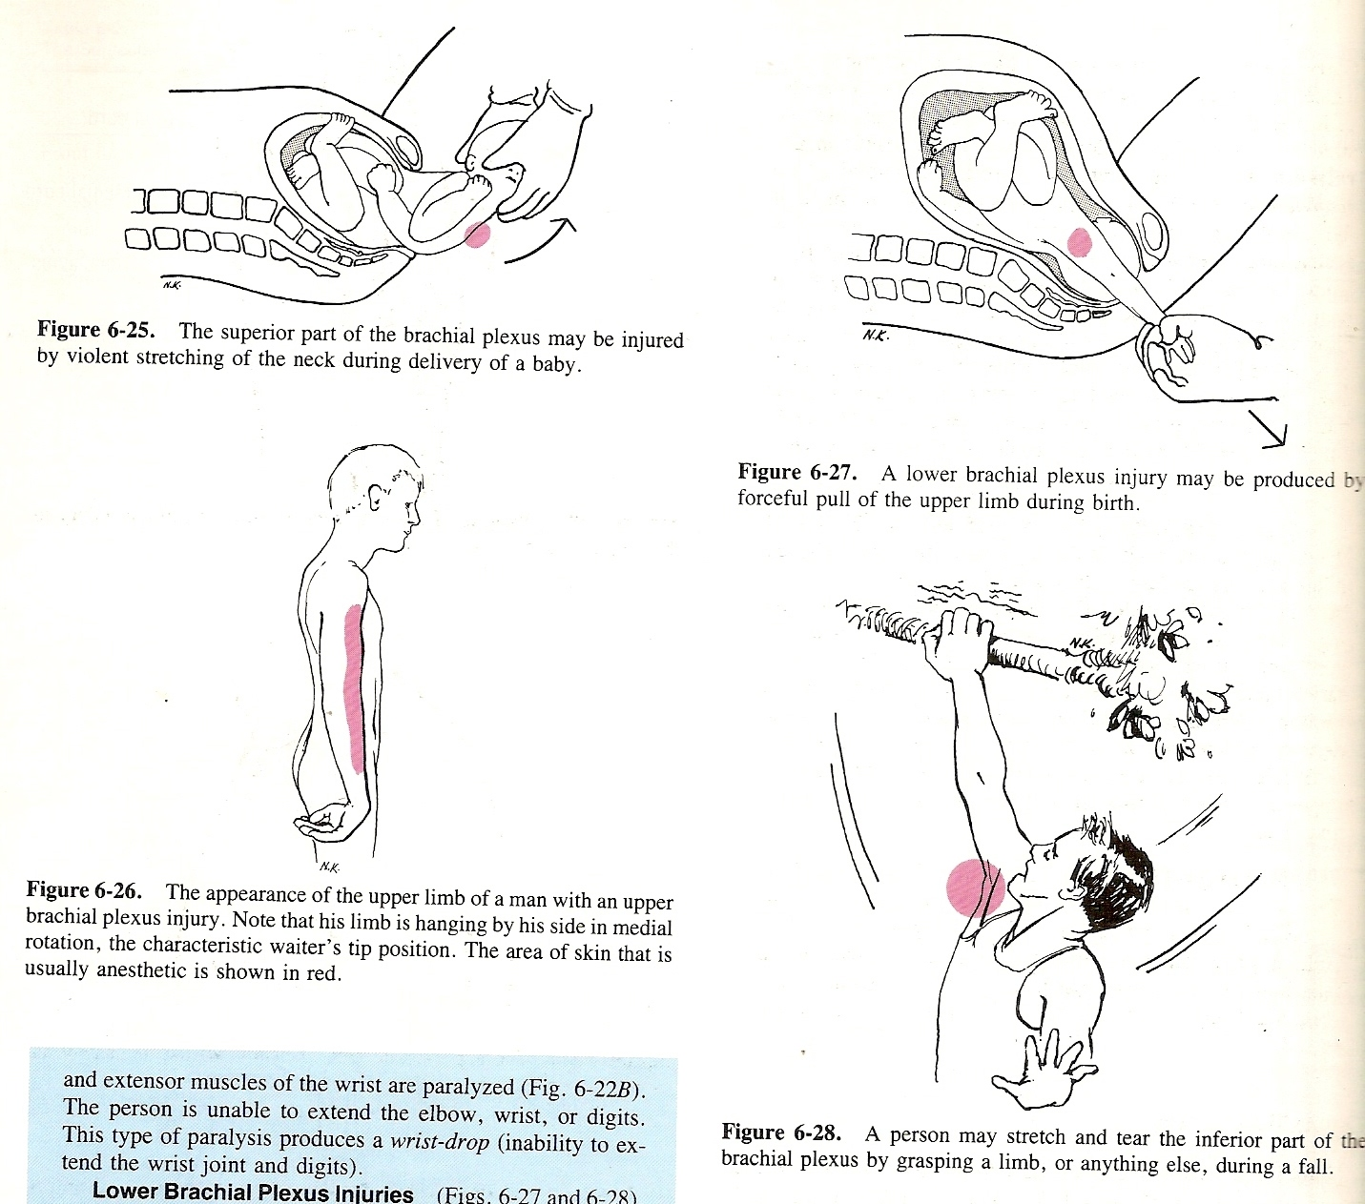
ERB DUCHENNE PARALYSIS

Slide 69
UPPER TRUNK PALSIES – ERB’S PALSY
Muscle paralysed/action affected/nerve involved
  Lat cord
    Biceps, – flexion at elbow, supination affected – Musculocut N
    Brachialis - flexion at elbow - Musculocut N
  Post cord
    Deltoid – abduction and lat rotation at shoulder jt affected – Axillary
    Brachioradialis – flexion at elbow ,supination from pronation affected – Radial
    Supinator – supination affected – radial N
  Upper trunk
    Supraspinatus – abduction of shoulder – suprascapular N
    Infraspinatus – lat rotation of humerus – suprascapular N

Slide 70
UPPER TRUNK PALSIES – ERB’S PALSY Cont’d
Symptom and sign
  position of limb-
    Arm hangs by side
      Adducted (no abduction)
    medially rotated. (no lateral rotation)
    Extension at elbow. (no flexion)
    Forearm is pronated. (no supination)
  POLICEMAN’S TIP OR WAITER TIP HAND

Slide 71
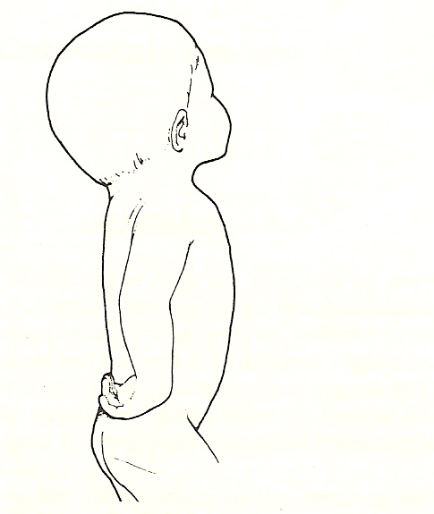
Waiters tip deformity

Slide 72
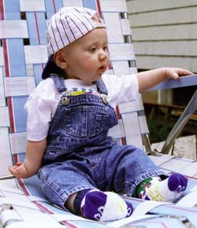
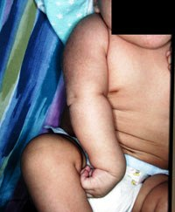
Waiters tip deformity

Slide 73
LOWER TRUNK PALSIES
Site of Injury
  Lower trunk injured (C 8, T1).
  Medial Cord involved.
    ulnar,
    medial cut N of Arm and forearm
Cause of injury
  Birth injury (klumpke’s paralysis)
  Cervical rib
    lower trk present anterior to S medius border and lies on 1st rib.
    If elevated by cervical rib the lower trk gets compressed. The cervical rib forces its way bt nerve and first rib.
  Undue abduction of arm while holding something with hands during fall from height.

Slide 74
  klumpke’s paralysis

Slide 75
during fall from height

Slide 76
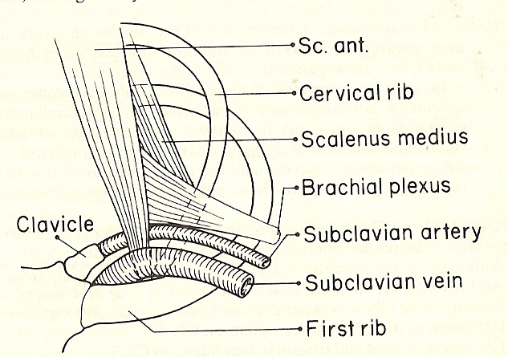
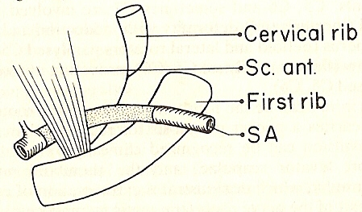
Cervical rib

Slide 77
LOWER TRUNK PALSIES
Muscle Involved
  Ulnar N (C7,8 T1)-
    paralysis of
      Intrinsic muscle of hand,
      ulnar flexors of wrist and fingers

Slide 78
Symptom and Sign
  CLAW HAND (medial two fingers more affected)–
    due to unopposed action of long flexors fingers and extensors and
    paralysis of all interossei and medial two lumbricals.
    FROMENT’S SiGN
      Flexion of distal phalanx of thumb when a piece of paper held bt thumb and index finger
      Due to overaction of FPL and weakness of Add Pol.
  Sensory loss
    on ulnar side of hand and forearm.

Slide 79
  HORNER’s syndrome –
    Ptosis and reverse ptosis,
    miosis,
    anhydrosis,
    enopthalmos,
    Ciliospinal reflex
    hererochromia
  Due to disruption of sympathetic fibres to head and neck which travels via T1 nerve.

Slide 80
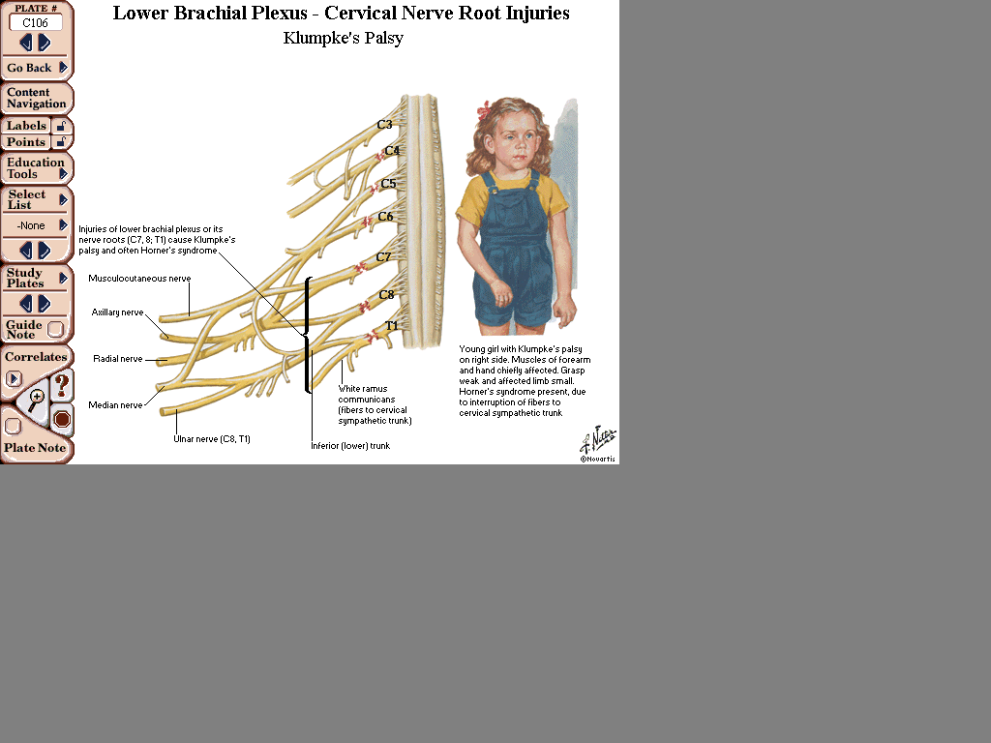
Klumpke’s paralysis

Slide 81
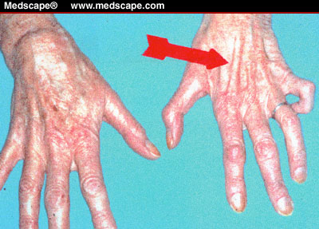
Loss of dorsal interrossei muscles

Slide 82
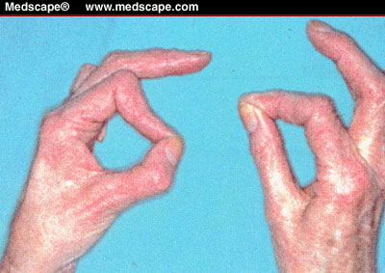
Froment’s sign

Slide 83
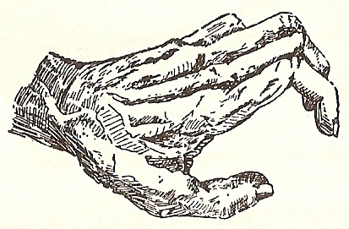
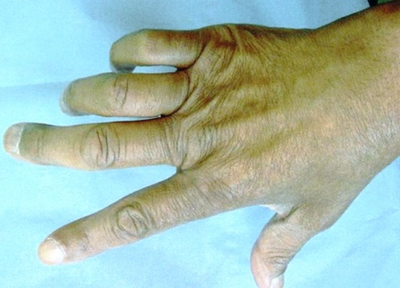
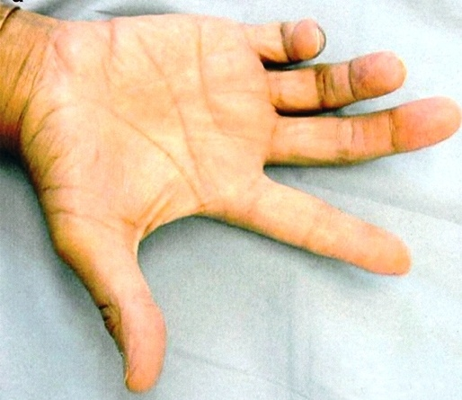
Claw hand

Slide 84
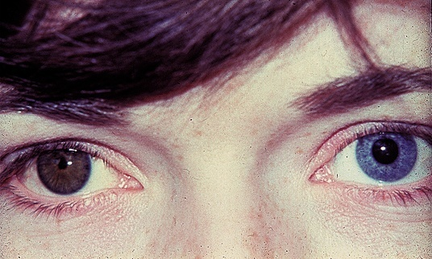
HORNER’s

Slide 85
Cord injuries
Associated with traction (RTA/penetrating wounds)
  Motor loss Sensory loss
Lateral Biceps,Brachialis Lateral forearm
(musculocutaneous) FCRL, PT
Medial Wrist flexor front/medial arm
(ulnar/median) Long flexors fingers medial forearm
intrinsic msl hand Ant surf- palm/hand
Post surf- hand (except radial)
Post Internal rot sh jt shoulder
(axillary, Abduction sh jt arm- post
Subscapular, extension- elbow, Metacarpals- 1 &2
Radial) wrist, MCP jt (dorsum), web- 1st

Slide 86
Variations
Prefixed and Post fixed
  Post fixed – inf trk compressed by 1st rib – neurovascular sym in upper limb
Variation in formations
  Trk divisions/cord formation absent - terminal br unchanged
  Median Nerve with two roots :
    due to three brs from medial cord, two forming Median Ner and one forming ulnar N

Slide 87
Brachial plexus block
Injection of anaesthetic soln into axillary sheath with brs of brachial plexus
Sensation blocked
  in deep structure of upper limb and
  skin distal to middle of arm
Use :
  Surgery on upper limb without GA
Approaches
  Interscalene, supraclavicular, axillary

Slide 88


