Slide 1
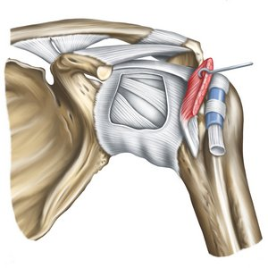
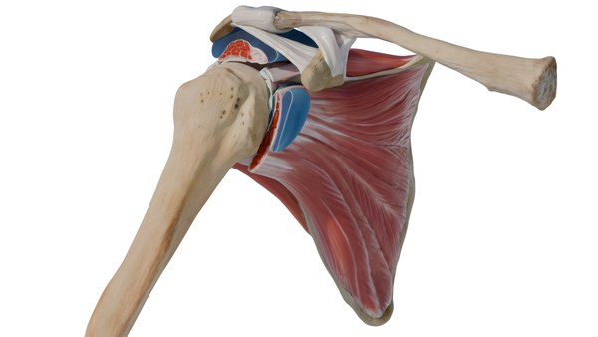
GROSS ANATOMY shoulder joint
Dr. Praveen Kumar Kurrey
M.B.B.S., M.S.,BCME,BCBR
Professor Anatomy

Slide 2
Components
Type
Articular surface
Ligaments
Stability of joint
Bursa related to the joints
Relations of the joint
Blood and Nerve supply
Movements
Applied anatomy

Slide 3
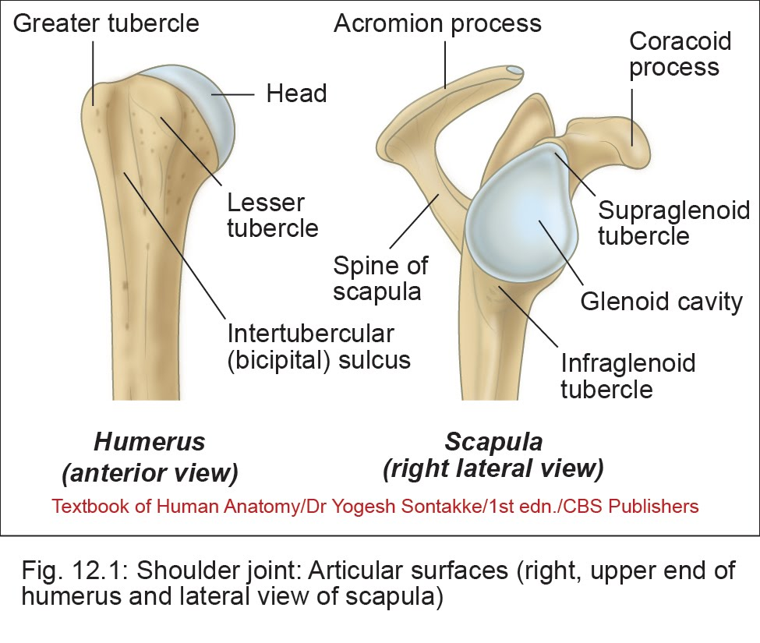
SHOULDER JOINT
Type
– Ball and socket type of synovial joint
– Multiaxial joint

Slide 4
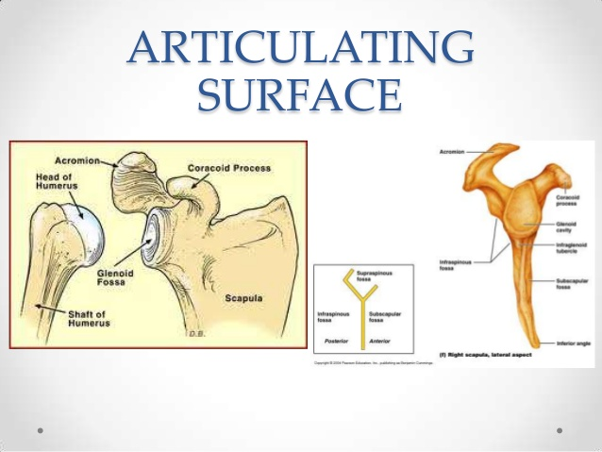
Type
Shoulder joint is a multiaxial ball and socket type of synovial joint.
Articular surface
Head of humerus -: The ball is represented by the spheroidal head of humerus.The head is directed upwards backwards and medially.
Glenoid cavity -: The socket is formed by the pear shaped small and shallow glenoid cavity of scapula which faces laterally upwards and forwards.

Slide 5
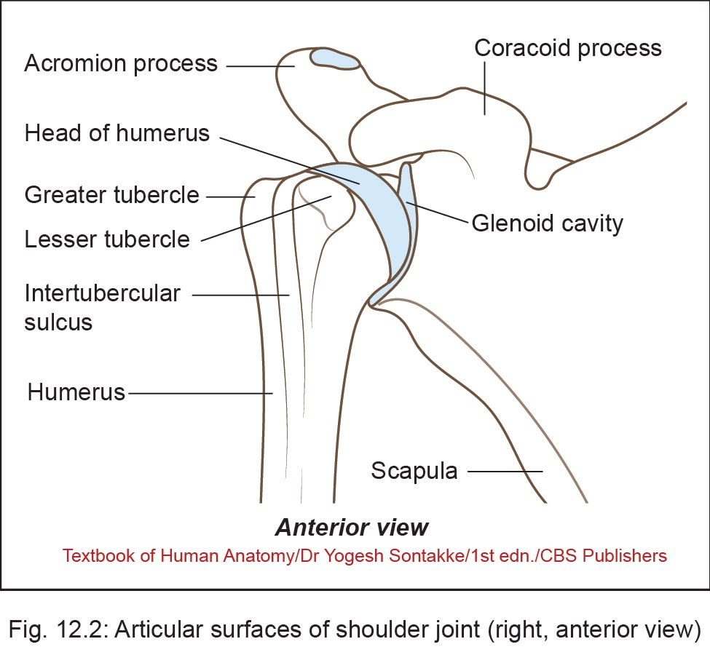

Slide 6
Ligaments
1. Fibrous capsule or Capsular ligament
2. Glenohumeral ligament
3. Coraco – humeral ligament
4. Transverse humeral ligament
5. Glenoid labrum

Slide 7
Capsular ligament -: It forms a loose envelope which permits free movements.
Medially – the capsule is attached to the scapula beyond the supraglenoid tubercle and glenoid labrum.
Laterally – the capsule is attached to the anatomical neck of the humerus except at two places-
-> superiorly it is deficient for passage of the tendon of the long head of biceps brachii.
-> inferiorly the attachment extends down to the surgical neck.
Synovial membrane- lines the inner side of capsule.

Slide 8
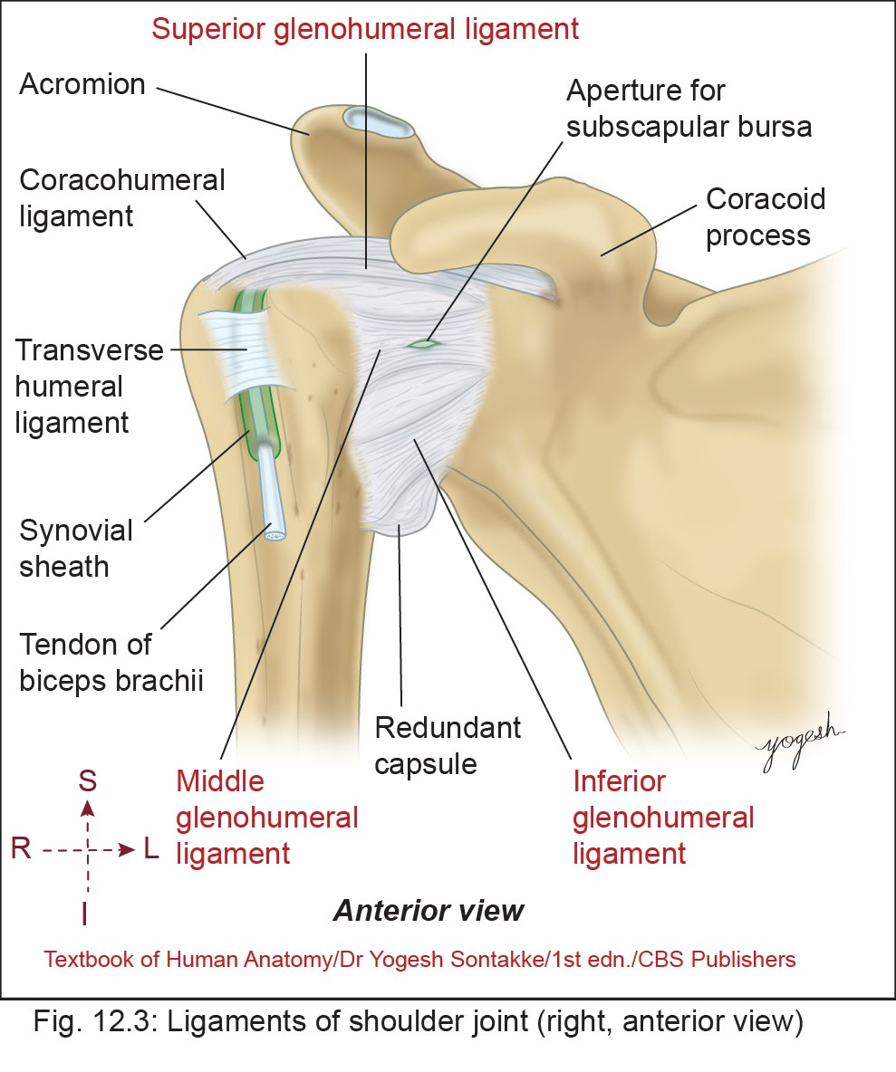
Capsular ligament

Slide 9
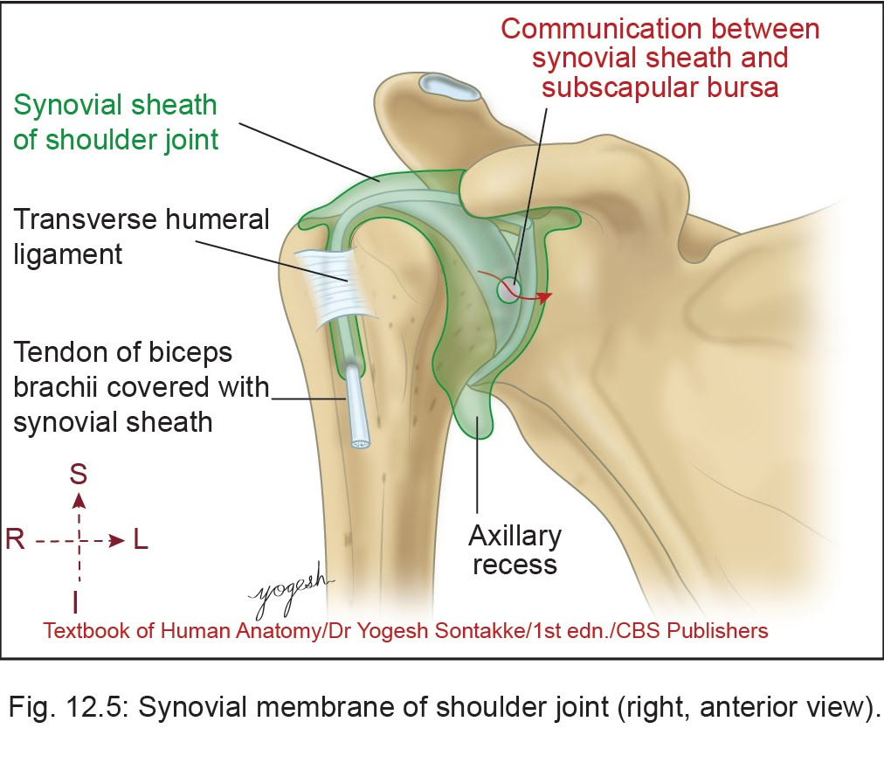
• Synovial membrane
– Synovial membrane lines the inner surface of the capsule.

Slide 10
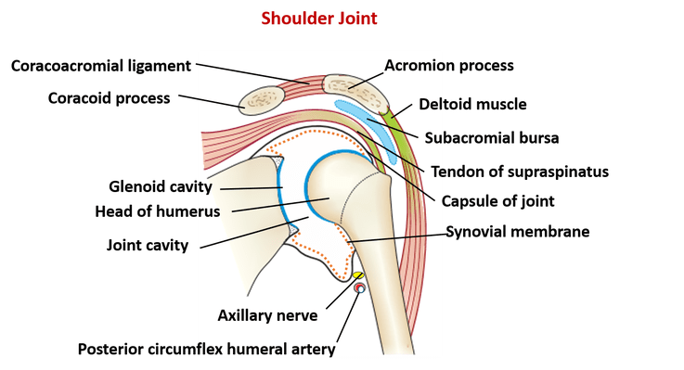

Slide 11
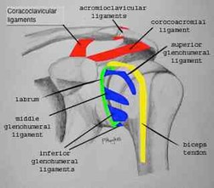
2. Gleno - humeral ligament -: These are three fibrous bands derived from the thickening of the ant. part of fibrous capsule.
-> Superior band – lies parallel
to the ant. edge of biceps
tendon and is attached to
the upper end of lesser
tubercle.
-> Middle band – is attached to
the lower part of the lesser
tubercle.
-> Inferior band – is attached to
the lower part of the anatomy-
cal neck of hummers.

Slide 12
Glenohumeral Ligaments
• Capsule of shoulder joint shows three thickenings as superior, middle, and inferior glenohumeral ligaments

Slide 13
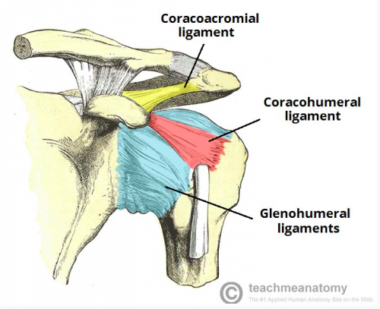
3. Coraco-humeral ligament –
It is a thick band in the upper part of the fibrous capsule
and extends from the lateral border of coracoids process
to the anatomical neck of hummers.

Slide 14
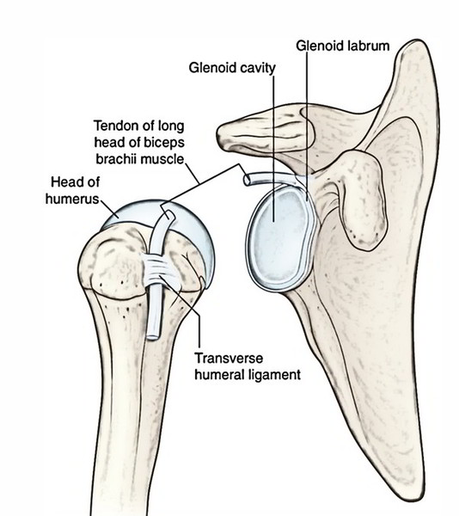
4. Transverse humeral ligament – It connects the two lips of the upper part of the bicipital groove, and acts as a retinaculum to keep the long tendon of the biceps in position.

Slide 15
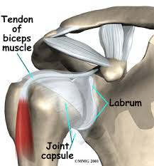
5. Glenoid labrum - It is a fibro- cartilaginous rim, triangular in cross section and attached to the peripheral margin of the glenoid cavity. The labrum deepens the glenoid fossa.

Slide 16
Stability of joint -
The laxity of the fibrous capsule and small and shallow glenoid cavity sacrificing stability of the joint.
The stability is maintained by following factors-:
Supraspinatus , tension of the upper part of the capsule and coracohumeral ligament prevent the downward displacement of the humerus.
The tonic contraction of the muscles of rotator cuff keeps the ball in contact with the socket.

Slide 17
In abduction of humerus the lower weak part of the capsule is supported by the long head of triceps and teres major.
4. The glenoid labrum deepens the socket and prevent skidding of the ball from its socket.
5. Upward displacement of the humeral head is prevented by the long tendon of biceps brachii and the coracoacromial arch.

Slide 18
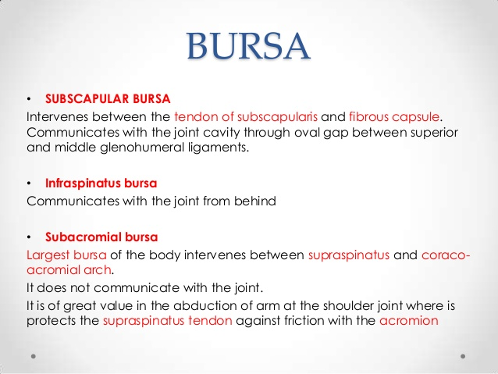

Slide 19
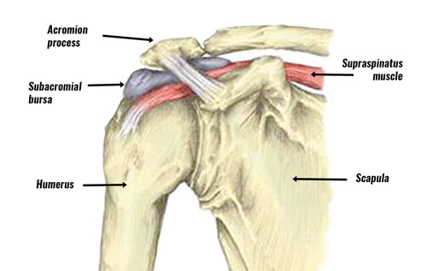
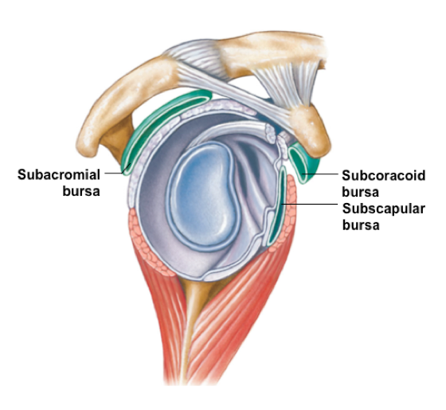

Slide 20
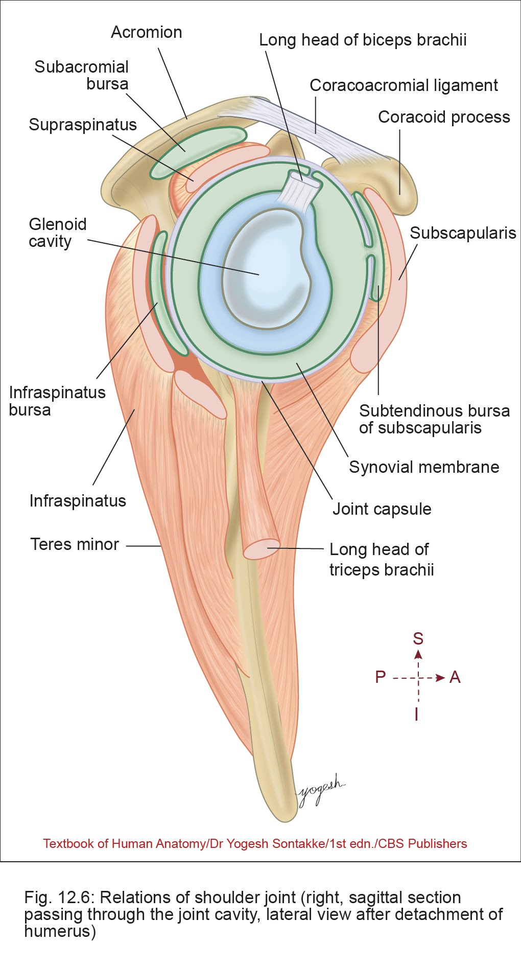
BURSA

Slide 21
Relations
Superior
• Subacromial bursa
• Supraspinatus
• Coracoacromial arch
• Deltoid (lateral fibers)

Slide 22
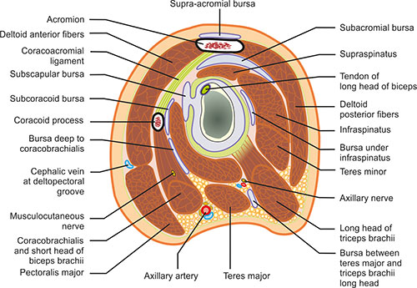
Relations
Inferior
• Long head of triceps
• Axillary nerve
• Posterior circumflex humeral vessels

Slide 23
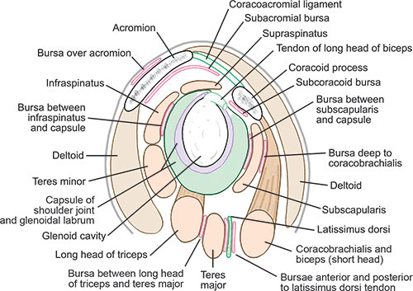
Relations
Anterior
• Coracobrachialis and short head of biceps brachii
• Subscapular bursa
• Subscapularis muscle
• Deltoid (anterior fibers)

Slide 24
Relations
Posterior
•Infraspinatus
• Teres minor
• Deltoid (posterior fibers)

Slide 25
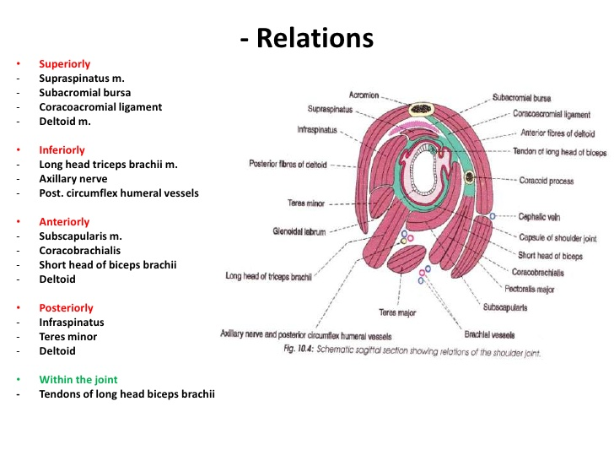

Slide 26
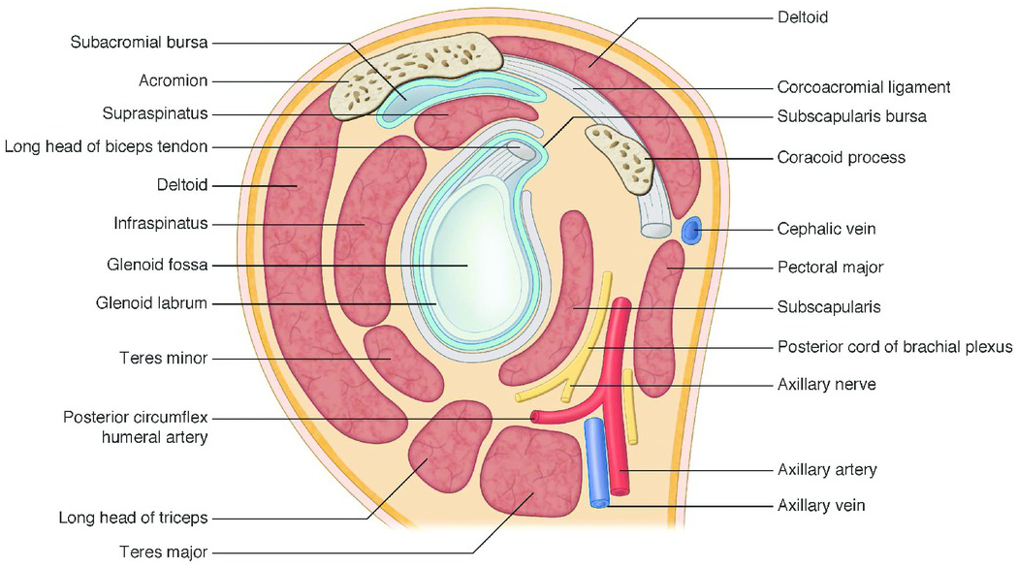
Relations of Shoulder Joint

Slide 27
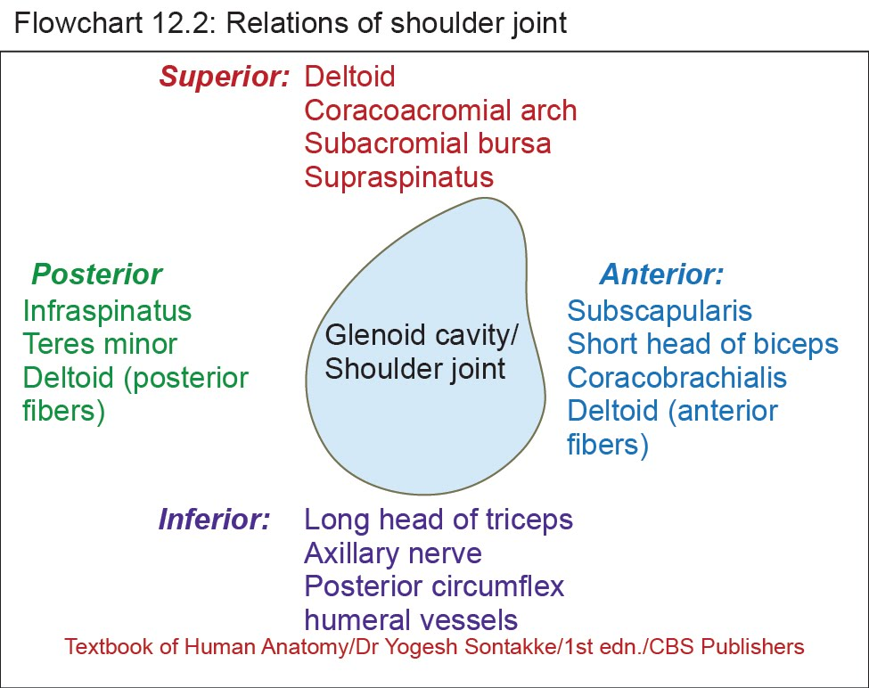

Slide 28
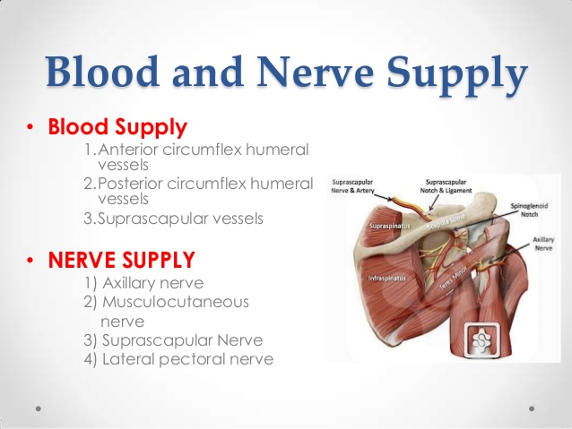

Slide 29
Movements
Active movements permitted at the shoulder joint are-
- Flexion
- Extension
- Abduction
- Adduction
- Circumduction
- Medial rotation
- Lateral rotation

Slide 30
Movements of the Shoulder Joint
Flexion and extension
• Flexion: Arm moves forward and medially.
• Extension: Arm moves backward and laterally.
• Plane of movements: Parallel to the surface of glenoid cavity.
• Axis: Around the transverse axis passing through the head of humerus and glenoid cavity.

Slide 31
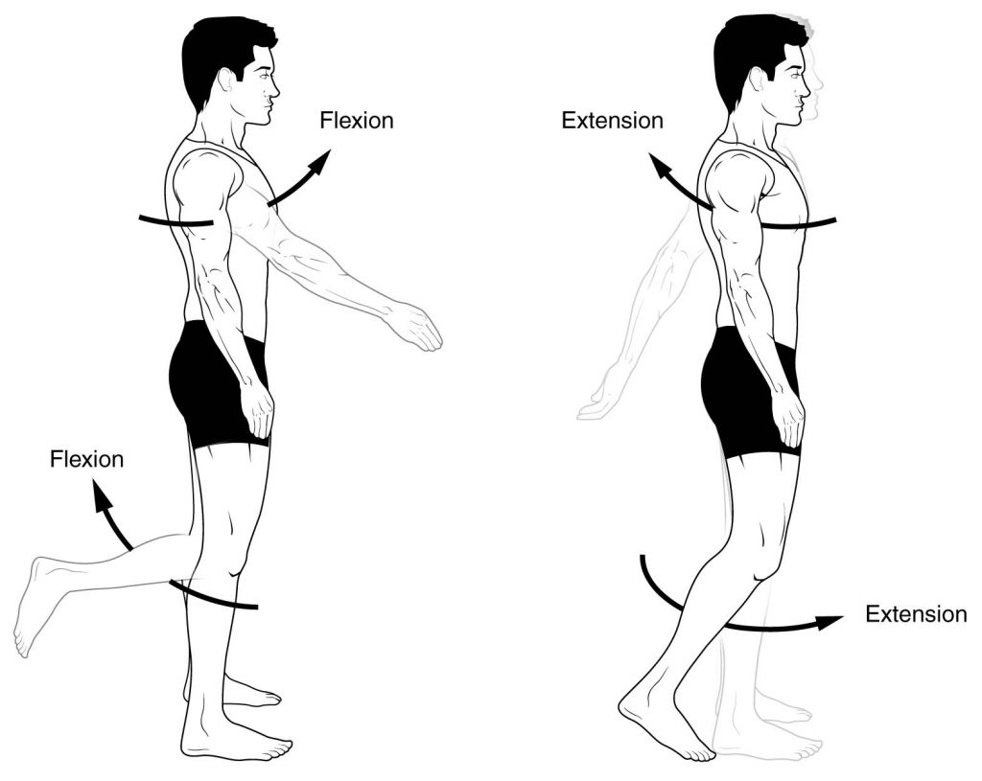
Flexion and Extension- Flexion and extension take place at right angle to the plane of the body of scapula around an axis which passes through the humeral head.

Slide 32
Movements
Adduction and abduction
• Adduction: Arm moves posteromedially near the trunk
• Abduction: Arm moves anterolaterally away from the trunk
• Plane of movement: It occurs in a plane midway between sagittal and coronal plane. It occurs at right angle to the plane of flexion and extension.
• Axis: It occurs around the axis passing through the head of humerus.

Slide 33
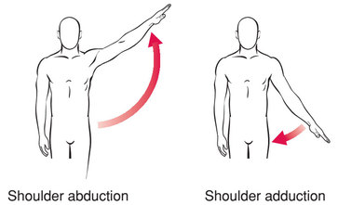
Abduction and Adduction – takes place parallel to the plane of the body of scapula around an axis passes through the head of humerus

Slide 34
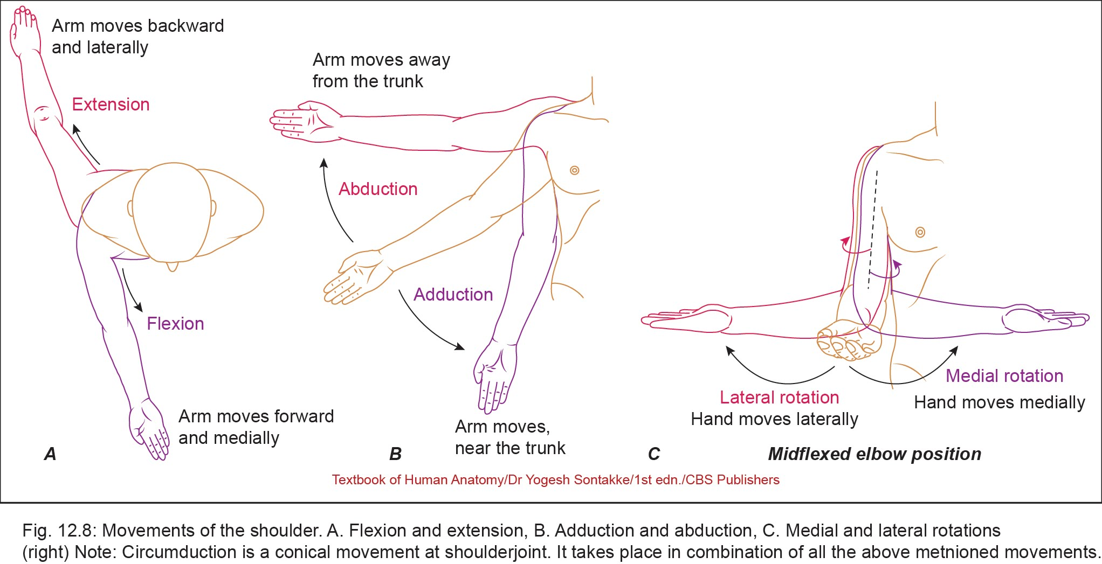
Movements
Medial rotation
• Anterior surface of humerus moves medially. In midflexed elbow position, in the medial rotation at shoulder joint, hand moves medially.

Slide 35
Movements
Lateral rotation
• Anterior surface of humerus moves laterally. In midflexed elbow position, in the lateral rotation at shoulder joint, hand moves laterally
• Plane of movements: occurs in transverse plane
• Axis: occurs around the vertical axis passing from head of humerus and lower end of humerus.

Slide 36
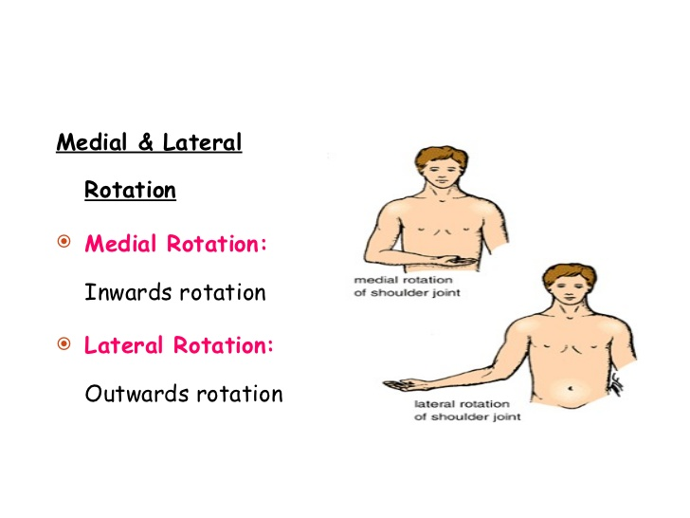
Medial and Lateral rotation- takes place around vertical axis and are best demonstrated with midflexed elbow

Slide 37
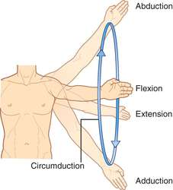
Circumduction - it is a combination of all four movements that is flexion ,extension, abduction and adduction.

Slide 38
MOVEMENTS

Slide 39
Muscles producing movements-
Flexion -: - Clavicular fibres of the pectoralis major.
- Ant. fibres of deltoid.
- Short head of biceps brachii
- Coracobrachialis.
Extension-: - Posterior fibres of deltoid
- Teres minor
- Infraspinatus
- Latissimus dorsi

Slide 40
Adduction-: - Sterno-costal fibres of pectoralis major
- Ant. and Post. fibres of deltoid
- Teres major
- latissimus dorsi
Abduction-: abduction of arm possible upto 180 degree
0 - 15 degree of abduction – by supraspinatus.
15 – 90 degree …………….. - acromial fibres of deltoid
90- 120 …………………….. - infraspinatus and teres minor
this is done by lateral rotation of
humerus
120 – 180 …………………….- serratus anterior
trapezius

Slide 41
Mechanism of Overhead Abduction
120 degree of elevation – occurs in the shoulder joint
Remaining 60 degree occurs in the shoulder girdle
In every 15 degree of elevation
- shoulder joint contributes 10 degree
- shoulder girdle …………5 degree
In the ratio of 2 : 1
called scapulohumeral rhythm.

Slide 42
Medial rotation - pectoralis major
- ant. fibres of deltoid
- teres major
- lattisimus dorsi
Lateral rotation - post.fibres of deltoid
- infraspinatus
- teres minor

Slide 43
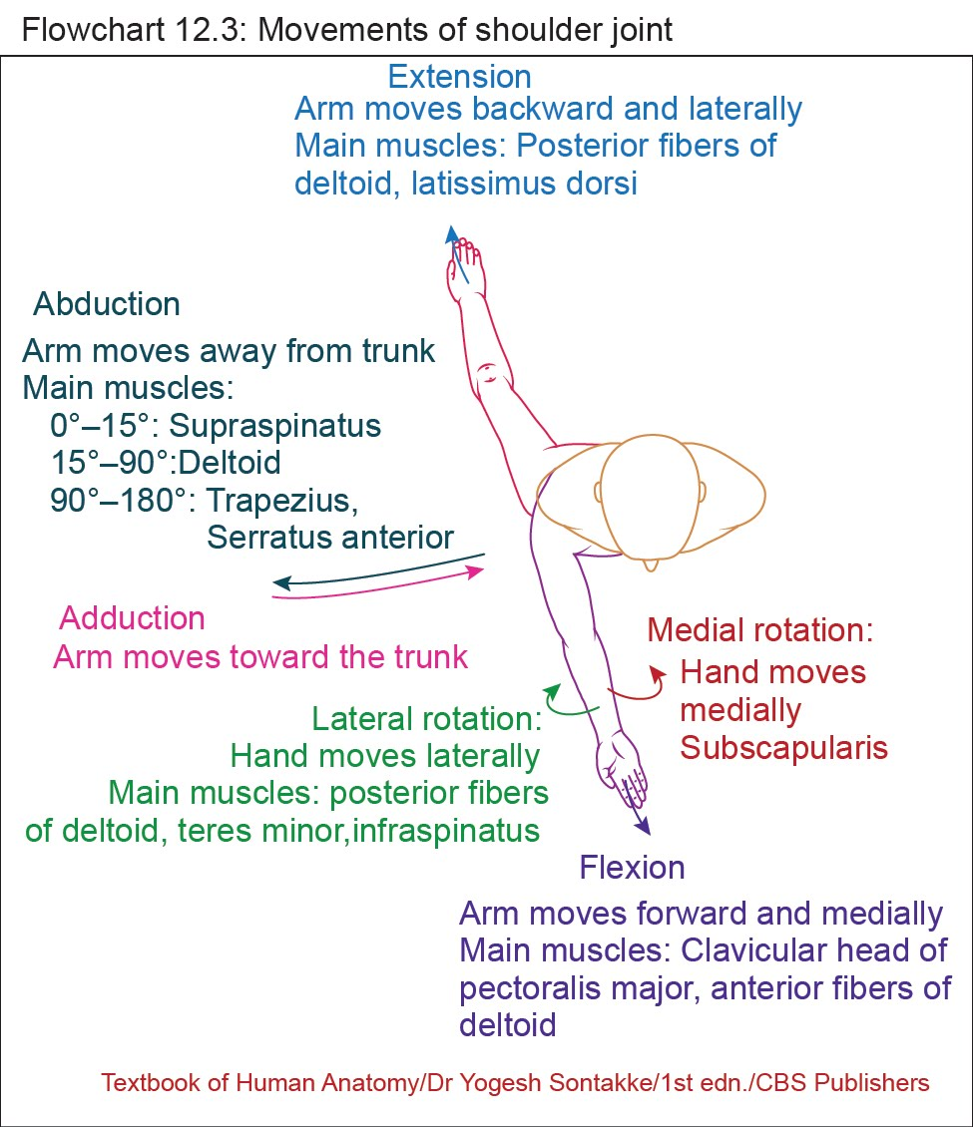

Slide 44
Applied anatomy
1. Dislocation - is common due to laxity of the ligaments and disproportionate articular surface. Inferior dislocation is most common because the capsule is lax inferiorly and the joint is least supported inferiorly
• May cause damage to the axillary nerve
2. Recurrent dislocation - sometime recurrent dislocation takes place anteriorly through tear in the anteroinferior part of the glenoid labrum.

Slide 45
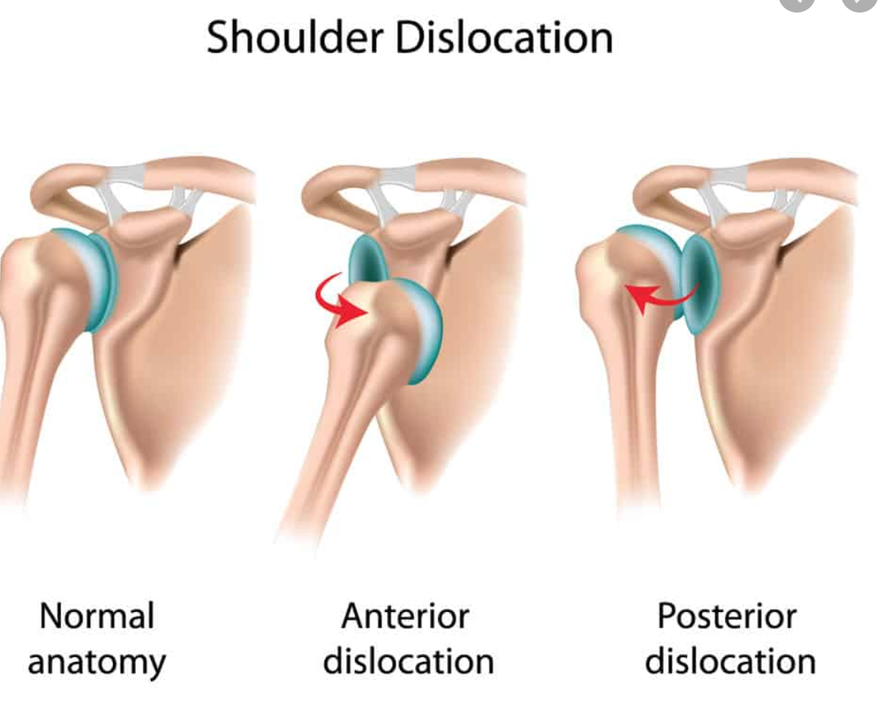

Slide 46
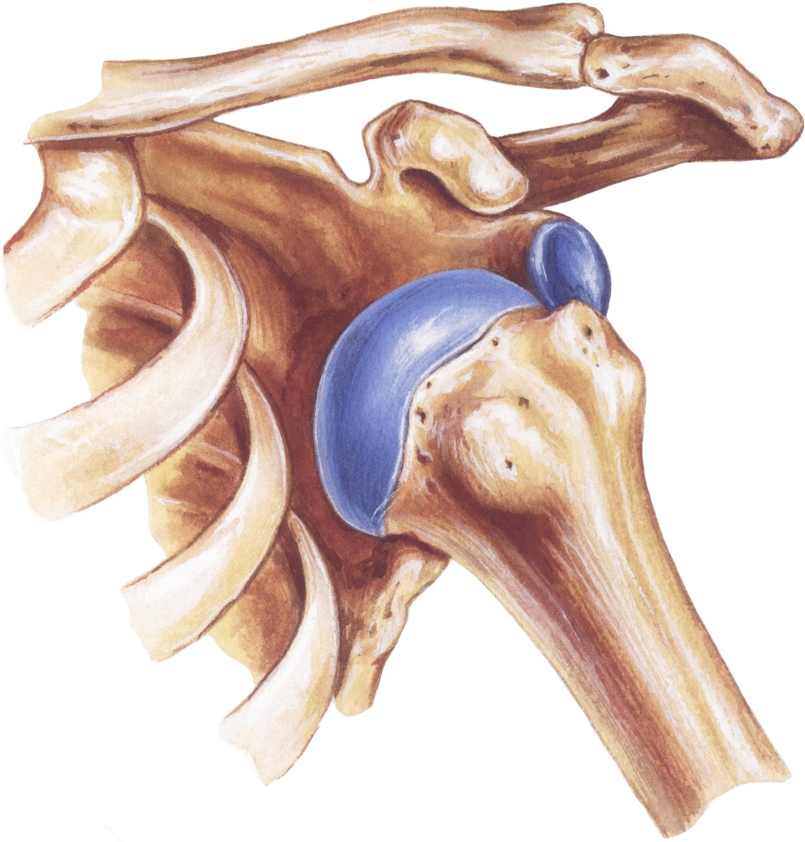
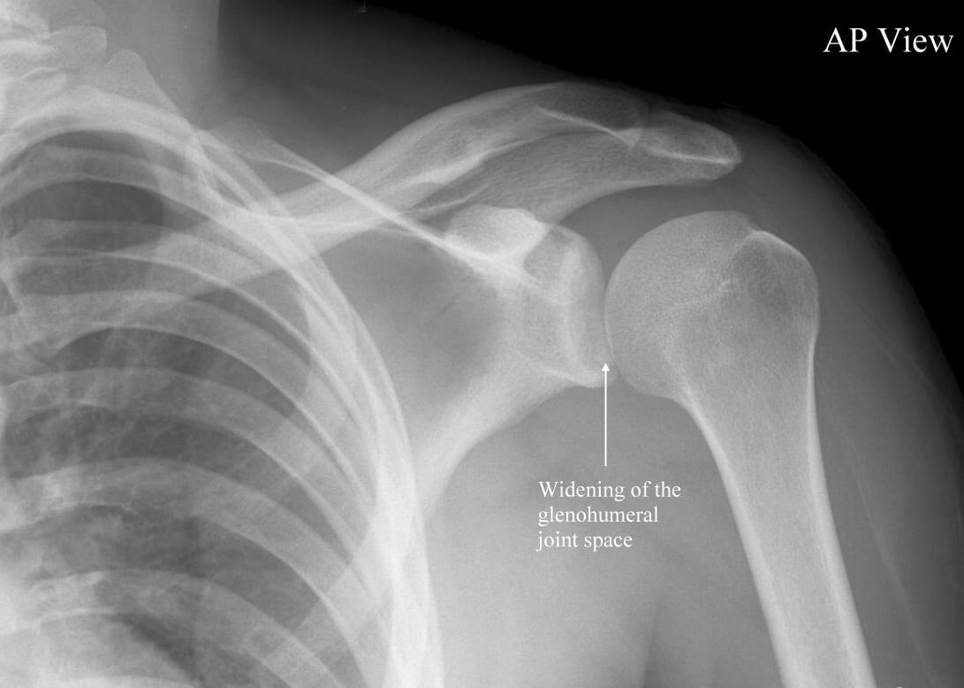
SHOULDER DISLOCATION

Slide 47

Painful arc syndrome - it is characterized by a chronic thickening of the tendon of the supraspinatus in which pain is experienced between 60 – 120 degree of abduction.

Slide 48
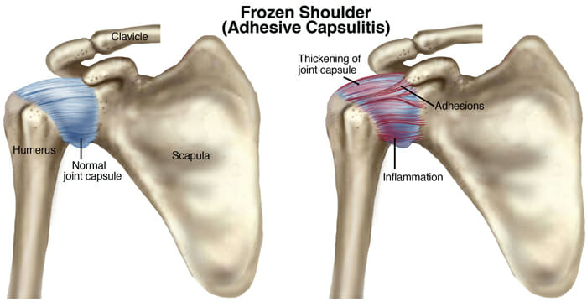
4. Frozen shoulder- (Adhesive capsulitis) it is due to tendinitis of entire rotator cuff. Eventually all shoulder movements are restricted due to adhesion.

Slide 49
5. Shoulder tip pain - irritation of peritoneum due to any surrounding pathology causes referred pain in the shoulder, because phrenic nerve supplying peritoneum and supraclavicular nerve supplying the skin over the shoulder both arises from same spinal segments C3- C4.
6. For aspiration needle introduced anteriorly through the deltopectoral triangle .
7. Rotator cuff injuries
• Occurs due to repetitive use of rotator cuff muscles.

Slide 50
8. Calcific tendinitis of shoulder- It results from
1. Inflammation and calcification of subacromial bursa – called calcific scapulohumeral bursitis.
2. Calcified supraspinatus tendon causing subacromial bursitis.
9. Glenoidal labrum tears
• Occurs commonly in athletes with shoulder instability
• Results in painful movements of the shoulder joint
10. Sprengel’s shoulder
• In this condition, the shoulder joint lies at higher position because of scapula placed at higher level

Slide 51


