Slide 1
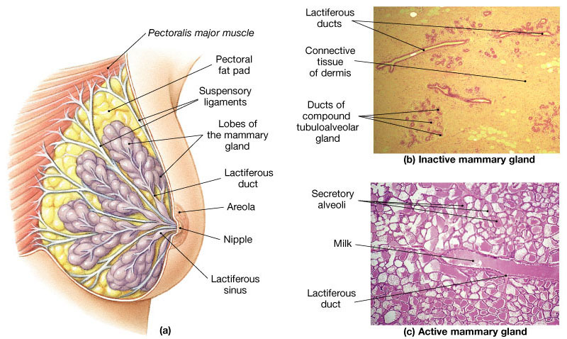
UPPER LIMB
THE MAMMARY GLAND
Dr. Praveen Kumar Kurrey
M.B.B.S., M.S.,BCME, BCBR
Professor Anatomy

Slide 2
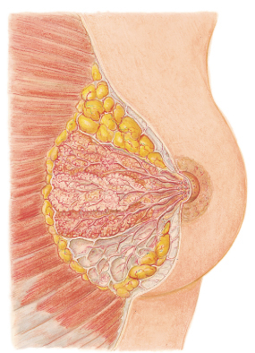
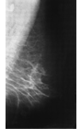
MAMMARY GLAND

Slide 3
MAMMARY GLAND
  Modified sweat gland in sup fascia
  No connective tissue covering.
  Accessory female reproductive org
  EXTENT
    Vertical : 2-6 ribs in MCL
    Hori : lat border sternum – MAL, level of 4th rib
    Extends into axilla
    Axillary tail of SPENCE
    Foramen of LANGER
  SHAPE : hemispherical, conical, pendulous, etc

Slide 4
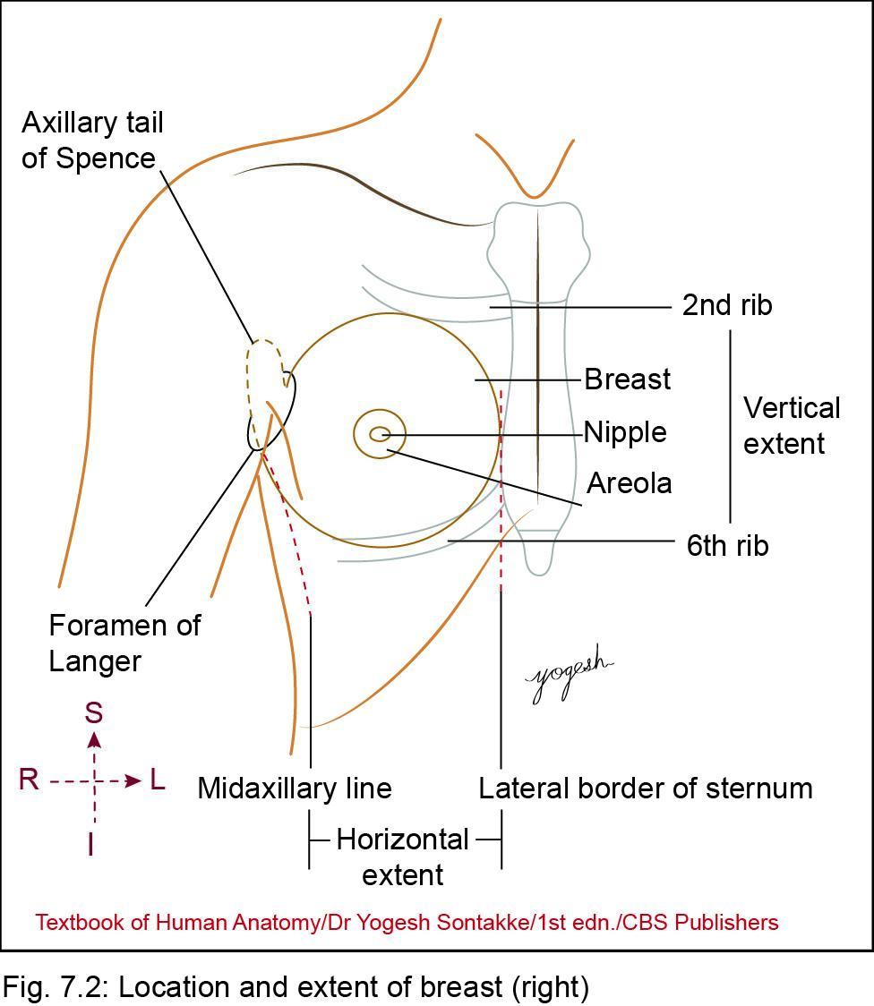
Location of breast
• Lies in superficial fascia of the pectoral region ^{MCQ}
• Axillary tail of Spence – extension of breast from its superolateral part pierces the deep fascia in the axilla
• foramen of Langer – Opening in the deep fascia for tail of Spence

Slide 5
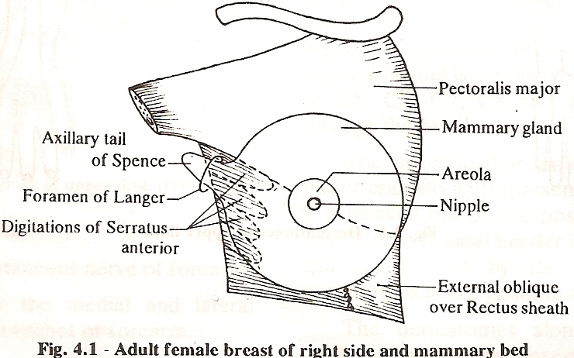
MAMMARY GLAND
Foramen of langer is a opening in axillary fascia for the axillary tail

Slide 6
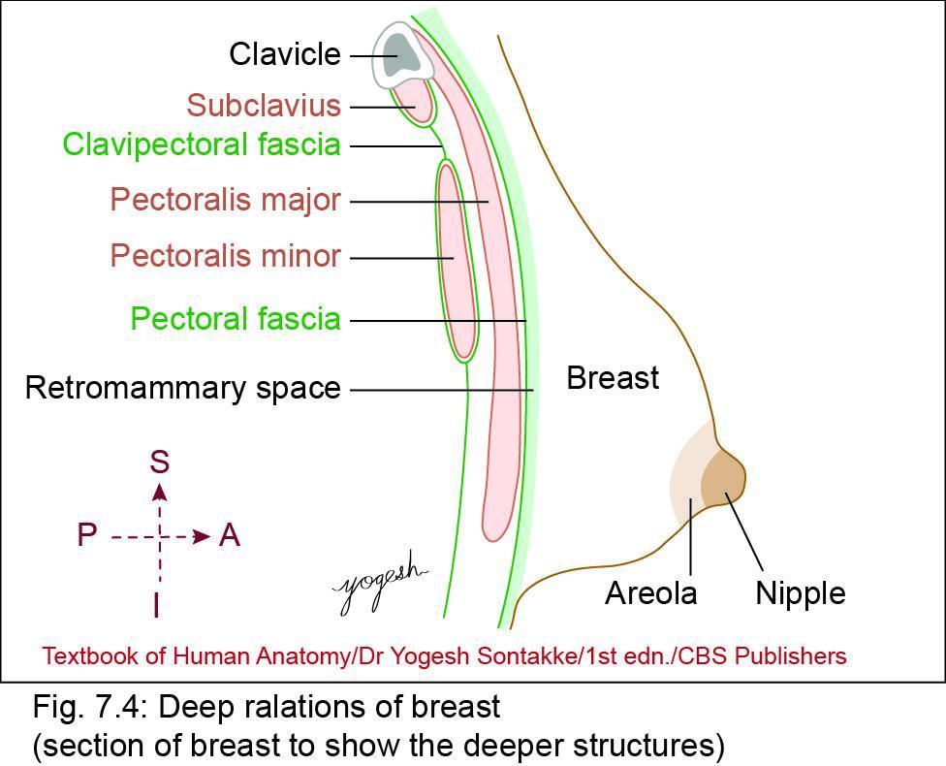
Structure of Breast
Components:
1. Skin
2. Stroma
3. Parenchyma

Slide 7
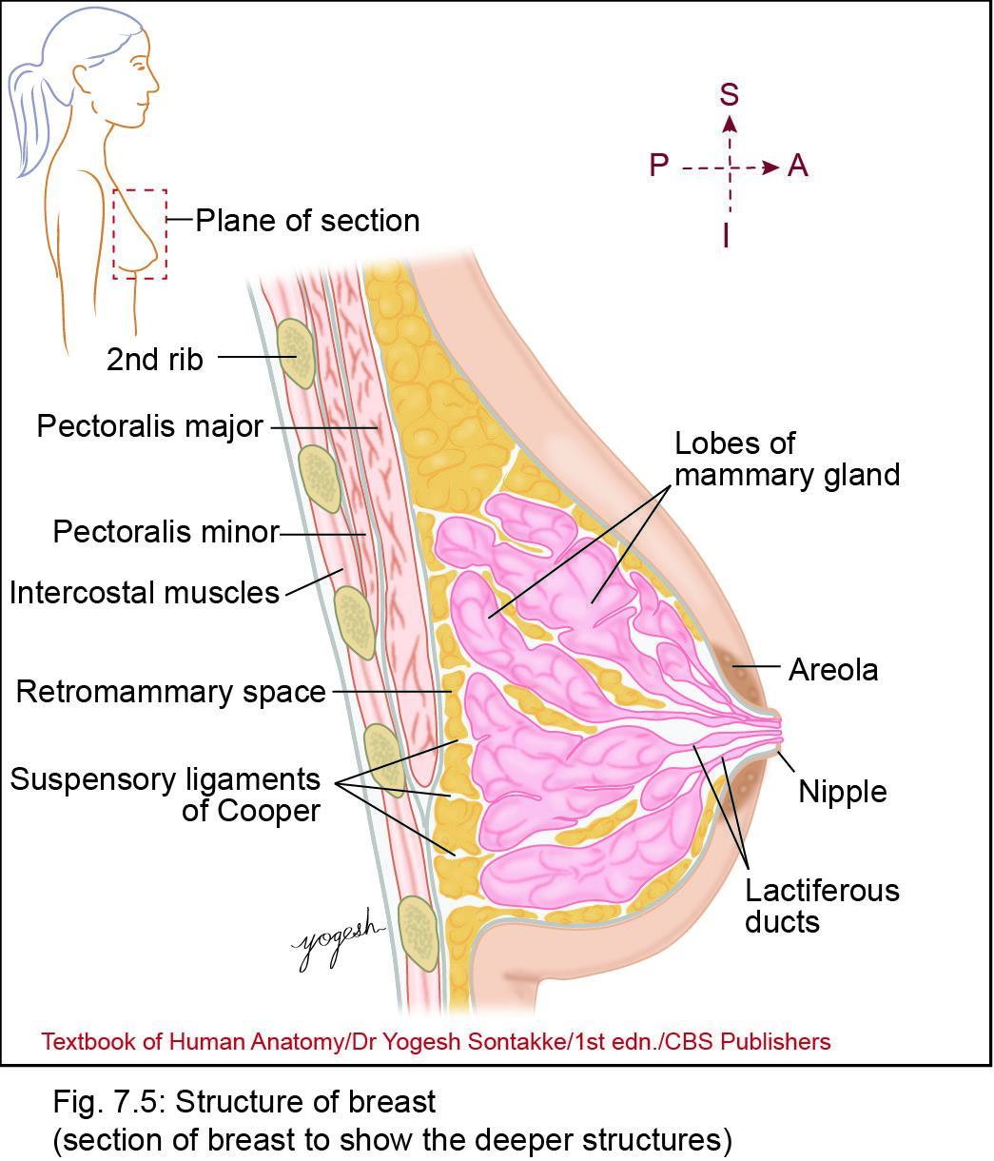
1. Skin covering the breast
Nipple
• Conical projection
• Location
  Just below the center of breast
  In 4th intercostal space, about 10 cm from the midline
• Structure
  Pierced by 15–20 lactiferous ducts

Slide 8
MAMMARY GLAND
SURFACES:
  Superficial
  deep
Superficial :
  Skin, nipple and areola
  Under skin, superficial fascia has nerves/vessels
  Nipple and areola - No subcutaneous fat and hair.
  Nipple :
    4th ICS, 4 inch from midline
    15 – 20 lactiferous ducts open
    Presence of circular muscle, longitudinal muscle
    Rich nerve supply

Slide 9
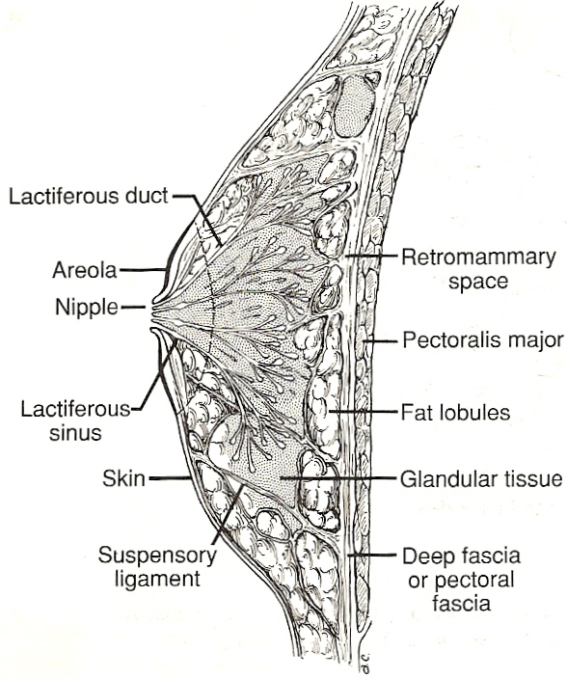
Mammary Gland

Slide 10
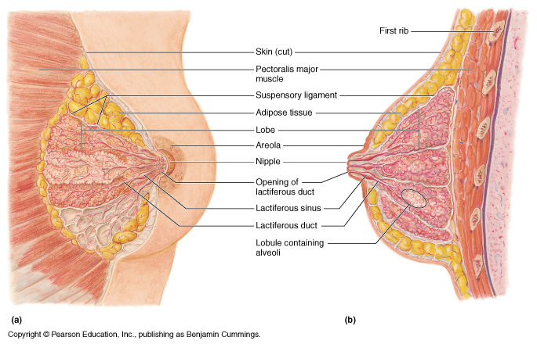
Mammary Gland : Surface and Structure

Slide 11
Skin
Areola
• Circular pigmented area that surrounds the nipple
• Has numerous modified sebaceous glands that produces oily secretions
• Skin of nipple and areola is devoid of hairs
• The color of areola becomes darker during pregnancy

Slide 12
MAMMARY GLAND
Areola :
  Circular pigmented area. Pink or brown.
  Periphery :
    sebaceous glands.
      Enlarged as Tubercles of MONTGOMERY during preg.
      Lubrication of nipple and areola
  Deep to areola
    Lactiferous sinus –
      duct dilated to form sinus
    Lymphatic plexus of Sappey – below areola
      Collect lymph from areola and nipple

Slide 13
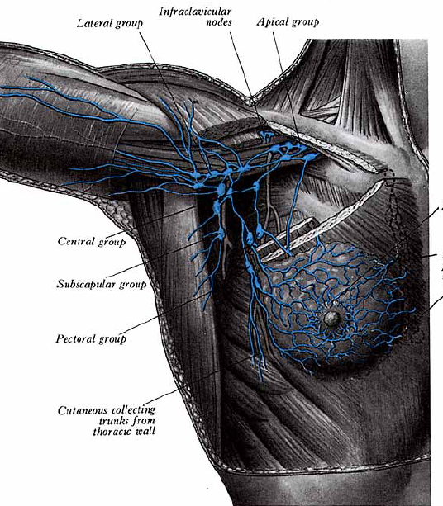
Mammary Gland: Lymphatics
Subareolar lymphatic plexus of Sappey

Slide 14
MAMMARY GLAND
deep
  LAKE OF MERCILLE (recto mammary space) - separates MG from Pect maj fascia.
  Pect maj muscle
  Contain areolar tissue
Recto mammary space
  Helps in mobility of breast
  Space for breast implants
Recto mammary space

Slide 15
MAMMARY GLAND – MAMMARY BED
DEEP RELATIONS
Covered by loose conn tissue of retromammary space
  Pect major :
    Medial 2/3,
  Serratus Anterior :
    Upper two digitations
    Lat 1/3,
  EO aponeurosis
    inferomedially –separate it from rectus sheath
Axillary tail :
  Projection from upper and outer quad
  Enter axilla thro opening of axillary fascia called Foramen of Langer
  In contact with Ant grp of axillary LN (d/d – lipoma)

Slide 16
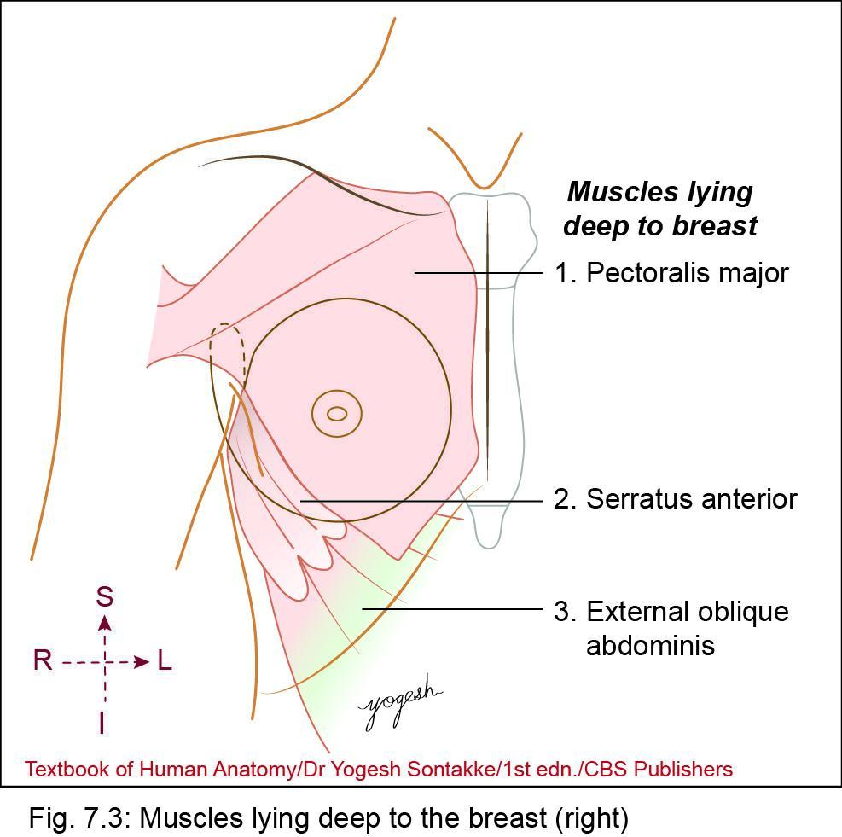
Deep Relations
• Pectoral fascia
• Muscles:
  1. Pectoralis major
  2. Serratus anterior
  3. External oblique muscle of abdomen
• Loose areolar tissue (retromammary space)

Slide 17
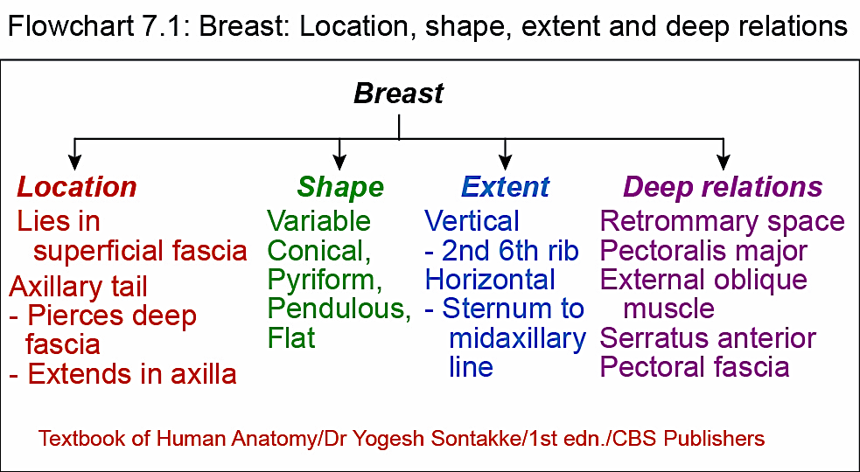

Slide 18
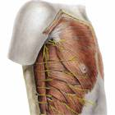
Mammary Gland : Bed
Pectoralis Major
Serratus Anterior
External Oblique

Slide 19
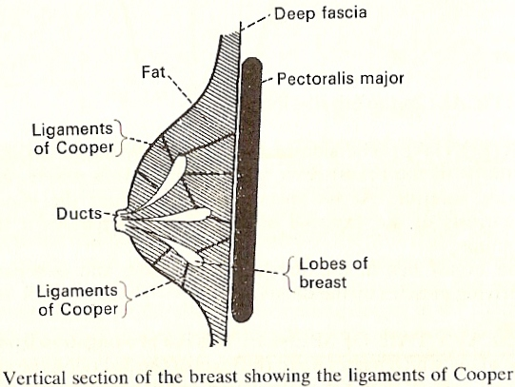
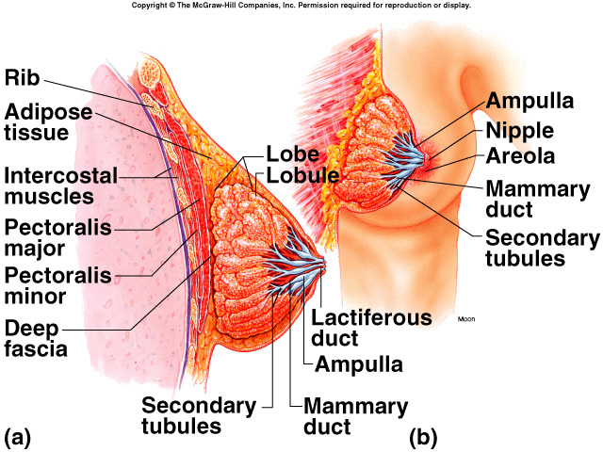
MAMMARY GLAND
STRUCTURE
Glandular portion with parenchyma
Connective tissue i.e stroma
2. Glandular portion with parenchyma
  15 -20 lobes each with multiple lobules
    containing acini or alveoli
  lactiferous duct-
    commence toward nipple from each lobe
  lactiferous sinus –
    which open into tip of nipple
  Lobes radially arranged, hence incision radially given
  Glandular tissue increase during preg and lactation
Lobules contain acini

Slide 20
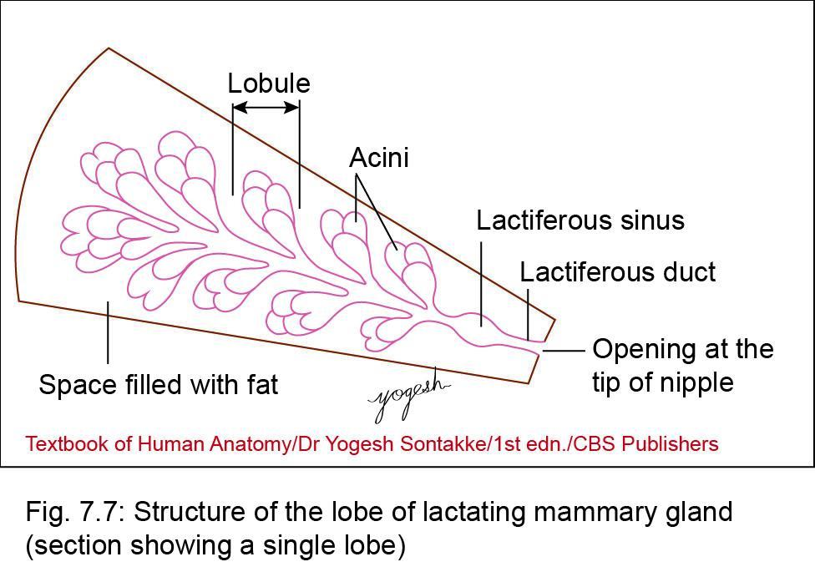
Parenchyma (mammary gland)
• lobe consists = lactiferous duct + surrounding clusters of acini or alveoli
• Each lactiferous duct converges toward nipple and open on the tip of nipple

Slide 21
Lobes
Lobules
Ducts
sinuses

Slide 22
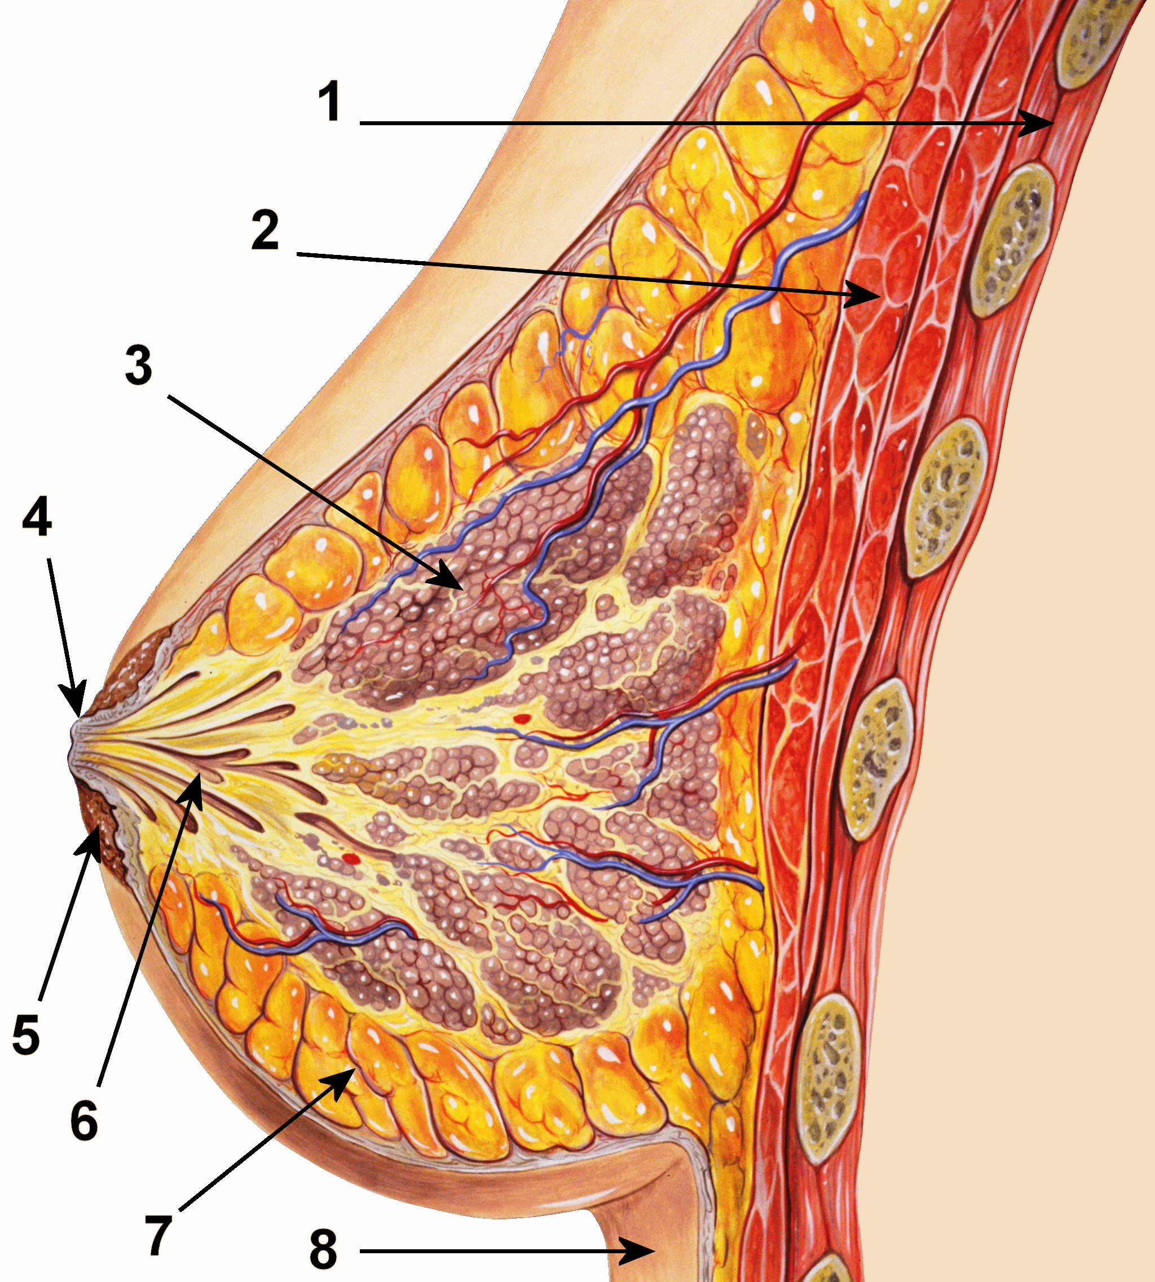

Slide 23
Mammary Gland : Structure & Relations

Slide 24
MAMMARY GLAND
3. Connective tissue i.e. stroma
  Consist of
    fibrous connective tissue
    adipose tissue.
  Fibrous tissue
    Form septa
      Run deep surface of gland to skin.
    Called Suspensory ligament of Cooper
      Gives firmness to gld.
      Elasticity lost during preg – pendulous.
      Involvement in carcinoma, cause dimpling or fixation to PM
  Fatty tissue
    increase during puberty – smooth contour
    Inter lobar in position

Slide 25
Mammary Gland: Structure
Suspensory ligament running from skin to P Major
Alveoli opening into duct

Slide 26
MAMMARY GLAND
BLOOD SUPPLY
Int thoracic art (subclavian)
  perforating br – 2,3,4 ICS
Br from Axillary :
  Sup thoracic Art
  Thoraco acromial – pectoral br
  Lat thoracic art
  Subscapular art
Intercostal art –
  2,3,4th ICS lat br
  2nd IC Art largest br –
    supply upper breast, Nipple and areola)

Slide 27
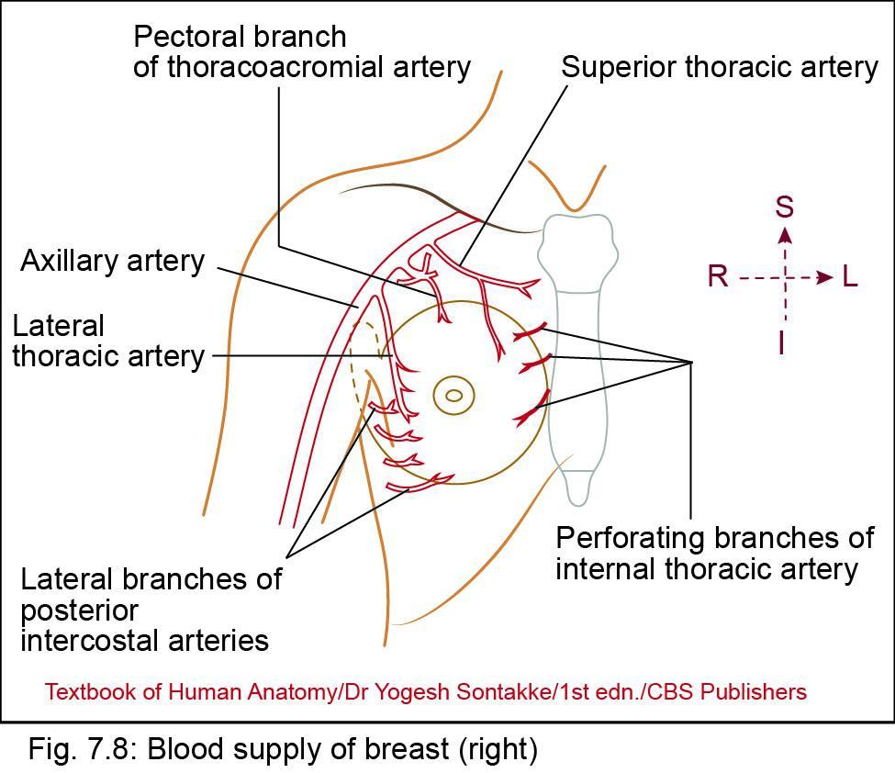
Blood Supply
Arterial supply
1. Lateral thoracic artery – main artery
2. Internal mammary artery
3. Lateral branches of posterior intercostal arteries
4. Pectoral branch of thoracoacromial artery
5. Superior thoracic artery.

Slide 28
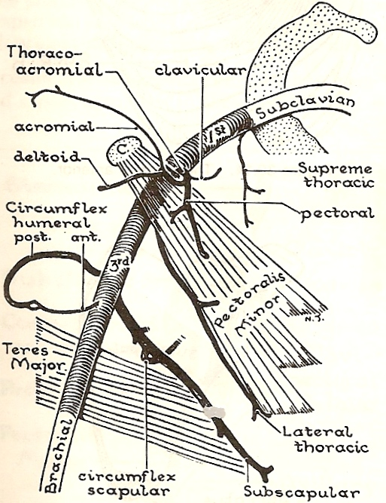
Mammary Gland : Blood Supply
Branches of Axillary
  Sup thoracic Art
  Thoraco acromial – pectoral br
  Lat thoracic art
  Subscapular art

Slide 29
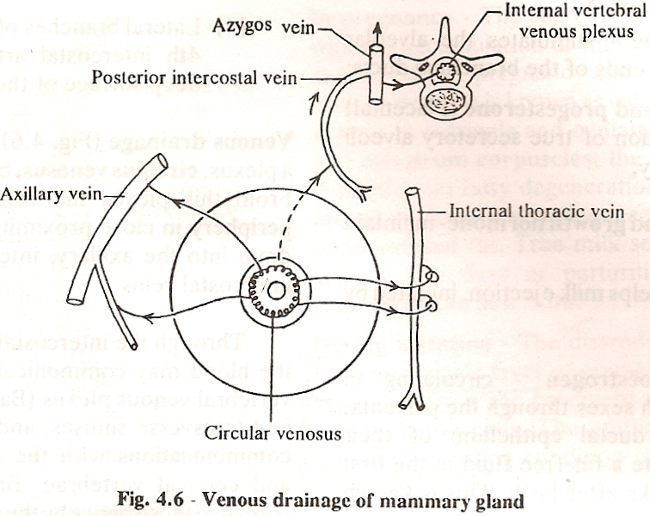
MAMMARY GLAND
VENOUS DRAINAGE:
  Superficial and
  deep veins
  Circulus venosus (part of superficial vein):
    sub areolar plexus of vein
  Superficial and deep vein drain into
    Int mammary V
    Axillary V
    Post IC vein –
      which drain into Azygous vein
Communication via Post IC vein, Azygous and Internal vert plexus which in turn communicate with transverse and sagittal sinus spreads malignancy to abdominal organs, brain, vertebrae, ribs and skull

Slide 30
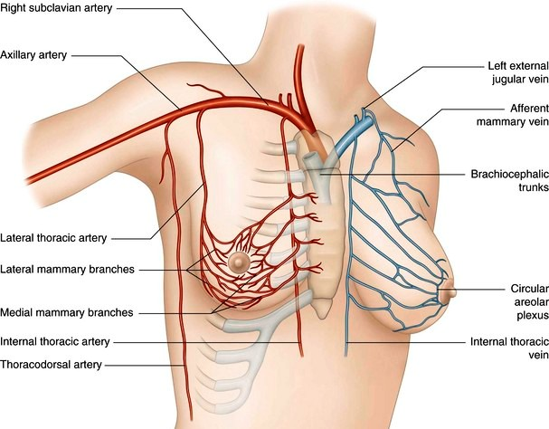

Slide 31
Venous drainage of mammary gland

Slide 32
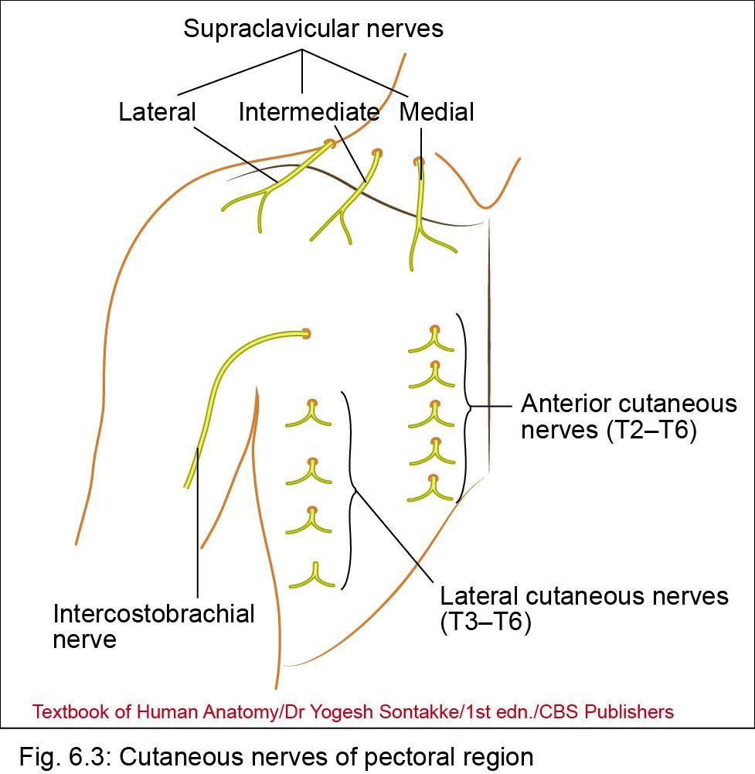
NERVE SUPPLY
Innervation (nerve supply)
• 2nd to 6th intercostal nerves – through anterior and lateral cutaneous branches.

Slide 33
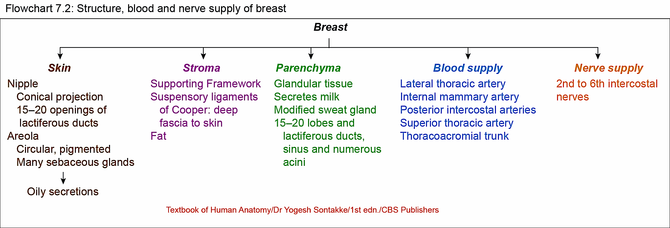

Slide 34
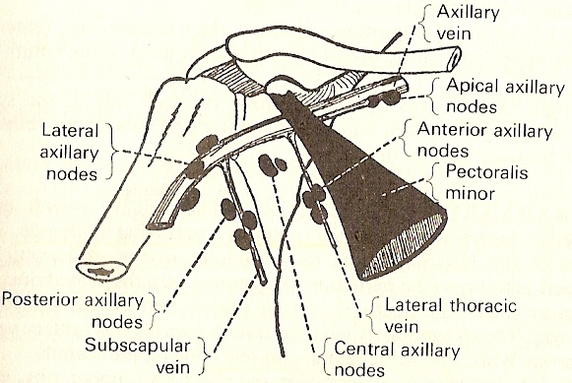
MAMMARY GLAND
LYMPHATIC DRAINAGE
Drain into following grp of lymph nodes
  Axillary (five sub grp)
  Internal mammary LN
    (along Internal mammary V)
  Supraclavicular
  Posterior IC Lymph nodes

Slide 35
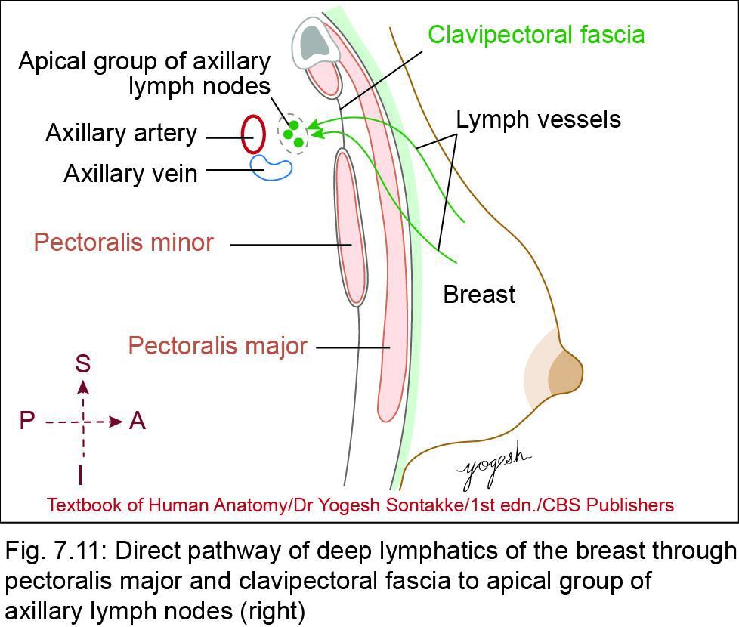
Lymph nodes draining breast
1. Axillary lymph nodes: drain most of the breast tissue
2. Internal mammary lymph nodes: lie along internal thoracic (mammary) artery – drain medial part of the mammary gland.
3. Posterior intercostal nodes: Few lymphatic vessels from lower lateral quadrant of breast follow posterior intercostal vessels and drain into posterior intercostal nodes.

Slide 36
Lymph nodes draining breast
4. Subdiaphragmatic and subperitoneal lymph plexuses: Few lymphatics from lower medial quadrant of the breast pierces anterior abdominal wall and drain into subdiaphragmatic and subperitoneal lymph nodes.
5. Rotter’s nodes: These lie between pectoralis major and pectoralis minor (hence called interpectoral nodes) – also drain mammary gland. [Josef Rotter, German surgeon, 1857–1924].
6. Apical group of lymph nodes: The lymphatics from deep surface of breast pierces pectoralis major muscle, and clavipectoral fascia and drain into apical axillary lymph nodes.^{Neet}

Slide 37
Axillary group of lymphnodes

Slide 38
MAMMARY GLAND
Lymphatics divided into two grps :
  Superficial grp :
    drain skin over breast EXCEPT nipple and areola
  Deep grp
    Parenchyma of breast,
    Nipple,
    Areola

Slide 39
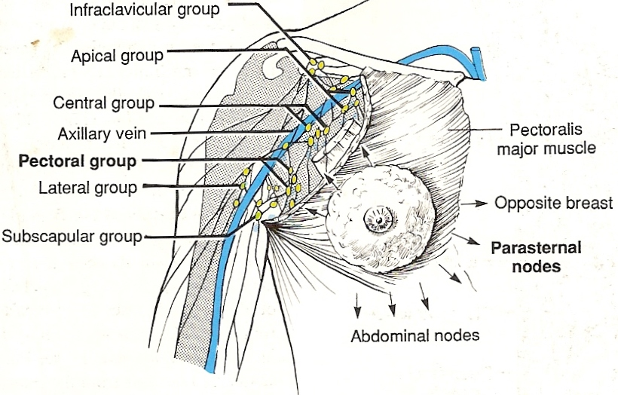
MAMMARY GLAND

Slide 40
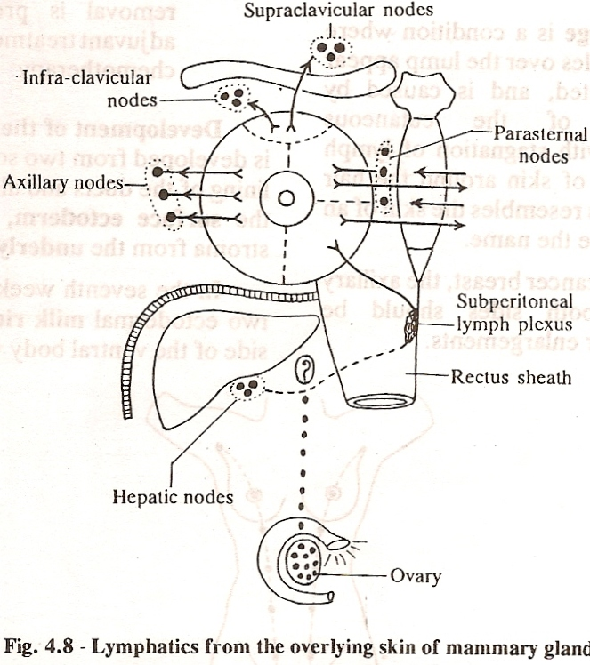
MAMMARY GLAND
SUPERFICIAL GROUP
UL & LL Quadrant
  Axillary LN (Ant –Central—Apical)
UM quadrant :
  Internal mammary/
  supraclavicular
LM quadrant :
  Internal mammary OR Subdiaphragmatic nodes
  thro Ant abdo wall to Hepatic grp of LN thro falciform lig
  Thro these nodes the malignancy may reach other side

Slide 41
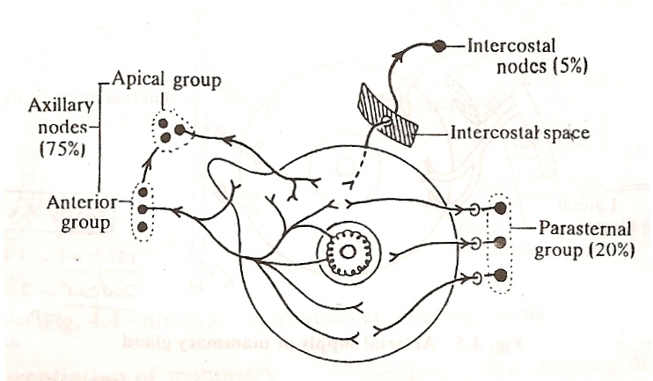
MAMMARY GLAND
DEEP GROUP
  Parenchyma :
    Anterior Axillary LN (via axillary tail)
  Nipple and Areola
    subareolar lymphatic plexus of SAPPEY --- Ant Axillary
  Medial part of gld :
      Internal Mammary
      Post IC nodes
      Supraclavicular LN

Slide 42
Mammary Gland: Lymphatics
Subareolar lymphaticplexus of Sappey

Slide 43
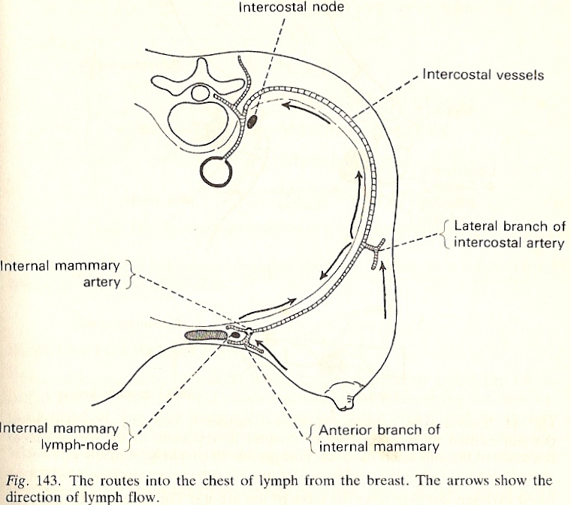
Post IC nodes
Deep lymphatic drainage
Internal mammary LN

Slide 44
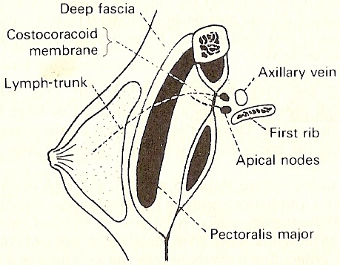
MAMMARY GLAND
Deep part of Gland :
  Solitary lymph channel pierce pectoral fascia, Pect major, Clavipectoral fascia------ Ant Axillary (BACKDOOR EXIT)
  Some lymph from deep part reach nodes bt Pect maj and Pect minor. Called as ROTTER’s NODES
Rotters nodes

Slide 45
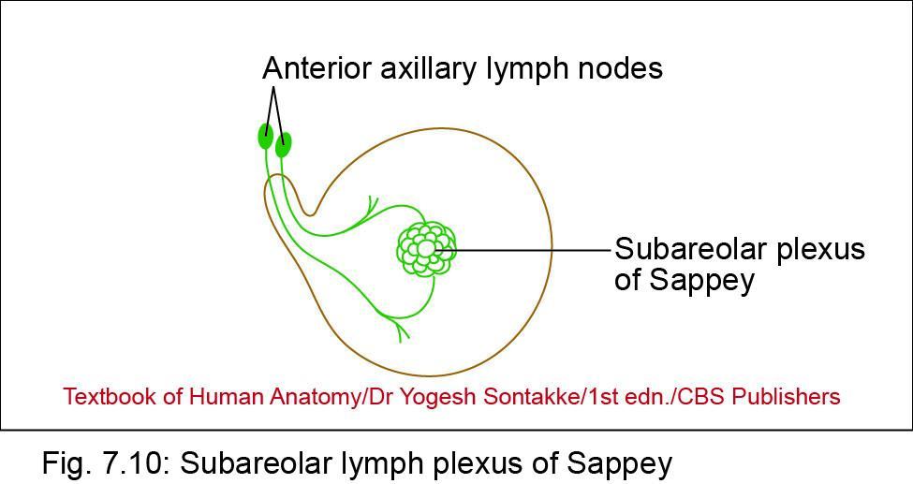
Lymphatic Drainage of Breast
Lymphatic vessels
• Subareolar plexus of Sappey: plexus of lymph vessels deep to the areola – drains into anterior group of axillary lymph nodes
• Previous concept: For lymphatic drainage, the breast is divided into 4 quadrants: upper lateral, upper medial, lower lateral, and lower medial. Currently, this concept is not in use

Slide 46
MAMMARY GLAND
Summary Lymphatic drainage :
  75 % Parenchyma = Axillary LN
  25 % Parenchyma = Internal mammary LN
  5 % parenchyma = Post IC Nodes along Post IC vein

Slide 47
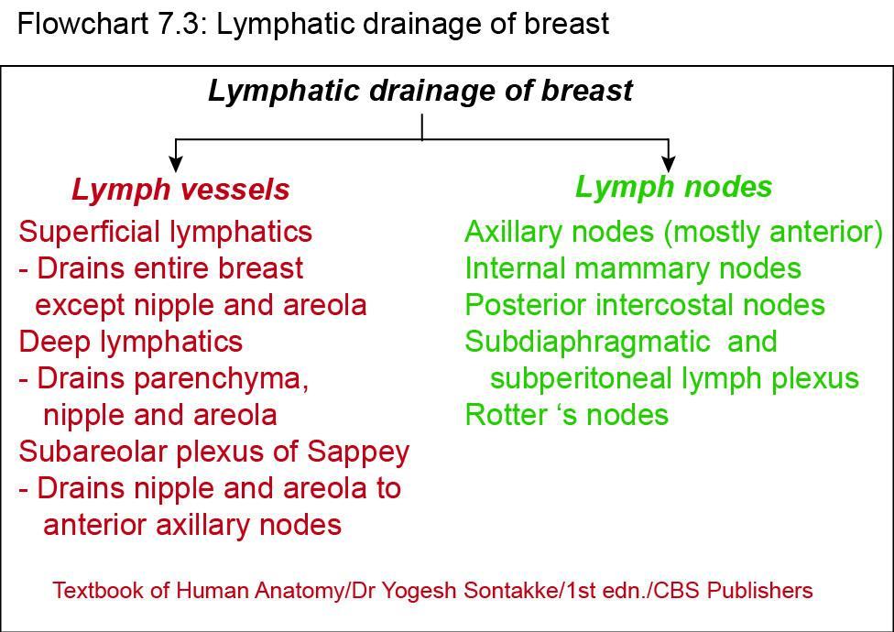

Slide 48
MAMMARY GLAND - APPLIED
AXILLARY TAIL
  Well developed axillary tail mistaken for enlarged lymph nodes/lipoma
Investigations
  Mammography
    Soft tissue radiographs of breast.
    Cyst (well defined smooth opacity) and carcinomas (irregular density, distortion of breast tissue, calcification)
  FNAC (fine needle aspiration cytology)
    Used for cell diagnosis

Slide 49
Nipple
  Cracked nipple –
    in later pregnancy and lactation.
    Nipple to be washed, and lubricated with lanolin
  Discharges –
    management depends upon presence of lump

Slide 50
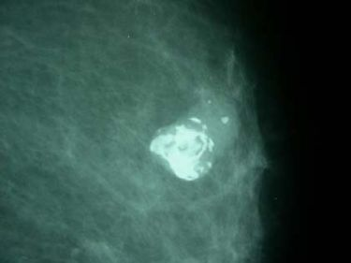
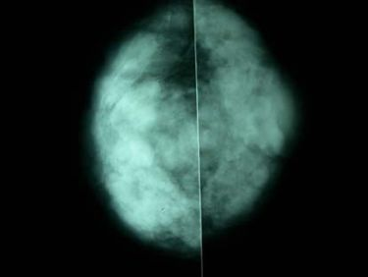
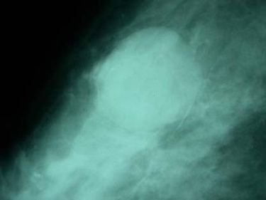
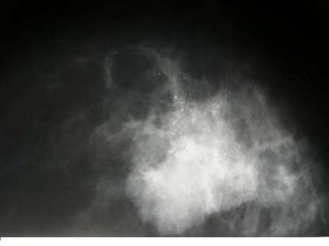
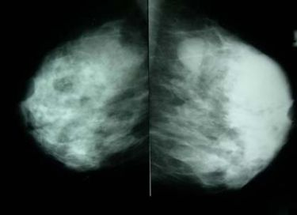
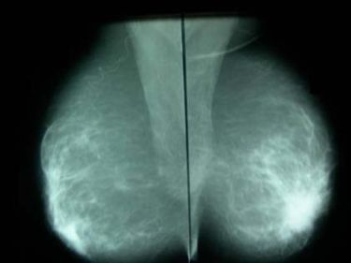
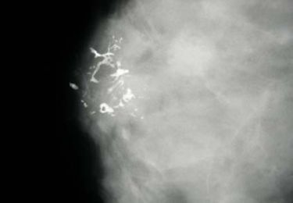
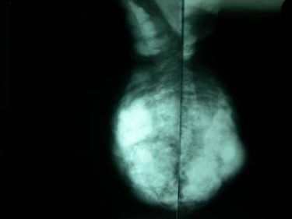
Calcification - fibroadenoma
Breast multiple fibroadenomas
MAMMOGRAPHY
fibroadenoma
Breast abcess sub areolar
Breast cyst
Fibroadenoma extending
to axilla
Calcified galactocoele
Ca breast with
microcalcification
Ca Breast with calcifications

Slide 51
MAMMARY GLAND - APPLIED
Breast
  Infections and inflammations – cause mastitis with abcess
  Cysts
  Tumours –
    Benign – lipoma, fibroadenoma
    Malignant – carcinoma “more in nulliparous and bearing child protective”
      Spread by local, lymphatic and blood stream.
      LN involvement shows metastatic potential.
      Advanced disease – involve supraclavicular LN

Slide 52
  Malignant tumours cont,d
    Presentation –
      Hard lump with retracted nipple
      Peau d’ orange (orange like skin) – involvement of skin of breast due to cutaneous lymphatic oedema
      Advanced – ulceration, fixation to chest wall, metastatsis to viscera, bone
    Treatment
      Mastectomy
      Radiotherapy
      Harmone therapy – tamoxifen
      chemotherapy

Slide 53
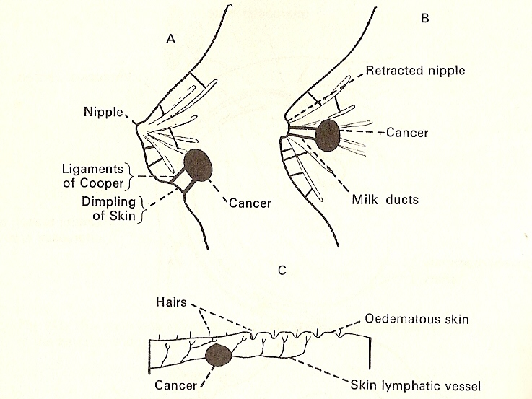
Breast Cancer
Breast cancer
  Peau d orange
  nipple retraction,
  skin dimpling
  Metastasis :
    skull and brain (Batsons plexus of veins)
A - Dimpling of skin
B - Retracted nipple
C - Peau d orange
A – due to pull by lig of cooper
B - due to retraction of milk ducts
C – due to lymphatic obstruction

Slide 54
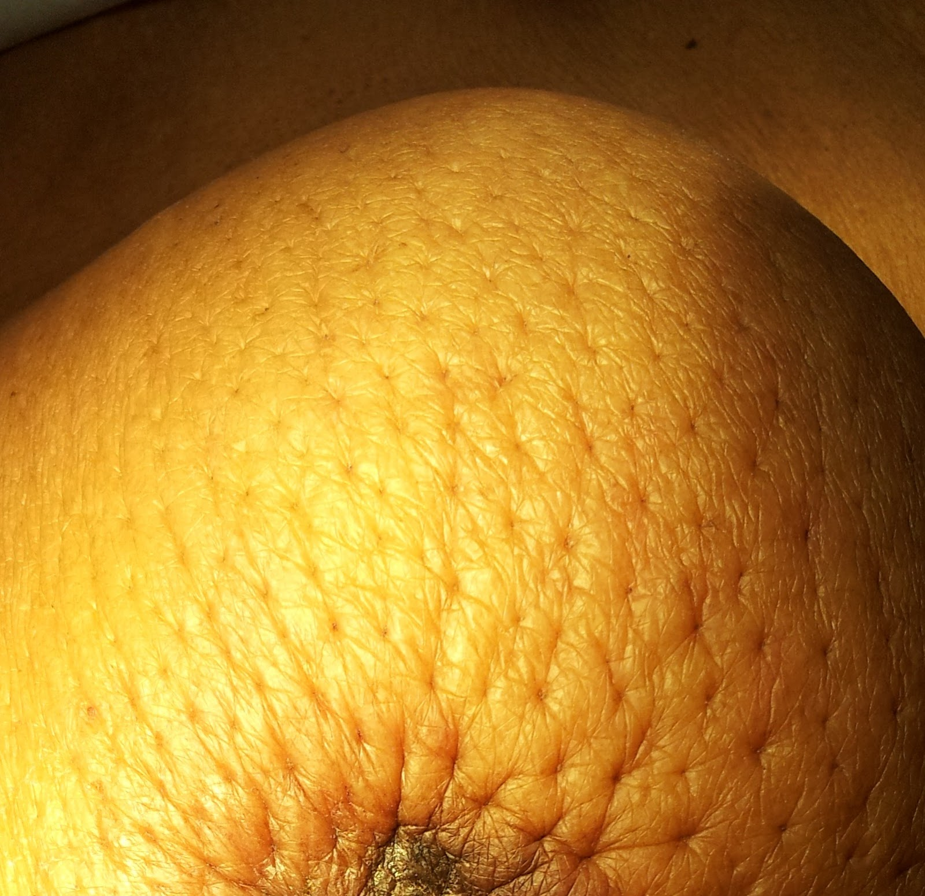
  Peau d orange

Slide 55
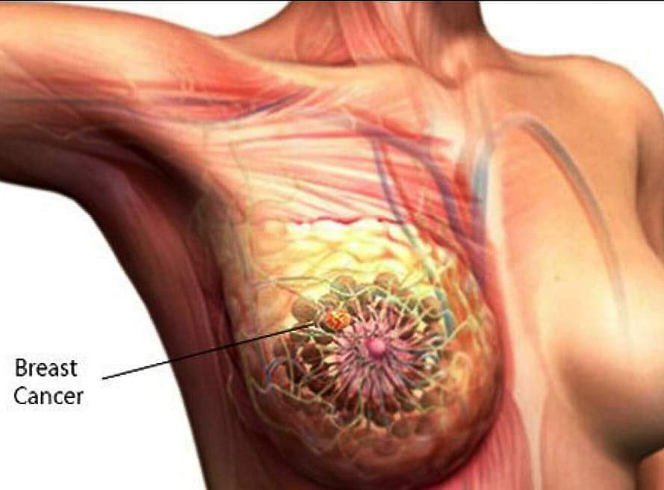

Slide 56
KRUKENBERGS TUMOUR
  Secondary deposits in ovaries due to spread from Ca breast :
    Lymph inferomedial part –
    communicate with rectus sheath –
    pierce Linea alba – forms Sub peritoneal plexus – drain into subdiaphragmatic LN –
    pass through Falciform lig –
    reach hepatic node –
      Cause obstructive jaundice
    Tumour cells drop from subperitoneal plexus into general cavity –
    reach surface of ovary and enter through ostia left by ovulating Graafian follicle – KRUKENBERGS (secondary deposits on surface of ovary)

Slide 57
Formation of Krukenberg’s tumour

Slide 58
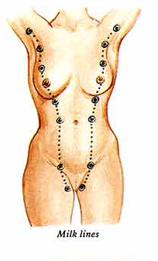
Congenital anomalies
  Polythelia
    Supernumery nipples over breast
  Polymastia
    Accessory breast along milk ridge
  Amastia
    No breast development
  Amazia
    Nipple developed, no breast development
  Athelia
    No nipple over breast (mainly accessory breast)
polymastia

Slide 59


THANK YOU

