Slide 1
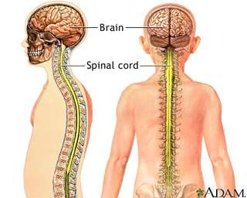
GENERAL ANATOMY
NERVOUS SYSTEM
Dr. Praveen Kumar Kurrey
M.B.B.S. M.S., BCME, BCBR
Professor Anatomy

Slide 2
Definition
It is also called master system of the body .
It monitors and controls all the activities of the body, whether they are voluntary or involuntary.
This is based on special property of sensitivity, conductivity and responsiveness of the nervous system

Slide 3
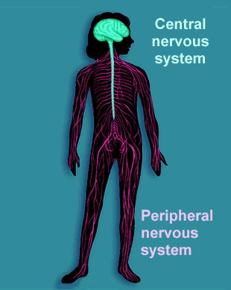
Two Major Divisions
Notes:
3

Slide 4
CENTRAL NERVOUS SYSTEM
CNS- includes brain and spinal cord
Brain - the highest governing body
lies within the cranium
Spinal cord- centre for reflex activity
lies within vertebral coloumn

Slide 5
Peripheral nervous system
1) somatic component of the pns which includes 12 pairs of cranial nerves and 31 pairs of spinal nerves.
2)peripheral autunomic nervos system or visceral nervous system–includes sympethetic & parasympethetic

Slide 6
Autonomic Nervous System
The involuntary branch of the nervous system
Consists of only motor nerves
Divided into two divisions
  Sympathetic division
  Parasympathetic division

Slide 7
Autonomic Functioning
Sympathetic – “fight-or-flight”
  Response to unusual stimulus
  Takes over to increase activities
  Remember as the “E” division = exercise, excitement, emergency, and embarrassment

Slide 8
Autonomic Functioning
Parasympathetic – housekeeping activites
  Conserves energy
  Maintains daily necessary body functions
  Remember as the “D” division - digestion, defecation, and diuresis

Slide 9
Classification of Nerves
Mixed nerves – both sensory and motor fibers
Afferent (sensory) nerves – carry impulses toward the CNS
Efferent (motor) nerves – carry impulses away from the CNS

Slide 10
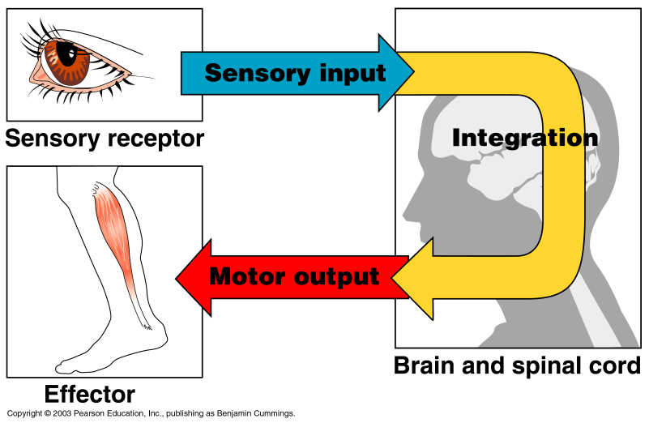
Functional Classification of the Peripheral Nervous System
Sensory (afferent) division
  Nerve fibers that carry information to the central nervous system
Figure 7.1

Slide 11
Cellular organisation of the nervous system
Two types of cell
1)Neurons
2)Neuroglial cells
Neurons-Structural and functional unit
-Excitable cells
-specialised for reception,integration and
onward transmission of impulses
-NS consists of 100 billions of neurons
Neuroglail cells- or glial means ‘nerve glue’
-supporting cell ,
-supports structurly and functionally

Slide 12
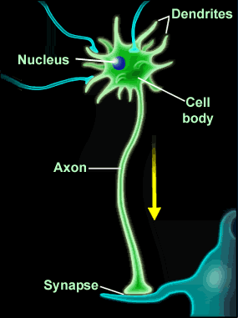
Anatomy of a Neuron
Each neuron contains:
- Cell body with nucleus
Size from 4-16 micron
-forms grey matter and nuclei in cns
-ganglia in pns
Notes:
12

Slide 13
Anatomy of a Neuron
Each neuron contains:
- cell processes of two types
- Dendrites :
Profusely branched
Carry nerve impulse towards the cell body
Number may be one or more
Notes:
13

Slide 14
Anatomy of a Neuron
Axons :
Single long efferent process ,which may gives off occasional branches (collaterals) and is of uniform diameter.
Carry impulses away from the cell body.
Axon terminal ,axolema,axoplasm
Notes:
14

Slide 15
Transmission of impulse b/w the neurons is by contiguity, there is a gap between them called a synapse
Messages are sent across the synapses by special chemicals called neurotransmitters
Notes:
15

Slide 16
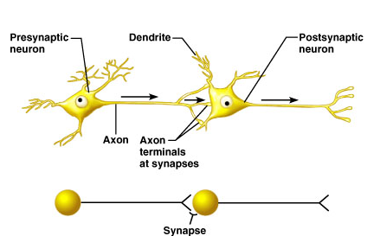
Synapses
Junctions between neurons
Information is passed (usually chemically)
Unidirectional
Presynaptic (toward synapse) vs postsynaptic (away from synapse): most neurons function as both
Synaptic cleft (tiny gap)

Slide 17
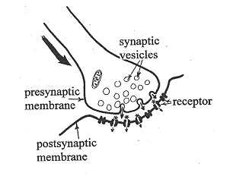

Slide 18
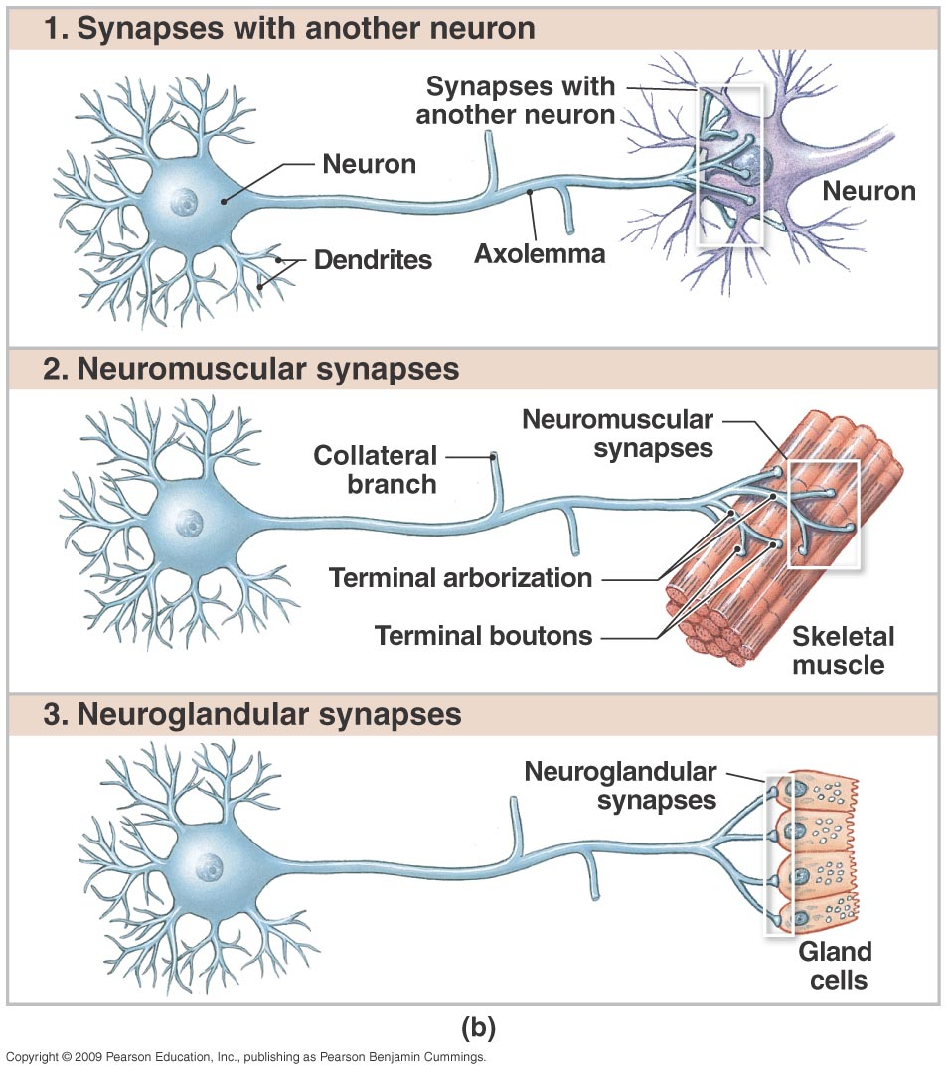
Neurons can synapse with:
  Neurons
  Muscle
  Glands

Slide 19
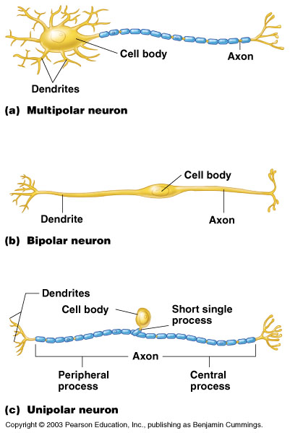
Structural Classification of Neurons
Unipolar neurons – have a short single process leaving the cell body e.g. mesencephalic nucleus of 5th cr nerve

Slide 20
Structural Classification of Neurons
Bipolar neurons – one axon and one dendrite
E.g. –spiral and vestibular ganglia

Slide 21
Structural classification of the neurons
Multipolar nerons –single axon with multiple dendrites
E.g.- most of the neurons in the body

Slide 22
Unipolar (pseudounipolar) neuron
  single process coming off cell body, giving rise to dendrites (at one end) & axon (making up rest of process)
Notes:
22

Slide 23
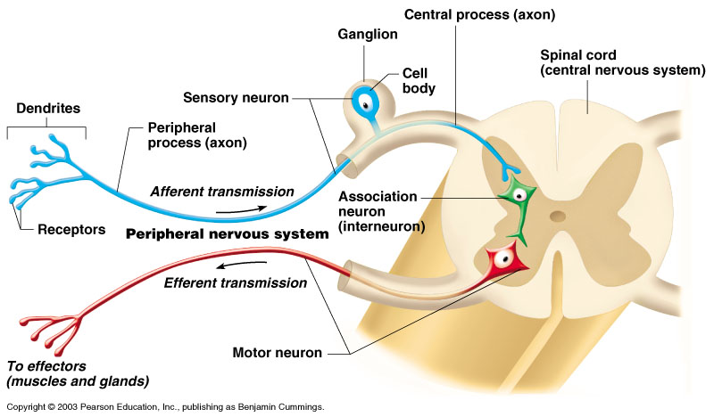
Structural classification of neurons
Psudounipolar neurons-appears that single process coming (T shaped manner) which soon divides into two
E.g. dorsal root ganglion of sensory spinal nerves

Slide 24
Functional Classification of Neurons
Sensory (afferent) neurons
  Carry impulses from the sensory receptors
    Cutaneous sense organs
    Proprioceptors – detect stretch or tension
Motor (efferent) neurons
  Carry impulses from the central nervous system

Slide 25
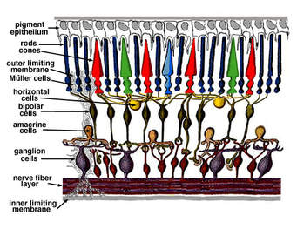
According to length of axons
Golgi type -1 length of axon is more and connects remote regions
Golgi type -2 short axon, end near cell body .
Very rarely a neuron may not have true axon e.g. Amacrine neurons of retina

Slide 26
Classification of neurons
Functional classification based on type of information & direction of information transmission:
Sensory (afferent) neurons –
    transmit sensory information from receptors of PNS towards the CNS
    most sensory neurons are unipolar, a few are bipolar
Motor (efferent) neurons –
    transmit motor information from the CNS to effectors (muscles/glands/adipose tissue) in the periphery of the body
    all are multipolar
Association (interneurons) –
    transmit information between neurons within the CNS; analyze inputs, coordinate outputs
    are the most common type of neuron (20 billion)
    are all multipolar
Notes:
26

Slide 27
Functional Classification of Neurons
Interneurons (association neurons)
  Found in neural pathways in the central nervous system
  Connect sensory and motor neurons

Slide 28
Supporting cells
Neuroglia usually refers to CNS ones
Just “glia” to both
Divide throughout life
Smaller and darker than neurons
Outnumber neurons 10 to 1

Slide 29
Neuroglia (CNS glial cells)
Astrocytes
  Star shaped; the most numerous
  Involved in metabolism & synapse formation
Microglia
  Phagocytes
Ependymal cells
  Line the cavities of CNS and spinal cord; cilia
Oligodendrocytes
  Produce myelin sheaths in CNS (see later slide)

Slide 30
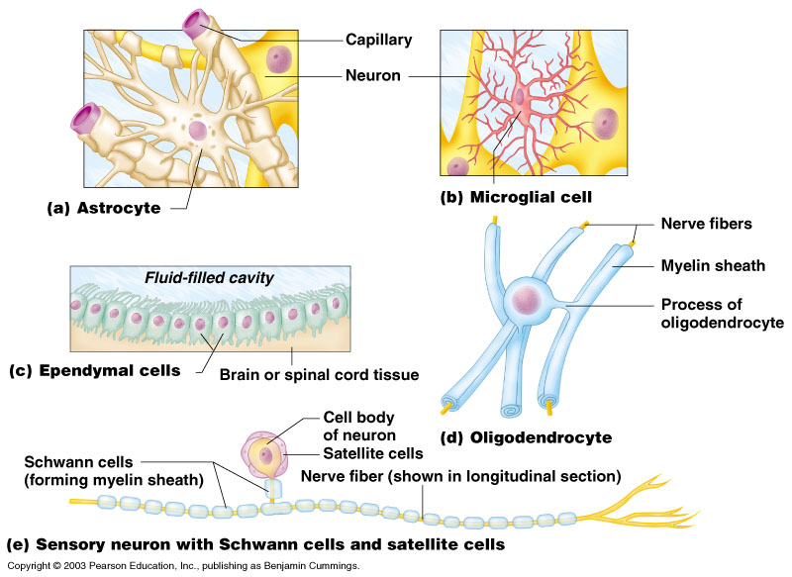
Nervous Tissue: Support Cells (Neuroglia or Glia)
Astrocytes
  Abundant, star-shaped cells
  Brace neurons
  Form barrier
  between capillaries
  and neurons
  Control the chemical
  environment of
  the brain (CNS)

Slide 31
Nervous Tissue: Support Cells
Microglia (CNS)
  Spider-like phagocytes
  Dispose of debris
Ependymal cells (CNS)
  Line cavities of the
  brain and spinal cord
  Circulate
  cerebrospinal
  fluid

Slide 32
Nervous Tissue: Support Cells
Oligodendrocytes(CNS)
  Produce myelin sheath around nerve fibers in the central nervous system

Slide 33
Neuroglia vs. Neurons
Neuroglia divide.
Neurons do not.
Most brain tumors are “gliomas.”
Most brain tumors involve the neuroglia cells, not the neurons.
Consider the role of cell division in cancer!

Slide 34
Support Cells of the PNS
Satellite cells
  Protect neuron cell bodies
Schwann cells
  Form myelin sheath in the peripheral nervous system

Slide 35
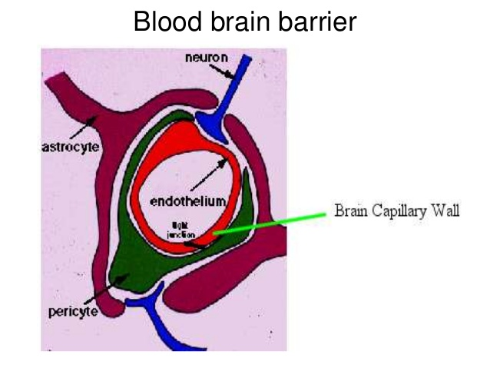

Slide 36
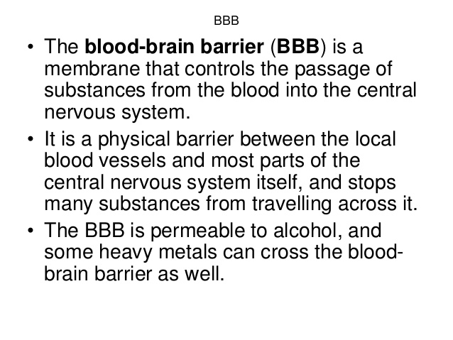

Slide 37
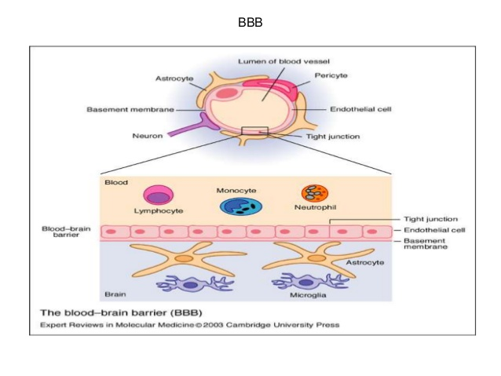

Slide 38
Blood brain barrier is absent in
1.Area postrema
2.posterior lobe of pituitary
3 Pineal gland
4.Tuber cinereum
5.Supraoptic recess of the third ventricle

Slide 39
Nerve fibre
Axon with its covering is known as nerve fibre
Collection of nerve fibres within the cns is tracts (bundles of nerve fibres having same origin ,function and termination)
outside the cns is peripheral nerves(solid thick white cord composed of bundles of nerve fibres)

Slide 40
Classification of nerve fibres

Slide 41
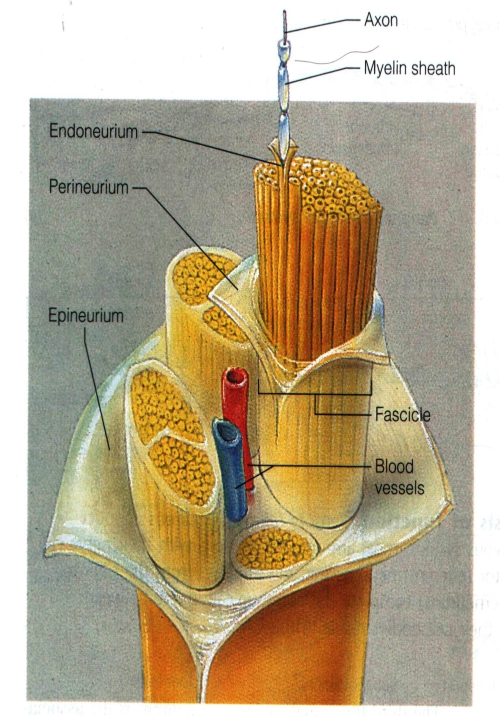
Axon (myelinated
Or not) = Nerve fiber
Nerve fibers are hold by
“endoneurium” forming
Fascicle.
A fascicle is covered by
“perineurium”
Fascicles are covered by
“epineurium” forming
NERVE TRUNK
Small artery ---> nerve trunk
Arteriole -----> fascicles.
capillaries -----> nerve fibers

Slide 42
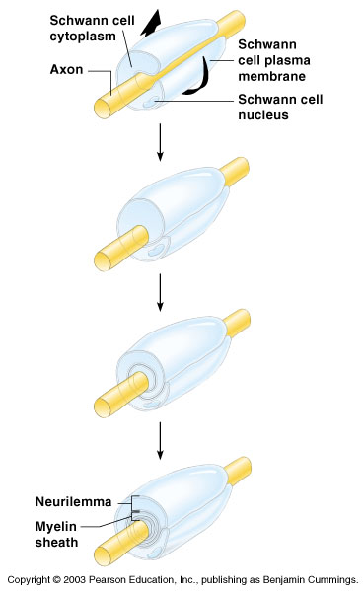
Nerve Fiber Coverings
Schwann cells – produce myelin sheaths in jelly-roll like fashion
Nodes of Ranvier – gaps in myelin sheath along the axon

Slide 43
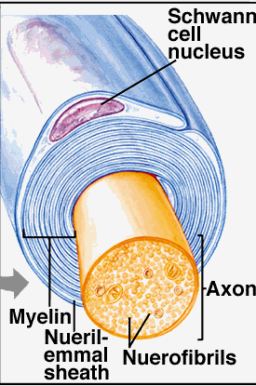
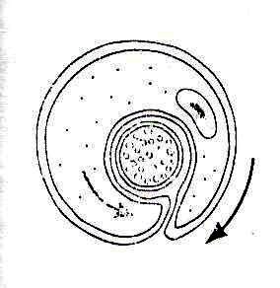
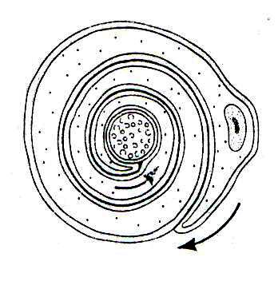
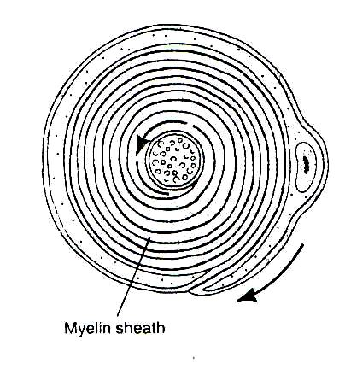

Slide 44
Myelin SHEath
Lipoprotein
Increases speed of conduction, large axons
  Are “insulation”
  Prevent leakage of electric current
Layers with spaces (nodes of Ranvier) between cells
Impulse “jumps” from node to node
“Unmyelinated” axons – smaller, slower

Slide 45
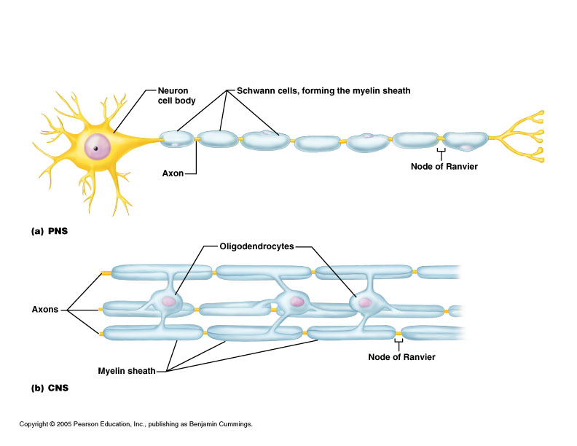
Myelin in the Peripheral and Central Nervous Systems
In multiple sclerosis (MS), patches of myelin are destroyed in the brain and spinal cord

Slide 46
Application
In Multiple Scleroses the myelin sheath is destroyed.
The myelin sheath hardens to a tissue called the scleroses.
This is considered an autoimmune disease.
Why does MS appear to affect the muscles?

Slide 47
Peripheral nerve
Peripheral nerves are solid white cords composed of bundles of nerve. The toughness of a nerve is due to its fibrous sheaths, otherwise the nervous tissue itself is very delicate and friable.

Slide 48
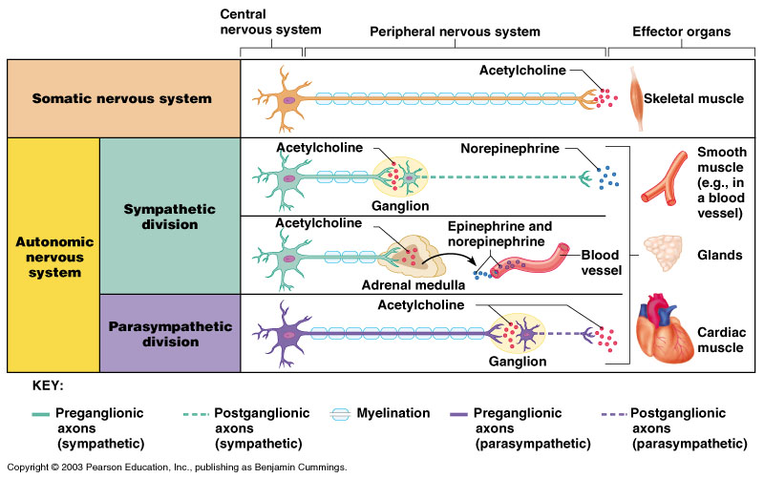
Comparison of Somatic and Autonomic Nervous Systems

Slide 49
Development of the
Nervous System
The nervous system is formed during the first month of embryonic development
Any maternal infection can have extremely harmful effects
The hypothalamus is one of the last areas of the brain to develop

Slide 50
Central Nervous System (CNS)
CNS develops from the embryonic neural tube
  The neural tube becomes the brain and spinal cord
  The opening of the neural tube becomes the ventricles
    Four chambers within the brain
    Filled with cerebrospinal fluid

Slide 51
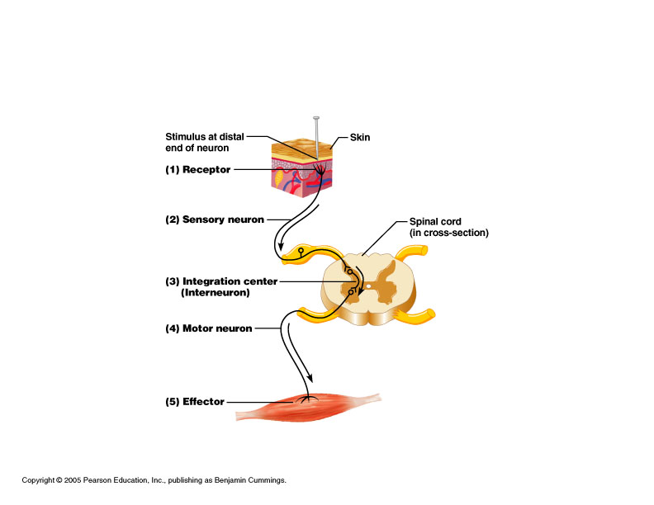
Reflex arcs: our “reflexes”
Fast, automatic, involuntary
Somatic or visceral
Motor responses
to stimuli
Monosynaptic or
polysynaptic
5 components:
see right
Example of simplest, monosynapatic reflex

Slide 52
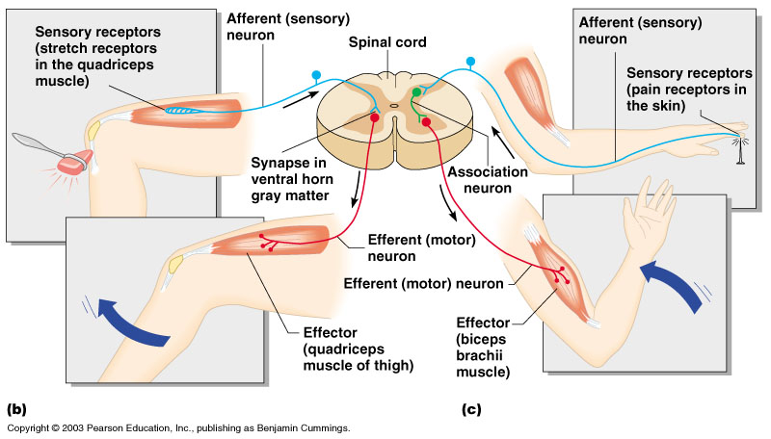
Simple Reflex Arc

Slide 53
Types of Reflexes and Regulation
Autonomic reflexes
  Smooth muscle regulation
  Heart and blood pressure regulation
  Regulation of glands
  Digestive system regulation
Somatic reflexes
  Activation of skeletal muscles

Slide 54
Applied anatomy
Neurities-Infection of the nerve e.g.-optic neurities, peripheral neurities(causes muscle spasm)
Neuralgia- pain along the distribution of a nerve e.g.-Trigeminal neuralgia (in face along the distribution of trigeminal nerve)
Neuropathy-any disease related to nervous system

Slide 55
Applied anatomy
Tingling and numbness-mild irritation of the nerve
Pain-sever irritation of the nerve
Paralysis- damage to a motor nerve causes muscular paralysis.
Anaesthesia & analgesia- damage to a sensory nerve causes anaesthesia & analgesia

Slide 56
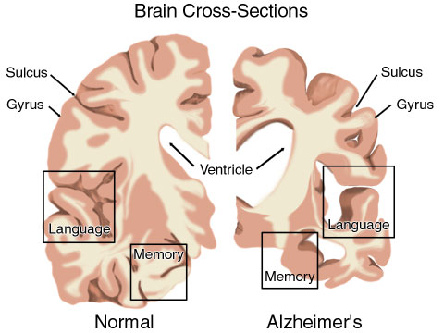
Alzheimer’s Disease
A gradual shrinking of the neurons in the cerebrum
Symptoms: memory loss, emotional disturbances, inability to function on own, death
Notes:
56

Slide 57


