Slide 1
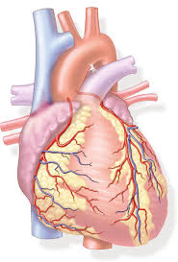
GENERAL ANATOMY CARDIOVASCULAR SYSTEM
Dr. Praveen Kumar Kurrey
M.B.B.S., M.S.,BCME, BCBR
Professor Anatomy
Pt. J.N.M. Medical college

Slide 2
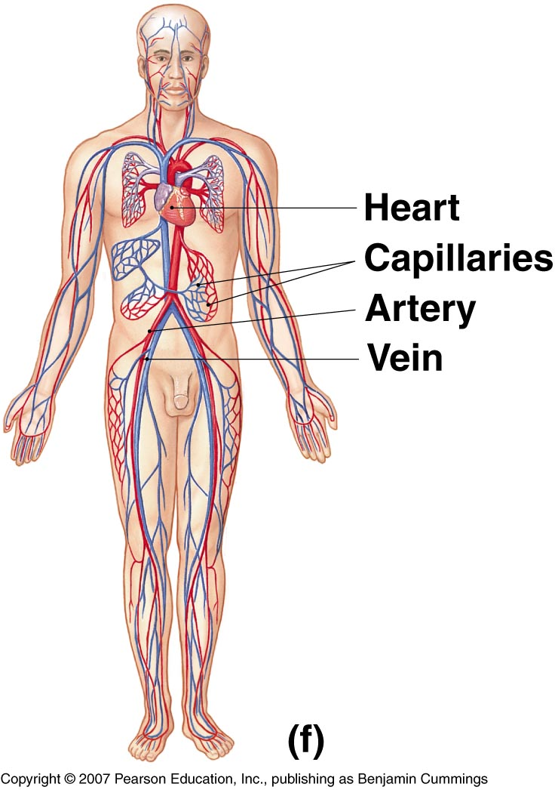
INTRODUCTION
The cardiovascular system is transport system of body
It comprises blood, heart and blood vessels.
The system supplies nutrients to and remove waste products from various tissue of body.
The conveying media is liquid in form of blood which flows in close tubular system.
Figure 1-2(f)

Slide 3
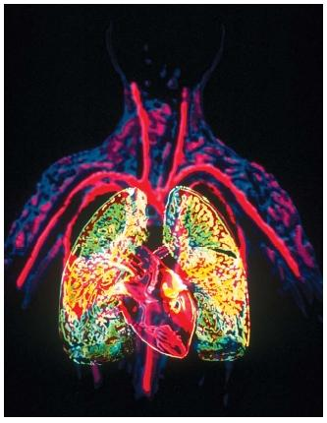
Terminology
Cardio
Heart
Vascular
Vessels that circulate blood
Oxygenated
High oxygen level
Deoxygenated
Low oxygen level

Slide 4
COMPONENTS OF CVS
1. Heart
2. Artery
3. Arteriole
4. Precapillary Sphincters
5. Capillary
6. Veins
7. Sinusoids
8. Anastmosis
9. End Arteries

Slide 5
FUNCTION OF CARDIOVASCULAR SYSTEM
Transport nutrients, hormones
Remove waste products
Gaseous exchange
Immunity
Blood vessels transport blood
Carries oxygen and carbon dioxide
Also carries nutrients and wastes
Heart pumps blood through blood vessels

Slide 6
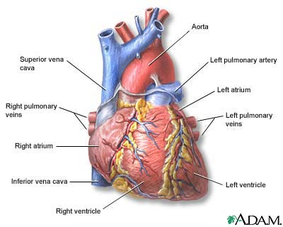
Heart
4 Chambered muscular organ
Pumps blood throughout the body
Receives deoxygenated blood through veins
Pumps oxygenated blood through arteries

Slide 7
The Heart
Location:
Under the sternum (slightly to the left) and between the lungs
Function:
to pump blood throughout the body
Blood carries oxygen and nutrients to the cells
Blood carries carbon dioxide and waste products away from the cells

Slide 8
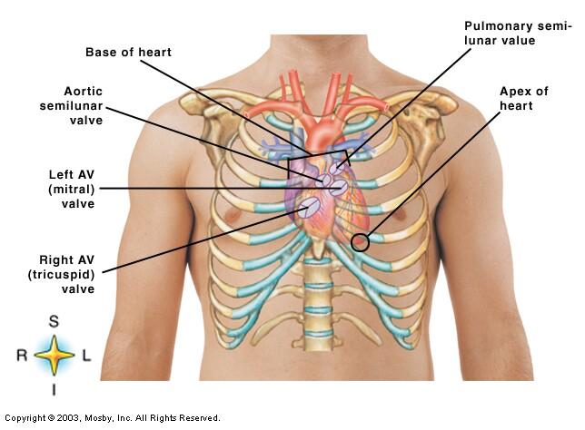
Heart

Slide 9
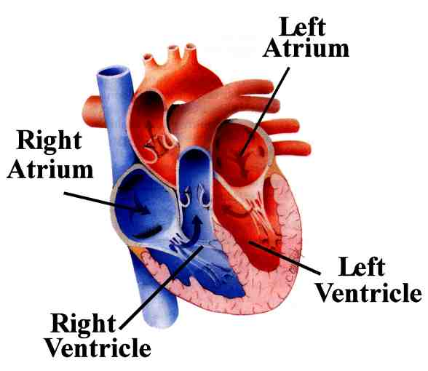
Heart Chambers

Slide 10
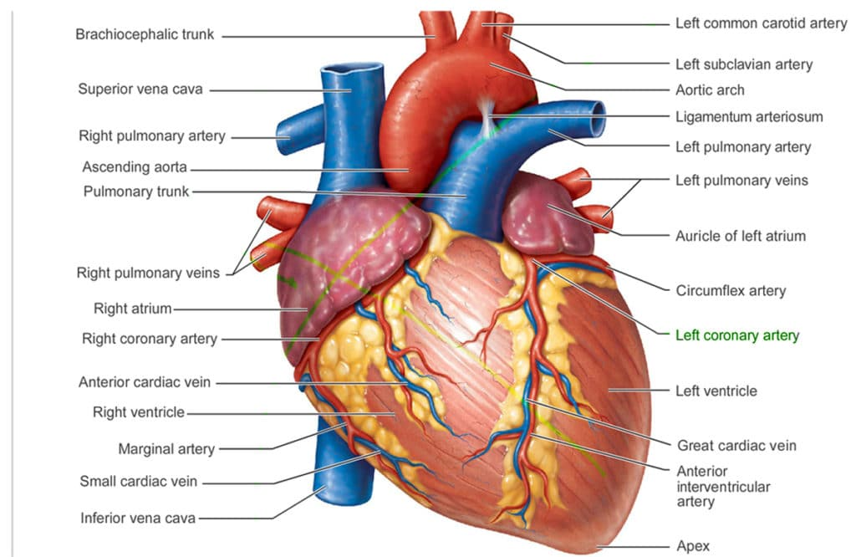

Slide 11
How does the blood flow through the Heart?
Right Side of Heart
Left Side of Heart
Blood enters the heart through two large veins, the inferior and superior vena cava, emptying oxygen-poor blood from the body into the right atrium of the heart.
As the atrium contracts, blood flows from your right atrium into your right ventricle through the open tricuspid valve.
When the ventricle is full, the tricuspid valve shuts. This prevents blood from flowing backward into the atria while the ventricle contracts.
As the ventricle contracts, blood leaves the heart through the pulmonic valve, into the pulmonary artery and to the lungs, where it is oxygenated and then returns to the left atrium through the pulmonary veins.
The pulmonary veins empty oxygen-rich blood from the lungs into the left atrium of the heart.
As the atrium contracts, blood flows from your left atrium into your left ventricle through the open mitral valve.
When the ventricle is full, the mitral valve shuts. This prevents blood from flowing backward into the atrium while the ventricle contracts.
As the ventricle contracts, blood leaves the heart through the aortic valve, into the aorta and to the body.
http://www.webmd.com/heart-disease/guide/how-heart-works?page=3

Slide 12
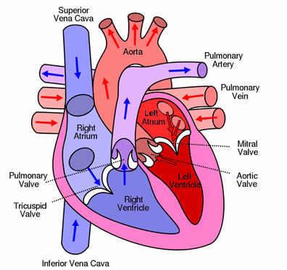
Direction blood pumps through the heart

Slide 13
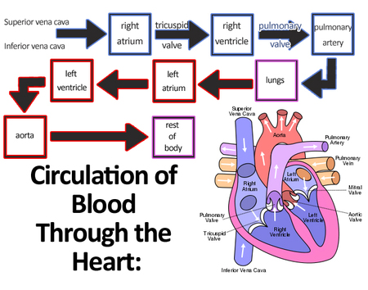

Slide 14
Circulatory Routes
Systemic Circulation – blood flow from the L ventricle to the body & back to the R atrium
Pulmonary Circulation – blood flow from the R ventricle to the lungs and back to the L atrium

Slide 15
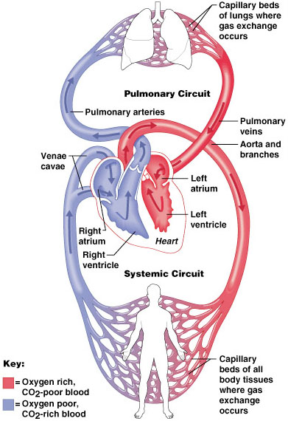
SYSTEMIC AND PULMONARY CIRCULATION
Pulmonary circulation
The flow of blood between the heart and lungs.
Systemic circulation The flow of blood between the heart and the cells of the body.
Chapter 18, Cardiovascular System
Figure 18.5
15

Slide 16
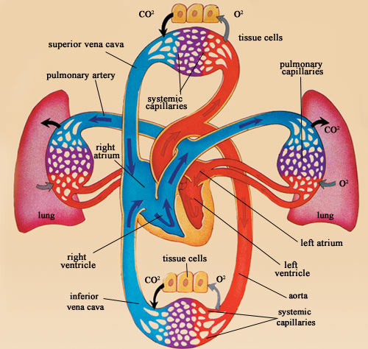
Blood Flow

Slide 17
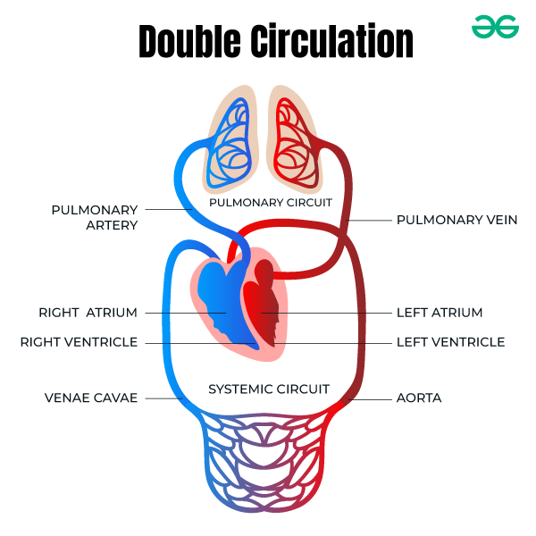

Slide 18
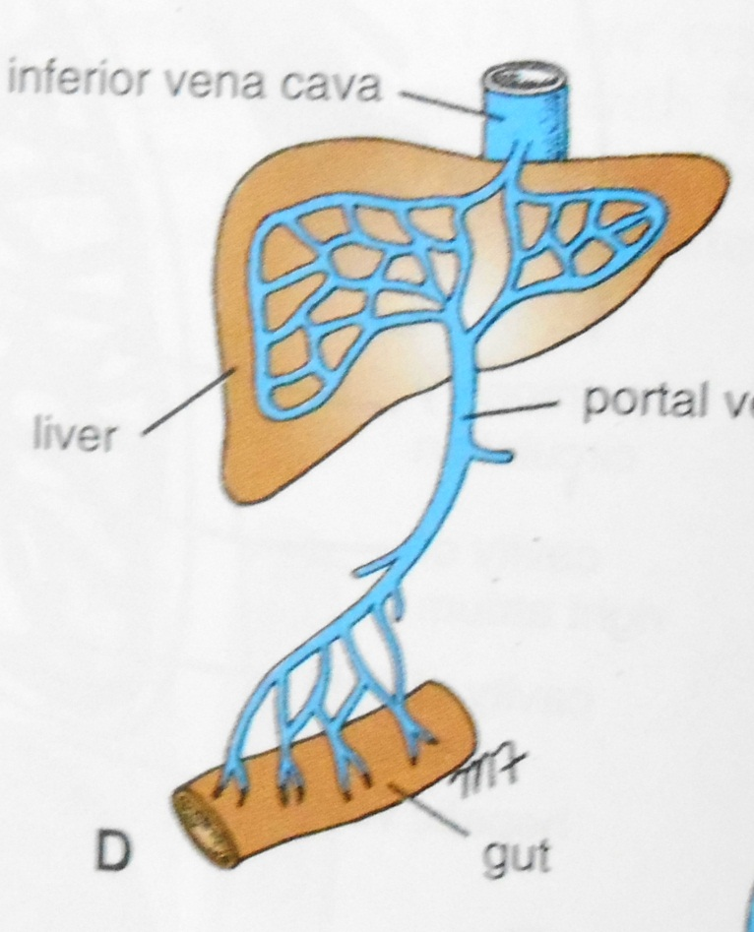
PORTAL CIRCULATION
Portal circulation - the flow of blood between TWO set of capillaries before draining in systemic veins.

Slide 19
CLASSIFICATION OF BLOOD VESSELS
Conducting Vessels -- Large Arteries
Distributing Vessels – Small Arteries
Resistance Vessels – Arterioles, Precapillary sphincters
Exchange Vessels -- Capillaries, Sinusoids and Post capillary venules
Capacitance / Reservoir Vessels – Large venules and veins

Slide 20
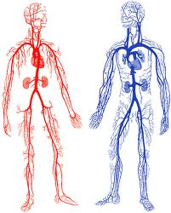
Blood Vessels
Elastic tubes
Carry blood
Arteries
Arterioles
Capillaries
Venules
Veins
Arteries
Veins

Slide 21
Structure of Blood Vessels
Tunica intima – innermost layer
Composed of endothelium
Semilunar valves present in veins
One cell thick in capillaries
Tunica media – middle layer
Smooth muscle and elastic CT
Helps vessels constrict and dilate
Larger in arteries
Tunica adventitia - outermost layer
Fibrous connective tissue
Holds vessels open; prevents tearing of vessels walls during body movements
Larger in veins than arteries

Slide 22
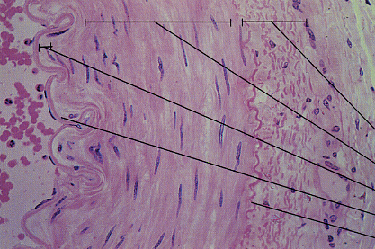
ARTERY WALL
Adventitia
Tunica media
Lamina propria
Endothelium
Ext. elastic mem

Slide 23
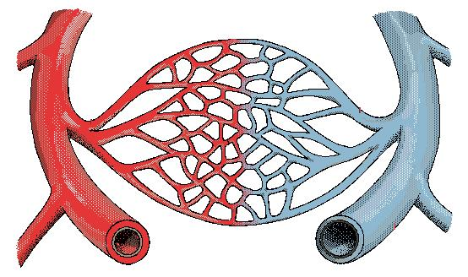
Arteries
Arteries
Muscular, thick, elastic blood vessels
Carry oxygenated blood away from the heart to body cells, tissue & organs
Except for pulmonary artery
artery

Slide 24
CLASSIFICATION OF ARTERIES
Elastic- e.g. (Aorta & its Major branches)
Muscular -e.g.(Renal, Testicular, Radial, Tibial etc.)
Arterioles (<0.1 mm)-
Terminal arterioles
Meta-arterioles

Slide 25
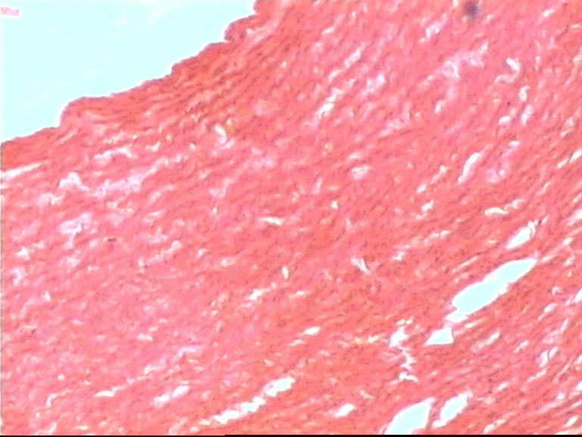
Elastic Artery

Slide 26
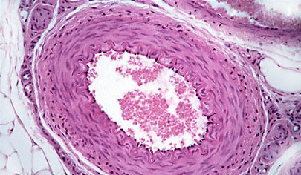
Artery (Muscular)

Slide 27
Arterioles
Arterioles
Small terminal branches of arteries
Connect arteries to capillaries
arteriole
artery

Slide 28
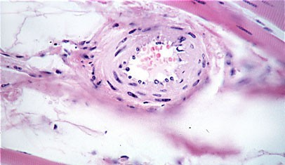
Arteriole

Slide 29
Capillaries
Capillaries
Very small blood vessels
Connect arterioles to venules
arteriole
artery
capillary

Slide 30
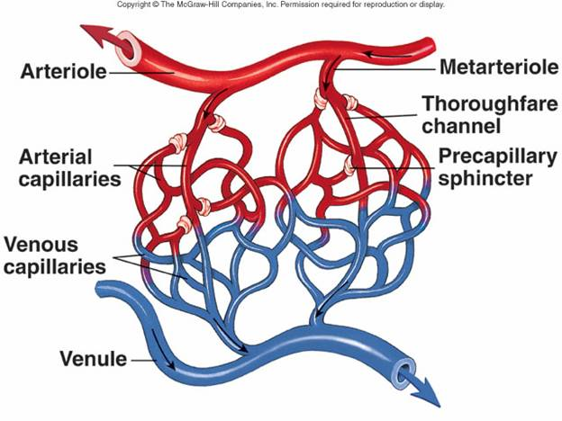
CAPILLARIES (5-8 micron)
The smallest blood vessels are capillaries and they connect the arteries and veins.
This is where the exchange of nutrients and gases occurs.

Slide 31
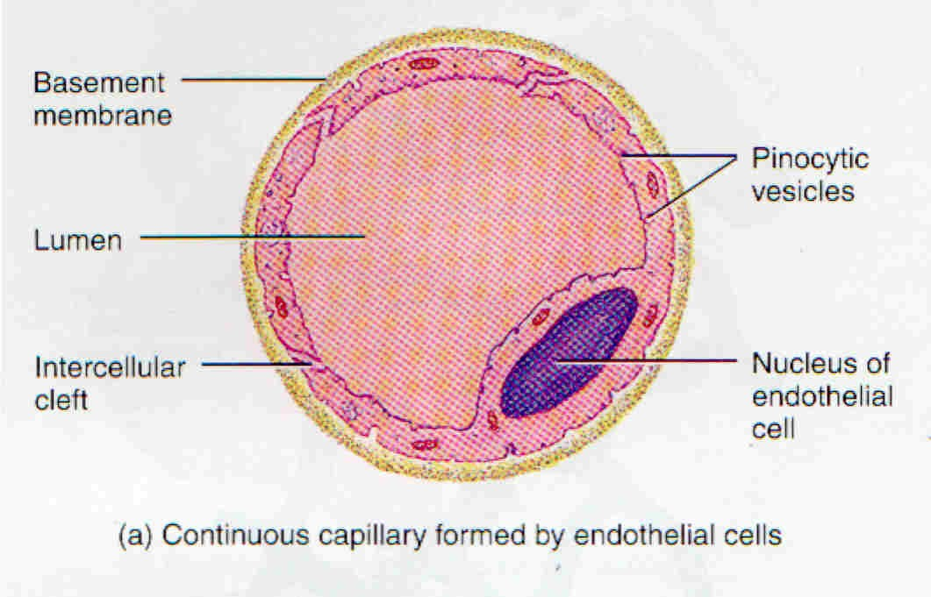
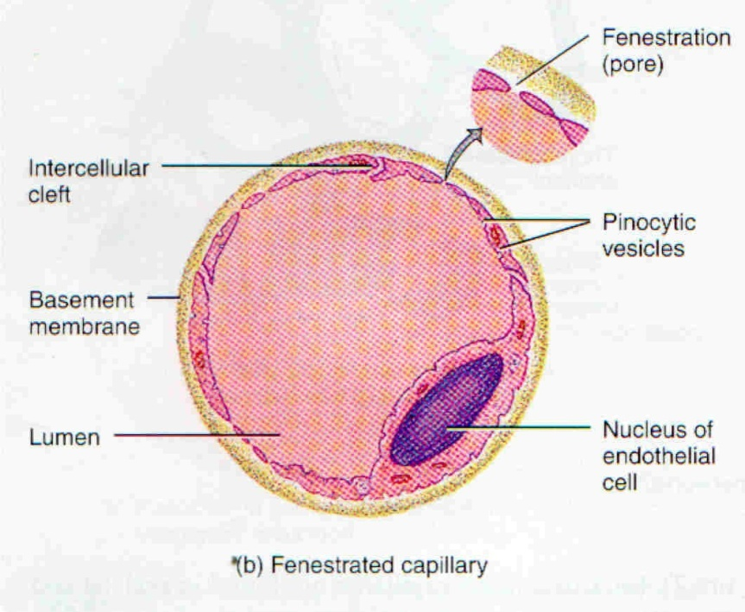
Capillaries

Slide 32
TYPES OF CAPILLARIES
CONTINUOUS- SKIN, LUNG, SMMOTH MUSCLE, CONNECTIVE TISSUES
FENESTRATED- PANCREAS,ENDOCRINE GLANDS, SMALL INTESTINE,CHOROID PLEXUS,CILLIARY PROCESS etc.

Slide 33
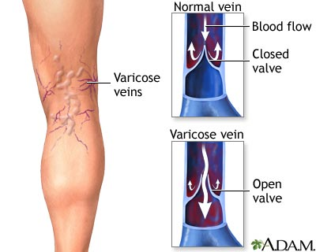
VEINS
Blood vessels that carry blood back to the heart are called veins.
They have one-way valves which prevent blood from flowing backwards.
They carry blood that is high in carbon dioxide known as deoxygenated blood (oxygen poor blood).

Slide 34
VEINS
Thin Walled
Large irregular lumen
Have valves
Dead space around
Types:
Large
Medium
Small

Slide 35
Veins
Veins
Thin walled blood vessels
Carry deoxygenated blood to the heart from body cells, tissue & organs
Except for pulmonary vein
venule
arteriole
artery
capillary
vein

Slide 36
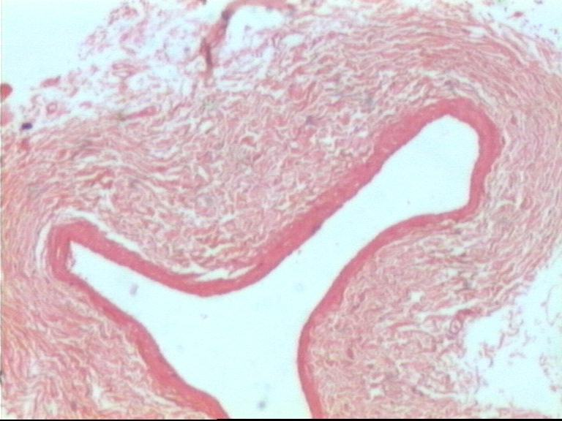
Vein L.P.

Slide 37
Difference B/n Artery & Vein
1. Thick walled
2. More muscular
3. More elastic
4. Smaller lumen, Patent,Circular
5. Tunica media is thickest layer
6. No valves in the lumen
7. Carry Oxygenated blood
Thin walled
Less muscular
Less elastic
Larger, Irregular, Collapsible lumen
Tunica adventitia is the thickest layer
Valves mostly present
Carry Deoxygenated blood

Slide 38
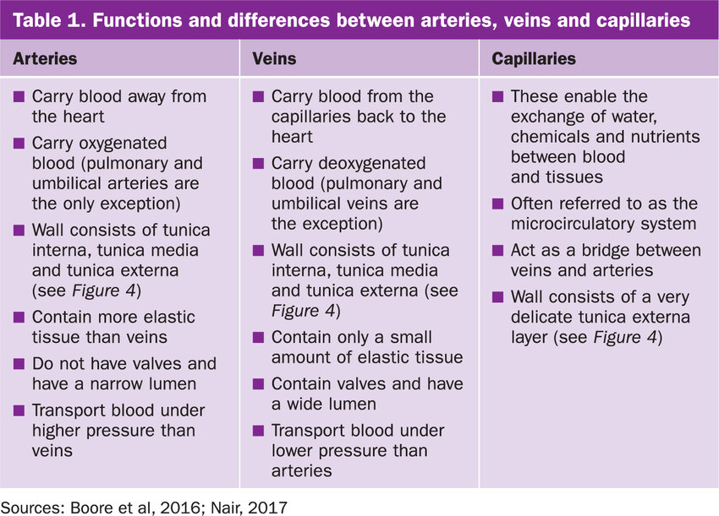

Slide 39
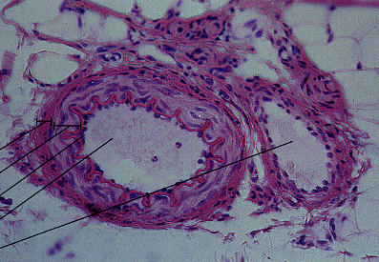
ARTERY and VEIN

Slide 40
SINUSOIDS
Large irregular vascular Blood filled spaces present in an organ which are closely surrounded by cells/parenchyma of that organ
(30-40 micron)
eg. Liver, Spleen, Bone marrow, suprarenal, Parathyroid etc.

Slide 41
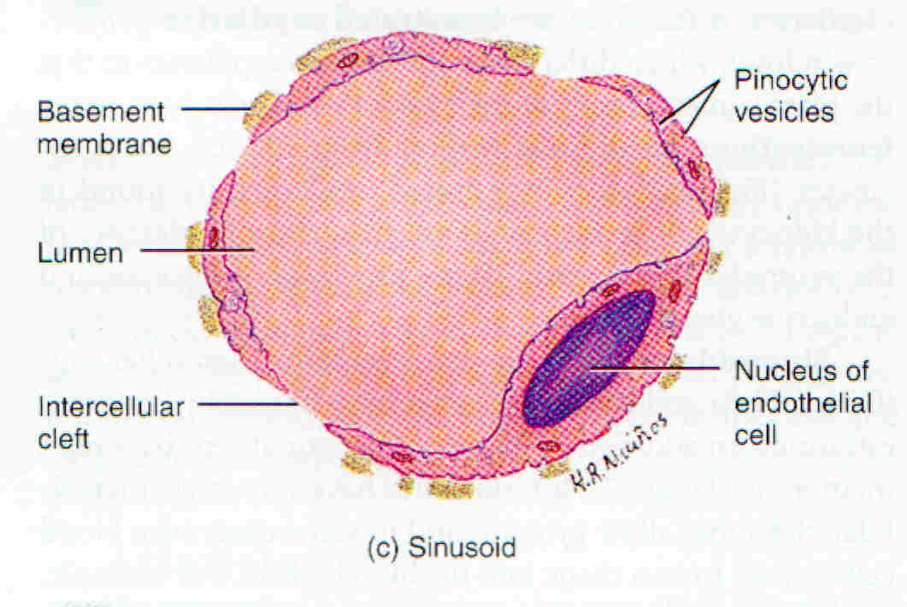
Sinusoid

Slide 42
Systemic Arteries
Arch of aorta
Subclavian (L and R)
Brachiocephalic
common carotid (L and R)
Axillary (L and R)
Brachial (L and R)
Radial
Ulnar
Abdominal aorta
Common iliac
External iliac
Femoral
Popliteal
Posterior tibial
Anterior tibial
Dorsal pedis

Slide 43
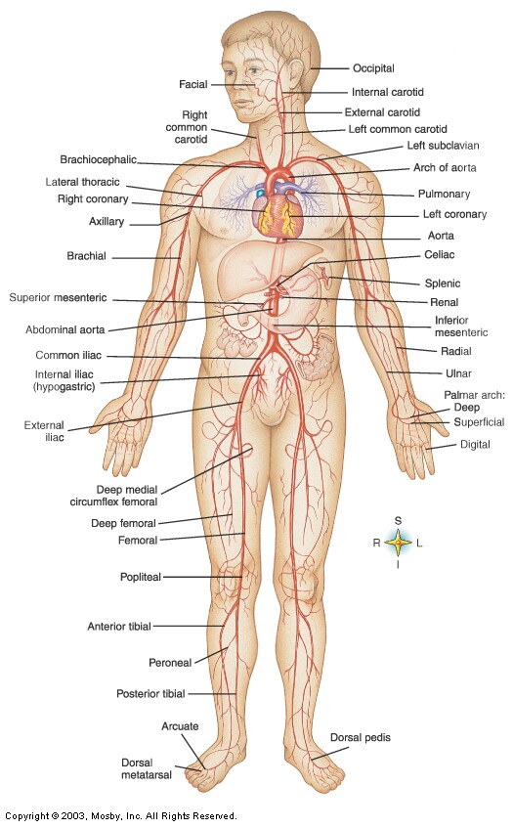

Slide 44
Systemic Veins
Superior vena cava
Inferior vena cava
External jugular
Internal jugular
Brachiocephalic (L and R)
Subclavian (L and R)
Cephalic
axillary
Basilic
Median basilic
Median cubital
Common iliac
External iliac
Femoral
Popliteal
Great saphenous
Small saphenous

Slide 45
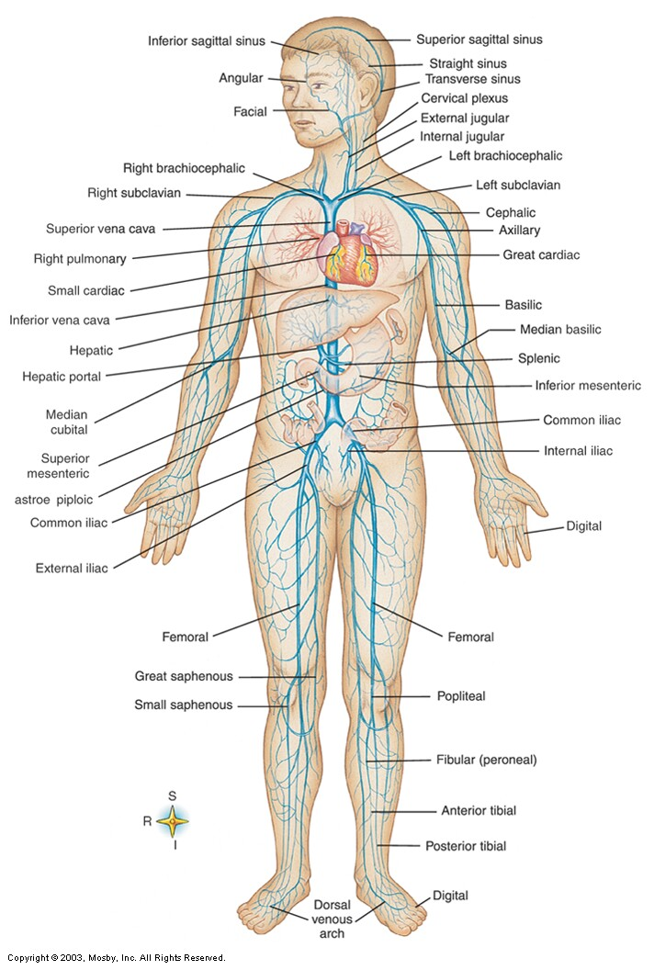

Slide 46
ANASTOMOSIS
A precapillary or post capillary communication between the neighbouring vessels is called anastmosis.
Types
1. Arterial
2. Venous
3. Arteriovenous

Slide 47
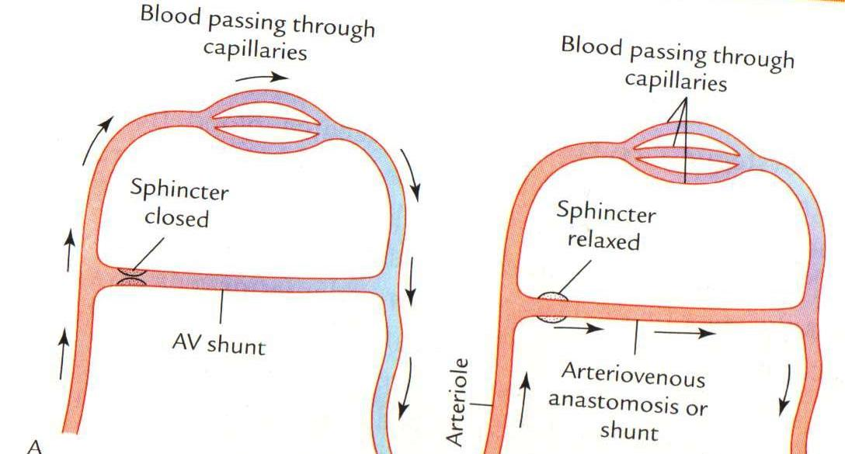
ANASTOMOSIS
ARTERIOVENOUS ANASTOMOSIS:
Skin of nose
Lips
External Ear
Mucus membrane of GI & nose
Erectile tissue of sex organ
Thyroid
Tongue

Slide 48
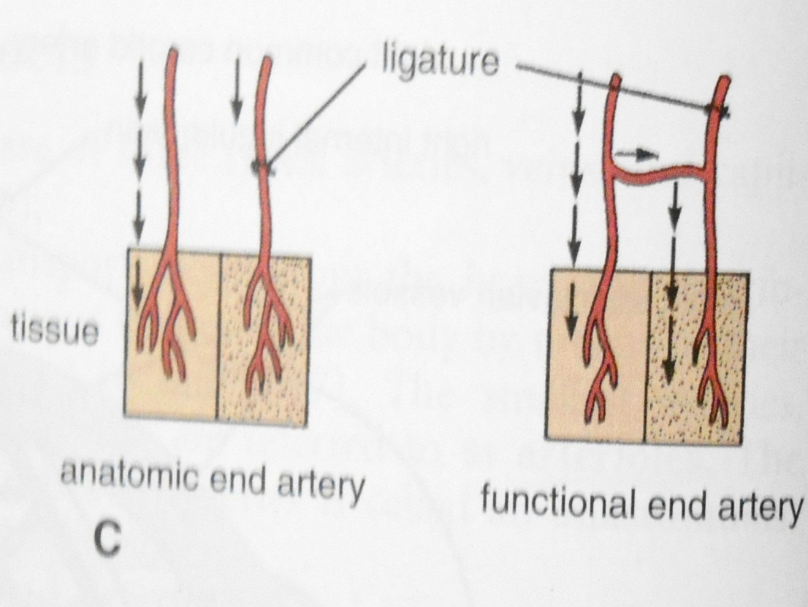
END ARTERIES
Arteries which do not anastmose with their neighbours .
Central artery of retina
Arteries of spleen, liver, kidneys, metaphyses of long bones
Central branches of cerebral cortex

Slide 49

APPLIED
Problems with the cardiovascular system are common, but they don’t just affect older people.
Many heart problems affect children and teenagers.

Slide 50
APPLIED ANATOMY
1. Blood Presssure
2. Hemorrhage
3. Arteritis
4. Phlebitis
5. Arteriosclerosis
6. Pulse

Slide 51
7 sites for Taking Pulse
1. Carotid
2. Brachial
3. Radial
4. Femoral
5. Poplitial
6. Posterior Tibial
7. Dorsalis Pedis

Slide 52
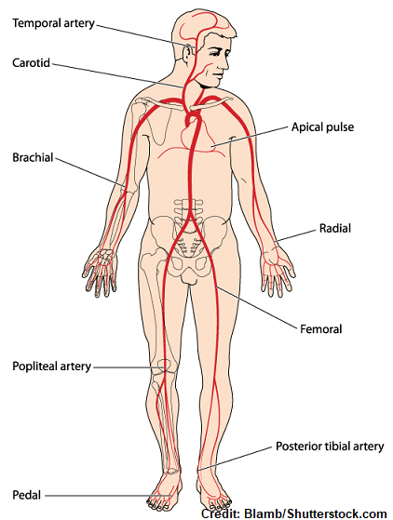

Slide 53
Myocardium Disorders
Myocardial Infarction
“Heart Attack”
Coronary thrombosis: clot
Coronary embolism: mobilized clot
Occlude coronary artery → heart tissue deprived of oxygen → cell death
S/S:
Angina pectoris – severe chest pain resulting from inadequate oxygen to myocardium
Treatment: Coronary Bypass Surgery
Veins are harvested from other areas of the body and used to bypass obstructions

Slide 54
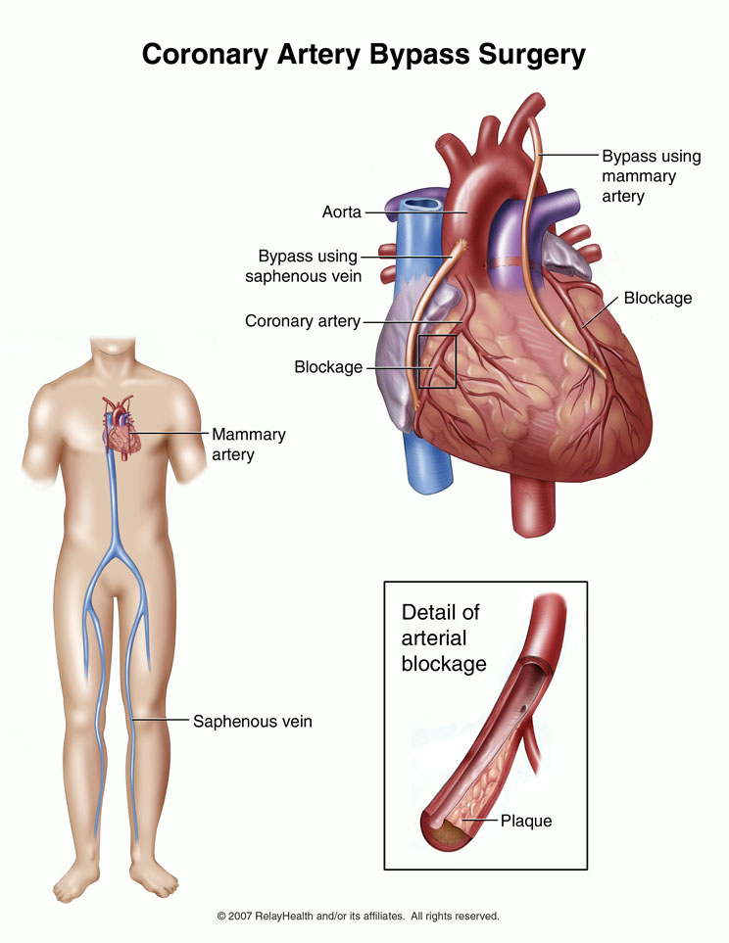

Slide 55
QUESTIONS
1-All of the following are the example of elastic arteries except:
Aorta
Common carotid artery
Subclavian artery
Radial artery

Slide 56
QUESTIONS
2-All of the following are the example of end arteries except:
Central branches of cerebral arteries
Central artery of retina
Facial artery
Splenic artery

Slide 57
QUESTIONS
3-Arteriovenous anastomosis are found at all of the following sites except:
Skin of lips
Erectile tissue of penis
Thyroid gland
Liver

Slide 58
QUESTIONS
4-All of the following are the example of portal circulation except:
Hepatic circulation
Renal circulation
Circulation of hypophysis cerebri
Pulmonary circulation

Slide 59
QUESTIONS
5-All of the following are features of veins except:
Thin walls
Thin tunica media
Thin tunica adventitia
Wide lumen

Slide 60


THANK YOU

