Slide 1
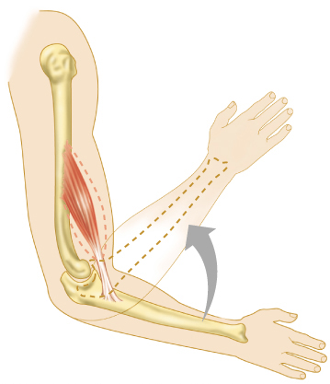
THE MUSCLE
DR PRAVEEN KUMAR KURREY
MBBS, MS, BCME, BCBR
PROFESSOR ANATOMY

Slide 2
MUSCLE TISSUE
(Latin – Mus = Mouse) (Gk = Mys)
Many resemble a mouse & with their tapering ends (tendons) representing tail
Contractile tissue - brings about a movement
Motors of body
Muscle terminology
  Sarcolemma – muscle plasma membrane
  Sarcoplasm – cytoplasm of a muscle cell
  Prefixes – Myo & Sarco: refer to muscle

Slide 3
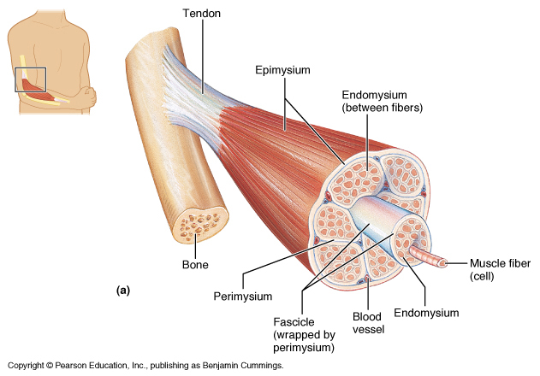
FUNCTIONAL FEATURES
  Contractility – Long cells shorten & generate pulling force
  Excitability – Electrical nerve impulse stimulates muscle cell to contract
  Elasticity – Can recoil after being stretched

Slide 4
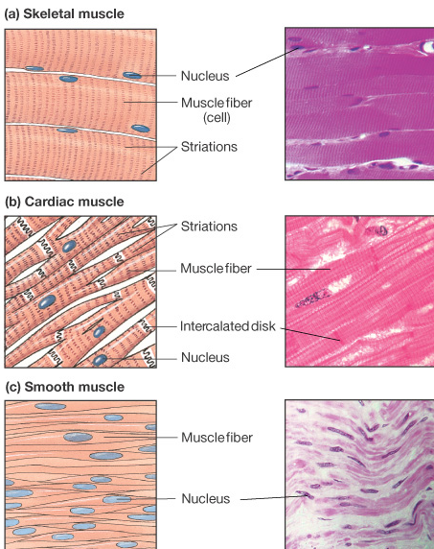
MUSCLE TISSUE
Types
  Skeletal
    Striated & voluntary
  Cardiac
    Striated & involuntary
  Smooth
    Nonstriated & involuntary

Slide 5
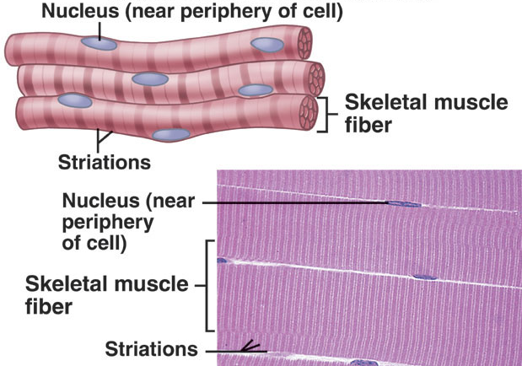
SKELETAL MUSCLE
Striped / Striated / Somatic / Voluntary
Features
Most abundant
Attached to skeleton
Supplied by somatic (Cerebrospinal) nerves; voluntary control
Responds quickly to stimuli
Capable of rapid contraction; hence easily fatigued
Help in adjusting to external environment
Under highest nervous control of cerebral cortex
Microscopically
Exhibit cross striations
Multinucleated cylindrical cell
Examples
Muscles of limbs & body wall

Slide 6
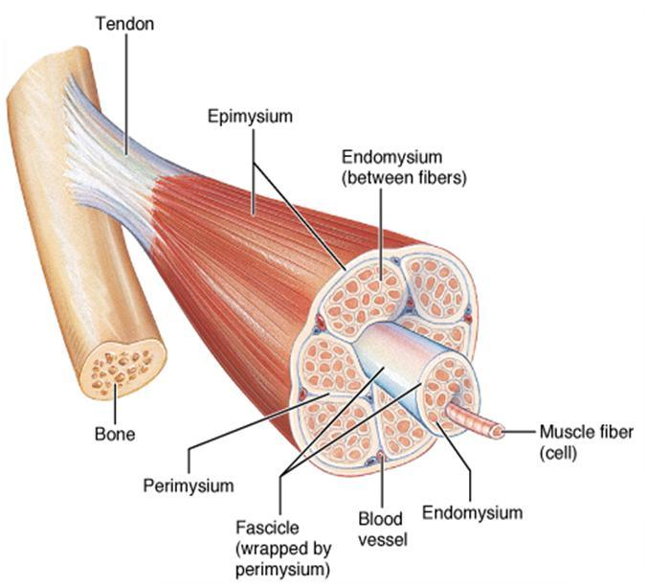
SKELETAL MUSCLE
Three connective tissue coverings:
  Epimysium –surrounds entire muscle
  Perimysium –surrounds fascicles
  Endomysium – surrounds each muscle fibre

Slide 7
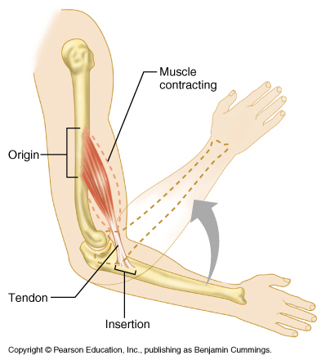
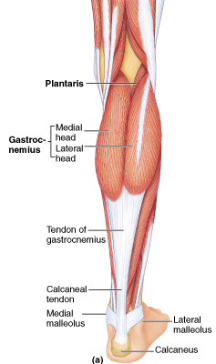
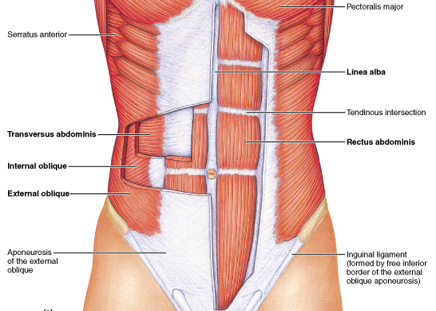
SKELETAL MUSCLE
Origin – muscle end; relatively fixed during contractions
Insertion – muscle end; moves during contraction
Attachments- origin & insertion are interchangeable.
Parts
Fleshy: Contractile - Belly
Fibrous: Non contractile
  Tendon (cord like)
  Aponeurosis (Flattened sheet)

Slide 8
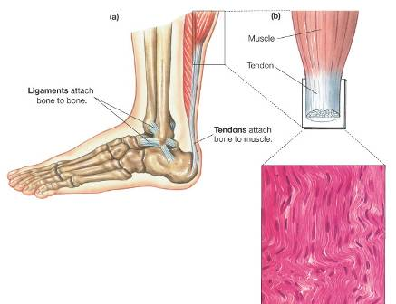
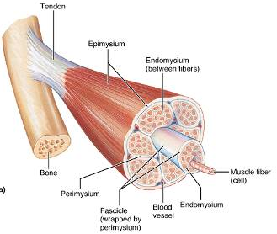
TENDON
Fibrous & non contractile; long cord like structure
Composed of bundles of collage fibers
Surrounded by epitendineum
Supplied by sensory nerve from muscle nerves. Also from nearby deep nerves
Vascular needs- minimal
Some tendons can be used for tendon transfer & transplantation
Tendons heal very slowly

Slide 9
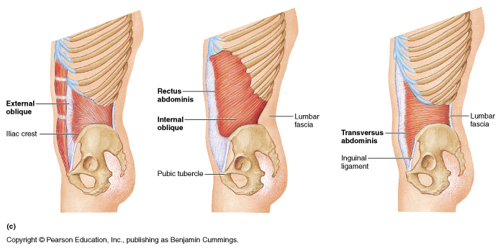
APONEUROSIS
Attachment of a muscle to bone by thin, broad sheet - aponeurosis
Composed of parallel bundles of collagen fibres
Exterior oblique aponeurosis

Slide 10
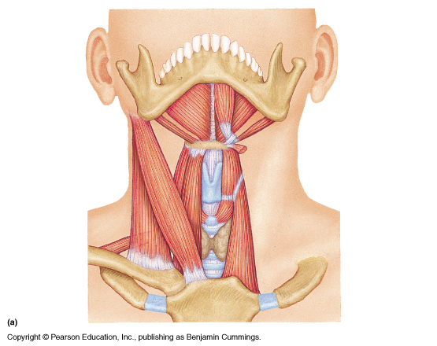
RAPHE
Fibrous band; interdigitating fibres of aponeurosis
Stretchable
  Mylohyoid raphe
MR

Slide 11
FASCICULAR ARCHITECTURE
Force - directly proportional to number & size of muscles fibres
Range - directly proportional to length of fibres
Classified: arrangement of their fasciculi
Parallel
Oblique
Spiral
Cruciate

Slide 12
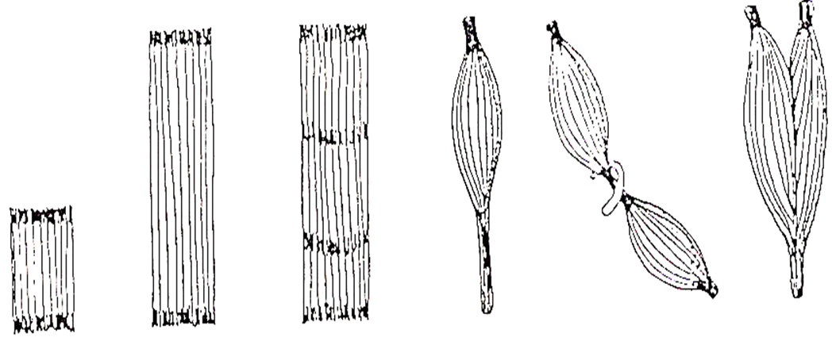
FASCICULAR ARCHITECTURE
PARALLEL FASCICULI
Fasciculi are parallel to line of pull; muscle be:
Quadrilateral -Thyrohyoid
Strap like - Stenohyoid
Strap like with tendinous intersections - Rectus abdominis
Fusiform - Biceps brachii
Range of movements is maximum

Slide 13
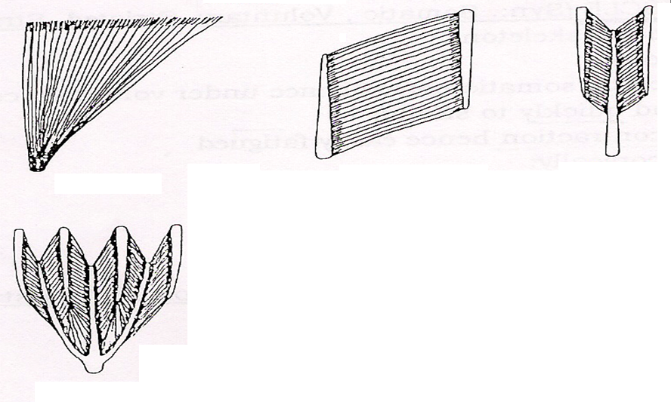
FASCICULAR ARCHITECTURE
OBLIQUE FASCICULI
Fasciculi are oblique to line of pull; muscle may be:
  Triangular - Temporalis
  Unipennate - Flexor pollicis longus
  Bipennate - Rectus femoris
  Multipennate – Deltoid (middle fibres)
  Circumpennate - Tibialis anterior
Arrangement makes muscle more powerful; range of movement is reduced

Slide 14
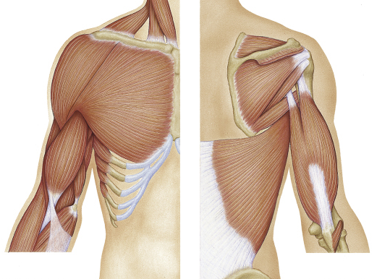
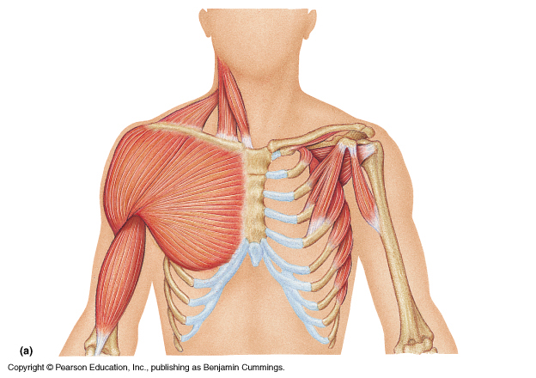
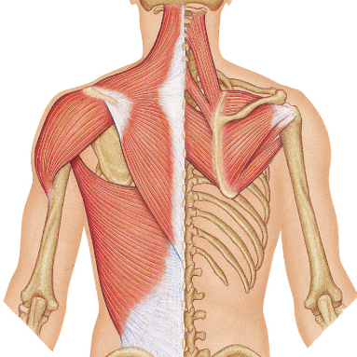
FASCICULAR ARCHITECTURE
SPIRAL / TWISTED FASCICULI
This is seen in:
  Trapezius
  Pectoralis major
  Latissimus dorsi
Lat. Dorsi
Pect. Major
Trapezius

Slide 15
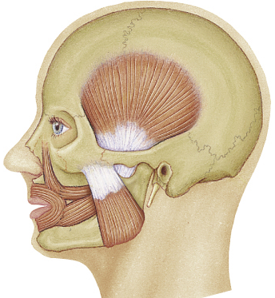
FASCICULAR ARCHITECTURE
CRUCIATE FASCICULI
Fasciculi are crossed (cruciate muscles)
  Sternocleidomastoid (SCM)
  Masseter
SCM
Masseter

Slide 16
NOMENCLATURE
Muscles have been named according to:
Shape: Trapezius, Rhomboideus, Deltoid
Number of heads: Biceps, Triceps, Quadriceps
Structure: Semimembranosus, Semitendinosus
Location: Temporalis, Supraspinatus
Attachments: Stylohyoid, Cricothyroid
Action: Adductor longus, Flexor carpi ulnaris
Direction of fibres: Rectus abdominis, Trans. abdo.
Relative position: Medial & lateral pterygoids

Slide 17
PRIME MOVER
Muscle or group of muscles that bring about a desired movement
Gravity may also act as a prime mover
Ex. Brachialis as flexor at elbow joint

Slide 18
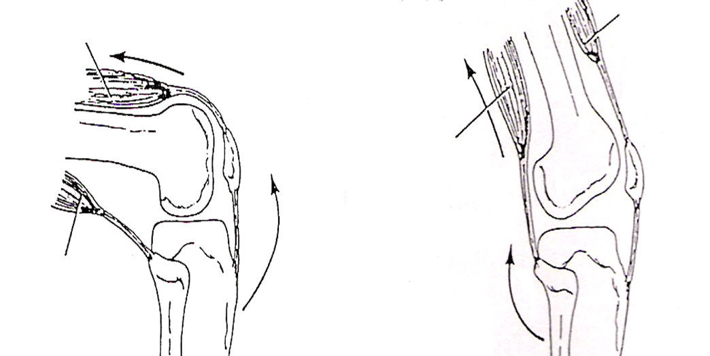
ANTAGONIST
Opponents. Muscle or group of muscles that directly oppose movement under consideration (Quadriceps - extensor of knee when acting as a prime mover is antagonist to flexor of knee).
Antagonists may be relaxed or by lengthening; control movement & make it smooth, jerk free & precise. Antagonist muscles cooperate. Gravity may act as an antagonist
QF
QF
BF
BF

Slide 19
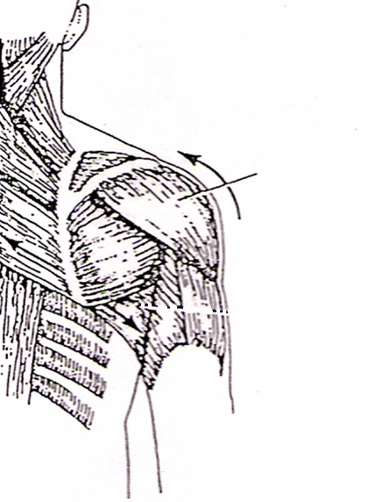
FIXATORS / FIXATION MUSCLES
Stabilize parts & thereby maintain position while prime movers act
Stabilize proximal joints so that desired movement at distal joint occur smoothly e.g.: Muscles holding scapula steady are acting as fixator while deltoid moves humerus
Deltoid

Slide 20
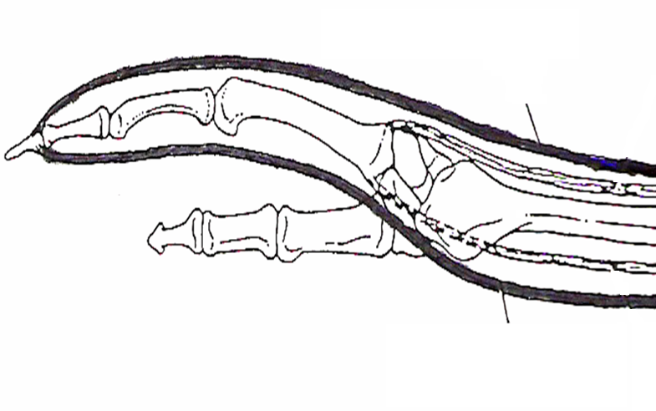
SYNERGISTS
Special fixation muscles
Partial antagonist to prime mover
When a prime mover crosses two or more joints, synergists prevent undesired actions at intermediate joints. e.g.: Long flexor that flexes fingers would at the same time flex wrist if wrist were not stabilized by extensors of wrist – synergists
Extensor tendon
Flexor tendon

Slide 21
NERVE SUPPLY
Nerve supplying a muscle - motor nerve
Motor point
Site where motor nerve enters muscle
May be one or more
Electrical stimulation at this point is more effective

Slide 22
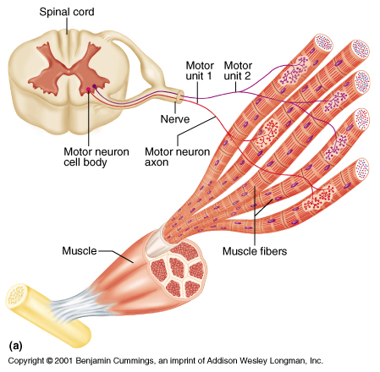
MOTOR UNIT
Motor unit - motor neuron & all muscle fibres it supplies
Number of muscle fibers per motor unit vary -four to several hundred
Muscles controlling fine movements (fingers, eyes) have small motor units:
5-10 fibres
Large weight-bearing muscles (thighs, hips) have large motor units:
100-200 fibres

Slide 23
DEVELOPMENTAL ASPECTS:
MALE & FEMALE
Biological basis for greater strength in men than in women
Women’s skeletal muscle- 36% body mass
Men’s skeletal muscle- 42% body mass
Differences - due to male sex hormone testosterone
More muscle mass- men are stronger than women
Body strength per unit muscle mass is same

Slide 24
APPLIED ANATOMY
Paralysis
Loss of power of movement
Muscles are unable to contract
Damage to motor neural pathways leading to Upper motor neuron (UMN) or Lower motor neuron (LMN) paralysis
UMN Paralysis: Spastic paralysis - exaggerated tendon jerks
LMN paralysis: Flaccid paralysis - loss or decrease tendon jerks
Muscular spasm
May be
Localized – commonly caused by a “muscle pull”
Generalized – seen in Tetanus & Epilepsy

Slide 25
APPLIED ANATOMY
Disuse atrophy
Muscles not used for long time, become thin & weak
Reduction in size (muscular wasting)
Seen in paralysis & Generalized debility
Hypertrophy
Excessive use of a particular muscle results in better development or hypertrophy (Body builders & Athletes)
Regeneration
Capable of limited regeneration
Large regions damaged- regeneration does not occur & replaced by CT
Myopathy
Characterized by muscle weakness, wasting & microscopic changes within muscle tissue. Cause- nerve dysfunction. Diagnosis: EMG & muscle biopsy

Slide 26
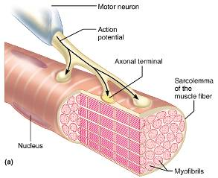
NEUROMUSCULAR JUNCTION
On approaching muscle axons of motor nerve lose their myelin sheath & break up into no. of branches to supply individual muscle fibres

Slide 27
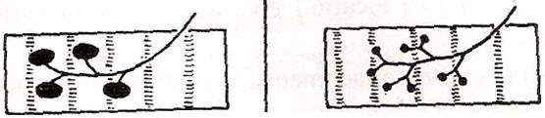
NEUROMUSCULAR JUNCTION
En plaque terminals: (Plaque = plate)
Plates like; called motor end plate
In most of skeletal muscles of body
En grappe’ terminals (Grappe = grape)
Resembles a bunch of grapes
Seen in extra-ocular muscles & tail endings of muscle spindles
En plaque terminals
En grappe’ terminals

Slide 28
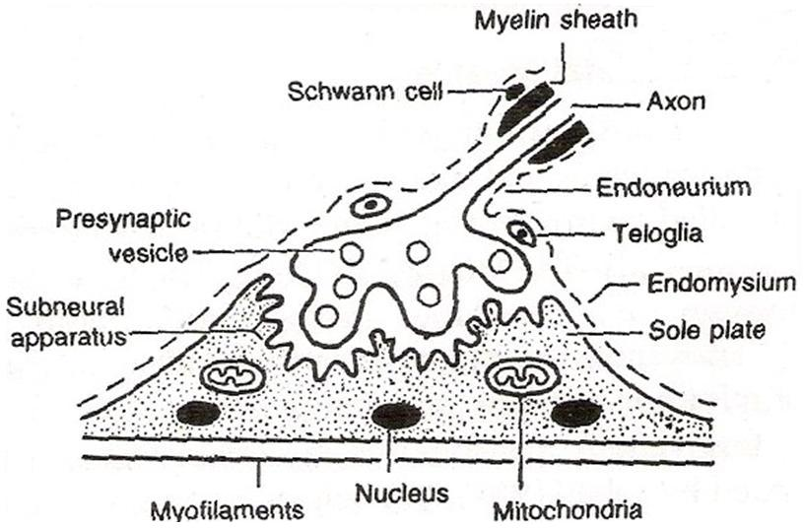
NEUROMUSCULAR JUNCTION
At NMJ, muscle fibre is specialized into sole plate - localized collection of granular sarcoplasm having many nuclei & mitochondria. Also presents “synaptic gutters” for end plates
Motor end plate & sole plate are separated by ultramicroscopic gap
Sarcolemma folds (sub-neural clefts) in synaptic gutters are rich in acetyl- cholinesterase - destroys liberated acetylcholine after each neuromuscular transmission of impulse

Slide 29
BLOOD SUPPLY OF MUSCLES
Muscular branches - from neighbouring arteries
Arteries, veins & motor nerve pierce muscle at neurovascular hilum - constant point
Subsidiary arteries enter muscle near ends
Arteries divide repeatedly to form arterioles in perimysium & capillaries in endomysium for “nutritive circulation”
Arteriovenous anastomoses - Present in epimysium & perimysium

Slide 30
THANK YOU

