Slide 1
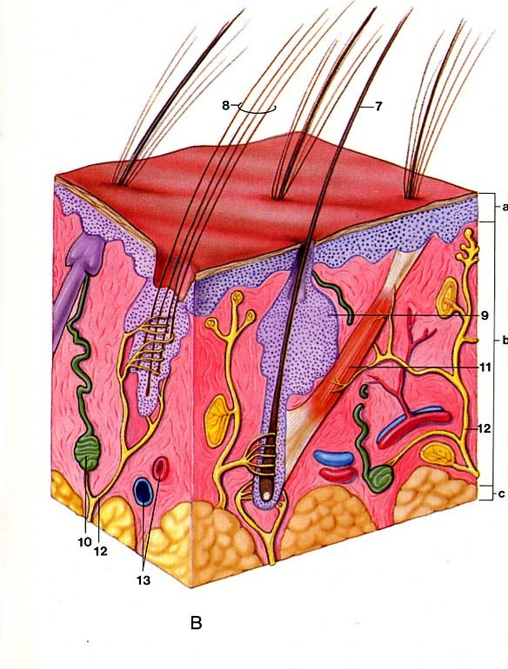
GENERAL ANATOMY
SKIN, FASCIA
Dr. Praveen Kumar Kurrey
M.B.B.S., M.S.,BCME, BCBR
Professor Anatomy

Slide 2
Tissues of the body
The tissue: is a group of cells which perform a specific function
There are four basic tissues: 1.Epithelium
2.Connective tissue 3.Muscular tissue 4.Nervous tissue

Slide 3
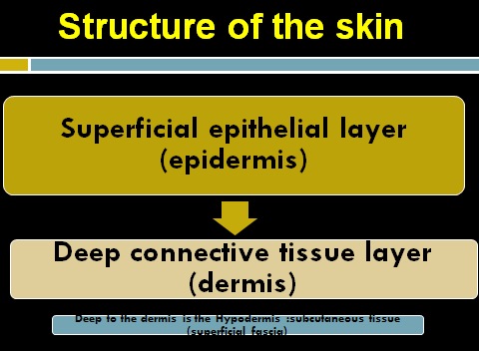

Slide 4
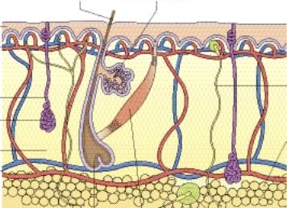



Structure of the skin

Slide 5
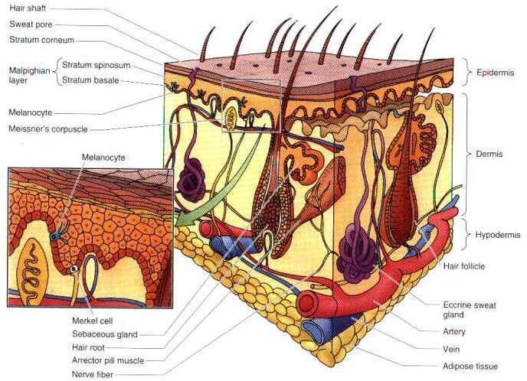

Slide 6
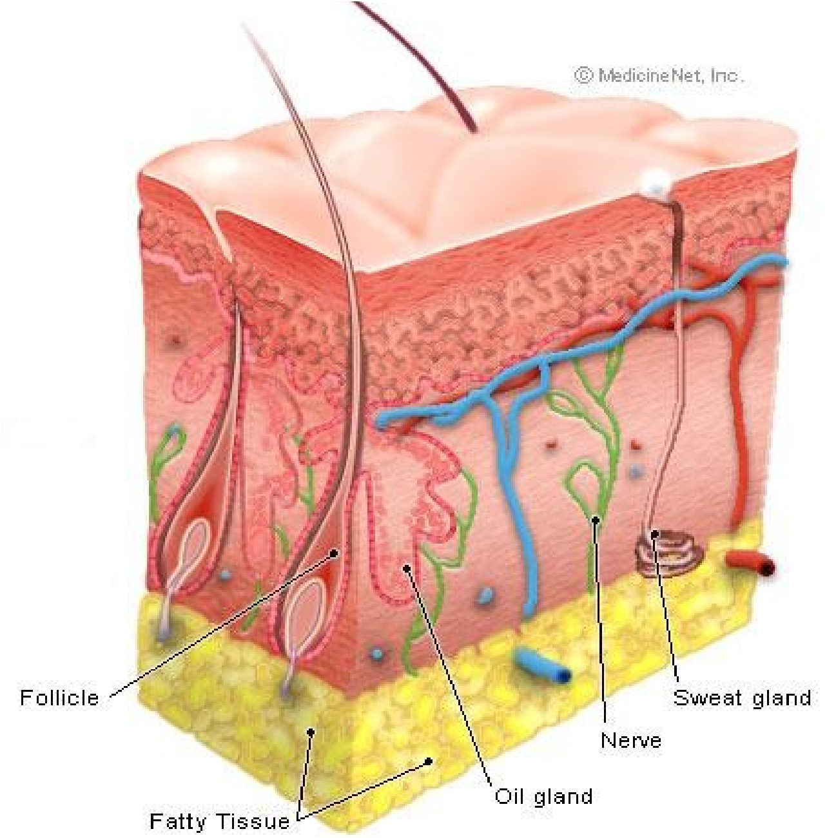




Slide 7
Structure of the skin
Epidermis
Keratinized stratified squamous epithelium devoid of blood vessels
Wear & tear occurs in superficial cells
Dermis
Connective tissue containing (bood. v. lymph v., sensory nerve endings, smooth m, hair follicles, sweat and sebaceous glands)
In its deep part the collagen bundles are arranged in parallel rows

Slide 8
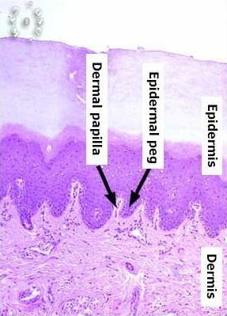
Skin
Layers of skin
•
•
•
•
Epidermis
Five layers
Dermis
Two layers
•
Dermal papilla – conical projections of papillary layer of dermis into epidermis

Slide 9
Epidermis
Thickness:
The epidermis is generally thin except in :
•
•
The palms of the hand. The soles of the feet.
Why?
To protect these parts and withstand friction, wear and tear that occurs in these regions.

Slide 10
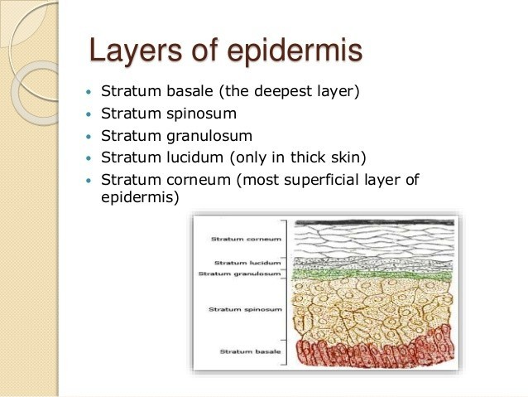

Slide 11
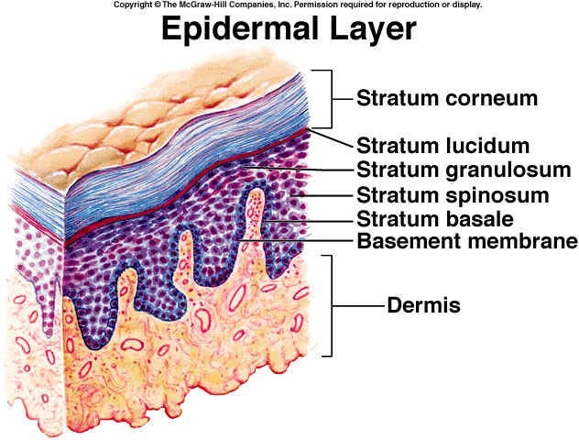

Slide 12
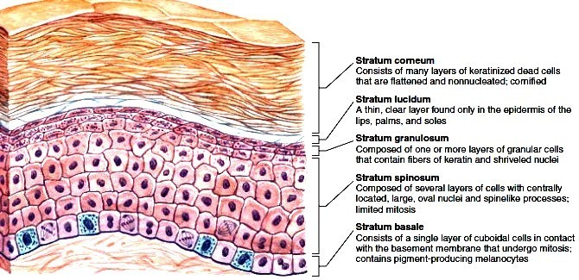

Slide 13
Dermis
Corium
Vascular layer of skin
Made up of connective tissue
Two layers:
  Superficial – papillary layer
    Thin
    20%
    Contains loosely arrange collagen fibers

Slide 14
Reticular layer:
  Thick
– 80%
  Composed of thick collagen bundles running parallel to skin

Slide 15
Functions of the Skin
1-Protection
■ abrasion, invasion, water loss, UV protection
2-Vitamin D synthesis
■ epidermal keratinocytes when exposed to UV light
■ helps maintain health of skeleton by increasing absorption of Ca2+
3-Sensation
■ receptors for heat, cold, touch, pressure, vibration and pain

Slide 16
4- Thermoregulation
■ thermo receptors and sweat glands
■ hypothalamus controls cutaneous arteries and sweat glands to retain or dissipate heat
5- Psychological and social functions
■ appearance and social acceptance
■ facial expression and nonverbal communication

Slide 17
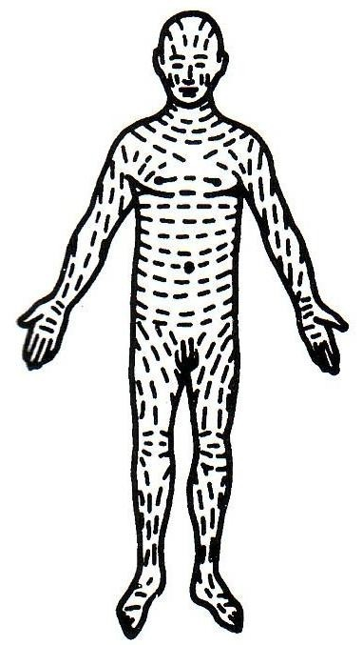
Langer’s lines
The collagen fibers, arranged in parallel rows, called:
Lines of cleavage (langer’s lines): Tension lines
The direction of the rows of collagen fibers in the dermis:
It runs
Longitudinally in the limbs.
Circumferentially in the neck and the trunk.

Slide 18
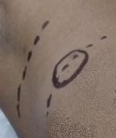
Lines of cleavage
These lines are important to determine the direction for an incision (cut) during a surgery to avoid obvious scars.

Slide 19
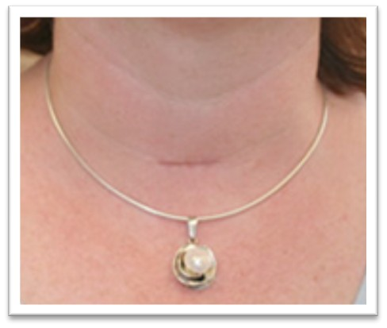
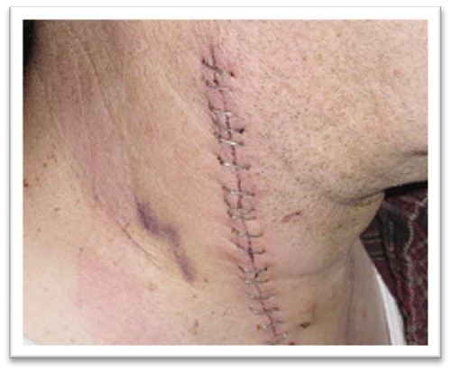
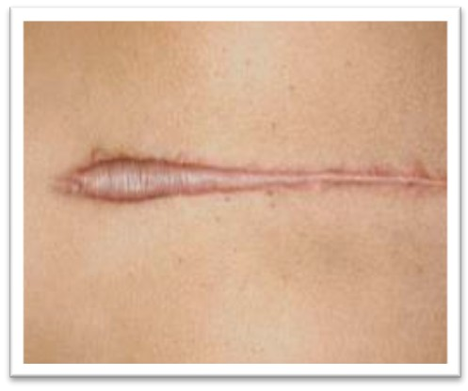
A surgical incision along or between these lines causes the minimum disruption of collagen so that the wound heals with a small scar.
Conversely, an incision made across the rows of collagen makes a disruption resulting in the massive production of fresh collagen and the formation of a broad scar.

Slide 20
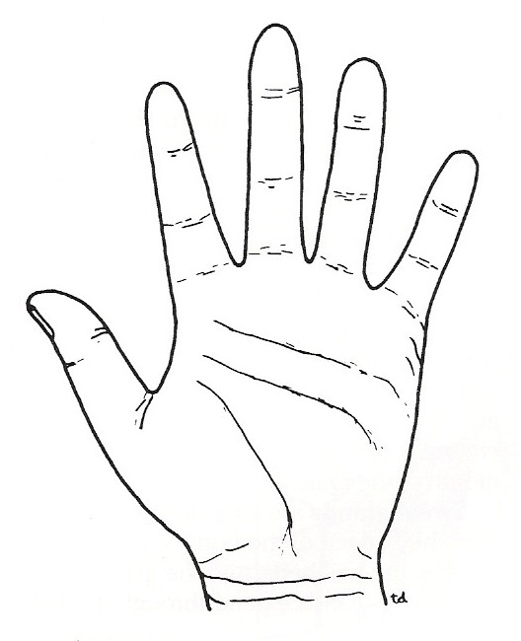
Flexors Lines
Skin creases
Folded skin over the joints.
Skin is thin and is firmly adherent to underlying structures.

Slide 21
Papillary ridges
Finger prints due to ridges & grooves present on finger tip, palms, toes & sole of the foot
Appears in intrauterine life – 3rd & 4th month
Peculiar to individual, used to identify person
Underlying structure of dermis forms a patten on epidermis

Slide 22
Skin Color
Due to Melanin, a pigment in the epidermis and Carotene, a pigment in dermis as well as the blood in the capillaries of the dermis.
Melanin is synthesized in cells called Melanocytes (found in basal layer).
Number of Melanocytes is essentially the same in all races.
The differences in skin color is due to the amount of pigment the melanocytes produce.
When skin is exposed to ultraviolet radiation, enzymatic activity is increased and both the amount and darkness of melanin increase and the skin darkens as a protective measure

Slide 23
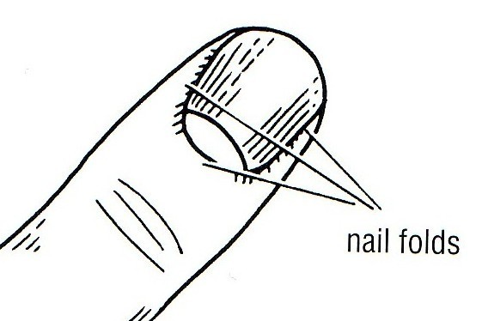
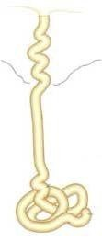
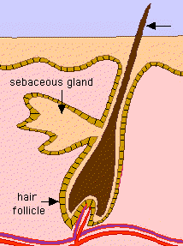
The appendages of the skin
Nails
Hairs
Sebaceous glands
Sweat glands

Slide 24
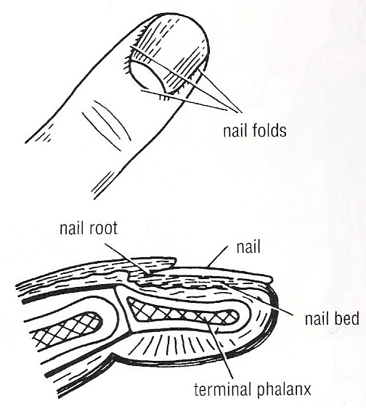
Nails
A nail is a flat horny plate on the dorsal surface of tips of the fingers and toes
Nail bed is very vascular causing pink color of the nail
The germinative zone lies beneath the root& is responsible for growth of nail

Slide 25
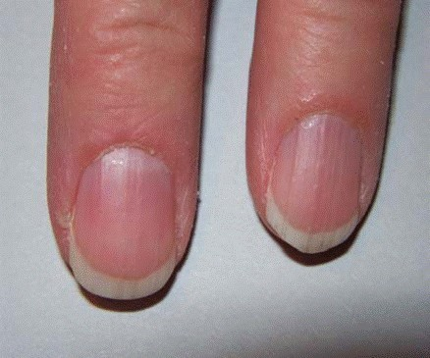
Nails
Nails
  Scale-like modifications of the epidermis
    Heavily keratinized
  Stratum basale extends beneath the nail bed
    Responsible for growth
  Lack of pigment makes them colorless

Slide 26
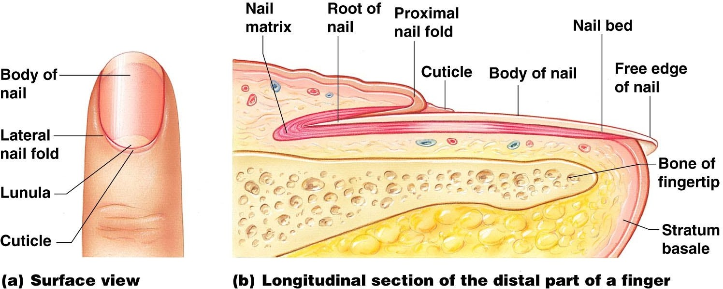
Nail Anatomy
Nail structures
  Free edge
  Body is the visible attached portion
  Root of nail embedded in skin
  Cuticle is the proximal nail fold that projects onto the nail body

Slide 27
Nail Plate: visible part
Nail root: hidden part lying in groove
Nail folds: skin fold bounding nail grooves
Nail bed: beneath nail bed is stratified squamous epithelium called nail bed
Nail matrix: beneath proximal portion of nail fold is epithelium from which nail grows (0.5 mm/week)
Hyponychium: thickened epidermis under free edge of nail

Slide 28
Hair
Hair
  Keratinous filaments derived from invagination of germinative layer of epidermis into dermis
  Produced by hair follicle which are made of hard keratinized epithelial cells
  Melanocytes provide pigment for hair color

Slide 29
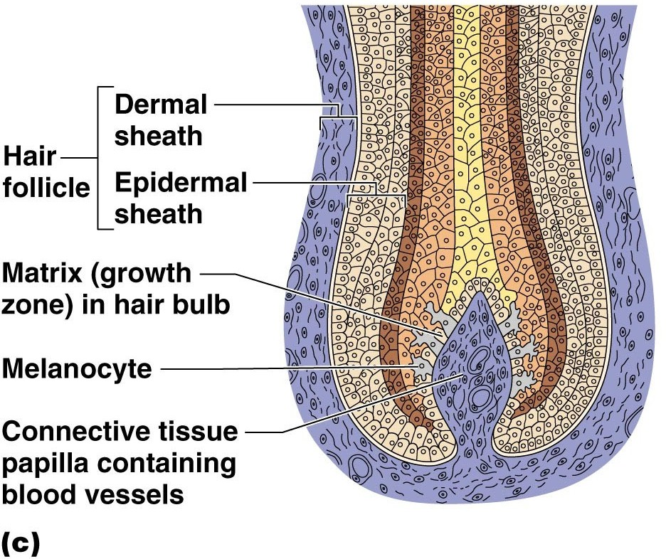
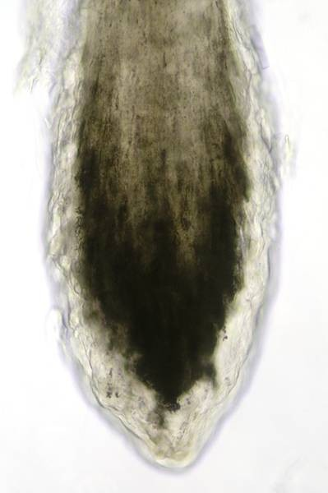
Structure of Hair Follicle

Slide 30
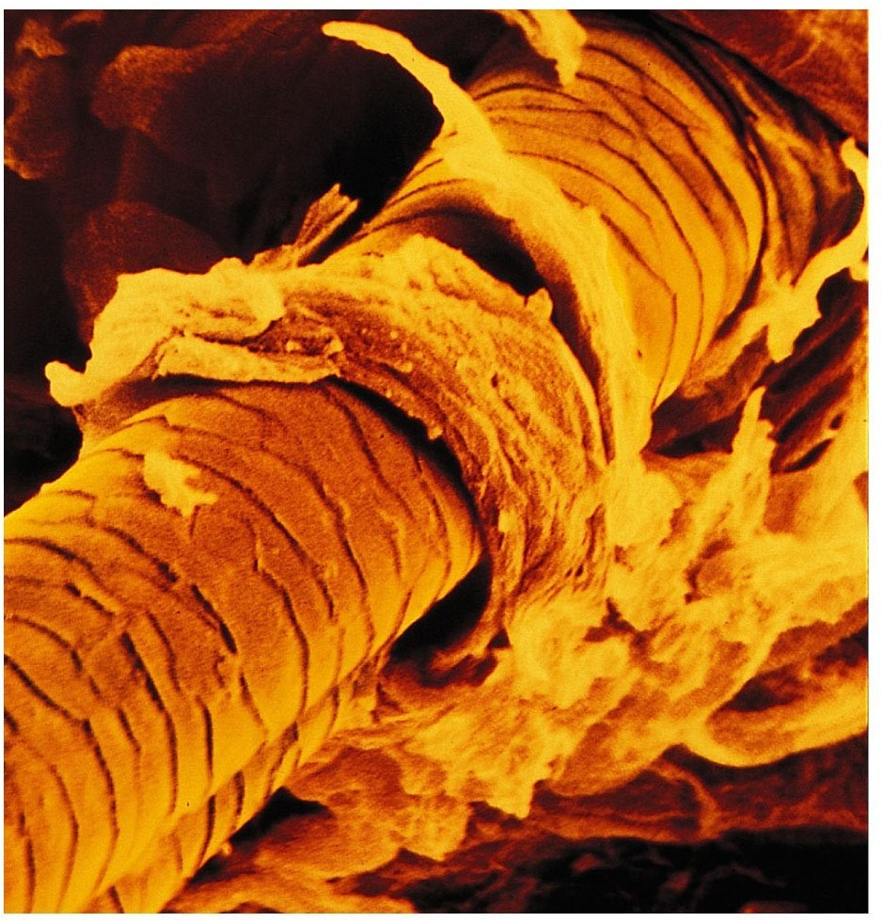
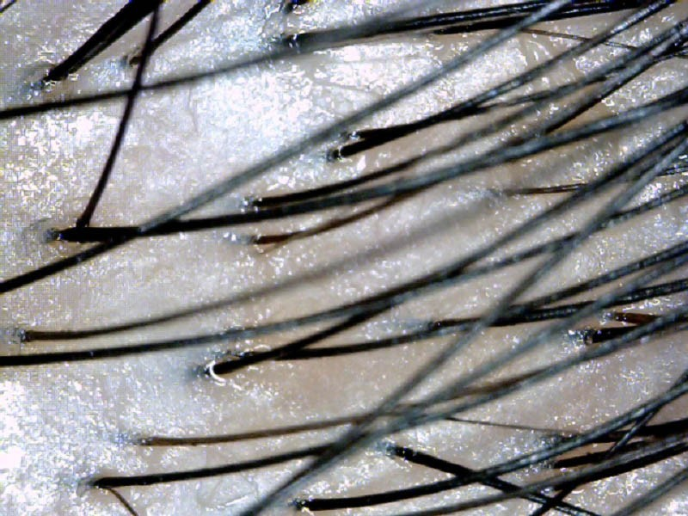
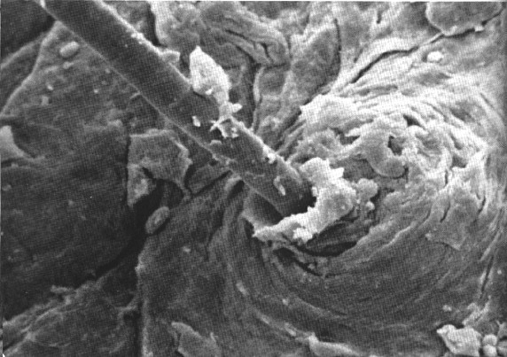
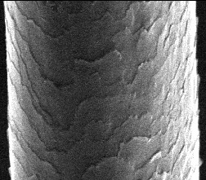

Slide 31
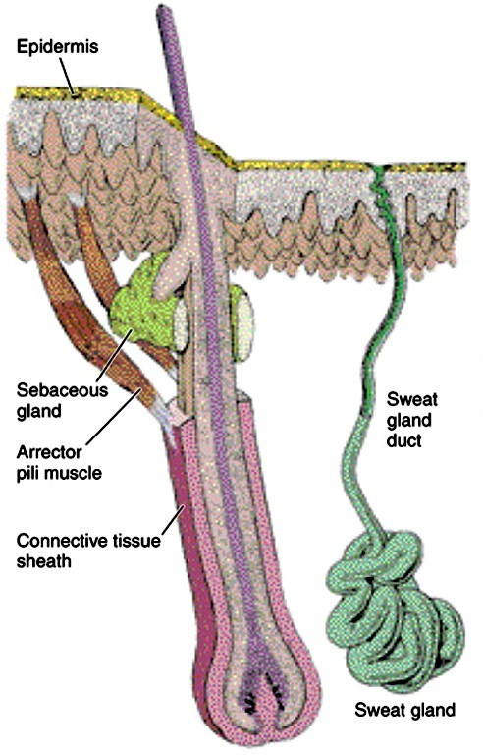
Hairs
Cover whole surface of the body except some areas as lips, palms, soles, reproductive organs.
Consist of 2 parts: Shaft: free end Root: embeded part

Slide 32
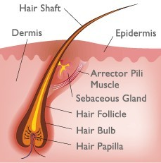
Hairs
Root is surrounded by hair follicle
Hair follicles: invaginations of the epidermis into the dermis, the hair grows out of these follicles (hair shaft).
Hair bulb: the expanded extremity of the follicle, concaved at the end (located deep in the dermis).
Hair papilla: a vascular connective tissue that occupies the concavity of the bulb.

Slide 33
Arrector Pilli muscle
A band of smooth muscle connects the undersurface of the follicle to the superficial part of the dermis.
It is innervated by sympathetic nerve fibers.
It is involuntary.

Slide 34
Arrector Pilli muscle
Functions:
Its contraction causes the hair to move into a more vertical position.
It compresses the sebaceous gland and causes it to extrude sebum.

Slide 35
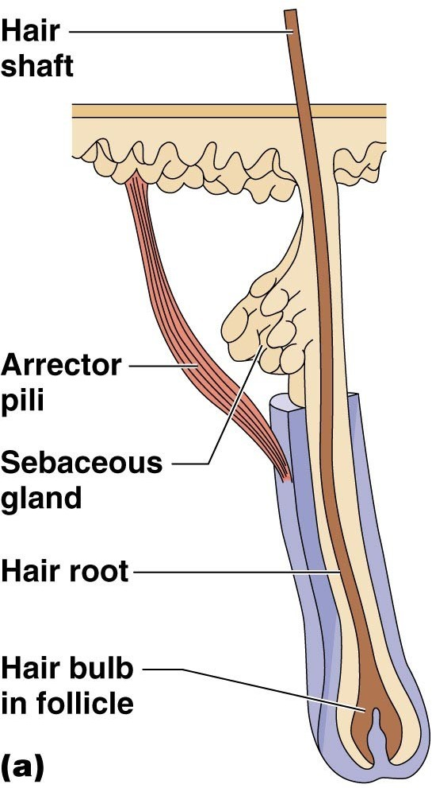
Hair Structures
Associated hair structures
  Hair follicle
    Dermal and epidermal sheath surround hair root
  Arrector pili muscle
•
•
Smooth muscle
Pulls hairs upright when cold or frightened
– Sebaceous gland

Slide 36
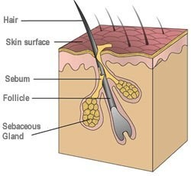
Sebaceous glands
Function
It secrets sebum to oil (lubricate) hair and skin.
Sebum
An oily material that keeps the flexibility of the hair and oils the epidermis around the mouth of the follicle.

Slide 37
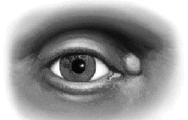
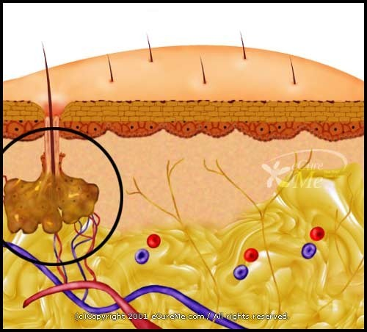
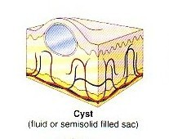
Sebaceous cyst
It occurs because of the obstruction (blocking) of the sebaceous duct.

Slide 38
Sweat glands
long tubular glands with deep coiled part.
All over the body except red margins of lips, nail beds, glans penis and clitoris.
The most deeply penetrated structure.

Slide 39
Consist of coiled tubes and straight duct
Secretory portion is embeded in dermis
Excretory portion open on surface – sweat pores
Two types:
  Eccrine glands:
  Found all over the skin especially sole, axilla, forehead
  Under psychological & thermal control
  Helps in regulation of body temprature
  Also secrete salts

Slide 40
Appocrine glands:
  Large glands
  Produce thick secretions
  Have characteristic odour – bacterial activity
  Composed of coiled secretory portion & excretory portion which secretes into hair follicle
  Appears on surface with sebum as both opens into hair follicle
  Present in axilla, anogenital region
  Active at puberty

Slide 41
– Merocrine in nature
Modified Sweat glands:
Ceruminous glands: external acoustic meatus
Glands of Mol: in margins of eye lids
Mammary glands: production of millk

Slide 42
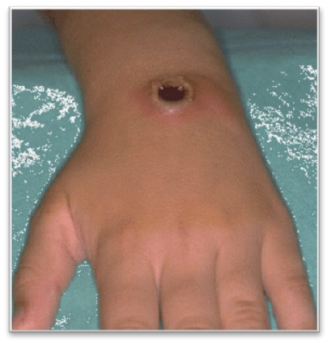
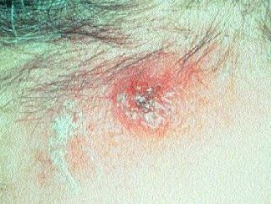
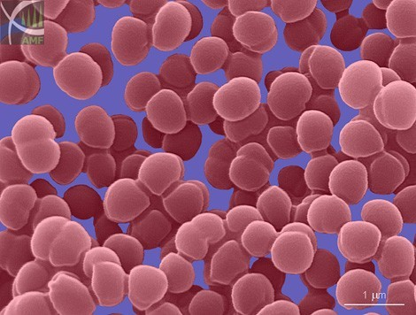
Skin infections
Pathogenic organisms can enter to the tissue through :
Nail Folds
Hair Follicles
Sebaceous Glands
Staphylococcus:
A type of bacteria that causes skin infections.

Slide 43
Skin infections
Paronychia, infection between the nail and nail fold
Boil, Infection of the hair follicle and sebaceous glands
Carbuncle, infection in the superficial fascia affecting single or group of hair follicles

Slide 44
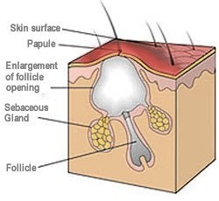
CARBUNCLE

Slide 45
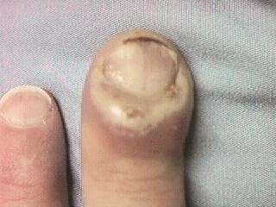
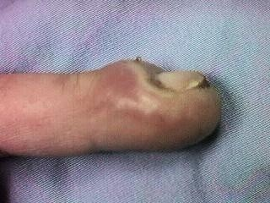
Par/onych/ia :
par- : through onych- :nail
-ia :abnormal condition

Slide 46
Severity of Burns
First-degree burns
  Only epidermis is damaged
  Skin is red and swollen
Second-degree burns
  Epidermis and upper dermis are damaged
  Skin is red with blisters
Third-degree burns (worst)
  Destroys entire skin layer
  Burn is gray-white or black

Slide 47
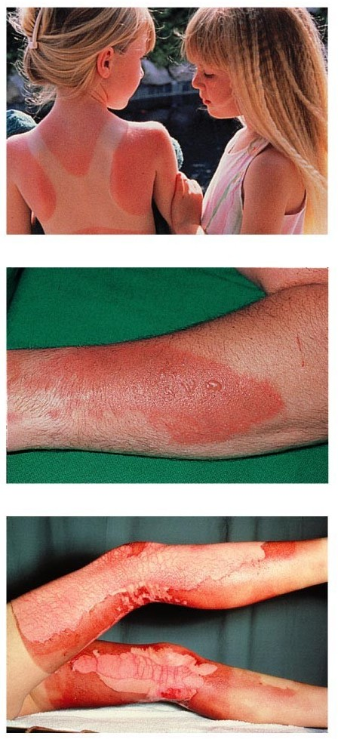
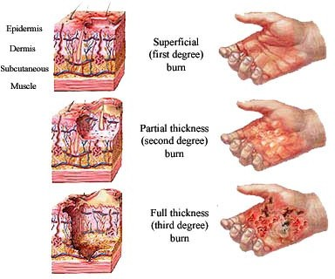
Severity of Burns

Slide 48
Rule of Nines
Way to determine the extent of burns
Body is divided into 11 areas for quick estimation
Each area represents about 9% of total body surface area

Slide 49
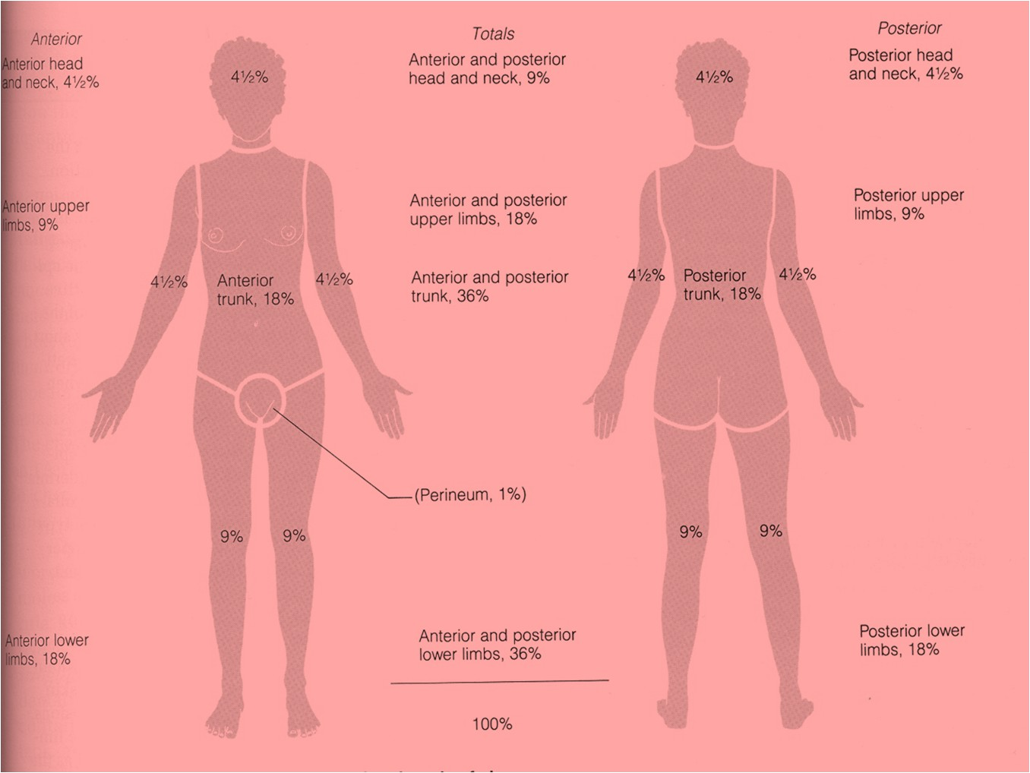
_{RULE OF NINE}

Slide 50
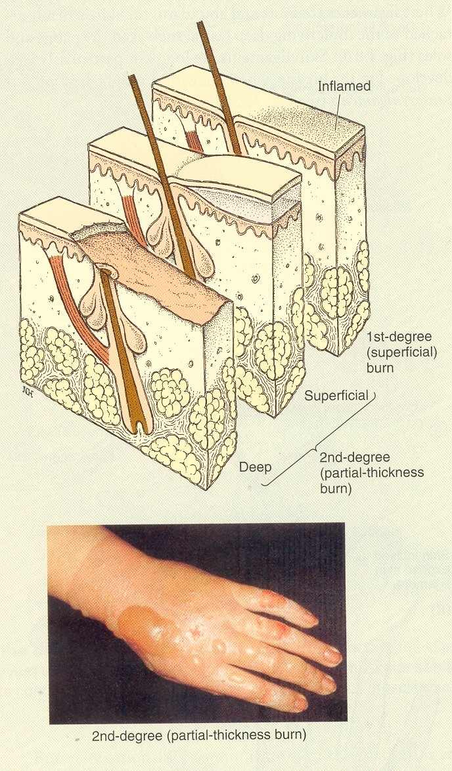

Slide 51
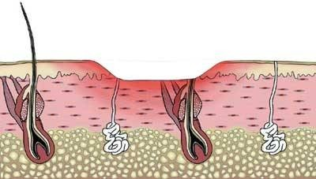
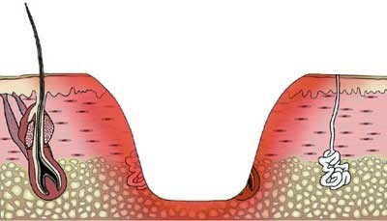
Skin burns
Superficial
Deep
Heals rapidly from the edges, cells of HF and glands.
Heals quickly.
Doesn’t need a skin graft.
Heals slowly from the edges. Usually needs skin grafting.

Slide 52
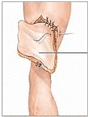
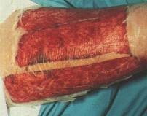
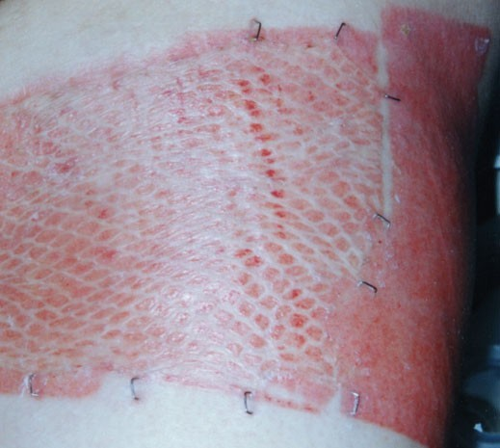
Clinical notes
Graft is transferring tissue from one site to another.
Skin graft is needed when the skin is damaged ( usually by deep burning )

Slide 53
Clinical notes
Skin Graft
Split thickness grafting
Full thickness grafting
Transferring epidermis only
Transferring both epidermis and dermis.

Slide 54
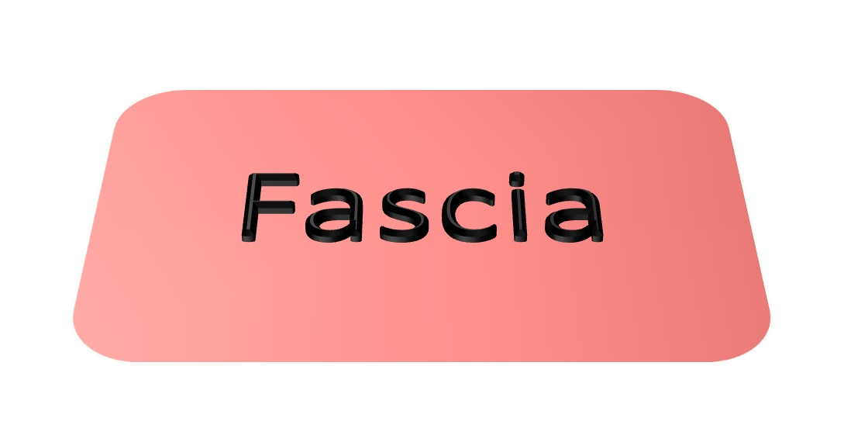

Slide 55
Fascia
Collection of connective tissue
Superficial fascia
Deep fascia

Slide 56

Superficial fascia

Slide 57

Deep Fascia

Slide 58
Superficial fascia
Superficial fascia:
•
Loose, mixture of adipose and loose areolar tissues. It unites the skin to the underlying structures.
It is dense in some places as scalp, palm of hand and sole of foot and contains collagen bundles
It is thin in the eyelids, auricle, scrotum, penis and clitoris (devoid of adipose tissue).
•
•
•
Functions:
•
Facilitates movement of skin over underlying structures. Passage for cutaneous vessels, nerves…
Protects the body against heat loss.
•
•

Slide 59

Superficial fascia

Slide 60
Deep fascia
It is more dense than superficial fascia
Collagenous bundles are more compact and more regularly arranged
It is usually present in the form of membranes

Slide 61

Examples of deep fascia
A. Intermuscular septa
lie between muscles
dividing the limb into compartments

Slide 62
Examples of deep fascia
B. Investing fascia
•
•
Covers the surfaces of muscles
In the neck: it forms well-defined layers, bounds fascial spaces so limits spread of infection or determine the path of infection
In the abdomen: it is thin
In the limbs: forms a definite sheath around the muscles
•
•

Slide 63


Slide 64


Examples of deep fascia
C. Retinacula
Localized thickening of deep fascia around joints, hold the tendons in place, prevent bowstringing of tendons

Slide 65
MODIFICATIONS OF DEEP FASCIA
intermuscular septa
epimysium, perimysium and endomysium
sheath around large arteries eg. Carotid sheath, Axillary sheath
Capsule, synovial membrane and bursa.
Tendon Sheath
Aponeurosis
Interosseous memberane

Slide 66

THANK YOU

