Slide 1
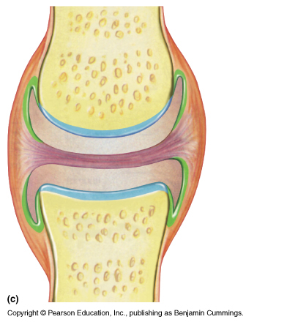
THE JOINTS (GROSS ANATOMY)
DR. PRAVEEN KURREY
M.B.B.S., M.S. BCME, BCBR
ASSOCIATE PROFESSOR
PT.JNMMC RAIPUR

Slide 2
Sprains
Dislocations
Fractures
Arthritis
Joint Replacement Surgeries

Slide 3
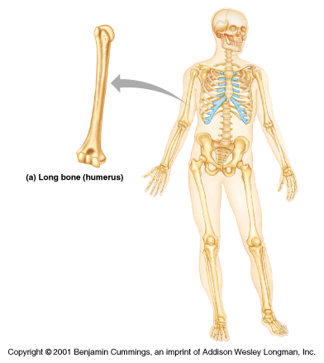

Slide 4
JOINTS
Rigid elements of skeleton meet at joints or articulations
Greek root “arthro” means joint
Articulations can be:
Bone to bone
Bone to cartilage
Teeth in bony sockets
Functions
Give skeleton mobility
Hold skeleton together

Slide 5
JOINTS: CLASSIFICATIONS
Functional classification: Based on amount of movement
Synarthroses: Immovable – common in skull skeleton
Amphiarthroses: Slightly movable – common in axial skeleton
Diarthroses: Freely movable – common in appendicular skeleton

Slide 6
JOINTS: CLASSIFICATIONS
REGIONAL: on the basis of location
Skull type – Immovable
Vertebral type – Slightly movable
Limb type – Freely movable

Slide 7
JOINTS: CLASSIFICATIONS
Structural classification based on:
Material that binds bones together
Presence or absence of a joint cavity
Structural classifications include
Fibrous
Cartilaginous
Synovial

Slide 8
JOINTS: CLASSIFICATIONS
Fibrous Cartilaginous Synovial
Fixed Slightly movable Freely movable
(Synarthroses) (Amphiarthroses) (Diarthroses)
Types Types Types
Sutures Pri.cart. joints Plane
Plane (Synchondroses) Hinge (Ginglymi)
Squamous Pivot (Trochoid)
Limbous Sec.cart. Joints Bicondylar
Serrate (Syndesmoses) Ellipsoid
Dentate Saddle (Sellar)
Gomphosis Ball & socket
Syndesmosis
Schindylesis

Slide 9
FIBROUS JOINTS
Bones are connected by fibrous connective tissue
Do not have a joint cavity
Immovable or slightly movable
Types –
Sutures
Syndesmoses
Gomphoses

Slide 10
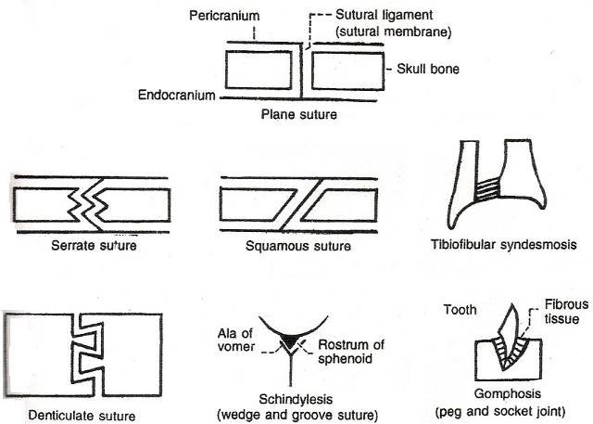
FIBROUS JOINTS

Slide 11
SUTURES
Bones are tightly bound by minimal amount of fibrous tissue
Only occur between bones of skull
Allow bone growth - skull can expand with brain during childhood
Fibrous tissue ossifies in middle age
Synostoses – closed sutures

Slide 12
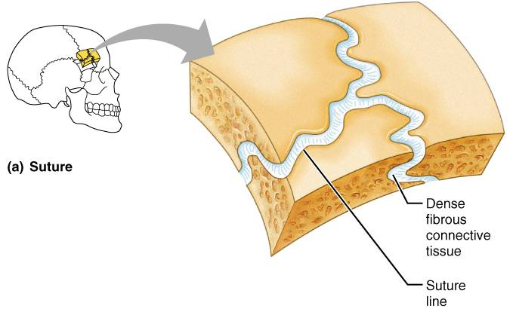
SUTURES

Slide 13
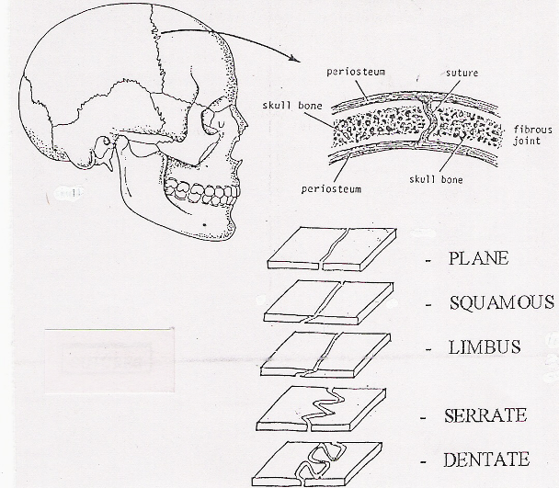
SUTURES

Slide 14
FIBROUS JOINTS

Slide 15
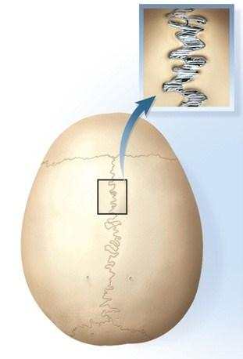
Fibrous Joints - sutures

Slide 16
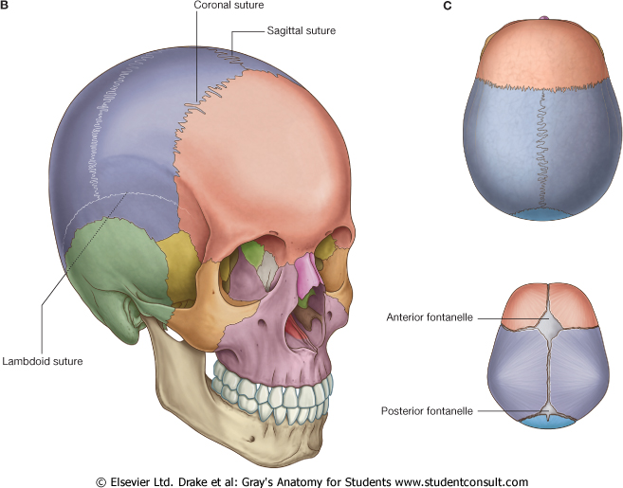

Slide 17
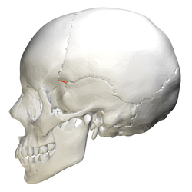
Fibrous Joints - sutures

Slide 18
SYNDESMOSES
Bones are connected exclusively by ligaments
Amount of movement depends on length of fibers
Tibiofibular joint: immovable( Synarthrosis)
Interosseous membrane between radius & ulna: freely movable (Diarthroses)

Slide 19
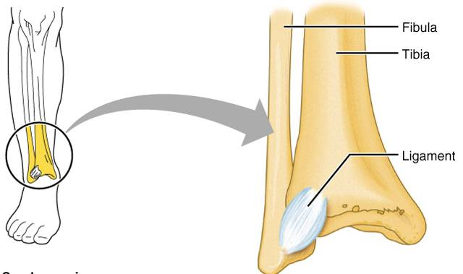
SYNDESMOSIS

Slide 20
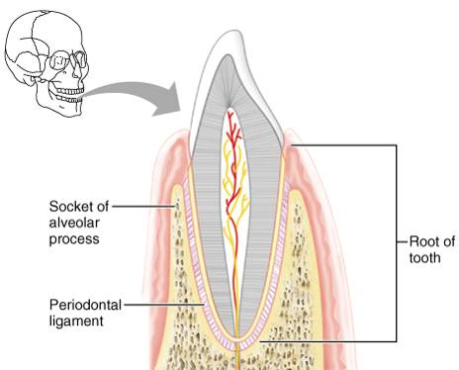
GOMPHOSES
Tooth in a socket
Connecting ligament
Periodontal ligament

Slide 21
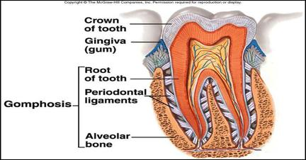
Fibrous Joints - gomphosis

Slide 22
CARTILAGINOUS JOINTS
Bones are united by cartilage
Lack a joint cavity
Two types
Synchondrosis
Symphysis

Slide 23
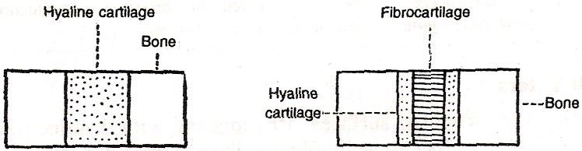
CARTILAGINOUS JOINTS
Primary cartilaginous joint
Secondary cartilaginous joint

Slide 24
Primary cartilagenous joints Synchondroses
A bar or plate of hyaline cartilage unites bones
Examples include:
Epiphyseal plates in children
Joint between costal cartilage of first rib & sternum

Slide 25
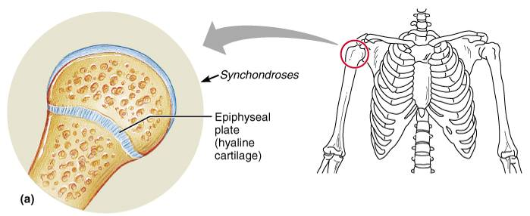
SYNCHONDROSES
Hyaline cartilage unites bones
Epiphyseal plates

Slide 26
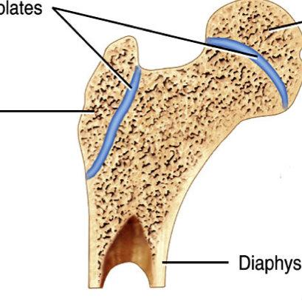
Primary Cartilaginous Joints

Slide 27
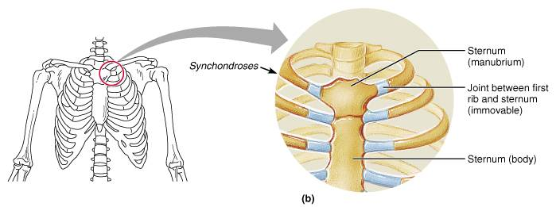
SYNCHONDROSES
Joint between first rib & manubrium

Slide 28
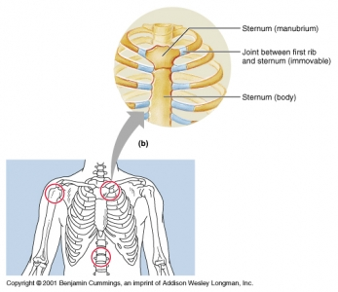
Primary Cartilaginous Joints

Slide 29
SEC CARTILAGINOUS JOINTS: SYMPHYSES
Fibrocartilage unites bones – Resists tension & compression
Slightly movable joints - Provide strength with flexibility
Intervertebral discs
Pubic symphysis

Slide 30
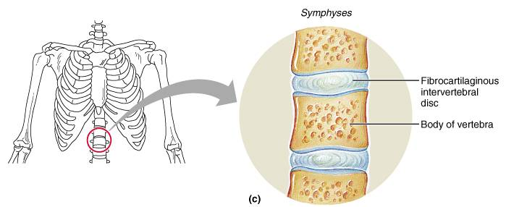
SYMPHYSES

Slide 31
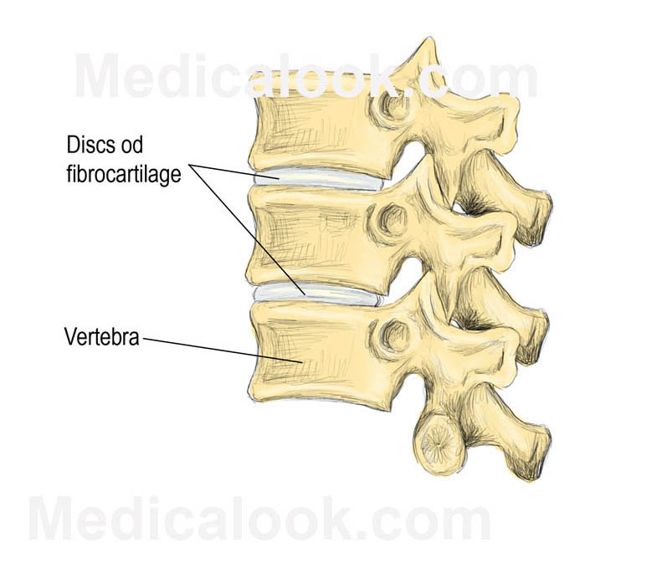
Secondary Cartilaginous Joints

Slide 32
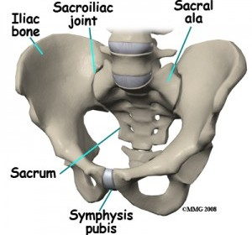
Secondary Cartilaginous Joints

Slide 33
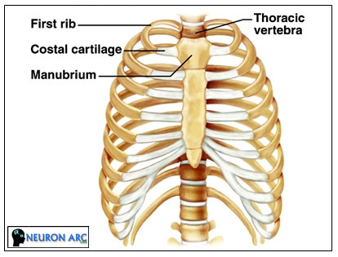
Secondary Cartilaginous Joints

Slide 34
Clinical Application
Joint Disorders
Sprains
damage to cartilage, ligaments, or tendons associated with joints
forceful twisting of joint
Bursitis
inflammation of a bursa
overuse of a joint
Arthritis
inflamed, swollen, painful joints
Rheumatoid Arthritis
Osteoarthritis
Gout

Slide 35
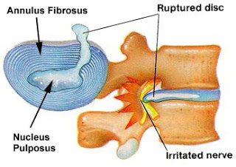
Clinical Anatomy
1. Disc Prolaps

Slide 36
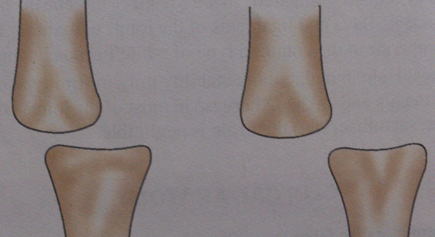
Subluxation / Dislocation

Slide 37
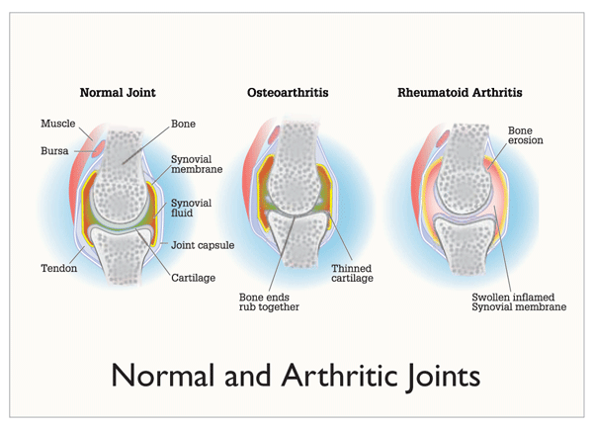

Slide 38
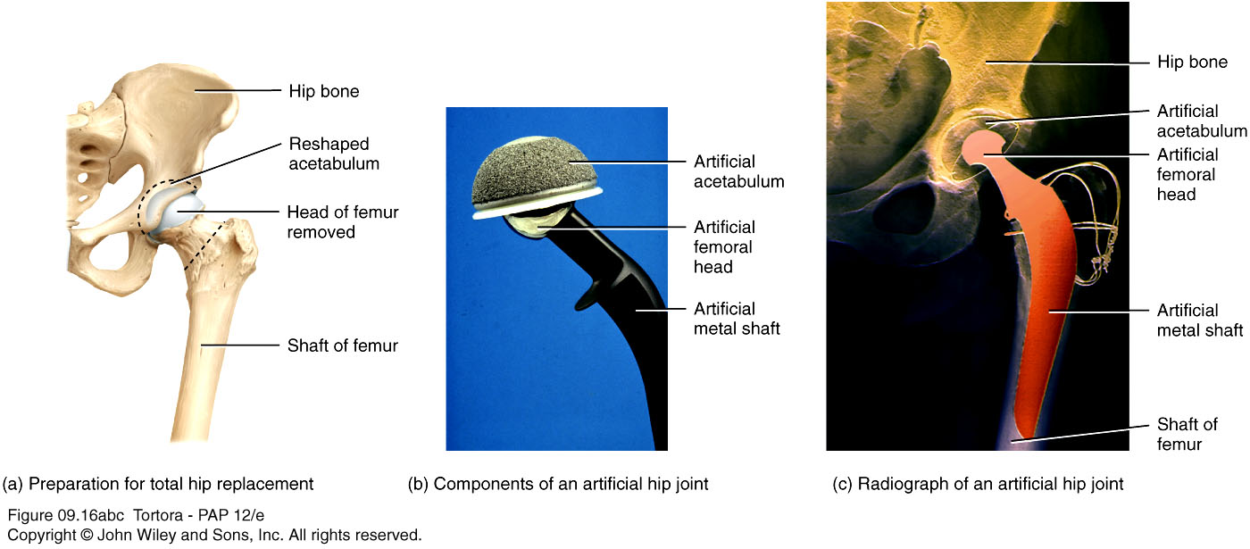
Joints (Arthroplasty)

Slide 39
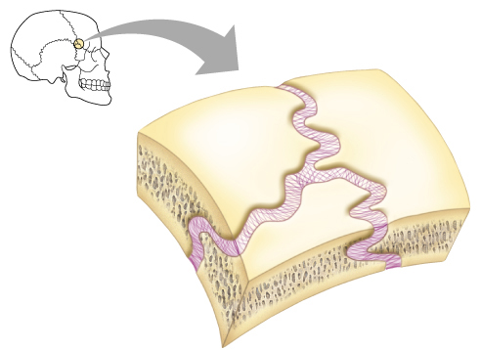
THANK TOU

Slide 40
II
SYNOVIAL JOINTS

Slide 41
SYNOVIAL JOINTS
Most movable joints
Are diarthroses
Contains a fluid-filled joint cavity
Simple: have just two articulating surfaces
Compound: more than two articulating surfaces
Examples: Elbow
Complex Joints : Intra-articular discs/Menisci - Knee

Slide 42
SYNOVIAL JOINTS: GENERAL STRUCTURE
Articular cartilage
Ends of opposing bones are covered with hyaline cartilage
Absorbs compression
Joint cavity (synovial cavity)
Unique to synovial joints
Cavity is potential space; contains small amount of fluid

Slide 43
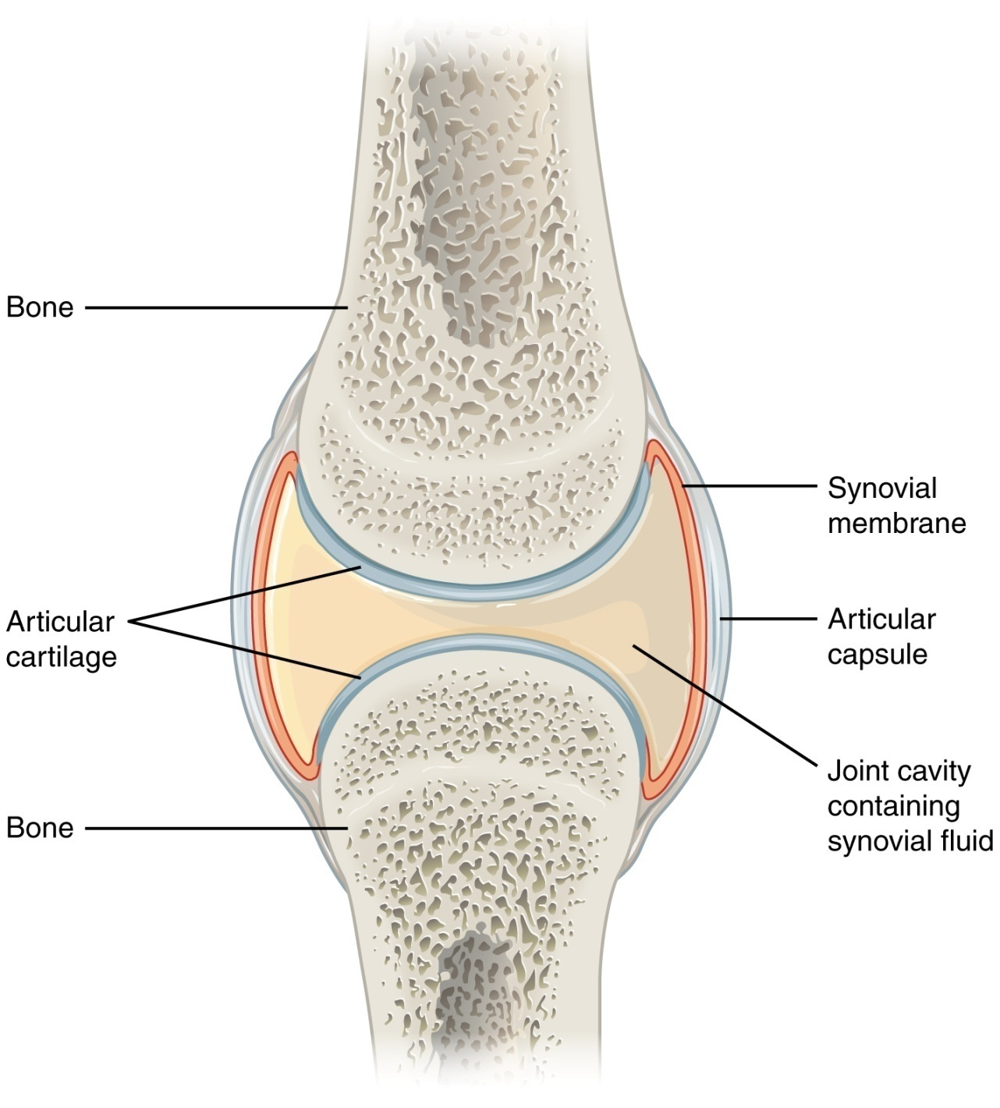

Slide 44
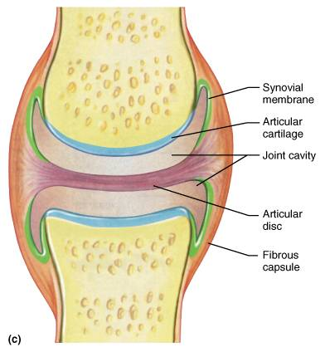

Slide 45
SYNOVIAL JOINTS: GENERAL STRUCTURE
Articular capsule: Joint cavity is enclosed in a two-layered capsule
Fibrous capsule: Made of Dense CT
strengthens joint
Synovial membrane – Important membrane
Lines joint capsule & covers internal joint surfaces
Function: produces synovial fluid

Slide 46
SYNOVIAL JOINTS: GENERAL STRUCTURE
Synovial fluid
Viscous fluid similar to raw egg white
A filtrate of blood
Arises from capillaries in synovial membrane
Contains glycoprotein molecules secreted by fibroblasts

Slide 47
SYNOVIAL JOINTS: GENERAL STRUCTURE
Reinforcing ligaments
Often are thickened parts of fibrous capsule
extracapsular ligaments- located outside capsule
intracapsular ligaments - located within capsule

Slide 48
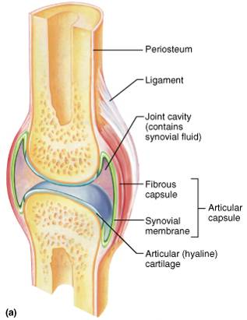
TYPICAL SYNOVIAL JOINT

Slide 49
SYNOVIAL JOINTSL: ARTICULAR DISCS
Some synovial joints contain articular disc
TM joint & knee joint
Occur in joints whose articulating bones have somewhat different shapes

Slide 50
BURSAE & TENDON SHEATHS
Bursae & tendon sheaths are
Closed bags of lubricant
Reduce friction between body elements
Bursa: flattened fibrous sac lined by synovial membrane
Tendon sheath: elongated bursa that wraps around a tendon

Slide 51
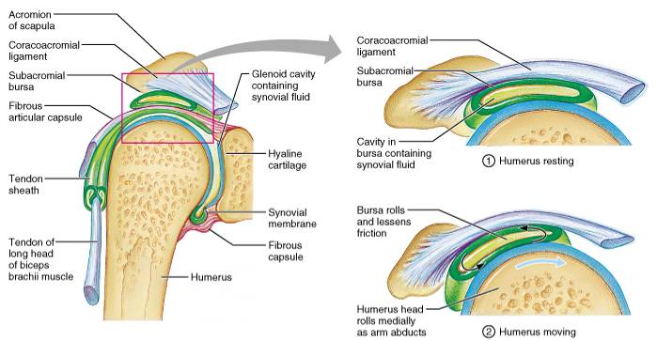
BURSAE & TENDON SHEATHS

Slide 52
SYNOVIAL JOINT: STABILITY
Muscles
Most important & indispensable factor
Tone of different groups of muscles acting on the joint
Ligaments
Important in stability & preventing any over movement
Guard against sudden excessive accidental movement
Not helpful against constant stress - once stretched; tend to remain in elongated position
Bones
Important especially in firm type/secure type of joint - Hip joint
In other, very little to negligible role to play - Shoulder joint
Gravity
May play a role in stability of joint

Slide 53
SYNOVIAL JOINTS: MOVEMENTS ALLOWED
Three basic movement
Gliding: One bone across the surface of another
Angular movement: Movements change angle between bones
Rotation: Movement around a bone's long axis

Slide 54
SYNOVIAL JOINTS: RANGE OF MOTION
Nonaxial- Slipping movements only
Uniaxial- Movement in one plane
Biaxial- Movement in two planes
Multiaxial- Movement in or around all three planes

Slide 55
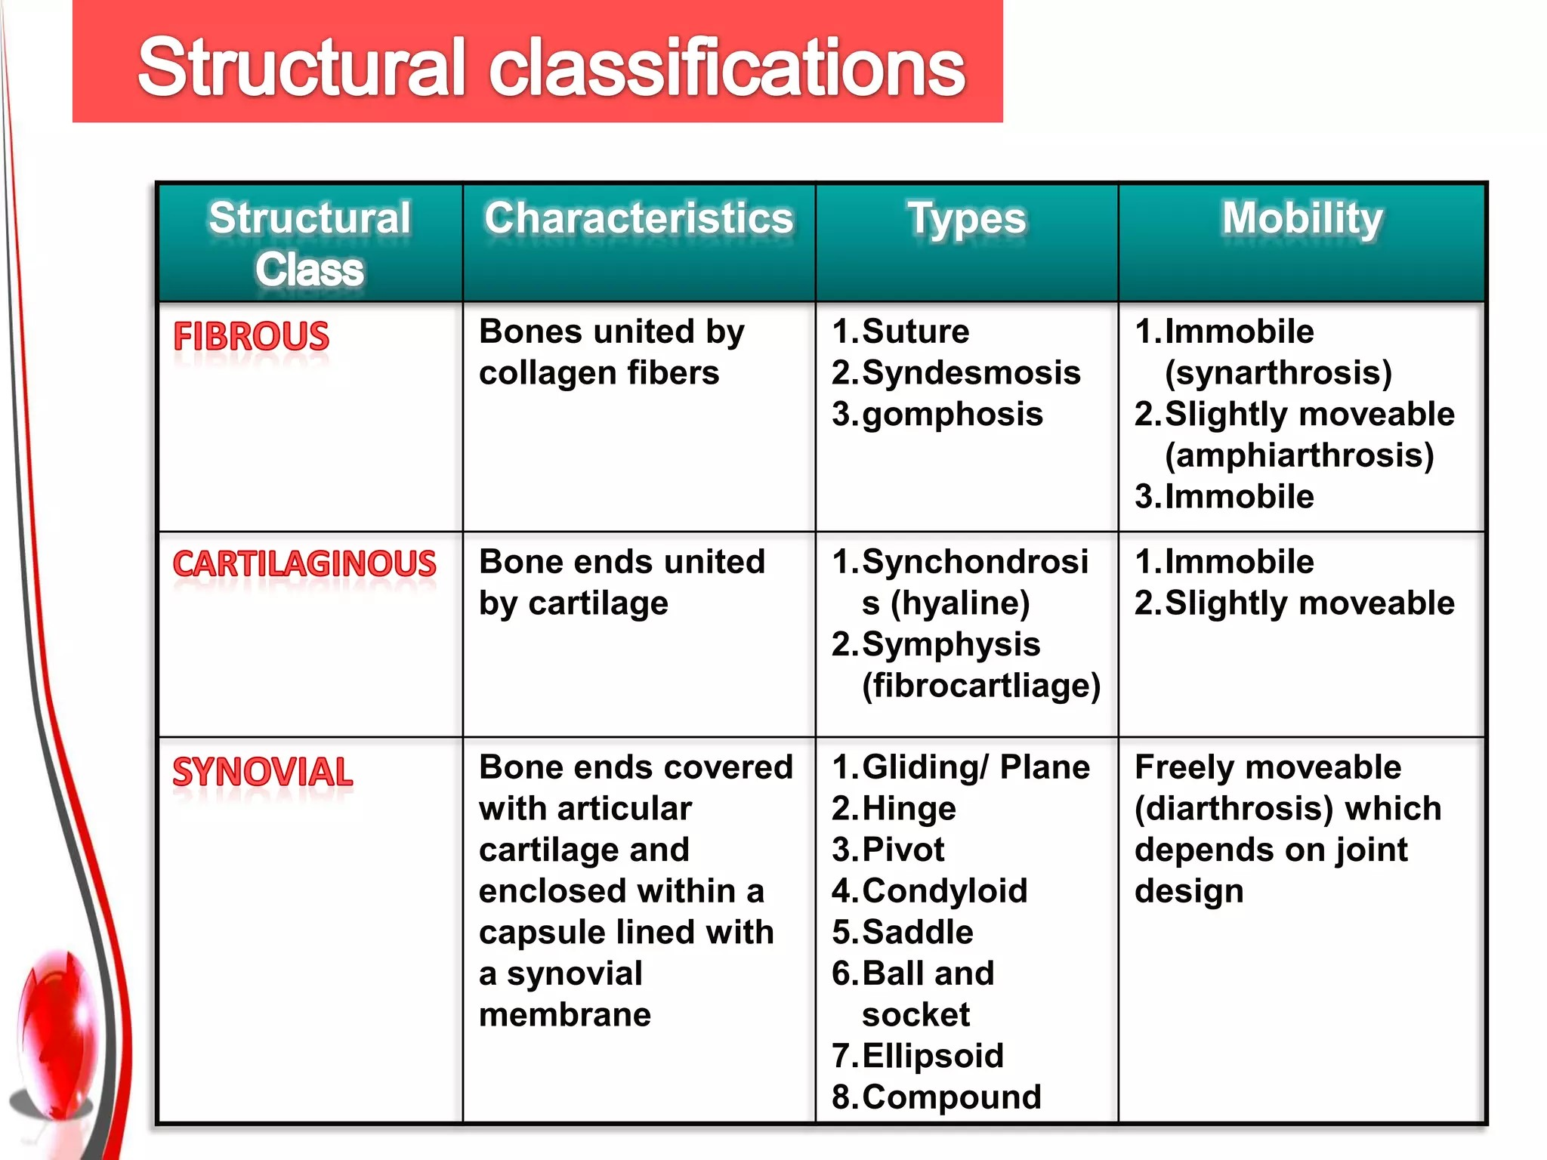

Slide 56
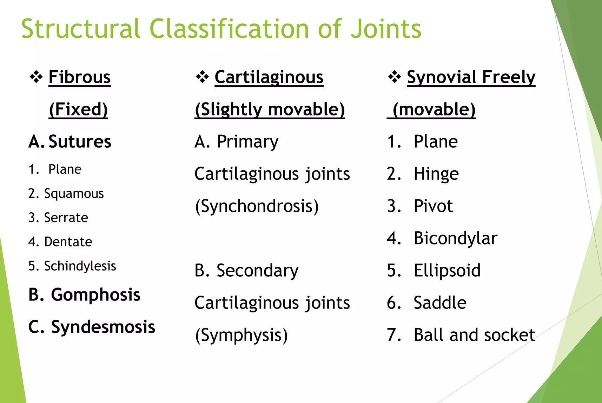

Slide 57
1. Plane joint
Articular surfaces are flat planes
Short gliding movements are allowed
No axis for movements
Gliding does not involve rotation around any axis
intercarpal joints
Intertarsal joints
Intermetacarpal Joints
Intermetatarsal Jints
Zygapophysial Joints (Articular Process of Adjascent Vertebra)

Slide 58
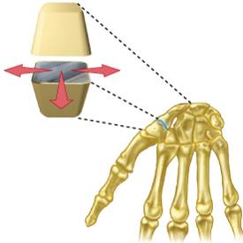
1. PLANE JOINT
Intercarpal joints

Slide 59
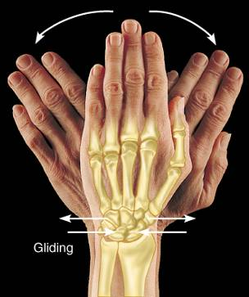
Movements Allowed
Flat surfaces of two bones slip across each other
Gliding occurs between
Carpals
Articular processes of vertebrae
Tarsals

Slide 60
2. Hinge joints (MOST COMMON)
Cylindrical end of one bone fits into a trough on another bone
Angular movement allowed in one plane
Movement is uniaxial – Allows movement around one axis only
Elbow Joint
Ankle Joint
Interphalangeal Joint

Slide 61
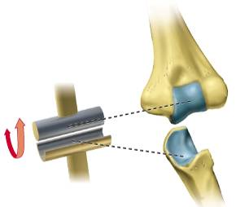
HINGE JOINT
Elbow Joint

Slide 62
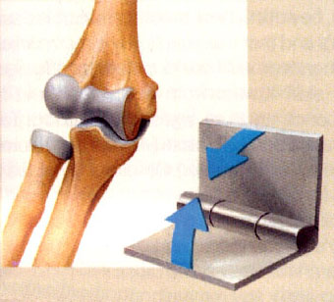

Slide 63
Movements Allowed
Flexion
Bending movement that decreases the angle of the joint
Brings two articulating bones closer together
Extension
Exact opposite!

Slide 64
3. Pivot joints
Uniaxial- Rotating bone only turns around its long axis
Examples
Superior & Inferior radioulnar joint
Atlantoaxial Joint (Joint between atlas & axis)

Slide 65
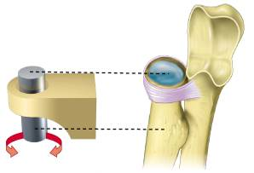
PIVOT JOINT
Superior radioulnar joint

Slide 66
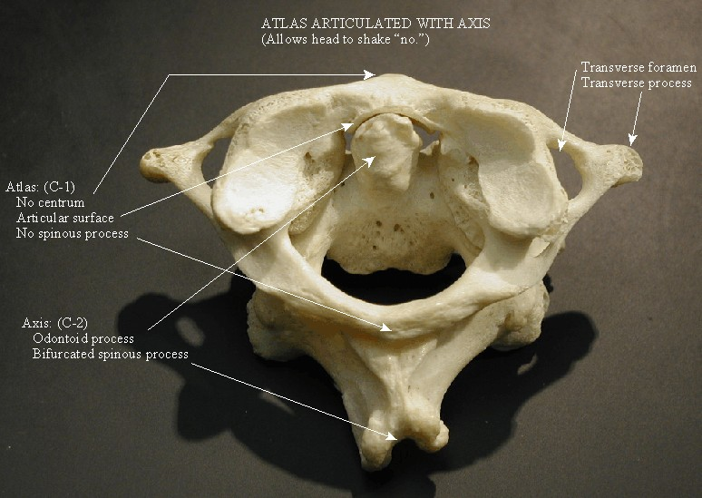
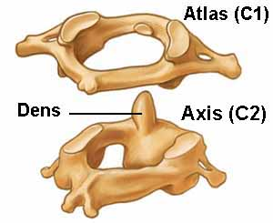

Slide 67
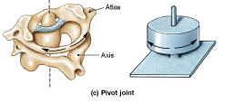

Slide 68
Movements Allowed
Rotation
Turning of bone along it’s own long axis
Supination – “turning backward”
Bones “back”!!
Palms forward and superior
Pronation – “turning forward”
Bones “forward”
Palms backwards

Slide 69
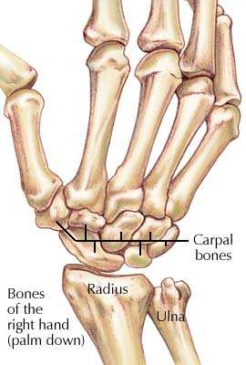
4. Ellipsoid synovial joint
Wrist Joint

Slide 70
Ellipsoid Joint
Wrist Joint (Radiocarpal)
Metacarpophalangeal Joint
Metatarsophalangeal Joint
Atlanto-Occipital Joint

Slide 71
5. Condyloid joints
Both articular surfaces are oval
Very similar to hinge but allows more movement
Allow moving bone to travel:
Side to side – Abduction & adduction
Back & forth – Flexion & extension
Biaxial: Movement occurs around two axes
Knee Joint
Temporomandibular Joint (Jaw Joint)

Slide 72
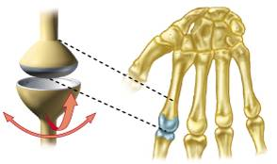
CONDYLOID JOINT
Metacarpophalangeal joint

Slide 73
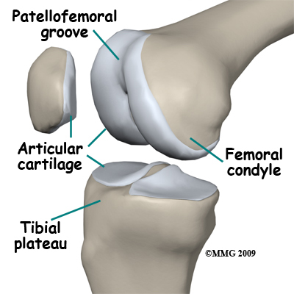
Condylar synovial joint

Slide 74
Movements Allowed
Flexion & extension
Abduction – “Moving away”
Movement of limb away from the midline
Adduction – “Moving towards”
Movement of limb towards the midline

Slide 75
6. Saddle joints (Sellar)
Each articular surface has concave & convex surfaces
Biaxial joints
First carpometacarpal joint (Thumb joint)
Sternoclavicular Joint
Calcaneocuboid joint
Incudomalleolar Joint (Smallest)

Slide 76
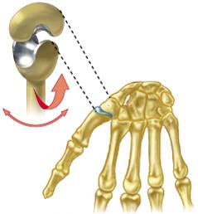
SADDLE JOINT
First carpometacarpal joint (Thumb joint)

Slide 77
Movements Allowed
Circumduction
Opposition
Movement of thumb towards the palm
This is why you can pick stuff up! ☺

Slide 78
7. Ball & socket joints
Spherical head of one bone fits into round socket of another
Multiaxial: Allow movement in all three axes
Shoulder joint
Hip joint
Incudostapedial Joint (Smallest)

Slide 79
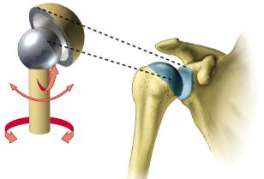
BALL & SOCKET JOINT
Shoulder joint

Slide 80
Movements Allowed
All combinations of angular movement
Rotational movement including circumduction

Slide 81
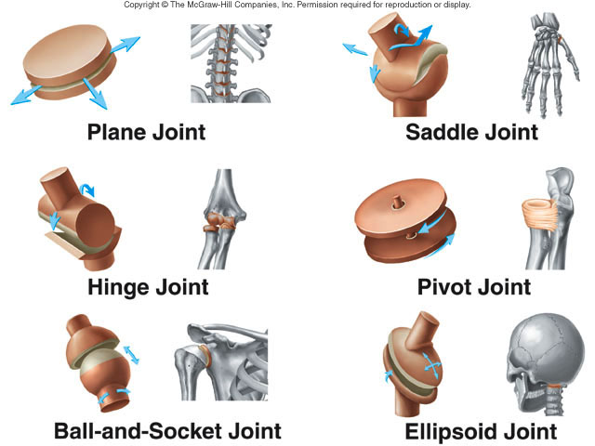

Slide 82
BLOOD SUPPLY
Periarticular plexus - articular & epiphyseal branches
Branches perforate fibrous capsule - vascular plexus in deeper parts of synovial membrane
BVs of synovial membrane terminate around articular margins in looped anastomoses- circularis vasculosus
Supplies capsule, synovial membrane & epiphyses
Articular cartilage is avascular
After epiphyseal fusion communication between circulus vasculosus & end arteries of metaphysis is established

Slide 83
NERVE SUPPLY
Capsule & ligaments: Rich nerve supply; sensitive to pain
Synovial membrane: Poor nerve supply
Articular cartilage: Non nervous & insensitive to pain
Articular nerves contain sensory & autonomic fibres
Some sensory fibres are proprioceptive; sensitive to position & movement. Connected to specialised receptors concerned with joint position and stretch. Concerned with reflex control of posture & locomotion.
Other sensory fibres are sensitive to pain
Autonomic fibres: vasomotor or vasosensory

Slide 84
HILTON’S LAW
A motor nerve supplying the joint also supply muscles regulating the movements of thatjoint and skin covering the joint.
Elucidated by Gardner (1948): Modification
Pattern of innervation is concerned with maintenance of efficient stability at the joint

Slide 85
NEUROPATHIC JOINT
Due to complete dennervation - all reflexes are eliminated
Joint is left unprotected & liable to mechanical damage
Affected joint shows:
Painless swelling
Excessive mobility
Destruction
Caused by:
Leprosy
Tabes dorsalis
Syringomyelia

Slide 86
DISORDERS OF JOINTS
Structure of joints makes them prone to traumatic stress
Function of joints makes them subject to friction & wear
Affected by inflammatory & degenerative processes

Slide 87
SPRAINS
Ligaments reinforcing a joint are stretched or torn
Partially torn ligaments slowly repair themselves
Completely torn ligaments require prompt surgical repair

Slide 88
DISLOCATIONS
Occur when bones are forced out of alignment
Usually accompanied by sprains, inflammation & joint immobilization
Caused by serious falls & are common sports injuries
Subluxation – Partial dislocation of a joint

Slide 89
Subluxation / Dislocation

Slide 90
INFLAMMATORY & DEGENERATIVE CONDITIONS
BURSITIS
Inflammation of a bursa, usually caused by a blow or friction
Symptoms are pain & swelling
Treated with Anti-inflammatory drugs; Excessive fluid may be aspirated
TENDONITIS
Inflammation of tendon sheaths typically caused by overuse
Symptoms & treatment are similar to bursitis

Slide 91
ARTHRITIS
More than 100 different types of inflammatory or degenerative diseases that damage the joints
Most widespread crippling disease
Symptoms – Pain, Stiffness & Swelling of a joint

Slide 92
OSTEOARTHRITIS (OA)
Most common chronic arthritis; “wear-and-tear” arthritis
Affects women more than men
More prevalent in the aged & probably related to normal aging process

Slide 93
OSTEOARTHRITIS: COURSE
Reflects years of abrasion & compression causing increased production of metalloproteinase enzymes that break down cartilage
As one ages, cartilage is destroyed more quickly than it is replaced
Exposed bone ends thicken, enlarge, form bone spurs & restrict movement
Joints most affected: Cervical & lumbar spine, Fingers, Knuckles, Knees & Hips

Slide 94
RHEUMATOID ARTHRITIS
Chronic, inflammatory, autoimmune disease of unknown cause, with an insidious onset

Slide 96
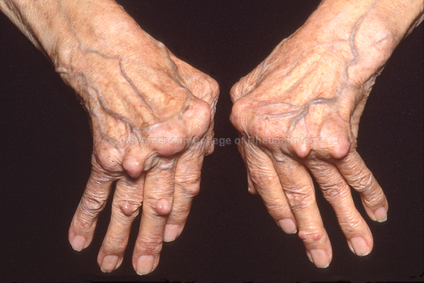

Slide 97
Clinical Anatomy
Disc Prolaps

Slide 98
Joints (Arthroplasty)

Slide 99
ANGULAR MOVEMENT
Flexion
Extension
Abduction
Adduction
Circumduction

Slide 100
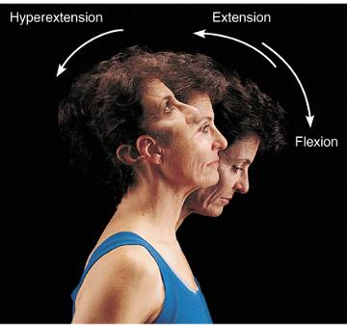
ANGULAR MOVEMENTS
Increase or decrease angle between bones
Movements involve:
Flexion & extension
Abduction & adduction
Circumduction

Slide 101
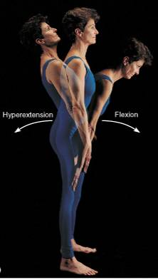
ANGULAR MOVEMENTS

Slide 102
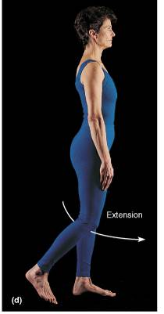
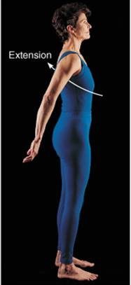

ANGULAR MOVEMENTS

Slide 103

ANGULAR MOVEMENTS

Slide 104


ANGULAR MOVEMENT

Slide 105

ROTATION
Turning of a bone around its own long axis
Examples:
Between C-1 & C-2 vertebrae
Hip & shoulder joints

Slide 106

SPECIAL MOVEMENTS
Supination: Forearm rotates laterally; palm faces superiorly
Pronation: Forearm rotates medially; palm faces inferiorly

Slide 107
SPECIAL MOVEMENTS
Dorsiflexion: Lifting the foot so its dorsal surface approaches shin
Plantarflexion: Depressing the foot; pointing the toes

Slide 108

SPECIAL MOVEMENTS
Inversion: Turning the sole medially
Eversion: Turning the sole laterally

Slide 109

SPECIAL MOVEMENTS
Protraction Nonangular movement of jutting out the jaw
Retraction
Opposite movement to protraction

Slide 110

SPECIAL MOVEMENTS
Opposition: Movement of thumb to touch the tips of other fingers

Slide 111

SPECIAL MOVEMENTS
Elevation
Lifting a body superiorly
Depression –
Moving the elevated part inferiorly

Slide 112
THANK TOU

