Slide 1
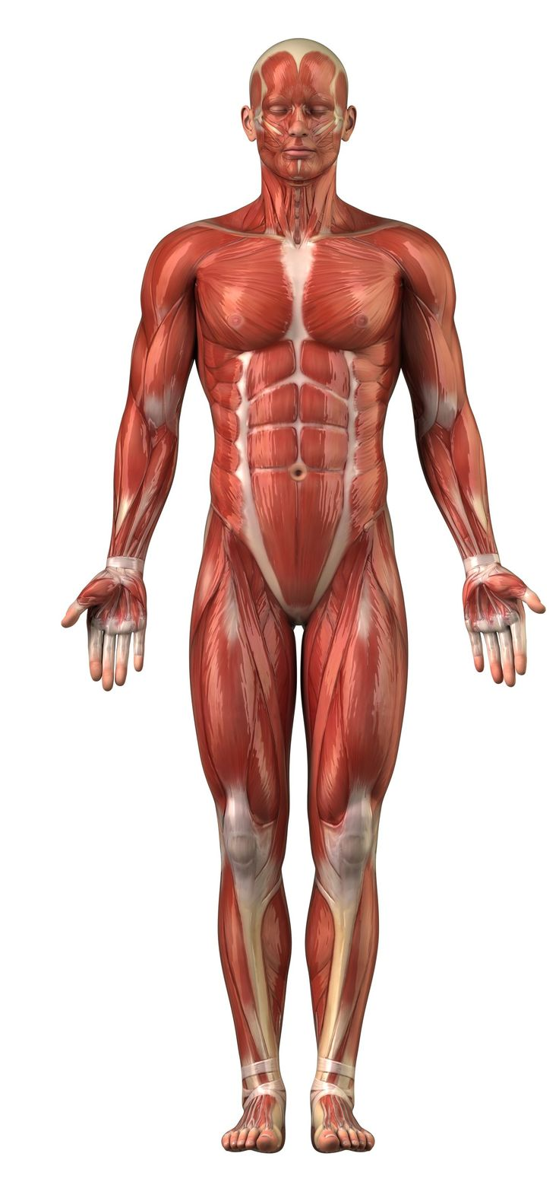
GROSS ANATOMY
INTRODUCTION TO ANATOMY - 2
Dr. Praveen Kumar Kurrey
M.B.B.S.,M.S., B.C.M.E, B.C.B.R.
Professor Anatomy

Slide 2
Anatomy
Anatomy –Study of the structural organization of living organisms.
Greek Word- Anatome – means To Cut Up
1. Gross or macroscopic
  2. Microscopic
  3. Developmental
  4. Topographic –Surface
  5. Radiological
  6. Applied/Clinical
  7. Comparative
  8. Living Anatomy
  9. Genetics
  10. Experimental

Slide 3
Gross Anatomy
Regional – All structures in one part of the body
(such as the abdomen or leg)
Systemic – Gross anatomy of the body studied by system

Slide 4
Microscopic Anatomy/Histology
Microscopy – examining small structures through a microscope
  Light microscopy – illuminates tissue with a beam of light (lower magnification)
  Electron microscopy – uses beams of electrons (higher magnification)

Slide 5
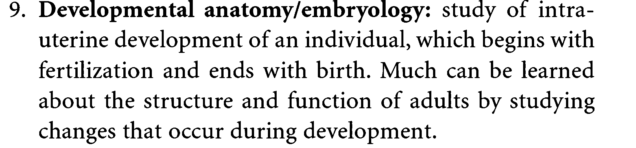
EMBRYOLOGY

Slide 6
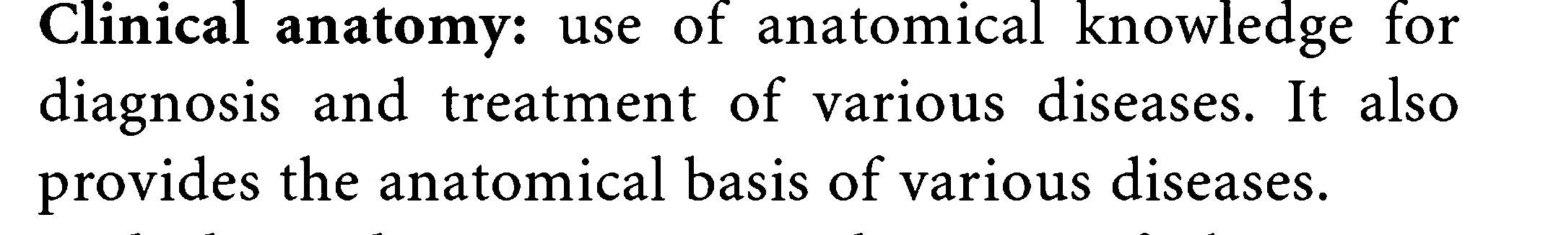
CLINICAL/ APPLIED ANATOMY

Slide 7
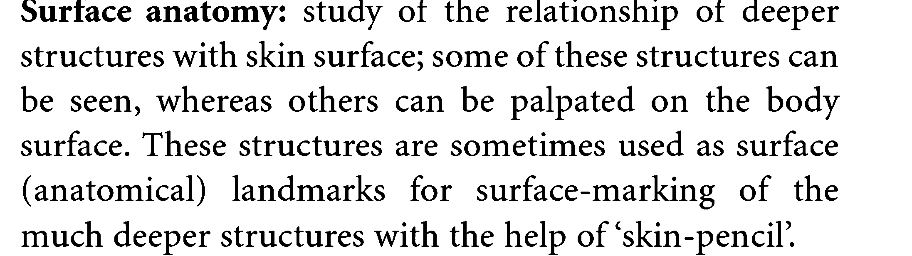
SURFACE ANATOMY

Slide 8
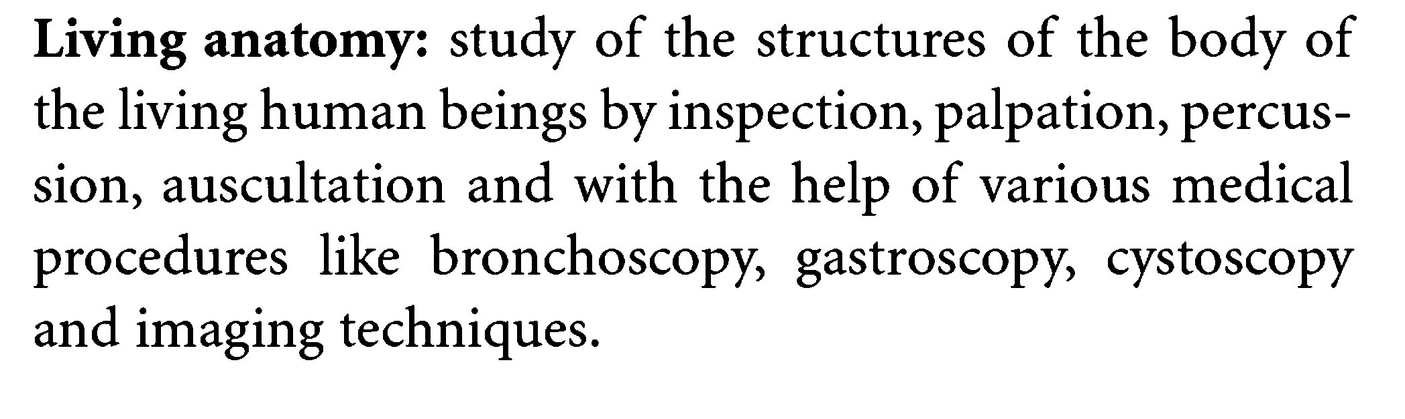
LIVING ANATOMY

Slide 9
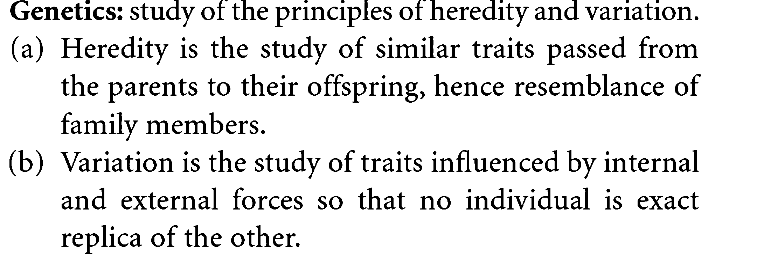
GENETICS

Slide 10
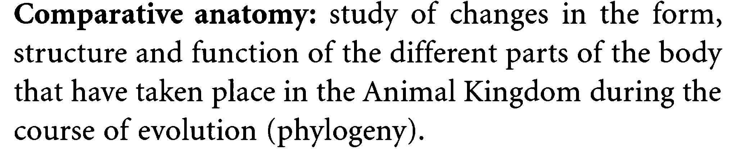
COMPARATIVE ANATOMY

Slide 11
Radiological Anatomy
X ray – electromagnetic waves of very short length
  Best for visualizing bones and abnormal dense structures

Slide 12
Radiological Anatomy –
An Introduction to Medical Imaging Techniques
Variations of X ray
  Fluoroscope – images are viewed on a fluorescent screen
    Allows viewing of internal organs as they move
  Cineradiography – uses X-ray cinema film to record organ movements

Slide 13
Advanced X-Ray Techniques
Computed (axial) tomography (CT or CAT) – takes successive X rays around a person's full circumference
  Translates recorded information into a detailed picture of the body section

Slide 14
Advanced X-Ray Techniques
Digital subtraction angiography imaging
(DSA) – provides an unobstructed view of small arteries
  DSA is often used to identify blockages of arteries that supply the heart or brain

Slide 15
Advanced X-Ray Techniques
Positron emission tomography (PET) – forms images by detecting radioactive isotopes injected into the body
Sonography (ultrasound imaging) – body is probed with pulses of high-frequency sound waves that echo off the body's tissues
  Imaging technique used to determine the age of a developing fetus

Slide 16
Advanced X-Ray Techniques
Magnetic resonance imaging (MRI) – produces high-quality images of soft tissues
  Distinguishes body tissues based on relative water content

Slide 17
Levels of Structural Organization
Chemical – atoms combined to form molecules
Cellular – cells are made of molecules
Tissue – consists of similar types of cells
Organ – made up of different types of tissues
Organ system – consists of different organs that work closely together
Organismal – made up of the organ systems

Slide 18
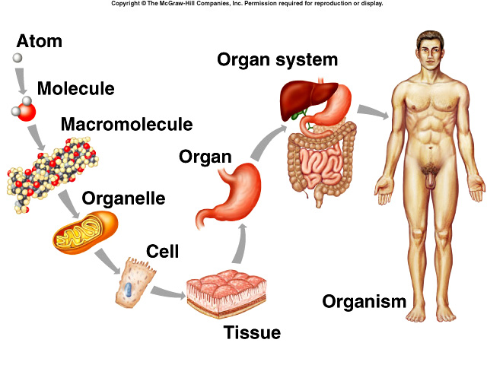
Levels of Organization

Slide 19
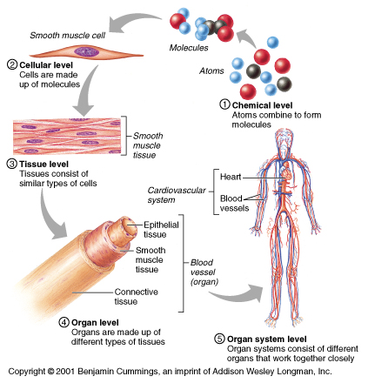
Levels of Structural Organization

Slide 20
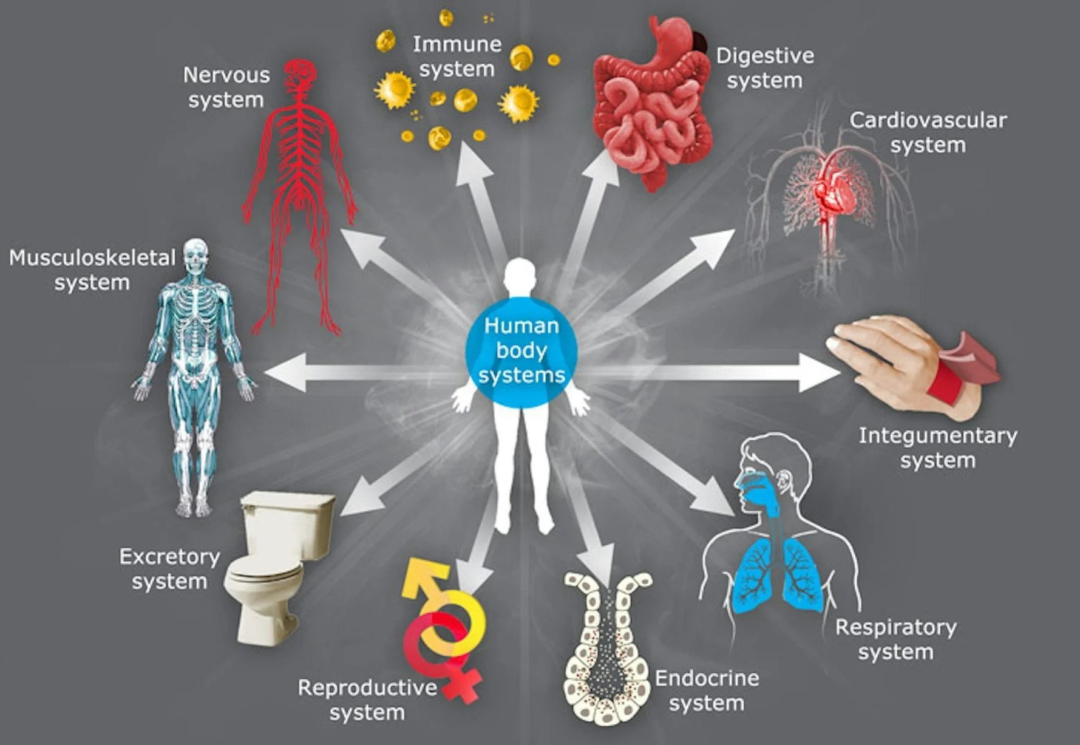
ORGAN SYSTEMS OF BODY

Slide 21
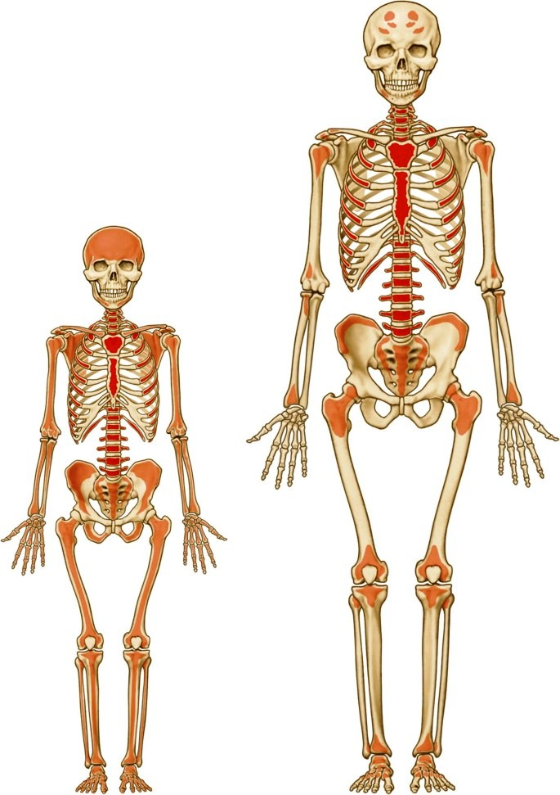
Organ Systems of the Body
Skeletal system
  Composed of bone, cartilage, and ligaments
  Protects and supports body organs
  Provides the framework for muscles
  Site of blood cell formation
  Stores minerals

Slide 22
Organ Systems of the Body
Muscular system
  Composed of muscles and tendons
  Allows manipulation of the environment, locomotion, and facial expression
  Maintains posture
  Produces heat

Slide 23
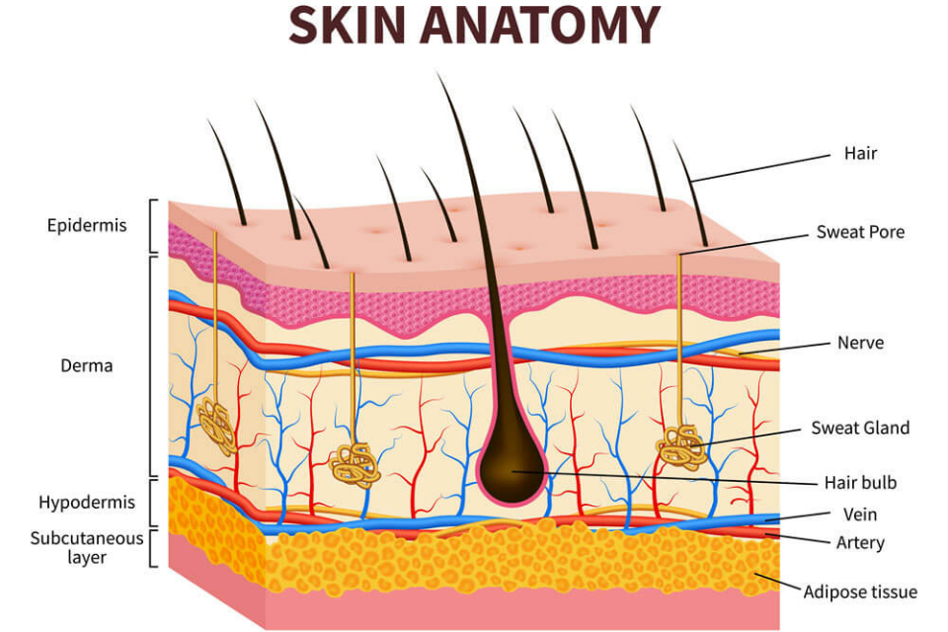
Organ Systems of the Body
Integumentary system
  Forms the external body covering
  Composed of the skin, sweat glands, oil glands, hair, and nails
  Protects deep tissues from injury and synthesizes vitamin D

Slide 24
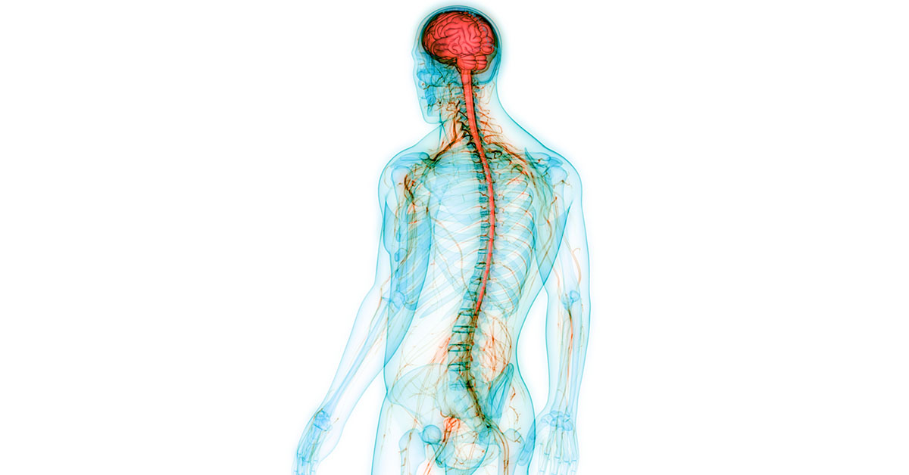
Organ Systems of the Body
Nervous system
  Composed of the brain, spinal column, and nerves
  Is the fast-acting control system of the body
  Responds to stimuli by activating muscles and glands

Slide 25
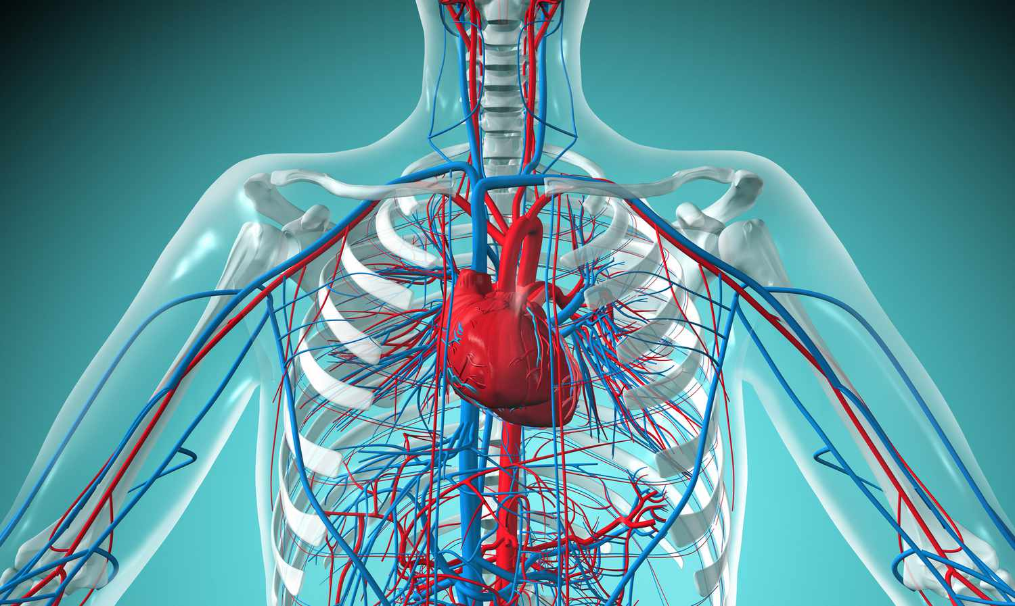
Organ Systems of the Body
Cardiovascular system
  Composed of the heart and blood vessels
  The heart pumps blood
  The blood vessels transport blood throughout the body

Slide 26
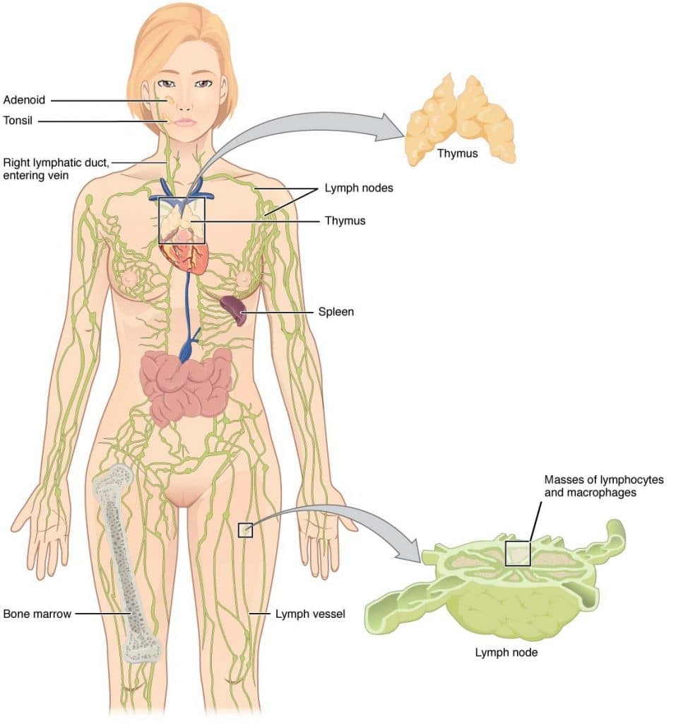
Organ Systems of the Body
Lymphatic system
  Composed of red bone marrow, thymus, spleen, lymph nodes, and lymphatic vessels
  Picks up fluid leaked from blood vessels and returns it to blood
  Disposes of debris in the lymphatic stream
  Houses white blood cells involved with immunity

Slide 27
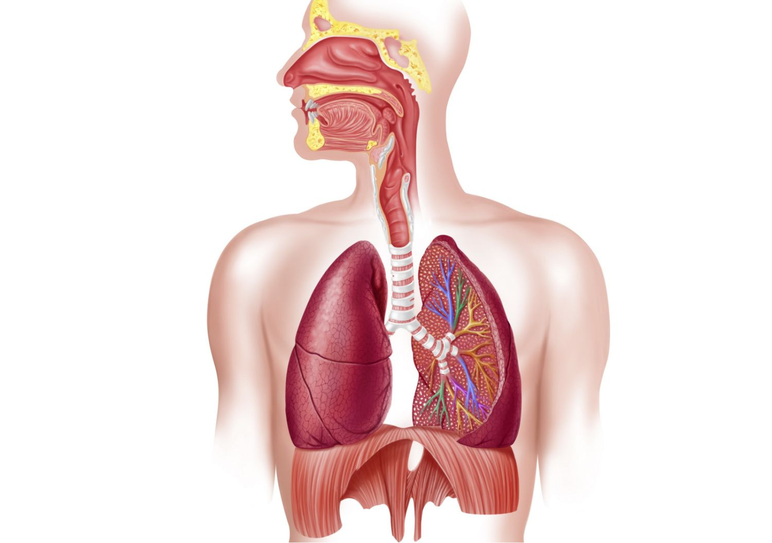
Organ Systems of the Body
Respiratory system
  Composed of the nasal cavity, pharynx, trachea, bronchi, and lungs
  Keeps blood supplied with oxygen and removes carbon dioxide

Slide 28
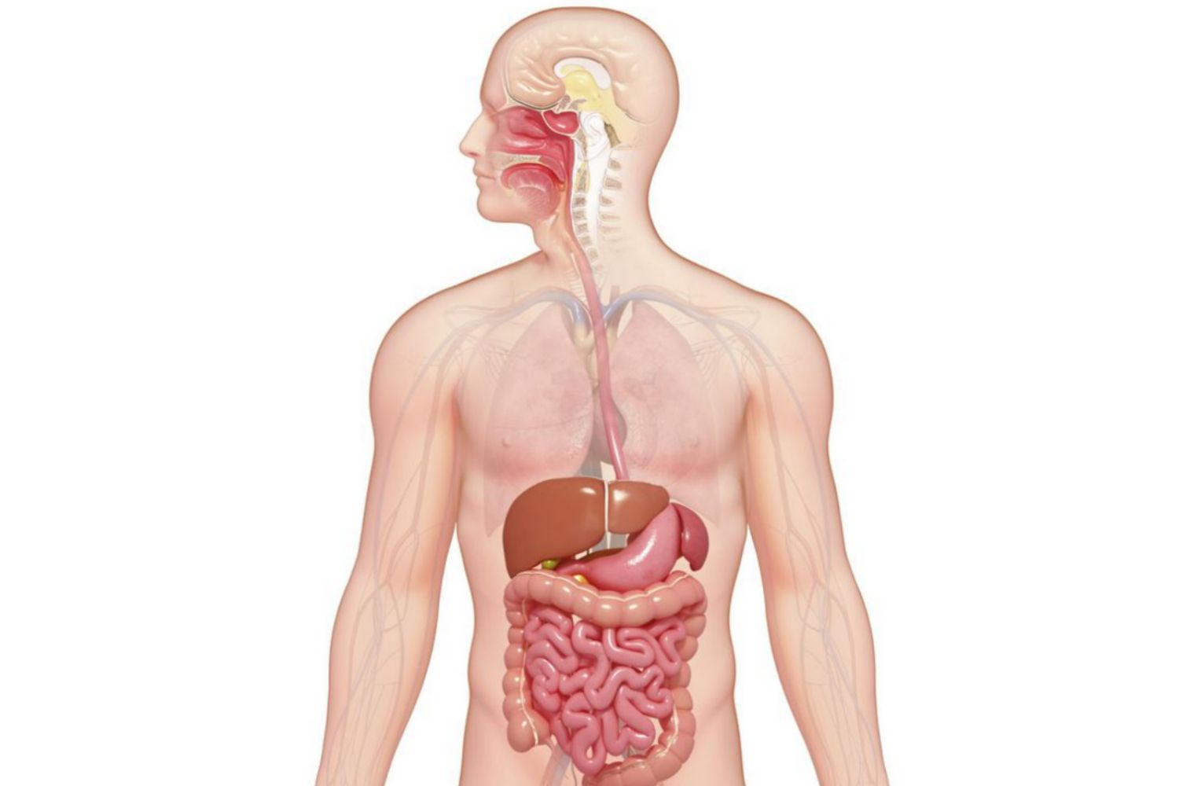
Organ Systems of the Body
Digestive system
  Composed of the oral cavity, esophagus, stomach, small intestine, large intestine, rectum, anus, and liver
  Breaks down food into absorbable units that enter the blood
  Eliminates indigestible foodstuffs as feces

Slide 29
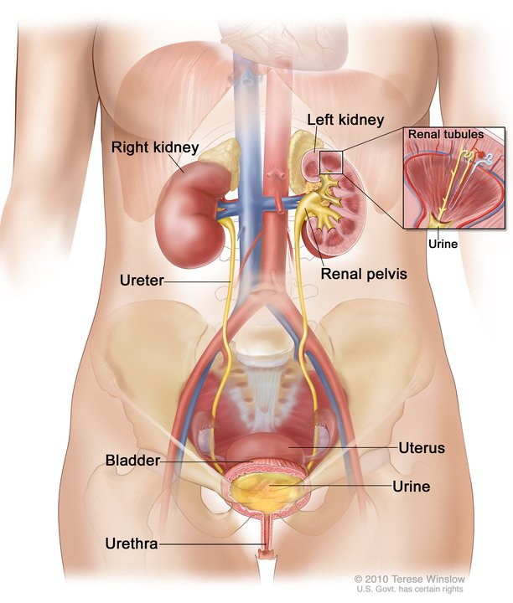
Organ Systems of the Body
Urinary system
  Composed of kidneys, ureters, urinary bladder, and urethra
  Eliminates nitrogenous wastes from the body
  Regulates water, electrolyte, and pH balance of the blood

Slide 30
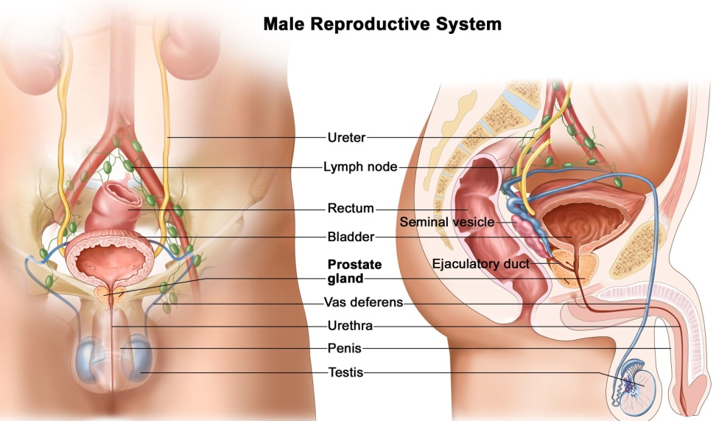
Organ Systems of the Body
Male reproductive system
  Composed of prostate gland, penis, testes, scrotum, and ductus deferens
  Main function is the production of offspring
  Testes produce sperm and male sex hormones
  Ducts and glands deliver sperm to the female reproductive tract

Slide 31
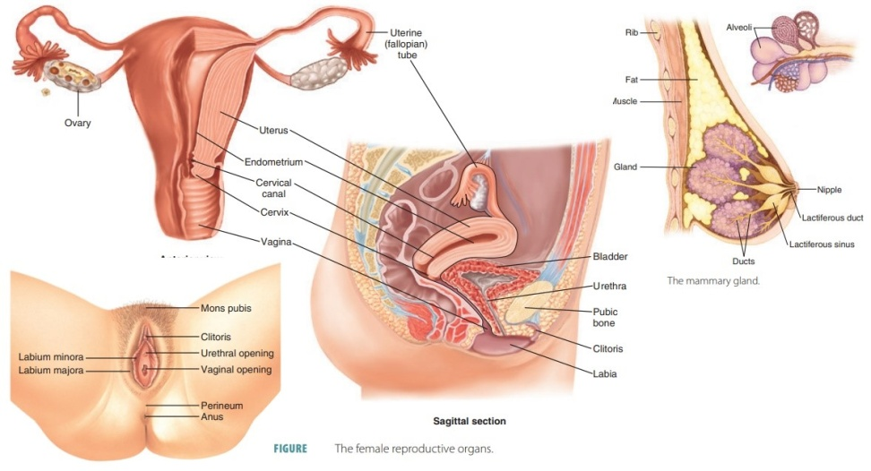
Organ Systems of the Body
Female reproductive system
  Composed of mammary glands, ovaries, uterine tubes, uterus, and vagina
  Main function is the production of offspring
  Ovaries produce eggs and female sex hormones
  Remaining structures serve as sites for fertilization and development of the fetus
  Mammary glands produce milk to nourish the newborn

Slide 32
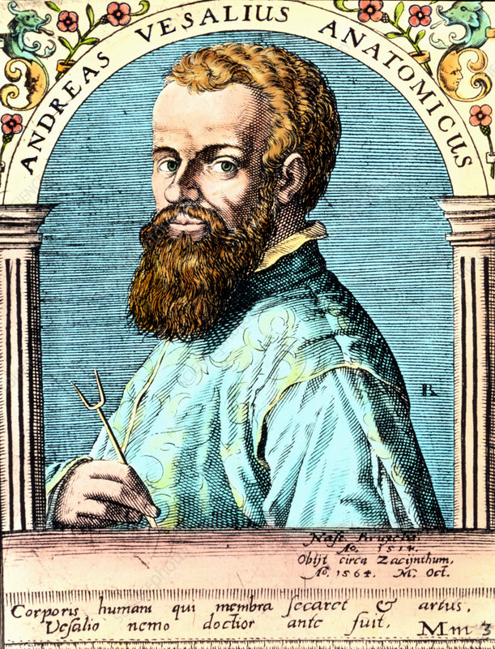
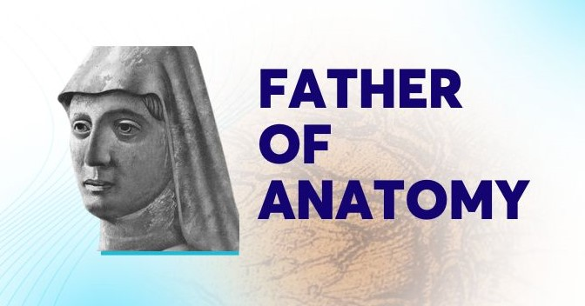
HISTORY OF ANATOMY

Slide 33
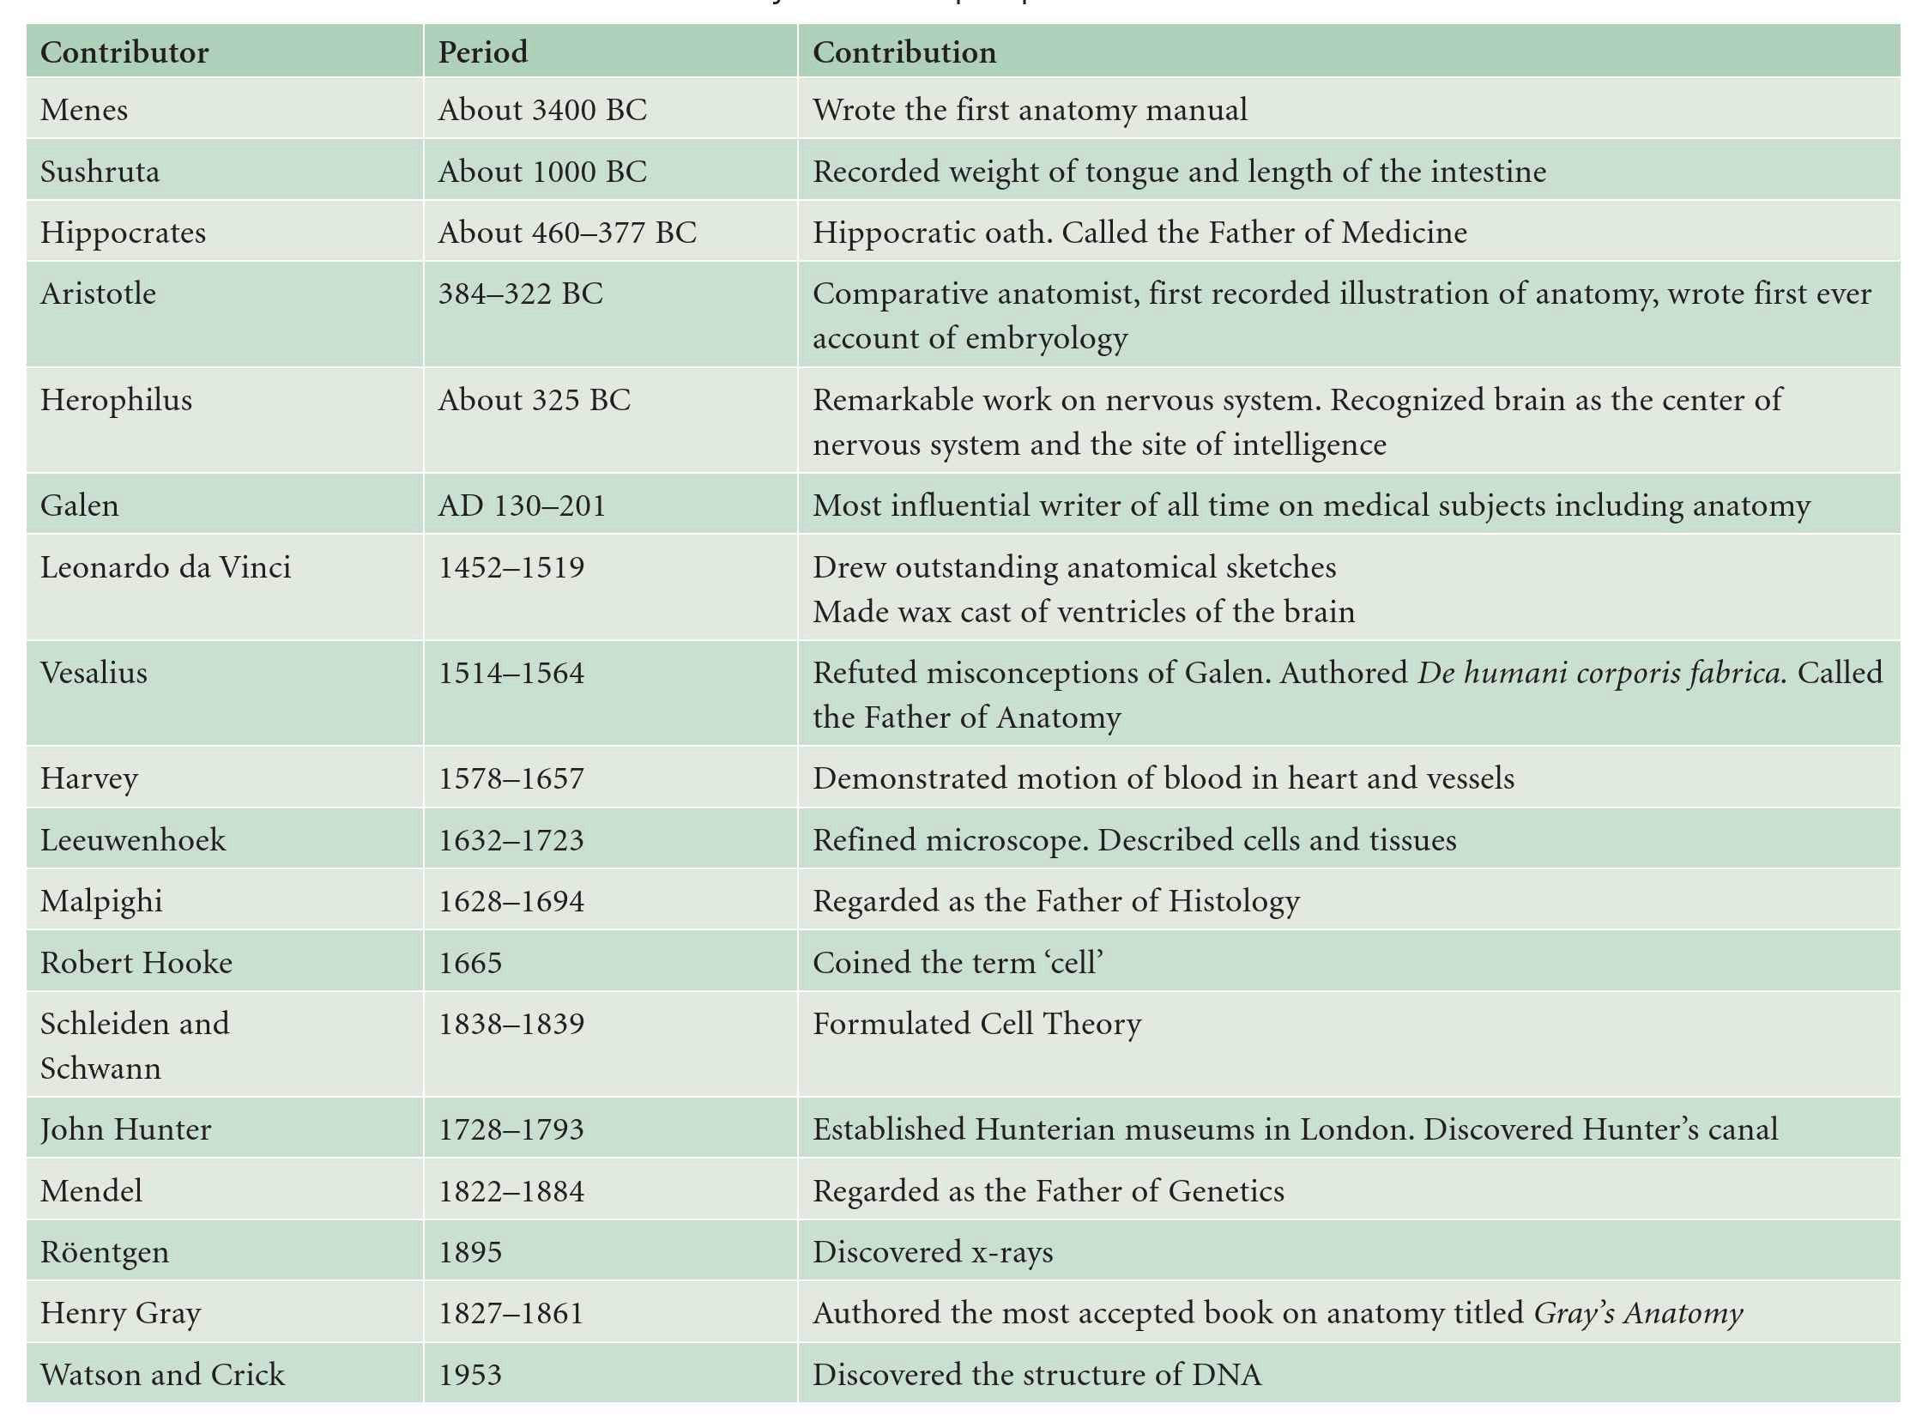

Slide 34
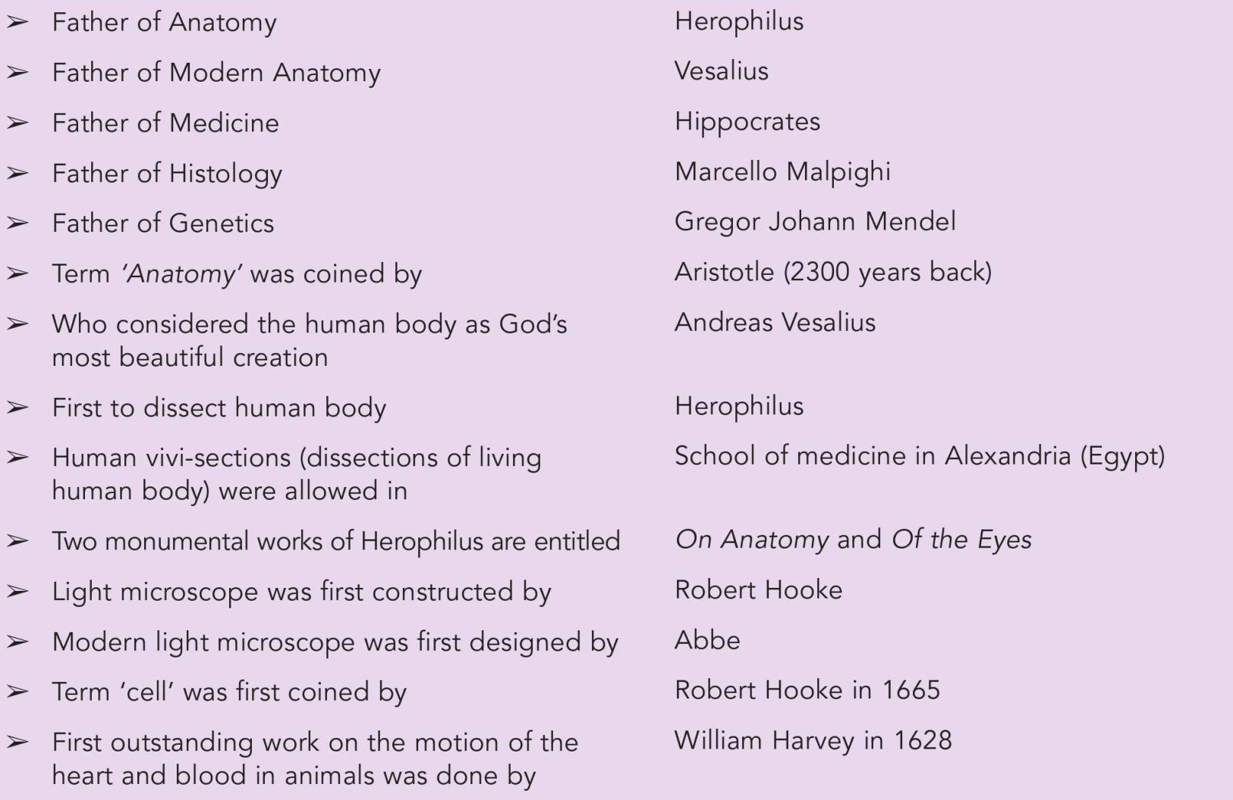

Slide 35
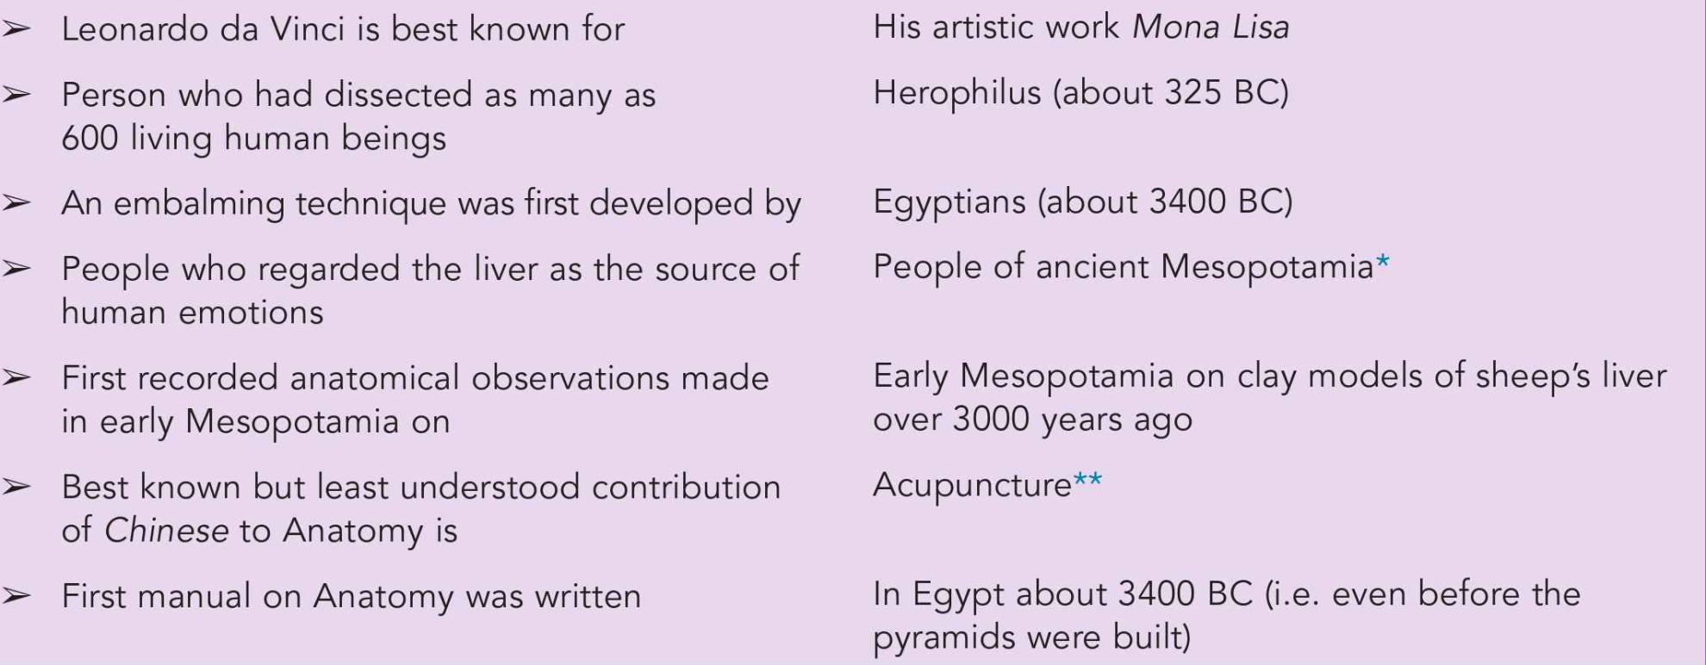

Slide 36
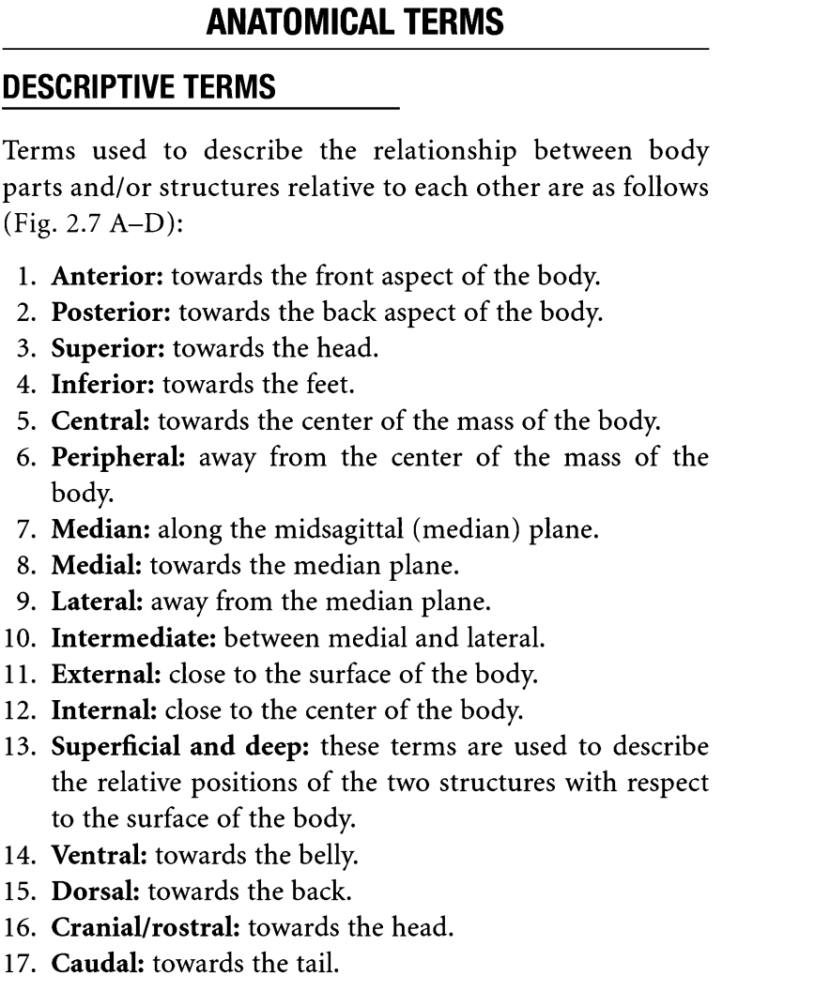

Slide 37
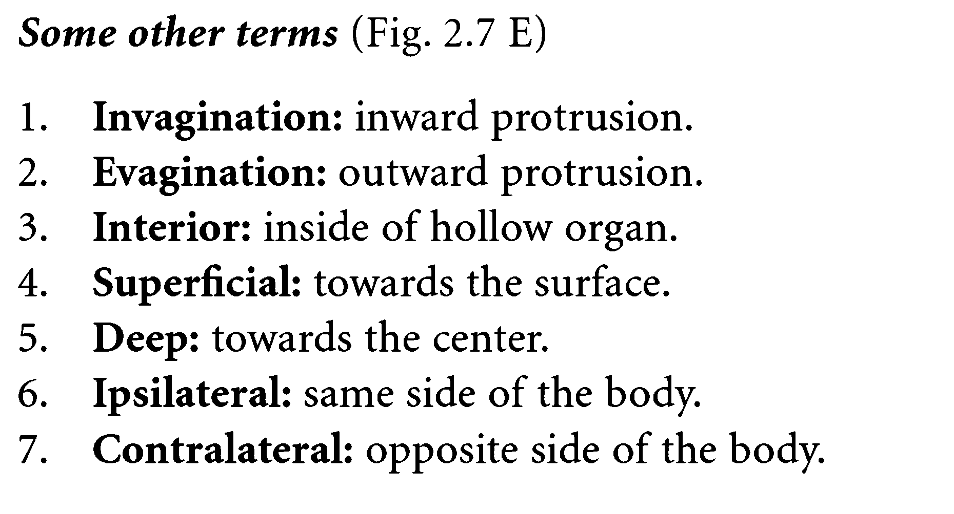

Slide 38
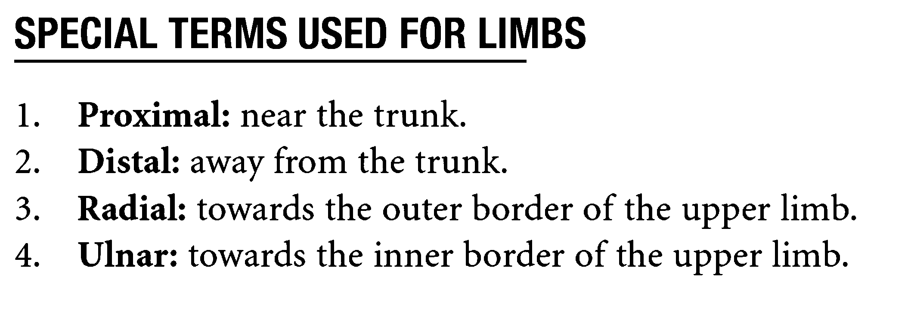

Slide 39
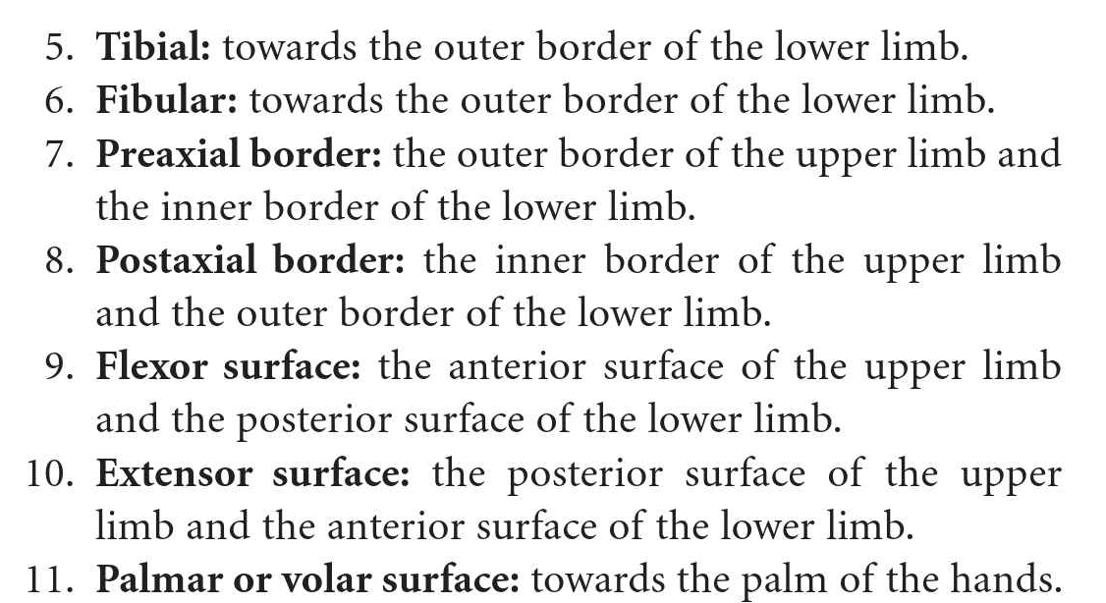

Slide 40

THANK YOU

