Slide 1
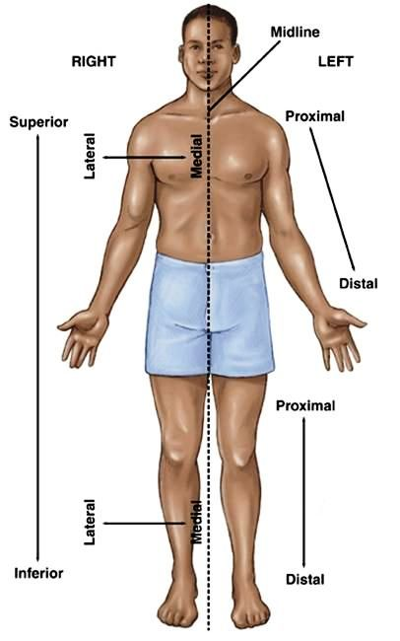
GROSS ANATOMY
INTRODUCTION TO ANATOMY
Dr. Praveen Kumar Kurrey
M.B.B.S.,M.S., B.C.M.E, B.C.B.R.
Professor Anatomy

Slide 2
ANATOMY
Study by Dissection
Is the study of the gross structure of the human body with the naked eyes and as well as microscopy.

Slide 3
ANATOMICAL POSITION
By definition,
“Anatomical position” is when ;
- The person is standing erect
- The upper-limbs are hanging by the sides
- Eyes, Palm and Toes are facing forwards

Slide 4
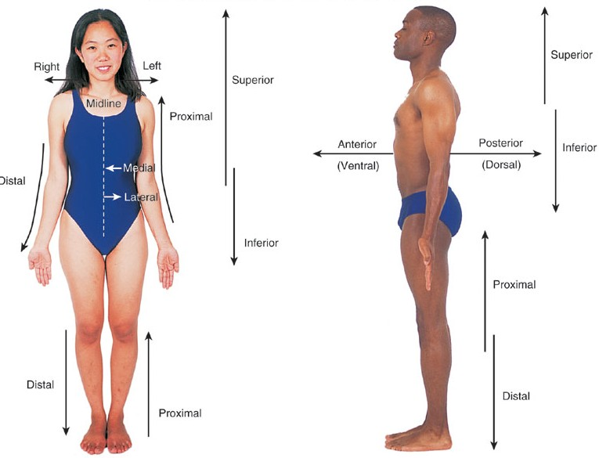
ANATOMICAL POSITION

Slide 5
Fundametal Position
- The person is standing erect
- The upper-limbs are hanging by the sides
- Eyes, and Toes are facing forwards
- Palm is Facing Medially

Slide 6
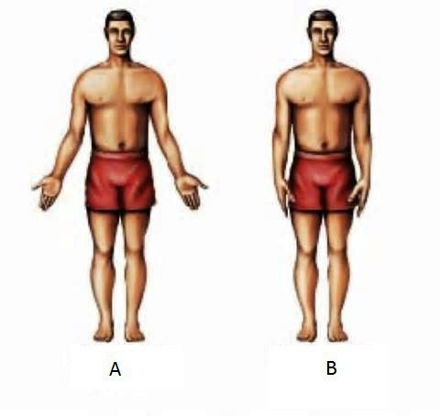
Fundametal Position

Slide 7
ANATOMICAL PLANES and SECTIONS
It is often useful to show a figure of a sectioned/cut human body or organ.
- SECTION - refers to a part cut along a plane.
- 3 Types of sections;
1. TRANSVERSE SECTION
2. LONGITUDINAL SECTION
3. OBLIQUE SECTION

Slide 8
ANATOMICAL SECTIONS
TRANSVERSE SECTION – (also called CROSS-SECTION) refers to a part cut crosswise/ ”width wise”
LONGITUDINAL SECTION – is a cut made along the long axis (length wise) of the organ.
OBLIQUE SECTION – refers to a cut are neither longitudinal nor transverse cut. They often lie on a slightly oblique plane.

Slide 9
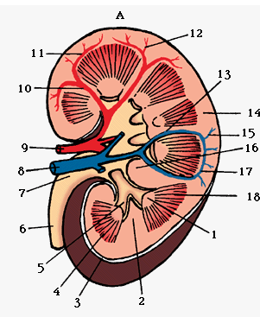
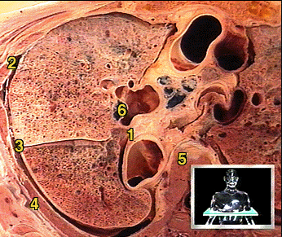
ANATOMICAL SECTIONS
Longitudinal section of kidney
Transverse section of lungs

Slide 10
ANATOMICAL PLANES
The terms of ANATOMICAL SECTIONS are limited in its usefulness because it does not us orientate us to how the cut was made.
i.e. was the cut made from “top-to-bottom” or front-to-back” or “side-to-side”. This is the reason why we have anatomical planes
PLANE - is geometrical concept referring to an imagined flat surface.
They are used to describe the sections of the body.
There are 3 main anatomical planes;
1. SAGITTAL PLANE
2. CORONAL PLANE (also called FRONTAL PLANE)
3. HORIZONTAL PLANE (also called TRANSVERSE PLANE)

Slide 11
ANATOMICAL PLANES
SAGITTAL PLANE – it is an imaginary vertical plane (extending from front to back and top to bottom), dividing the body into left and right portions.
MIDSAGITTAL PLANE – (also called MEDIAN PLANE) refers to a sagittal plane that divides the body into exactly equal right and left portions.
PARASAGITTAL – any plane parallel to the medial plane (often used by neurologists)
FRONTAL PLANE – (also called the CORONAL PLANE)
- A vertical plane passing through the body (at right angles to sagittal plane) and divides the body into front
(anterior) and back (posterior) portions
HORIZONTAL PLANE – (also called a TRANSVERSE plane)
- It divided the body into top (superior) and bottom (inferior) portions

Slide 12
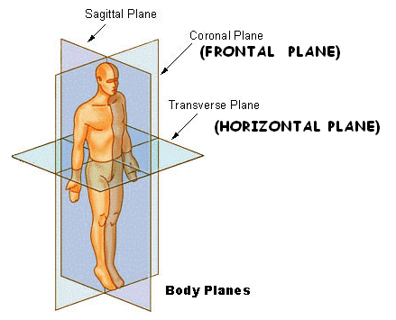
ANATOMICAL PLANES

Slide 13
ANATOMICAL DIRECTIONS
Directional terms are used to locate structures in the body.
Below is a list of directional terms and their definitions.
LEFT - To the left of the body (not your left, the subject’s)
E.g. The stomach is to the left of the liver
RIGHT – To the right of the body or structure being studied.
E.g. The right kidney is damaged
LATERAL – Toward the side; away from the midsagittal plane.
E.g. The eyes are lateral to the nose.
MEDIAL – Toward the midsagittal plane; away from the side
E.g. The eyes are medial to the ears.

Slide 14
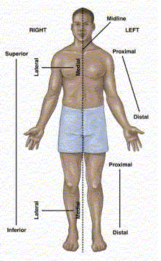
ANATOMICAL DIRECTIONS

Slide 15
ANATOMICAL TERMINOLOGY
ANTERIOR – Toward the front of the body.
E.g. The nose is on the anterior of the head.
POSTERIOR – Toward the back (rear) of the body
E.g. The heel is posterior to the toes.
SUPERIOR – Toward the top of the body.
E.g. The shoulders are superior to the hips.
INFERIOR – Toward the bottom of the body.
E.g. The stomach is inferior to the heart.

Slide 16
MEDIAL – Towards the Midline
-Ulna is Medial bone
LATERAL – Away from Midline
- Radius is Lateral Bone

Slide 17
ANATOMICAL DIRECTIONS- TERMINOLOGY
DORSAL – Along (or toward) the vertebral surface of the body. E.g. Her scar is along the dorsal surface.
VENTRAL – Along (toward) the belly surface of the body.
E.g. The navel is on the ventral surface.
CAUDAD (caudal) – Toward the tail.
E.g. The neck is caudad to the skull.
CEPHALAD –Toward the head.
E.g. The neck is cephalad to the tail.

Slide 18
ANATOMICAL DIRECTIONS
DEEP – Toward the inside of a part; away from the surface.
E.g. The thigh muscles are deep to the skin
SUPERFICIAL – Toward the surface of a part; away from the inside.
E.g. The skin is a superficial organ
MEDULLARY – Refers to an inner region, or medulla
E.g. The medullary portion of the organ contains nerve
tissue
CORTICAL – Refers to an outer region, or cortex.
E.g. The cortical area produces hormones

Slide 19
BODY CAVITIES
DORSAL BODY CAVITIES – are cavities in the “back” half of the body
2 main groups;
1. CRANIAL CAVITIES
2. SPINAL CAVITY

Slide 20
DORSAL BODY CAVITIES
1. CRANIAL CAVITIES – Within the skull
Organ: Brain
2. SPINAL CAVITY – Within the vertebral column
Organ: Spinal cord

Slide 21
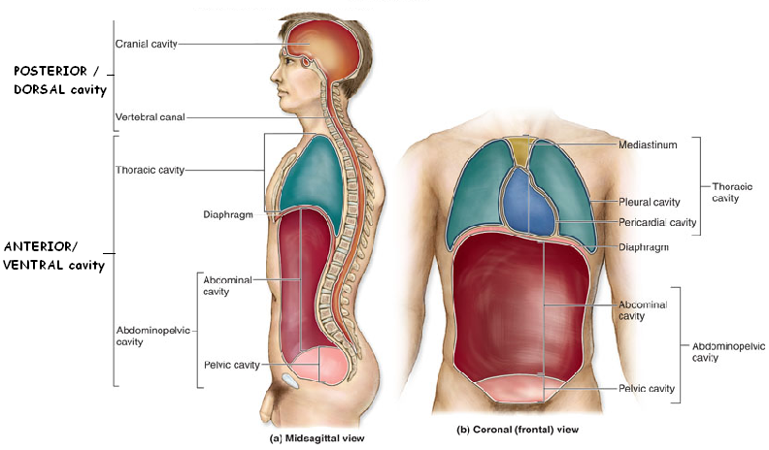
BODY CAVITIES

Slide 22
BODY CAVITIES
VENTRAL BODY CAVITIES – are cavities in the “front” half of the body.
6 main groups;
THORACIC CAVITY
PLEURAL CAVITY
MEDIASTINUM
ABDOMINOPELVIC CAVITY
ABDOMINAL CAVITY
PELVIC CAVITY

Slide 23
VENTRAL BODY CAVITIES
THORACIC CAVITY – within the rib cage
2. PLEURAL CAVITY – Left one third and right one third of the thoracic cavity
Organ: lung
3. MEDIASTINUM – Middle one third of thorax
Organ: Heart, Trachea and oesophagus

Slide 24
VENTRAL BODY CAVITIES
4. ABDOMINOPELVIC CAVITY – From the diaphragm to the bottom of the trunk
5. ABDOMINAL CAVITY – From the diaphragm to the rim of the pelvic bones
Organs: stomach, liver, most of the intestines, pancreas, spleen and kidneys
6. PELVIC CAVITY – From the pelvic rim to the floor of the trunk
Organs: Portions of the intestines, ovaries, uterus, urinary bladder.

Slide 25
SURFACE REGIONS
ANTERIOR ASPECT
1. ABDOMINAL – Area overlying the abdominal cavity
2. ANTEBRACHIAL – forearm
3. AXILLARY – Armpit
4. BRACHIAL – Upper arm
5. BUCCAL – cheek
6. CARPAL – wrist
7. CERVICAL – Neck
8. COXAL - Hip

Slide 26
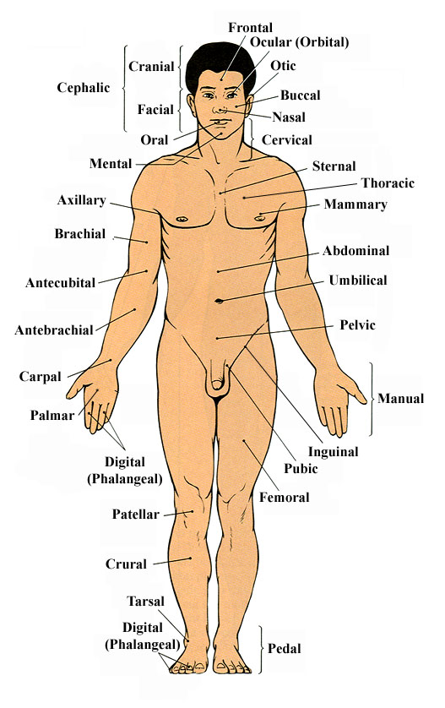

Slide 27
SURFACE REGIONS
ANTERIOR ASPECT
9. CRURAL – Anterior lower legs (shin)
10. CUBITAL – Anterior elbow joint
11. FEMORAL – Upper leg (thigh)
12. MENTAL – Chin
13. ORBITAL – Eye
14. PATELLA – Anterior knee joint
15. PUBIC – Lower front of trunk, between legs
16. TARSAL – ankle
17. THORACIC - Chest

Slide 28
SURFACE REGIONS
POSTERIOR ASPECT
1. CERVICAL – Neck
2. GLUTEAL – Buttocks
3. LUMBAR – lower back
4. OCCIPITAL – Posterior of head
5. POPLITEAL – Posterior knee joint
6. SCAPULAR – shoulder blade
7. SURAL – calf
8. THORACIC – upper back

Slide 29
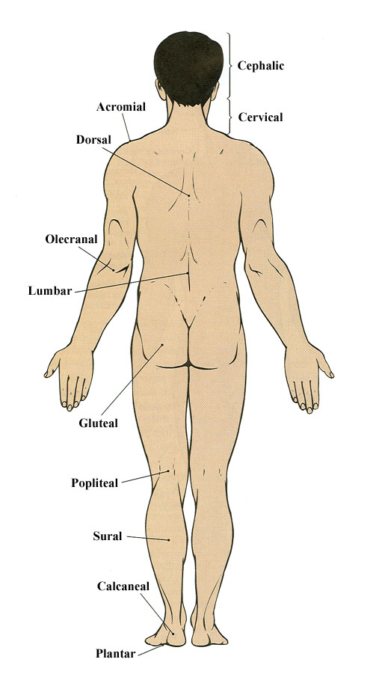

Slide 30
MOVEMENTS
Movements take place at joints where two or more
bones or cartilages articulate with one another.
The different types of movements are;
  FLEXION
  EXTENSION
  DORSIFLEXION
  PLANTARFLEXION
  ABDUCTION
  ADDUCTION
  ROTATION – MEDIAL and RADIAL ROTATION
  OPPOSITION

Slide 31
MOVEMENTS
9. PROTRACTION
10. RETRACTION
11. ELEVATION
12. DEPRESSION
13. EVERSION
14. INVERSION
15. PRONATION
16. SUPINATION
17. PRONE
18. SUPINE

Slide 32
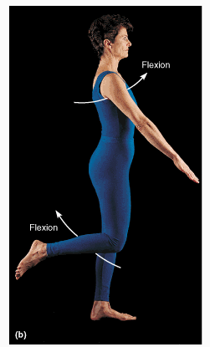
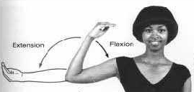
MOVEMENTS
FLEXION – Bending or decreasing the angle between the bones or parts of the body.
E.g. Flexion of the upper
limb at elbow joint is an
anterior bending; Flexion
of the knee at the knee
joint is a posterior bending.

Slide 33
MOVEMENTS
EXTENSION – indicates straightening or increasing the angle between the bones or parts of the body.
E.g. Extension at elbow joint occurs at posterior direction. Extension at knee joint occurs in anterior direction.
HYPEREXTENSION – (OVER EXTENSION beyond anatomical limit) - can cause injury
E.g. Whiplash – hyperextension of the neck during rear- end automobile collision.

Slide 34
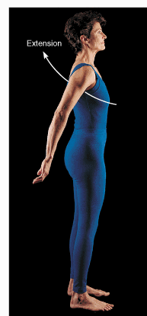
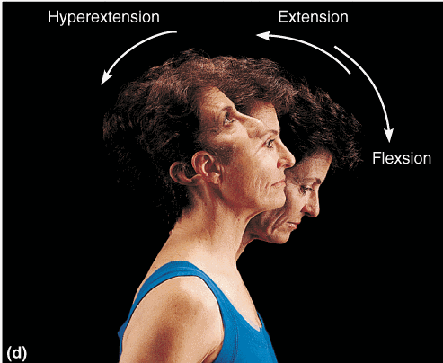
MOVEMENTS - EXTENSION

Slide 35
MOVEMENTS
WHIPLASH INJURY --
- Sudden extension of the cervical spine (backward movement of the neck) and flexion (forward movement of the neck).
- This type of trauma is also referred to as a cervical acceleration-deceleration (CAD) injury.
- Rear-end or side-impact motor vehicle collisions are the number one cause of whiplash with injury to the muscles, ligaments, tendons, joints, and discs of the cervical spine.
- Produce symptoms and signs of “pinched nerve” (radiculopathy of cervical spine - e.g. Neck pain or neck pain that travels down the arm ).

Slide 36
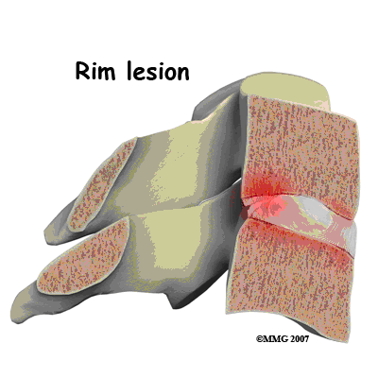
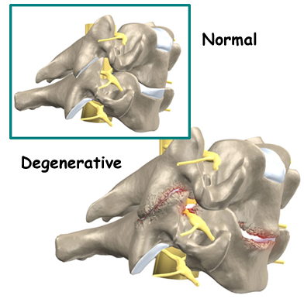
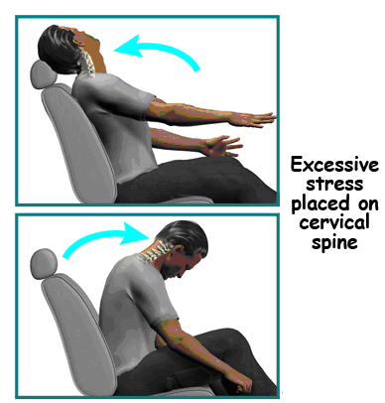
WHIPLASH injury

Slide 37
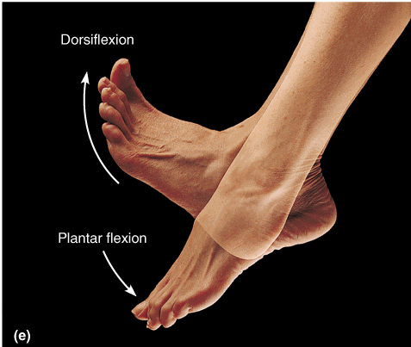
MOVEMENTS
DORSIFLEXION – Flexion at the ankle joint, as occurs when walking uphill or lifting the toes off ground
PLANTARFLEXION – Turns the foot or toes toward the plantar surface.
E.g. When standing on your toes)

Slide 38
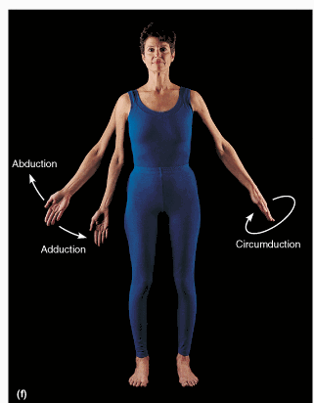
MOVEMENTS
ABDUCTION – means moving away
from body midline. E.g. Moving
an upper-limb away from the
side of the body.
ADDUCTION – means moving
toward the body midline
E.g. Moving an upper-limb
toward the side of the body.

Slide 39
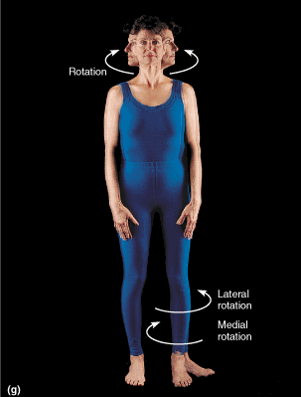
MOVEMENTS
ROTATION – involves turning
or revolving a part of the body
around its longitudinal axis
(E.g. turnings one’s head to the side)
MEDIAL ROTATION – Rotation
toward the midline of the body.
LATERAL ROTATION – Rotation
away from the midline of the body

Slide 40
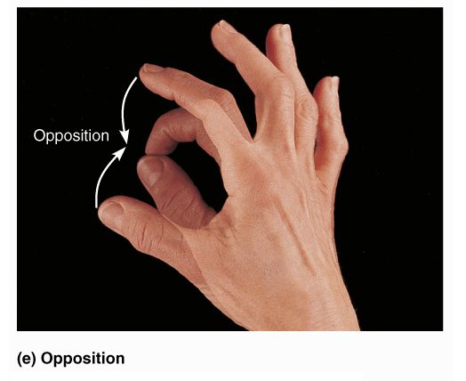
MOVEMENTS
OPPOSITION – Movement by which
the pad of the thumb is brought to
another digit pad. E.g. We use this
movement to pinch, button a shirt.

Slide 41
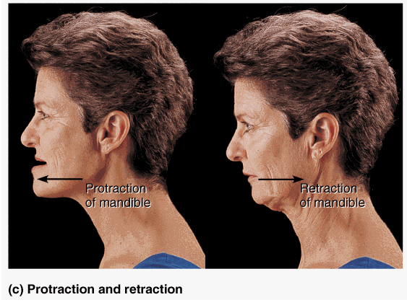
MOVEMENTS
PROTRUSION (Protraction)– Anterior (forward) movement.
E.g. Sticking the chin out.
RETRUSION –(Retraction) Posterior
(backward) movement.
E.g. Tucking the chin in.

Slide 42
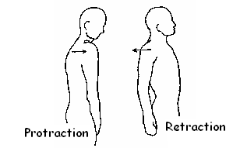
MOVEMENTS
PROTRACTION- (SCAPULAR ABDUCTION) Shoulder girdle moves forward to anatomical position.
RETRACTION – (SCAPULAR ADDUCTION) Shoulder girdle moves backward from anatomical position.

Slide 43
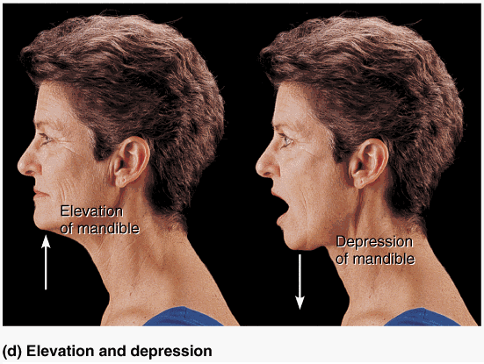
MOVEMENTS
ELEVATION – Raises or moves a part superiorly (upward)
E.g. Elevating the shoulders when shrugging.
DEPRESSION – Lowers or moves a part inferiorly .
E.g. Depressing the shoulders when standing at ease.

Slide 44
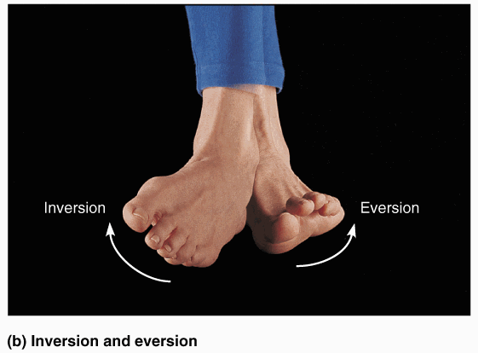
MOVEMENTS
EVERSION – Lateral (outward) rotation of sole of foot.
INVERSION – Medial (inward) rotation of the sole of foot.

Slide 45
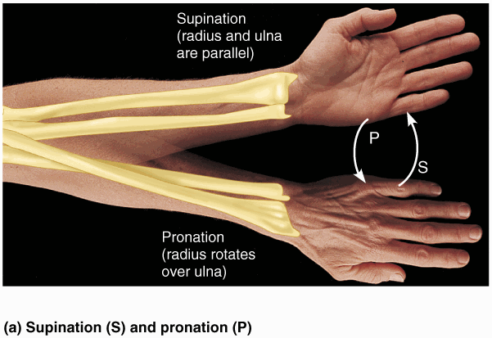
MOVEMENTS
PRONATION – Movement of the forearm and hand so that the it is rotated medially along the longitudinal axis - so that the palm of the hand faces posteriorly (backward) and the dorsum of the hand faces anteriorly (frontward).
SUPINATION – Movement of the forearm and hand so that it is rotated laterally along the longitudinal axis – so the palm of the hand faces anteriorly (frontward) and the dorsum of the hand faces posteriorly (backward)

Slide 46
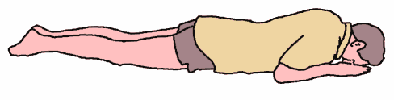
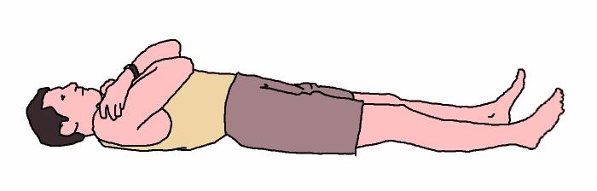
MOVEMENTS
ADDITIONAL TERMS
PRONE – Face down
SUPINE – Face up

Slide 47


Slide 48

THANK YOU

