Slide 1
EMBALMING
DR. PRAVEEN KURREY
MBBS, MS, BCME, BCBR
PROFESSOR ANATOMY

Slide 2
EMBALMING
DEFINITION : Embalming is defined as the preservation of the dead body from decomposition .
It is a means of artificially preserving the dead human body.

Slide 3
AIMS OF EMBALMING
1 : To treat (a corpse) with preservatives in order to prevent decay.
2 : To protect from change .
3 : To impart fragrance .

Slide 4
HISTORY OF EMBALMING
Since the days of ancient Egypt, if not before, embalming has been part of the funeral process. The Egyptians embalmed for religious reasons, believing it necessary for to enter the afterlife, because once in the afterlife the decedent would need a body. During the American Civil War, embalming was done to preserve the bodies of troops so that they could be shipped back to their families for burial. Today we embalm our dead for preservation and restoration to a more pleasing appearance.

Slide 5
PRE-EMBALMING
An embalming report is filled out that logs all jewelry and personal items on the body; details any discolorations, cuts, bruises, etc. on the body; and documents the procedures and chemicals used during embalming. This report can become very valuable if a deceased's family bring a lawsuit against the funeral home.
All clothing, bandages, IV needles, catheters and such are removed. A strong disinfectant spray is used to clean the skin, eyes, mouth, and other orifices. If rigor mortis (the stiffening of muscles after death) has set in, it is relieved by moving the limbs and head about and massaging the muscles.

Slide 6
FEATURE- SETTING
The embalmer places the remains straight from head to toe on the embalming table. The arms are held in position, usually with hands folded across the stomach, by a special positioning device. The head is placed on a headblock, and many embalmers will tilt the head 15 degrees to the right so mourners can more easily see the face.
Great care is taken to close the eyes. The traditional method for doing this involves placing a bit of cotton between the eye and eyelid. Many times after death the eyes sink back into their sockets, so small plastic "eye caps" are placed on each eye ball. An eyecap is shaped like a large contact lens and has a textured surface that grips and holds the eyelid in place.
The mouth is closed either by suture-string or by a special injector gun. Many times a mouth-former is used.

Slide 7
EMBALMING PROCESS
The body is placed on stainless steel or porcelain table, then washed with agermicide-insecticide-olfactant. The insides of the nose and mouth are swabbedwith the solution.
Rigor mortis (stiffness) is relieved by massage.
Facial features are set by putting cotton in the nose, eye caps below the eyelids,a mouth former in the mouth.
Arterial embalming is begun by injecting embalming fluid into an artery while theblood is drained from a nearby vein or from the heart.

Slide 8
EMBALMING PROCESS
The second part of the embalming process is called cavity embalming. A trocar— a long, pointed, metal tube attached to a suction hose — is inserted close to the navel. The embalmer uses it to puncture the stomach, bladder, large intestines, and lungs. Gas and fluids are withdrawn before "cavity fluid" (astronger mix of formaldehyde) is injected into the torso.

Slide 9
TYPES OF EMBALMING
ARTERIAL EMBALMING
CAVITY EMBALMING
HYPODERMIC EMBALMING
SURFACE EMBLAMING

Slide 10
ARTERIAL EMBALMING
Arterial embalming begins by selecting an artery to inject the fluid into and a vein to drain away blood. The most popular site (however multiple injection and drainage sites may be used) is on the right side of the body near the collarbone. Here are located, right next to each other, the right common carotid artery and the right internal jugular vein.

Slide 11
ARTERIAL EMBALMING
Factors which determine the flow of fluid into the tissues are
1 Capillary resistance.
2 Chemical composition of the solution.
3 Injection pressure.
4 Osmosis.
5 Diffusion.
6 Gravity.

Slide 12
METHODS OF
ARTERIAL EMBALMING
Injections -
  Gravity injection.
  Electric pump (air pressure machine).
Types of incisions –
  Transverse.
  Longitudinal.
  Combined.
  Wedge.

Slide 13
ARTERIAL EMBALMING
Criteria for selection of a vessel –
  Size of the vessel.
  Depth of the location of the vessel.
  Proximity of the vessel to the heart.
  Choice in infants and children.
  Choice of artery in non-autopsied bodies.
  Choice of artery in autopsied bodies.

Slide 14
ARTERIAL EMBALMING
Injection techniques.
  Single point injection.
  Split injection.
  Restricted cervical injection.
  Multi-point injection.
  Six point injeciton.

Slide 15
CAVITY EMBALMING
Cavity treatment starts with aspirating (suctioning) fluids out of the internal organs in the abdomen and thoracic cavity. We accomplish this with the use of a trocar. A trocar is a long metal tube with sharp blades at one end and a connector for a hose at the other. The hose is connected to a device that creates suction, either an electric aspirator or water powered aspirator (called a hydro-aspirator) and then connected to the trocar

Slide 16
HYPODERMIC EMBALMING
1. This method is used to preserve the small ,local body areas are large areas by subcutaneous injection of a suitable chemical.
2. The solution may be an arterial fluid are cavity fluid.
3. It is injected by hypodermic syringe.

Slide 17
SURFACE EMBALMING
In this method the local body areas are preserved by application of a suitable chemical to the surface of the body.
The chemical may be an arterial fluid .
Hypodermic and Surface embalming may be used as a primary method of embalming for the preservation of an infant ,fetus , viscera or a mutilated portion of the body.

Slide 18
TYPES OF EMBALMING FLUIDS
There are eight groups of chemicals as following :
Preservatives
Germicides
Anticoagulants
Buffers
Wetting agents
Vehicle
Dyes
Perfuming agents

Slide 19
TYPES OF EMBALMING FLUIDS
According to their use embalming fluids are up to three types:
Arterial fluid
Cavity fluid
Pre-injection fluid

Slide 20
EMBALMING FLUID
Typically embalming fluid contains a mixture of formaldehyde, methanol, ethanol and other solvents. The formaldehyde content generally ranges from 5 to 29 percent and the ethanol content may range from 9 to 56 percent.

Slide 21
LONG TERM EFFECTS OF FLUIDS
• Brain damage
• Bronchitis
• Coma
• Convulsions
• Coughing
• Destruction of muscle tissue
• Fever
• Heart attack
• High blood pressure
• Inflammation of the throat, nose, and
esophagus
• Kidney damage
• Lung damage
• Maturation process cessation
• Pneumonia
• Spinal cord destruction

Slide 22
SHORT TERM EFFECTS OF FLUIDS
• Anger and frustration
• Depression
• Hallucinations and delusions
• Headache• Impaired vision and coordination
• Increase in women's sexual appetites
• Loss of consciousness
• Memory loss
• Paranoia
• Physical violence
• Sleepiness
• Vomiting

Slide 23
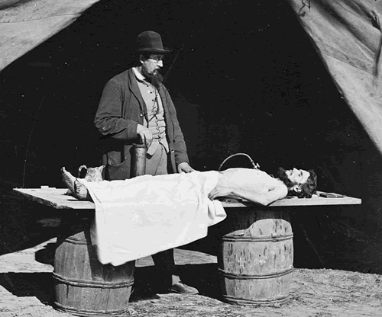
CIVIL WAR

Slide 24
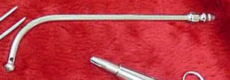
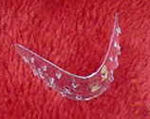
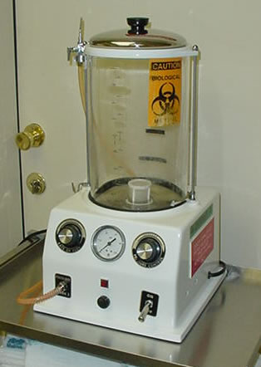

NASAL, MOUTH FORMER, JUGULAR TUBE, EMBALMING MACHINE

Slide 25
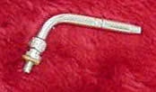

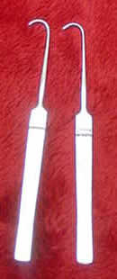
AUTOPSY ASPIRATOR, ARTERIAL TUBE, ANEURYSM HOOK

Slide 26
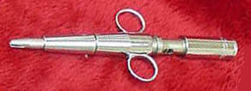

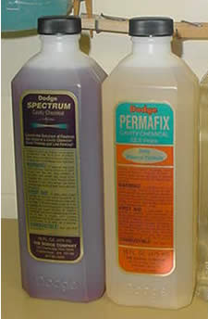
INJECTOR GUN, EYE CAPS, CAVITY CAMICALS

Slide 27
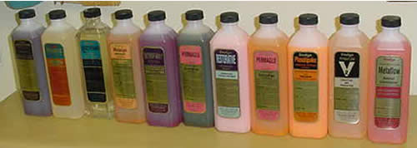
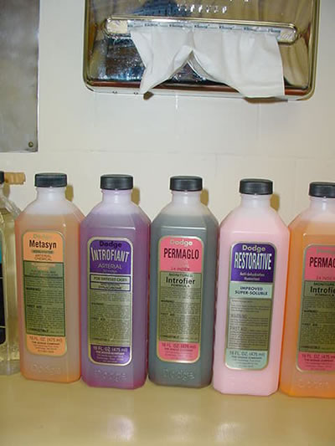
FLUIDS

Slide 28
ANATOMICAL EMBALMING
Main criteria is proper preservation, total sterilization and suitability for dissection.
Venous drainage not required.
Cavity treatment is not required.

Slide 29
EMBALMING IN SPECIAL CASES
Infants.
Burnt bodies.
Decomposed bodies.
AIDS bodies.

Slide 30
RISK IN EMBALMING PROCEDURE
Infections –
Hepatitis, URI, fungal infecitons, tuberculosis, septicemia, wound infections, HIV.

Slide 31
PROTECTION IN EMBALMING PROCEDURE
Preparation room
  Air exhaust system.
Personal
  Apron / protective gown.
  Rubber / plastic gloves.
  Protective head and shoe coverings.
  Oro-nasal mask.
  Separate disinfectants for instruments.
  Prophylactic antibiotics / immunization.

Slide 32
THANKS

Slide 33
MORDERN EMBALMING
Mordern embalming is defined as the study and science of treating a dead human body to achieve an antiseptic condition , a pre-mortem appearance and preservation .
The embalming fluids act on body proteins and change the colloidal nature of the proteins .

Slide 34
The mouth is closed either by tying the jaw together with a piece of suture string or by a special injector gun
To finish clo

