Slide 1
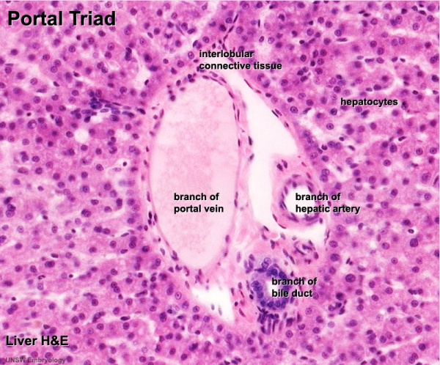
HISTOLOGY GASTROINTESTINAL TRACT-3
LIVER
PANCREAS
GALL BLADDER
DR. PRAVEEN KURREY
M.B.B.S., M.S. BCME, BCBR PROFESSOR ANATOMY

Slide 2
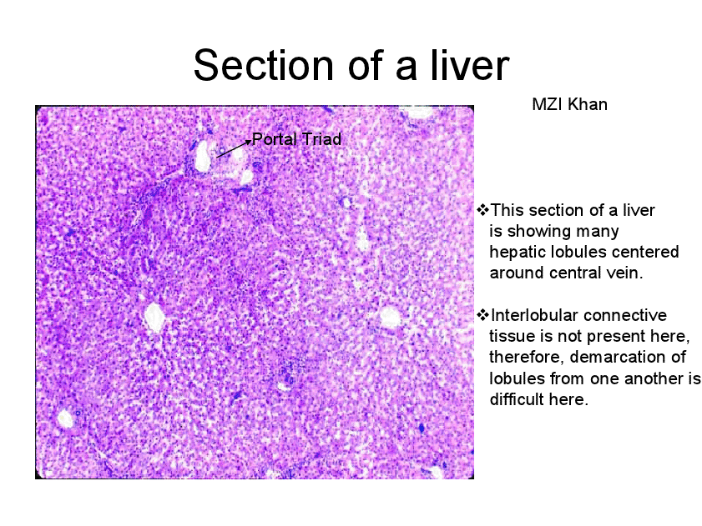

Slide 3
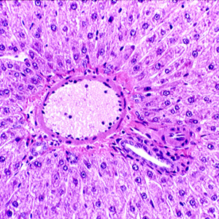
PORTAL TRIAD

Slide 4
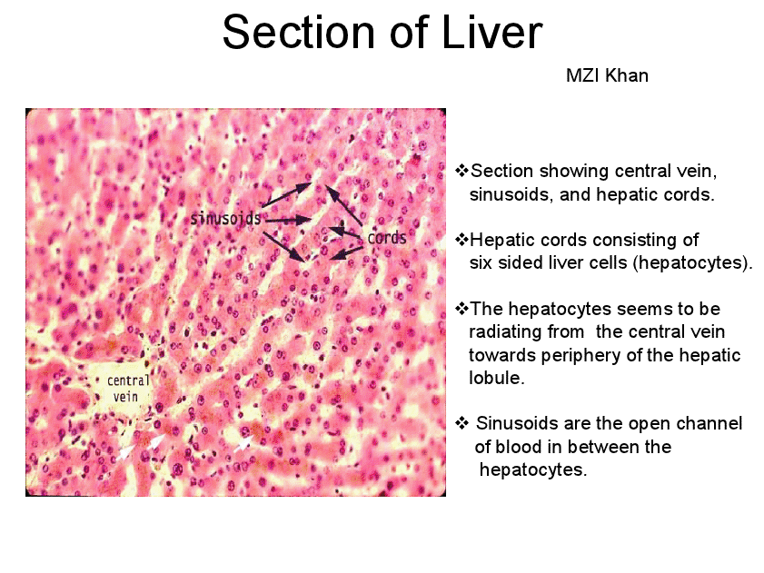

Slide 5
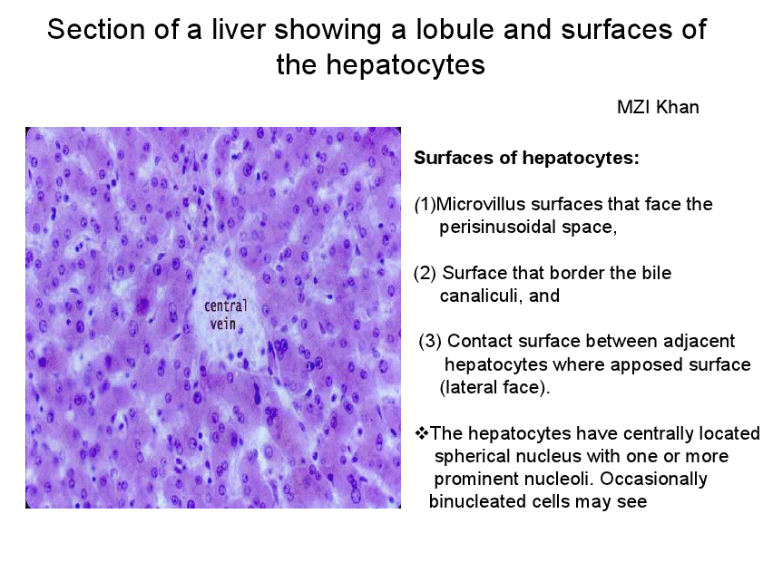

Slide 6
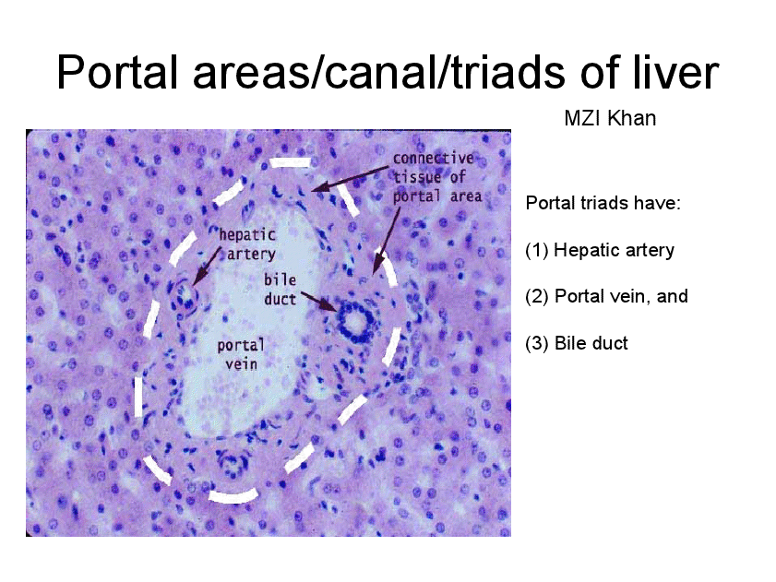

Slide 7
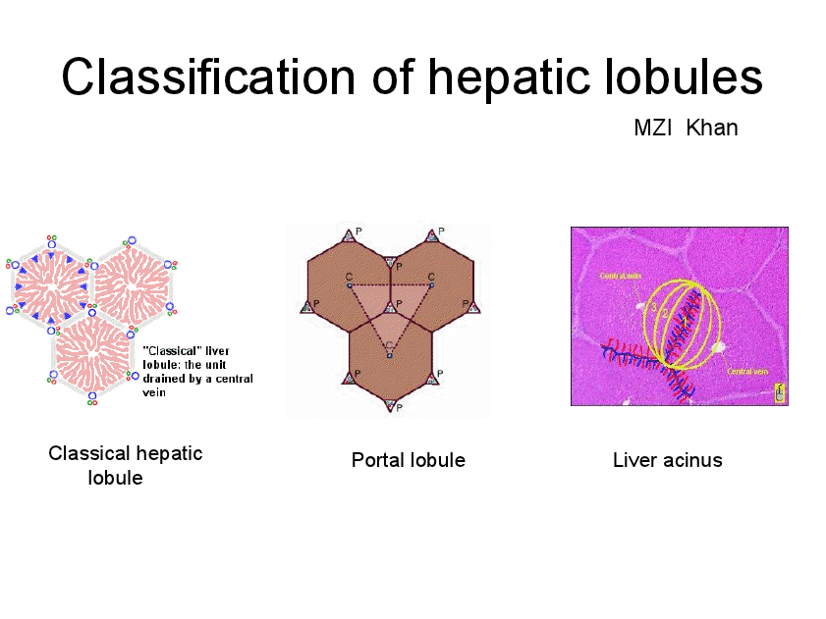

Slide 8
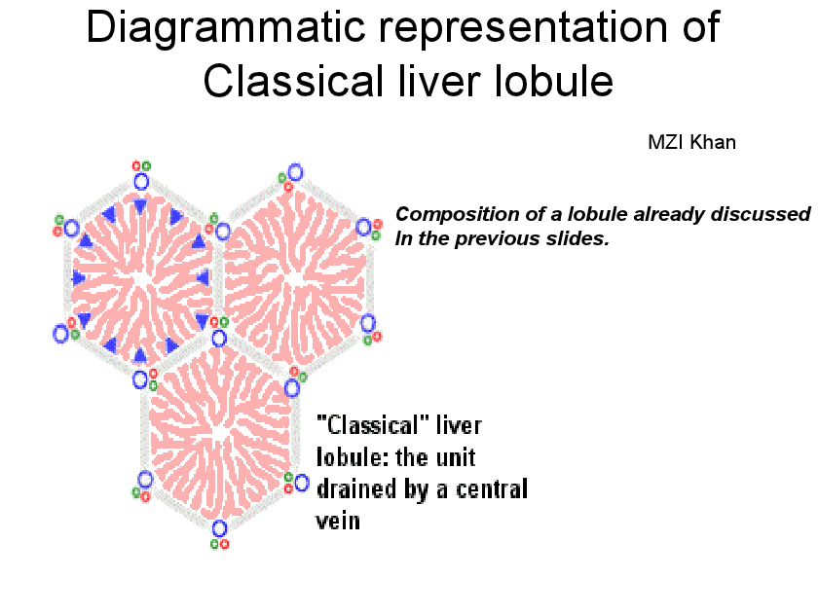

Slide 9
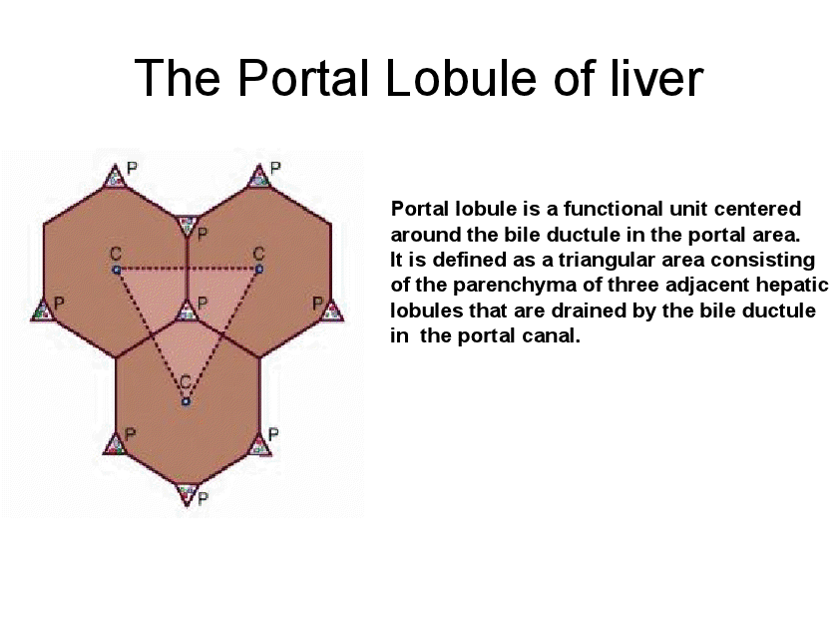

Slide 10
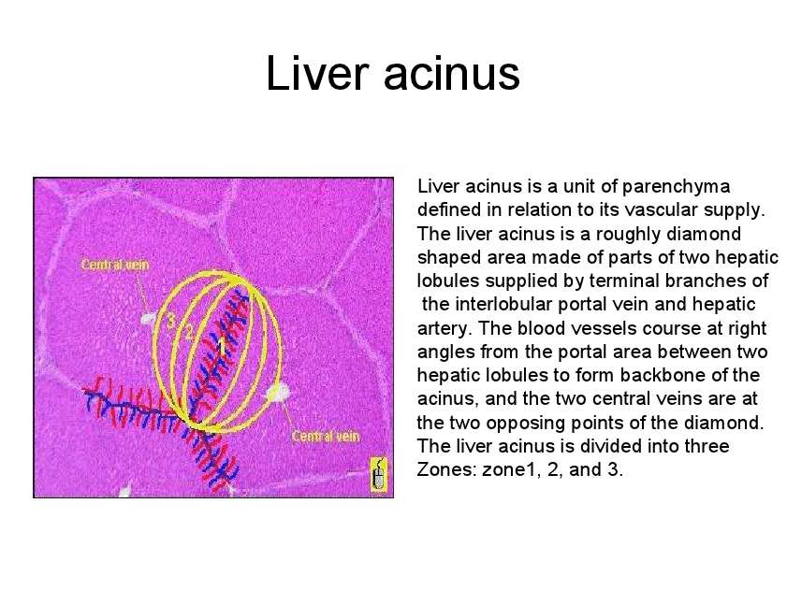

Slide 11
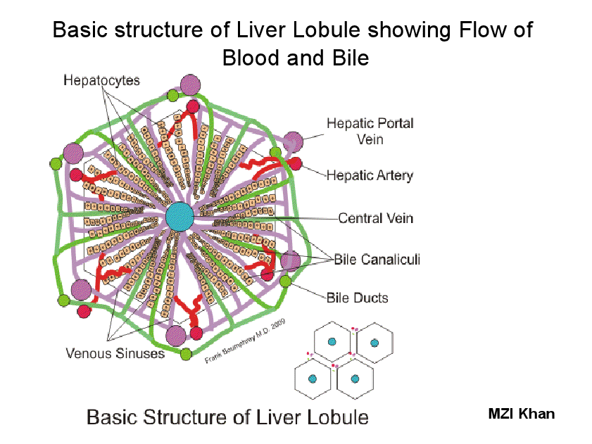

Slide 12
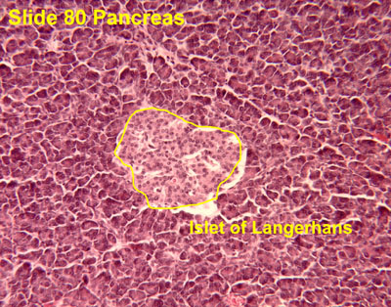
PANCREAS

Slide 13
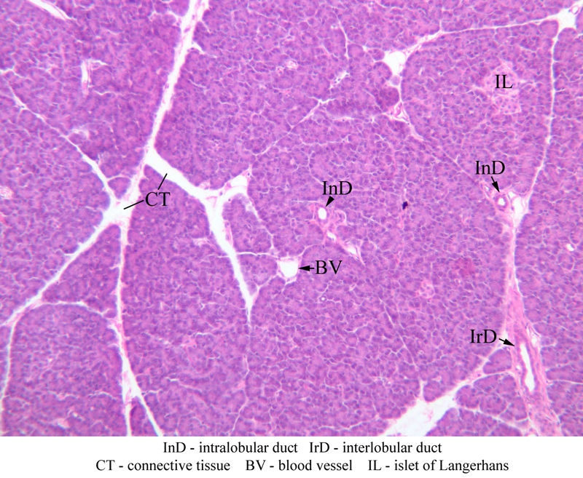
PANCREAS

Slide 14
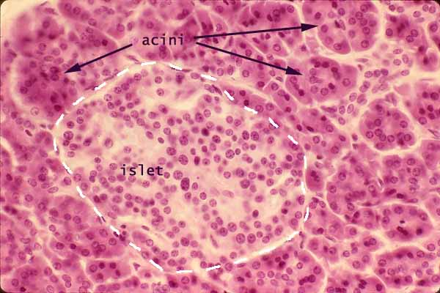
PANCREAS

Slide 15
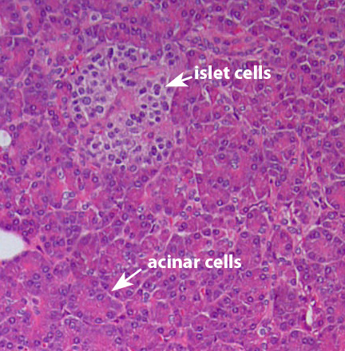
PANCREAS

Slide 16
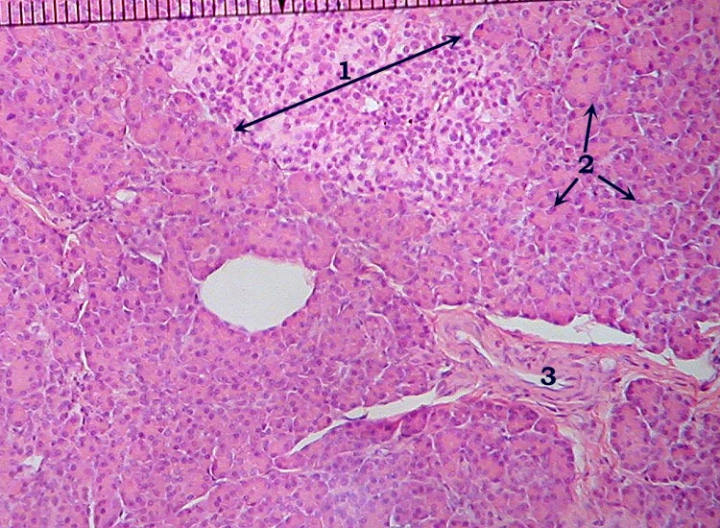
PANCREAS

Slide 17
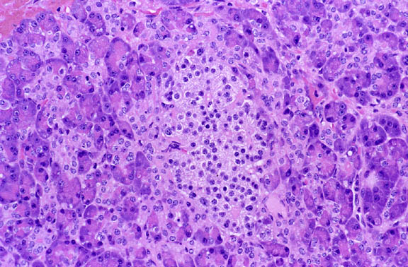
PANCREAS

Slide 18
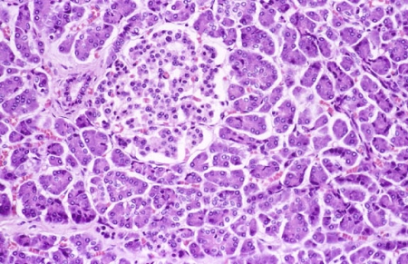
PANCREAS

Slide 19
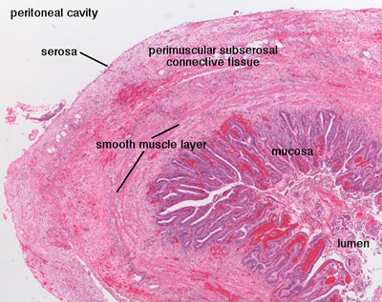
GALL BLADDER

Slide 20
GALL BLADDER
b) an inner mucosa (columnar epithelial lining and lamina propria)
c) a muscular layer
d) a perimuscular layer of loose connective tissue
e) a covering of peritoneum (serosa), except in hepatic bad
BILE DUCT
-mucosa – a single layer of tall columnar epithelium connects with
subepithelial mucous glands.
-a supportive framework of connective tissue with rare smooth
muscle
fibers.

Slide 21
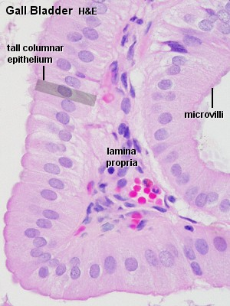
GALL BLADDER

Slide 22
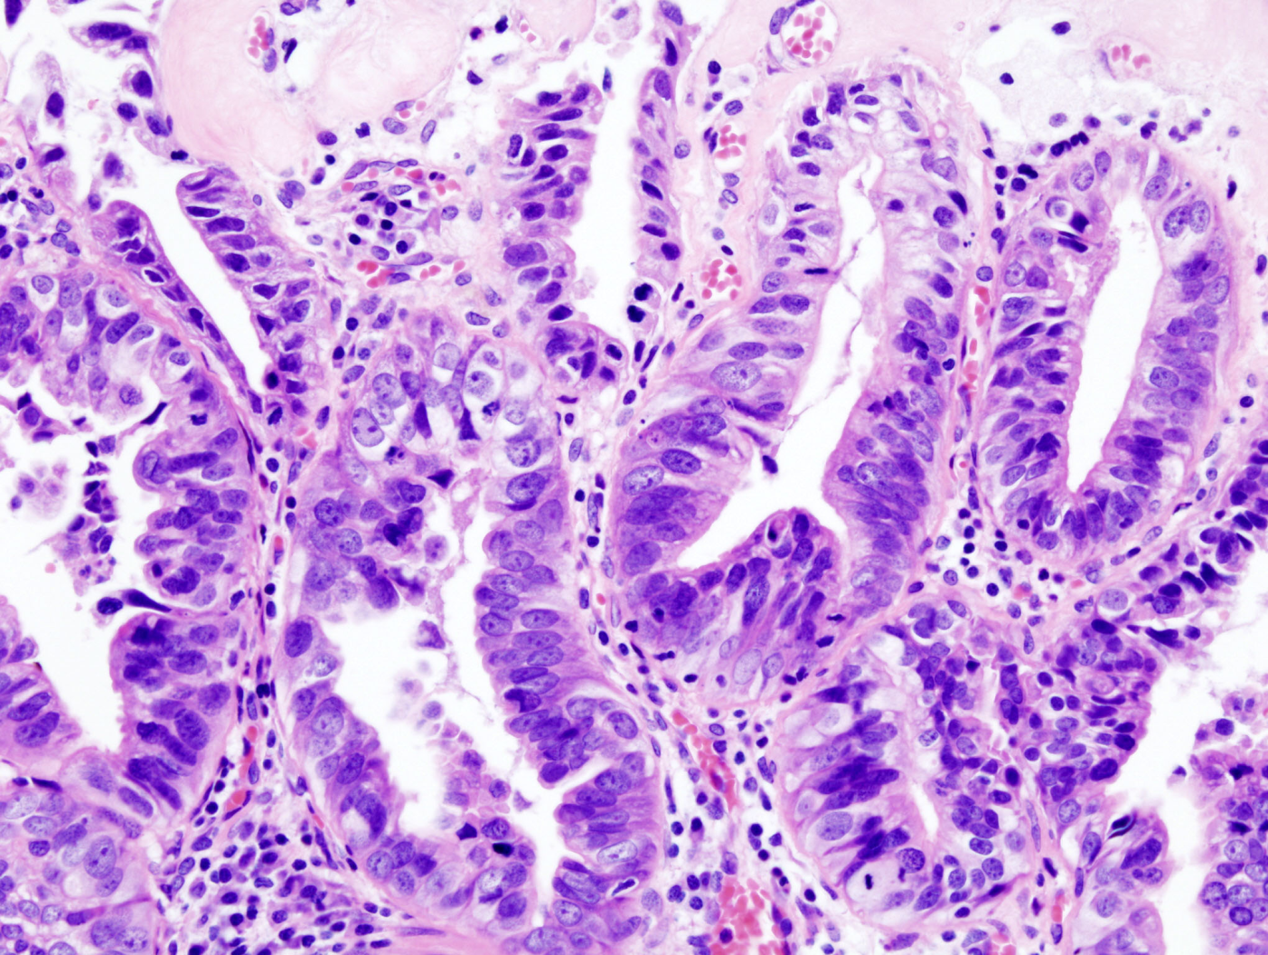
GALL BLADDER

Slide 23
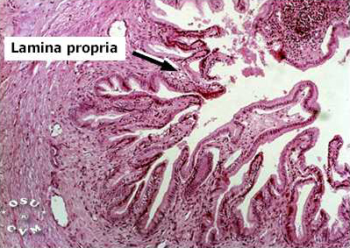
GALL BLADDER

Slide 24
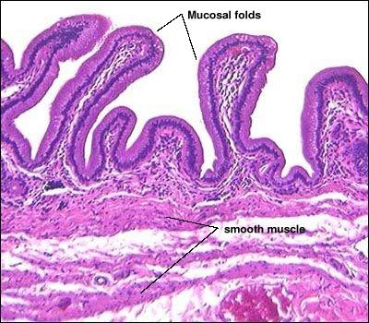
GALL BLADDER

Slide 25
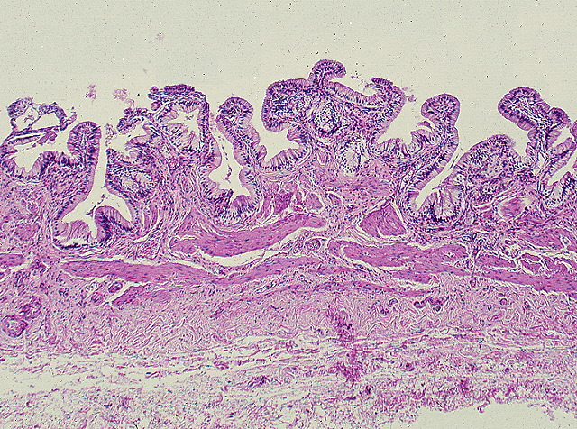
GALL BLADDER

Slide 26
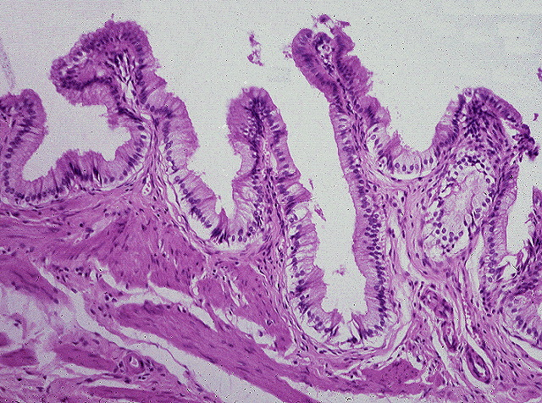
GALL BLADDER

Slide 27
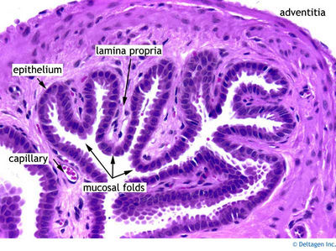
GALL BLADDER

Slide 28
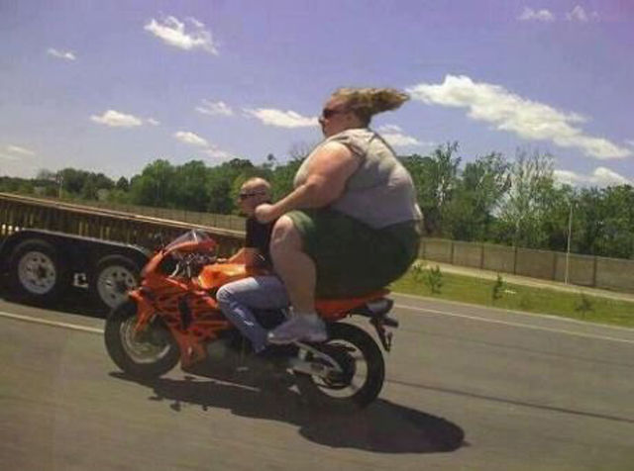

THANK YOU

