Slide 1
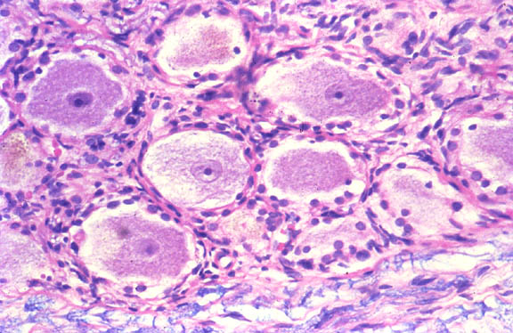
HISTOLOGY
NERVOUS SYSTEM
DR. PRAVEEN KURREY
M.B.B.S., M.S.BCME, BCBR PROFESSOR ANATOMY

Slide 2
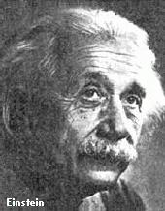
Histology of Nervous Tissue
Despite the complexity of organization, there are only two functional cell types
  neurons - excitable nerve cells that transmit electrical signals
  neuroglia (glial) cells - support cells
Einstein’s brain was unusual in having more glial cells than most humans, not more neurons!

Slide 3
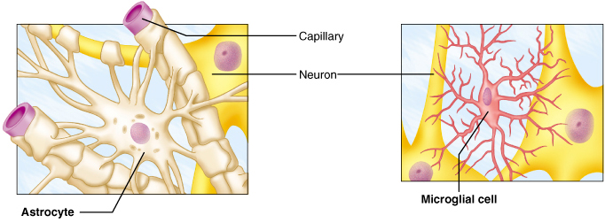
Histology of CNS Tissue - Neuroglia
Neuroglia - 4 types in the Central NS
  astrocytes
    star shaped with many processes
    connect to neurons; help anchor them to nearby blood capillaries
    control the chemical environment of the neurons
  microglia
    oval with thorny projections
    monitor the health of neurons
    if infection occurs, they change into macrophages (eating viruses, bacteria and damaged cells)

Slide 4
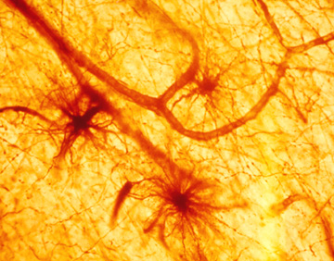
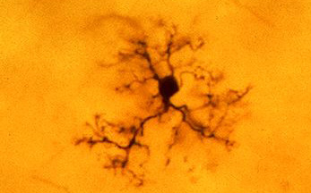
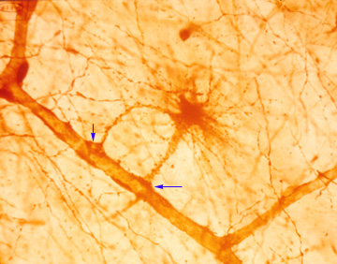
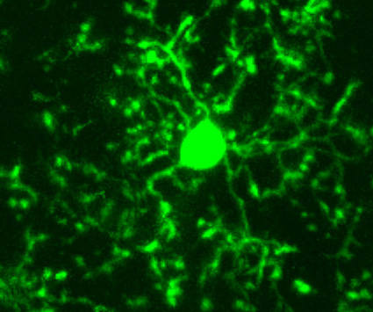
Astrocytes and Microglial Cells

Slide 5
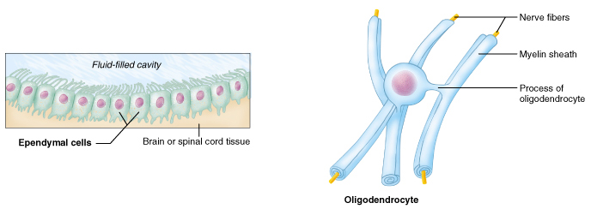
Histology of CNS Tissue - Neuroglia
Neuroglia - 4 types in the CNS (continued)
  ependymal cells
    range in shape from squamous to columnar; many are ciliated
    line the dorsal body cavity housing the brain and spinal cord
    form a barrier between the neurons and the rest of the body
  oligodendrocytes
    have few processes
    line up along neurons and wrap themselves around axons
    form the myelin sheath – an insulating membrane

Slide 6
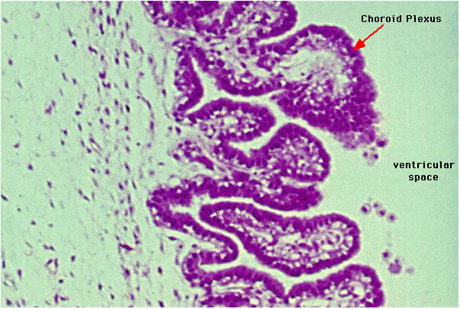
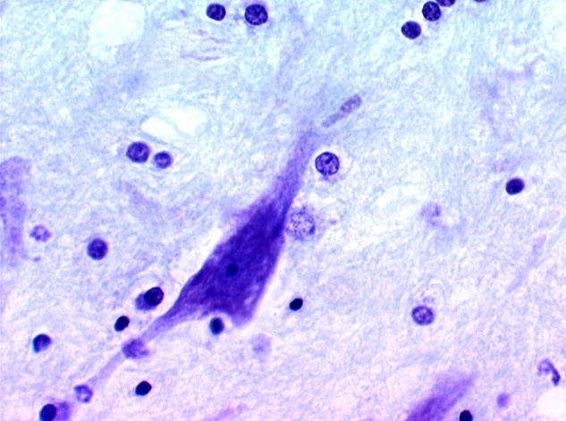
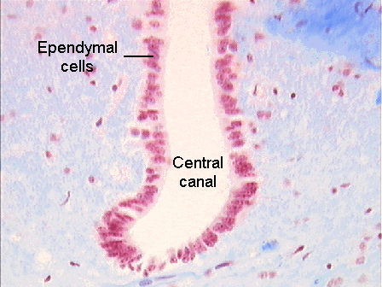
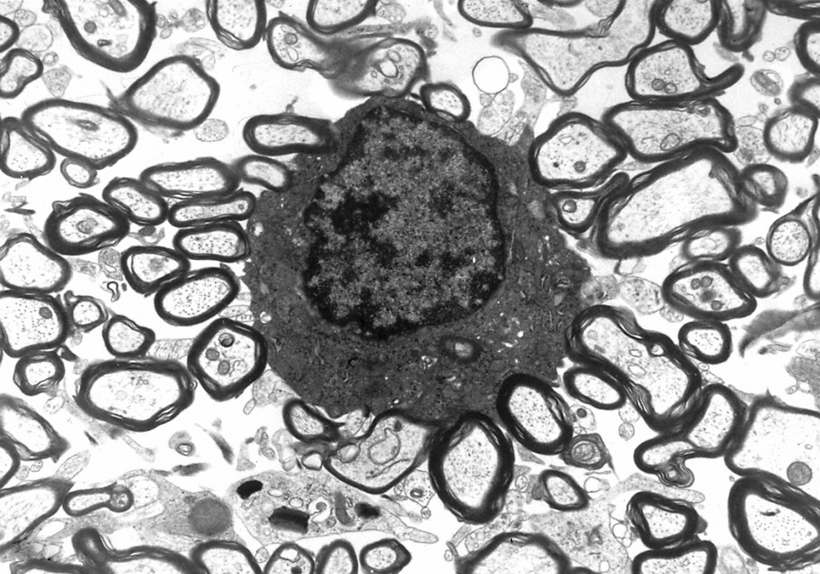
Ependymal Cells and Oligodendrocytes

Slide 7
Histology of PNS Tissue - Neuroglia
Neuroglia - 2 types in the Peripheral NS
  satellite cells
    surround neuron cell bodies in the periphery
    maintain the extracellular environment
  neurolemmocytes (Schwann cells)
    surround axons/dendrites and form the myelin sheath around larger nerve fibers in the periphery
    similar to oligodendrocytes in function – insulators

Slide 8
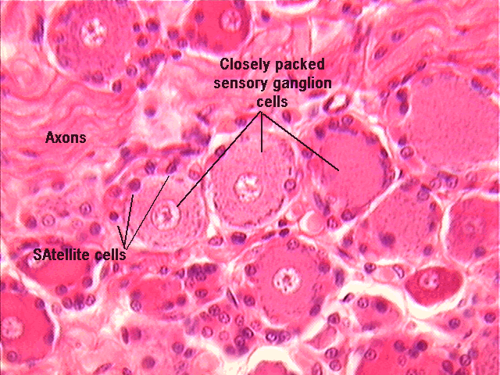
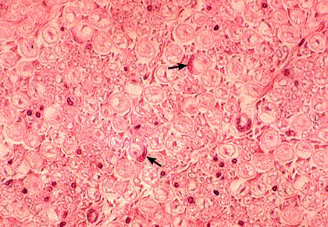
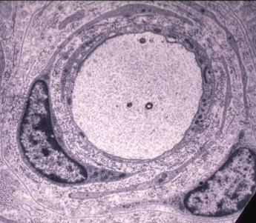
Satellite Cells and Neurolemmocytes

Slide 11
Histology of CNS Tissue - Neurons
Neurons - highly specialized cells which conduct electrochemical signals (nerve impulses)
  extreme longevity – neurons live and function normally for a lifetime
  amitotic
    once mature, neurons lose the ability to divide
    damaged nervous tissue cannot regenerate
  high metabolic rate
    need a large, constant supply of oxygen and glucose
    can survive only a few minutes without oxygen

Slide 12
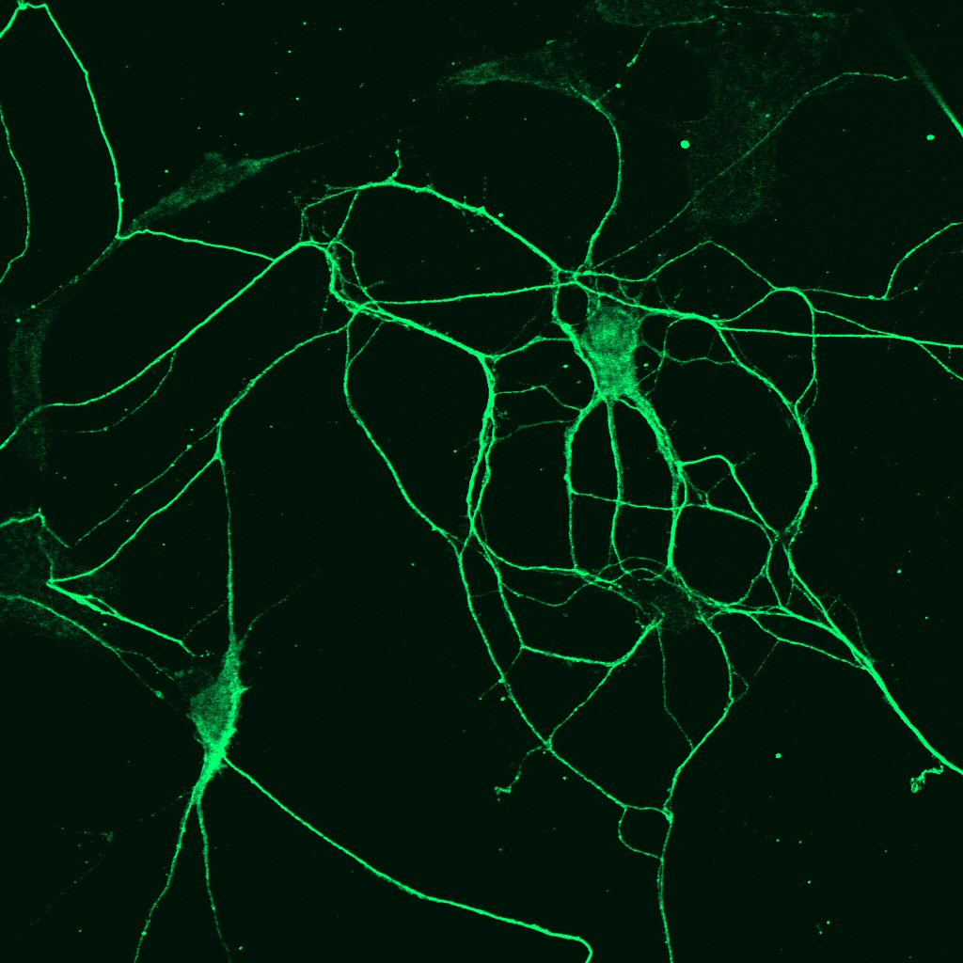
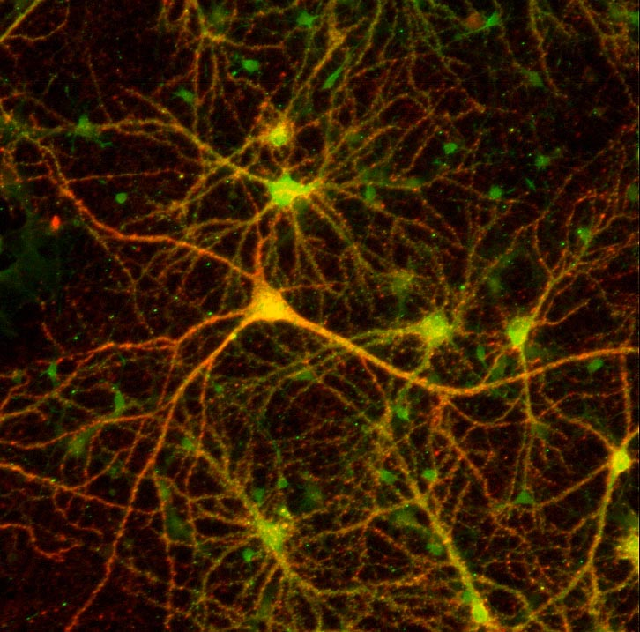
Neurons

Slide 13
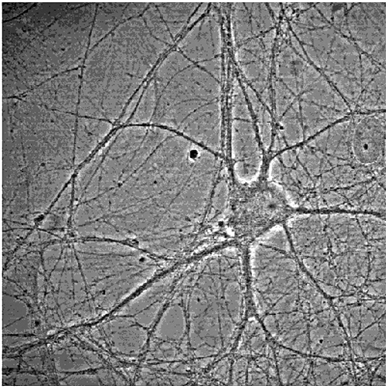
Neuron Structure – Cell Body (Soma)
Contains the usual cellular organelles
Site of most cell metabolism
Receptive: membrane receptors initiate and transmit graded potentials (not action potentials) in response to incoming stimuli
  Most neuron cell bodies are located within the CNS:
  Nuclei: clusters of neuron cell bodies in the CNS
  Ganglia: clusters of neuron cell bodies in the PNS

Slide 14
