Slide 1
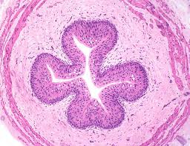
HISTOLOGY 3
URINARY SYSTEM
KIDNEY
URETER
URINARY BLADDER
DR. PRAVEEN KURREY ASSISTANT PROFESSOR CMCH BHOPAL

Slide 2
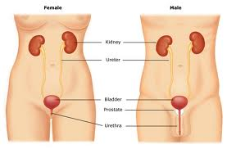
KIDNEY, URINARY BLADDER
URETER

Slide 3
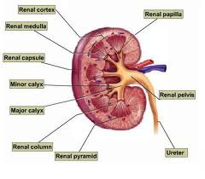
KIDNEY

Slide 4
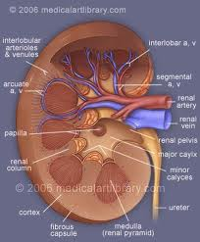
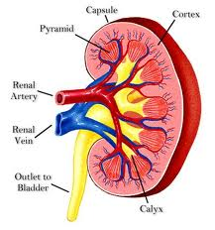
KIDNEY

Slide 5
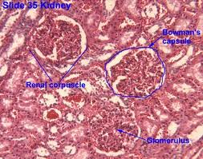
KIDNEY

Slide 6
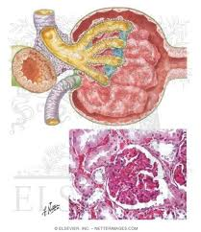
BOWMAN S CAPSULE

Slide 7
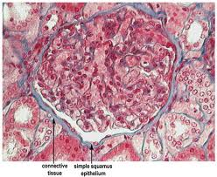
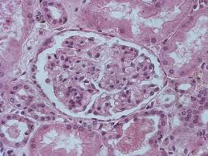
BOWMAN S CAPSULE

Slide 8
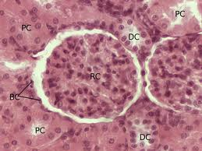
BOWMAN S CAPSULE

Slide 9
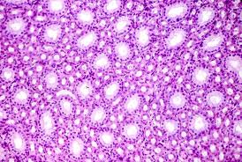
PCT,DCT ,LOOP OF HENLE

Slide 10
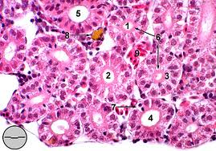
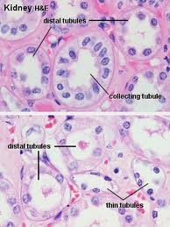
PCT,DCT ,LOOP OF HENLE

Slide 11
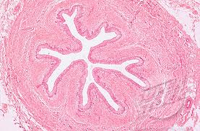
URETER

Slide 12
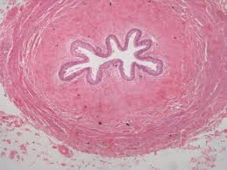
URETER

Slide 13
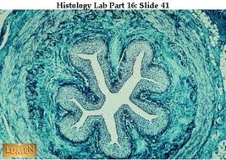
URETER

Slide 14
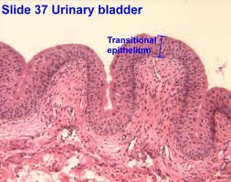
URINARY BLADDER

Slide 15
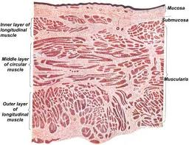
URINARY BLADDER

Slide 16
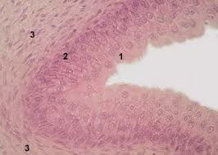
URINARY BLADDER

Slide 17
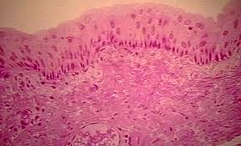
URINARY BLADDER

Slide 18

THANK YOU

