Slide 1
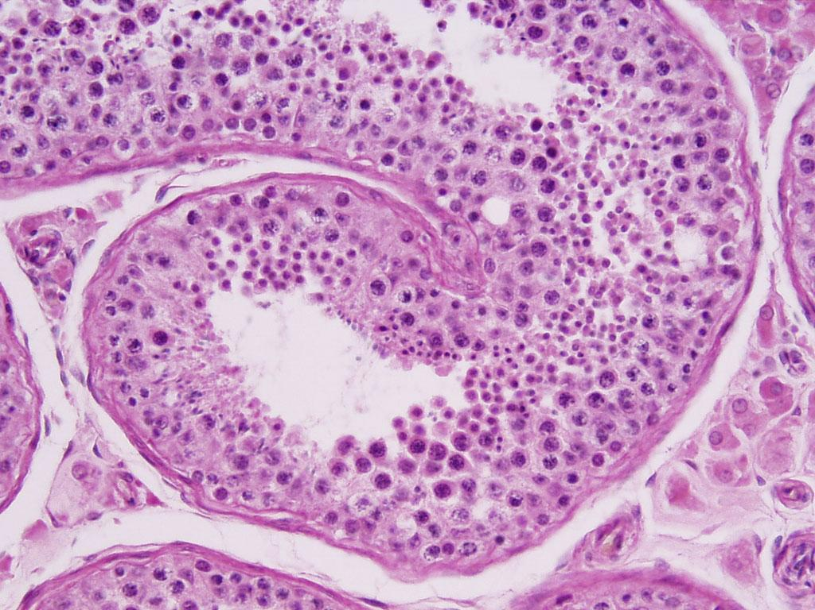
HISTOLOGY
MALE REPRODUCTIVE SYSTEM
TESTIS
EPIDIDYMIS
VAS DIFFERENCE
PROSTATE
DR. PRAVEEN KURREY
M.B.B.S., M.S. BCME, BCBR PROFESSOR ANATOMY

Slide 2
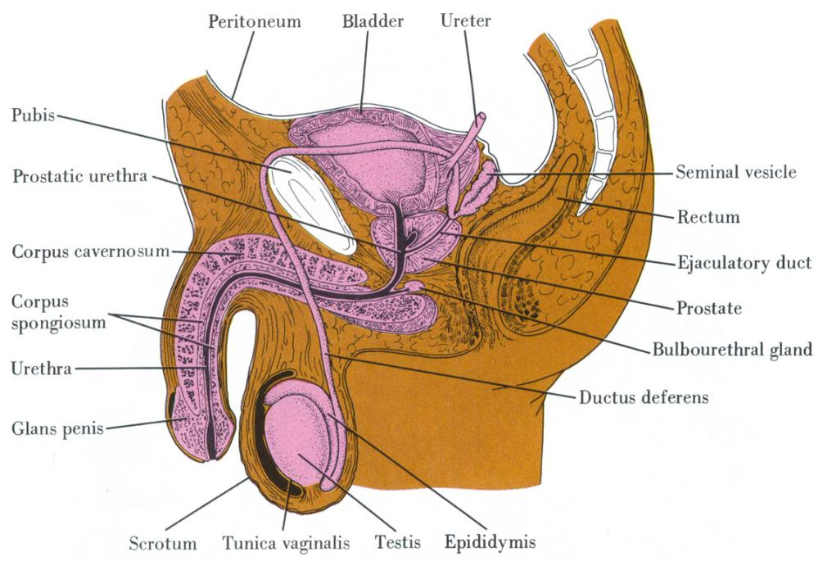
Introduction
Parts
  Testis
  Genital ducts
    Epididymis
    Ductus Deferens
  Accessory Glands
    Seminal Vesicles
    Prostate
    Bulbouretheral glands
  Penis

Slide 3
TESTIS
Testis develops in abdomen & descend to scrotum
Both endocrine & exocrine
  Endocrine – Testosterone (Interstitial cells of Leydig)
  Exocrine – Spermatogenesis (Seminiferous Tubules)
Oval, approx 5 cm X 2.5 cm, 10 – 15 g
Surrounded by serous sac - Tunica Vaginalis

Slide 4
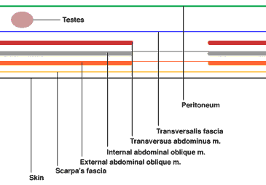
Testis

Slide 5
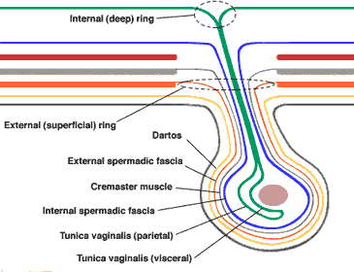
Testis

Slide 6
Testis
Stroma
  Tunica Albuginea - Thick
  Tunica Vasculosa
  Thicker posteriorly – Mediastinum - Attachment epididymis
  From mediastinum - Thin septa - pyramidal lobules
  Lobule 2-3 seminiferous tubules (ST)
  Between ST loose CT containing Interstitial cells of Leydig

Slide 7
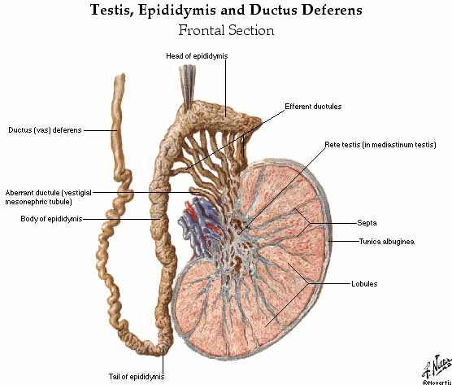
Testis

Slide 8
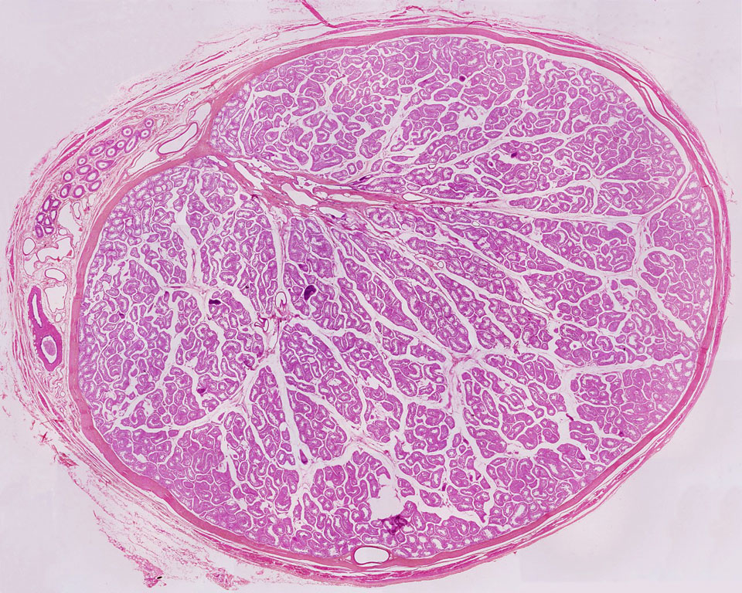
Testis
• TESTIS
Mediastinum containing RETE TESTIS
EPIDIDYMIS
LOBULES
TUNICA ALBUGINEA
Notes:
testis-06

Slide 9
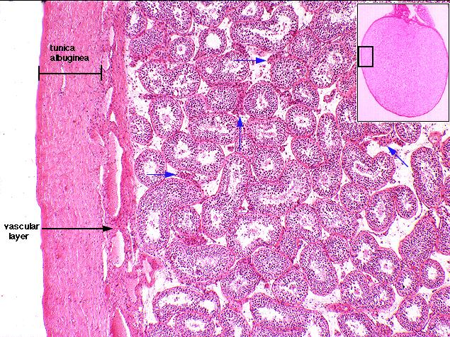
Testis

Slide 10
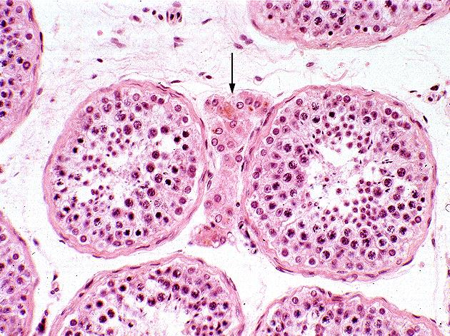
Testis

Slide 11
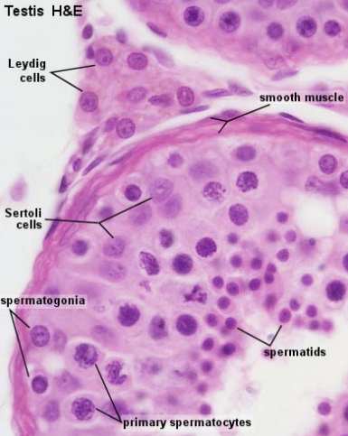
Testis

Slide 12
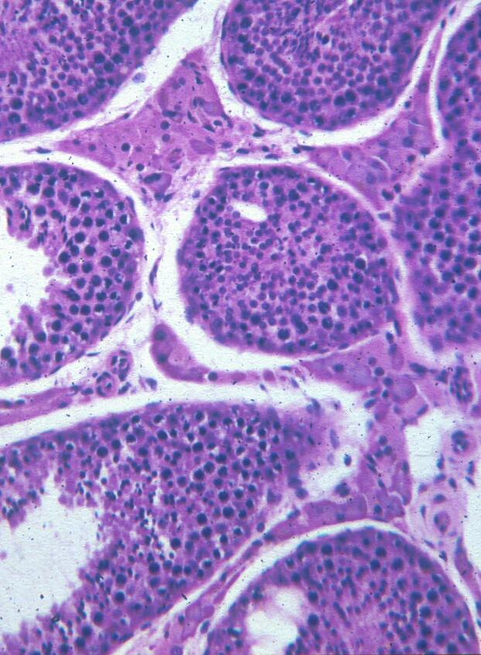
Testis
Myoid cells
Leydig cells
Primary spermatocytes
Spermatogonia
Lymph space
Spermatids

Slide 13
Testis
Parenchyma
  250 Lobules
  Lobule 2-3 seminiferous tubules 50-80 cm (150-250 µ) -Tubuli Recti (tall columnar cells - Rete testis - Ductuli efferentes - Epididymis
  Seminiferous tubules
    No Lumen till 2nd Decade
    Lining epithelium called as germinal
    Other cells- Sertoli/Sustentacular cells

Slide 14
Testis
Germ cells
  Lie in pockets in b/w sertoli cells
  Transported toward lumen with maturation
  Differentiation & maturation – 74 days
  Spermatogonia – stem cells- Diploid, 3 types
    Pale Type A- Dividing
    Dark Type A- Quiscent
    Type B - Pr Spermatocyte

Slide 15
Testis
Germ cells
  Pr Spermatocyte - Largest, - Sec spermatocyte
  Sec spermatocyte - Spermatid
  Spermatid - Spermatozoon (Spermiogenesis)
    Note- All progeny of a spermatogonium connected to each other till spermatozoon stage

Slide 16
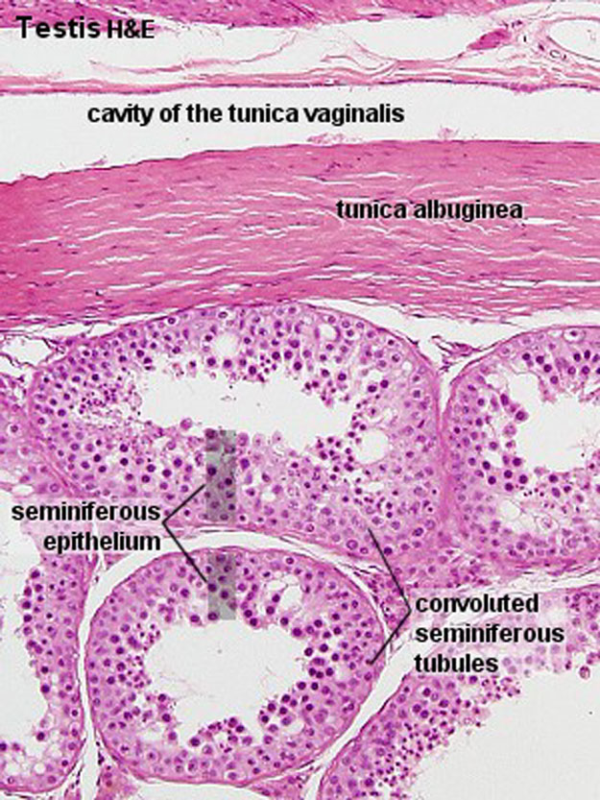
Testis
TUNICA VAGINALIS
TUNICA ALBUGINEA
SEMINIFEROUS TUBULES
SEMINIFEROUS EPITHELIUM
- complex stratified epithelium containing two basic cell populations:
(1) SPERMATOGENIC CELLS
(2) SERTOLI CELLS
Notes:
3

Slide 17
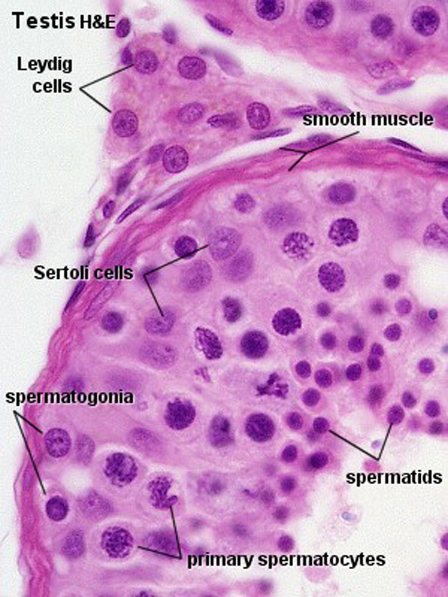
Testis
SEMINIFEROUS TUBULES
SEMINIFEROUS EPITHELIUM
- complex stratified epithelium containing two basic cell populations:
(1) SPERMATOGENIC CELLS
stem cells which regularly replicate and differentiate into mature sperm as they migrate toward the lumen
(2) SERTOLI CELLS
nonreplicating physical support cells
INTERSTITIAL CONNECTIVE TISSUE
(1) LEYDIG CELLS
produce and release testosterone
Notes:
4

Slide 18
Spermatogenesis
A
A
Meiosis
A
A
gonocyte
A
B
1º
2º
A
B
2º
1º
A
A
spermatogonia
spermatid
spermatocyte
spermatozoa

Slide 19
Testis
Parenchyma
  Sertoli cells
    Non dividing cells
    Tall columnar
    Fewer
    Nucleus toward base - pale, ovoid to Δ, Prominent compound nucleolus
    Cytoplasm contains lipids, fibrils & crystalloid inclusions
    Plenty of SER
    Cell memb thrown into folds – tight junctions b/w two
      Basal , ad luminal compartment

Slide 20
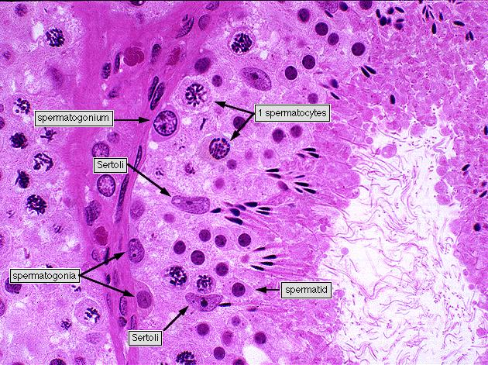
Testis

Slide 21
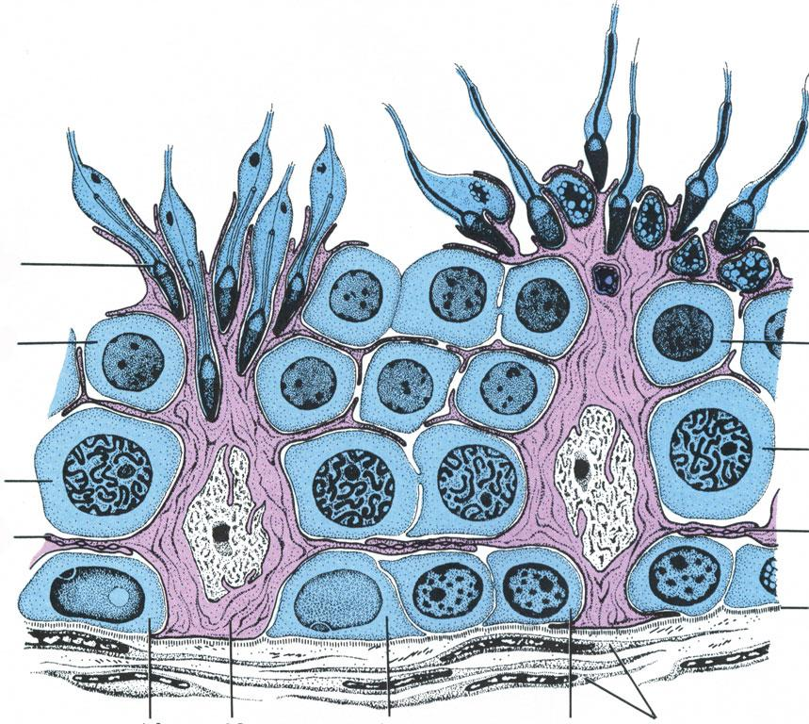
Testis
SPERMATOGONIA
1º SPERMATOCYTE
2º SPERMATOCYTE
SPERMATIDS
SPERMATIDS
2º SPERMATOCYTE
1º SPERMATOCYTE
SERTOLI CELLS:
- columnar with adjoining lateral processes
- extend from basal lamina to lumen
- Sertoli-Sertoli junctions divide seminiferous tubules into basal and adluminal compartments
SERTOLI CELLS
SPERMATOGONIA
Notes:
tight junctions of lateral processes may temporarily open to permit the passage of spermatogenic cells toward the lumen

Slide 22
Testis
Parenchyma
  Sertoli cell- functions
    Maintain blood- testis barrier
    Provide nourishment to dividing cells
    Concentrate testosterone locally (androgen binding pr) helps spermatogenesis
    Transport interconnected maturing germ cells toward lumen
    Active release of spermatozoa into lumen
    Phagocytose excess cytoplasm from maturing S’zoa
    Phagocytose degenerating germ cells

Slide 23
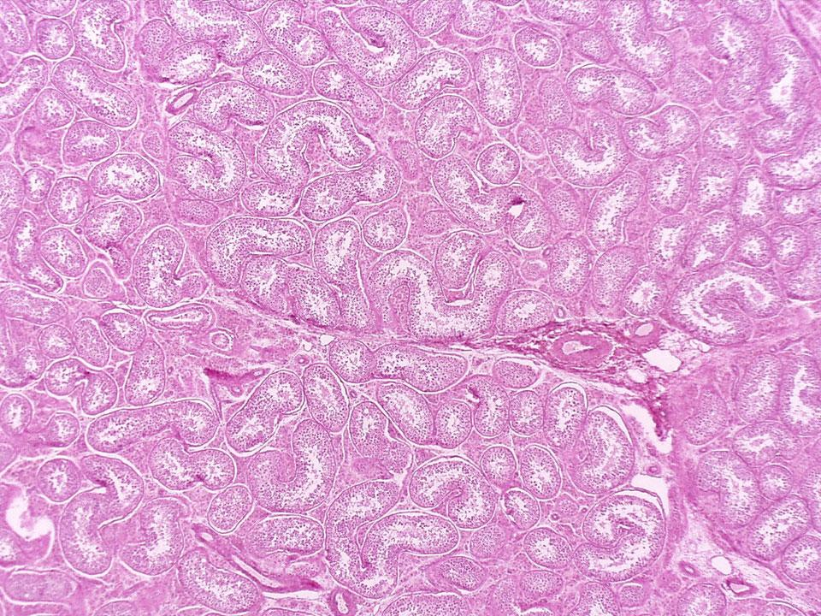
Testis H&E
Seminiferous Tubules
Notes:
testis-01

Slide 24
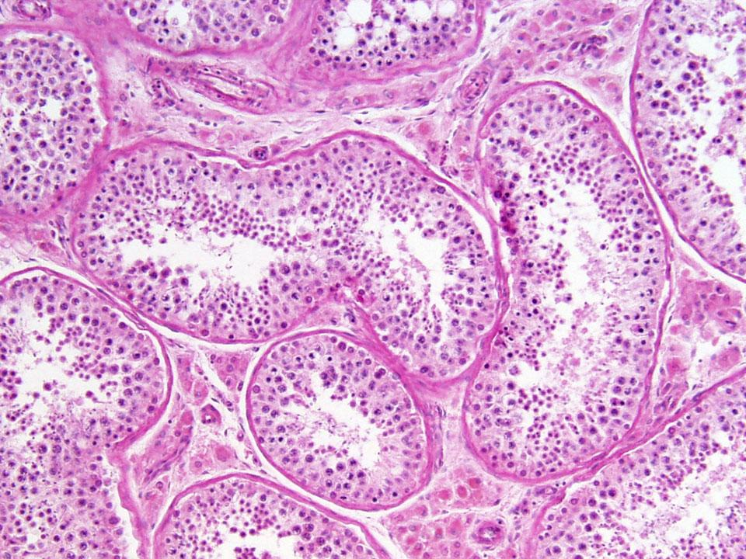
Testis H&E
Seminiferous Tubules
Interstitial Conn. Tissue
Notes:
testis-02

Slide 25
Seminiferous Tubules
Interstitial Conn. Tissue
Notes:
testis-03

Slide 26
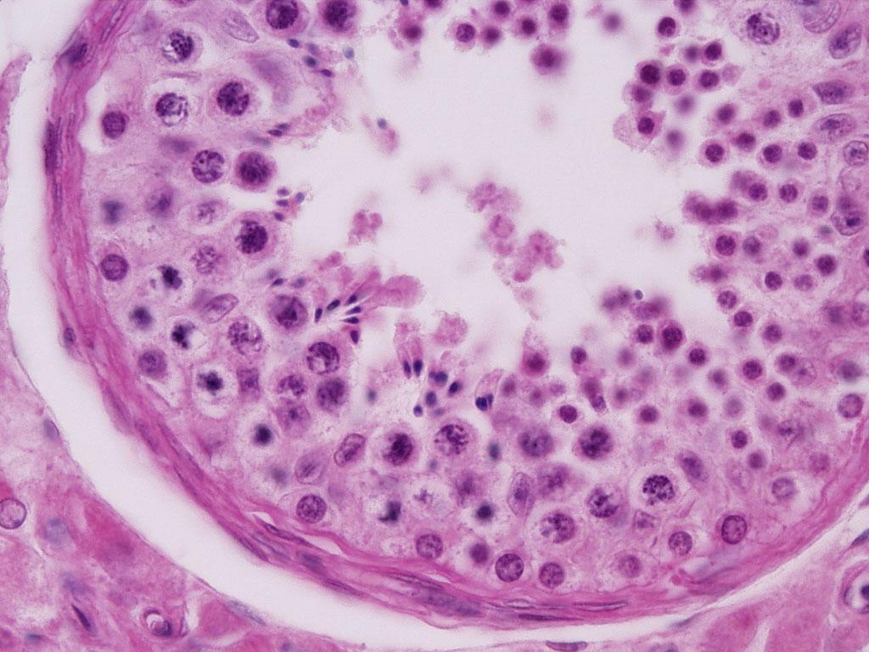
Notes:
testis-05

Slide 27
Testis
Interstitial cells of Leydig
  Found in groups near sinusoids in loose CT b/w ST
  Derived from mesenchyme
  Large 20 μ
  Nucleus spherical
  Cytoplasm pale- lipid content
  SER prominent
  Lipochrome pigment, extensive sER
  Crystalloid inclusions- Crystals of Reinke – Functions ?

Slide 28
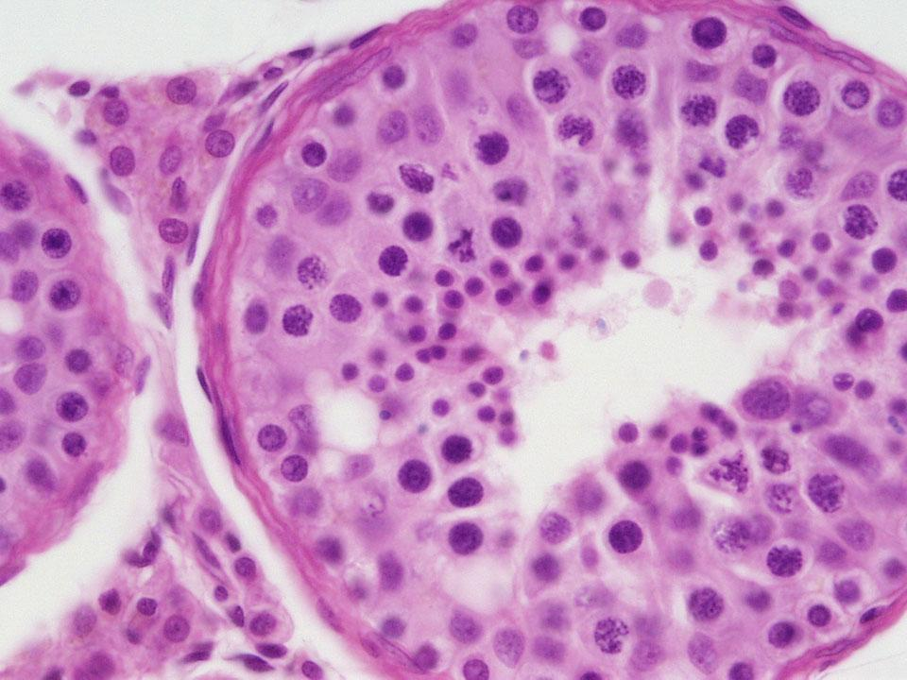
Notes:
testis-09

Slide 29
Testis
Microscopic Appearance
  Thick fibro elastic conn tissue capsule
  S Tubules cut in different sections
  Epithelium seems 4-8 cells thick
  Cells adjacent to lumen transforming to spermatozoa
  Lumen full of spermatozoa

Slide 30
Epididymis
Along posterior border testis
Single long tube – 6 m
Receives efferent ductules at head
Smooth regular lumen
Pseudostratified columnar with stereocilia
Circularly arranged smooth muscle fibres – Thicker at distal end
Continuous with Ductus Deferens

Slide 31
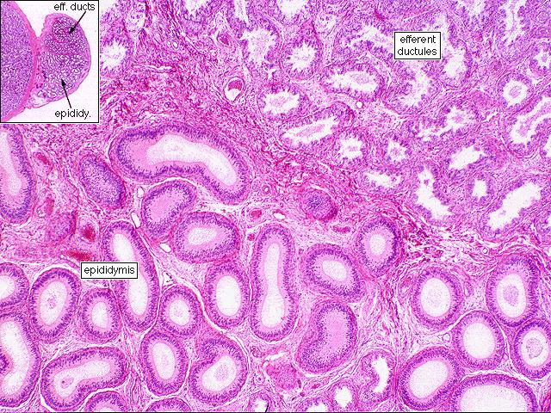
Epididymis

Slide 32
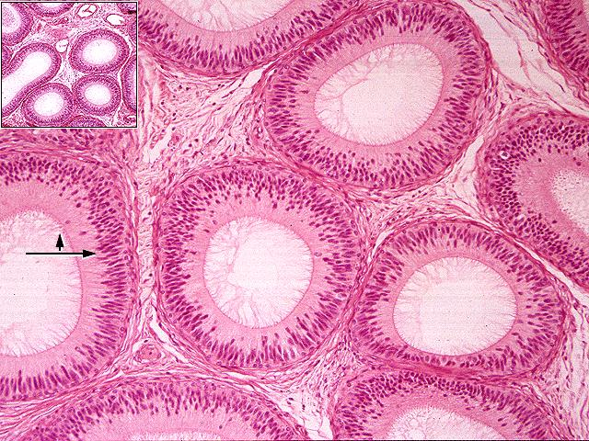
Epididymis

Slide 33
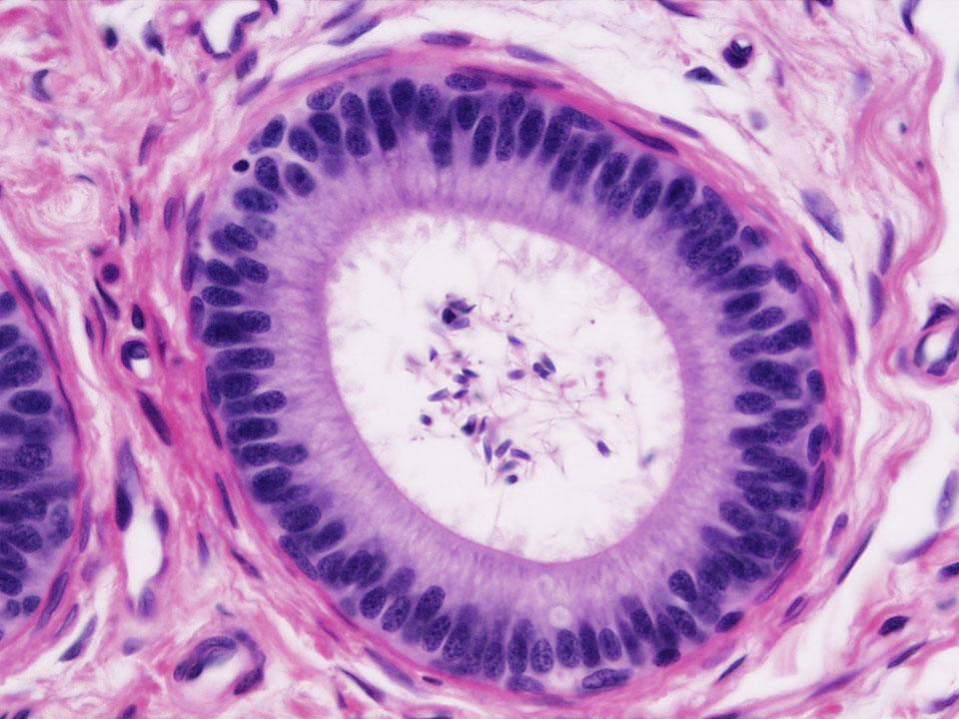
EPIDIDYMIS
Notes:
epididymus-08

Slide 34
Ductus Deferens
Small lumen folded irregular
Pseudostratified columnar with stereocilia
Lamina propria – Fibro elastic (thin)
Muscular layer - 3, Thick, palpable (cord like)
Adventitia - fibroelastic
Surrounded by arteries, nerves, lymphatics & pampiniform plexus

Slide 35
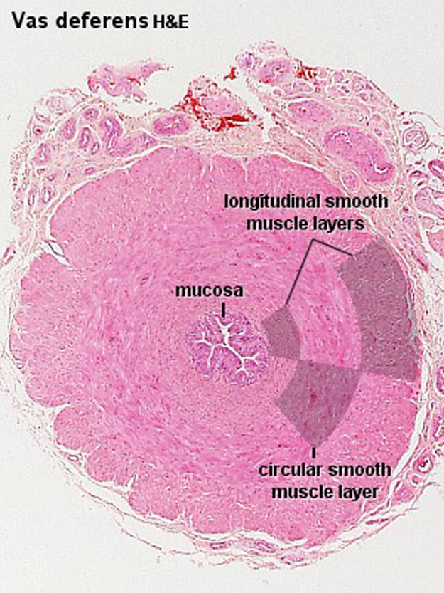
Notes:
8

Slide 36
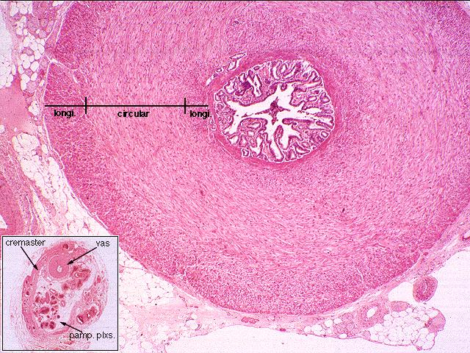
Vas Deferens

Slide 37
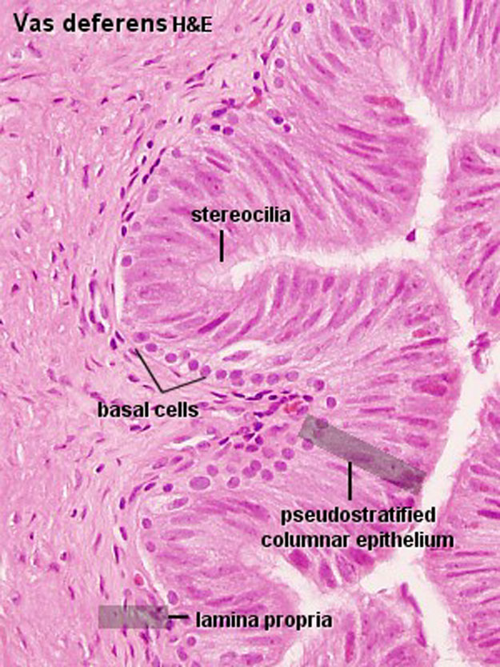
Vas Deferens
Notes:
9

Slide 38
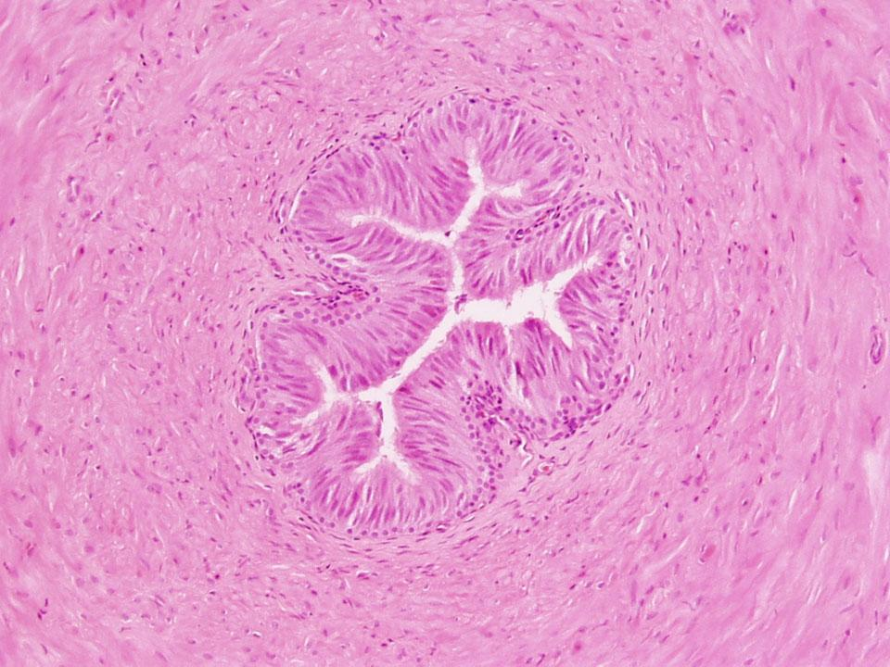
Vas Deferens H&E
Notes:
vas-02

Slide 39
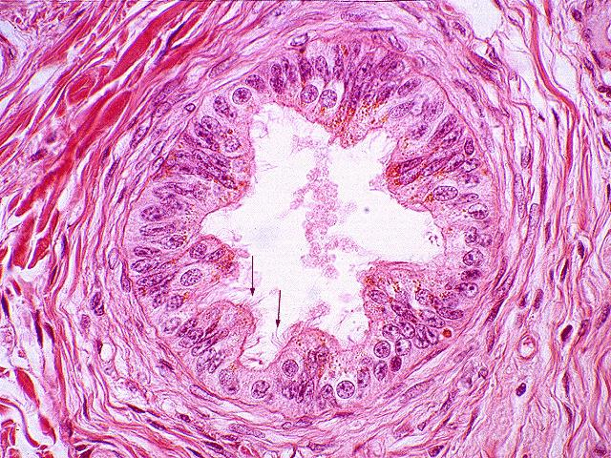
Vas Deferens

Slide 40
Prostate

Slide 41
Introduction
Largest accessory sex gland
Surrounds begining of male urethra
Size of chestnut – 20 g in adult
2 capsules – True and false
Compound tubulo-alveolar gland
Prostatic fluid – citric acid, acid phosphatase amylase and fibriolysin
Serum PSA in ca prostate

Slide 42
Introduction
Glands in 3 concentric regions
  First- Smallest- Mucosal- periurethral - prone to adenoma obstruction
  Second- Submucosal – Open into urethral sinuses
  Third- Main glands- Bulk- Open into urethral sinuses

Slide 43
Prostate
Parenchyma
  Glands Tubulo alveolar
  Large irregular prostatic alveoli / acini – follicles
  Follicles folded at places – papillary folds get ironed out when full of secretion
  Lining epithelium - secretory cells
    Tall columnar basal elongated nu - interspersed smaller, flatter cells
    Columnar cells have prominent Golgi supra nu
    Ducts ? At times bilaminar epith

Slide 44
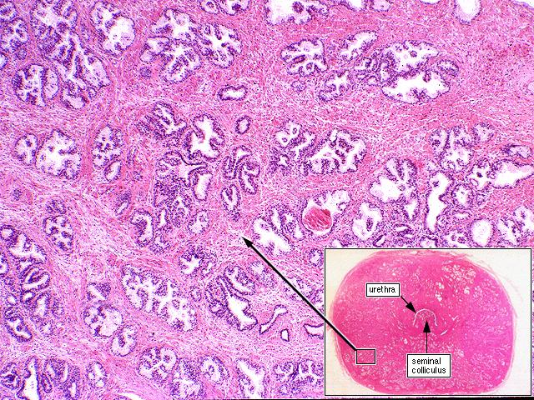
Prostate

Slide 45
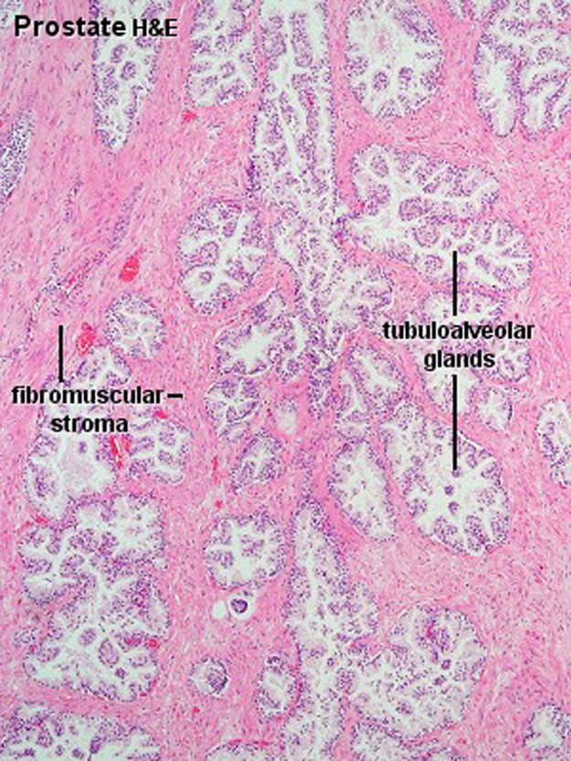
PROSTATE
SIMPLE OR PSEUDOSTRATIFIED COLUMNAR EPITHELIUM
30-50 TUBULOALVEOLAR GLANDS WHICH EMPTY INTO URETHRA
PROSTATIC SECRETIONS RICH IN CITRIC ACID, ACID PHOSPHATASE, AND PROTEOLYTIC ENZYMES
Notes:
10

Slide 46
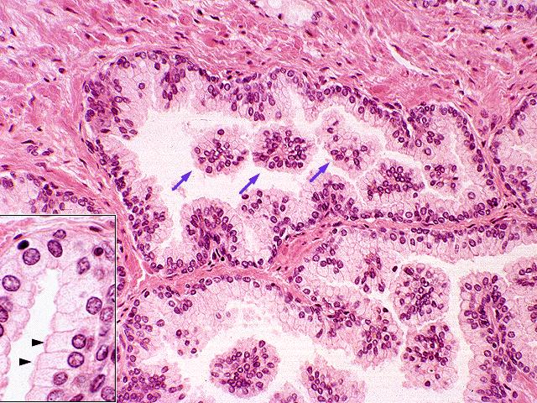
Prostate

Slide 47
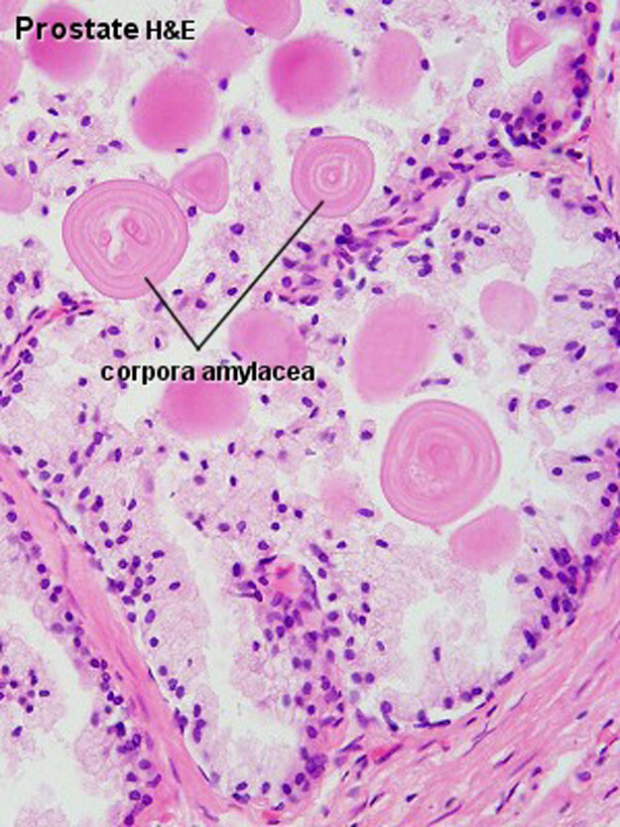
PROSTATE
PROSTATIC CONCRETIONS
Condensation of prostatic secretions
No increases with age, calcified
Notes:
11

Slide 48
Prostate
Fibromuscular stroma
  Charac feature
  In b/w follicles
  Smooth muscle + ct fibres + bv + lymphatics + nerves

Slide 49
Age changes
Age Changes
  Birth – Small, simple duct system, mainly stroma
  1st 6 wks- Hyperplasia (Maternal hormones)
  9-14 yrs- Elaboration of duct system
  Puberty- Stroma reduces, gland size – follicle
  Till 4th decade- follicles grow typical infolding epithelium
  Mid 4th decade- involution, amyloid bodies
  Old age- BPH or atrophy, occ malignant change

