Slide 1
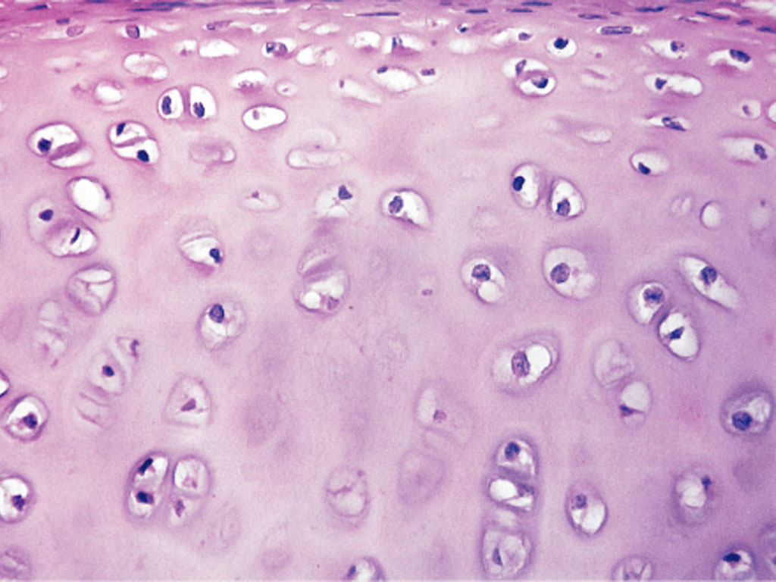
HISTOLOGY
CARTILAGE
DR. PRAVEEN KURREY
M.B.B.S., M.S. BCME, BCBR PROFESSOR ANATOMY

Slide 2
Definition
Cartilage is a flexible connective tissue found in many areas in the bodies of humans and other animals, including the joints between bones, the rib cage, the ear, the nose, the bronchial tubes and the intervertebral discs. It is not as hard and rigid as bone but is stiffer and less flexible than muscle.

Slide 3
Specialized type of dense connective tissue
  Gives support
  Bears weight
  Withstands tension, torsion and bending
Avascular and devoid of lymphatics
Derives nutrition from tissue fluids

Slide 4
Consists of-
Cartilage cells
  Chondroblast
  Chondrocyte
Intercellular Matrix
  Ground substance
    Chondromucoprotein
  Fibres
    Collagen fibres
    Elastic fibres

Slide 5
Chondroblasts
less differentiated cartilage cells, originate from non-differentiated mesenchyme;
have a flattened shape; a well-developed rough endoplasmic reticulum in a basophilic cytoplasm;
function - elaboration of cartilage intercellular matter; under certain circumstances chondroblasts are capable of producing matrix-degrading enzymes - collagenase, elastase, hyaluronidase;
reside in the internal layer of periosteum and in the depth of matrix - within lacunes;
chondroblasts mature into chondrocytes.

Slide 6
Chondrocytes
Differentiated cartilage cells;
Round or angular shapes, with advancing cellular age chondrocytes progressively lose their rough endoplasmic reticulum;
Function - elaboration of cartilage intercellular matter; under certain circumstances chondroblasts are capable of producing matrix-degrading enzymes - collagenase, elastase, hyaluronidase
Reside in the depth of matrix - within minute special cavities lacunes
Sometimes the number of cartilage cells in one lacune is more than one, it is the consequence of cell division;
Quite often the division is accomplished through amitosis; such cellular groups are called isogenic groups

Slide 7
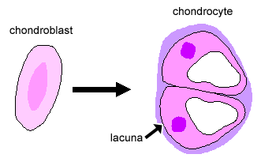
Chondroblast vs Chondrocyte

Slide 8
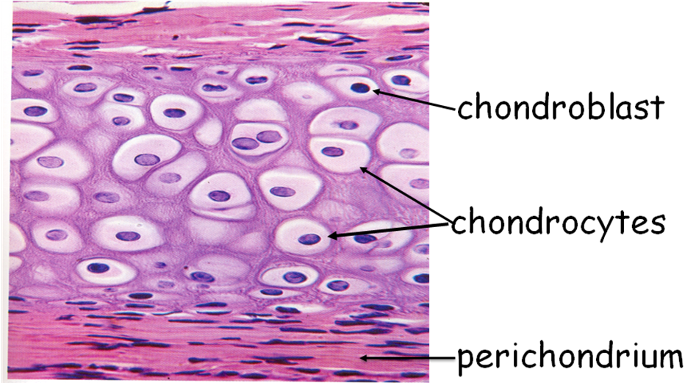
Chondroblast And Chondrocyte

Slide 9
Types of Cartilage-
Hyaline Cartilage
Elastic Cartilage
Fibrocartilage

Slide 10
1. Hyaline Cartilage
Encapsulated cartilage cells forming cell nests.
Intercellular substance consists of ground substance only.
Ground substance homogenous.
Metachromasia.
Perichondrium present except in articular cartilage.
Sites-trachea,bronchus,nose,costal,articular & epiphyseal, cricoid.

Slide 11
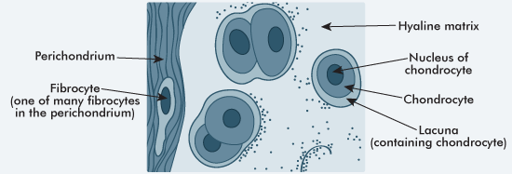
Hyaline Cartilage

Slide 12
Hyaline Cartilage

Slide 13
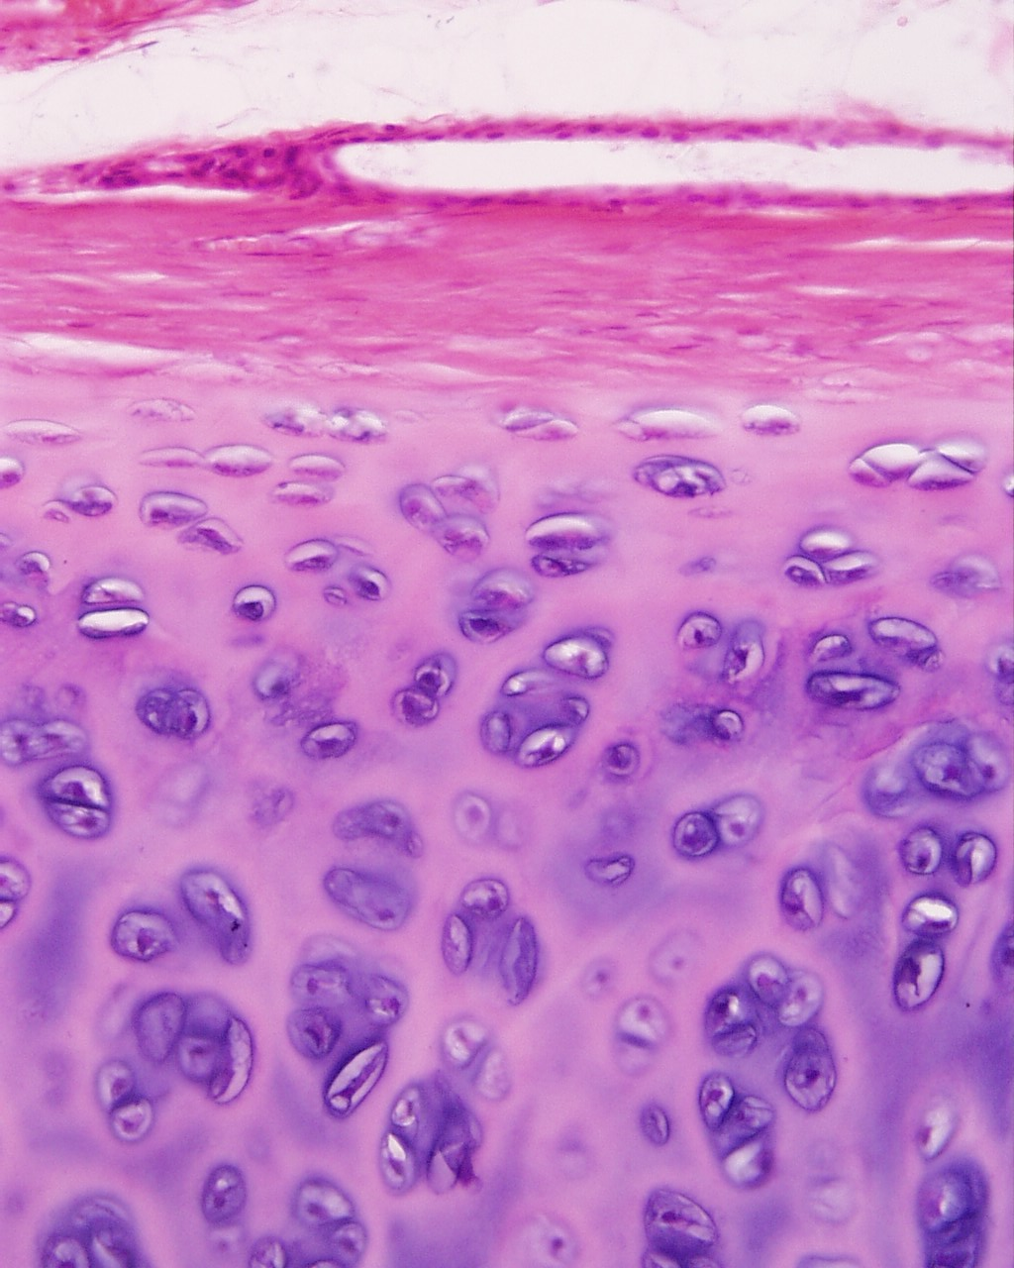
Hyaline Cartilage

Slide 14
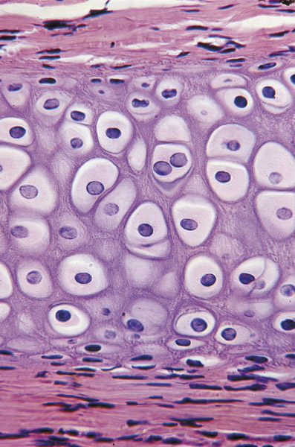
Perichondrium
Dense CT that covers cartilage (except articular cartilage of joints.)
Fibrous layer
Contains collagen fibers, fibroblasts
Contains blood v, nerve supply, lymphatics.
Cellular layer (cambium)
Hyaline cartilage

Slide 15
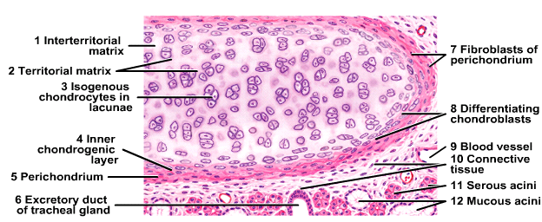
Hyaline Cartilage

Slide 16
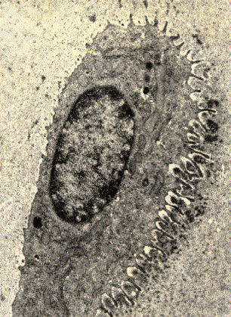
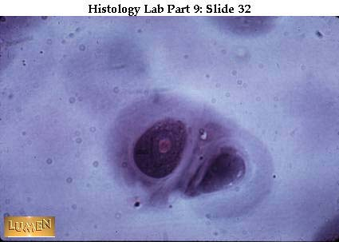
Chondrocytes in Lacunae

Slide 17
2. Elastic Cartilage
Similar to hyaline cartilage
Elastic fibers in addition to collagen.
Found in - auricle of ear, walls of external auditory canals, eustachian tubes, epiglottis, larynx
Maintains shape, deforms but returns to shape; flexibility of organ; strengthens and supports structures.

Slide 18
Elastic Cartilage
Cartilage cells.
Ground substance contains network of branching & anastomosing elastic fibres.
Perichondrium present.
Sites-epiglottis,pinna,ext acoustic meatus,pharyngotympanic tube.

Slide 19
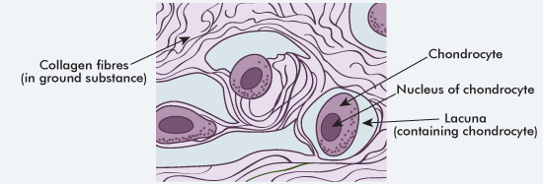
Elastic Cartilage

Slide 20
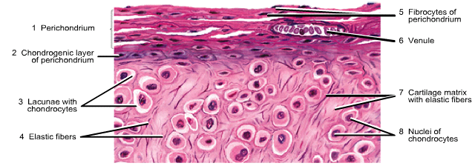
Elastic Cartilage

Slide 21
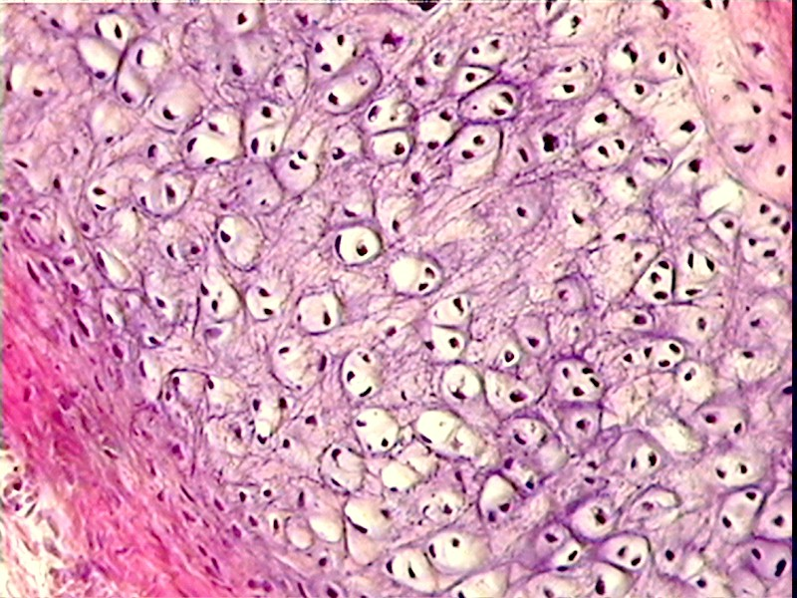
Elastic Cartilage

Slide 22
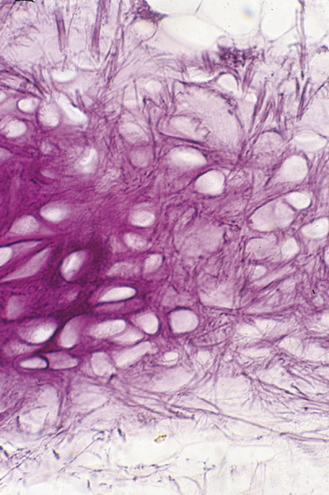
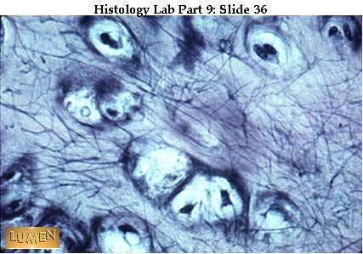
Elastic Cartilage
Elastic fibers (elastin)
Yellow color

Slide 23
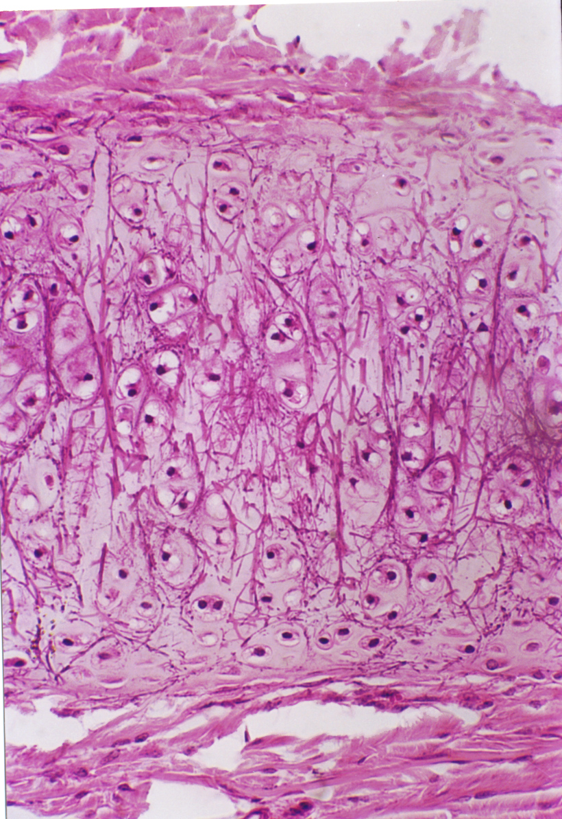
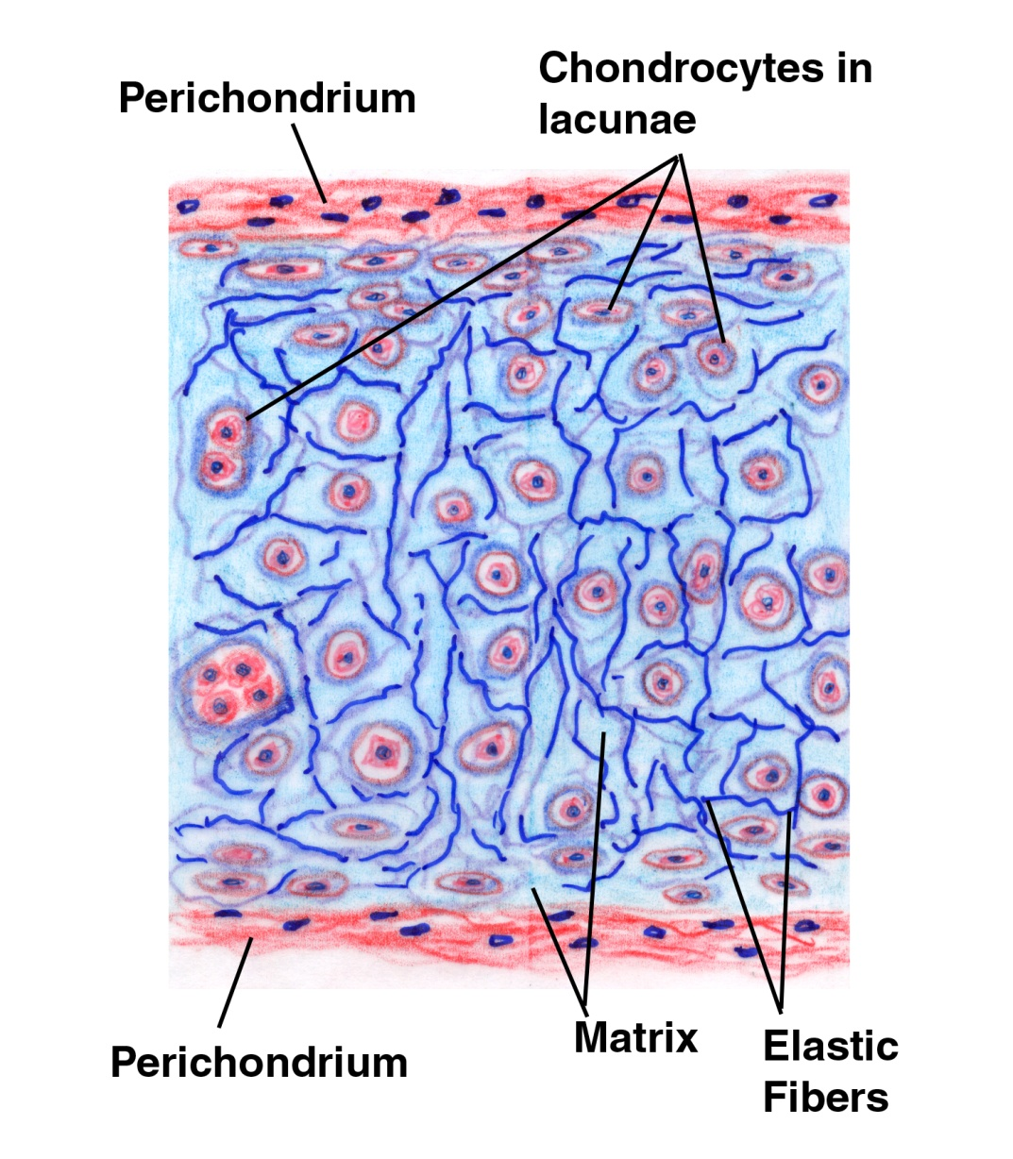
Elastic Cartilage
(Epiglottis)

Slide 24
3. Fibrocartilage
Cartilage cells present but in smaller number & most occur singly.
Intercellular substance has thick bundles of collagen fibres running parallel to each other & r separated by narrow areas of non fibrous matrix where the cartilage cells r lodged.
Perichondrium absent.
Sites-intervertebral disc,pubic symphysis,articular discs of joints.

Slide 25
Fibrocartilage
No Perichondrium
Collagen fibres (Type I)
  Densely packed – bundles - branch
  Feathery appearance
  Merge with surrounding conn tissue
Scanty Chondrocytes
  Small cells in lacunae
  form short rows between dense bundles of collagen fibres

Slide 26
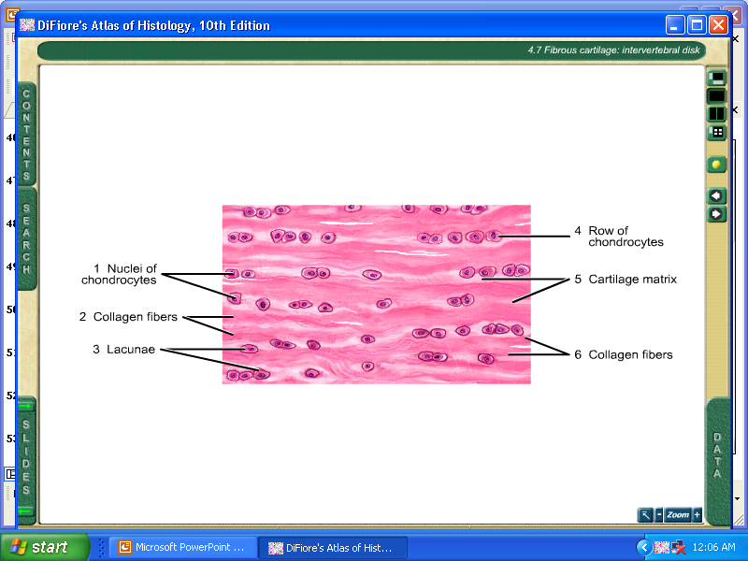
Fibrocartilage

Slide 27
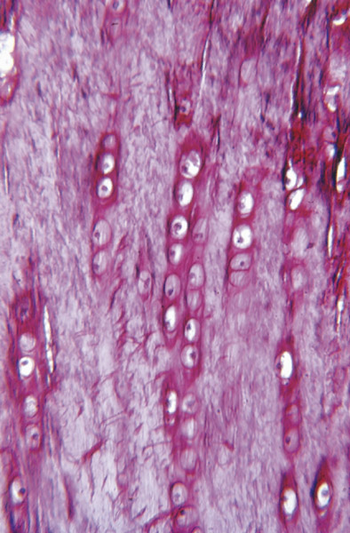
Fibrocartilage

Slide 28
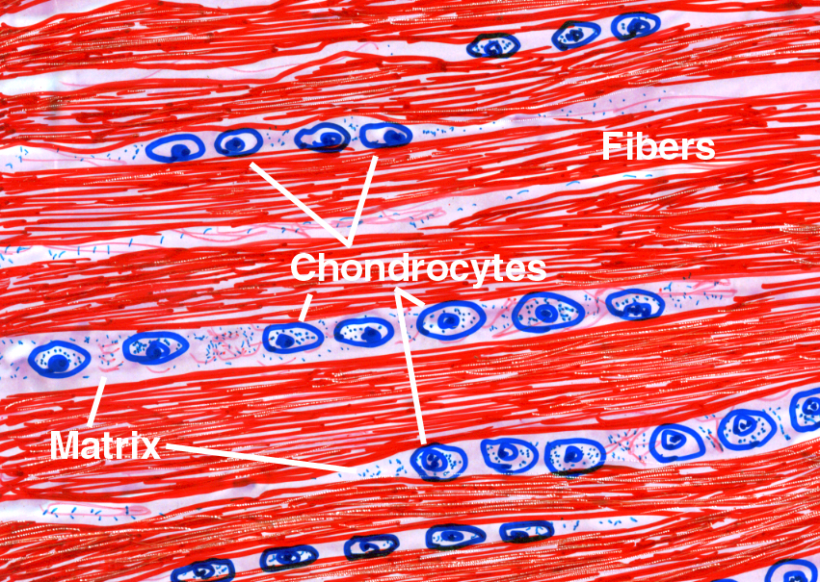
Fibrocartilage

Slide 29
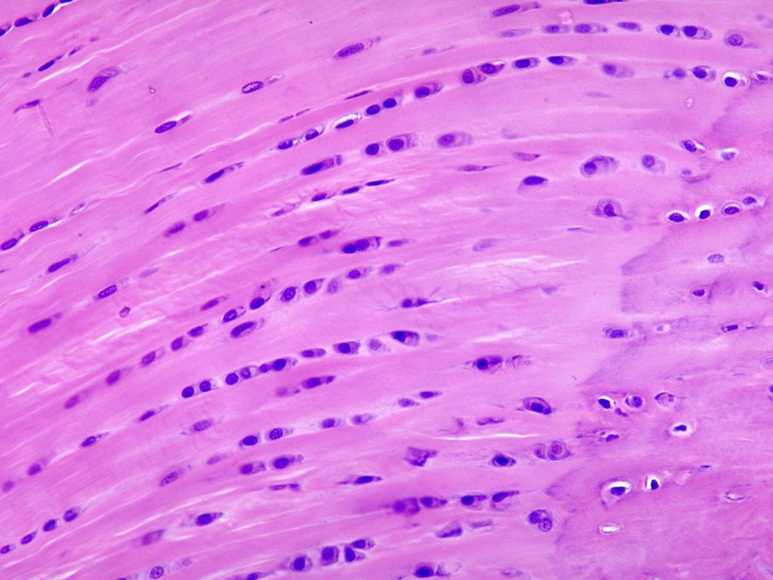
Fibrocartilage

Slide 30
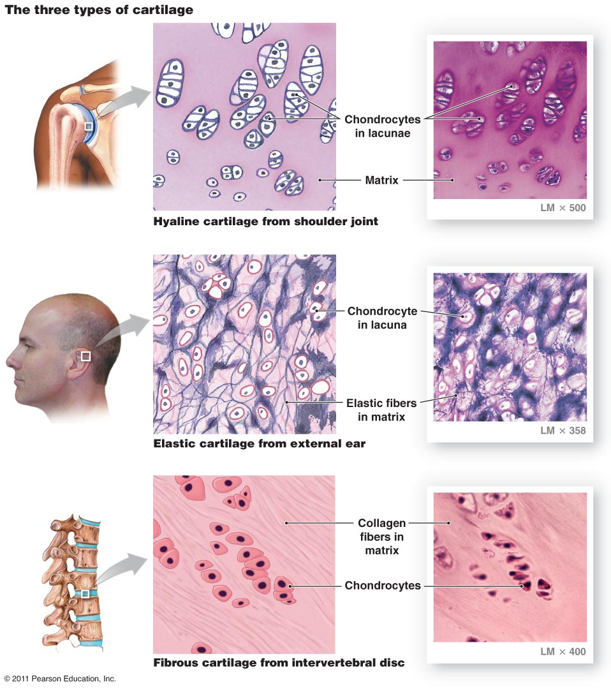

Slide 31
Growth of Cartilage
Growth is attributable to two processes:
  Interstitial growth
    Mitotic division of preexisting chrondrocytes
    Synthesis of matrix
    Expands cartilage matrix from within
    Occurs in epiphyseal plates, articular cartilage
  Appositional growth
    Differentiation of perichondrial cells → chondroblasts
    Synthesis of matrix – deposited at surface
    Increase in girth
    Seen in mature cartilage

Slide 32
Growth in the Epiphyseal Plate

Slide 33
Epiphyseal Plate
(Interstitial Growth)
http://web.indstate.edu/thcme/mwking/glycans.html

Slide 34
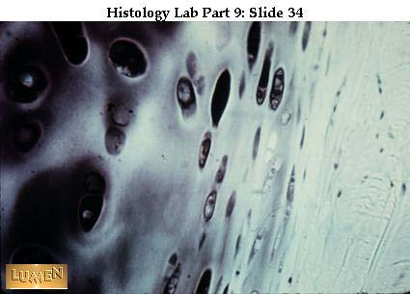
Appositional Growth

Slide 35
Functions of Cartilage
Specialized CT in which the firm consistency of the extracellular matrix allows the tissue to bear mechanical stresses without permanent distortion
Supports soft tissues.
Shock-absorbing because it is resilient.
Smooth surface allows sliding against it.
Essential for growth, development of bone.

Slide 36
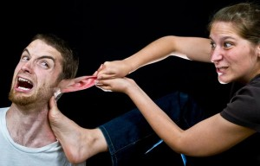
THANK YOU

