Slide 1
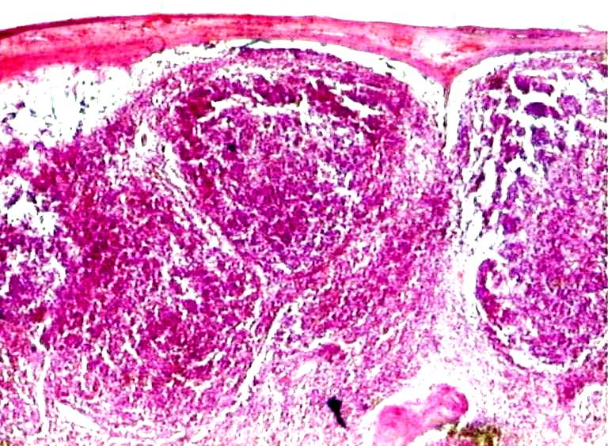
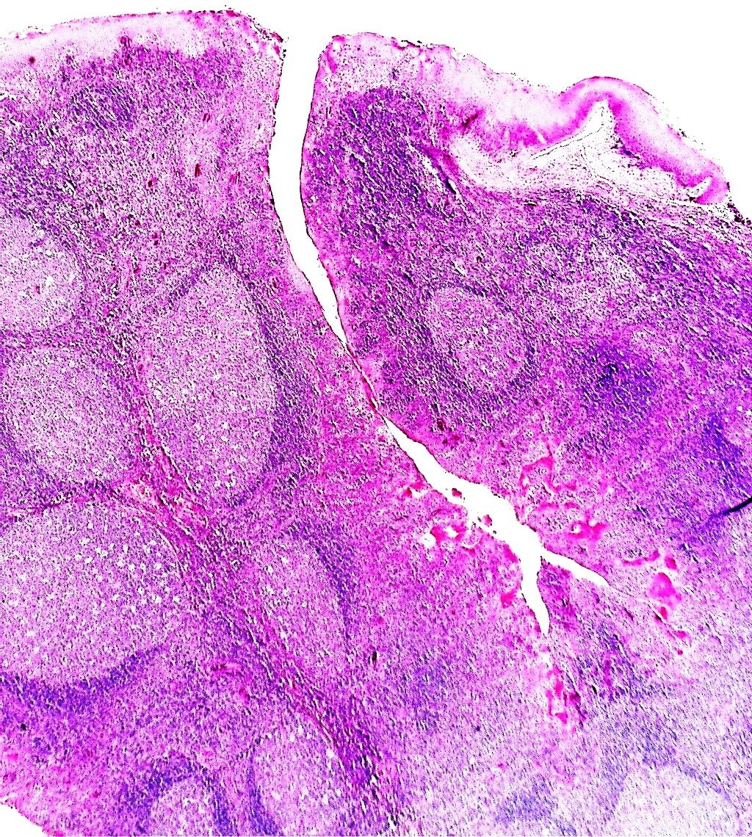
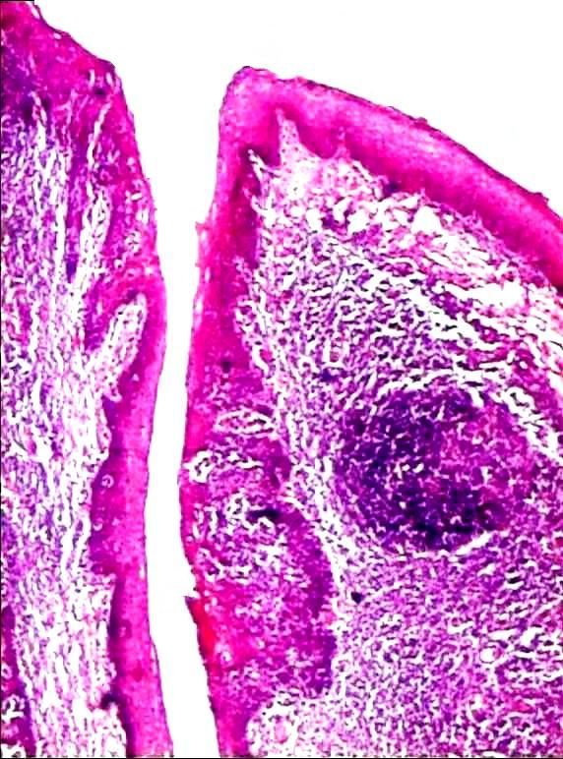
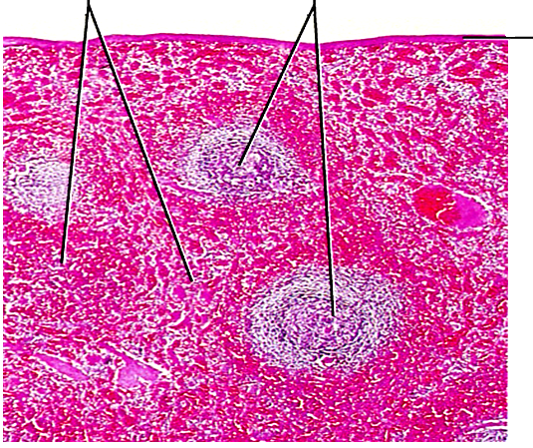
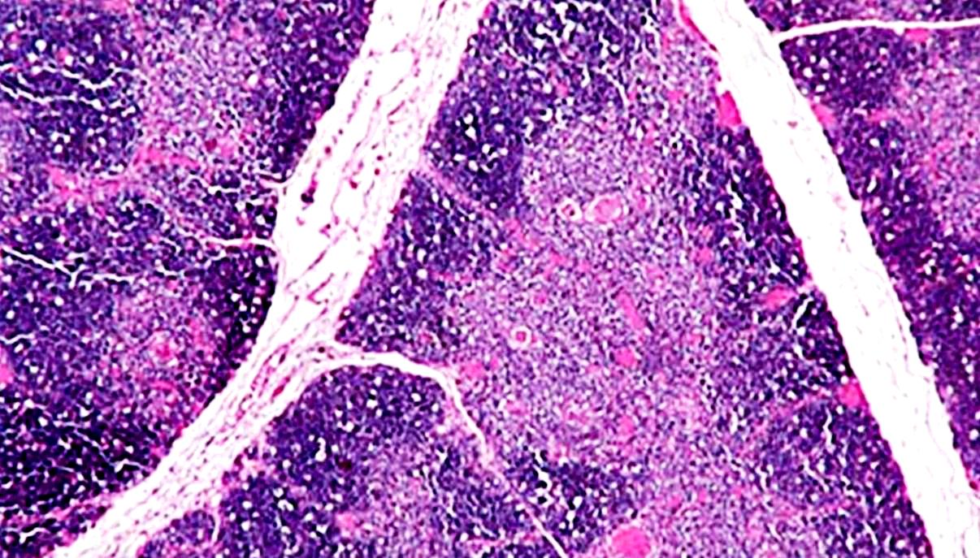
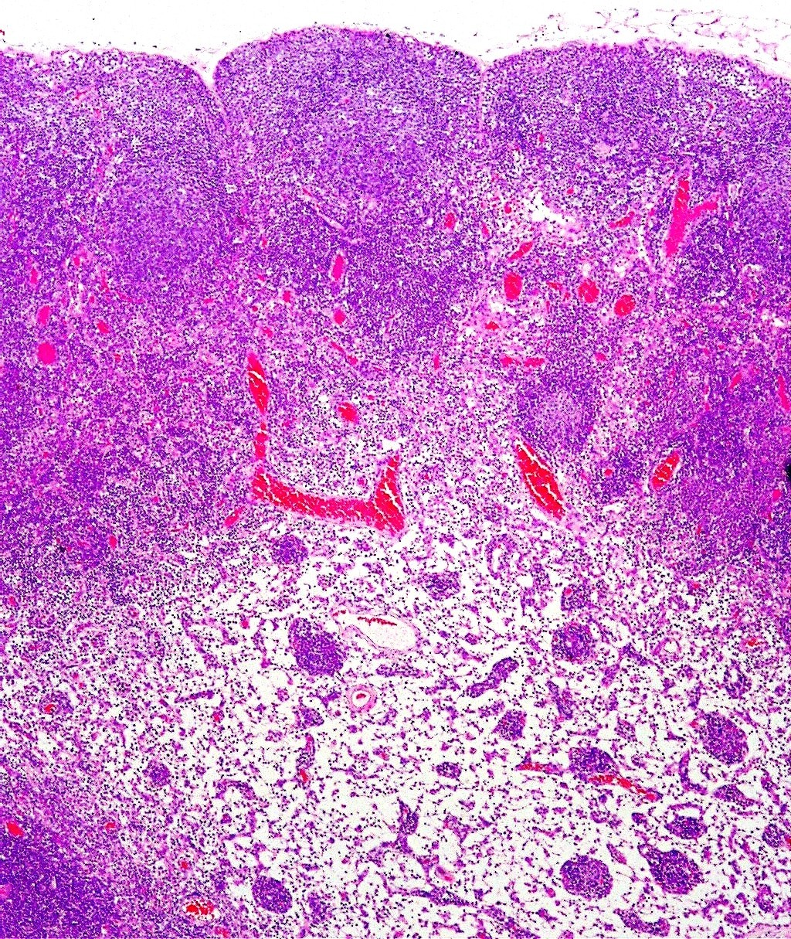
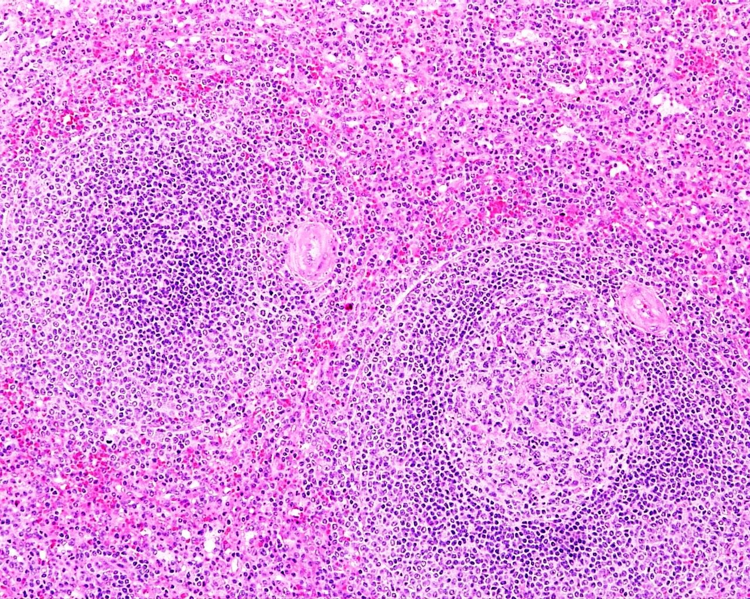
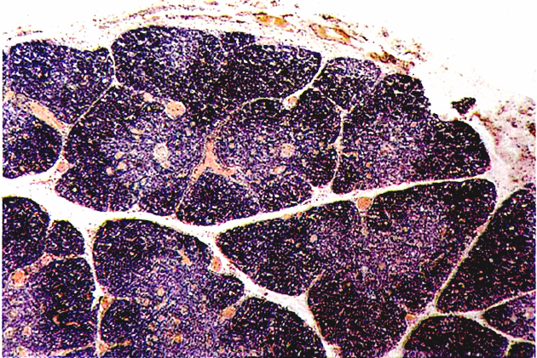
LYMPH NODE
PALATINE TONSIL
SPLEEN
THYMUS
1
Red pulp
Hassal’s
corpuscles
2
Subcapsular sinus
1
Str squamous
nonkeratinised epi
3
2
White pulp
1
3
1
4
4
2
2
3
5
5
3
4
4
5
Capsule
Subcapsular sinus
Lymphatic nodule in cortex
Germinal centre
Medulla
Capsule
Tonsillar crypt
Lymphatic nodule
Lamina propria
Mucous glands
White pulp
Central arteriole
Germinal centre
Red pulp
Capsule
Cortex
Medulla
Hassal’s corpuscles
Blood vessel
IDENTIFYING FEATURES
Crypts lined by St Sq nonkeratinised epi
Subepithelial lymphatic nodules
Mucous glands
IDENTIFYING FEATURES
Thick capsule with trabeculae
Divided into white pulp & red pulp
Lymphatic nodules traversed by
central arterioles
Red pulp contains splenic cords &
sinusoids
IDENTIFYING FEATURES
Thin capsule
Subcapsular sinus
Lymphatic nodules with
germinal centres
Medullary cords & sinuses in medulla
IDENTIFYING FEATURES
Many lobules of lymphoid tissue
Darkly stained cortex & lightly
stained medulla in each lobule
Hassal’s corpuscles in medulla

Slide 2
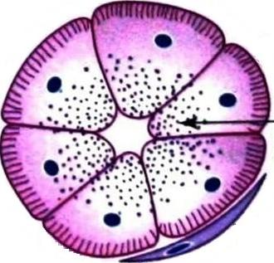
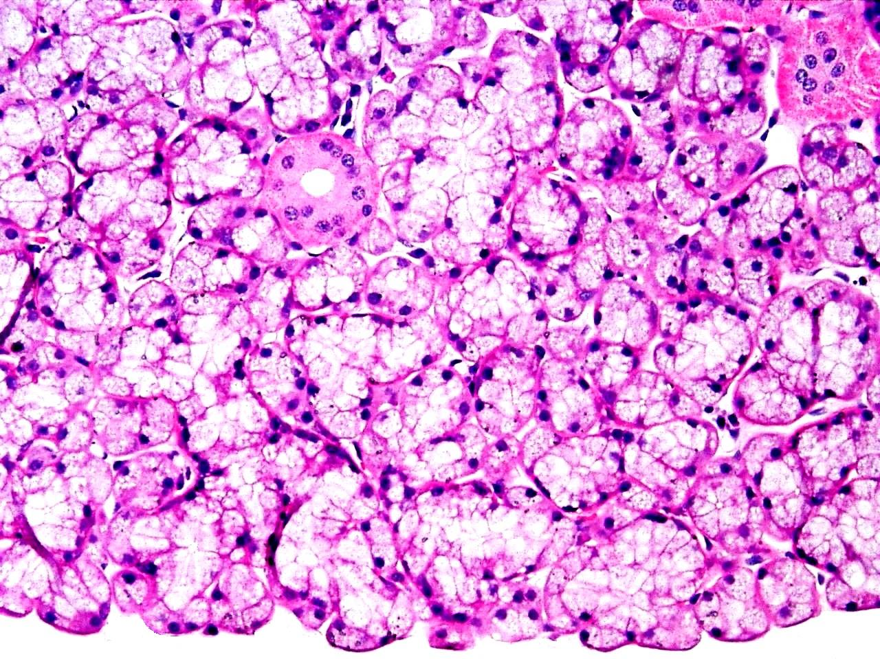
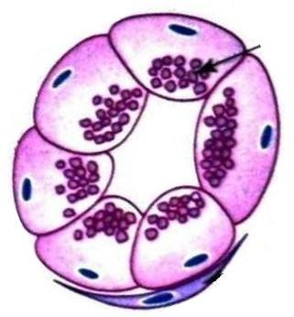
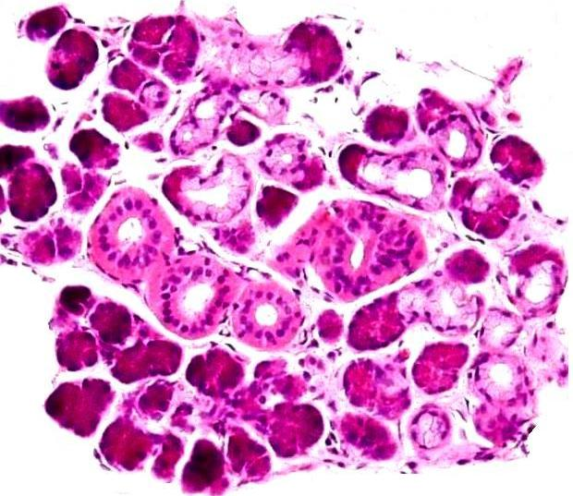
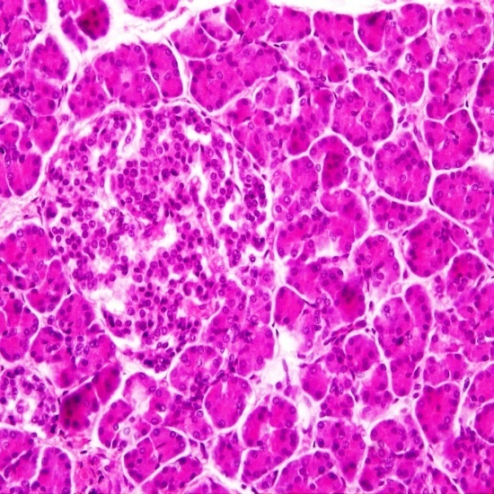
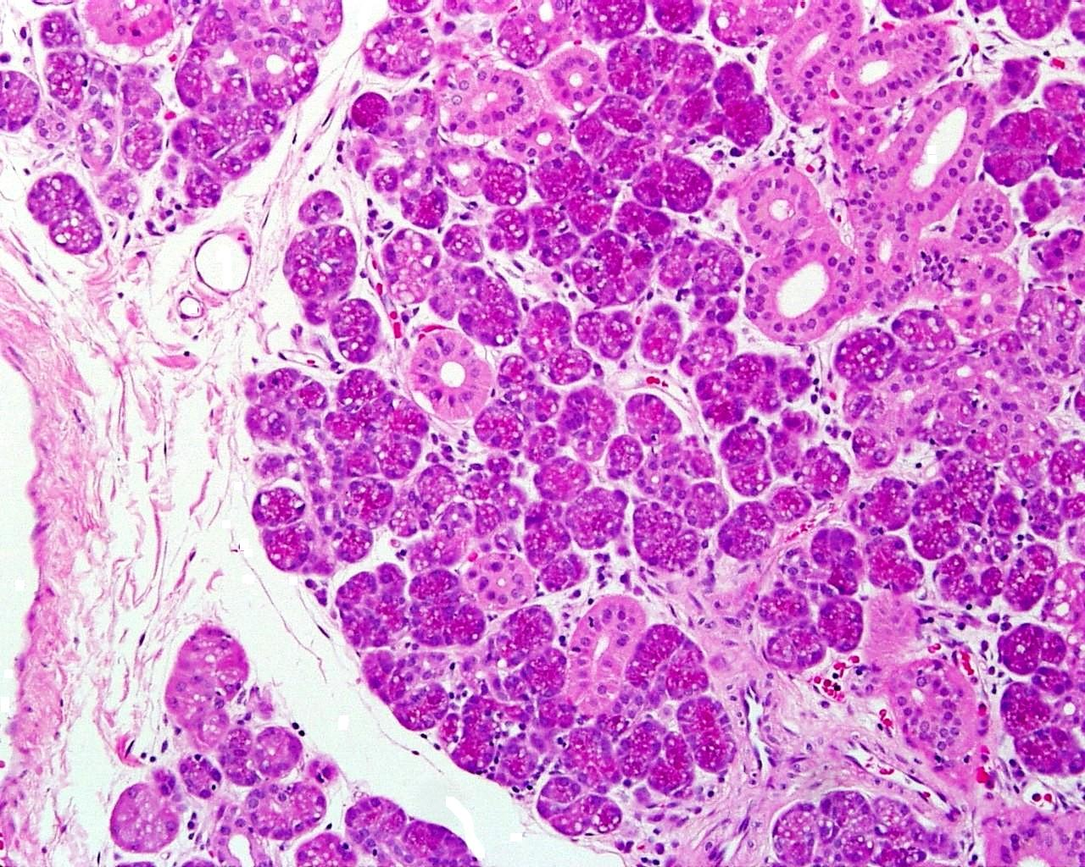
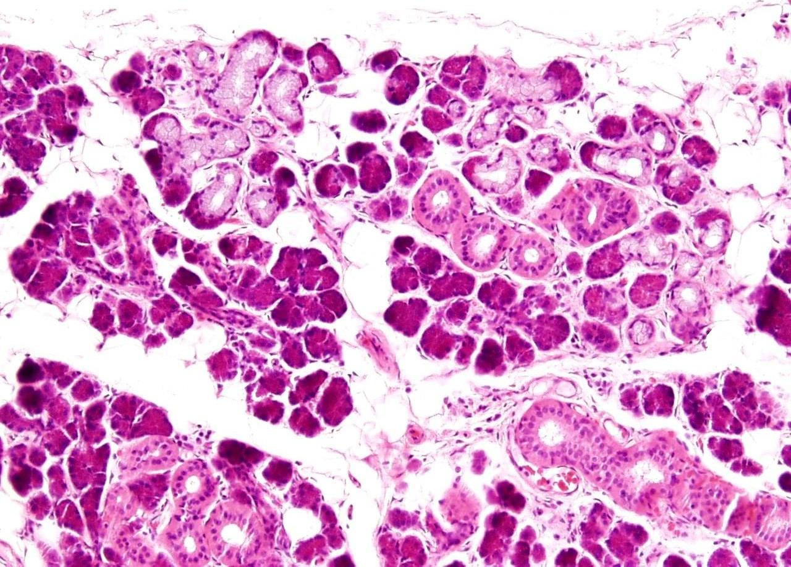
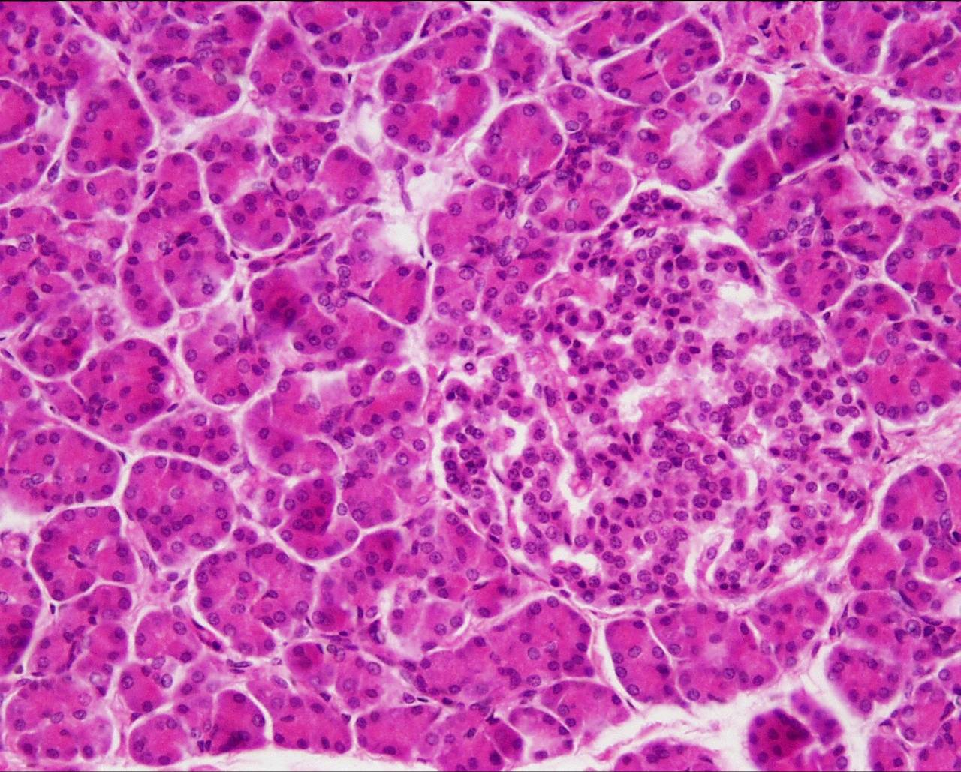
SEROUS SALIVARY GLAND
MUCOUS SALIVARY GLAND
MIXED SALIVARY GLAND
PANCREAS
Mucigen
droplets
Serous demilune
Islets of
Langerhans
Zymogen
granules
Intralobular
ducts
4
SEROUS ACINUS
1
MUCOUS ACINUS
1
2
2
1
1
3
5
3
3
2
2
3
4
4
3
Serous acini
Intralobular ducts
Intralobular CT
Arteriole
Interlobar CT
Intralobular duct
Mucous acini
Serous demilunes
Scanty intralobular CT
Serous acini
Intralobular ducts
Mucous acini
Interlobular CT
Serous acini
Islets of Langerhans
Centroacinar cell
IDENTIFYING FEATURES
Many serous acini, few mucous acini
Mucous acini with serous demilunes
of Gianuzzi
Many striated ducts
IDENTIFYING FEATURES
Darkly stained serous acini
Lightly stained islets
of Langerhans
Centroacinar cells
Absence of striated ducts
IDENTIFYING FEATURES
Serous acini
Acini: small, basophilic stain
Nuclei: Round & basal
Large number of ducts
including striated ducts
IDENTIFYING FEATURES
Larger lightly stained mucous acini
Nuclei: flattened & peripheral
Cytoplasm: pale & vacuolated
Serous demilunes
Few striated ducts

Slide 3
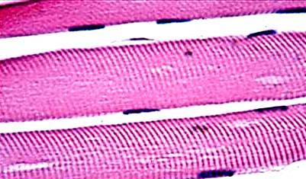
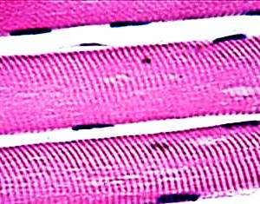
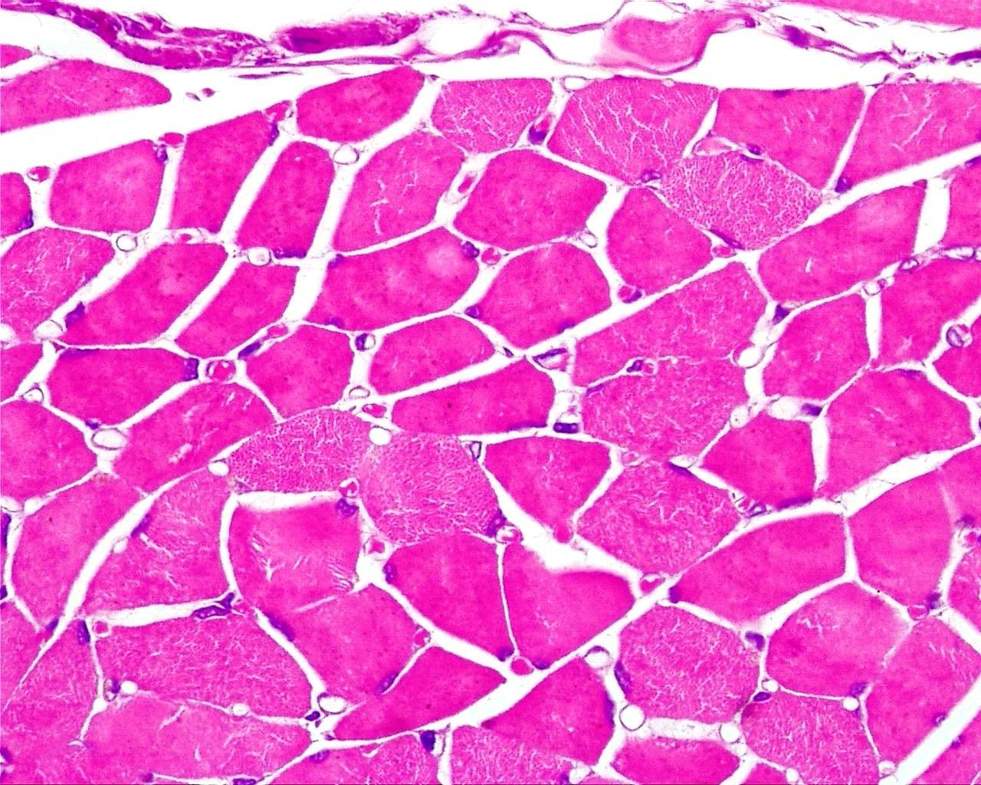
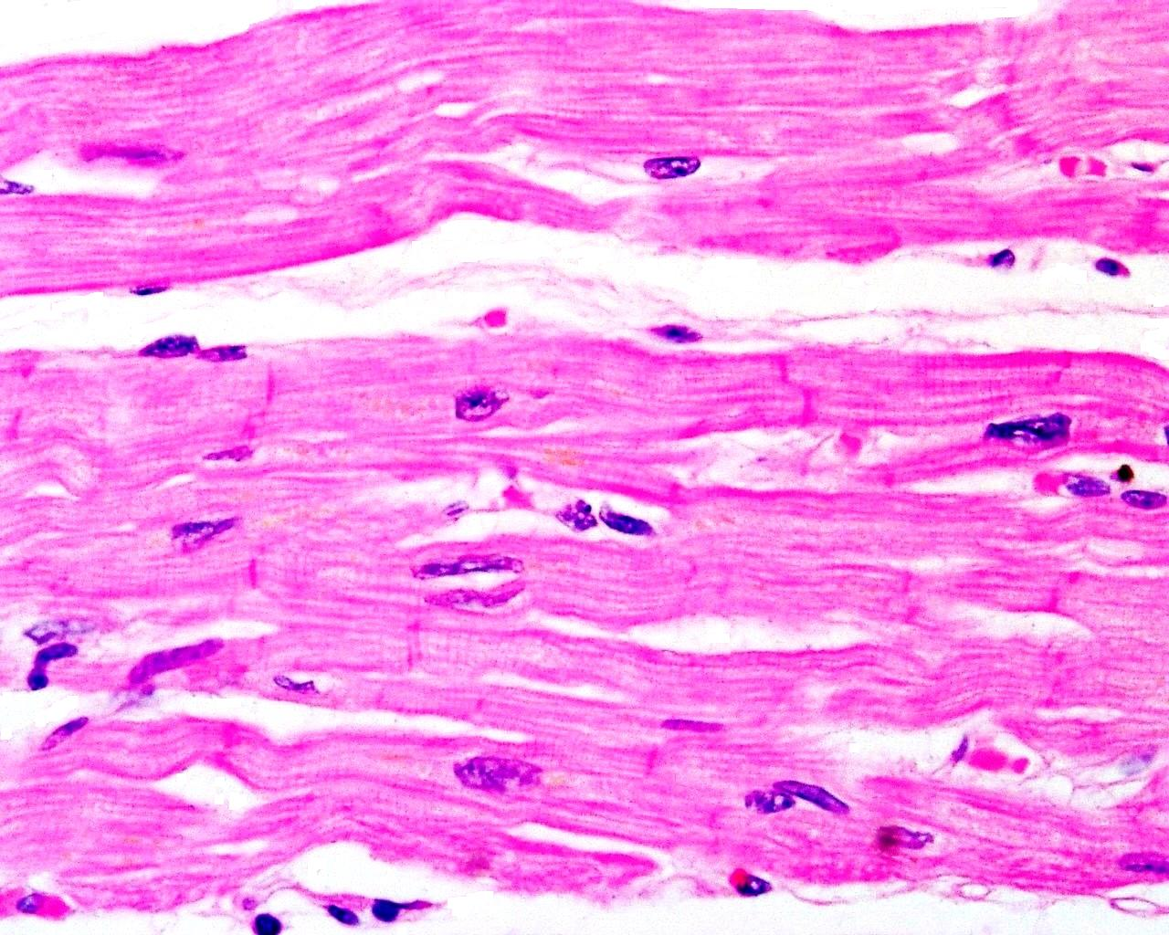
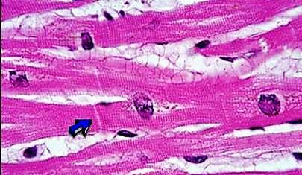
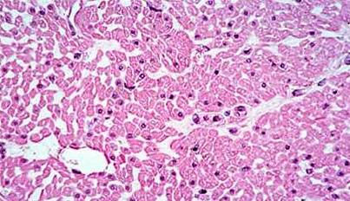
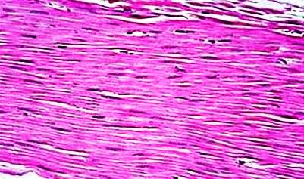
SKELETAL MUSCLE (LS)
SKELETAL MUSCLE (TS)
CARDIAC MUSCLE
SMOOTH MUSCLE
Striations
1
1
1
T S
1
2
2
2
3
2
3
3
4
4
4
5
6
5
Myofibril
Cross striations
Peripheral nuclei
Endomysium
Epimysium
Perimysium
Myofibrils
Peripheral nuclei
Blood vessel in perimysium
Endomysium
Fibroblast in endomysium
Cardiac muscle fibre
Nucleus of muscle fibre
Branching of muscle fibre
Intercalated disc
Smooth muscle fibres
Nuclei of muscle fibres
IDENTIFYING FEATURES
Elongated spindle shaped cells
No striations
Single elongated centrally placed
nucleus
IDENTIFYING FEATURES
Long, parallel,
cylindrical fibres
without branching
Cross striations
Many, flat, peripheral nuclei
IDENTIFYING FEATURES
Skeletal muscles fibres cut transversely
Muscles fibres aggregated into fascicles
CT framework of epi, peri & endomysium
Blood vessels in CT framework
IDENTIFYING FEATURES
Branching muscles fibres
Faint longitudinal & transverse
striations
Single central nucleus
Intercalated discs

Slide 4
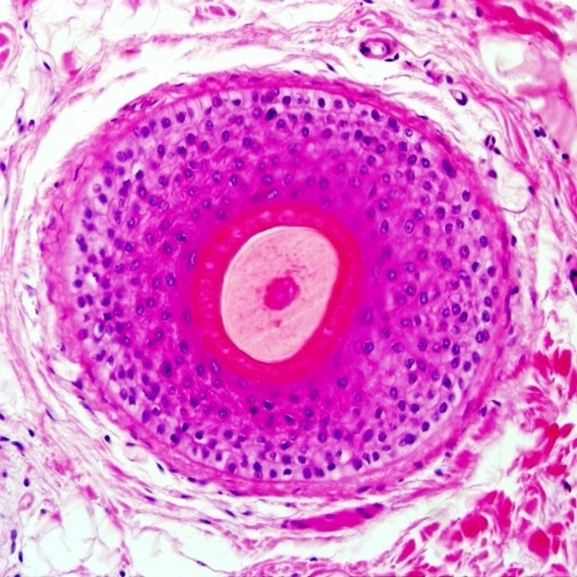
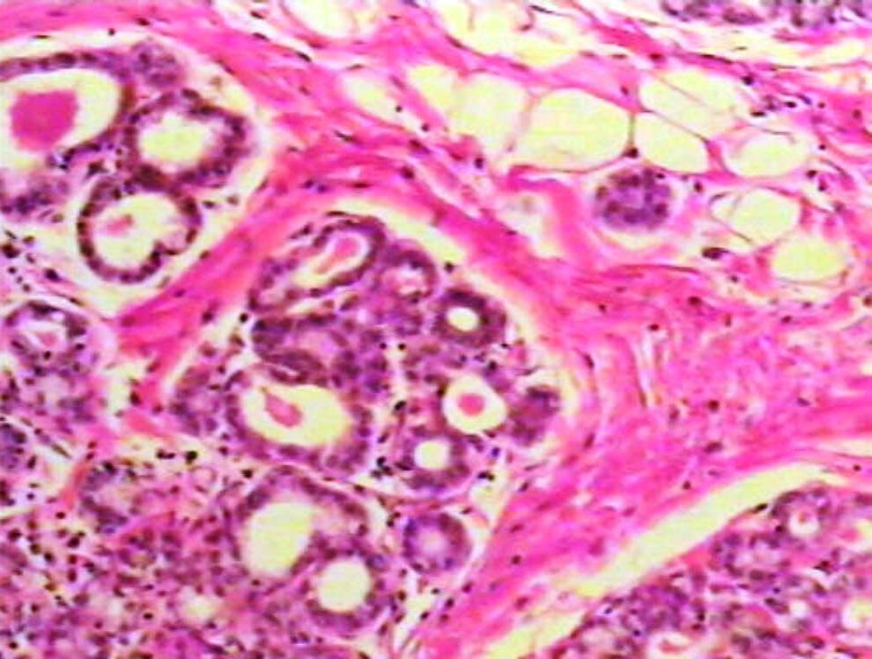
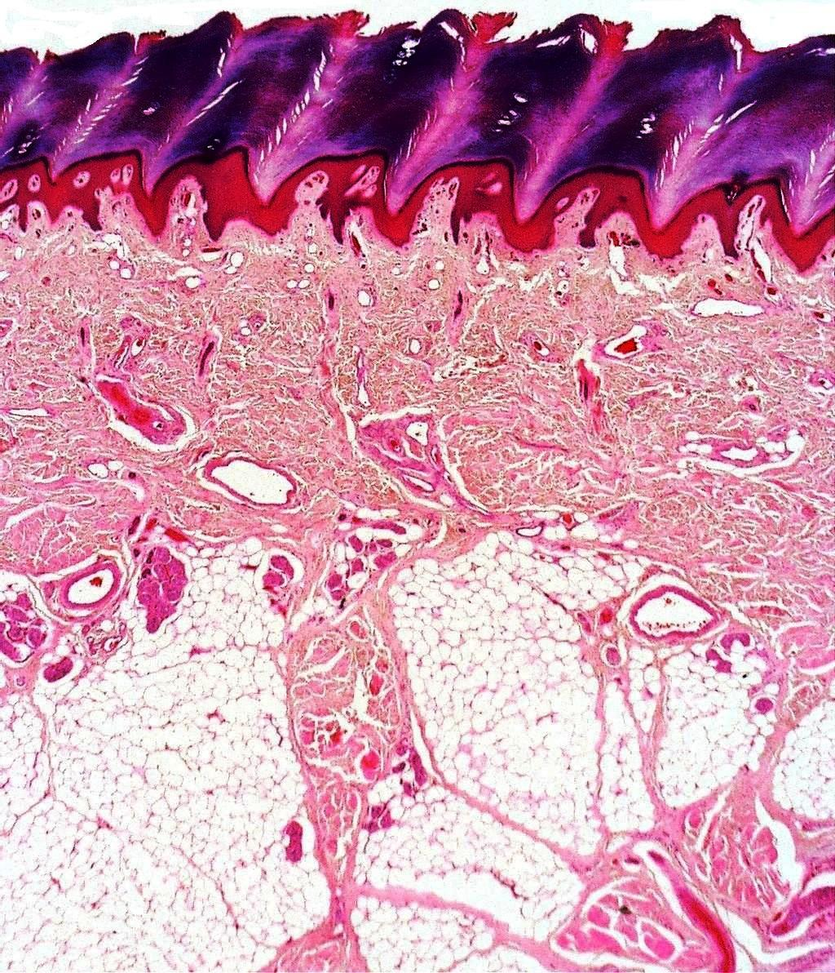
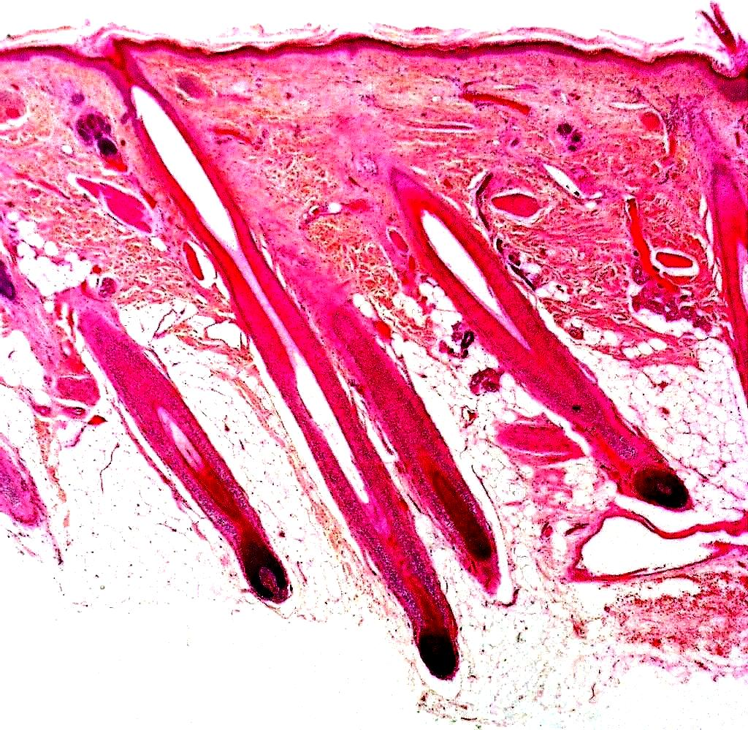
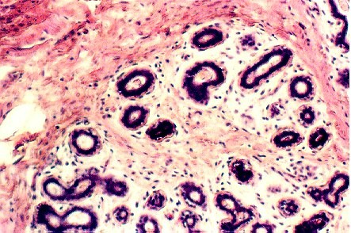
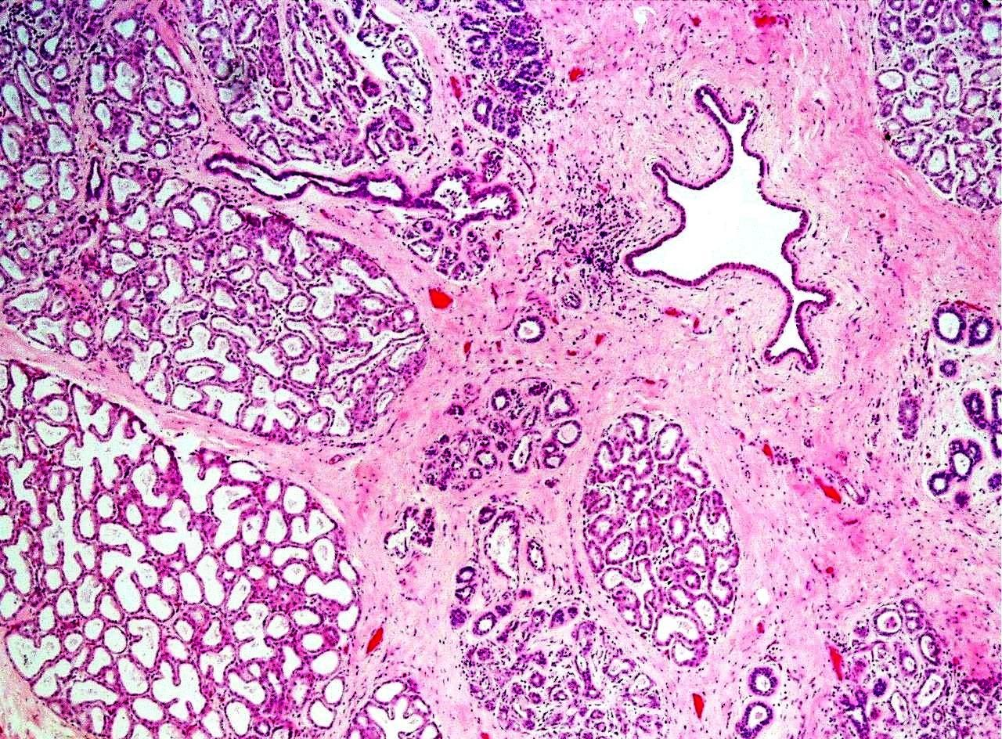

THICK SKIN
THIN SKIN
INACTIVE MAMMARY GLAND
ACTIVE MAMMARY GLAND
2
1
1
1
2
2
1
3
2
4
HAIR FOLLICLE
3
3
4
5
5
3
4
4
6
6
5
5
St Sq keratinised epithelium
Stratum corneum
Dermal papilla
Papillary layer
Reticular layer
Hypodermis
St Sq keratinised epithelium
Papillary layer
Reticular layer
Sweat gland
Hair follicles (cut sections)
Sebaceous gland
Interlobar CT
Intralobular ducts
Intralobular CT
Tubules
Solid cords of cells
Glandular alveoli
Intralobular duct
Intralobular CT
Interlobar CT
Large interlobar duct
IDENTIFYING FEATURES
Less glandular tissue, more CT
Underdeveloped alveoli,
represented by solid cords of cells
Extensive branching of duct system
Ducts of different sizes
Plenty of fat cells
IDENTIFYING FEATURES
More glandular tissue, less CT
Compactly packed, well developed
alveoli with distended lumen
Irregular branching pattern
IDENTIFYING FEATURES
Thin epidermis
Stratum corneum is thin
Hair follicles & sebaceous glands
Sweat glands in dermis
IDENTIFYING FEATURES
Thick epidermis
St Sq keratinised epithelium
Very thick stratum corneum
Absent hair follicles & sebaceous glands
Sweat glands in dermis
DEPT OF ANATOMY AFMED FORCES MEDICAL COLLEGE

Slide 5
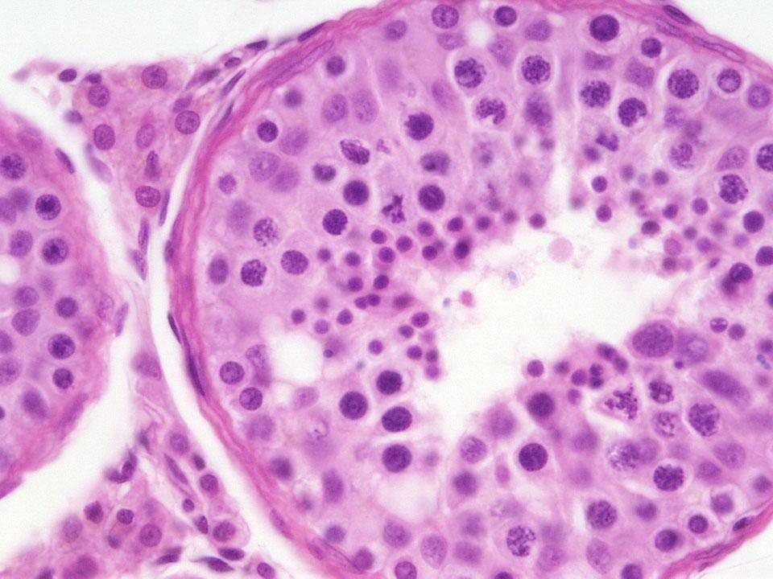
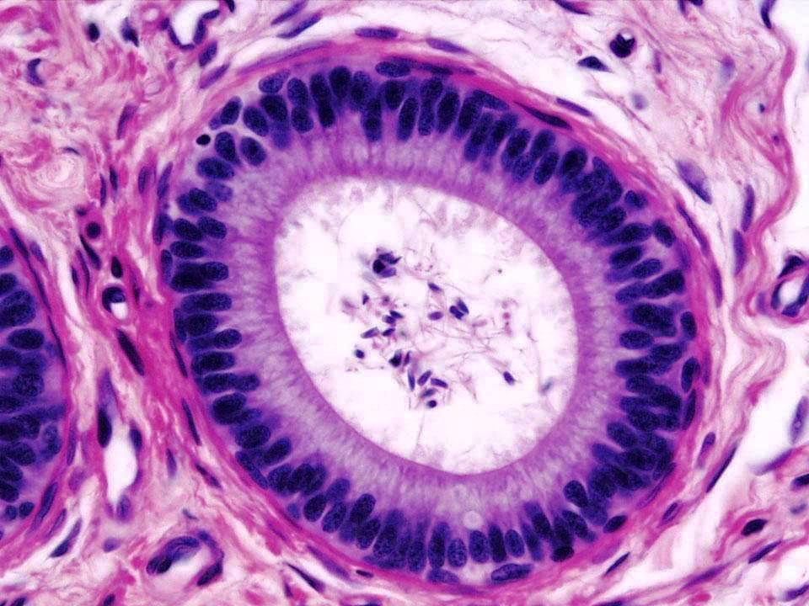
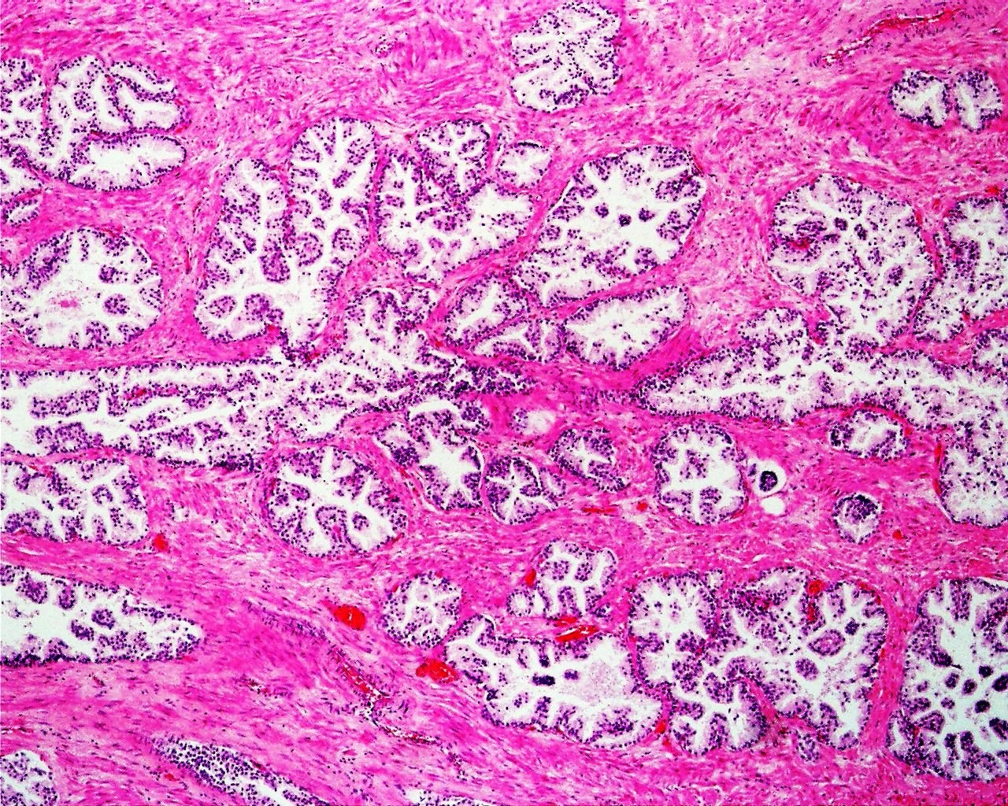
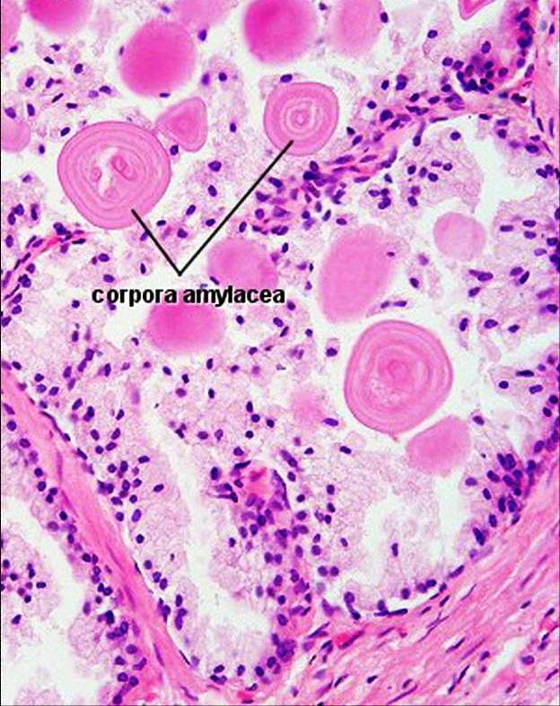
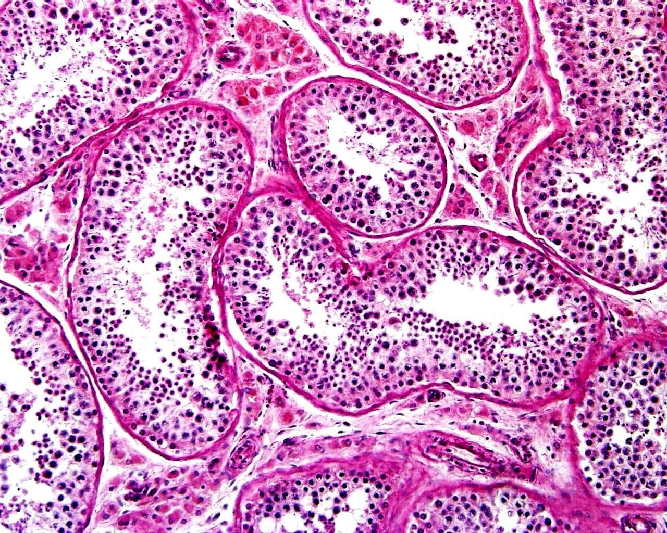
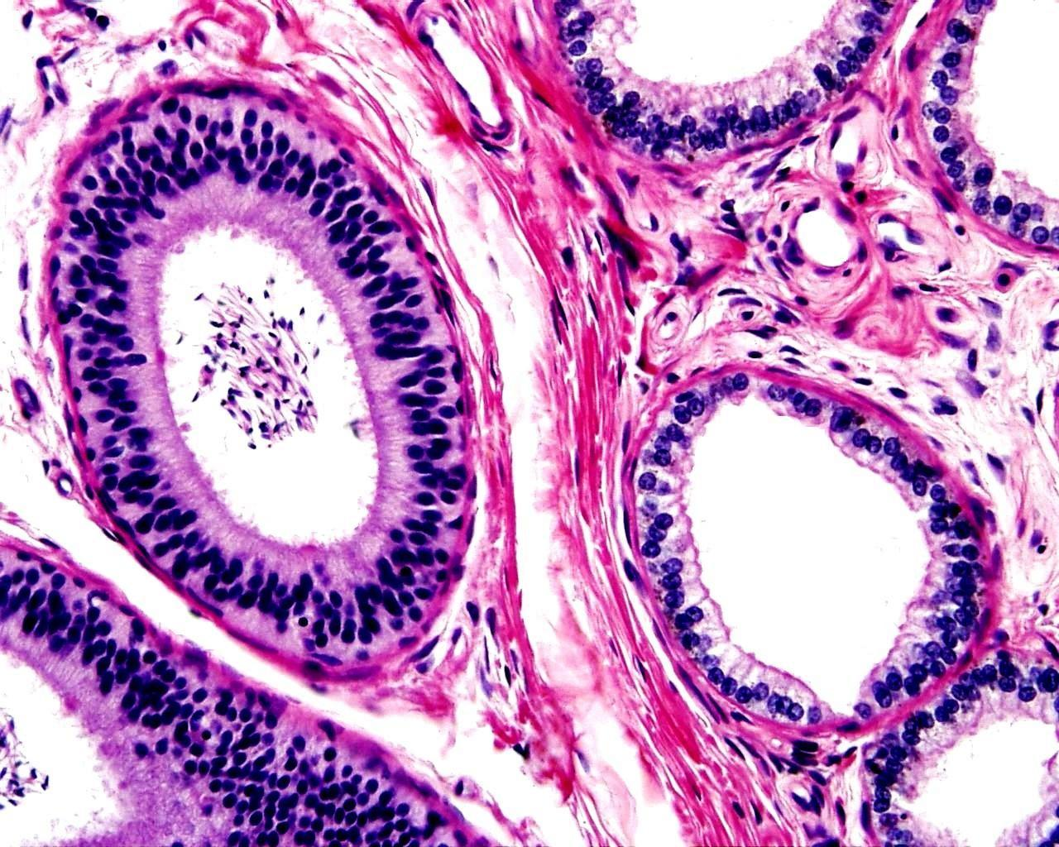
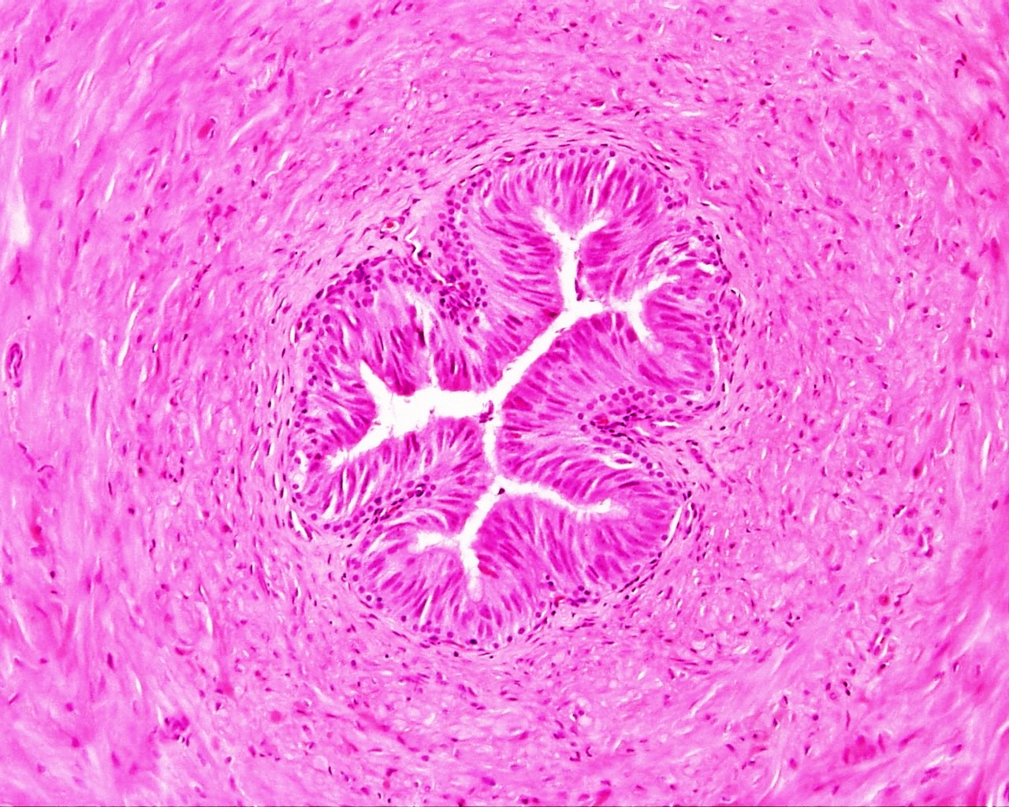
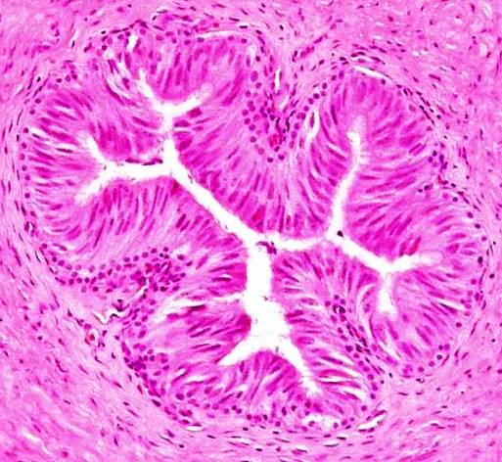

PROSTATE
TESTIS
EPIDIDYMIS
DUCTUS DEFERENS
Prostatic
concretions
SEMINIFEROUS TUBULE
DUCTUS EPIDIDYMIS
1
1
1
2
1
3
2
2
4
5
3
2
6
3
4
3
7
5
Prostatic glands (alveoli)
Fibromuscular stroma
Smooth muscle of stroma
Seminiferous tubules
Spermatogonia
Sertoli cell
Spermatozoa
Spermatids
Spermatocytes
Interstitial cells of Leydig
Ductus epididymis (cut sections)
Pseudostratified columnar epithelium
Sperms in lumen
Connective tissue
Blood vessels
Pseudostratified columnar epithelium
with stereocilia
2. Lumen
3. Muscle coat (smooth muscle)
IDENTIFYING FEATURES
Large irregular alveoli lined by
simple columnar epithelium
Fibromuscular stroma
Corpora amylacea
Prostatic urethra lined by
transitional epithelium
IDENTIFYING FEATURES
Lining epithelium:
Pseudostratified epithelium with
stereocilia
Sperms in the lumen
Smooth muscle surrounds each ductus
IDENTIFYING FEATURES
Small stellate lumen
Thick muscle coat arranged in
three layers
IDENTIFYING FEATURES
Seminiferous tubules (cut sections)
Spermatogenic cells at various stages
of maturation
Interstitial cells of Leydig
DEPT OF ANATOMY AFMED FORCES MEDICAL COLLEGE

Slide 6
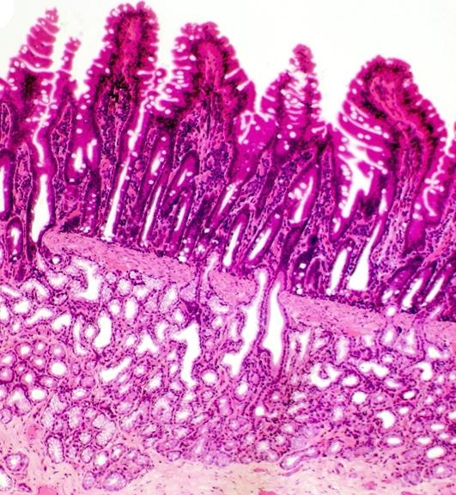
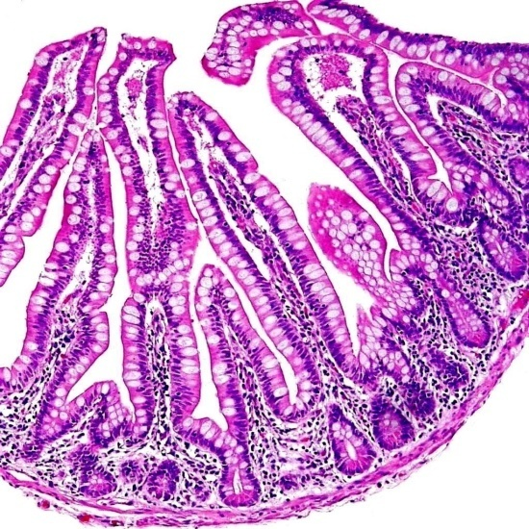
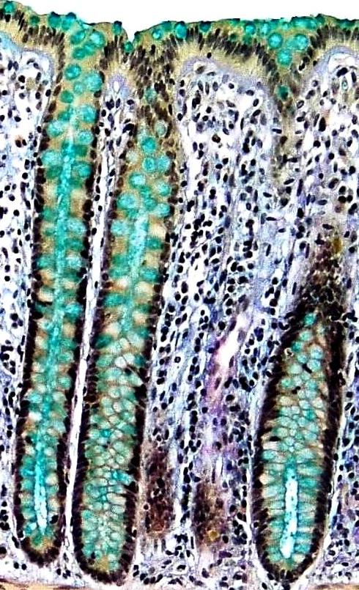
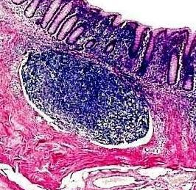
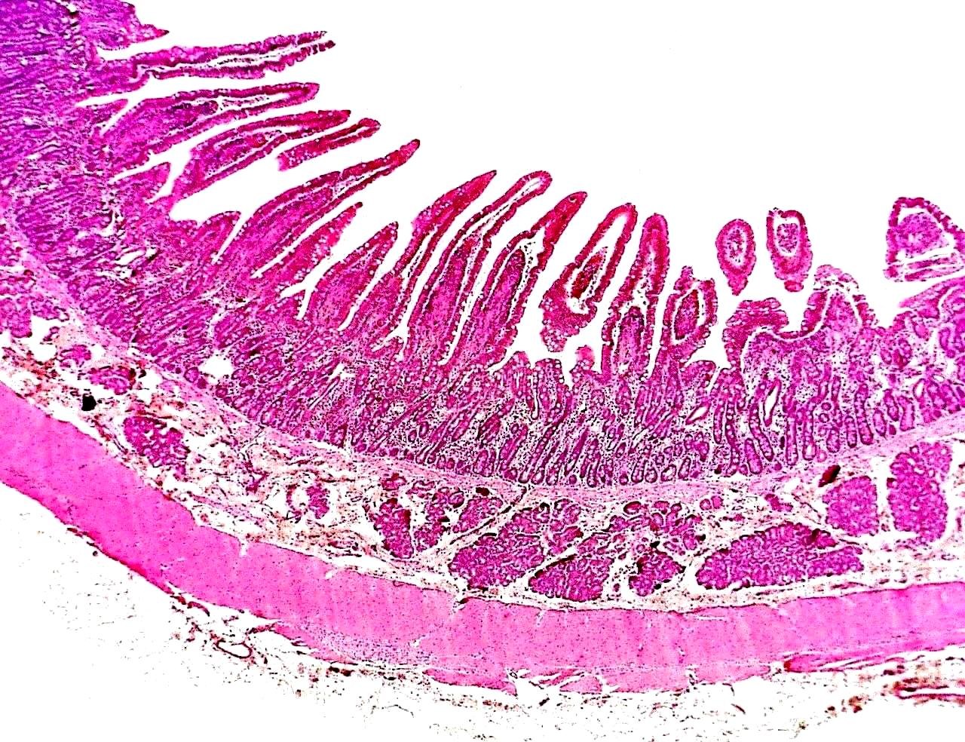
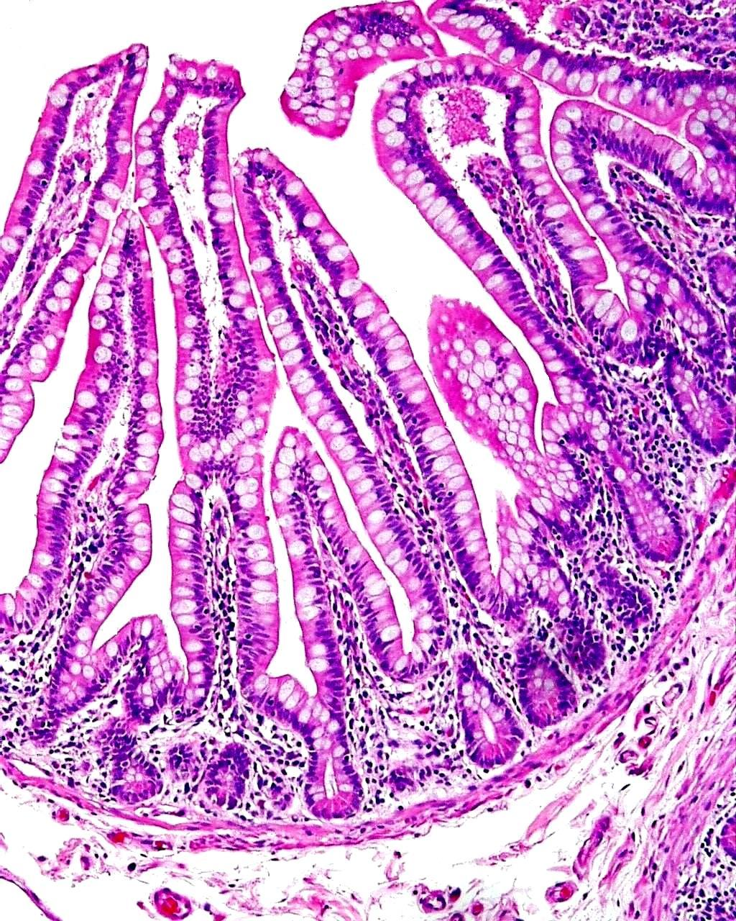
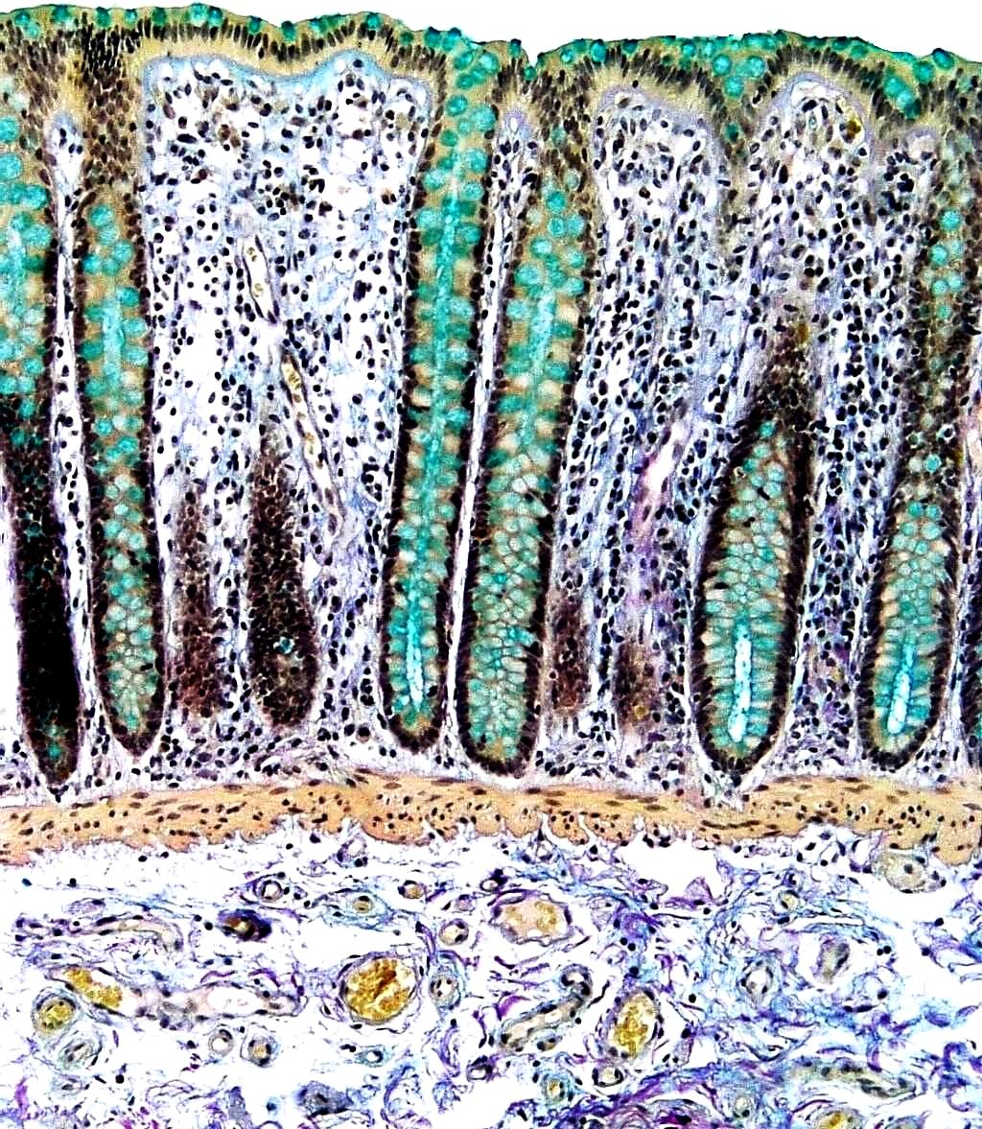
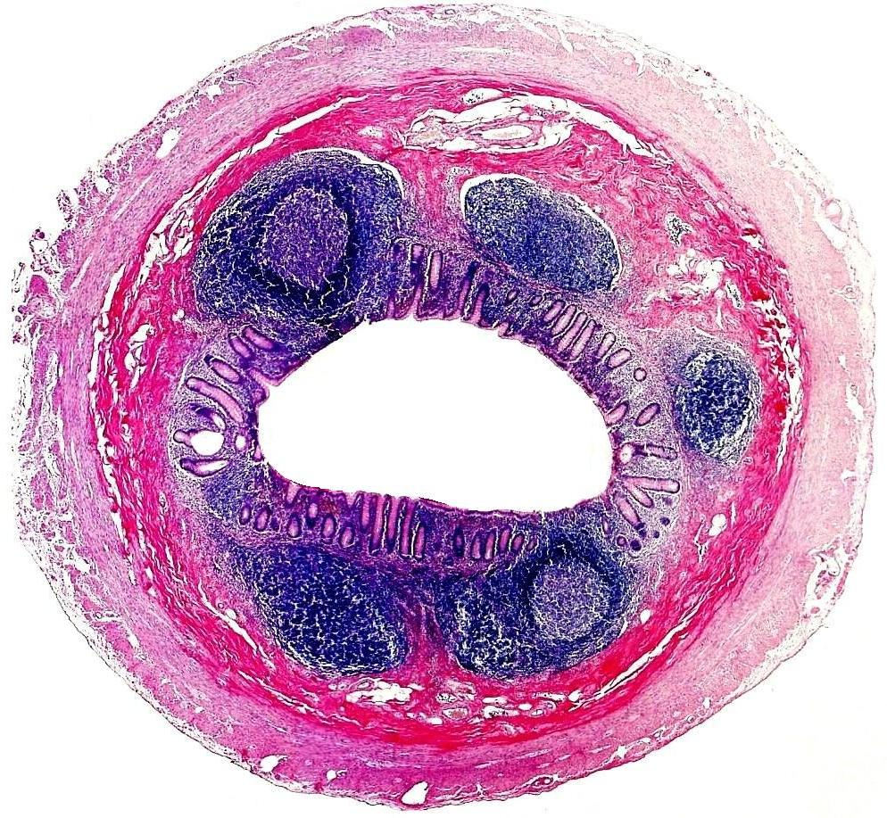

DUODENUM
SMALL INTESTINE
LARGE INTESTINE
APPENDIX
Villi
Goblet cells
Lumen
Brunner’s
glands
Crypts
Crypts
1
Disrupted
muscularis mucosa
1
1
2
1
2
2
3
3
2
4
3
4
3
4
4
5
5
5
6
6
Intestinal villi
Intestinal crypts
Lamina propria
Duodenal (Brunner’s) glands
Muscularis externa
Adventitia
Intestinal villi
Core of lamina propria
Crypts of Lieberkuhn
Muscularis mucosa
Submucosa
Crypts of Lieberkuhn
Lamina propria
Muscularis mucosa
Submucosa
Lining epithelium
Crypt of Lieberkuhn
Disrupted muscularis mucosa
Lymphatic nodule
Muscularis externa
Adventitia
IDENTIFYING FEATURES
No villi
Distance between surface
epithelium & muscularis mucosa
remains constant
Plenty of goblet cells
IDENTIFYING FEATURES
Finger like villi lined by columnar
epithelium with striated border
No submucosal glands
Peyer’s patches in submucosa
IDENTIFYING FEATURES
Short leaf-like villi lined by
columnar epithelium
Crypts of Lieberkuhn
Brunner’s (mucous) glands
in submucosa
IDENTIFYING FEATURES
Crypts lined by simple columnar
epithelium with goblet cells
Absence of intestinal villi
Lymphatic nodules in lamina propria
DEPT OF ANATOMY AFMED FORCES MEDICAL COLLEGE

Slide 7
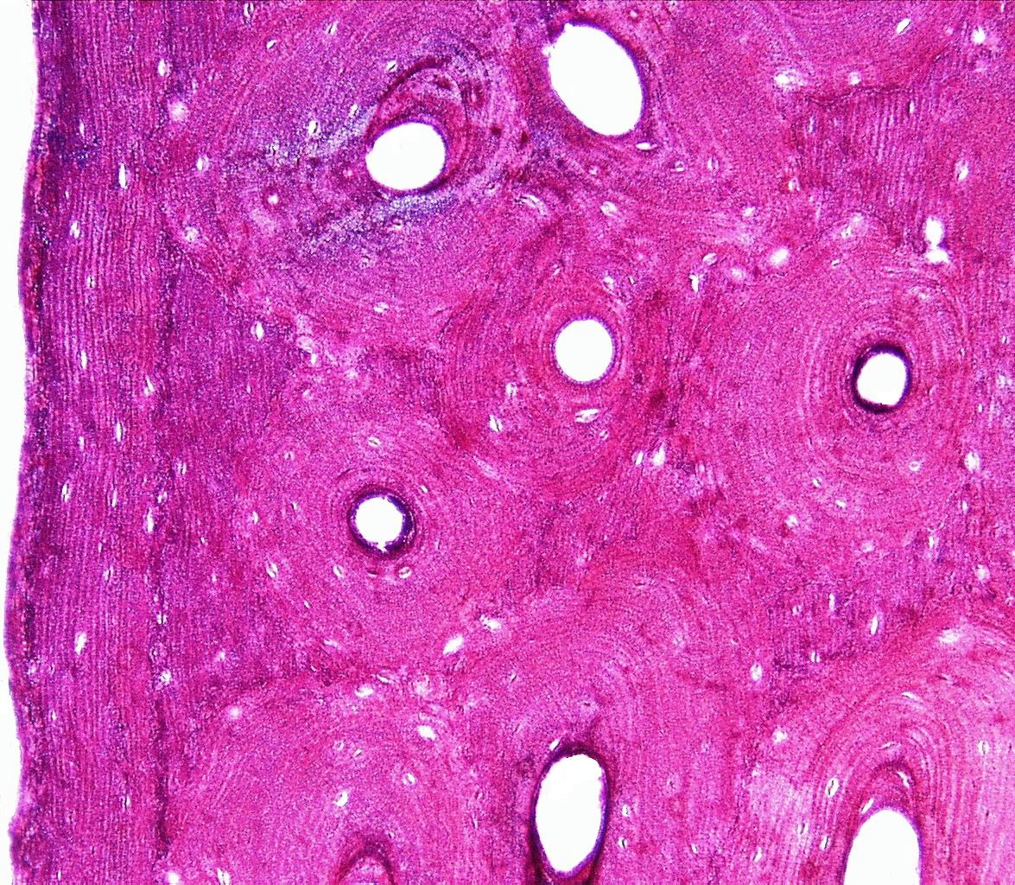
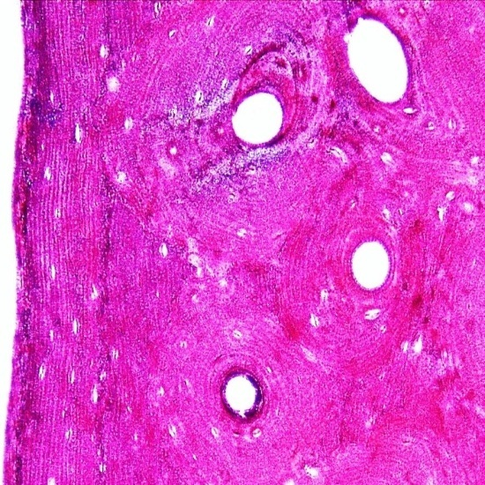
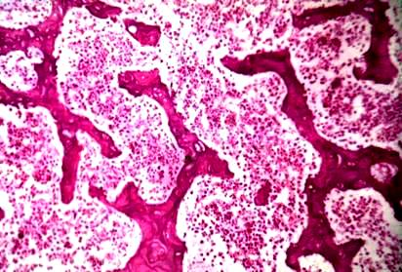
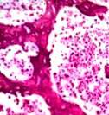
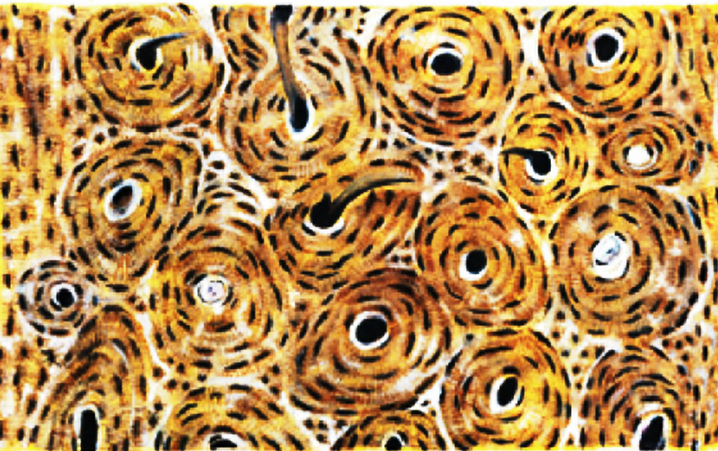




DECALCIFIED BONE (TS)
SPONGY BONE
GROUND SECTION (TS)
GROUND SECTION (LS)
Haversian canal
Bone marrow
Haversian canal
Osteon
Lacunae with
canaliculi
1
OSTEON
1
1
1
2
2
2
3
3
2
4
3
4
3
3
3
4
4
5
Interstitial lamellae
Osteonic (circular) lamellae
Circumferential lamellae
Haversian canal
Bony trabeculae
Bone marrow
Lamellae
Haversian canals
Circumferential lamellae
Interstitial lamellae
Concentric lamellae
Lacunae
Volkmann’s canal
Haversian canals
Lamellae
Cement line
IDENTIFYING FEATURES
Bony trabeculae separated by
marrow space
Absence of typical osteons
Lamellae aligned along trabeculae
IDENTIFYING FEATURES
Presence of osteons
Haversian system with
Haversian canals
Various types of lamellae
IDENTIFYING FEATURES
Longitudinally running lamellae
Horizontally running
Volkmann’s canals
Longitudinally running
Haversian canals
IDENTIFYING FEATURES
Lacunae with radiating canaliculi
Haversian system with
Haversian canals
Various types of lamellae
DEPT OF ANATOMY AFMED FORCES MEDICAL COLLEGE

Slide 8









EPIGLOTTIS
OESOPHAGUS
STOMACH (FUNDUS)
STOMACH (PYLORUS)
1
1
Long pits
1
2
Short glands
1
2
2
3
2
3
3
4
5
6
4
4
3
7
Stratified squamous epithelium
Lamina propria
Elastic cartilage
Stratified squamous epithelium
Surface epithelium- St Sq nonkeratinised
Lamina propria
Muscularis mucosa
Oesophageal glands in submucosa
Gastric pits
Fundic glands
Oxyntic cells
Lamina propria
5. Muscularis mucosa
6. Submucosa
7. Muscularis externa
Surface mucous cells
Gastric pits
Pyloric glands
IDENTIFYING FEATURES
Stratified squamous epithelium
covering elastic cartilage
Elastic cartilage in the middle
Presence of serous, mucous or
mixed glands in lamina propria
IDENTIFYING FEATURES
St Sq nonkeratinised epithelium
Oesophageal glands in submucosa
Thick muscularis externa
IDENTIFYING FEATURES
Lamina propria filled with simple
straight tubular glands
Short pits; long glands (1:4)
Glands have beaded appearance
due to pink stained bigger
Oxyntic cells
IDENTIFYING FEATURES
Lamina propria filled with
branched coiled tubular glands
Long pits; short glands (3:1)
Light stained glands because of
plenty of mucous cells
DEPT OF ANATOMY AFMED FORCES MEDICAL COLLEGE

Slide 9








ELASTIC ARTERY
MUSCULAR ARTERY
VEIN
UMBILICAL CORD
1
Lumen
1
Lumen
2
Thick T. Media
Internal elastic
lamina
T Media
Lumen
T Externa
1
1
2
2
3
2
3
4
3
3
Tunica intima
Tunica media
Tunica externa
Internal elastic lamina
T. Media with lots of smooth muscle fibres
Tunica externa
Blood vessel in T. Externa
4
Endothelium
Tunica media
Tunica externa
Amnion
Umbilical arteries
Wharton’s jelly (Mucoid CT)
Umbilical vein
IDENTIFYING FEATURES
Thick tunica media,
full of elastic fibres
Internal elastic lamina present,
not seen
Tunica media: Tunica adventitia
3:1
IDENTIFYING FEATURES
Thin T. Media with few
smooth muscle fibres &
less elastic fibres
Large collapsed lumen
IDENTIFYING FEATURES
Tunica intima thrown into folds
Prominent internal elastic lamina
T Media has plenty of
smooth muscle fibres
T Media: T Adventitia 1:1
IDENTIFYING FEATURES
Two arteries & one vein
Wharton’s jelly
Amniotic epithelium (simple cuboidal)
DEPT OF ANATOMY AFMED FORCES MEDICAL COLLEGE

Slide 10









PITUITARY GLAND
THYROID GLAND
PARATHYROID GLAND
SUPRARENAL GLAND
Cells of
medulla
Alpha cells
Oxyphil cells
Chief cells
1
Beta cells
1
1
1
2
2
2
2
3
3
3
4
3
4
Colloid filled thyroid follicles
Simple cuboidal epithelium lining follicles
Sinusoidal capillary
Parafollicular cells
5
Pars distalis
Pars intermedia
Pars nervosa
Principal (chief) cells
Colloid vesicle
Oxyphil cells
Zona glomerulosa
Zona fasciculata
Sinusoidal capillary
Zona reticularis
Medulla
IDENTIFYING FEATURES
Pars distalis containing
chromophobes & chromophils
Pars nervosa containing
pituicytes & unmyelinated
nerve fibres
Pars intermedia with
colloid vesicles
IDENTIFYING FEATURES
Small basophilic chief cells
in large number
Large eosinophilic oxyphil cells
in small number
Colloid vesicles occasionally seen
CT trabeculae are present
IDENTIFYING FEATURES
Thyroid follicles lined by
simple columnar epithelium
Follicles filled with colloid-
thyroglobulin
Parafollicular cells (C cells) between
follicles
IDENTIFYING FEATURES
Presence of Zona glomerulosa,
fasciculata & reticularis in cortex
Medulla has chromaffin cells &
sympathetic ganglia
DEPT OF ANATOMY AFMED FORCES MEDICAL COLLEGE

Slide 11









OVARY
FALLOPIAN TUBE
UTERUS: PROLIFERATIVE
UTERUS: SECRETORY
1
Lamina propria
2
1
Uterine glands
1
Uterine
glands
Peg cells
Myometrium
Graafian follicle: HP
Ciliated columnar
epithelium
3
2
2
1
2
4
3
3
5
4
Highly folded mucosa
Lamina propria
Muscle coat
Serosa
3
Germinal epithelium
Primordial follicles
Graafian follicle
Developing follicles
Medulla
Surface epithelium: Columnar
Straight uterine glands
Myometrium
Surface epithelium: Columnar
Uterine glands
Myometrium
IDENTIFYING FEATURES
Shows endo, myo & perimetrium
Few straight uterine glands
Thick myometrium- muscle fibres
in all directions
IDENTIFYING FEATURES
Shows endo, myo & perimetrium
Plenty of cork-screw shaped
glands
Highly vascular stroma
IDENTIFYING FEATURES
Highly folded mucosa: primary, sec &
tertiary folds
Cellular lamina propria
Thick muscle coat
IDENTIFYING FEATURES
Germinal epithelium-
simple cuboidal epithelium
Outer cortex & inner medulla
Cortex - follicles in various
stages of development
Medulla- swirly appearance
DEPT OF ANATOMY AFMED FORCES MEDICAL COLLEGE

Slide 12









LIVER
GALL BLADDER
TONGUE: ANT 2/3
TONGUE: POST 1/3
Bile duct
Papillae
1
Portal vein
Columnar
epithelium
Taste buds
Hepatic artery
Portal vein
PORTAL TRIAD
1
1
2
1
2
2
3
4
2
3
3
3
4
4
5
5
Central vein
Cords of hepatocytes
Sinusoids
Surface epithelium
Lamina propria
Fibromuscular coat
Adventitia
Fungiform papilla
Filiform papillae
Lamina propria
Lingual glands
Skeletal muscles fibres in various directions
Stratified Sq nonkeratinised epithelium
Lamina propria
Taste bud
Circular furrow
Skeletal muscles fibres
IDENTIFYING FEATURES
Cords of hepatocytes
radiating from central vein
Portal triads
Polygonal hepatic lobules
IDENTIFYING FEATURES
Simple columnar epithelium-
thrown into folds
Fibromuscular layer
No muscularis mucosa & submucosa
IDENTIFYING FEATURES
St Sq nonkeratinised epithelium
Presence of filiform & fungiform
papillae
Striated muscle with mucous acini
IDENTIFYING FEATURES
Sunken inverted cone shaped vallate
papillae with flat top
Numerous taste buds in lateral wall
of papilla
Deep trench around papilla
von Ebnor (serous) glands
DEPT OF ANATOMY AFMED FORCES MEDICAL COLLEGE

Slide 13








NERVE (LS)
NERVE (TS)
SPINAL GANGLION
SYMPATHETIC GANGLION
1
Node of Ranvier
1
Myelinated fibres
Axons
Epineurium
Central nuclei
Myelin sheath
Perineurium
Satellite cell
Nucleus
Satellite
cell
1
2
1
2
2
3
3
2
3
4
4
5
3
4
4
Axon
Schwann cell nuclei
Node of Ranvier
Perineurium
Epineurium
Perineurium
Endoneurium
Nerve fibres
Myelinated fibres & fibroblasts
Nucleus & nucleolus of ganglion cell
Light & dark ganglion cells
Fibroblasts
Satellite cells (nuclei)
Nucleus of ganglion cell
Satellite cells
Ganglion cells- multipolar neurons
Intercellular area
Blood vessel
IDENTIFYING FEATURES
Bundles of nerve fibres
Perineurium around each bundle
Nodes of Ranvier
Nuclei of Schwann cells
IDENTIFYING FEATURES
Bundles of nerve fibres
CT layer of perineurium around
each bundle
IDENTIFYING FEATURES
Groups of rounded pseudo-unipolar
neurons
Centrally placed nuclei in perikaryon
Well defined satellite cells
IDENTIFYING FEATURES
Small scattered, angular
multipolar neurons of uniform size
Poorly defined satellite cells
Eccentrically placed nuclei
DEPT OF ANATOMY AFMED FORCES MEDICAL COLLEGE

Slide 14









TRACHEA
INTRAPULMONARY BRONCHUS
LUNG
SPINAL CORD
Pseudostratified ciliated
columnar with goblet cells
Simple squamous
epithelium
White matter
1
1
Lung alveoli
Grey matter
Isolated plates of
hyaline cartilage
2
Anterior
horn cells
3
1
2
4
1
2
3
3
2
4
5
4
5
3
6
5
Pseudostratified ciliated columnar epithelium
Lamina propria
Deep part of lamina propria with elastic fibres
Submucosa with tracheal glands
Hyaline cartilage
Wavy mucous membrane
Lamina propria
Bundles of smooth muscle fibres
Serous glands in submucosa
Plate of hyaline cartilage
Terminal bronchiole
Lung alveoli
Blood vessel
Posterior horn (Grey matter)
Posterior median septum
Central canal
Anterior horn (Grey matter)
White matter
Anterior median sulcus
IDENTIFYING FEATURES
Lung alveoli- honeycomb appearance
Simple squamous epithelium
lining alveoli
Presence of bronchioles
IDENTIFYING FEATURES
Wavy mm- pseudostratified
ciliated columnar
Isolated plates of hyaline cartilage
Discontinuous bundles of
smooth muscle
Glands in submucosa
IDENTIFYING FEATURES
Pseudostratified ciliated columnar
epithelium with goblet cells
Hyaline cartilage (C shaped)
Tracheal glands (mixed)
in submucosa
IDENTIFYING FEATURES
Roughly H- shaped grey matter
White matter containing nerve fibres
Central canal lined by ependymal cells
DEPT OF ANATOMY AFMED FORCES MEDICAL COLLEGE

Slide 15









KIDNEY: CORTEX
KIDNEY: MEDULLA
URINARY BLADDER
URETER
1
Transitional
epithelium
PCT
1
Thin segment
2
Lumen
Glomerulus
Thick segment
Inner
longitudinal
JG Apparatus
Lumen
Outer
circular
2
LOOP OF HENLE
1
1
2
3
3
2
3
4
5
4
3
5
Renal capsule
Renal corpuscles
Medullary rays
PCT
DCT
Loop of Henle: thick segment
Loop of Henle: thin segment
Collecting ducts (terminal collecting tubules)
6
Surface epithelium
Lamina propria
Smooth muscle bundles
Lumen
Urothelium
Lamina propria
Inner longitudinal muscle layer
Outer circular muscle layer
Adventitia
IDENTIFYING FEATURES
Collecting tubules-cuboidal epithelium
Loop of Henle (thin segment)-
simple squamous epithelium
Loop of Henle (thick segment)-
cuboidal epithelium
IDENTIFYING FEATURES
Transitional epithelium
Thick muscle coat- discrete bundles
of smooth muscle separated by CT
Glands are absent
IDENTIFYING FEATURES
Melpighian (Renal) corpuscles
Darkly stained PCTs with
brush border
Lightly stained DCTs without
brush border
IDENTIFYING FEATURES
Transitional epithelium
Star shaped lumen
Muscle coat: inner longitudinal
& outer circular
DEPT OF ANATOMY AFMED FORCES MEDICAL COLLEGE

Slide 16








CEREBRUM
CEREBELLUM
THREE COATS OF EYE
RETINA
1
Cornea
1
Ant. chamber
2
Molecular layer
2
Iris
Betz cells
Purkinje cell layer
Post. chamber
Granular cell layer
Vitreous
Lens
Sclera
1
3
1
SCLEROCORNEAL
JUNCTION
2
4
2
3
3
4
5
3
5
6
4
7
6
Molecular layer
External granular layer
External pyramidal layer
Inner granular layer
Inner pyramidal (ganglionic) layer
Polymorphic (multiform) layer
Outer molecular layer
Purkinje cell layer
Inner granular layer
White matter
Sclera
Choroid
Retina
8
Rods & Cones
Outer limiting membrane
Outer nuclear layer
Outer plexiform layer
5. Inner nuclear layer
6. Inner plexiform layer
7. Ganglion cell layer
8. Inner limiting membrane
IDENTIFYING FEATURES
Sclera- composed of collagen fibres
Choroid- composed of BVs & pigment cells
Retina- composed of pigment epithelium &
nervous layer
IDENTIFYING FEATURES
Lightly stained superficial
molecular layer
Flask shaped Purkinje cells
Well defined deep granular
cell layer
IDENTIFYING FEATURES
Pigment epithelium-
simple cuboidal
Layer of Rods & Cones
Outer & inner nuclear layers
Outer & inner plexiform layers
IDENTIFYING FEATURES
Lightly stained superficial
molecular layer
Pyramidal cells &
granular cells in deep layers
DEPT OF ANATOMY AFMED FORCES MEDICAL COLLEGE

Slide 17








COSTAL CARTILAGE
ARTICULAR CARTILAGE
ELASTIC CARTILAGE
FIBROCARTILAGE
1
Perichondrium
1
Horizontal layer
Large chondrocytes
Collagen
fibres
2
2
Oblique layer
Vertical layer
Elastic fibres
Chondrocytes
Chondrocytes
3
1
1
3
4
4
2
2
3
3
5
5
4
1
Perichondrium: fibrous layer
Perichondrium: cellular layer
Ground substance
Chondrocytes
Cell nest
Horizontally arranged cells
Obliquely arranged cells
Ground substance
Vertically arranged cells
Cancellous bone
Perichondrium
Chondrocytes
Elastic fibres in matrix
Nuclei of chondrocytes
Collagen fibre bundles
Lacuna
Row of chondrocytes
IDENTIFYING FEATURES
Perichondrium is present
Intercellular substance has
elastic fibres
Eccentrically placed nuclei in
chondrocytes
IDENTIFYING FEATURES
Perichondrium present
Ground glass appearance
of intercellular substance
Presence of cell-nests
Size of cells increase from
periphery to centre
IDENTIFYING FEATURES
Perichondrium is absent
Ground glass appearance of
intercellular substance
Small cells arranged in horizontal,
oblique & vertical layers
IDENTIFYING FEATURES
Perichondrium absent in adults
Intercellular substance has
plenty of collagen fibres-
feathery appearance
Few scattered chondrocytes
DEPT OF ANATOMY AFMED FORCES MEDICAL COLLEGE

