Slide 1
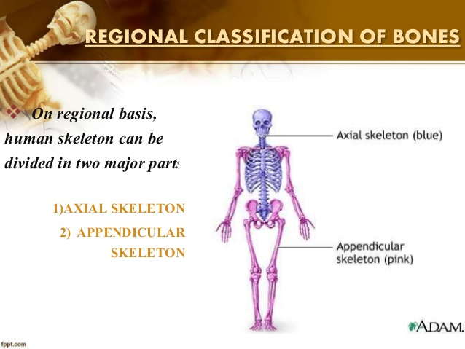
GENERAL ANATOMY
BONE - 1
Dr. Praveen Kumar Kurrey
M.B.B.S., M.S., B.C.M.E, B.C.B.R.
Professor Anatomy

Slide 2
Introduction
Bones are highly vascular, constantly changing living and specialized connective tissue, which makes up the body skeleton , and is one of the hardest structure of the body.

Slide 3
BONE
Also known as Os in Latin and Osteon in Greek
1/3
COLLAGEN
2/3
INORGANIC SALTS
FLEXIBILITY+ TOUGHNESS
HARDNESS

Slide 4
Composition of bones
Inorganic minerals
Organic substances
Inorganic Minerals-:
About 60% of the bone are composed of inorganic minerals.
These includes-
Calcium, Phosphorus, Magnesium,Potassium,
Sodium etc.
Major minerals are calcium and phosphorus.
Calcium is in the form of calcium salt mainly calcium phosphate.
These minerals are responsible for hardness, rigidity and great compressive strength of bone.

Slide 5
Organic Substances
About 25% of bone is composed of organic substances which includes-
-> Collagen fibers- mainly type I collagen fibers
-> Ground substance - Glycoprotein's
- Muccopolysaccharides
Organic substances provide strength and stability to bone.
Make the bone tough.
Provide flexibility which can afford resistance to tensile force.

Slide 6
Types of Bone Cells
Osteocytes
  Mature bone cells
Osteoblasts
  Bone-forming cells
Osteoclasts
  Bone-destroying cells
  Break down bone matrix for remodeling and release of calcium
Bone remodeling is a process by both osteoblasts and osteoclasts

Slide 7
Functions Of Bone
Bones give shape and support to the body, and resist any forms of stress.
Bones provide surface for the attachment of muscles, tendons and ligaments.
These serve as levers for muscular actions.
The skull, vertebral column and thoracic cage protect brain, spinal cord and thoracic viscera respectively.
Bone marrow manufactures blood cells.
Bones store 97% of the body calcium and phosphorus.
Bone marrow contains reticulo-endothelial cells which are phagocytic in nature.

Slide 8
CLASSIFICATION OF BONES
REGIONAL CLASSIFICATION
ACCORDING TO SHAPE
ACCORDING TO DEVELOPMENT
STRUCTURAL CLASSIFICATION

Slide 9
Regional classification of bones
On regional basis, human skeleton can be divided in two major parts-
Axial skeleton
Appendicular skeleton

Slide 10
SKELETAL SYSTEM (206)
AXIAL SKELETON (80)
SKULL (29)
THORAX (25)
APPENDICULAR SKELETON (126)
UPPER LIMB (60)
VERTEBRAL COLUMN (26)
PELVIC GIRDLE (2)
PECTORAL GIRDLE (4)
LOWER LIMB (60)

Slide 11
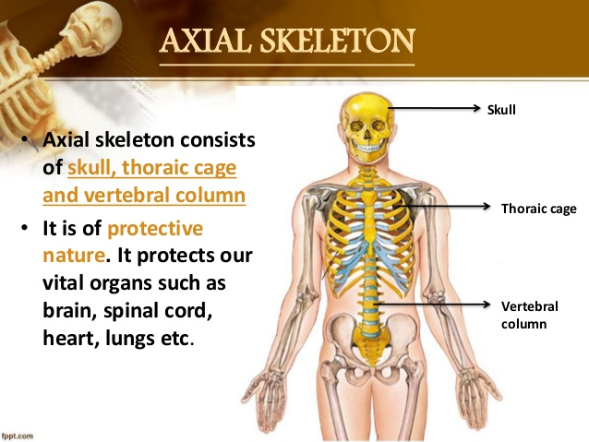

Slide 12
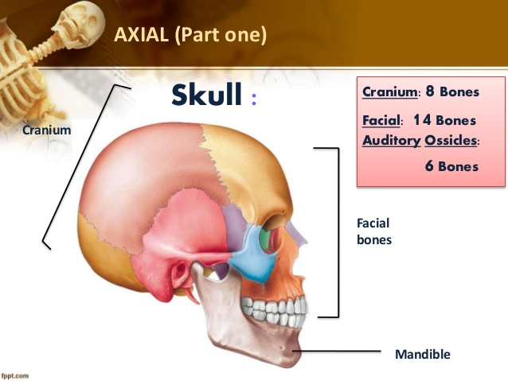

Slide 13
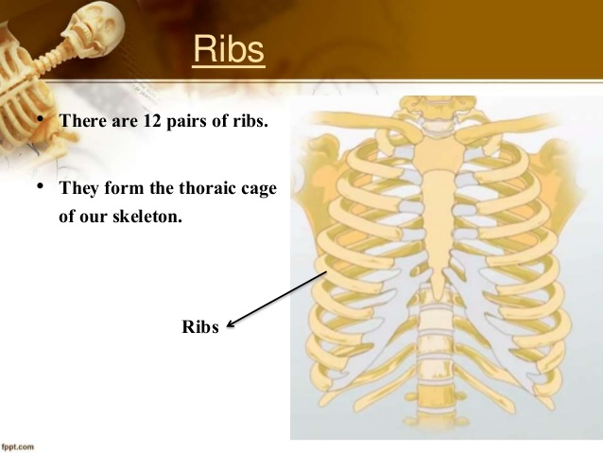

Slide 14
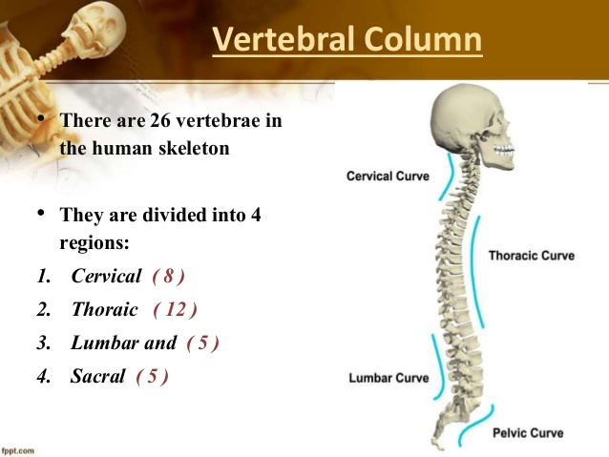
Vertebral column
Consist of 26 bones
7 – cervical
12- thoracic
5 – lumber
5 – sacral fuse to form 1 sacrum
1 – coccyx -----------(4 coccygeal)

Slide 15
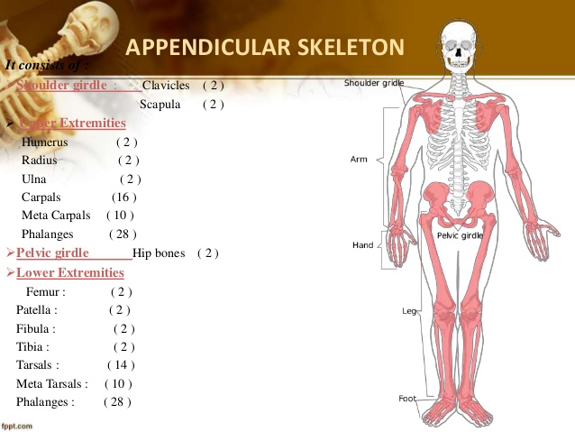

Slide 16
Notes:
3

Slide 17
Notes:
4

Slide 18
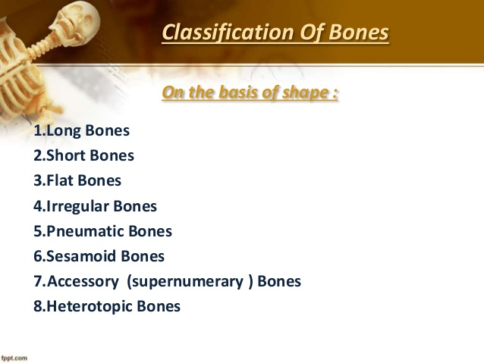

Slide 19
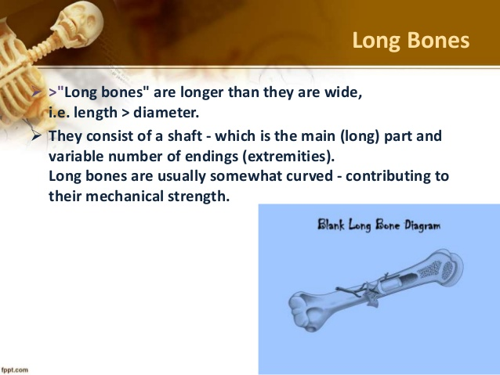

Slide 20
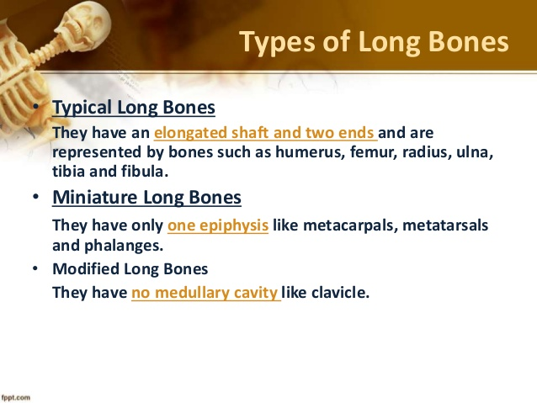

Slide 21
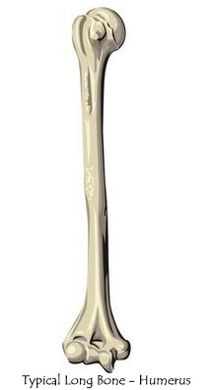
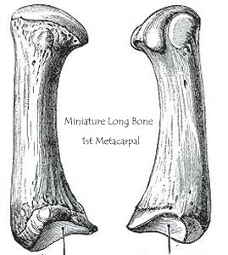
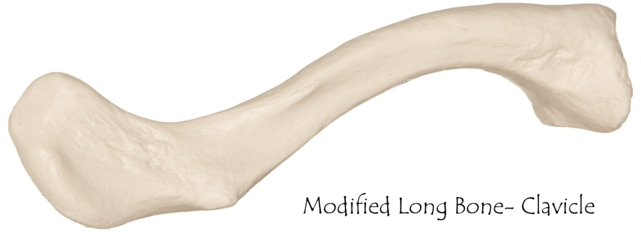

Slide 22
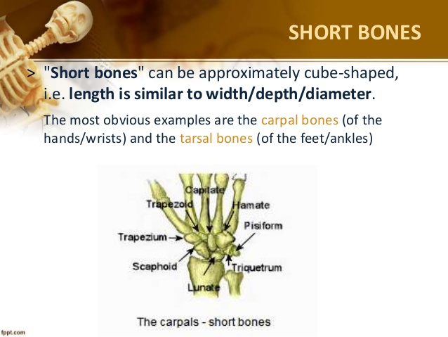

Slide 23
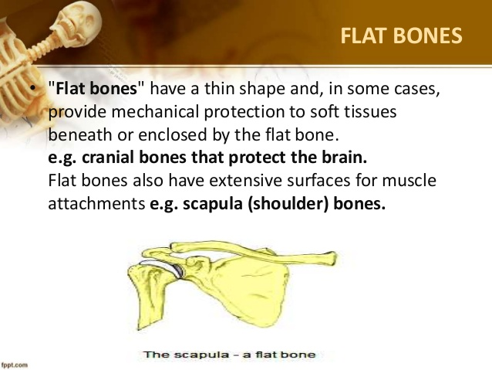

Slide 24
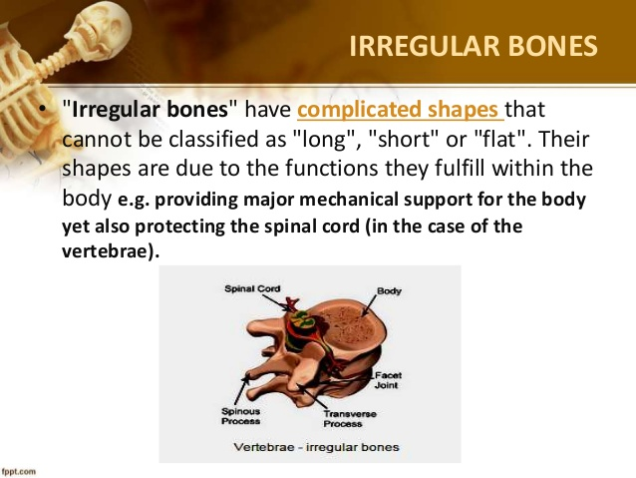

Slide 25
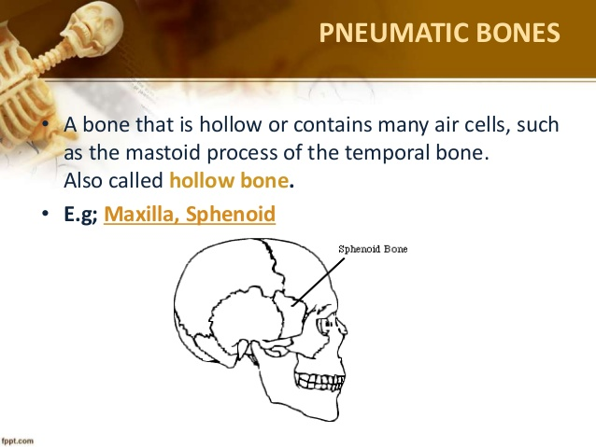

Slide 26
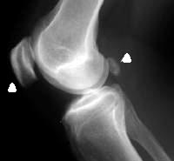
Sesamoid Bones-
These are bony nodules found embedded in the tendons or joint capsules.
They have no periosteum and ossify after birth.
They are related to articular or non articular bony surface, and the surfaces of contact are covered with hyaline cartilage.
They are lubricated by a bursa or synovial membrane.
Ex- Patella- Tendon of Quadriceps,
Pisiform- Tendon of Flexor carpi ulnaris,
Fabella- Tendon of Lateral head of Gastrocnemius
Functions of Sesamoid Bones-
To resist pressure
To minimise friction
To alter the direction of the pull of the muscle
To maintain the local circulation

Slide 27
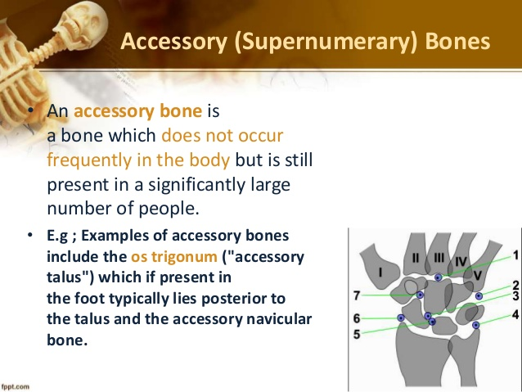

Slide 28
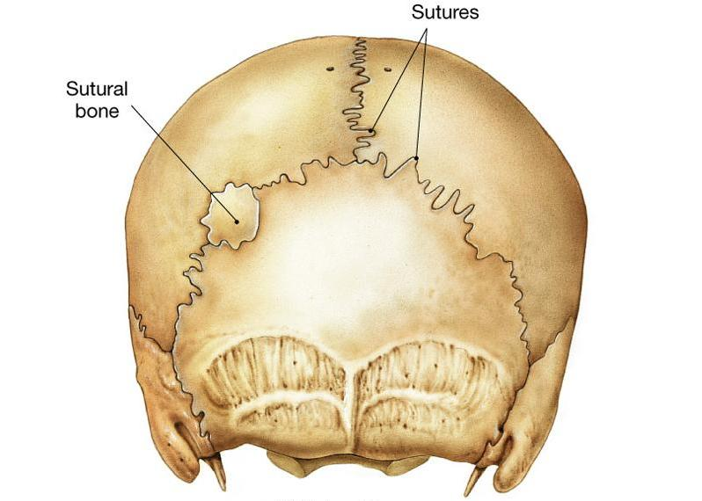
7. Accessory/ Supernumerary Bones- may occur as ununited epiphyses developed from extra centres of ossification.
Ex- Sutural bones, os trigonum, os vesalianum, etc.
Accessory bones may be mistaken for fractures. But these are often bilateral with smooth surface without any callus.

Slide 29
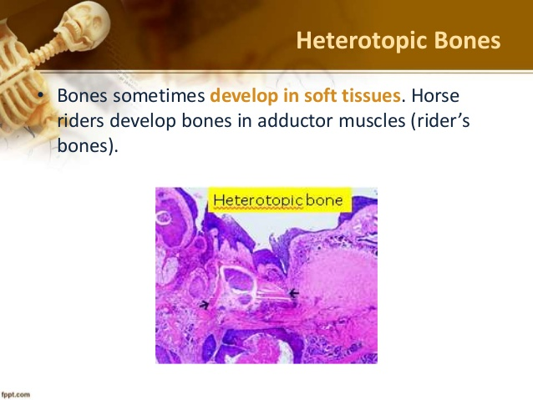

Slide 30
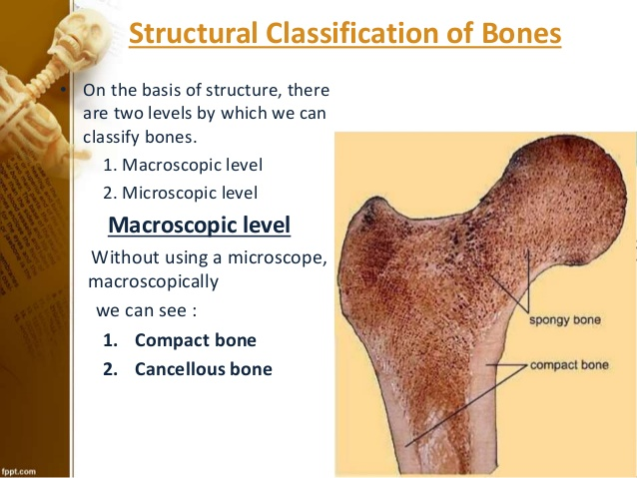

Slide 31
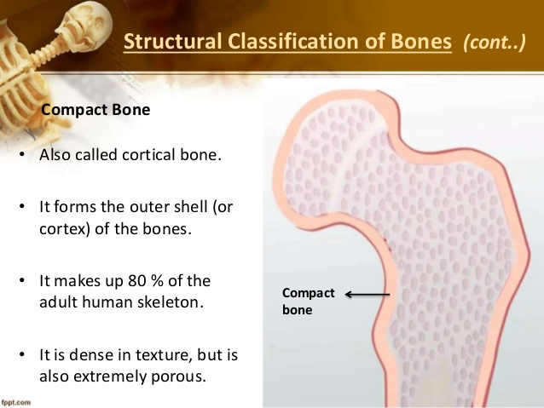

Slide 32
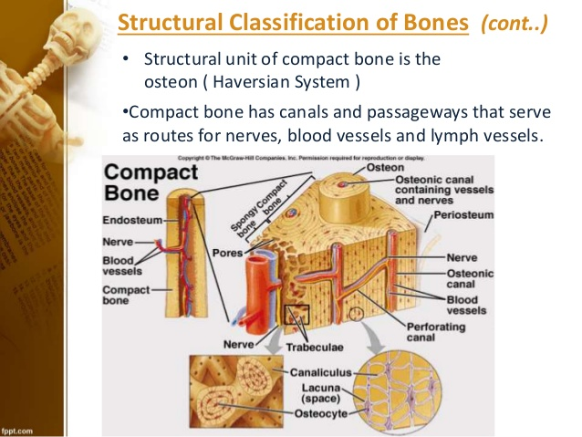

Slide 33
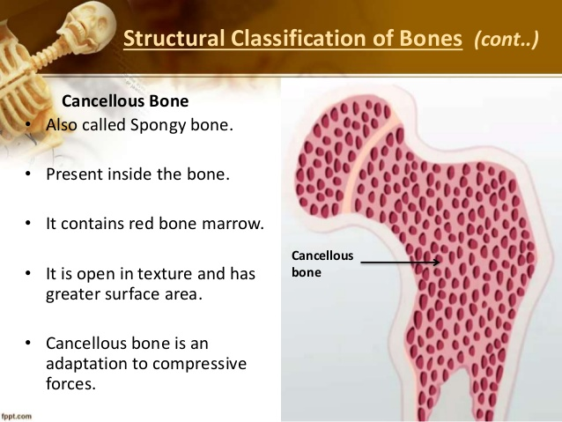

Slide 34
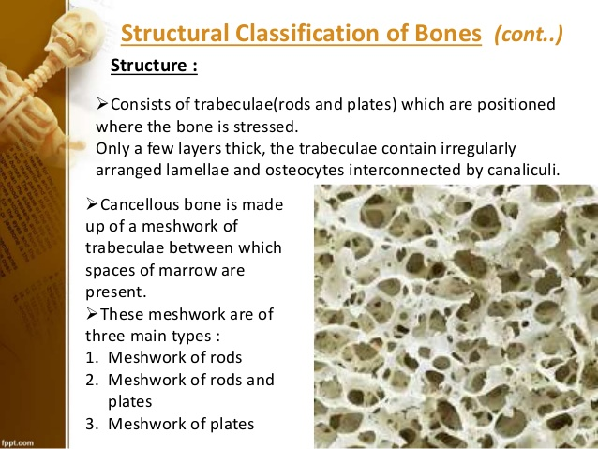

Slide 35
COMPACT BONES CANCELLOUS BONES
Location Lamellae Bone marrow Nature | In Shaft of long bone Arranged to form Haversian system Red marrow till puberty. Yellow marrow after puberty, which stores fat Hard and Ivory like | In Epiphysis of long bone Arranged in meshwork. Haversian system absent Red, which produce RBC, granular series of WBC and platelets Spongy

Slide 36
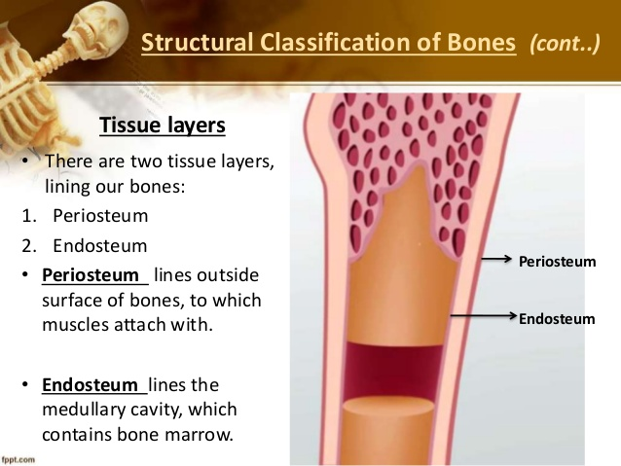

Slide 37
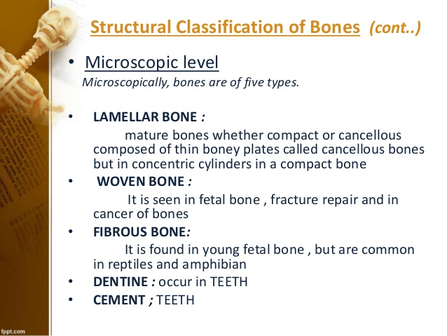

Slide 38
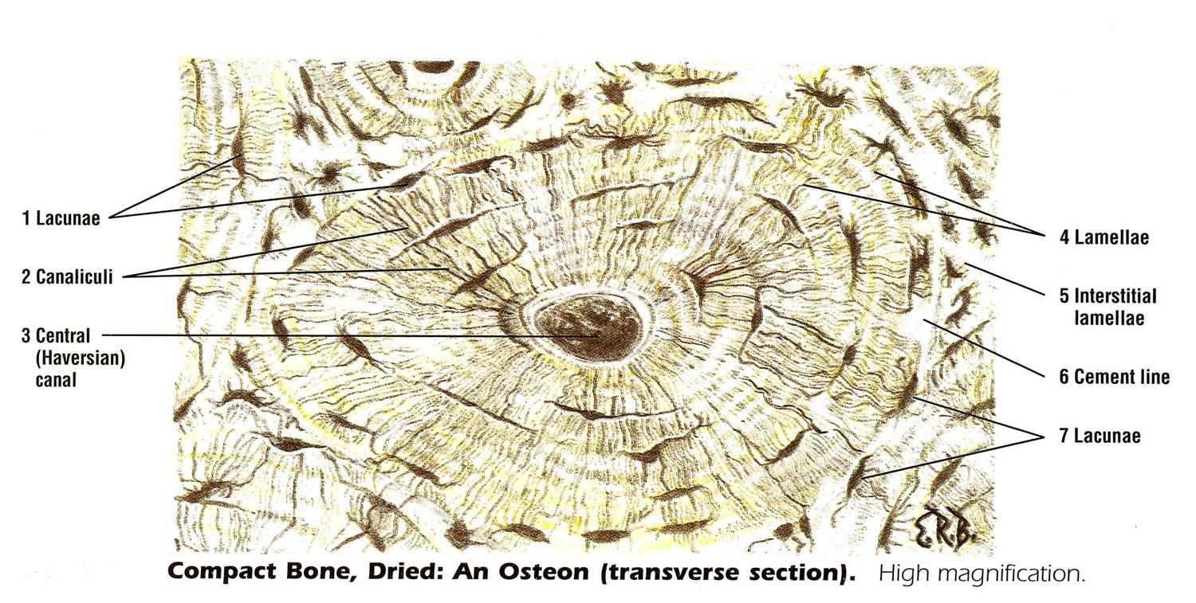
Lamellar– These are arranged in piles in a cancellous bone, while, in concentric cylinders (Haversian System) in a compact bone.

Slide 39
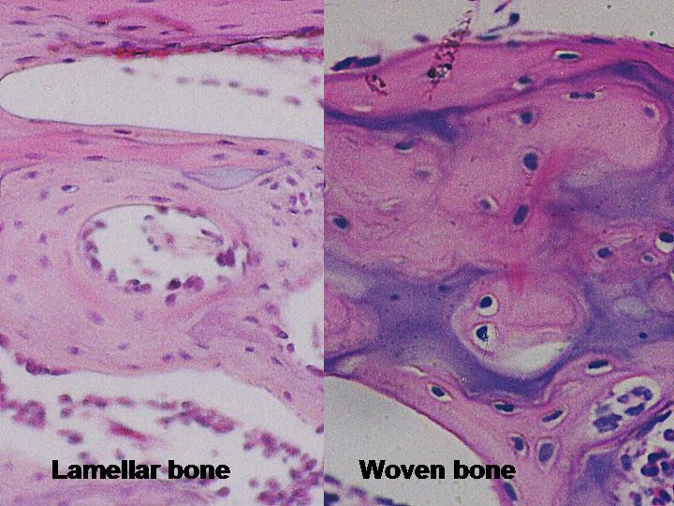
II. Woven- Aka Primary Bone. These are either replaced by lamellar bone or by medullary cavity.
Seen in fetal bone, fracture repair and in cancer bone.

Slide 40
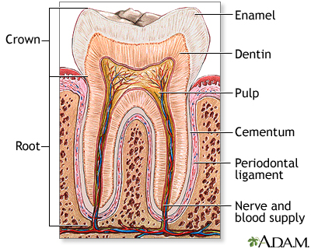
III. Fibrous- Seen in young fetal bones
IV. Dentine- Teeth
V. Cement- Teeth

Slide 41
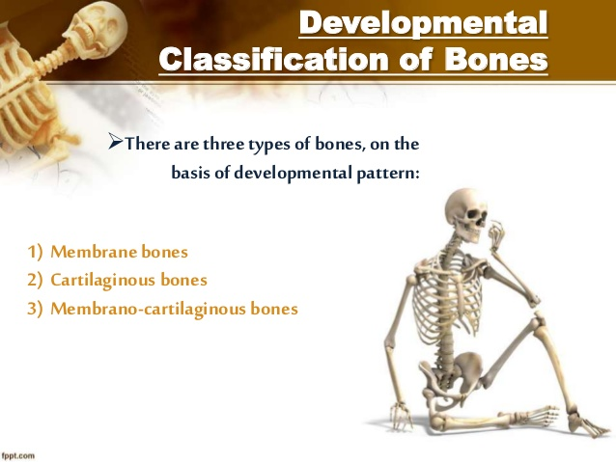

Slide 42
Membrane/ Dermal Bones- ossify in membrane (intramembranous/ mesenchymal ossification), and are thus derived from mesenchymal condensations. Ex- Bones of the vault of skull and facial bones.
Cartilagenous Bones- ossify in cartilage (intracartilaginous or endochondral ossification), and are thus derived from preformed cartilaginous models. Ex- Bones of limbs, vertebral column and thoracic cage.
Membrano-cartilaginous Bones- ossify partly in membrane and partly in cartilage. Ex- Clavicle, mandible, occipital, temporal, sphenoid.

Slide 43
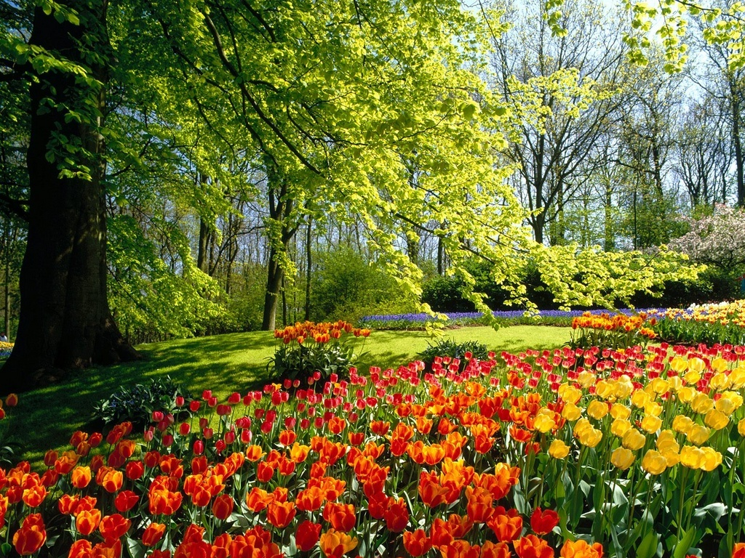
THANK YOU

