Slide 1
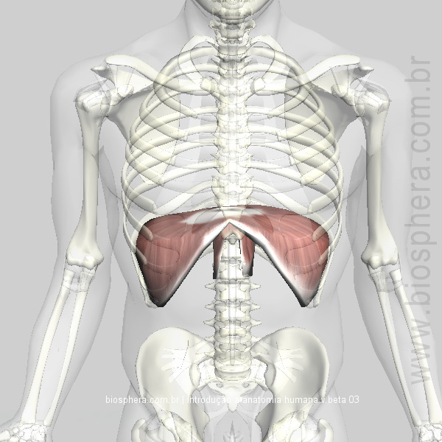
THE THORACIC DIAPHRAGM
Dr. Praveen Kumar Kurrey
M.B.B.S.,M.S.BCME, BCBR
Professor Anatomy

Slide 2
Contents
Introduction
Origin
Insertion
Nerve supply
Bloodsupply
Actions
Positions of Diaphragm
Relations of Diaphragm
Openings of Diaphragm
Development of Diaphragm
Applied

Slide 3
Introduction
Greek, from dia 'through, apart' + phragma 'a fence'.
Fibro-muscular sheet
Separates the thoracic cavity from the abdominal cavity
Performs an important function in respiration.

Slide 4
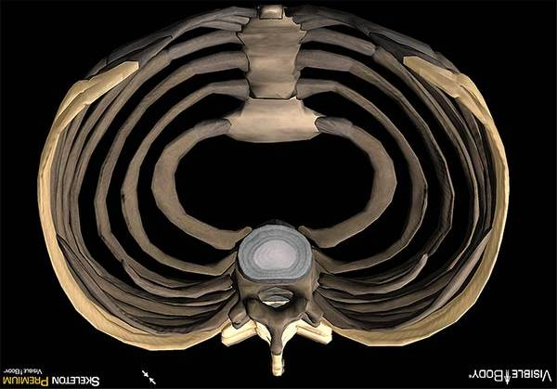
Origin
3 parts:-
Sternal
Costal
lumbar

Slide 5
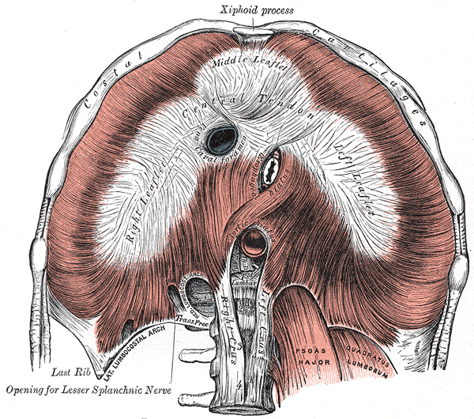

Slide 6
Insertion
Central tendon of diaphragm
Central tendon :
trilobar in shape
3 leaflets (middle, right & left)

Slide 7
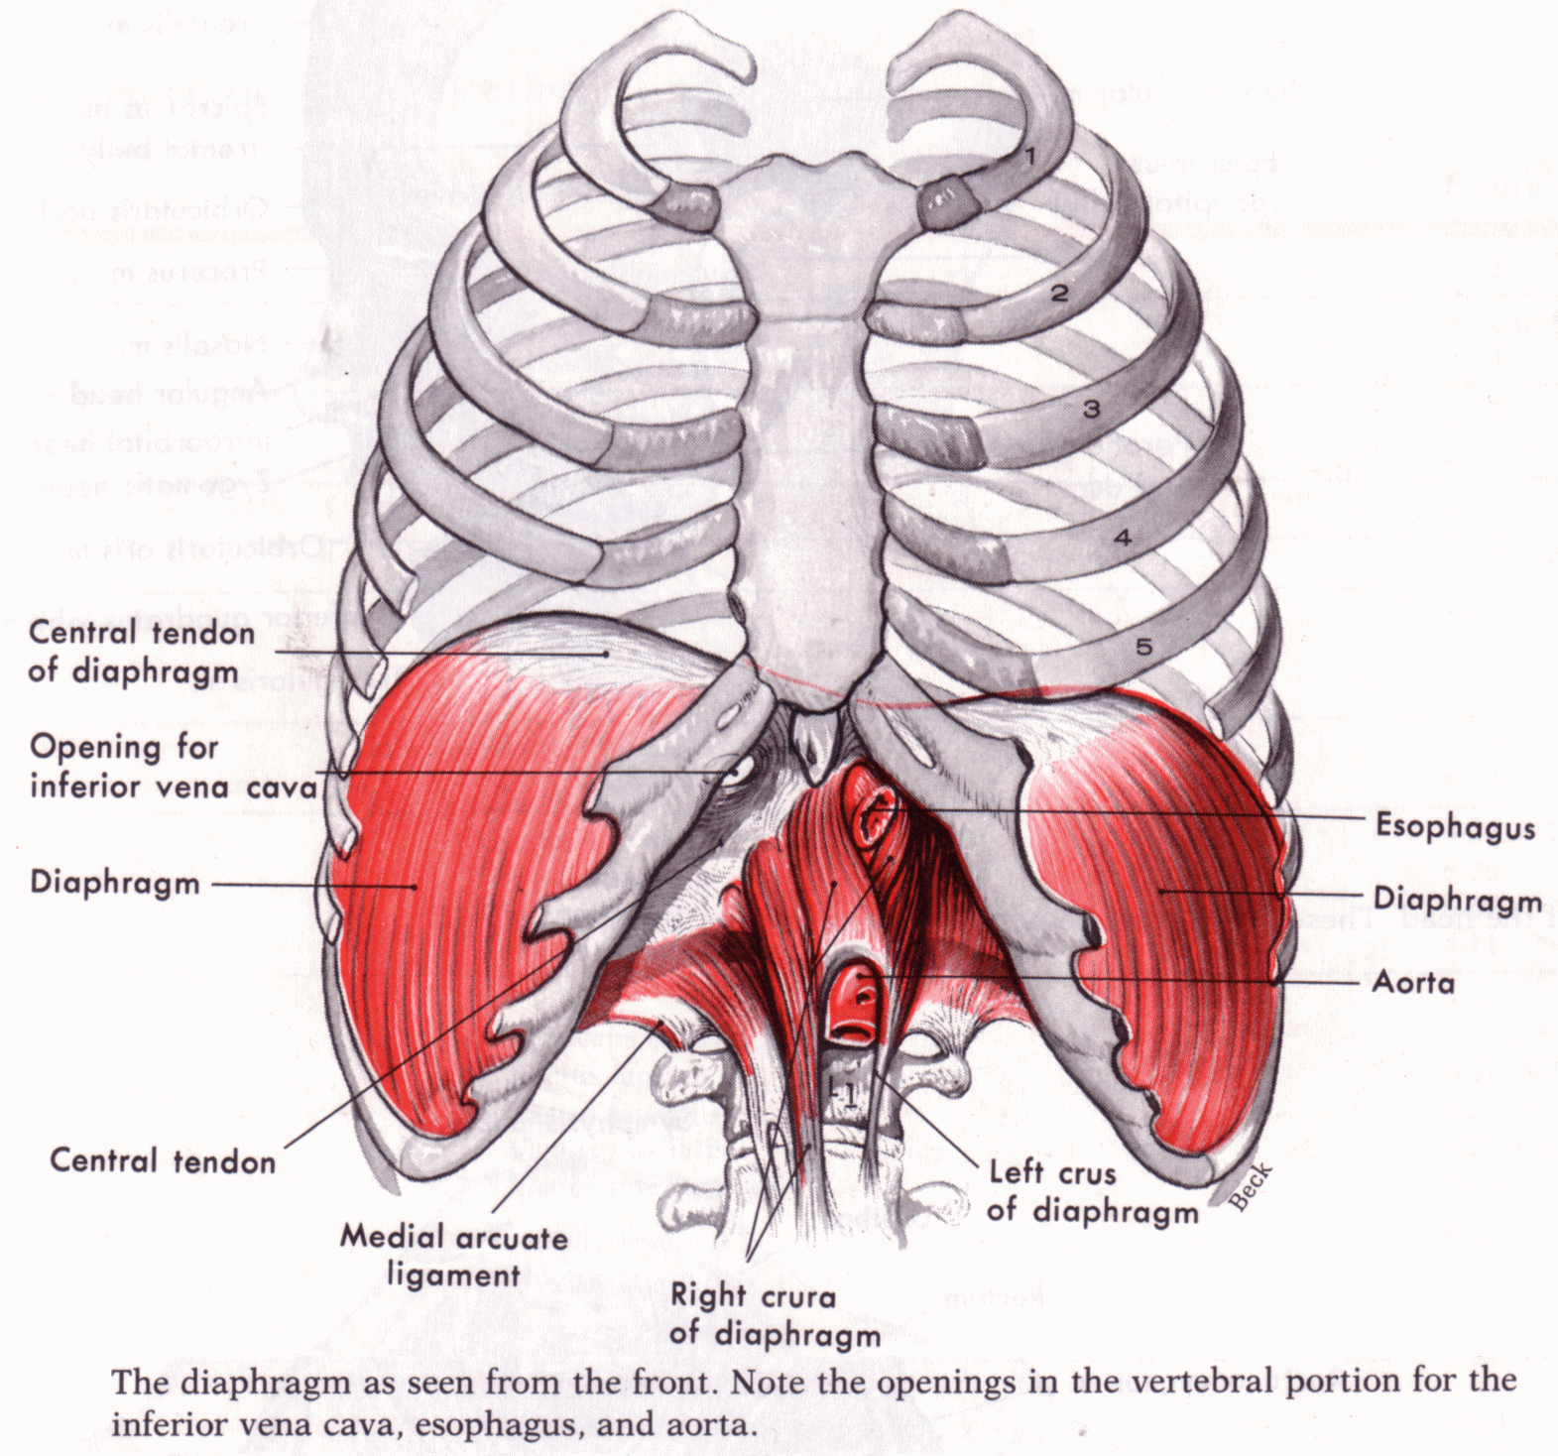
Direction of muscle fibres
Upwards & inwards
Right and left dome

Slide 8
Nerve Supply
Motor – Phrenic nerve(C3,4,5)
Sensory –
1.central part- phrenic nerve
2.peripheral part- lower six thoracic nerve

Slide 9
Blood Supply
Musculophrenic artery
Superior phrenic arteries
Lower 5 intercostal arteries + subcostal artey
Inferior phrenic artery

Slide 10
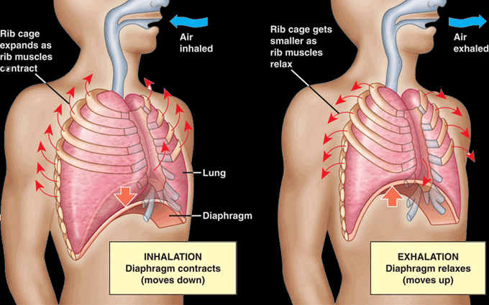
Actions
1. Principal muscle of Inspiration.

Slide 11
2. Helps in expulsive acts-
sneezing, coughing, laughing, crying, vomiting
micturition, defaecation or parturation.
3. May have sphincteric action on the lower oesophagus.

Slide 12
Position of Diaphragm
3 Factors :-
1.The elastic recoil of Lung
2.The pressure exerted by abdominal viscera
3.The muscles of abdominal wall
Highest- in supine position
Lowest- in sitting
Intermediate- in standing

Slide 13
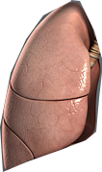

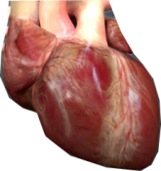
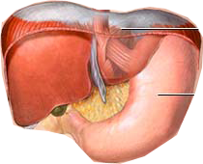
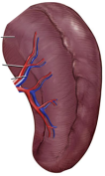

Relations
Superiorly-
pleurae
pericardium
Inferiorly -
peritoneum
liver
fundus of stomach
spleen
kidneys
suprarenal

Slide 14
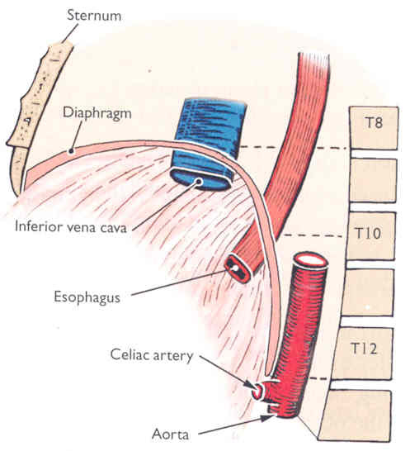
Openings
Major openings
Caval opening
Oesophageal opening
Aortic opening

Slide 15
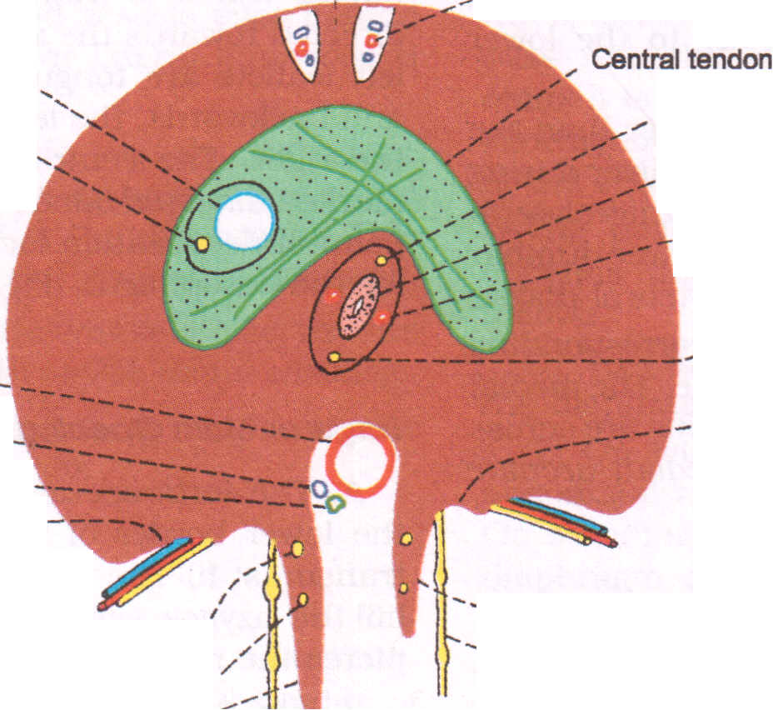
Minor openings
2 aperture in right crus
3 lesser aperture in left crus
under the medial lumbocostal arches
under the lateral lumbocostal arches
foramina of Morgagni

Slide 16
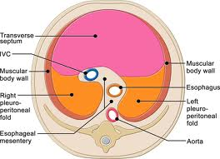
Development
The Diaphragm 'develops from the following sources.
Septum transversum
2. Pleuroperitoneal membranes
3. Lateral thoracic wall
4. Dorsal mesentery of oesophagus

Slide 17
Applied Anatomy
Hiccough- a)peripheral
      b)central
Shoulder tip pain
Unilateral paralysis of Diaphragm
Eventration
Diaphragmatic hernia – a) Congenital
          b) Acquired

Slide 18
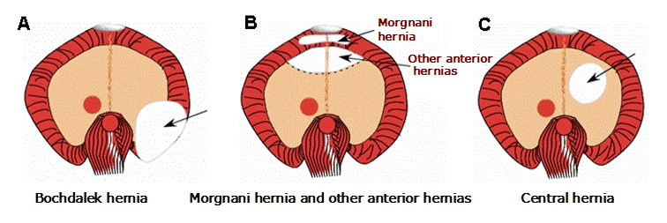
Congenital Hernia
a) Morgagni hernia or Retrosternal hernia
b) Bochdalek hernia or Posterolateral
c) Central hernia

Slide 19
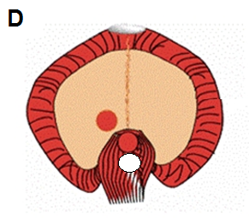
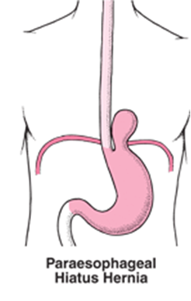
d) Posterior hernia
e) Congenital hiatal hernia

Slide 20
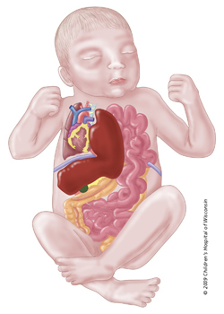
Bochdalek hernia

Slide 21
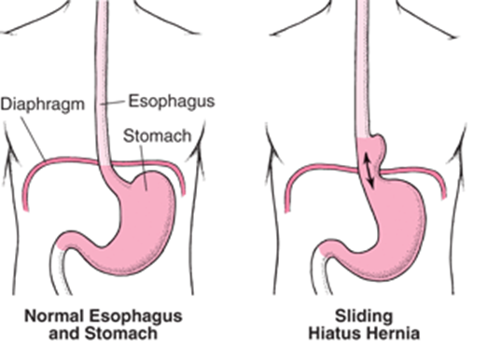
Acquired Hernia
Traumatic hernia
Acquired hiatal hernia

Slide 22
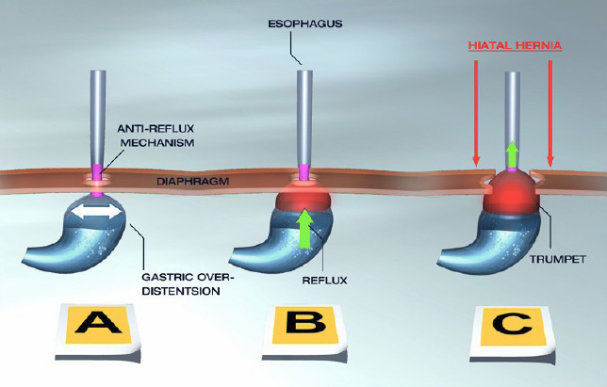

Slide 23
THANK YOU

