Slide 1
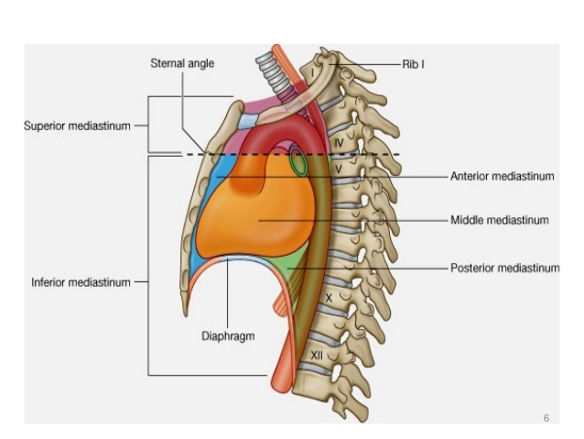
MEDIASTINUM
(THORAX)
Dr. Praveen Kumar Kurrey
M.B.B.S., M.S. BCME, BCBR
Professor Anatomy

Slide 2
DEFINITION
It is a partition between the right & left pleural sacs. It includes all the structures which lie in the intermediate compartments of the thoracic cavity

Slide 3
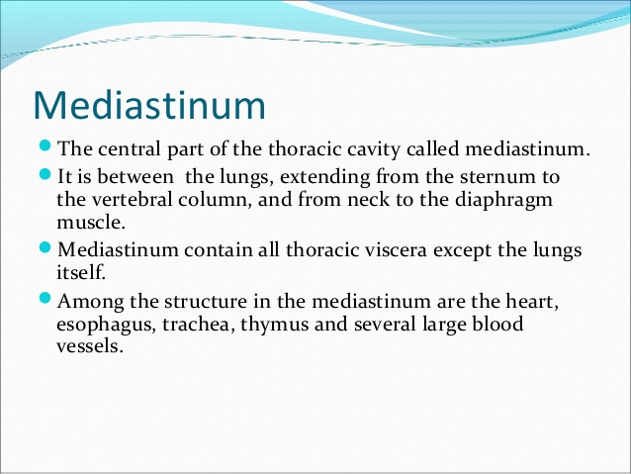

Slide 4
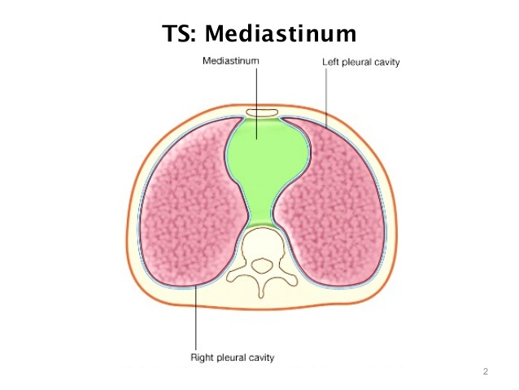

Slide 5
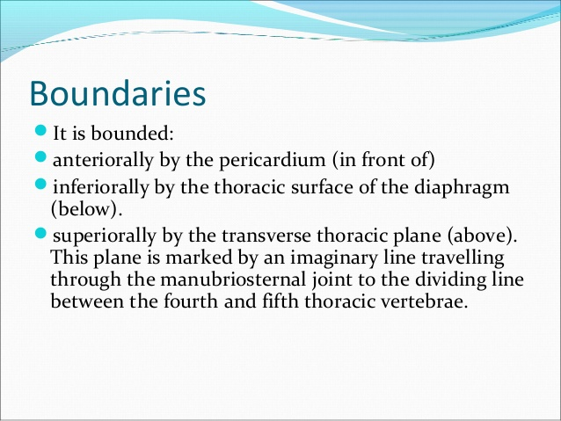

Slide 6
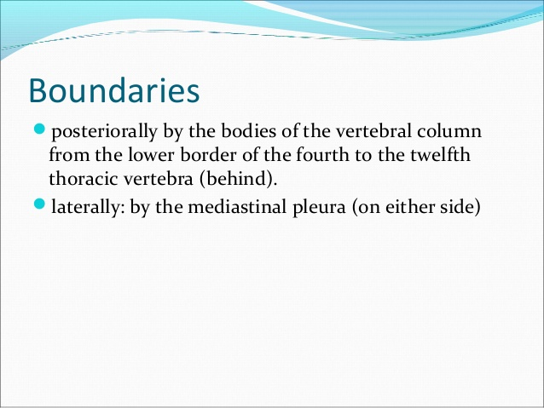

Slide 7
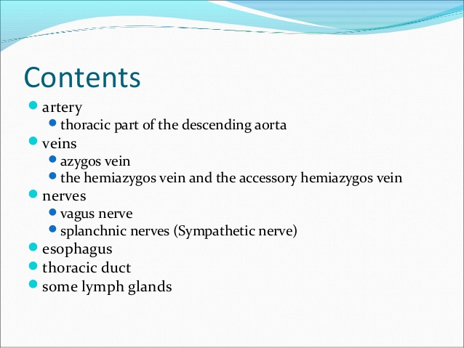

Slide 8
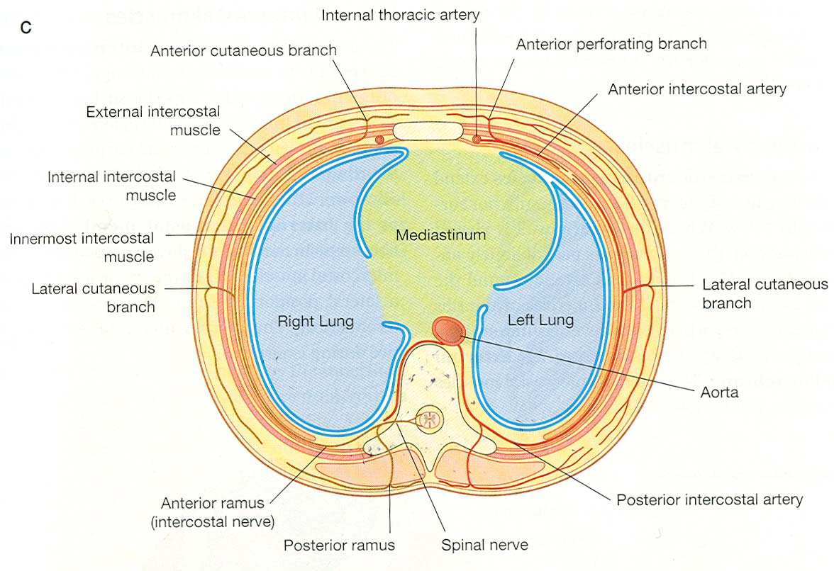

Slide 9
DIVISIONS OF MEDIASTINUM
It is divided by a horizontal plane extending from sternal angle to lower border of 4th thoracic vertebra into:
Superior mediastinum: above the plane
Inferior mediastinum: below the plane, it is subdivided into:
Anterior mediastinum: in front of pericardium
Middle mediastinum: contains heart & pericardium
Posterior mediastinum: behind pericardium

Slide 10
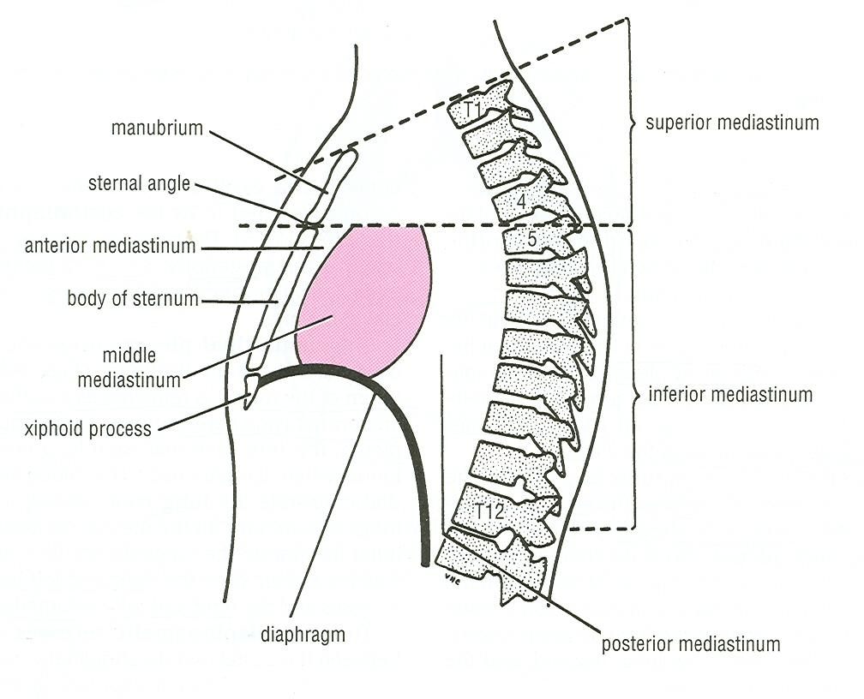
DIVISIONS OF MEDIASTINUM

Slide 11
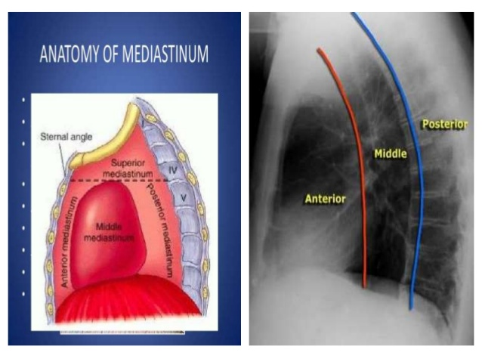

Slide 13
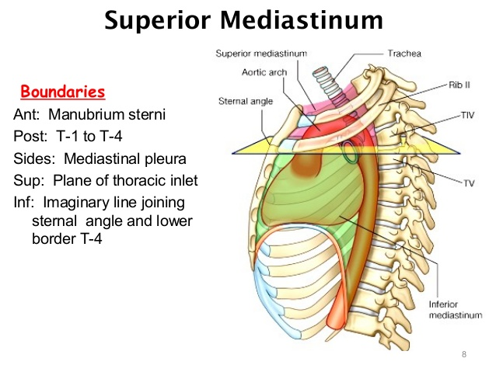

Slide 14
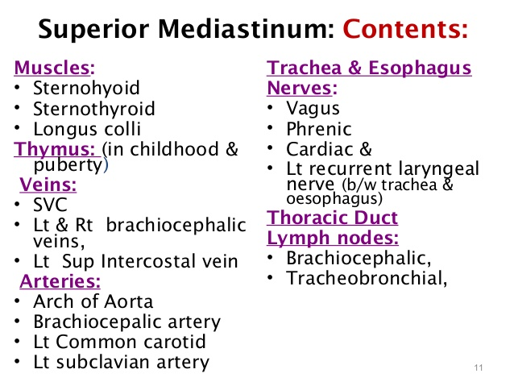

Slide 15
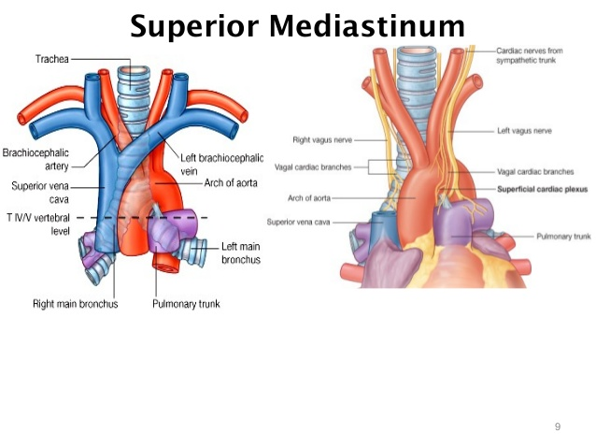

Slide 16
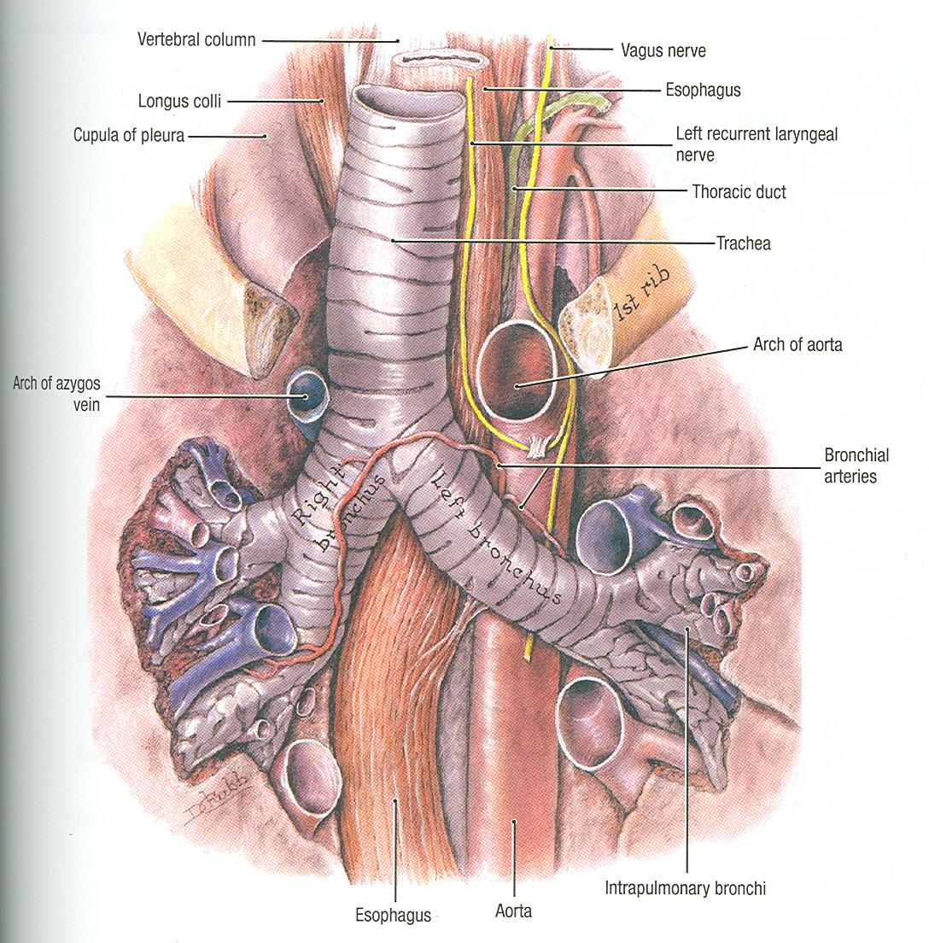
SUPERIOR MEDIASTINUM

Slide 17
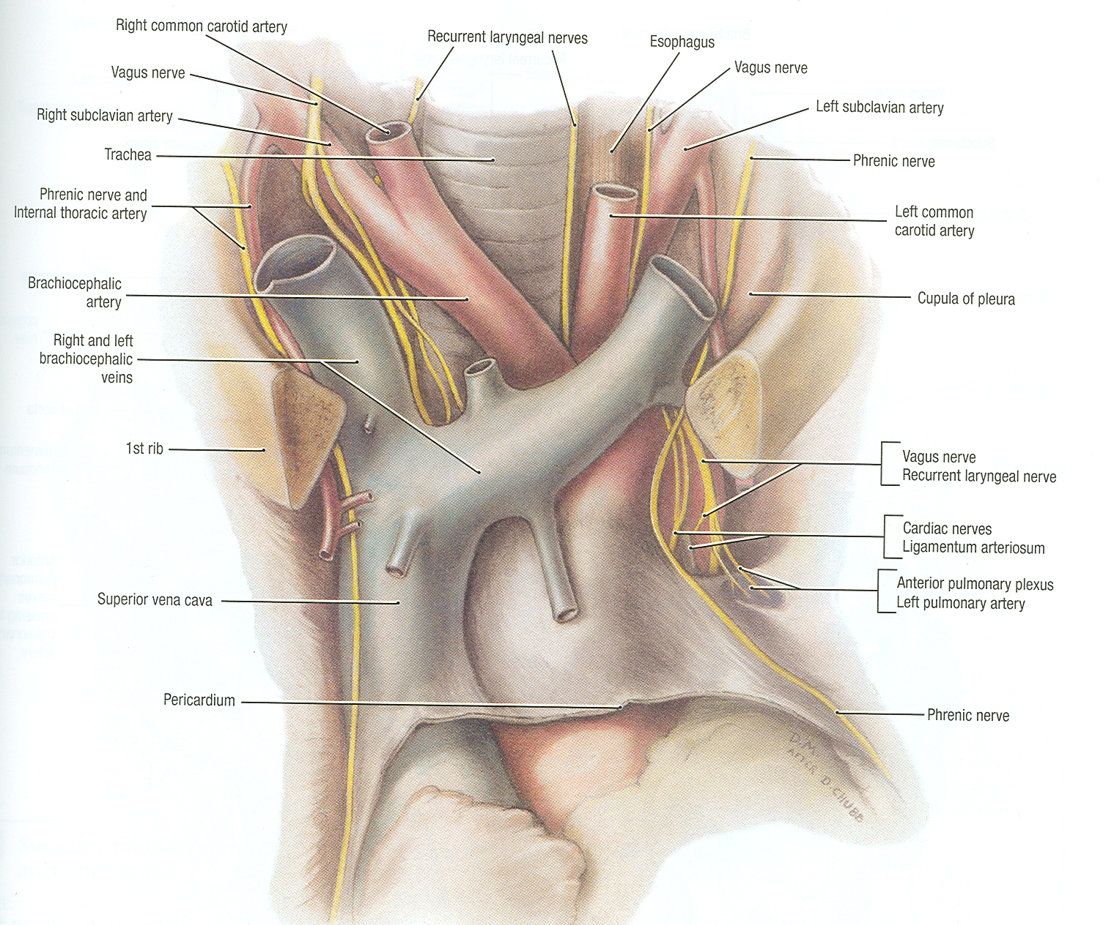
SUPERIOR MEDIASTINUM

Slide 18
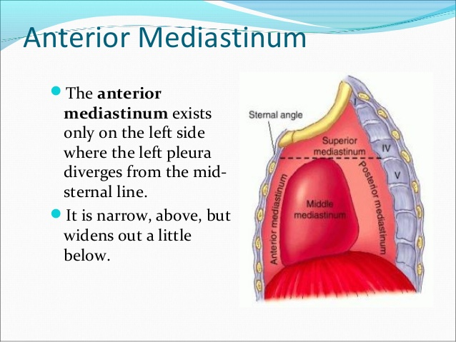

Slide 19
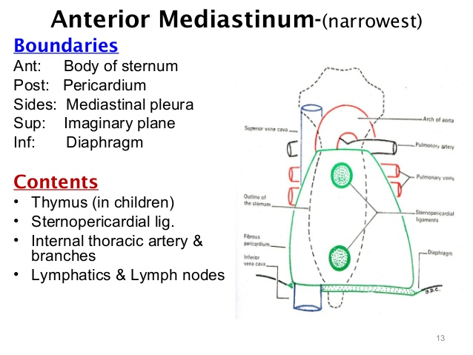

Slide 20
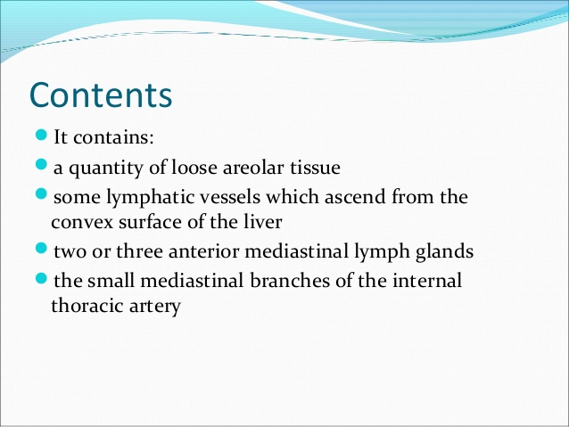
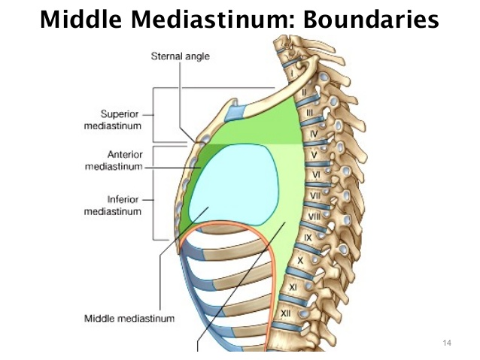

Slide 21
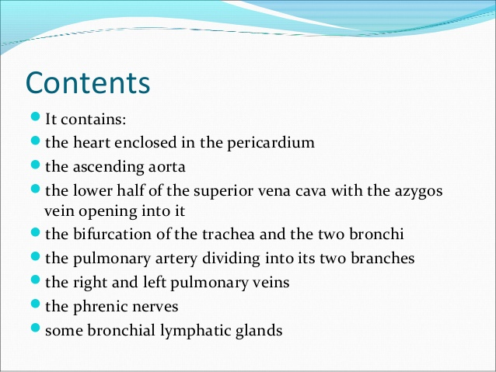

Slide 22
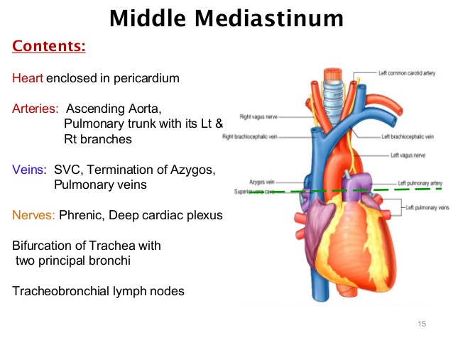

Slide 23
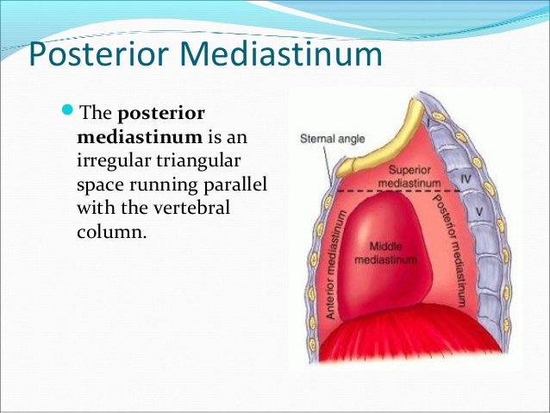

Slide 24
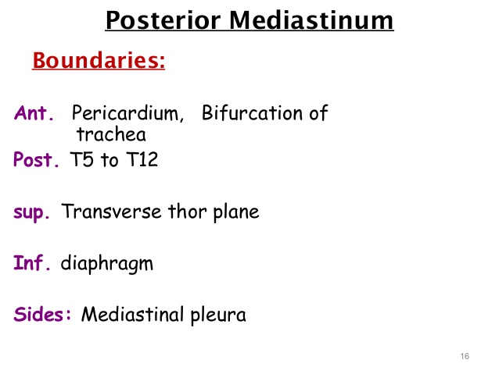

Slide 25
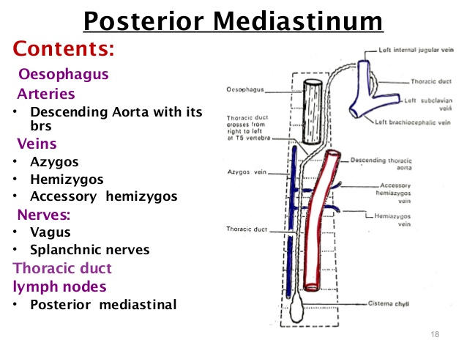

Slide 26
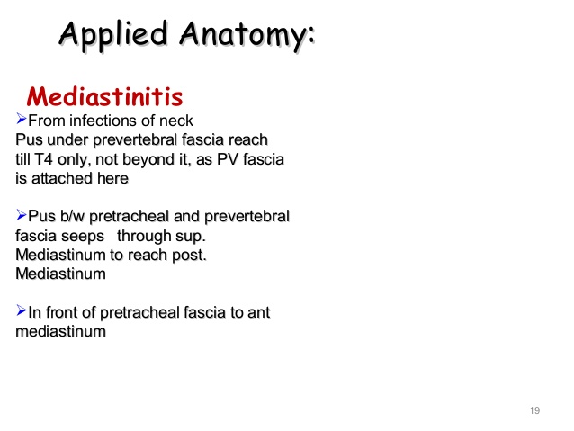

Slide 27
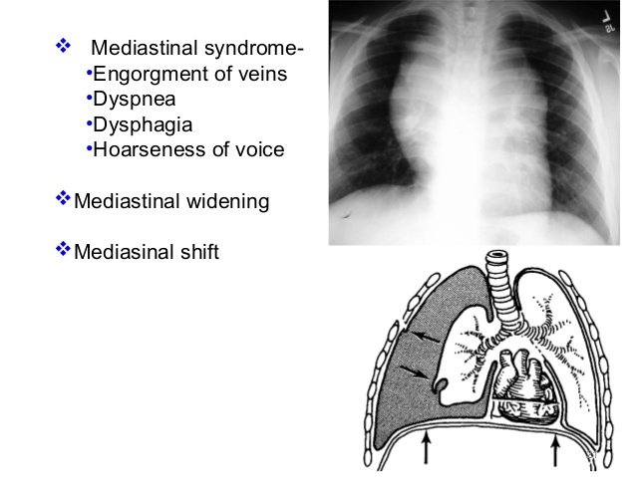

Slide 28
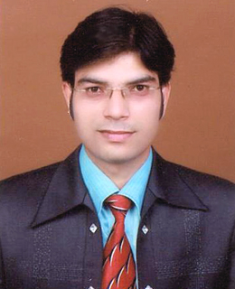
For Students……..
Don’t take the university exam lightly.
Study hard ,daily, in a routine and all subjects daily.
Don’t break continuity.
Focus on ur future.
Careful about ur health, diet and sleep.
I hope all u will get grand success….
Hoping best for ur future……………
Dr. Praveen Kurrey
Be Positive…….Feel Positive…Stay Positive…..and Live Positive…

Slide 29


