Slide 1
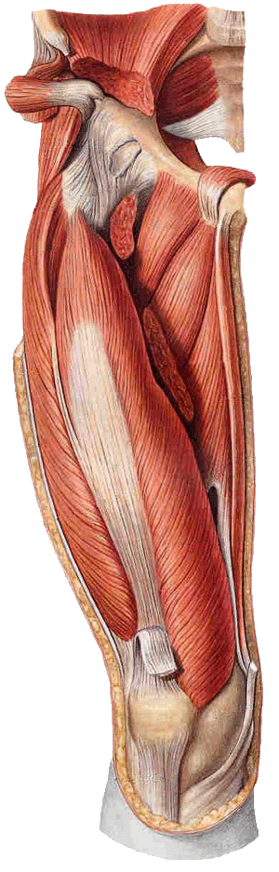
THE LOWER LIMB
(INTRODUCTION)
Dr. Praveen Kumar Kurrey
M.B.B.S., M.S.
Associate Professor
Dept. Of Anatomy
Pt. J.N.M. Medical college

Slide 2
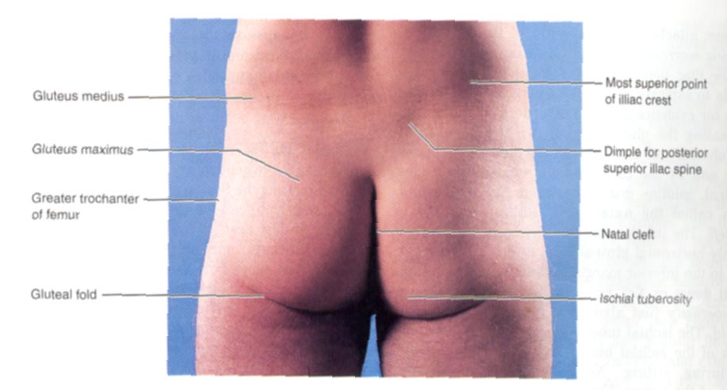
Surface Anatomy: Posterior Pelvis
Iliac crest
Gluteus maximus = cheeks
Natal/gluteal cleft = crack
Gluteal folds = bottom of cheek

Slide 3
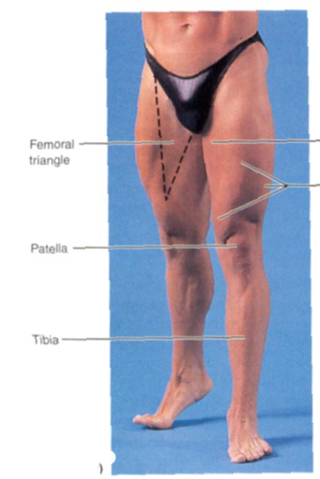
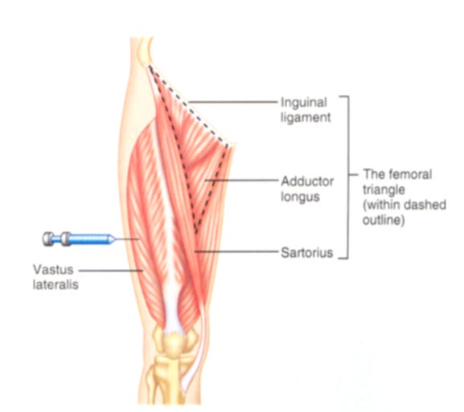
Surface Anatomy: Anterior Thigh + Leg
Palpate
  Patella
  Condyles of femur
Femoral Triangle
  Sartorius (lateral)
  Adductor longus (medial)
  Inguinal ligament (superior)
  Femoral a + v, lymph nodes

Slide 4
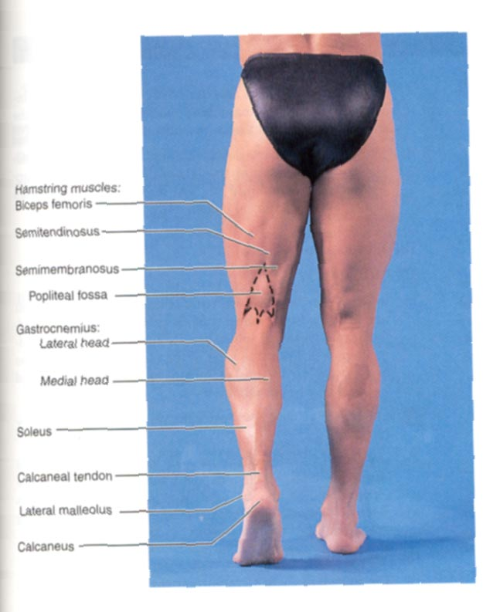
Surface Anatomy: Posterior Leg
Popliteal fossa
  Diamond-shape fossa behind knee
  Boundaries
    Biceps femoris (sup-lat)
    Semitendinosis + semimembranosis (sup-med)
    Gastrocnemius heads (inf)
  Contents
    Popliteal a + v
Calcaneal (Achilles) tendon

Slide 5
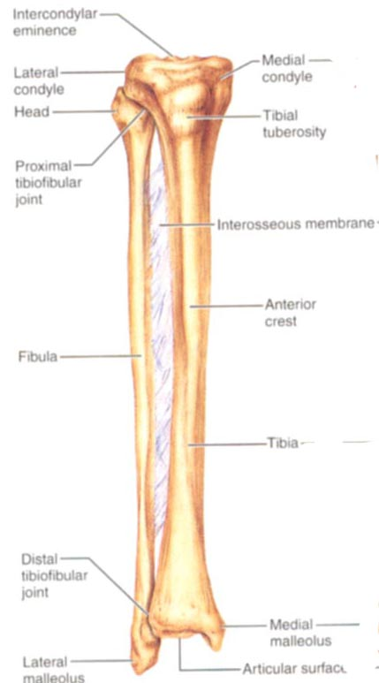
Surface Anatomy: Anterior Leg
Tibia
  Tibial tuberosity
  Anterior crest
  Medial surface
  Medial malleolus
Fibula
  Lateral malleolus
Pg 192

Slide 6
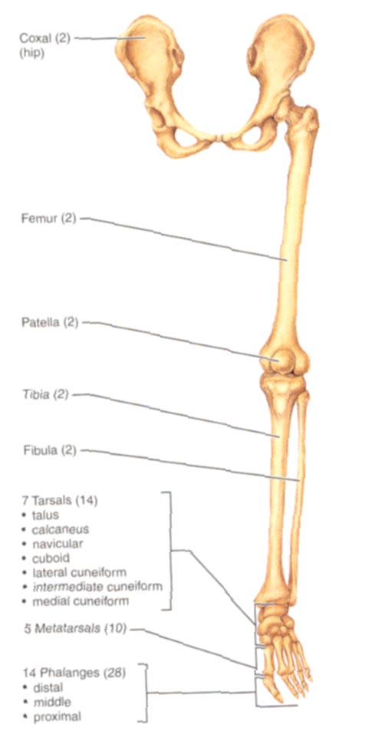
Bones of Lower Limb
Function
  Weight transmission
  Support & locomotion
  Muscle attachment
Thigh
  Femur
Knee
  Patella
Leg
  Tibia (medial)
  Fibula (lateral)
Foot
  Tarsals (7)
  Metatarsals (5)
  Phalanges (14)

Slide 7
Lower Limb Bones
Femur
  Articulates w/acetabulum (prox)
  Articulates w/Tibia & patella (distally)
Tibia
  Articulates with fibula proximally + distally
  Receives weight from femur
  Muscle attachment
Fibula
  Receives no weight
  Muscle attachment
  Not part of knee joint
  Stabilizes ankle joint
Interosseous membrane

Slide 8
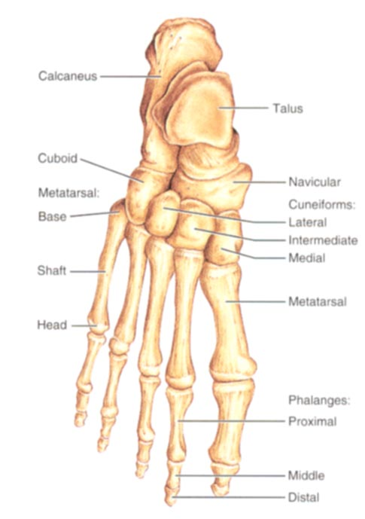
Foot
Function:
  Support weight
  Act as lever when walking
Tarsals (posterior ½ )
  Talus = ankle
    Between tibia + fibula
    Articulates w/both
  Calcaneus = heel
    Attachment for Calcaneal tendon
    Carries talus
Metatarsals (anterior ½ )
  Homologous to metacarpals
Phalanges (anterior ½)
  Smaller, less nimble
3 Arches
pg 193

Slide 9
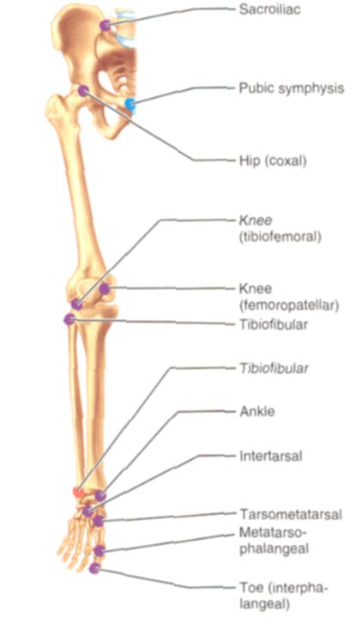
Joints of Lower Limb
Hip (femur + acetabulum)
  Ball + socket
  Multiaxial
  Synovial
Knee (femur + patella)
  Plane
  Gliding of patella
  Synovial
Knee (femur + tibia)
  Hinge (modified)
  Biaxial
  Synovial
  Contains menisci, bursa, many ligaments

Slide 10
Joints of Lower Limb
Proximal Tibia + Fibula
  Plane, Gliding
  Synovial
Distal Tibia + Fibula
  Slight “give” (synarthrosis)
  Fibrous (syndesmosis)
Ankle (Tibia/Fibula + Talus)
  Hinge, Uniaxial
  Synovial
Intertarsal & Tarsal-metatarsal
  Plane, synovial
Metatarsal-phalanges
  Condyloid, synovial
Interphalangeal
  Hinge, uniaxial
pg 206

Slide 11
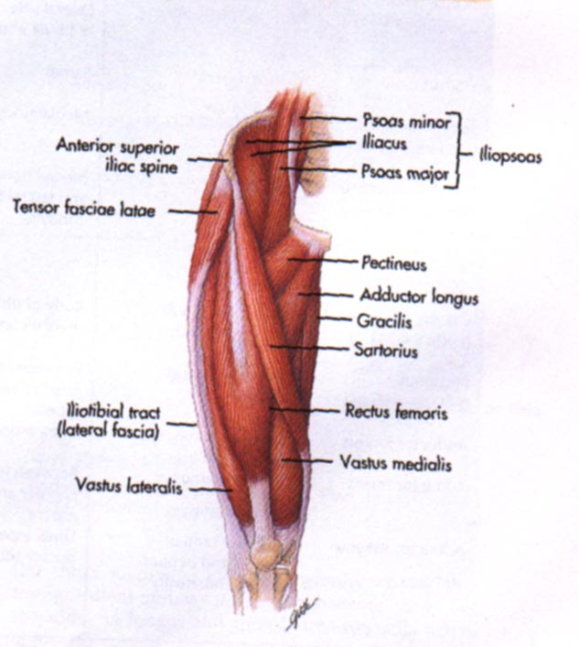
Muscles of Hip and Thigh
Gluteals (posterior pelvis)
  Extend thigh
  Rotate thigh
  Abducts thigh
Anterior Compartment Thigh
  Flexes thigh at hip
  Extends leg at knee
Medial/Adductor Compartment
  Adducts thigh
  Medially rotates thigh
Posterior Compartment Thigh
  Extends thigh
  Flexes leg
pg 299

Slide 12
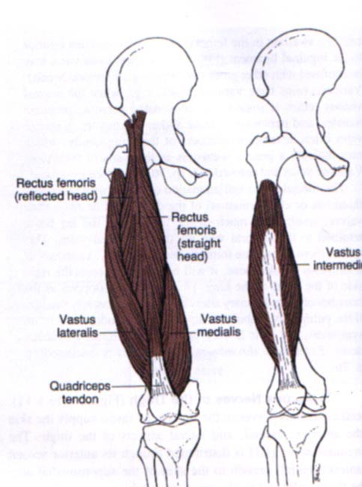
Anterior Compartment Thigh
Quadriceps Femoris =
1) Vastus lateralis
2) Vastus medialis
3) Vastus intermedias
  O: femur, I: patellar ligament
  Fxn: Knee extension
4) Rectus femoris
  O: A.I.I.S., margin acetabulum
  I: patellar ligament
  Fxn: Knee extension, flexes thigh
Sartorius
  O: A.S.I.S. I: medial tibia
  Fxn: flex, abduct, lat rotate thigh; weak knee flexor
Innervation: Femoral n (all of the above)
pg 299

Slide 13
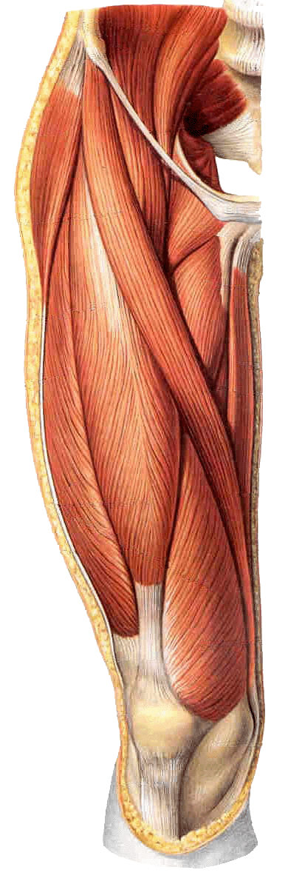
Contents of the anterior fascial compartments of the thigh
Psoas major
Iliopsoas
Iliacus
Sartorius
Vastus lateralis
Quadriceps femoris
Rectus femoris
Vastusintermedius
Vastus medialis

Slide 14
Anterior Compartment Thigh
Tensor fasciae latae
  O: iliac crest, A.S.I.S.
  I: iliotibial tract
  Fxn: Flex thigh, abduct thigh, medial rotation of thigh
Innervation: Superior Gluteal n
Iliopsoas
  Prime flexor of thigh
  O: Ilia, sacrum, lumbar vertebrae
  I: Lesser trochanter
  Femoral n.
pg 299

Slide 15
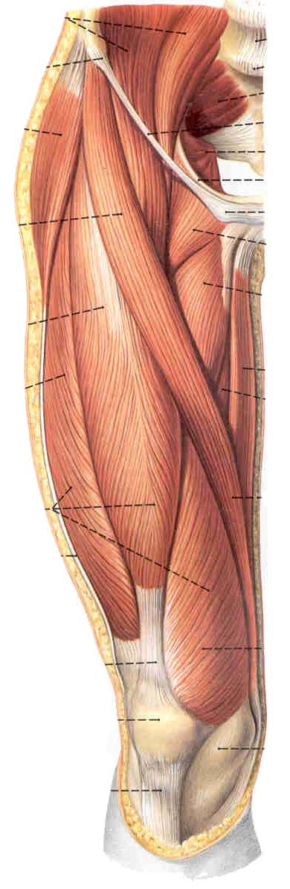
Femoral triangle
This triangle is bounded by: the inguinal ligament (base) superiorly; the medial border of sartorius laterally; the medial border of adductor longus medially. Inferiorly, the apex of the triangle is continuous with adductor canal.
The anterior wall is fascia lata
The posterior wall consists of adductor longus, pectineus and iliopsoas , from medial to lateral side.

Slide 16
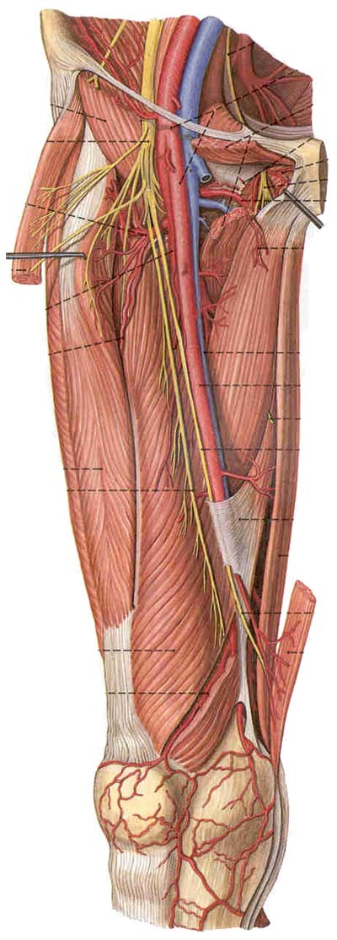
Adductor canal
Extends from apex of femoral triangle to adductor hiatus
Bounded by vastus medialis laterally, adductors longus and magmus posteriorly, and adductor lamina and sartorius anteriorly
Contents – saphenous nerve, femoral a., femoral v., lymphatic vessels, and loose connective tissue

Slide 17
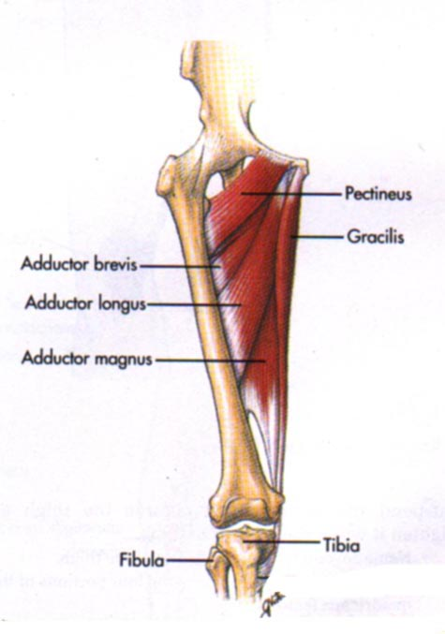
AdductorsMedial Compartment
Adductor longus
Adductor brevis
Adductor magnus
  O: inferior pelvis, I: femur
  Innervation: Obturator nerve
  Fxn: Adducts, medial rotates some
Pectineus
  O: pubis, I: lesser trochanter
  Fxn: Adducts, medial rotates
  Innervation: Femoral, st obturator
Gracilis
  O: pubis, I: medial tibia
  Fxn: Adducts thigh; flex, medial rotates leg
  Innervation: Obturator nerve
pg 299

Slide 18
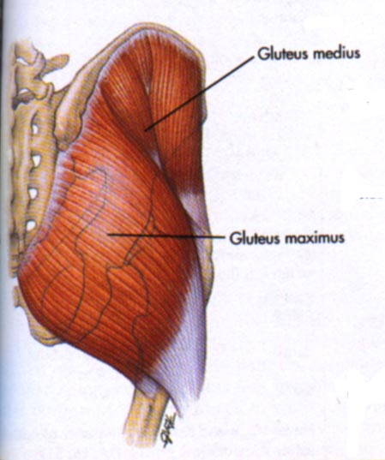
Posterior Compartment: Gluteals
Gluteus Maximus
  O: sacrum, ilium, coccyx
  I: femur, iliotibial tract
  Fxn: Extends thigh, some lateral rotation + abduction
  Innervation: Inferior Gluteal n
Gluteus Medius
Gluteus Minimus
  O: ilium, I: greater trochanter
  Fxn: Abduction, medial rotation
  Innervation: Superior Gluteal n.
Lesser Gluteals help stabilize hip to allow fluent bipedal walking
pg 302

Slide 19
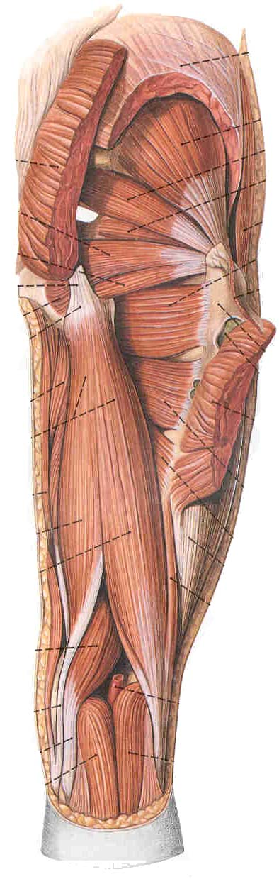
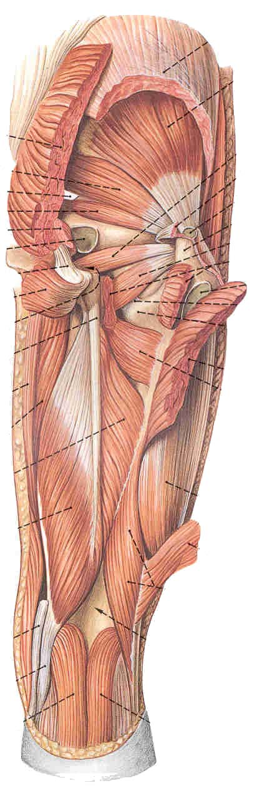
Posterior group
  Gluteus maximus
  Gluteus medius
  Gluteus minimus
  Piriformis
  Obturator internus
  Quadratus femoris
  Obturator externus

Slide 20
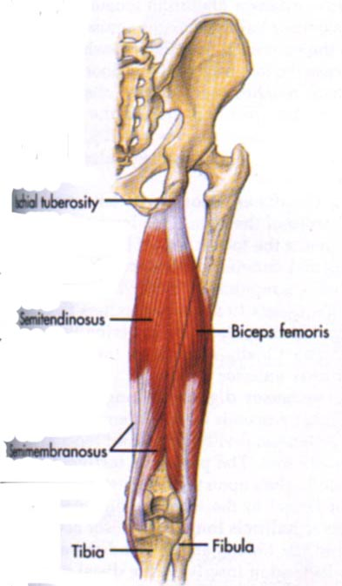
Posterior Compartment: Hamstring
Biceps femoris (2 heads)
  O: ischial tuberosity
  I: lateral tibia, head fibula
  Fxn: thigh extension, knee flexion, lateral rotation
Semitendinosis
Semimembranosis
  O: ischial tuberosity
  I: medial tibia
  Fxn: thigh extension, knee flexion, medial rotation
ALL hamstring muscles innervated by SCIATIC NERVE
pg 302

Slide 21
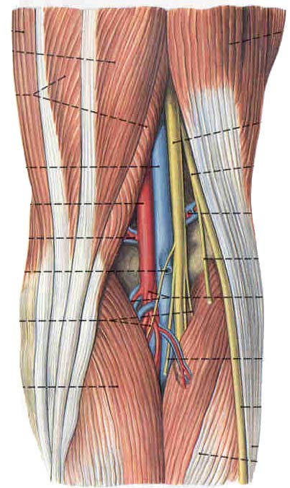
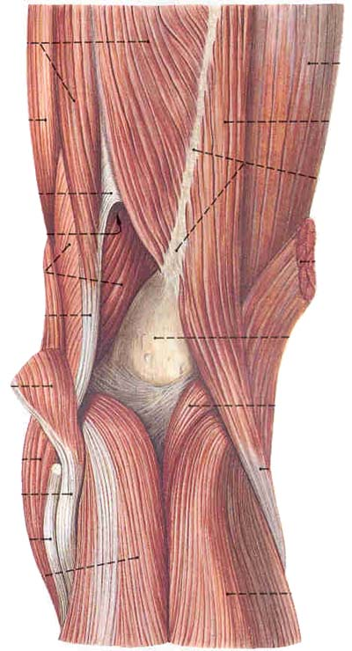
Popliteal fossa
Diamond-shaped
Upper lateral boundary: Biceps femoris
Upper medial boundary:
semimembranosus and semitendinosus
Two lower boundaries are the heads of gastrocnemius
Posterior wall: deep fascia
Anterior wall: popliteal surface of the femur, the posterior capsule of the knee joint, and the fascia covering poplitells

Slide 22
Contents of the popliteal fossa
Tibial and common peroneal nerves and their branches
Popliteal vein and its tributaries
Popliteal artery and its branches
Popliteal lympn nodes
Fatty tissue

Slide 23
Muscles of Leg
Anterior Compartment
  Dorsiflex ankle, invert foot, extend toes
  Innervation: Deep fibular nerve
Lateral Compartment
  Plantarflex, evert foot
  Innervation: Superficial Fibular nerve
Posterior Compartment
  Superficial + deep layers
  Plantarflex foot, flex toes
  Innervation: Tibial nerve

Slide 24
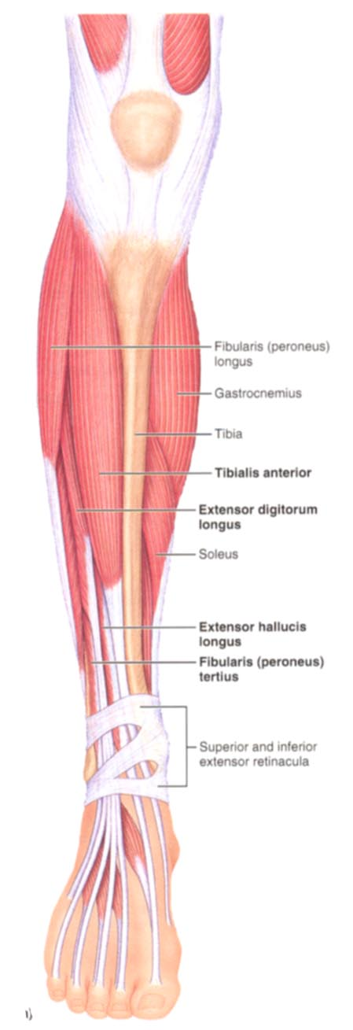
Anterior Compartment
Tibialis anterior
  O: tibia, I: tarsals
  Fxn: dorsiflexion, foot inversion
Extensor digitorum longus
  O: tibia + fibula, I: phalanges
  Fxn: toe extension
Extensor hallucis longus
  O: fibula, interosseous membrane, I: big toe
  Fxn: extend big toe, dorsiflex foot
All Deep Fibular nerve
pg 305

Slide 25
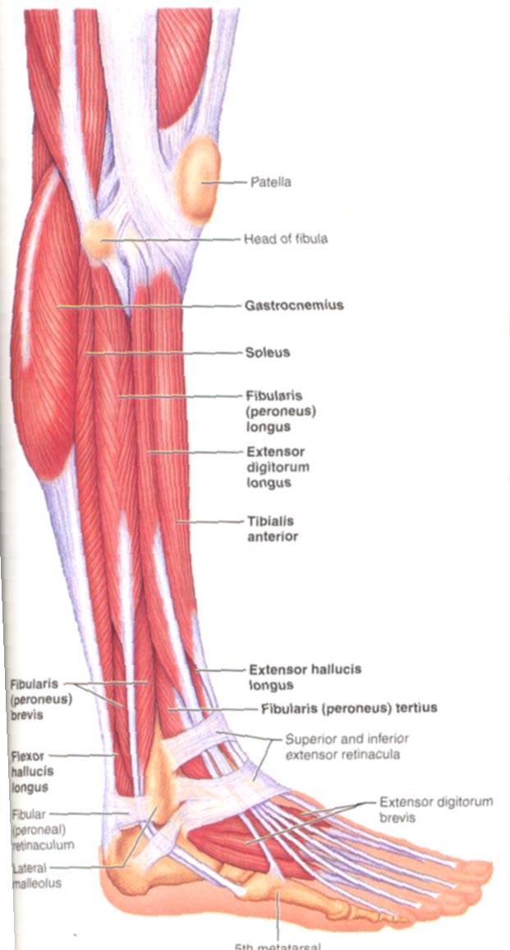
Lateral Compartment
Fibularis (peroneus) longus
  O: lateral fibula
  I: 5th metatarsal, tarsal
  Fxn: plantarflex, evert foot
Fibularis (peroneus) brevis
  O: distal fibula
  I: proximal fifth metatarsal
  Fxn: plantarflex, evert foot
Both Superficial Fibular nerve
pg 306

Slide 26
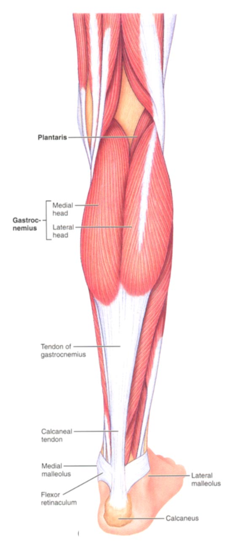
Posterior Compartment: Superficial
Triceps Surae
  Gastrocnemius (lateral + medial heads)
    O: medial + lateral condyles of femur
    I: posterior calcaneus via tendon
  Soleus
    O: Tibia + Fibula,
    I: posterior calcaneus via tendon
  Fxn: Plantarflex foot
Plantaris
  O: posterior femur
  I: posterior calcaneus via tendon
  Fxn: Plantarflex foot, weak knee flexion
Innervation: Tibial nerve
pg 308

Slide 27
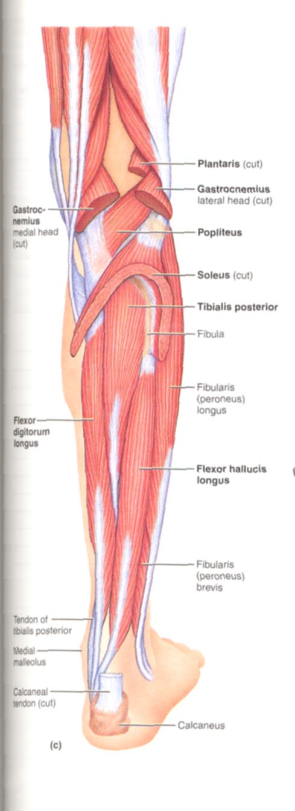
Posterior Compartment: Deep
Popliteus
  O: lat condyle femur & lat meniscus, I: prox tibia
  Fxn: Flex + Medially Rotate leg
Flexor digitorum longus
  O: tibia, I: distal phalanges of toe 2-5
Flexor hallicus longus
  O: fibula, I: distal phalanx of hallux
  Fxn: Plantarflex + Invert foot, Flex toes
Tibialis posterior
  O: tibia, fibula + IO membrane
  I: tarsals + metatarsals
  Fxn: Plantarflex + invert foot
Innvervation: All Tibial nerve
pg 309

Slide 28
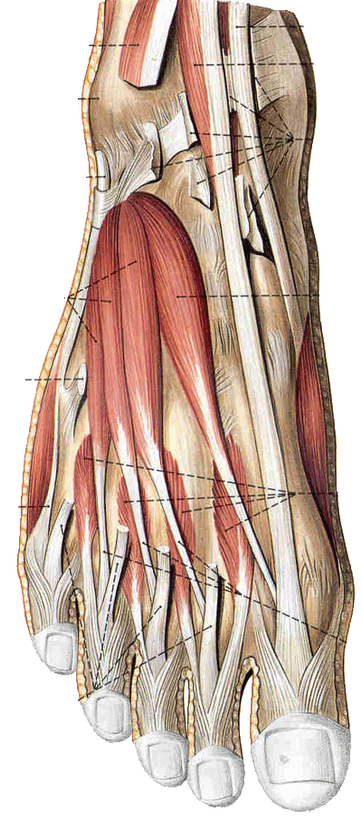
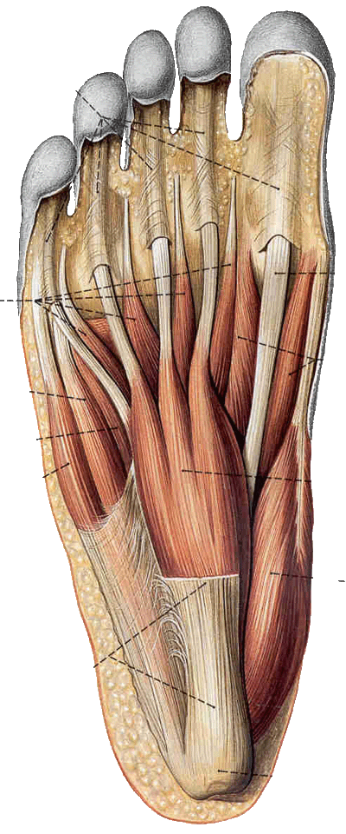
Muscles of foot
Muscles on dorsum: extensor digitorum brevis
Muscles in sole: medial, lateral and intermediate groups

Slide 29
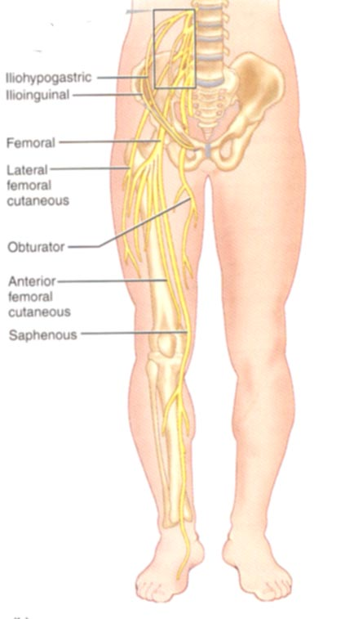
Lumbar Plexus (L1-L4)
Femoral nerve
  Cutaneous branches: thigh, leg, foot (e.g. saphenous nerve)
  Motor branches: ant. thigh muscles (e.g. quadriceps, sartorius, iliopsoas)
Obturator nerve
  Sensory: skin med thigh; hip, knee joints
  Motor: Adductor muscles
Lateral Femoral Cutaneous nerve
  Sensory: skin lat. thigh
Genitofemoral nerve
  Sensory: skin scrotum, labia major, ant. thigh
  Motor: cremaster muscle

Slide 30
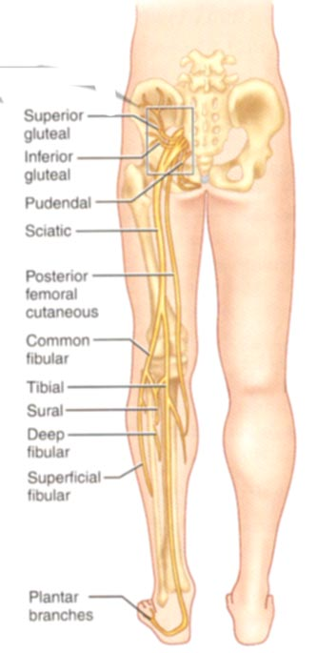
Sacral Plexus (L4-S4)
Sciatic nerve
  Motor: hamstring
  Tibial nerve
    Cutaneous: post leg and sole of foot
    Motor: post leg, foot
  Common Fibular (Peroneal) nerve
    Cutaneous: ant+lat leg, dorsum foot
    Motor: lat compartment, tibialis ant., toe extensors
Superior Gluteal nerve
  Motor: gluteus medius + minimus, tensor fasciae latae
Inferior Gluteal nerve
  Motor: gluteus maximus
Post. Femoral Cutaneous nerve
  Sensory: inf. Buttocks, post thigh, popliteal fossa
Pudendal nerve
  Sensory: external genitalia, anus
  Motor: muscles of perineum

Slide 31
Arteries of Lower Limb
Common Iliac (split from aorta)
Internal Iliac (branches from common iliac)
  Cranial + Caudal Gluteals= gluteals
  Internal Pudendal = perineum, external genitalia
  Obturator = adductor muscles
  Other branches supply rectum, bladder, uterus, vagina, male repro glands
External Iliac (branches from common iliac)
  Femoral = lower limb
    Deep femoral = adductors, hamstrings, quadriceps
      Medial/lateral femoral circumflex = head and neck of femur
  Popliteal (continuation of femoral)
    Geniculars = knee
    Anterior Tibial = ant. leg muscles, further branches to feet
    Posterior Tibial = flexor muscles, plantar arch, branches to toes
Pg 562

Slide 32
Veins of Lower Limb
Deep Veins: Mostly share names of arteries
  Ultimately empty into Inferior Vena Cava
    Plantar
    Tibial
    Fibular
    Popliteal
    Femoral
    External/internal iliac
    Common iliac
Superficial Veins
  Dorsal venous arch (foot)
  Great saphenous (empties into femoral)
  small saphenous (empties into popliteal)

Slide 33
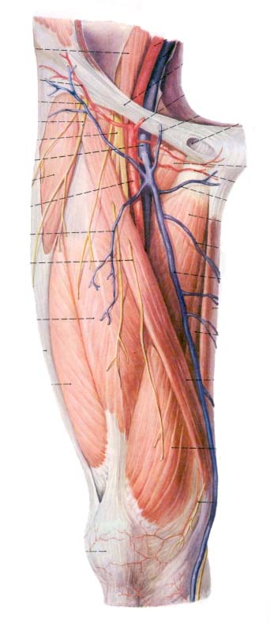
Superficial epigastric v.
Superficial circumflex iliac v.
External pudendal v.
Superficial medial femoral v.
      Superficial lateral femoral v.
Great saphenous v.

Slide 34
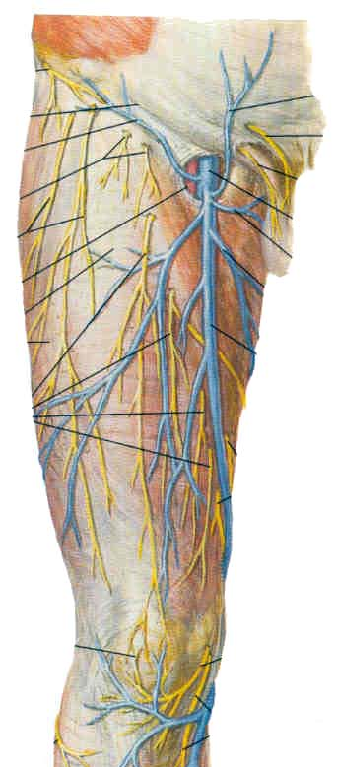
Dissetion
Superficial epigastric v.
Superficial circumflex iliac v.
Lateral cutaneous n. of thigh
External pudendal v.
Anterior cutaneous n. of thigh
Superficial medial femoral v.
Great saphenous v.
Superficial lateral femoral v.

Slide 35
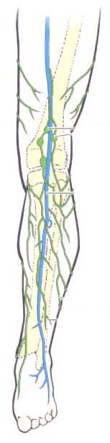
Lymph nodes and vessels of lower limb
Popliteal LN.
Embedded in the fatty connective tissue of popliteal fossa
Receive superficial lymphatic vessels from posterolateral part of calf, and from deep lymphatic vessels accompanying anterior and posterior tibial a.
Efferents pass to the deep inguinal ln.

Slide 36
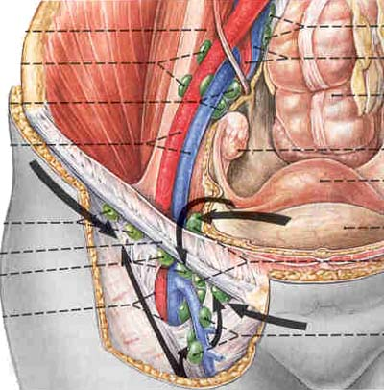
  Superficial inguinal lymph nodes
Superior group:
  Lies just distal to the inguinal ligament
  Receive lymph from anterior abdominal wall below umbilicus, gluteal region, perineal region, external genital organs
Inferior group:
  Lies vertical along the terminal great saphenous v.
  Receives all superficial lymphatics of lower limb, except for those from the posterolateral part of calf
  Efferent vessels drain into the deep inguinal ln. or external iliac ln.

Slide 37
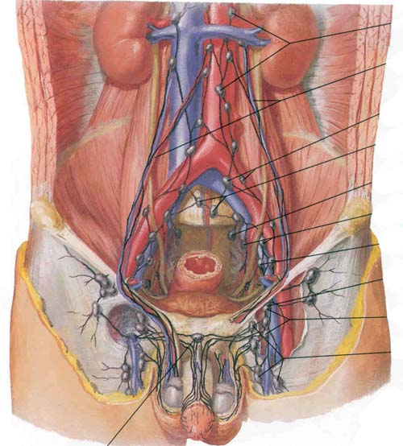
Deep inguinal lymph nodes
Lie medial to the femoral v.
Receive deep lymphatics of lower limb, perineal region, and efferent lymphatics from the superficial inguinal ln.
Drain into the external iliac ln.

Slide 38
You must identify following structures
Anterior and Medial Region of Thigh
Muscles
  Psoas Iliacus
  Sartorius
  Quadriceps femoris
  Rectus femoris
  Vastus medialis
  Vastus lateralis
  Vastus intermedius
  Patellar ligament
  Pectineus
  Adductor longus
  Adductor brevis,
  Adductor magnus
  Gracilis
Vessels
  Great saphenous v.
  Femoral a.
  Deep femoral a.
Nerves
  femoral n.
  Saphenous n.
  Obturator n.

Slide 39
You must identify following structures
Anterolateral crural region and dorsum of the foot
Muscles
  Tibialis anterior
  Extensor hallucis longus
  Extensor digitorum longus
  Peroneus longus
  Peroneus brevis
Vessels
  Great saphenous v.
  Anterior tibial a.
  Dorsalis pedis a.
Nerves
  Common peroneal n.
  Deep peroneal n.
  Superficial peroneal n.

Slide 40
For Students……..
Don’t take the university exam lightly.
Study hard ,daily, in a routine and all subjects daily.
Don’t break continuity.
Focus on ur future.
Careful about ur health, diet and sleep.
I hope all u will get grand success….
Hoping best for ur future……………
Dr. Praveen Kurrey (M.S.)

Slide 41
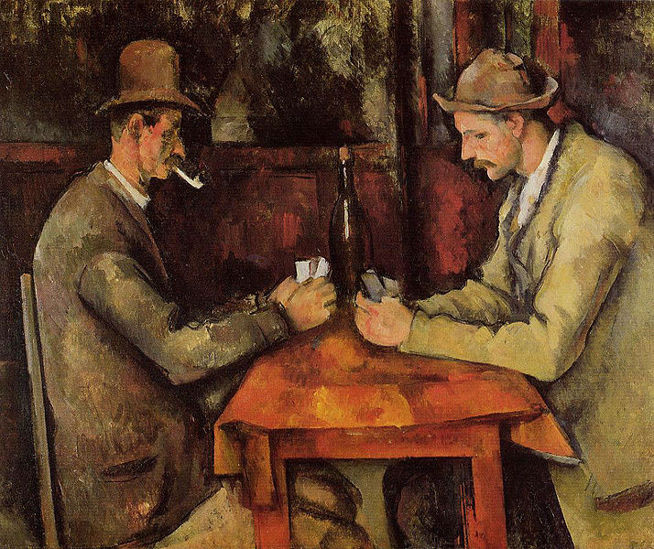
Painting by- Paul Cezane (CARD PLAYERS,1894)
Rs. 1,15,00,00,000 - SOLD

Slide 42

THANK YOU

