Slide 1
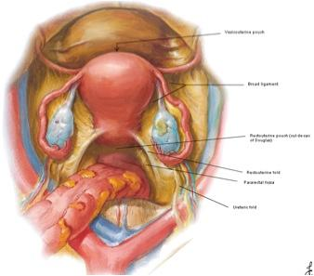
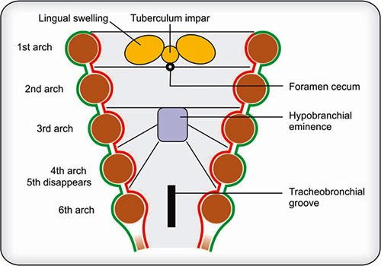
EMBRYOLOGY
DEVELOPMENT OF TONGUE
Dr. Praveen Kumar Kurrey
M.B.B.S., M.S., BCME, BCBR
PROFESSOR ANATOMY

Slide 2
Development of Tongue
.
Tongue develops in the floor of the primitive pharynx and developing mouth.
Three different sources:
  Endoderm covering the pharyngeal arches forms mucous membrane covering the tongue
  Mesenchyme of arches forms fibroareolar stroma of the tongue
  Occipital myotomes form muscles of the tongue

Slide 3
Development of Tongue
1. Epithelium/ Mucus Membrane
2. Muscles
3. Fibroareolar Tissue
4. Papillae

Slide 4
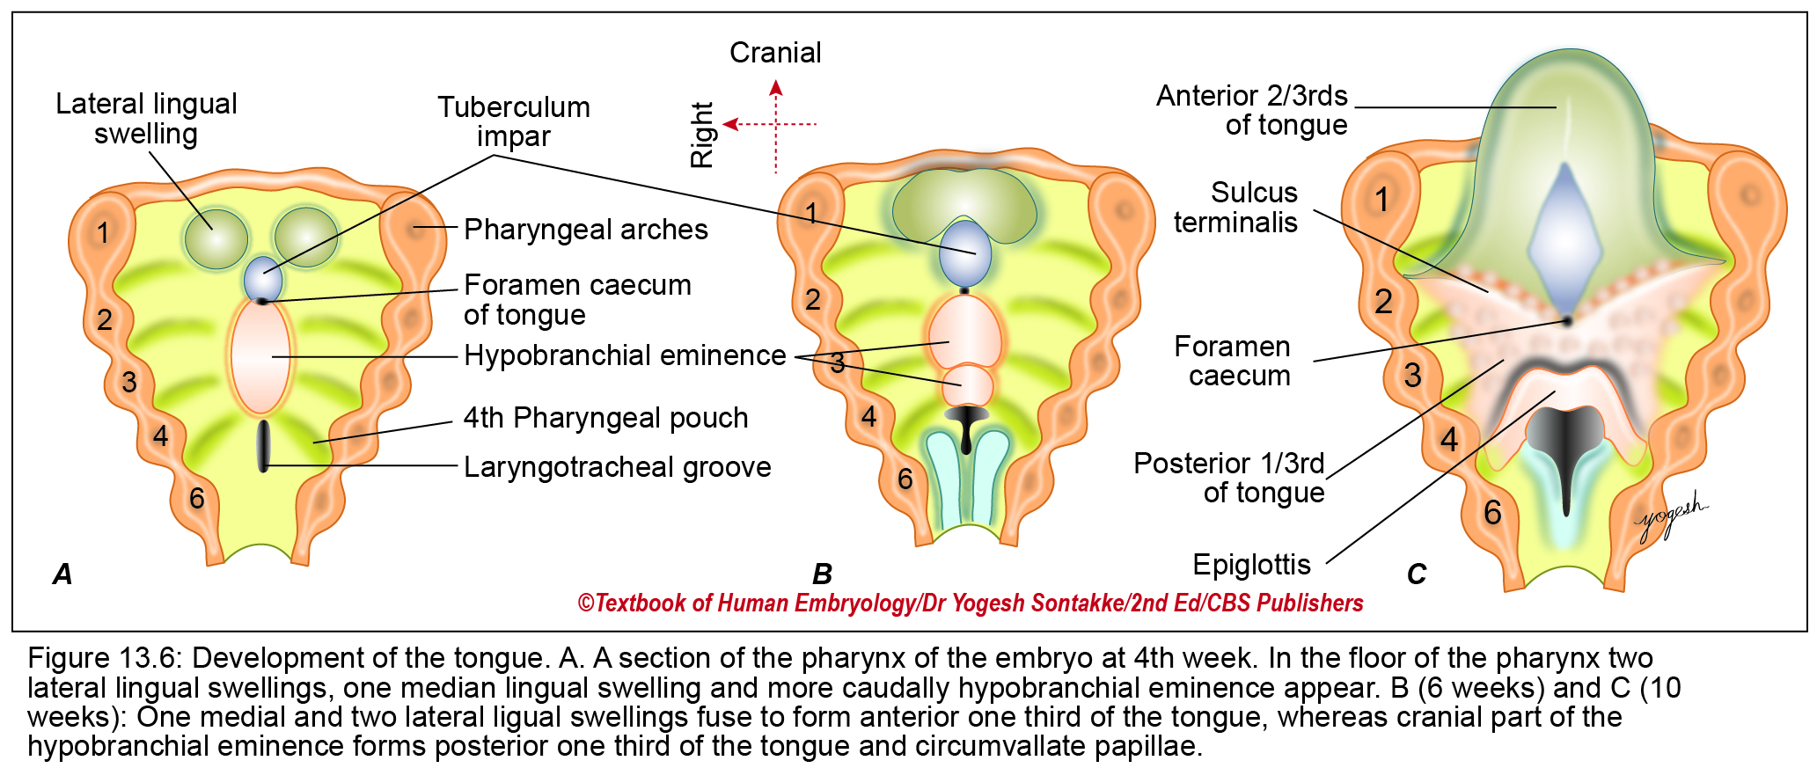

Slide 5
Mucous Membrane
4th week: Mandibular arches show 3 swellings:
1. single midline swelling as tuberculum impar
2. and two lateral lingual swellings.
Fuse and form anterior 2/3rd of tongue
3. Foramen caecum: A depression at the site of thyroglossal duct
4. 5th week: Third and fourth arch: show swelling called hypobranchial eminence or copula of His
Hypobranchial eminence
  Ventral part forms posterior one-third of the tongue
  Caudal part forms Most Posterior Part.
Some cells migrate from posterior one-third of tongue and cross sulcus terminalis to form circumvallate papillae.

Slide 6
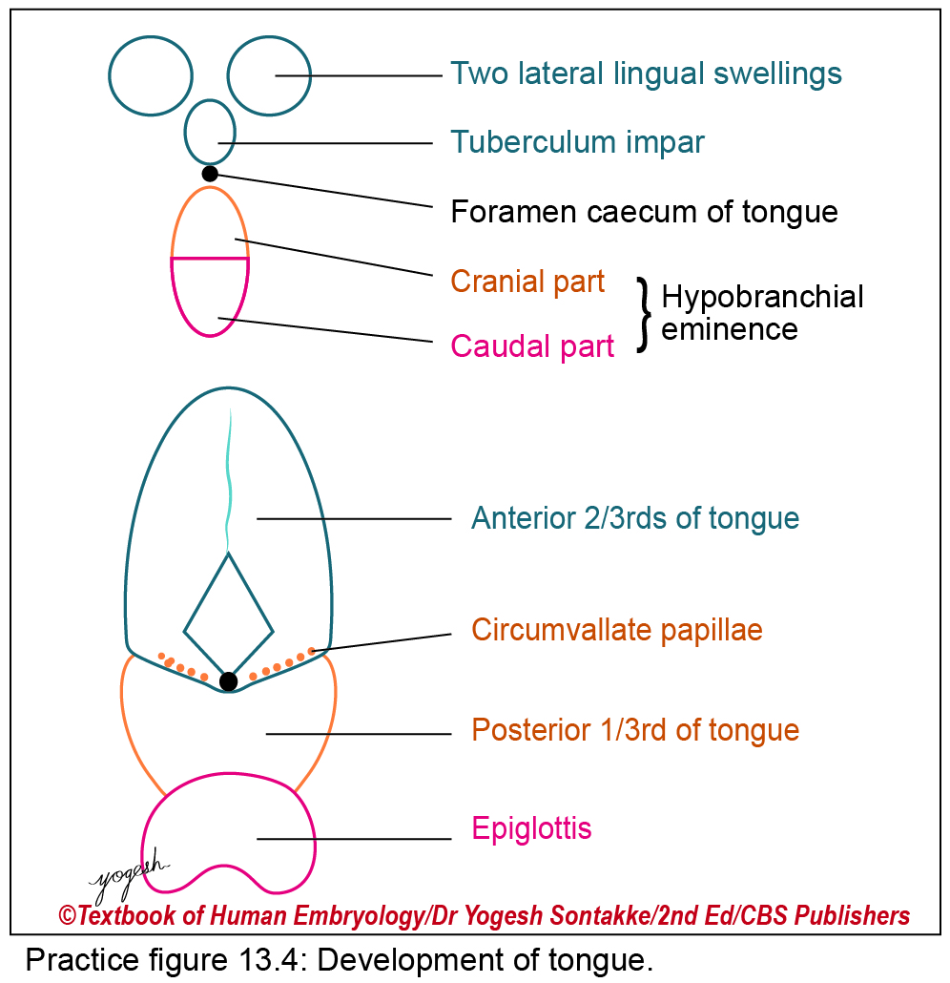

Slide 7
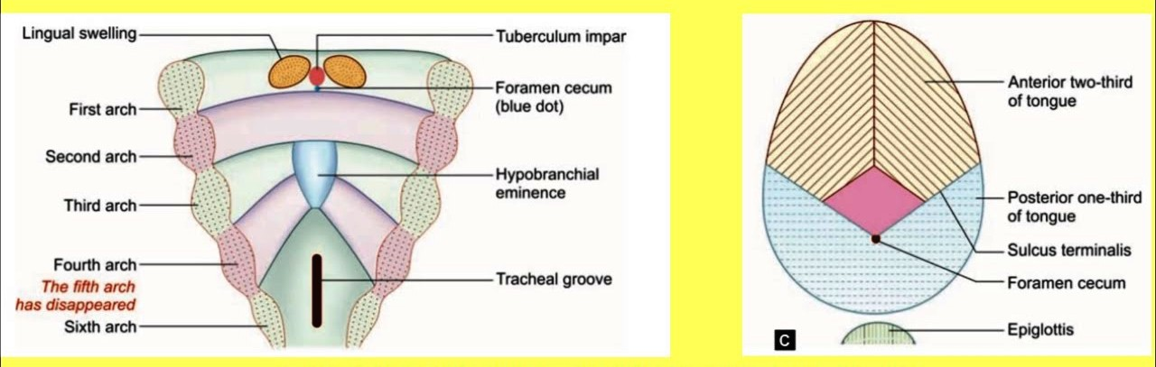

Slide 9
Muscles of Tongue
3–4 occipital myotomes migrate ventrally to the mesenchyme of the tongue and forms all extrinsic and intrinsic muscles of the tongue.
The occipital myotomes pull their nerve (hypoglossal nerve) during migration; hence hypoglossal nerve crosses both external and internal carotid arteries superficially.
All muscles except Palatoglossus

Slide 10
Nerve Supply
The mucosa of the anterior two-thirds of tongue develops from mandibular (1st) pharyngeal arch. Hence, supplied by the mandibular branch of trigeminal nerve (post-trematic nerve of 1st arch) and for a taste sensation, supplied by chorda tympani branch of facial nerve (pre-trematic nerve of 1st arch).
The mucosa of a posterior-one third of the tongue and circumvallate papillae develop from mucosa of the third arch by the hypobranchial eminence; hence supplied by the glossopharyngeal nerve (nerve of third arch).
The mucosa of Most posterior part of the tongue (near vallecula) develops from mucosa of fourth arch by the hypobranchial eminence; hence, supplied by the Internal Laryngeal branch of vagus nerve (nerve of the fourth arch).
Muscles of the tongue except palatoglossus are derived from the occipital myotomes; hence, supplied are the hypoglossal nerve.

Slide 11
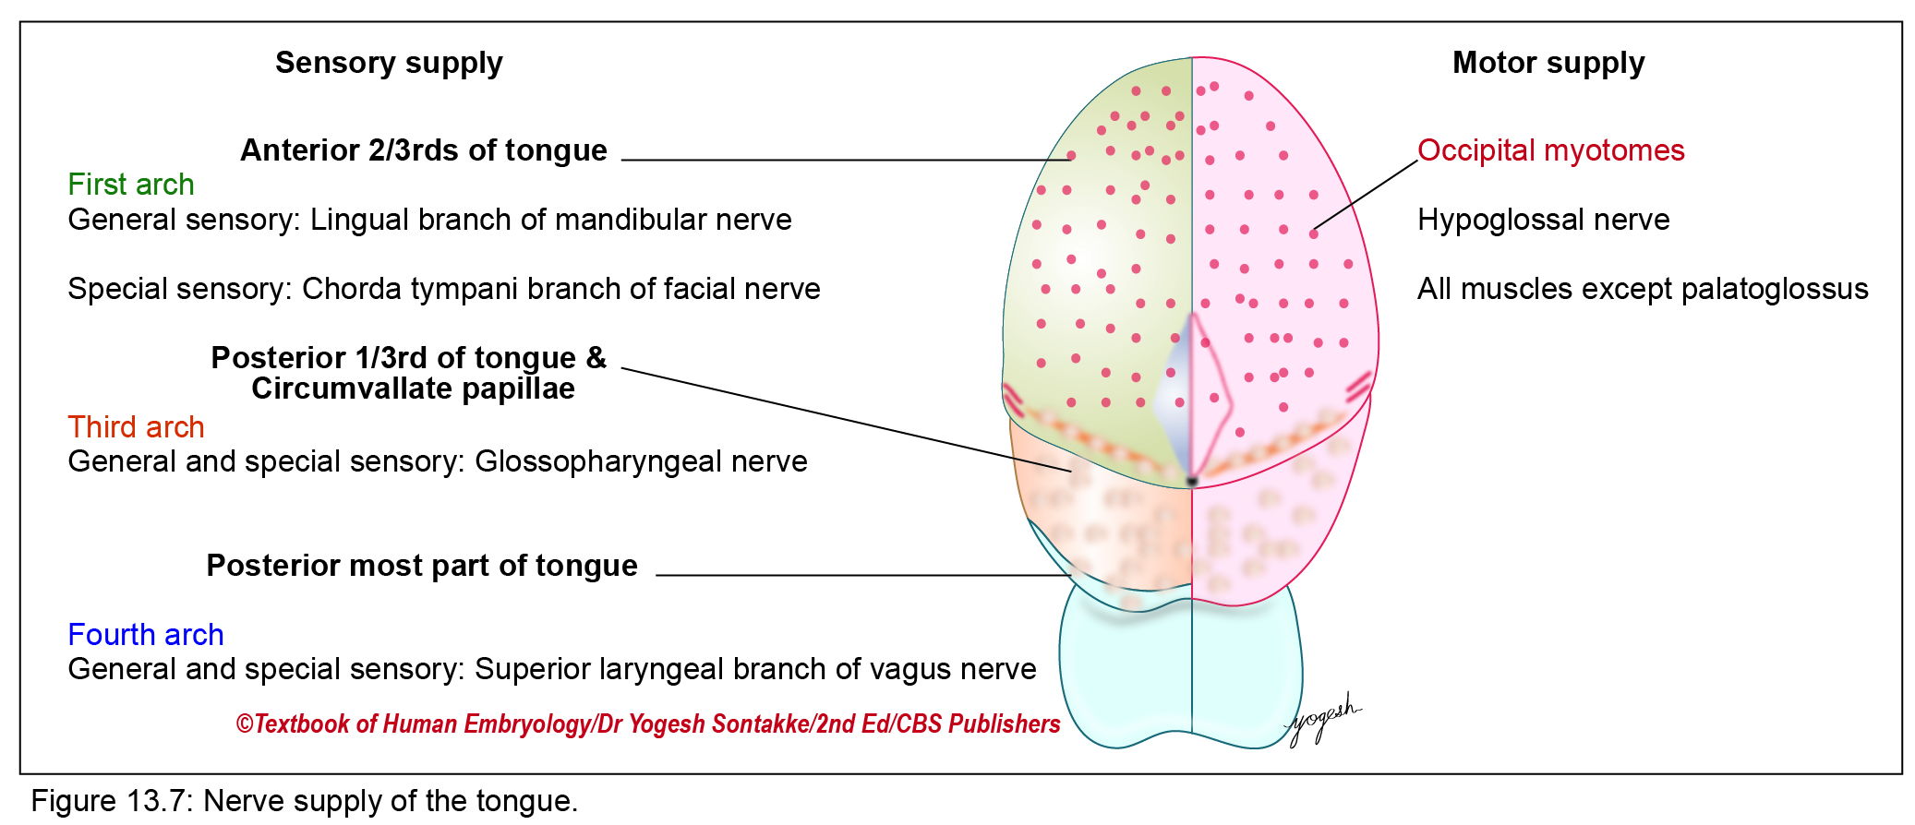
Nerve Supply

Slide 12
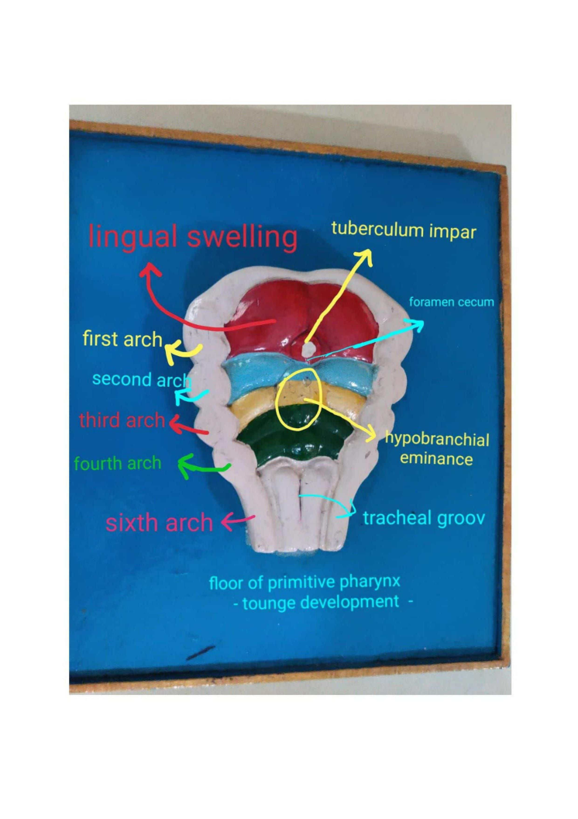

Slide 13
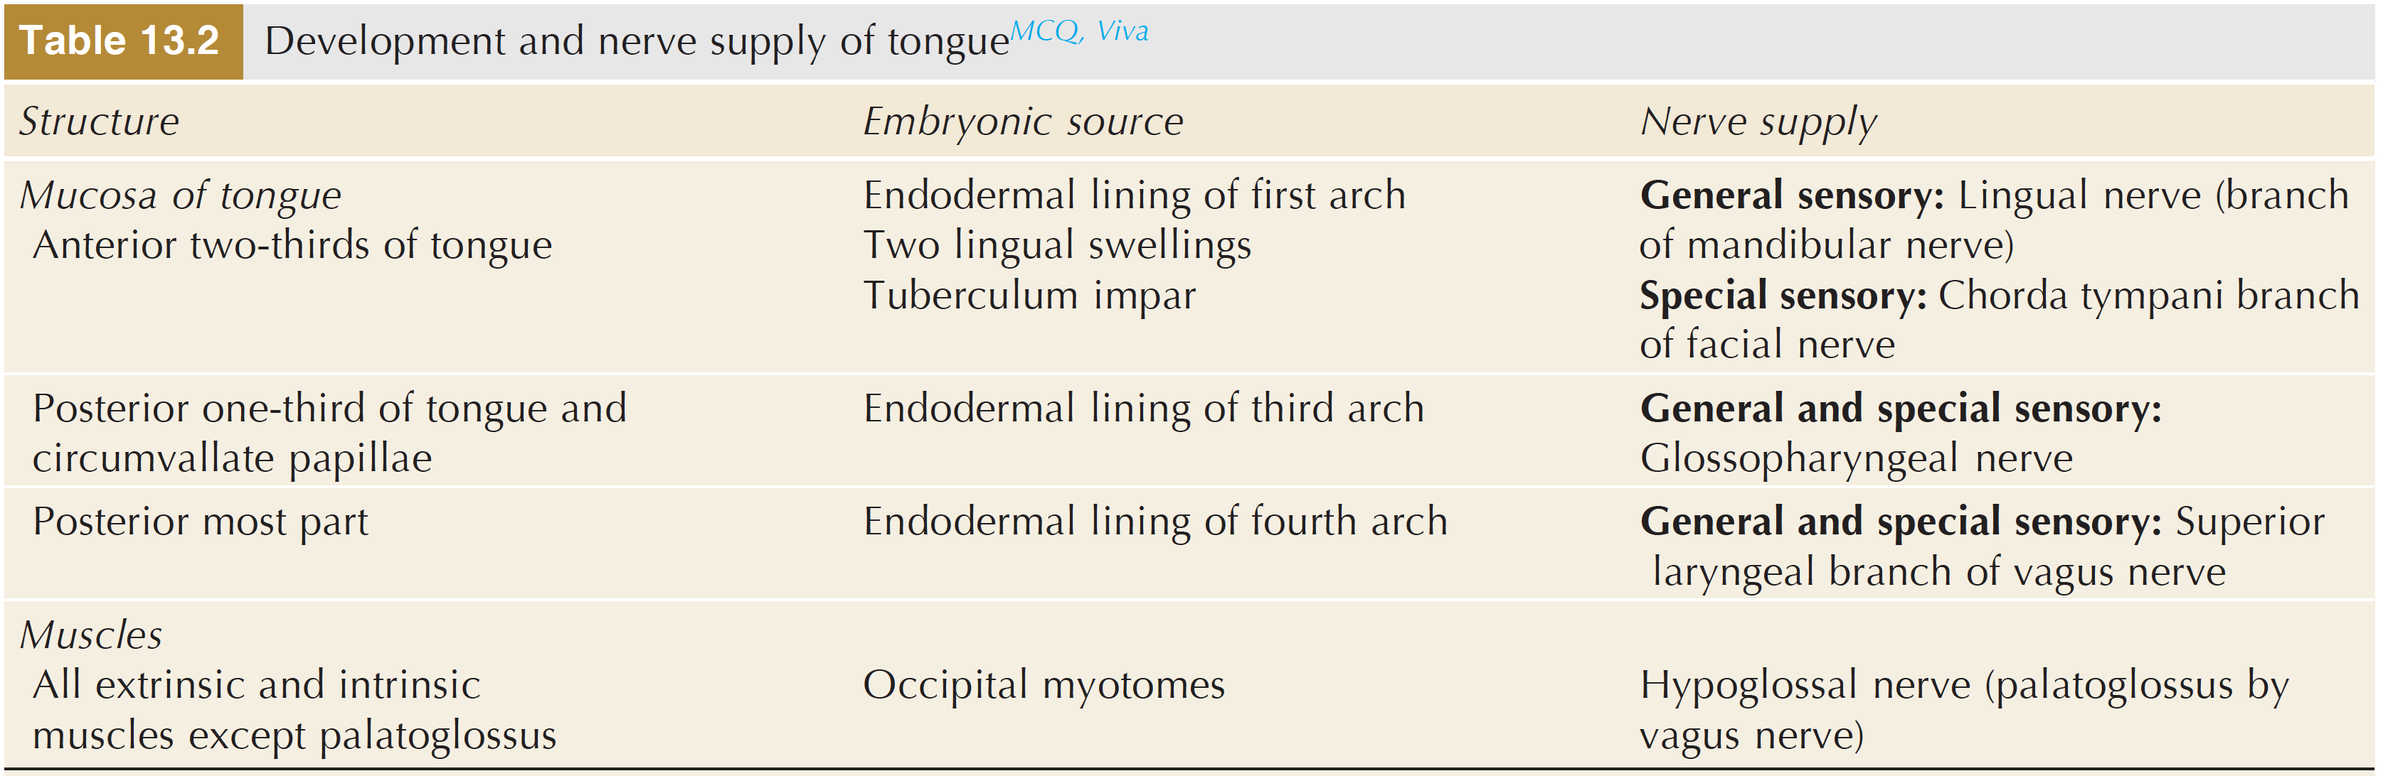
Development and nerve supply of tongue

Slide 14
FIBROAREOLAR TISSUE
Blood vessels, Lymphatics and Connective tissues developes from Mesoderm of corresponding Arches.

Slide 15
PAPILLAE
1. Fungiform – Development is induced by terminal ends of Chorda tympani nerve.
2. Circumvallate Papillae- Development is induced by terminal ends of Glossopharyngeal nerve.

Slide 16
Separation of Tongue
Developing Tongue is attached to floor of mouth .
Anterior 2/3 rd is separated from mouth by appearance of Linguogingival sulcus .
Thus anterior 2/3rd of Tongue is Mobile.
If fails to separate- Tongue Tie

Slide 17
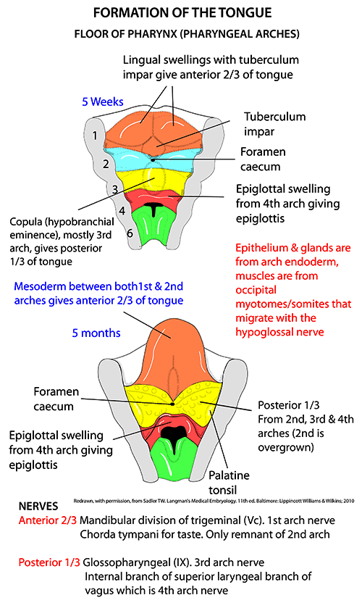

Slide 18
Developmental Anomalies of Tongue
Aglossia: complete agenesis of tongue.
Hemiglossia: due to failure of one lingual swelling to form half part of tongue.
Bifid tongue: split tongue into the anterior two thirds due to non-fusion of two lingual swellings.
Tongue tie or ankyloglossia: occurs due to incomplete formation of alveolo-lingual sulcus. The tongue is connected with a floor of the mouth by short frenulum.
Ankyloglossia superior is a condition of the adherent tongue with the palate.
Microglossia is a small tongue and macroglossia is a large tongue
Lingual thyroid occurs due to the failure of migration of the thyroid gland.

Slide 19


