Slide 1
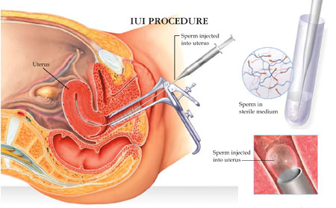
ASSISTED REPRODUCTIVE TECHNOLOGY
Dr. PRAVEEN KUMAR KURREY
M.B.B.S.,M.S.,BCME, BCBR
PROFESSOR ANATOMY

Slide 2
ASSISTED REPRODUCTIVE TECHNOLOGY
METHODS USED TO ACHIVE PREGNENCY BY ARTIFICIAL OR PARTIALY ARTICIAL MEANS.
USES:
INFERTILITY TRETMENT
WITH REGARD TO FERTILE COUPLES FOR GENETIC REASON(pre implantation genetic diagnosis)
COUPLES DISCORDAND FOR CERTAIN COMMUNICABLE DISEASES.LIKE AIDS.

Slide 3
REPRODUCTIVE CHRONOLOGY
1934 Gregory Pincus 1st animal IVF
1944 John Rock 1st human IVF
1960 FDA approves “the pill”
1978 1st IVF baby
1984 1st baby born by GIFT
1986 1st baby born by ZIFT
2001 421 U.S ART clinics with 41,000 live births annually
Notes:
Chronology is the science of arranging events in their order of occurrence in time.

Slide 4
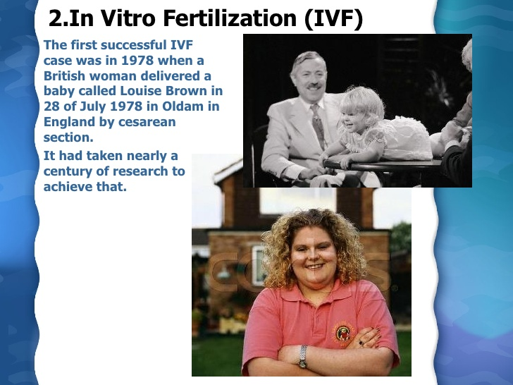

Slide 5
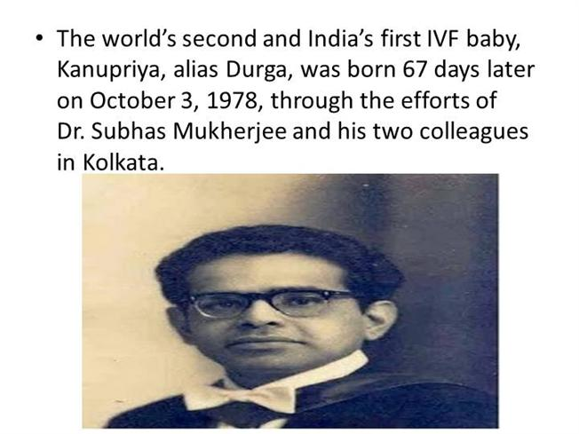
ASSISTED REPRODUCTIVE TECHNOLOGY
Methods used to achieve pregnancy by artificial or partialy artificial means
USES
INFERTILITY TREATMENT
WITH REGARD TO FERTILE COUPLES FOR GENETIC REASONS (Preimplantation genetic diagnosis)
FOR COUPLES WHO ARE DISCORDANT FOR CERTAIN COMMUNICABLE DISEASES. For ex. AIDS . TO REDUCE THE RISK OF INFECTION WHEN A PREGNENCY IS DESIRED.

Slide 6
DEFINITION
Treatments or procedures that include the handling of human eggs & sperms or embryo for the purpose of establishing pregnancy.
Generaly the process of sexual intercourse is bypassed either by artificial insemination or by fertilization of the oocyte in the laboratory environment
The Centre For Disease Control & Prevention (CDC) defines ART to include “all fertility treatments in which both eggs and sperms are handled.
Notes:
Acordng to cdc thy do nt include tts inwich only sperms are handled ie iu or artificial insem. Or procedures in wich a women takes medicine only to stimulate egg production widout the intention of having eg retrieved.

Slide 7
METHODS
ARTIFICIAL INSEMINATION
INVITRO FERTILIZATION
INTRACYTOPLASMIC SPERM INJECTION
ASSISTED HATCHING
ZIFT, GIFT
FREEZING
SEX SELECTION
SURROGACY

Slide 8
INFERTILITY:
IS THE INABILITY TO CONCEIVE AFTER ONE YEAR OF PROPERLY TIMED UNPROTECTED SEX
IN ORDER TO GET PREGNANT UNDER NORMAL CONDITIONS:
Healthy Sperms: Sperm Retrieval Procedure
Sperm Ascent: Artificial Insemination
An Ovum: Ovulation Induction & Oocyte Retrieval
Fertilization: ICSI
Implantation: Assisted Hatching

Slide 9
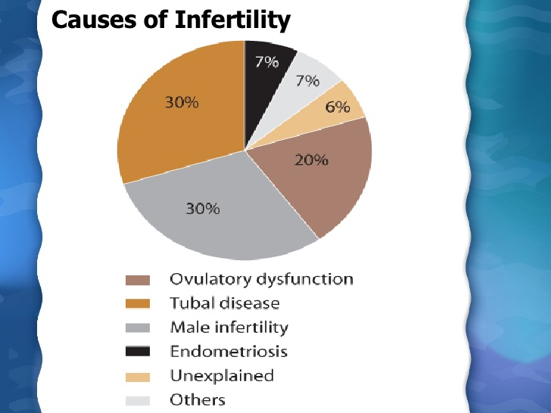

Slide 10
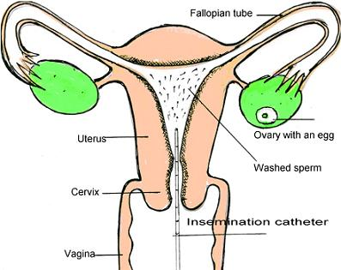
Artificial insemination husband (AIH)
Process by which sperms are placed into the reproductive tract of a female for the purpose of impregnating her by using means other than sexual intercourse.
METHODS:
INTRA VAGINAL
INTRACERVICAL
INTRAUTERINE
INTRATUBAL

Slide 12
Indications:
Mechanical infertility.
Defective seminal parameters:
-low count, motility or
abnormal forms.
-low or high volume, high viscosity
or abnormal liquefaction.
Immune infertility.
Idiopathic infertility.
Notes:
Mif fm factors like cervical scarring or blockage fm endometriosis or thick cervical mucous

Slide 13
CONCEPTION DEVICES
CONCEPTION CAP
SPECIAL CONDOMS
Notes:
Special condom kas collection condom may b used to cllect d semen during intercourse

Slide 14
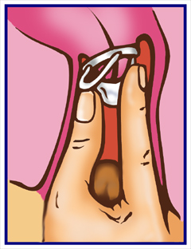
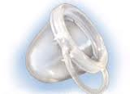
CONCEPTION CAP
Notes:
Used for placing semen into a small conception cap , then placing the cap onto the cervix. This holds the semen at the cervical os , protecting the semen from the acidic vaginal secretion &keeping it in contact with the cervical mucus.

Slide 15
INVITRO FERTILIZATION (IVF)
Technique of letting fertilization of the male and female gametes (sperm & egg) occurs outside the female.
INDICATIONS
# Women with blocked fallopian tubes
# Ovulation problems
# Seminal problems for the man: sperm transport , motility..
# Unexplained fertility cases
# Presence of seminal antibodies in the women’s body

Slide 16
STEPS OF IVF…
1) OVARIAN STIMULATION
2)VAGINAL ULTRASOUND:
Monitor the number & size of the follicles
Adjust the dose of The injections accordingly
3)HCG HORMONE INJECTION IS GIVEN FOR FINAL MATURATION OF EGG
4)OOCYTES RETRIVAL IS DONE 34 To37 hours AFTER TAKING THE HCG INJECTION
5)THE FLUID COLLECTED FROM THE FOLLICLES IN SPECIAL TUBES IS EXAMINED BY THE EMBRYOLOGIST & THE EGGS ARE ISOLATED
6)THE SEMEN SAMPLE IS TAKEN IN THE SAME DAY AND THE EGGS FERTILIZED EITHER USING THE CONVENTIONAL IVF OR ICSI.

Slide 17
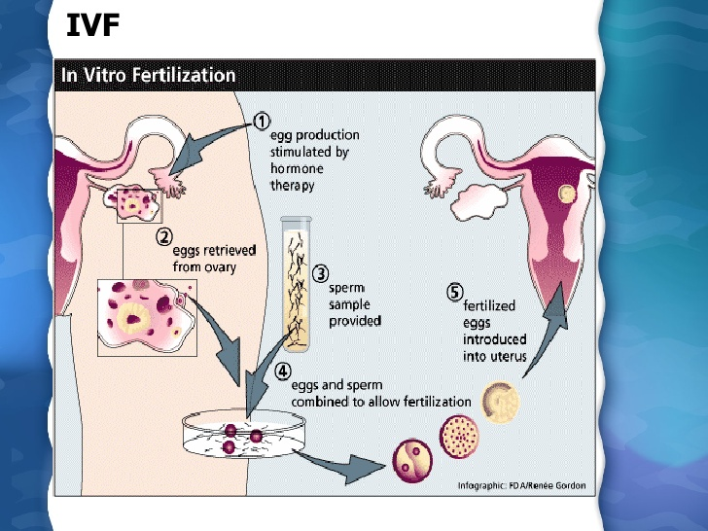

Slide 18
MEDICATION
Medication for ovarian stimulation
FSH
LH
hCG
Clomiphene citrate
Medication to prevent premature ovulation
GnRH agonist & antagonists
Notes:
Most fertility medications are agents that stimulate the development of follicles in the ovary . They are a.k.a ovulation induction medication or “fertility drugs” to stimulate growth of multiple eggs in the ovary rather than single egg that normally develops each mth .
Multiple eggs are stimulated because some eggs will not fertilize or fail to develop normally after fertilization .

Slide 19
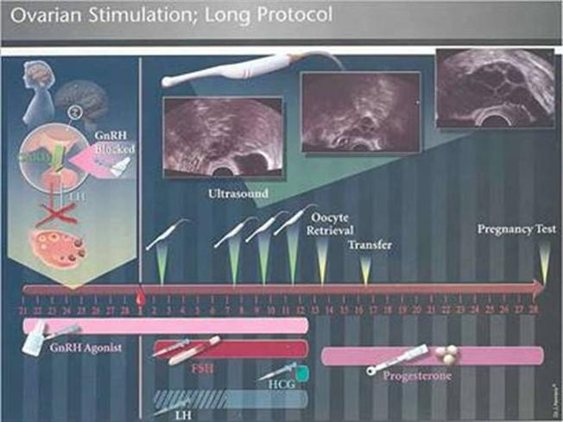

Slide 20
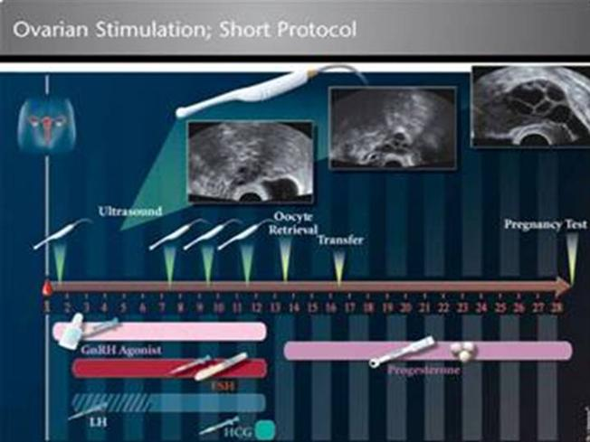

Slide 21
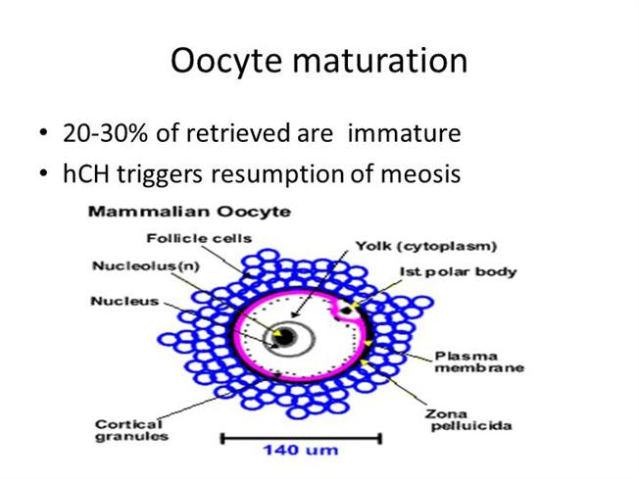

Slide 22
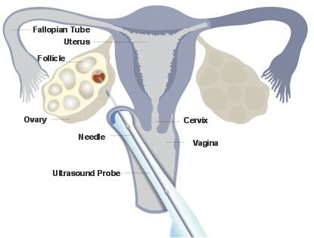
OOCYTE RETRIEVAL
Notes:
By using the vaginal ultra sound transabdominal ultrasound or laproscope under general or local anaesthesia

Slide 23
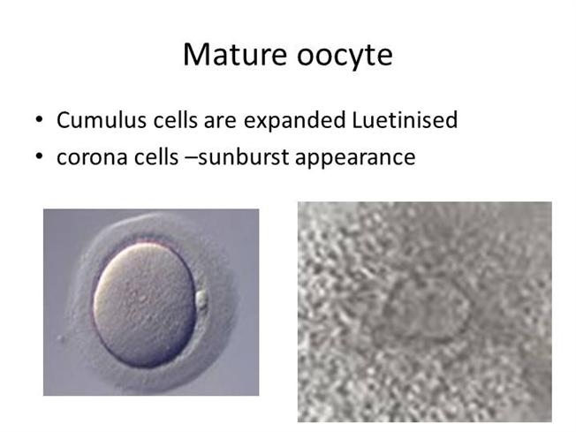

Slide 24
Sperm retrieval methods
Penile vibratory stimulation (PVS )
Electro-ejaculation (EEJ )
Microsurgical-epididymal sperm aspiration (MESA)
Percutaneous epididymal sperm aspiration (PESA )
Testicular sperm extraction (TESE )
Testicular sperm asiration (TESA)

Slide 25
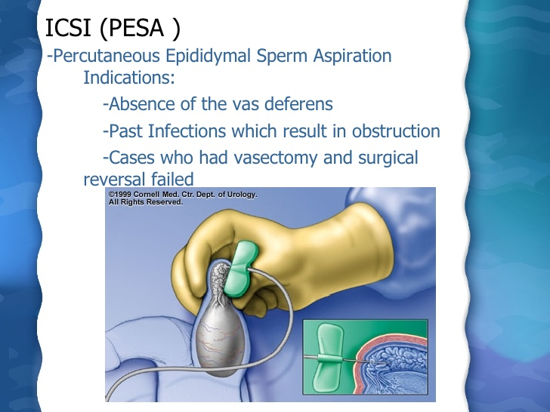

Slide 26
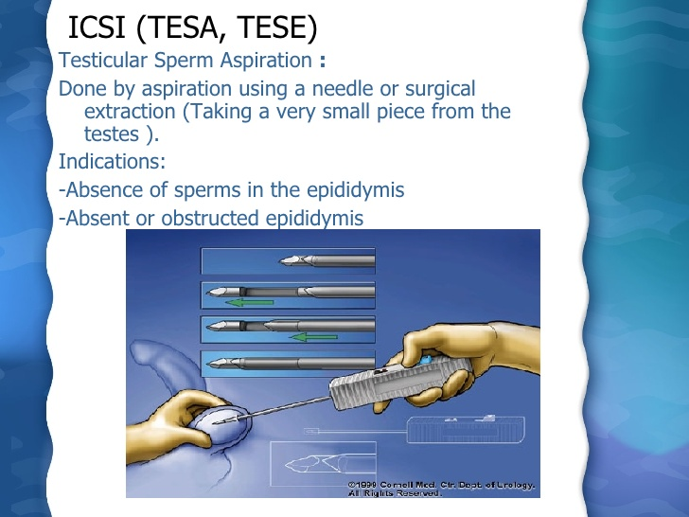

Slide 27
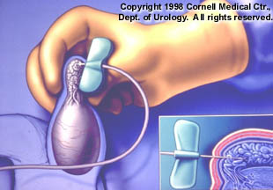
Percutaneous epididymal sperm aspiration (PESA )

Slide 28
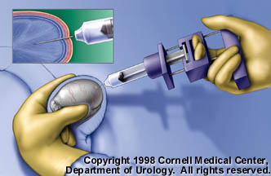
Testicular sperm extraction (TESE )

Slide 29
CONVENTIONAL IVF PROCEDURE
Egg mixed with thousand of sperms in a special dish.
Special incubators stimulating natural conditions
The fertilization is observed in the laboratory
After fertilization is assured & cell division obsereved the embryo (usually 3) are returned to the womens uterus through the cervix using a special catheter (done from 2-5 days).
Luteal phase support.
Notes:
Lps :progesterone progestin or gnrh agonists. To increase d success rate of implantation &early embrogenesis supporting the fn of corpus luteum

Slide 30
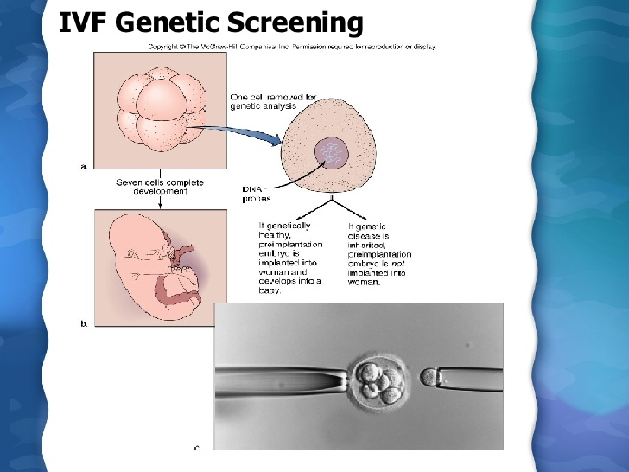

Slide 31
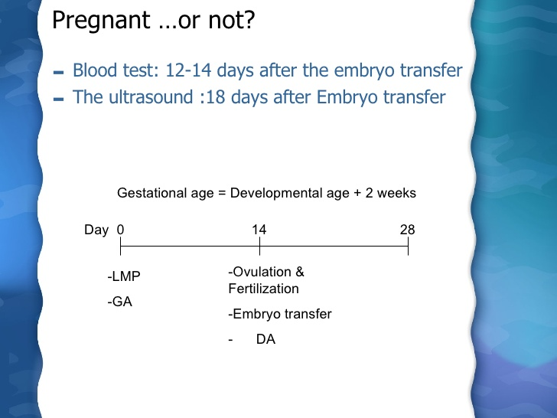

Slide 32
METHODS OF IMPROVING IVF
TRANSFER EMBRYO AT BLASTOCYST STAGE.
CULTURE FERTILIZED OVA & EARLY EMBRYOS WITH CELLS THAT NORMALLY SURROUND THE OOCYTE, SO THEY CAN PROVIDE GROWTH FACTORS. (AUTOLOGOUS ENDOMETRIAL TRANSFER )
SCREEN EARLY EMBRYOS FOR CHROMOSOMAL ABNORMALITIES & IMPLANT ONLY THOSE WITH NORMAL KARYOTYPE.

Slide 33
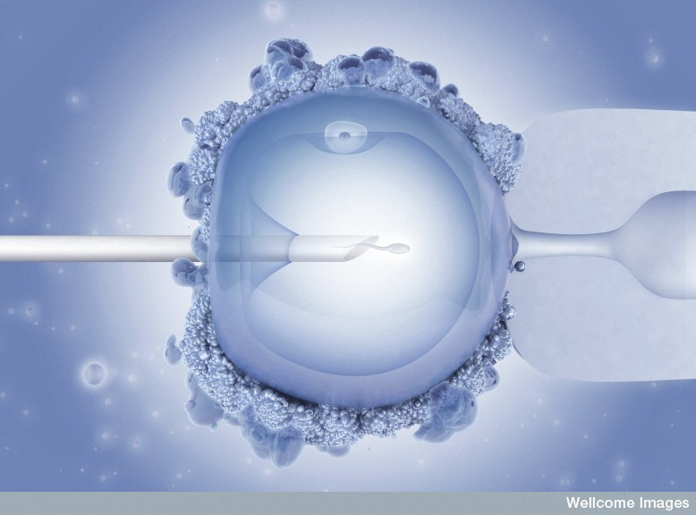
INTRACYTOPLASMIC SPERM INJECTION (ICSI)
Notes:
The oocyte is subjected to suction from the large micropipette called holding hydraulic system and supporting the egg against the background of the plate where it is deposited .the small micropipette called ICSI contains the spermatozoa & also helps to mainipulate the oocyte to place it in correct position.

Slide 34
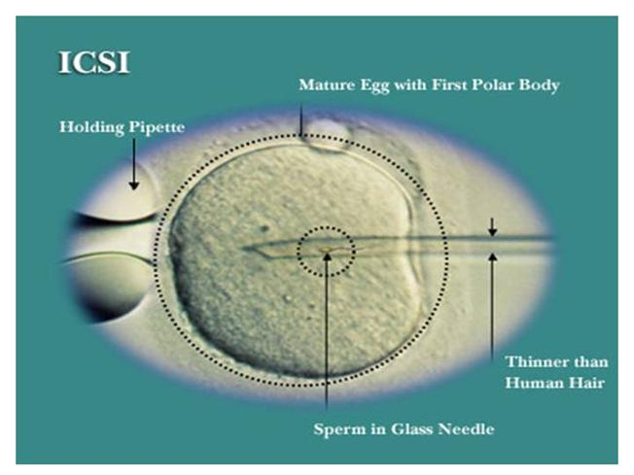
INTRACYTOPLASMIC SPERM INJECTION

Slide 35
INDICATIONS OF ICSI
Absent or reduced sperm count <5 million/ml
Abnormal sperm morphology
Previous failed IVF
Unexplained infertility
Pre Genetic Diagnosis (PGD)

Slide 36
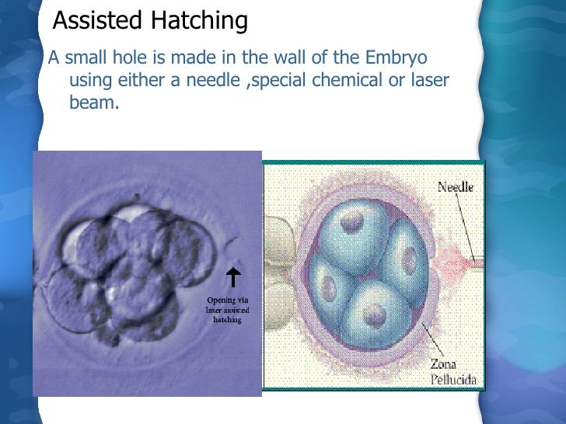
.

Slide 37
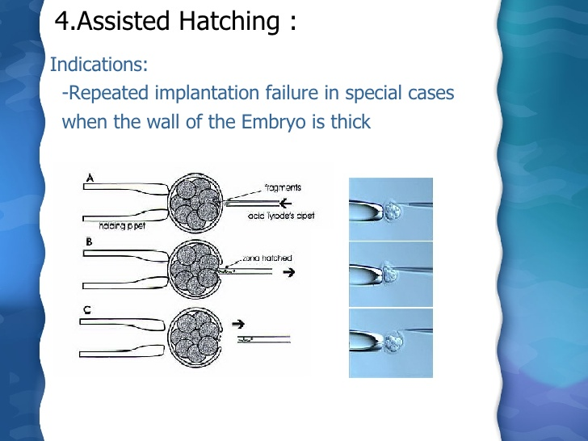
.

Slide 38
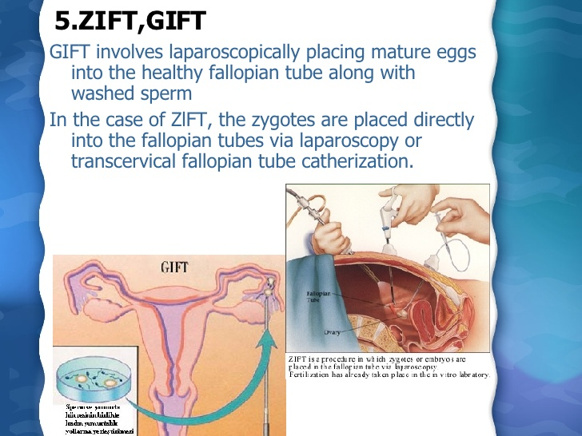
.

Slide 39
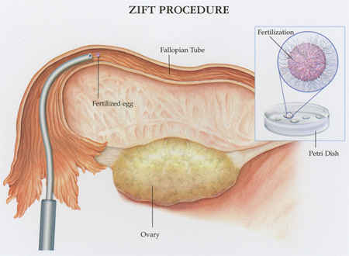
.

Slide 40
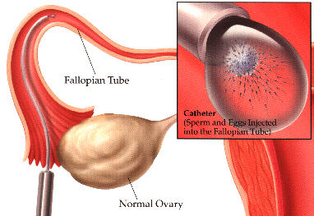
Gamete Intra-Fallopian Transfer
(GIFT)
Notes:
GIFT:is similar to IVF but 1.the gametes (eggs & sperms) are transferred to the woman’s FT rather then the Utx 2.fertilization takes place in the tubes rther then the lab.3.laproscopy : a Sx procedure is necessary to transfer the gametes. It is an option only for woman with normal FT. Some couples consider GIFT for religious reason as eggs are not fertilized outside the body . One limitation is that fertilization cannot be confirmed as with IVF . Today GIFT comparises <1% of ART procedures performed in US.

Slide 41
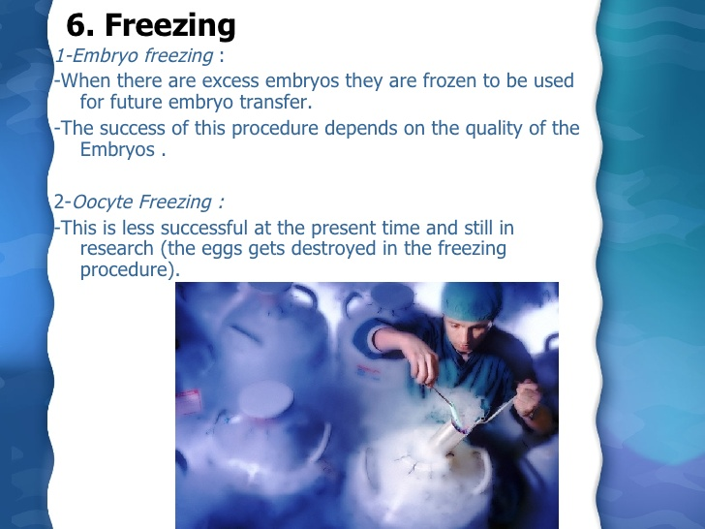
.

Slide 42
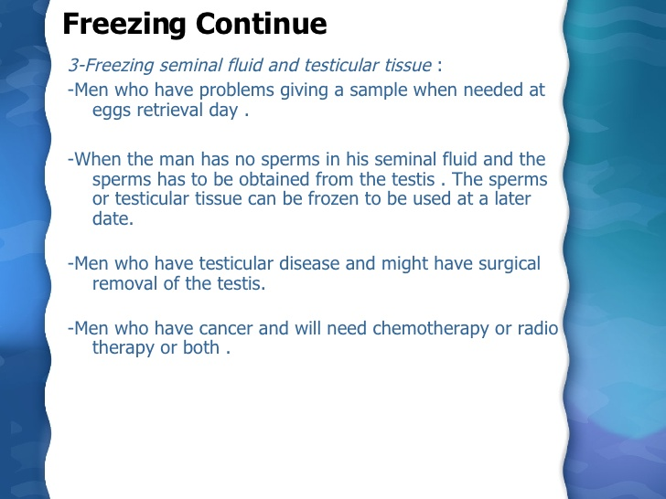
.

Slide 43
SEX SELECTION AND GENETIC SCREENING
It is possible to select the sex of the baby by taking a cell biopsy from the embryo and using either PCR or FISH Technique to determine the sex of the embryos
Detect certain chromosomal abnomalities and transferring the healthy desired embryos.

Slide 44
SURROGACY
When a woman agrees to become pregnant and deliver a child for a contracted party .
Two types:
GESTATIONAL SURROGACY
TRADITIONAL SURROGACY
Surrogate may be relative, friend, or paid stranger

Slide 45
Indications :
*Congenital absence of uterus
* Irrepairable uterus :Congenital
Asherman
* life threatening medical disorder
* previous surgical removal

Slide 46
RISKS & COMPLICATION OF ART:
OHSS (Ovarian hyperstimulation syndrome )
Risk of ovarian cancer
Risk related to egg retrieval procedures
Multiple pregnancy
Pre-term delivery
Pre-mature babies or low birth weight
1st trimester bleeding
Birth defects
Genetic disorders
Membrane damage
Psychological consideration
Notes:
1.OHSS :ovaries become swollen & painful . Fluid may accumulate in the abdominal cavity & chest , bloated , nauseated & experience vomiting & lack of appetite .30% severe , 2% mild
2. Initial report suggested that women who use fertility drugs have increase risk of ovarian cancer ,recent studies show no such result .

Slide 47
ETHICAL ISSUES
Sex selection
Designer babies /saviour sibling
Multi-fetal pregnancy reduction (MFPR)
Posthumous use of gametes

Slide 48
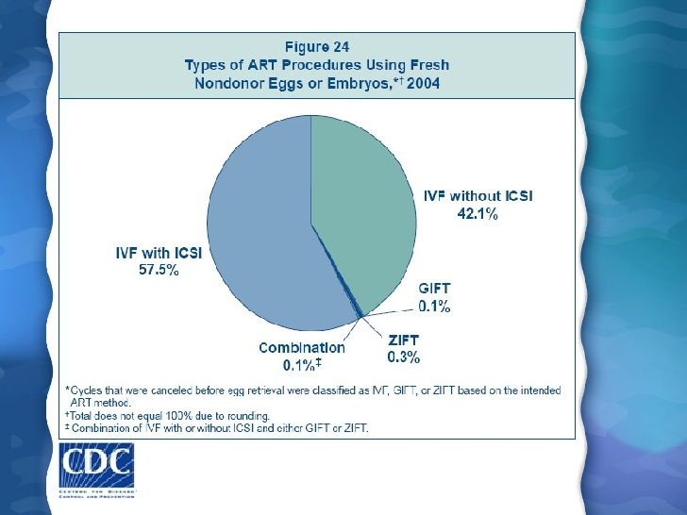

Slide 49
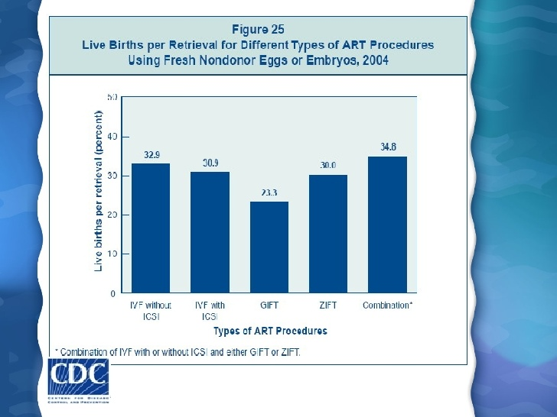

Slide 50


