Slide 1
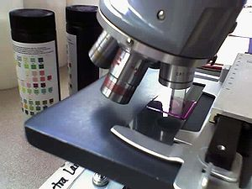
Histological techniques
Dr. Praveen Kumar Kurrey
M.B.B.S., MS, BCME, BCBR
PROFESSOR ANATOMY

Slide 2
INTRODUCTION
HISTOLOGY (Greek ,Histos-Tissue +Logos-to study of)
1) The science dealing with the microscopic identification of cells and tissue.
2) The structure of organ tissues, including the composition of cells and their organization into various body tissues.
Father of Histology is Marcello Malpighi.
HISTOPATHOLOGY :Is the study of diseased tissues.
HISTOLOGICAL TECHNIQUE
DEFINITION- Biological process by which details of the structures of the tissues are demonstrated by microscope . The trained scientists who perform the preparation of histological sections are histotechnicians.

Slide 3
ROLE IN DIAGNOSTIC LABORATORY
Examination of tissue to enable identification and classification of structural changes resulting from disease.
Appreciation of normal structure.
Involves-Macroscopic,
-Microscopic examination.

Slide 4
TISSUE
Can be taken in following ways-
Biopsy- Histopathological specimens are mostly collected by a surgeon in an operation theater.Each specimen is immediately placed in a proper fixative and then entered in a log book (logging) and given identification number.
Surgical resection.
Needle.
Trephine.
Amputation.
Whole organ or limb.
Post-mortem (after death).

Slide 5
MACROSCOPIC EXAMINATION
Grossing or cut-up.
Naked eye examination of the tissue.
Measurement is to be taken (by ruler).
Digital images captured (report).
Pathological changes if any are to be described.
Representative samples are then selected for microscopic examination (diagnosis).

Slide 6
MICROSCOPIC EXAMINATION
Standard histological technique – To examine tissue under microscope to observe cellular & tissue details.
Other procedures often indicated are-
> Frozen.
> Electron microscopy.
> Microbiology.
> Cytogenetics
> Flow cytometery.
> Molecular genetics.

Slide 7
STANDARD HISTOLOGICAL TECHNIQUE
Origin in 1860 `s ( Germany)
Consequence of development in optics.
AIM -Produce thin “ sections “ of tissues: enables cells to be resolved.
-Impart sufficient contrast to enable identification (staining).

Slide 8
preparation of tissue for simple study
Basic steps are-
Fixation
Dehydration
Clearing
Paraffin embedding
Blocking
Section cutting
Staining

Slide 9
TISSUE FIXATION
Is a process in which semisolid or gel like protiens in the cell cytoplasm get hardened by forming additive compounds with fixative agents. Once the proteins in the tissues are fixed ,cellular cytoplasm ,cytoplasmic organelles and nucleus get fixed and preserved. PRINCIPLES- Discovered in 1970s.
Started as soon as possible.
Chemical s are used.
Tissues can be fixed in two ways-
A) by putting the tissues directly into the fixatives.
B) by injecting the tissue with fixative fluid.
VOLUME OF FIXATIVE- must be 10 times of the volume of tissue. If the tissue size is 0.5 cm, then it should be fixed in 5 to 10 ml of 10% formal saline.

Slide 10
aims of fixation
To prevent autolysis and bacterial decomposition.
Hardening of soft tissues.
To fortify the tissue against the harmful effects of dehydration & embedding procedures .
To prepare tissue and leave it in a condition which allow clear staining of sections.
To leave tissue as close as their living state as possible, and no small molecules should be lost.
Alteration of refractive indices to varying degrees, which enables unstained components to be more easily seen.
Some fixatives act as mordant –those fixatives which facilitates certain constituents of cell to be demonstrated by special staining.

Slide 11
FACTORS AFFECTING FIXATION
PH.
Temperature.
Duration of fixation and size of specimen.
Concentration of fixative.
Volume of tissue.
Additives.
Osmolality of fixatives and ionic composition.

Slide 12
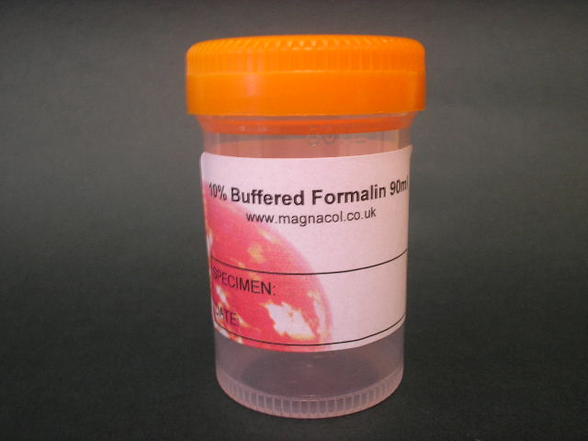
fixatives
FORMALDEHYDE(HCHO)
Discovered in 1970`s.
Gas at room temperature which is soluble in water to a maximum extent of 40% by weight. This saturated solution is available commercially as 40% (W/v) formaldehyde or formalin.
It cross-links with the proteins irreversibly , making the tissue hard.
Commercial formalin is usually acid (due to formic acid content).It should be made neutral or slightly alkaline by mixing with phosphate buffer pH 7.2 or by adding calcium acetate.

Slide 13
composition of formaldehyde
Commonly used as 10% Formol saline.
-Formalin 40%- 10cc
- Distilled water - 90cc
- Sodium chloride - 0.85mg
Time- 12 to 24 hrs.
SPECIFIC FEATURES- Rapid penetration & slow reacting.
- 10% neutral buffered formalin (4% formalin in phosphate buffered saline) is most common fixative to be used in Light Microscopy. In Electron microscopy ,the most commonly used fixative is glutaraldehyde, usually as a 2.5% solution in phosphate buffered saline.
-It is so popularly used because- a) Cheap, b) easily kept in bulk c) preservation of tissues or animals as a whole can be done.d) favourable to most stains,,e) acts as non precipitating fixative(denaturing of protein of cells)

Slide 14
bouin`s fluid
Composition- Formol - 20 cc
-Saturated aqueous solution of picric acid- 75cc
- Glacial acetic acid (it should be mixed before)- 5 cc
Time – 12 to 24 hrs.
SPECIFIC FEATURES: -This fixative is good for skin tissue and also for all tissues including nerve tissues.
-It penetrates evenly and rapidly and causes little shrinkage.
-It can be used to demonstrate glycogen.
-Tissue fixed in it gives brilliant staining by trichrome methods.
-It is necessary to remove excess picric acid by washing or by alcohol treatment.

Slide 15
zenker`s fluid
Composition-Potassium bichromate- 2.5 gms
- Mercuric chloride- 5gms
-Sodium sulphate- 1gm.
-Distilled water -100cc
-Glacial acetic acid (just before use)-5cc
Time- 6 to 18 hrs.
SPECIFIC FEATURES- Gives fairly rapid & even penetration.
-Preferred for fixing bone marrow aspirate since the acetic acid decalcifies the bone spicules if present in the specimen.
-It is not stable after the addition of acetic acid, hence it should be added just before use.
-Washing of tissues in running water is necessary to remove excess dichromate.
-Mercuric chloride pigment should be removed with iodine.

Slide 16
Other fixatives
Susa fixative(Mercuric chloride)
Zenker`s formol(Helly`s fluid)
Carnoy`s fluid
Clarke`s fluid
Newcomer`s fluid
Vapour fixatives

Slide 17
tissue processing
The aim of tissue processing is to embed the tissue in a solid medium firm enough to support the tissue and give it sufficient rigidity to enable thin sections to be cut , and yet soft enough not to damage the knife or tissue. Processing can be done Manually or by using an Automatic tissue processor.
STAGES - *Dehydration
*Clearing.
*Infiltration & impregnation.
*Embedding(Paraffin).

Slide 18
dehydration
Aim-To remove fixative and water from the tissue and replace them with dehydrating fluid to bring it to the refractive index of embedding material.
DEHYDRATING AGENTS - Ethanol,Methanol,Acetone. PROCEDURE-
Tissue sections are placed in capsules (casettes).
The identification number is written with a lead pencil on a piece of paper.
These tissues are passed through a series of increasing concentrations of alcohol i.e;70%,80%,90%, 100%(Absolute alcohol).However straight away application of 100% alcohol will remove water so rapidly that cells may be damaged. (Shrinkage occurs)
The reliability of dehydration is checked by using anhydrous copper sulphate (white).The last batch of alcohol is tested with anhydrous copper sulphate. If it turns blue it indicates incomplete dehydration.

Slide 19
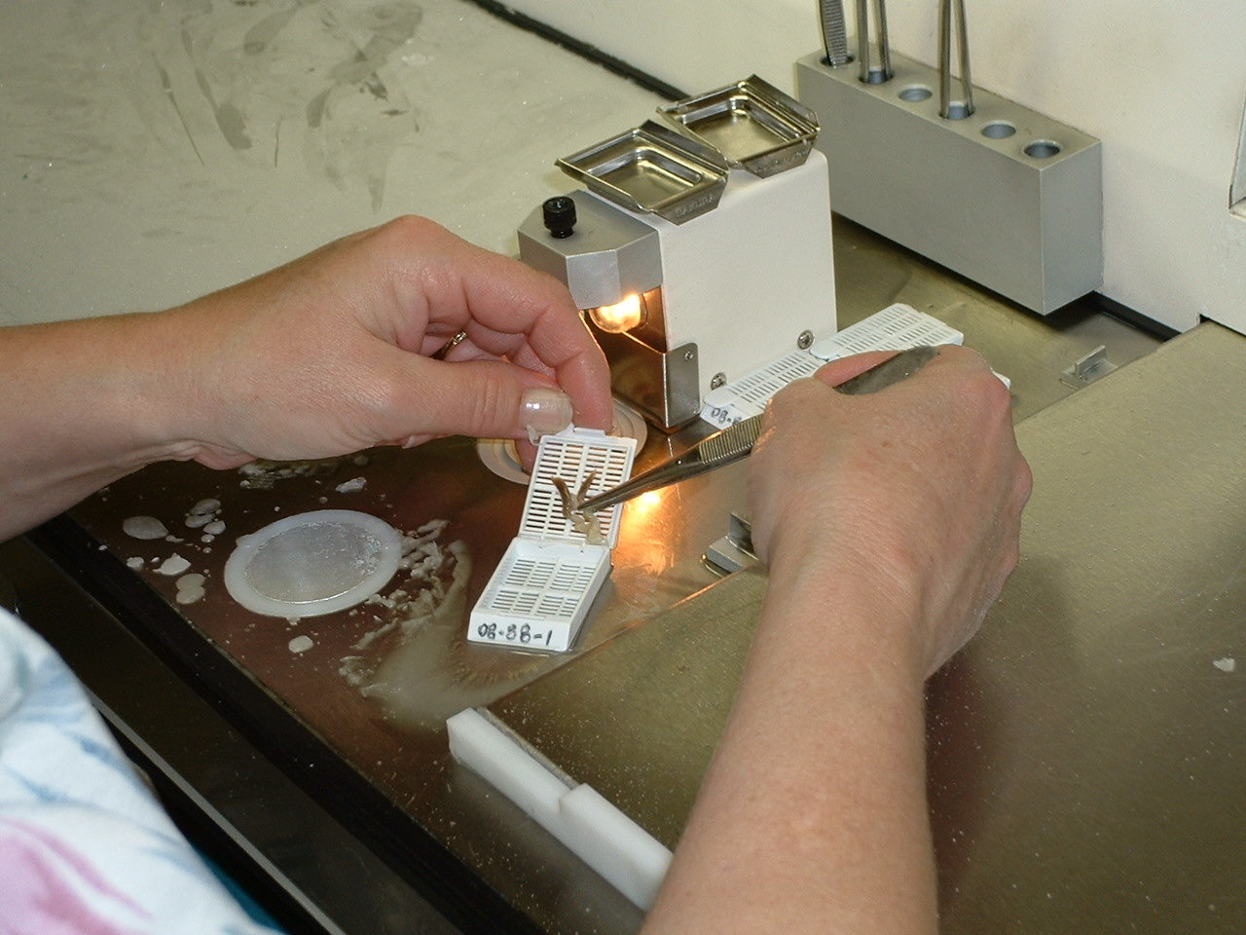
Steps are
steps | Treatment | Time (hrs)
1-2 | 80% alcohol (2 times) | 1 + 1
3 | 90% alcohol | 1
4-6 | 100% alcohol ( 3 times) | 1 + 1 + 1

Slide 20
clearing
Aim- Replacing the dehydrating fluid with a fluid that is totally miscible with both the dehydrating fluid and the embedding medium. Choice of clearing agent depends upon-
The type of tissues to be processed, and the type of processing to be undertaken.
Intended processing conditions such as temperature, vacuum and pressure.
Safety factors, flammability.
Cost and convenience.
Speedy removal of dehydrating agent .
Ease of removal by molten paraffin wax .
Minimal tissue damage .

Slide 21
Clearing agents
Xylene-Is commonly used ,since it is miscible in both paraffin wax and alcohol.
Toluene
Benzene
Chloroform
Cedar wood oil.
INFILTRATION & IMPREGNATION-During this process xylene is eliminated from the tissue by diffusion in the surrounding melted wax(infiltration).The wax afterwards diffuses in the tissue by replacing the xylene (impregnation).This procedure is carried out in the paraffin oven for 2-3 hrs.The temperature of paraffin oven should be between 50 to 56 deg.
Step | Treatment | Time ( hrs)
7 - 8 | Xylene ( two times) | 1 + 1

Slide 22
embedding(paraffin method)
First introduced by KLEB(1869).Means casting or blocking. Is the process by which tissues are surrounded by a medium such as agar, gelatin, or wax which when solidified will provide sufficient external support during sectioning.Blocks are made of the size 1.5cm x 2cms.
PROPERTIES OF WAX- Paraffin wax is a polycrystalline mixture of solid hydrocarbons produced during the refining of coal and mineral oils.It is traditionally marketed by its melting points which range from 39°C to 68°C.
The commonly used paraffin for routine work has melting point 54 deg C .
This gives support for hard tissues & also allows easy ribboning of sections.

Slide 23
TYPES OF WAX HARD WAX- melting point is 60 deg C,used for hard fibrous tissues.
SOFT WAX- melting point is 45 deg C ,used for soft tissues like foetal & areolar tissue.
PRECAUTIONS WHILE EMBEDDING-
The wax should be clear of clearing agent.
No dust particles must be present

Slide 24
MOULD SYsTEMS
There are four main mould systems and associated embedding protocols presently in use :
1) Traditional methods using paper boats.
2) Leuckart or Dimmock embedding irons or metal containers (consisting of two L shaped pieces of heavy metallic material brass).,is commonly used one.
3) The Peel-a-way system using disposable plastic moulds .
4) Systems using embedding rings or cassette-bases which become an integral part of the block and serve as the block holder in the microtome.

Slide 25
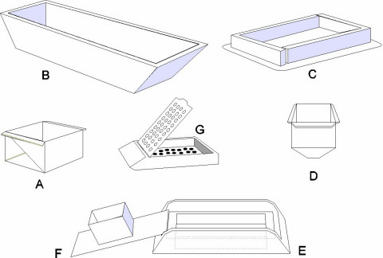
Tissue processing Embedding moulds:
(A) Paper boat;
(B) Metal bot mould;
(C) Dimmock embedding mould;
(D) Peel-a-way disposable mould;
(E) base mould used with embedding ring ( F) or cassette bases (G)

Slide 26

GENERAL EMBEDDING PROCEDURE
Two L shaped metal moulds are arranged on a flat glass to which liquid paraffin is applied (as to remove block easily), there should be sufficient room for the tissue with allowance for at least a 2 mm surrounding margin of wax.
Melted wax is poured into arranged L moulds cavity.
Using warm forceps impregnated tissue is directly taken & placed in the L mould cavity, with tissue close to one of the surfaces of the block.

Slide 27
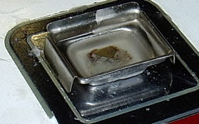
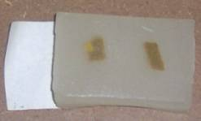
GENERAL EMBEDDING PROCEDURE
Chill the mould on the cold plate, orienting the tissue and firming it into the wax with warmed forceps. This ensures that the correct orientation is maintained and the tissue surface to be sectioned is kept flat.
Insert the identifying label or place the labeled embedding ring or cassette base onto the mould.
Cool the block on the cold plate, or carefully submerge it under water when a thin skin has formed over the wax surface.
Remove the block from the mould.Cross check block, label and worksheet.

Slide 28
caution
. When melted wax is poured in the L shaped moulds some air enters in the molten wax & forms air bubbles. Air bubbles are removed by steering the molten wax with red hot tips of the forceps or by a metal spatula.
Blocks are hardened by allowing them to cool. They are stored in refrigerator for an overnight period for further hardening. Section cutting is preferably done on the next day in the morning hours when the atmospheric temperature is cool

Slide 29
ORIENTATION OF TISSUE IN THE BLOCK
Correct orientation of tissue in a mould is the most important step in embedding. Incorrect placement of tissues may result in diagnostically important tissue elements being missed or damaged during microtomy.
Elongated tissues are placed diagonally across the block.
Tubular and walled specimens such as vas deferens, cysts and gastrointestinal tissues are embedded so as to provide transverse sections showing all tissue layers
Tissues with an epithelial surface such as skin, are embedded to provide sections in a plane at right angles to the surface (hairy or keratinised epithelia are oriented to face the knife diagonally)
Multiple tissue pieces are aligned across the long axis of the mould, and not placed at random.

Slide 30
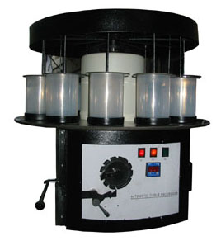
Automatic tissue processor

Slide 31
TISSUE PROCESSING BY AN AUTOMATIC TISSUE PROCESSOR
 | STEP | TIMING | SOLUTION | PERIOD
 | 1. | Starting point | 80% alcohol | 0 hrs
 | 2. | 4.30 – 6.30 pm | 80% alcohol | 2 hrs
 | 3. | 6.30 – 7.30 pm | 95% alcohol | 1 hr
 | 4. | 7.30 – 8.30 pm | 95% alcohol | 1 hr
 | 5. | 8.30 – 9.30 pm | 100% alcohol | 1 hr
 | 6. | 9.30 – 10.30 pm | 100% alcohol | 1 hr
 | 7. | 10.30 – 11.30 pm | 100% alcohol | 1 hr
 | 8. | 11.30pm – 12.30 am | Xylene | 1 hr
 | 9. | 12.30 – 2.30 am | Xylene | 2 hrs
 | 10. | 2.30 – 4.30 am | Paraffin | 2 hrs
 | 11. | 4.30 – 6.30 am | Paraffin | 2 hrs
 | 12. | 6.30 – 8.30 am | Paraffin | 2 hrs

Slide 32
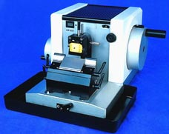
SECTION CUTTING
The instruments used for section cutting are known as Microtomes.
A microtome (from the Greek mikros, meaning "small", and temnein, meaning "to cut") is a mechanical instrument used to cut biological specimens into very thin segments known as sections for microscopic examination.Microtomes are an important devices in microscopy preparation, allowing for the preparation of samples for observation under transmitted light or electron radiation. This instrument is designed to cut 1 to 100 micron thin
sections.

Slide 33
DIFFERENT TYPES OF MICROTOMES
Rotary microtome
Rocking microtome
Sliding microtome
Freezing microtome
Sledge microtome
Cold(cryostat) microtome
Ultramicrotome.
The knife remains fixed but the block moves forward in rocking, rotary, & sledge microtomes.Contrarily,the knife moves but the block is fixed in sliding & freezing type. Rotary type is most commonly used microtome.

Slide 34
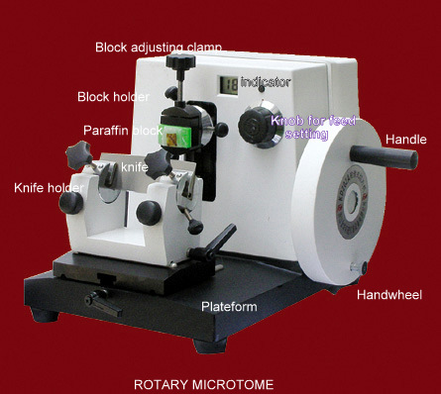
rotary microtome

Slide 35
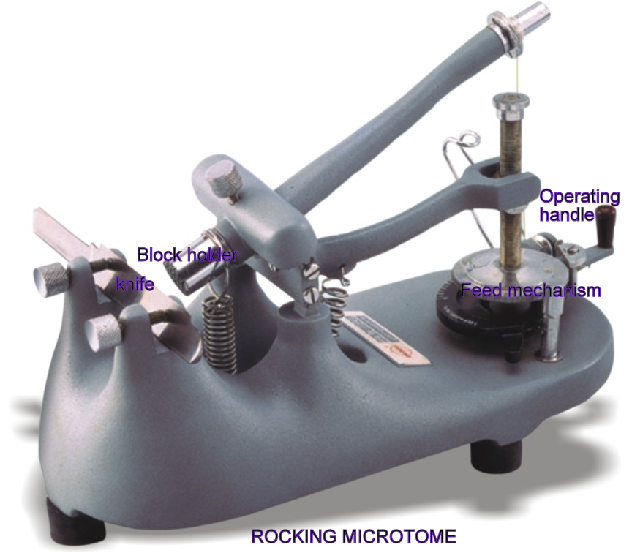
rocking microtome

Slide 36
Recent development
A recent development is the Laser microtome, which cuts with a femtosecond laser instead of a mechanical knife. It uses Infrared laser. This method is contact-free and does not require sample preparation techniques thereby minimizing the artifacts from preparation methods. The laser microtome has the ability to slice almost every tissue in its native state. This microtome can also be used for very hard materials like bones, teeth. Depending on the material being processed, slice thickness of 10 to 100 micron are feasible.

Slide 37
uses of microtomes
Embedded tissues are cut by either rotary , rocking , or by sliding microtome. For rotary & rocking microtomes paraffin embedding is required while celluloidin –embedded sections are cut by sliding microtome. Sledge microtome is used for cutting very large blocks of tissues (eg.whole brain, heart).
The freezing & cryostat microtome are used for cutting frozen section of a tissue. This method is useful for rapid histopathological diagnosis during an operation. It is also a useful method to examine the sections of a structure or a substance (eg.fat) that would be destroyed in routine preparation of sections.
In freezing microtome specimen is kept frozen by liquid carbon dioxide, while the knife of microtome is kept warm. The cold microtome is however kept in cold chamber(-20 C)& the knife is also cold.
Ultramicrotomes are used to prepare very thin sections (up to 1micron thickness) which are examined by using electron microscope.

Slide 38
Microtome knives
Steel blades are used to prepare sections of animal or plant tissues for light microscopy histology.
Glass knives are used to slice sections for light microscopy and to slice very thin sections for electron microscopy.
Industrial grade diamond knives are used to slice hard materials such as bone, teeth and plant matter for both light microscopy and for electron microscopy. Gem quality diamond knives are used for slicing thin sections for electron microscopy.
Non corrosive knives for cryostat.
Disposable blades.

Slide 39
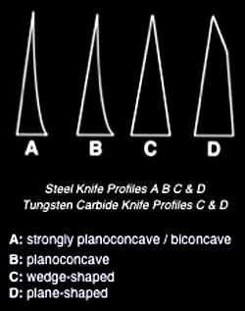
Microtome knives are classified as-
BICONCAVE-Is recommended for cutting paraffin sections on rocking & sledge microtome.
PLANOCONCAVE-Used on sledge & some rotary microtomes.Mainly used for cellulose nitrate embedded material.These knives are available in greater or lesser degree of concavity.
WEDGE SHAPED(Plane surface on both sides)-has wide application in microtomy.Used for wax embedded tissue with any microtome.
TOOL SHAPED - is intended for exceptionally hard materials such as wood , plastics & undecalcified bone.

Slide 40
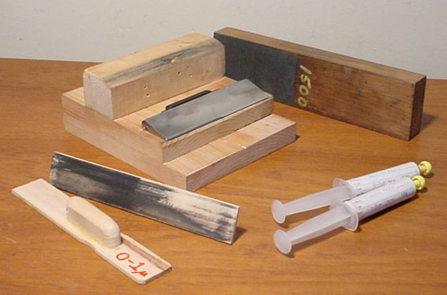
SHARPNING OF MICROTOME KNIFE
The edge of microtome knife performs the function of cutting & it should be sharp in order to get good sections of the tissues.
Mechanically, or
Automatic knife sharpener.
The process of sharpening
consists of –
Honing, &
Stropping.

Slide 41
What is a hone
honing
stropping
Is the process of polishing the already fairly sharpened edge after honing. It removes the buffs during honing. The knife edge cannot be sufficiently sharp to cut good sections directly from honing or sharpening. Stropping must follow sharpening.
WHAT IS A STROP
Is the process in which all the nicks and irregularities in the cutting edge of the knife are removed to make the cutting edge straight and sharp.
A hone is a rectangular block of stone especially made for sharpening of knife.
The strop is usually made up of leather(from rump of horse) and is fixed in wooden piece .

Slide 42
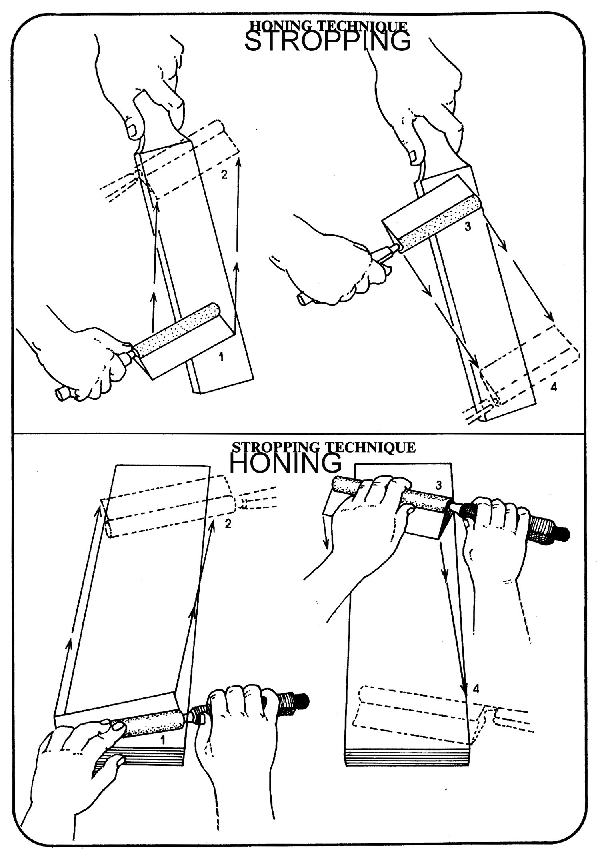

Slide 43
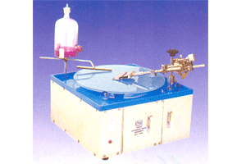
automatic knife sharpener
These are the machines used for sharpening the microtome knives. Current models of these knives use glass plates ,have automatic turn over of the blade, pressure control & provision for selection & reproduction of the correct setting of edge in relation to the honing surface ,thus disposing of the need for honing bevels.
Though expensive these machines are efficient ,save valuable man hours for the actual cutting of sections.

Slide 44
Procedure of section cutting
TRIMMING OF A PARAFFIN BLOCK-
Separate out blocks so that one block should contain only one tissue.
Trim the block with a razor or knife until 1-3mm of paraffin remains on all sides of the tissue.
ATTACHING THE PARAFFIN BLOCK TO THE MICROTOM
Heat the holder on the flame of a burner.
The hot holder is then pressed over paraffin block so that it gets attached to the holder firmly.
The holder with attached block is clamped firmly into the microtome.

Slide 45
Section cutting of a paraffin block
Insert knife tightly in the knife holder with proper position.
Adjust the moving mechanism so that the block almost touches the knife & the block moves parallel to the edge of knife. This ensures a straight ribbon of the section.
Set the gauge, controlling the thickness of the sections & operate the microtome until complete sections of the tissues are obtained.
As the microtome head moves with block,a section is cut from the block and it lies on the knife. The upper & lower edges of the block face are kept parallel to the edge of knife so that a ribbon of the section will form.

Slide 46
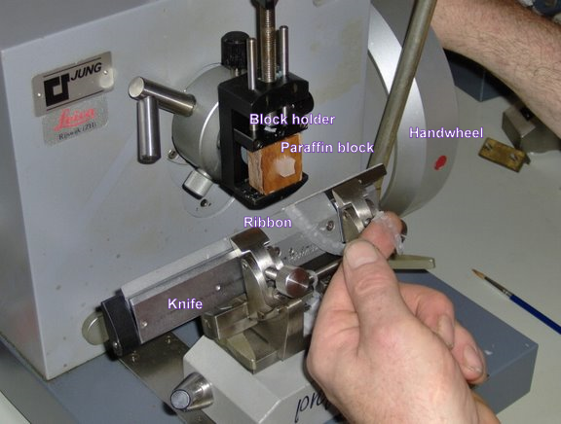
Ribbon of the section

Slide 47
Sections are received with a brush or litter and are placed in warm water bath (46 deg C) to remove the creases. These sections are received carefully on the Albumin slides.
Albumin slides –Equal parts of glycerine and distilled water & white of egg are mixed thoroughly filter through a filter paper. Then a small crystal of thymol is added. This mixture can be preserved for many days.
It acts as adhesive to keep the section firmly adherent to slide otherwise the section may wash away. Albumin solution is the most commonly used one. Other adhesive used is the Starch paste.

Slide 48
A drop of adhesive (albumin solution mostly) is put on each slide and then sections are received from water bath to these slides.
By keeping about 1cm gap between the sections these are arranged on microscope slide by using forceps.
The slides with the sections are dried in an incubator or at 37deg C overnight to dry .Slide warmers can also be used .Its function is to remove paraffin for the staining.
Careful writing of identification no. on each slide is confirmed before the staining.

Slide 49
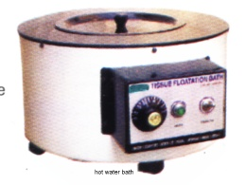
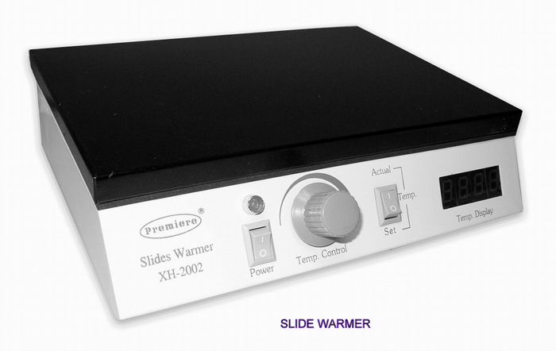
Warm water bath slide warmer

Slide 50
Slides and cover slips
Slides- most commonly used size is 76 x 26 mm 1mm and
Thickness – 1.35mm 0.5mm.
Cover slips- most commonly used sizes are 22 x 22mm,
26 x 22mm, 32 x 22mm, 40 x 22mm.
With smears of cells, rather longer cover slips such as
50 x 22 mm is used.
Circular cover slips of 22mm diameter are also available.

Slide 51
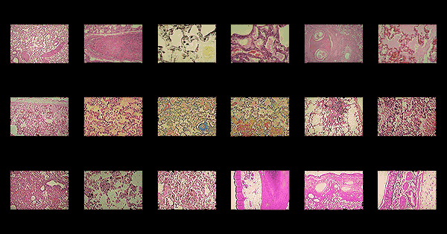
staining
Staining is a combination of chemical processes. Biological tissue has little inherent contrast in either the light or electron microscope. Staining is employed to give both contrasts to the tissue as well as highlighting particular features of interest. Where the underlying mechanistic chemistry of staining is understood, the term histochemistry is used. Usually staining is done with Haematoxylin & Eosin.

Slide 52
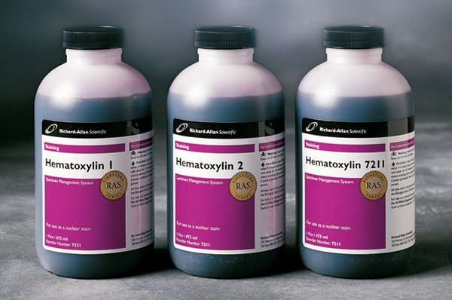
haematoxylin
First used by Waldeyer (1863)
Is a constituent of Logwood tree.
It is a basic dye & stains the nuclei of the cells & basophill granules due to affinity to nucleic acids in the cell nucleus & colours them blue.
It is oxidized to Haemation & gets stained properly.
It is ripened or matured by being exposed to sunlight & air entry for 6-8 wks.Maturing can be done rapidly by adding oxidizing agents -Potassium permanganate, Mercuric oxide.
It is a permanent stain.

Slide 53
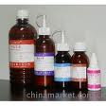
eosin
It is a xanthene dye.
Is an acidic dye & stains cytoplasm of the cells & acidophil granules.
It is not a permanent stain.
It colours them red/pink.
The procedure of H & E staining is known as Double staining i.e., staining of nucleus & cytoplasm with different stains.

Slide 54
Preparation of stain
Harris haematoxylin-
Haematoxylin- 2.5 gm
Absolute alcohol- 50gm
Ammonium alum-50gm
Distilled water- 500ml
Mercuric oxide- 1.5gm
Glacial acetic acid- 20ml
Eosin
Eosin (water soluble)- 1gm
Distilled water – 100 ml

Slide 55
PROCEDURE FOR H & E STAINING (HARRI`S METHOD)
DEPARAFFINISATION-Sections of slide are washed with xylene with two changes for about 3-5 min. to deparaffinize the section.
HYDRATION-The tissue is then washed with absolute alcohol with two changes & descending grades of alcohol (90%, 70%, 50%) for 10 min to remove xylene from the tissue.Then washed with tap water & stained with staining solution.
STAINING WITH HAEMATOXYLIN
Haematoxylin A (Haematoxylin 1gm,absolute alcohol 100cc),Haematoxylin B(Ferric chloride 37% 4cc,1cc HCL & 95cc distilled water) are taken.
Equal parts of the above two are mixed just before use & the tissue is covered with mixed Haematoxylin for 5-10 min.
DIFFERENTIATION-The sections are then differentiated for a few sec in 1% HCL in 70% alcohol until sections turn brown.

Slide 56
BLUEING- The sections were washed in running tap water for 5-10 min till it turned bluish.
COUNTER STAIN USUALLY WITH EOSIN- now the section is stained in 1% Eosin (1 gm of eosin in 100 cc distilled water) for 2-5 min.
DEHYDRATION-The sections were dehydrated by the ascending grades of alcohol (50%, 70%, 90%, ) & finally with the two changes of absolute alcohol, each of 3 min.
CLEARING- The sections are now cleared with two changes of xylene ,each 3 min.
MOUNTING--Then the tissue is covered with mounting reagent DPX {Distrene,(a polystyrene),a plasticizer (tricresyl phosphate) and xylene} was introduced in 1939.Finally a cover slip is placed over mountants. Thus it is permanently mounted.

Slide 57
IMPORTANT POINTS
If washing is not done properly the section will either look blue or pink or red.
After blueing, section should be seen under the microscope to ensure that nucleus is dark blue and the cytoplasm is pale blue.
After staining the section, water has to be removed from the tissue section because refractive index of water is 1.5,this refractive index will obstruct us from studying the tissue. water has to be replaced from the tissue with xylol whose refractive index is same as that of glass i.e.1.

Slide 58
MOUNTANTS
Aqueous mounting media- used for unstained material , material stained for fat or for material stained metachromatically.These are of three types-
a) The syrups .
b) Gelatin media.
c) Gum Arabic media.
Resinous mounting media - used for most of the routine staining techniques. These are composed of resin ( natural or synthetic) dissolved in its natural solvent or in xylol. The commonly used resinous media are-
a) Kirkpatrick and Lendrum`s DPX (Distrene, Plasticizer i.e.Trycresyl phosphate, and Xylene).It is a synthetic resin. Its refractive index is 1.52. It is most commonly used mountant.
b) Canada Balsam, is a natural resin & usually dissolves in xylol .By using this mounting media H & E stained slides are preserved well but basic aniline dyes tend to fade and Prussian blue is slowly bleached.

Slide 59

Thank you
…………………………………………………………………………………………………………………

