Slide 1
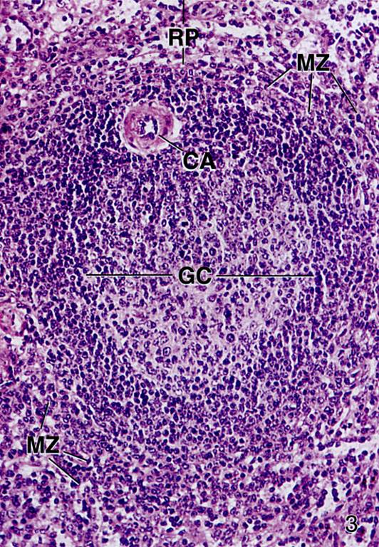
HISTOLOGY OF LYMPHOID ORGANS
DR. PRAVEEN KURREY
M.B.B.S., M.S., BCME, BCBR PROFESSOR ANATOMY

Slide 2
HISTOLOGY OF LYMPHOID ORGANS AND THEIR FUNCTIONAL CORRELATIONS
DR. PRAVEEN KURREY
M.B.B.S., M.S. ASSISTANT PROFESSOR PT. JNMMC RAIPUR.

Slide 3
INTRODUCTION
Lymphoid (or lymphatic) tissues, which mainly consist of dense accumulations of lymphocytes , represent the sites of proliferation and differentiation of lymphocytes.
Lymphoid organs may be defined as anatomical "entities" which consists chiefly of lymphoid tissues.
Notes:
Lymphoid tissues are typically located at sites that provide a possible route of entry of pathogens and/or sites that are liable to infections. Epithelia delimit all other tissues from the "outside world", and it is not surprising that lymphoid tissues are often found near them.

Slide 4
Functions of the Lymphatic System
1. Monitor body surfaces and fluid compartments
(e.g. epidermis, mucosae*, interstitium)
2. React to the presence of potentially harmful
antigens recognized as “non-self”
3. Autoimmune diseases (rheumatoid arthritis, type I diabetes, etc.)

Slide 5
Cells of immune system
1-B & T lymphocytes.
2-Natural killer cells.
3-Macrophages & cells of mononuclear phagocytic system.
4-Antigen presenting cells (APC)-
* Langerhan’s cells-Epidermis.
*Follicular dendritic cells-Lymphoid organ.
*M cells-Epithelium of ilium.
5-Neutrophils.
6-Mast cells & eosinophils.

Slide 6
LYMPHATIC SYSTEM CONSISTS OF:
A. Cells
  Lymphocytes (B,T, natural killer)
  Antigen-presenting cells (dendritic cells, Langerhans’ cells & macrophages)
B. Lymphatic “tissue” –diffuse and nodular
C. Lymphatic “organs” (lymph nodes, spleen, thymus)
D. Lymphatic vessels that carry the cells and fluid

Slide 7
CLASSIFICATION OF LYMPHOID TISSUE
DIFFUSE LYMPHOID TISSUE : Consists of diffusely arranged lymphocytes and plasma cells in the mucosa of large intestine, trachea, bronchi and urinary tract.
DENSE LYMPHOID TISSUE : Consists of an aggregation of lymphocytes arranged in the form of nodules.
(1)MUCOSA –ASSOCIATED LYMPHOID TISSUE(MALT)
Bronchial associated lymphoid tissue :MALT in the respiratory system
Gut associated lymphoid tissue: Payer’s patches of illium
Adenoids (in the roof of pharynx) L Lingual tonsil in posterior 1/3rd of tongue
Palatine tonsils
Lymphoid nodules in Vermiform appendix
(2)DISCREAT LYMPHOID ORGANS (encapsulated)
Thymus
Lymph node
Spleen
Tonsil

Slide 8
II. MORPHOLOGICAL

Slide 9
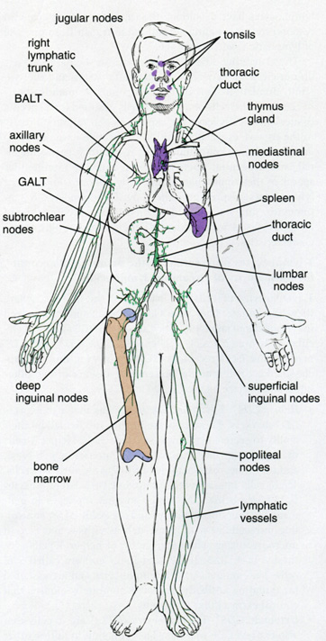
Lymphoid organs are classified as:
PRIMARY OR CENTRAL LYMPHOID ORGANS
Thymus
Bone marrow
SECONDARY (EFFECTOR) OR PERIPHERAL LYMPHOID ORGANS/TISSUE
  Spleen & lymph nodes (organs)
  Mucosal associated lymphoid tissue (MALT), e.g. lymphocytes and lymphatic nodules in the lamina propria
Ross, Fig. 14.1
Notes:
Primary Lymphoid Organs:
The bone marrow and the thymus and the Gut-Associated Lymphoid Tissue (e.g. appendix, terminal ileum) are the initial “education centers” of the immune system
In these organs, lymphocytes (T cells in the thymus, B cells in bone marrow and gut) differentiate into immunocompetent cells
(i.e. they can recognize “self” vs. “nonself”)
This differentiation is said to be antigen-independent
The lymphocytes then enter the blood and lymph to populate:
epidermis and mucosae
connective tissue
secondary lymphoid organs
Secondary Lymphoid Organs:
The lymph nodes, lymphatic nodules, tonsils, spleen are the
secondary “education centers” of the immune system
In these organs, immunocompetent lymphocytes differentiate
into immune effector and memory cells that undergo antigen-dependent activation and proliferation in these organs.
These lymphocytes then carry out their functions in the:
connective tissue
secondary lymphoid organs
mucosal surfaces lining epithelia
They participate in:
Cell mediated immunity (mostly “cytotoxic” T cells)
Humoral responses (production of antibody) (B cells, also requires “helper” T cells.

Slide 10
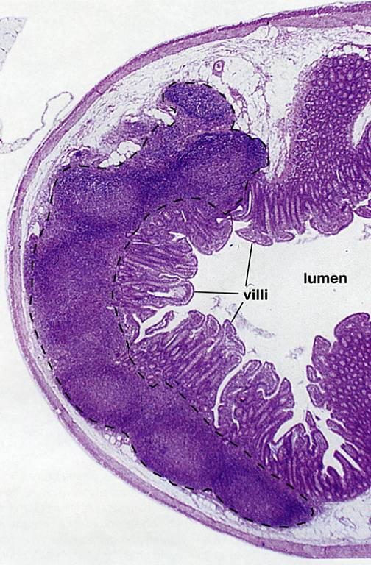
So, associated with just about any mucosa (GI, respiratory, genitourinary), you may see:
Intraepithelial lymphocytes
Diffuse lymphoid tissue:
Primary nodules
Secondary nodules
  Germinal center with lymphoblasts and macrophages.
Source Undetermined

Slide 11
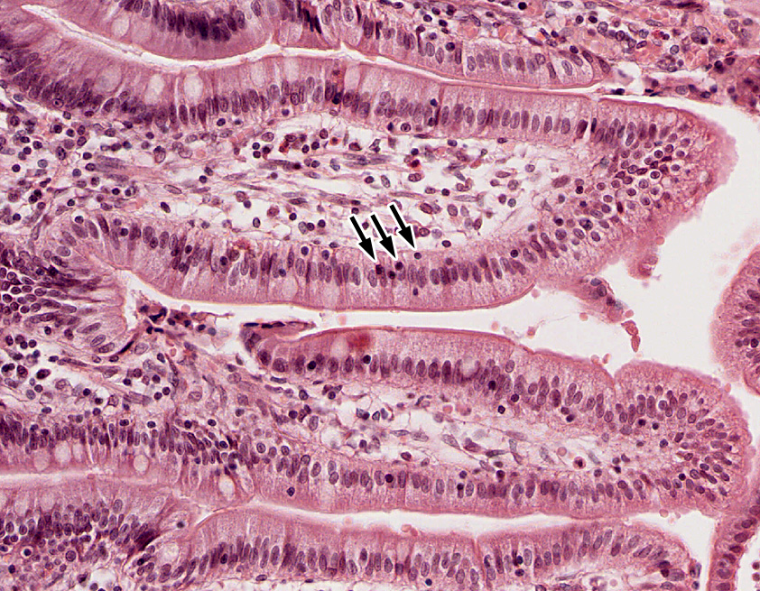
MALT: intraepithelial lymphocytes:
U-M Histology Collection
Notes:
γδT-cells (neither helper nor cytotoxic): first to see antigens

Slide 12
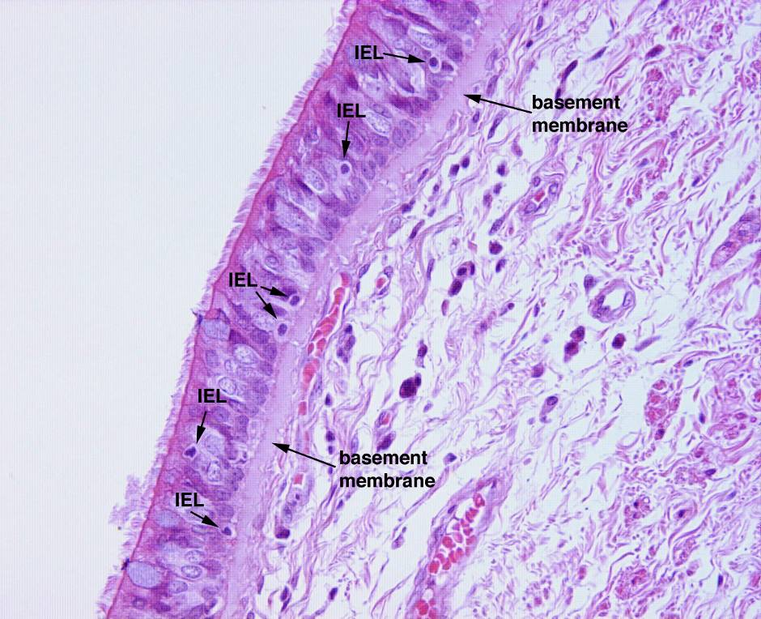
INTRAEPITHELIAL LYMPHOCYTES
Shown here in resp. epith.
U-M Histology Collection

Slide 13
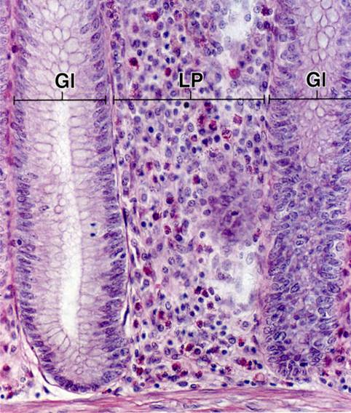
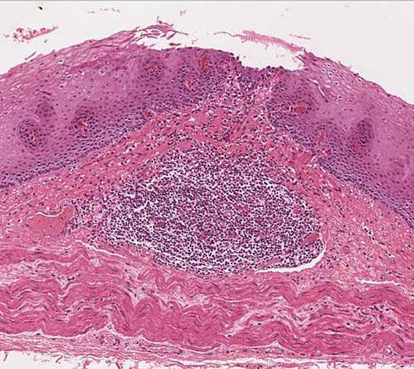
LYMPHOCYTES IN CONNECTIVE TISSUE:
LN
Ross and Pawlina, Histology: A Text and Atlas
U-M Histology Collection
Diffuse lymphoid tissue
Lamina propria (LP) of gut shown here, but can be found associated with mucosae anywhere in the gut, respiratory, and genitourinary tracts.
Primary lymphatic nodule/follicle (LN)
Aggregation of lymphocytes in lamina propria or submucosa

Slide 14
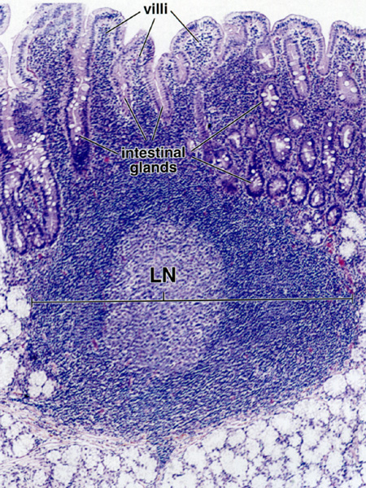
SECONDARY FOLLICLES/NODULES
Contain germinal centers
Arise when B-lymphocytes are presented with appropriate antigen, receive T-cell help, and then begin proliferating as lymphoblasts
Lymphoblasts differentiate into plasma cells or memory cells; aberrant lymphoblasts undergo apoptosis.
Ross and Pawlina, Histology: A Text and Atlas

Slide 15
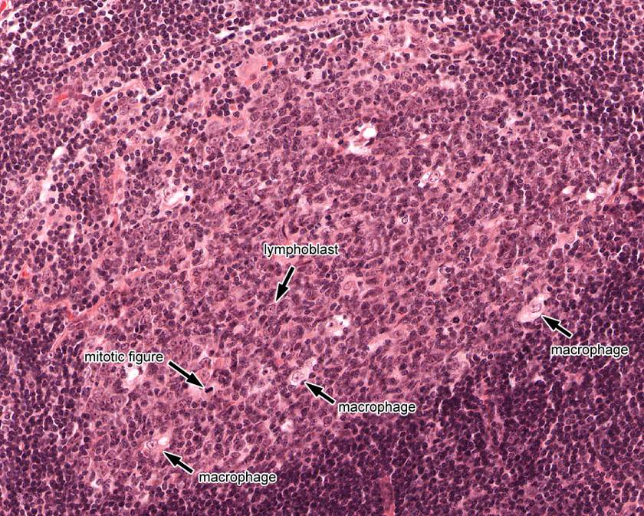
GERMINAL CENTER: HIGH MAGNIFICATION
U-M Histology Collection. Slide 175.

Slide 16
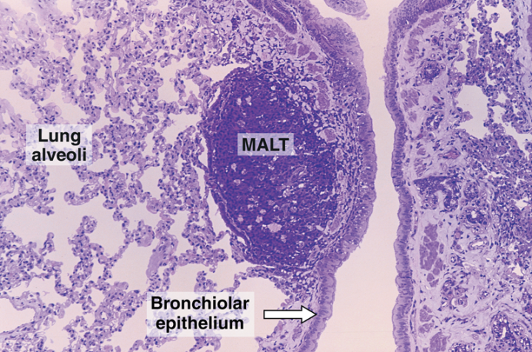
BRONCHUS-ASSOCIATED LYMPHOID TISSUE (BALT) → similar to peyer’s patches
Section of lung showing a collection of lymphocytes in the connective tissue of the bronchiolar mucosa, an example of mucosa-associated lymphoid tissue (MALT). Pararosaniline—toluidine blue (PT) stain. Low magnification

Slide 17
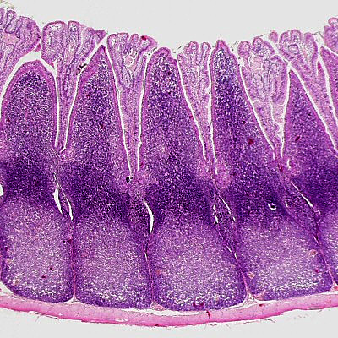
Gut-Associated Lymphoid Tissue - GALT
Peyer’s patches
Aggregates of lymphoid follicles in the ileum.
Source Undetermined
Notes:
Small accumulations of lymphocytes or solitary lymph follicles are found scattered in beneath the epithelium throughout the gastrointestinal tract. However, the most prominent accumulations occur in the ileum and appendix in the form of Peyer's patches. In the ileum, they form dome-shaped protrusions into the lumen. Beneath the epithelial lining of the domes, Peyer's patches extend from the lamina propria to the submucosa. Within Peyer's patches, lymph follicles with germinal centers are typically located deep in the submucosa.
The epithelium in contact with the lymphoid tissue is specialised to facilitate the contact of antigens with cells of the immune system. The epithelium appears columnar and contains cells with deeply invaginated basal surfaces - microfold cells or M-cells. Immune system cells can enter these invaginations (intraepithelial pockets) where they are exposed to materials which have been endocytosed by the epithelial cells and then released into the invaginations. Goblet cells are rare or absent in the epithelium which covers the domes.

Slide 18
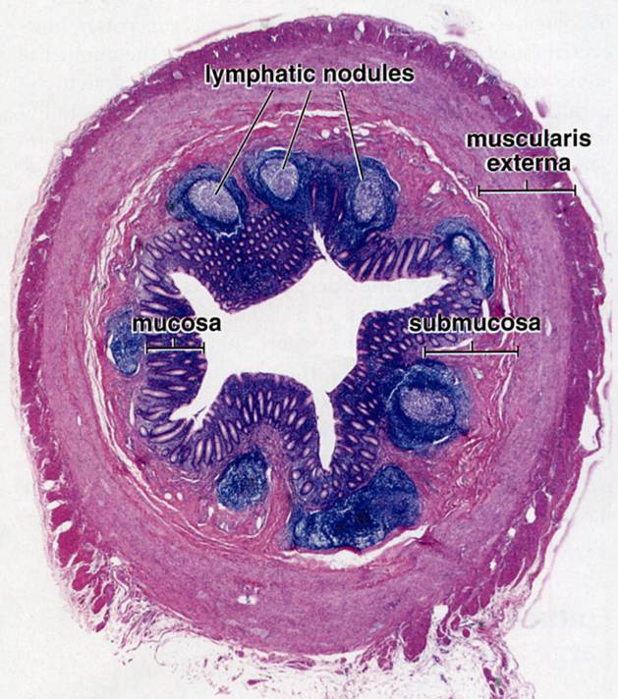
Appendix
Blind sac extending
from the caecum
Ross and Pawlina, Histology: A Text and Atlas
Notes:
primary and secondary follicles in lamina propria and submucosaSo, clearly a secondary lymphoid organ…

Slide 19
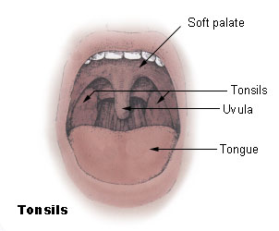
Tonsils: MALT of the oropharynx
United States Federal Government

Slide 20
1. THE TONSIL
The tonsils are accumulations of lymphoid tissue surrounding the openings of the digestive and respiratory tracts.
The tonsils and smaller accumulations of lymphoid tissue, which may be found between them, are also called Waldeyer's ring.
Depending on their localisation we distinguish between
A. Palatine tonsils (THE tonsils)
B. Lingual tonsils
C.Pharyngeal tonsils (also called nasopharyngeal tonsils or adenoids)
Notes:
A. Palatine tonsils (THE tonsils), which are located in the lateral wall of the oropharynx and covered by a stratified squamous epithelium,
B. Lingual tonsils which are situated in the lamina propria at the root of the tongue and also covered by a stratified squamous epithelium, and
C. Pharyngeal tonsils (also called nasopharyngeal tonsils or adenoids) which are located in the upper posterior part of the throat (nasopharynx) and covered by a pseudostratified ciliated epithelium with goblet cells.

Slide 21
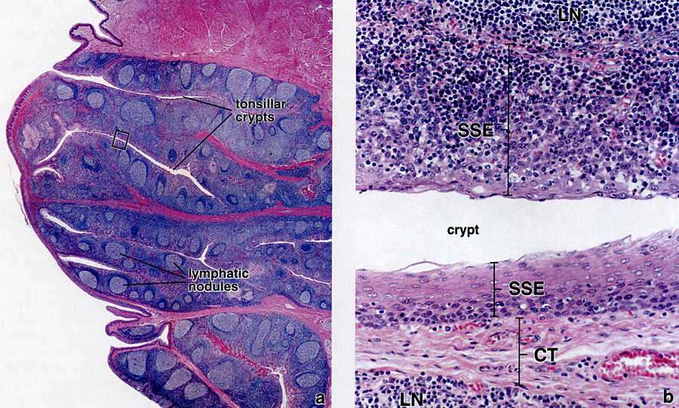
PALATINE TONSILS
Ross and Pawlina, Histology: A Text and Atlas
Notes:
The palatine tonsils are paired structures made of dense accumulations of lymphatic tissue located in the mucous membrane of the junction of the oropharynx and oral cavity. The tonsils dip down into the underlying CT, forming crypts. There are also lingual tonsils and pharyngeal tonsils (under the roof of the nasopharynx and around the opening of the Eustachian tubes). Key features: crypts, abundant nodules, stratified squamous epithelium

Slide 22
PALATINE TONSIL
Aggregates of lymphatic nodules located in the oral cavity.
It is surrounded on all sides by connective tissue capsule except the oral or medial aspect.
The oral surface of the palatine tonsil is covered by a protective stratified squamous nonkeratinized epithilium that covers the rest of the oral cavity
Epithelium shows evaginations into the subepithelial tissue called tonsilar crypt also lined by stratified squamous nonkeratinized epithilium
Below the epithelium in underlying connective tissue are numerous lymphatic nodules distributed along the length of tonsillar crypts. Lymphatic nodules frequently merge with each other and usually exhibit lighter staining germinal centres.
A dense connective tissue underlies the palatine tonsil and form its capsule
The connective tissue trabeculae , some with blood vessels arise from the capsule and pass towards the surface of the tonsil between the lymphatic nodules.
Below the connective tissue capsule are sections of skeltal muscle fibers.

Slide 23
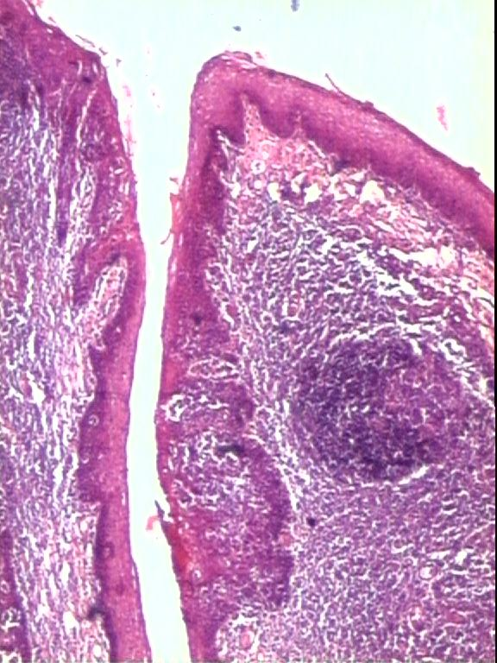

Slide 24
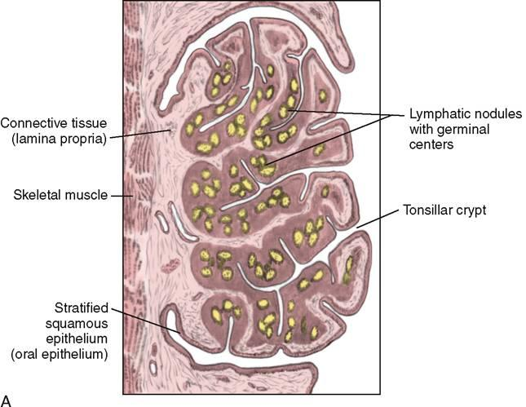

Slide 25
Lymph Node

Slide 26
Lymph Nodes
Main functions:
Filter lymph, thereby promoting lymphocyte contact with antigen
Provides necessary microenvironment for antigen-dependent differentiation
Ross, Fig. 14.1

Slide 27
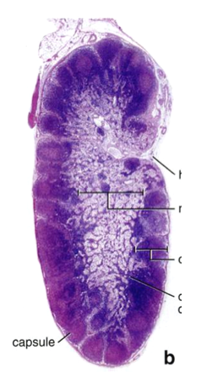
LYMPH NODE STRUCTURE
Lymph node consists of dense masses of lymphocyte aggregations intermixed with dilated lymphatic sinuses that contain lymph and are supported by a framework of fine reticular fibers.
CAPSULE with blood vessels and adipose tissue
SUBCAPSULAR(MARGINAL) SINUS
CORTEX contains numerous lymphatic nodules, some of which contain a lighter staining germinal centre.
MEDULLA lighter staining, central region contains
Medullary cord
Medullary sinuses

Slide 28
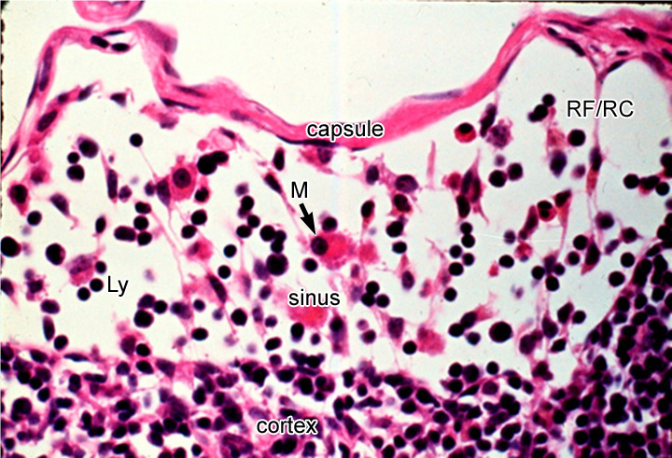
High magnification view of a sinus (subcapsular sinus shown here) that continue on each side of the trabecula as trabecular sinuses into the medulla of the node and eventually exit through the efferent lymph vessels in the hilum.
U-M Histology Collection
M=macrophage, Ly=lymphocytes, RF/RC=reticular fiber (and associated reticular cell)

Slide 29
LYMPH NODE CORTEX
LYMPHATIC NODULES : situated adjacent to each other but incompletely seperated by internodular connective tissue trabeculae and trabecular (cortical) sinuses.
GERMINAL CENTRE : central light staining , surrounded by a deeper staining peripheral portion of the nodule. The cells are more loosely aggregated and the developing lymphocytes have larger and lighter staining nuclei with more cytoplasm.
PARACORTEX : Deeper portion of the cortex. This is the thymus dependent zone , primarily occupied by T cells. This is the transitional area from lymphatic nodules to the medullary cords.

Slide 30
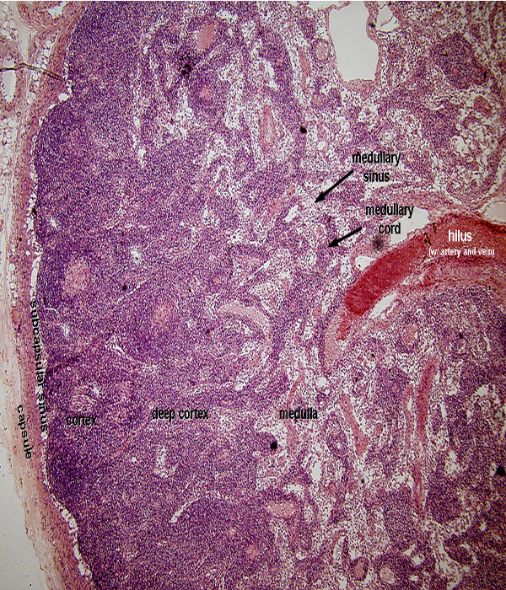
CORTEX

Slide 31
MEDULLA
MEDULLARY CORDS : Irregular cords of lymphatic tissue. Contain macrophages , plasma cells, and small lymphocytes.
MEDULLARY SINUSES: drains the lymph from the cortical region of the lymph node and course between the medullary cords towards the hilus of the organ.

Slide 32
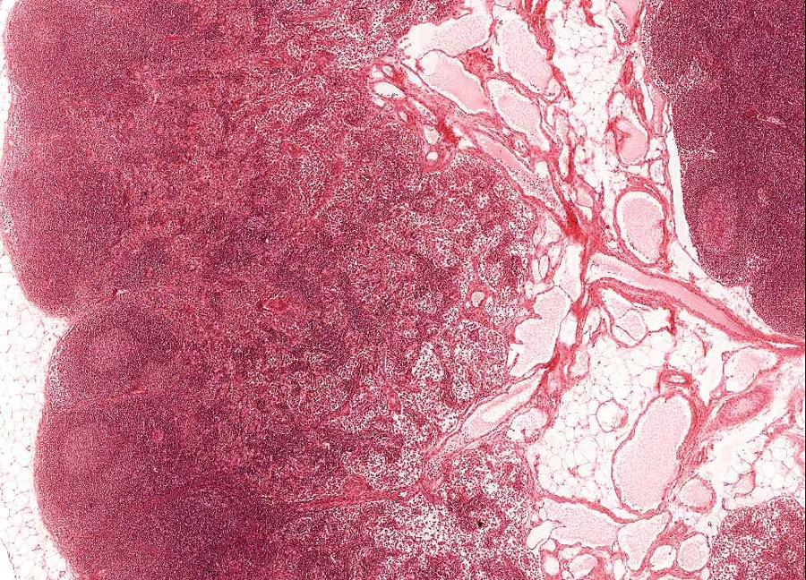
LYMPH NODE
U-M Histology Collection

Slide 33
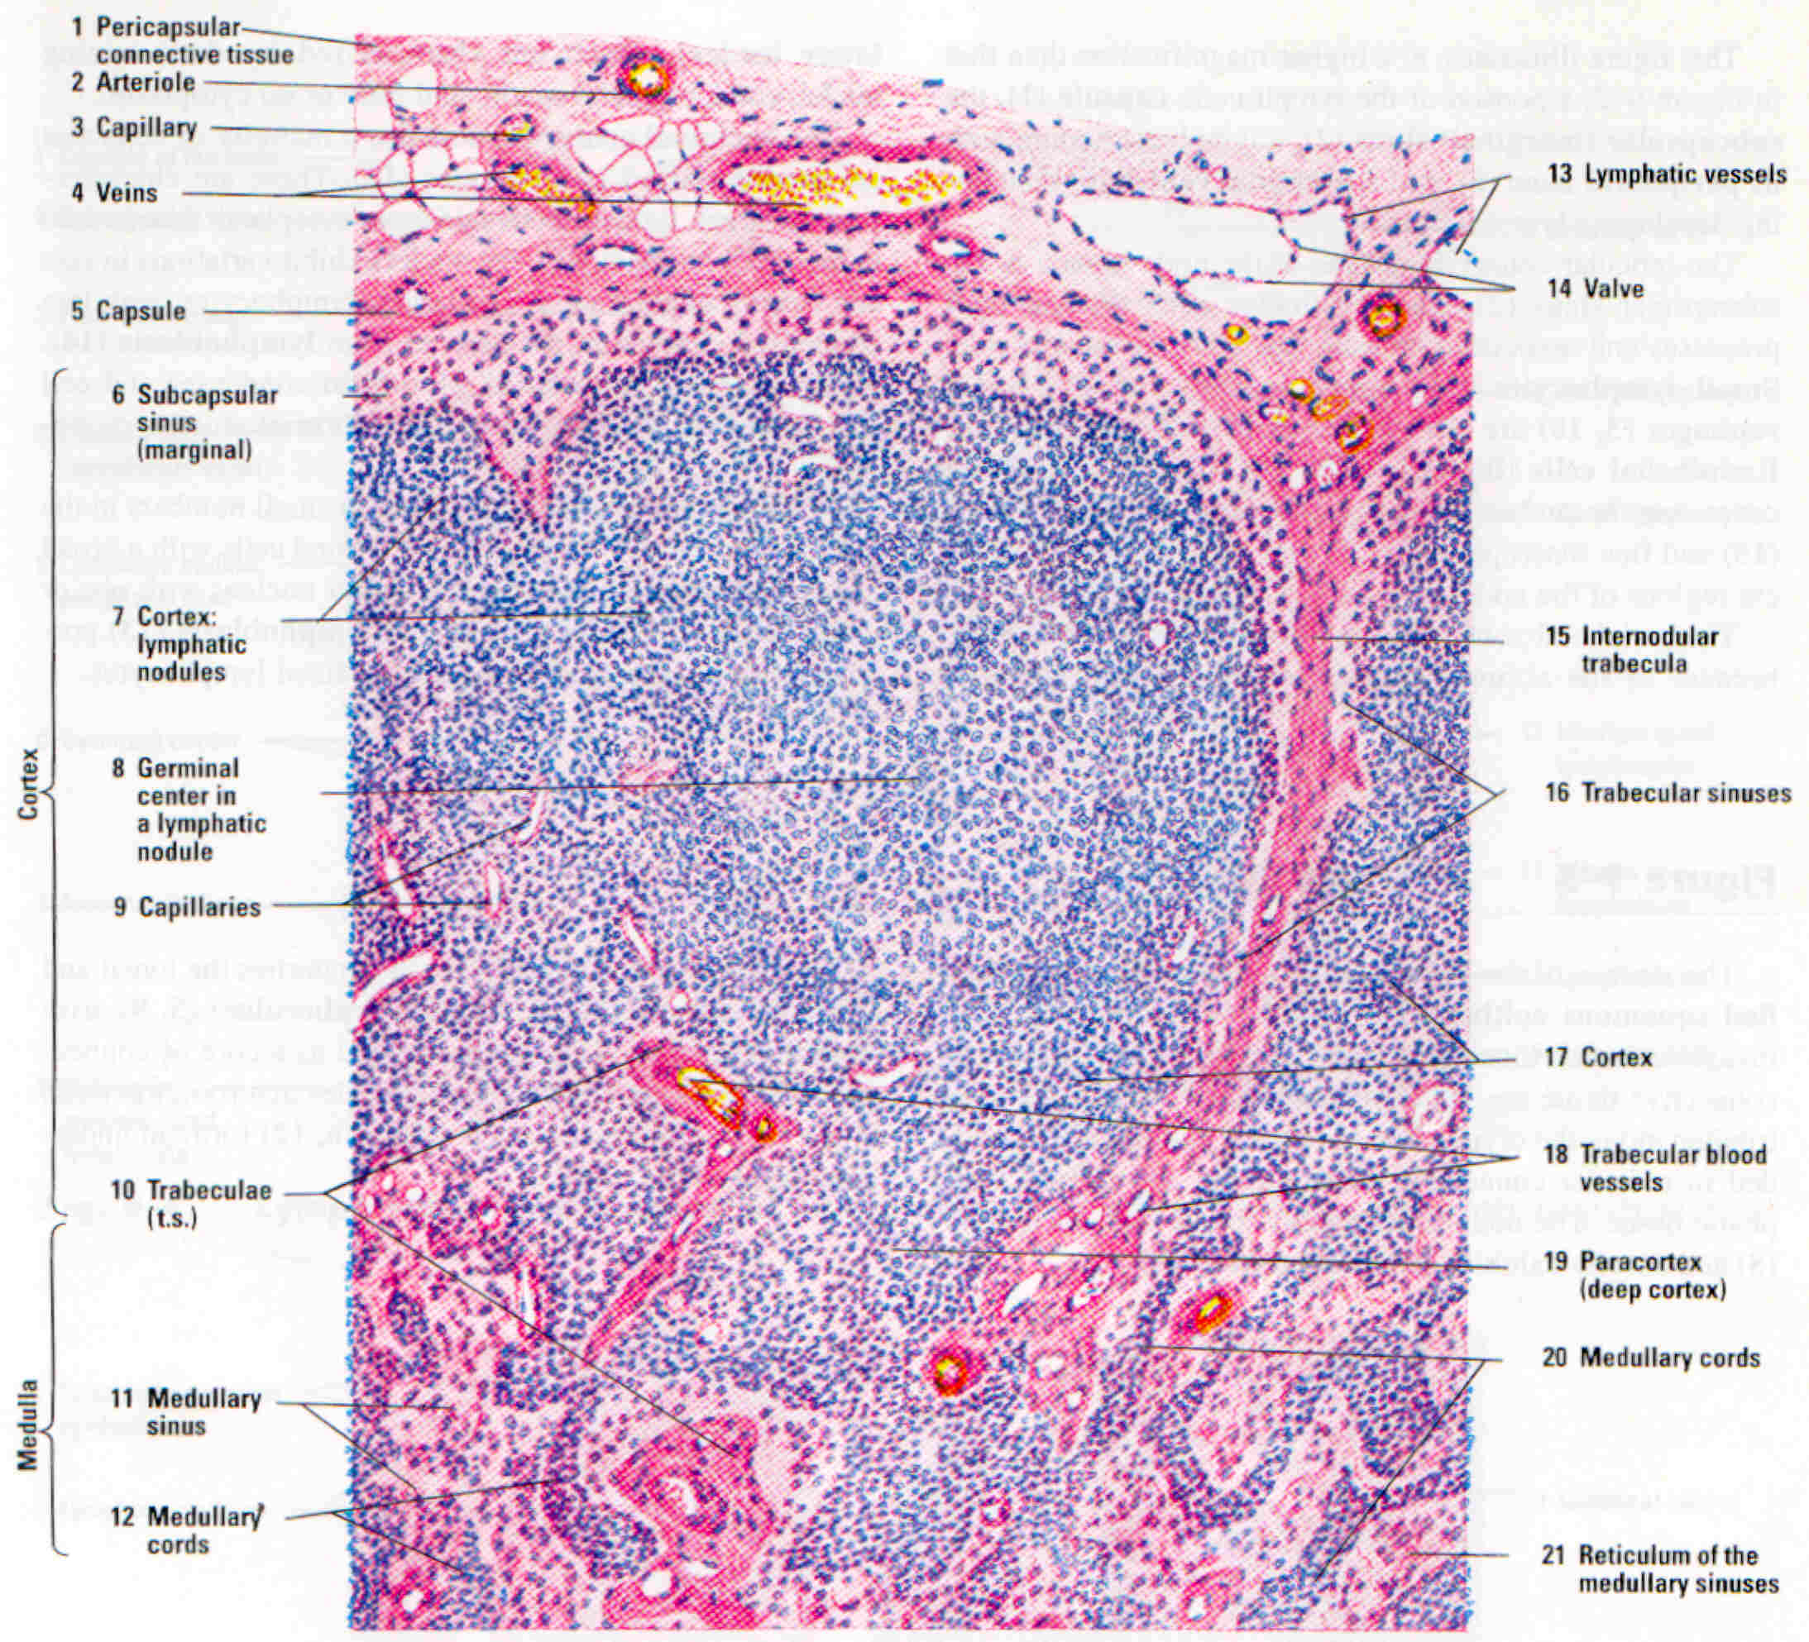

Slide 34
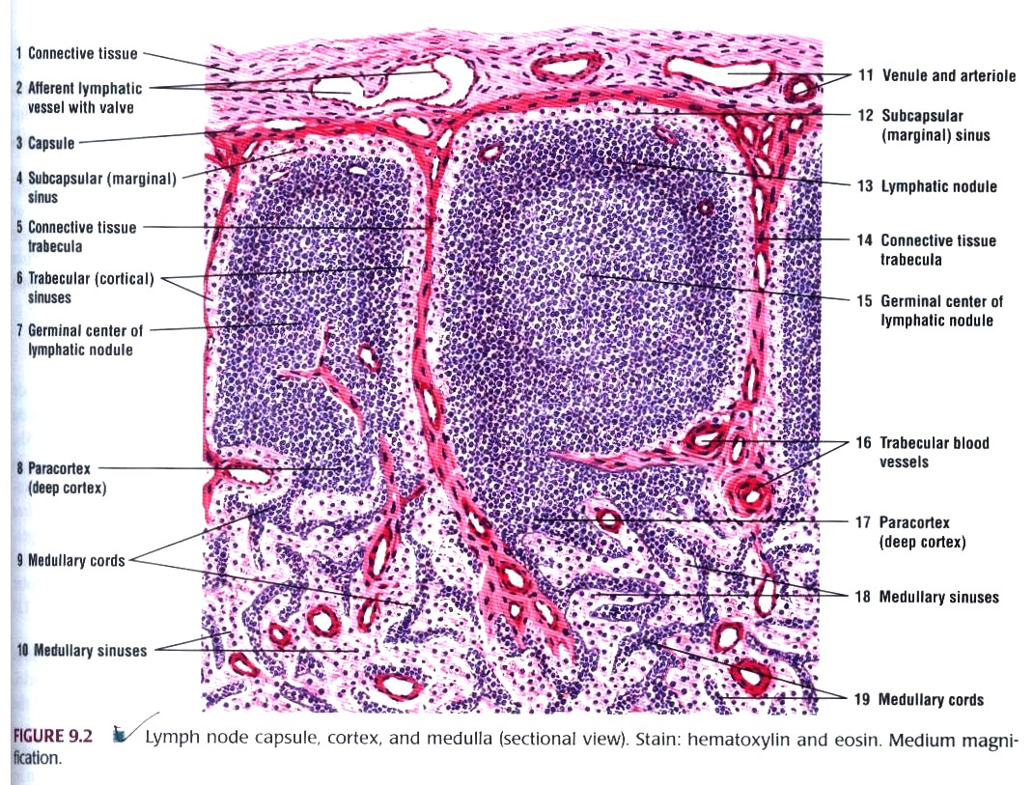
Microscopic structure of lymph node

Slide 35
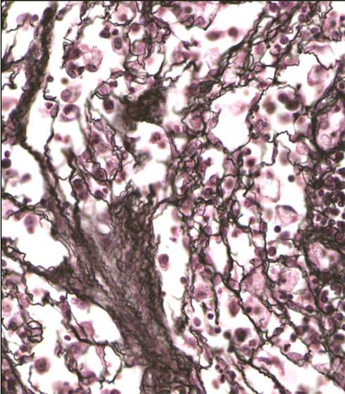
Reticular (Reticulin) Fibers
Provide the main structural support to lymph node and forms the core of the lymphatic nodules in the cortex, the medullary cords and all medullary sinuses in the medulla.
Composed mainly of Type III collagen, with a carbohydrate moiety that reduces Ag+ to metallic sliver = argyrophilic.
Special stain: silver impregnation to visualize.
Thinner than type I collagen (Type III fibrils are 30-40 nm diameter; type I fibrils are ~200 nm diameter)
Source Undetermined
Notes:
Reticular fibers are also mixed with collagen fibers in other CT types. However, they are difficult to visualize without special stains (they do not form fiber bundles). Coz the lymphocytes are so abundant

Slide 36
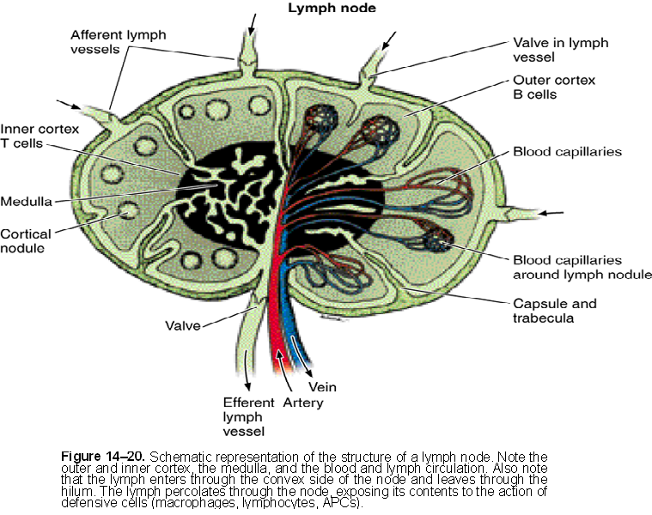
BLOOD AND LYMPHATIC CIRCULATION THROUGH A LYMPH NODE
Notes:
HILAR ARTERY-> ARTERIOLES ->CAPILLARY BED(DRAINED BY) -> POST CAPILLARY VENULES ->HILAR VEIN
AFFERENT LYMPHATICS – SUBCAPSULAR SINUSES- TRABECULAR SINUSES- MEDULLARY SINUSES- EFFERENT LYMPHATICS EXIT THROUGH THE HILUM.
SINUSES ARE LINED BY ENDOTHELIUM. Lymphocytes and macrophages pass easily between these sinuses and the tissue of the lymph node.
Macrophages in sinuses monitor the fluids. Macs phagocytose the antigenic material and present it to T- and B-cells

Slide 37
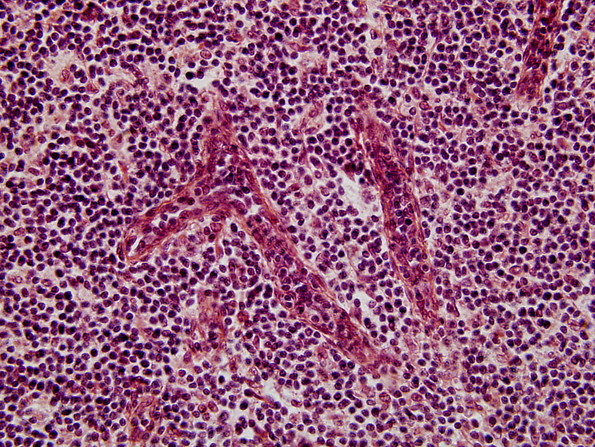
high endothelial venules
U-M Histology Collection

Slide 38
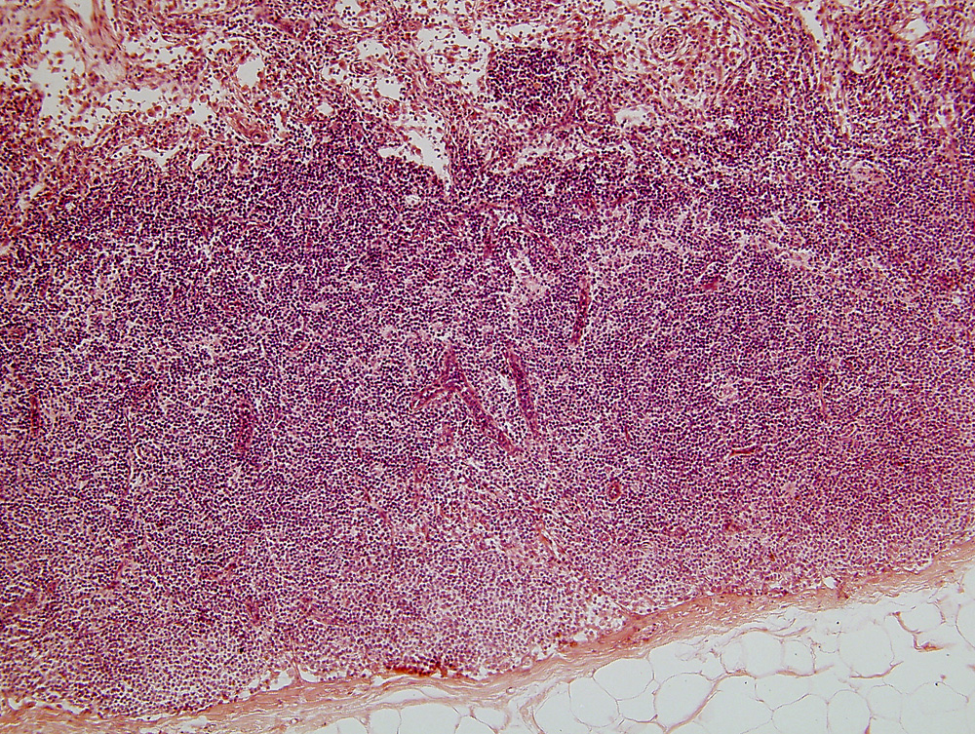
lymph node, H&E, 10x obj.
medulla
deep cortex
high endothelial venules
cortex
capsule
U-M Histology Collection
Notes:
*HEVs are sites where lymphocytes can leave blood stream to enter the lymph node tissue bed.

Slide 39
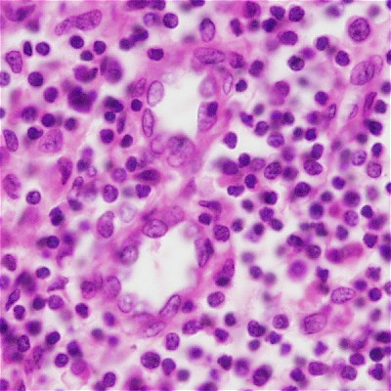
HIGH ENDOTHELIAL VENULES
Situated in The paracortex region of the lymph node
Have an unusual morphology to facilitate the migration of lymphocytes from blood in to the lymph nodes
Lined by tall cuboidal endothelium instead of the usual squamous endothelium
Site of:
Fluid absorption (via aquaporin-1 channels), which causes lymph flow
EXIT of lymphocytes from bloodstream via diapedesis
Source Undetermined
Notes:
Present in other lymphoid org like payers patches insi, tonsils, appendixand cortex of thymus, absent in spleen

Slide 40
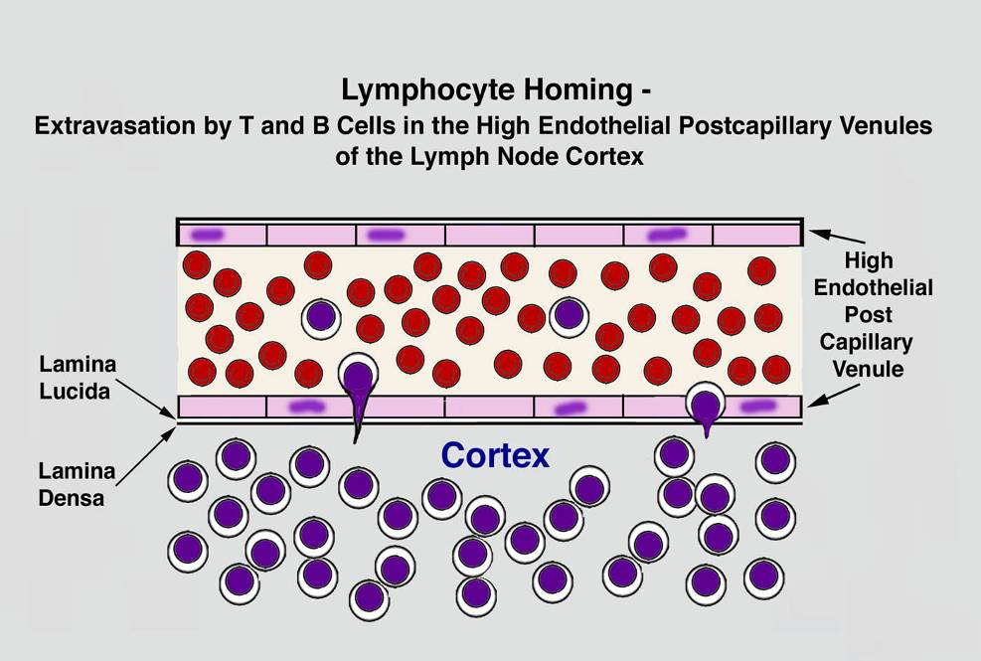
Source Undetermined

Slide 41
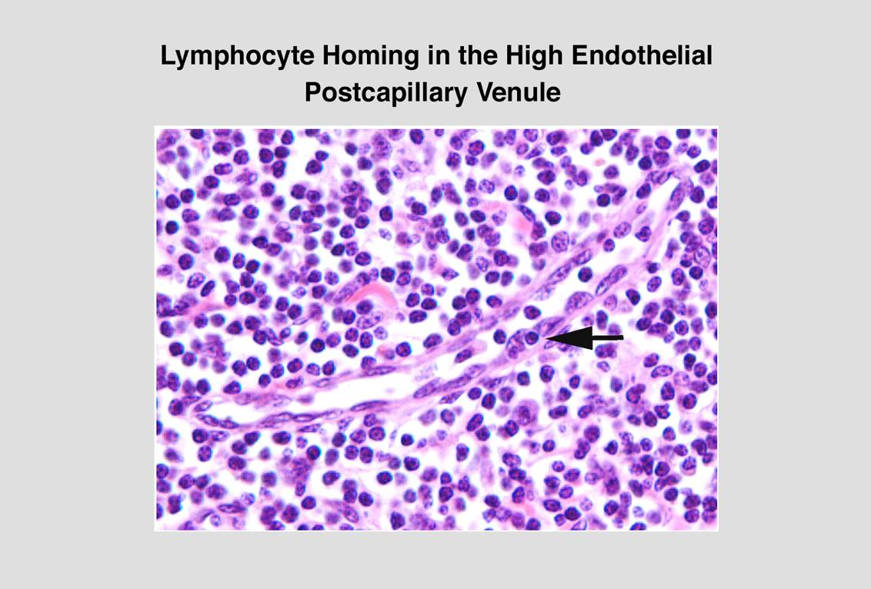
Source Undetermined

Slide 42
SUMMARY OF LYMPHOCYTE TRAFFIC IN A LYMPH NODE
Solvent drag caused by HEV fluid transport draws lymph in via afferent vessels
  ~10% of lymphocytes enter this way; mostly memory cells
HEV endothelial cells express selectins and other receptors for antigen-primed lymphocytes that stimulate them to EXIT bloodstream via diapedesis
  ~90% enter this way; mostly naïve lymphocytes
T-cells move to deep cortex; B-cells migrate to superficial cortex; differentiated plasma cells move to medullary cords and secrete IgG into lymph
Lymphocytes may leave lymph node via EFFERENT lymph vessels (can rejoin bloodstream via thoracic duct, jugular vein, etc.)

Slide 43
SPLEEN

Slide 44
SPLEEN
Filters the blood
Destroys old red blood cells
Serves as an immune organ
Divided into Red Pulp (RBC/
hemoglobin recycling)
White Pulp (responsible for
immune functions)
Ross, Fig. 14.1

Slide 45
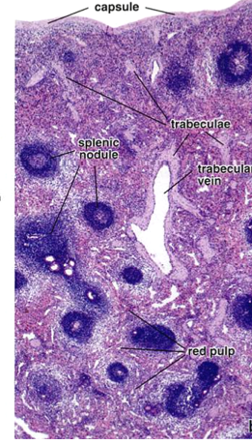
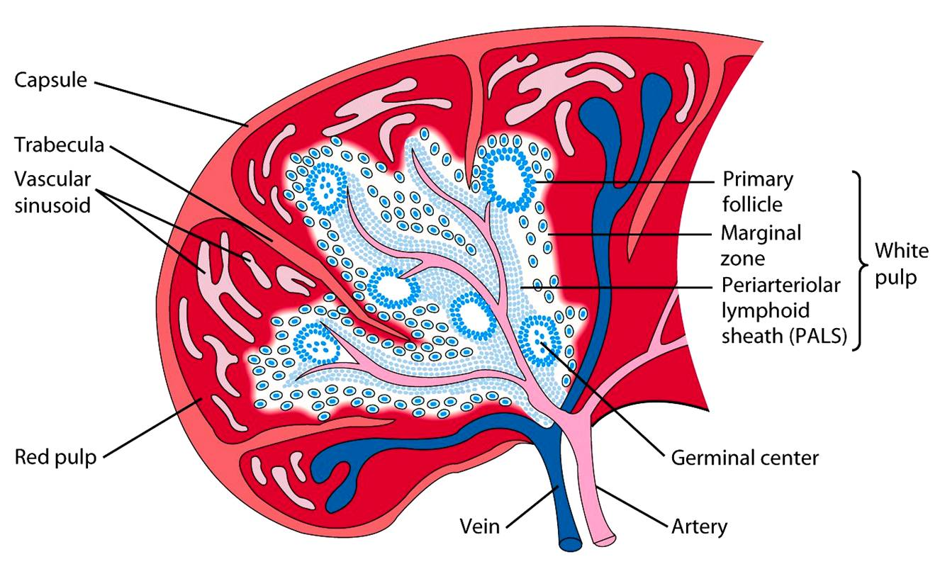
ORGANIZATION OF THE SPLEEN
Ross, 14.29

Slide 46
ORGANIZATION OF THE SPLEEN
Except for the hilum, the surface of the spleen is covered by a layer of peritoneum reffered to as SEROUS COAT.
CAPSULE: spleen is surrounded by dense connective tissue capsule
TRABECULAE : from the capsule arises connective tissue trabeculae that extend deep into the spleens interior. The main trabeculae enters the spleen at the hilus and extend throughout the organ. Contains:
Trabecular arteries
Trabecular vein

Slide 47
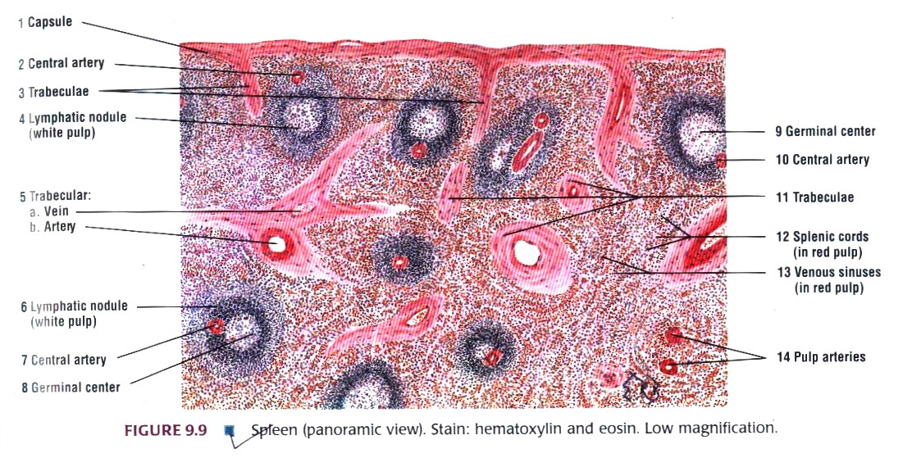
Microscopic structure

Slide 48
WHITE PULP
WHITE PULP: consists of numerous aggregation of lymphatic nodules that surround the central artery
At places the cords are thicker and contain lymphatic nodules. These nodules are called MALPIGHIAN BODIES.
Each lymphatic nodule contains:
Germinal centre : decrease in number with age.
Central artery : Located in the periphery of the lymphatic nodule. Are branches of trabecular arteries that become ensheathed with lymphatic tissue as they leave the connective tissue trabeculae.
This periarterial lymphatic sheath also forms the lymphatic nodules that constitute the white pulp .

Slide 49
PALS with secondary follicle
Shown here with “central” artery cut in cross section –note that the CA has been pushed off to the side by the rapid expansion of cells in the germinal center (GC)
RP= red pulp
MZ= marginal zone (antigen presentation)
dashed circle = T-cell rich zone
Ross, plate 35-3

Slide 50
RED PULP
RED OR SPLEENIC PULP: Diffuse cellular meshwork that makes the bulk of the organ . Surround the lymphatic nodule and intermeshed with the connective tissue trabeculae .
In fresh preparations, appears red because of its extensive vascular tissue.
Contains:
SPLEENIC CORDS OF BILLROTH: Are thin aggregation of lymphatic tissue containing small lymphocytes , associated cells and various blood cells.
VENOUS SINUSES: Dilated vessels lined with the modified endothelium of elongated cells that appear cuboidal in transverse section.
PULP ARTERIES: Branches of central artery after it leaves lymphatic nodule.
CAPPILARIES AND PULP VEIN.
Notes:
Spleen does not exhibit a distinct cortex and medulla as seen in lymph nodes.
Lymphatic nodules are found throughout spleen
Spleen contains venous sinuses.
Does not exhibit subcapsular or trabecular sinuses.
Capsule and trabeculae in the spleen are thicker than those arround lymph nodes.

Slide 51
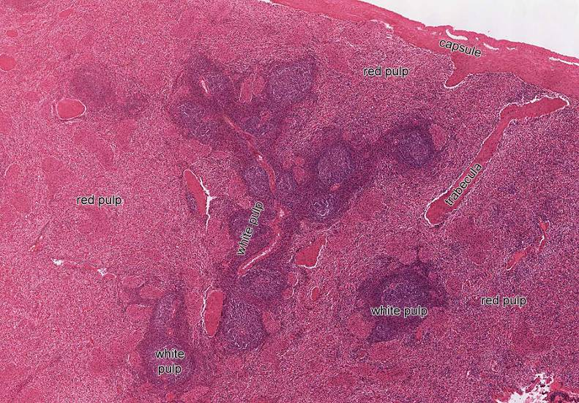
Organization of the spleen: white pulp and red pulp
U-M Histology Collection
Notes:
White pulp: lymphatic aggregations around “central” arteries:
periarterial lymphatic sheath (PALS): T-cells
lymph nodules: B-cells
Red pulp: cords and sinuses

Slide 52
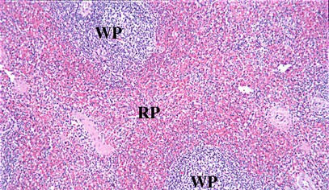
SPLENIC PULP

Slide 53
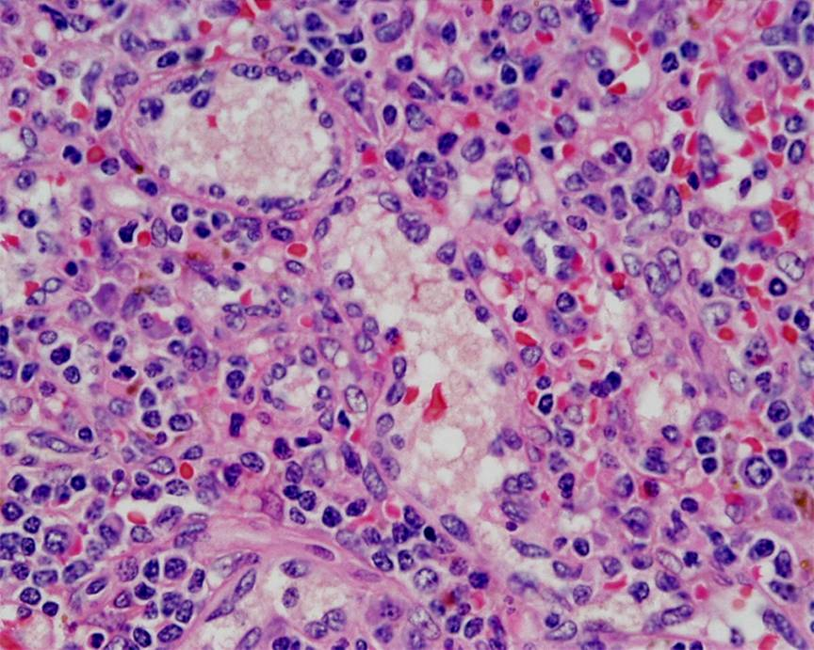
Spleen (red pulp) at high power (40x)
sinus
cord
cord
sinus
U-M Histology Collection

Slide 54
SPLENIC CIRCULATION
Blood enters via splenic artery at hilus
Splenic artery branches into trabecular arteries (which travel within connective tissue trabeculae).
Trabecular arteries give off branches known as central arteries which leave the trabecula and enter the substance of the spleen (covered by a peri-arterial lymphatic sheath).
Central arteries branch into penicillar arterioles that piece through the lymphatic sheath and spill into splenic cords. Or the red pulp (open circulation)
Blood percolates through splenic cords and across walls of splenic sinuses.(closed circulation)
Splenic sinuses drain into pulp veins.
Pulp veins drain into trabecular veins.
Trabecular veins drain into splenic vein at the hilus.

Slide 55
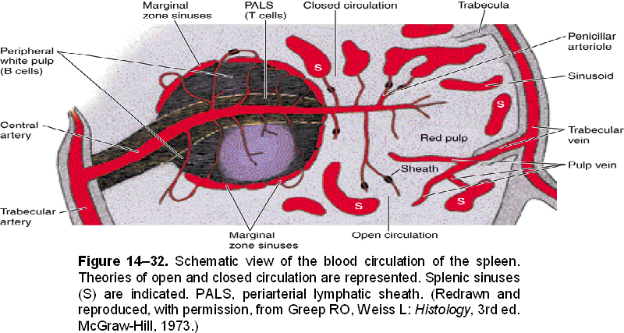
Blood Circulation of Spleen

Slide 57
STAVE CELLS
The sinusoids of the spleen are lined by a somewhat modified endothelium. The endothelial cells here are elongated and are shaped like bananas. They are referred to as stave cells.
With the EM a system of ultramicroscopic fibrils is seen to be present in their cytoplasm. The fibrils may help to alter the shape of the endothelial cells thus opening and closing gaps between adjoining cells.

Slide 58
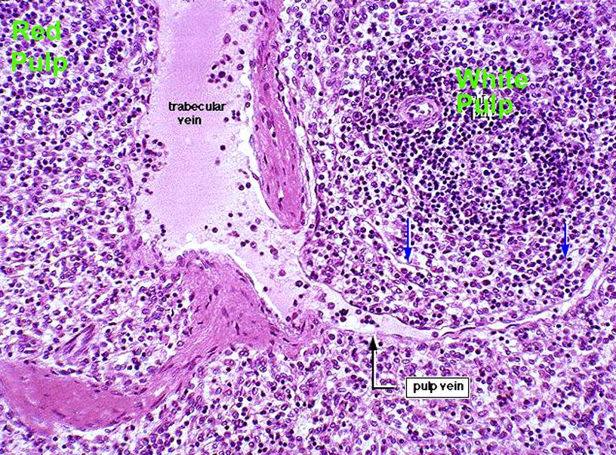
SPLENIC CIRCULATION
Sinuses drain into splenic pulp veins, which, in turn, drain into trabecular veins. Trabecular veins travel within trabeculae and drain into splenic vein at the hilus.
red
pulp
white
pulp
U-M Histology Collection

Slide 59
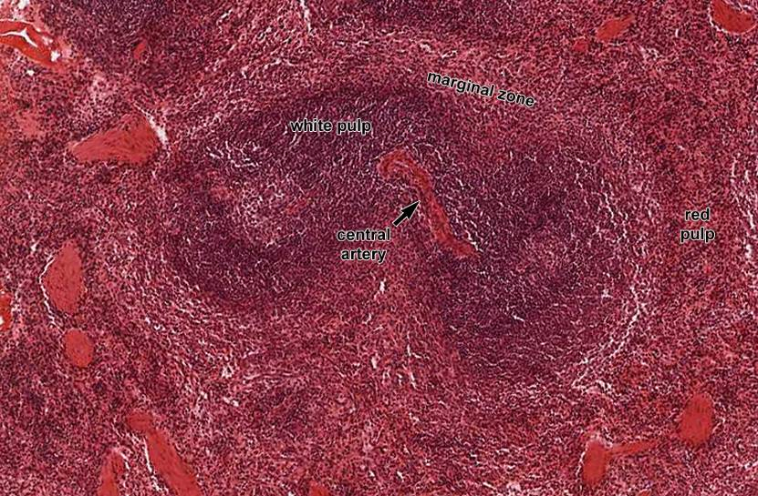
White pulp function
Blood and antigens pour into red pulp (more on that later)
Antigen presentation takes place in MARGINAL ZONE
T-cells (from PALS) provide “help” to activate mphages and B-cells
  activated mphages stimulated to destroy ingested material (e.g. bacteria)
  activated B-cells set up proliferative germinal centers
U-M Histology Collection

Slide 60
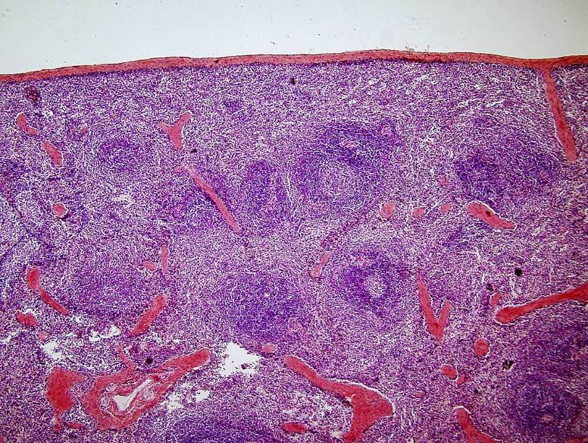
As the body is exposed to antigens and the immune system mounts an immune response in the form of antibody production, lymph nodules (w/ germinal centers) appear in the white pulp of the spleen.
U-M Histology Collection

Slide 61
Immune Functions
Of the Spleen
Monitoring antigens in blood
Proliferation of lymphocytes
Production of humoral antibodies
Hematopoietic
Functions
Of the Spleen
Formation of blood cells in fetal life
Removal and destruction of RBCs & platelets
Retrieval of iron from RBC hemoglobin
Storage of RBCs and platelets

Slide 62
The Thymus

Slide 63
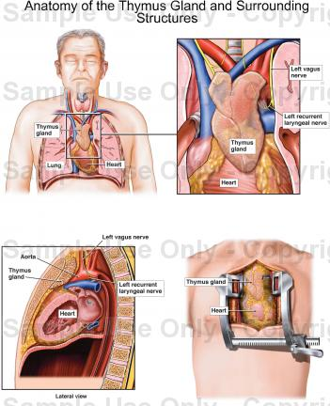
THYMUS
-Central lymphoid organ.
-Responsible for development of immune system.
-Essential for growth & development of other lymphoid organs.
-Bilobed,of unequal size, present in superior & anterior mediastinum of thorax.

Slide 64
The Thymus
Ross, Fig. 14.1

Slide 65
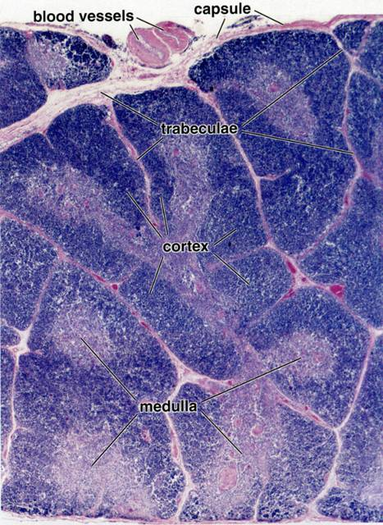
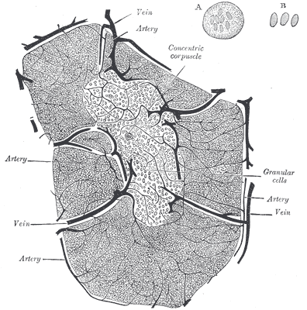
The Young Thymus
Surrounded by a CT capsule; cortex has a lot of lymphocytes, fewer in the medulla
THERE ARE NO GERMINAL CENTERS IN THE THYMUS!
Gray’s Anatomy
Ross and Pawlina, Histology: A Text and Atlas

Slide 66
STRUCTURAL ORGANISATION OF THYMUS
Lobulated lymphoid organ enclosed by a connective tissue capsule from which arises connective tissue trabeculae
TRBECULAE: extend to the interior of the organ and subdivide the thymus gland into numerous incomplete lobules.
Each lobule consist of:
CORTEX: (Outer dark staining ) each lobule contains densely packed lymphocytes that do not form lymphatic nodule.
MEDULLA: ( inner lighter staining)contains fewer lymphocytes ‘but more epithelial reticular cells. Also contains numerous THYMIC OR HASSALL CORPUSCLES that characterize the thymus gland.
Because the lobules are incomplete, the medulla shows continuity between the neighbouring lobules.
Blood vessels pass into the thymus gland via connective tissue capsule and the trabeculae.
Notes:
Specialized epithelial cells (called epithioreticular cells) that are joined to one another by long processes with desmosomes on the extremities of the cells (like starfish joined together at the tips) make up the bag-like support for:
Lymphocytes that, when the organ is young, fill this “bag”.
NOTE: There are generally no B cells in the Thymus.
Only efferent no afferant lymphatic vessels

Slide 67
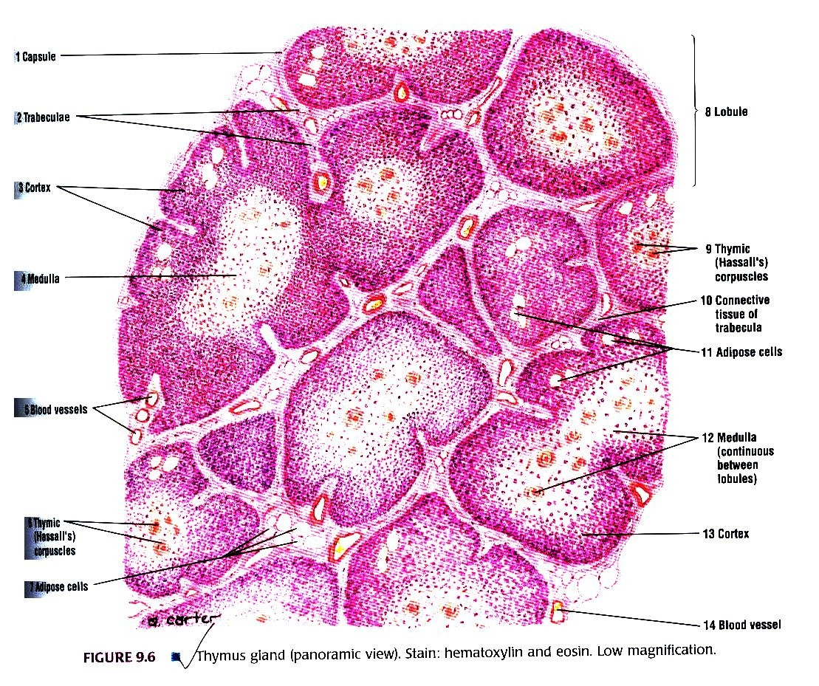

Slide 68
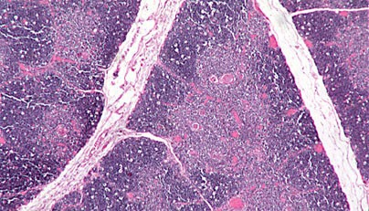

Slide 69
EPITHILIAL RETICULAR CELLS / RETICULOEPITHELIAL CELLS
Specialized epithelial cells called epithioreticular cells that are joined to one another by long processes with desmosomes on the extremities of the cells (like starfish joined together at the tips) make up the bag-like support for Lymphocytes that, when the organ is young, fill this “bag”.
Type 1: line the inner aspect of the capsule, the septa and blood vessels and form part of blood thymus barrier.
Type 2 and Type 3 :present in outer and inner part of cortex respectively.
Type 4: Lies in deepest part of cortex and also medulla
Type 5: present arround corpuscles of Hassall
THYMIC NURSE CELLS: Cortical epitheliocytes , destroy lymphocytes that react to self antigen.

Slide 70
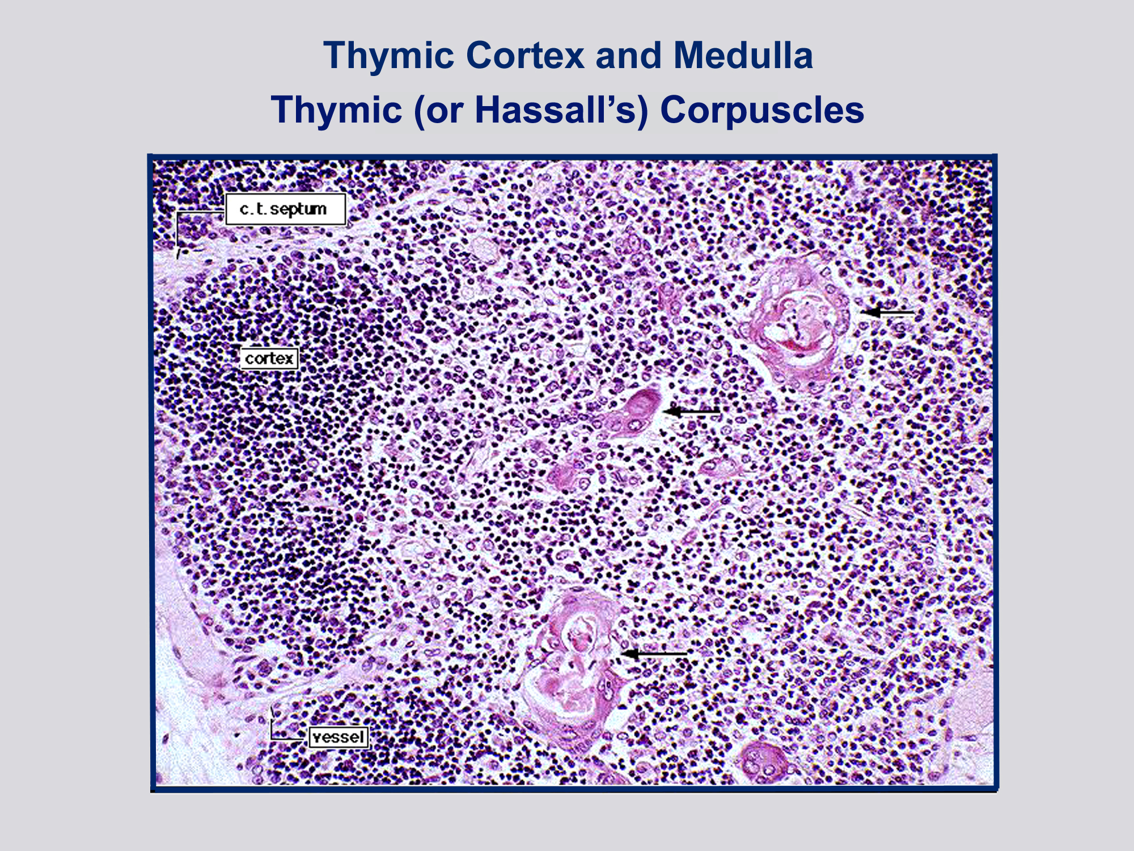
Source Undetermined

Slide 71
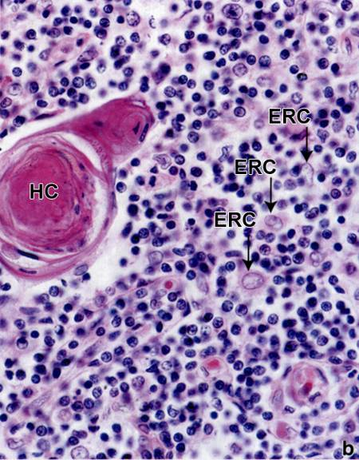
In the medulla, epithelioreticular cells form onionized structures called Hassall’s corpuscles –quite prevalent in older thymus
LM view
Ross and Pawlina, Histology: A Text and Atlas
Ross and Pawlina, Histology: A Text and Atlas

Slide 72
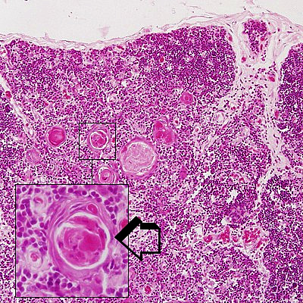
THYMIC (HASSALL) CORPUSCLES
Oval structures consisting of round or spherical aggregations(whorls) of flattened epithilial cells.
Also exhibit calcification or degeneration centres that stain pink or eosinophilic.
Type VI ERCs; function not very well known, but produce interleukins (such as IL-4 and IL-7) and so likely influence T-cell differentiation
Notes:
ERCs secreat hormones that are necessary for proliferation differentiation and maturation of T cells and the expression of their surface markers. Hormones are thymulin, thrombopoetin, thymosin. Thymic humoral factors, interlukinsand interferon.

Slide 73
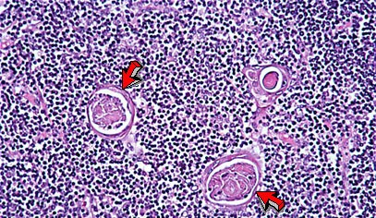
HASSALL’S CORPUSCLES

Slide 74
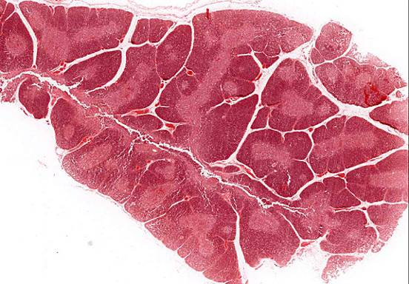
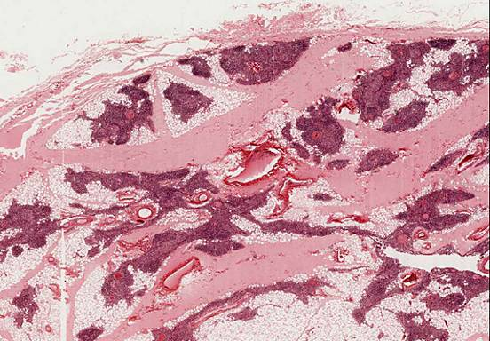
The Thymus undergoes
a process called
THYMIC INVOLUTION, as
T cells leave the thymus to
populate other lymphoid
effector organs, the organ
shrinks, leaving only the
epithelioretucular cells
U-M Histology Collection
The young thymus
Thymus at puberty
U-M Histology Collection

Slide 75

THYMUS, ADULT HUMAN - H&E
illustrates the presence of adipose tissue, and the decrease in the amount of cortical and medullary thymic tissue

Slide 76
BLOOD-THYMUS BARRIER
Education of T-cells must occur in a very controlled environment such that antigens are ONLY presented by epithelial reticular cells.
To ensure that no other cells or free antigens are present, there is a very tight BLOOD-THYMUS BARRIER consisting of:
The blood capillary wall
  endothelial cells
  endothelial cell basal laminae
  pericytes
Perivascular connective tissue
  type III collagen
  macrophages
Epithelioreticular cell layer
  basal lamina of the epithelial reticular cells (type I ERCs)
  epithelial reticular cells
(NOTE: T-cells can enter thymus ONLY via bloodstream –NO AFFERENT LYMPH VESSELS!)

Slide 77

Macrophage
Source Undetermined

Slide 78

High mag view of medulla
Source Undetermined
T-cells that survive selection process allowed to cross venule endothelium (INTRAvasation) to enter circulation.

Slide 79
Overview of T-cell “education”
Naïve T-cells enter medulla via diapedesis across venules
Pass into cortex to undergo POSITIVE selection:
  Presented with MHC molecules and self or non-self antigens by ERCs
  T-cells that recognize MHCs and self/non-self antigens “pass” this selection process and survive (those that don’t undergo apoptosis)
Move into medulla to undergo NEGATIVE selection:
  T-cells that recognize SELF antigens displayed by self MHCs (i.e. are :autoreactive”) are eliminated
Differentiate into helper (CD4+) or cytotoxic (CD8+) T-cells and leave medulla via diapedesis across venules

Slide 80
HORMONES PRODUCED BY THYMUS
THYMULIN: enhances the function of various types of T cells specially suppressor cells.
THYMOPOIETIN: stimulates production of cytotoxic cells.
THYMOSIN ALFA 1: stimulates production of lymphocytes and antibodies.
THYMIC HUMORAL FACTOR: controls the multiplication of helper and suppressor cells.

Slide 81

Source Undetermined

Slide 82


