Slide 1
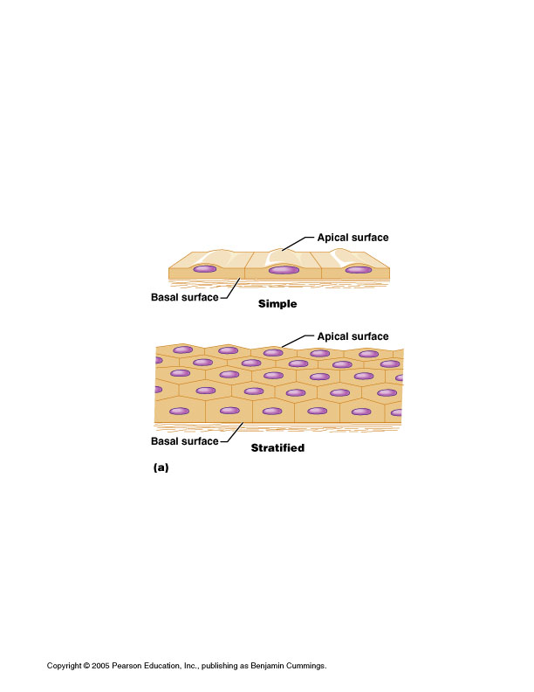
HISTOLOGY
EPITHELIAL TISSUE
Dr. Praveen Kumar Kurrey
M.B.B.S., M.S., B.C.M.E., B.C.B.R.
Associate Professor
Pt. J.N.M. Medical college

Slide 2
EPITHELIUM
DEFINITION
Basic tissue of the body.
A sheet of cells (single / multiple layer) that covers
the external & internal body surface.
DESCRIPTION
Serves as barrier membrane separating underlying tissue
from various external & internal environment.
Free surface- exposed to body cavity, lumen of internal organ
or external surface of body.
Basal surface- adheres to a thin supporting layer
also called basement membrane.
Basement membrane is made up of-
1. Basal lamina- product of epithelium.
2. Reticular lamina- product of connective tissue.

Slide 3
CLASSIFICATION OF EPITHELIAL TISSUE
Surface epithelium Glandular epithelium
Neuroepithelium Myoepithelium
Surface epithelium is again classified as follows-
  Simple-1-Squamous
  2-Cuboidal
  3-Columnar- Ciliated & Non ciliated
  (B) Stratified-
  1-Squamous- Keratinized & Nonkeratinized
  2-Cuboidal
  3-Columnar- Ciliated & Non ciliated
  (C) Pseudo stratified-
  Columnar-Ciliated & Non ciliated
  (D) Tansitional

Slide 4
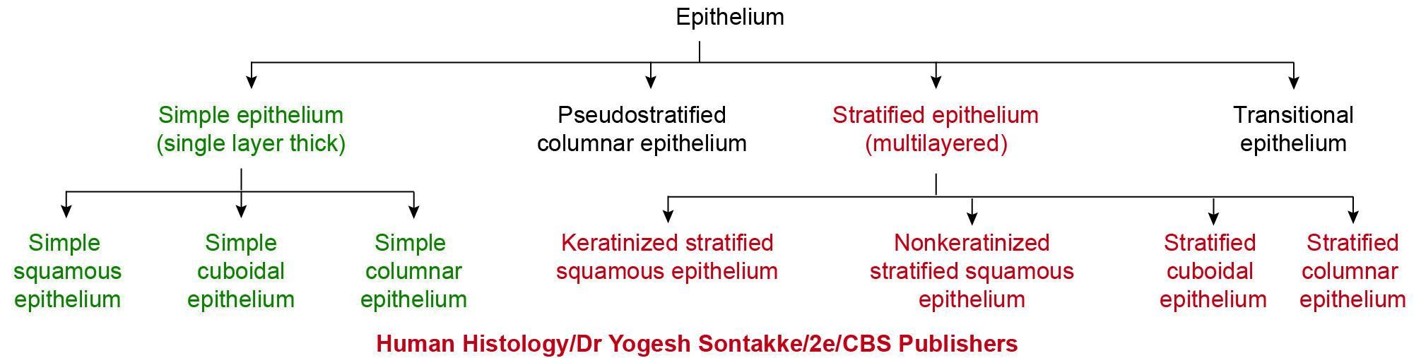
Classification of epithelium

Slide 5
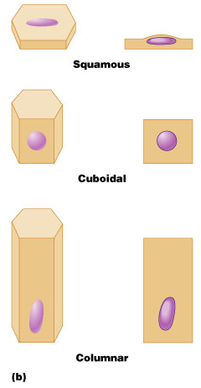
Classifications

Slide 6
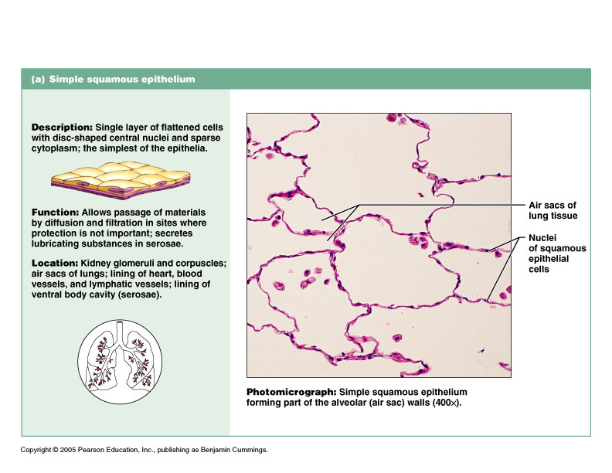
Simple Squamous Epithelium

Slide 7
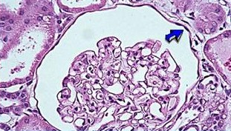
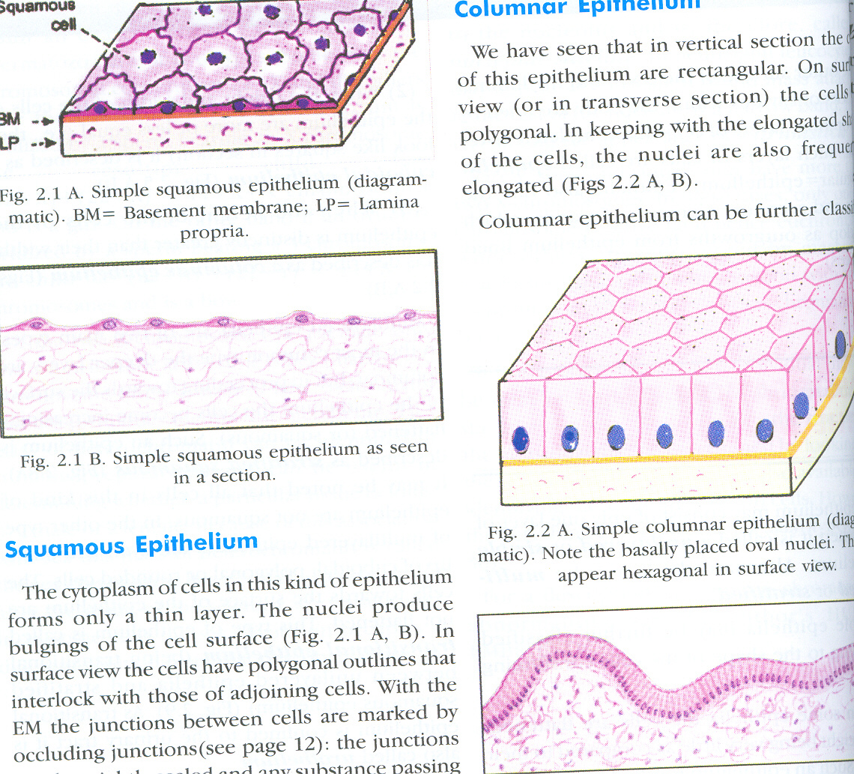
SIMPLE SQUAMOUS EPITHELIUM

Slide 8
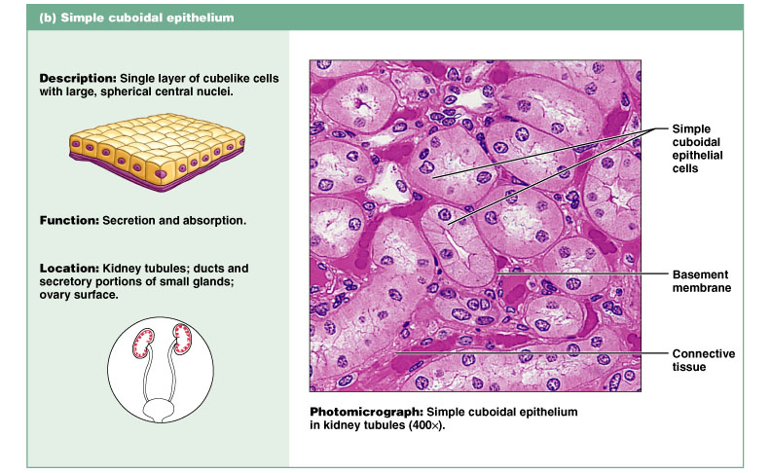
Simple Cuboidal Epithelium
Figure 4.3b

Slide 9
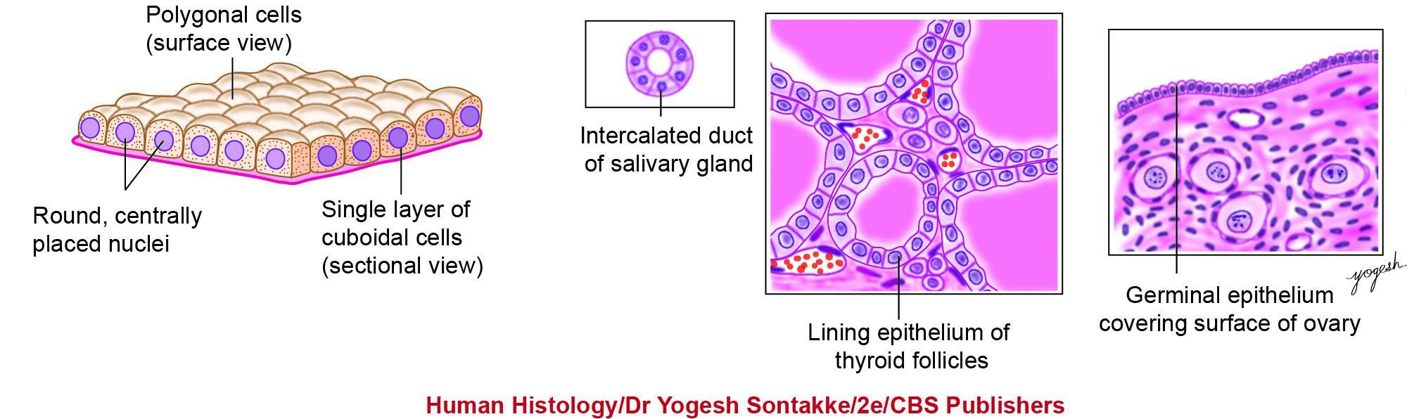
Fig. 4.4: Simple cuboidal epithelium (with practice figure)

Slide 10
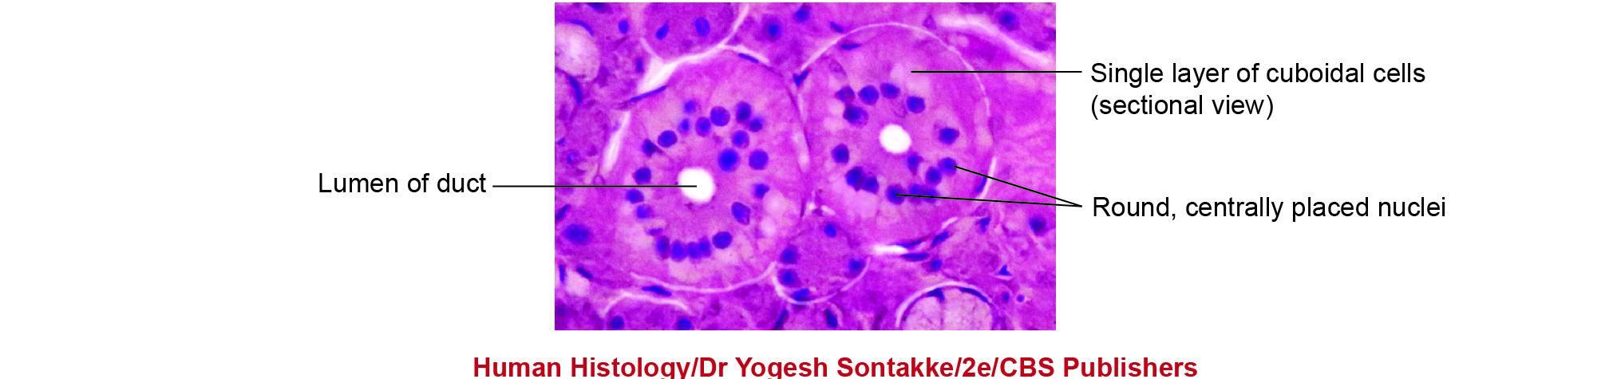
Fig. 4.5: Photomicrograph. Simple cuboidal epithelium (ducts in salivary gland, H&E stain, high magnification).

Slide 11
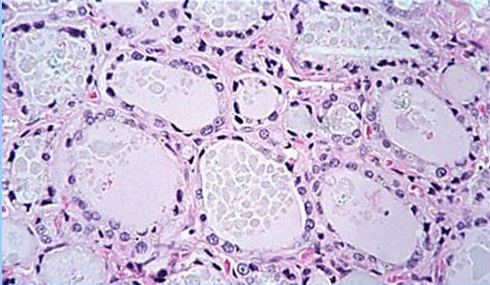
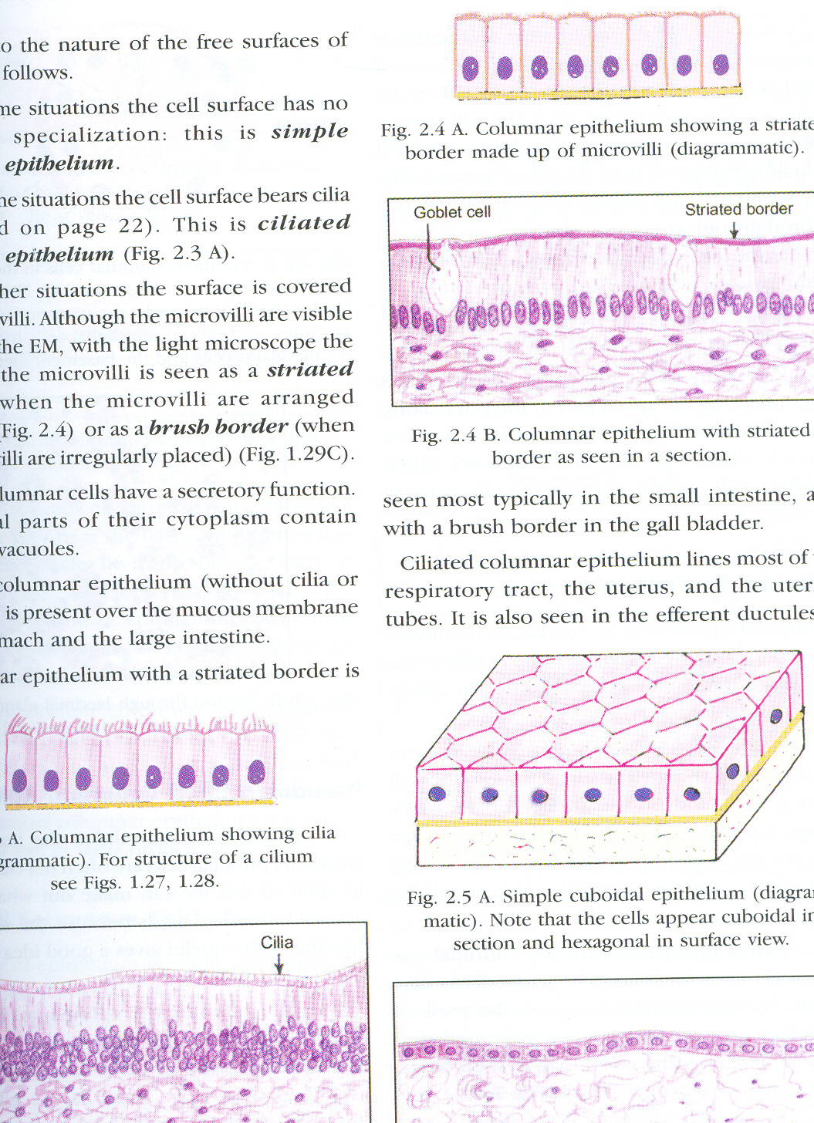
SIMPLE CUBOIDAL EPITHELIUM

Slide 12
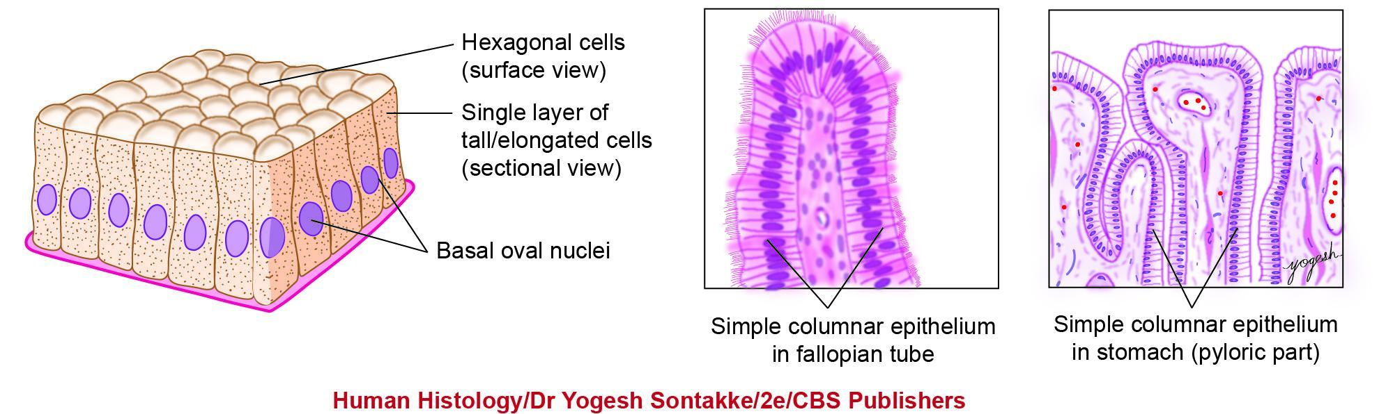
Fig. 4.6: Simple columnar epithelium (with practice figures)

Slide 13
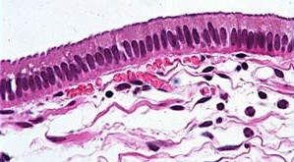
COLUMNAR EPITHELIUM
Striated border

Slide 14
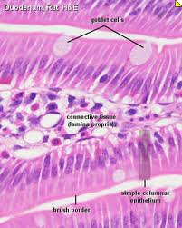
Simple columnar epithelium

Slide 15
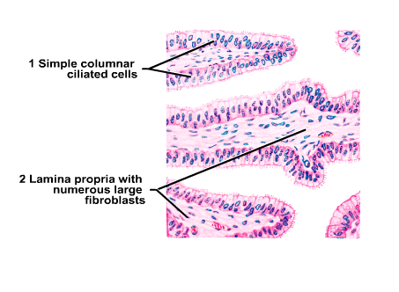
CILIATED COLOUMNAR EPITHELIUM

Slide 16
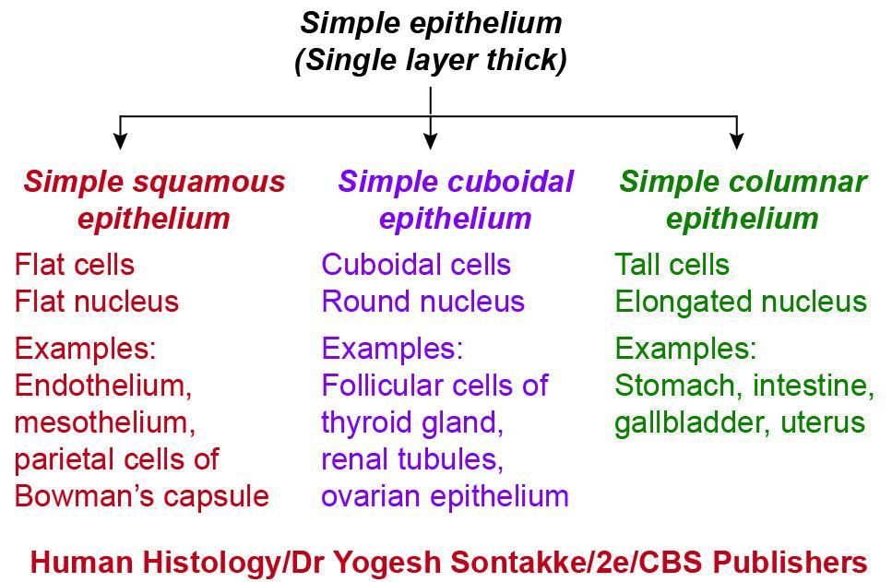
Simple epithelium

Slide 17
Stratified squamous epithelium
Description- Cells are arranged in many layers. Superficial layer consists of squamous cells. Intermediate layer consists of irregularly polyhedral cells. Basal layer consists of columnar or cuboidal cells.
1- Keratinised- Superficial cells become dead, non nucleated, like scales & seen as eosinophilic fibrillar strands.
2- Non keratinised- Superficial cells remain moist, living & nuclei can be seen.
Location- Both types are found on those surface of body that are subject to friction.
1- Keratinised- Epidermis.
2- Non keratinised- Cornea, oral cavity, tongue, epiglottis, pharynx, oesophagus, vagina, anal canal.

Slide 18
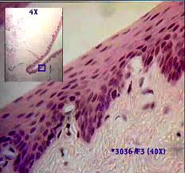
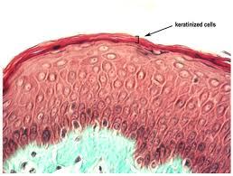
Fuction-( Keratinised & non keratinised)
Protection of deeper structure.
keratin prevents dehydration of underlying tissue. It prevents absorption of water.
Stratified squamous epithelium:
Non keratinised Keratinised

Slide 19
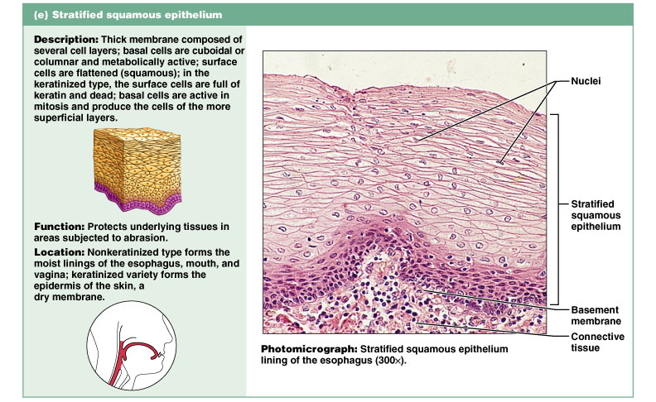
Stratified Squamous Epithelium
Figure 4.3e

Slide 20
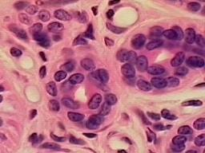
Stratified cuboidal epithelium
Description- cells of superficial layer are cuboidal in shape.
Location- Ducts of sweat glands, ovarian follicles.
Function- Protection (provides passage to the secretions & acts as a barrier).
Stratified cuboidal epithelium
Description- cells of superficial layer are cuboidal in shape.
Location- Ducts of sweat glands, ovarian follicles.
Function- Protection (provides passage to the secretions & acts as a barrier).

Slide 21
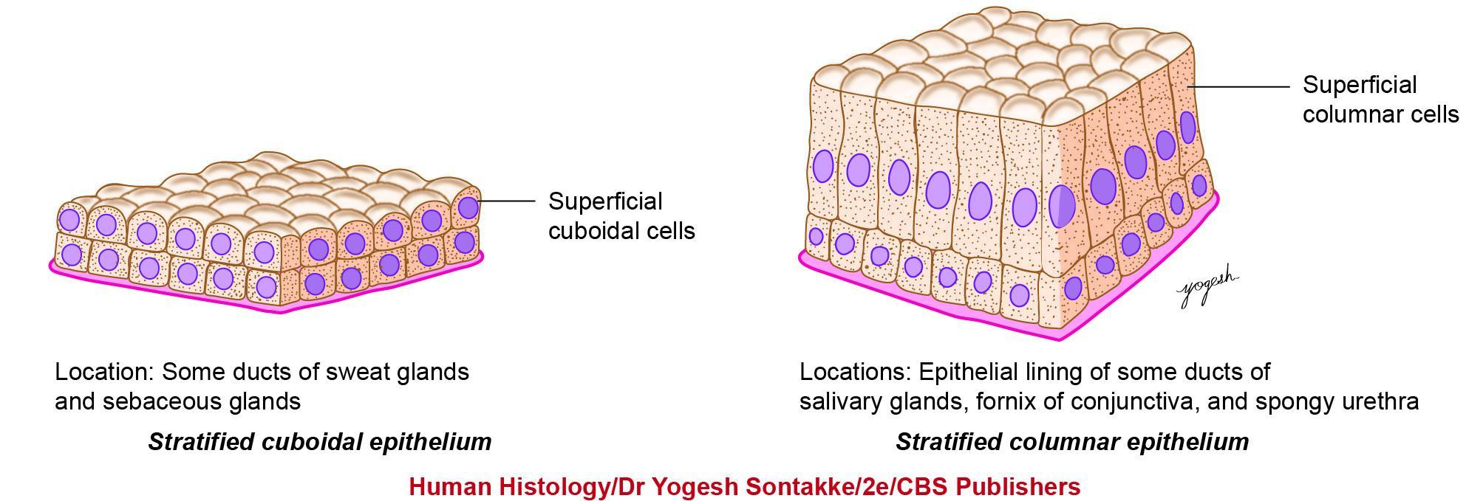
Fig. 4.12: Stratified cuboidal and columnar epithelium

Slide 22
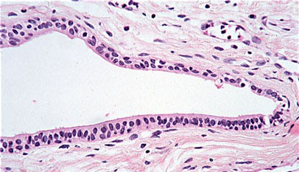
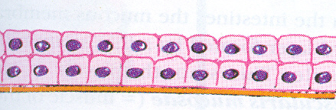
STRATIFIED CUBOIDAL EPITHELIUM

Slide 23
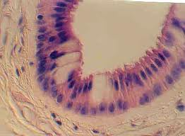
Stratified columnar epithelium
Description- cells of superficial layer are columnar in shape.
Location- Fornix of conjunctiva,
ducts of some glands,
cavernous urethra.
Function- Protection( provides passage to the secretion & acts as a barrier).

Slide 24
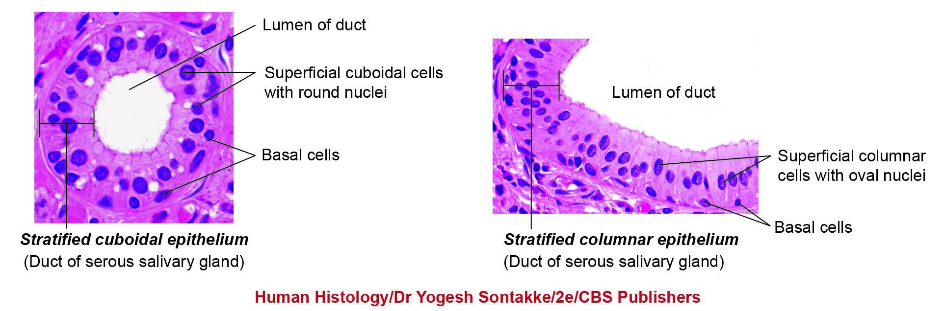
Fig. 4.13: Photomicrograph. Stratified cuboidal and columnar epithelium.

Slide 25
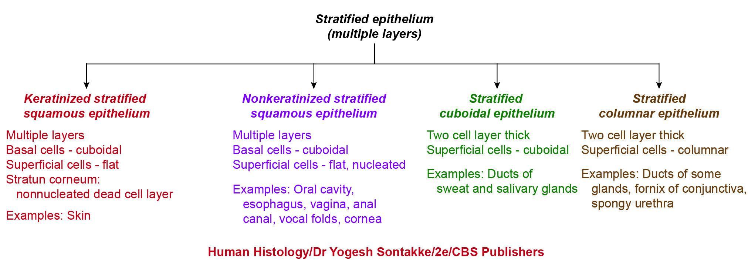
Flowchart 4.3: Stratified epithelium

Slide 26
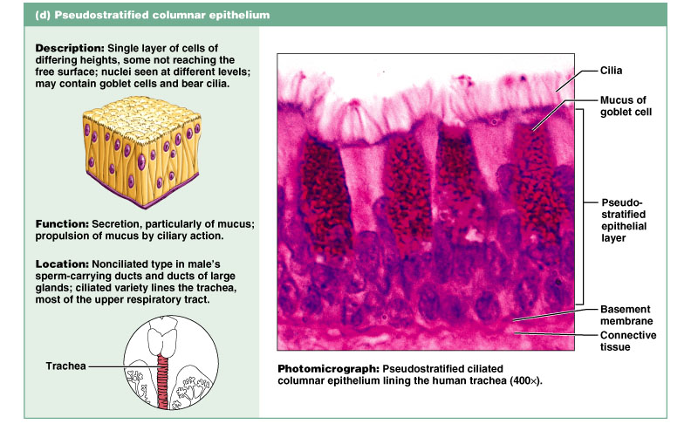
Pseudostratified Ciliated Columnar Epithelium
Figure 4.3d

Slide 27
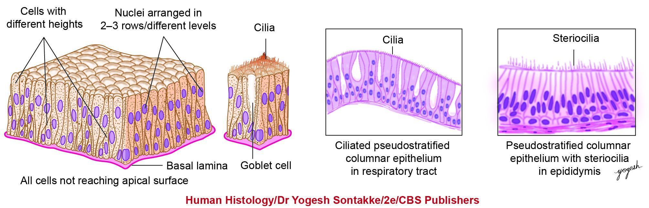
Fig. 4.8: Pseudostratified columnar epithelium (with practice figures)

Slide 28
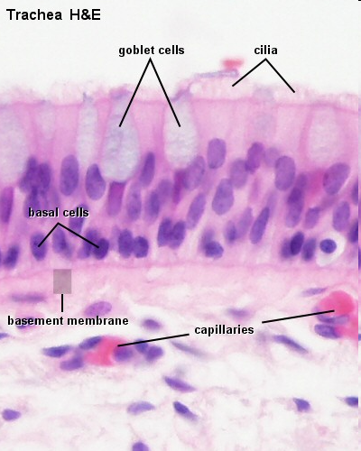
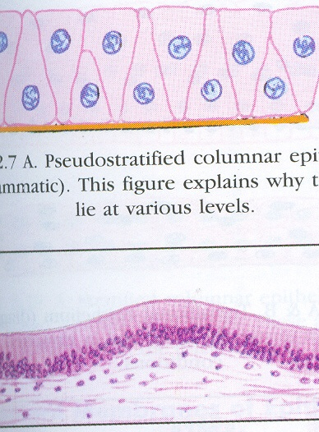
PSEUDOSTRATIFIED COLUMNAR
NON-CILIATED
PSEUDOSTRATIFIED COLUMNAR CILIATED

Slide 29
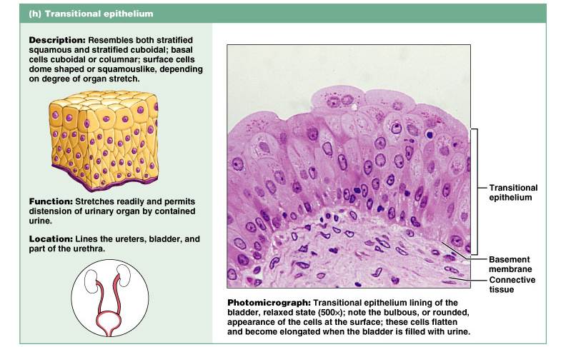
Transitional Epithelium
Figure 4.3h

Slide 30
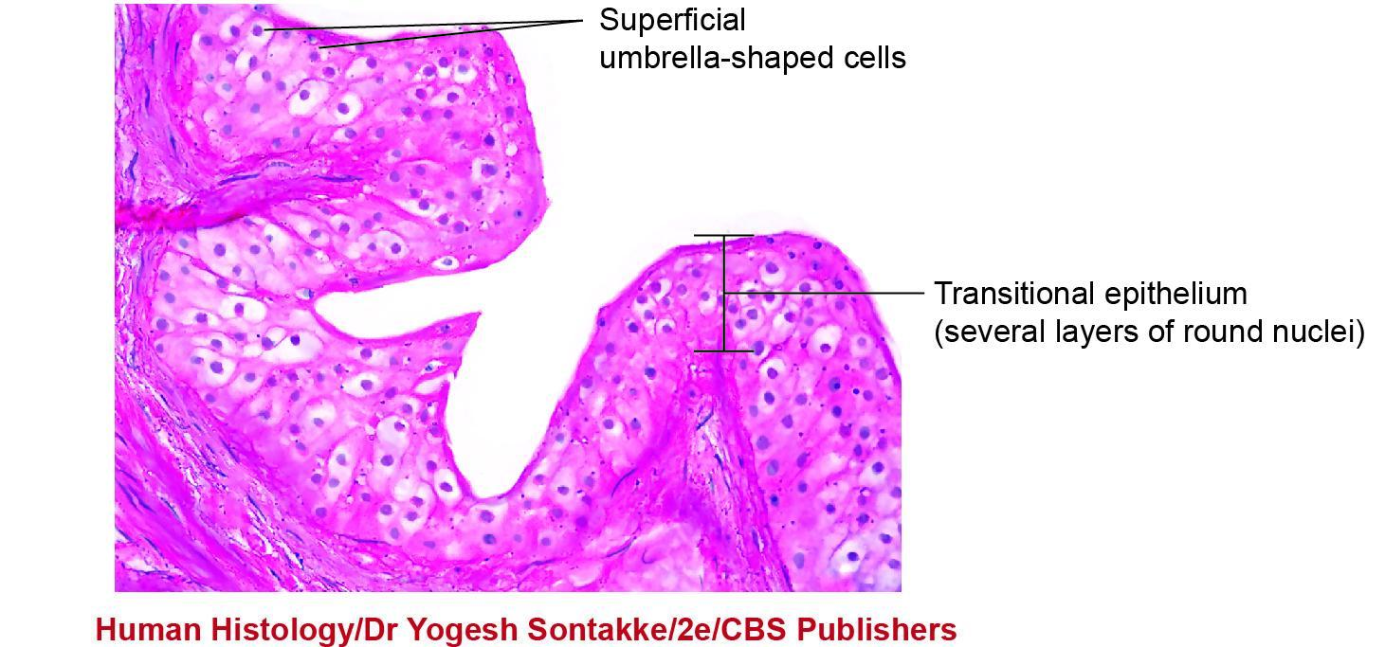
Transitional epithelium/urothelium from ureter (ureter, high magnification)

Slide 31
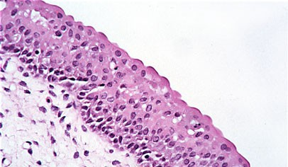
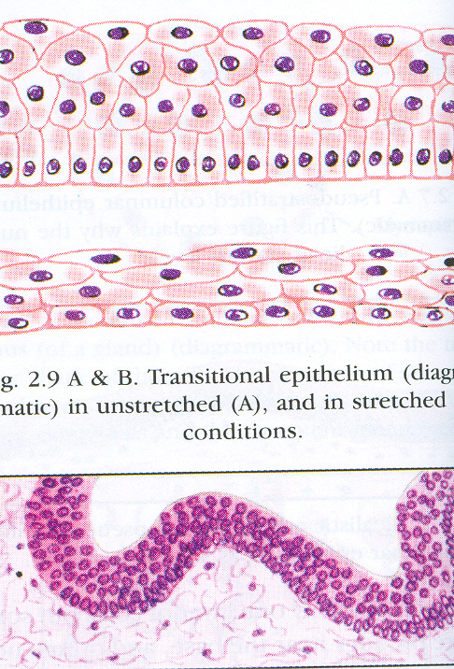
TRANSITIONAL EPITHELIUM

Slide 32
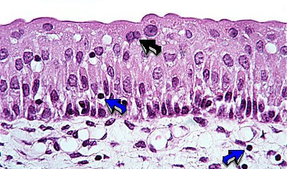
TRANSITIONAL EPITHELIUM

Slide 33
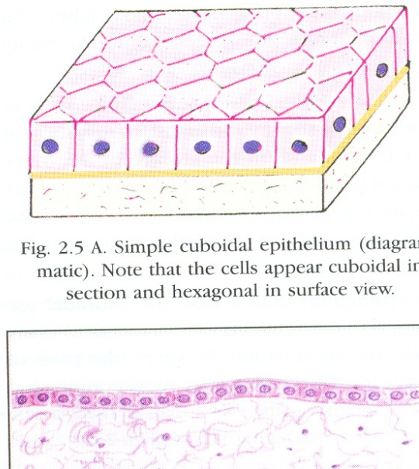
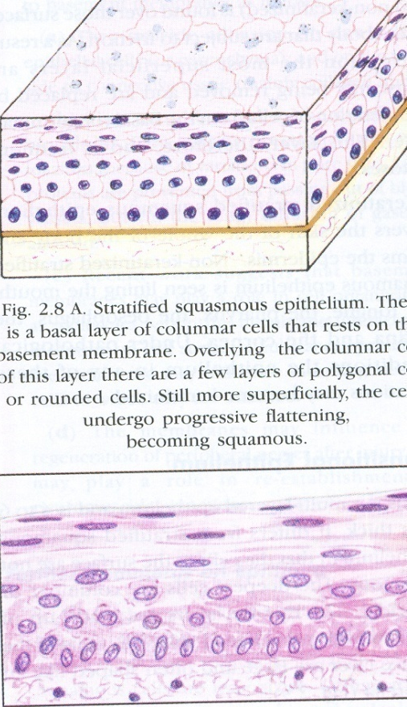
STRIATED COL EPI
SQUAMOUS
CUBOIDAL
PSEUDO STR
CILIATED COL
PSEUDOSTRA CILIATED
STA SQ NON KER
GOBLET
EPITHILIUM
TRANSITIONAL

Slide 34

THANK YOU

