Slide 1
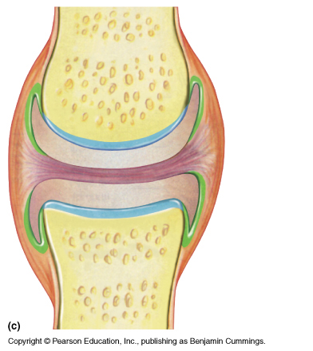
THE JOINTS
DR. PRAVEEN KURREY
M.B.B.S., M.S.
ASSOCIATE PROFESSOR
PT.JNMMC RAIPUR

Slide 2
Sprains
Dislocations
Fractures
Arthritis
Joint Replacement Surgeries

Slide 3
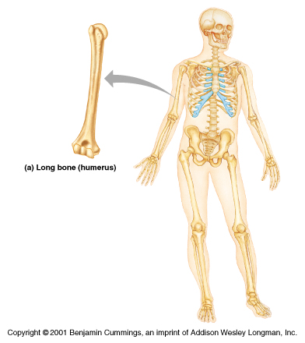

Slide 4
JOINTS
Rigid elements of skeleton meet at joints or articulations
Greek root “arthro” means joint
Articulations can be:
  Bone to bone
  Bone to cartilage
  Teeth in bony sockets
Functions
  Give skeleton mobility
  Hold skeleton together

Slide 5
JOINTS: CLASSIFICATIONS
Functional classification: Based on amount of movement
  Synarthroses: Immovable – common in skull skeleton
  Amphiarthroses: Slightly movable – common in axial skeleton
  Diarthroses: Freely movable – common in appendicular skeleton

Slide 6
JOINTS: CLASSIFICATIONS
REGIONAL: on the basis of location
  Skull type – Immovable
  Vertebral type – Slightly movable
  Limb type – Freely movable

Slide 7
JOINTS: CLASSIFICATIONS
Structural classification based on:
  Material that binds bones together
  Presence or absence of a joint cavity
  Structural classifications include
    Fibrous
    Cartilaginous
    Synovial

Slide 8
JOINTS: CLASSIFICATIONS
Fibrous Cartilaginous Synovial
Fixed Slightly movable Freely movable
(Synarthroses) (Amphiarthroses) (Diarthroses)
Types Types Types
Sutures Pri.cart. joints Plane
Plane (Synchondroses) Hinge (Ginglymi)
Squamous Pivot (Trochoid)
Limbous Sec.cart. Joints Bicondylar
Serrate (Syndesmoses) Ellipsoid
Dentate Saddle (Sellar)
Gomphosis Ball & socket
Syndesmosis
Schindylesis

Slide 9
FIBROUS JOINTS
Bones are connected by fibrous connective tissue
Do not have a joint cavity
Immovable or slightly movable
Types –
  Sutures
  Syndesmoses
  Gomphoses

Slide 10
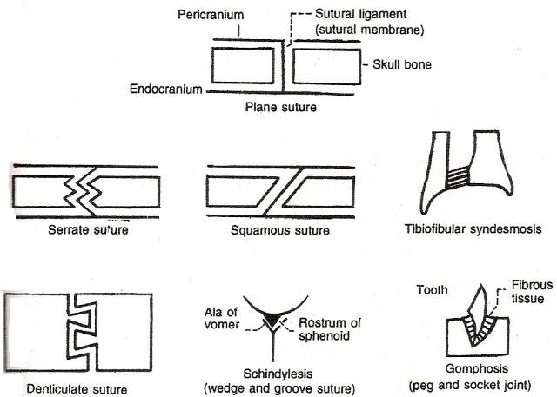
FIBROUS JOINTS

Slide 11
SUTURES
Bones are tightly bound by minimal amount of fibrous tissue
Only occur between bones of skull
Allow bone growth - skull can expand with brain during childhood
Fibrous tissue ossifies in middle age
  Synostoses – closed sutures

Slide 12
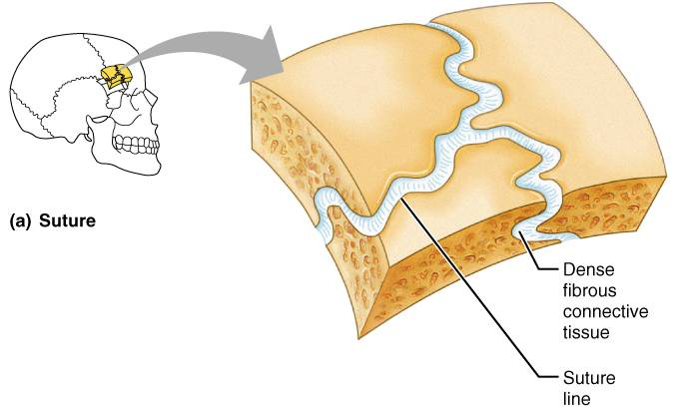
SUTURES

Slide 13
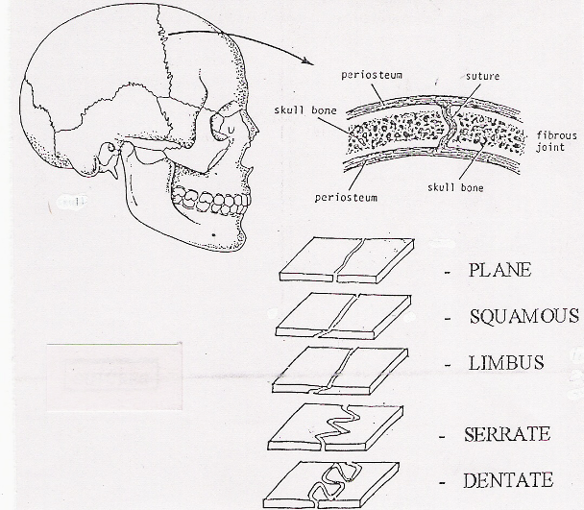
SUTURES

Slide 14
FIBROUS JOINTS

Slide 15
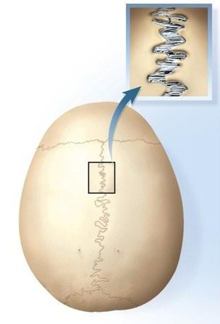
Fibrous Joints - sutures

Slide 16
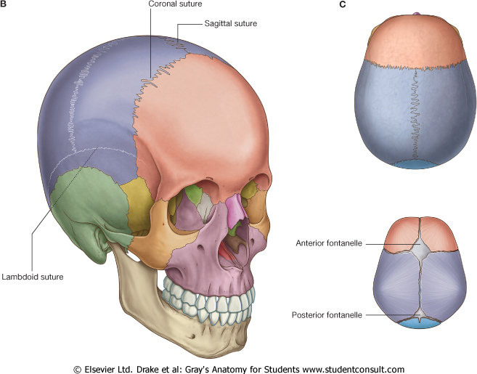

Slide 17
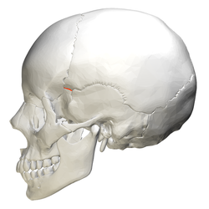
Fibrous Joints - sutures

Slide 18
SYNDESMOSES
Bones are connected exclusively by ligaments
Amount of movement depends on length of fibers
  Tibiofibular joint: immovable( Synarthrosis)
  Interosseous membrane between radius & ulna: freely movable (Diarthroses)

Slide 19
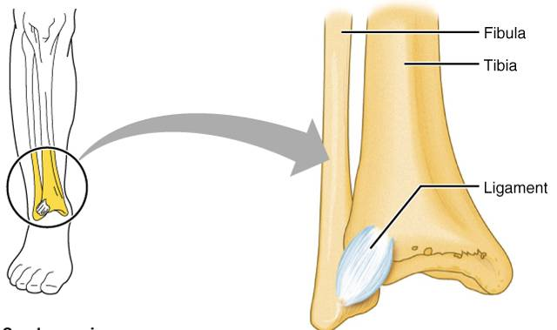
SYNDESMOSIS

Slide 20
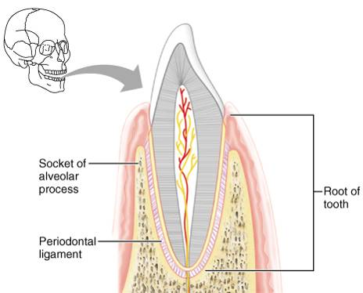
GOMPHOSES
Tooth in a socket
Connecting ligament
  Periodontal ligament

Slide 21
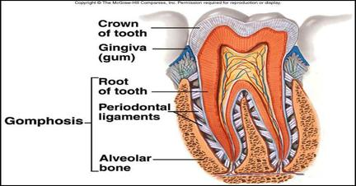
Fibrous Joints - gomphosis

Slide 22
CARTILAGINOUS JOINTS
Bones are united by cartilage
Lack a joint cavity
Two types
  Synchondrosis
  Symphysis

Slide 23
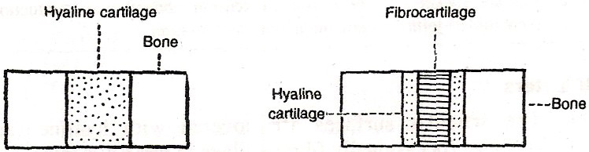
CARTILAGINOUS JOINTS
Primary cartilaginous joint
Secondary cartilaginous joint

Slide 24
Primary cartilagenous joints
Synchondroses
A bar or plate of hyaline cartilage unites bones
Examples include:
  Epiphyseal plates in children
  Joint between costal cartilage of first rib & sternum

Slide 25
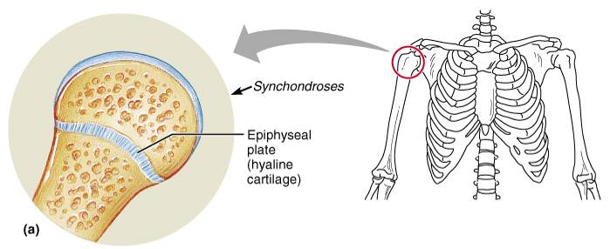
SYNCHONDROSES
Hyaline cartilage unites bones
  Epiphyseal plates

Slide 26
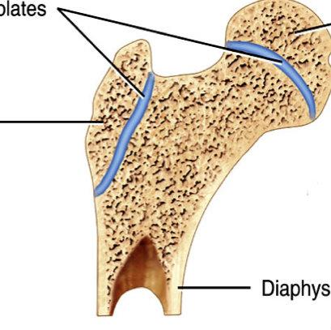
Primary Cartilaginous Joints

Slide 27
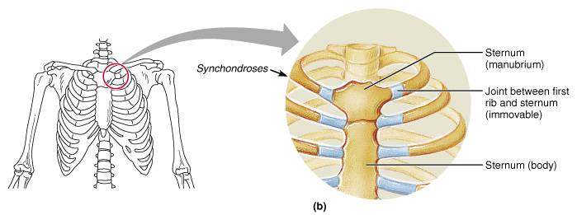
SYNCHONDROSES
  Joint between first rib & manubrium

Slide 28
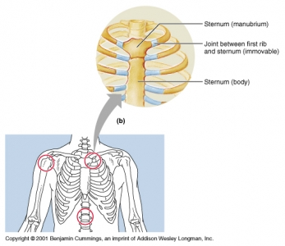
Primary Cartilaginous Joints

Slide 29
SEC CARTILAGINOUS JOINTS: SYMPHYSES
Fibrocartilage unites bones – Resists tension & compression
Slightly movable joints - Provide strength with flexibility
  Intervertebral discs
  Pubic symphysis

Slide 30
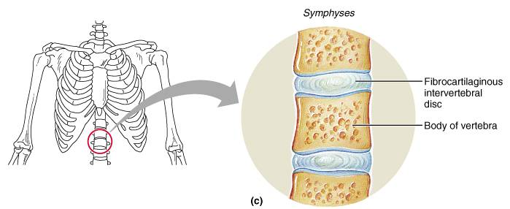
SYMPHYSES

Slide 31
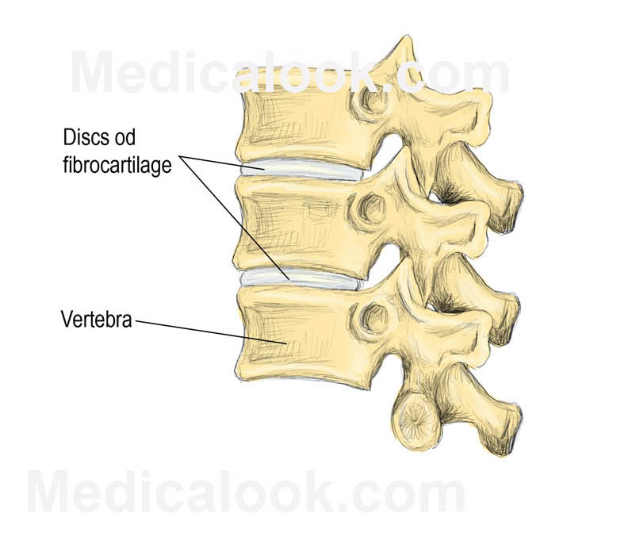
Secondary Cartilaginous Joints

Slide 32
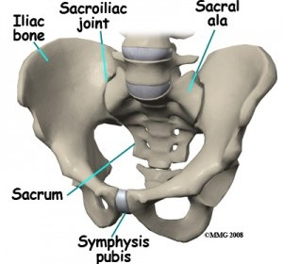
Secondary Cartilaginous Joints

Slide 33
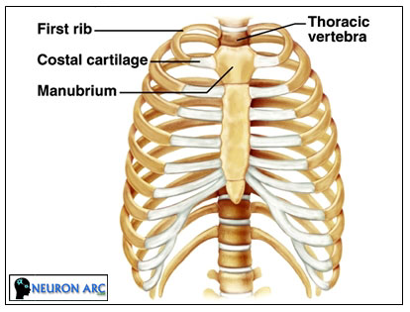
Secondary Cartilaginous Joints

Slide 34
Clinical Application
Joint Disorders
Sprains
  damage to cartilage, ligaments, or tendons associated with joints
  forceful twisting of joint
Bursitis
  inflammation of a bursa
  overuse of a joint
Arthritis
  inflamed, swollen, painful joints
    Rheumatoid Arthritis
    Osteoarthritis
    Gout

Slide 35
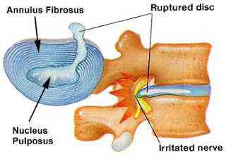
Clinical Anatomy
1. Disc Prolaps

Slide 36
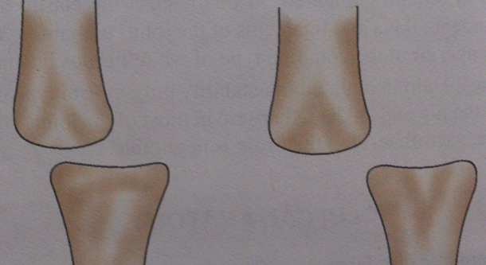
Subluxation / Dislocation

Slide 37
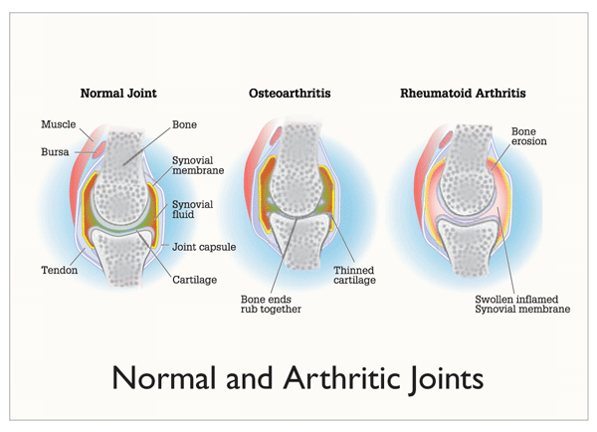

Slide 38
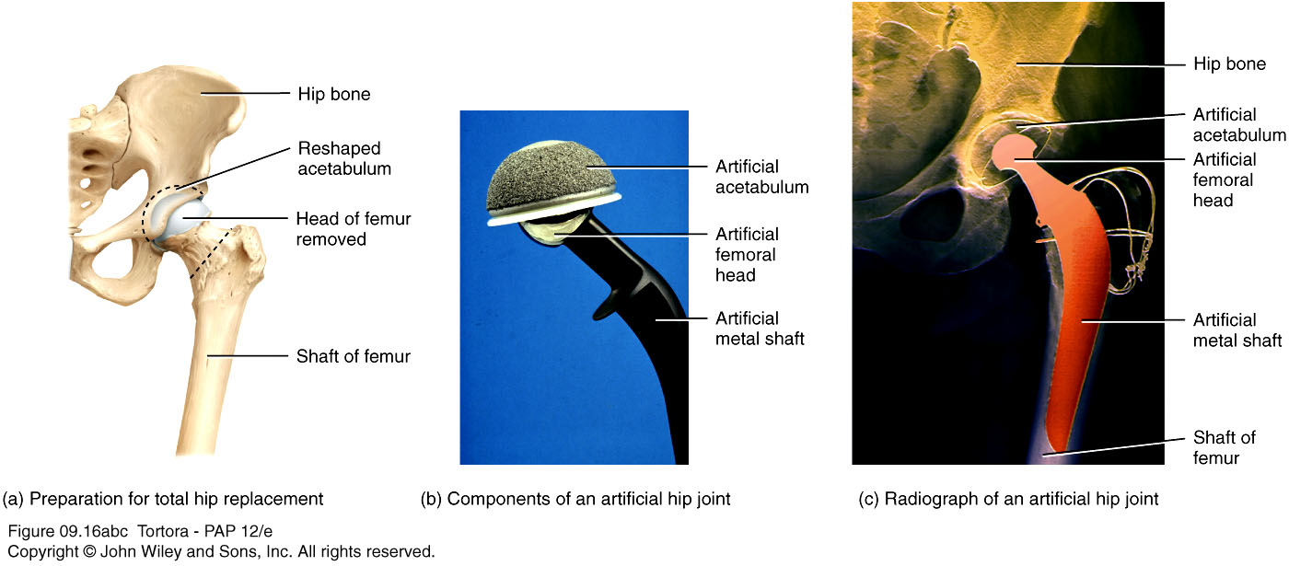
Joints (Arthroplasty)

Slide 39
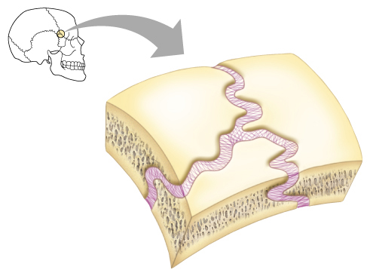
THANK TOU

Slide 40
SYNOVIAL JOINTS
Most movable joints
Are diarthroses
Contains a fluid-filled joint cavity
Simple: have just two articulating surfaces
Compound: more than two articulating surfaces
  Examples: Elbow
Complex Joints : Intra-articular discs/Menisci - Knee

Slide 41
SYNOVIAL JOINTS: GENERAL STRUCTURE
Articular cartilage
  Ends of opposing bones are covered with hyaline cartilage
  Absorbs compression
Joint cavity (synovial cavity)
  Unique to synovial joints
  Cavity is potential space; contains small amount of fluid

Slide 42
SYNOVIAL JOINTS: GENERAL STRUCTURE
Articular capsule: Joint cavity is enclosed in a two-layered capsule
  Fibrous capsule: Made of Dense CT
    strengthens joint
  Synovial membrane – Important membrane
    Lines joint capsule & covers internal joint surfaces
    Function: produces synovial fluid

Slide 43
SYNOVIAL JOINTS: GENERAL STRUCTURE
Synovial fluid
  Viscous fluid similar to raw egg white
    A filtrate of blood
      Arises from capillaries in synovial membrane
    Contains glycoprotein molecules secreted by fibroblasts

Slide 44
SYNOVIAL JOINTS: GENERAL STRUCTURE
Reinforcing ligaments
  Often are thickened parts of fibrous capsule
  extracapsular ligaments- located outside capsule
  intracapsular ligaments - located within capsule

Slide 45
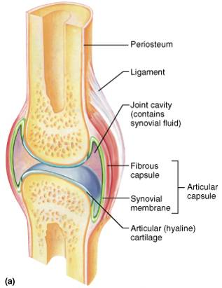
TYPICAL SYNOVIAL JOINT

Slide 46
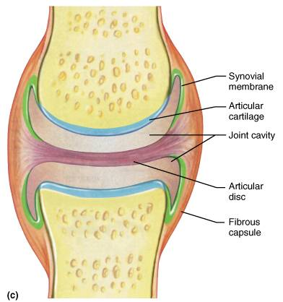
SYNOVIAL JOINTSL: ARTICULAR DISCS
Some synovial joints contain articular disc
  TM joint & knee joint
Occur in joints whose articulating bones have somewhat different shapes

Slide 47
BURSAE & TENDON SHEATHS
Bursae & tendon sheaths are
  Closed bags of lubricant
  Reduce friction between body elements
Bursa: flattened fibrous sac lined by synovial membrane
Tendon sheath: elongated bursa that wraps around a tendon

Slide 48
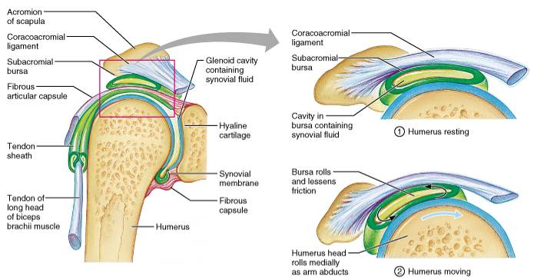
BURSAE & TENDON SHEATHS

Slide 49
SYNOVIAL JOINT: STABILITY
Muscles
Most important & indispensable factor
Tone of different groups of muscles acting on the joint
Ligaments
Important in stability & preventing any over movement
Guard against sudden excessive accidental movement
Not helpful against constant stress - once stretched; tend to remain in elongated position
Bones
Important especially in firm type/secure type of joint - Hip joint
In other, very little to negligible role to play - Shoulder joint
Gravity
May play a role in stability of joint

Slide 50
SYNOVIAL JOINTS: MOVEMENTS ALLOWED
Three basic movement
  Gliding: One bone across the surface of another
  Angular movement: Movements change angle between bones
  Rotation: Movement around a bone's long axis

Slide 51
SYNOVIAL JOINTS:
RANGE OF MOTION
Nonaxial- Slipping movements only
Uniaxial- Movement in one plane
Biaxial- Movement in two planes
Multiaxial- Movement in or around all three planes

Slide 52
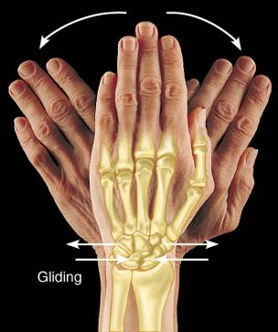
GLIDING JOINTS
Flat surfaces of two bones slip across each other
Gliding occurs between
  Carpals
  Articular processes of vertebrae
  Tarsals

Slide 53
ANGULAR MOVEMENT
Flexion
Extension
Abduction
Adduction
Circumduction

Slide 54
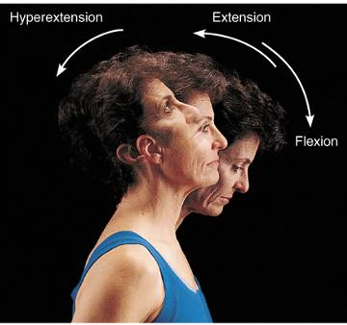
ANGULAR MOVEMENTS
Increase or decrease angle between bones
Movements involve:
  Flexion & extension
  Abduction & adduction
  Circumduction

Slide 55
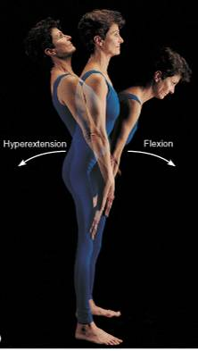
ANGULAR MOVEMENTS

Slide 56
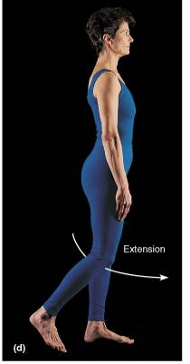
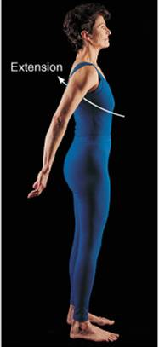
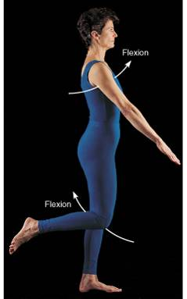
ANGULAR MOVEMENTS

Slide 57
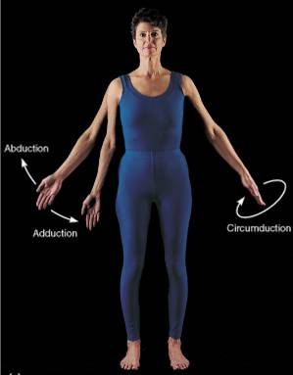
ANGULAR MOVEMENTS

Slide 58
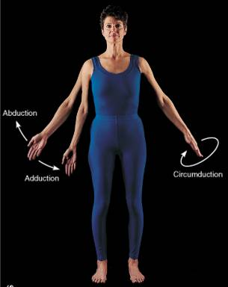
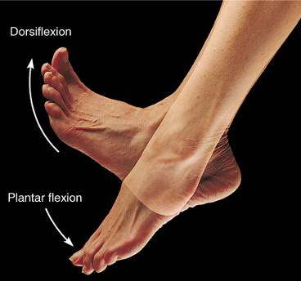
ANGULAR MOVEMENT

Slide 59
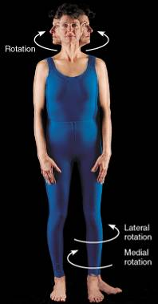
ROTATION
Turning of a bone around its own long axis
Examples:
  Between C-1 & C-2 vertebrae
  Hip & shoulder joints

Slide 60
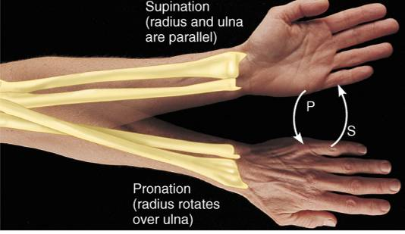
SPECIAL MOVEMENTS
Supination: Forearm rotates laterally; palm faces superiorly
Pronation: Forearm rotates medially; palm faces inferiorly

Slide 61
SPECIAL MOVEMENTS
Dorsiflexion: Lifting the foot so its dorsal surface approaches shin
Plantarflexion: Depressing the foot; pointing the toes

Slide 62
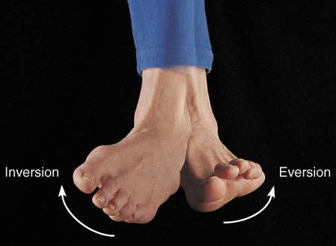
SPECIAL MOVEMENTS
Inversion: Turning the sole medially
Eversion: Turning the sole laterally

Slide 63
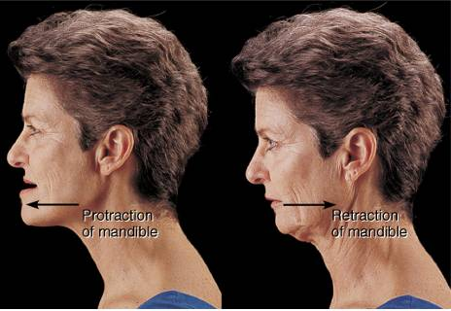
SPECIAL MOVEMENTS
Protraction Nonangular movement of jutting out the jaw
Retraction
Opposite movement to protraction

Slide 64
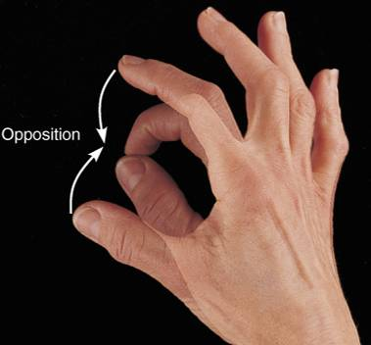
SPECIAL MOVEMENTS
Opposition: Movement of thumb to touch the tips of other fingers

Slide 65
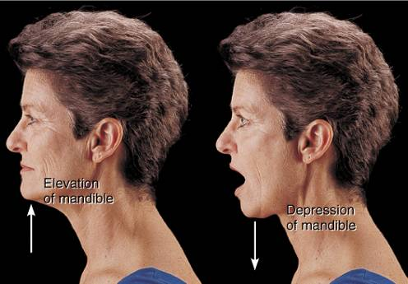
SPECIAL MOVEMENTS
Elevation
Lifting a body superiorly
Depression –
Moving the elevated part inferiorly

Slide 66
SYNOVIAL JOINTS : SHAPE
Plane joint
  Articular surfaces are flat planes
  Short gliding movements are allowed
  No axis for movements
  Gliding does not involve rotation around any axis
    Intertarsal joints
    intercarpal joints

Slide 67
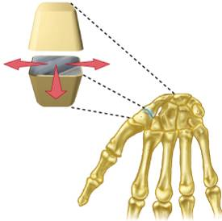
PLANE JOINT
    Intercarpal joints

Slide 68
SYNOVIAL JOINTS : SHAPE
Hinge joints
  Cylindrical end of one bone fits into a trough on another bone
  Angular movement allowed in one plane
  Movement is uniaxial – Allows movement around one axis only
    Elbow Joint
    Ankle Joint
    Joints between phalanges

Slide 69
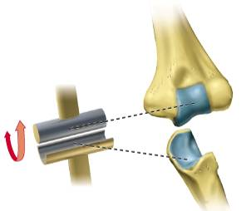
HINGE JOINT
Elbow Joint

Slide 70
SYNOVIAL JOINTS : SHAPE
Pivot joints
  Uniaxial- Rotating bone only turns around its long axis
  Examples
    Superior & Inferior radioulnar joint
    Joint between atlas & axis

Slide 71
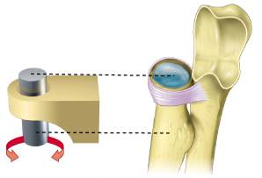
PIVOT JOINT
    Superior radioulnar joint

Slide 72
SYNOVIAL JOINTS: SHAPE
Condyloid joints
  Allow moving bone to travel:
    Side to side – Abduction & adduction
    Back & forth – Flexion & extension
Biaxial: Movement occurs around two axes
    Metacarpophalangeal joint

Slide 73
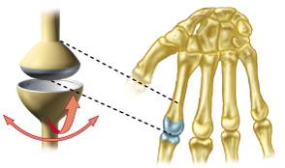
CONDYLOID JOINT
  Metacarpophalangeal joint

Slide 74
SYNOVIAL JOINTS : SHAPE
Saddle joints
  Each articular surface has concave & convex surfaces
  Biaxial joints
    First carpometacarpal joint (Thumb joint)

Slide 75
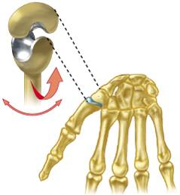
SADDLE JOINT
  First carpometacarpal joint (Thumb joint)

Slide 76
SYNOVIAL JOINTS : SHAPE
Ball & socket joints
  Spherical head of one bone fits into round socket of another
  Multiaxial: Allow movement in all three axes
    Shoulder joint
    Hip joint

Slide 77
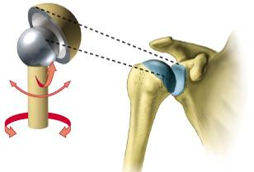
BALL & SOCKET JOINT
    Shoulder joint

Slide 78
BLOOD SUPPLY
Periarticular plexus - articular & epiphyseal branches
Branches perforate fibrous capsule - vascular plexus in deeper parts of synovial membrane
BVs of synovial membrane terminate around articular margins in looped anastomoses- circularis vasculosus
  Supplies capsule, synovial membrane & epiphyses
Articular cartilage is avascular
After epiphyseal fusion communication between circulus vasculosus & end arteries of metaphysis is established

Slide 79
NERVE SUPPLY
Capsule & ligaments: Rich nerve supply; sensitive to pain
Synovial membrane: Poor nerve supply
Articular cartilage: Non nervous & insensitive to pain
Articular nerves contain sensory & autonomic fibres
Some sensory fibres are proprioceptive; sensitive to position & movement. Connected to specialised receptors concerned with joint position and stretch. Concerned with reflex control of posture & locomotion.
Other sensory fibres are sensitive to pain
Autonomic fibres: vasomotor or vasosensory

Slide 80
HILTON’S LAW
A motor nerve to muscle acting on joint tends to give a branch to that joint & another branch to skin covering joint
Elucidated by Gardner (1948): Modification
Pattern of innervation is concerned with maintenance of efficient stability at the joint

Slide 81
NEUROPATHIC JOINT
Due to complete dennervation - all reflexes are eliminated
Joint is left unprotected & liable to mechanical damage
Affected joint shows:
    Painless swelling
    Excessive mobility
    Destruction
Caused by:
    Leprosy
    Tabes dorsalis
    Syringomyelia

Slide 82
DISORDERS OF JOINTS
Structure of joints makes them prone to traumatic stress
Function of joints makes them subject to friction & wear
Affected by inflammatory & degenerative processes

Slide 83
SPRAINS
Ligaments reinforcing a joint are stretched or torn
Partially torn ligaments slowly repair themselves
Completely torn ligaments require prompt surgical repair

Slide 84
DISLOCATIONS
Occur when bones are forced out of alignment
Usually accompanied by sprains, inflammation & joint immobilization
Caused by serious falls & are common sports injuries
Subluxation – Partial dislocation of a joint

Slide 85
INFLAMMATORY &
DEGENERATIVE CONDITIONS
BURSITIS
  Inflammation of a bursa, usually caused by a blow or friction
  Symptoms are pain & swelling
  Treated with Anti-inflammatory drugs; Excessive fluid may be aspirated
TENDONITIS
  Inflammation of tendon sheaths typically caused by overuse
  Symptoms & treatment are similar to bursitis

Slide 86
ARTHRITIS
More than 100 different types of inflammatory or degenerative diseases that damage the joints
Most widespread crippling disease
Symptoms – Pain, Stiffness & Swelling of a joint

Slide 87
OSTEOARTHRITIS (OA)
Most common chronic arthritis; “wear-and-tear” arthritis
Affects women more than men
More prevalent in the aged & probably related to normal aging process

Slide 88
OSTEOARTHRITIS: COURSE
Reflects years of abrasion & compression causing increased production of metalloproteinase enzymes that break down cartilage
As one ages, cartilage is destroyed more quickly than it is replaced
Exposed bone ends thicken, enlarge, form bone spurs & restrict movement
Joints most affected: Cervical & lumbar spine, Fingers, Knuckles, Knees & Hips

Slide 89
RHEUMATOID ARTHRITIS
Chronic, inflammatory, autoimmune disease of unknown cause, with an insidious onset

Slide 90
By embryonic week 8- synovial joints resemble adult joints
Few problems occur until late middle age
Advancing years take their toll on joints including:
  Ligaments & tendons shorten & weaken
  Intervertebral discs become more likely to herniate
  OA is inevitable & people of 70 have some degree of OA
Prudent exercise (especially swimming) that coaxes joints through their full range of motion is key to postponing joint problems

Slide 91
THANK TOU

