Slide 1
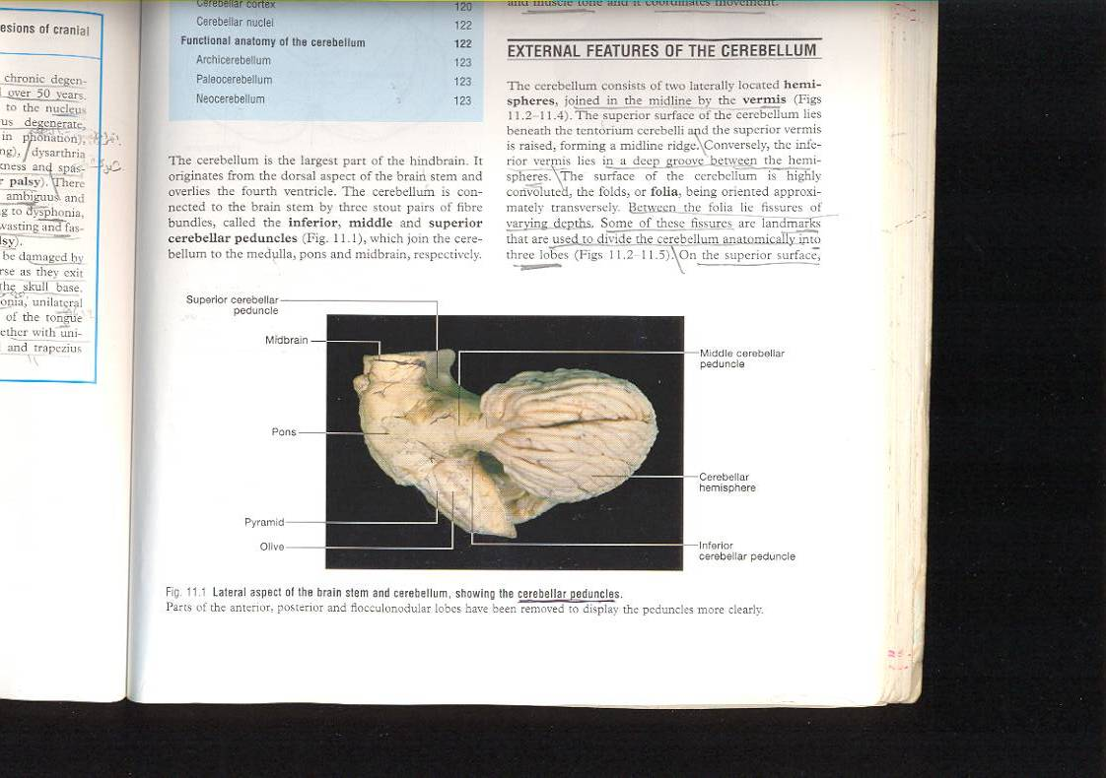
CEREBELLUM ( LECTURE)
DR. PRAVEEN KURREY
MBBS, MS, BCME, BCBR PROFESSOR ANATOMY

Slide 2
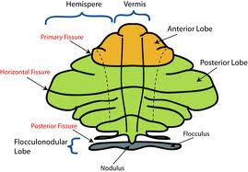

Slide 3
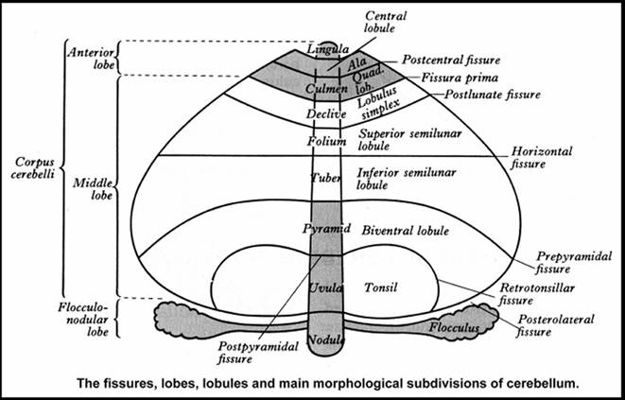
PARTS OF CEREBELLUM

Slide 4
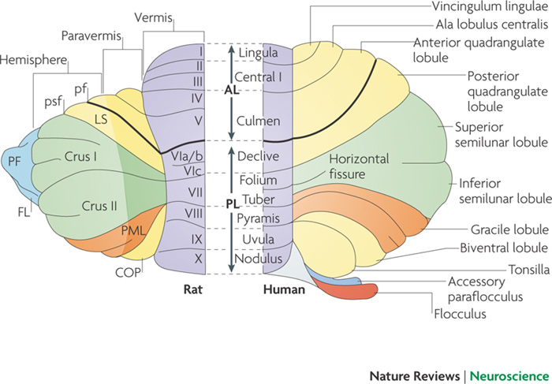

Slide 5
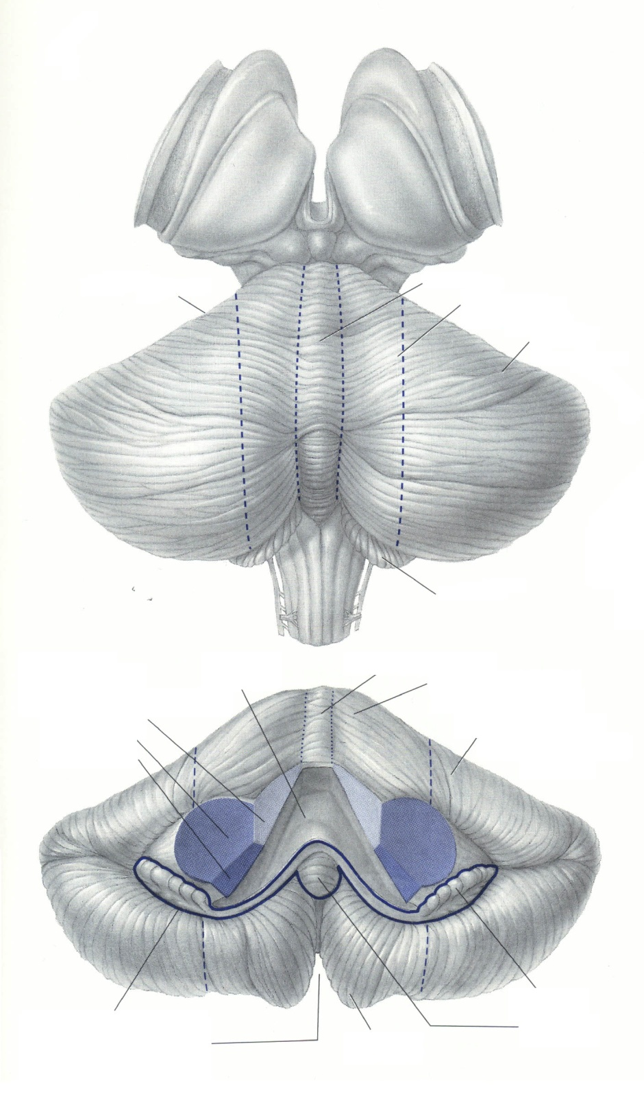
Cerebellar divisions
Spinocerebellum:
Vermis Intermediate hem.
Spinocerebellum
(Vermis + Intermed. Hem)
Cerebrocerebellum:
Lateral hem.
Control of limbs
and trunk
Cerebrocerebellum
(Lateral hemisphere)
Planning of movement+
IVth vent
Vermis
Vestibulo-cerebellum
(Floculo-nodular lobe)
Intermediate hem.
Lateral hem.
Control of eye &
head movements
Balance
Floculo-nodular lobe

Slide 6
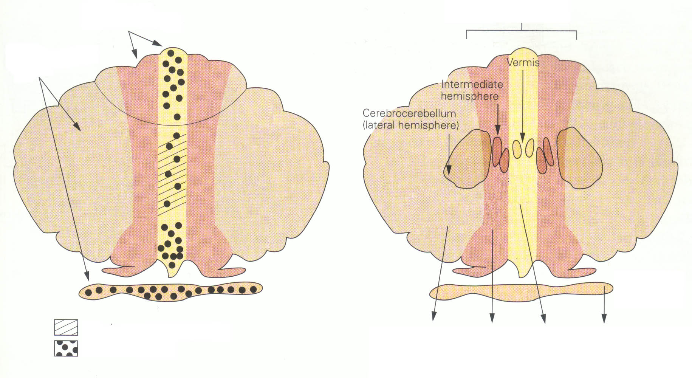

Functional divisions of cerebellar cortex --> Deep nuclei
Spinocerebellum
Vermis
Intermediate hemisphere
Vermis
Spinocerebellum
Cerebrocerebellum Lateral hemisphere
Intermediate hem
Cerebrocerebellum Lateral hemisphere
Dentate
Inter
posed
Fastigial
Vestibulo- cerebellum
Vestibulo- cerebellum
Floculo-nodular lobe
To frontal motor areas
To lateral
sysetms
To medial
sysetms
To vestibular nuclei
Motor
Planning
+++
Motor
execution
Eye mvt &
balance
PNS Fig. 42-3
NTA Fig. 13-1

Slide 7
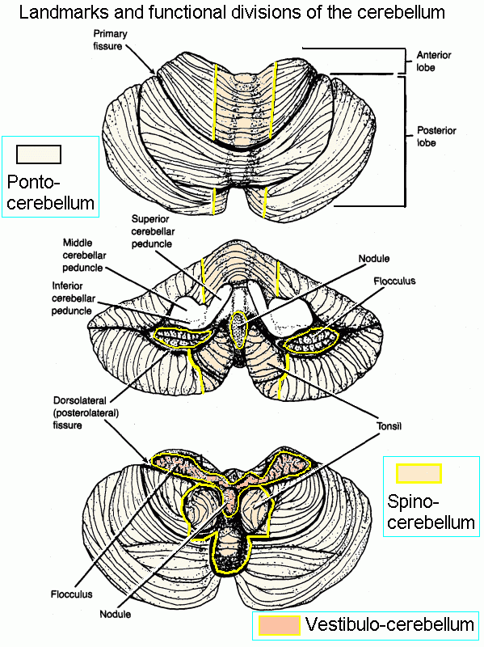

Slide 8
External Features of Cerebellum :
Superior surface : lies beneath tentorium cerebelli and has a raised superior vermis + a large cerebellar hemisphere on each side + primary & horizontal fissures.
1- Primary fissure V-shaped,well defined fissure, lies on superior surface and separates the small anterior lobe from the larger middle lobe (or posterior lobe).
2- Horizontal fissure lies along the sides of cerebellum, extending from anterior notch to posterior notch, separates the superior from the inferior surfaces.
3- Secondary (posterolateral) fissure lies on inferior surface and separates flocculo-nodular lobe from the ramainder of cerebellum.

Slide 9
Functional subdivision of cerebellum :
1- Archi-cerebellum = posterior lobe (Vestibular part) :
_ It is formed of the flocculo-nodular lobe + associated fastigial nuclei, lying on inf. Surface in front of postero-lateral fissure. _Embryologically, it is the oldest part of cerebellum.
_It receives afferent Fs. From vestibular apparatus of internal ear Via vestibulo-cerebellar tracts.
_It is concerned with equlibrium

Slide 10
It represents flocculo-nodular lobe.
It has connections with vestibular & reticular nuclei of brain stem through the inferior cerebellar peduncle.
Afferent vestibular Fs. Pass from vestibular nuclei in pons & medulla to the cortex of ipsilateral flocculo-nodular lobe.
Efferent cortical (purkinje cell) Fs. Project to fastigial nucleus, which projects to vestibular nuclei & reticular formation.
It affects the L.M.system bilaterally via descending vestibulo-spinal & reticulo-spinal tracts.

Slide 11
2- Paleo-cerebellum= (spinal part)
it is formed of midline vermis + surrounding paravermis + globose & emboliform nuclei.
It receives afferent proprio-ceptive impulses from Ms.& tendons Via spino-cerebellar tracts (dorsal & ventral) mainly.
-it sends efferents to red nucleus of midbrain.
-it is concerned with muscle tone

Slide 12
It is concerned with muscle tone & posture.
Afferents spinal Fs. consist of dorsal & ventral spino-cerebellar tract from muscle, joint & cutaneous receptors to enter the cortex of ipsilateral vermis & para vermis Via inferior & superior cerebellar peduncles .
Efferents cortical fibres pass to globose & emboliform nuclei, then Via sup. C. peduncle to contra-lateral red nucleus of midbrain to give rise descending rubro-spinal tract.

Slide 13
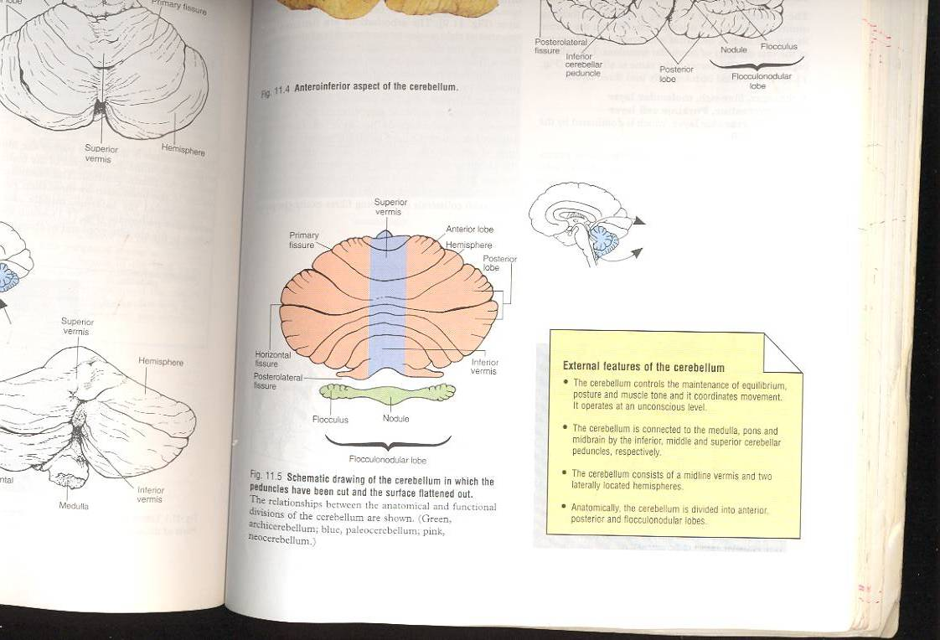
3- Neo-cerebellum= (cerebral part) : _It is the remaining largest part of cerebellum. _It includes the most 2-cerebellar hemispheres + dendate nuclei. _It receives afferent impulses from the cerebral cortex+pons Via cerebro-ponto- cerebellar pathway. -it sends efferents to V.L.nucleus of thalamus. -it controls voluntary movements (muscle coordination).
Schematic drawing of cerebellum showing the relationships between the anatomical & functional divisions of cerebellum.
Green =archi-cerebellum, blue=paleo-cerebellum. Pink= neo-cerebellum

Slide 14
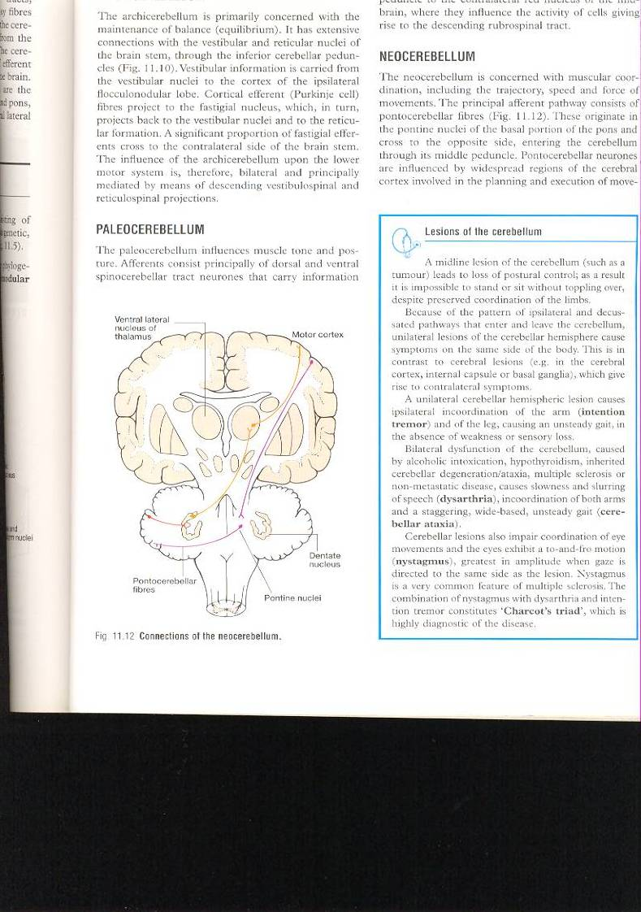
3- Neo-cerebellum
It is concerned with muscular coordination.
It receives afferents from cerebral cortex involved in planning of movement- to pontine nuclei ,cross to opposite side Via middle Cerebellar peduncle to end in lateral parts of cerebellum (cerebro-ponto-cerebellar tract).
Neo-cerebellar efferents project to dendate nucleus,which in turn projects to contra-lateral red nucleus & ventral lateral nucleus of thalamus ,then to motor cortex of frontal lobe, giving rise descending cortico-spinal & cortico-bulbar pathways. Efferents of dentate nucleus form a major part of superior C. peduncle.
Connections of Neo-cerebellum.

Slide 15
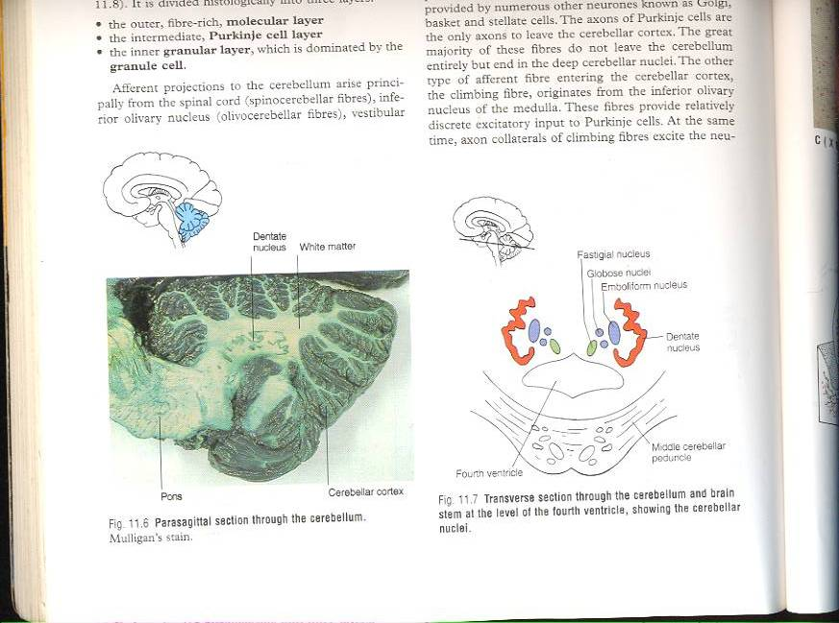
Internal Structure of cerebellum :
It consists of an outer layer of grey matter (cerebellar cortex) , & inner layer of white matter containing 4-pairs of cerebellar nuclei : above roof of 4th V. from medial to lateral :
1-Fastigial nucleus. 2-Globose nucleus.
3-Emboliform nucleus. 4-Dendate nucleus. (the only one that can be seen clearly with the naked eye).
Sagittal section of cerebellum.
T.S.of cerebellum & brain at level of 4th V. to show cerebellar nuclei.

Slide 16
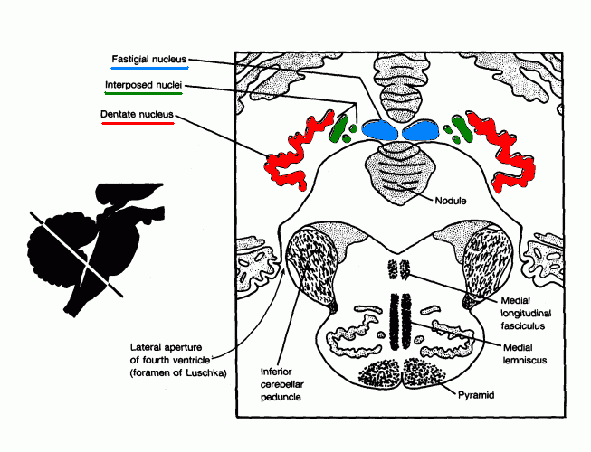

Slide 17
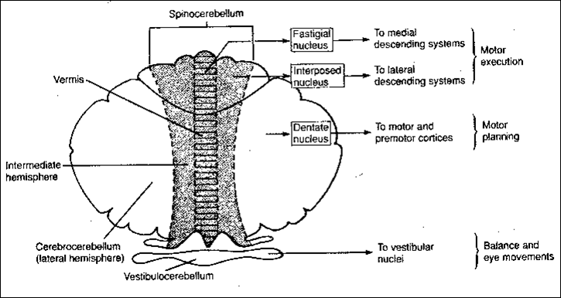

Slide 18
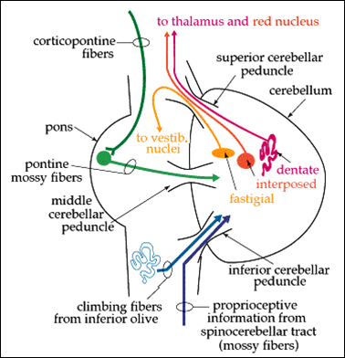
CONNECTIONS OF CEREBELLUM

Slide 19
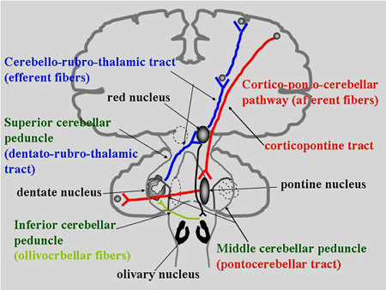
CONNECTIONS OF CEREBELLUM

Slide 20
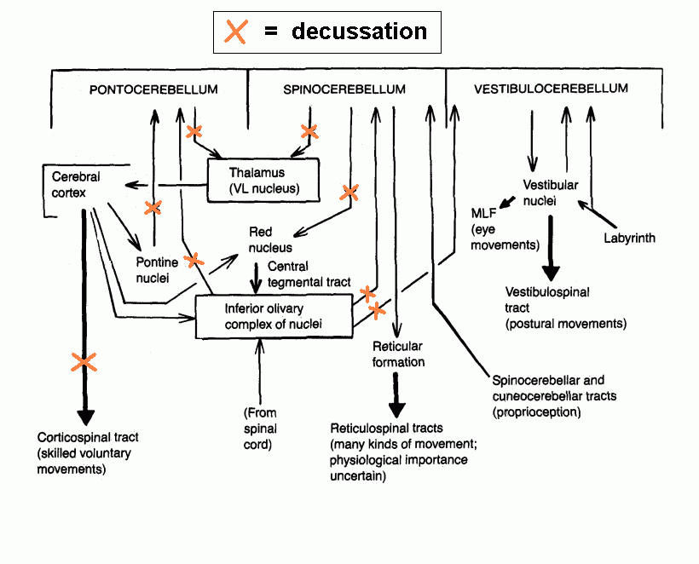
CONNECTIONS OF CEREBELLUM

Slide 21
EFFECT OF CEREBELLAR LESION
Archi-cerebellum
a) Truncal ataxia & staggering gait
b) Nystagmus
Paleocerebellum
a) Hypotonia
b) Flail joints
c) Disturbed tendon eflexes
d) Ataxia while walking
Neocerebellum
a) Dysmetria (Finger-nose test)
b) Intentional tremers
c) Dysdiadochokinesia
d) Dysarthria/ Scanning speech

Slide 22
Cerebellar Lesions
Are usually vascular, may be traumatic or tumour.
Manifestations of unilateral cerebellar lesions : 1-ipsilateral incoordination of (U.L) arm = intention tremors : it is a terminal tremors at the end of movement as in touching nose or button the shirt. 2-Or ipsilateral cerebellar ataxia affects (L.L.) leg, causing wide-based unsteady gait.
Manifestations of bilateral cerebellar lesions (caused by alcoholic intoxication, hypothyrodism, cerebellar degeneration & multiple sclerosis) : 1-dysarthria : slowness & slurring of speech. 2-Incoordination of both arms.= intention tremors. 3-Cerebellar ataxia : intermittent jerky movements or staggering , wide-based, unsteady gait. 4-Nystagmus : is a very common feature of multiple sclerosis. It is due to impairment coordination of eye movements /so, incoordination of eye movements occurs and eyes exhibit a to-and-fro motion.
Combination of nystagmus+ dysarthria + intension tremors constitutes Chacot’triad, which is highly diagnostic of the disease.

Slide 23

THANK YOU

Slide 24


