Slide 1
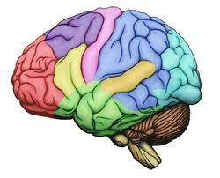
BRAIN
DEVELOPMENT, MENINGES & CSF
DR. PRAVEEN KURREY
MBBS, MS, BCME, BCBR PROFESSOR ANATOMY

Slide 2
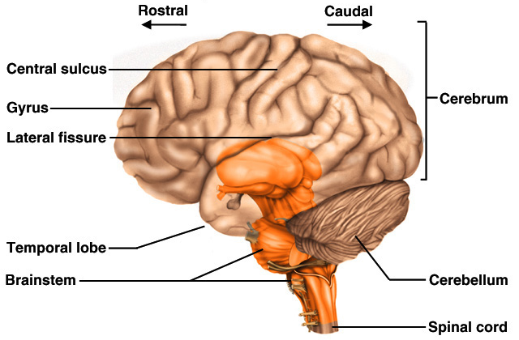
Brain Description
Brain weighs 3 to 3.5 pounds
Major portions of the brain--brainstem, cerebrum, and cerebellum
  cerebrum is 83% of brain volume; cerebellum contains 50% of the neurons

Slide 3
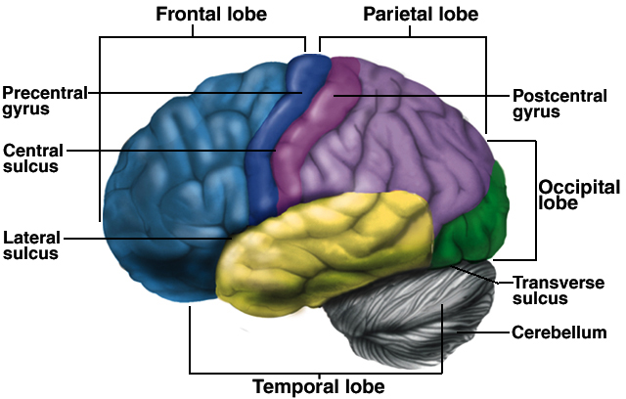
Cerebrum -- Gross Anatomy
Cerebral cortex is 3mm layer of gray matter with extensive folds to increase surface area ---- divided into lobes

Slide 4
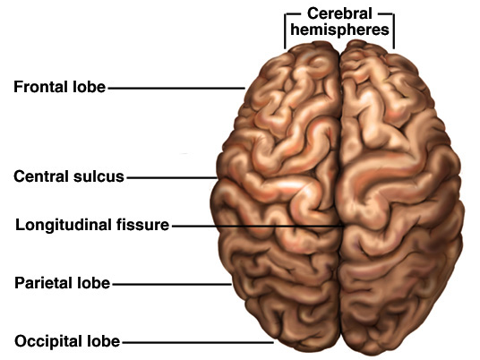
Brain
Longitudinal fissure separates 2 cerebral hemispheres.
Central sulcus separates frontal and parietal lobe.

Slide 5
Meninges
Dura mater -- outermost, tough membrane
  outer periosteal layer against bone
  where separated from inner meningeal layer forms dural venous sinuses draining blood from brain
  supportive structures formed by dura mater
    falx cerebri, falx cerebelli and tentorium cerebelli
  epidural space filled with fat in lower back region
    epidural anaesthesia during childbirth
Arachnoid mater is spider web filamentous layer
Pia mater is a thin vascular layer adherent to contours of brain

Slide 6
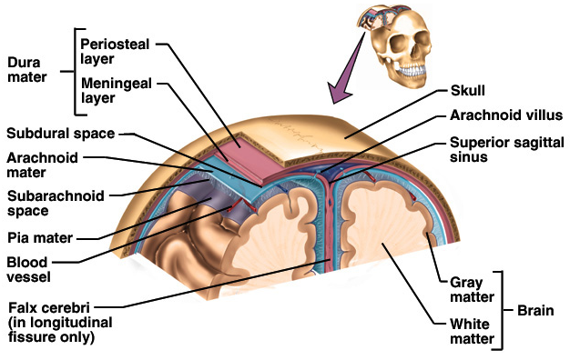
Cranial Meninges

Slide 7
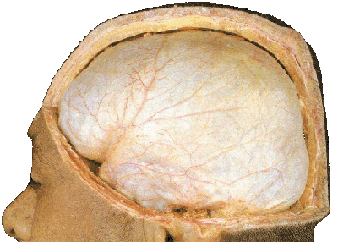
Cerebral Dura mater
Characters
A thick and dense inelastic membrane that composed of two layers, an inner or meningeal and outer or endosteal
It is in loose contact with calvaria, and most strongly adherent to base of skull

Slide 8
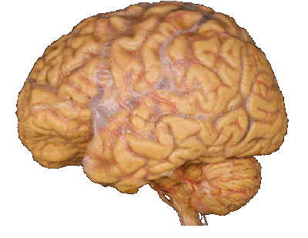
Cerebral arachnoid mater
Characters: a delicate membrane covering brain loosely, passing over sulci and entering only cerebral longitudinal and transverse fissures

Slide 9
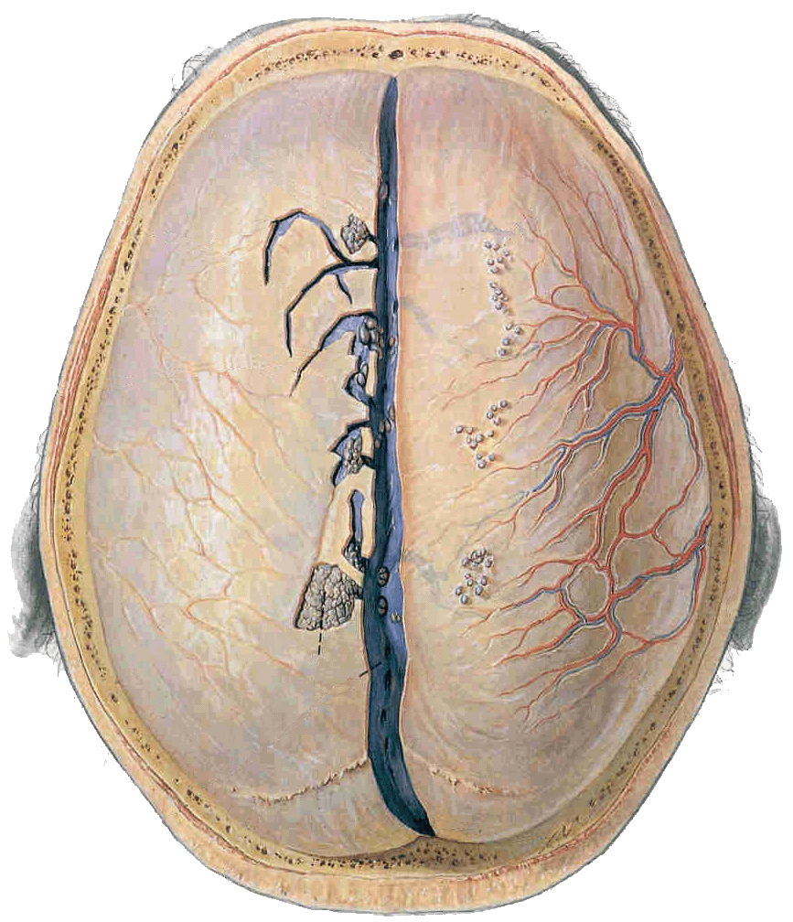
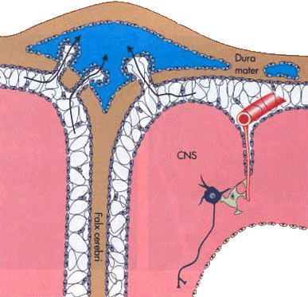
Arachnoid granulations － project into sinuses of dura mater, serve as sites where cerebrospinal fluid diffuses into bloodstream

Slide 10
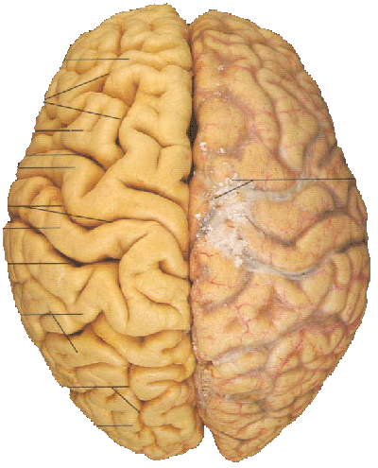
Cerebral Piamater
Closely invests brain surface, in some areas the pia invaginates into ventricles to take part in the formation of choroids plexus

Slide 11
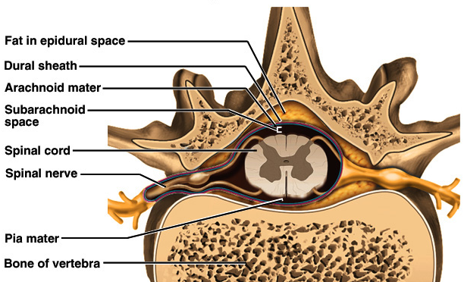
Meninges of Vertebra & Spinal Cord

Slide 12
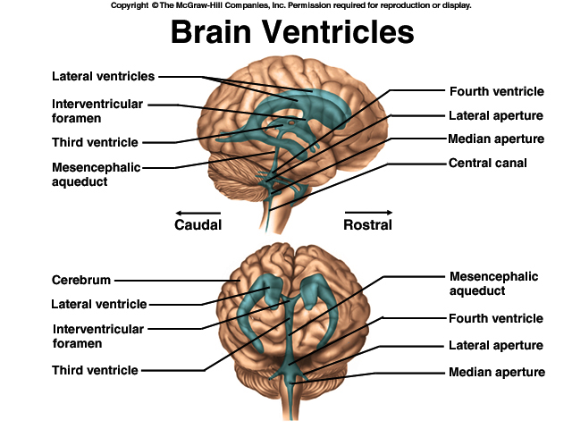
Brain Ventricles

Slide 13
Ventricles and Cerebrospinal Fluid
Internal chambers within the CNS
  lateral ventricles found inside cerebral hemispheres
  third ventricle is single vertical space under corpus callosum
  cerebral aqueduct runs through midbrain
  fourth ventricle is small chamber between pons & cerebellum
  central canal runs down through spinal cord
Lined with ependymal cells and containing choroid plexus of capillaries that produce CSF

Slide 14
Cerebrospinal Fluid
Clear liquid fills ventricles and canals & bathes its external surface (in subarachnoid space)
Brain produces & absorbs about 500 ml/day
  filtration of blood through choroid plexus
  has more Na+ & Cl- but less K+ & Ca+2 than plasma
Functions
  buoyancy -- floats brain so it neutrally buoyant
  protection -- cushions from hitting inside of skull
  chemical stability -- rinses away wastes
Escapes from 4th ventricle to surround the brain
Absorbed by arachnoid villi into venous sinus

Slide 15
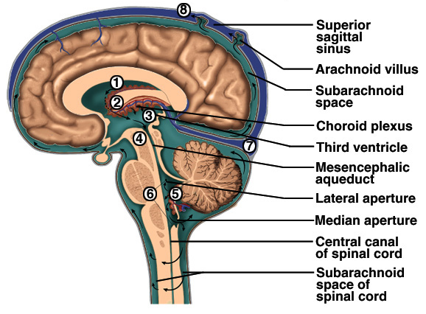
Flow of Cerebrospinal Fluid

Slide 16
Circulation of cerebrospinal fluid
CSF drains from lateral ventricle
interventricular foramina
third ventricle
mesencephalic aqueduct
fourth ventricle
median and two lateral apertures
subarachnoid space
arachnoid granulations
superior sagittal sinus
vein

Slide 17
Blood-Brain and Blood-CSF Barriers
Blood-brain barrier is tightly joined endothelium
  permeable to lipid-soluble materials (alcohol, O2, CO2, nicotine and anesthetics)
  administer drugs through nasal sprays
  circumventricular organs in 3rd & 4th ventricles at breaks in the barrier where blood has direct access
    monitoring of glucose, pH, osmolarity & other variations
    allows route for HIV virus to invade the brain
Blood-CSF barrier at choroid plexus is ependymal cells joined by tight junctions

Slide 18
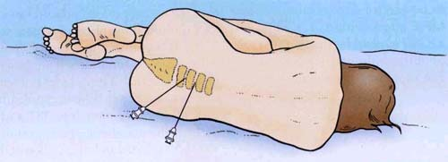
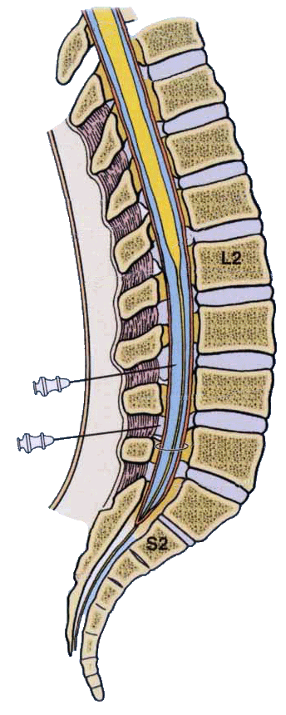
Lumbar spinal puncture (spinal tap)

Slide 19
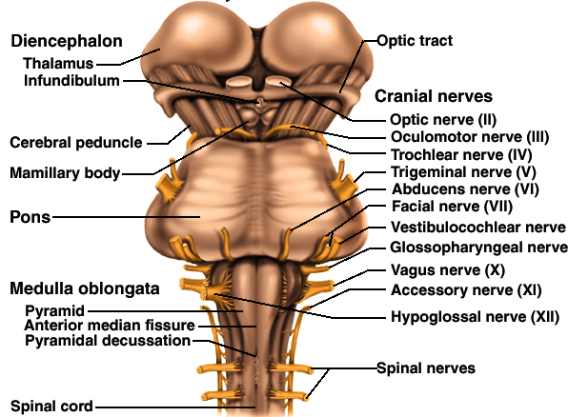
Medulla and Pons
Olive

Slide 20
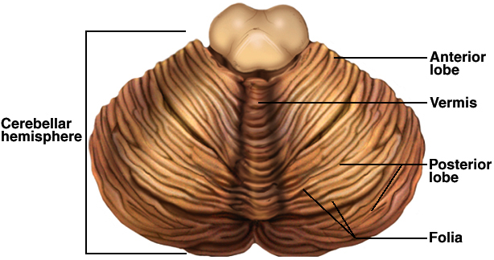
Cerebellum
Right & left hemispheres connected by vermis
Parallel surface folds called folia are gray matter
  all of output comes from deep gray nuclei
  large cells in single layer in cortex are purkinje cells synapse on deep nuclei

Slide 21

THANK YOU

