Slide 1
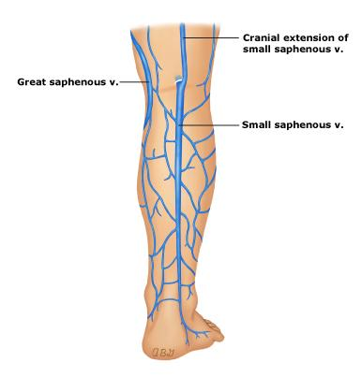
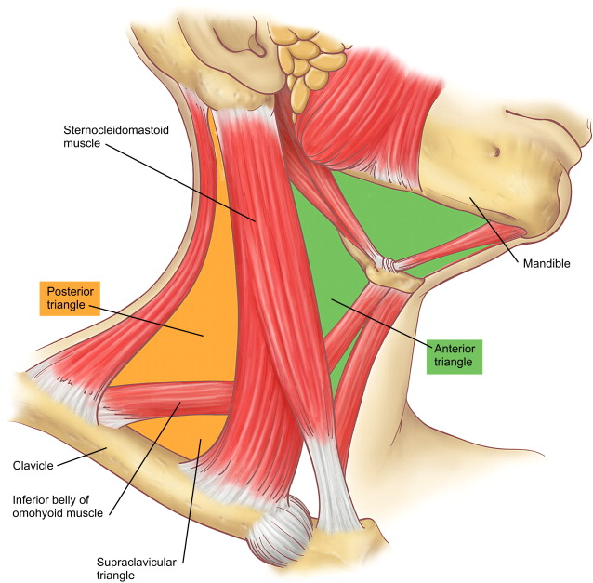
GROSS ANATOMY Anterior triangles of neck
DR. PRAVEEN KURREY MBBS,MS, BCME, BCBR
PROFESSOR ANATOMY

Slide 2
Anterior triangles

Slide 20
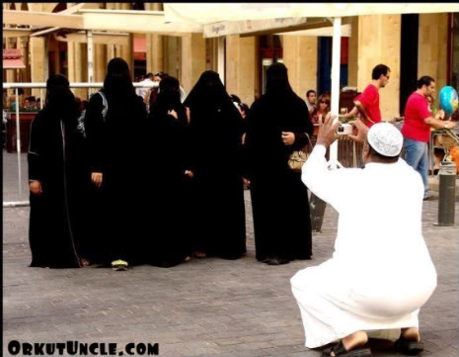
NICE CLICK

Slide 21
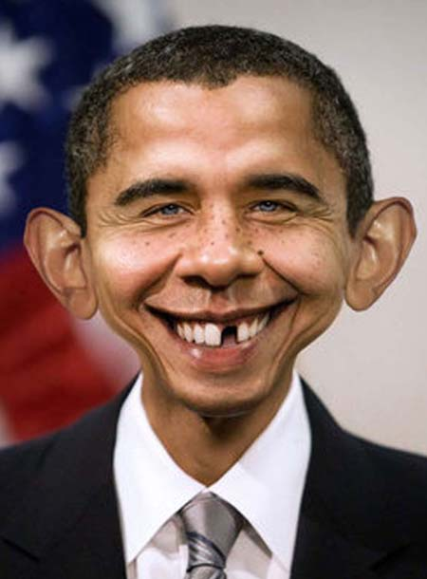
THE MOST POWERFUL PERSON

Slide 22

THANK YOU

