Slide 1
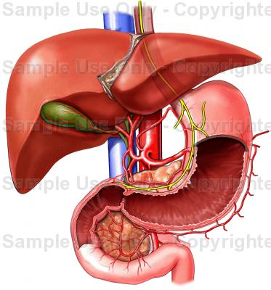
stomach
( LECTURE)
DR. PRAVEEN KURREY
MBBS, MS, BCME, BCBR PROFESSOR ANATOMY

Slide 2
Stomach
Muscular bag intervenes between esophagus and duodenum
Acts as reservoir of food and convert into chyme with help of acidic juice (gaster = stomach in Greek; venter = stomach in Latin)
Functions of Stomach
Are as follows
  Serves as reservoir of food
  Secretes gastric juice containing hydrochloric acid and pepsinogen
  Mixes food with gastric juice
  Softens food
  Hydrochloric acid of gastric juice kills microorganisms of food

Slide 3
Stomach
Functions of Stomach
Pepsinogen helps in digestion of proteins
Mucous secretion protects lining epithelium of stomach
Castle’s intrinsic factor of gastric juice binds with vitamin B12 and helps in absorption in small intestine
Site for absorption of glucose, sodium, alcohol, and so on

Slide 4
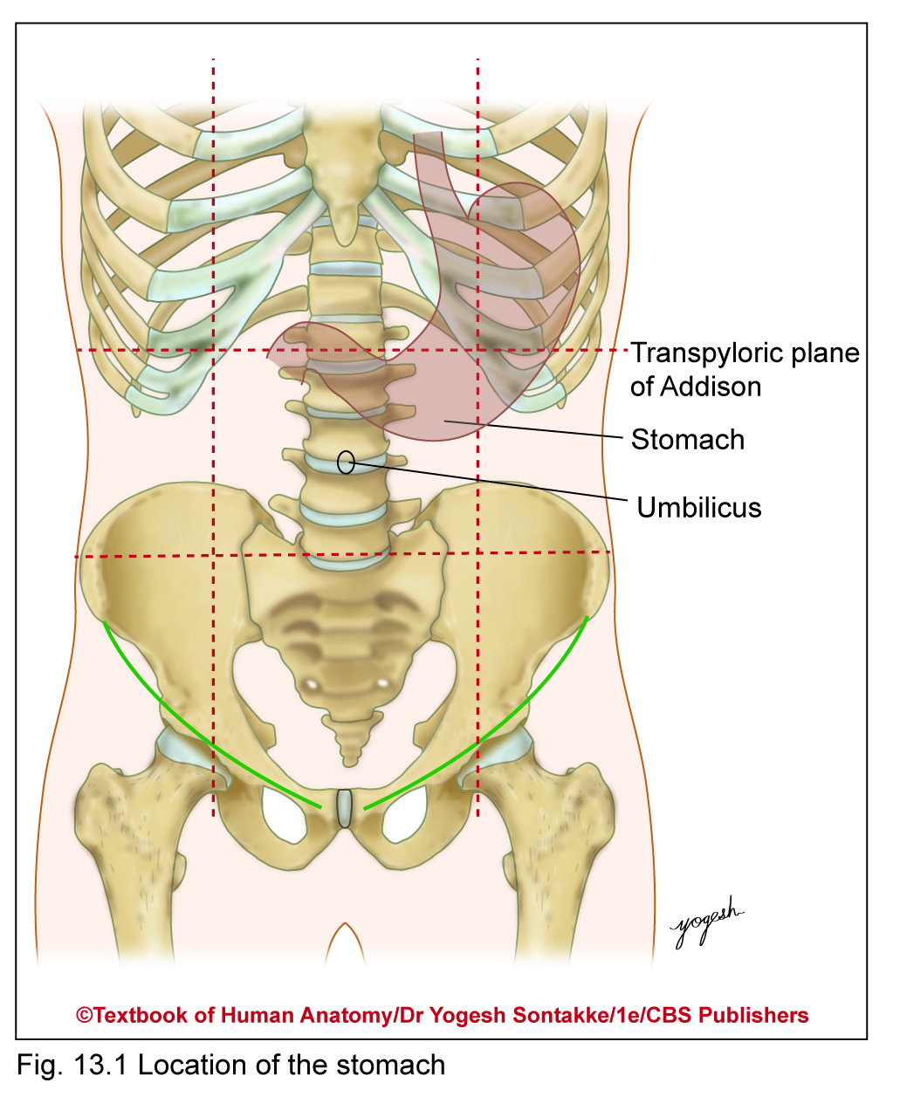
Stomach
Location
•Occupies left hypochondriac, umbilical, and epigastric region
Most of stomach lies under cover of left costal margin and lower ribs
Shape
• Usually J-shaped, called asthenic or normal type

Slide 5
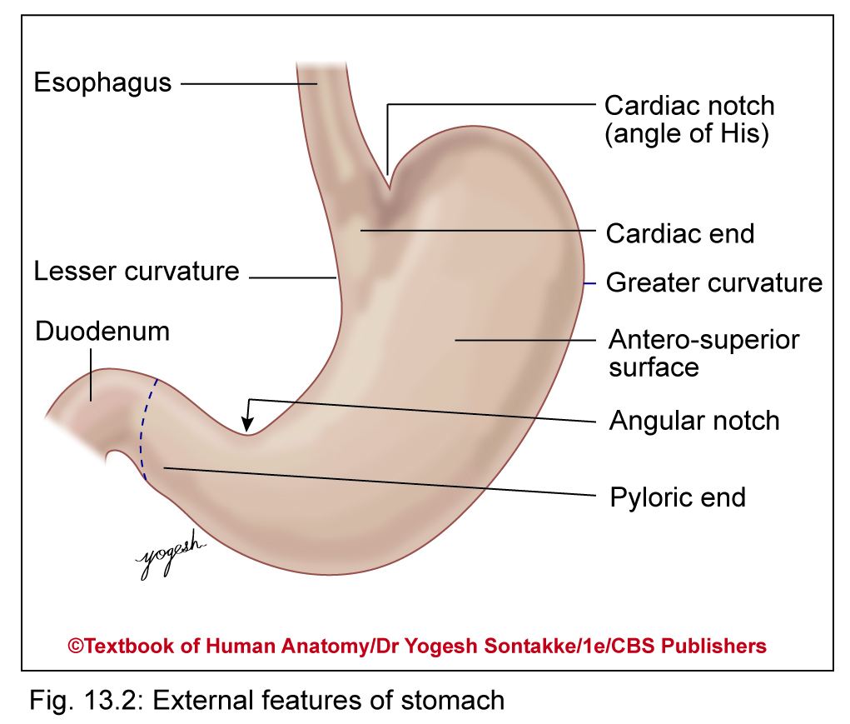
Stomach
Size and Capacity
Very distensible organ
Capacity of stomach varies with age as follows
At birth: 20–30 ml
In newborn: 300 ml (1 ounce)
At puberty: 1000 ml
In adults: 1000–1500 ml
Length: 25 cm (10 inches)

Slide 7
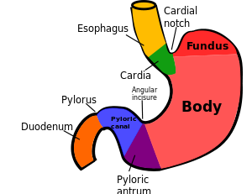
Stomach

Slide 8
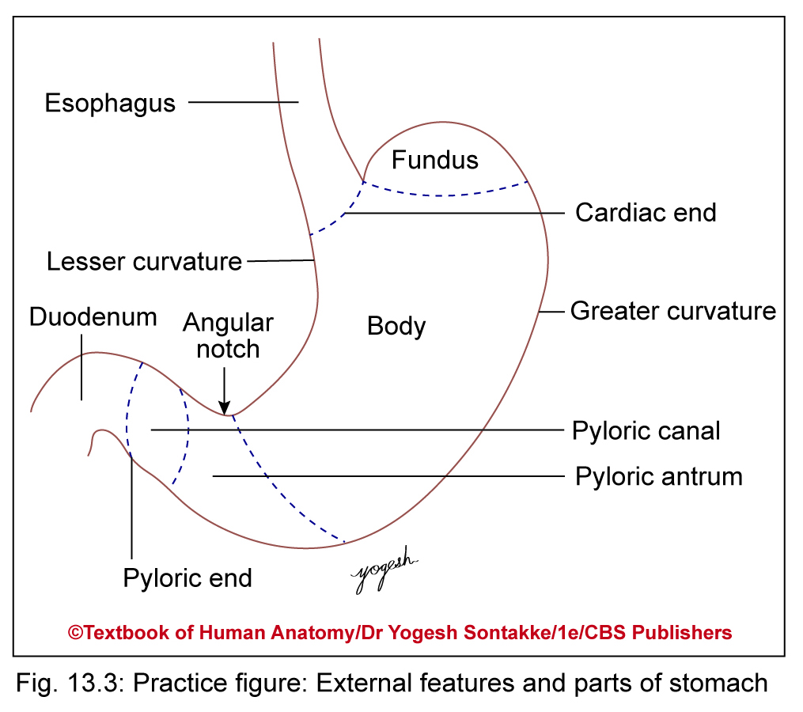

Slide 12
Stomach
Anatomical Position
Hold stomach in such way that
Flat anteroposteriorly
Concave lesser curvature faces to right and convex greater curvature faces to left and inferiorly
Thick pyloric end directed downward and to right.
Cardiac or upper end of stomach lies at higher level and to left than pyloric end

Slide 13
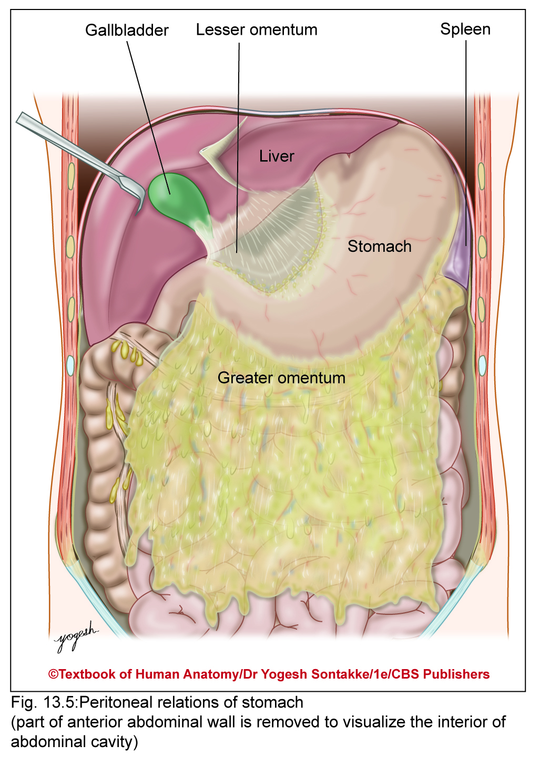
RELATIONS OF STOMACH
Peritoneal Relations
Lined by peritoneum on both surfaces except where vessels run along curvatures and at bare area of stomach
Bare area of stomach
Small area – devoid of peritoneum and comes in direct contact with left crus of diaphragm

Slide 14
RELATIONS OF STOMACH
Bare area of stomach
Located near cardiac end on posterior surface
Folds of peritoneum extending from stomach
Lesser omentum extends from lesser curvature to liver

Slide 15
RELATIONS OF STOMACH
Greater omentum extends downward from greater curvature
Gastrosplenic ligament extends from upper part of greater curvature to spleen
Gastrophrenic ligament extends from fundus of stomach to diaphragm
Greater curvature of stomach gives attachment to gastrophrenic ligament, gastrosplenic ligament, and greater omentum from above downward

Slide 16
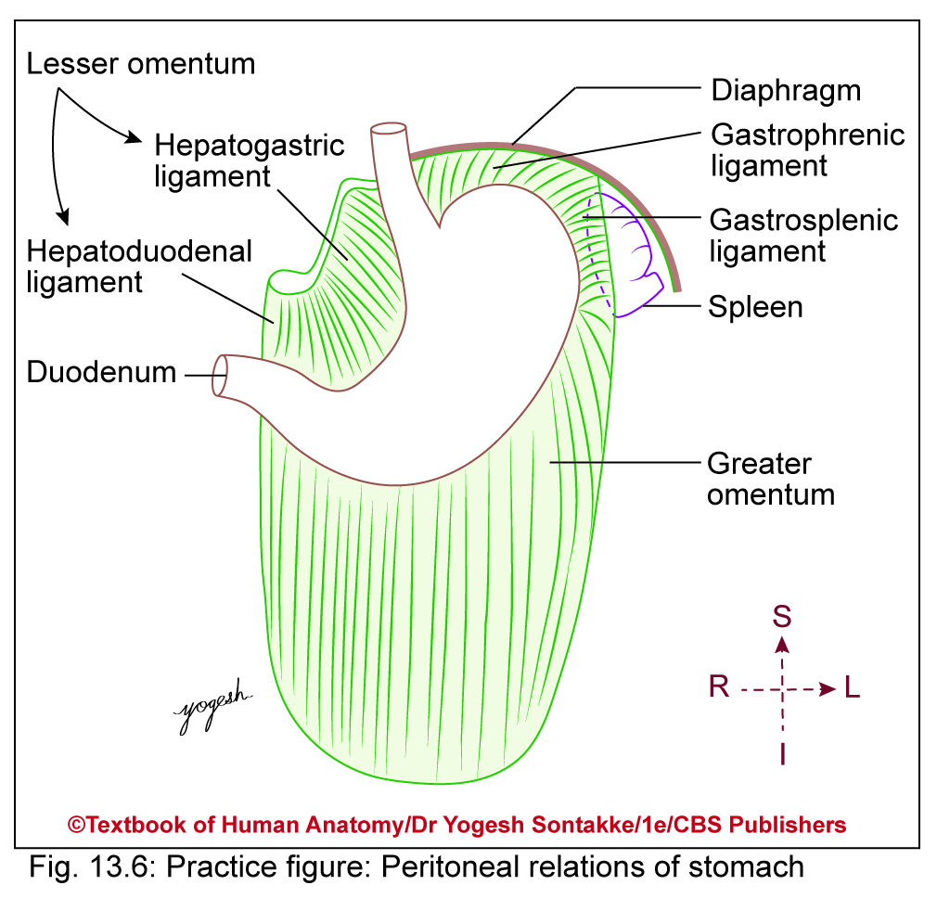

Slide 17
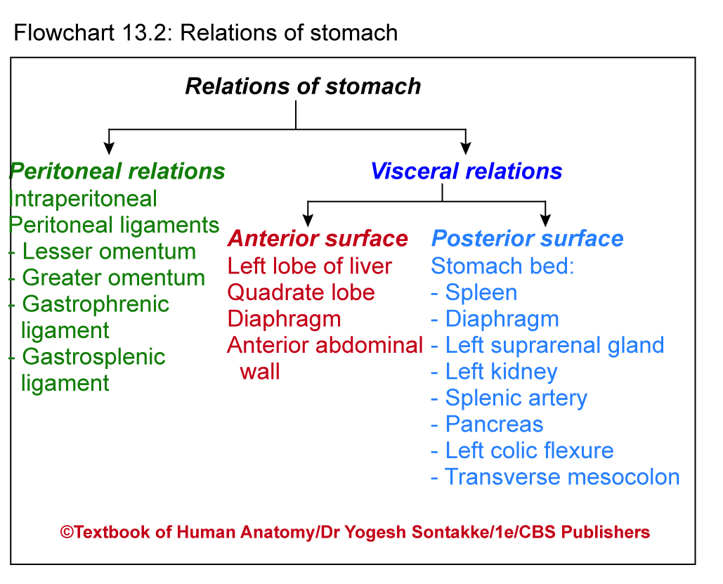

Slide 18
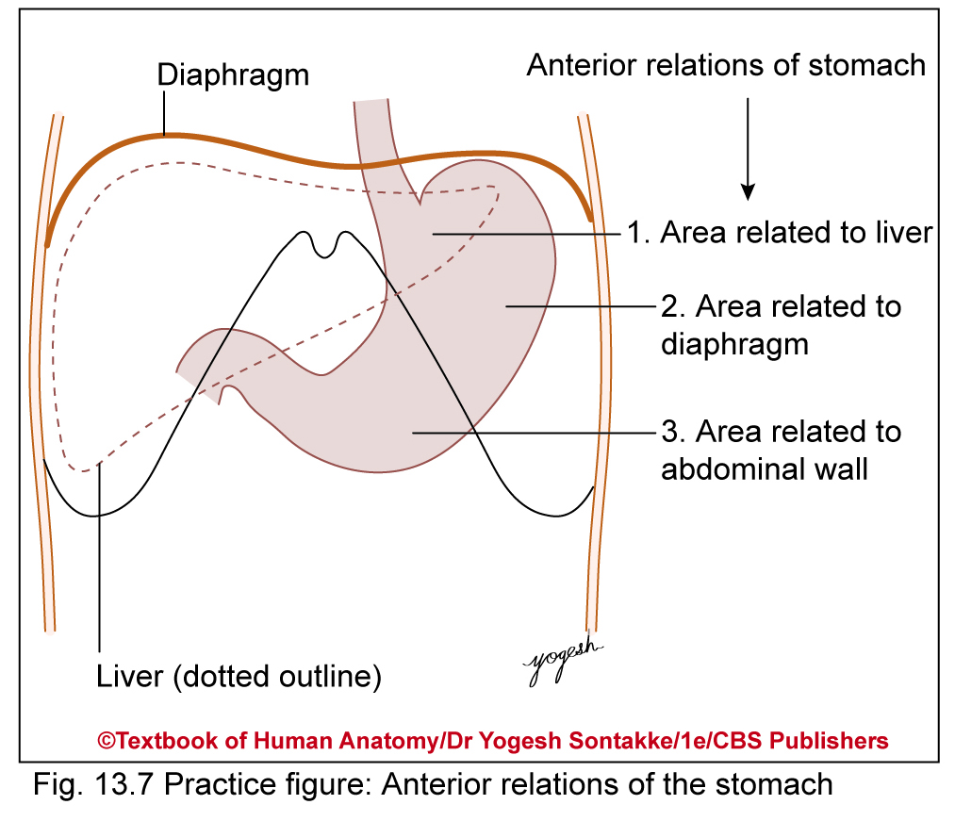
Visceral Relations
Relations of anterior surface
Related anteriorly to following structures
Left lobe and quadrate lobe of liver – related to right part of stomach
Diaphragm separates upper and left part of stomach from left pleura, base of left lung, pericardium and heart, and left 6th to 9th costal cartilages
Anterior abdominal wall in contact with lower part of stomach

Slide 19
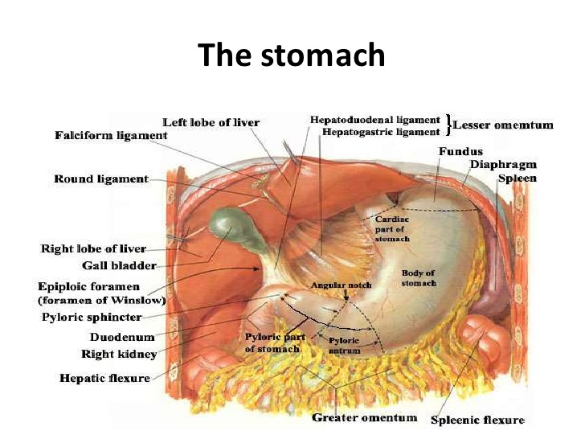
Relations of Stomach

Slide 22
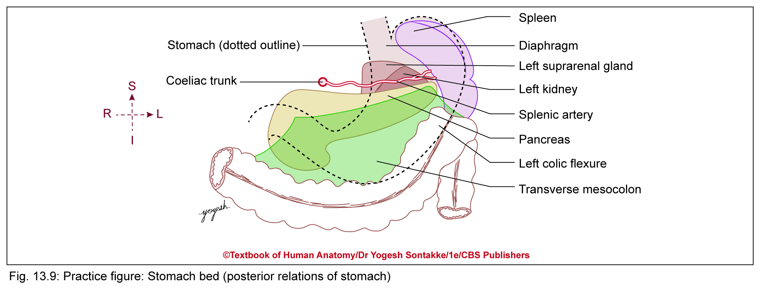

Slide 23
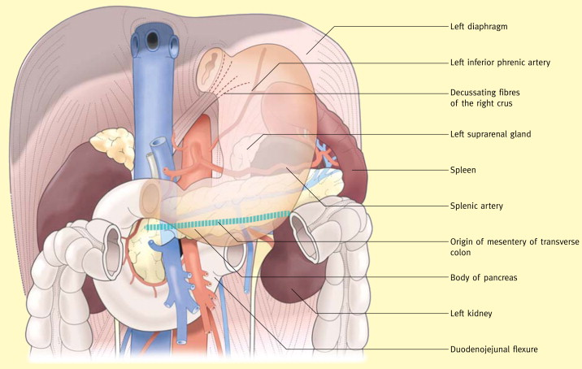
Relations of Stomach

Slide 24
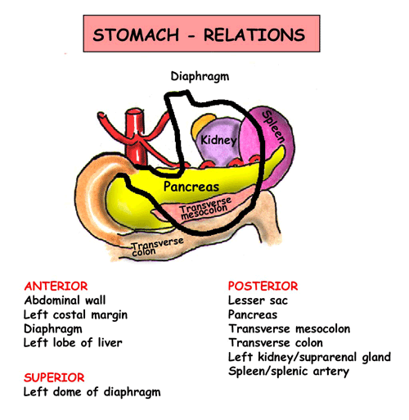

Slide 25
BLOOD SUPPLY, LYMPHATIC DRAINAGE, AND INNERVATION
Arterial Supply
Q. Write short note on blood supply of stomach
Supplied by following arteries
Left gastric artery – branch of coeliac trunk
Right gastric artery – branch of common hepatic artery
Left gastroepiploic artery – branch of splenic artery
Right gastroepiploic artery – branch of gastroduodenal artery
Short gastric arteries (5–7 in number) – branch of splenic artery
Posterior gastric artery – branch of splenic artery

Slide 26
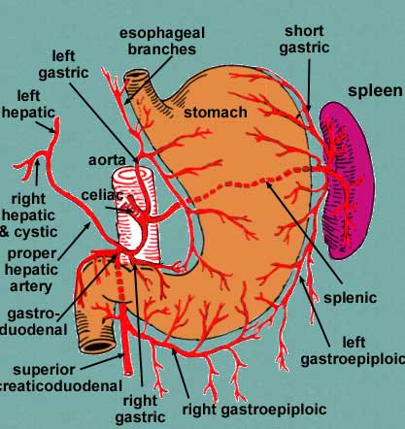
Arterial Supply

Slide 29
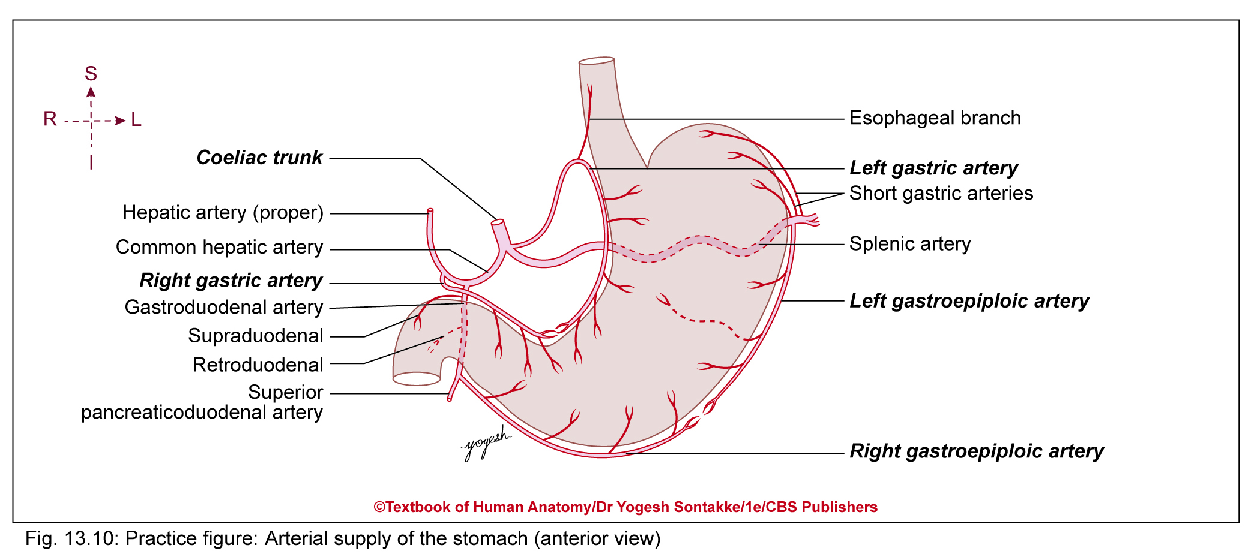

Slide 30
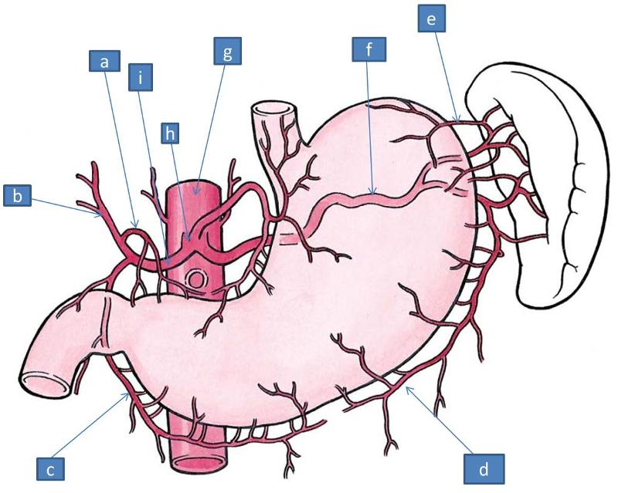

Slide 31
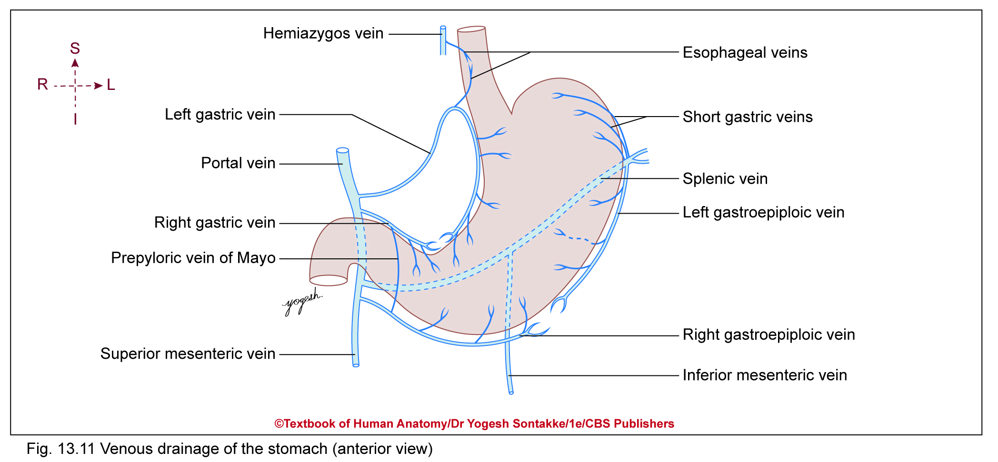

Slide 32
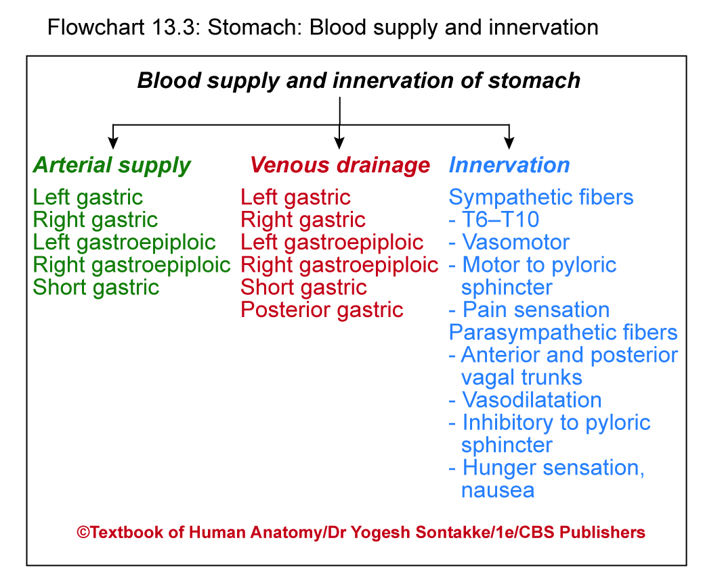

Slide 35
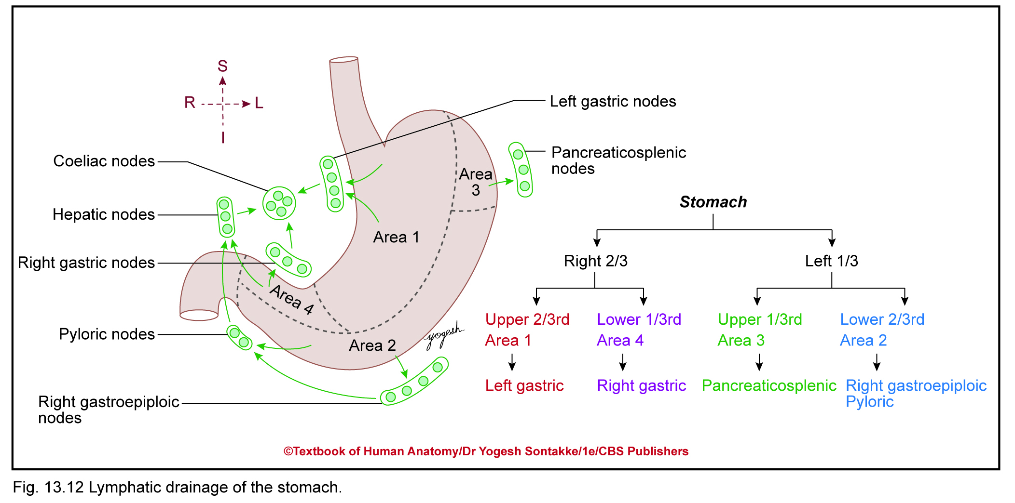
Lymphatic Drainage
Following nodes drain lymphatics from stomach
Left paracardial nodes, lesser curvature nodes, right paracardial nodes, and left gastric nodes
Short gastric nodes, left gastroepiploic nodes, splenic hilar nodes, and splenic nodes
Right gastroepiploic nodes, infrapyloric nodes, suprapyloric nodes, and common hepatic nodes
All above nodes finally drain into coeliac lymph nodes

Slide 38
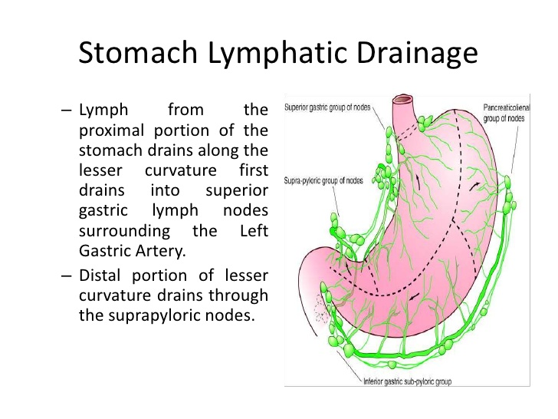

Slide 39
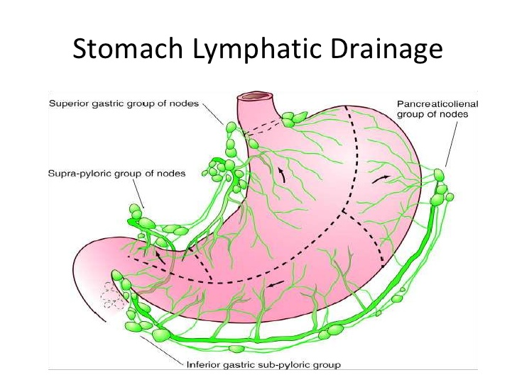

Slide 46
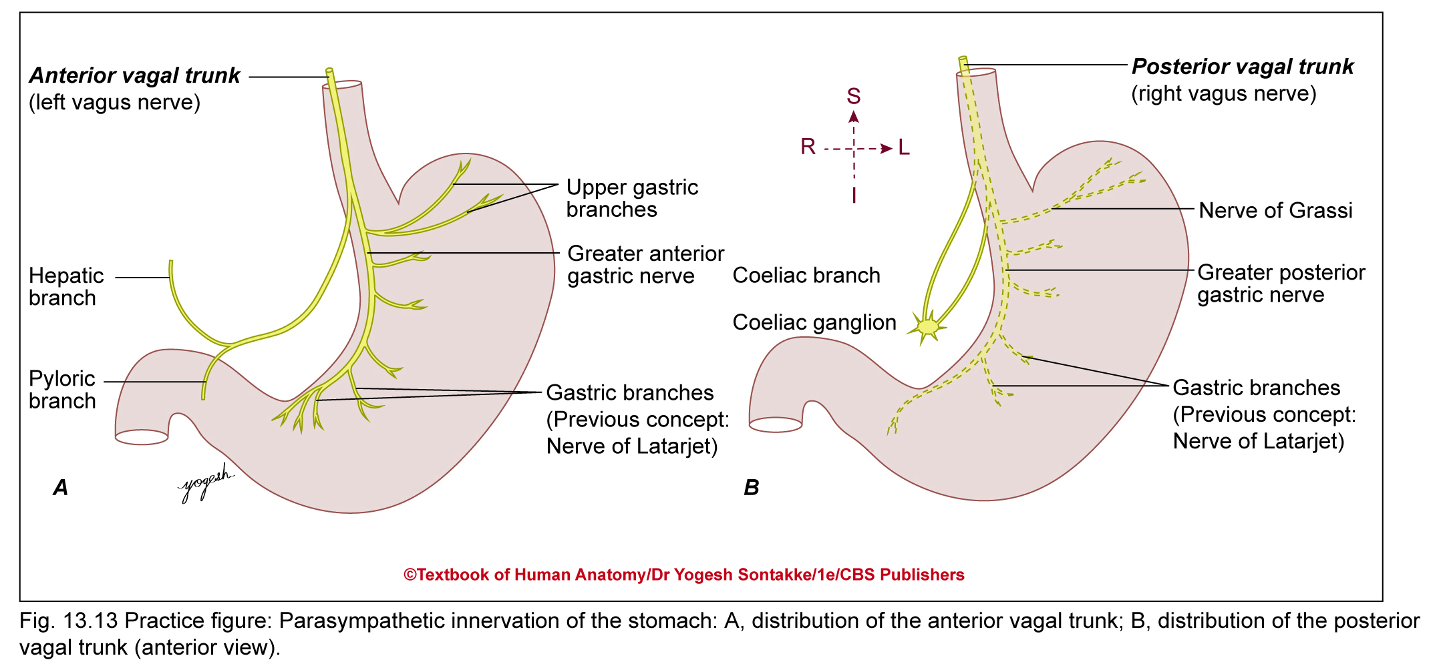

Slide 47
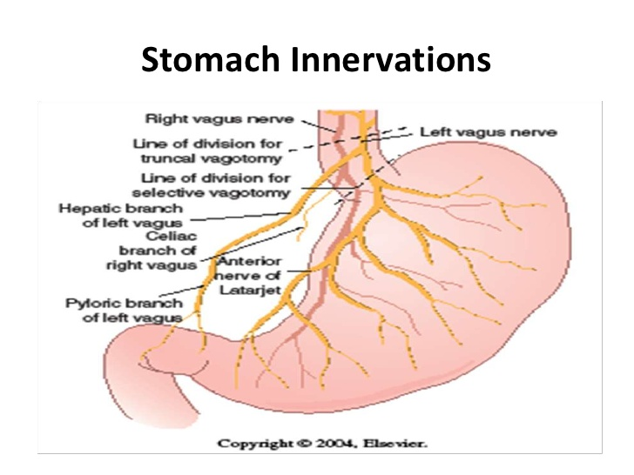

Slide 50
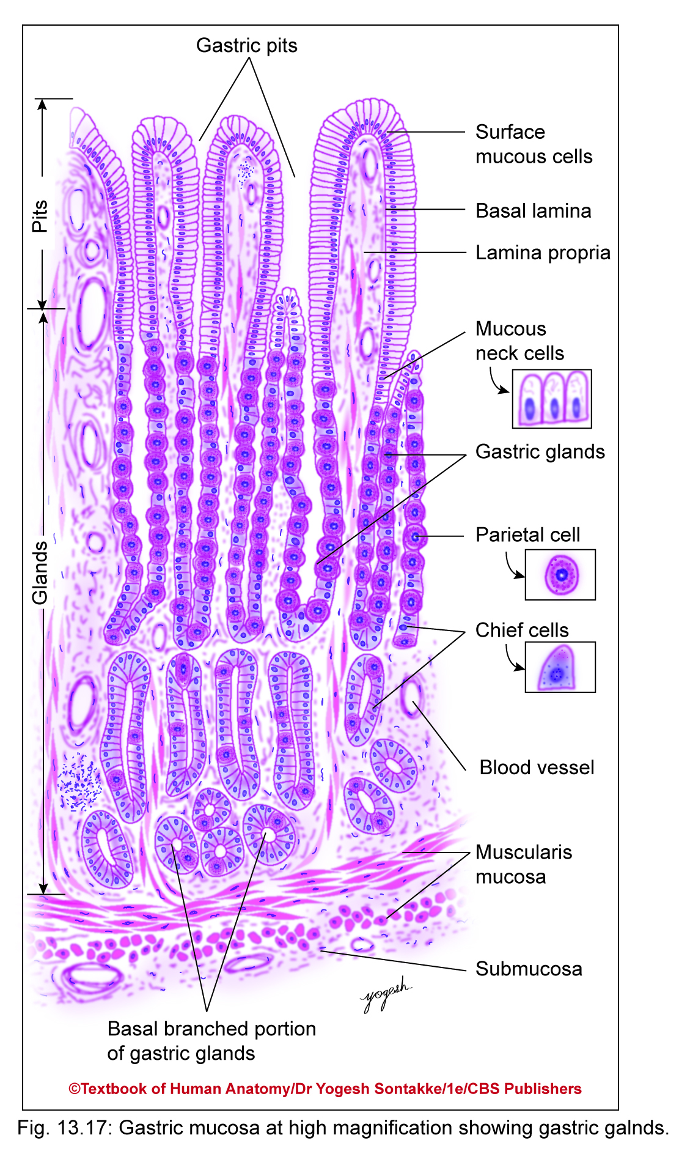

Slide 51
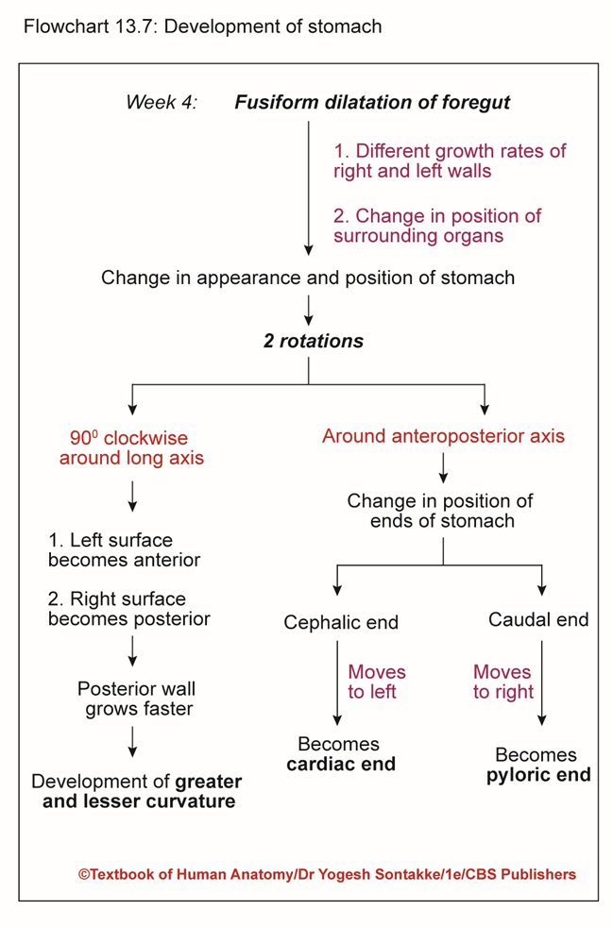

Slide 52
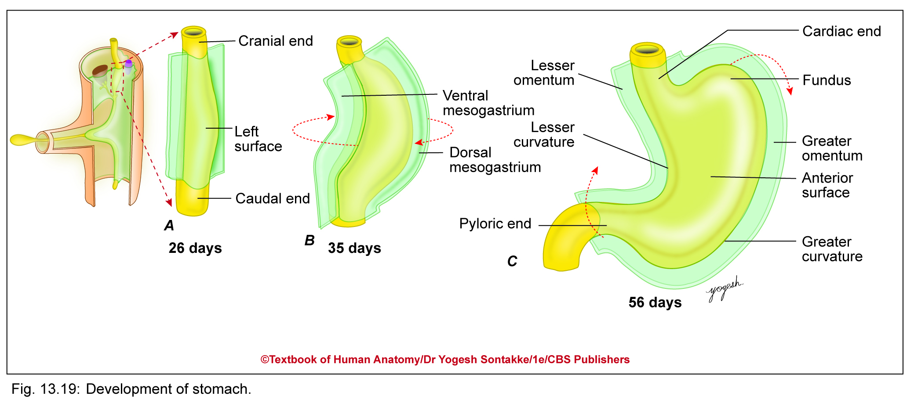

Slide 53

Self Click Photo Of Kerwa Dam

Slide 54
THANK YOU

